Slide 1
XIX
INTERNATIONAL BURDENKO SCIENTIFIC CONFERENCE
DEDICATED TO THE DECADE OF SCIENCE AND TECHNOLOGY
Dear colleagues,
Student Scientific Association is pleased to invite you to participate in the XIX INTERNATIONAL BURDENKO SCIENTIFIC CONFERENCE, which is dedicated to the decade of science and technology, to be held on April 20-22, 2023 in Voronezh N.N. Burdenko State Medical University.
Burdenko Conference offers a unique platform for exchange of ideas among medical students and young researchers in medical and biomedical areas of science.
The Conference will include the traditional Forum «Medicine of the 21 century -medicine without frontiers!» you are welcome to present results of basic and clinical research in different medicine disciplines.
They include but are not limited to:
Fundamental medicine
Dentistry
Pharmacology
Surgery
Therapy

Slide 2
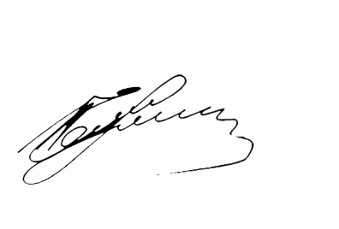
The forum's working language is English.
The formats of participation are as follows:
oral presentation up to 15 min including discussion
oral presentation up to 15 min including discussion and publication
Publication
The best presentations will be awarded with Diplomas of I, II and III degree.
The participants’ papers will be published in the Conference Proceedings and in the Russian Science Citation Index system.
Further information including the conference program and time will be available at the official websites
http://vrngmu.ru/
http://vrngmu.ru/
For further questions, please contact the Conference Coordinator via the conference email sno.vsmu@gmail.com.
We are looking forward to seeing you at the conference, which will be held in online format with the usage of “Voov Meeting” platform.
King regards,
Rector of VSNU named after N.N.Burdenko
I.E. Esaulenko

