Slide 1
Department of Restorative Dentistry and Endodontics Case presentation protocol
Dear Student, please follow the guidelines below when preparing your case presentation:
Document all phases of the treatments with text and photographs.
Do not change the format of the presentation and follow the content guidelines.
Use blue-background slides to aid understanding, which convey technical information. (The information and images on these slides do not belong to the same patient.)
The white-background slides are required to be used in the case presentation. Replace the light blue italicised sections with data for your own patient. The blue squares indicate the location of the images.
The case presentation should not include patient details that would allow them to be identified.
The anamnesis sheet, status sheet must not be photographed.
Multiple treatments for one patient should be included in the same presentation, one after the other if possible.
The name of the student can be changed under the View - Slide tab.
Notes:
The following presentation shows the Official Case Presentation protocol of the Department of Prosthodontics.

Slide 2
Department of Restorative Dentistry and Endodontics Case presentation protocol
For editing purposes, the case should be presented to the teacher in ppt format.
Presentation title: name of student _treatment short form_name of teacher (e.g.: Jessica Smith_26MOfilling_DrNagy)
The tutor will give a mark for the case presentation after the requested corrections.
Deadline for submission of case presentations:
Autumn Semester: 13th week
Spring Semester: IV. year 13th week, V. year 11th week
You may send your comments on the case presentation to the contact person for students of the English program.

Slide 3
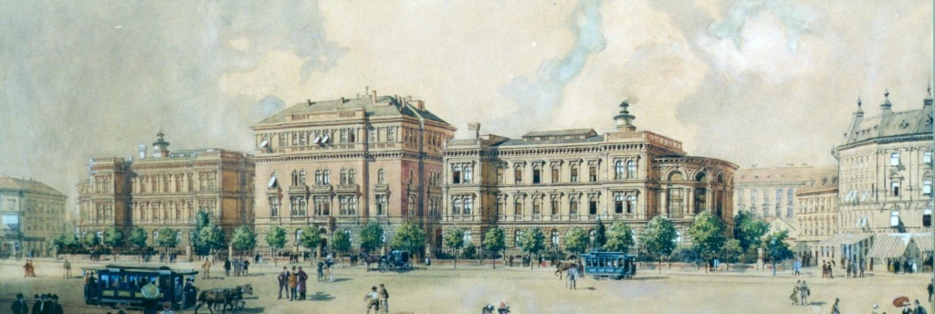


Semmelweis University Faculty of Dentistry
Department of Restorative Dentistry and Endodontics
Head of Department: Prof. Dr. Vág János DMD, PhD.
Case report
Student: name of student
Teacher: name of teacher
Treatment: short form- 16 MO filling, 24 RCT, 36 MOD inlay/onlay
Practice: name of practice and semester of the documented case

Slide 4
Semmelweis University Faculty of Dentistry
Department of Restorative Dentistry and Endodontics
Head of Department: Prof. Dr. Vág János DMD, PhD.
Case report
Student: Jessica Smith
Teacher: Dr. Kiss Zoltán
Treatment: 25 RCT, 25 onlay
Practice: Restorative Dentistry and Endodontics II. – 2024. September

Slide 5
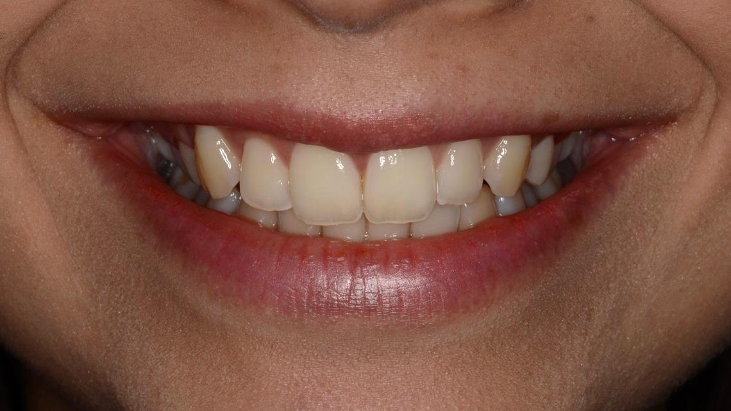
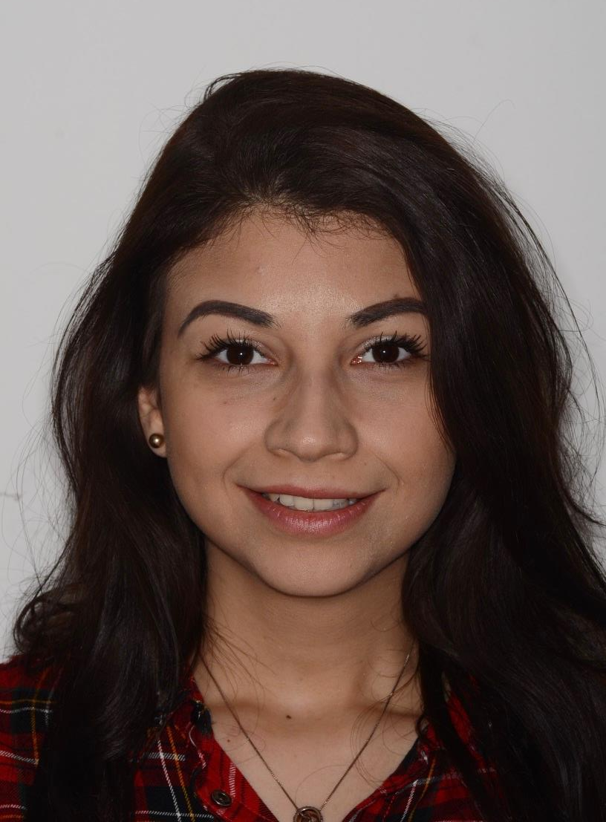
Introduction of the patient
Patient’s name abbreviated
Age, gender
Occupation (previous in case of retirement)
The face photo should show the petient’s teeth.
The photo should be taken before anaesthesia, without dental bibs, in front of a neutral background.
The reason for dental investigations’ needs
Pl.: acute pain, aesthetic problem, check-up, etc.

Slide 6
Introduction of the patient
K. J.
70 years old, male
retired (teacher)
The reason for dental investigations’ needs
Dental check-up/ The patient is here to continue a previously started root canal treatment.

Slide 7
Medical History
Factors and diseases affecting dental treatment – medication (name, active substance, adverse side effects):
e.g. conditions requiring antibiotic prophylaxis, immunosuppressed state, infectious diseases, taking anticoagulant drugs, pacemaker, bruxism, reduced saliva production... etc.
e.g. high blood pressure: Amlodipine (Ca channel blocker) - ase.: gingival hyperplasia
e.g. osteoporosis: Bonviva (ibandronate: bisphosphonate) - ase.: MRONJ osteonecrosis of the jaw
Allergy: e.g. medicine, metal allergy
Bad habits, addiction: e.g. alcohol consumption, smoking (what and how much), drug use

Slide 8
Medical History
Factors and diseases affecting dental treatment - medication
Artificial valve - Antibiotic prophylaxis required
High blood pressure - Amlodipine (Ca channel blocker) - gingival hyperplasia
Allergies:
Penicillin allergy
Bad habits, addiction:
Smoking - 1 pack a day

Slide 9
Dental History
When was your last dental check-up/treatment?
Previous dental treatments and their approximate dates - e.g.: orthodontics, tooth extraction, oral surgery, implants, dental prostheses, etc.
This is not the dental status, the dental history is based on the patient’s statement!

Slide 10
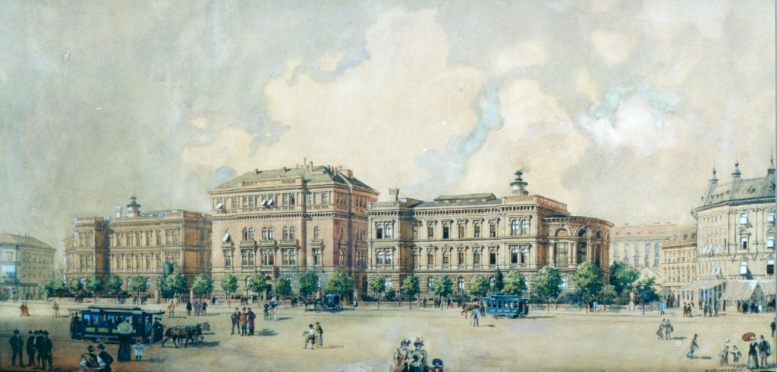
Dental History
Date of last dental check-up/treatment:
1 year ago
Previous tooth extractions:
Removal of first molars and wisdom teeth 10 years ago
Any other previous dental treatment
Fillings, root canal treatment
Orthodontic treatment
A brief description of dental prostheses:
Right lateral bridge made 2 years ago

Slide 11
Inspection of Head and Neck Region, Extraoral and Intraoral Investigation
TMJ examination: no pathological lesions or description of complaints, diagnosis
Stomato-oncoligical screening: e.g.: no visible pathological lesion, or description of the oral mucosal lesion present, description of the precancerous lesion
Oral hygiene: e.g.: good, average, poor
DMF-T number: max. 28
Periodontal health - BPE:
Angle classification or bite form: I-II-III. (only if the canines and the first molars are present), eugnath vagy dysgnath; deep bite, open bite, cross bite etc.
Fábián and Fejérdy classification: upper jaw – 2A lower jaw– 1A
X | 1 | x
2 | 2 | 2
Notes:
chrome-extension://efaidnbmnnnibpcajpcglclefindmkaj/https://www.bsperio.org.uk/assets/downloads/BSP_BPE_Guidelines_2019.pdf

Slide 12
Inspection of Head and Neck Region, Extraoral and Intraoral Investigation
TMJ examination: no pathological findings
Stomato-oncological screening: no pathological findings
Oral hygiene: average
DMF-T number: 16
Periodontal health- BPE:
Angle classification or bite form: eugnath, deep bite
Fábián and Fejérdy classification: upper jaw – 2A lower jaw – 1A
0 | 1 | 0
2 | 2 | 2
Notes:
chrome-extension://efaidnbmnnnibpcajpcglclefindmkaj/https://www.bsperio.org.uk/assets/downloads/BSP_BPE_Guidelines_2019.pdf

Slide 13
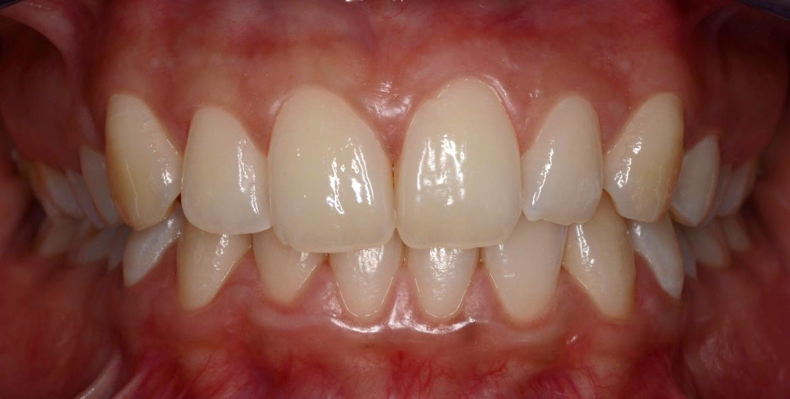
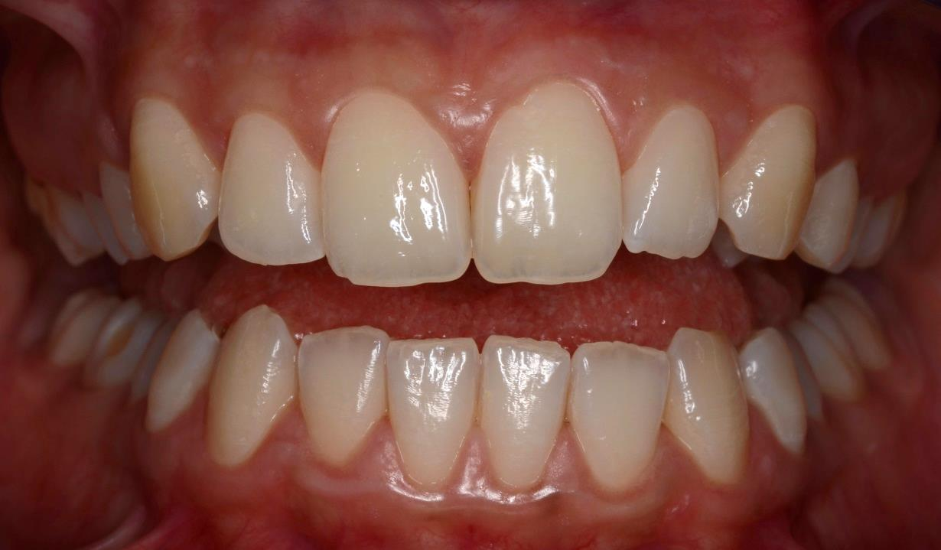
Dental Status
ICP and slightly open position
Angle classification/bite form

Slide 14
Dental Status
ICP and slightly open position
Deep bite, right side crossbite

Slide 15

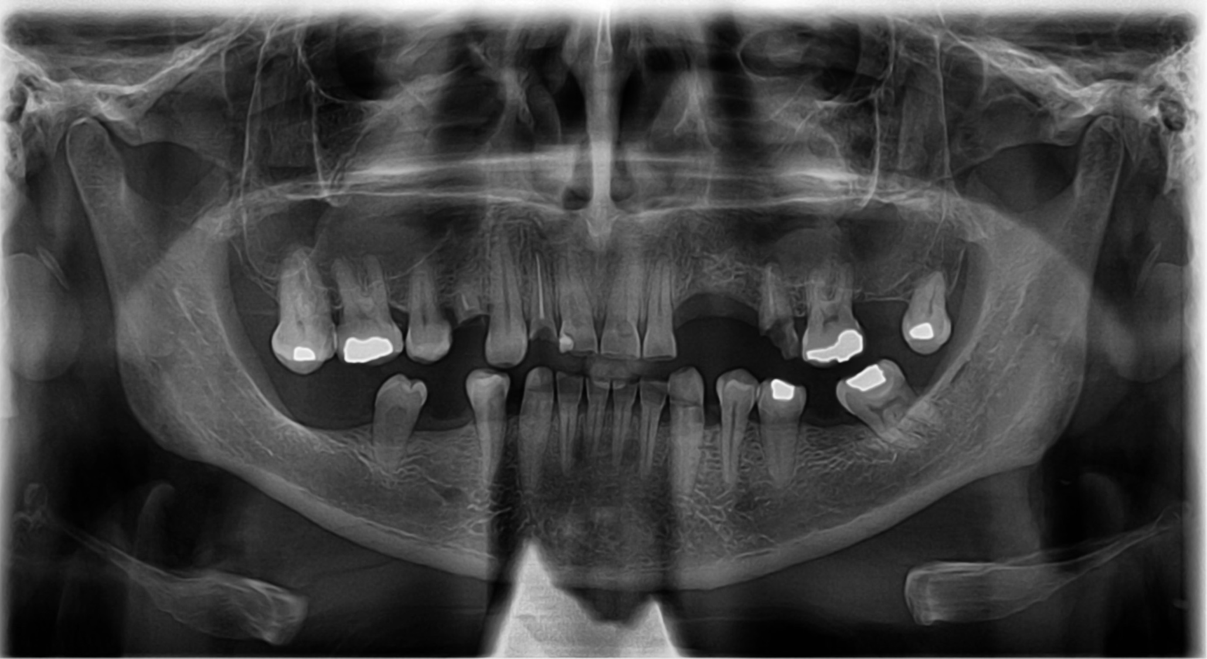
The patient's personal data must be blanked out, initials can remain!
Dental Status
Panoramic X-ray (OPG)
export without data
Date
Mark teeth removed since the given date with an X
Save X-rays from FlexiDent or IMPAX, screenshots are not acceptable.

Slide 16
Dental Status
Panoramic X-ray (OPG)

Slide 17
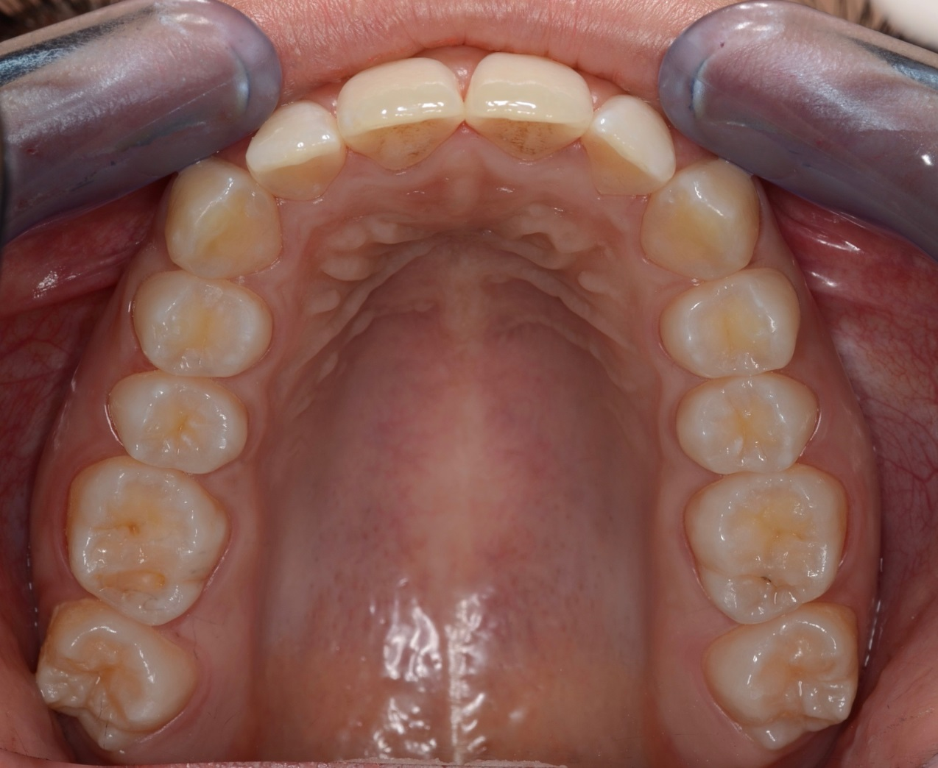
Upper jaw – dental status
X = missing tooth
)( = closed extraction gap
C = primer caries
SC = secunder caries
F_{A,}= amalgam filling
F_{C}= composite filling
F_{GIC v, C} =glassionomer filling or any kind of cement filling
T = temporary filling
E = RCT (endo)
P = periapical lesion
VPT = vital pulptherapy
INL/ONL = inlay, onlay
CR = crown
B = bridge – )( dimensions
U = telescope
I = implant
PC = post and core
Take photos using a lip retractor and mirror.
Crop the photos, flip and rotate them according to their orientation.
Use the list of abbreviations to fill in the table according to the dental status.
Don’t forget to name the surface of the fillings!
8 | 7 | 6 | 5 | 4 | 3 | 2 | 1 | 1 | 2 | 3 | 4 | 5 | 6 | 7 | 8
 | (B | B | B) |  |  |  |  |  |  |  |  | F_{A} MO SC | C MO | X
Fábián- és Fejérdy classification: class 0.
Notes:
Státuszfelvételhez applikáció: https://www.derec.ch/

Slide 18
Upper jaw – dental status
X = missing tooth
)( = closed extraction gap
C = primer caries
SC = secunder caries
F_{A,}= amalgam filling
F_{C}= composite filling
F_{GIC v, C} =glassionomer filling or any kind of cement filling
T = temporary filling
E = RCT (endo)
P = periapical lesion
VPT = vital pulptherapy
INL/ONL = inlay, onlay
CR = crown
B = bridge – )( dimensions
U = telescope
I = implant
PC = post and core
8 | 7 | 6 | 5 | 4 | 3 | 2 | 1 | 1 | 2 | 3 | 4 | 5 | 6 | 7 | 8
Fábián- és Fejérdy classification:
Notes:
Státuszfelvételhez applikáció: https://www.derec.ch/

Slide 19
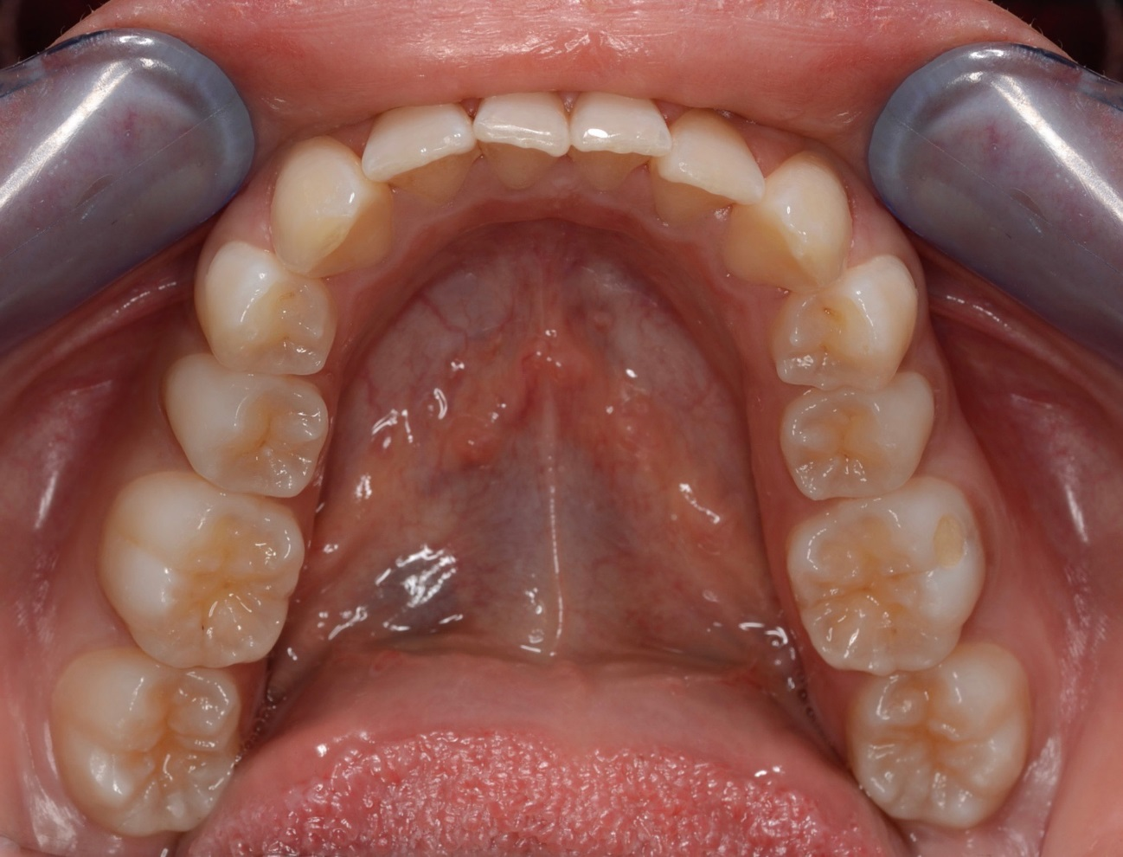
Lower jaw – dental status
X = missing tooth
)( = closed extraction gap
C = primer caries
SC = secunder caries
F_{A,}= amalgam filling
F_{C}= composite filling
F_{GIC v, C} =glassionomer filling or any kind of cement filling
T = temporary filling
E = RCT (endo)
P = periapical lesion
VPT = vital pulptherapy
INL/ONL = inlay, onlay
CR = crown
B = bridge – )( dimensions
U = telescope
I = implant
PC = post and core
Take photos using a lip retractor and mirror.
Crop the photos, flip and rotate them according to their orientation.
Use the list of abbreviations to fill in the table according to the dental status.
Don’t forget to name the surface of the fillings!
8 | 7 | 6 | 5 | 4 | 3 | 2 | 1 | 1 | 2 | 3 | 4 | 5 | 6 | 7 | 8
 | (B | B | B) |  |  |  |  |  |  |  |  | F_{A} MO SC | C MO | X
Fábián- és Fejérdy classification: class 0.

Slide 20
Lower jaw – dental status
X = missing tooth
)( = closed extraction gap
C = primer caries
SC = secunder caries
F_{A,}= amalgam filling
F_{C}= composite filling
F_{GIC v, C} =glassionomer filling or any kind of cement filling
T = temporary filling
E = RCT (endo)
P = periapical lesion
VPT = vital pulptherapy
INL/ONL = inlay, onlay
CR = crown
B = bridge – )( dimensions
U = telescope
I = implant
PC = post and core
8 | 7 | 6 | 5 | 4 | 3 | 2 | 1 | 1 | 2 | 3 | 4 | 5 | 6 | 7 | 8
Fábián- és Fejérdy classification:

Slide 21
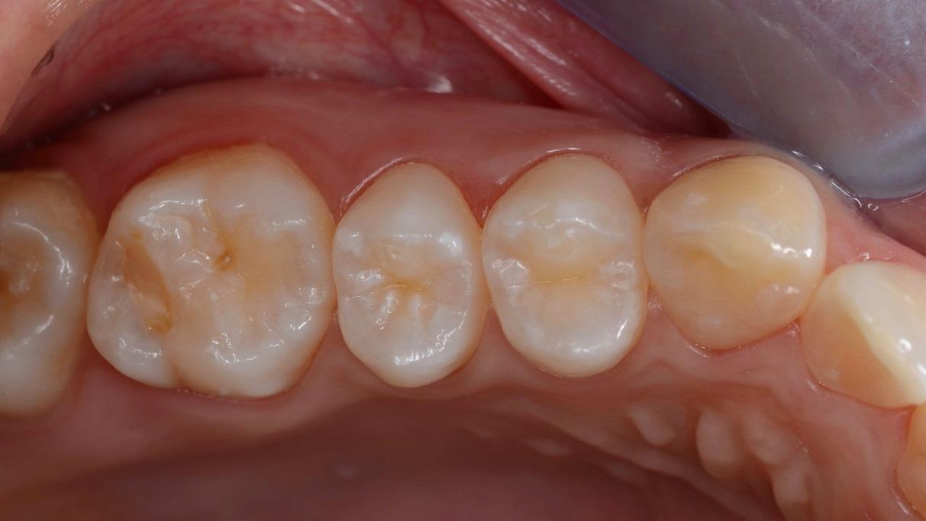
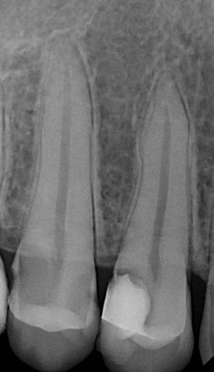
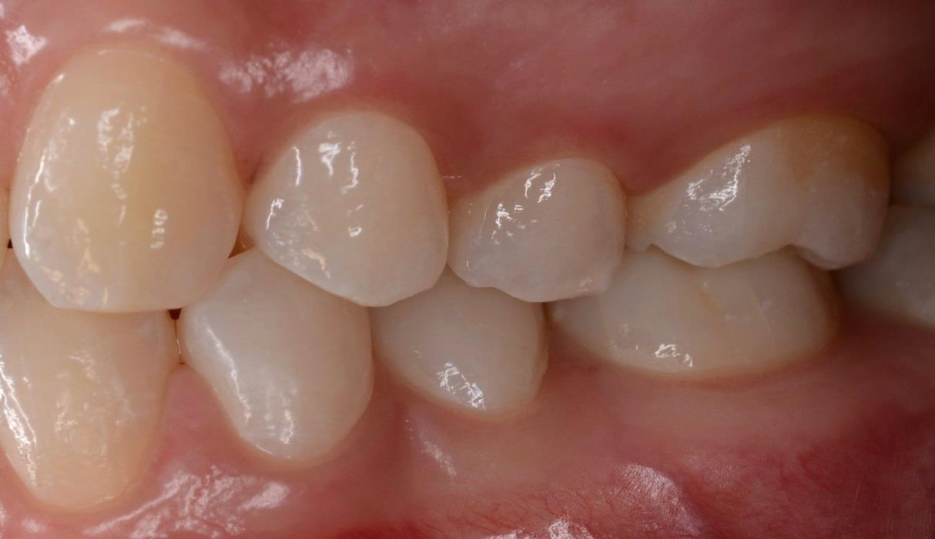
Investigation of the tooth to be treated (e.g. 15)
Sharp initial photo, preoperative intraoral X-ray is mandatory for root canal treatment!
Complaints: e.g. pain anamnesis
Inspection: description of the things you can see
Palpation: tests on the tooth surface with a probe and with fingers in the vestibule
Sensibility test: describe the tooth's response to cold in your own words compared to a reference tooth The reference tooth must be marked!
Percussion: describe the tooth’s response to vertical and horizontal percussion in your own words compared to a reference tooth The reference tooth must be marked!
Radiological findings: description the periapical area, healthy/widened PDL/periapical lesion etc.
Diagnosis/status: e.g. caries media/profunda/penetrans, fractura coronae, acuta/chr apical periodontitis., status post trepanationem, incomplete RCT/obturation, acute/chronicap. abscess etc.
SI | PTN | E | C | DPI
1 | 0 | 1 | 0 | 2
Notes:
chrome-extension://efaidnbmnnnibpcajpcglclefindmkaj/https://www.nature.com/articles/sj.bdj.2017.447.pdf

Slide 22
Investigation of the tooth (16)
Complaints: no pain/ throbbing pain for 2 days
Inspection: O composite filling, discoloration, M fracture
Palpation: marginal gap mesially, no swelling on palpation of vestibule
Sensibility test: the tooth is sensitive to cold, pain disappears immediately after the stimulus has stopped, pain similar to normal tooth/cold sensitivity persists for a long time after the stimulus has stopped (ref. 26)
Percussion: not sensitive to percussion/sensitive to biting on cotton rolls (ref. 26)
Radiological findings: diffuse v. circumscribed periapical lesion/widened PDL
Diagnosis/status: caries media/root canal treated tooth/status post trepanation
SI | PTN | E | C | DPI
Notes:
chrome-extension://efaidnbmnnnibpcajpcglclefindmkaj/https://www.nature.com/articles/sj.bdj.2017.447.pdf

Slide 23
Treatment plan
List the required treatments for the whole oral cavity in the appropriate order. Take into considearation the condition of the adjacent and antagonistic teeth.
Order of treatments:
Acute pain: trepanation, exstirpation, curettage
Periodontal treatment: professional oral hygiene treatment, instructions, motivation, primer periodontal therapy
Oral surgery care: list of hopeless teeth
Restorative treatments - RCT, fillings, inlays/onlays Highlight the treatments presented in the case report in bold. E.g.:
26 RCT
25 OD, 27 MO composite fillings
26 E.max ceramic onlay
Orthodontic treatment
Prosthodontic treatment: a brief description of the restorations needed, e.g. 26 post and core and crown

Slide 24
Treatment plan
26 RCT – trepanation, exstirpation
Professional oral hygiene treatment
Instructions and motivation
18, 28 extraction
26 RCT
25 OD, 27 MO composite fillings
26 E.max ceramic onlay
14MO, 15OD composite filling
…
…
45 post and core and PFM crown

Slide 25
Documentation of the filling
Preoperative photo – occlusal and buccal view (initial intraoral X-ray, if taken)
DPI determination- after exploration of the lesion on the basis of the primary preparation (any change?)
Isolation after preparation - rubberdam, matrix and wedge in situ
The exact meeting of the sticker and the margin of the cavity should be visible in the photo. The cavity, work area should be clean and free of blood.
Finished, polished, dried (no saliva, no blood) restoration - occlusal and buccal view, contact point evaluability is important!
Type of adhesive technique and list of materials used for filling
SI | PTN | E | C | DPI

Slide 26
Documentation of the filling

Slide 27
Documentation of the filling I.
Preoperative photo
Occlusal view
Preoperative photo
Buccal view
Preoperative X-ray (if taken)

Slide 28

Documentation of the filling II.
Lesion after primer preparation
Prepared cavity, isolation, wedge(s), matrix in situ
SI | PTN | E | C | DPI

Slide 29
Documentation of the filling III.
Finished, polished restoration
Occlusal view
Finished, polished restoration
Buccal view
Type of adhesive technique and list of materials used for filling:

Slide 30
Documentation of the Root Canal Treatment
Preoperative photo
Preoperative intraoral radiograph
Cleaned cavity (after removal of old filling and caries), cusp reduction (if needed)
Preendo build up (if needed)
Access cavity photo in absolute isolation with preendo build up (if made)
Table of working length measurement
Needle control radiograph
Prepared canals after final irrigation and drying
Photo of the guttapercha cut-back, cleaned pulp chamber
Photo of the coronal sealing of the obturation
Description of materials used during RCT, preparation and root canal filling techniques
Control radiograph
Long-term temporary or final restoration

Slide 31
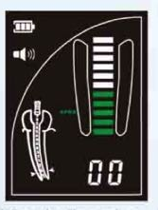
Documentation of the Root Canal Treatment
Working length measurement
Measurement with apexlocator
Needle control radiograph
eccentric radiograph needed for multiple channels (or separate radiographs for each channel)
mark the canal which had the Hedstrom file with H
Canals | Reference point | Estimated Working Length | IAF | „00” for. anatomicum | -0,5 mm for. physiologicum | Final WL | MAF | MG size
MB I | Mb cusp | 17 mm | #15 | 18 mm | 17,5 mm | 17,5 mm | #30 | #30
MB II | Mb cusp | 17 mm | #10 | - | 16 mm | 16 mm | #25 | #25
DB
P

Slide 32
Documentation of RCT

Slide 33
Documentation of RCT I.
Preoperative photo
Preoperative X-ray
Cleaned cavity before trepanation

Slide 34
Documentation of RCT II.
Isolation,matrix, wedge in situ before preendo build up
Access cavity in absolute isolation

Slide 35
Needle control X-ray
Documentation of RCT III.
Working length measurement
Canals | Reference point | Estimated Working Length | IAF | „00” for. anatomicum | -0,5 mm for. physiologicum | Final WL | MAF | MG size

Slide 36
Chemo-mechanical preparation, obturation and coronal sealing
Documentation of RCT IV.
Prepared canals after final irrigation and drying
Guttapercha cut-back, cleaned pulp chamber
Coronal seal of the obturation
Root canal preparation technique, root canal filling technique, materials used, final irrigation protocol:

Slide 37
Documentation of RCT V.
Long-term temporary filling/Final restoration
Control X-ray

Slide 38
Documentation of aesthetic inlay/onlay/crown
Digital workflow
Preoperative photo occlusal and buccal view (and preoperative radiograph, if made)
Shade selection
Prepared cavity from occlusal and buccal view
Temporary filling/crown
CAD/CAM screenshots:
Digital impressions of the prepared cavity from occl., bucc., oral view (equivalent of the precisional-situational impression) and antagonistic teeth
Bite (ICP) from buccal and oral view
Margin from occl., bucc., oral view
Designed restoration from occl., bucc., oral view
Restoration with antagonistic teeth, occlusal contacts
Approximal contactpoint(s)
Material thickness, sprue placement
Notes:
https://www.ivoclar.com/en_li/products/metal-free-ceramics/ips-e.max-shade-navigation-app

Slide 39
Documentation of aesthetic inlay/onlay/crown
Digital workflow
Milled restoration in front of a natural background
Restoration try in in the mouth in relative or absolute isolation
Rubberdam, matrix and wedge(s)/ teflontape in situ
Type of adhesive technique used for adhesive cementation, name of cement and list of materials used for cavity and restoration pre-treatment (manufacturer’s name, percentage, time)
Finished, polished restoration from an occlusal view (contact points!) and buccal view in ICP
https://www.ivoclar.com/en_li/products/metal-free-ceramics/ips-e.max-shade-navigation-app

Slide 40
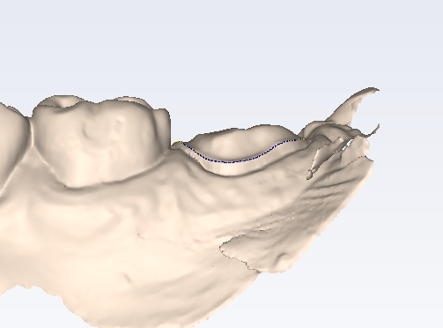
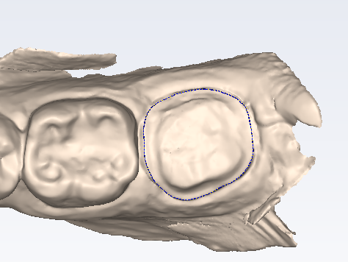
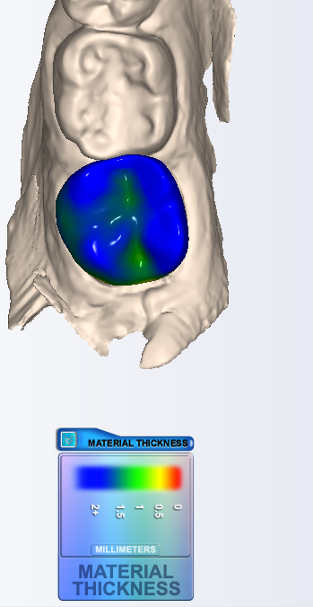
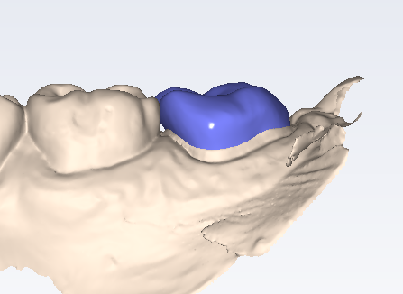
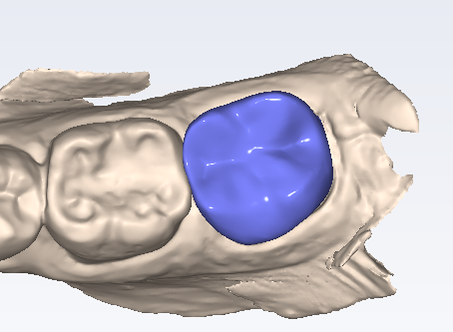
Margin and the designed restoration, material thickness (occlusal view)

Slide 41
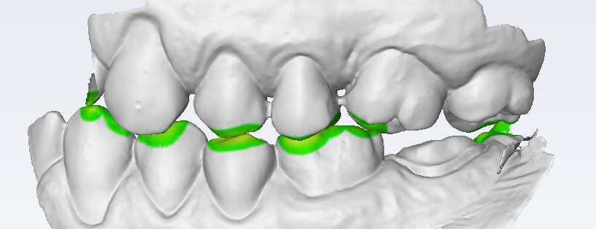
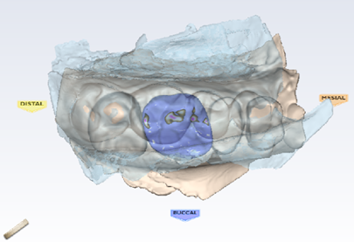
Bite (ICP), interocclusal space,
Restoration with the antagonistic teeth and occlusal contacts

Slide 42
Documentation of aesthetic inlay/onlay/crown

Slide 43
Documentation of aesthetic inlay/onlay/crown I.
Digital workflow
Preoperative photo occlusal and buccal view
Preoperative radiograph
Shade selection

Slide 44
Documentation of aesthetic inlay/onlay/crown II.
Digital workflow
Prepared cavity occlusal view
Prepared cavity buccal view
Temporary filling/crown

Slide 45
Digital impressions
Documentation of aesthetic inlay/onlay/crown III.
Digital workflow
Buccal view
Occlusal view
Lingual/palatal view
Antagonist

Slide 46
Documentation of aesthetic inlay/onlay/crown IV.
Digitális technika
Bite from buccal and oral view
Buccal view
Lingual/palatinal view

Slide 47
Margin and designed restoration from an occlusal, buccal and oral view
Documentation of aesthetic inlay/onlay/crown V.
Digitál workflow
Buccal view
Occlusal view
Lingual/palatal view

Slide 48
Documentation of aesthetic inlay/onlay/crown VI.
Digital workflow
Restoration with the antagonistic teeth, occlusal contacts
Occlusal view contacts
Buccal view
Oral view

Slide 49
Approximal contact(s), material thickness, sprue placement
Documentation of aesthetic inlay/onlay/crown VII.
Digital workflow
Mesial view
Material thickness
Distal view
Sprue placement

Slide 50
Documentation of aesthetic inlay/onlay/crown VIII.
Digital workflow
Absolute isolation, matrix and wedge/ teflon tape in situ
Restoration
Try-in
Adhesive cement:
Pre-treatment of restoration:
Pre-treatment of cavity:

Slide 51
Documentation of aesthetic inlay/onlay/crown IX.
Digital workflow
Finished and polished restoration from occlusal and buccal view
Occlusal view
Buccal view

