Slide 1
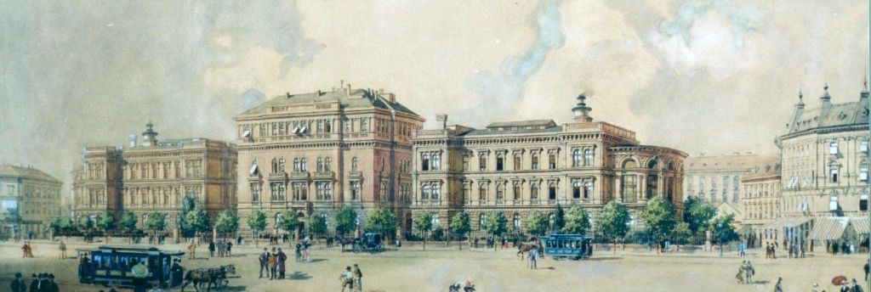
Semmelweis University, Faculty of Dentistry
Department of Restorative Dentistry and Endodontics
Head: Prof. Dr. János Vág DMD, PhD.
Case Report
Student:
Teacher:
Treatment summary: (e.g.: 16 MO filling, 24 RCT, 36 MOD inlay)
Patient: (e.g.: S. Arnold)
Beginning and end of treatment:

Slide 2
Medical history
Patient abbreviated name, age, gender, occupation
Factors affecting the dental treatment (e.g.: pacemaker, pathological conditions requiring antibiotic prophylaxis, allergy, bruxism, xerostomia, etc.)
Current illnesses
Current medication (precise knowledge of drug substance and side effects)
Addiction, bad habits effecting general health

Slide 3
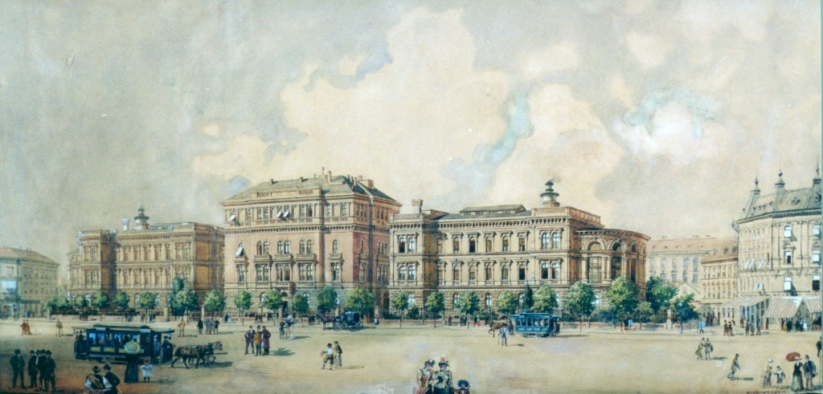
Main complaint and dental history
The reason of dental investigation’s need
This is NOT the dental status!!!
Previous dental treatments (according to the patient) E.g.: orthodontic treatments, prosthetic procedures, oral surgery (with dates)

Slide 4
Inspection of the head-, neck region, intraoral investigation
Investigation of TMJ
Stomato-oncological monitoring
Oral hygiene, DMF-T
Periodontal status (BPE/PSR)
Angle classification
Fábián and Fejérdy classification

Slide 5
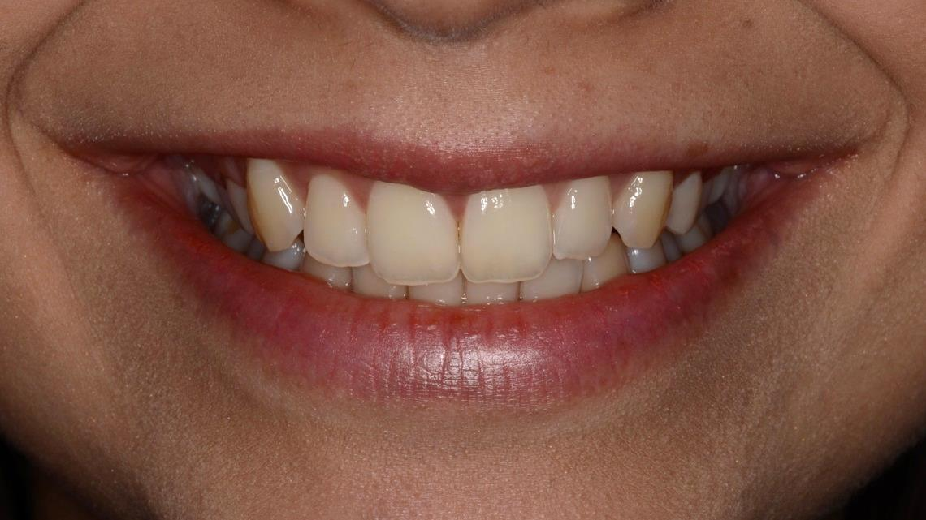
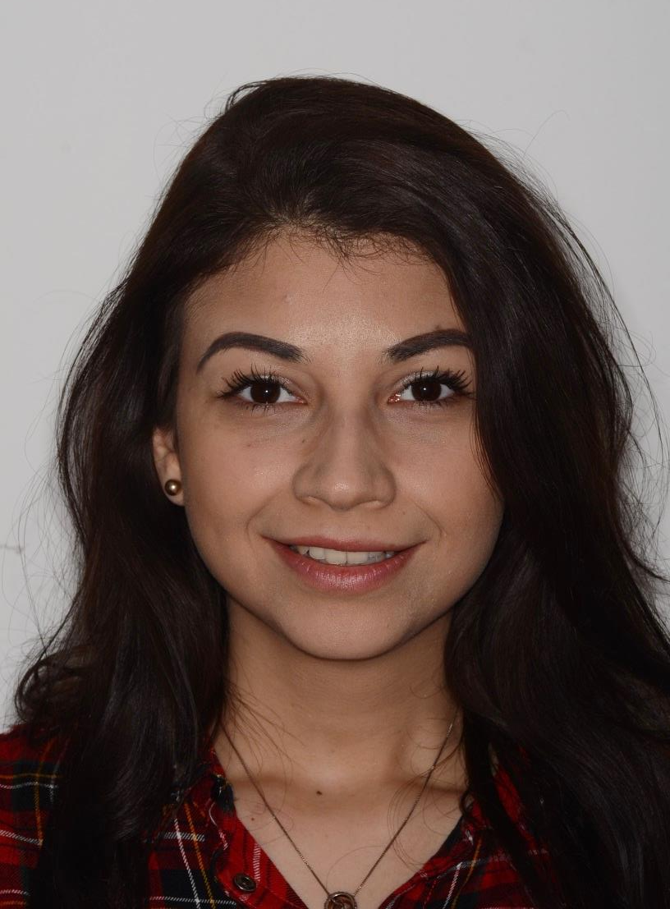
Full face and smile photos
Teeth should be visible on the full face photo as well!!

Slide 6
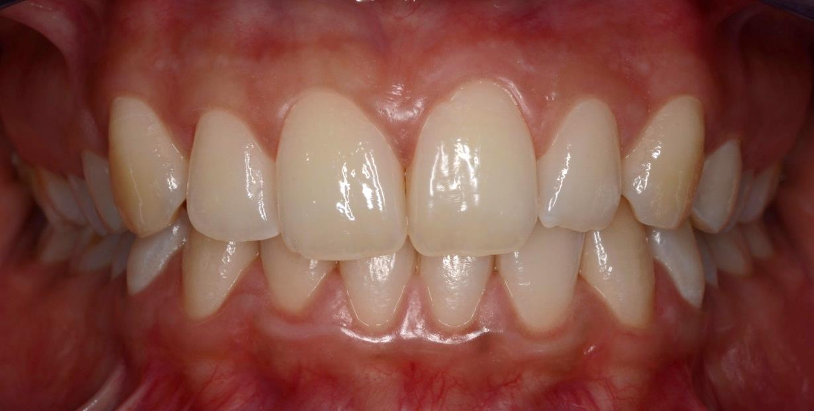
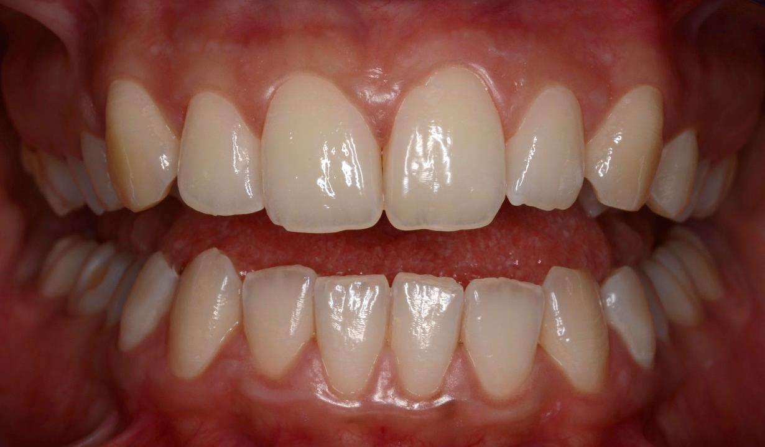
IKP and slightly open position
Angle classification, crossbite, deep bite, midline shift, deviation, etc.

Slide 7
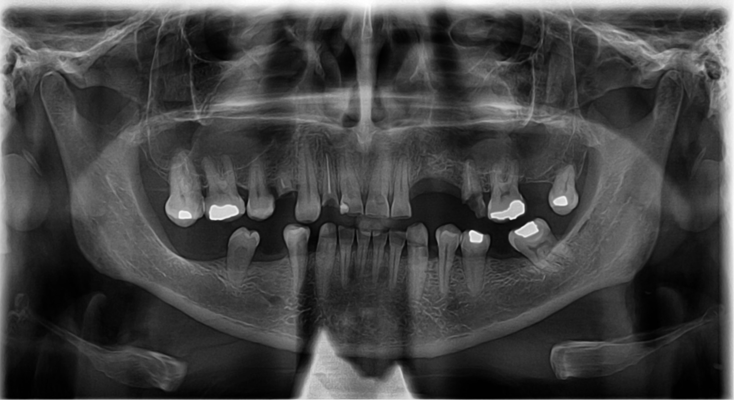
Panoramic X-ray (OPG)
Without personal data or it should be hidden!

Slide 8
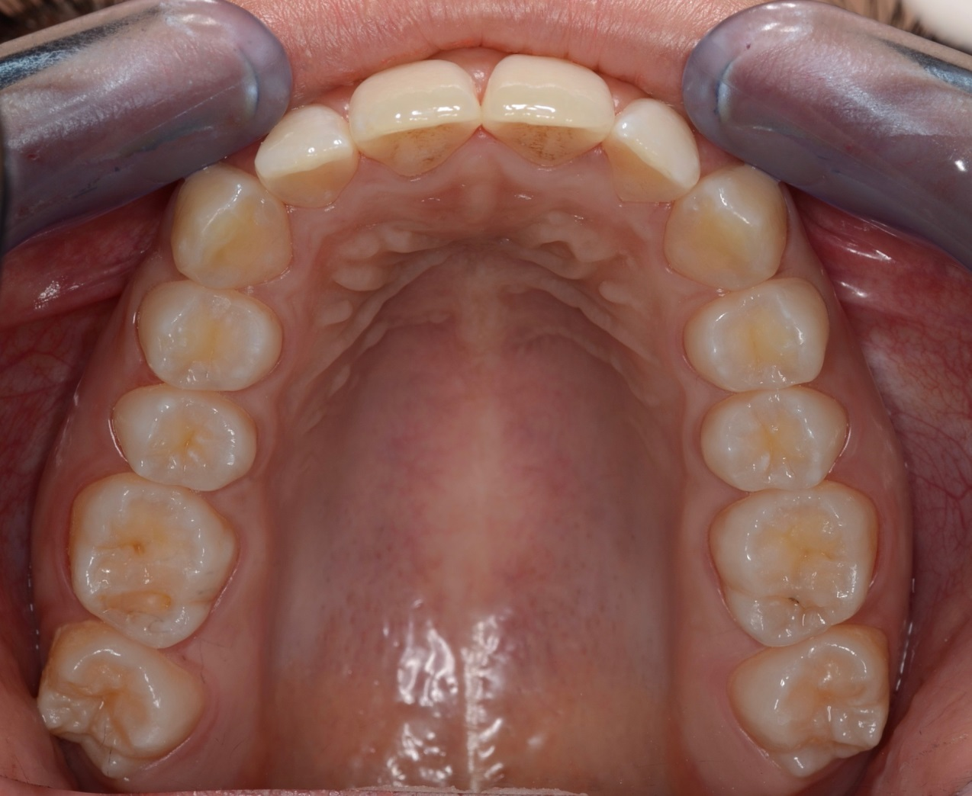
Upper jaw - dental status
Photo should be taken with lip retractor and mirror
Correctly rotated, mirrored (illusion of direct view) and cropped
Listed dental status or in a table
Intraoral X-rays (if available)
Fábián and Fejérdy classification (if there are missing teeth)

Slide 9
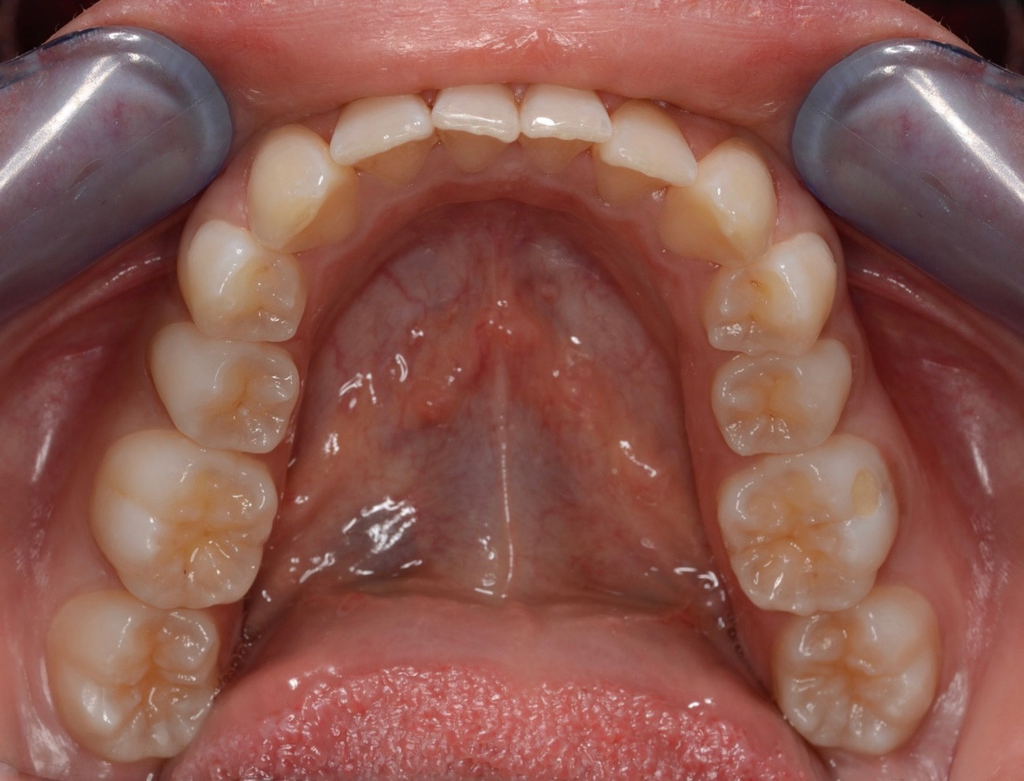
Lower jaw- dental status
Photo should be taken with lip retractor and mirror
Correctly rotated, mirrored (illusion of direct view) and cropped
Listed dental status or in a table
Intraoral X-rays (if available)
Fábián and Fejérdy classification (if there are missing teeth)

Slide 10
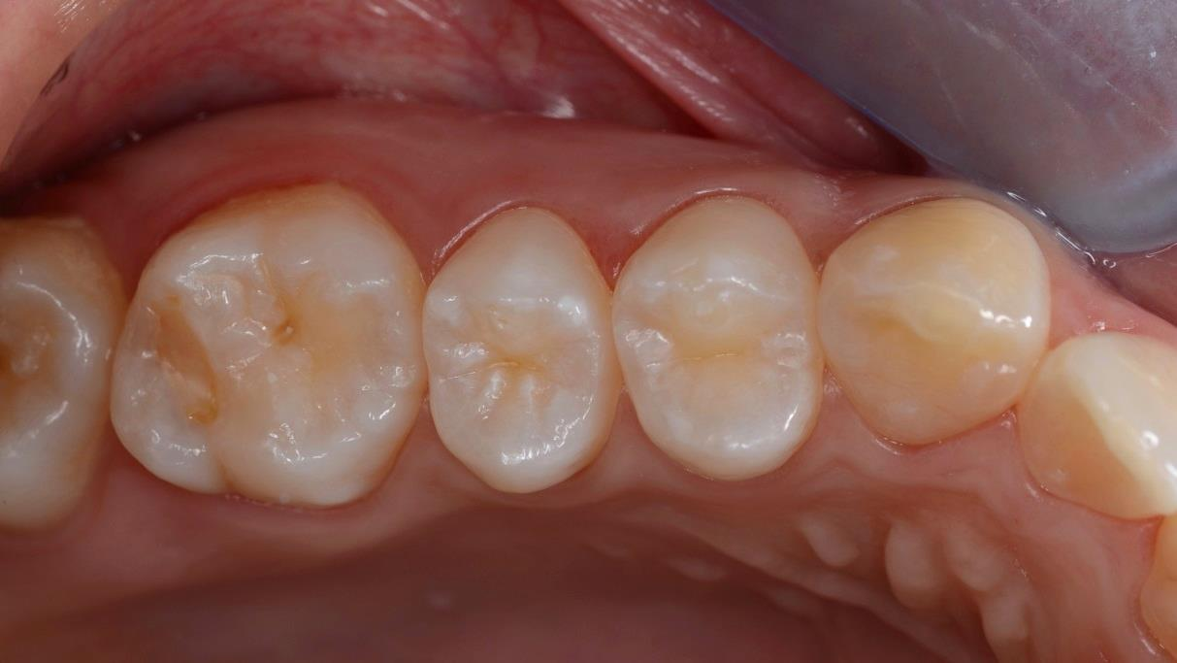
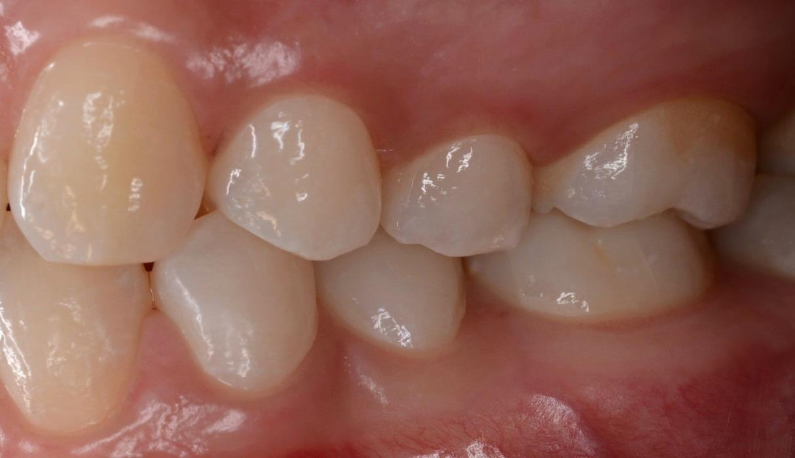
Investigation of the tooth with complain (e.g.:16)
Preoperative photo (sharp!)
Inspection : …..
Palpation : ……
Sensitivity test: (Reference tooth needed!)
Percussion: (Reference tooth needed!)
.
Intraoral X-ray (if needed)
Diagnosis!

Slide 11
Treatment plan
Treatment plan:
Oral cavity
Full dentition
Tooth with complaint
Evaluation regarding the rehabilitation of the full oral cavity
Condition and future of the periodontium
Adjacent and antagonistic teeth considering the alternatives of prosthetic solutions

Slide 12
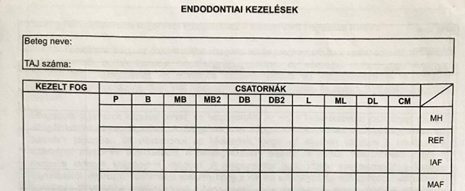
Documentation of the full treatment
Preoperative photo, X-ray (panoramic, periapical, dental status, bitewing), Pre-endodontic build-up
Endodontic treatment documentation:
Photo from access cavity with rubber dam
working length determination (with apex locator, X-ray)
IAF, MAF sizes, working length

Slide 13
Documentation of the full treatment Endodontic treatment documentation:

Slide 14
Documentation of the full treatment
Preoperative photo, X-ray (panoramic, periapical, dental status, bitewing)
Photos of a filling (direct restoration):
After cavity preparation
Rubber dam, matrix, wedge in situ
Finished, polished restoration (without saliva, blood)

Slide 15
Documentation of the full treatment
Preoperative photo, X-ray (panoramic, periapical, dental status, bitewing)
Photos of an inlay (indirect restoration):
Shade determination
cavity after preparation
Temporization/provisional restoration
Prepared tooth from occl., bucc., oral view (screenshot of CAD/CAM works)
Antagonist (screenshot of CAD/CAM works)
Buccal view of the bite (screenshot of CAD/CAM works)
The digital design of the restoration (screenshot of CAD/CAM works)
Final restoration
Rubber dam, matrix, wedge in situ
Finished, polished restoration from occlusal view and in intercuspidation

Slide 16
Photo documentation guidelines
Photo after scaling and oral hygiene treatments (or before and after)
Tooth surfaces (and mucosa) should be dried (avoiding from saliva/blood) before taking the picture
Recommended to take more pictures from the same situation, because only sharp photo is acceptable!
Investigated/treated tooth should be in the middle of the photo,
Unwanted, non-informative parts should be cropped
If the photo was taken with a mirror, it should be mirrored (illusion of direct view)
Correctly rotated regarding the quadrant
Download the pictures often from the camera, not to loose any pictures (only complete case is acceptable)!!!

