Slide 1
MODULATED ELECTRO-HYPERTHERMIA ENHANCES THE EFFICACY OF ANTI-CANCER DRUGS IN MICE WITH TRIPLE-NEGATIVE BREAST CANCER
Kenan Aloss
Supervisor: Prof. Péter Hamar
Opponents: Dr. Valéria Dezső Tékus
Dr. Tamás Szabolcs Micsik
Institute of Translational Medicine

Slide 2
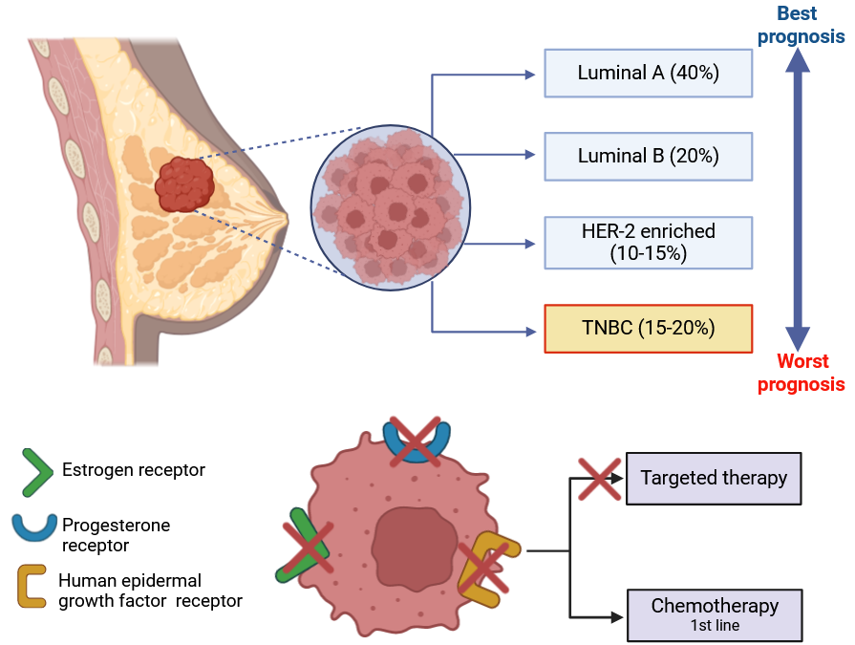

Background: Triple-negative breast cancer (TNBC)
New treatment options

Slide 3
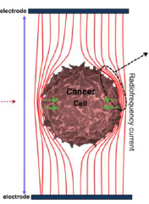
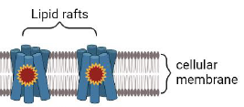
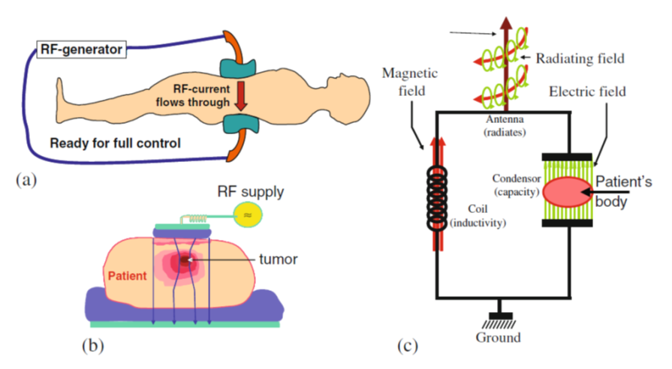
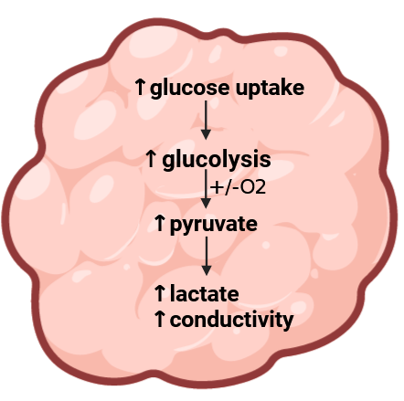
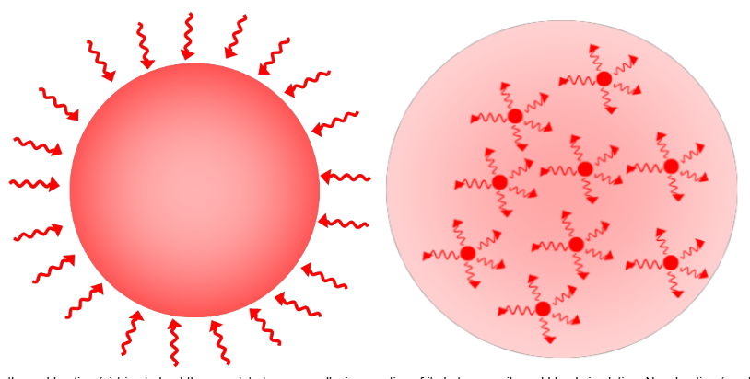
Background: Modulated electro Hyperthermia (mEHT)
Clinical mEHT
Lipid rafts
Conventional Hyperthermia
mEHT
Notes:
This specific energy absorption by lipid rafts reduces side effects and make mEHT different from conventional hyperthermia which try to heat the whole tumor mas homogenously without selectivity leading to burning of surrounding tissues
TNBC is the most aggressive breast cancer subtype and treatment options are limited because the cells lack the expression of hormone receptors
Most of you have already heard enough about TNBC and mEHT from the last presentation of my colleague however as we have a guest I am going to talk briefly so TNBC represents aroud fouth of all breast cancer cases. Since ….which shows the need of alternative treatments such as mEHT
I would like first to introduce our model IN OUR MODEL we are using mEHT which is a complemtry treatment for chemo and radiotherapy. It is Hungarian invention invented by oncotherm company . SO In the clinic tumor is between 2 electrodes and electro magnatic field will accumulate in the tumor. But what We are using in our model is mEHT device optimized for mice with the same principal and we found from pilot experiment that when the skin temperature is 39.5 the temperature inside the tumor is 42 so we could base our treatment on the skin temperature. So breiefly what we do we inject 4T1 TNBC cells in the mammary gland of the mice then randomize after 8 days according to tumor volum and treat with mEHT 42C 30 min and after harvest we go for follow up worl like pce and IHC
The modulated electro-hyperthermia generated by 13.56 MHz amplitude-modulated radio-frequency
mEHT utilizes the bioelectrical difference between the tumor tissue and healthy tissues [7]. The difference in bioelectrical properties results from the higher aerobic glycolysis of cancer cells, known as the Warburg-effect, that causes higher lactate and ion levels in the cancer cells and thus elevates electric conductivity of the tumor [8]. Due to these factors, the energy of the electromagnetic field is absorbed mainly by the tumor.
I The modulated electro-hyperthermia generated by 13.56 MHz amplitude-modulated radio-frequency
mEHT utilizes the bioelectrical difference between the tumor tissue and healthy tissues [7]. The difference in bioelectrical properties results from the higher aerobic glycolysis of cancer cells, known as the Warburg-effect, that causes higher lactate and ion levels in the cancer cells and thus elevates electric conductivity of the tumor [8]. Due to these factors, the energy of the electromagnetic field is absorbed mainly by the tumor.
Modulated electro-hyperthermia (mEHT) is a non-invasive, complementary therapeutic option, by which selective tumor cell destruction can be induced by loco-regional radiation with amplitude modulated (AM), 13.56 MHz frequency (radiofrequency) electromagnetic field [4]. The communicated energy is detected as a temperature rise in the tumor. Selective power absorption by cancer cells is based on their higher glycolytic rate, discrepant ionic composition, and altered permittivity compared to normal tissues. The selective power absorption results in tumor-specific tissue damage [5] and tumor cell deat
LabEHY-200 device and the newly developed treating setup: temperature-controlled (heated) lower electrode and position-adjustable pole electrode (upper electrode).
To properly adjust the amount of energy delivered into the tumor by mEHT, we determined the temperature within the tumor and its surroundings (skin, rectum) in a pilot experiment (Figure 2A). The tumor temperature was 2.5 ± 0.5 °C higher (p < 0.0001) compared to the skin directly above the tumor and 4.4 ± 1.2 °C higher (p < 0.0001) than in the rectum below the tumor (Figure 2B). Based on these findings, only the noninvasive rectal and skin temperatures were recorded in all further experiments to monitor the energy communicated to the tumor without any mechanical injury.
Six-to-eight-week-old female BALB/c mice. 1 × 106 4T1 cells in 50 μL, Inoculation was made orthotopically into the 4th mammary gland’s fat pad in each mouse [58]. Six days after inoculation tumors were measured with digital caliper and ultrasound and mice were randomized into mEHT and sham-treated groups according to tumor size, age, and weight. Animals (n = 7) with the largest, smallest, or twin tumors were excluded from the study. Twenty-four hours after the last treatment mice were euthanized by cervical dislocation. The tumors were resected and cleaned of the surrounding connective tissue, fat, and skin. The condition of the internal organs (bowels, urinary bladder, spleen) and possible adherences between the tumor and muscles were inspected. Tumors were cut in half precisely along their longest diameter, one half was placed in a 4% formaldehyde solution (Molar Chemicals Kft., Halásztelek, Hungary) that was replaced with 70% alcohol after forty-eight hours. Samples were stored for further histological processing for a maximum of 2 weeks. The other half of the tumors were frozen in liquid nitrogen for molecular analysis (RNA isolation, RT-PCR).
The 4T1 cell line is one of the most commonly used isogenic BALB/C TNBC cell lines. Specific features of the 4T1 cell line are the epithelial phenotype, strong invasiveness and high metastatic potential, which makes it a suitable experimental model for human TNBC

Slide 4
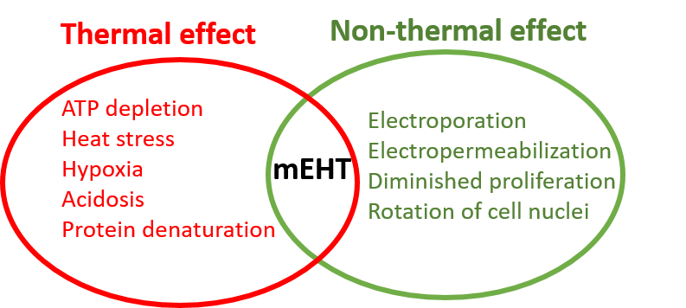
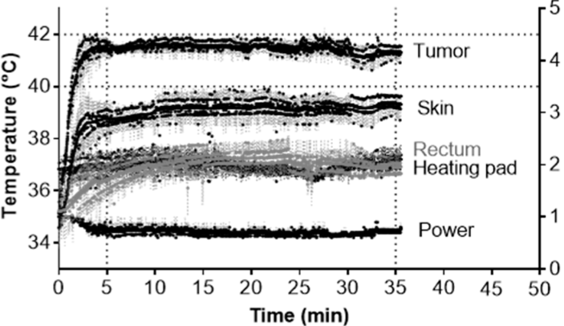
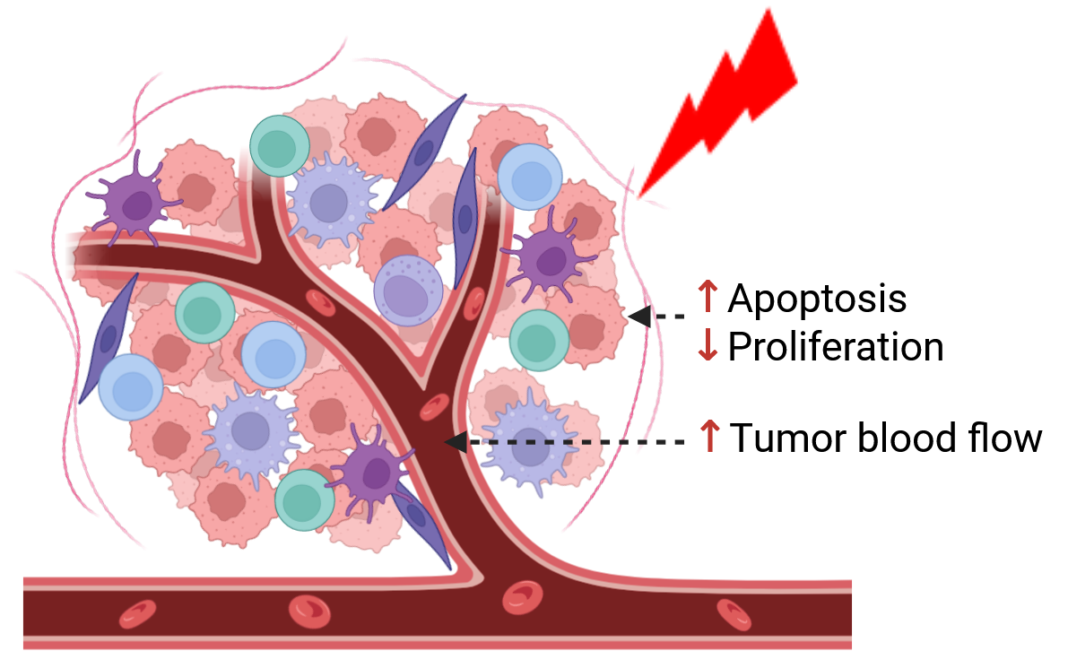
Background: Advantages of Modulated electro Hyperthermia (mEHT)
mEHT: Tumor-selective heating
ΔT(tumor-skin) ≥ 2 °C
Thermo-sensitive nanoparticles
Notes:
TNBC is the most aggressive breast cancer subtype and treatment options are limited because the cells lack the expression of hormone receptors
Most of you have already heard enough about TNBC and mEHT from the last presentation of my colleague however as we have a guest I am going to talk briefly so TNBC represents aroud fouth of all breast cancer cases. Since ….which shows the need of alternative treatments such as mEHT
I would like first to introduce our model IN OUR MODEL we are using mEHT which is a complemtry treatment for chemo and radiotherapy. It is Hungarian invention invented by oncotherm company . SO In the clinic tumor is between 2 electrodes and electro magnatic field will accumulate in the tumor. But what We are using in our model is mEHT device optimized for mice with the same principal and we found from pilot experiment that when the skin temperature is 39.5 the temperature inside the tumor is 42 so we could base our treatment on the skin temperature. So breiefly what we do we inject 4T1 TNBC cells in the mammary gland of the mice then randomize after 8 days according to tumor volum and treat with mEHT 42C 30 min and after harvest we go for follow up worl like pce and IHC
The modulated electro-hyperthermia generated by 13.56 MHz amplitude-modulated radio-frequency
mEHT utilizes the bioelectrical difference between the tumor tissue and healthy tissues [7]. The difference in bioelectrical properties results from the higher aerobic glycolysis of cancer cells, known as the Warburg-effect, that causes higher lactate and ion levels in the cancer cells and thus elevates electric conductivity of the tumor [8]. Due to these factors, the energy of the electromagnetic field is absorbed mainly by the tumor.
I The modulated electro-hyperthermia generated by 13.56 MHz amplitude-modulated radio-frequency
mEHT utilizes the bioelectrical difference between the tumor tissue and healthy tissues [7]. The difference in bioelectrical properties results from the higher aerobic glycolysis of cancer cells, known as the Warburg-effect, that causes higher lactate and ion levels in the cancer cells and thus elevates electric conductivity of the tumor [8]. Due to these factors, the energy of the electromagnetic field is absorbed mainly by the tumor.
Modulated electro-hyperthermia (mEHT) is a non-invasive, complementary therapeutic option, by which selective tumor cell destruction can be induced by loco-regional radiation with amplitude modulated (AM), 13.56 MHz frequency (radiofrequency) electromagnetic field [4]. The communicated energy is detected as a temperature rise in the tumor. Selective power absorption by cancer cells is based on their higher glycolytic rate, discrepant ionic composition, and altered permittivity compared to normal tissues. The selective power absorption results in tumor-specific tissue damage [5] and tumor cell deat
LabEHY-200 device and the newly developed treating setup: temperature-controlled (heated) lower electrode and position-adjustable pole electrode (upper electrode).
To properly adjust the amount of energy delivered into the tumor by mEHT, we determined the temperature within the tumor and its surroundings (skin, rectum) in a pilot experiment (Figure 2A). The tumor temperature was 2.5 ± 0.5 °C higher (p < 0.0001) compared to the skin directly above the tumor and 4.4 ± 1.2 °C higher (p < 0.0001) than in the rectum below the tumor (Figure 2B). Based on these findings, only the noninvasive rectal and skin temperatures were recorded in all further experiments to monitor the energy communicated to the tumor without any mechanical injury.
Six-to-eight-week-old female BALB/c mice. 1 × 106 4T1 cells in 50 μL, Inoculation was made orthotopically into the 4th mammary gland’s fat pad in each mouse [58]. Six days after inoculation tumors were measured with digital caliper and ultrasound and mice were randomized into mEHT and sham-treated groups according to tumor size, age, and weight. Animals (n = 7) with the largest, smallest, or twin tumors were excluded from the study. Twenty-four hours after the last treatment mice were euthanized by cervical dislocation. The tumors were resected and cleaned of the surrounding connective tissue, fat, and skin. The condition of the internal organs (bowels, urinary bladder, spleen) and possible adherences between the tumor and muscles were inspected. Tumors were cut in half precisely along their longest diameter, one half was placed in a 4% formaldehyde solution (Molar Chemicals Kft., Halásztelek, Hungary) that was replaced with 70% alcohol after forty-eight hours. Samples were stored for further histological processing for a maximum of 2 weeks. The other half of the tumors were frozen in liquid nitrogen for molecular analysis (RNA isolation, RT-PCR).
The 4T1 cell line is one of the most commonly used isogenic BALB/C TNBC cell lines. Specific features of the 4T1 cell line are the epithelial phenotype, strong invasiveness and high metastatic potential, which makes it a suitable experimental model for human TNBC

Slide 5
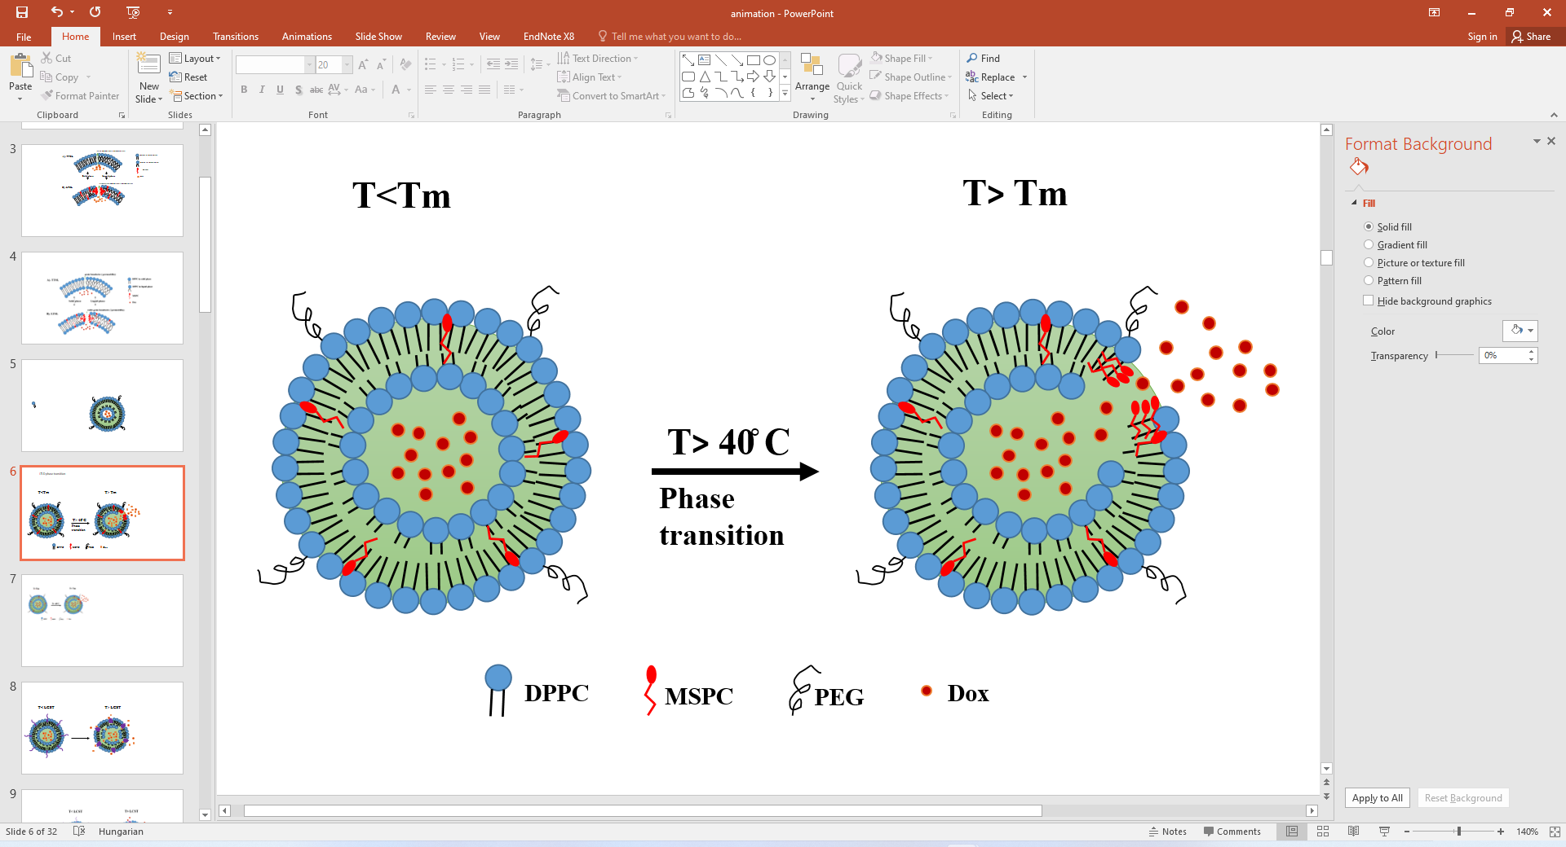

Background. I: Liposomal Doxorubicin
Doxorubicin (DOX)
  1st –line in TNBC
  Cardiotoxicity
  ↓ accumulation in tumor
Lyso-Thermo-sensitive liposomal DOX (LTLD, Thermodox®)
FDA-approved liposomal DOX
PLD
Non-PLD
LTLD + conventional Hyperthermia (cHT)
↓cardiotoxicity
Efficacy = DOX
↓cardiotoxicity
Efficacy = DOX
Pre-clinical
Phase I
Phase III
New HT?
LTLD+ RFA
Tumor selectivity:
ΔT(tumor-skin)
mEHT 2.5 ̊C ˃ cHT1 ̊C
PLD: PEGylated liposomal DOX, DPPC: Dipalmitoylphosphatidylcholine, MSPC: 1-Myristoyl-2-stearoyl-sn-glycero-3-phosphocholine, RFA: radiofrequency ablation
Notes:
caelyx – pronouncation
doxorubicin is capable of generating a variety of free radical
These liposomes deliver their dox by extravasation. Liposome should extravasate through the fenesters in the blood vessl into
Short initial distribution half- life (5-10min) →↓Accumulation in tumor
Doxil: ↓DOX release→↓ bioavailable DOX
1-slow not complet release
2- no deep penetration due to entrapment in cellular lysomes
3- complet reliance of EPR is heterogenous
4- interation with cellular bariers such as ECM component
Myocet is a non-pegylated liposomal doxorubicin which is approved in Europe and Canada for treatment of metastatic breast cancer in combination with cyclophosphamide. The rationale behind its design is similar to Doxil [15-20]. Unlike Doxil, the myocet liposome does not have a polyethylene glycol coating and therefore does not result in the same prevalence of Hand-Foot Syndrome. The minimization of this side effect may allow 1: 1 substitution with doxorubicin in the same treatment regimen, thereby improving safety with no loss of efficacy
Doxil/Caelyx is a Pegylated (polyethylene glycol coated) liposome-encapsulated (PLD) form of doxorubicin [4,7,14]. Doxil has preferential concentration in the skin because of the polyethylene glycol coating. The main dose limiting side effects associated with Doxil is the palmar plantar erythrodysesthesia (PPE), otherwise known as hand-foot syndrome. Following administration of Doxil, small amounts of the drug can leak from capillaries in the palms of the hands and soles of the feet. The result of this leakage is redness, tenderness, and peeling of the skin that can be uncomfortable and even painful. The prevalence of this side effect limits the Doxil dose that can be given as compared with doxorubicin in the same treatment regimen. Outside the United States, Doxil is known as Caelyx.
fter accumulation of the liposomes in the tumor, the chemotherapeutic agent diffuses from these liposomes over the course of days
The liposome-encapsulated anthracyclines was designed to reduce the toxicity of doxorubicin while preserving its antitumor efficacy by altering its tissue distribution and pharmacokinetics. Intravenously injected liposomes cannot escape the vascular space in sites that have tight capillary junctions, such as the heart muscle and gastrointestinal tract. The liposomes generally exit the circulation in tissues and organs lined with cells that are not tightly joined (fenestrated) or areas where capillaries are disrupted by inflammation or tumor growth. Thus, liposomes should preferentially direct doxorubicin away from sites of potential toxicity, but leave the tumor exposed [11]. Liposomal doxorubicin was associated with significantly less cardiac and gastrointestinal toxicity, while antitumor efficacy was at least comparable to that of the parent molecule
However doxil deceased toxicity but efficacy was the same because the liposome need too extravasate to tumor then release the dox which takes several days also the liposomes after extravastion is entrapped in lysosoms and dox will be released therir and it will not reach the nucleus where it should act because dox works by inhibition of pproliferation by interlacating in DNA
From her came the idea to trigger dox release from liposome in response to externall trigger like heating
The extended circulation lifetime of many liposome formulations can improve tumor drug uptake, through a mechanism known as the enhanced permeability and retention (EPR) effect. The EPR effect relies on the unique pathophysiological nature present at some tumor sites with the enhanced permeability attributed to leaky vasculature and enhanced retention to compromised lymphatic drainage [11], [12]. Indeed, in preclinical studies, tumor uptake levels of drugs were found to be about 3- to 20-fold higher post-administration of liposomal drug relative to free drug in various tumor models resulting in significantly improved treatment efficacy
t this time it has been realized that there are a number of challenges associated with liposomes as a delivery platform. First of all, clinical heterogeneity in the EPR effect has been shown to result in considerable variability in tumor accumulation of liposomes. In addition, the extracellular matrix of the tumor creates a physical barrier that limits penetration of the bulky liposomal carriers away from the tumor perivascular space [46]. Moreover, despite the significantly increased tumor accumulation of liposomal drugs, relative to free drug administered at chemically equivalent doses, tumor drug availability following administration of liposomes has been shown to be limited, due to a lack of drug release from the vehicles
LTSL: Lysolipid-containing low temperature-sensitive liposomes, DPPC : 1,2-dipalmitoyl-sn-glycero-3-phosphocholine, MSPC: monopalmitoylphosphatidylcholine, mPEG2000-DSPE: N-(carbonyl methoxypolyethyleneglycol2000)-1,2-distearoyl-sn-glycero-3-phosphoethanolamine EPR: enhanced permeability and retention
DPPC, MSPC, mPEG2000-DSPE (molar ratio 86:10:4)
The key feature of ThermoDox® is the inclusion of a lysolipid (MSPC or S-lyso-PC) → pores within the lipid bilayer upon heating → 80% of drug release within 20 s at 42 °C
Size 100 nm
In contrast to doxil and myocet LTLD release dox in the blood vessel
After promising pre clinical results, LTLD became the first TSL to reach clinical trial. In phase I showed promising results in combination with hyperthermia called RFA. however 2 phase3 trials using this combination were stoped as the study coudnot reach the endpoints as we can see on the graphs. This shows the need for new modality to activate the LTLD. mEHT is a promising candidate to activate the LTLD due to the
as th The quick release of the encapsulated drug from TSLs is caused by increased permeability of the liposomal membrane for temperatures exceeding a threshold, its phase transition temperature
During RFA, RF needle electrodes are placed into tumor tissue under image guidance (e.g. ultrasound, computed tomography (CT), MR imaging) to create an ablation zone of typically ≤ 4–5 cm in diameter [96]. High frequency alternating current is delivered via the electrodes causing ionic agitation that results in frictional heating to raise the tumor temperature to > 50 °C [97], [98]. This produces coagulative necrosis of the tumor tissue [99]. The heat from the ablation zone can be transferred to its proximity (i.e. thermal zone) resulting in a moderate temperature increase of 39 °C < T < 50 °C, which can activate release of doxorubicin from ThermoDox®
high concentration of doxorubicin in the thermal zone can potentially improve the treatment outcome associated with RFA by enabling treatment of larger tumors (> 5 cm) and micro-metastases that are outside of the ablation zone.
The main reason for this failure was the inappropriate design of these trials, including the insufficient dosage of DOX (i.e. single dose ), the insensitivity of HCC to DOX and the heating protocol [19]. In addition, RFA results in heat diffusion from the ablative zone (T ˃ 50 ̊C) into the tumor margins (T: 39- 40 ̊C) where the DOX is released from LTLD. Between these two regions, an intermediate zone with vascular shunts can be formed leading to the obstruction of DOX delivery [18] maybe we can mention that our study is using repeated dosage of LTLD in contrast to most previous studies
Not only absolute drug concentration in the tumor, but also the spatial drug distribution of the drug is an important factor to achieve effective tumor treatment [33]. For example, Torok et al. showed that a more homogeneous spatial distribution of anti-angiogenic receptor tyrosine kinase inhibitors correlated with improved antitumor and anti-vascular effects [34]. Cesca et al. demonstrated that larger anti-tumor activity of paclitaxel after bevacizumab is due not necessarily to overall tumor drug levels but to better drug penetration and more homogenous drug distribution [35] A promising approach to improve the drug distribution and the drug concentration in the tumor is by TSL in combination with hyperthermia. TSL in combination with hyperthermia results in a more homogeneous spatial doxorubicin concentration [25], increased doxorubicin concentrations at larger distances from the vessels [24], and increased doxorubicin concentrations in the whole tumor [21,25,26] compared to DOX.
However, it is known that doxorubicin concentration is preferably assessed between 30 and 60 minutes after administration of DOX [59] and between 24 and 48 hours after administration of DOXIL
4.5. Hyperthermia Treatment
For hyperthermia treatment, mice were anesthetized with isofluorane (1.5–2%) immediately after ThermoDox administration. Subsequently, the tumor and the tumor bearing leg were covered with Vaseline and submerged in a water bath (WNE14l, Memmert, Schwabach, Germany) of 42 °C for 1 hour (Figure S2A).
In a separate experiment, intra tumor and core (rectal) temperatures were monitored by calibrated fiber optic temperature probes (Neoptix Reflex, Neoptix, QC, Canada, LP). Within one minute, tumors reached a temperature of 42.0 ± 0.19 °C, which was similar to the water bath temperature and remained constant over time. The core temperature was 36.9 ± 0.18 °C during the treatment
ThermoDox® is the first and only thermosensitive liposome formulation to reach clinical development. The initial Phase III clinical trial on ThermoDox® (i.e. HEAT trial) evaluating the combination of ThermoDox® and radiofrequency ablation (RFA) in comparison to RFA alone for treatment of inoperable hepatocellular carcinoma (HCC) failed to reach its primary endpoint in progression-free survival (PFS). Nevertheless, a subgroup analysis demonstrated a marked improvement in PFS and a significant improvement in overall survival (OS) for patients who underwent RFA treatment for at least 45 min
Potential reasons for failure of the HEAT trial have been summarized in this review and include issues with clinical trial design, lack of supporting preclinical data, and improvements in the control arm (i.e. RFA alone). In recent years, there have been many developments and improvements in heating infrastructure, thermometry and treatment planning of hyperthermia and ablation treatments. Still, there are many barriers to the clinical implementation and accessibility of heat treatment (https://www.sciencedirect.com/science/article/pii/S0168365917300238?via%3Dihub)
at 2.5 dose LTLD was more effective than dox however at higher doses the tumors were comparable
hyperthermia is generally applied prior to or immediately following administration of ThermoDox® leading to intravascular release of drug at the tumor site. This overcomes a reliance on the EPR effect for passive targeting of liposomes to solid tumor sites and ensures the drug is free to penetrate on its own through the tumor interstitium
Externally triggered smart drug delivery system encapsulating idarubicin shows superior kinetics and enhances tumoral drug uptake and response
However doxil deceased toxicity but efficacy was the same because the liposome need too extravasate to tumor then release the dox which takes several days also the liposomes after extravastion is entrapped in lysosoms and dox will be released therir and it will not reach the nucleus where it should act because dox works by inhibition of pproliferation by interlacating in DNA
From her came the idea to trigger dox release from liposome in response to externall trigger like heating
LTSL: Lysolipid-containing low temperature-sensitive liposomes, DPPC : 1,2-dipalmitoyl-sn-glycero-3-phosphocholine, MSPC: monopalmitoylphosphatidylcholine, mPEG2000-DSPE: N-(carbonyl methoxypolyethyleneglycol2000)-1,2-distearoyl-sn-glycero-3-phosphoethanolamine EPR: enhanced permeability and retention
DPPC, MSPC, mPEG2000-DSPE (molar ratio 86:10:4)
The key feature of ThermoDox® is the inclusion of a lysolipid (MSPC or S-lyso-PC) → pores within the lipid bilayer upon heating → 80% of drug release within 20 s at 42 °C
Size 100 nm

Slide 6
Objective. I
mEHT as a trigger of DOX release from LTLD?
DOX delivery and efficacy: mEHT+ LTLD vs. free DOX, PLD +/-mEHT

Slide 7
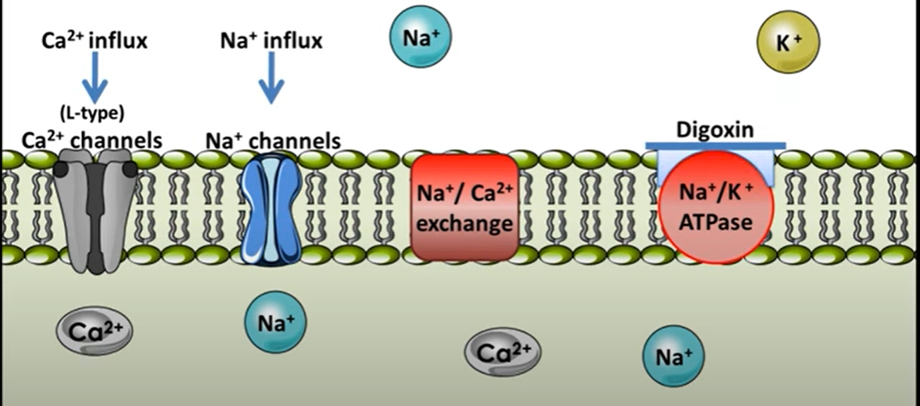
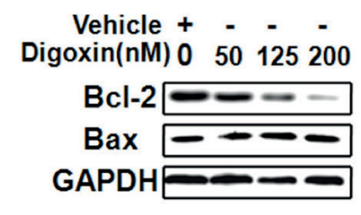
Background. II: Digoxin in cancer therapy
Digoxin in TNBC
In vitro: Digoxin→↑ apoptosis
Anti-cancer effects of Digoxin
(Zhao et al, 2017)
  ↑Apoptosis
  ↓Proliferation
  ↓Angiogenesis
In vivo: digoxin is not studied
Notes:
Digoxin, a cardiac glycoside, is a Na/K ATPase inhibitor (16) and a common drug of choice for patients with arrhythmias and congestive heart failure. Over the years, its potential as an anticancer therapy has been investigated. (17−19) There are several clinical trials running to assess the ability of digoxin as a treatment modality for cancer. (20−29) Zhang et al. reported that digoxin potently inhibited HIF1-α translation and reduced tumor volume. (18) Digoxin further inhibited angiogenesis and tumor volume effectively in various cancer types. (30−32) The effectiveness of digoxin in combination with chemotherapies such as doxorubicin, (33) adriamycin, (32) and gemcitabine (34) have been already

Slide 8
Objective. II
Digoxin efficacy in TNBC in vivo
Efficacy: digoxin vs. mEHT+digoxin

Slide 9
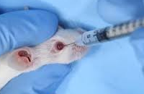
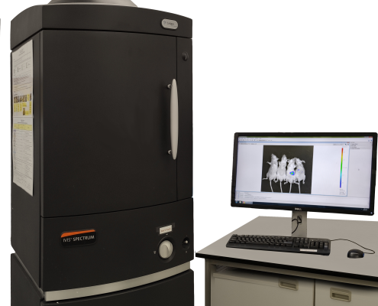
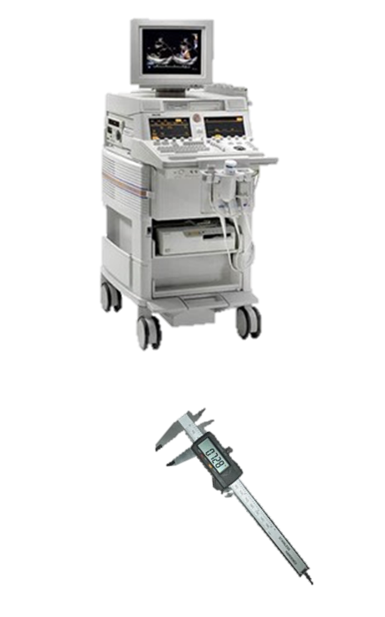

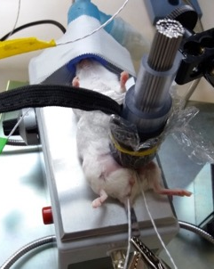
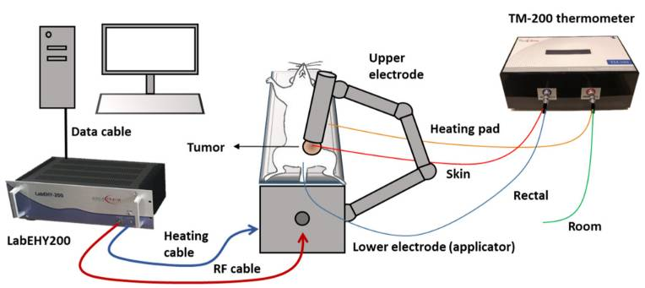
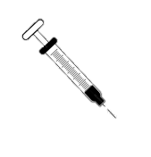
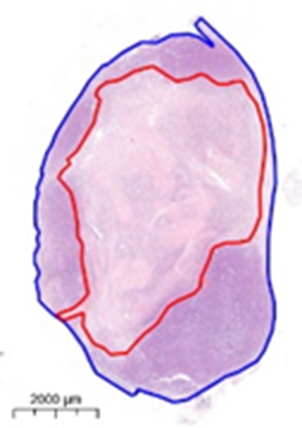
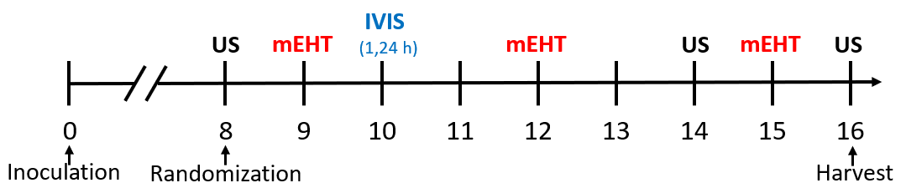
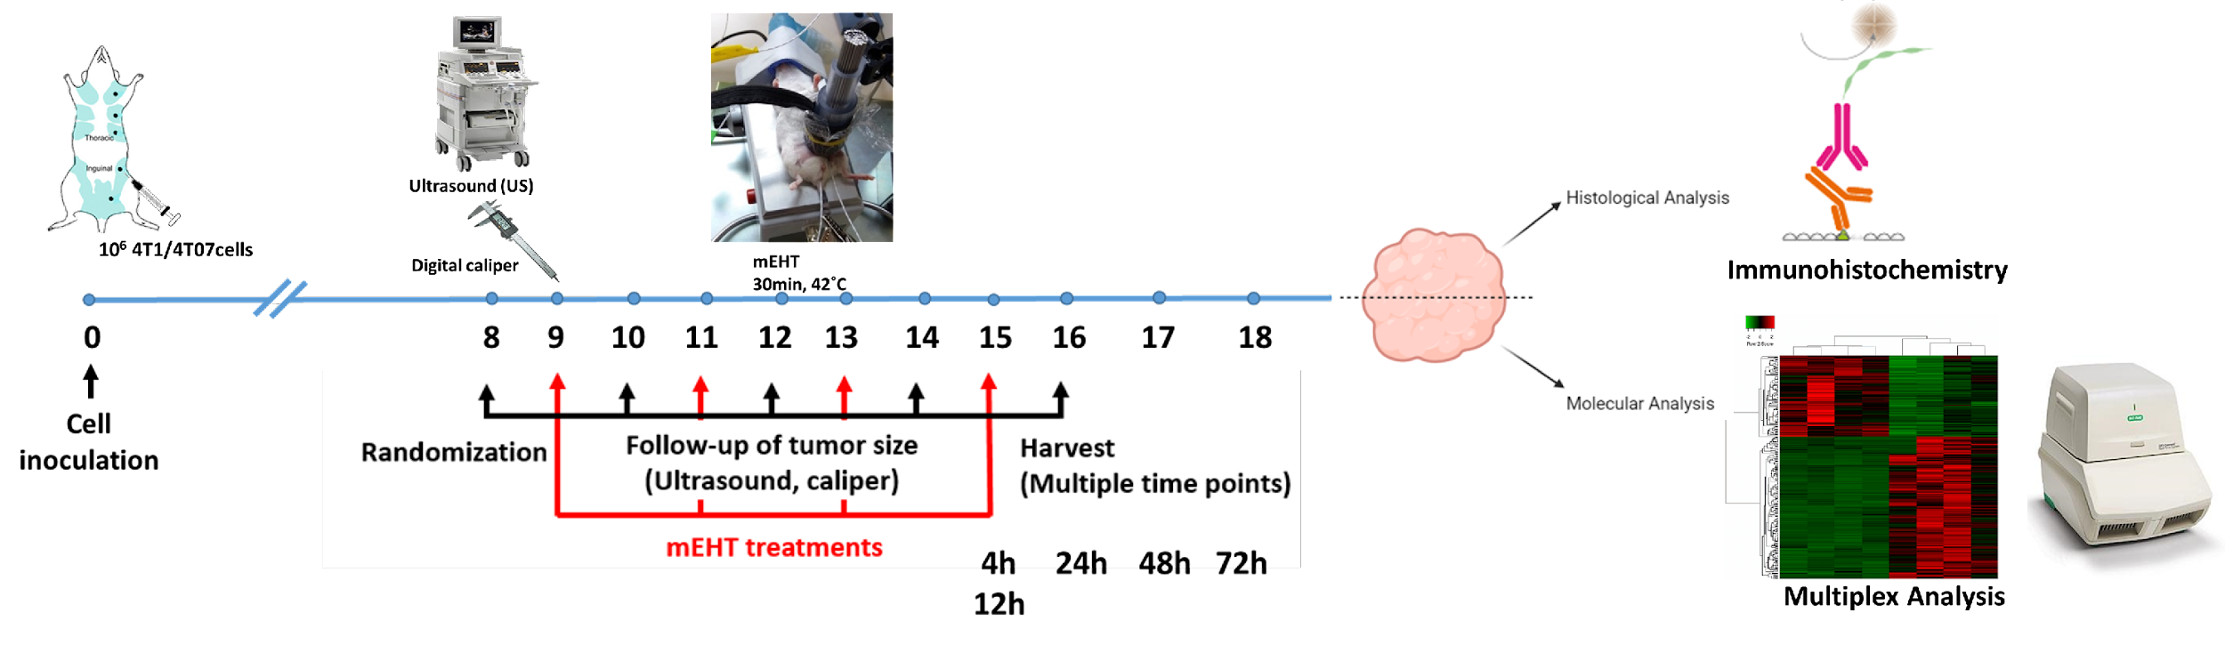
Methods
Study model:
4T1 TNBC mouse model
mEHT+ LTLD:
72h interval
3x mEHT
mEHT+ Digoxin:
48h interval
4x mEHT
Digoxin: daily
LTLD: 7.5 mg/kg
IVIS: 1, 24h
mEHT in vivo
Ultrasound (US)
mEHT:
30min, 42C˚
10⁶ 4T1cells
Digital caliper
H&E, TDR
IVIS: In vivo imaging system, TDR: Tumor destruction ratio, IHC: Immunohistochemistry, WB: Western blot
WB, IHC: Ki67, c caspase3
Notes:
To test this hypothesis
LTLD administered into the retroorbital venous plexus
prof Miklós ! Zsuzsa. Echo was done using the same US which we used for tumor volume. During the echo we had longitudinal and cross sectional view of the left ventricle by making short videos for few cardiac cycles and from those video we could choose some images that corresponds the diastole and systole and by analysing those images we could calculate the main parameters
The maximum tolerated dose was 50 mg/m2,
with seven subjects (24%) developing reversible grade 3–4 neutropenia and four (14%)
reversible grade 3–4 leucopenia. The rate of overall local response was 48% (14/29, 95% CI:
30–66%), with. five patients (17%) achieving complete local responses and nine patients (31%)
having partial local responses. There were no clinically significant cardiac toxicities;
however, in Trial B, one asymptomatic decline in LVEF from
55% to 45% was recorded after six LTLD treatments and a
prior anthracycline exposure of 240 mg/m2. were no cases of hand–foot syndrome,

Slide 10
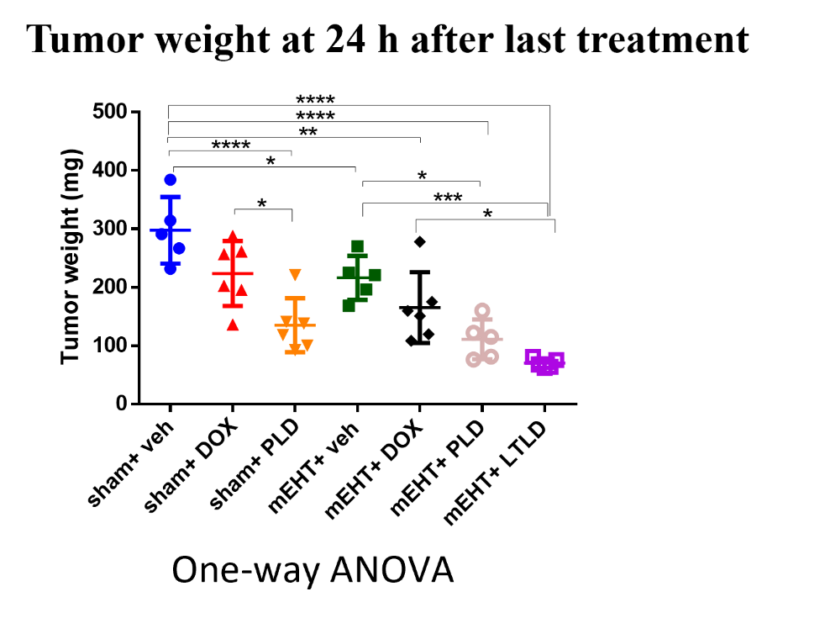
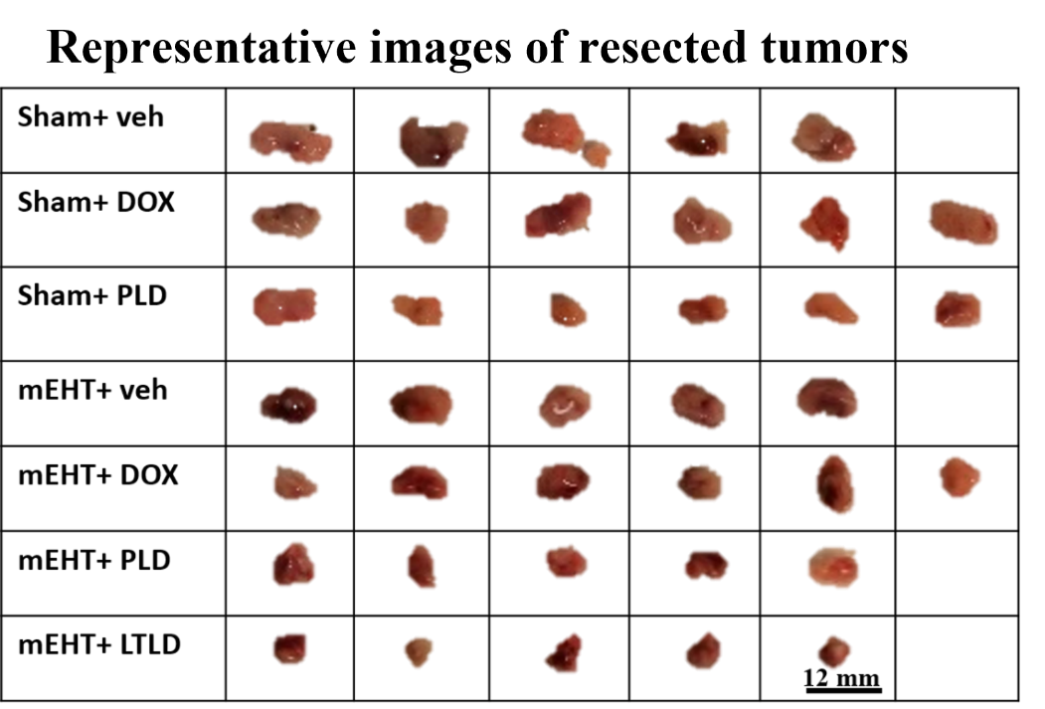
Results. I: mEHT enhanced the anti-tumor effect of Dox encapsulated in LTLD
Two-way ANOVA
Two-way ANOVA
Veh: vehicle, mEHT: modulated electro-hyperthermia, DOX: doxorubicin, PLD: pegylated liposomal Dox, LTLD: lyso-thermosensitive liposomal DOX

Slide 11
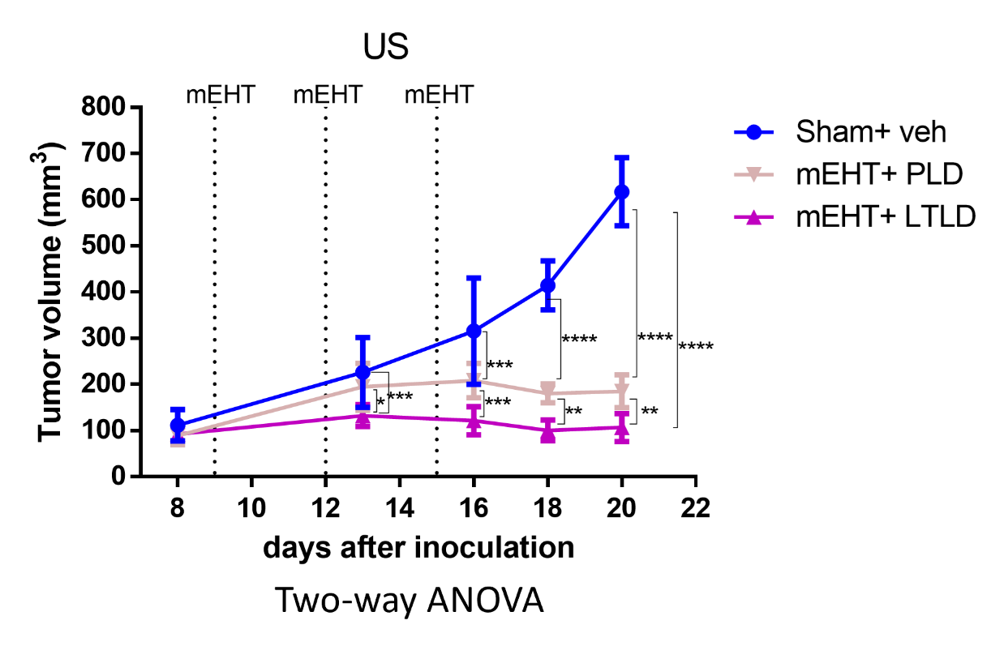
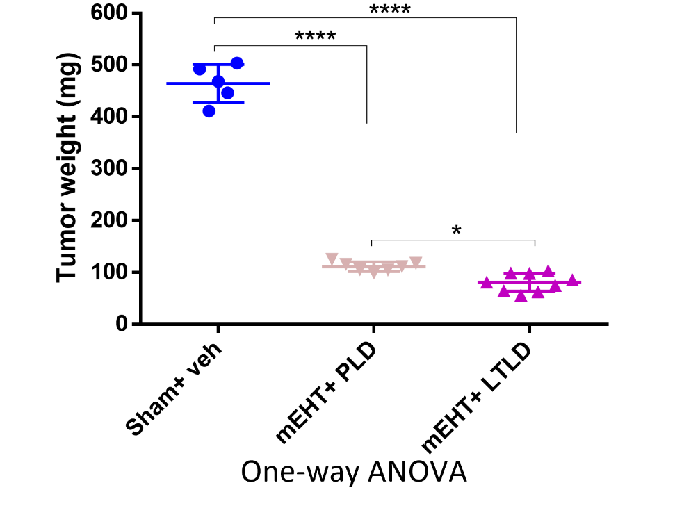
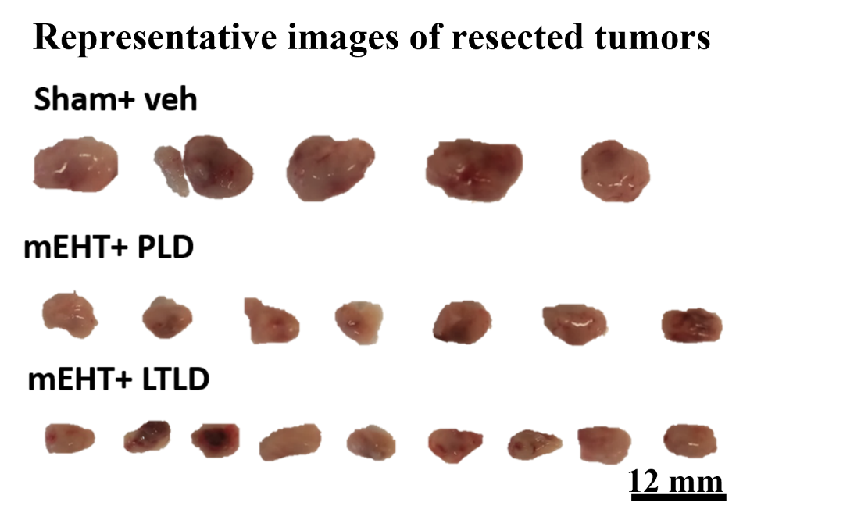
Results. I: mEHT enhanced the anti-tumor effect of Dox encapsulated in LTLD
Veh: vehicle, mEHT: modulated electro-hyperthermia, PLD: pegylated liposomal Dox, LTLD: lyso-thermosensitive liposomal DOX
Notes:
After that we wanted to follow tumor growth after stoping the treatment with high number of mice. And for that we chose the most effective treatment s from the first study. In this case mEHT+LTLD/PLD

Slide 12
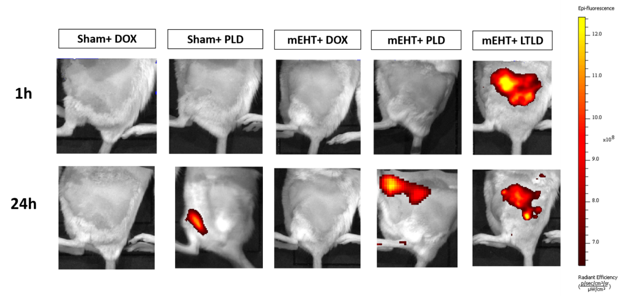
Results. I: mEHT accelerated tumor accumulation of DOX encapsulated in LTLD
IVIS images of DOX accumulation in tumors
DOX concentration in the tumor
Two-way ANOVA
LTLD: intravascular release
PLD: Passive extravasation
T≥40 ̊C
DOX
LTLD
PLD
Veh: vehicle, mEHT: modulated electro-hyperthermia, DOX: doxorubicin, PLD: PEGylated liposomal Dox, LTLD: lyso-thermosensitive liposomal DOX
Notes:
LTLD releases 80% of DOX within 20 s in the bloodstream of the heated tumor

Slide 13
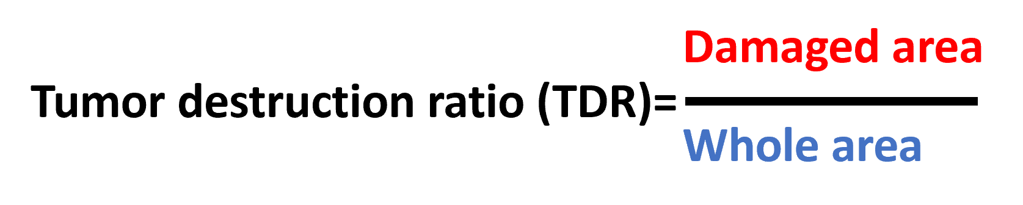
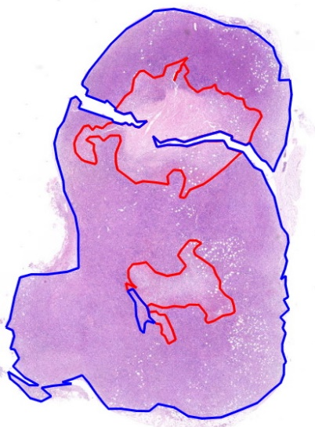
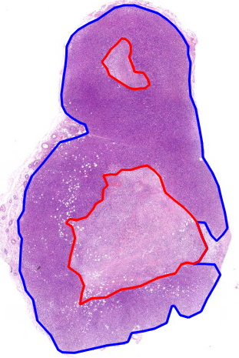
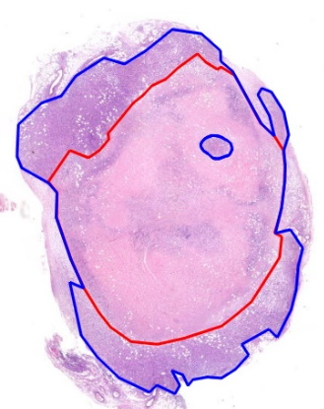
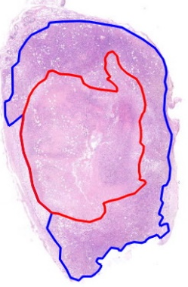
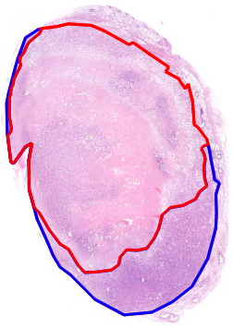
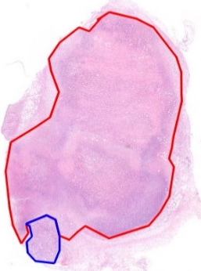

Results. I: mEHT+LTLD augmented cancer cell damage
TDR at 24h after last treatment
One-way ANOVA
Sham+ veh
Sham+ DOX
Sham+ PLD
mEHT+ veh
mEHT+ DOX
mEHT+ PLD
mEHT+ LTLD
1000 mm
Veh: vehicle, mEHT: modulated electro-hyperthermia, DOX: doxorubicin, PLD: pegylated liposomal Dox, LTLD: lyso-thermosensitive liposomal DOX
Notes:
And evaluating apoptosis of cardiomyocet by IHC staining for CC3

Slide 14
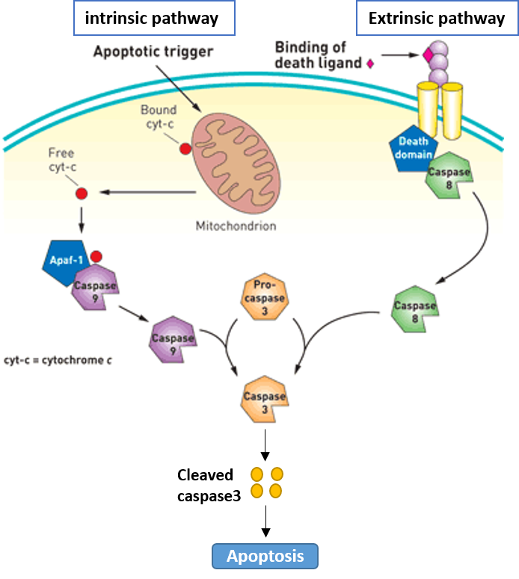
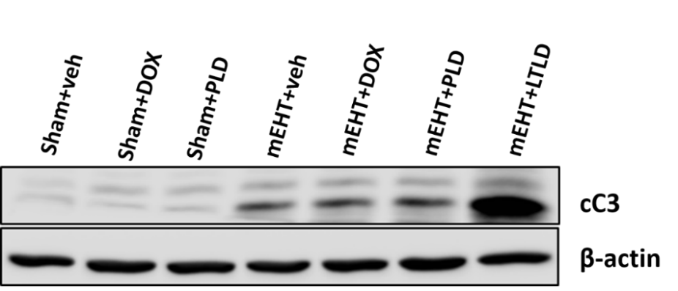
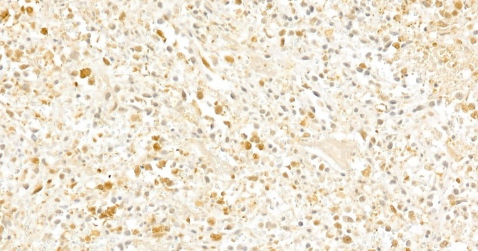
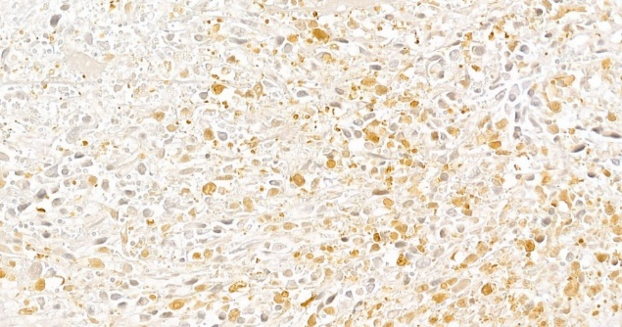
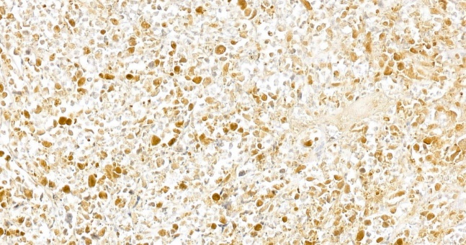
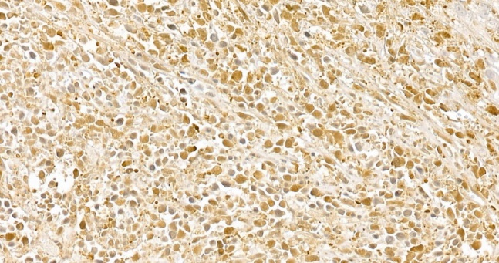
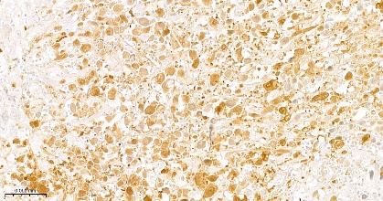
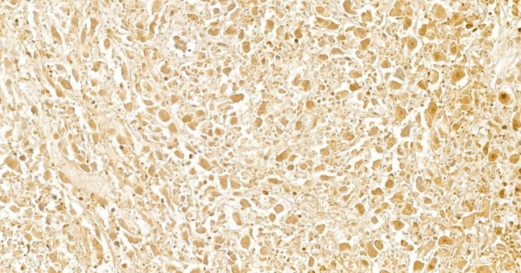
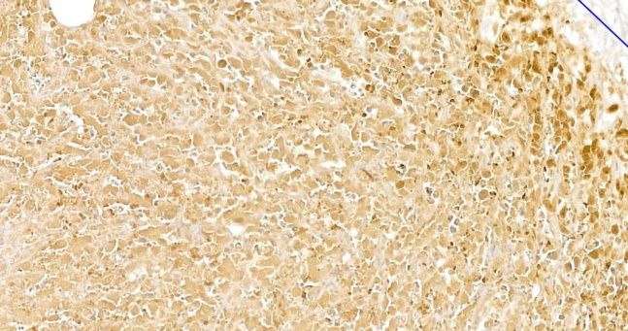
Results. I: mEHT+LTLD had the strongest pro-apoptotic activity
One-way ANOVA
One-way ANOVA
Sham+ veh
Sham+ DOX
Sham+ PLD
mEHT+ veh
mEHT+ DOX
mEHT+ PLD
mEHT+ LTLD
cC3: cleaved caspase 3, Veh: vehicle, mEHT: modulated electro-hyperthermia, DOX: doxorubicin, PLD: pegylated liposomal Dox, LTLD: lyso-thermosensitive liposomal DOX
Notes:
And as we can see from the table in the first 2 groups some mice died and the resthad sever reaction while all mice survived with no sever reaction in the third group. Therefore we concluded that slow and fractioned injection is the beststratgy
Slow and fractioned injection was the best strategy to reduce this reaction as all mice in this grop survived with no severe reaction while in the other 2 groups some mice died and the rest had sever reaction

Slide 15
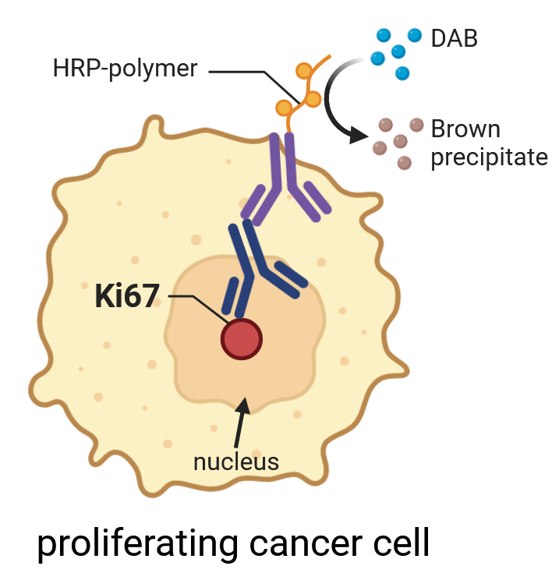
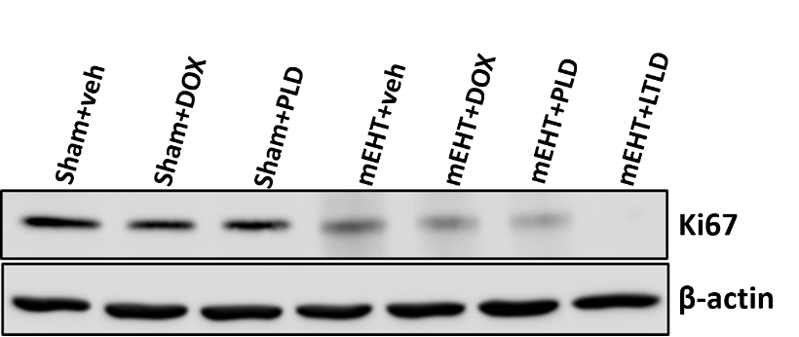
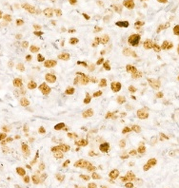
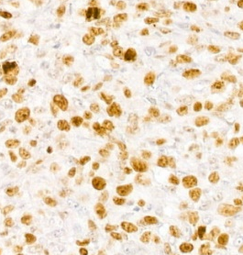
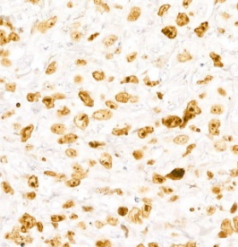
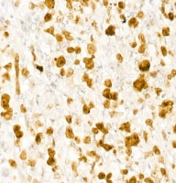
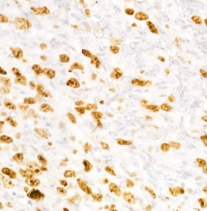


Results. I: mEHT+LTLD had the strongest proliferation inhibitory effects
One-way ANOVA
One-way ANOVA
Sham+ veh
Sham+ DOX
Sham+ PLD
mEHT+ veh
mEHT+ DOX
mEHT+ PLD
mEHT+ LTLD
Veh: vehicle, mEHT: modulated electro-hyperthermia, DOX: doxorubicin, PLD: pegylated liposomal Dox, LTLD: lyso-thermosensitive liposomal DOX

Slide 16

Results. I: All DOX formulations reduced mice body weight
LTLD leakage at 37 ̊C
Body weight changes over the study
Previous studies:
DOX dose: 7.5 vs. 5 mg/kg
Repeated vs. single dose→ failure of clinical trials
Single dose→ failure of clinical trials
Two-way ANOVA
DPPC: Dipalmitoylphosphatidylcholine, MSPC: 1-Myristoyl-2-stearoyl-sn-glycero-3-phosphocholine, PEG: Polyethylene glycol, PLD: PEGylated liposomal DOX
Notes:
Chemotherapy is given in cycles in . We used 7.5 because 5 mg/kg was not effective

Slide 17
Results. II: mEHT enhances cancer inhibitory effects of digoxin
Body weight changes over the study
Two-way ANOVA
Two-way ANOVA
mEHT+Digoxin: safe combinational therapy
In the clinic: digoxin dose is titrated to the serum digoxin level
Notes:
0.8 – 2 ng/ml

Slide 18


Conclusions
Thermo-sensitive nanoparticles activation
Novel DOX delivery approach
Effective and safe
TNBC: Triple-negative breast cancer, mEHT: modulated electro-hyperthermia, LTLD: lyso-thermosensitive liposomal DOX

Slide 19

Acknowledgement
Prof. Peter Hamar
Prof. Zoltán Benyó
Csaba Schvarcz
Pedro Leroy
Nino Giunashvili
Mahak Bokhari Zahra
Gábor Szénási
Zoltán Koós
Dániel Bócsi
All colleagues- Institute of Translational Medicine
Family
Tempus Public Foundation

Slide 20
Thank you for your attention
Kenan Aloss

Slide 21

4T1 tumor section with high magnification
Notes:
0.8 – 2 ng/ml

