Slide 1
ENHANCEMENT OF MODULATED ELECTRO-HYPERTHERMIA EFFECTS BY HEAT SHOCK FACTOR 1 INHIBITION AND RE-SENSITIZATION OF CANCER CELLS TO ANTIPROGESTINS IN A TRIPLE-NEGATIVE BREAST CANCER MODEL
Pedro Henrique Leroy Viana
Supervisor: Péter Hamar, MD, D.Sc
Institute of Translational Medicine
Notes:
Dear committee members, dear audience, thank you all for being here today. It is my honor to present the results of my thesis, titled...

Slide 2
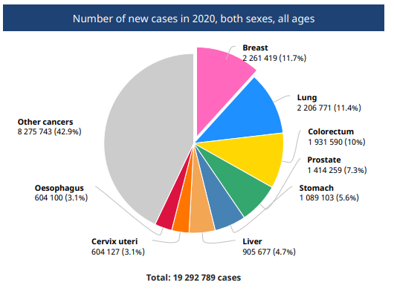
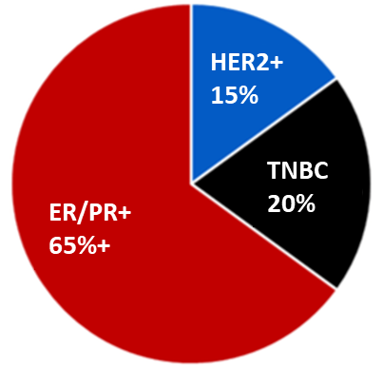
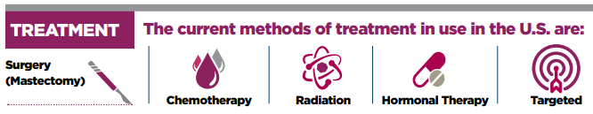
Introduction – Triple-Negative Breast Cancer
TNBC: Triple-negative breast cancer
PR: Progesterone receptor
ER: Estrogen receptor
HER2: Human epidermal growth factor receptor 2
TNBC
HER2
ER
PR
X
X
X
GLOBOCAN, 2020
X
X
High invasiveness
High metastatic potential
Ability to relapse
Poor prognosis
Notes:
Female breast cancer is the most prevalent type of cancer worldwide. Among its subtypes, TNBC is an aggressive form that does not express ER, PR, or HER2, and accounts for 15-20% of all patients. TNBC has features that include high invasiveness, high metastatic potential, ability to relapse, and poor prognosis. Because TNBC tumors lack the receptors expression, they are not sensitive to endocrine therapy and efficient TNBC treatments are still missing. Therefore, the development of new TNBC treatment strategies is needed.

Slide 3
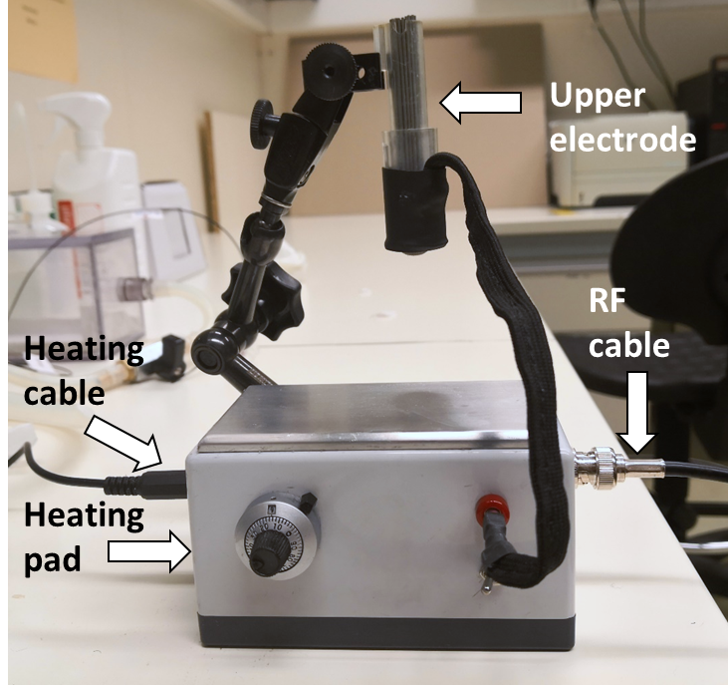
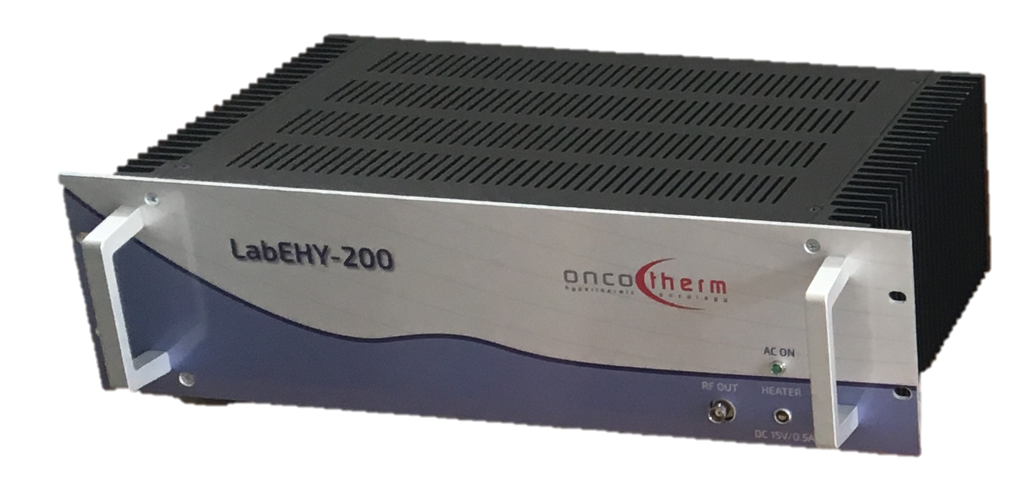
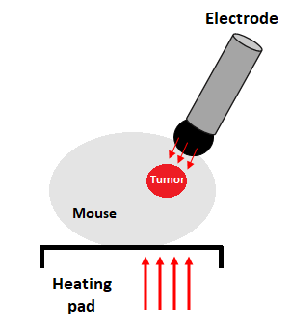
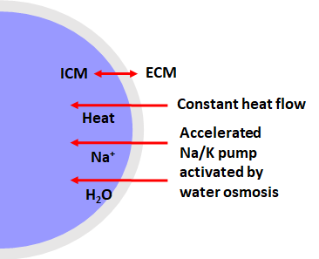
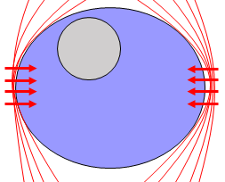
Introduction – Modulated Electro-Hyperthermia
Non-invasive therapy
Induces tumor cell destruction
Modulated Electro-hyperthermia (mEHT)
Amplitude modulated 13.56 MHz radiofrequency
Electric field
APOPTOSIS
Electric field
Heat flow
42°C
Single cell
Cell membrane
Notes:
Modulated electro-hyperthermia is a non-invasive therapy using an amplitude-modulated 13.56 MHz radiofrequency electromagnetic field to induce tumor cell destruction at 42 °C. 1: On the upper right corner you can see an image of the mEHT mouse setup used by our group for the treatments. 2: In this setup, an eletric field is generated and directed to the area of the malignant tumor to induce heat. 3: This electric field concentrates along the cell membrane and the heat flow triggers biochemical process, such as the elevated intracellular sodium concentration, potassium efflux, and water osmosis. The combined effects drive apoptosis.

Slide 4
HEAT SHOCK INHIBITION
  HSF1 Knockdown
  KRIBB11 inhibition
RE-EXPRESSION OF PROGESTERONE RECEPTOR
Notes:
This study is basically divided into two main topics: the inhibition of Heat Shock Factor 1, which is a master regulator of the heat shock response, and the re-expression of the progesterone receptor in TNBC cells. The heat shock inhibition section is then subdivided into HSF1 knockdown and KRIBB11 inhibition.

Slide 5
HEAT SHOCK INHIBITION
HSF1 Knockdown
Notes:
We are going to start with HSF1 knockdown by CRISPR/Cas9 technology.

Slide 6
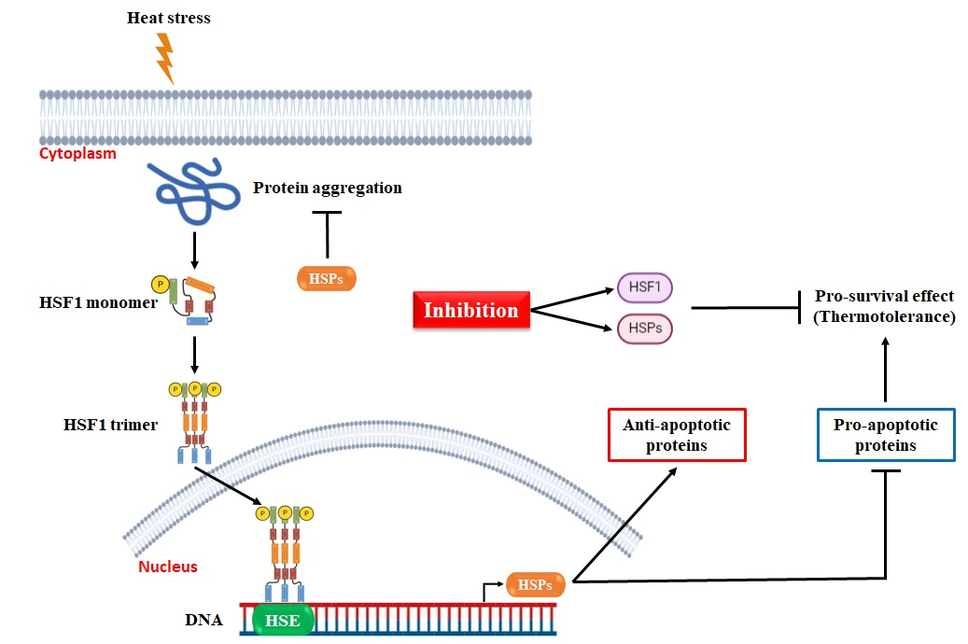
Introduction – Heat Shock Response (HSR)
HSF1: Heat shock factor 1
HSP: Heat shock protein
HSE: Heat shock elements
Notes:
So, basically mEHT can induce heat shock response, and the heat-induced thermotolerance can protect cancer cells from hyperthermia-induced apoptosis. This process is illustrated here. Shortly, heat stress leads to aggregation of HSF1 monomer into HSF1 trimer that translocates to the nucleus where it binds to Heat Shock Elements in the promoter region of Heat Shock Protein genes. This complex activates transcription of HSPs which activates anti-apoptotic proteins and inhibits pro-apoptotic proteins, leading to thermotolerance. Therefore, blocking or silencing the heat shock response by targeting HSF1 or HSPs can be an effective way to reverse thermotolerance in cancer cells.

Slide 7
Objectives
To establish a 4T1 cell model in vitro using a CRISPR/Cas9 lentiviral construct to knockdown HSF1 gene;
To investigate the impact of HSF1 downregulation on the heat shock response subsequent to mEHT treatments in vivo;
To explore the modulation of HSP70 in response to mEHT in combination with HSF1 knockdown.
Notes:
Our objectives with the HSF1 knockdown were...

Slide 8
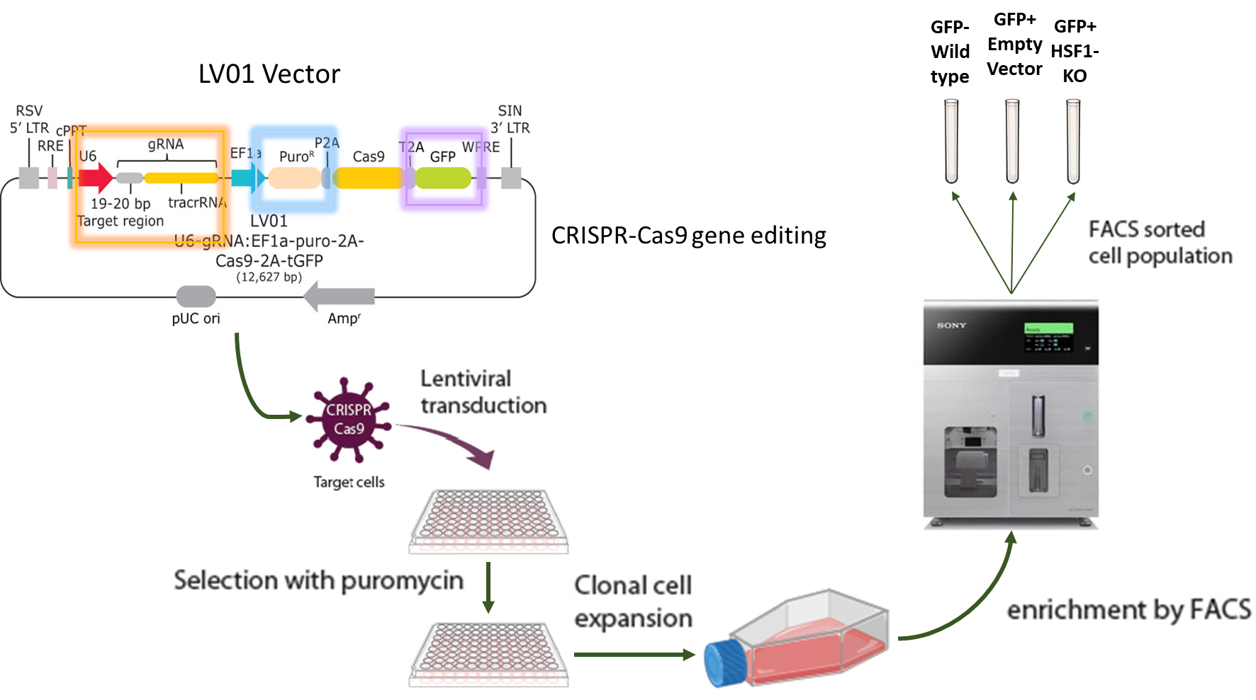
Methods – Gene Knockdown Workflow
FACS: Fluorescence-activated cell sorting
GFP: Green fluorescent protein
Notes:
The HSF1 gene was knockdown by using a lentiviral construct that contained:
A target region to remove the HSF1 gene;
A puromycin resistance gene responsible for selective growth of transduced cells in puromycin-containing culture;
A GFP gene to sort transduced cells.
After lentiviral transduction and positive selection of transduced cells via puromycin exposure, cells were expanded and GFP- and GPF+ cells were sorted by FACS into wild type (cells that do not contain the construct), empty vector (cells that contain the construct without the target region), and HSF1-KO (cells that contain the construct with the HSF1 target region).

Slide 9
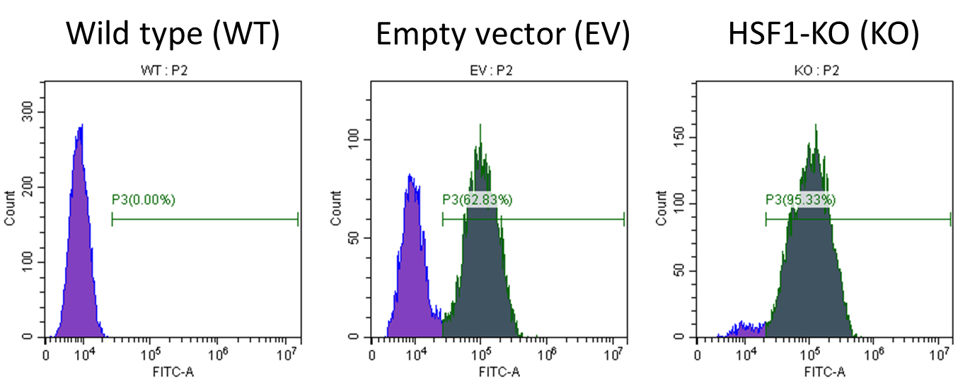
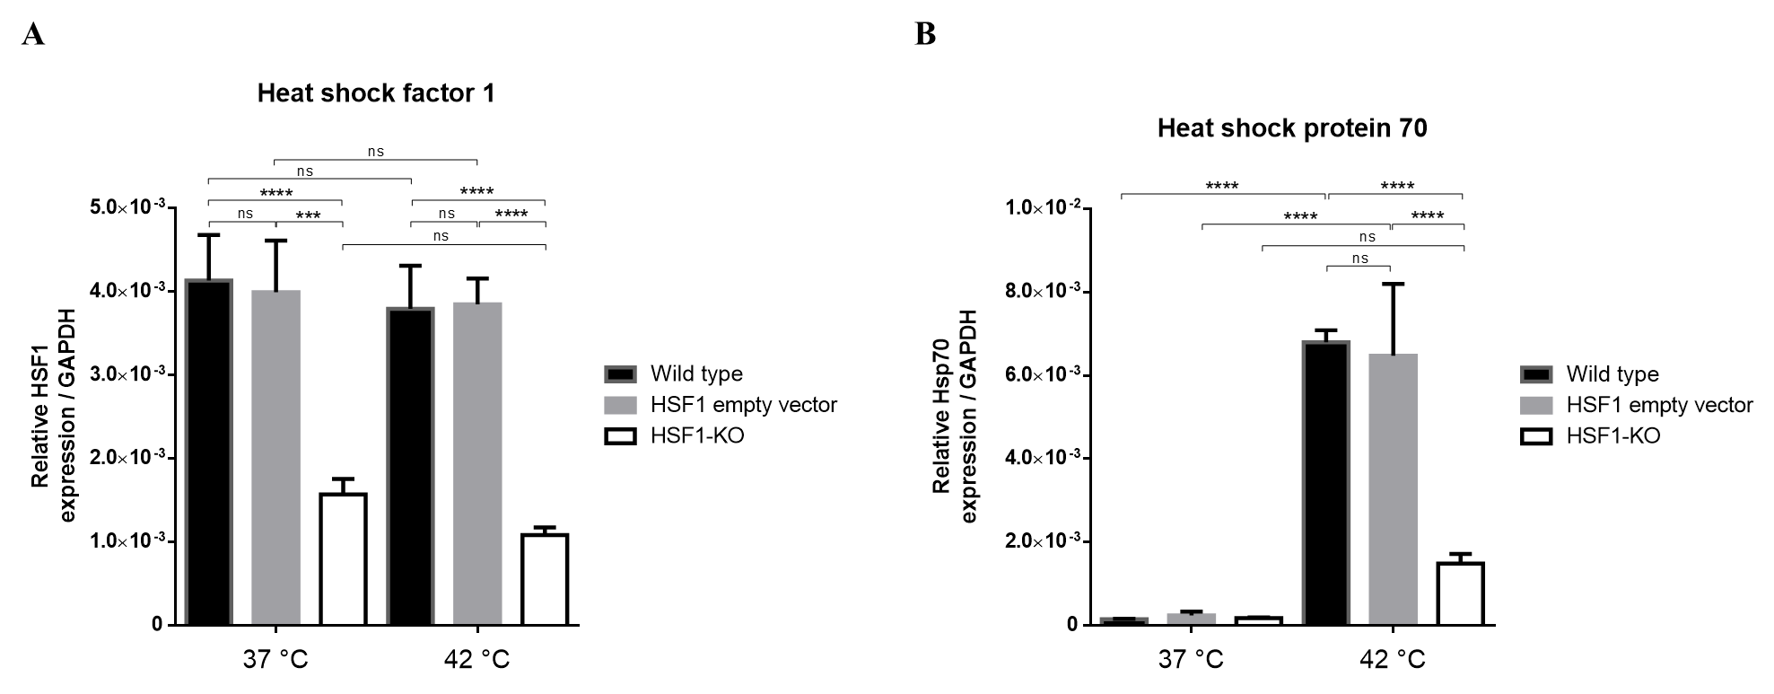
Results – Transduction Efficiency
Notes:
Flow cytometry was used to assess the transduction efficiency of our model, and revealed that over 95% of the cells in the HSF1-KO group were GFP+, meaning that these cells took up the lentiviral construct. Subsequent treatment with conventional hyperthermia in vitro showed significant downregulation of HSF1 gene expression in the knockdown group, and the heat induced stimulation of HSP70 decreased in the HSF1-KO group at 42°C. We next hypothesized that downregulation of the HSF1 gene sensitizes the transduced tumor cells to mEHT and reduce tumor growth.

Slide 10
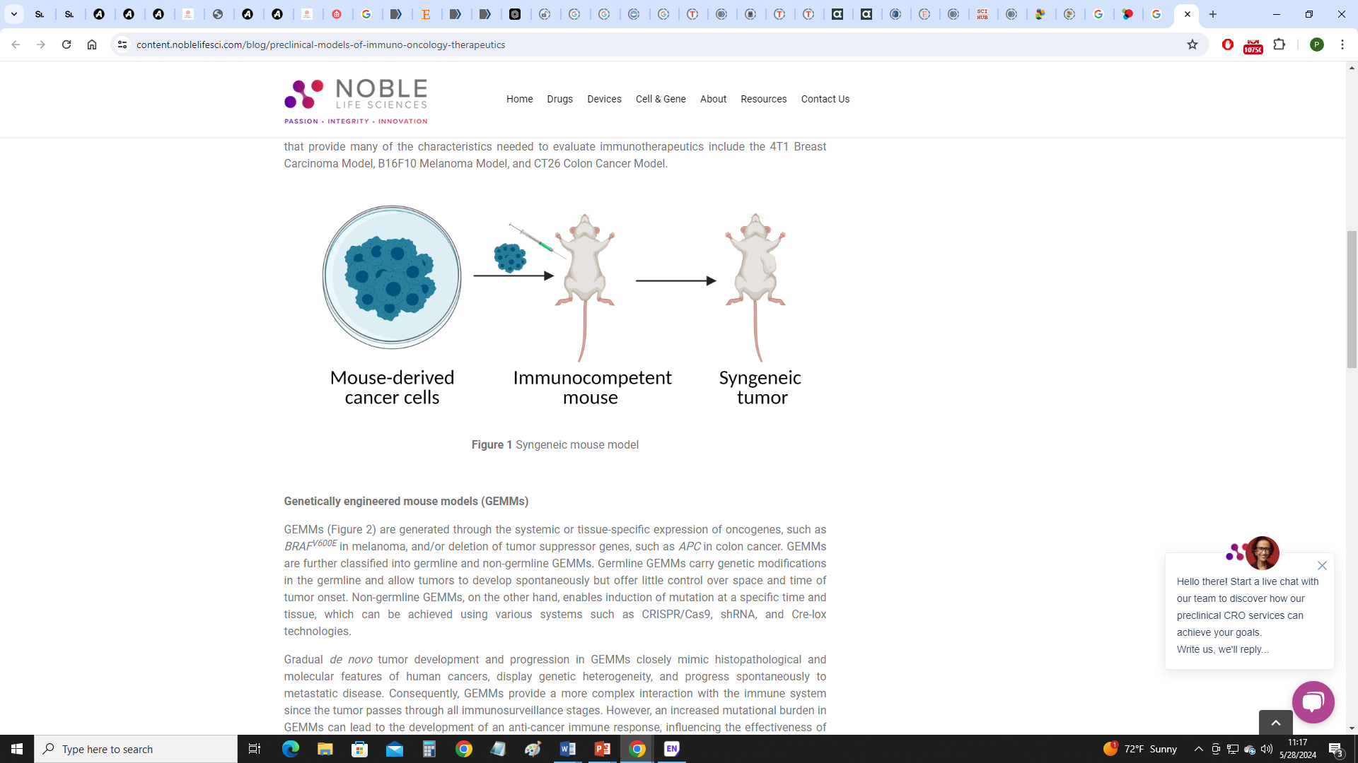
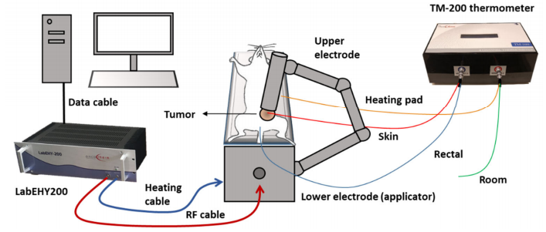
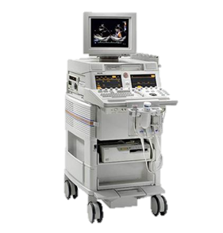
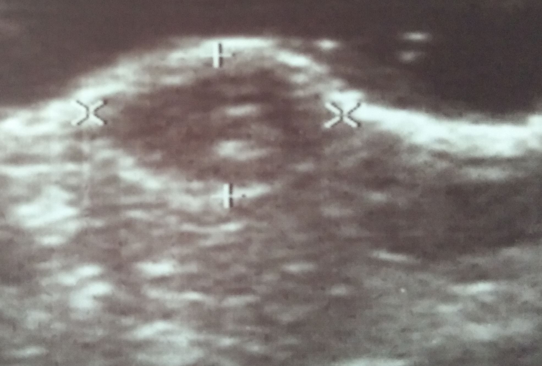

Methods – mEHT HSF1-KO in vivo Design
♀ BALB/c mice
4T1 cells
Density: 1 × 10⁶
Ultrasound
Caliper
Schvarcz, 2021
Notes:
The experimental design of the 4T1 HSF1 knockdown model in vivo is demonstrated here. 4T1 TNBC cells, with either the empty vector or the HSF1 knockdown lentiviral constructs, were inoculated at day zero. Mice were randomized into groups at day 8. mEHT treatments were performed every two days and tumor volume was monitored by ultrasound and caliper between mEHT treatments. The study was terminated on day 16 with the harvest of tumors.

Slide 11
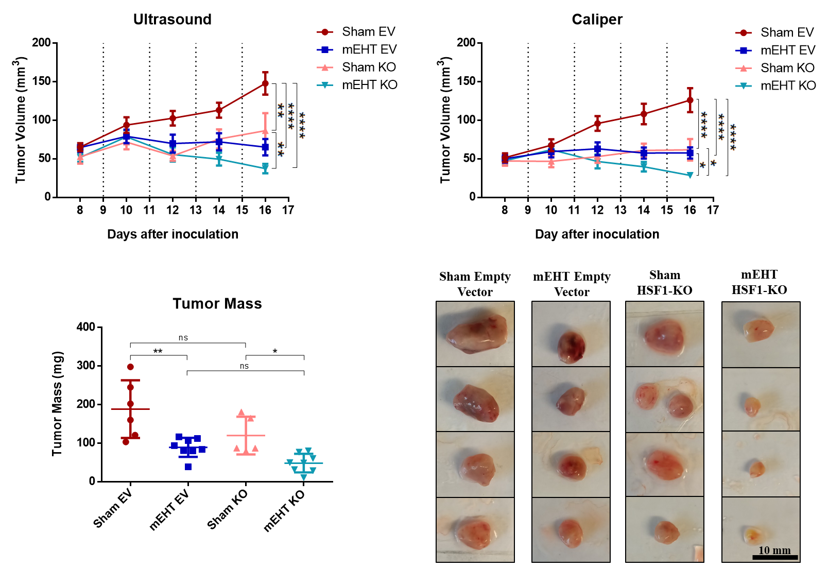
Results – Tumor Volume and Mass
Notes:
Ultrasound and caliper measurements revealed a significantly reduced tumor growth rate in the HSF1-KO mEHT-treated group, as indicated in light blue. Likewise, the tumor mass was significantly decreased in the mEHT-treated knockdown group. Representative tumor images of each group at study termination are displayed here.

Slide 12
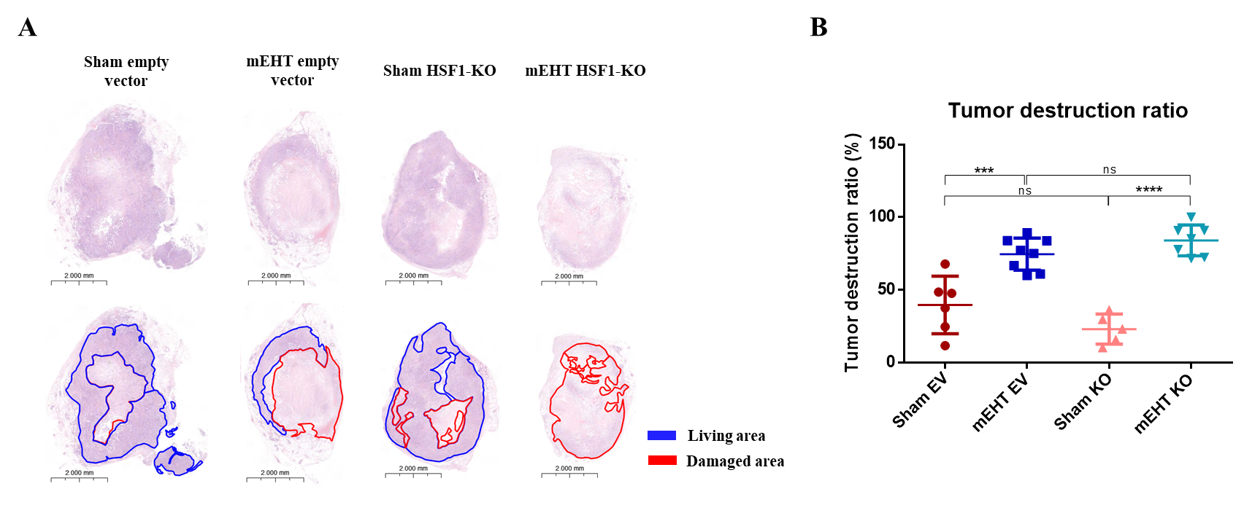
Results – Tumor Destruction Ratio (TDR)
Damaged area
TDR (%) =
Whole tumor area
Notes:
The tumor destruction ratio, calculated as the damaged area per total tumor area, demonstrated increased tissue damage in mEHT-treated tumors compared to sham groups. However, no additional increase in TDR was observed when comparing mEHT HSF1-KO group to mEHT EV group. On the right, the panel shows representative figures of tumor samples for all groups. Red lines delimit damaged areas and blue lines correspond to living areas.

Slide 13
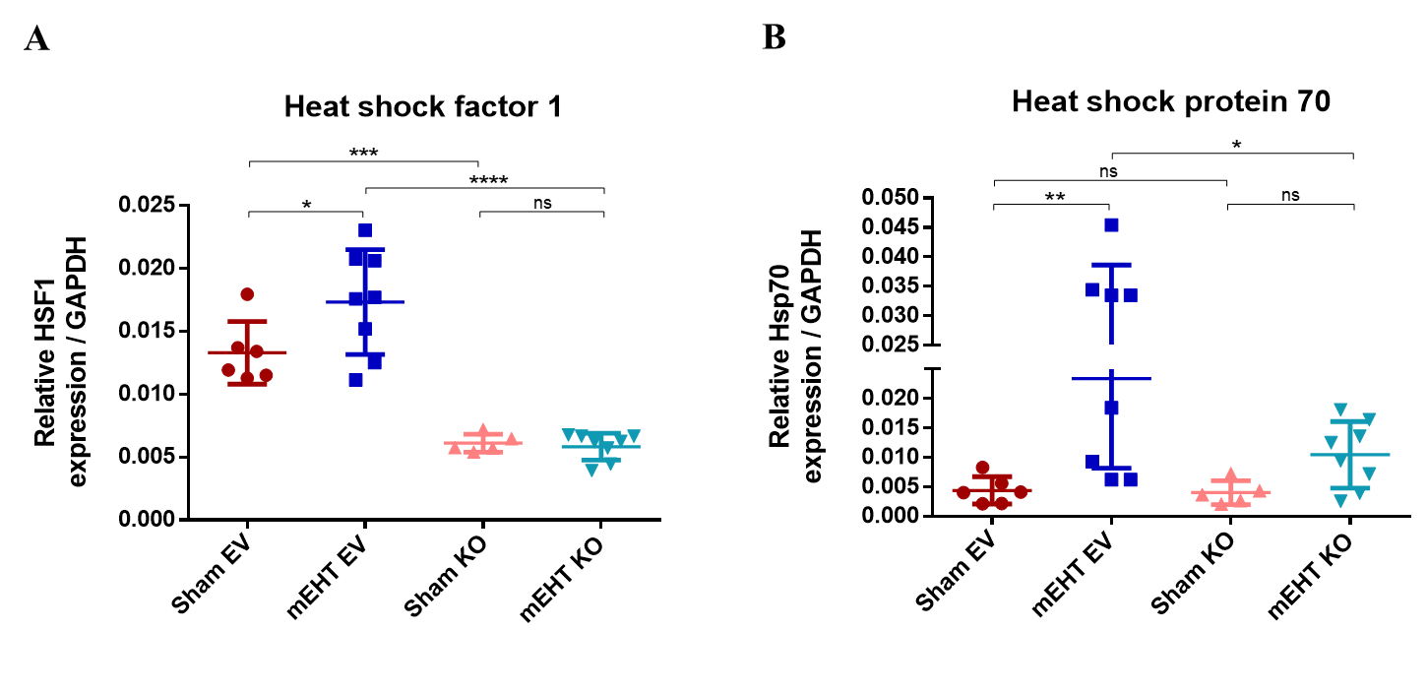
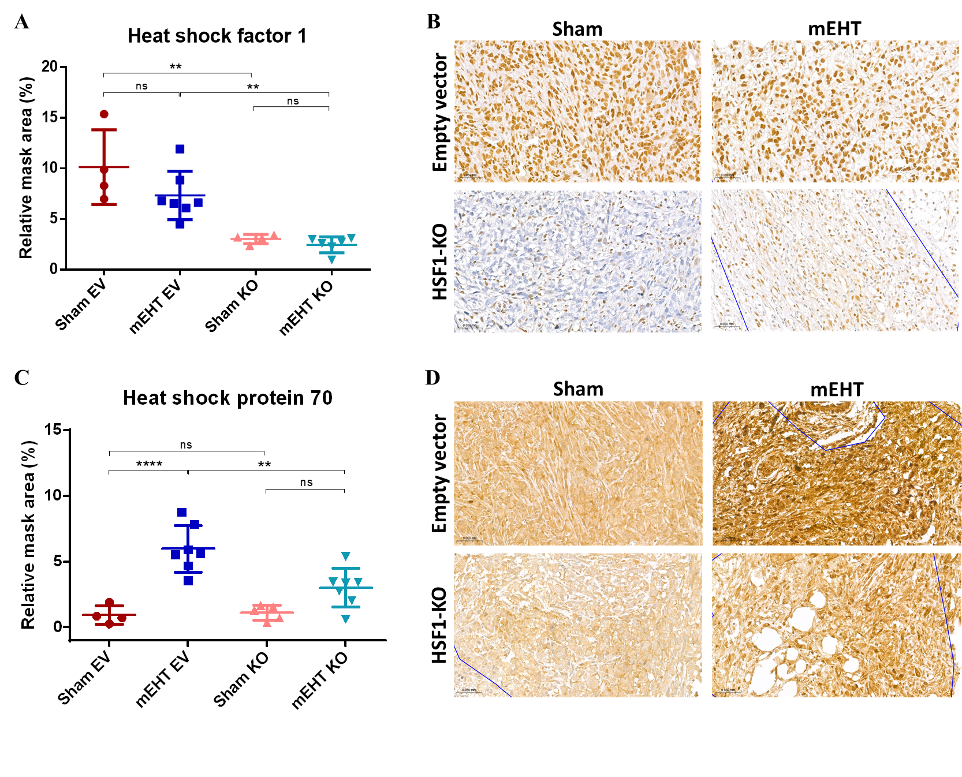
Results – HSF1 and HSP70 levels
qPCR
Immunohistochemistry
HSF1 1:100
HSP70 1:100
Notes:
qPCR and immunohistochemistry data revealed a significant reduction in HSF1 expression in the KO groups, suggesting effective targeting of the HSF1 gene. mEHT did not change HSF1 expression in the KO group, as compared to the empty vector group. Likewise, HSP70 expression, upregulated by mEHT in the empty vector group, was not significantly induced by mEHT in the KO group.

Slide 14
HEAT SHOCK INHIBITION
KRIBB11 inhibitor
Notes:
Another way to evade thermotolerance is by blocking HSF1 protein with small molecule inhibitors. Therefore, to check for the translational potential of HSF1 inhibition in combination with mEHT, we used KRIBB11.

Slide 15
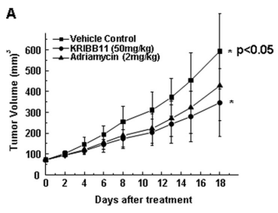
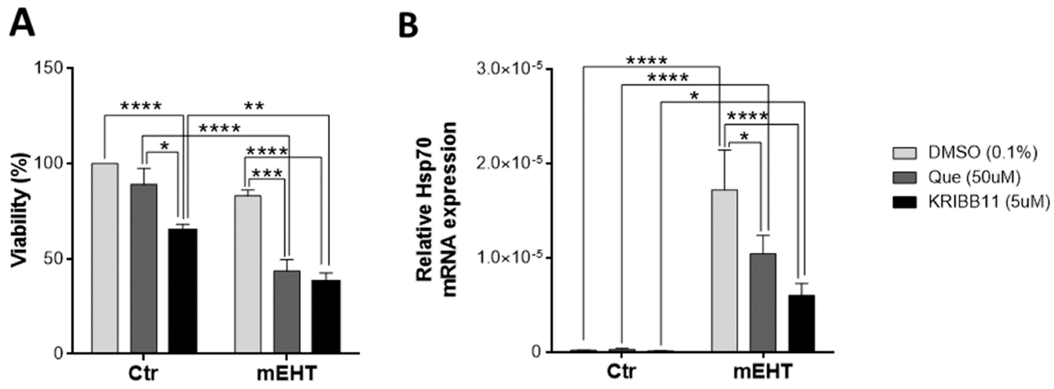
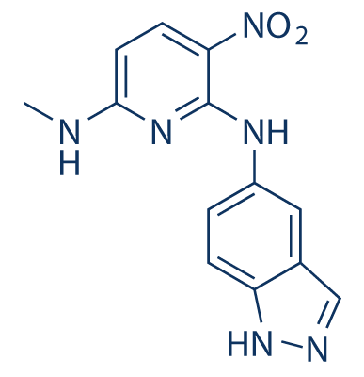
Introduction – KRIBB11
KRIBB11 prevents the transcriptional activity of HSF1 (Yoon, 2011)
KRIBB11 synergestically amplifies mEHT-induced cancer cell apoptosis and inhibits Hsp70 upregulation in vitro (Danics, 2020)
Yoon, 2011
KRIBB11
Danics, 2020
Notes:
KRIBB11 is the only available HSF1 specific inhibitor that is able to directly block HSF1 transcriptional activity. Our group has demonstrated that KRIBB11 synergestically enhances mEHT-induced tumor cell destruction and suppresses Hsp70 upregulation in vitro.

Slide 16
Objectives
To evaluate the combined therapeutic impact of mEHT and HSF1 inhibition with KRIBB11 inhibitor in vivo;
To explore the modulation of HSP70 in response to mEHT in combination with KRIBB11 treatment.
Notes:
With this in mind, we decided to…

Slide 17
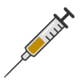
Methods – mEHT KRIBB11 in vivo Design
♀ BALB/c mice
KRIBB11 dose
50 mg/Kg
4T1 cells
Density: 1 × 10⁶
Ultrasound
Caliper
Schvarcz, 2021
Notes:
The in vivo experimental design model for KRIBB11 was similar to the one already presented here, so I will not go through the details again. However, it is important to note that KRIBB11 solution was administered every day for 8 days following randomization.

Slide 18
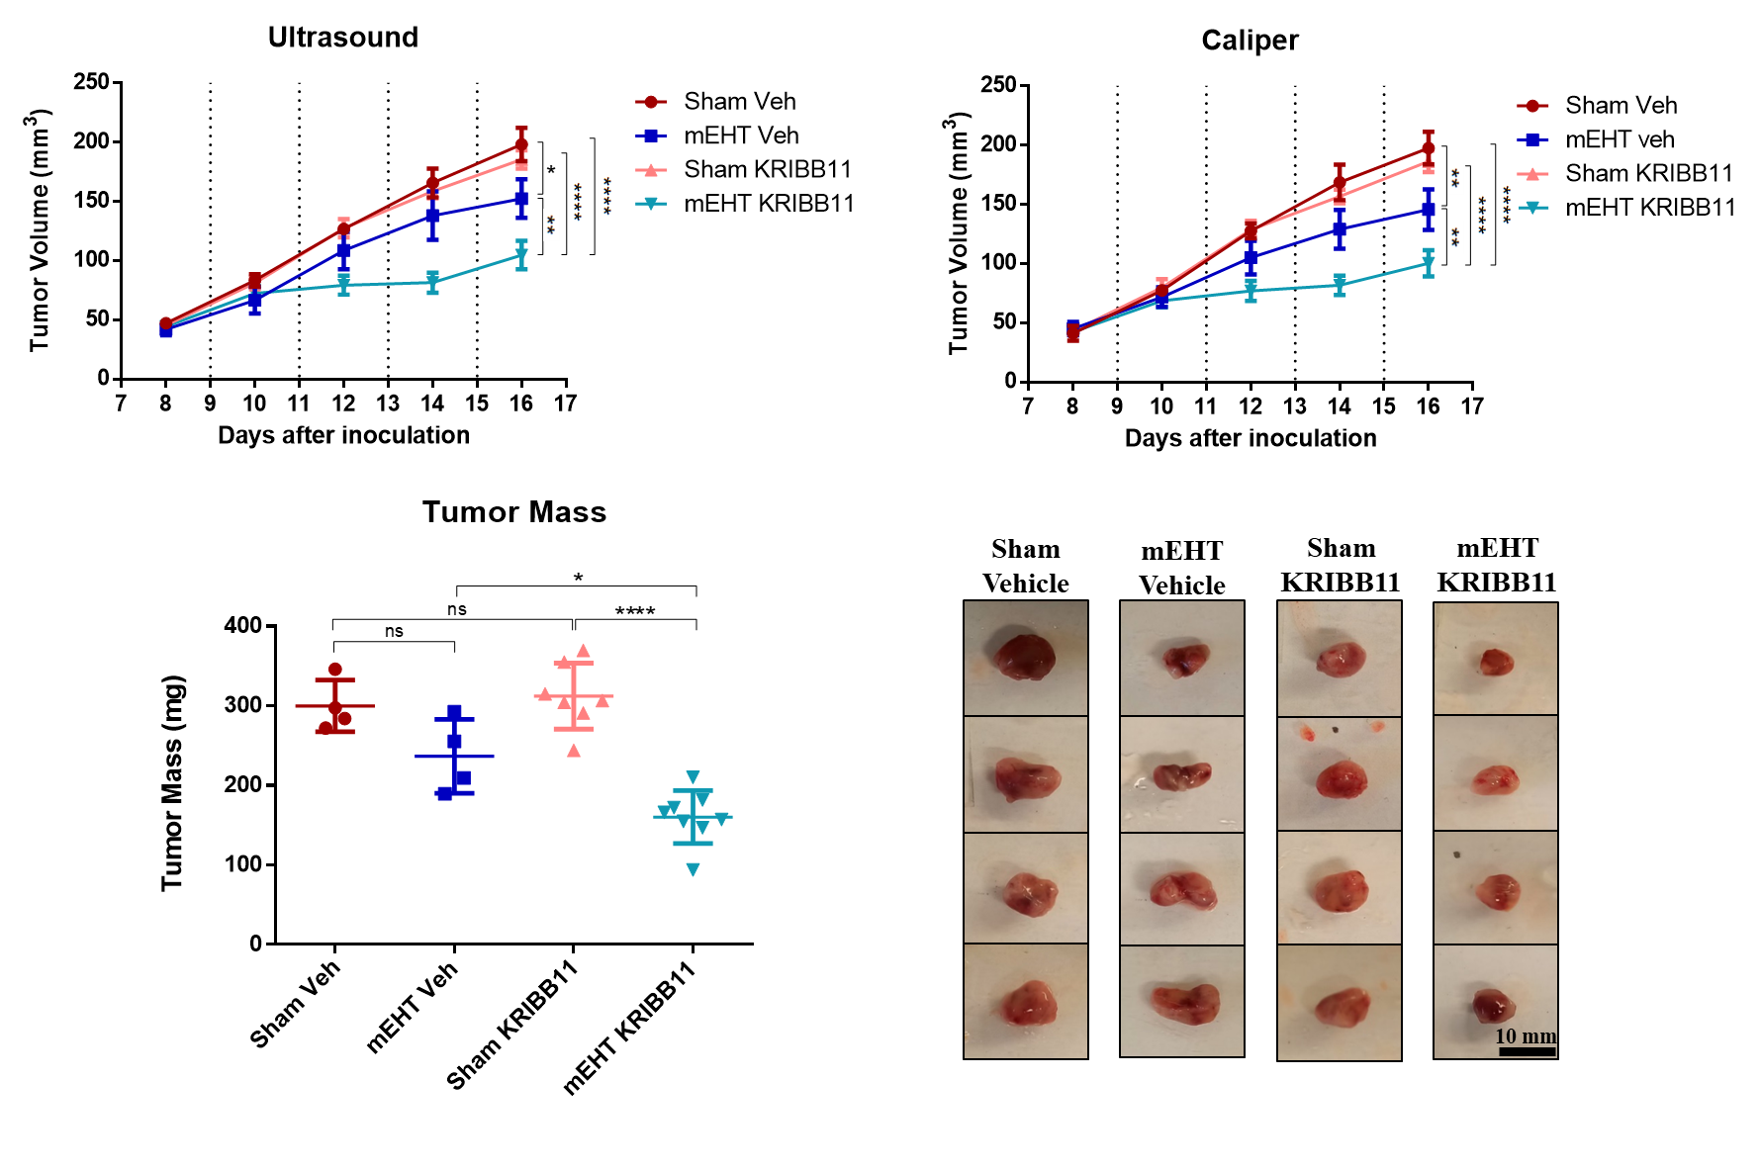
Results – Tumor Volume and Mass
Notes:
In accordance with our previous in vitro studies, there was a synergistic effect with the combined treatment of mEHT and KRIBB11. The upper graphs demonstrated significant reduction in tumor growth rate in the combination group (light blue) compared to mEHT alone (dark blue) by both ultrasound and caliper measurements. Likewise, the tumor mass data also revealed a significant reduction in tumor size in the group treated with mEHT and KRIBB11. Interestingly, KRIBB11 monotherapy (pink) did not reduce tumor growth. Representative tumor images of each group at study termination are shown here.

Slide 19
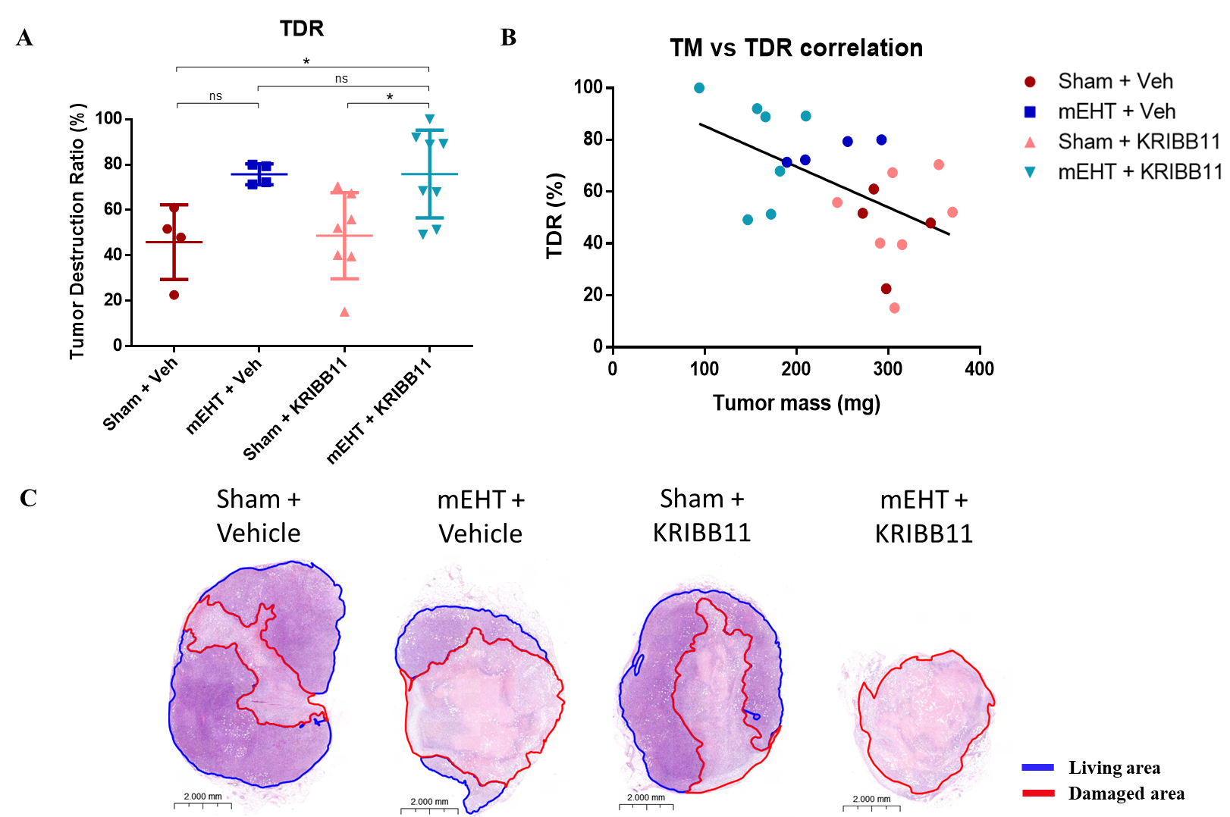
Results – Tumor Destruction Ratio (TDR)
.
.
.
Notes:
The TDR data revealed significant tissue damage in mEHT + KRIBB11-treated tumors compared to Sham. This correlation graph here indicates a negative correlation between TDR and tumor mass. In general, mEHT-treated tumors were smaller and showed bigger TDRs. On the other hand, larger sham tumors tended to have moderate TDRs. On the bottom, the panel displays representative figures of tumor samples for all groups.

Slide 20
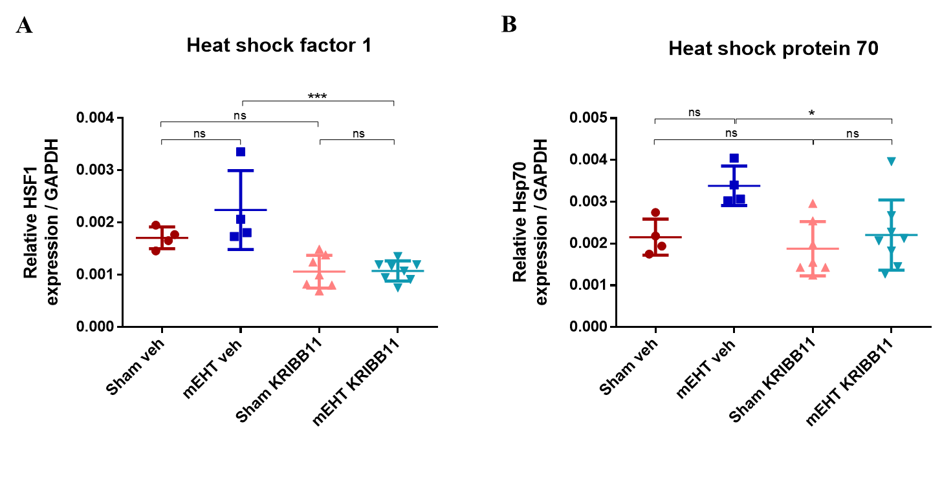
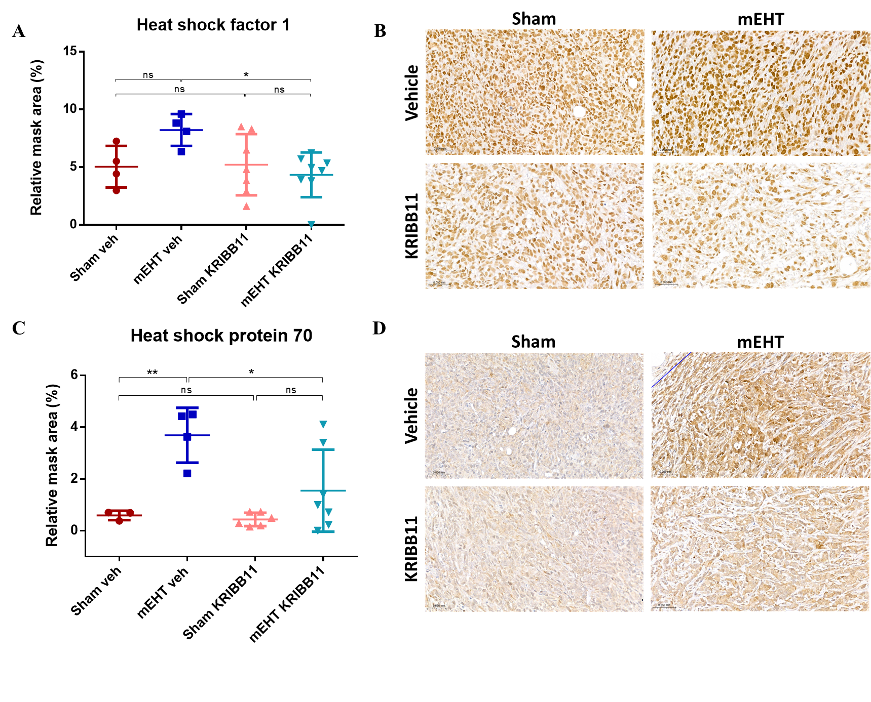
Results – HSF1 and HSP70 levels
qPCR
Immunohistochemistry
HSF1 1:100
HSP70 1:100
Notes:
Analysis of qPCR and immunohistochemistry revealed that KRIBB11 monotherapy (pink) did not significantly reduce HSF1 expression compared to the vehicle. No significant differences were observed between Sham and mEHT + KRIBB11 groups. But, the tendency for HSF1 upregulation observed in the mEHT group (blue) was significantly reduced in the mEHT + KRIBB11 group. In turn, HSP70 levels tended to increase with mEHT treatment. However, the combined treatment of mEHT + KRIBB11 led to a significant reduction of HSP70 upregulation when compared to mEHT + veh.

Slide 21
Conclusions – HSF1 inhibition
CRISPR/Cas9-mediated HSF1 knockdown was successful and demonstrated high transduction efficiency in 4T1 murine TNBC cells.
The mEHT cancer cell-killing effect was enhanced by the knockdown of HSF1.
Integration of KRIBB11 alongside mEHT demonstrated a synergistic effect with significant reduction of tumor growth.
HSF1 inhibition, either by CRISPR/Cas9 or KRIBB11, resulted in a diminishment of HSP70 upregulation typically seen after mEHT treatments.
Notes:
Taking together our results we can conclude that:

Slide 22
RE-EXPRESSION OF PROGESTERONE RECEPTOR
Notes:
Our second study focus on the re-expression of progesterone receptor in a 4T1 TNBC cell line.

Slide 23
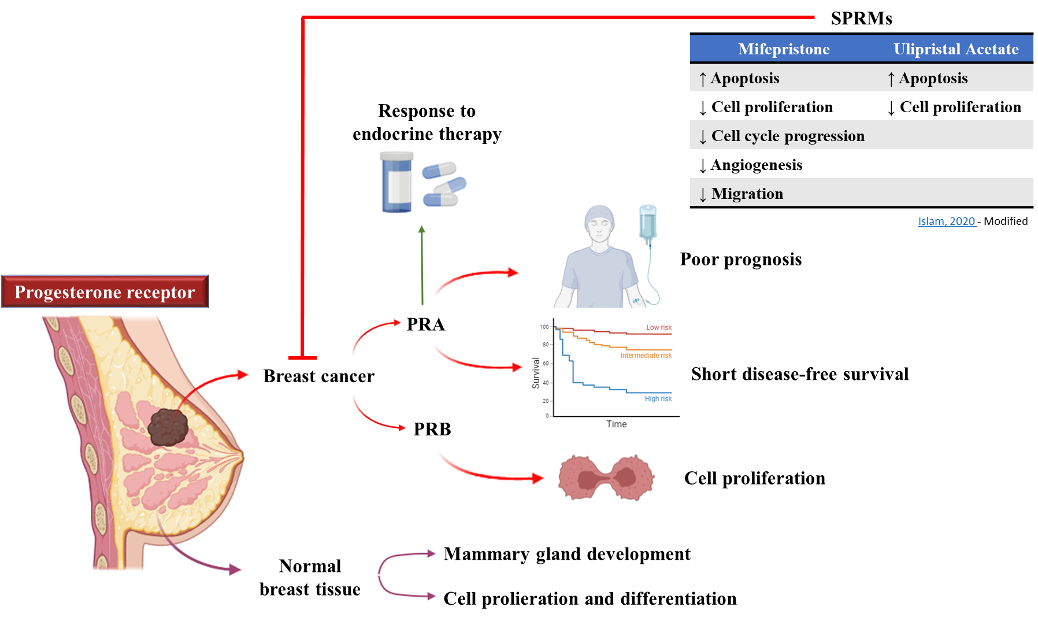
Introduction – Progesterone Receptor
SPRM: Selective Progesterone Receptor Modulator
Notes:
The PR, a nuclear receptor activated by progesterone, has two key isoforms, PRA and PRB. The PRA/PRB ratio impacts breast cancer outcomes, with elevated PRA levels linked to poorer prognosis and shorter disease-free survival, but plays a significant role in the response to endocrine therapy using antiprogestins, also called Selective Progesterone Receptor Modulators, while PRB mediates cell proliferation. SPRMs are a new class of compounds developed to target the PR. This group includes mifepristone and ulipristal acetate, that in breast cancer are responsible for ↑ Apoptosis and ↓ Cell proliferation.

Slide 24
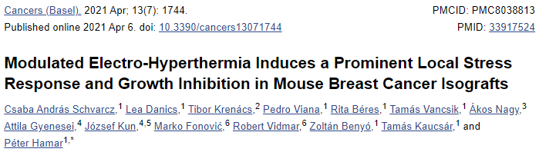
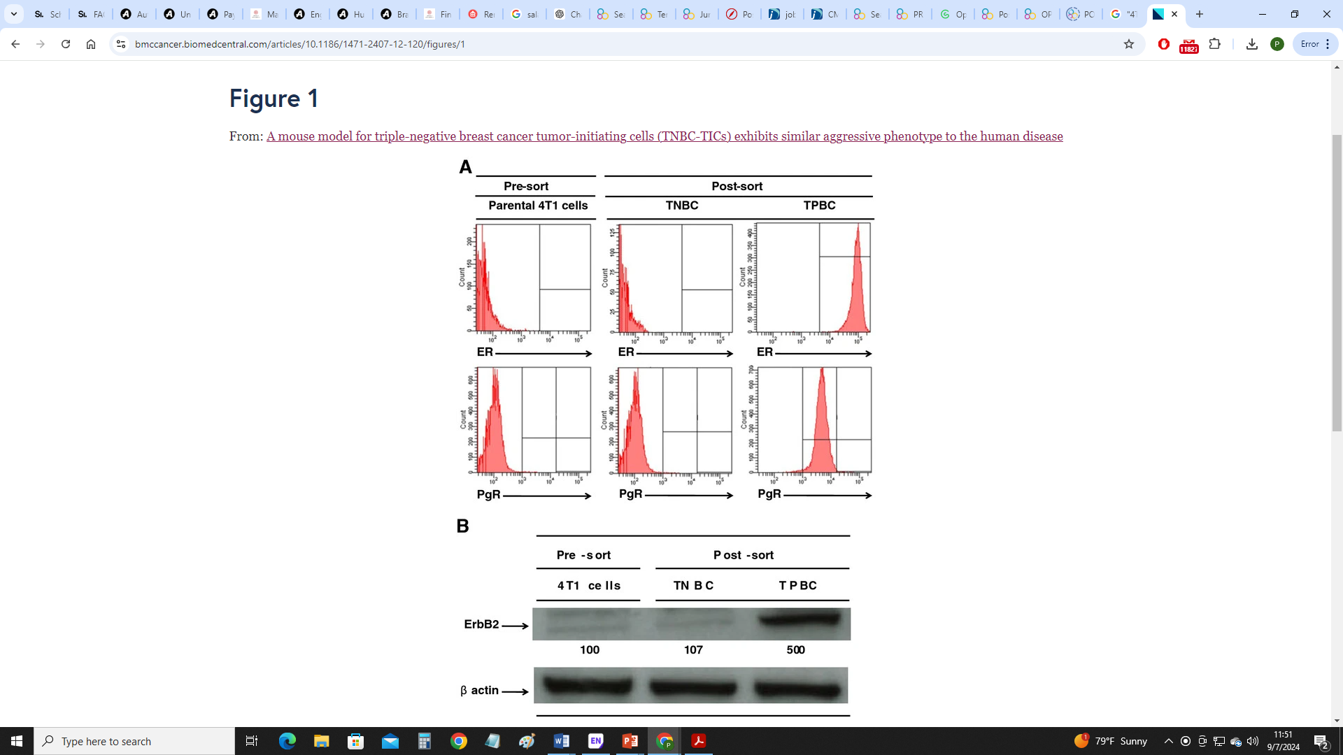
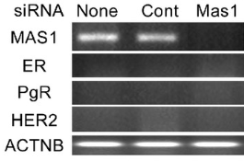
Introduction – Progesterone Receptor
4T1 TNBC mouse model
4T1 cells
NGS
4T1 TNBC cells
Luo, 2015 - Modified
Kaur, 2012 - Modified
NGS: Next-Generation Sequencing
PgR: Progesterone Receptor
Notes:
Studies have confirmed by different methods no PR expression in 4T1 TNBC cells. However, in a next-generation sequencing study, our group identified a significant upregulation of PR in the mEHT-treated group compared to the sham group.

Slide 25
Objectives
To elucidate the alterations in Progesterone Receptor (PR) expression in response to in vivo mEHT treatments using a multiplex analysis at the mRNA level;
To verify the changes in PR expression at the protein level;
To evaluate the potential synergistic effect of combining mEHT treatments with SPRMs, Mifepristone (MIF) or Ulipristal Acetate (UPA), on the viability of 4T1 TNBC cells;
To evaluate how effective is to combine MIF or UPA with mEHT treatments, as opposed to combining these SPRMs with conventional hyperthermia in vitro.
Notes:
With the upregulation of PR in mind, we decide to first...

Slide 26
Results – Multiplex Analysis
NanoString
qPCR
PR mRNA levels were upregulated in the mEHT compared to the sham group in a TNBC cell line
Notes:
Validation of gene expression at the mRNA level was conducted by using NanoString. Again, PR expression was significantly upregulated in the mEHT-treated group. PR mRNA levels were further analyzed by qPCR. Compared to sham group, PR was also significantly upregulated after mEHT treatments. Taking together, the mRNA multiplex analysis demonstrated expression of PR in the 4T1 TNBC cells treated with mEHT.
NanoString is a molecular biology technology used for the detection and quantification of nucleic acids (RNA, DNA) in a sample. It is known for its high sensitivity, precision, and ability to analyze multiple targets simultaneously without the need for amplified samples. The technology utilizes color-coded molecular barcodes hybridized to target molecules, and the readout is performed using a digital analyzer. NanoString is widely used in cancer research.

Slide 27
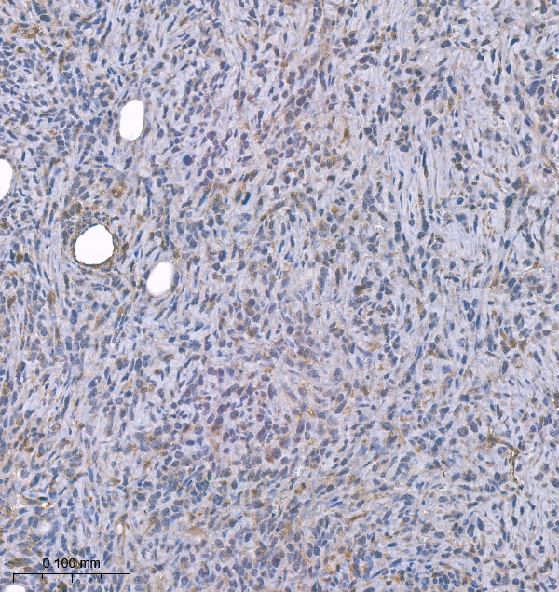
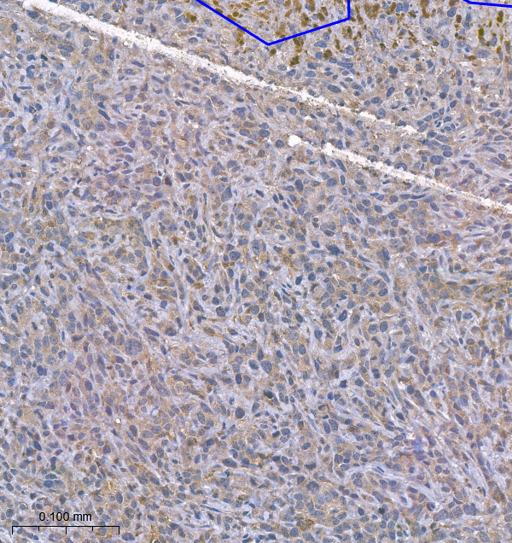
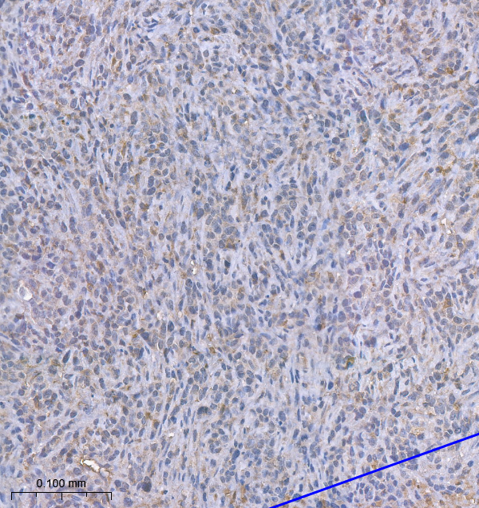
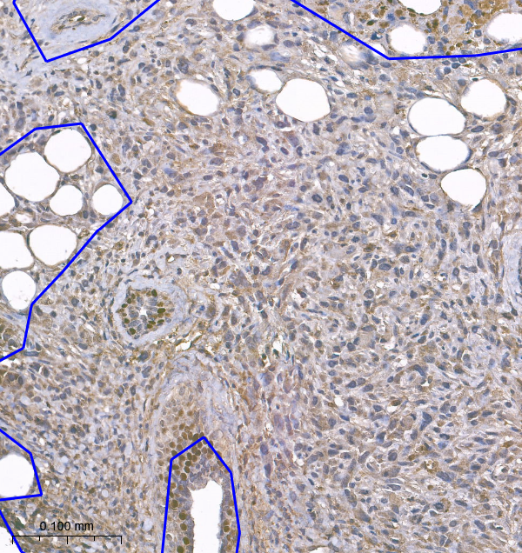
Results – Immunohistochemistry
Sham
mEHT
PR 1:100
Notes:
To confirm PR re-activation induced by mEHT at the protein level, immunohistochemistry was used. Consistent with the multiplex analysis, a significant increase in PR expression in mEHT-treated tumor samples was observed. Representative tumor images on the right demonstrate the differences in PR staining intensity between sham and mEHT-treated samples.

Slide 28
Results – Selective Progesterone Receptor Modulators
Significant decrease in cell viability due to MIF or UPA, further enhanced by mEHT in vitro treatment
SPRM | Dose (μM)
Mifepristone | 30
Ulipristal Acetate | 35
MIF: Mifepristone
UPA Ulipristal Acetate
cHT: Conventional Hyperthermia
DMSO: Dimethyl Sulfoxide
Notes:
The potential to re-express PR in TNBC cells offers an important avenue for re-sensitizing these cells to antiprogestins. These graphs show the effects of MIF or UPA on 4T1 TNBC cell viability through different treatment conditions. Both drugs reduced cell viability at 37°C. Conventional hyperthermia did not significantly enhance the cell killing effect of both drugs. However, the combination of MIF or UPA with mEHT resulted in a significant decrease in cell viability, suggesting enhanced cell-killing effects compared to individual treatments.

Slide 29
Conclusions – Progesterone Receptor
The multiplex analysis revealed the re-establishment of PR expression in 4T1 TNBC mouse model treated with mEHT.
The re-expression of PR was also confirmed in the protein level.
The combination of mEHT treatments and SPRMs, MIF or UPA, reduced 4T1 cell viability in vitro, resulting in additional cell-killing effect.
Conventional hyperthermia did not enhance the cell-killing effect of MIF or UPA.
Notes:
Taken together, we can conclude that:

Slide 30

Acknowledgements
Prof. Hamar Péter
Prof. Benyó Zoltán
Dr. Schvarcz Csaba, Dr. Danics Lea, Dr. Vancsik Támas
Kenan Aloss, Zahra Bokhari, Nino Giunashvili, Balázs Besztercei
Zóltan Koós and Dániel Bócsi
Oncotherm
All members of the Institute of Translational Medicine
Tempus Foundation – Stipendium Hungaricum scholarship
Notes:
I would like to say few words to show my gratitude. I am profoundly grateful to Prof. Hamar Péter, my supervisor, for his guidance and mentorship on this research and Prof. Benyo Zoltan for all his support. I would like to thank Dr. Schvarcz Csaba, Dr. Danics Lea, and Dr. Vancsik Tamas for their warm welcome and assistance; I would also like to thank Kenan, Zahra, Nino and Balázs for their support and collaborative spirit. I would also like to thank the lab assistants, Zoli and Dani for their administrative support; Oncotherm company and all members of the Institute of Translational medicine. Finally, a special thanks to Tempus Foundation for giving me the opportunity to be here.

Slide 31
Thank you for your attention!
Pedro Leroy
pedro.leroy@phd.semmelweis.hu

Slide 32

Results – Western Blot
Sham
mEHT
Sham
mEHT
Sham
mEHT
Sham
mEHT
120 kDa
← PRB
94 kDa
← PRA
45 kDa
β-actin
Notes:
The upregulation of PR was further confirmed by Western blot analysis, comparing sham and mEHT-treated samples. The immunoblot data show PRA and PRB expression. The molecular masses are indicated. The expression of β-actin was used as an internal standard to verify equal loading of proteins. The results revealed significantly elevated protein levels of PRA following mEHT treatment. However, PRB levels were not found to be statistically different.

Slide 33
Results – Estrogen Receptor
NGS
NGS: Next-Generation Sequencing
ERα: Estrogen Receptor α
ERβ: Estrogen Receptor β

Slide 34
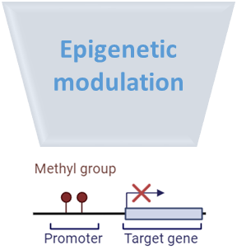
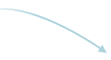
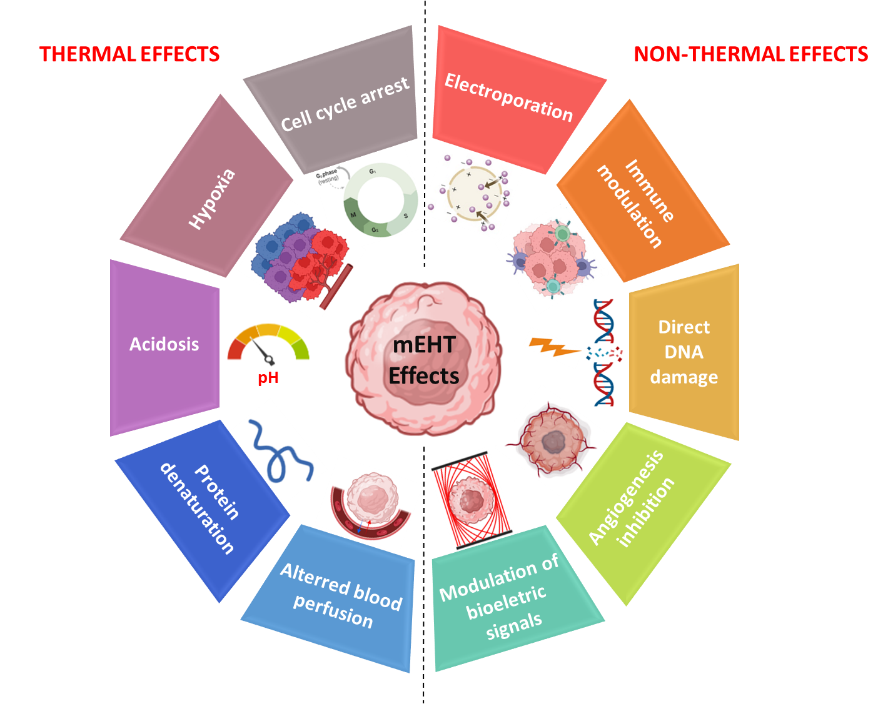
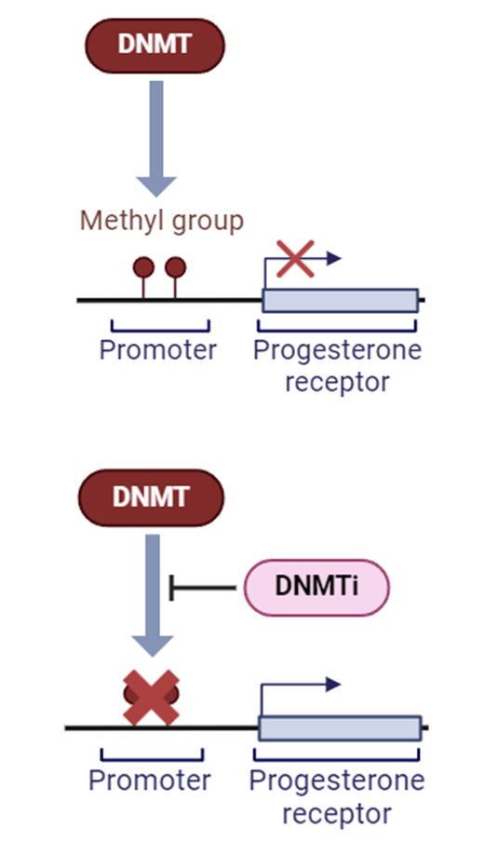
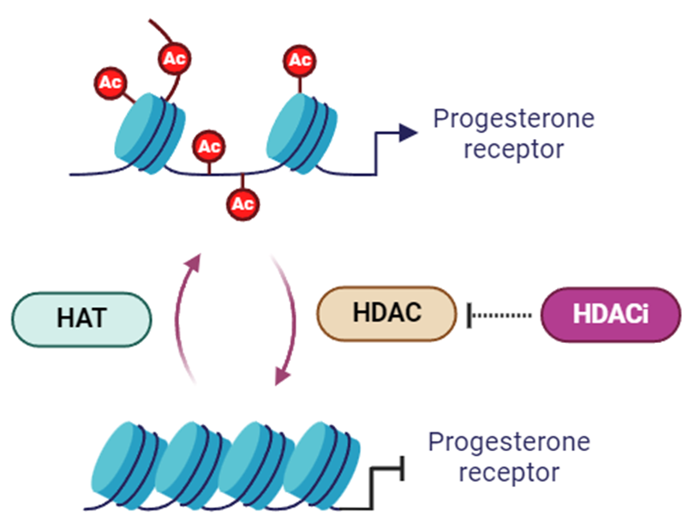
Future Directions
?
Epigenetics Modulation
DNA methylation
Histone deacetylation
DNMT: DNA Methyltransferase
DNMTi: DNA Methyltransferase inhibitor
HDAC: Histone Deacetylase
HDACi: Histone Deacetylase inhibitor
Viana, 2024 - Modified
Notes:
These results suggest that PR is re-expressed in 4T1 TNBC cell line and this re-expression could benefit the sensitivity of these cells to MIF and UPA. Future experiments will investigate these mechanisms, with focus on epigenetic modulation. Evidences suggest that PR is not absent in TNBC but is epigenetically silenced by DNA methylation and histone deacetylation, and the use of epidrugs can revert the null-expression, therefore sensitizing TNBC cells to endocrine therapy. While preclinical studies have demonstrated promising outcomes of epidrugs, their translation to clinics has been challenging. The potential PR re-activation by mEHT shows promise for improving patient outcomes, as mEHT has limited side effects. Therefore, investigating how mEHT influences epigenetic mechanisms has yet to be elucidated.

