Slide 1

VASCULAR AND HYPOXIA DYNAMICS OF MURINE TRIPLE-NEGATIVE BREAST CANCER IN RESPONSE TO MODULATED ELECTRO-HYPERTHERMIA
PhD thesis
Supervisor: Prof. Péter Hamar
Syeda Mahak Zahra Bokhari

Slide 2
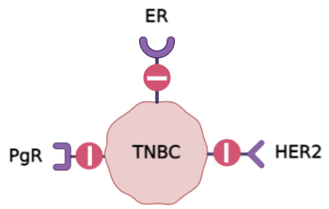
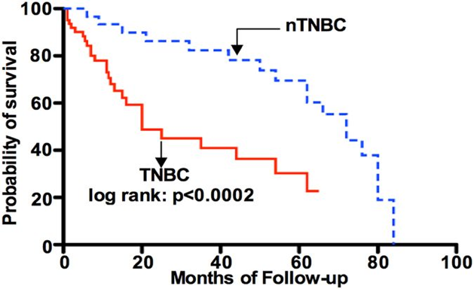
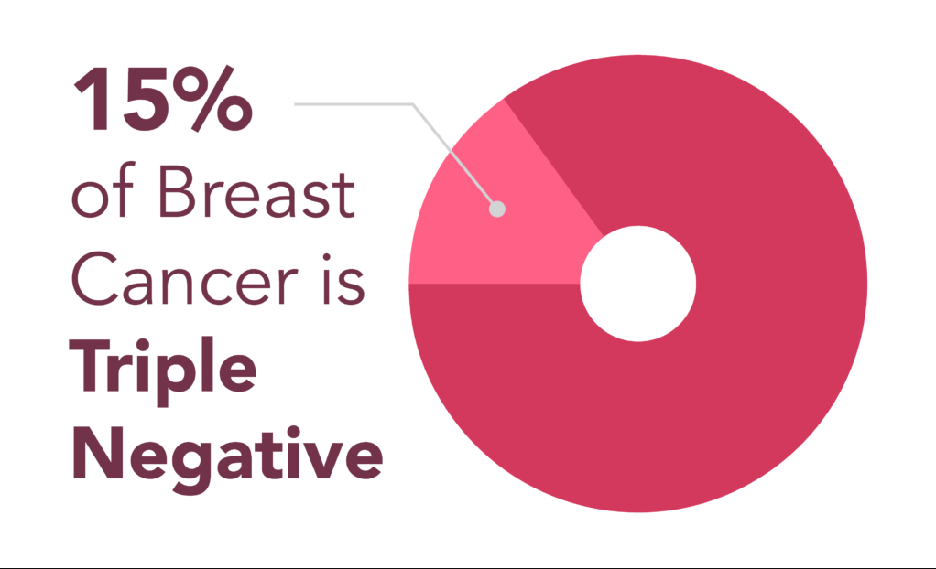
Triple-negative breast cancer (TNBC)
Lack of estrogen, progesterone, and HER-2.
Diverse molecular subtypes - aggressive disease course.
non-TNBC
Islam, S.S, et al., 2016
Chemotherapy as the first line of defence; poor response.
No targeted therapy, Neoadjuvant and adjuvant chemotherapy are common approaches.

Slide 3
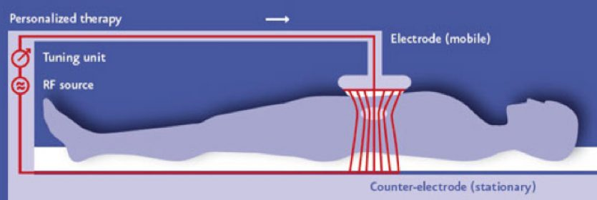
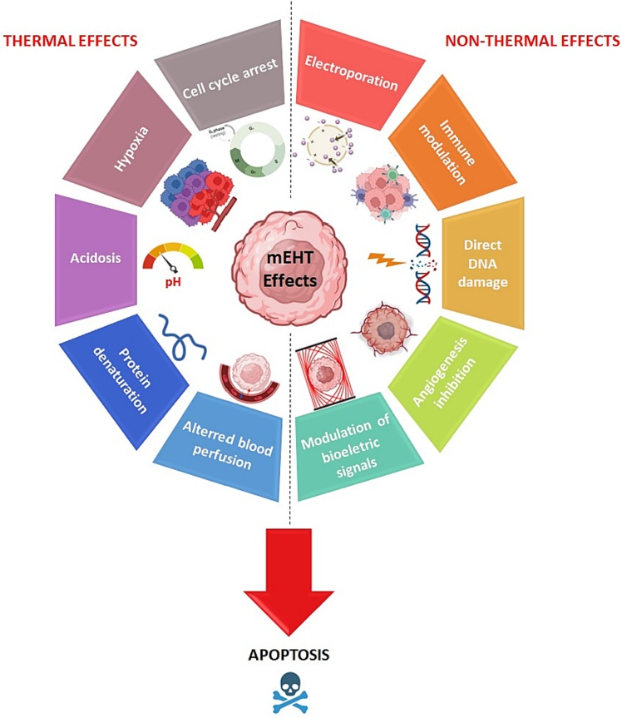

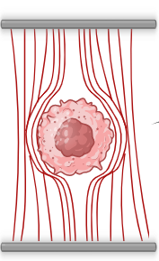
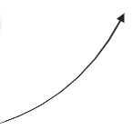
modulated electro-hyperthermia (mEHT)
Complementary therapy, selective cytotoxicity by mild elevation of tumor temperature
A 13.6MHz radiofrequency current generated electromagnetic energy absorbed by tumor tissue.
Selection of cancer cell based on:
High Glucose influx
High Ionic concentration in ECM
Low membrane potential
Poor contact with neighbouring cells
Autonomy

Slide 4
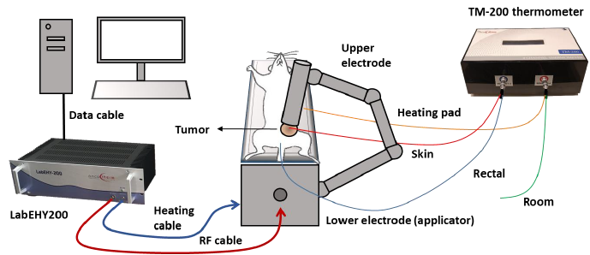
modulated electro-hyperthermia (mEHT) LabEHY200 Setup
Lab EHY 200, model for rodent usage
Schvarcz, C. et al., 2020
Danics, L. et al., 2020

Slide 5
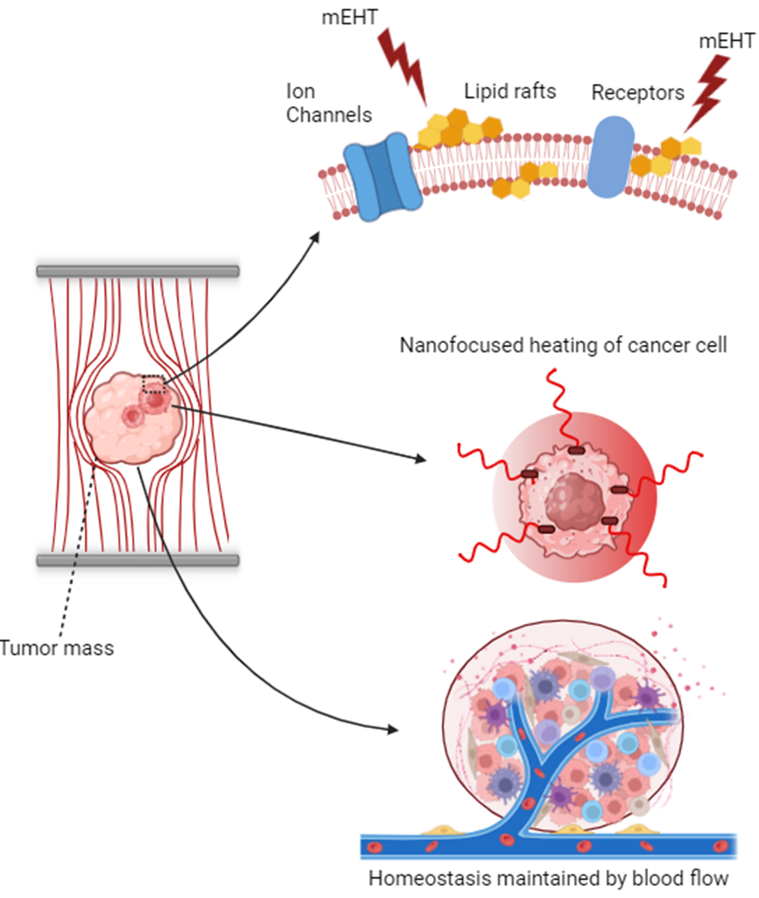
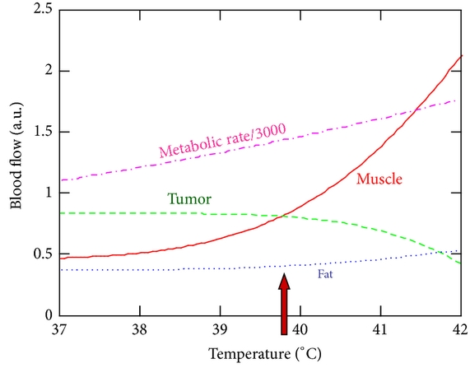
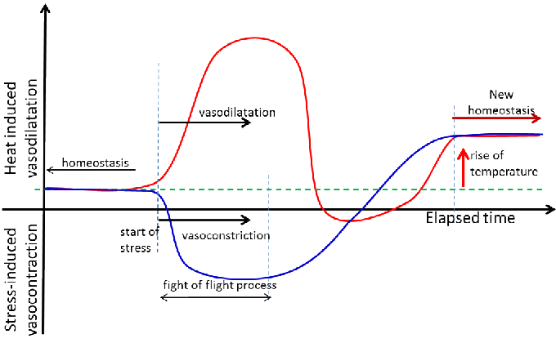
Blood flow in response to modulated electrohyperthermia
Szasz, A., 2013
Szigeti, G. et al., 2016

Slide 6
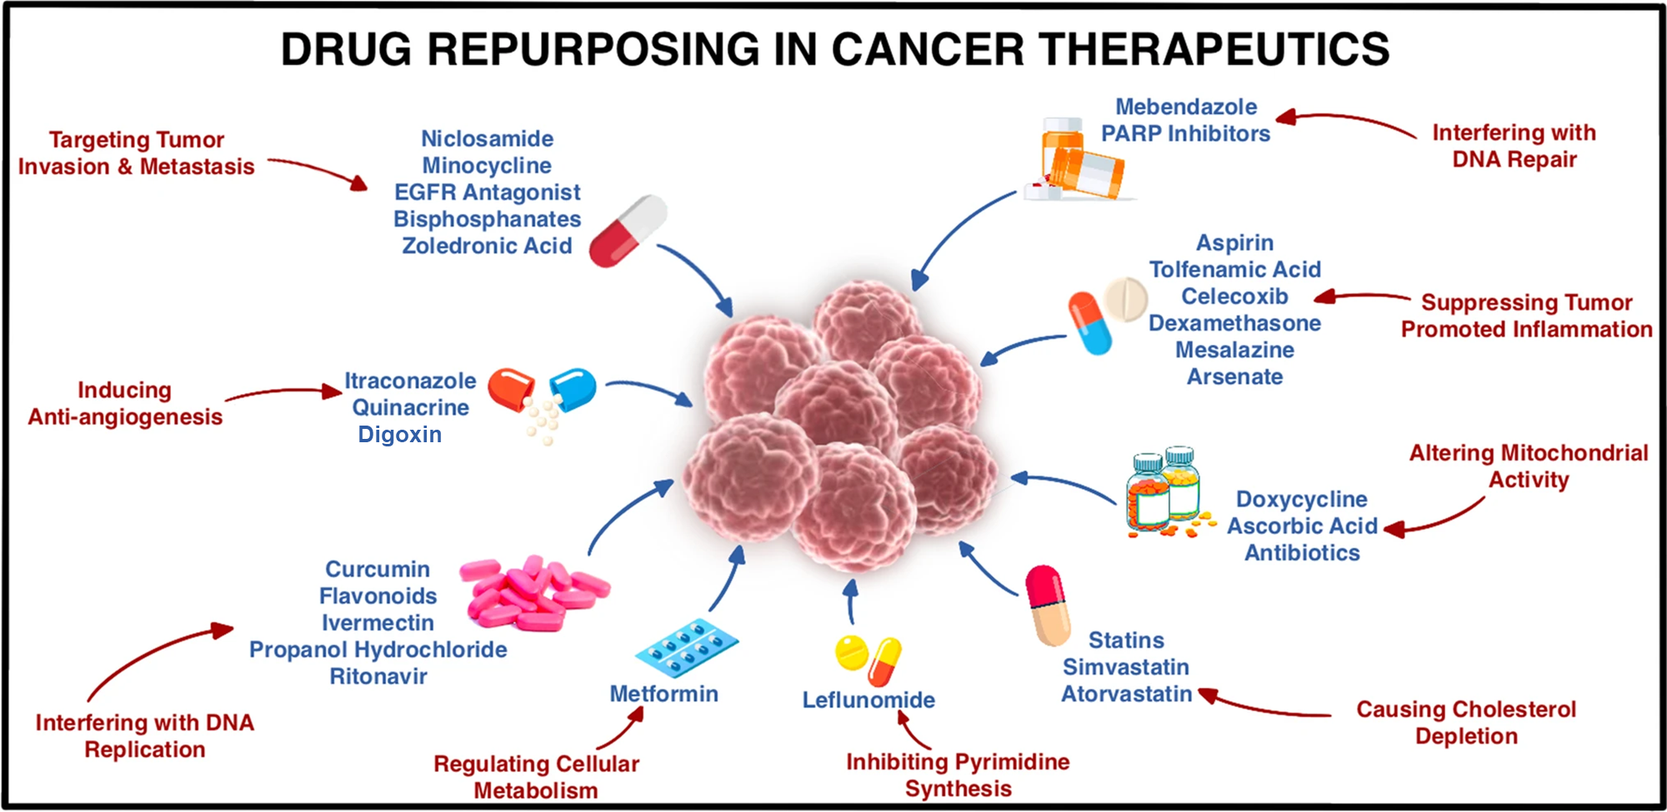
mEHT as a potentiator of anti-cancer drugs
Repurposing drugs with anticancer potential.
Turabi K,S., et al.,2022
Digoxin
Cardiac glycoside with anticancer effects
Reduces protein expression of HIF1-a
Common side effects; tachycardia or myocardial fibrillation
Non-Steroidal Anti-Inflammatory Drugs (NSAIDs)
Apirin and Celecoxib (SC-236)
NSAIDs reduce pro-tumorigenic inflammation
Common side effects: Gastrointestinal ulcers, bleeding, cardiovascular, renal, and hepatic adversities.

Slide 7
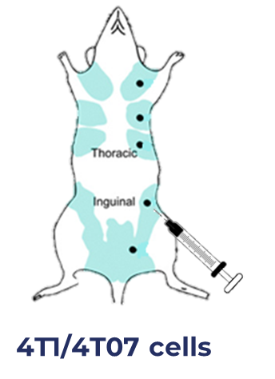
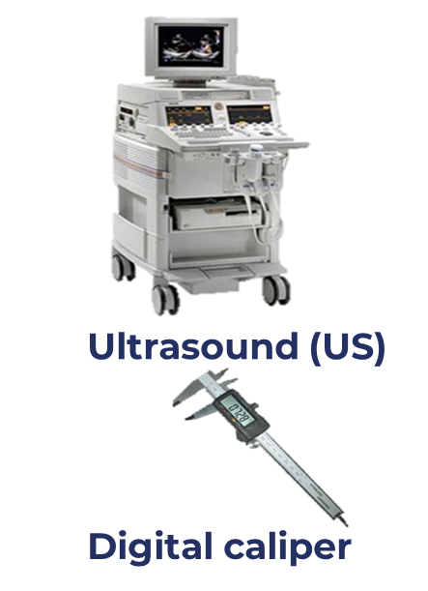
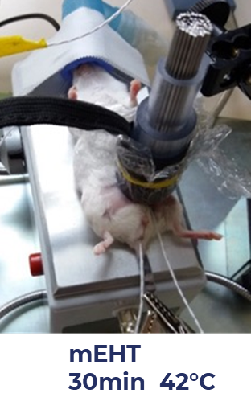
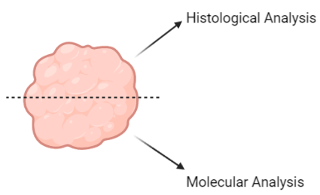
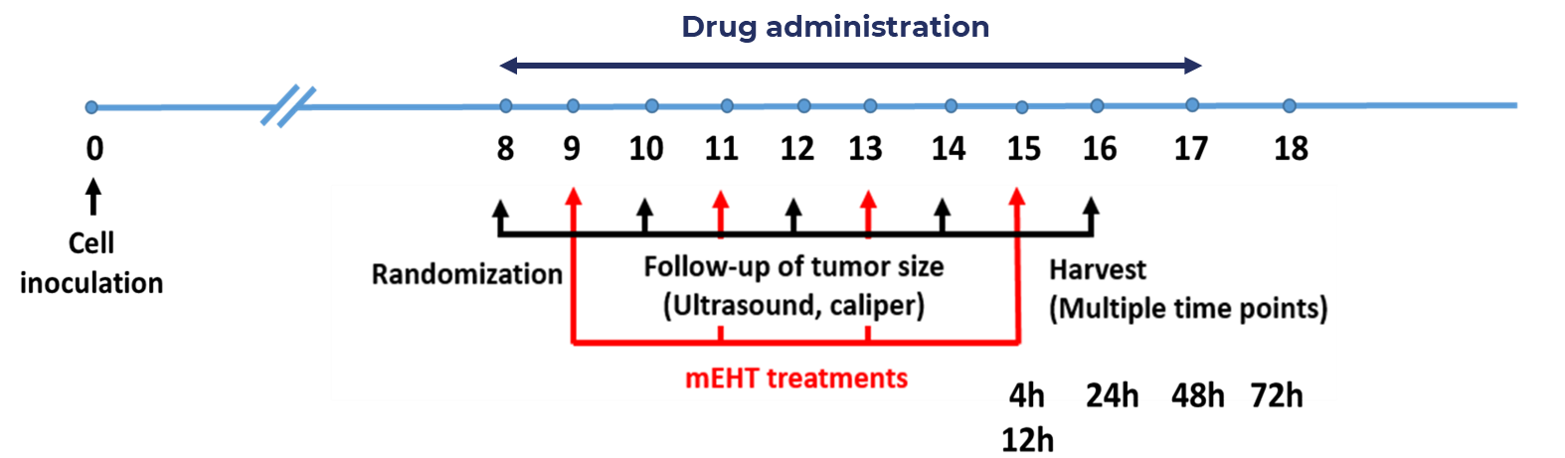
Methods

Slide 8
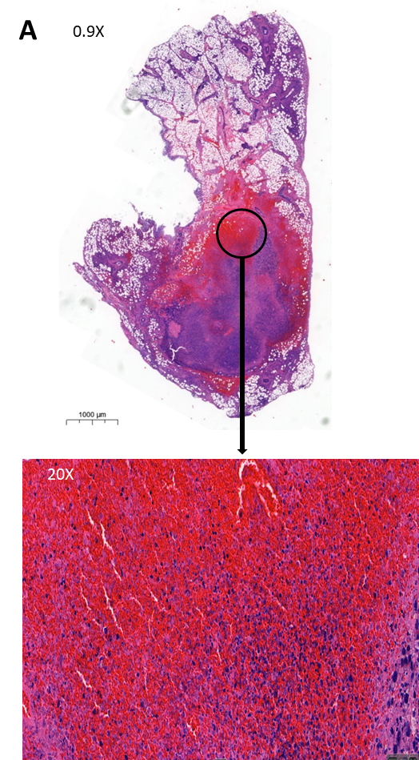
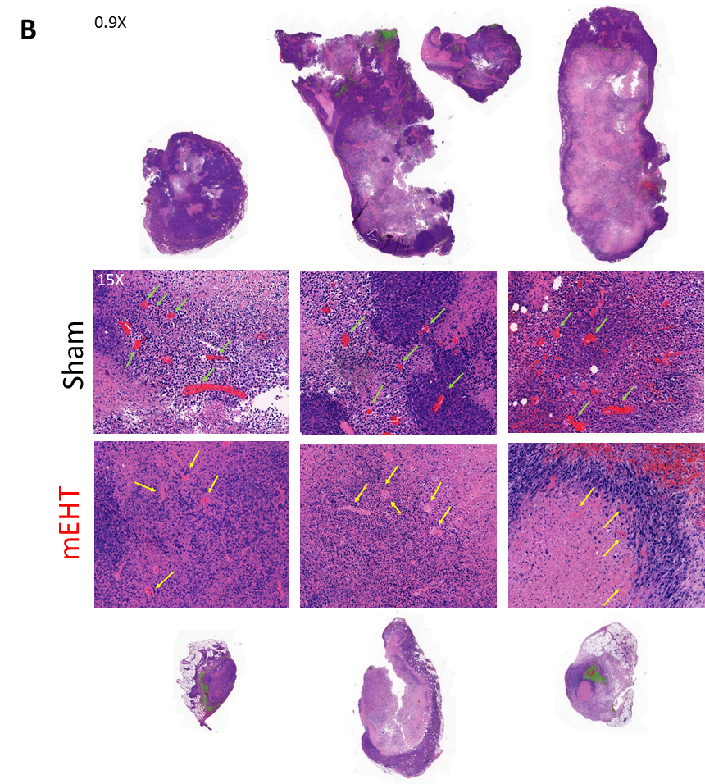
Capillary damage in 4T07 TNBC murine isografts after 5 treatments.
Interstitial bleeding in the tumour tissue
Functional capillary; filled with RBCs
Functional capillaries per tumor area
Bleeding was quantified by double masking.

Slide 9
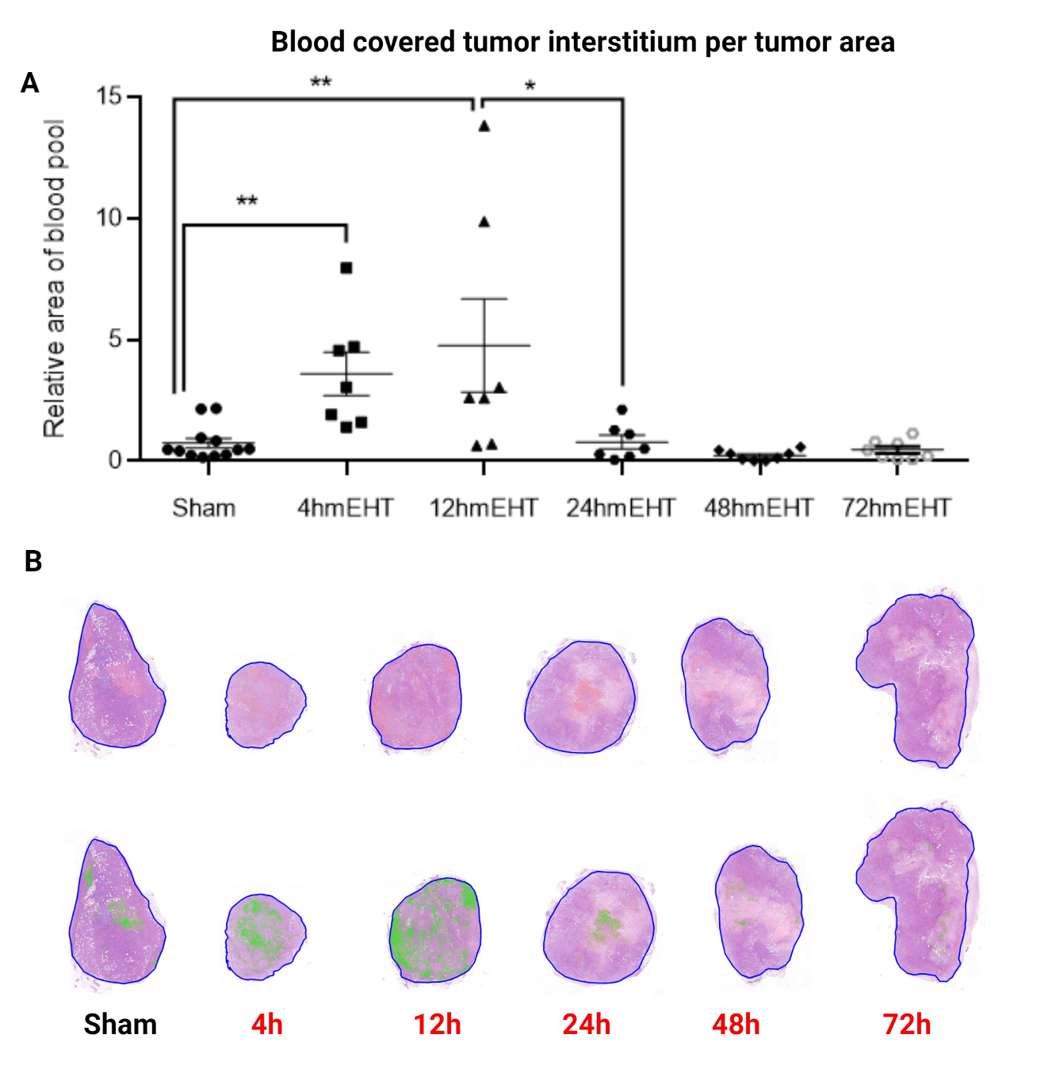
Capillary damage in 4T1 TNBC murine isografts after 3 treatments.
Time-related capillary damage in tumour tissues.
Magnification 1X

Slide 10
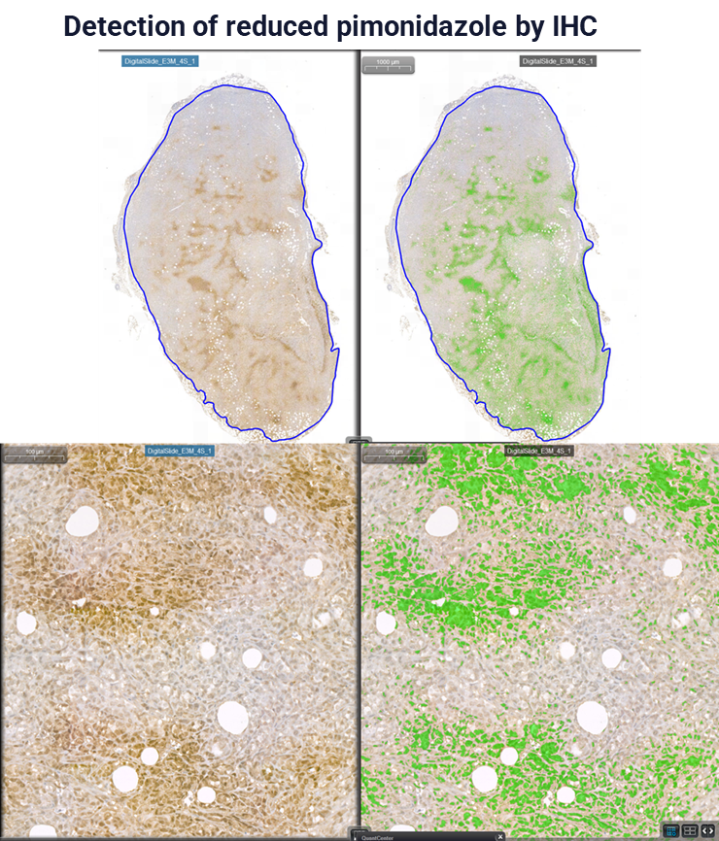
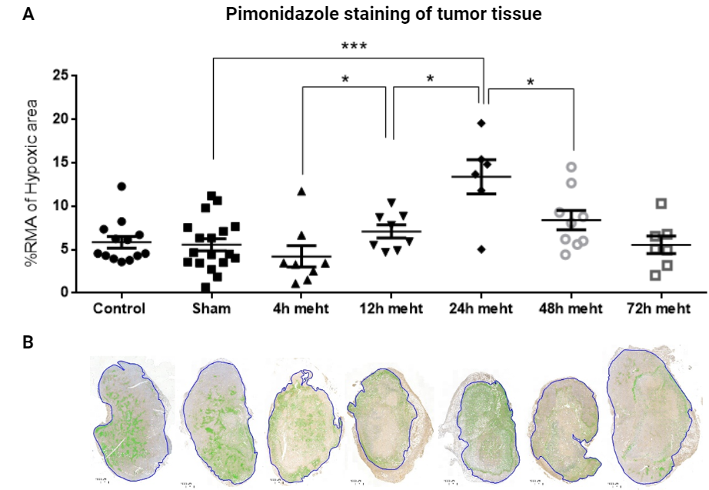
mEHT induced vascular damage led to Hypoxia
Pimonidazole: hypoxia marker (binds to protein SH- groups under hypoxia).
Magnification 0.8X

Slide 11
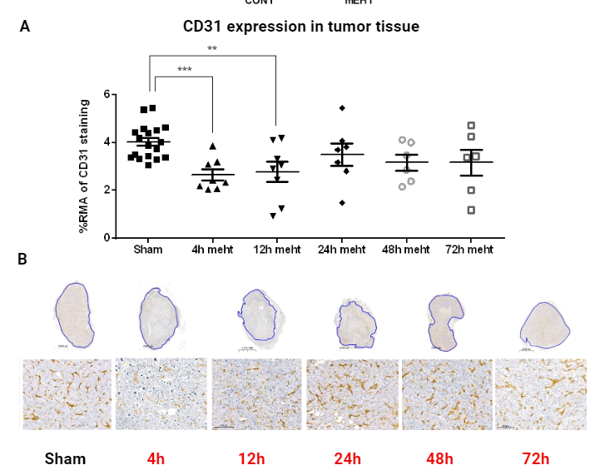
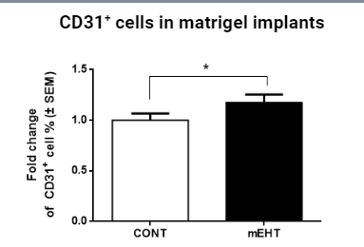
Angiogenic repair is initiated in response to mEHT induced stress
CD31, a specific marker for vascular endothelial cells.
CD31 staining shows a decrease at 12h followed by recovery to sham level
Increase in CD31+ cells 24 hours after mEHT in non-cancerous matrigel implants.
Magnification Whole tumor: 0.8x insert: 15x

Slide 12
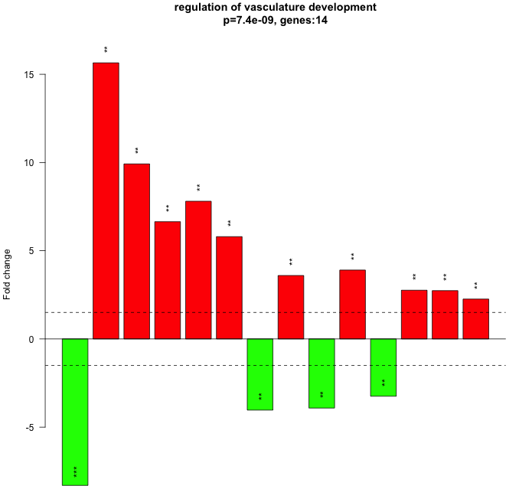
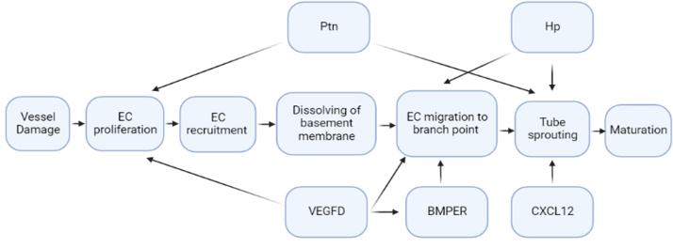
Stress related genes were upregulated in 4T1 tumours after 3 mEHT treatments.
Significant upregulation of stress related gene which have roles in vasculature development
Nr. | Gene name | Description | NGS |  | Nanostring
statistics |  |  | FC | p | FC | p
1 | Bmper | BMP-binding endothelial regulator | 15.65 | 0.00042 | No DE
2 | Hp | haptoglobin | 9.7 | 0.0002 | 7.5 | 2.5E-04
3 | VEGFD | vascular endothelial growth factor D | 9.9 | 0.0030 | 15.7 | 2.6E-05
4 | Ptn | Pleiotropin | 7.8 | 0.0099 | 7.6 | 8.2E-04
5 | CXCL12 | chemokine (C-X-C motif) ligand 12 | 6.80 | 0.0016 | No DE
Hc
Creb3l1
Bmper
Ptn
Asb4
Cx3cr1
Fgfbp1
Abcc8
Glul
Vegfd
Hhip
Myocd
Aplnr
Adam12
Theoretical network of genes involved in stress-responsive angiogenesis

Slide 13
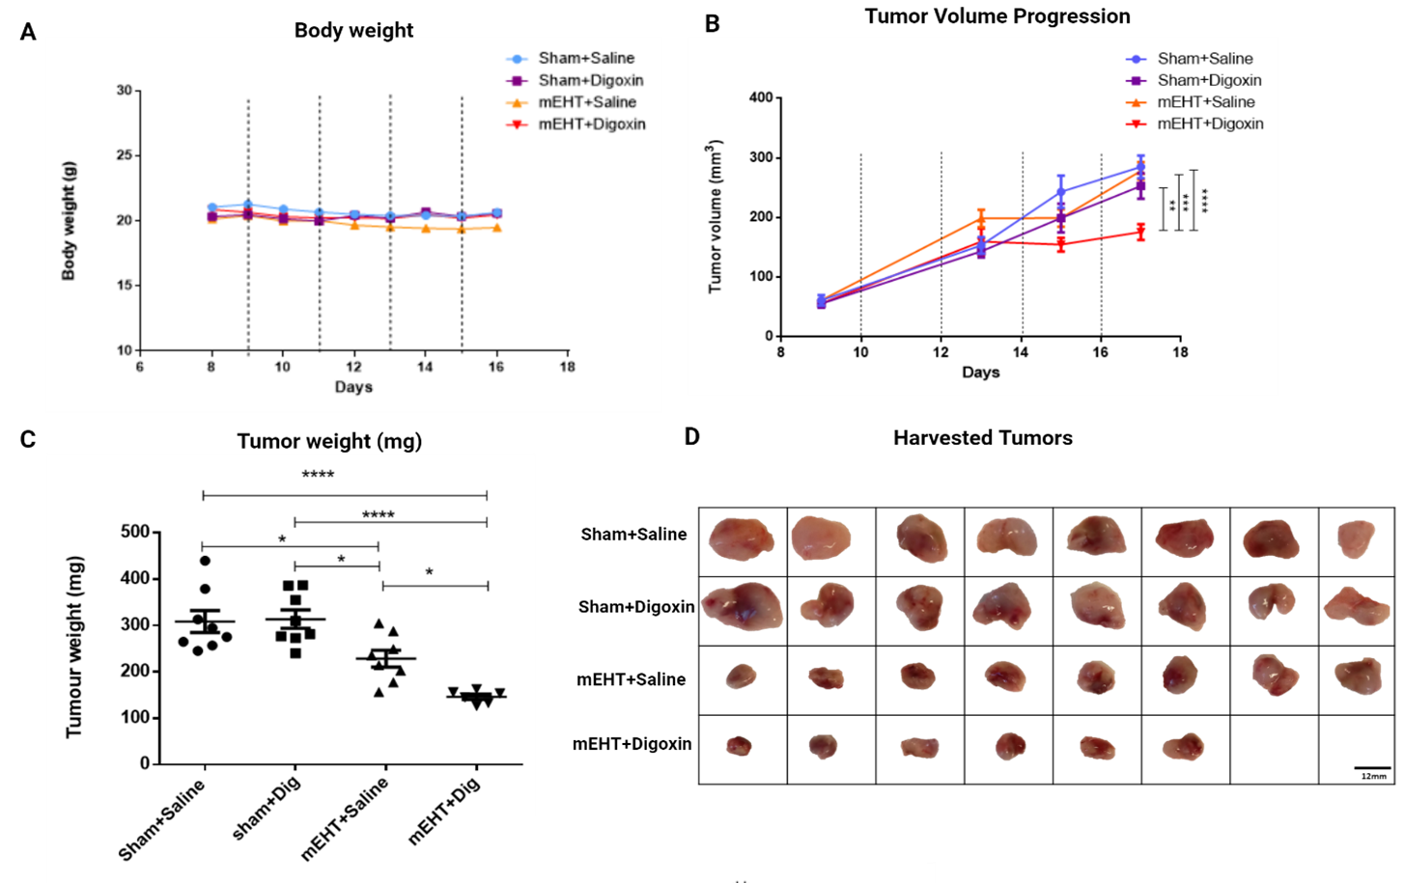
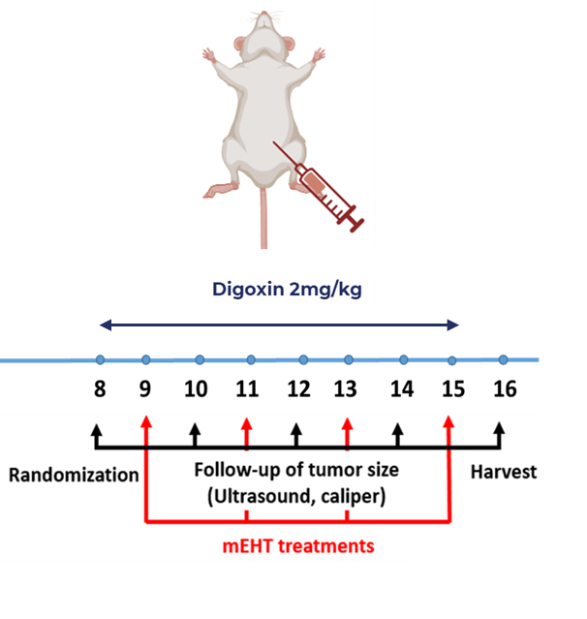
Combined mEHT and digoxin therapy reduced tumor growth
Digoxin, reduces HIF1a expression
mEHT and digoxin combination synergistically reduced tumor weight and volume.

Slide 14
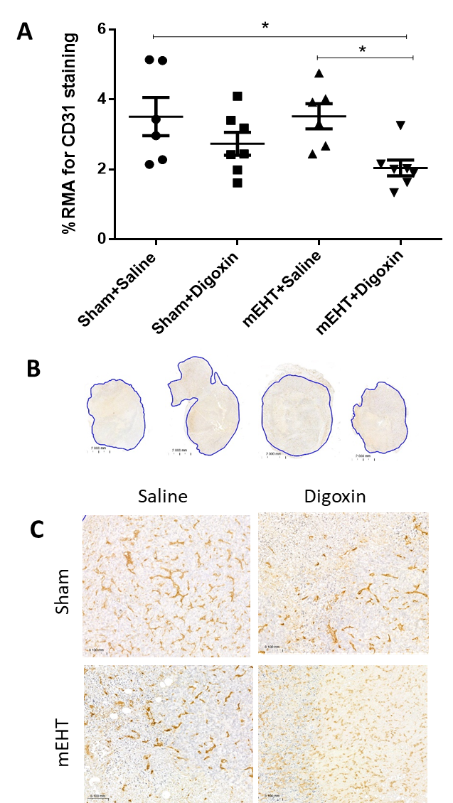
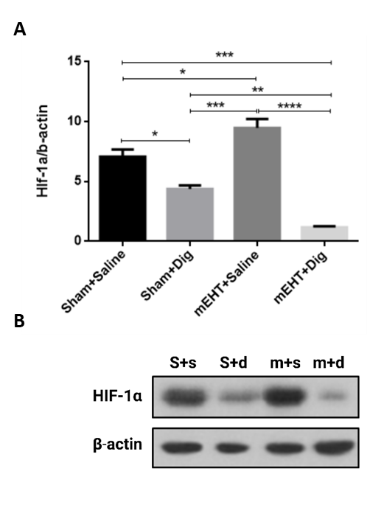
Combined therapy with digoxin reduced hypoxia and angiogenesis
Digoxin in combination with mEHT could significantly reduce HIF1a expression.
CD-31 staining for tumor angiogenesis.
0.8X,15X

Slide 15
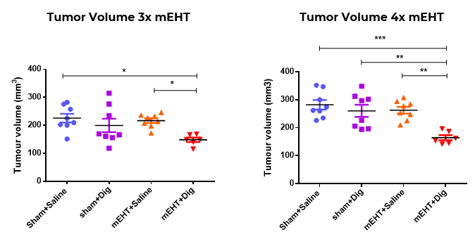
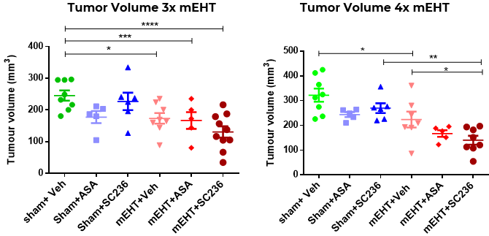
mEHT enhances anti-cancer efficacy of drugs eliciting early response
mEHT promoted anti-cancer drug activity in shorter treatment times.
Digoxin
Administration for an average of 21 days to observe anticancer effects.
We observed significant tumor proliferation reduction after 7 days of administration
Non-Steroidal Anti- Inflammatory drugs
Typical therapeutic dosage for 22-28 days for anticancer effects.
Significant reduction in tumor volume as compared to SC-236 monotherapy
Dig: Digoxin 2mg/kg
ASA: Aspirin 100mg/kg
SC-236: Celecoxib 6mg/kg

Slide 16
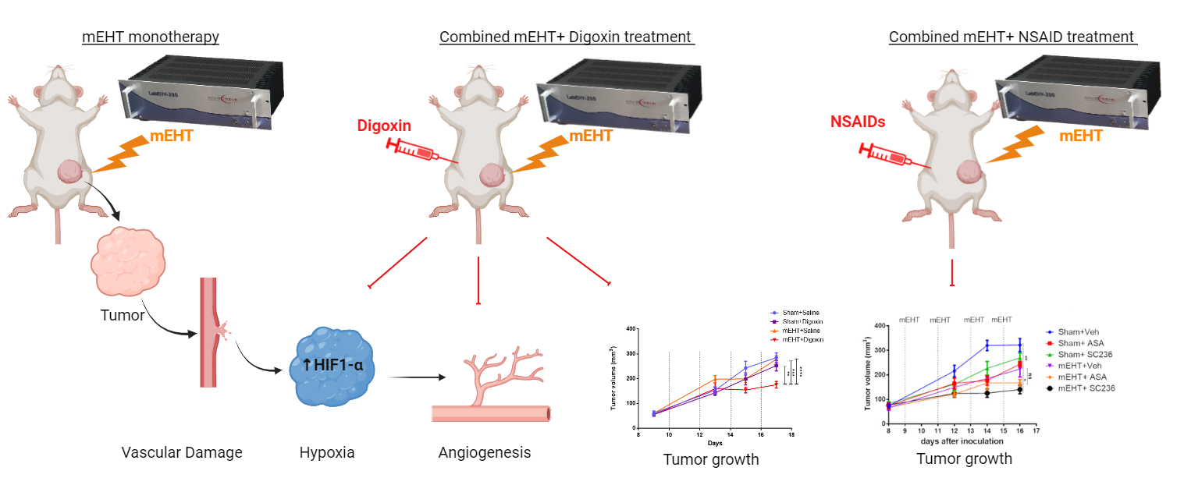
Conclusion
Repeated modulated electrohyperthermia (mEHT) induced vascular damage in triple-negative breast cancer.
mEHT-mediated vascular damage triggers hypoxia in a time dependent manner.
A potential angiogenic repair is initiated in response to mEHT in our model.
Combination therapy (mEHT+digoxin) has synergistic anti-tumor effects.
Combining mEHT with repurposed anti-cancer drugs (digoxin, SC-236) can reduce overall treatment time.

Slide 17
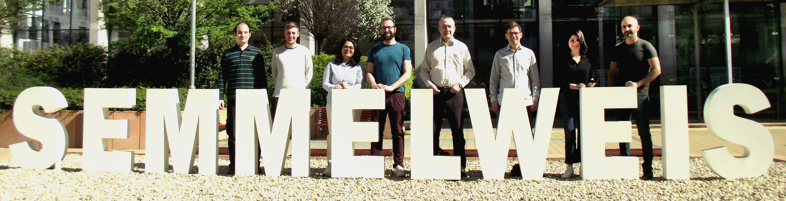



Acknowledgements
Prof. Péter Hamar
Prof. Zoltán Benyó
Kenan Aloss
Pedro Leroy Viana
Nino Giunashvili
Balázs Besztercei
Dr. Csaba András Schvarcz
Dr. Lea Danics
Zoltan Koos, Pedro Leroy, Zahra Bokhari, Csaba Schvarsz, Gábor Szénási, Peter Hamar, Nino Giunashvili, Kenan Aloss
Zoltán Koós
Dániel Bócsi
All current and former colleagues
Family and friends

Slide 18
Thank you

Slide 19
Correct statistics (Pimonidazole staining)
Correct statistics (CD-31 staining)
One way ANOVA (Tukey correction), ****p<0.0001, ***p<0.0010, **p=0.0008
One way ANOVA (Tukey correction), *p<0.05
Correct statistics (Red blood pool area)
One way ANOVA (Tukey correction), **p<0.005, *p=0.05

Slide 20
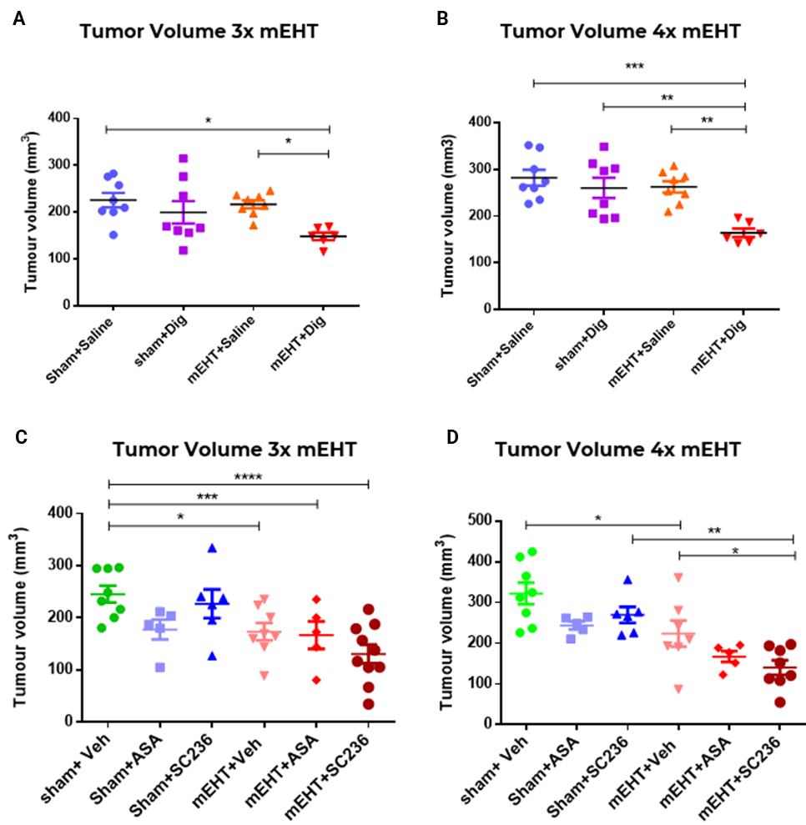
Correct statistics (Nino, SEM instead of SD)

