Slide 1
SYNERGISTIC EFFECTS OF MODULATED ELECTRO-HYPERTHERMIA AND COX-2 INHIBITION IN TRIPLE-NEGATIVE BREAST CANCER AND MELANOMA MOUSE MODELS
Supervisor: Prof. Péter Hamar
Nino Giunashvili, Jeremiah Thomas, Csaba Schvarcz, Lea Danics, Kenan Aloss, Mahak Zahra, Pedro Viana, Enikő Major, Zoltán Koós, Dániel Bócsi, Zoltán Benyó.
Nino Giunashvili,MD, MSc
nino.giunashvili@phd.semmelweis.hu
Institute of Translational Medicine
13.08.2024

Slide 2
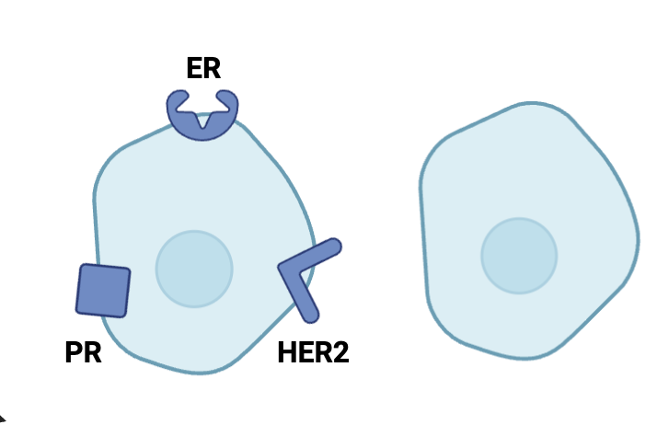
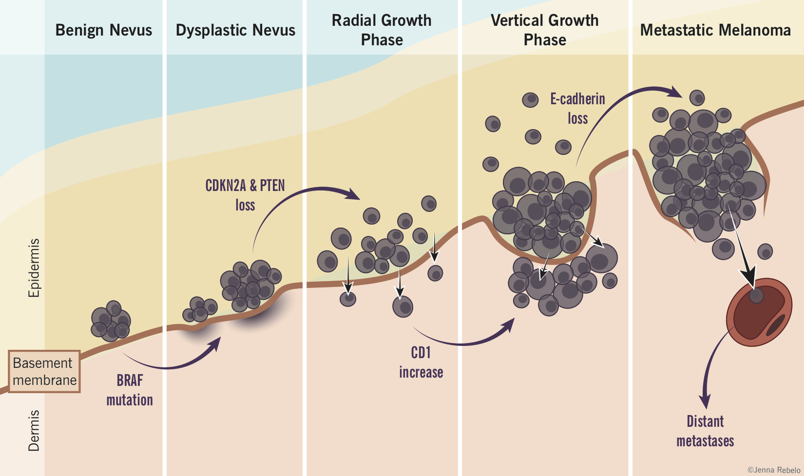
Introduction
Triple Negative Breast Cancer (TNBC)
15-20% of all types of breast cancer
BC
TNBC
Arrangóiz, Rodrigo etx al. 2016.
Notes:
TNBC accounts for 15% of all types of breast cancer. Cancer cells are characterized by the absence of estrogen receptors (ER), progesterone receptors, and human epidermal growth factor receptor 2 (HER2), making traditional hormonal therapies ineffective against it. Therefore, complementary treatments are highly valuable in the reatemnt.
2. Melanoma is also an aggresice cancer. Around 65% of people diagnosed with melanoma face metastasis, which significantly reduces survival rate.
Advanced therapeutical or combination treatments are highly valuable to improve the outcome in those cancer types.

Slide 3
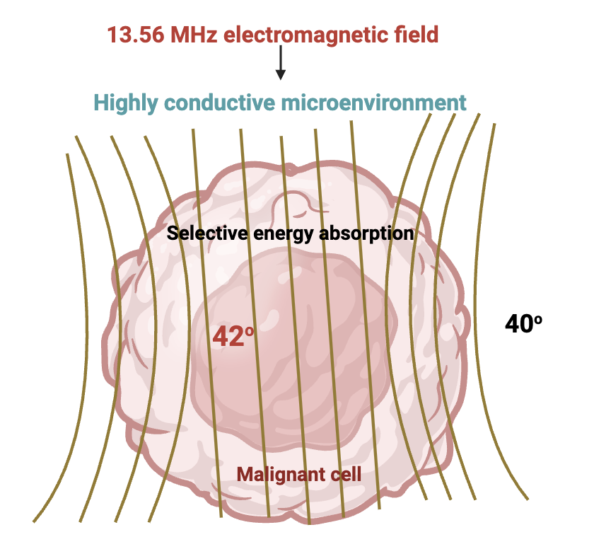
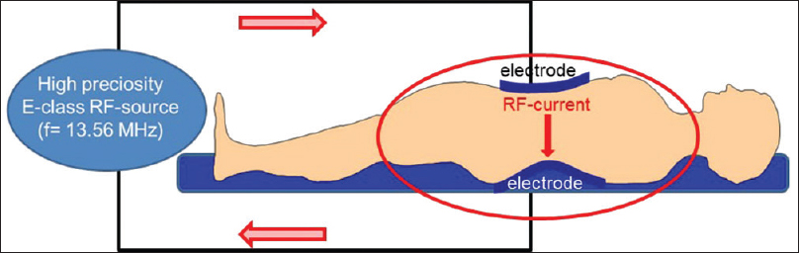
Introduction
Modulated electro-hyperthermia (mEHT)
Szasz et al.2019
www.Biorender.com
Notes:
2. Modulated electro-hyperthermia, which I refer as mEHT is a noninvasive adjuvant treatment method applied to different types of tumors in clinics. mEHT delivers energy using a 13.56 MHz frequency electromagnetic current, generated by a setup consisting of two coupled electrodes.
Its thermal effect leads to the breaking of DNA, which affects the cell cycle and apoptosis.
In addition to that, modulated electro-hyperthermia exerts a non-thermal effect through the 1/frequency amplitude modulation of the electromagnetic field. The modulation disturbs cancer cells by inducing the rotation of cell particles. It is enhancing cell membrane permeability and enabling effective drug delivery through electroporation
mEHT specifically targets the tumor without affecting healthy neighboring tissues.

Slide 4
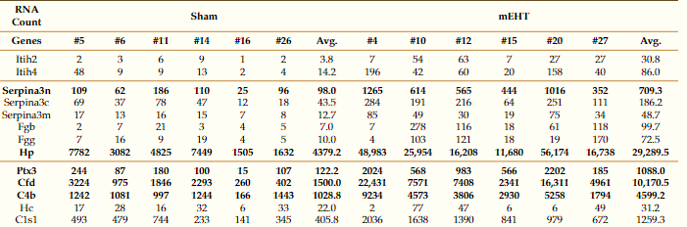
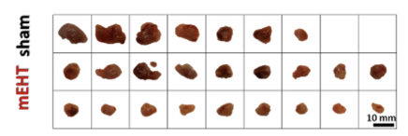
Introduction
mEHT-induced local acute phase reaction in 4T1 TNBC
Acute Phase Proteins
ITIHs
3x
SERPINs
FIBRINOGENs
Schvarcz et al. 2021
HAPTOGLOBIN
COMPLEMENT
SYST. PROTEINS
Schvarcz et al. 2021
Notes:
Our colleagues have shown that mEHT can significantly inhibit tumor growth in TNBC. He demonstrated that mEHT induced lAPR and synthesis of APP.
The authors hypothesized that the reaction occurs due to mEHT induced stress.
In this study, we aimed to investigate mEHT-induced APR-related molecular events further for a better understanding of its impact on the tumor development in 4T1 TNBC mouse model.

Slide 5
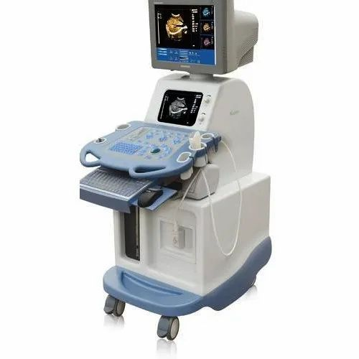
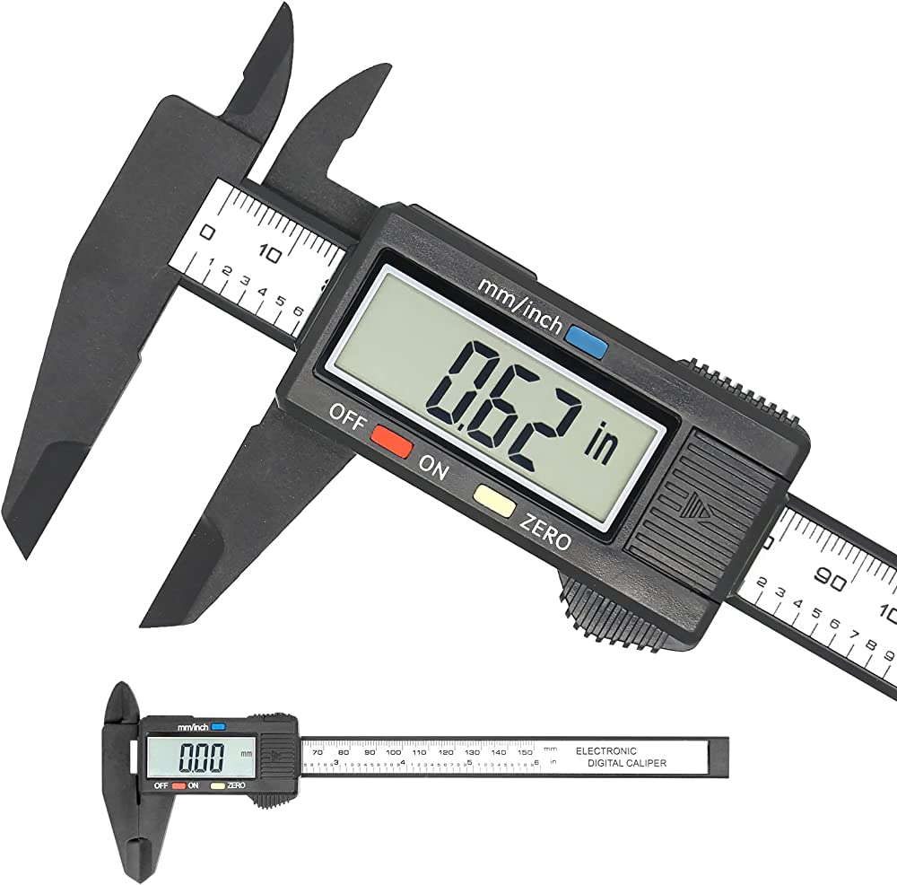
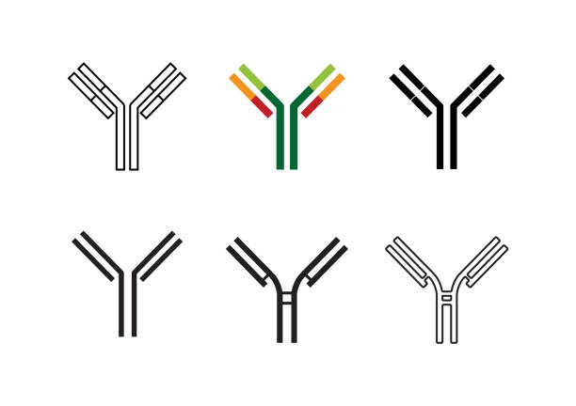



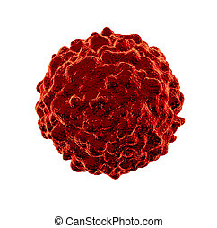
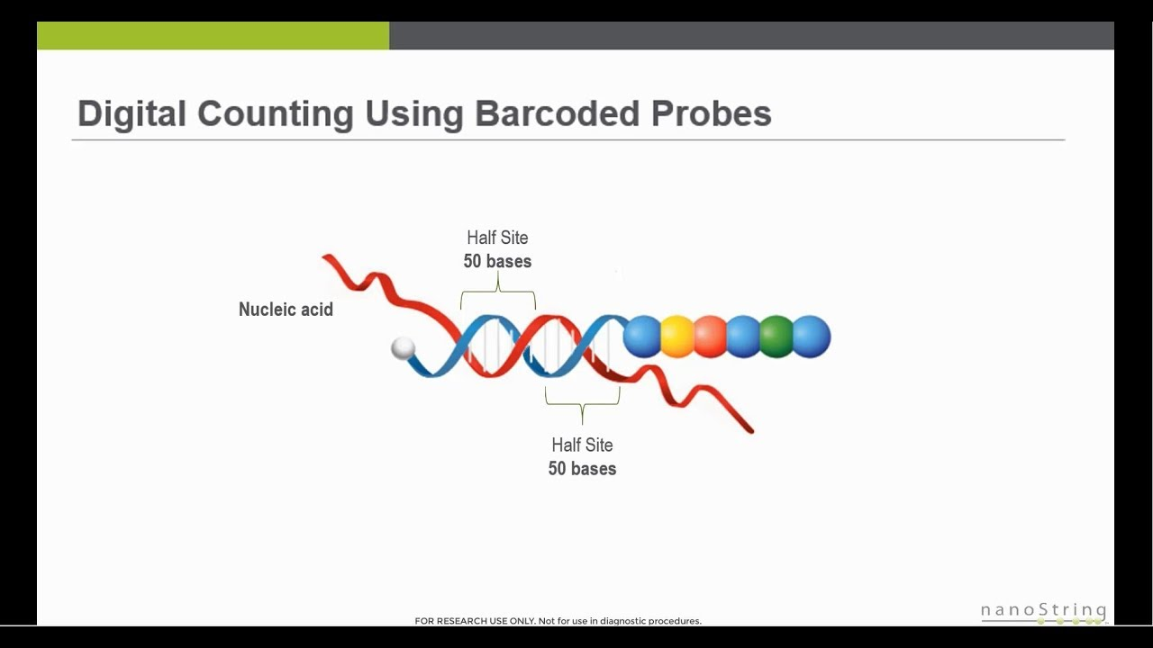
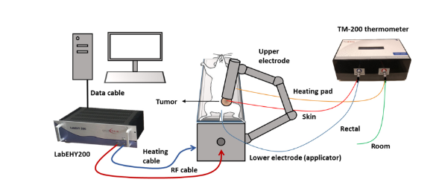
Methods
SC236
ASA
IHC
+
mEHT
4T1
B16F10
RT-PCR
Nanostring
mEHT in vivo setup
Abbreviations:
mEHT: modulated electro-hyperthermia
IHC: Immune histochemistry
ASA: Aspirin
SC236: Selcoxib
RT-PCR: Real-Time polymerase chain reaction
Schvarcz et al. 2021
Notes:
Methods: For conducting the in vivo experiments, we cultivate cells in vitro, and inject them subcutaneously into the 6th mammary fat pad of BALB/c mouse.
On the day eighth, mice are randomized according to tumor volume.
We wait for the tumor to grow. We treat mice with mEHT alone or mEHT in combination with other therapies.
We monitor the tumor growth during the experiment with ultrasound and digital caliper. At the end of the experiment,
At the final step, tumor is excised for molecular investigations ex. qPCR, IHC, nanostring.
There is a Schematic illustration of pre-clinical modulated electro-hyperthermia (mEHT) set-up. The bodyheating pad, and room temperature is monitored by optical sensors.

Slide 6
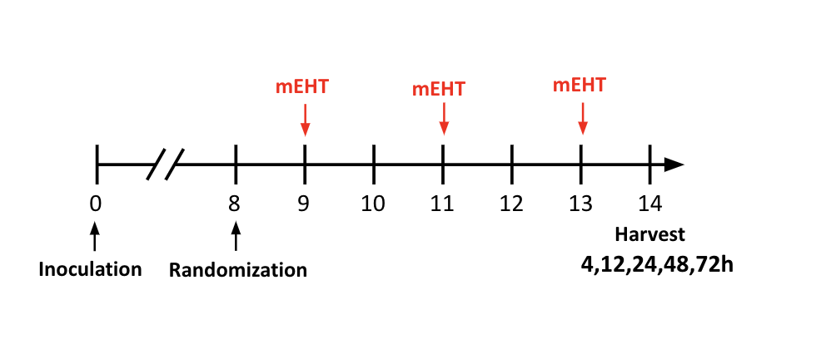
Results
mEHT induces inflammatory cytokines: IL-1β and IL-6 mRNA expression
IL-6
IL-1β
COX-2
Groups
Groups
Days
Notes:
After repeated (3x) mEHT treatment, mice were terminated at different time points. RNA was isolated from 4T1 tumor tissue and RT-PCR was performed.
Results demonstrated that mEHT induced significant upregulation of inflammatory cytokines -interleukin-6 (IL6) and interleukin-1 beta(IL1b) expression. RNA expression reached the peak after 12h and 24h, respectively, in both case at 72h time point, cytokines expression started to decline.
IL6 and IL1-beta cytokines are involved in inflammatory pathways and play a central regulatory role in acute phase response.
There is a strong positive feedback loop between COX-2 expression and IL-6 and IL-1β, as they stimulate each other's synthesis.
We checked the COX-2 expression

Slide 7
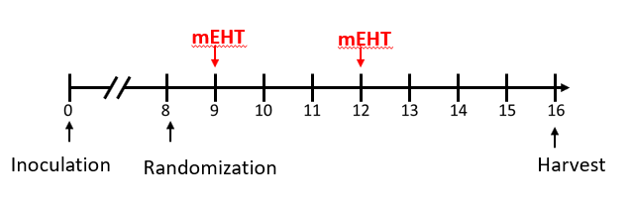
Results: mEHT monotherapy induces COX-2 mRNA expression in 4T1 TNBC model
COX-2 time kinetics
COX-2 at 96h
p=0.06
Groups
Groups
Notes:
Within the same experimental samples we have seen significant upregulation of prostaglandin-endoperoxide synthase-2 (PTGS2- encoding for the COX-2 enzyme expression) at 72 hour time point
Furthermore, COX2 RNA expression was measured in the following experimental samples as well, in which mice were treated 2x with mEHT, and animals were terminated at 96h time points after last treatment. COX2 gene expression was higher in the mEHT-treated group compared to Sham, although the difference was not statistically significant.
So, COX-2 expression was significantly upregulated at later – 72h and 96 h time points.

Slide 8
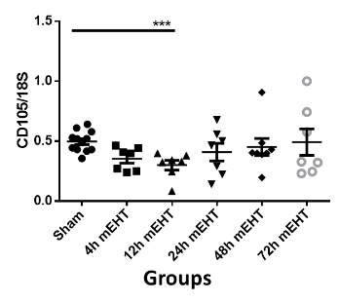
mEHT regulates endothelial marker CD105 expression in TNBC

Slide 9
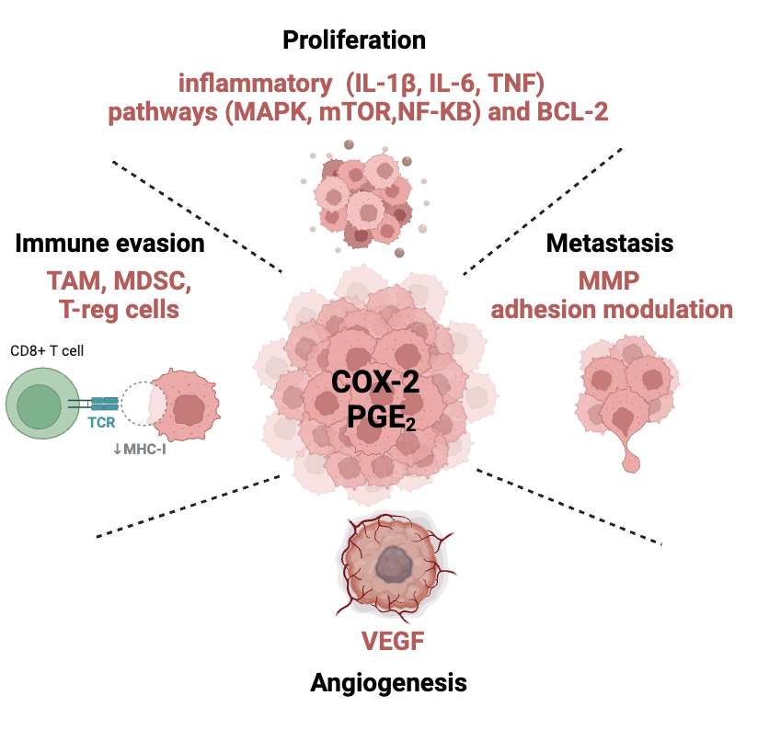
Role of the COX-2 and cytokines in cancer
Created in Biorender.com
Abbreviations:
IL-1 β: Interleukin - 1 betta
IL-6: Interleukin -6
COX-2: Cyclooxygenase -2
PGE2: prostaglandin E2
MAPK: Mitogen-activated protein kinase
mTOR:Mammalian target of rapamycin
NF-kB:Nuclear factor kappa B
BCL-2: B cell lymphoma 2
MMP: matrix metalloproteinases
VEGF: Vascular growth factor
TAM: Tumor activating macrophages
MDSC: Myeloyed derived suppressor cells
Treg: T regulatory cells
Notes:
It is accepted that COX-2 promotes tumor growth through prostaglandins, particularly prostaglandin E2. There are diverse functions of PGE2, which favor tumor progress as follows:
Malignant cells become resistant to apoptosis through the upregulation of the proto-oncogene B-cell lymphoma 2 (Bcl-2).
Angiogenesis through the upregulation of vascular endothelial growth factor (VEGF).
Metastasis through the upregulation of adhesion molecules.
Invasion through the matrix metalloproteinases (MMP) – MMP-2 and MMP-9, which breaks down the matrix and supports the cell mobility.
Immune evasion through the increase of regulatory T cells (Tregs), activity of tumor-associated macrophages (TAM) and Myeloid-Derived Suppressor Cells (MDSC).
Cancer cell survival and proliferation through the modulation of inflammatory pathways (Interleukin- 1 betta (IL-1β), Interleukin-6 (IL-6), Tumor necrosis factor (TNF), Mitogen-activated protein kinase (MAPK), Mammalian target of rapamycin (mTOR), Nuclear factor kappa B (NF-kB)) and Signal Transducer and Activator of Transcription 3 (STAT3) activation.

Slide 10
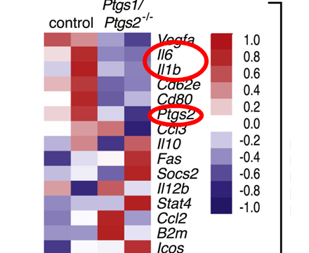
Hypothesis
Created in Biorender.com
Abbreviations:
IL-1 β: Interleukin - 1 betta
IL-6: Interleukin -6
COX-2: Cyclooxygenase -2
NSAIDs: non-steroid anti-inflammatory drugs
mEHT: modulated electro-hyperthermia
SC236: Selectiv COX-2 inhibitor
Asprin: non-selective anti-inflammatory drug
4T1
Zelenay S at al.2015. Cell
Notes:
We hypothesize that inhibition of the described reaction through applying a COX-2 in combination with mEHT, could enhance the mEHT effect.
Study suggests that COX-2 inhibition can reverse the IL-6 and IL-1beta cytokines expression too.
We applied mEHT in combination with non selective COX (Aspirin) and selective COX inhibitors (Sc236).
Numerous studies have suggested that such key inflammatory mediators can promote the outgrowth of malignant cells by enriching tumor favorable microenvironment, (Which contains multiple residents and inflating cells, including immune cells, along with growth factors and cytokines that they release. Subsequently, tumor progression can be promoted by potentially increasing migration, metastasis, angiogenesis, decreasing apoptosis )
We hypothesized that in our model, the described inflammatory reaction n could be part of the self-defensive, wound-healing reaction of tumor cells used for their survival. The idea could corroborate our previous findings when Heat Shock Proteins (HSPs) and APPs were produced as a result after mEHT treatment.
Therefore, our idea was to apply non-specific anti-inflammatory treatment such an NSAIDs in combination with mEHT which could reverse described inflammatory reaction.
On the right figure we see one of the studies, suggesting COX2 (KO) in 4T1 cells, that can alter a few inflammatory protein expression.
Within our studies we have applied Aspirin- non-selective COX and SC236-selective COX2 inhibitors in combination with mEHT.

Slide 11
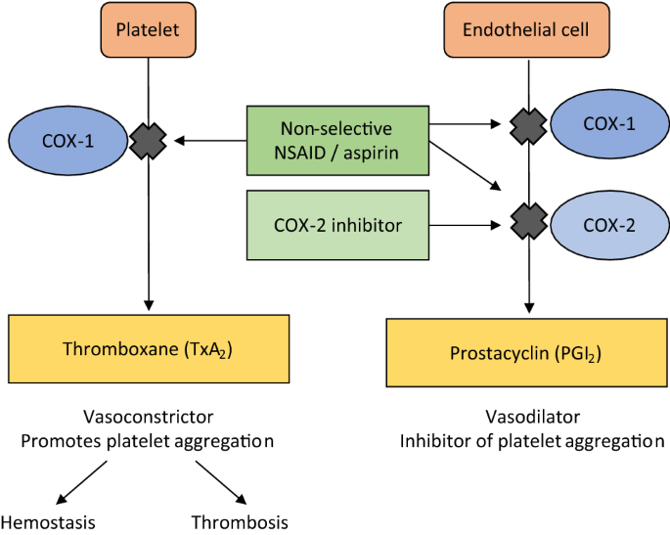
NSAIDs – Mechanism of action
 | Sham (animals) | mEHT (animals)
Vehicle | 8 | 8
Aspirin (100mg/kg) | 6 | 10
SC236 (6mg/kg) | 6 | 10
Abbreviations:
COX-2: Cyclooxygenase -2
NSAIDs: non-steroid anti-inflammatory drugs
Curtis E et al.2019. Drugs and Aging
Notes:
Non selective COX- inhibitorscan inactivate COX-1 and COX-2 irreversible due to acetylation but inhibits COX-1 more than COX-2. COX-1 is involved in platelet aggregation; therefore, aspirin is used in cardiovascular protection. Inhibition of COX-1 in a long term may cause aa significant gastrointestinal side effects, such as gastritis, stomach ulceration and bleeding.
selCOXIBs are designed for COX-2 inhibition, while sparing COX-1. They have demonstrated a better anti-inflammatory effect, but also a risk of increased cardiovascular adverse events to to increased platelet aggregation and thrombosis.

Slide 12
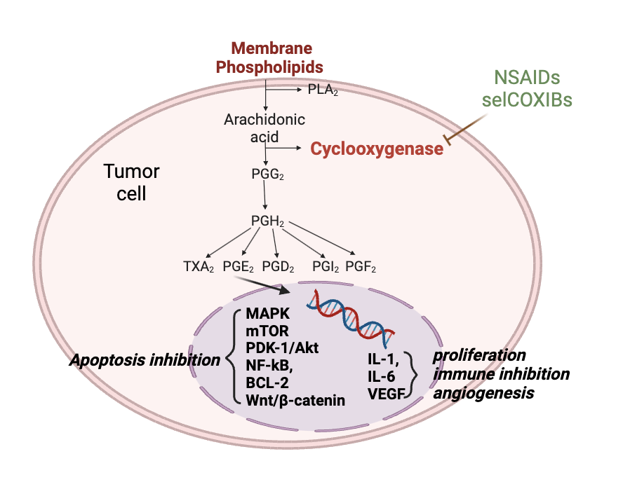
NSAIDs in cancer

Slide 13
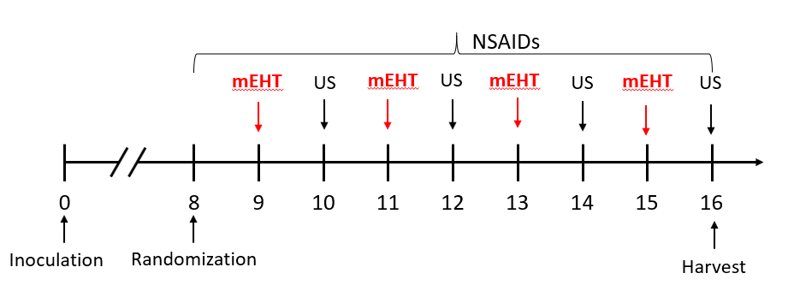
Results: mEHT +NSAIDs demonstrated significant tumor growth inhibition after 2nd mEHT treatment
In vivo treatment of TNBC
 | Sham (animals) | mEHT (animals)
Vehicle | 8 | 8
Aspirin (100mg/kg) | 6 | 10
SC236 (6mg/kg) | 6 | 10
Ultrasound after 2X treatment
Ultrasound after 3x treatment
Notes:
During the experiment, animals were treated four times with mEHT while ASA or SC236 was continuously given every day via intraperitoneal injections until the day of termination.
Follow-up ultrasound (US) and digital calliper measurements have been performed once every 48 hours, which revealed a tumor volume decrease in all treated groups after two mEHT treatments. However, inhibition was statistically significant only in the mEHT+ASA or mEHT +SC236 treated groups as compared to Sham.
Previous findings also have demonstrated that mEHT monotherapy is able to diminish tumor growth significantly only after 3 treatments.
We validated this - 3 mEHT treatments had significantly diminished tumor growth measured by both US and Digital calliper. As we see on the representative graphs , NSAIDs have enhanced it’s effectiveness but not significantly.

Slide 14
Results: SC236 and ASA enhanced mEHT effect after 4x mEHT treatment in 4T1 TNBC
Ultrasound after 4X treatment
Tumor weight
Notes:
The day after 4th treatment with mEHT, tumor volume was measured by ultrasound and digital caliper again.
Animals were terminated at the same day and tumors excised.
Tumor volume and tumor weights data revealed that mEHT treatment alone significantly inhibited tumor growth but the effect was enhanced by both NSAIDs, although it reached statistical significance while mEHT+SC236 was applied.

Slide 15
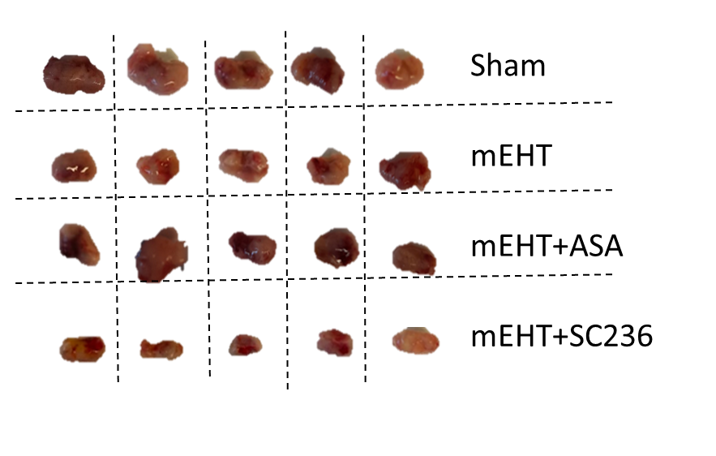
Results: SC236 and ASA enhanced mEHT effect in 4T1 TNBC after 4x mEHT treatment
Time curve of tumor volume with US
Notes:
representative pictures have been recorded
Curve of the tumor growth with US measurement.

Slide 16
Results: Tolerable dose of NSAIDs
 | Sham (animals) | mEHT (animals)
Vehicle | 8 | 8
Aspirin (100mg/kg) | 6 | 10
SC236 (6mg/kg) | 6 | 10
Body weight
Notes:
The body weight of the animals was measured daily. We chose the dose human equivalent does of Aspirin(100mg/kg) and SelCOXIB 6mg/kg based on the literature
Graph shows all experimental groups could tolerate the given dose of treatment, as they have not lost more then 10% of body weight at any time duirng experiment. .

Slide 17
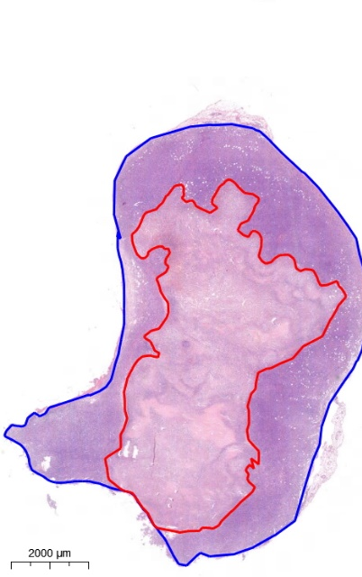
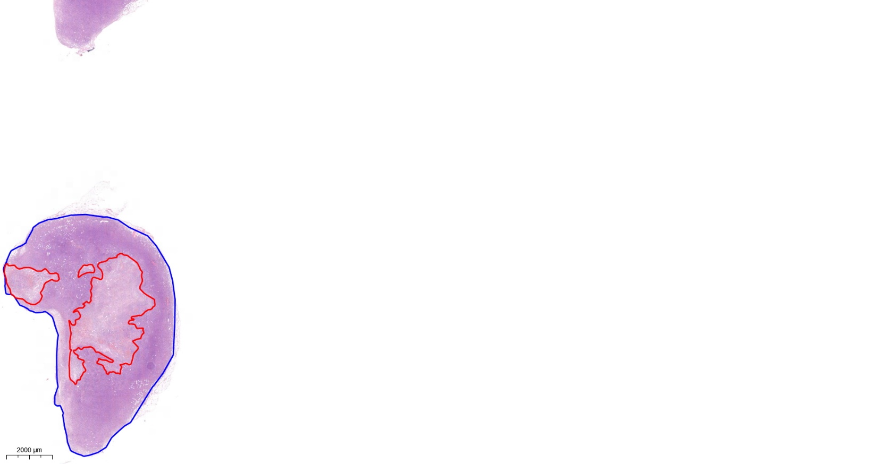
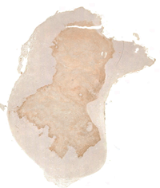

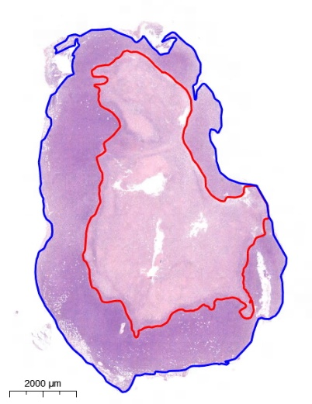
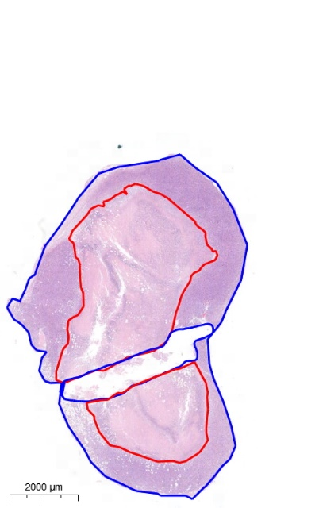
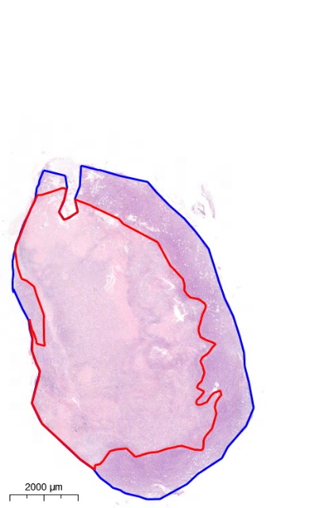
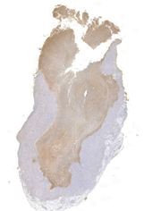
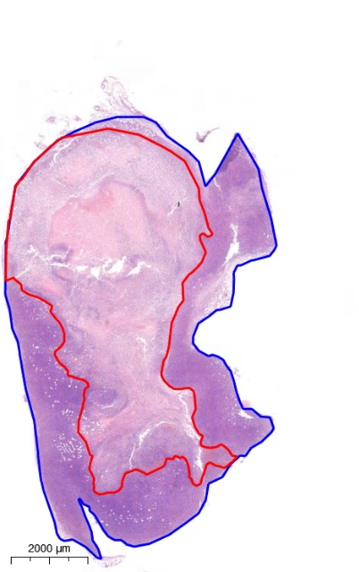
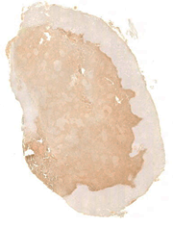
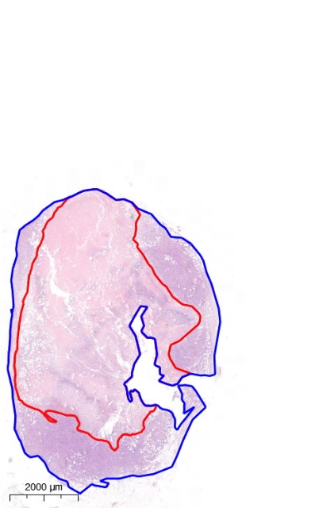
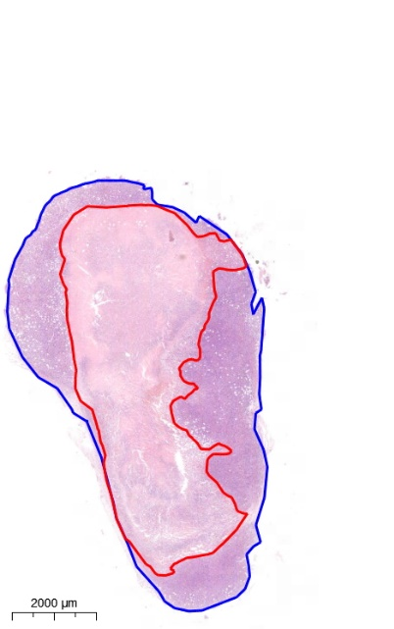

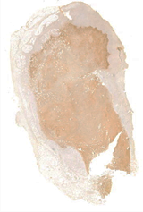
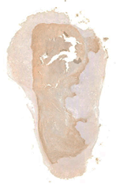

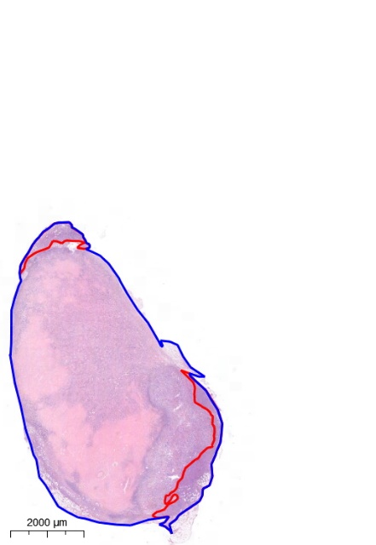
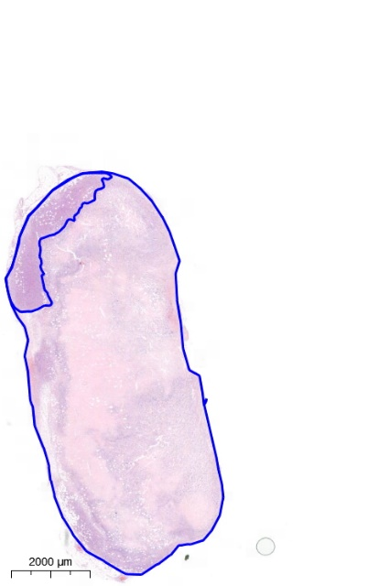
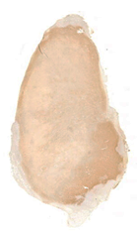
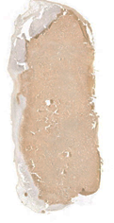
Results: mEHT induced tumor tissue destruction was significantly enhanced by SC236
Tumor Destruction Ratio
cC3
sham
mEHT+veh
mEHT+ASA
mEHT+SC236

Slide 18
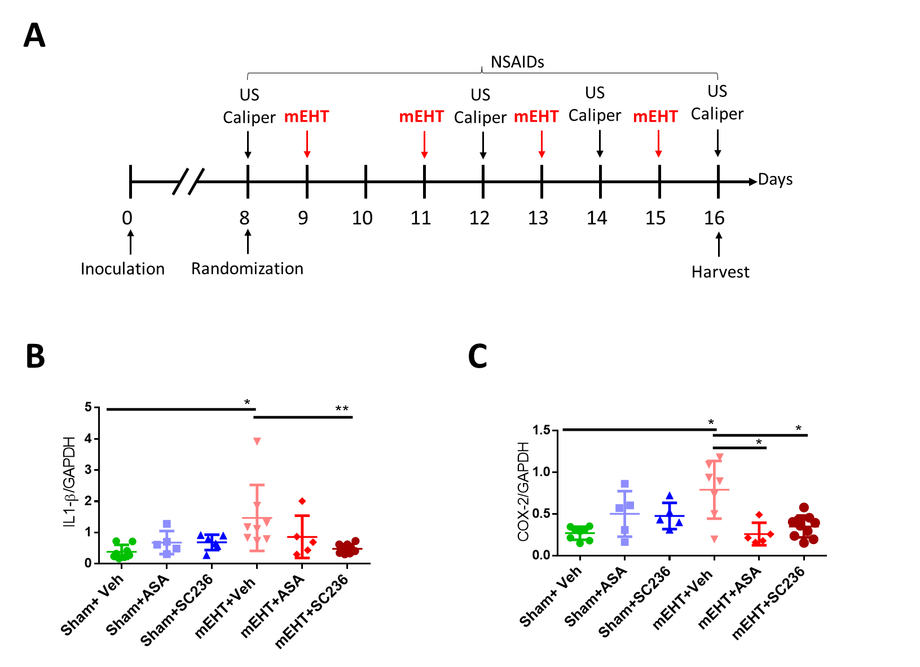
Results: NSAIDs attenuated COX-2 and IL-1β expression
IL-1β
COX-2

Slide 19
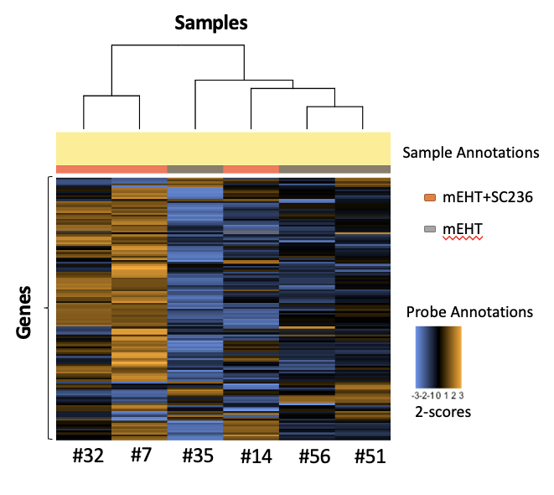
Results: SC236 regulated extracellular matrix and cell membrane proteins, inhibiting cell proliferation
DAVID (The Database for Annotation, Visualization, and Integrated Discovery)

Slide 20
Results: SC236 regulated extracellular matrix and cell membrane proteins, inhibiting cell proliferation
Group | RNA count | mEHT |  |  |  | mEHT+SC236
 | Genes | #35 | #51 | #56 | Avg. | #7 | #14 | #32 | Avg.
Secreted proteins | Adamts15 | 28 | 98 | 74 | 65 | 294 | 286 | 113 | 231
 | Cxcl11 | 77 | 89 | 148 | 105 | 370 | 213 | 396 | 326
 | Efemp1 | 51 | 118 | 150 | 106 | 940 | 562 | 325 | 609
 | Fgfbp1 | 355 | 224 | 155 | 245 | 56 | 174 | 68 | 99
 | Npnt | 1870 | 1714 | 817 | 1467 | 499 | 610 | 762 | 323
 | Stc1 | 544 | 464 | 232 | 413 | 138 | 102 | 190 | 143
Membrane proteins | Ackr1 | 24 | 46 | 22 | 31 | 143 | 136 | 42 | 107
 | Tenm2 | 3 | 19 | 19 | 14 | 47 | 87 | 35 | 56
 | Clec10a | 48 | 98 | 80 | 75 | 1239 | 1173 | 418 | 943
 | Ednrb | 48 | 62 | 51 | 54 | 614 | 352 | 231 | 399
 | Nrxn3 | 4 | 10 | 11 | 9 | 27 | 40 | 22 | 29
 | Ephb6 | 75 | 51 | 52 | 59 | 22 | 44 | 24 | 30
 | Epcam | 3263 | 5624 | 4580 | 4489 | 1832 | 3646 | 3090 | 2856
Listed regulated genes are primarily involved in the tumor microenvironment (TME) and are considered prognostic biomarkers in various cancers (red-upregulated, green-downregulated).

Slide 21
Results: SC236 regulated extracellular matrix and cell membrane proteins, inhibiting cell proliferation
Group | Genes | mEHT | mEHT+SC236
 | Genes | RNA count (Avg) | RNA count (Avg)
Secreted proteins | Adamts15 | 65 | 231
 | Cxcl11 | 105 | 326
 | Efemp1 | 106 | 609
 | Fgfbp1 | 245 | 99
 | Npnt | 1467 | 323
 | Stc1 | 413 | 143
Membrane proteins | Ackr1 | 31 | 107
 | Tenm2 | 14 | 56
 | Clec10a | 75 | 943
 | Ednrb | 54 | 399
 | Nrxn3 | 9 | 29
 | Ephb6 | 59 | 30
 | Epcam | 4489 | 2856
Listed regulated genes modulate the extracellular matrix and cell membrane function in the TME leading to the inhibition of cancer cell proliferation
They considered prognostic biomarkers in various cancers
red-upregulated
green-downregulated

Slide 22
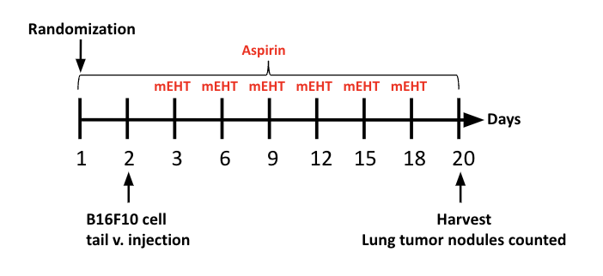
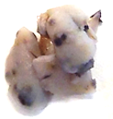
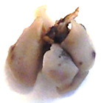
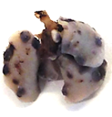
Results: mEHT +ASA diminished lung nodules of B16F10 melanoma cell line
Sham mEHT mEHT+ASA
No.of melanoma nodules
1mm

Slide 23
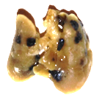
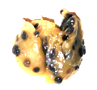
Results: ASA alone did not diminish the lung nodules of B16F10 melanoma
Sham ASA
1mm

Slide 24
Conclusion
mEHT treatment stimulated the local expression of proinflammatory cytokines IL-1β, IL-6, and COX-2 in 4T1 TNBC.
Our animal study investigating the mEHT+Aspirin and mEHT+selCOXIB combination therapy demonstrated a synergistic inhibition of tumor growth in 4T1 TNBC, although SelCOXIBs were more effective.
NSAIDs attenuated the mEHT-induced IL-1β and COX-2 mRNA expression.
Selective COX-2 inhibitors may modulate the extracellular matrix and cell membrane function in the TME leading to the inhibition of cancer cell proliferation.
mEHT + Aspirin demonstrated synergistic lung nodule inhibition in the B16F10 melanoma mouse model.

Slide 25
Summary
Created in Biorender.com
Abbreviations:
IL-1 β: Interleukin - 1 betta
IL-6: Interleukin -6
COX-2: Cyclooxygenase -2
NSAIDs: non-steroid anti-inflammatory drugs
mEHT: modulated electro-hyperthermia
SC236: Selectiv COX-2 inhibitor
Aspirin: non-selective anti-inflammatory drug

Slide 26
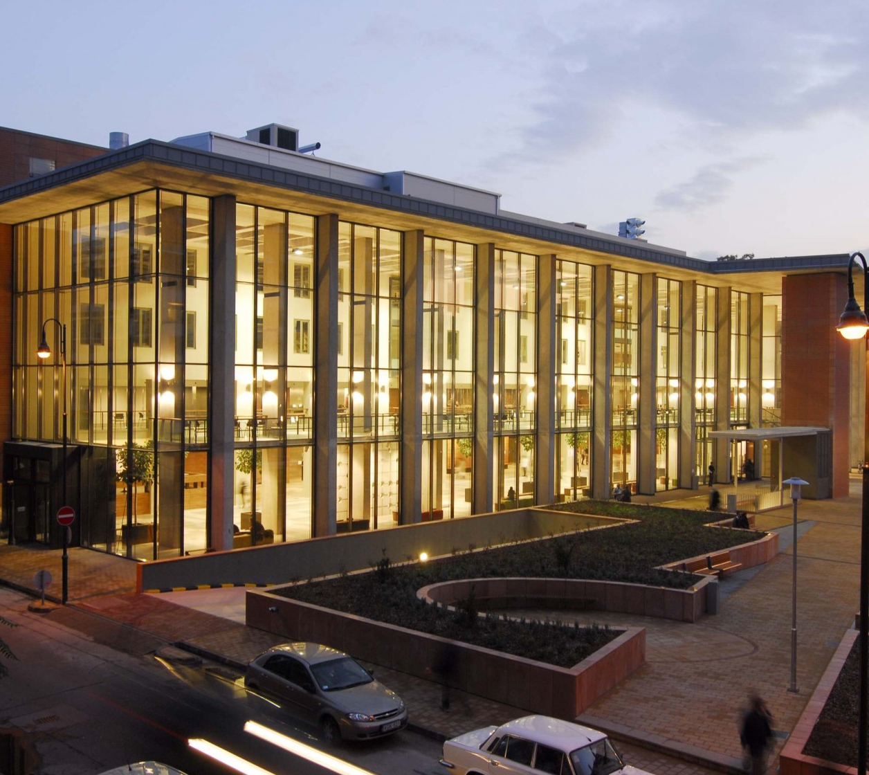
Acknowledgment
Professor Peter Hamar – PhD supervisor
Professor Zoltan Benyo
Reviewers and committee members
My colleagues - Jeremiah Mbuotidem Thomas, Csaba Andras Schvarcz, Pedro Henrique Leroy Viana, Kenan Aloss, Syeda Mahak Zahra Bokhari, Zoltan Koos, Daniel Bocsi, Tamas Vancsik, Lea Danics, Eniko Major, Andrea Balogh.
To my family, grandparents and friends.

Slide 27
Thank you for your attention!
Nino Giunashvili

Slide 28
summary of combination treatments of COX inhibitors and possible synergistic mechanisms of action
Combination | Cancer type | Effect(s) | Mechanism/Signaling pathway | References
Celecoxib and cyclophosphamide | Breast cancer | Anti-angiogenic | Decrease VEGF | (78)
Celecoxib and 5-FU | Squamous cell carcinoma | Inhibit proliferation | Inhibit AKT pathway | (79)
Celecoxib and epirubicin | Novikoff hepatoma | Reduce proliferating | Suppress CD44, CD133 and MDR-1 expression | (80)
Celecoxib and doxorubicin | Human skin cancer | Enhance apoptosis | Inhibit AKT pathway | (81)
Celecoxib and curcumin | HCC | Inhibit angiogenesis | Inhibit Akt, NF-kB, and PGE2 | (84)
Tolfenamic acid and cisplatin | Breast cancer | Induce apoptosis | Increasing P-53 | (85)
Celecoxib and erlotinib | NSLC | Enhance apoptosis and radio-sensitivity | Inhibit EGFR and PIK/AKT pathway | (86)
Celecoxib and gefitinib | Prostate cancer | Enhance apoptosis/reduce tumor proliferation | Increased caspase 3 cleavage/ decreases in BCL-2 and ABCB1 expression | (88)
Celecoxib and vandetanib | Osteosarcoma | Promote apoptosis | Inducing ERK phosphorylation | (89)
Celecoxib and imatinib | Colon cancer | Inhibit proliferation | Increase Caspase-3 activity | (89)
Celecoxib and sunitinib | Renal cancer | Immunomodulation/ Alleviate tumor progress | Inhibit GM-CSF and STAT3 expression/Alleviating MDSCs | (90)
Celecoxib and sildenafil | Ovarian cancer | Induce apoptosis/Increased platinum sensitivity | Reduce chaperone proteins | (91)

Slide 29
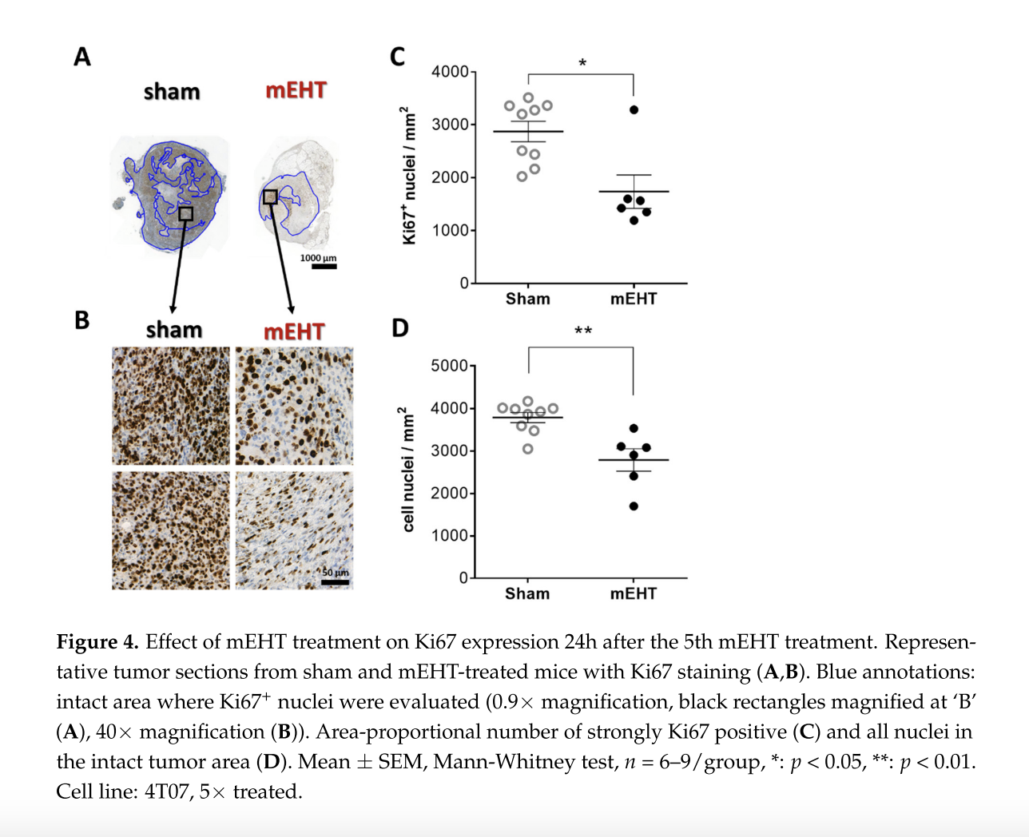
Proliferation – after mEHT in TNBC

Slide 30
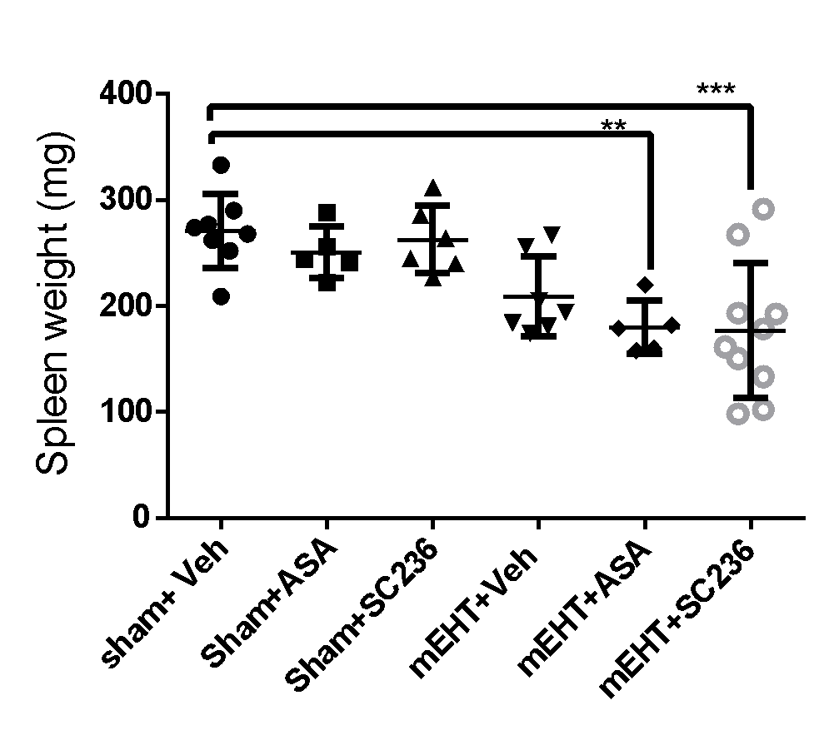
Spleen weight

Slide 31
