Slide 1
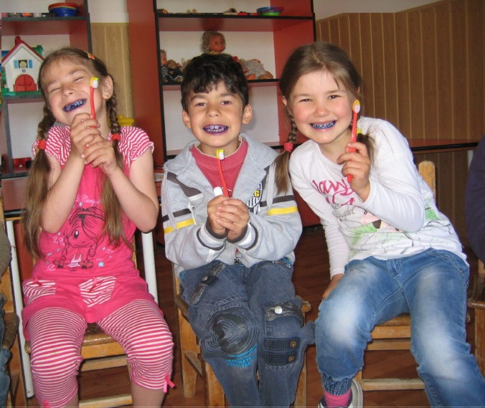
Dental hard tissue discolouration . Etiology and treatment
2014.04.28.
Dr. Déri Katalin

Slide 2
Tooth discolouration
primary / permanent teeth
enamel / dentin
several possible causes
during development / after eruption

Slide 3
Tooth discolouration
External cause
(extrinsic)
Enviromental factors
Can be removed
Internal cause
(intrinsic)
Developing before /meanwhile/after eruption

Slide 4
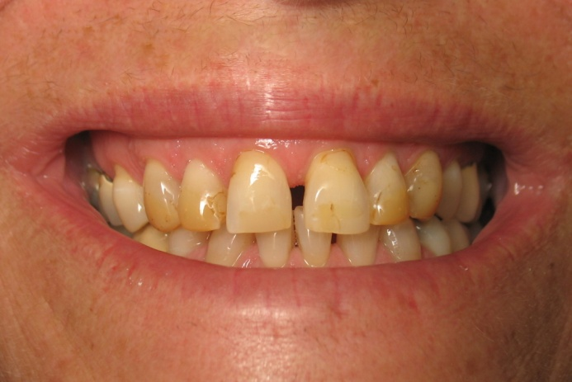
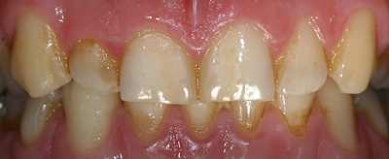
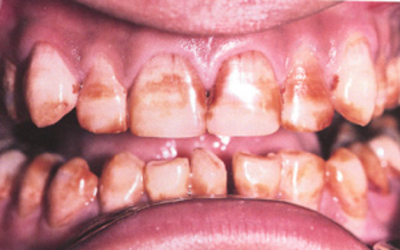
Extrinsic discolourations
Non metallic stains :
Tea, coffee, red wine, colourful fruits, tobacco, curry, saffron, soya sauce, fruit juice, candies, food containing clorophyll , mouthwashes containing chlorhexidine

Slide 5
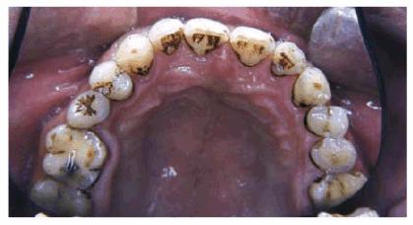
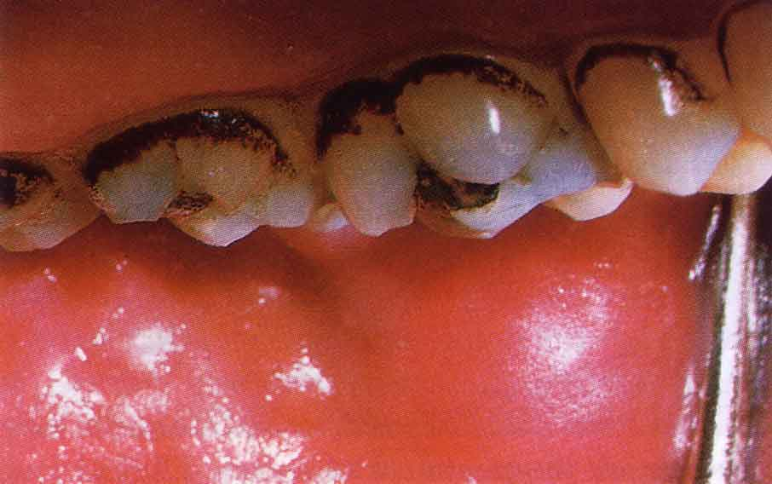
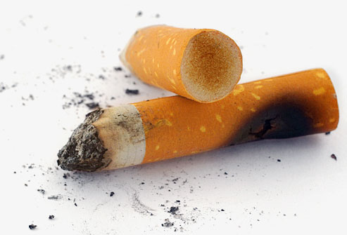
Extrinsic discolourations
Non metallic stains :
Tea, coffee, red wine, colourful fruits, tobacco, curry, saffron, soya sauce, fruit juice, candies, food containing clorophyll , mouthwashes containing chlorhexidine

Slide 6
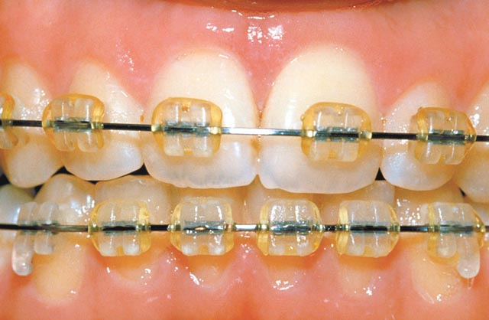
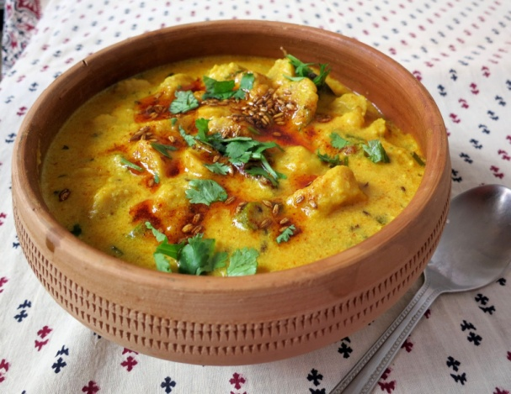
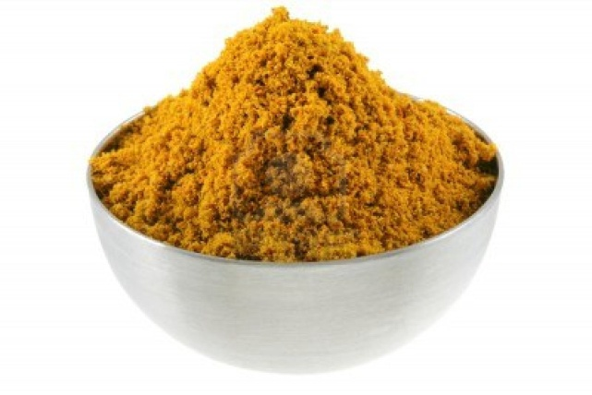
Extrinsic discolourations
Non metallic stains :
Tea, coffee, red wine, colourful fruits, tobacco, curry, saffron, soya sauce, fruit juice, candies, food containing clorophyll , mouthwashes containing chlorhexidine

Slide 7
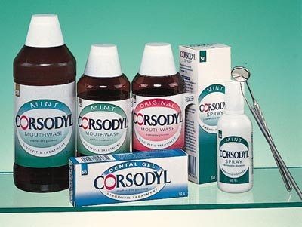
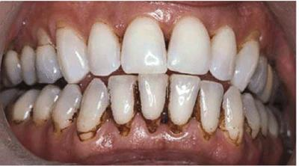
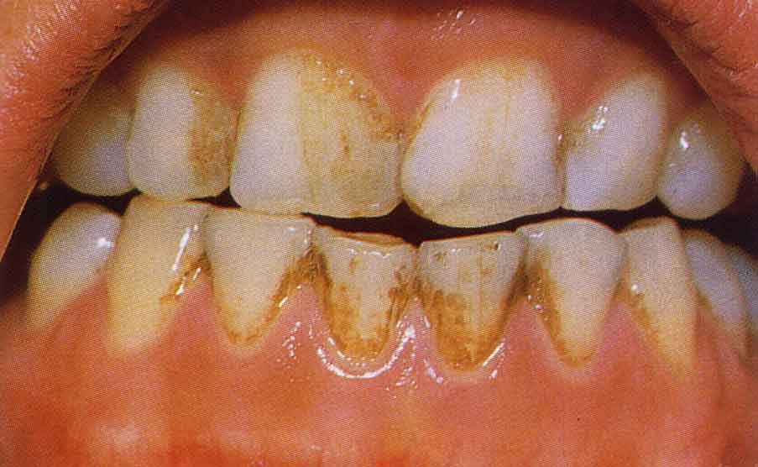
Extrinsic discolourations
Non metallic stains:
Tea, coffee, red wine, colourful fruits, tobacco, curry, saffron, soya sauce, fruit juice, candies, food containing clorophyll , mouthwashes containing chlorhexidine

Slide 8
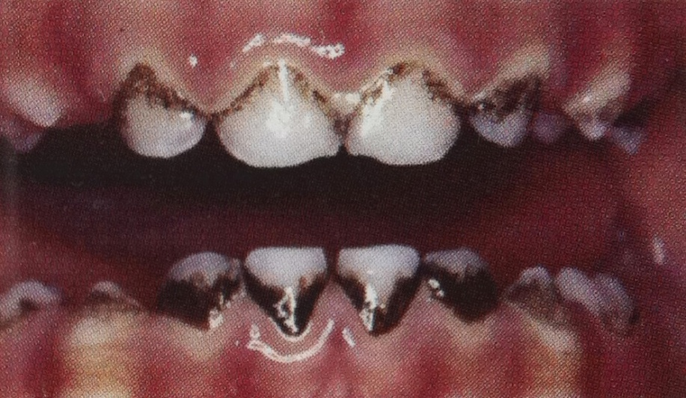
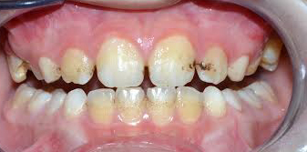
Extrinsic discolourations
Non metallic stains :
Gram-positive bacteria- Bacteroides Melaninogenicus
Black stain in a line in parallel with the gingiva
Hydrogen sulphide → Iron sulphide (black)

Slide 9
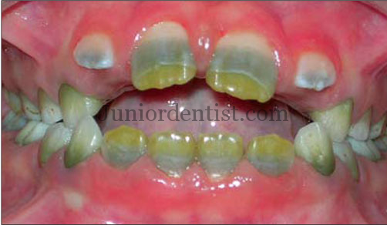
Extrinsic discolourations
Non metallic stains :
Chromogenic bacteria- Serratia Marcescens
Presence of the bacteria + Amoxicillin (long term) → extrinsic factor
Presence of the bacteria during tooth development → intrinsic factor

Slide 10
Extrinsic discolorations
Non metallic stains:
Greenish discoloration
poor oral hygiene→bacteria+inflamed bleeding gingiva (hemoglobin)
Orange discoloration
Labial surface of anterior teeth
Unknown origin

Slide 11
Extrinsic discolourations
Metallic stains - factors:
Rare in childhood
Environmental factors
water-, air pollution
Mouthwashes containing metals
Zinc, Stannous fluoride
Medication containing iron

Slide 12
Metallic stains
Iron, magnesium, silver– black pigmentation
Mercury –grey or green pigmentation
Lead – grey pigmentation
Copper – brown or green pigmentation
Bromides – brown pigmentation
Nickel – green pigmentation
Cadmium – yellow pigmentation
Potassium – violet pigmentation

Slide 13
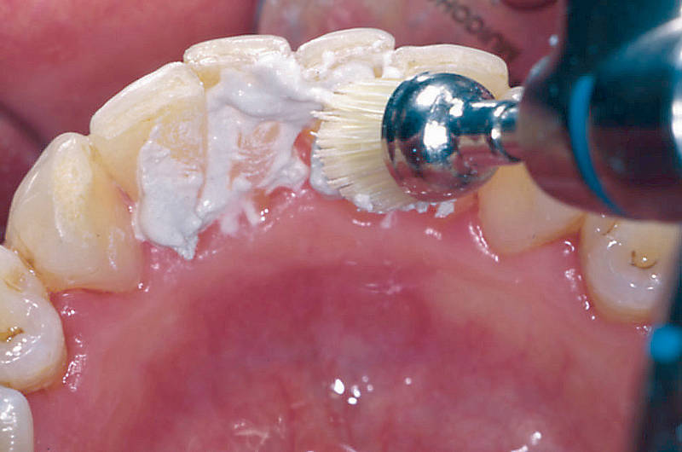
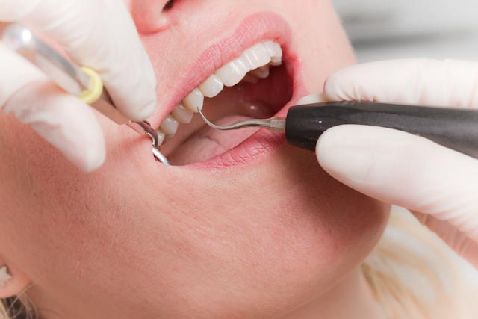
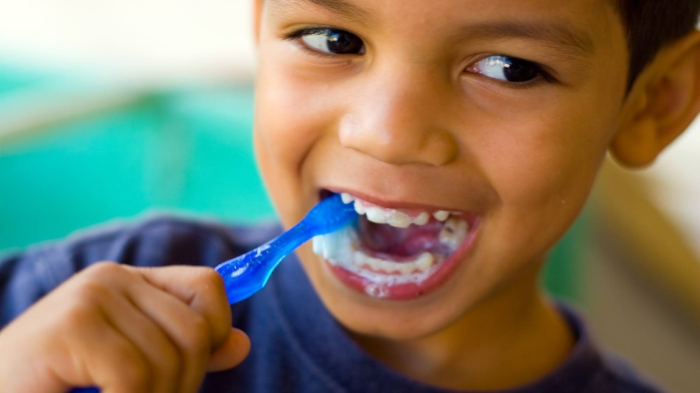
External (extrinsic) discolourations
Therapy:
Scaling
Polishing
Improving oral hygiene

Slide 14
Internal (intrinsic) discolourations
Discolourations developed before /during eruption
Turner-tooth
Tetracycline caused discolouration
Fluorosis
MIH
Neonatal hyperbilirubinaemia
Erythroblastosis foetalis
Porphyria
Amelogenesis Imperfecta
Dentinogenesis Imperfecta
Thalassaemia

Slide 15
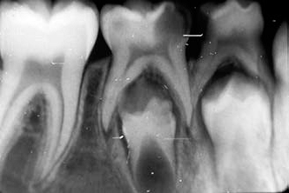
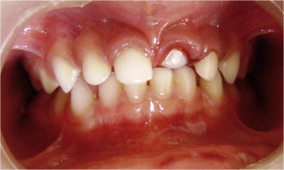
Turner-tooth
Formal and structural anomaly of the germ of permanent incisor /canine/premolar
Causes:
Periapical inflammation of the primary tooth close to the developing germ
Traumatic injuries of primary incisors (intrusion)

Slide 16
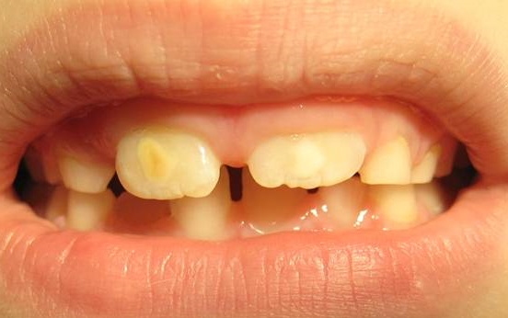
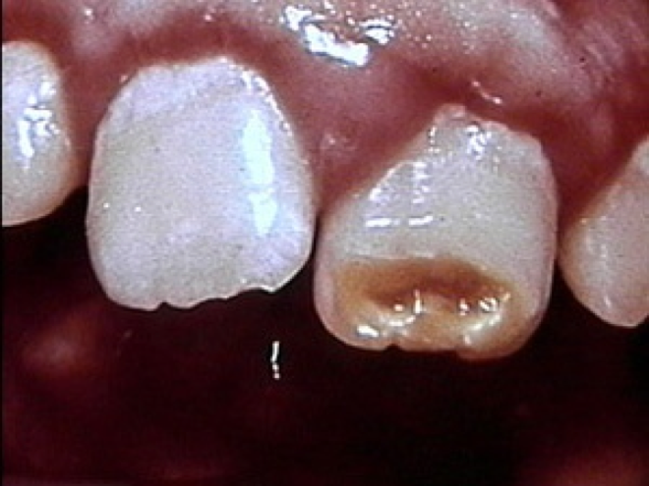
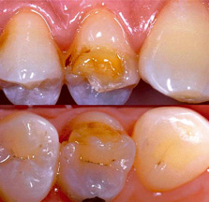
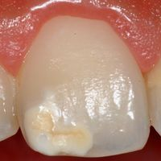
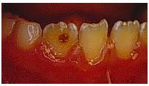
Turner-tooth

Slide 17
Tetracycline caused discolouration
Tetracycline medication in the second half of the pregnancy→ striped discolouration of primary and permanent teeth
Tetracyclin medication under the age of 8 → primary and permanent teeth discolouration
Higher dosage→ more severe discolouration
Binds to Ca-, Mg-, Fe-, Al-→ chelates
High dose→hypoplasia
Light → enhances the discolouration
No tetracycline during pregnancy and under the age of 8!!!

Slide 18
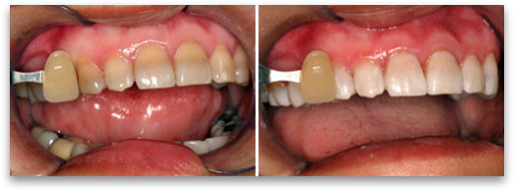
Tetracycline caused discolourations
Stages :
Light yellowish brownish greyish discolouration → can be bleached easily
More intensive discolouration→ can be bleached
Dark yellow/grey/bluish striped discolouration→ hardly can be bleached

Slide 19
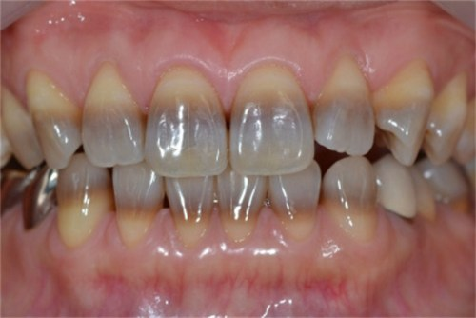
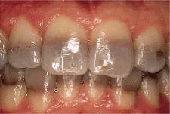
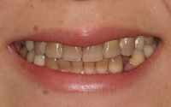
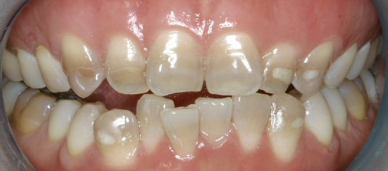
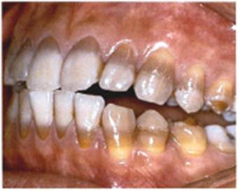
Tetracyclin caused discolouration

Slide 20
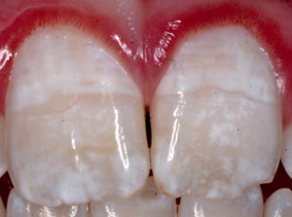
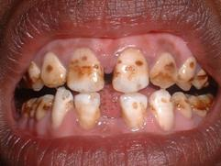
Fluorosis
Functional anomaly of ameloblasts, developing during tooth development because of too much fluoride intake
Anomaly of:
Enamel crystallization
Enamel development
Enamel maturation
Severity depends on:
Amount of absorbed fluoride
Time of exposition
Stage of tooth development
Individual sensitivity

Slide 21
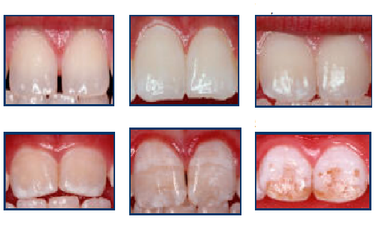
Fluorosis
Stages depending on the fluoride content of the water
Mild: 2 ppm
Medium: 3-5 ppm
Severe: 5-6 ppm
1
2
3
Normal
At issue
Very mild
Mild
Medium
Severe
4
5
6

Slide 22
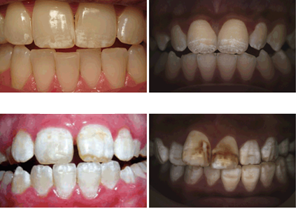
Fluorosis
Causes:
Toothpastes → fluoride content and amount should based on the age
Some food: mushroom, seafood
Mineral water , black tea
Fluoride medication
Amoxicillin → increases the risk of fluorosis 2,5 x
1
2
Very mild
Mild
Medium
Severe
3
4

Slide 23
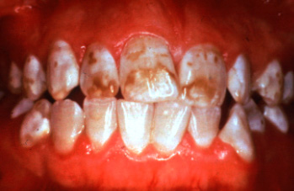
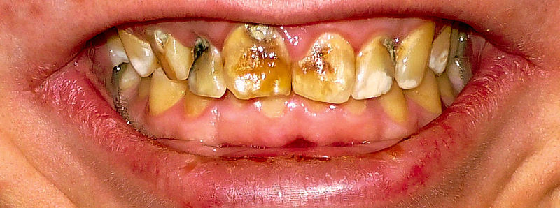
Fluorosis
Therapy:
Microabrasion
Remineralisation
Regular check -ups
Conservative or prosthodontic treatment

Slide 24
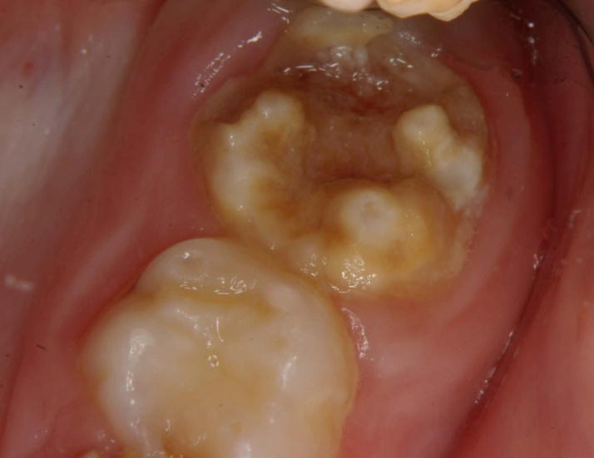
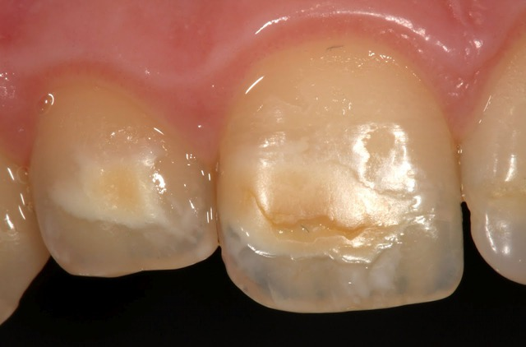
Molar and incisor hypoplasia (MIH)
Anomaly of enamel matrix development
Symmetric anomaly of teeth developing at the same time ( first molar-first incisor)
Molars:
yellowish colour,
irregular shape,
underdeveloped cusps,
no visible enamel right after eruption
Incisors :
brownish –yellowish inciso-labial surface
lack of enamel

Slide 25
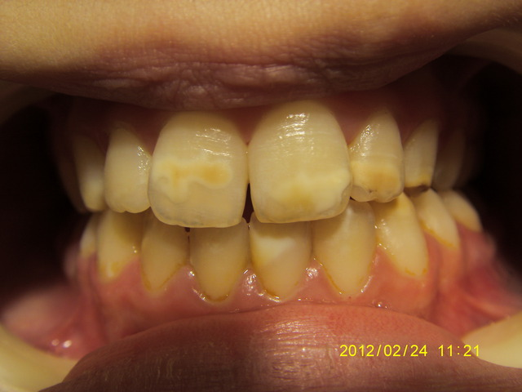
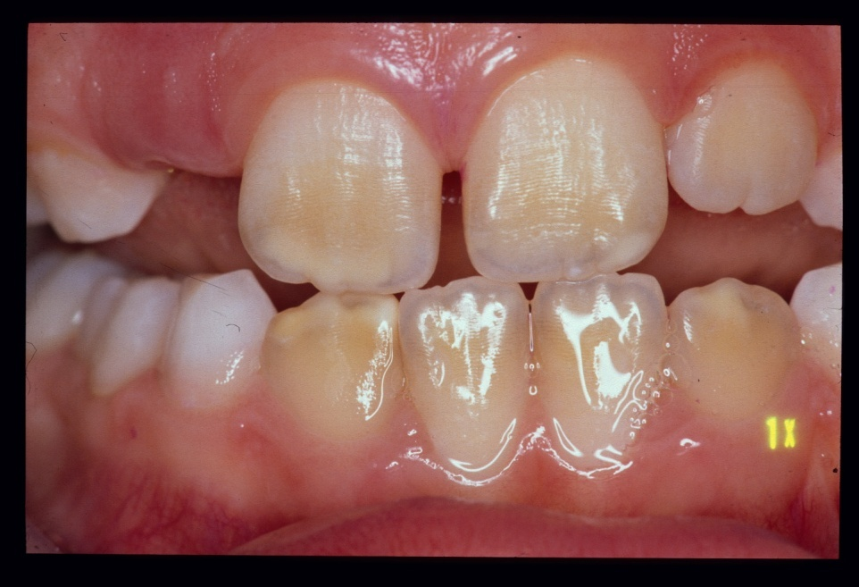
Molar and incisor hypoplasia (MIH)
Definitive cause: unknown
Possible causes:
malnutrition
Celiac disease
Neonatal hypoxia,
Acute absorption disorders, urinary infections, asthma bronchiale, otitis media, scarlate fever ,parotitis, chemotherapy, antibiotics

Slide 26
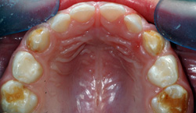
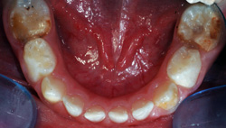
Molar and incisor hypoplasia (MIH)
Therapy:
Temporary – glass ionomer or compomer build-up
Definitive – prosthodontic therapy

Slide 27
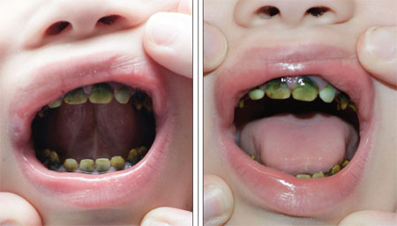
Neonatal hyperbilirubinaemia
Bilirubin→ biliverdin → subsides in the enamel /dentin of developing primary teeth
Greenish-greyish teeth
Can be lighter in time

Slide 28
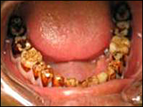
Erythroblastosis foetalis
Rh factor incompatibility in new-borns → haemolysis → haemosiderin→dentin→brownish/bluish/greenish discolouration

Slide 29
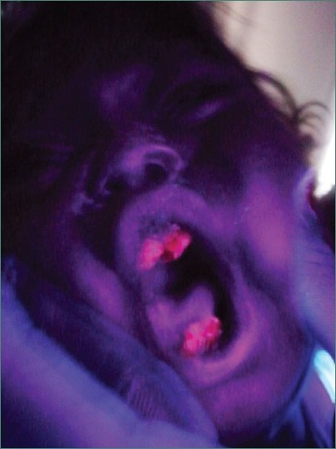
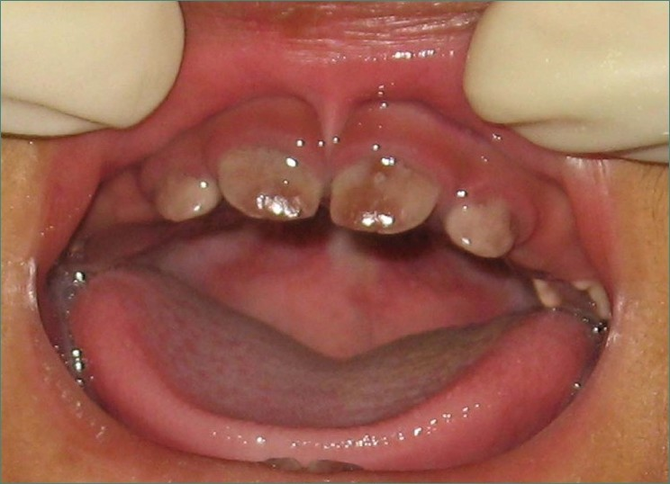
Porphyria
Hereditary disorder of haemoglobin metabolism
Primary and permanent teeth
Redish –brownish tooth discolouration that turns violet for ultraviolet light

Slide 30
Amelogenesis imperfecta
Hereditary disease
Disorder of enamel formation
Normal dentin structure
3 types:
Hypoplastic type
Hypocalcification type
Hypomatured type

Slide 31
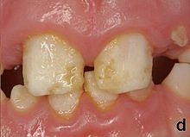
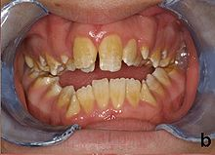
Amelogenesis imperfecta
Hypoplastic type
Disorder of organic matrix formation of the enamel
Enamel is thin , discoloured, fast abrasion ,pits on the surface
Small amount of enamel→ no contact points

Slide 32
Amelogenesis imperfecta
Hypocalcification type
Thickness of the enamel: normal or thinner
Fragile, soft
Discolouration: opaque-yellow-brown
Disorder of crystallization of the organic matrix of the enamel

Slide 33
Amelogenesis imperfecta
Hypomatured type
Disorder of maturation of the crystallized enamel matrix
Fragile , removable enamel
Tooth colour: white, yellow, brown

Slide 34
Amelogenesis imperfecta
Enamel disorder→ higher risk for caries
Higher sensitivity for heat and cold
Therapy:
improving oral hygiene
preventive treatments
conservative/prosthodontic treatment

Slide 35
Dentinogenesis imperfecta
Hereditary developmental disturbance of dentin
Poor quality dentin→discoloured teeth, enamel breaks easily
Dentin not covered with enamel→abrasion, caries
In primary dentition - more frequent
Teeth are redish-brownish-bluish
3 types

Slide 36
Dentinogenesis imperfecta
I. type – accompanied by osteogenesis imperfecta, the pulp chamber is smaller than normal
II. type – no bone defect, only the dentin is involved, pulp chamber is smaller than normal
III. (Brandywine) type – most severe , pulp chamber is big, can be reached easily, short roots, round apex

Slide 37
Dentinogenesis imperfecta
Father’s teeth
B Neeti. Dentinogenesis Imperfecta – “A Hereditary Developmental Disturbance of Dentin”. The Internet Journal of Pediatrics and Neonatology. 2010 Volume 13 Number 1.

Slide 38
Dentinogenesis imperfecta
Son’s teeth
B Neeti. Dentinogenesis Imperfecta – “A Hereditary Developmental Disturbance of Dentin”. The Internet Journal of Pediatrics and Neonatology. 2010 Volume 13 Number 1.

Slide 39
Dentinogenesis imperfecta
Therapy:
Main problem: abrasion, caries→ functional and esthetic issues→ conservative or prosthodontic treatment

Slide 40
Thalassaemia
Hereditary (autosomal ,recessive) haemolytic anaemia
Bluish –brownish-greenish discolouration

Slide 41
Internal (intrinsic) discolourations
Developed after eruption
Necrosis (gangraena)
Traumatic injuries caused discolouration
Pulp resorption
Internal granuloma
Chemicals caused discolouration

Slide 42
Necrosis (gangraena)
Necrotized pulp tissue degeneration→ discolouration
Therapy:
RCT, bleaching / extraction

Slide 43
Discolouration caused by trauma
Trauma→bleeding in the pulp chamber→pink discolouration→ can heal spontaneously
More severe cases→ necrosis→ greyish/brownish

Slide 44
Discolouration caused by trauma
Therapy:
RCT, bleaching

Slide 45
Internal resorption of the pulp
Trauma→ secondary, tertiary dentinogenesis in the pulp chamber
Pulp chamber obstruction
Yellowish/ivory discolouration
Vitality kept
Therapy: primary teeth – no need for therapy, permanent teeth – bleaching (age!)

Slide 46
Internal granuloma
Trauma→dislocated tooth→internal granuloma
Chronic inflammation of the pulp tissues→ widening in a circle within the pulp chamber
Violet-pink discolouration
Spontaneous crown fracture

Slide 47
Internal discolourations caused by chemicals
Dental materials
E.g.: amalgam, N2, Endomethason, AH, iodoform-based sealer, Ledermix
Therapy:
Primary– no treatment
Permanent- bleaching (age!)

Slide 48
Thank you for your attention!!! ☺

