Slide 1
Case presentation Guidelines
The following presentation shows the Official Case Presentation protocol of the Department of Prosthodontics. Both the form and content are to follow. The slides and textboxes with the green background are to provide you with helpful technical information. Each stage of the Treatment needs to be documented and presented both written and with photos.
Photo Guidelines:
Photo after scaling and oral hygiene treatment! Saliva-free, dry surfaces!
Take multiple pictures about the same situation, as only sharp photos are acceptable!
Investigated/treated tooth should be in the middle of the photo. Crop and mirror the photos, according to the quadrant! Use of Photoshop programs (eg. Picasa) is recommended for cropping and smaller light-adjustments, but modification of the content is forbidden!
Use professional-grade equipment (full-frame digital single-lens reflex camera, macro lens, Ring/twin flash), available in the Practice Rooms. For settings, see the Photo Aid Slide (green background).
For subject photography, use single shade background (like white paper or wall, black reflection or green textile), that emphasizes the subject of the photo!

Slide 2
Prosthodontic Final Exam Case Presentation
Title (Type of Denture)
Eg.: Combined Prosthesis, Complete Denture, Fixed Partial Denture, etc..
Student:
Consultant:
Supervisor:
Starting and finishing Date of Treatment:

Slide 3
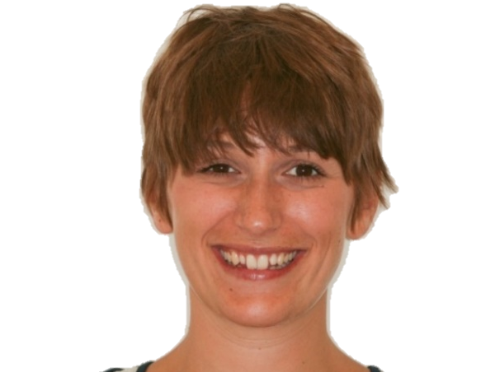
Introduction of the Patient
Age, Gender
Occupation
Reason for dental investigation
Eg. Pain, Aesthetic Complaints, Instability of Dentures etc.

Slide 4
Medical History
Factors which would affect the dental treatment
General diseases – Medication – relevant adverse effects!
  Eg. High blood pressure: Amlodipin (amlodipine, Calcium channel blocker) – AE: gingiva hyperplasia
  Eg. Osteoporosis: Bonviva (Ibandronate: Bisphosphonate) – AE: MRONJ osteonecrosis of the jaw
Allergy (eg. medicaments, metals)
Bad habits, Addiction: Smoking, Alcohol etc. (how much?)

Slide 5
Dental History
Worn prosthodontic appliances (when they were made)
Extractions (when?)
Other dental treatments, eg. orthodontics, dental surgery etc.

Slide 6
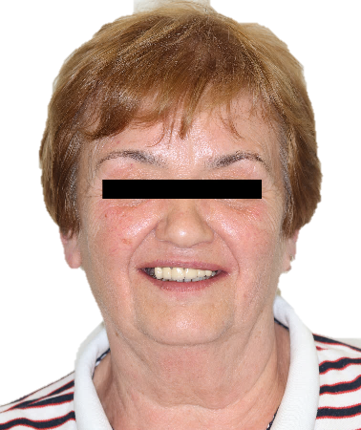
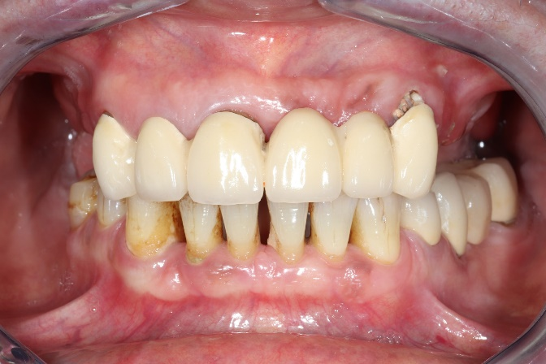
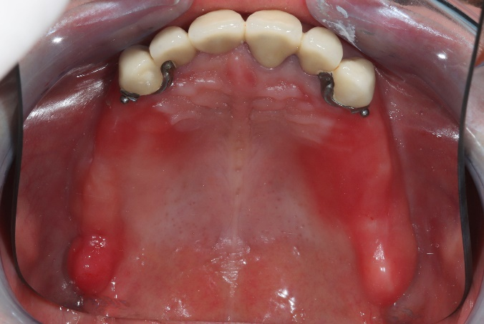
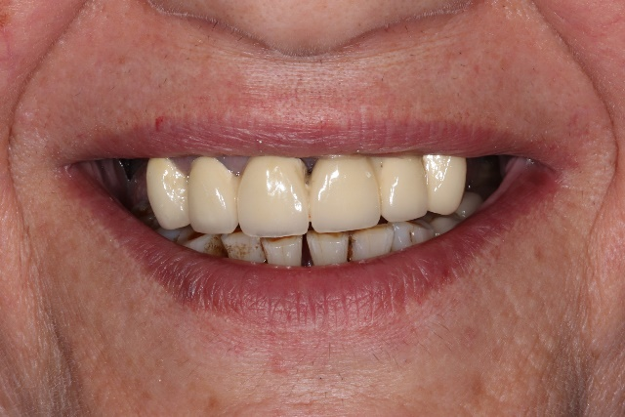
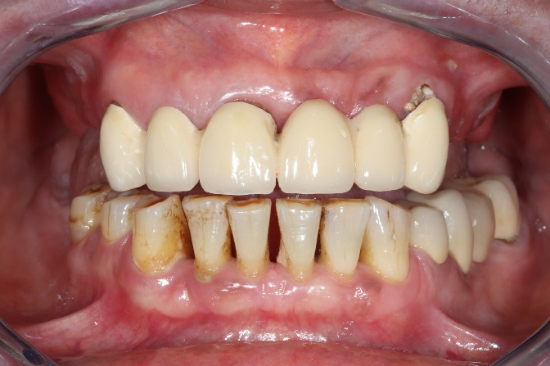
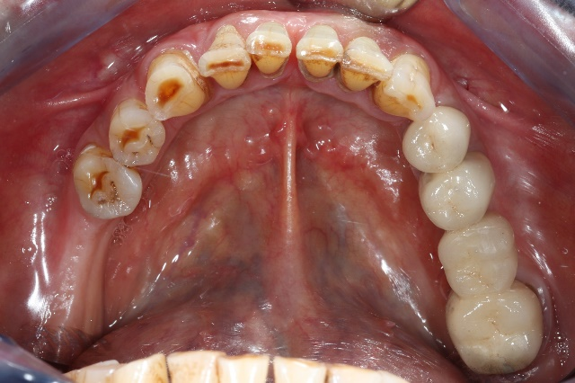
Dental Status
Portrait and Intraoral Photos
Portrait – with natural smile
Maximum ICP
Maxillary arch
Full smile
Mouth slightly open
Mandibular arch

Slide 7
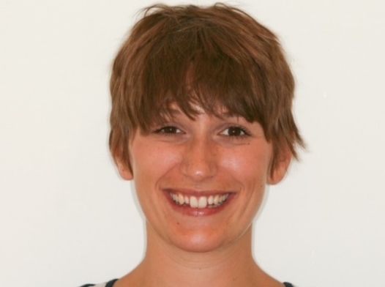
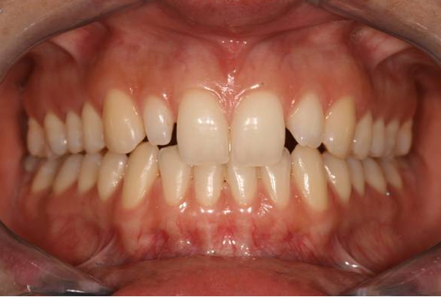
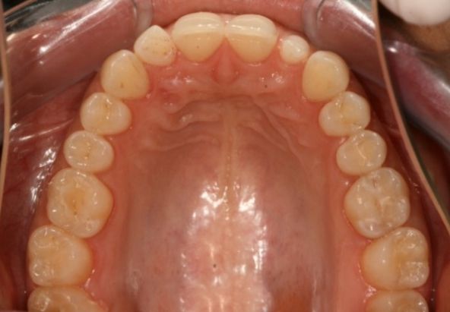
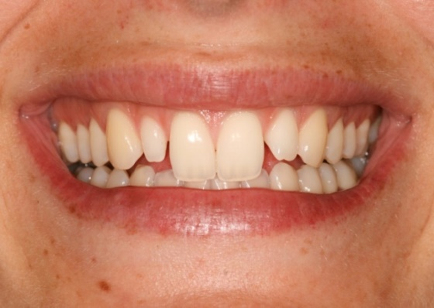
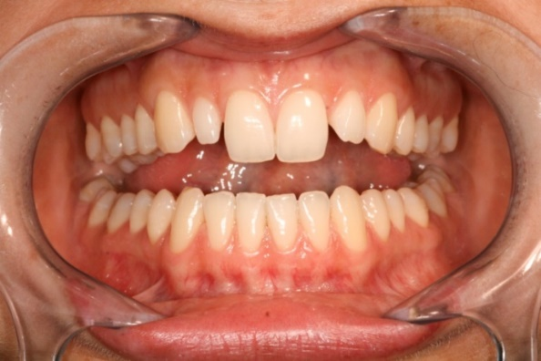
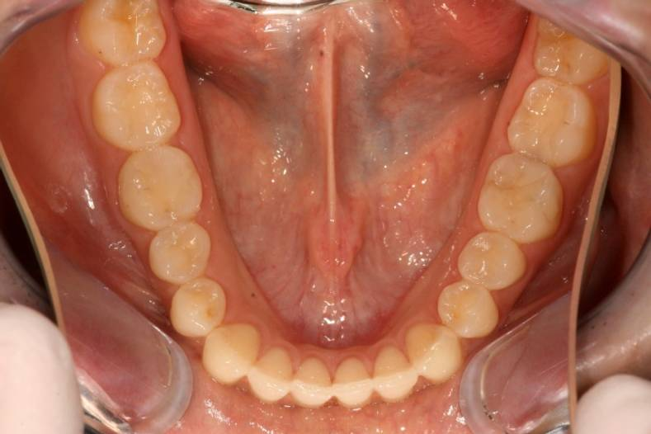
Photo-Aid: Camera settings
f 8
Portrait – with natural smile
Maximum ICP
Maxillary arch
- - - - - - - - - - - - - - - - - - - - - - - - - - - - - - - - - - - - - - - - -
- - - - - - - - - - - - - - - - - - - - - - - - - - - - - - - - - - - - - - - - -
- - - - - - - - - - - - - - - - - - - - - - - - - - - -
- - - - - - - - - - - - - - - - - - - - - - - - - - - - -
- - - - - - - - - - - - - - - - - - - - - - - - - - - - -
1.
3.
5.
Occlusal mirror
- - - - - - - - - - - - - - - - - - - - - - - - - - - - - - - - - - - - - - - - -
- - - - - - - - - - - - - - - - - - - - - - - - - - - - - - - - - - - - - - - - -
- - - - - - - - - - - - - - - - - - - - - - - - - - - - -
- - - - - - - - - - - - - - - - - - - - - - - - - - - - -
- - - - - - - - - - - - - - - - - - - - - - - - - - - - -
2.
4.
6.
Mosoly
Mouth slightly open
Mandibular arch
Cheek retractors (big size)
- Focus
Manual mode: f 22, ISO 200, 1/200; Flash: M 1/2

Slide 8
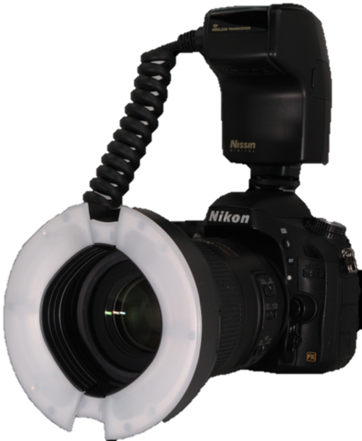
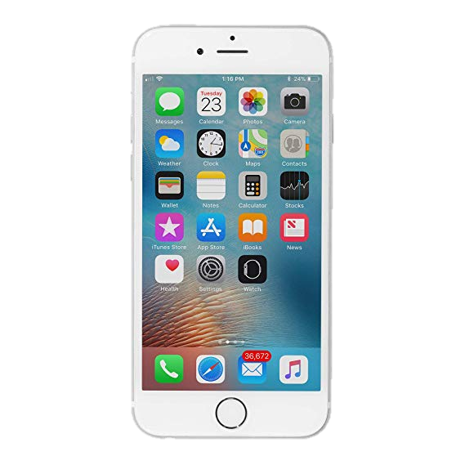
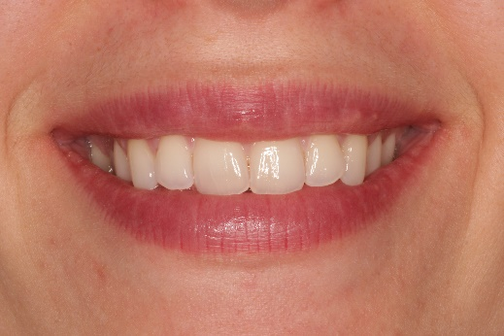
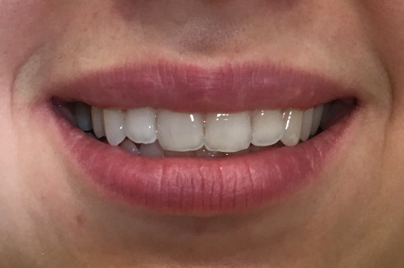
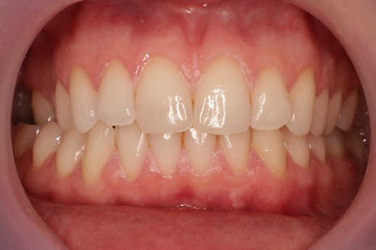
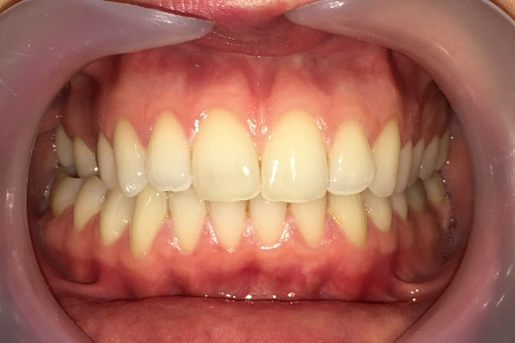
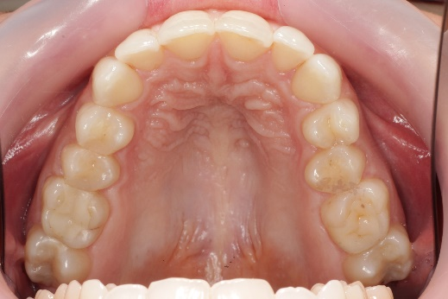
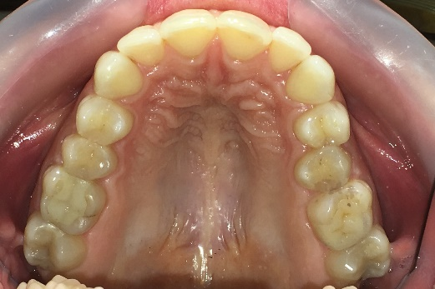
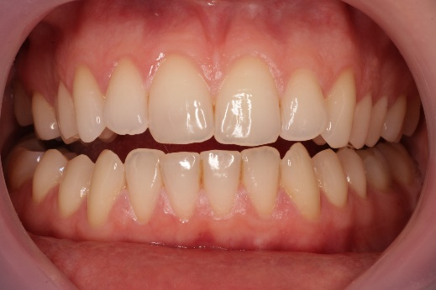
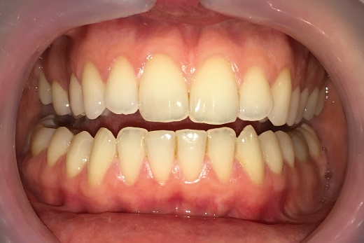
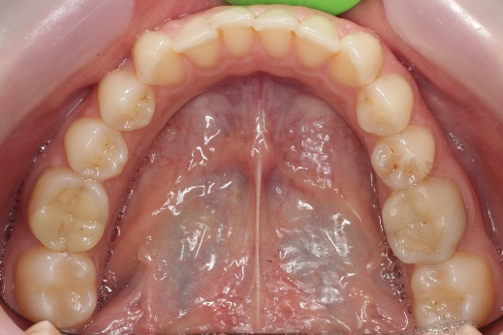
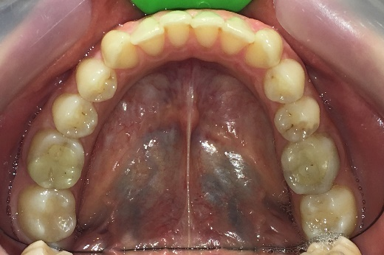
Camera – Difference in Quality
If you use cellphone for photography, the lighting is poorer and the quality will be lower.
The settings (picture composition, focus, patients position etc.) however remain the same.

Slide 9
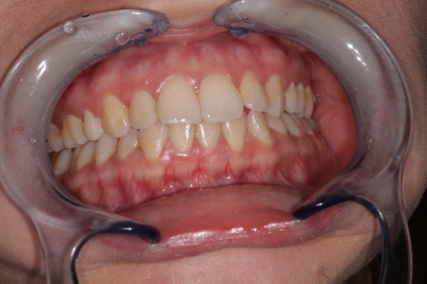
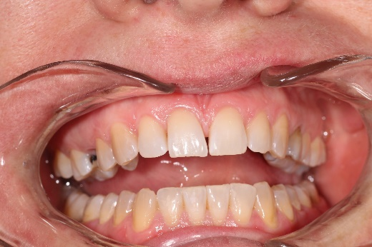
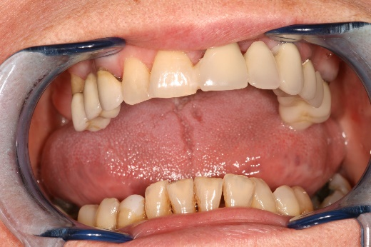
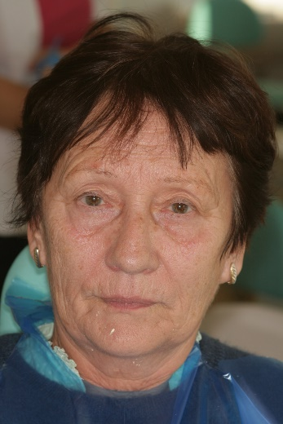
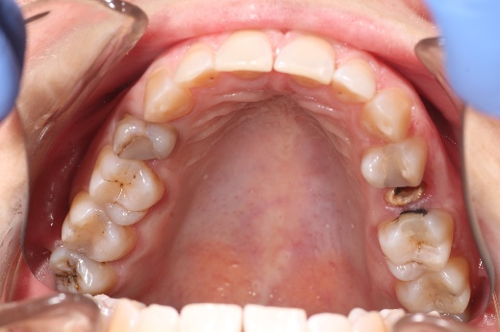
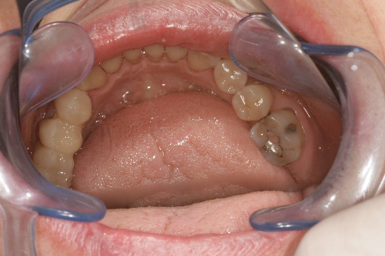
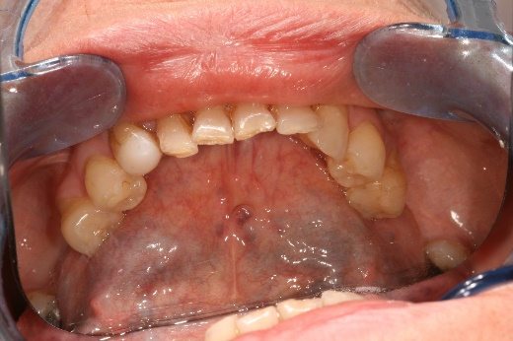
Common errors in Photography
The quality of photographs is significantly influenced by whether the subject of the image is properly positioned within the frame. Therefore, attention should be paid to the following:
1. Proper camera settings (brightness, focus)
2. Correct patient positioning (head posture, smile, degree of mouth opening)
3. Our own positioning and the appropriate use of auxiliary tools (the photograph should be taken from the front, not from the side or from below; the mirror should not be fogged, etc.)

Slide 10
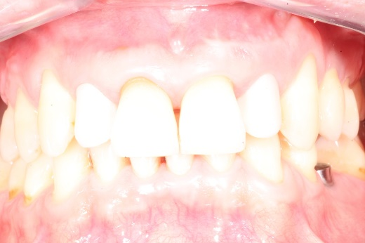
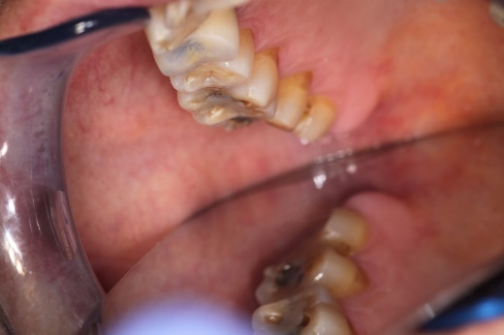
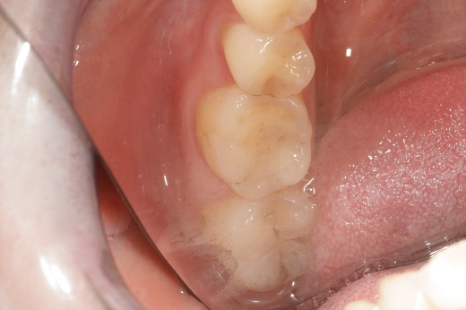
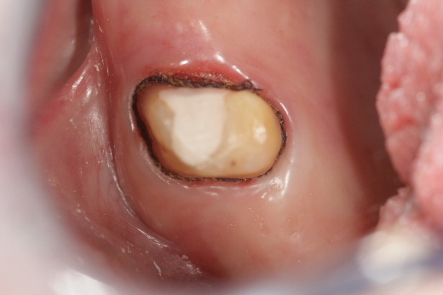
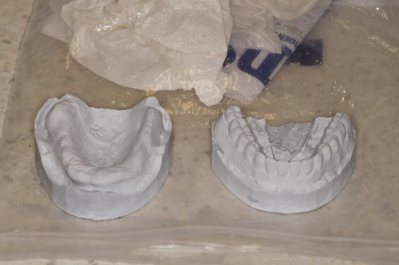
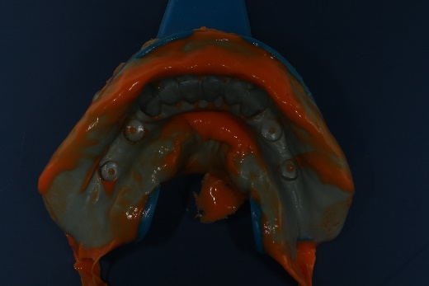
Common errors in Photography
Too bright / too dark picture (overexposed / underexposed)
Image blurry (lack of focus and/or improper depth of field)
Bad positioning: image taken from an improper angle (inferior/superior/canted), improper framing with mirror
Meaningless content (keep in mind what we want to show!)
No uniform backdrop, fogging of mirror

Slide 11
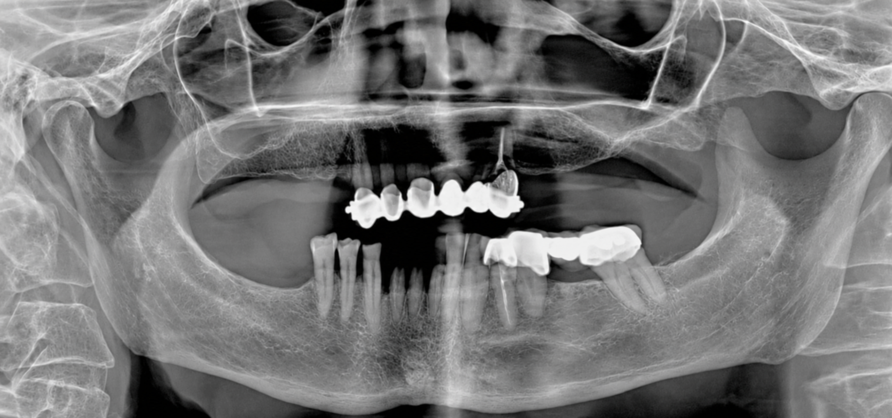
Dental Status
Panoramic Radiograph
NO
PATIENT’S DATA,
Just
DATE of
The X-ray
2025.06.17.
Please indicate, if the actual status differs from what is shown on the radiograph! Eg. Extractions – „X” mark on the tooth!

Slide 12
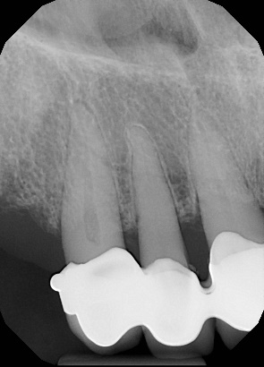
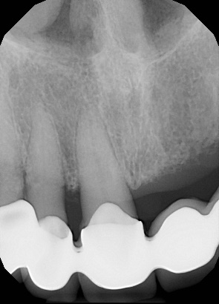
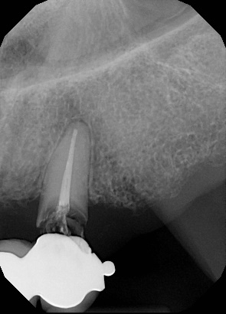
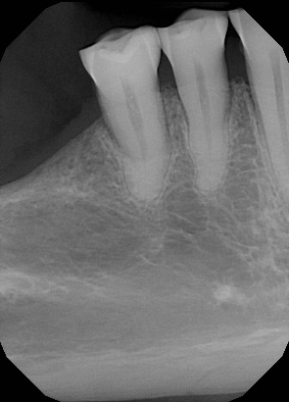
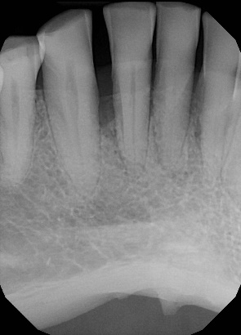
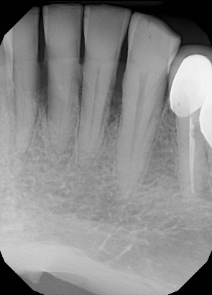
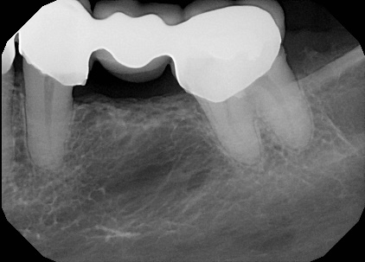
Dental Status
Intraoral radiographs and findings
Take a periapical x-ray of each abutment!
2025.06.17.
grey colour = missing tooth
X = hopeless tooth (to be extracted)
)( = closed extraction gap
C = crown,
B = bridge with () showing dimensions
T = telescope
I = implant
E = root canal treated tooth (endo)
L = periapical lesion
P = post and core
F = filling
D = decay
* = to be replaced
 |  |  |  |  | (B | B | B | B | B | E, X B)
8 | 7 | 6 | 5 | 4 | 3 | 2 | 1 | 1 | 2 | 3 | 4 | 5 | 6 | 7 | 8
8 | 7 | 6 | 5 | 4 | 3 | 2 | 1 | 1 | 2 | 3 | 4 | 5 | 6 | 7 | 8
 |  |  |  |  |  |  |  |  |  |  | E, C | (B | B | B)
FF classification | 2B
FF classification | 1B
Indicate the initial prosthodontic classification of partial edentulism according to Fábián and Fejérdy.
2025.06.17.

Slide 13
Inspection of Head and Neck Region
Intraoral Investigation I.
Stomato-oncological screening: eg. no findings, red/white lesion (where?), precancerous lesions or cancer etc.
TMJ examination: complaints, diagnosis
eg. Reciprocal clicking –
diagnosis: Anterior Disc Displacement
Static Occlusion - Bite form: eugnathic or dysgnathic
Dynamic Occlusion - Type of Guidance: canine/group guidance etc.
ANOMALIES | Dental
Transversal | Crossbite Asymmetry
Sagittal | Angle Class II. Angle Class III.
Vertical | Open bite Deep bite

Slide 14
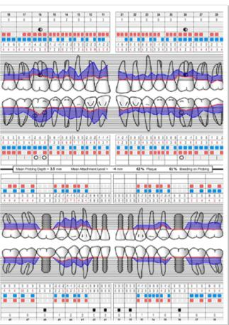
Inspection of Head and Neck Region
Intraoral Investigation II.
Oral hygiene: eg. Good, poor
Oral mucosal abnormalities: eg. Denture stomatitis
Periodontal health: pl. gingivitis (type), generalized/localized acut/chronic periodontitis etc.
→ in case of periodontal disease, periodontal charting or BPE is needed!
www.periodontalchart-online.com
BPE

Slide 15

Dental status
Upper Jaw
Photo of Upper Jaw (with and without RPD) and Study cast
Intraoral x-rays
Fábián and Fejérdy Classification of Partial Edentulism: 0 / 1A / 1B / 2A / 2B / 2A/1 / 3
Status (Zsigmondy cross, with indication of Findings)
 |  |  |  |  | (B | B | B | B | B | X,E B)
8 | 7 | 6 | 5 | 4 | 3 | 2 | 1 | 1 | 2 | 3 | 4 | 5 | 6 | 7 | 8
grey colour = missing tooth X = hopeless tooth (to be extracted) )( = closed extraction gap C = crown B = bridge with () showing dimensions T = telescope | I = implant E = root canal treated tooth (endo) L = periapical lesion P = post and core F = filling D = decay * = to be replaced

Slide 16
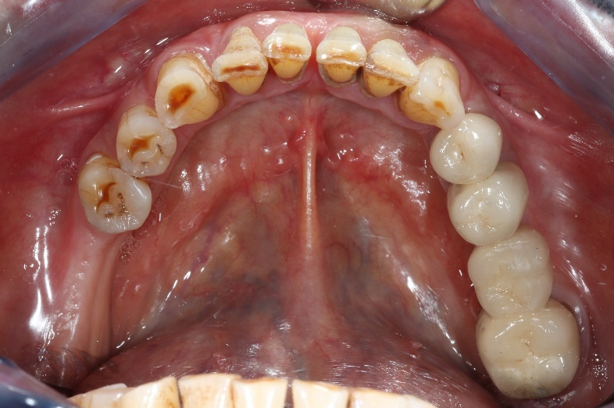


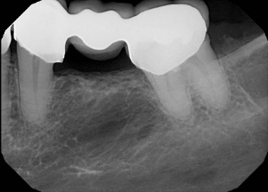
Dental status
Lower Jaw
Photo of Upper Jaw (with and without RPD) and Study cast
Intraoral x-rays
Fábián and Fejérdy Classification of Partial Edentulism: 0 / 1A / 1B / 2A / 2B / 2A/1 / 3
Status (Zsigmondy cross, with indication of Findings)
8 | 7 | 6 | 5 | 4 | 3 | 2 | 1 | 1 | 2 | 3 | 4 | 5 | 6 | 7 | 8
 |  |  |  |  |  |  |  |  |  |  | E | (B | B | B)
grey colour = missing tooth X = hopeless tooth (to be extracted) )( = closed extraction gap C = crown B = bridge with () showing dimensions T = telescope | I = implant E = root canal treated tooth (endo) L = periapical lesion P = post and core F = filling D = decay * = to be replaced

Slide 17
Preoperative Treatments
Periodontology
Oral surgery
Restorative and endodontic
Treatment plans (if necessary)
Prosthetic planning phase: study impressions and casts, diagnostic wax-up and diagnostic mock-up, smile design, diagnostic tooth setup

Slide 18
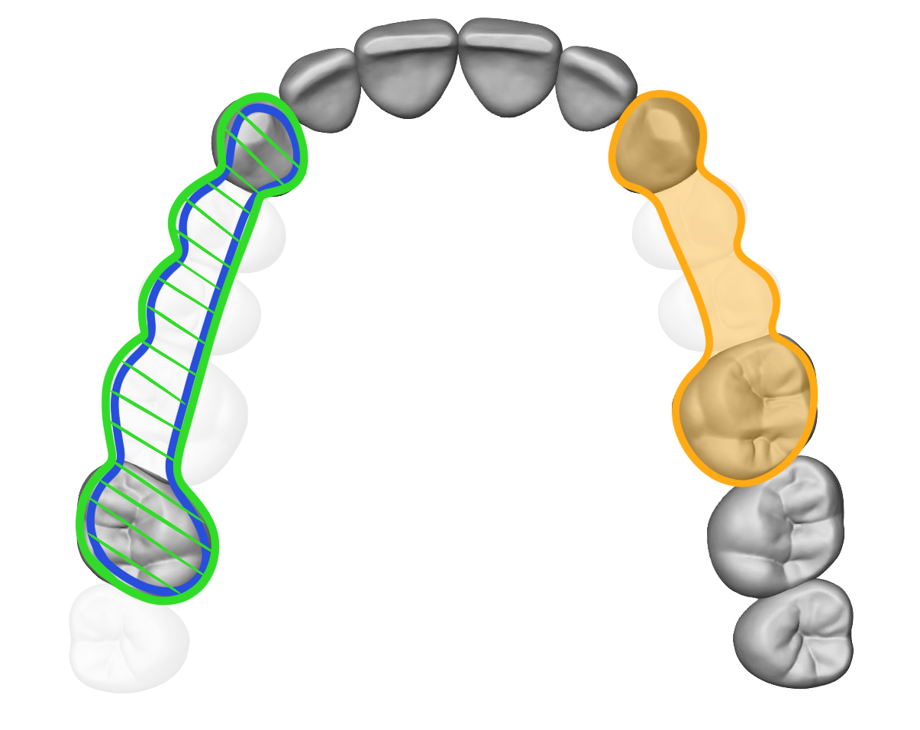

Prosthodontic Treatment Plan
Description and drawing!
Fábián and Fejérdy Calssification of Partial Edentulism
Color coding: Blue = metal Green = ceramic
Red = acrilic/composite
Yellow = hidden attachment (matrix)
Orange = zirconia
UPPER ARCH (Class 1A): FIXED PROSTHESIS
5-unit metal-ceramic bridge (CoCr) fabricated using laser-sintering technology
Veneered retainer crowns: 13, 17
Veneered pontics: 14, 15, 16
4-unit monolithic zirconia bridge fabricated using CAD/CAM technology
Retainer crowns: 23, 26
Pontics: 24, 25
LOWER ARCH (Class 1B): FIXED PROSTHESIS
8-unit metal-ceramic bridge (CoCr) fabricated using laser-sintering technology
Veneered retainer crowns: 34, 35, 41, 42, 43
Veneered pontics: 31, 32, 33

Slide 19


Prosthodontic Treatment Plan
Description and drawing!
Fábián and Fejérdy Calssification of Partial Edentulism
Color coding: Blue = metal Green = ceramic
Red = acrilic/composite
Yellow = hidden attachment (matrix)
Orange = zirconia
UPPER ARCH (Class 2B): Clasp-retained removable partial denture
Support: dentomucosal
  Casted/Laser-sintered, metal (CoCr) baseplate, reduced in a horseshoe shape
  Occlusal rest on tooth 26
Retention:
  Rigid clasp retention: 13, 23, 26
    Roach C clasp: 13, 23
    Ney-5 clasp: 26
  Continuous clasp: 12
8 acrylic denture teeth (16, 15, 14, 11, 21, 22, 24, 25)
LOWER ARCH (Class 2A): Clasp-retained removable partial denture
Support: dentomucosal
  Casted/Laser-sintered, reduced metal (CoCr) baseplate with a lingual bar
Retention:
  Rigid clasp retention: on teeth 33, 43
    Roach C clasp
  Indirect retainer extension: 32, 42
8 acrylic denture teeth (47, 46, 45, 44, 34, 35, 36, 37)

Slide 20


Prosthodontic Treatment Plan
Description and drawing!
Fábián and Fejérdy Calssification of Partial Edentulism
Color coding: Blue = metal Green = ceramic
Red = acrilic/composite
Yellow = hidden attachment (matrix)
Orange = zirconia
UPPER ARCH: Combined fixed-removable prosthesis with hidden attachments
Fixed part: 7-unit metal-ceramic bridge (CoCr) fabricated using laser-sintering technology
  Veneered retainer crowns: 12, 13, 23, 26
  Veneered pontics: 11, 21, 22
  Semi-Precision attachment components: 13 (Preci-Vertix patrix), between 23-26 (Preci-Horix patrix)
  Interlock: between teeth 13-12
  Milled shoulders: 13, 23, 26
Removable part: removable partial denture with hidden attachments
Support: dentomucosal
  Casted/Laser-sintered, metal (CoCr) baseplate, reduced in a butterfly shape
Retention: rigid with hidden attachments
  Preci-Vertix and Preci-Horix matrix components
  Indirect retainer extension in the milled shoulders of 13, 23, 26
5 acrylic denture teeth (16, 15, 14, 24, 25)
LOWER ARCH: Combined fixed-removable prosthesis with hidden attachments
Fixed part: 6-unit metal-ceramic splint (CoCr) fabricated using laser-sintering technology
  Veneered retainer crowns: 31, 32, 33, 41, 42, 43
  Milled shoulders and semi-precision attachment components (Preci-Vertix patrix): 33, 43
  Interlock between teeth 32-33 and 42-43
Removable part: removable partial denture with hidden attachments
Support: dentomucosal
  Casted/Laser-sintered, reduced metal (CoCr) baseplate with a lingual bar
Retention: rigid with hidden attachments
  Preci-Vertix matrix components
  Indirect retainer extension in the milled shoulders of 33, 43
8 acrylic denture teeth (47, 46, 45, 44, 34, 35, 36, 37)

Slide 21


Prosthodontic Treatment Plan
Description and drawing!
Fábián and Fejérdy Calssification of Partial Edentulism
Color coding: Blue = metal Green = ceramic
Red = acrilic/composite
Yellow = hidden attachment (matrix)
Orange = zirconia
UPPER ARCH: Telescopic overdenture
Support: mucodental
  Non-reduced acrylic baseplate
Retention: with a telescopic system
  Laser-sintered cylindroconical primary telescopes (CoCr): 13, 14
  Laser-sintered secondary telescope copings (CoCr): 13, 14
12 acrylic denture teeth (16-26)
LOWER ARCH: Telescopic overdenture
Support: mucodental
  Non-reduced acrylic baseplate
Retention: with a telescopic system
  Laser-sintered cylindroconical primary telescopes (CoCr): 34, 43
  Laser-sintered secondary telescope copings (CoCr): 34, 43
12 acrylic denture teeth (46-36)

Slide 22


Prosthodontic Treatment Plan
Description and drawing!
Fábián and Fejérdy Calssification of Partial Edentulism
Color coding: Blue = metal Green = ceramic
Red = acrilic/composite
Yellow = hidden attachment (matrix)
Orange = zirconia
UPPER ARCH (CLASS 2B): IMPLANT-SUPPORTED FIXED PROSTHESIS
16: solo monolithic zirconia crown fabricated using CAD/CAM technology, supported by a tissue-level/bone-level implant and retained on a stock/custom, straight/angled implant abutment; cement-retained/screw-retained
12: glass fiber-reinforced composite post-and-core restoration
12, 22: lithium disilicate crowns fabricated using CAD/CAM technology
11, 21: lithium disilicate veneers fabricated using CAD/CAM or pressing technology
3-unit, screw-retained metal-ceramic (CoCr) bridge fabricated using laser sintering technology, supported by tissue-level/bone-level implants and retained on stock titanium bases/custom/multi-unit abutments
  Veneered retainer crowns: 25, 27
  Veneered pontic: 26
LOWER ARCH (CLASS T): IMPLANT-SUPPORTED FIXED PROSTHESIS
12-unit, screw-retained monolithic zirconia bridge supported by six bone-level implants, retained on multi-unit abutments and a custom CAD/CAM-fabricated titanium i-bar
  Retainer crowns: 36, 34, 32, 42, 44, 46
  Pontics: 35, 33, 31, 41, 43, 45

Slide 23


Prosthodontic Treatment Plan
Description and drawing!
Fábián and Fejérdy Calssification of Partial Edentulism
Color coding: Blue = metal Green = ceramic
Red = acrilic/composite
Yellow = hidden attachment (matrix)
Orange = zirconia
UPPER ARCH (CLASS T): IMPLANT-RETAINED REMOVABLE OVERDENTURE
Support: muco-implantal
  Casted metal (CoCr) baseplate reduced in a horseshoe shape
Retention: ball or locator-type attachments at implant positions 14, 12, 22, 24
14 acrylic denture teeth (17–27)
MANDIBLE (CLASS T): IMPLANT-SUPPORTED REMOVABLE OVERDENTURE
Support: implanto(-mucosal)
  Reduced acrylic baseplate with metal reinforcement
Retention: bar attachment system
  Bar: Preci-Horix bar connecting the implants at positions 45, 43, 33, 35
14 acrylic denture teeth (37–47)

Slide 24
Prosthodontic Procedures
Indicate the different treatment phases on new slides, create a logical structure!
The title of the slides should be the name of these Phases.
See the Content guide slides!
Indicate the methods used, as well as the type, name and producer of the materials!
  precisional-situational impression, putty-wash technique; C-Silicone impression material; Zetaplus+Oranwash (Zhermack®)
  Eg. glass ionomer luting cement, Ketac Cem (3M ESPE®)

Slide 25
Short term control
Long term control
Professional oral hygiene treatment, repeated instruction and motivation - if necessary.
Recheck Status.

Slide 26
CONTENT GUIDE

Slide 27
Description of Restorative and Endodontic Treatments
Before photo, periapical X-ray, diagnosis ALWAYS
Inlay/onlay/overlay:
Prepared cavity
Impressions, models
Temporary restoration
Final restoration on the cast
Rubber dam, matrix, wedge in situ
Finished, polished restoration (occlusal view, ICP)
Filling procedure:
Prepared, Ready Cavity
Rubber dam, matrix, wedge in situ
Finished, polished restoration
Endodontic treatment:
Access cavity with rubber dam
Photo with apex locator, X-ray for working length
Control radiograph
Please refer to the case presentation protocol of the Department of Restorative Dentistry and Endodontics.

Slide 28

Fixed partial denture
Clinical phases | Additional information
Preparation Situational impression for the temporary restoration Prepared abutment teeth Temporary restorations | (method, material type and name) ICP + occlusal view (material type and name)
Impressions Precisional-situational impression Antagonistic impression Bite registration Maintained occlusion: wax bite Non-maintained occlusion: occlusal rim / intraoral gothic arch tracer | (method, material type and name) (method, material type and name) (intraorally and extraorally with the antagonistic cast)
Framework trial Sectioned cast In the articulator and in the mouth Shade selection | (material type) (ICP + occlusal view + lateral view) VITA Linearguide 3D-MASTER®
Bisque trial In the articulator and in the mouth | (ICP + occlusal view + lateral view + smile)
Final restoration, cementation In the articulator and in the mouth | (material type and name) (ICP + occlusal view + lateral view + smile)

Slide 29

Clasp-retained RPD with metal baseplate
Clinical phases | Additional information
Impressions Situational impression Antagonistic impression Bite registration (if possible) | (method, material type and name) (intraorally and extraorally)
Bite registration (if it’s necessary for making the metal baseplate) Occlusal rim / Intraoral gothic arch tracer | (intraorally and extraorally with the casts)
Outline of the metal baseplate on the master cast
Metal baseplate trial Metal baseplate on the cast and in the mouth | ICP + occlusal view
Determination of CO/ICP (this time at the latest) Shade selection | (intraorally and extraorally with the casts) VITA classical A1–D4®
Try-in denture In the articulator and in the mouth | Occlusal view + lateral view + ICP + smile
Final denture + education on hygiene In the articulator (ICP, occlusal view, lateral view, polished and non-polished surfaces) In the mouth (ICP, occlusal view, lateral view, smile)

Slide 30

Combined fixed-removable prosthesis
Clinical phases | Additional information
Fixed part | See „Fixed prosthodontic appliances”
Situational (pick-up) impression with the fixed part
Removable part
Try-in of RPD’s metal framework with the FPD Determination of ICP | (in the mouth, on the cast) (intraorally and extraorally with the casts)
Try-in denture In the articulator and in the mouth | ICP + occlusal view + smile
Final denture In the articulator and in the mouth Cementation of the fixed part (with the removable part) | Only the fixed part then the fixed + the removable part together. ICP + occlusal view + smile Precision attachments, parallel milled shoulders, interlock should be visible! (material type and name)

Slide 31

Telescopic overdenture
Clinical phases | Additional information
Preparation Situational impression for the temporary restoration Prepared abutment teeth Temporary restorations
Diagnostic teeth set-up – in case of telescopes in front region.
Impressions Precisional-situational impression Antagonistic impression
Primary telescopes: on the cast, in the mouth. Special tray, functional tray. Functional-situational impression with the primary telescopes. | (on the cast, mucosal surface)
Determination of CO with occlusal rims Ready primary telescopes (on the cast, in the mouth) Adjustment of the occlusal rim with the secondary telescopes in it Shade selection | (intraorally and extraorally with the casts) VITA classical A1–D4®
Try-in denture In the articulator and in the mouth | (ICP + occlusal view + smile)
Final denture, cementation of primary telescopes. Final denture and telescopes on the cast and in the mouth. Cementation of primary telescopes. Primary telescopes after cementation. Final denture in the mouth after the cementation. | (polished and non-polished surfaces) (ICP + occlusal view) (ICP + occlusal view + smile)

Slide 32

Complete denture
Clinical phases | Additional information
Primary/anatomical impression | (impression material type and name)
Primary/anatomical cast Outline of special tray on the cast
Secondary/Functional impression Special tray (on the cast) , Adjusted functional impression tray Secondary/Functional impression (from mucosal side) Antagonistic impression | (type and material of the tray) (type and name of material used for adjustments) (impression material type and name)
Determination of CO Occlusal rim on the functional cast Adjusted occlusal rims intraorally and extraorally (with the casts) Shade selection | VITA classical A1–D4®
Try-in denture In the articulator (ICP, occlusal view) and in the mouth (ICP, occlusal view, smile)
Final denture + education on hygiene In the articulator (ICP, occlusal view, polished and non-polished surfaces) In the mouth (ICP, occlusal view, smile)

Slide 33

Implant-retained crowns and bridges
Clinical phases and additional information
General information Date of implant placement Name, type and description of the implant and its prosthetic components (material, type, custom/cast etc.) Healing component (healing abutment/cap) in the mouth, peri-implant soft tissues
Impressions Implant-level impression: impression components in the mouth, x-ray control. Abutment-level impression: (for a screw-retained prosthesis): insertion of the implant abutments, followed by the placement of the impression copings on them + radiographic verification. Closed-tray impression: impression caps in mouth, precisional-situational impression with implant analogs (material + method). Open-tray impression: open tray on the cast, impression posts in mouth (with tray), precisional-situational impression with implant analogs (material + method). Antagonistic impression (material + method). Wax bite (extraorally, material type and name), occlusal rim (intraorally and extraorally with the antagonistic cast)
Framework trial: in the articulator and in the mouth. Shade selection: VITA Linearguide 3D-MASTER®
Bisque trial: in the articulator and in the mouth.
Final insertion of restoration In the articulator and in the mouth (ICP + occlusal view) Control x-ray Cement-retained: cement type Screw-retained: torque, covering of the screw hole (teflon tape, filling)

Slide 34
Thank you for your attention!
NAME

