Slide 1
Case presentation Guidelines
The following presentation shows the Official Case Presentation protocol of the Department of Prosthodontics. Both the form and content are to follow. The slides with the green background are to provide you with helpful technical information. Each stage of the Treatment needs to be documented and presented both written and with photos.
Photo Guidelines:
Photo after scaling and oral hygiene treatment! Saliva-free, dry surfaces!
Take multiple pictures about the same situation, as only sharp photos are acceptable!
Investigated/treated tooth should be in the middle of the photo.
Crop and mirror the photos, according to the quadrant! Use of Photoshop programs (eg. Picasa) is requested for cropping and smaller light-adjustments, but modification of the content is forbidden!
Use professional-grade equipment (full-frame digital single-lens reflex camera, macro lens, Ring/twin flash), available in the Practice Rooms. For settings, see the Photo Aid Slide (green background).
For subject photography, use single shade background (like white paper or wall, black reflection or green textile), that emphasizes the subject of the photo!

Slide 2
Prosthodontic Final Exam
Case Presentation
Title (Type of Denture)
Eg.: Combined Denture, Complete Denture, FPD, etc..
Student:
Consultant:
Supervisor:
Starting and finishing Date of Treatment:

Slide 3
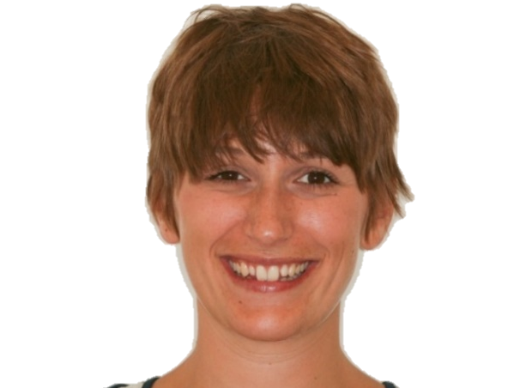
Introdution of the Patient
Age, Gender
(previous) Occupation
Reason for dental investigation
Eg. Pain, Aesthetic Complaints, Instability of Dentures etc.

Slide 4
Medical History
Factors which would affect the dental treatment
General diseases – Medication – relevant adverse effects!
  Eg. High blood pressure: Amlodipin (amlodipine, Calcium channel blocker) – AE: gingiva hyperplasia
  Eg. Osteoporosis: Bonviva (Ibandronate: Bisphosphonate) – AE: MRONJ osteonecrosis of the jaw
Allergy (eg. medicaments, metals)
Bad habits, Addiction: Smoking, Alcohol etc. (how much?)

Slide 5
Dental History
(Previously) worn Prosthodontic Appliances (when they were made)
Extractions (when?)
Other dental treatments, eg. orthodontics, dental surgery etc.

Slide 6
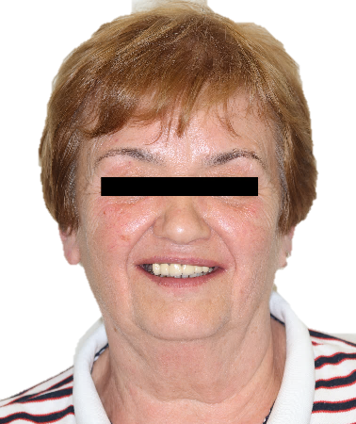
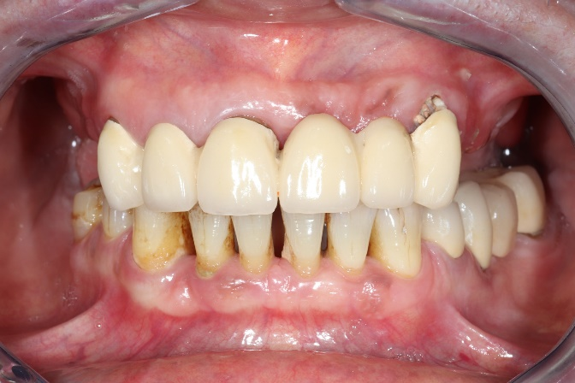
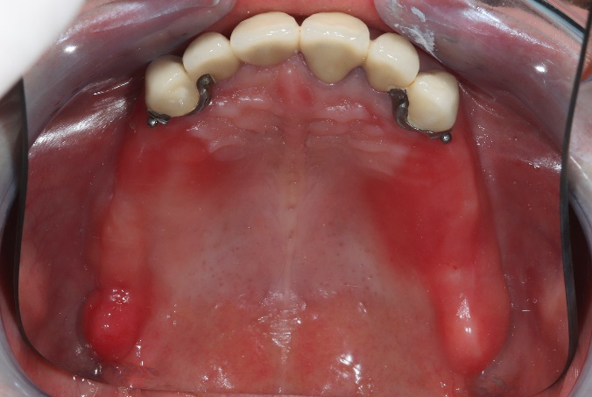
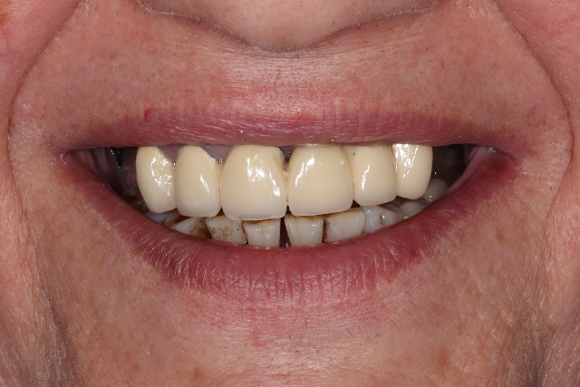
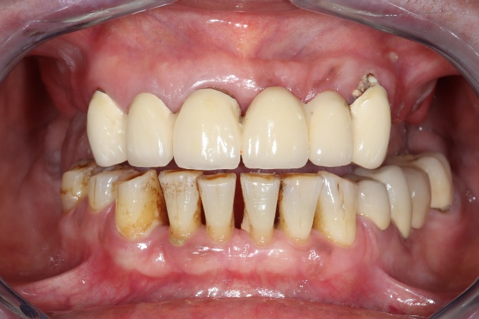
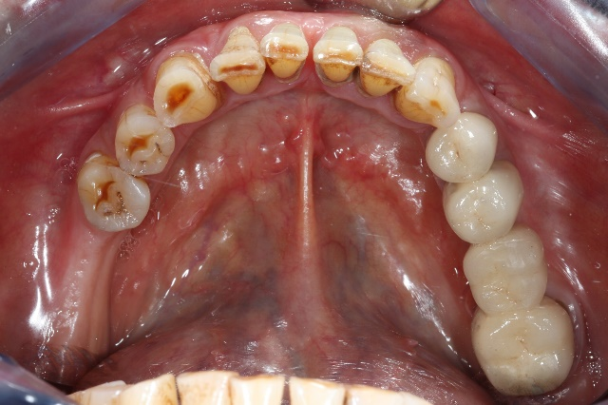
Dental Status
Portrait and Intraoral Photos
Portrait – with natural smile
Maximum ICP
Maxillary arch
Full smile
Mouth slightly open
Mandibular arch

Slide 7
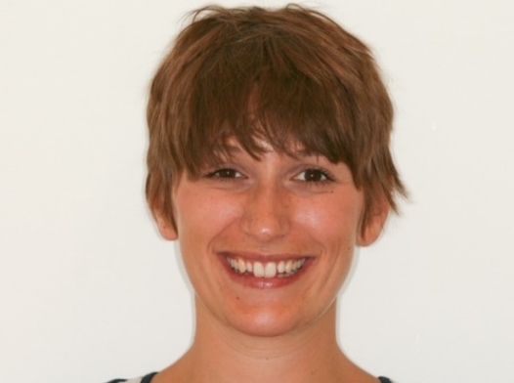
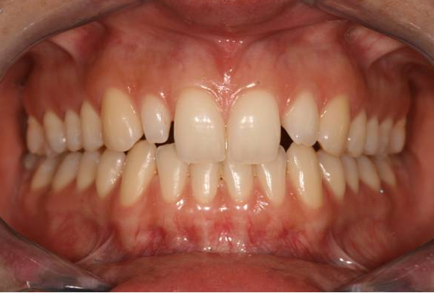
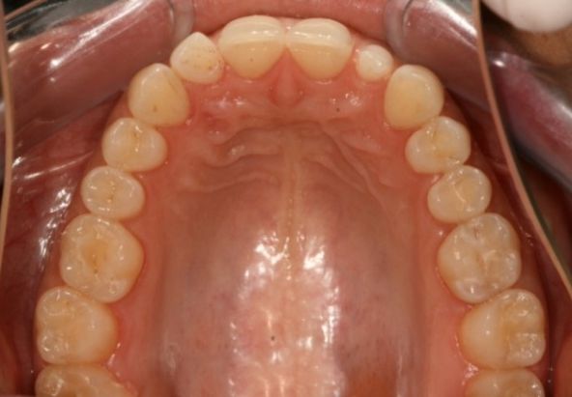
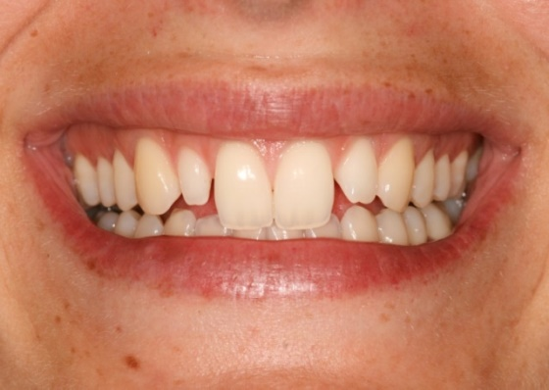
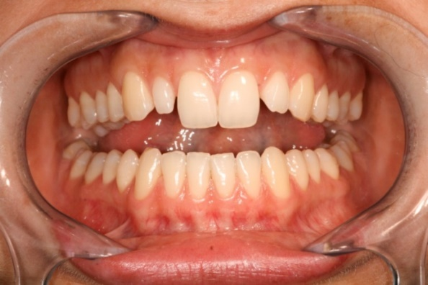
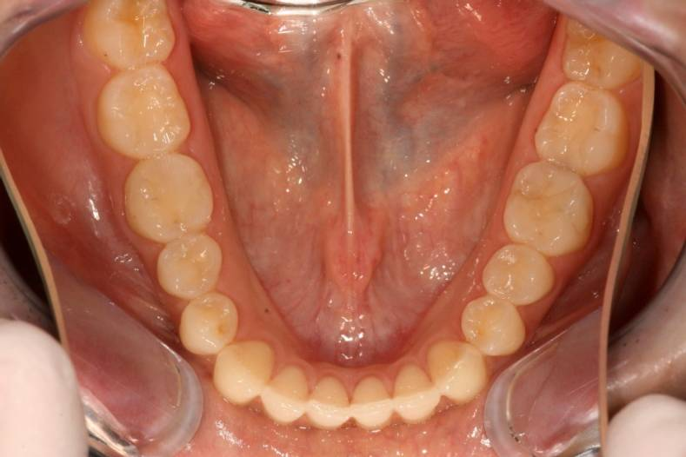
Photo-Aid: Camera settings
f 8
Portrait – with natural smile
Maximum ICP
Maxillary arch
- - - - - - - - - - - - - - - - - - - - - - - - - - - - - - - - - - - - - - - - -
- - - - - - - - - - - - - - - - - - - - - - - - - - - - - - - - - - - - - - - - -
- - - - - - - - - - - - - - - - - - - - - - - - - - - -
- - - - - - - - - - - - - - - - - - - - - - - - - - - - -
- - - - - - - - - - - - - - - - - - - - - - - - - - - - -
1.
3.
5.
Occlusal mirror
- - - - - - - - - - - - - - - - - - - - - - - - - - - - - - - - - - - - - - - - -
- - - - - - - - - - - - - - - - - - - - - - - - - - - - - - - - - - - - - - - - -
- - - - - - - - - - - - - - - - - - - - - - - - - - - - -
- - - - - - - - - - - - - - - - - - - - - - - - - - - - -
- - - - - - - - - - - - - - - - - - - - - - - - - - - - -
2.
4.
6.
Mosoly
Mouth slightly open
Mandibular arch
Cheek retractors (big size)
- Focus
Manual mode: f 22, ISO 200, 1/200; Flash: M 1/2

Slide 8
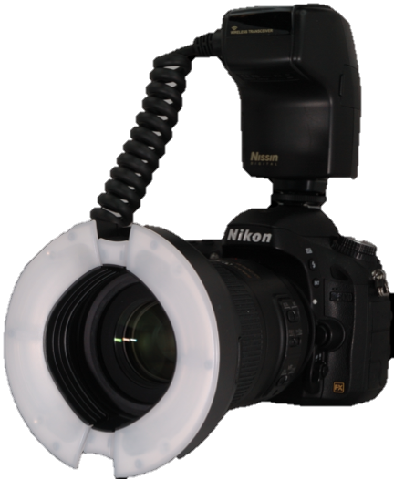
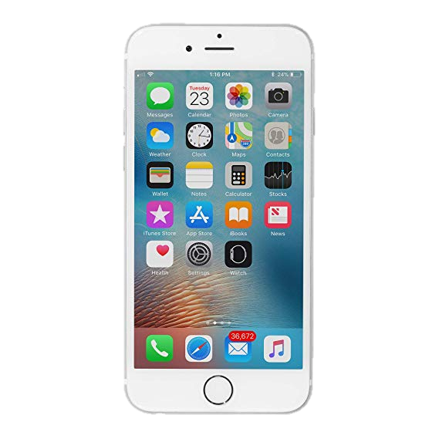
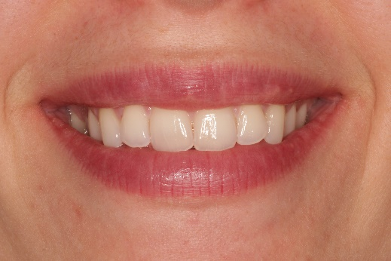
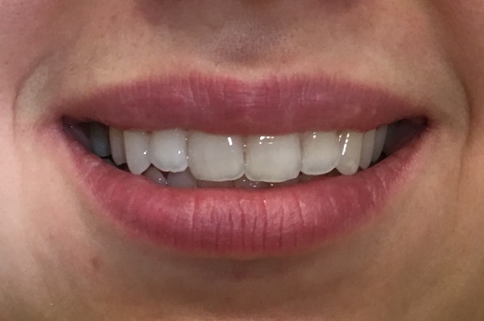
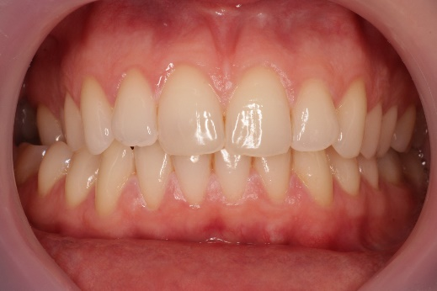
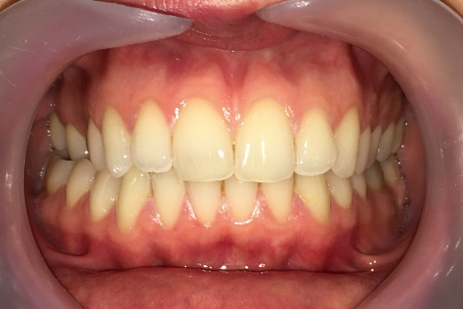
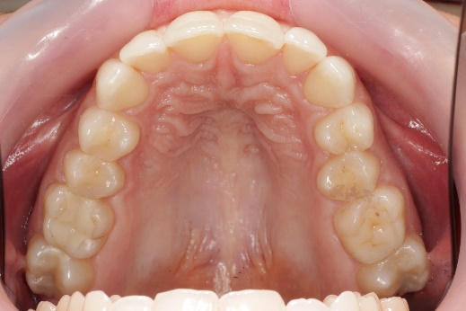
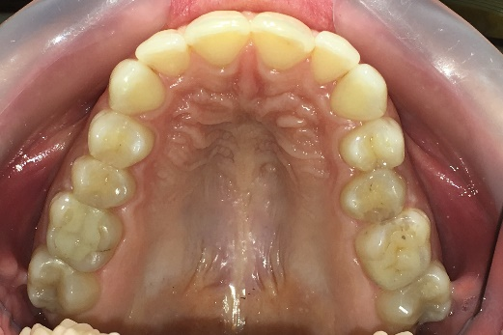
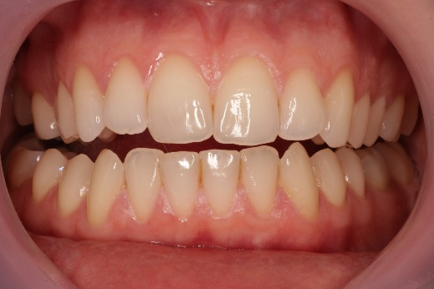
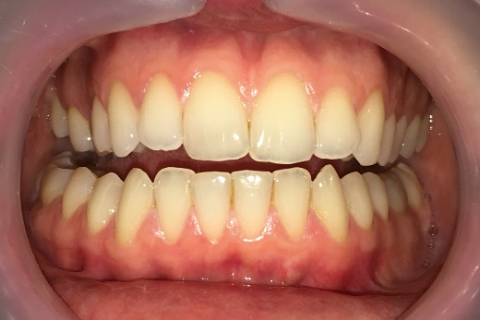
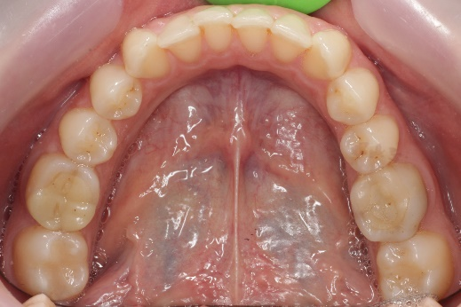
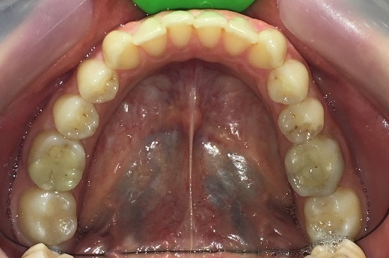
Camera – Difference in Quality
If you use cellphone for photography, the lighting is poorer and the quality will be lower.
The settings (picture composition, focus, patients position etc.) however remain the same.

Slide 9
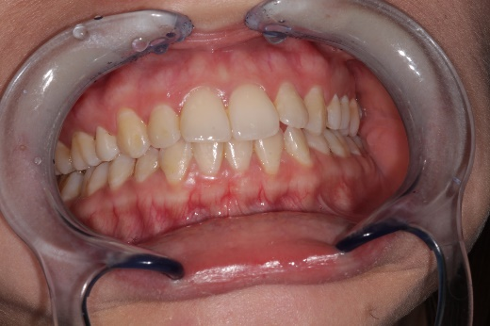
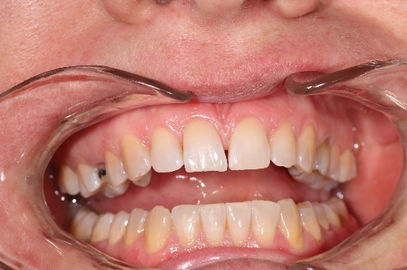
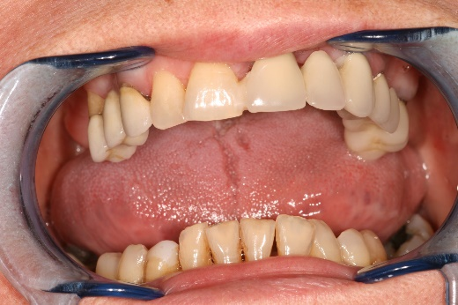
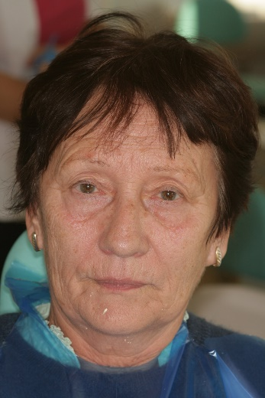
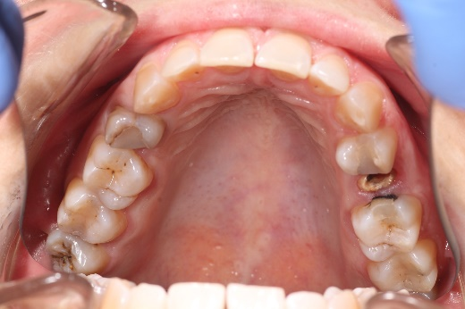
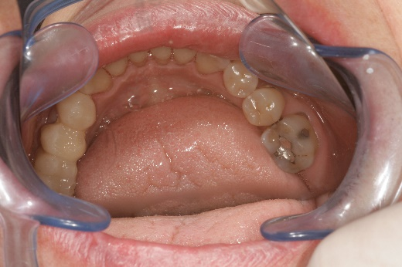
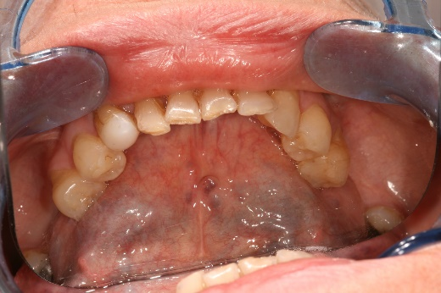
Common errors in Photography
The quality of photographs is significantly influenced by whether the subject of the image is properly positioned within the frame. Therefore, attention should be paid to the following:
1. Proper camera settings (brightness, focus)
2. Correct patient positioning (head posture, smile, degree of mouth opening)
3. Our own positioning and the appropriate use of auxiliary tools (the photograph should be taken from the front, not from the side or from below; the mirror should not be fogged, etc.)

Slide 10
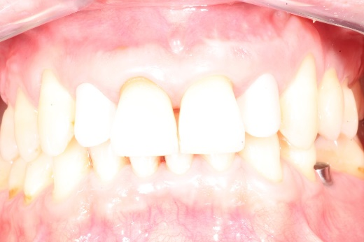
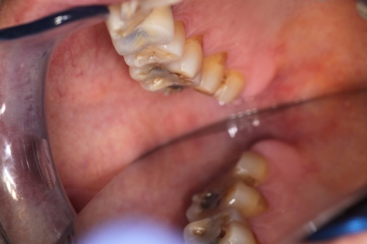
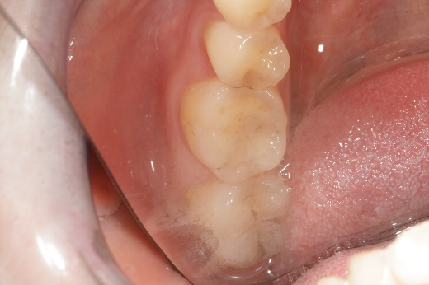
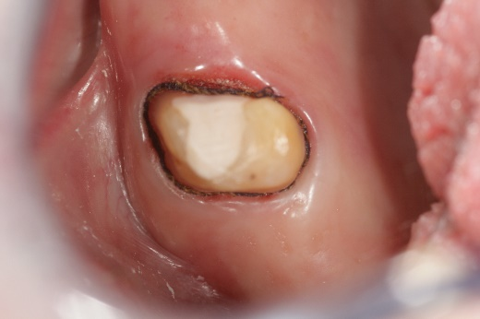
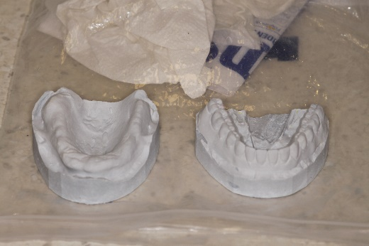
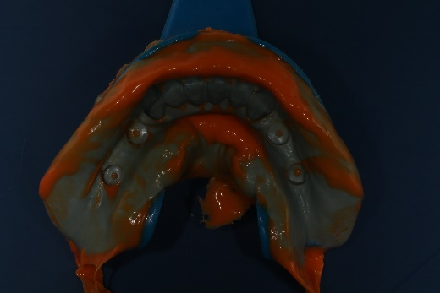
Common errors in Photography
Too bright / too dark picture (overexposed / underexposed)
Image blurry (lack of focus and/or improper depth of field)
Bad positioning: image taken from an improper angle (inferior/superior/canted), improper framing with mirror
Meaningless content (keep in mind what we want to show!)
No uniform backdrop, fogging of mirror

Slide 11
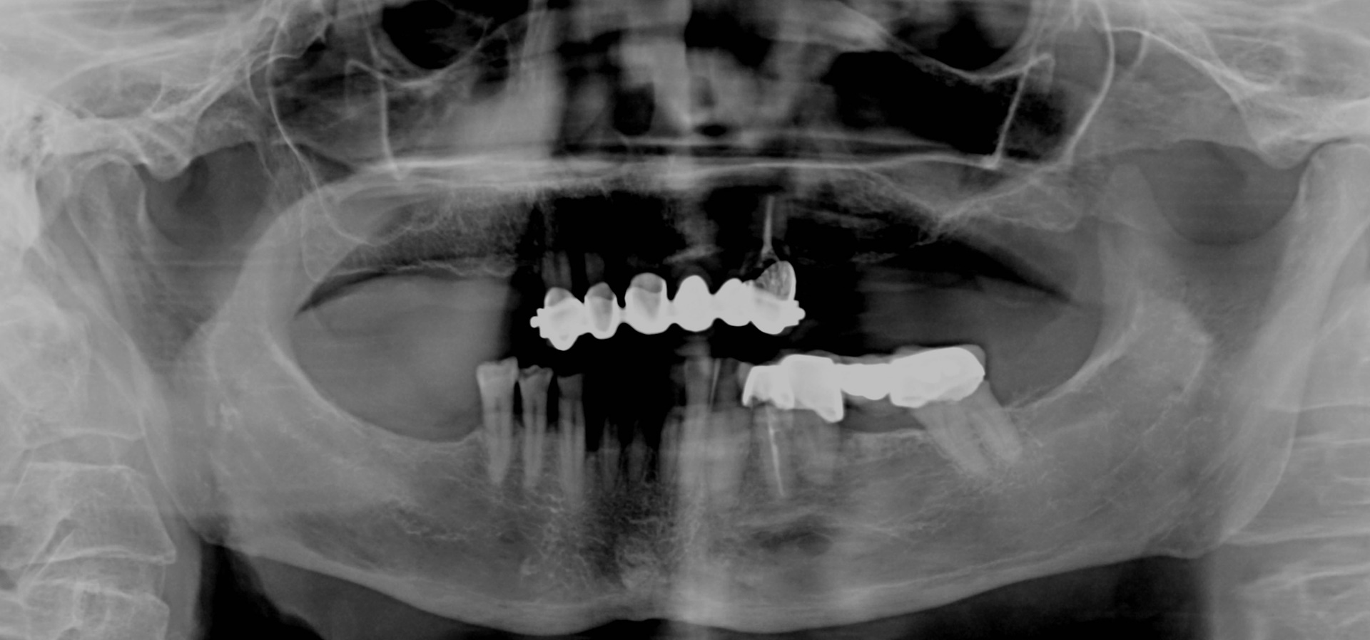
Dental Status
Panoramic Radiograph
NO
PATIENT’S DATA,
Just
DATE of
The X-ray
2025.06.17.
Please indicate, if the actual status differs from what is shown on the radiograph! Eg. Extractions – „X” mark on the tooth!

Slide 12
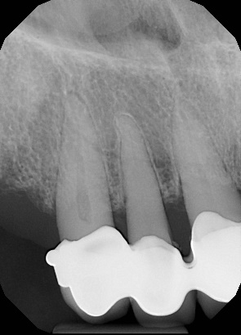
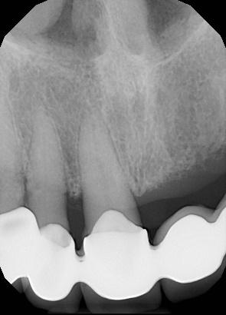
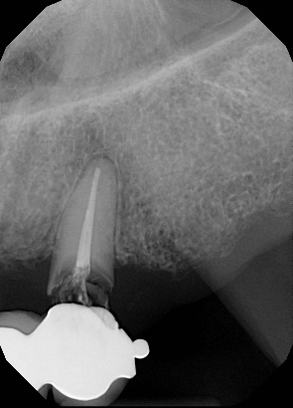
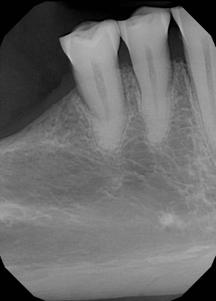
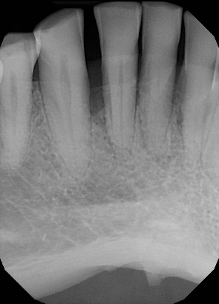
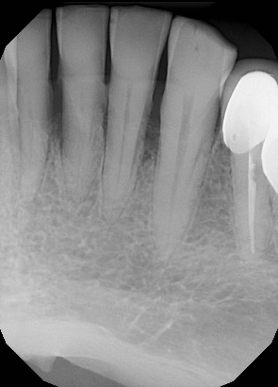
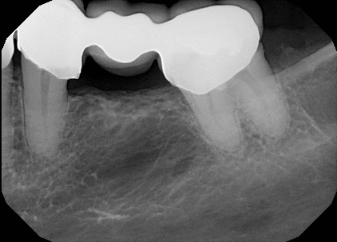
Dental Status
Intraoral radiographs and findings
2025.06.17.
grey colour = missing tooth
X = hopeless tooth (to be extracted)
)( = closed extraction gap
C = crown, bridge – )( dimensions
U = telescope
I = implant
E = root canal treated tooth (endo)
L = periapical lesion
P = post and core
F = filling
D = decay
* = to be replaced
Take a periapical x-ray of each abutment!
 |  |  |  |  | (B | B | B | B | B | E, X B)
8 | 7 | 6 | 5 | 4 | 3 | 2 | 1 | 1 | 2 | 3 | 4 | 5 | 6 | 7 | 8
8 | 7 | 6 | 5 | 4 | 3 | 2 | 1 | 1 | 2 | 3 | 4 | 5 | 6 | 7 | 8
 |  |  |  |  |  |  |  |  |  |  | E, C | (B | B | B)
2025.06.17.

Slide 13
Inspection of Head and Neck Region
Intraoral Investigation I.
Stomato-oncological screening: eg. no findings, red/white lesion (where?), precancerous lesions or cancer etc.
TMJ examination: complaints, diagnosis
eg. Reciprocal clicking –
diagnosis: Anterior Disc Displacement
Static Occlusion - Bite form: eugnathic or dysgnathic
Dynamic Occlusion - Type of Guidance: canine/group guidance etc.
ANOMALIES | Dental | Skeletal
Transversal | Crossbite Asymmetry | Crossbite Asymmetry
Saggital | Angle Class II. Angle Class III. | Prognathia Progenia
Vertical | Open bite Deep bite | Hyperdivergent Hypodivergent

Slide 14
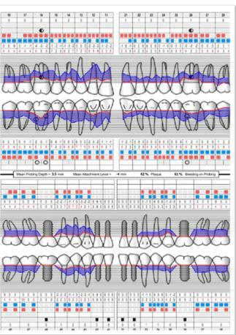
Inspection of Head and Neck Region
Intraoral Investigation II.
Oral hygiene eg. Good, poor
Oral mucosal abnormalities: eg. Denture stomatitis
Periodontal health: pl. gingivitis (type) generalized/localized acut/chronic periodontitis etc.
→ in case of periodontal disease, periodontal charting is needed!
www.periodontalchart-online.com

Slide 15

Dental status
Upper Jaw
Photo of Upper Jaw (with and without RPD) and Study cast
Intraoral x-rays
Fábián and Fejérdy Classification of Partially Edentulous Arch: 0 / 1A / 1B / 2A / 2B / 2A/1 / 3
Status (Zsigmondy cross, with indication of Findings)
 |  |  |  |  | (B | B | B | B | B | X E B)
8 | 7 | 6 | 5 | 4 | 3 | 2 | 1 | 1 | 2 | 3 | 4 | 5 | 6 | 7 | 8
grey colour = missing tooth X = hopeless tooth (to be extracted) )( = closed extraction gap C = crown, bridge – )( dimensions U = telescope | I = implant E = root canal treated tooth (endo) L = periapical lesion P = post and core F = filling D = decay * = to be replaced

Slide 16
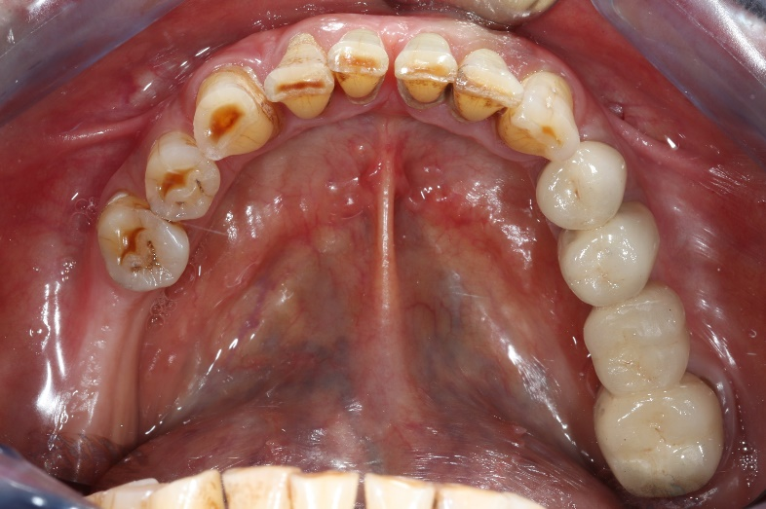


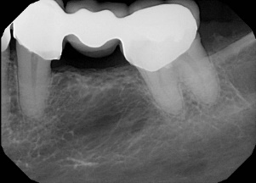
Dental status
Lower Jaw
Photo of Upper Jaw (with and without RPD) and Study cast
Intraoral x-rays
Fábián and Fejérdy Classification of Partially Edentulous Arch: 0 / 1A / 1B / 2A / 2B / 2A/1 / 3
Status (Zsigmondy cross, with indication of Findings)
8 | 7 | 6 | 5 | 4 | 3 | 2 | 1 | 1 | 2 | 3 | 4 | 5 | 6 | 7 | 8
 |  |  |  |  |  |  |  |  |  |  | E | (B | B | B)
grey colour = missing tooth X = hopeless tooth (to be extracted) )( = closed extraction gap C = crown, bridge – )( dimensions U = telescope | I = implant E = root canal treated tooth (endo) L = periapical lesion P = post and core F = filling D = decay * = to be replaced

Slide 17
Preoperative Treatments
Detailed description (text, drawings and photos!) of Surgical, Periodontal, Conservative treatment plan and treatments. (with methods and materials used)
Detailed description of Prosthodontic Planning phases (eg. Study impressions and casts, diagnostic wax-up and mock-up, smile design etc. Photos!)

Slide 18
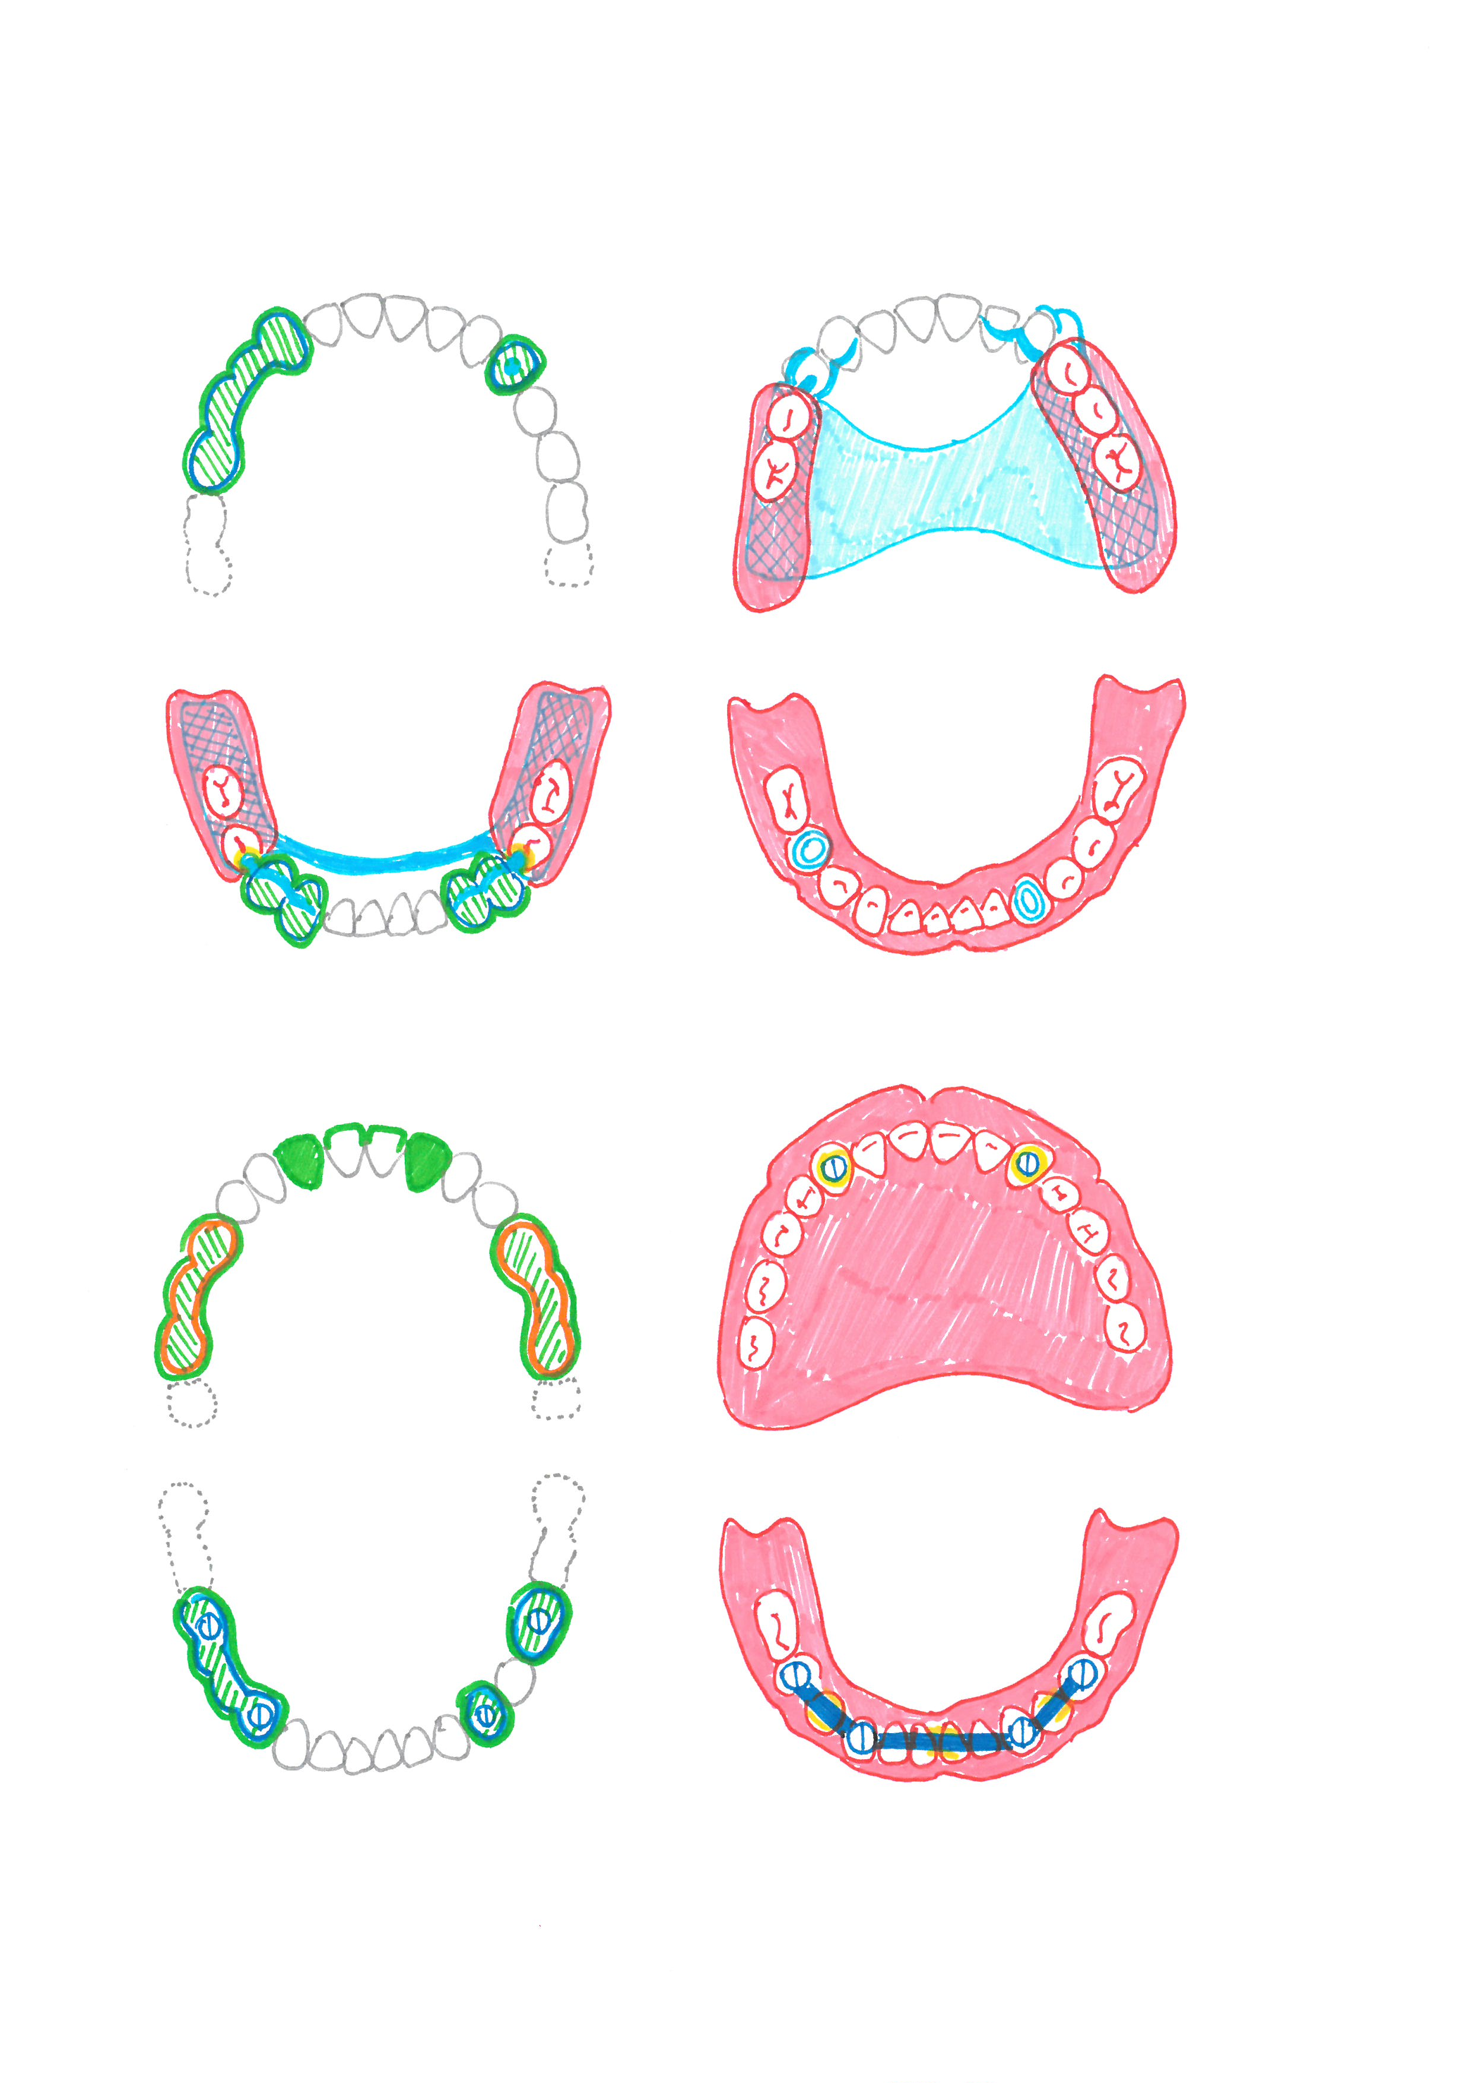

Prosthodontic Treatment Plan
Description and drawings!
Meaning of colours:
Blue = metal, Green = Ceramic, Red = Acrylic
Yellow = precision attachment (female part)
Orange = zirconia
UPPER JAW: FIXED partial denture (FPD)
4-unit porcelain fused to metal (PFM) bridge (CoCr)
Retainers: 16, 13
Pontics: 15, 14
Cast post and core / Dowel core, PFM (CoCr) crown: 24
Lower Jaw: COMBINED FIXED-REMOVABLE PARTIAL DENTURE
Fixed appliance:
2-unit PFM (CoCr) splint:
  Retainers: 34, 33
Semi-precision attachment: Preci-Vertix slide attachment patrix (male part) with lingual parallel milled shoulder and interlock (34)
2-unit PFM (CoCr) splint:
Retainers: 44, 43
Semi-precision attachment: Preci-Vertix slide attachment patrix (male part) with lingual parallel milled shoulder and interlock (34)
Removable appliance: attachment-retained removable partial denture
Acrylic base, cast metal mesh framework (CoCr) , lingual bar major connector
Semi-precision attachment: preci vertix slide attachment matrix (female part), lingual bracing arm (indirect retainer) with interlock 44, 34
Replaced teeth: 47, 46, 45, 35, 36, 37 (6 pcs) acrylic artificial teeth
Dento-mucosal support

Slide 19
Prosthodontic Treatment Plan
Description and drawings!
Meaning of colours:
Blue = metal, Green = Ceramic, Red = Acrylic
Yellow = precision attachment (female part)
Orange = zirconia
UPPER JAW: CLASP-RETAINED Removable Partial Denture (RPD)
Dento-mucosal support
  Acrylic base, cast metal (CoCr) mesh framework and (butterfly) palatal strap major connector
  14: mesial occlusal rest
Clasp-retention
  14: back-action clasp
  23: Roach C clasp
  13, 22: bracing arms
5 pcs acrylic artificial teeth (15, 16, 24, 25, 26)
Lower Jaw: telescopic Overdenture
Muco-dental support
  Acrylic base
Telescopic retention
  Cylindro-conical primary coping (CoCr): 33, 45
  Cylindro-conical secondary coping (CoCr): 33, 45
12 pcs acrylic artificial teeth (36-46)

Slide 20
Prosthodontic Treatment Plan
Description and drawings!
Meaning of colours:
Blue = metal, Green = Ceramic, Red = Acrylic
Yellow = precision attachment (female part)
Orange = zirconia
MAXILLA: FIXED DENTAL PROSTHESIS
11, 21 lithium disilicate ceramic veneers (pressed ceramic, e.max®)
12, 22 lithium disilicate ceramic crowns (pressed ceramic, e.max®)
[17-x-15] 3-unit zirconia-based ceramic bridge
Veneered abutment crowns: 17, 15
Veneered pontic: 16
[27-x-25] 3-unit zirconia-based ceramic bridge
Veneered abutment crowns: 27, 25
Veneered pontic: 26
MANDIBLE: IMPLANT-SUPPORTED FIXED DENTAL PROSTHESIS
34 cement-retained metal-ceramic crown (CoCr)
  prefabricated titanium prosthetic abutment (e.g., TiDesign®) (e.g., Astra TX) on a bone-level implant
36 cement-retained metal-ceramic crown (CoCr)
  prefabricated titanium prosthetic abutment (e.g., TiDesign®) (e.g., Astra TX) on a bone-level implant
[36-x-34] 3-unit screw-retained metal-ceramic bridge (CoCr)
2 prefabricated titanium prosthetic abutments (e.g., Uni Abutment®) (e.g., Astra TX) on bone-level implants in positions 36 and 34

Slide 21

Prosthodontic Treatment Plan
Description and drawings!
Meaning of colours:
Blue = metal, Green = Ceramic, Red = Acrylic
Yellow = precision attachment (female part)
Orange = zirconia
MAXILLA: IMPLANT-SUPPORTED OVERDENTURE
Support: mucosa-implant-supported
Horseshoe-shaped reduced acrylic denture base with metal mesh reinforcement
Retention: ball attachments in positions 14, 12, 22, 24
14 hard acrylic denture teeth (17–27)
MANDIBLE: IMPLANT-SUPPORTED OVERDENTURE
Support: implant-mucosa-supported
Reduced acrylic denture base with metal mesh reinforcement
Retention: bar attachment system
Preci Horix® type bar connecting the implants in positions 45–43–33–35
14 hard acrylic denture teeth (37–47)

Slide 22
Prosthodontic Procedures
Step by step
Indicate the different treatment phases on new slides, create a logical structure!
The title of the Slides of Prosthodontic treatment Phases should be the name of these Phases.
SEE the Study-Aid (following slides)
Indicate the methods used, as well as the type, name and producer of the materials!
  precisional-situational impression, putty-wash technique; C-Silicone impression material; Zetaplus+Oranwash (Zhermack®)
  Eg. glass ionomer luting cement, Ketac Cem (3M ESPE®)

Slide 23
Short term control
Long term control
Professional oral hygiene treatment, repeated instruction and motivation - if necessary.
Recheck Status.

Slide 24
Content Guide

Slide 25
Description of Conservative Treatments
Before photo, periapical X-ray
Inlay/onlay/overlay:
  Prepared cavity
  Impressions, models
  Temporary restoration
  Final restoration on the cast
  Rubber dam, matrix, wedge in situ
  Finished, polished restoration (occlusal view, ICP)
Filling procedure:
  Prepared, Ready Cavity
  Rubber dam, matrix, wedge in situ
  Finished, polished restoration
Endodontic treatment:
  Access cavity with rubber dam
  Photo with apex locator, X-ray for working length
  Control radiograph
Please refer to the case presentation protocol of the Department of Restorative Dentistry and Endodontics.

Slide 26

Complete denture
Clinical phases | Additional information
Primary/anatomical impression | (impression material type and name)
Primary/anatomical cast Outline of special tray on the cast
Secondary/Functional impression Special tray (on the cast) , Adjusted functional impression tray Secondary/Functional impression (from mucosal side) Antagonistic impression | (type and material of the tray) (type and name of material used for adjustments) (impression material type and name)
Determination of CO Occlusal rim on the functional cast Adjusted occlusal rims intraorally and extraorally (with the casts) Shade selection | Using VITA Classical shade guide
Try-in denture In the articulator (ICP, occlusal view) and in the mouth (ICP, occlusal view, smile)
Final denture + education on hygiene In the articulator (ICP, occlusal view, polished and non-polished surfaces) In the mouth (ICP, occlusal view, smile)

Slide 27

Clasp-retained RPD with metal baseplate
Clinical phases | Additional information
Impressions Situational impression Antagonistic impression Bite registration (if possible) | (method, material type and name) (intraorally and extraorally)
Bite registration (if it’s necessary for making the metal baseplate) Occlusal rim / Intraoral gothic arch tracer | (intraorally and extraorally with the casts)
Outline of the metal baseplate on the master cast
Metal baseplate trial Metal baseplate on the cast and in the mouth | ICP + occlusal view
Determination of CO/ICP (this time at the latest) Shade selection | (intraorally and extraorally with the casts) Using VITA Classical shade guide
Try-in denture In the articulator and in the mouth | Occlusal view + lateral view + ICP + smile
Final denture + education on hygiene In the articulator (ICP, occlusal view, lateral view, polished and non-polished surfaces) In the mouth (ICP, occlusal view, lateral view, smile)

Slide 28

Fixed prosthodontic appliances (FPD)
Clinical phases | Additional information
Preparation Situational impression for the temporary restoration Prepared abutment teeth Temporary restorations | (method, material type and name) ICP + occlusal view (material type and name)
Impressions Precisional-situational impression Antagonistic impression Bite registration Maintained occlusion: wax bite Non-maintained occlusion: occlusal rim / intraoral gothic arch tracer | (method, material type and name) (method, material type and name) (intraorally and extraorally with the antagonistic cast)
Framework trial Sectioned cast In the articulator and in the mouth Shade selection | (material type) (ICP + occlusal view + lateral view) Using VITA 3D Master shade guide
Bisque trial In the articulator and in the mouth | (ICP + occlusal view + lateral view + smile)
Final restoration, cementation In the articulator and in the mouth | (material type and name) (ICP + occlusal view + lateral view + smile)

Slide 29

Combined fixed-removable partial denture
Clinical phases | Additional information
Fixed part | See „Fixed prosthodontic appliances (FPD)”!
Situational (pick-up) impression with the fixed part
Removable part
Try-in of RPD’s metal framework with the FPD Determination of ICP | (in the mouth, on the cast) (intraorally and extraorally with the casts)
Try-in denture In the articulator and in the mouth | ICP + occlusal view + smile
Final denture In the articulator and in the mouth Cementation of the fixed part (with the removable part) | Only the fixed part then the fixed + the removable part together. ICP + occlusal view + smile Precision attachments, parallel milled shoulders, interlock should be visible! (material type and name)

Slide 30

Telescopic overdenture
Clinical phases | Additional information
Preparation Situational impression for the temporary restoration Prepared abutment teeth Temporary restorations
Diagnostic teeth set-up – in case of telescopes in front region.
Impressions Precisional-situational impression Antagonistic impression
Primary telescopes: on the cast, in the mouth. Special tray, functional tray. Functional-situational impression with the primary telescopes. | (on the cast, mucosal surface)
Determination of CO with occlusal rims Ready primary telescopes (on the cast, in the mouth) Adjustment of the occlusal rim with the secondary telescopes in it Shade selection | (intraorally and extraorally with the casts)
Try-in denture In the articulator and in the mouth | (ICP + occlusal view + smile)
Final denture, cementation of primary telescopes. Final denture and telescopes on the cast and in the mouth. Cementation of primary telescopes. Primary telescopes after cementation. Final denture in the mouth after the cementation. | (polished and non-polished surfaces) (ICP + occlusal view) (ICP + occlusal view + smile)

Slide 31

Implant-retained crowns and bridges
Clinical phases and additional information
General information Date of implant placement Name, type and description of the implant and its prosthetic components (material, type, custom/cast etc.) Healing component (healing abutment/cap) in the mouth, peri-implant soft tissues
Impressions Implant-level impression: impression components in the mouth, x-ray control. In the case of an abutment-level impression (for a screw-retained prosthesis): insertion of the implant abutments, followed by the placement of the impression copings on them + radiographic verification. Closed-tray impression: impression caps in mouth, precisional-situational impression with implant analogs (material + method). Open-tray impression: open tray on the cast, impression posts in mouth (with tray), precisional-situational impression with implant analogs (material + method). Antagonistic impression (material + method). Wax bite (extraorally, material type and name), occlusal rim (intraorally and extraorally with the antagonistic cast)
Framework trial: in the articulator and in the mouth. Shade selection: using VITA 3D Master shade guide.
Bisque trial: in the articulator and in the mouth.
Final insertion of restoration In the articulator and in the mouth (ICP + occlusal view) Control x-ray Cement-retained: cement type Screw-retained: torque, covering of the screw hole (teflon tape, filling)

Slide 32
Thank you for your attention!
NAME

