Slide 1
Introduction to Patient Care
Cardiology
Balázs T. Németh, MD PhD
Heart and Vascular Centre

Slide 2




Medical Universities in Hungary
Semmelweis University, Budapest
University of Szeged
University of Debrecen
University of Pécs

Slide 3

Education
Education in three languages: Hungarian, English and German
Diplomas granted varies by faculties B.Sc., M.Sc., M.D., D.M.D., Ph.D.
Number of students: approx. 10,000
~3500 of these are international students
70% of dentists
50% of pharmacists
42% of doctors
27% of health care professionals
in Hungary are Semmelweis University graduates.
Introduction to Patient Care - Cardiology
1st March, 2022

Slide 4

International Students
International students make up 30.5% of the student population.
They come from 74 countries around the world.
The top 10 countries of origin are:
  Germany (985)
  Norway (319)
  Iran (248)
  Italy (208)
  Israel (158)
  Slovakia (93)
  Spain (98)
  Sweden (82)
  Japan (80)
  United Kingdom (72)
Introduction to Patient Care - Cardiology
1st March, 2022

Slide 5
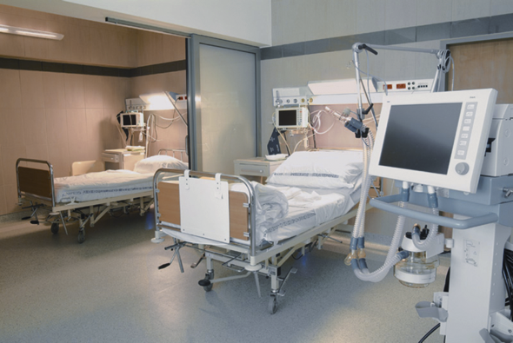
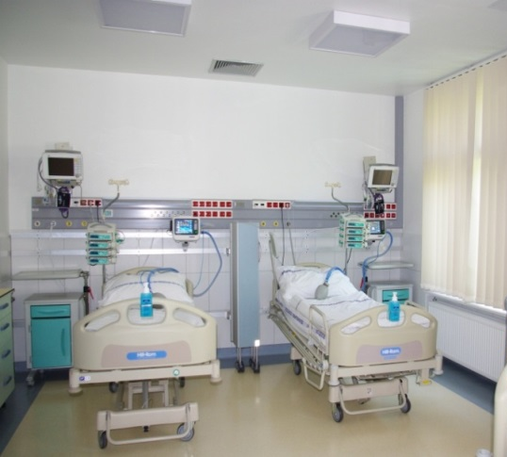
Health Care
Semmelweis University is the biggest health care institution in Hungary
Over 8,000 employees covering six per cent of the health care needs of Hungary
About two million patients are
treated annually at the 26 clinical departments of the university
About 145,000 out-patients and close to 12,000 in-patients every month
More than 2,100 beds are available for acute and elective cases
Introduction to Patient Care - Cardiology
1st March, 2022

Slide 6


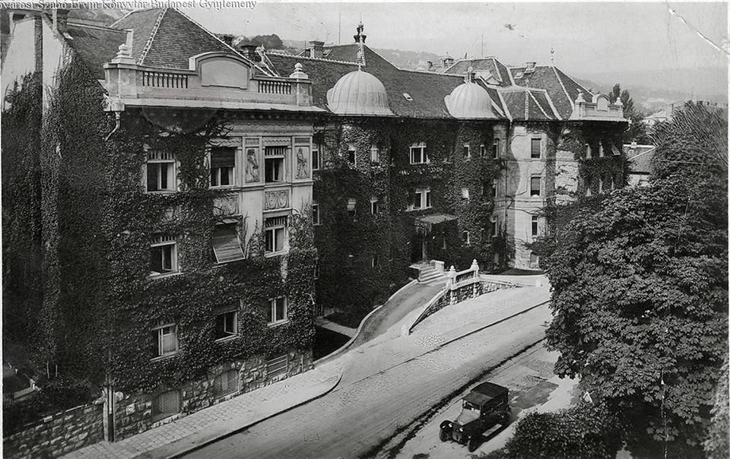
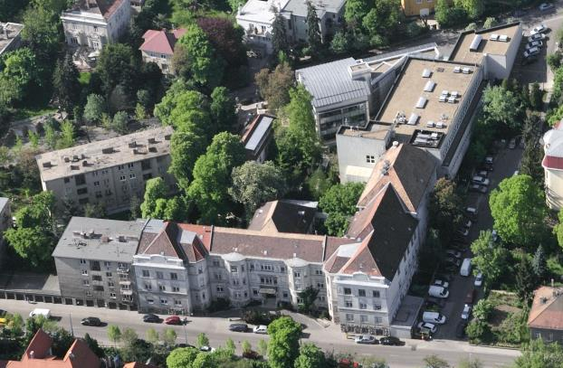
Introduction to Patient Care - Cardiology
1st March, 2022

Slide 7

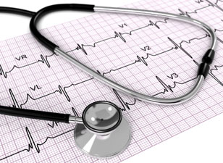
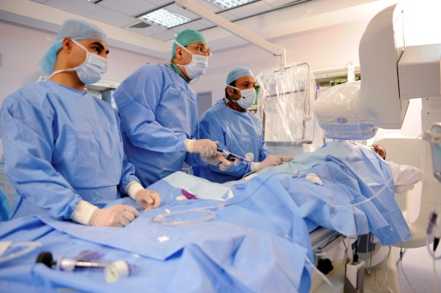



Symptoms, medical history, physical examination
Diagnostic
procedure
Therapy
Follow-up
THE ROAD IS LONG…
Introduction to Patient Care - Cardiology
1st March, 2022

Slide 8
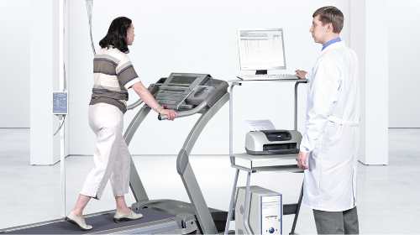
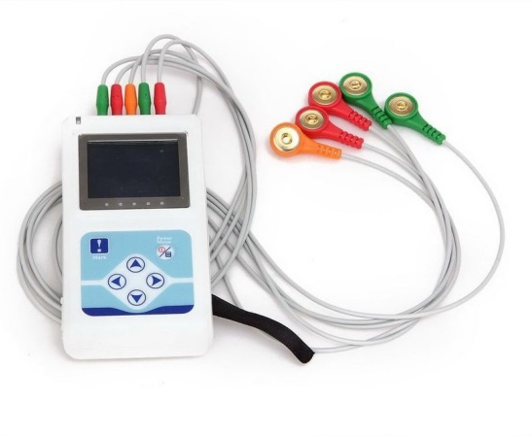
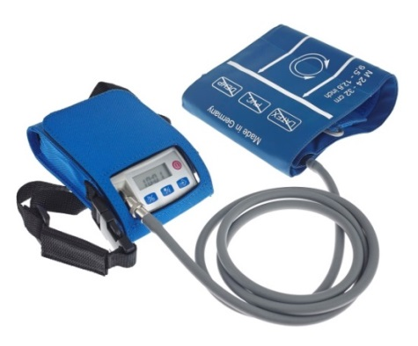
Outpatient Department
Treadmill and cycle ergometry testing
Outpatient management of:
Heart failure patients
Patients with PM/ICD/CRT
Post transplant patients
Ergometry
Echocardiography
CT
MR
Vascular ultrasound
24-hour Holter monitoring
24-hour ambulatory blood pressure monitoring (ABPM)
Vascular surgery
Heart surgery
Introduction to Patient Care - Cardiology
1st March, 2022

Slide 9
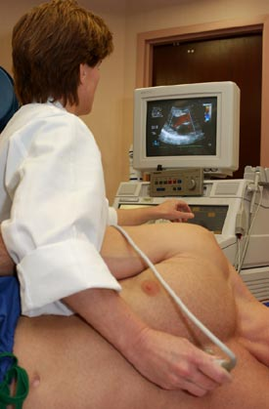
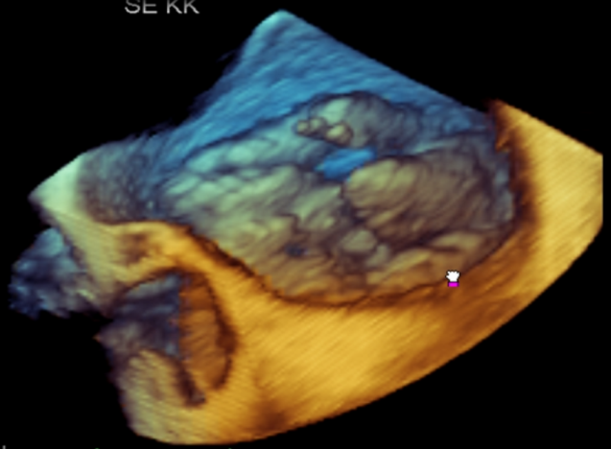
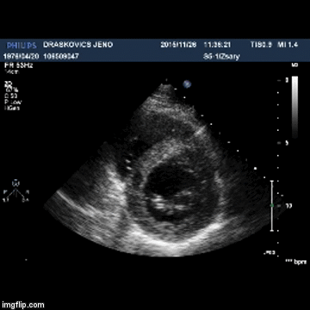
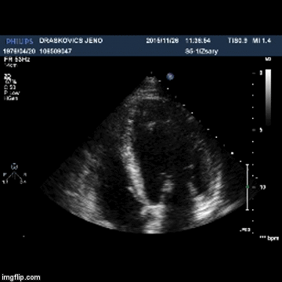
Diagnostic radiology department
Echocardiography
Transthoracic
Transesophageal
Stress
3D
Contrast
Introduction to Patient Care - Cardiology
1st March, 2022

Slide 10
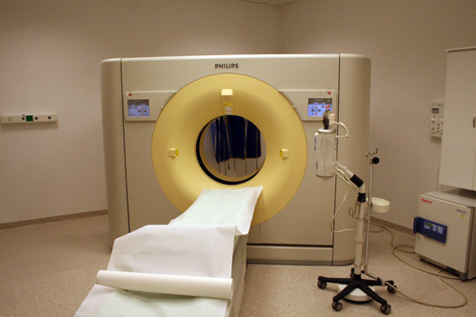
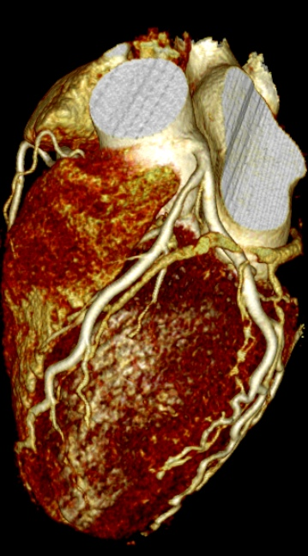
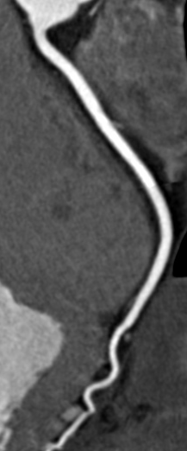
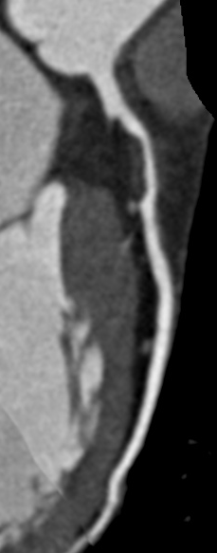
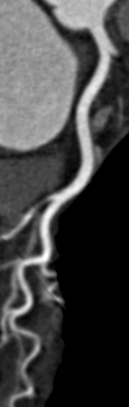
Diagnostic radiology department
Coronary CT angiography
Coronary plaque detection and characterization
Introduction to Patient Care - Cardiology
1st March, 2022

Slide 11
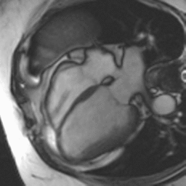
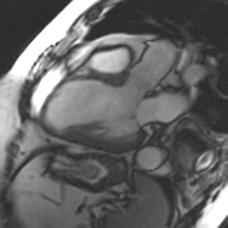
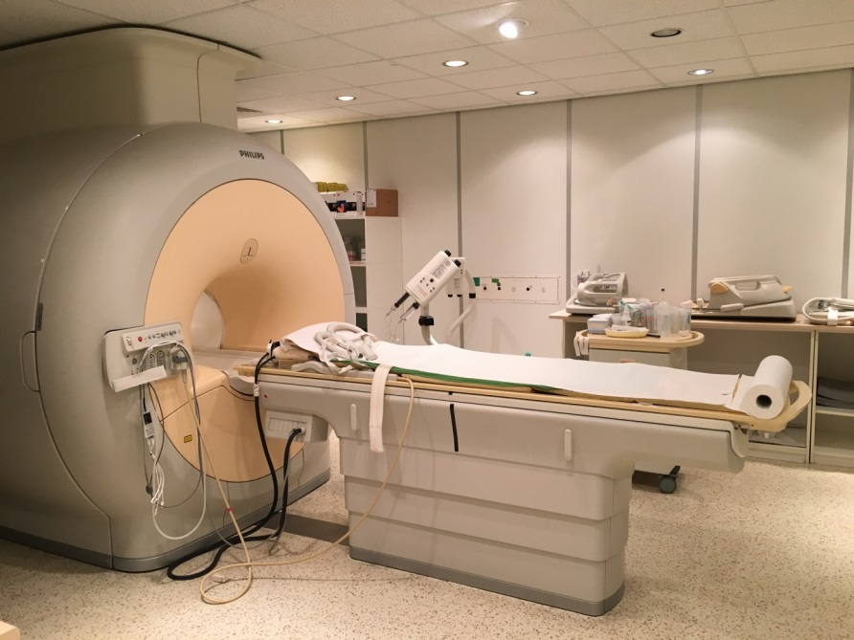
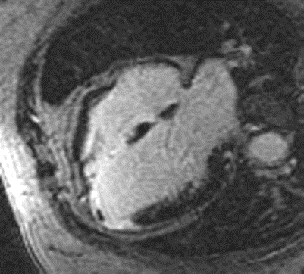
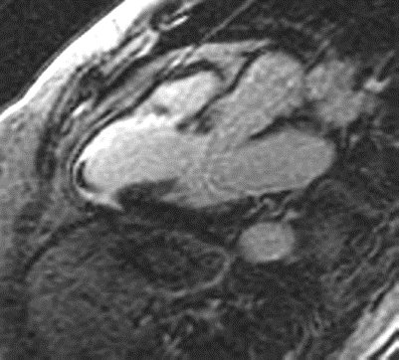
Diagnostic radiology department
Cardiac magnetic resonance imaging (CMR)
Ventricular volumes, ejection fractions, masses
Edema, necrosis, scar tissue
Ischaemic heart disease
Cardiomyopathies
Myocarditis
Congenital heart disease
Tumours
Pericardial diseases
Coronary anomalies
Introduction to Patient Care - Cardiology
1st March, 2022

Slide 12
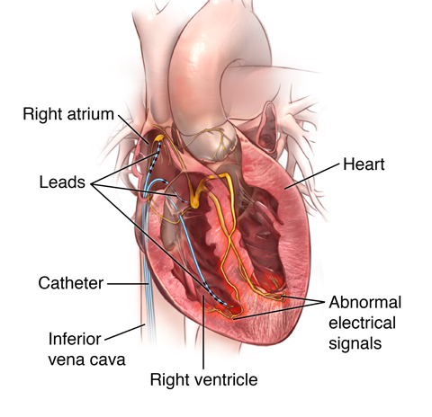
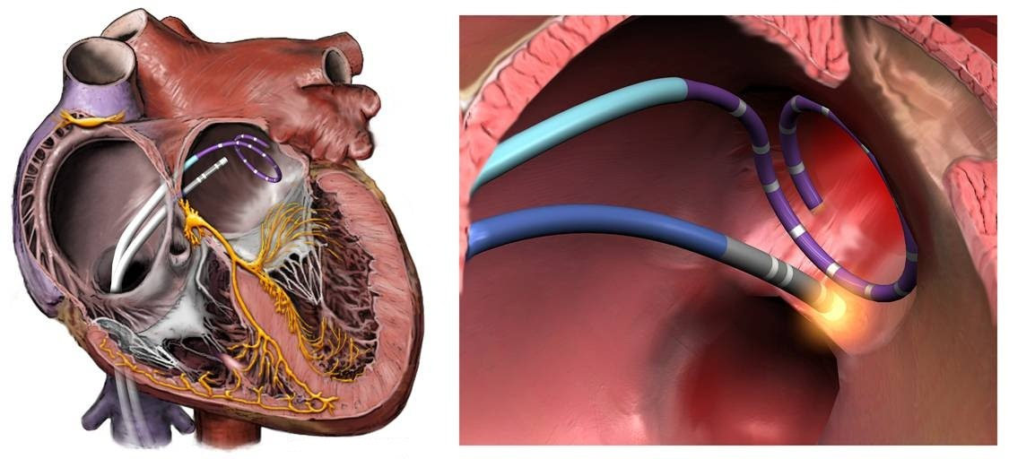
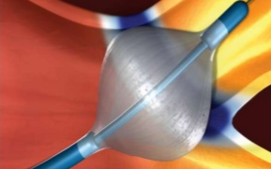
Electrophysiology laboratory
Atrial fibrillation ablation - Pulmonary vein isolation
Introduction to Patient Care - Cardiology
1st March, 2022

Slide 13
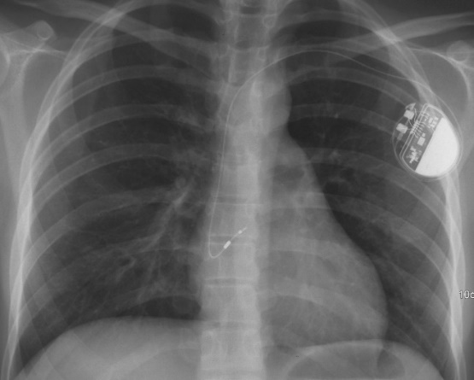
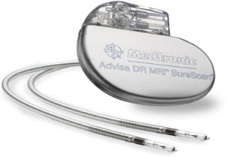
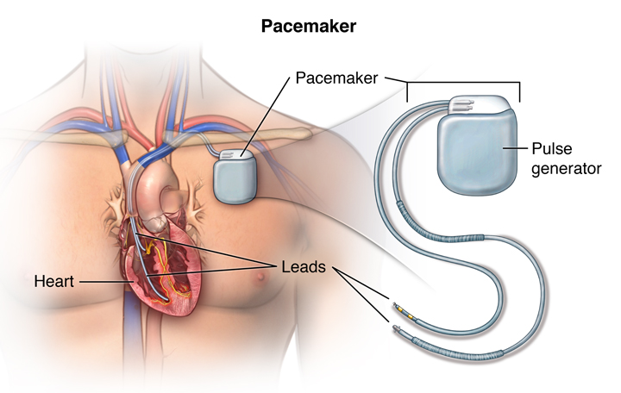
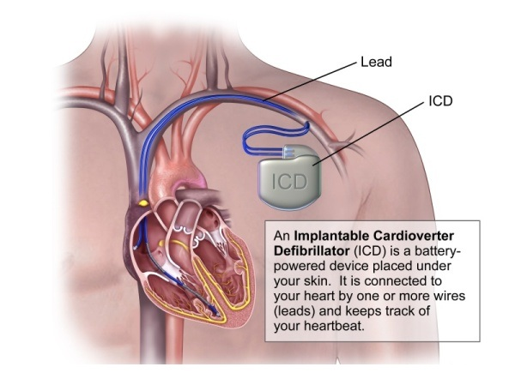
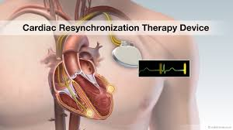
Pacemaker laboratory
Cardiac Pacing and Cardiac Resynchronization Therapy (CRT)
Introduction to Patient Care - Cardiology
1st March, 2022

Slide 14
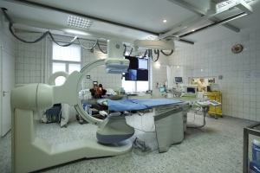
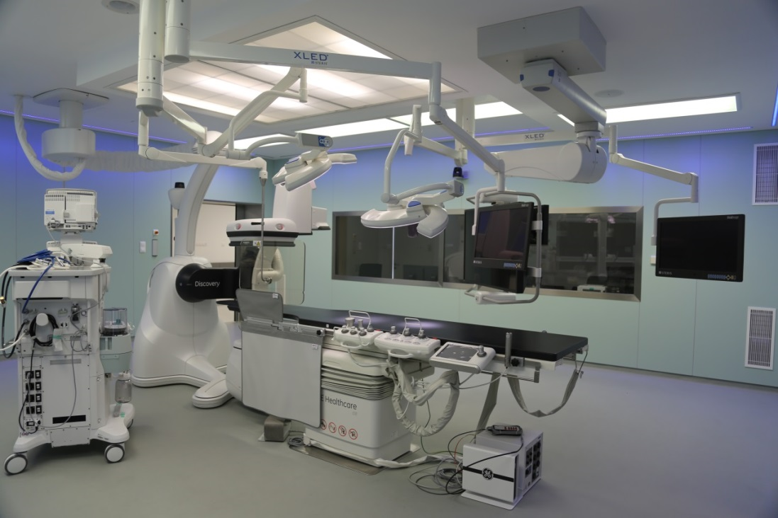
Catheterization Lab and
Hybrid Operating Room
Introduction to Patient Care - Cardiology
1st March, 2022

Slide 15
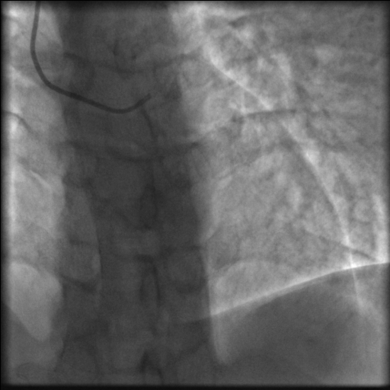
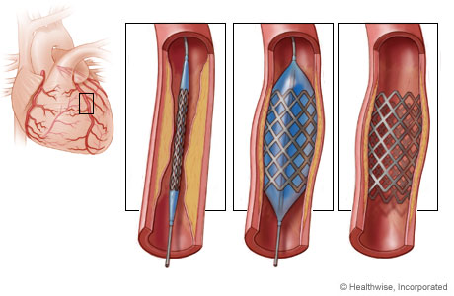
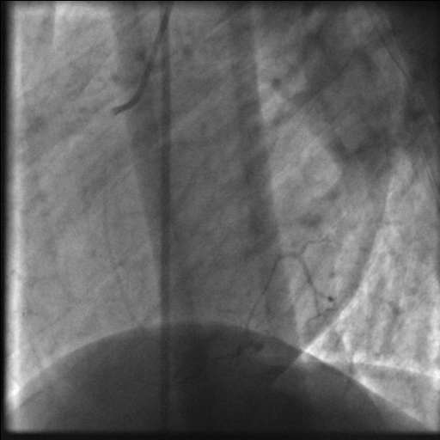
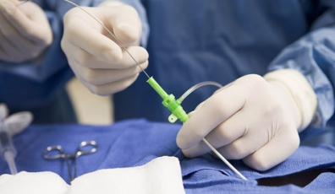
Invasive coronary angiography
Percutaneous coronary intervention
Introduction to Patient Care - Cardiology
1st March, 2022

Slide 16
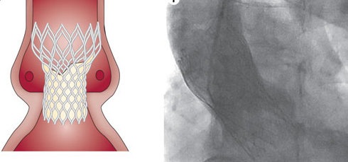
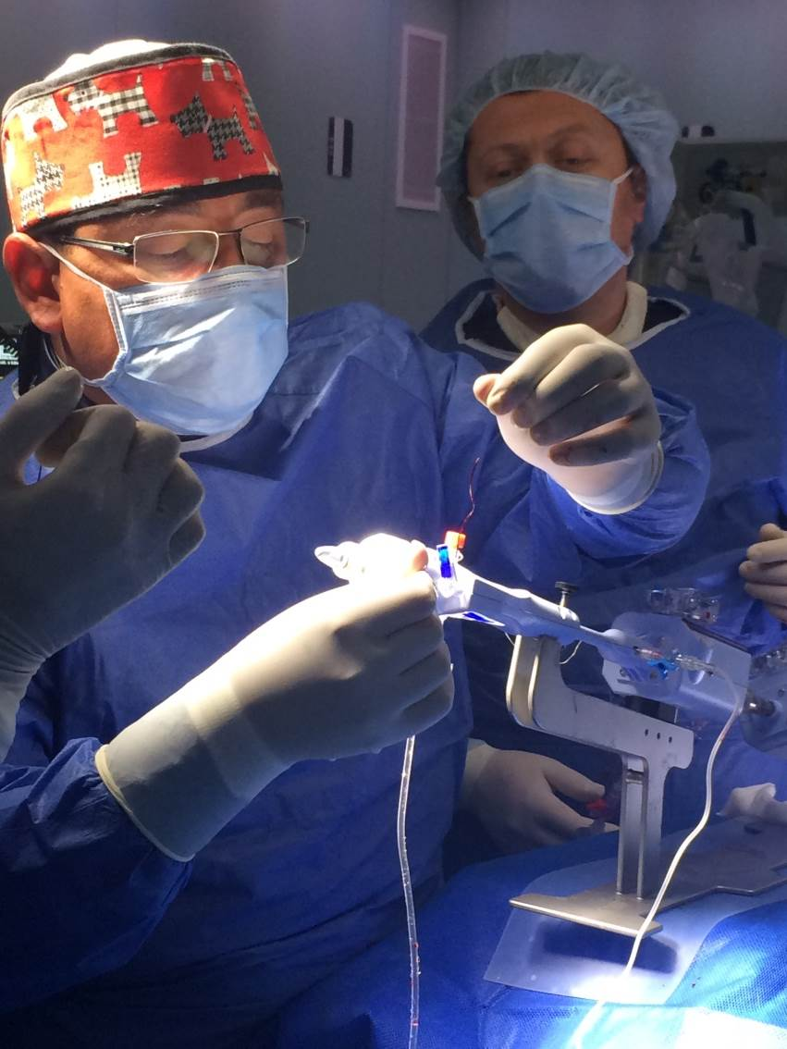
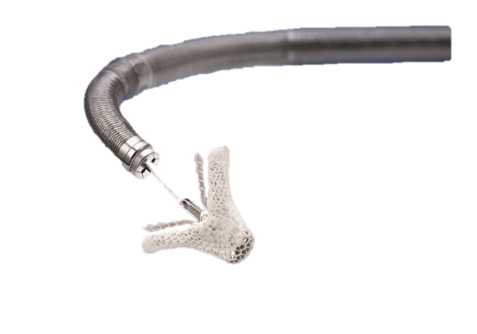
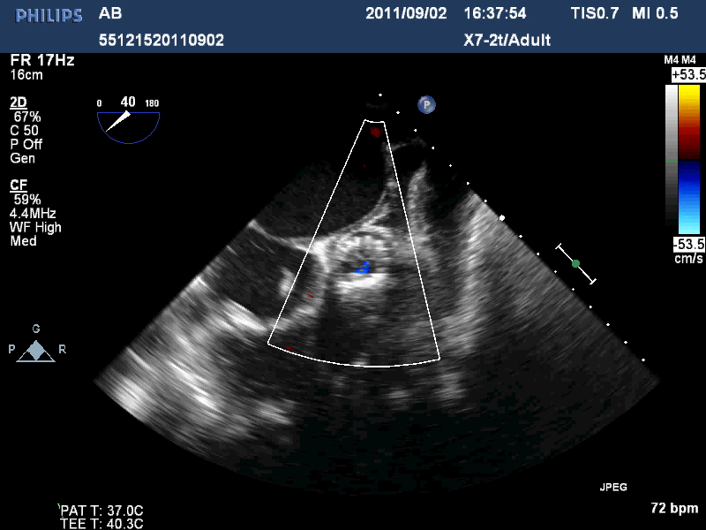
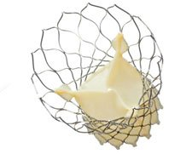
Transcatheter aortic valve implantation (TAVI)
Transcatheter Mitral Valve Repair
(MitraClip)
Transfemoral, transapical, transaortic, approach
Instead of surgical aortic valve replacement in high risk patients
Broad range of patients with severe aortic stenosis
minimally invasive technique for treatment of symptomatic chronic moderate-severe or severe mitral regurgitation
Introduction to Patient Care - Cardiology
1st March, 2022

Slide 17
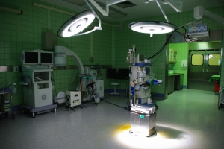
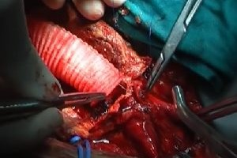
Department of Cardiothoracic Surgery
Patients are treated on 29 beds
6-800 heart surgery/year
Department of Vascular Surgery
Patients are treated on 55 beds, with an additional six beds reserved for intensive care
Introduction to Patient Care - Cardiology
1st March, 2022

Slide 18
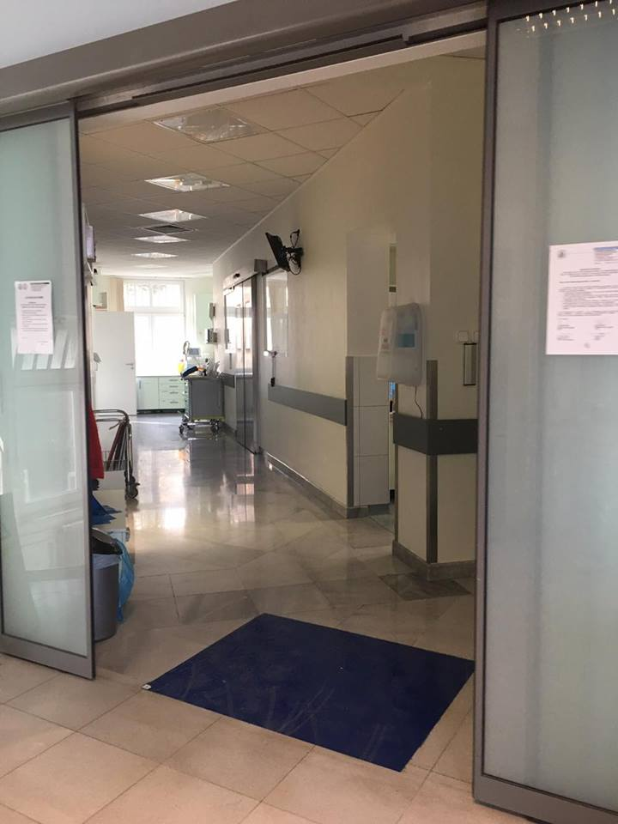
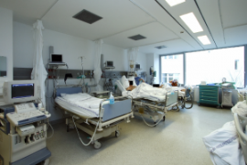
Intensive care unit and „VAD department”
Introduction to Patient Care - Cardiology
1st March, 2022

Slide 19
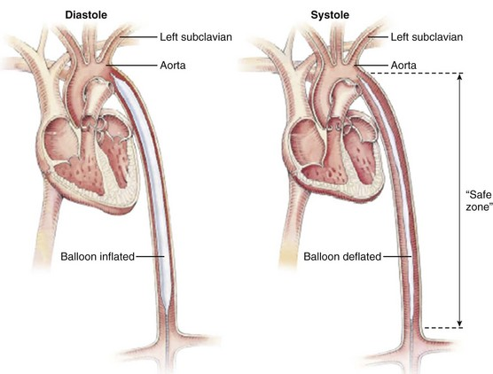
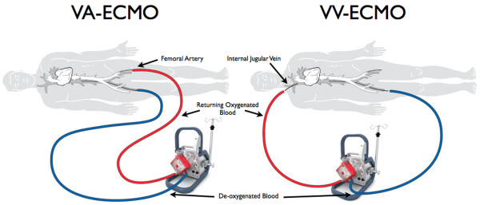
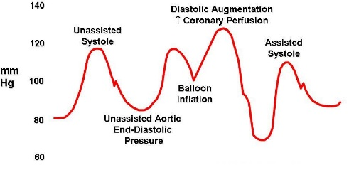
Non-pharmalogical treatment of
heart failure
Extracorporeal Membrane Oxygenator (ECMO)
Intra Aortic Balloon Pump (IABP)
works by removing blood from the body and artificially removing CO2 and oxygenating red blood cells
Veno-Arterial (VA): provides support for both the lungs and the heart
Veno-Venous (VV): support for the lungs only
actively deflates in systole, increasing forward blood flow by reducing afterload through a vacuum effect
actively inflates in diastole, increasing blood flow to the coronary arteries via retrograde flow
Introduction to Patient Care - Cardiology
1st March, 2022

Slide 20
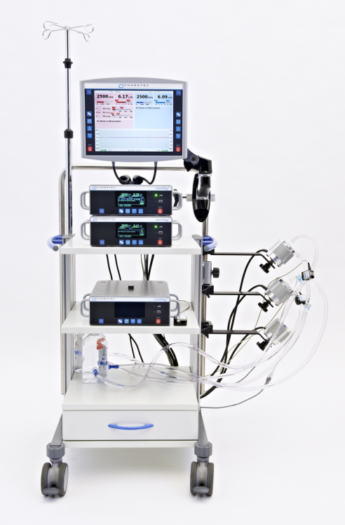



Non-pharmalogical treatment of
heart failure
Medium term extracorporeal ventricular assist device
  - First assist device in Hungary (2008)
  - First long term ventricular assist device (2012)
Long term left ventricular assist device
Introduction to Patient Care - Cardiology
1st March, 2022

Slide 21


Non-pharmalogical treatment of
heart failure
Cardiac resynchronisation therapy (CRT) and left ventricular assist device (LVAD)
Introduction to Patient Care - Cardiology
1st March, 2022

Slide 22



HTX and MCS
1992 - 2016
Non-pharmalogical treatment of
heart failure
HTX and MCS activity in the Heart and Vascular Centre
Heart transplantation (HTX)
Introduction to Patient Care - Cardiology
1st March, 2022

Slide 23


Modern technologies
Hybrid Operating Room
Introduction to Patient Care - Cardiology
1st March, 2022

Slide 24

Thank you for your attention!

