Slide 1
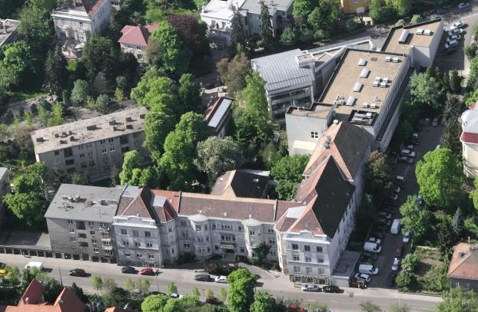
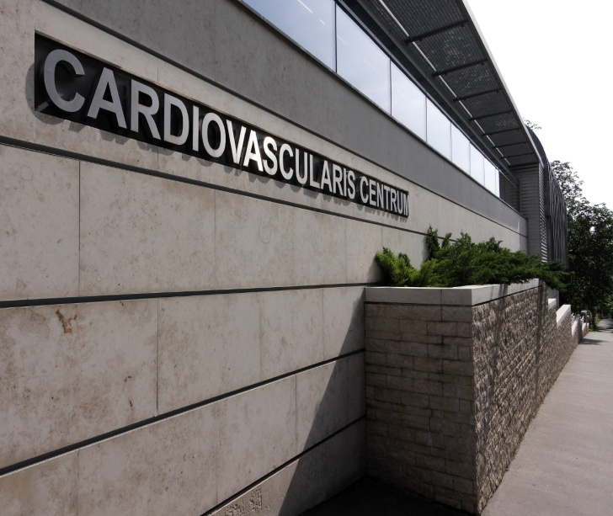
Introduction to Patient Care:
CARDIOLOGY

Slide 2
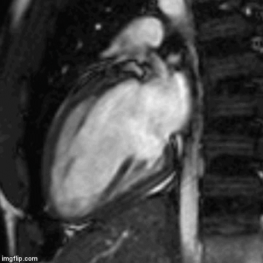
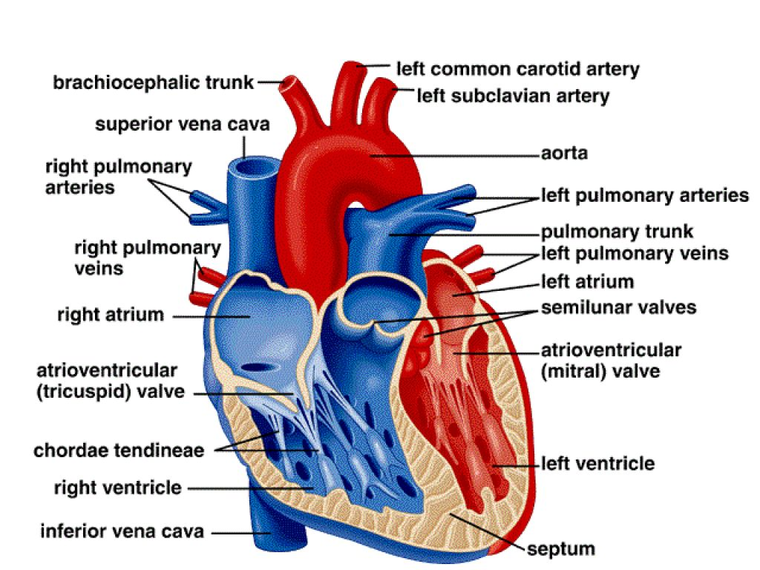
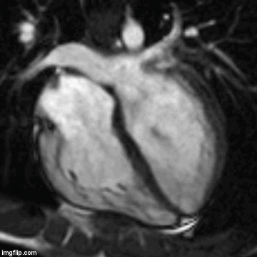
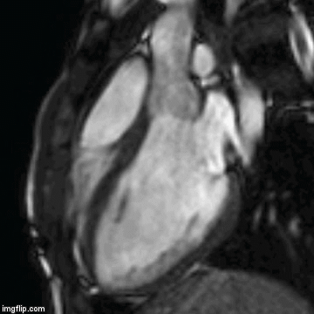
Anatomy of the heart
2 chamber view
4 chamber view
Cardiac magnetic resonance images
3 chamber view

Slide 3
Clinical status of the cardiovascular patient
Thorough medical history
family history
comorbidities / previous diseases, surgeries
cardiovascular risk factors
(smoking, high blood pressure, diabetes mellitus, hyperlipidaemia, age, male sex, obesity)
lifestyle / profession
medications
Complaints / Symptoms
Detailed physical examination

Slide 4
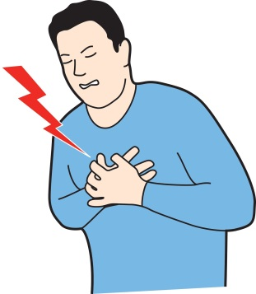
The most common symptoms
Chest pain
Palpitation
an awareness of the beating of the heart, too slow, too fast, irregular, or at it’s normal frequency
Dizziness
Fatigue
Syncope
fainting, sudden and generally momentary loss of consciousness
Dyspnea
shortness of breath is perceived as difficulty in breathing
Claudication

Slide 5
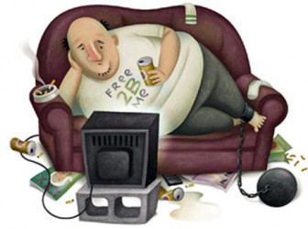
Case report
50 year-old man
heavy smoker
height: 175 cm, weight: 110 kg (BMI: 35.9)
has never been in hospital in his life
does not take any medications
his father got a heart attack at the age of 55
Complaints:
headache with high blood pressure,
average BP > 140/90 mmHg
occasionally BP > 180/100 mmHg !
rarely chest pain during exercise
John

Slide 6
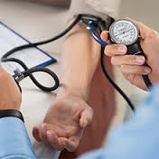
Newly diagnosed hypertension
What shall we do in the outpatient clinic?
A: I immediately admit John to the ward
B: I calm John down as stress could cause such
symptoms and no further examinations are needed
C: I start treating his hypertension and book appointments for further examinations
D: I book an appointment for coronarography for the patient

Slide 7
„Further examinations”
Exclude all of the diseases, which can cause
secondary hypertension
Looking for other cardiovascular risk factors:
blood test:
- high blood cholesterol level
- hyperuricaemia
- diabetes mellitus
Check the blood pressure with
24-hour ambulatory blood pressure monitoring (ABPM)

Slide 8
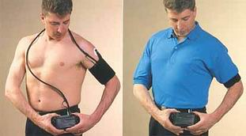
ABPM
(Ambulatory Blood Pressure Monitoring)
measures blood pressure at regular intervals throughout the day and night
it is believed to be able to reduce the „white coat” hypertension effect
Checks for
blood pressure variability,
nocturnal hypertension

Slide 9
John said: „I had some chest pain a few weeks ago,
when I carried heavy baggage. It lasted only 1-2 minutes.”
ECG:
- baseline
- during symptoms
(ST-segment and T wave abnormalities, arrhythmias)
Stress Test :
- to evaluate coronary artery disease (CAD)
- to determine functional capacity
- to estimate prognosis
- to provide information about the effectiveness of the current medical therapy

Slide 10
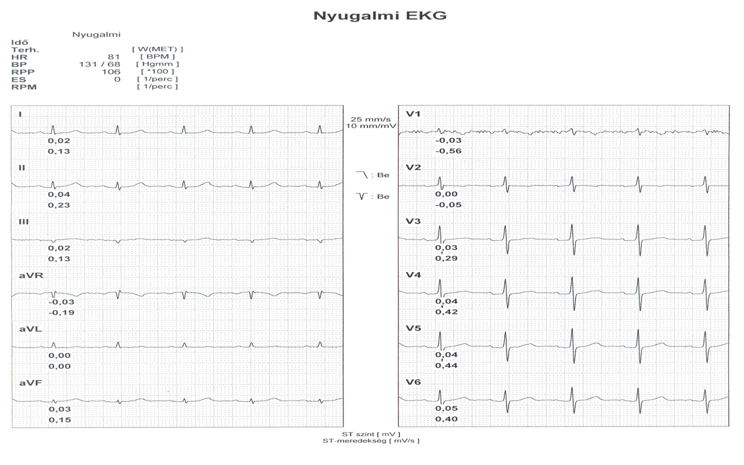
Stress test – baseline ECG

Slide 11
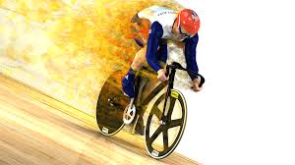
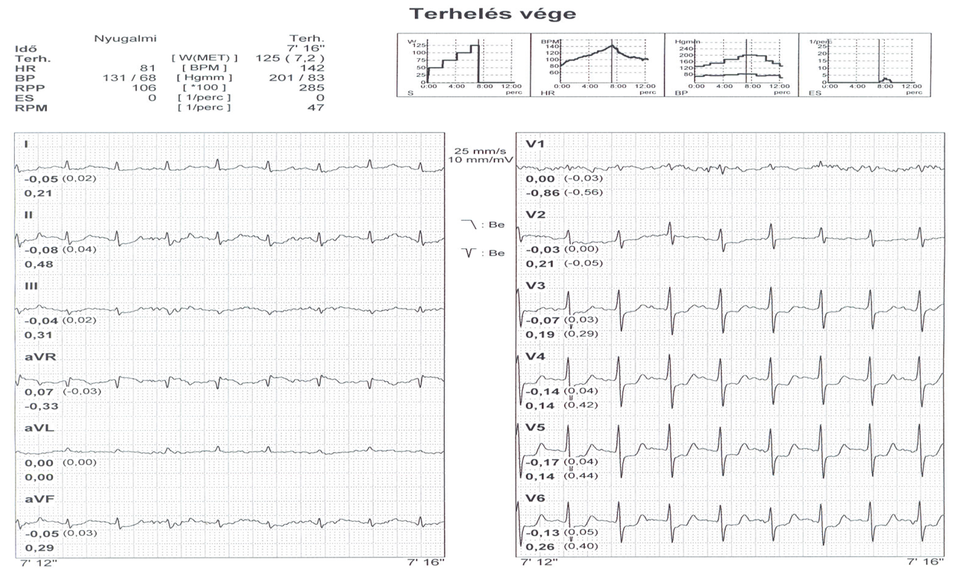
Stress test – maximal exercise

Slide 12
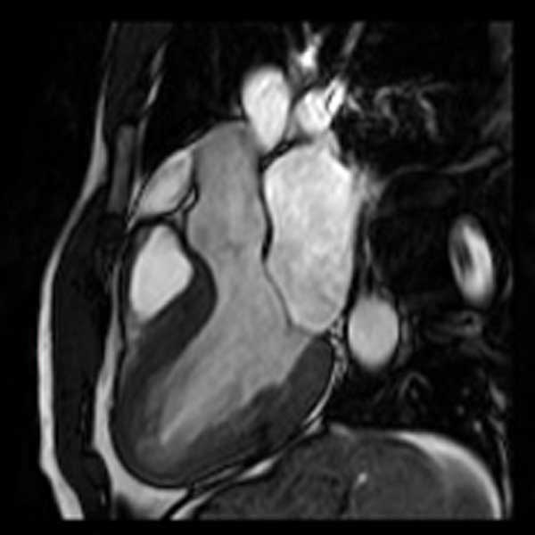
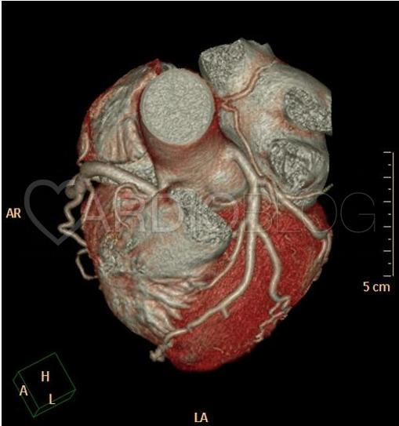
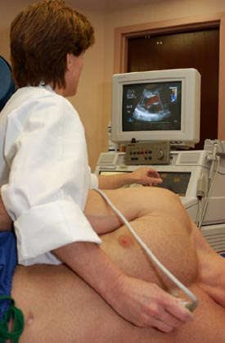
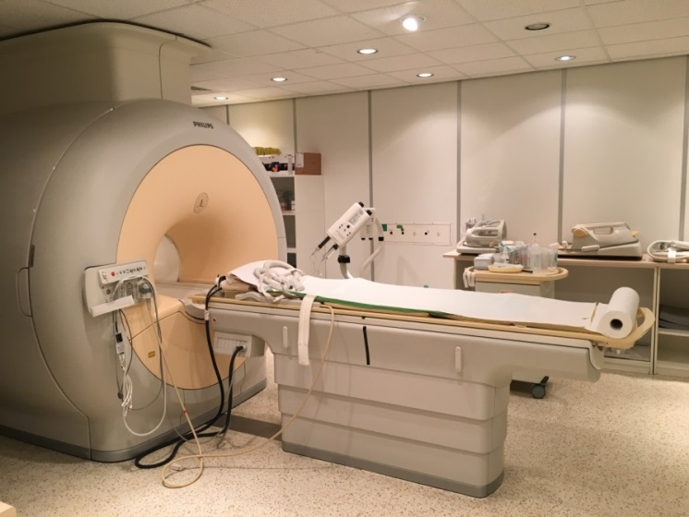
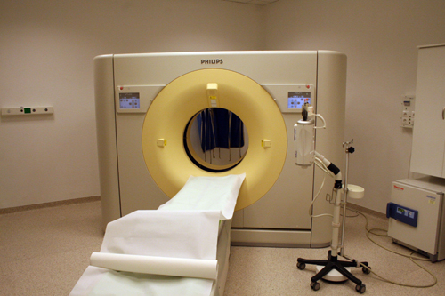
Non-invasive imaging modalities
Echocardiography
Cardiac MRI
Cardiac CT

Slide 13
Echocardiography
1. M-mode:
- detects the motion of the heart structure during heart cycle
- measuring heart structures, such as cavities
2. 2D echo:
- cone-shape, real-time motion of the heart's structures
- description of the cavities (size, function, wall thickness)
- valvular abnormalities
3. Doppler echo:
- blood flow through the valves and cavities
- transvalvular gradients, blood pressure in the great vessels
- valvular abnormalities
4. Color Doppler echo:
- visualizes the flow according to direction
- detection of transvalvular gradients, regurgitations, shunts

Slide 14
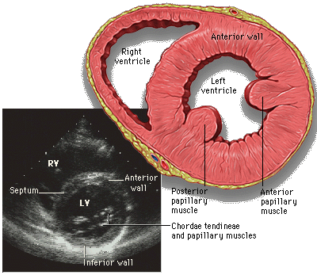
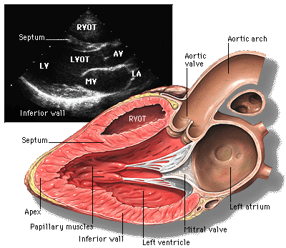
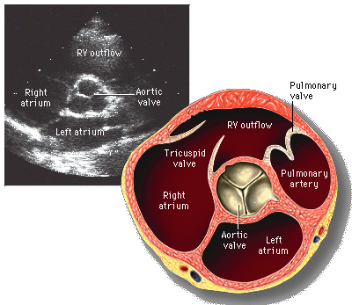
Parasternal long and short axis view

Slide 15
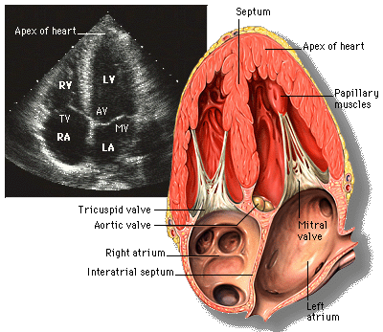
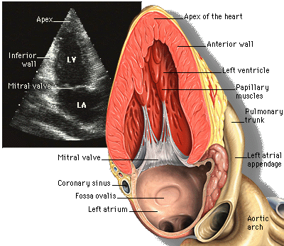
Apical 4 chamber view
Apical 2 chamber view

Slide 16
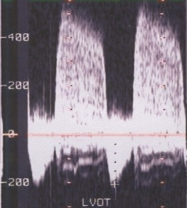
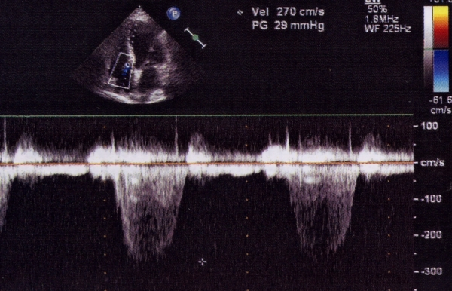
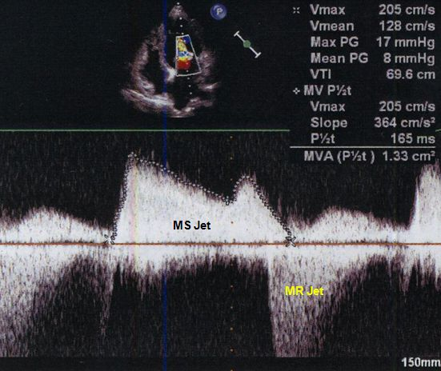
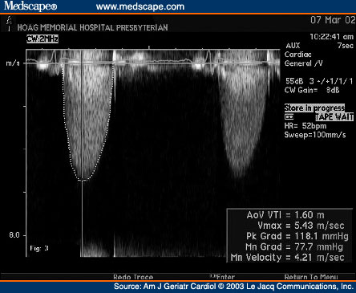
Aortic regurgitation
Tricuspidal regurgitation
Mitral stenosis
ΔP=4v²
Aortic stenosis

Slide 17
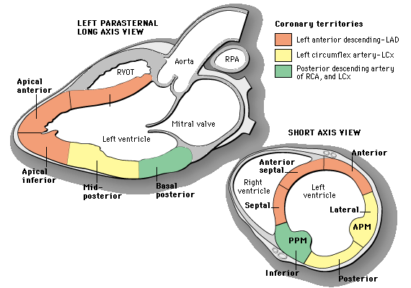
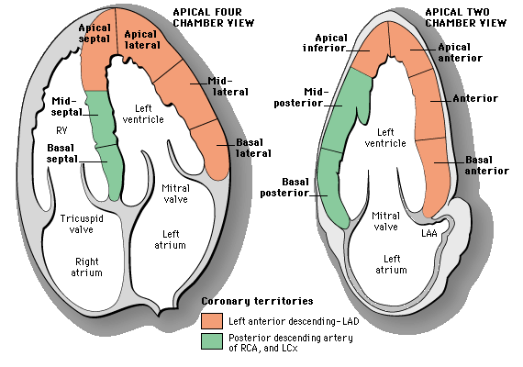
Assessment of
wall motion abnormalities
according to the
coronary territories

Slide 18
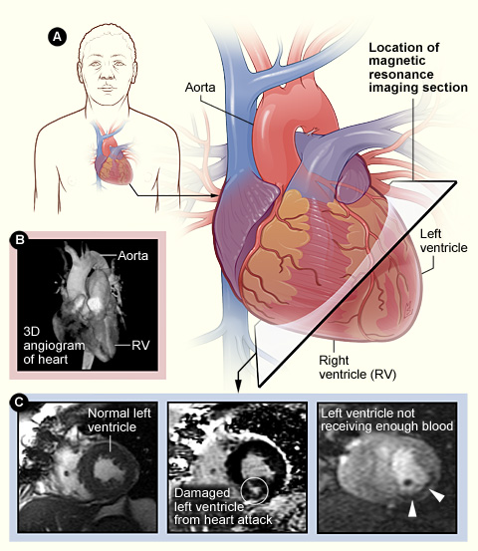
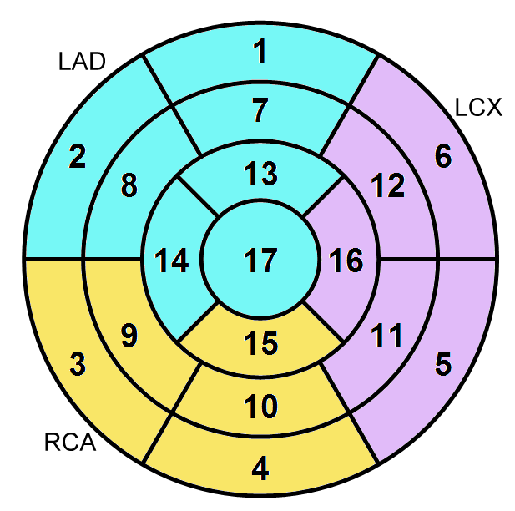
Cardiac MRI
evaluate the structures and function of the heart
evaluate valves and major vessels
viability assessment – detection of the presence, extent and severity of infarcted and viable myocardium
characterize rare cardiac tumors
Ischaemic heart disease
Cardiomyopathies
Myocarditis
Congenital heart disease
Tumours
Pericardial diseases

Slide 19
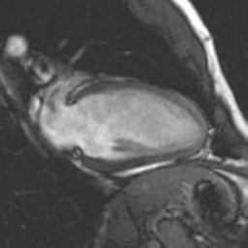
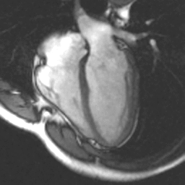
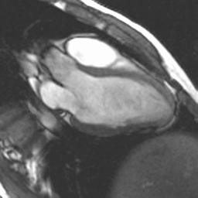
Cardiac MRI
Left and right ventricular volumes, ejection fractions (EF), myocardial masses, wall motion

Slide 20
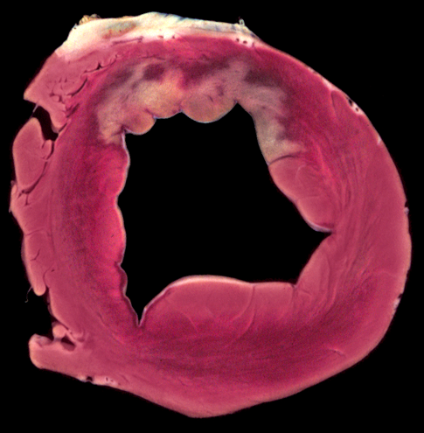
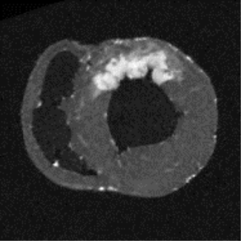
Delayed contrast enhancement
Viable myocardium is myocardium which due to ischaemia does not contract normally at rest but has the potential to recover its function, either by itself over time or after revascularisation.
Ischaemic heart disease
Global and regional left ventricular function
Viability „the bright is dead”

Slide 21
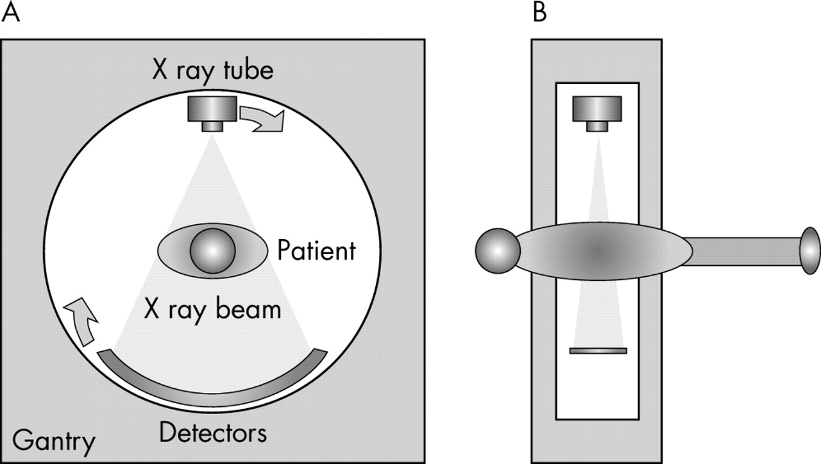
Non-invasive imaging: Computed Tomography (CT)
CT produces a volume of data of the body part on the basis of different X-ray attenuation values.

Slide 22
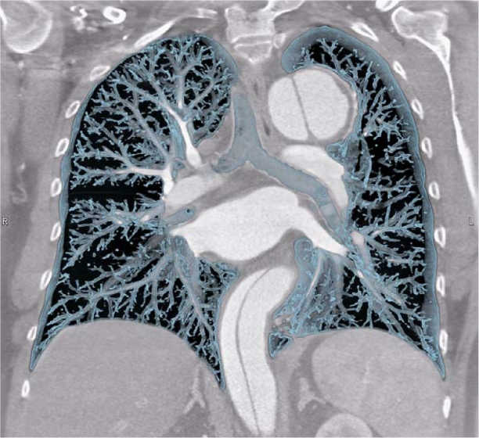
New CT applications in acute cardiology: Triple rule out
To rule out the most dangerous conditions which can cause acute chest pain with a single CT scan:
Myocardial infarction
Aortic dissection
Pulmonary embolism

Slide 23
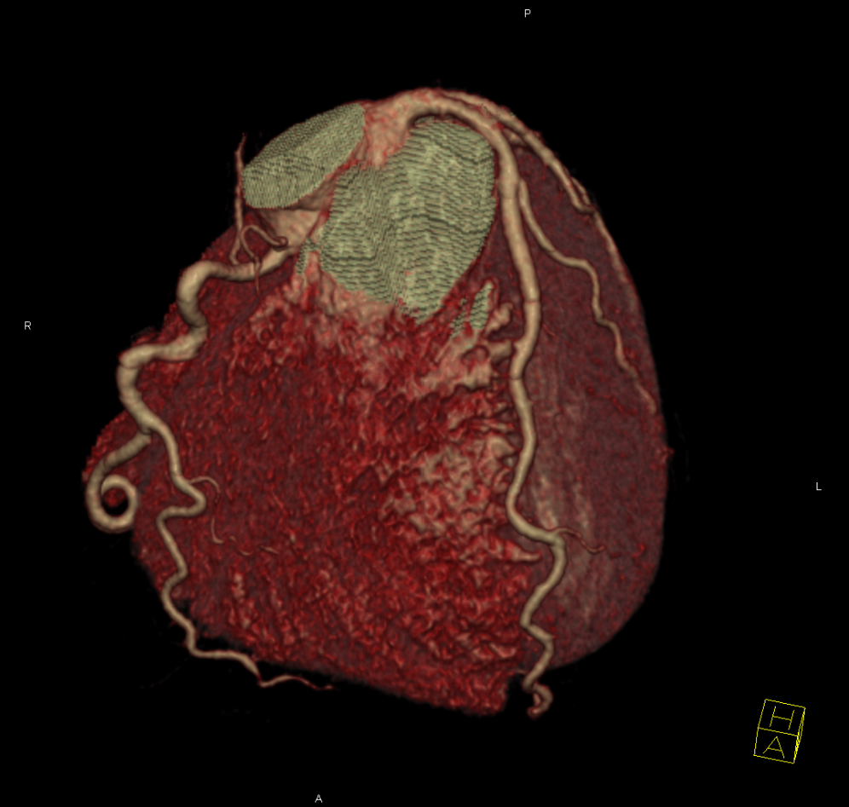
New CT applications in cardiology: coronary visualisation
Non-invasive coronary imaging: to depict the lumen and the wall of the coronary arteries without an invasive procedure
It can replace invasive coronary angiography (heart catheterization) in a selected patient population

Slide 24
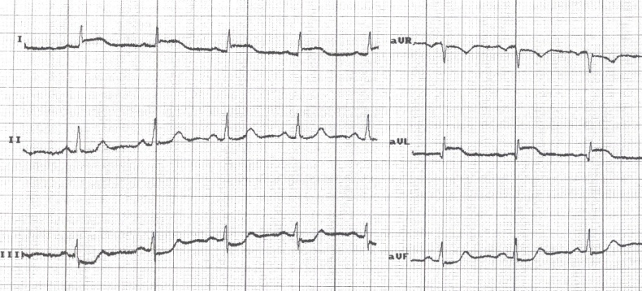
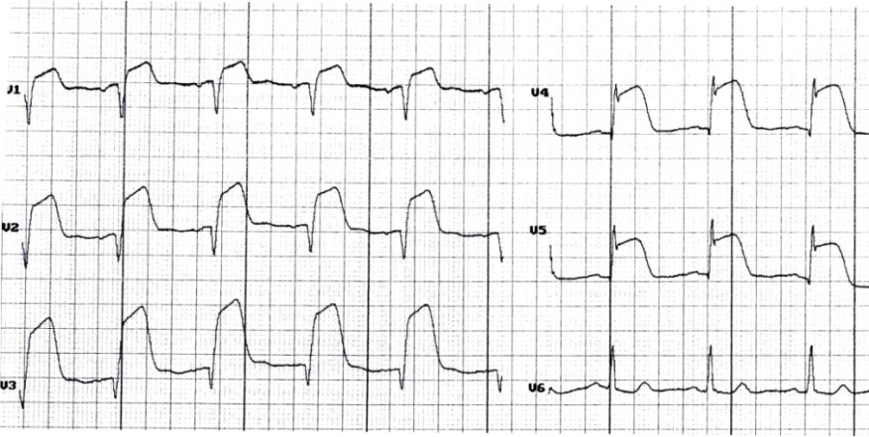
We have not seen John for 5 years …
- he did not stop smoking
- he did not lose any weight
- he did not control his blood pressure and stopped taking medications
Present complaints:
- pressure-like feeling in the chest
- sweating, shortness of breath
- nausea, fatigue
- pain killers did not help…
12-lead resting
ECG!!!

Slide 25
Ask questions!
When did the complaint begin?
How long did the chest discomfort last?
Quality, localization, radiation of pain?
Previous medical history and meds?
Any cardiac disease in the family?
Risk factors?
Answers:
Chest discomfort started 4 hours ago, and has not stopped yet
The chest pain/pressure radiates to the left arm, and he feels tingling of his fingers
The last two days he had short episodes of chest pain, which terminated at rest
He has been diagnosed with hypertension 5 years ago. He refuses medications.
Heavy smoker and obese
No operations and no other medical history
His father had a myocardial infarction at the age of 55

Slide 26
What is the diagnosis?
What shall we do?
Acute ST-segment elevation myocardial infarction
First care: ambulance
- examination (pulse, cardiac murmurs, rales over the lungs, blood pressure, ECG)
- medication (aspirin, clopidogrel, heparin, morphine, nitroglycerine…)
- fast transportation
Cardiology Department
specialized for cardiac catheterization
primary Percutaneous Coronary Intervention
Main goal:
to shorten the time between onset of pain and to open up the closed coronary artery

Slide 27
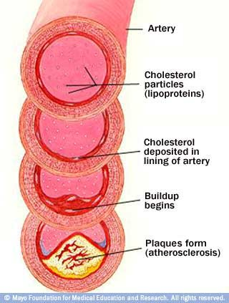
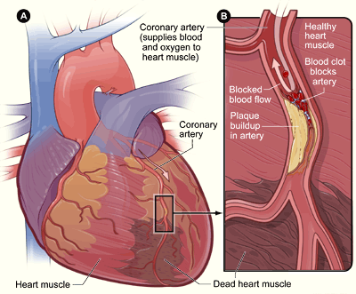
Coronary Artery Disease (CAD):
arteriosclerosis of the coronary arteries
Acute coronary syndrome
rupture of an unstable plaque of the coronary artery
acute thrombosis and occlusion of the coronary artery
unstable angina/
myocardial infarction

Slide 28
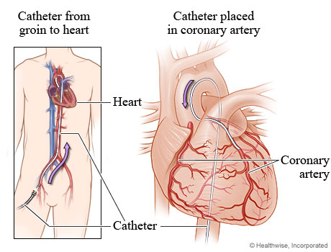
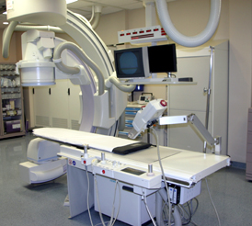
Invasive coronary catheterization
Minimally invasive procedure
to visualize coronary circulation
Seldinger technique
access site:
radial or femoral artery punction
Cannulation of the left and right
coronary artery from the aortic root
using a special catheter

Slide 29
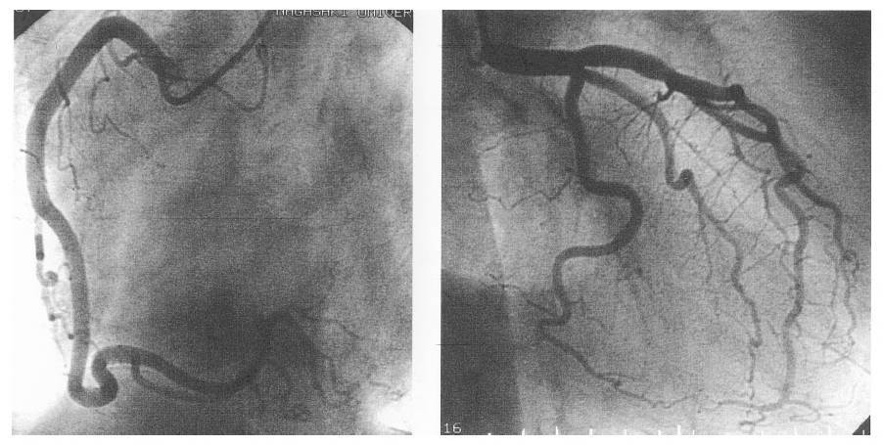
Coronary Angiography
Right coronary artery
Left coronary artery

Slide 30
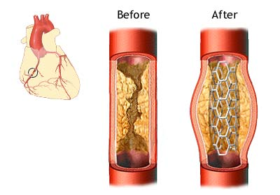
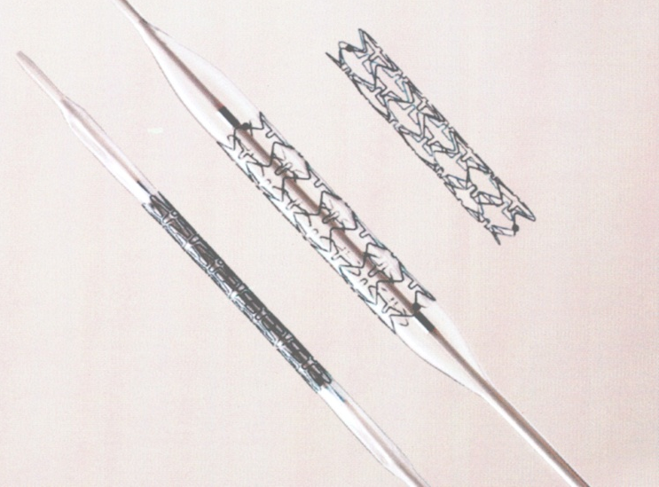
Percutaneous coronary intervention (PCI)
X-ray and selective injection of radiocontrast agent into the coronary arteries - coronary angiogram
Visualization of coronary artery occlusion (acute or chronic), severe stenosis, collateral coronary circulation
Balloon dilatation, stent implantation

Slide 31
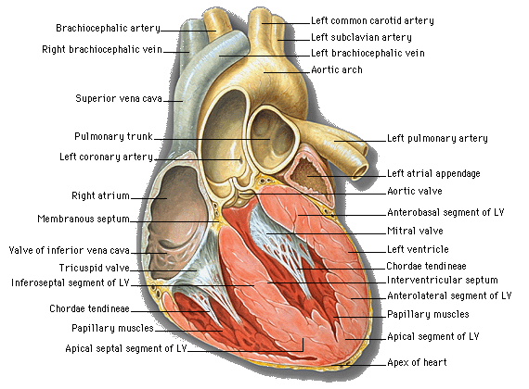
Complications of acute myocardial infarction
Cardiogenic shock
Atrial fibrillation,
heart block
Acute mitral regurgitation
Heart failure
Ventricular arrhythmias
(VT, VF)
Acute VSD
Thrombus
RV infarction
Aneurysm,
remodelling of LV
Pericardial tamponade
Myocardial free wall rupture

Slide 32
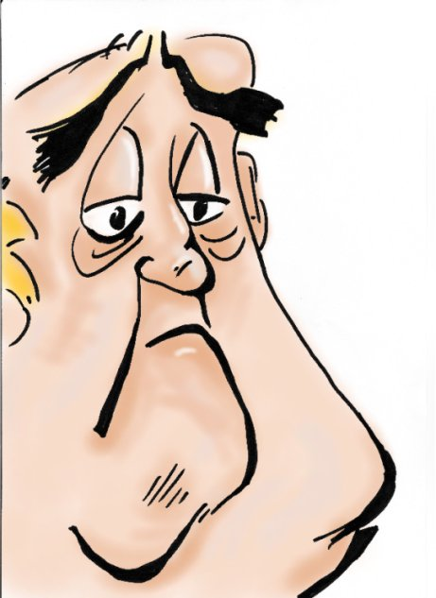
During the next couple of years, John was getting worse …
Shortness of breath
Fatigue
Less and less exercise resulted in complaints
Fluid retention - peripheral dependent edema
Cyanosis
Cough – blood stinged sputum, orthopnoe
Congestion of the liver – ascites
Congestion of the intestines – less appetite, GI disorders
More and more medications
Poor quality of life
Rehospitalization
HEART FAILURE !

Slide 33
Symptoms:
HEART FAILURE
Dilated cardiomyopathy

Slide 34
Severe coronary artery disease – 3 vessel disease
Dilative cardiomyopathy: poor myocardial contractility, EF:<35%
Chronic heart failure with acute exacerbations
Arrhythmias - atrial fibrillation
ventricular tachycardia
Sudden cardiac death - ventricular fibrillation
Optimal medical therapy
Preventive ICD implantation
Cardiac resynchronisation therapy

Slide 35
Heart transplantation
48 heart transplantations at our Institute last year

Slide 36
HTX 1992 - 2016

Slide 37
The future is now…
Temporary circulatory support - extracorporeal membrane oxygenator (ECMO)
Medium term extracorporeal ventricular assist device

Slide 38
Long term left ventricular assist device
- First assist device in Hungary (2008)
- First long term ventricular assist device (2012)
Heart Mate II

Slide 39
Resynchronization therapy
Ventricular assist device

Slide 40
Mitraclip
Mitraclip

Slide 41
Dr. Merkely Béla igazgatói beszámoló
Notes:
41

Slide 42
Modern Technologies
High Throughput NGS
Sequencer (Illumina)
Hybrid operation theatre
Semmelweis
Biobank database
Human and experimental
imaging
Multimodal microsopy
Bioinformatics

Slide 43
Thank you for the attention!

