Slide 1
Introduction to Patient Care:
Psychiatry
Attila J. Pulay, M.D., Ph.D.
Assistant Professor
Semmelweis University
Department of Psychiatry and Psychotherapy

Slide 2

Psychiatry: the meeting point of clinical profession, biology, social sciences, and human care

Slide 3
Synopsis
Historical roots
Scientific background
Clinical practice

Slide 4
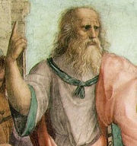
The Graeco-Roman period
Alcmaeon (ca. 500 B.C.): mental processes are located in the brain
Plato (427?-347 B.C.): tripartie soul of thought, desire, emotion; rational part in the brain
Aristotle (384-322 B.C.): the task of the brain is to cool the blood
Raphael`s Plato

Slide 5
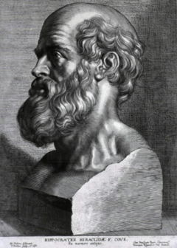
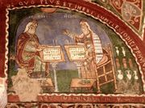
Hippocrates (460-377 B.C.)
The body humor hypothesis:
Black bile – melancholia
Yellow bile – mania
Hysteria – disease of uterus
Paranoia
Sacred disease - epilepsy
Galen (129-199 A.D.)
Imagination, reason and memory
Morositas – deadening of the emotional life
Paraphrosune – paranoia
Alienation – bizarre behavior
Rubens` Hippocrates
Mural painting depicting
Galen and Hippocrates (Anagni)

Slide 6
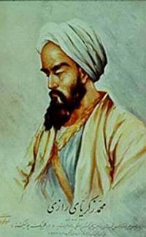
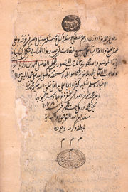
The first ward for the mentally ill:
Hospital of Baghdad
Al-Razi (865-925): scholar of Greek medicine, philosopher and alchemist
ابو بکر محمد بن زكريا الرازی Textbook of Al-Razi

Slide 7
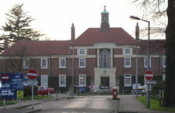
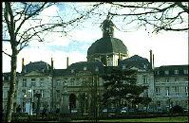
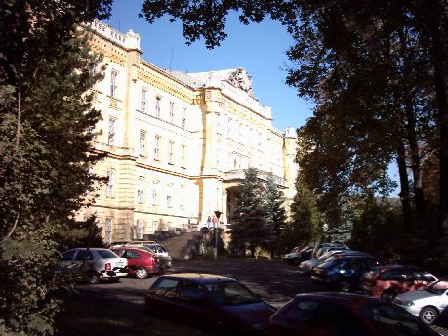
Psychiatric Asylums in Europe
Bethlem Hospital, London (1330)
Salpêtrière, Paris (1675)
Asylum of Budapest (1886)

Slide 8
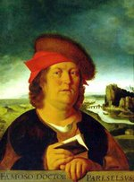
Paracelsus
(1493-1541)
- experimentation in learning about the human body
- sickness and health in the body relied on the harmony of man, the microcosm,
and Nature, the macrocosm
- using this analogy not in the manner of soul-purification but that humans must have
certain balances of minerals in their bodies
illnesses of the body and soul had chemical remedies that could cure them –
the concept of medicine

Slide 9
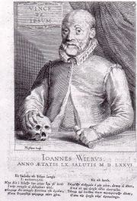
Johann Weyer (1515-1588)
Psychiatric illness is not a consequence of transcendent factors
- De Praestigiis Daemonum et Incantationibus ac Venificiis
(On the Illusions of the Demons and on Spells and Poisons), 1563
- De Lamiis Liber (Book on Witches), 1577
- Pseudomonarchia Daemonum (The False Kingdom of the Demons), 1577

Slide 10
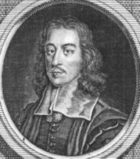
Thomas Willis (1621-1675)
“Cerebri anatomi”, 1664 (the term “neurology”)
- “Pathologicae cerebri, et nervosi generis specimen”, 1667
“Two Discourses concerning The Soul of Brutes, Which is that of the Vital
and Sensitive of Man”, 1672 (the first English work on medical psychology)

Slide 11
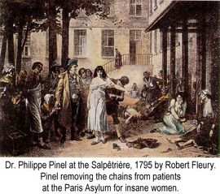
Philippe Pinel (1745-1826)
Humanization of the treatment of the mentally ill

Slide 12
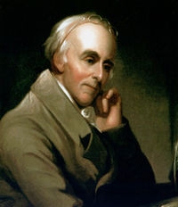
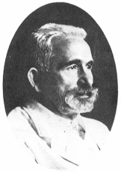
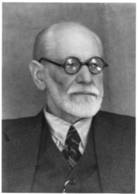
Johann Christian Reil (1759 -1813): the term Psychiatry in 1808 (psyche - soul
Iatros – doctor)
The first psychiatric university department:1865, Berlin
Károly Laufenauer, 1882, Budapest
America: Benjamin Rush (1745-1813), American Psychiatric Association (1844)
Emil Kraepelin (1856-1926): classification of mental disorders
Eugen Bleuler: the term schizophrenia
Sigmund Freud (1856-1939): psychoanalysis

Slide 13
Kraepelin's view
Treated patients with severe mental disorders in asylums
Origin of illness:
brain pathology
Freud's view
Treated less severe outpatients
Origin of illness: repressed unconscious (sexual) desires, abnormal psychosexual development

Slide 14
Psychiatric disorders today: The heritage
Symptom | Ancient | XIX. century | Today
Acute disorder of consciousness, disorientation | Phrenitis Delirium | Infectious and toxic psychosis | Acute organic disorders Disorders due to general medical condition
Lack, decline or loss of mental functions | Dementia, amentia | Dementia paralytica (syphylis) Degenerative psychosis of old age | Dementia Psychiatric symptoms caused by neurological disorders
Low mood, loss of pleasure and motivation or the opposite | Melancholia Mania | Manic-depressive psychosis Melancholia | Bipolar disorder Unipolar depression
Hallucinations (hearing voices), bizarre beliefs and behavior | Mania | Dementia praecox (Bleuler’s schizophrenia) Paranoia | Schizophrenia Delusive disorder
Predatoriness, lack of compassion, empathy and foresight | - | Moral insanity | Antiscocial personality disorder
Anxiety, phobias, body symptoms with no objective origin | Hysteria | Neuroses | Anxiety disorders Somatoform disorders Dissociative disorders

Slide 15
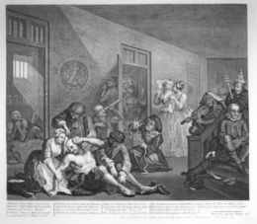

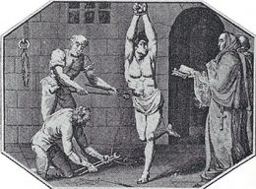
The dark side of psychiatry
Torture of patients in medieval ages
Patients were closed in large institutions
Political psychiatry (Soviet Union and Nazis)
Lobotomy, insulin coma, electroconvulsive therapy with no anaesthesia
No scientific bases of mental illness
Psychoanalysis is a myth and not science
1960: antipsychiatry movement (David Cooper, Thomas Szasz)

Slide 16
What happens if we reject and forget psychiatry?
Attempts in Italy as an influence of antipsychiatry
  Patients on the street and behind the bars
  Patients as victims and criminal offenders
Restriction of psychiatry services due to financial shortcuts (USA today)
  US Dept. of Justice (1999): 16% of inmates in jails have severe mental illness
  Human Right Watch Report (2003): on a given day 70000 psychotic patients are in prisons

Slide 17
Response and development
Social psychiatry and assertive community treatment
Closing asylums and helping patients find their way back to the community using modern psychotherapy
Development of neuroscience
Molecular genetics, brain imaging, and pharmacology

Slide 18
Is it true that psychiatric disorders lack scientific bases?

Slide 19
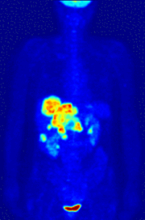
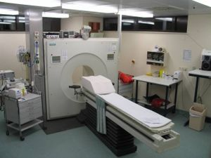
Modern neuroimaging methods allow the visualization of brain working during thinking, feeling, and deciding:
- Positron emission tomography (PET)
- Functional magnetic resonance imaging (fMRI)
Positron emitting radioligand in the body

Slide 20
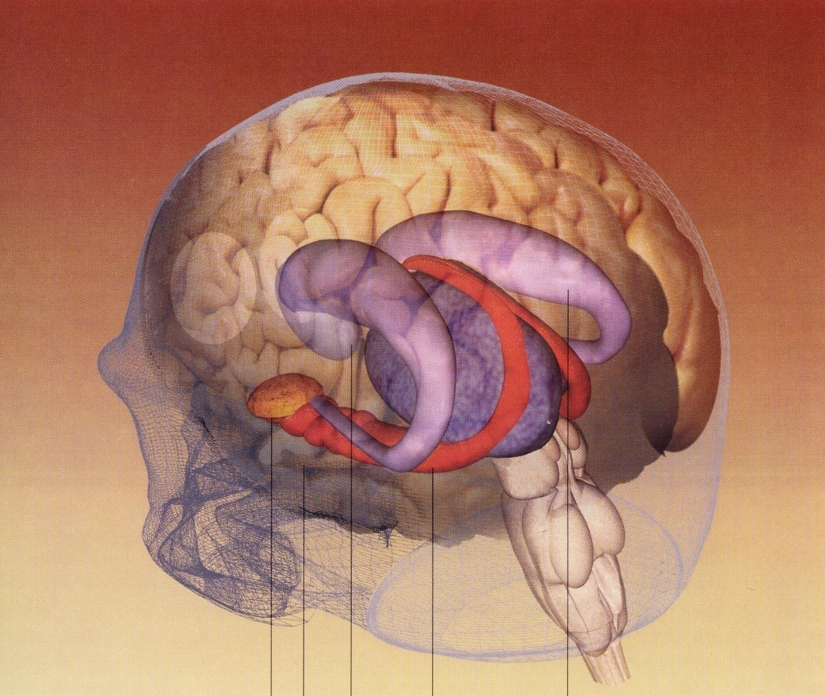
basal ganglia
thalamus
brainstem
amygdala
hippocampus
Limbic system

Slide 21
(Pre)Frontal lobe: - Higher cognition (lateral part)
- Emotional and social functions (bottom part)
- Schizophrenia, ADHD, OCD
Basal ganglia: - Movement regulation
- Skill and habit learning (feedback and reward)
- Parkinson`s disease, ADHD, OCD
Amygdala: - Emotion, fear, anxiety
- Depression, anxiety disorders
Hippocampus: - Remembering facts and events (explicit memory)
- Alzheimer`s disease

Slide 22
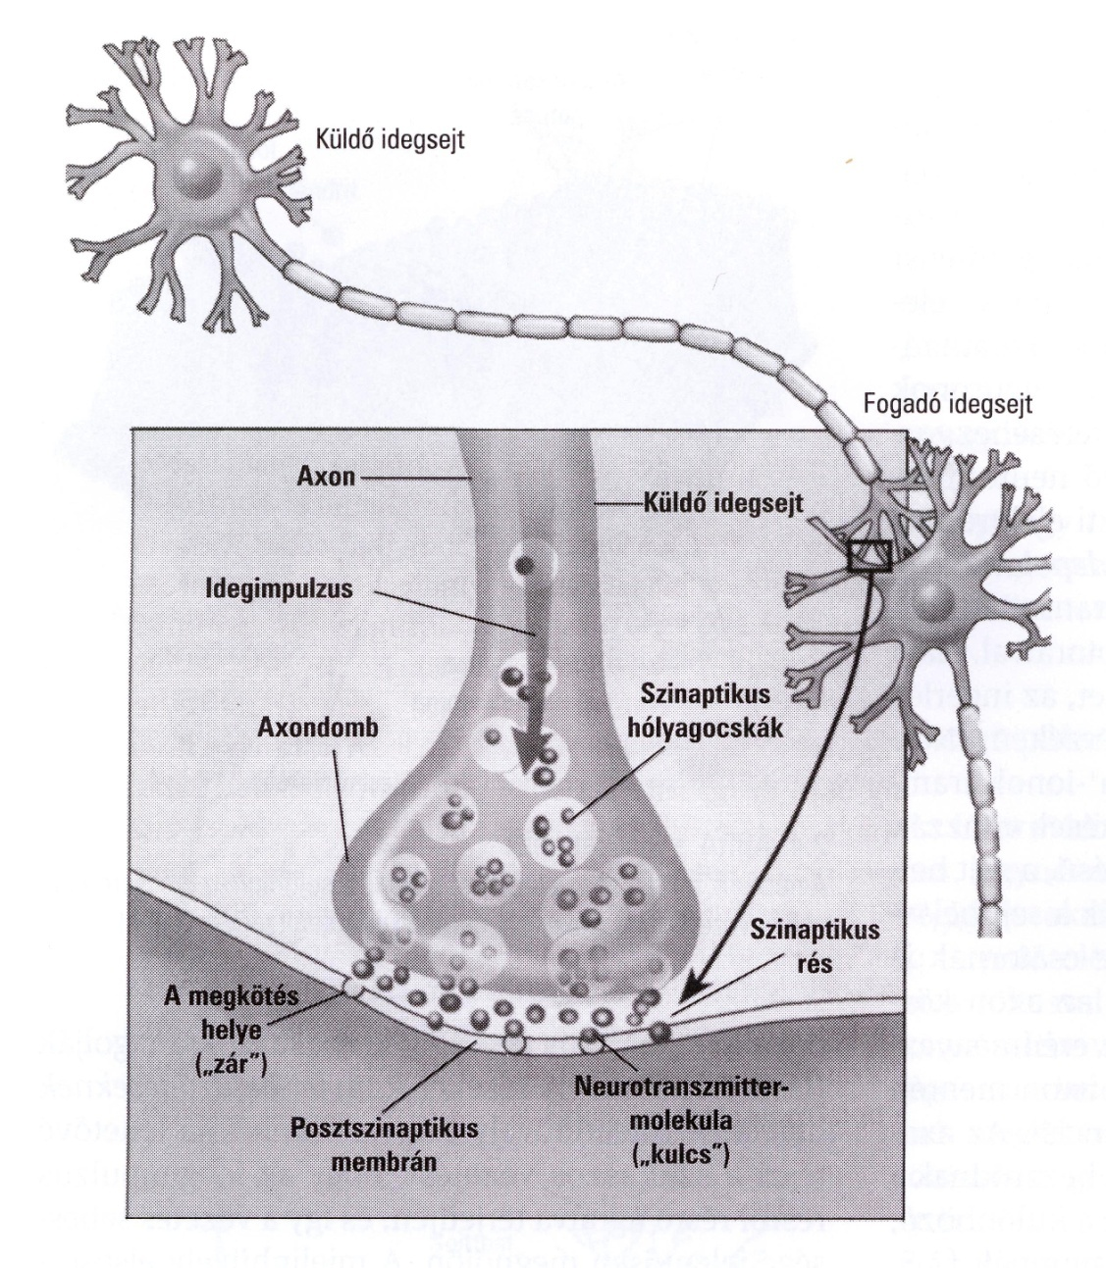
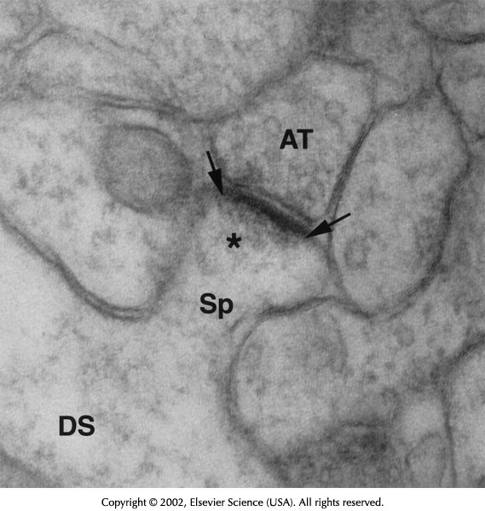
Sending neuron
Receiving neuron
Action potential
Vesicles
Presynaptic
terminal
Synaptic cleft
Receptor
Postsynaptic
membrane
Neurotransmitter

Slide 23
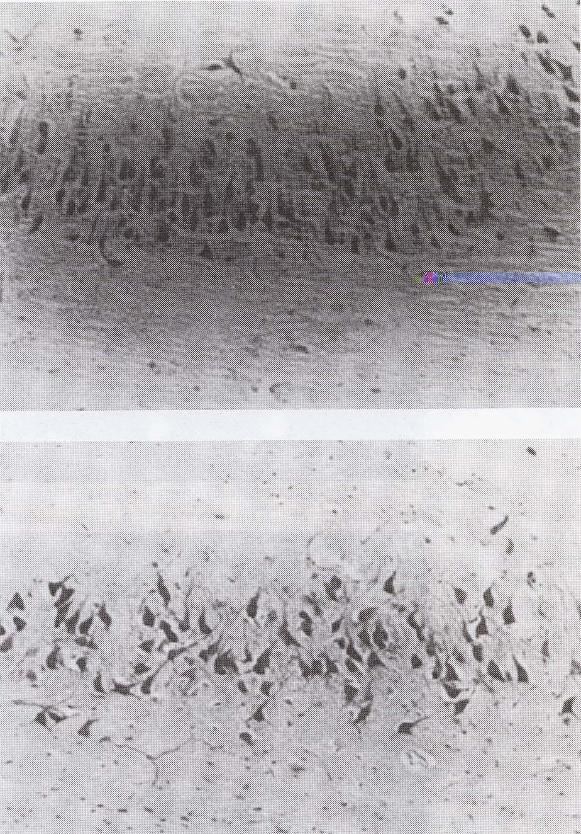
Cells are abnormally localized and disorganized in the brain of schizophrenia patients

Slide 24
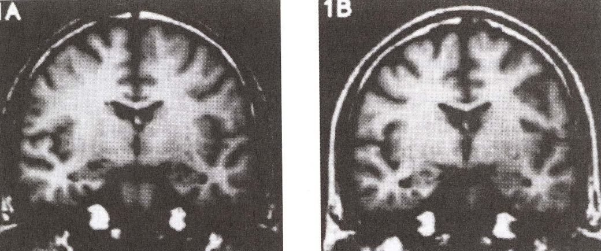
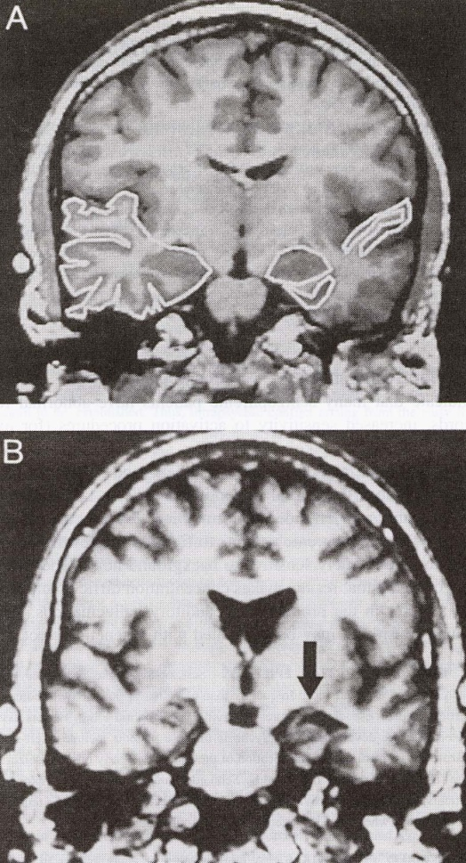
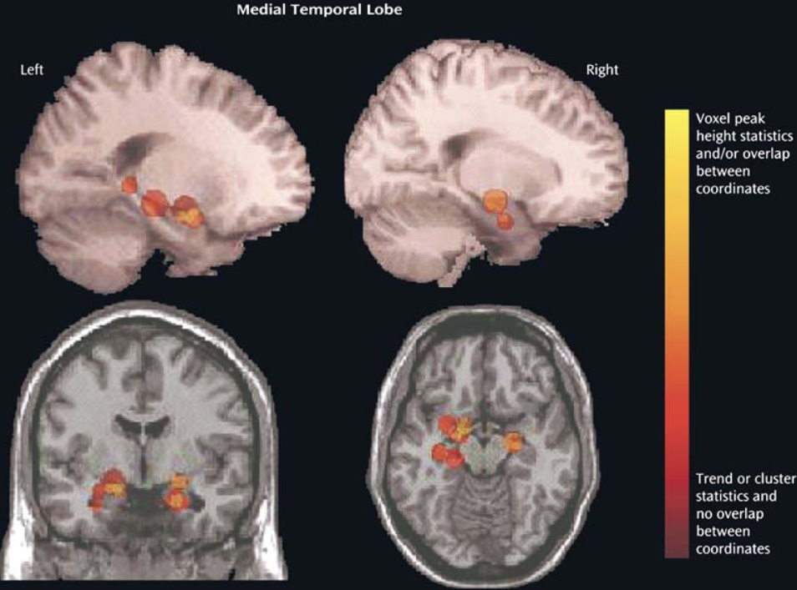
Enlarged ventricles and smaller hippocampus in schizophrenia

Slide 25
Brain activation during auditory hallucinations

Slide 26
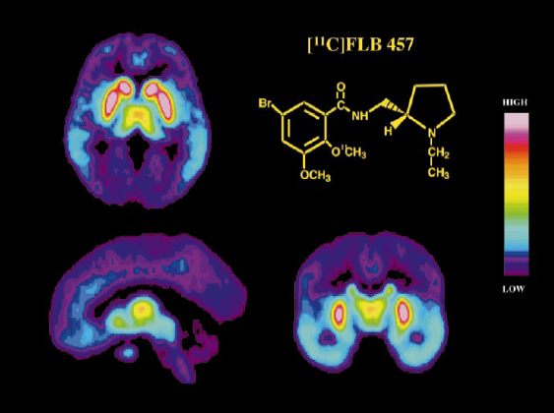
PET shows increased release of the neurotransmitter DOPAMINE
in schizophrenia
Antipsychotic drugs, such as haloperidol, block dopamine in the brain
and reduce hallucinations and delusions

Slide 27
Depression = the level of serotonin is too low in your brain?
Antidepressants, such as Prozac, act on these molecules
Oquendo et al., 2007

Slide 28
The genetics of the serotonin transporter affects your vulnerability to stress
Serotonin transporter
short (s) and long (l) versions
Hariri et al., 2002; Caspi et al., 2003

Slide 29
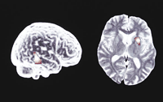
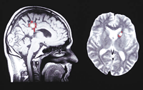
The effect of antidepressants (venlafaxine) and interpersonal psychotherapy on brain activation (fMRI)
Martin et al., 2001

Slide 30
Genes and brain networks for schizophrenia and depression:
a new era in psychiatry

Slide 31
Clinical practice
What is the definition of a psychiatric disorder?
What kind of disorders do we treat?
What methods do we use?
How does the system work?
What is the perspective for a mentally ill?

Slide 32
Simple questions, difficult answers
Have you ever
felt depressed or anxious?
had problems with attention and memory?
felt that strange things happen to you?
believed that ghosts and aliens exist?
been frightened?
had sleeping problems or nightmares?
had problems with alcohol or drugs?

Slide 33

If so, do you have a psychiatric disorder?
Psychiatric disorder:
severe and prolonged impairment of affect, cognition, and behavior leading to social dysfunction
fulfill official diagnostic criteria
DSM-5: Diagnostic and Statistical Manual of Mental Disorders,
fifth revision (2013)

Slide 34
How to make a diagnosis in psychiatry?
Examination (+ internal, neurological)
Observation
Heteranamnesis (informant report)
Diagnostic questionnaires/interviews
Rating scales
Laboratory tests
Imaging

Slide 35
Psychotic disorders
Psychosis: loss of contact with reality
Delusion, hallucination, strange or bizarre behavior, emotional disturbance
Schizophrenia
Schizoaffective disorder
Paranoia
Psychosis due to other mental illness
Drug induced psychosis

Slide 36

A story of a famous mathematician, John Nash, who lives with SCHIZOPHRENIA:
- Hallucinations (e.g. voices in your head giving you messages)
- Delusions (e.g. false beliefs of persecution or special power)

Slide 37
Mood disorders
Major depression (unipolar)
Bipolar disorders:
  Depressive episodes
  Manic/hypomanic episodes
  Mixed mood episodes
Persisting depressive disorder
Cyclothymic disorder
Premenstrual dysphoric disorder

Slide 38
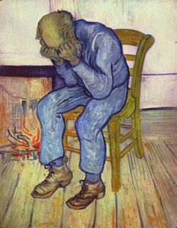
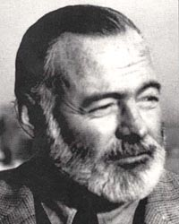
DEPRESSION: abnormal sadness, loss of joy and motivation, decreased energy, desperation, and suicide
Van Gogh Hemingway

Slide 39
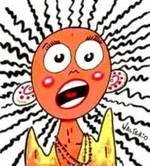
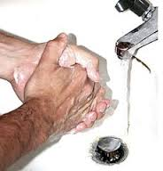
Anxiety disorders
Panic disorder
Generalized anxiety disorder
Phobias
  agoraphobia
  social phobia
  Specific phobias
Obsessive-compulsive disorder
PTSD

Slide 40

Substance use disorders
Nicotine
Alcohol
Cannabis
Amphetamine (speed, ecstasy)
Designer drugs
Cocaine
Heroine

Slide 41
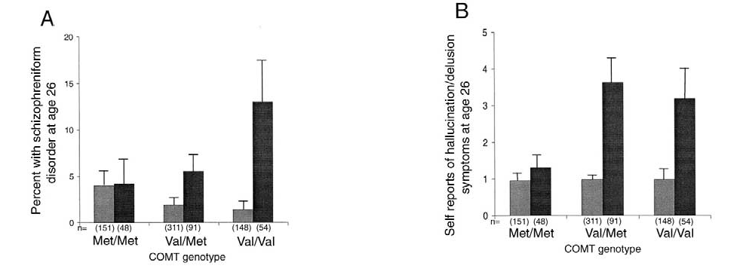
Cannabis and schizophrenia
Gene-environment interaction
Psychosis (SCH) risk for COMT Val158 carrier cannabis users
Caspi, 2005

Slide 42
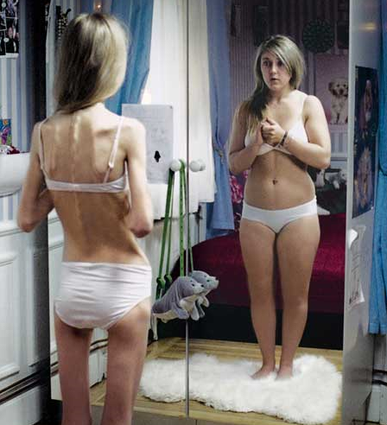
Eating disorders
Anorexia
Weight loss > 15%
Fear of becoming fat
Disturbance in body experience
Bulimia
Binge eating
Night eating
Muscle dysmorphia

Slide 43
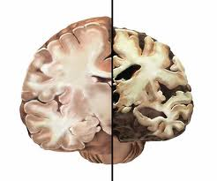
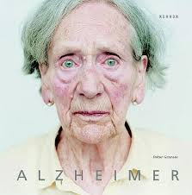
Organic mental disorders
Dementias
  Alzheimer’s disease
  Vascular dementia
  More than 100 types…
Mental retardation
Psychiatric disorders due to internal or neurological conditions

Slide 44
Suicide
Suicide attempt
  Risk factors: untreated depression, psychosis, SUD, social problems
  50% of schizophrenia and bipolar patients
Completed suicide
  2-40/100.000 people/year worldwide
  10% of schizophrenia patients
  20% of bipolar patients
PREVENTION WITH APPROPRIATE TREATMENT!

Slide 45

Mental health care
Outpatient care facilities
Community care, private practice
Hospitals
Types of admission:
  Voluntary
  Involuntary
  (in case of dangerous
  behavior to others or self)
  Long-term programs for patients with SUD

Slide 46
Therapeutical approaches
Pharmacotherapy
Biological treatments
  Light therapy
  TMS (transcranial magnetic stimulation)
  ECT (electroconvulsive therapy)
Psychotherapy
Social therapy

Slide 47
Psychotherapy
Interaction and communication between 2 or more persons
Goal: reduction of symptoms, increasing coping skills, better insight and personality development
Non-specific factors: understanding, acceptance, empathy, congruence
Specific factors: gaining insight of the subconscious, modifying abnormal thinking, correcting abnormal relationships

Slide 48
Modern psychotherapy
Instead of the interpretation of subconscious sexual fantasies and dreams:
Focusing on abnormal thinking (e.g. extreme pessimism and hopelessness in depression) – COGNITIVE-BEHAVIOR THERAPY
Focusing on human relationships (e.g. dispute, role changes, grief, communication skills) – INTERPERSONAL PSYCHOTERAPY

Slide 49
Modern social therapy
Instead of large institutions to isolate (“store”) the patients:
Case manager that helps the patient in everyday activity
Sheltered houses
Supported employment
Daytime “hospitals” and clubs
Social skill training

Slide 50
Summary
The roots of psychiatry: religion, alchemy,
philosophy, psychology, and neuroscience
From black bile and demons to “mindreading” techniques of fMRI/PET and genes
From torture and misery to humanity and empathy

Slide 51
Thank you for your attention!
Questions/Comments?

