Slide 1
Muscle tissue tendons
Prof. Dr. Anna L. Kiss
Department of Anatomy, Histology and Embryology
Semmelweis University
Budapest
2021

Slide 2
Muscle tissue
Function: contraction
Origin: mesoderm
Structure: cells or „fibers”

Slide 3
Types of the muscle tissue
Smooth muscle
Stiated muscle: skeletal
visceral
cardiac

Slide 4
Smooth muscle
evolutionary the most ancient type
spindle shaped cells
slow, non-synchronized, unvoluntary contraction
actin and myosin are NOT arranged in registers
internal organs wall

Slide 5
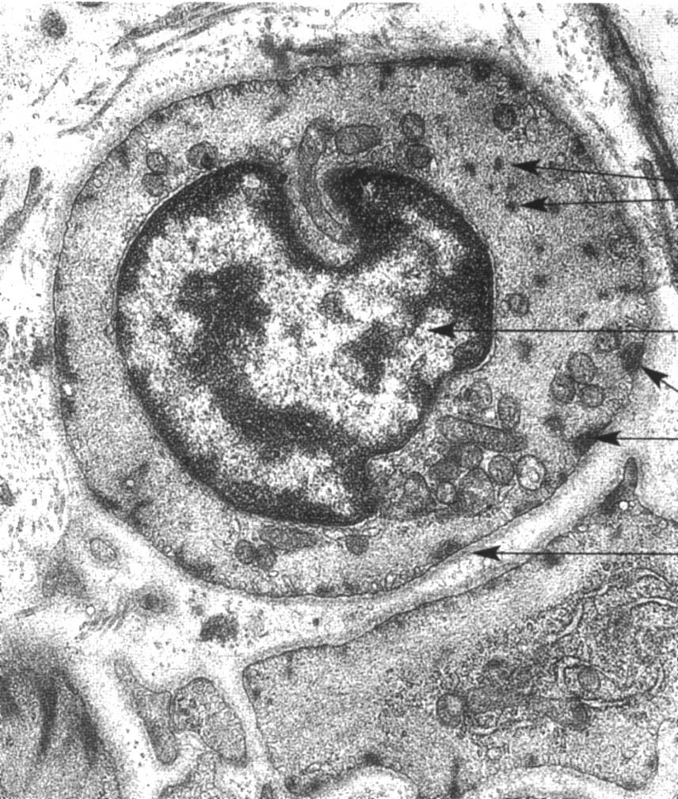
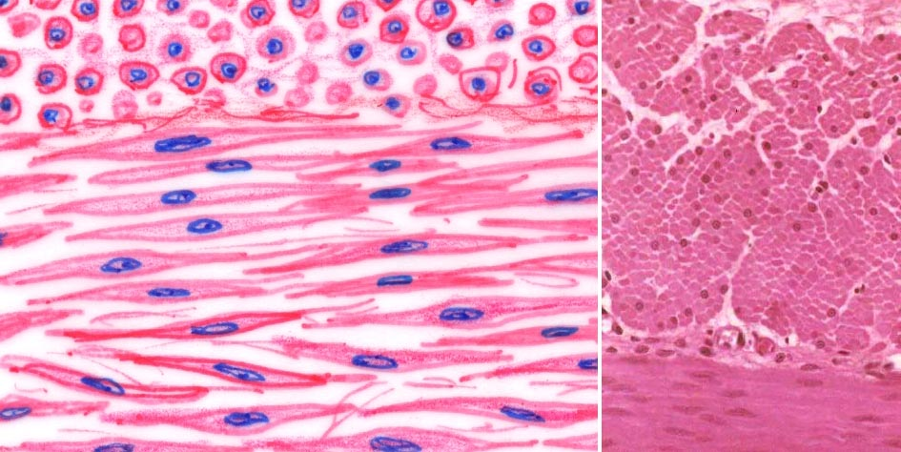
Smooth muscle
nucleus: in the middle of the cells

Slide 6
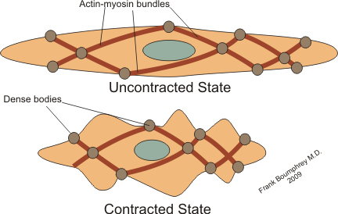
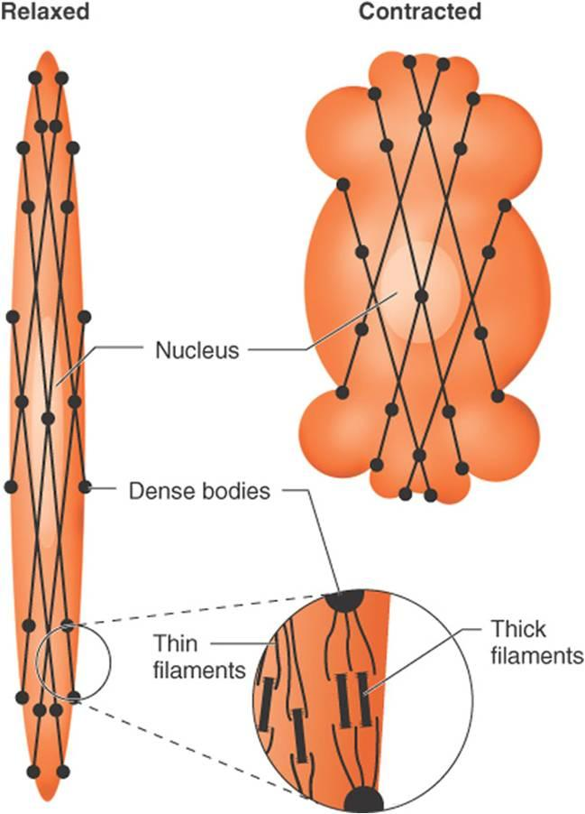
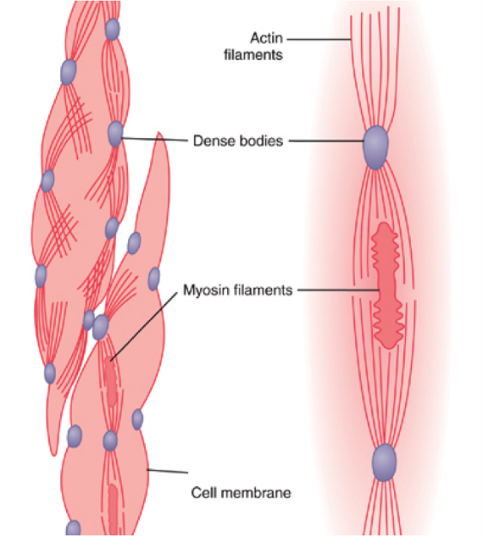
Contraction of smooth muscle
Contractile proteins: actin and myosin
thick filaments: myosin
thin filaments: actin
dense bodies: to help the contraction

Slide 7
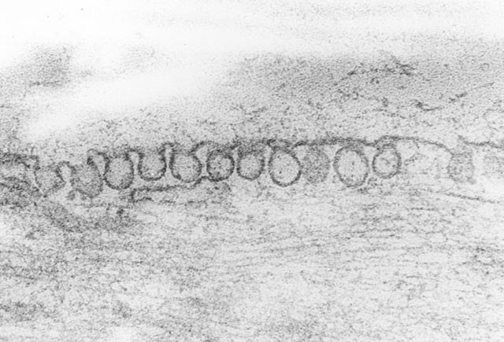
Smooth muscle contraction
For the contraction: Ca ion: taken up by caveolae
Ca-binding protein: calmodulin
Contractile protein: actin+myosin
ATP (mitochondria)

Slide 8
Striated(skeletal) muscle

Slide 9
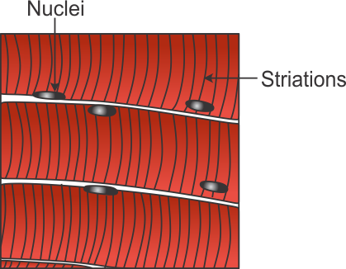
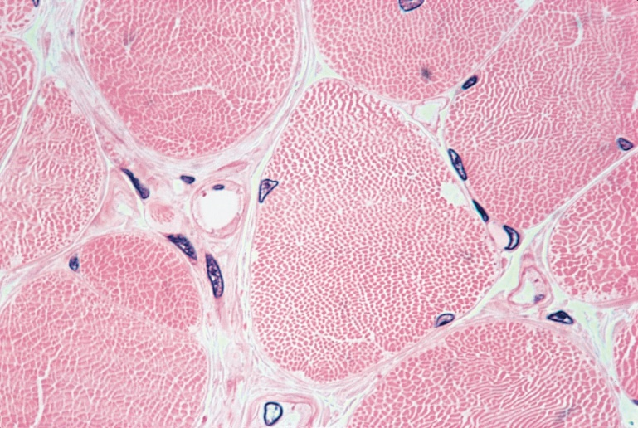
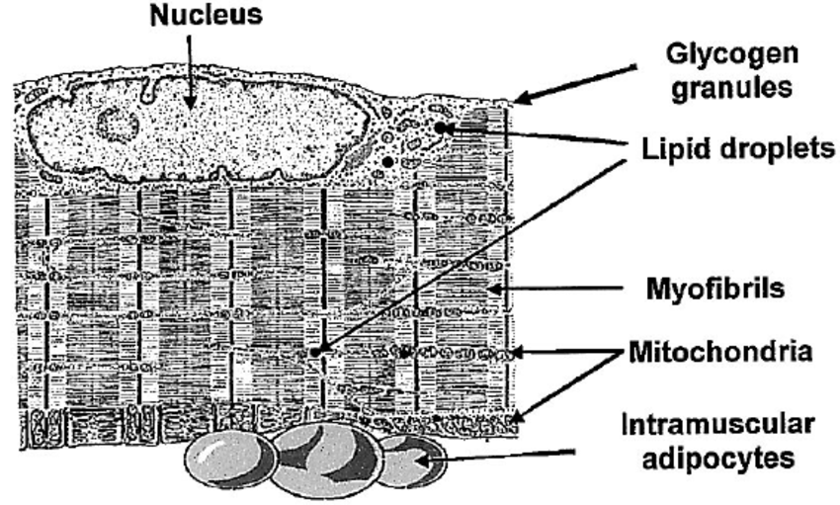
Stiated (skeletal muscle)
Muscle „fibers”: multinucleated giant cells

Slide 11
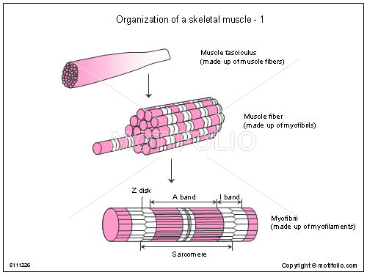
Skeletal muscle
myosin: think, anisotropic: A band
actin: thin, isotropic, I bind

Slide 12
Structural and functional unit of the striated muscle: sarcomera
Muscle fibers
myofilaments: contractile proteins: actin and myosin: partly overlapping
regularly arranged
cross striation

Slide 13
Electron Microscopic picture
Sarcomere: functional unit

Slide 14
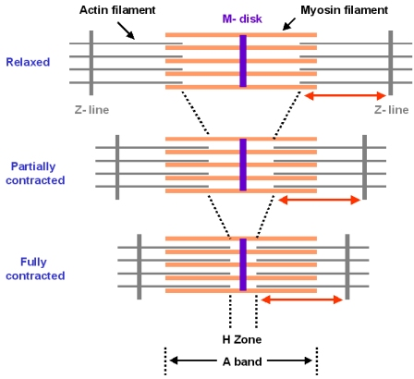
Sarcomere during contraction
Z line: actin binding protein (filamin)

Slide 15
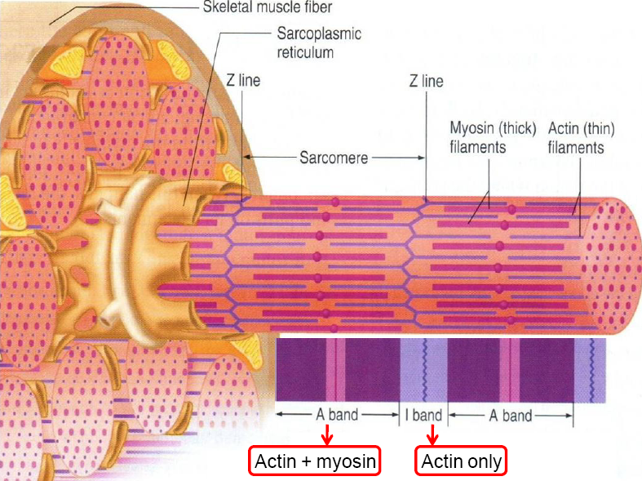
Skeletal muscle

Slide 16
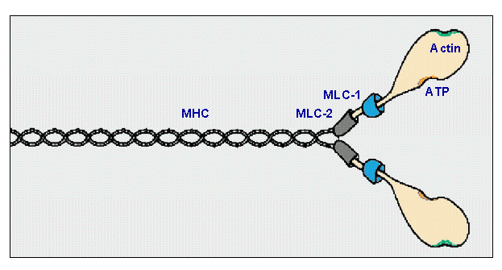
Contractile proteins
thin filaments
Myosin head: actin binding site + ATP binding
thick filaments

Slide 17
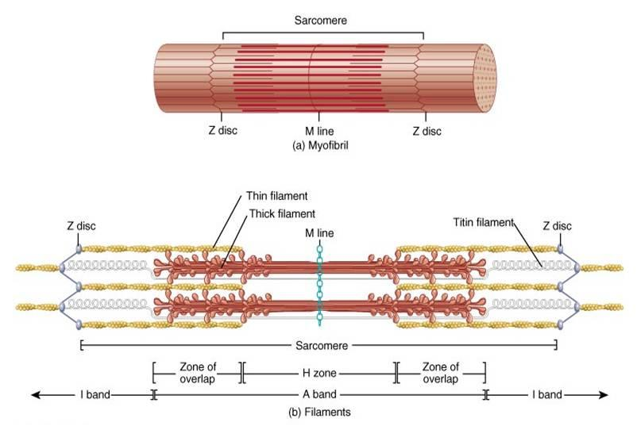
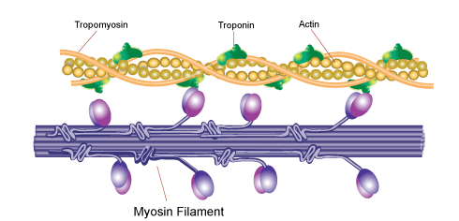
Sarcomere

Slide 18
mysosine head
mysosine binding site

Slide 19
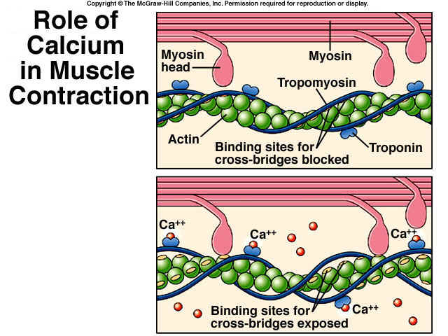
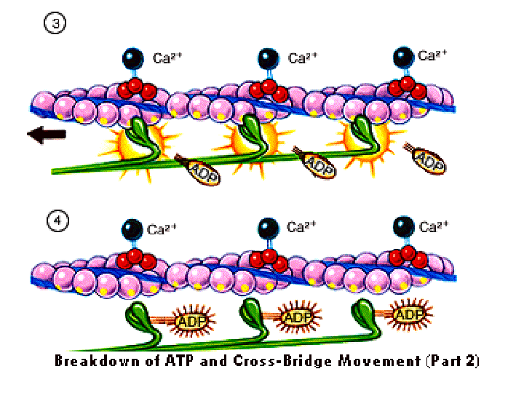
Ca ion binds to troponin
conformation is changing
tropomyosin „moves” down
the myosin binding site of actin in becoming avalable
when myosin binds to actin becomes ATP-ase splits the ATP
contraction

Slide 20
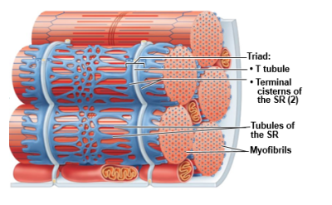
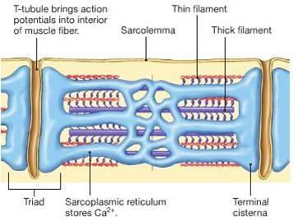
Impulse transmission

Slide 21
For the contraction of the skeletal muscle:
contractile proteins: actin and myosin
Ca²⁺ (stored in sER)
impulse transfer from the sarcoplasm to sER-re (triads)
ATP (directly from kreatin phosphate, 20 mmól/kg)
mitochondria
oxygen (myoglobin + haemoglobin)
aerob (biological oxidation)
anaerob (fermentation)
glycogen: skeletal muscle is the second biggest glycogen store

Slide 22
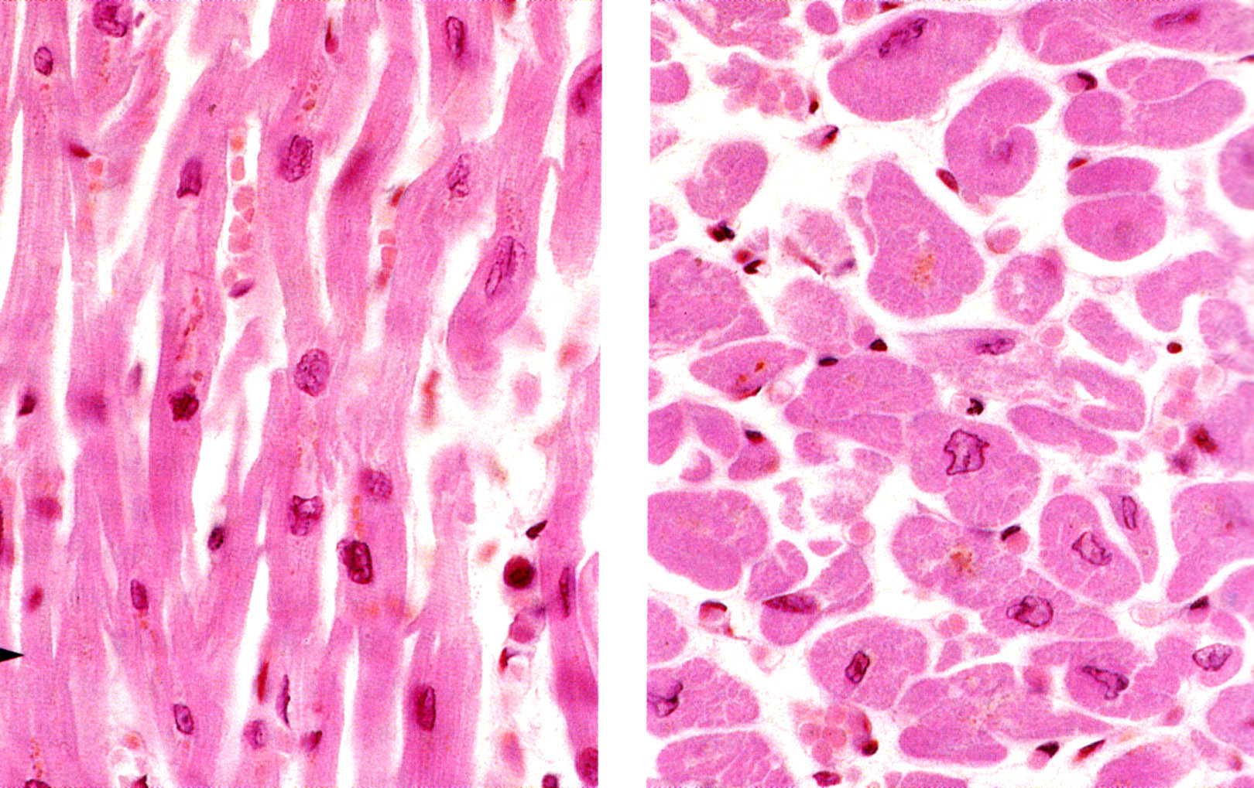
Cardiac muscle

Slide 23
Cardiac muscle
cells (bifurcation; X or Y shaped branching cells)
cross striation: actin and myosin are in register
nucleus is in the middle of the cells
intercalated disc (Eberth’s line – junctions)
lots of capillaries
many mitochondria
lipofuscin by aging
fast, unvoluntary contraction (fast impulse
transmission)

Slide 24
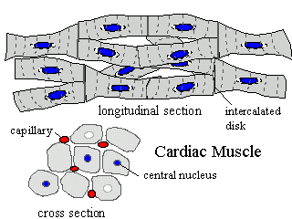
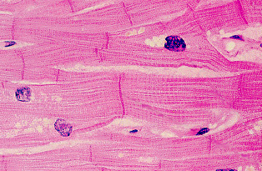
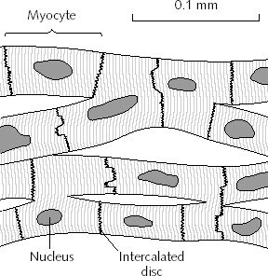
Cardiac muscle
Intercalated disc:
special junctions between cells
fast impulse cinduction

Slide 25
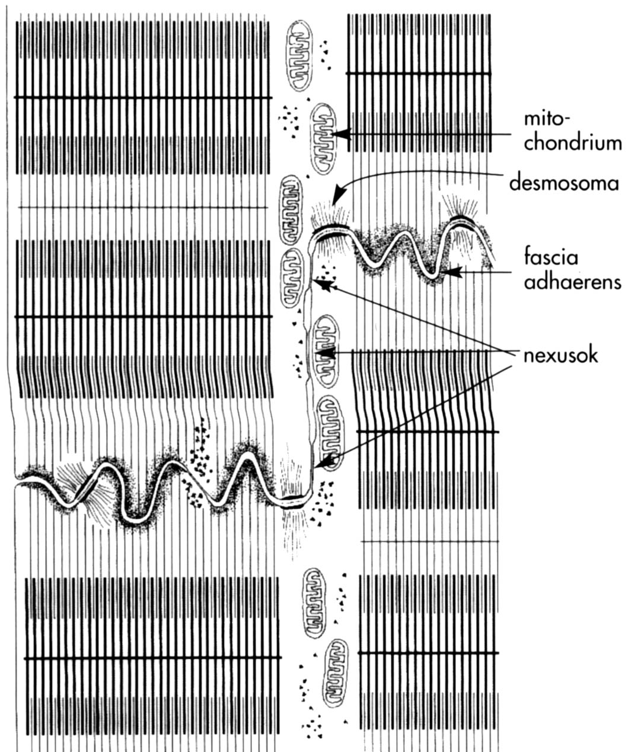
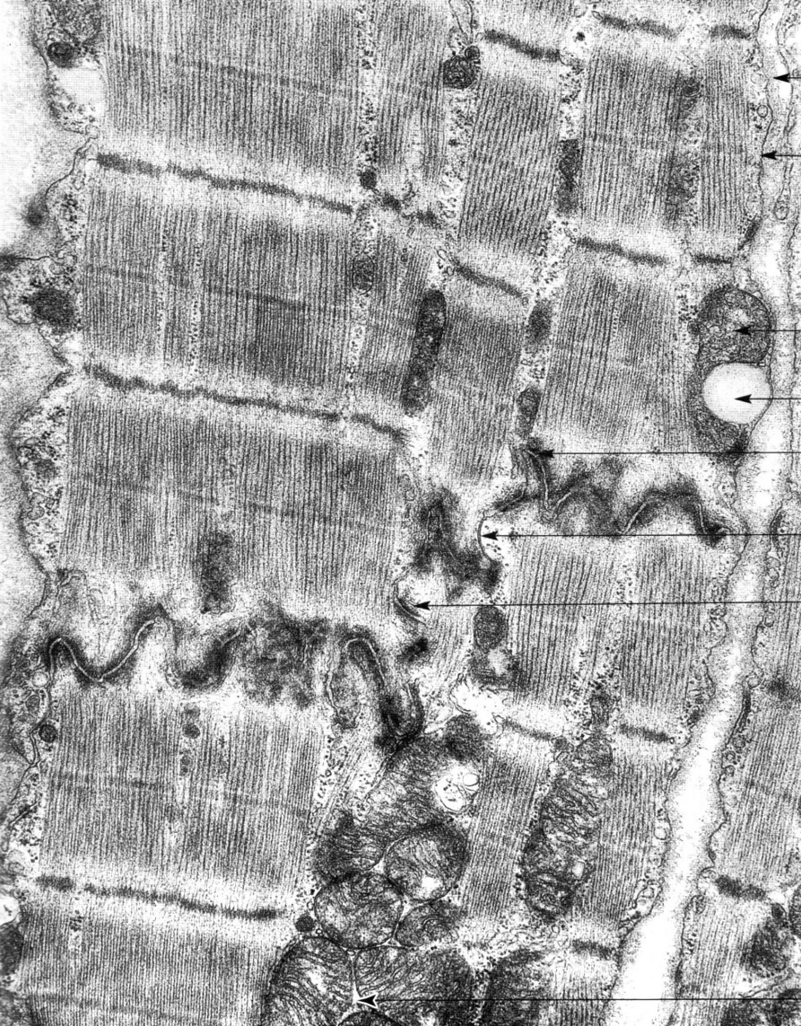
Intercalated disc (Eberth’s line)
fascia adherens
desmosoma
gap junction (nexus)

Slide 26
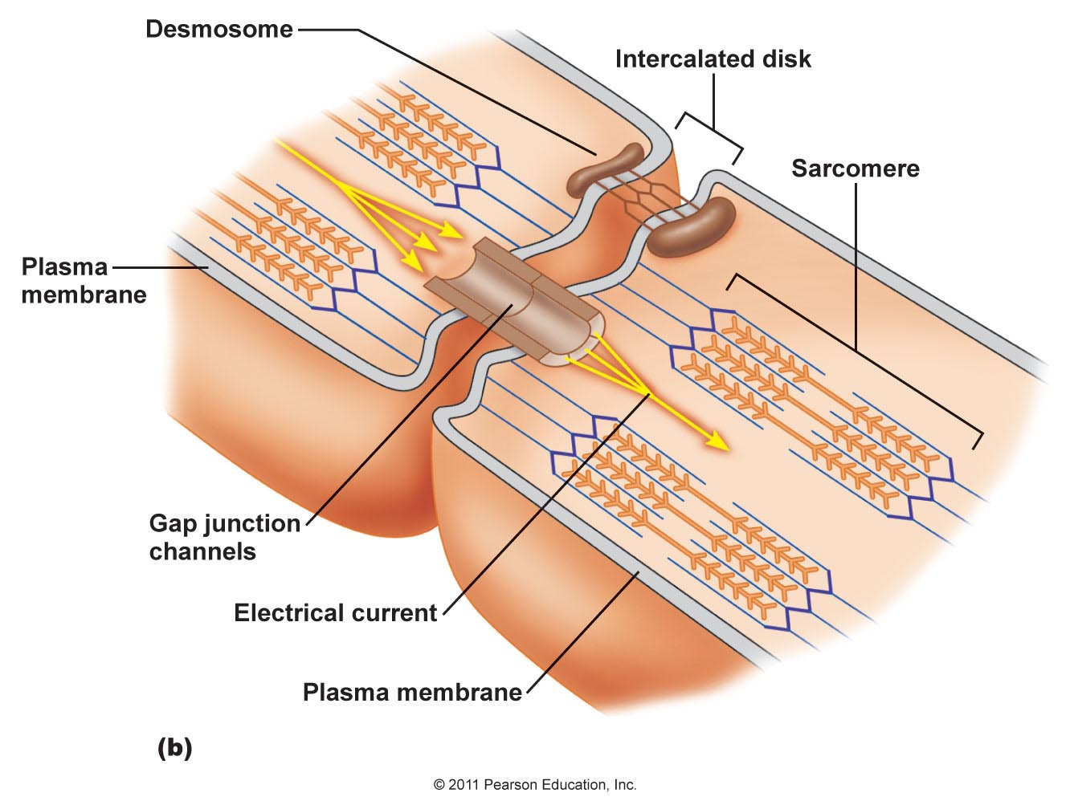
Cardiac muscle
Gap junction:
ion channel; fast ion flow, fast impulse transmission

Slide 27
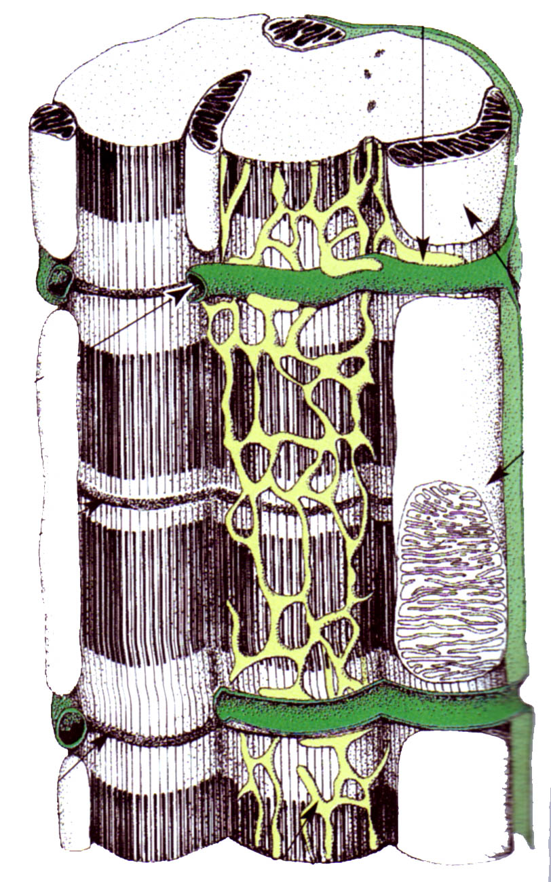
Fine structure of the cardiac muscle
diad: transverse tubule (from the plasma membrane+sER cistern)
large amount of mitochondria

Slide 28
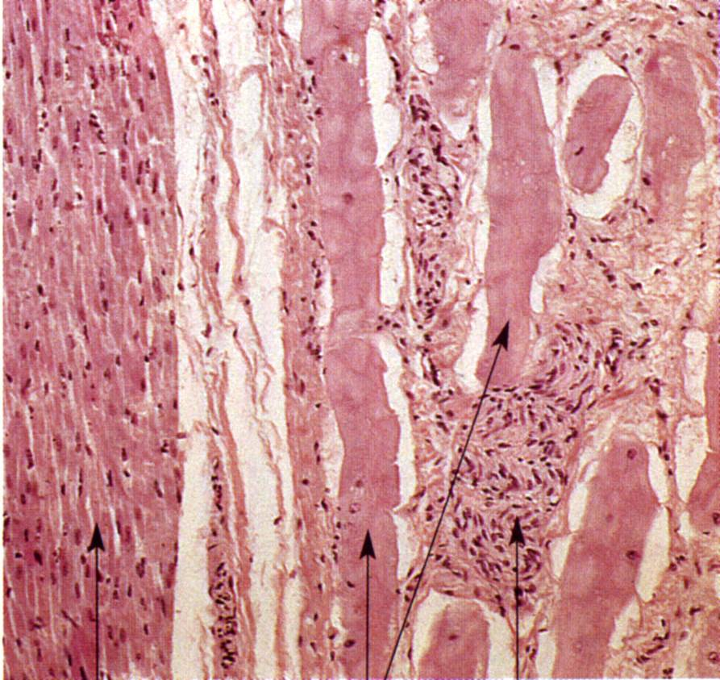
impulse conducting cells: Purkinje cells
non-differentiated muscle cells!!

Slide 29
General myology
Musculature: active component of the movement
Structure: striated muscle (skeletal)
tendons: dense regular connective tissue
connective tissue sheath: fascia
(epimysium)
Notes:
Muscle tissues, striated muscle,, contractile proteins, sarcomere

Slide 30
proximal end: origin
belly
tendon
distal end: insertion

Slide 31
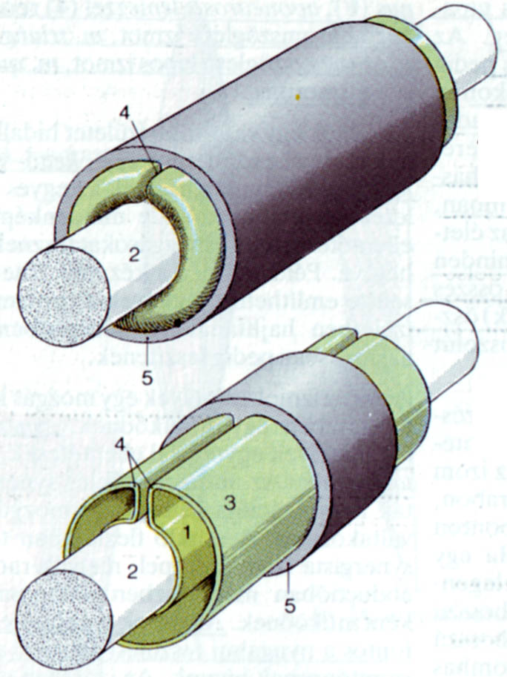
Structure of the tendon
tendon sheath
a.) outer, fibrous layer
b.) inner, synovial layer
mesotendon

Slide 32
References
Röhlich Pál: Szövettan. Budapest, 1999
A szövettani képek a Humánmorfológiai és Fejlődésbiológiai Intézet gyűjteményéből származnak.
Carola R, Harley JP, Noback CR: Human Anatomy & Physiology, McGraw-Hill Inc., USA, 1990
Wikipaedia

