Slide 1
General osteology and arthtology
Prof Dr Anna L. Kiss
Department of Anatomy, Histology and Embryology
Semmelweis University
Budapest
2021

Slide 2
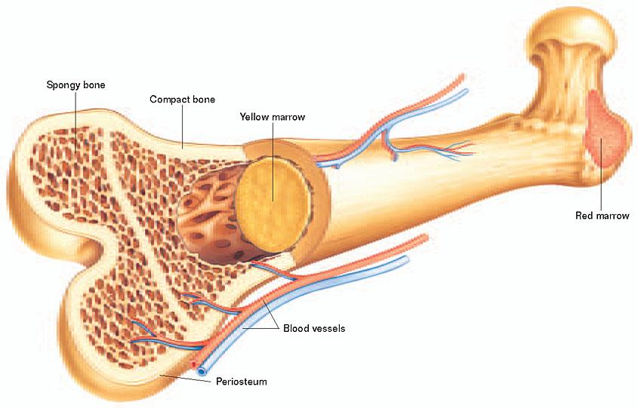
Structure of the bone

Slide 3
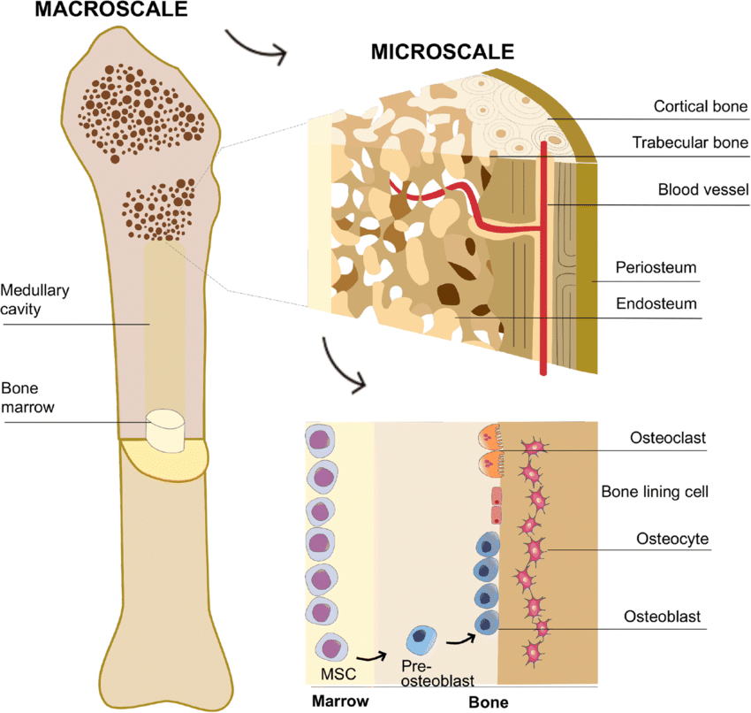
Structure of the bone

Slide 4
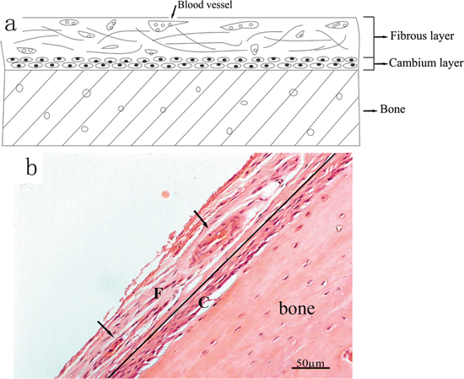
Structure of the periosteum

Slide 5
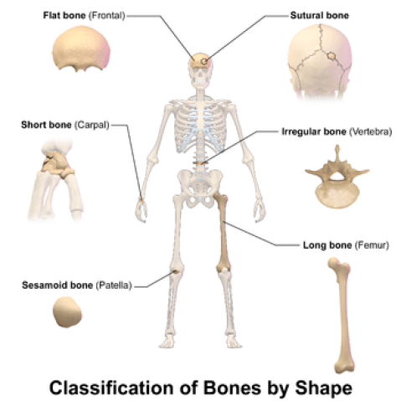

Slide 6
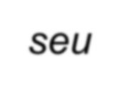
Connection between bones
continouos
discontinouos:
synarthrosis
diarthrosis
seu
joint or articulation

Slide 7
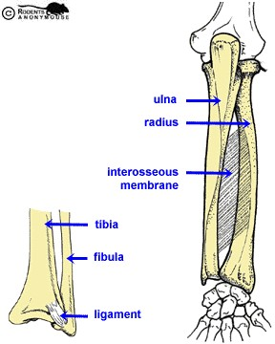
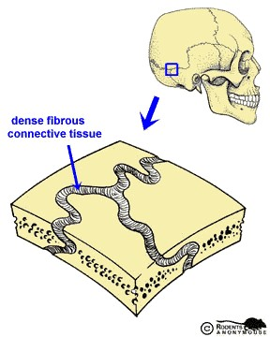
Synarthrosis
:
syndesmosis
Connective tissue
Membrana
sutura
interossea

Slide 8
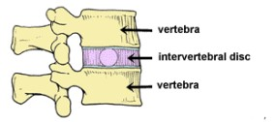
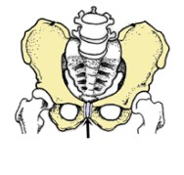
Synarthrosis
Synchondrosis: cartilage
discus intervertebralis
symphysis pubica

Slide 9
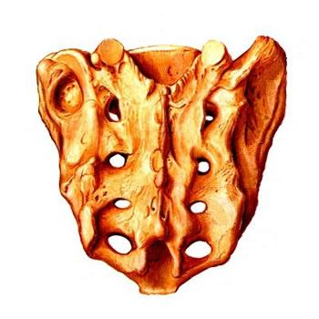
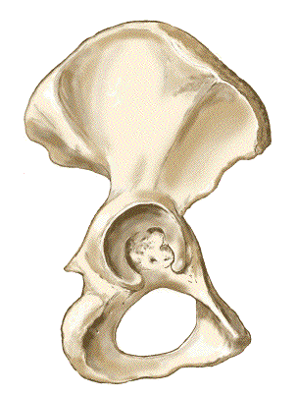
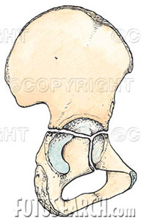
Synostosis

Slide 10
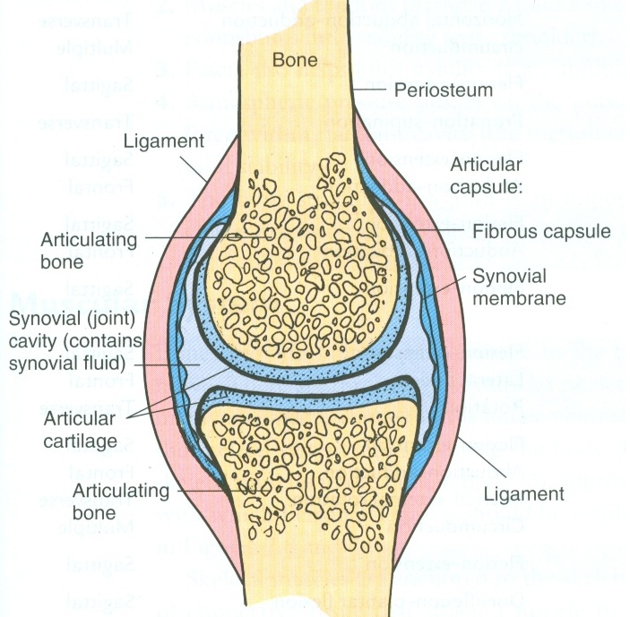
Diarthrosis: joints
Cartilage: hyalin (sometimes fibrous)
Capsule:
outer laye: fibrous
inner layer: synovial: producing fluid: synova
Outer layer continouos with the periosteum
Accessory structures:
ligaments: (outer, inner): dense regular connective tissue
disc or menisci (fibrous cartilage): to avoid surface incongruency
connective tissue lips or labrum
bursas

Slide 11
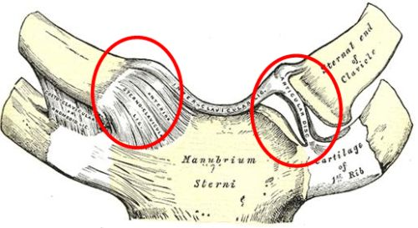
disc

Slide 12
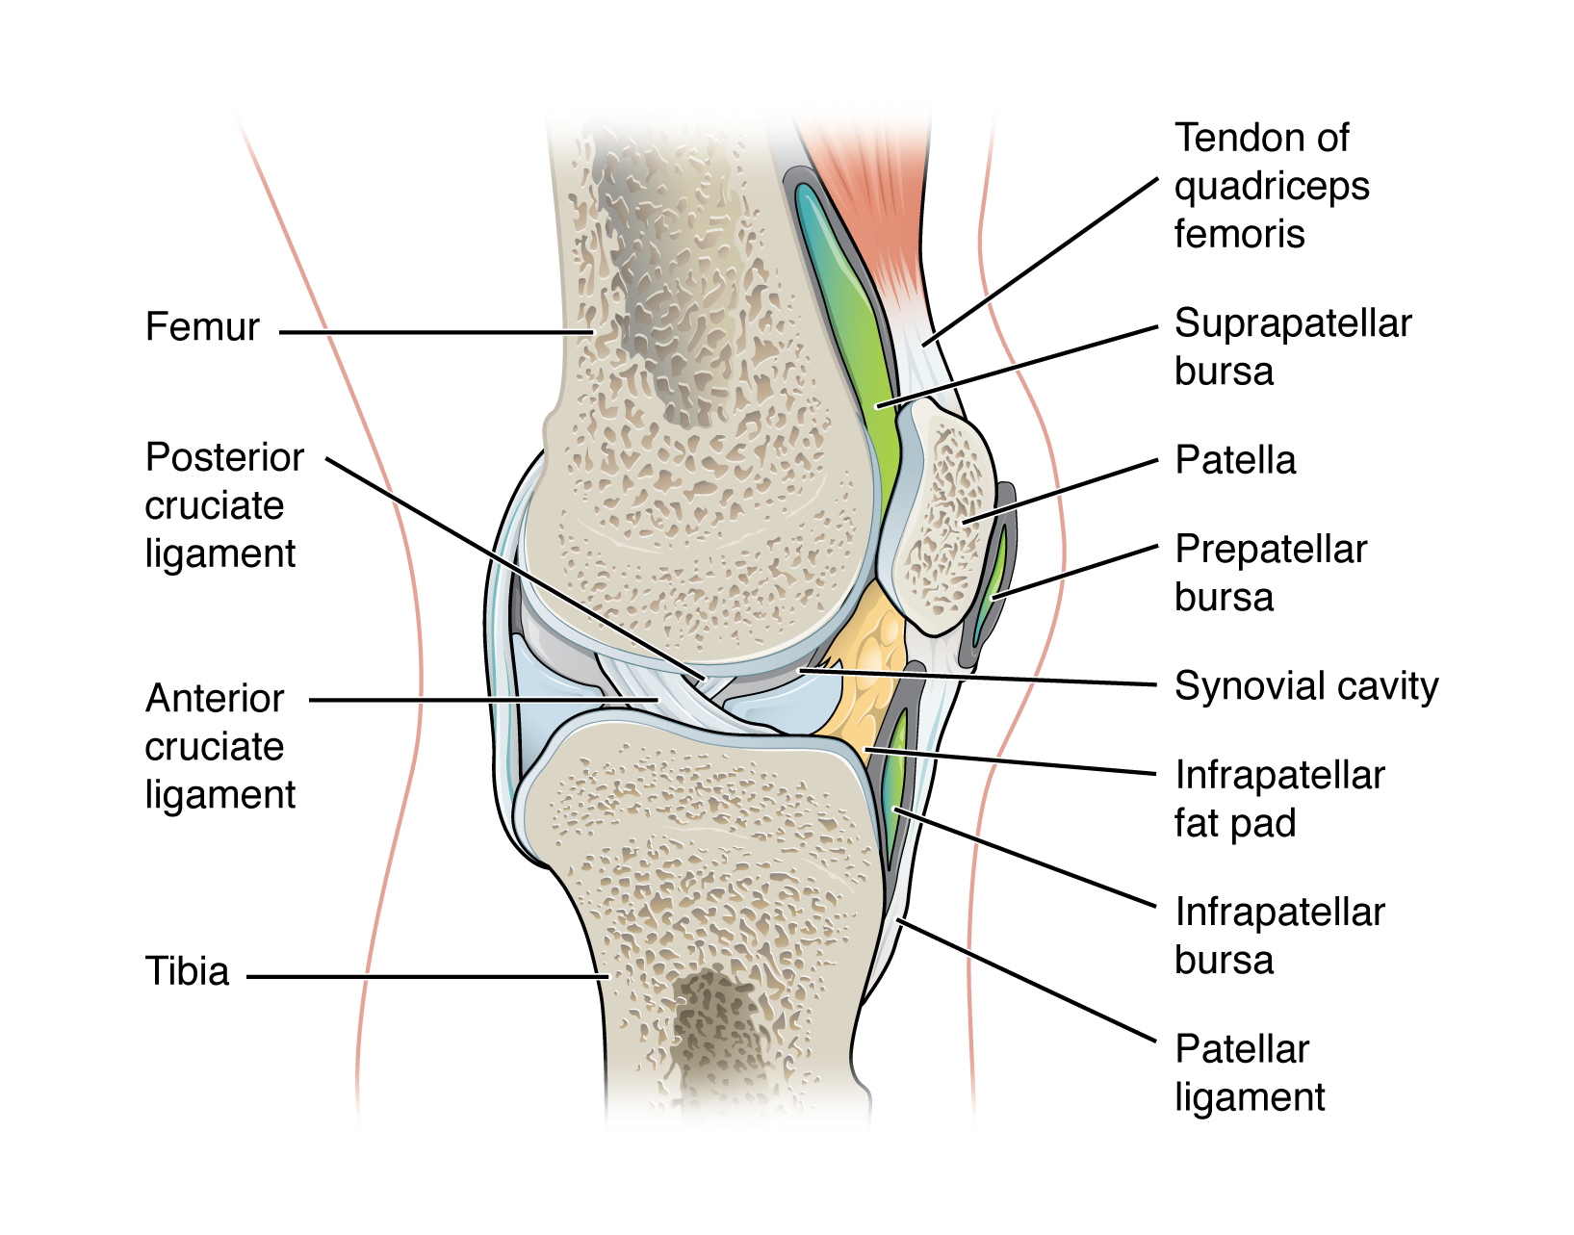

Slide 14
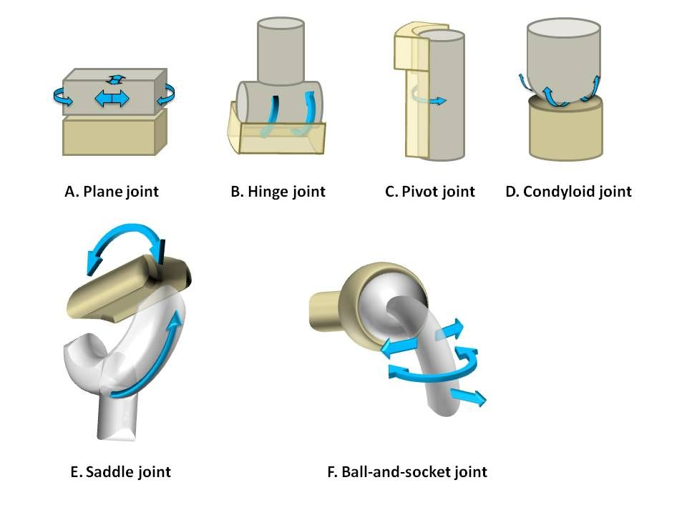
Types of the joints
uniaxial joints:
hinge: flexion-extension
pivot: pronation-supination
biaxial joints:
ellipsoid (wrist):
flexion-extension
abduction-adduction
saddle joint:
abduction-adduction
opposition-reposition
multiaxial joints:
flexion-extension
abduction-adduction
rotation

