Slide 1
Anatomy: nomenclature, orientation
Dr. Anna L. Kiss
Department of Anatomy, Histology and Embryology
Semmelweis University
Budapest
2021

Slide 2
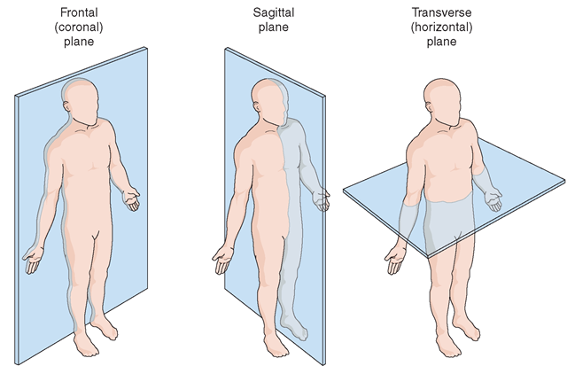
Planes, parts of the body

Slide 3
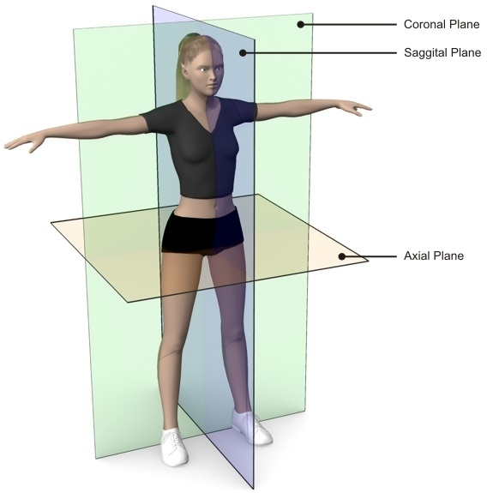
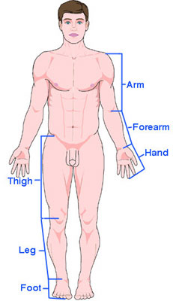
Planes, parts of the body
head
neck,
trunck
uppear limb
lower limb

Slide 4
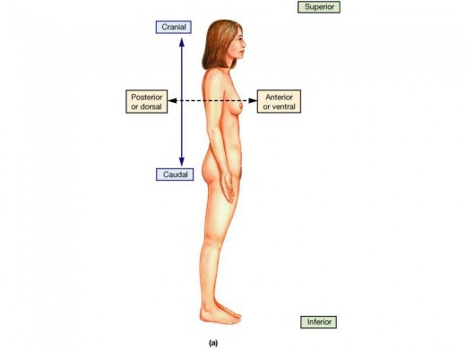
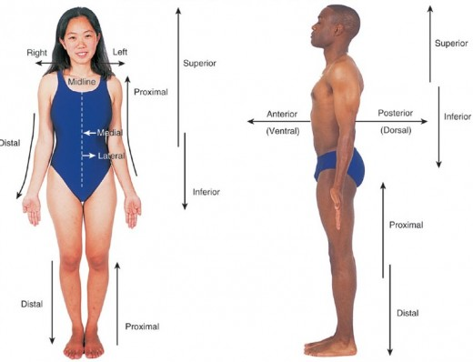
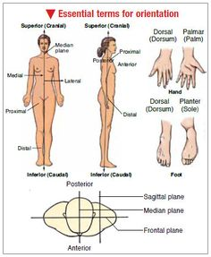
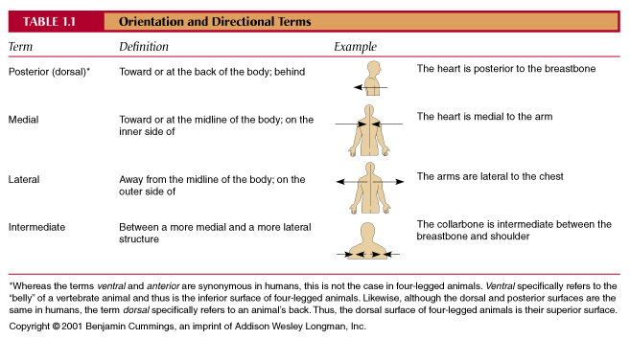

Slide 5
Planes and directions
superficial – deep
radial – ulnar
tibial - fibular

Slide 6
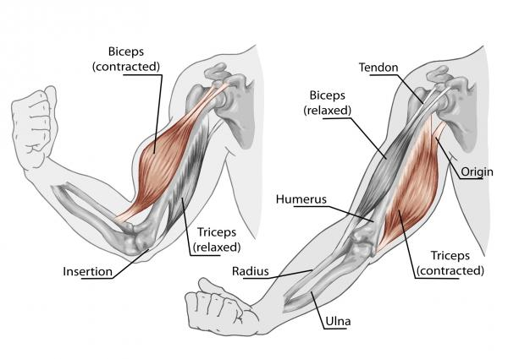
Nomenclature

Slide 7
Basic tissues
Tissue: cells clusters, having same function, same morphology and
same origin (ektorerm, endodernm or mesoderm)
Basic tissues:
epithelial tissue
connective and supporting tissue
muscle tissue
nervous tissue

Slide 8
Epithelial tissue

Slide 9
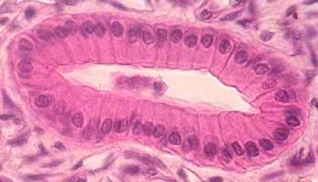
Epithelial tissue
poligonal, tightly attached cells
small amount of intercellular matrix
– junctions
- membrana basalis
functions: isolation, protection vs. transport: surface covering
bidirectional transport: secretion(glandular epithelium)
absorption (absorptive epithelium)
sensory epithelium

Slide 10
Epithelial tissue
surface covering
glandular
sensory
absorptive
pigment

Slide 11
Epithelial tissue: surface covering epithelium
Poligonal cells
apical
lateral
basal

Slide 12
Surface covering epithelium
simple – squamous
- cuboidal
- columnar
- speudostratified columnar
stratified - squamous – ceratinized
- non-keratinized
- ? urothelium (transient)

Slide 13
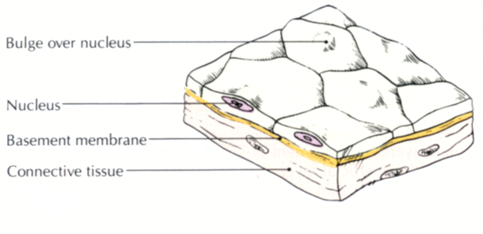
Simple squamous epithelium
endothel (blood vessels)
kidney
serous membranes
lung
transport!

Slide 14
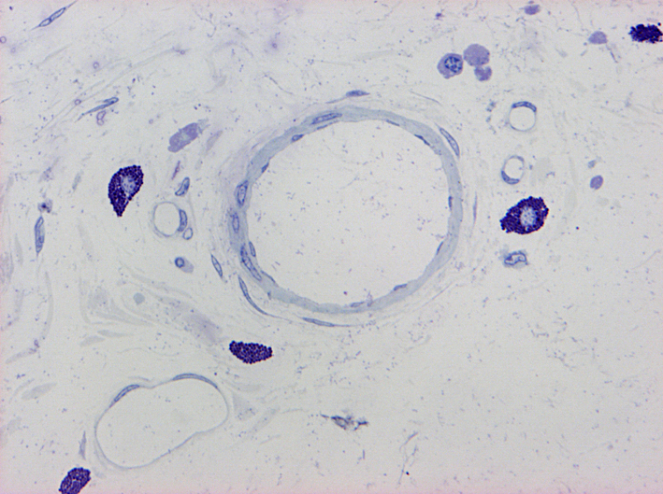
endothel

Slide 15
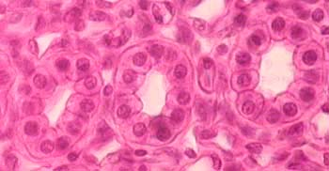
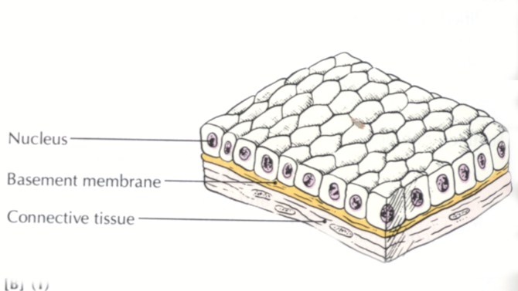
Simple cuboidal epithelium
kidney tubules
glands

Slide 16
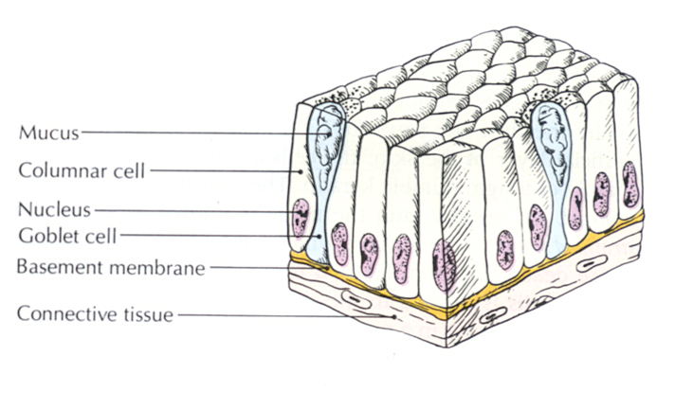
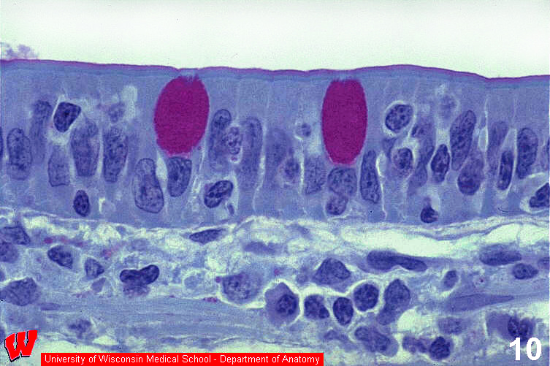
Simple columnar epithelium
uterus
stomach, intestine
cilia, brush border
function: transport and absorption

Slide 17
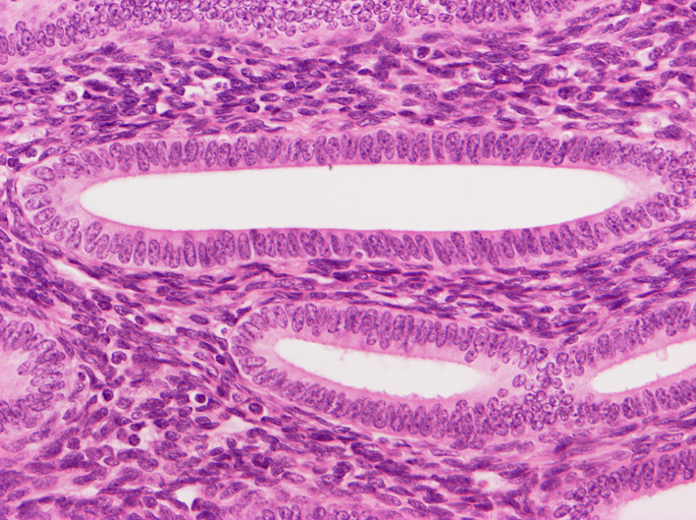

Slide 18
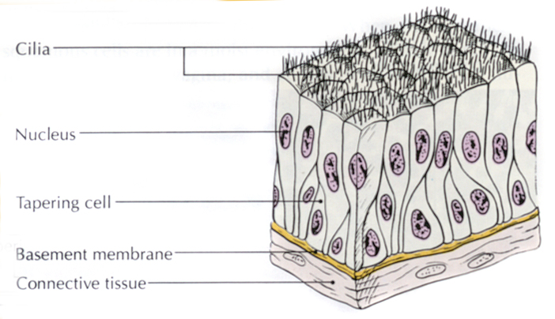
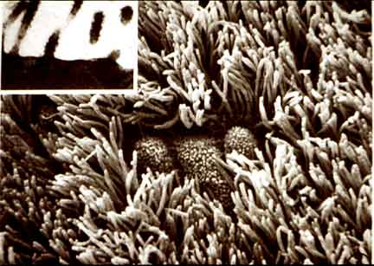
Pseudostratified columnar ciliated
epithelium
Respiratory system: cilia
protection

Slide 19
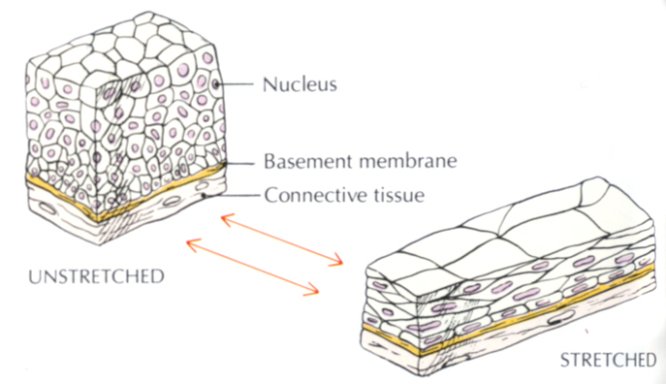
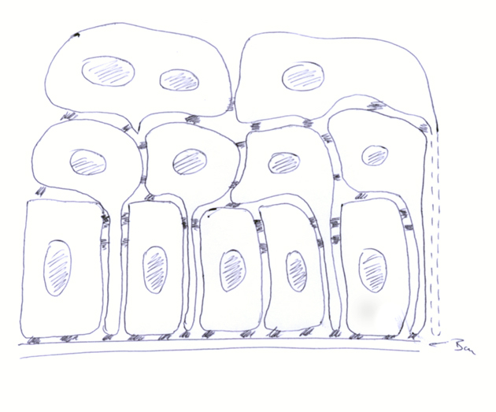
Urothelium
Urinary system (ureter, urinary bladder, urethra)
EM: stratified!

Slide 20
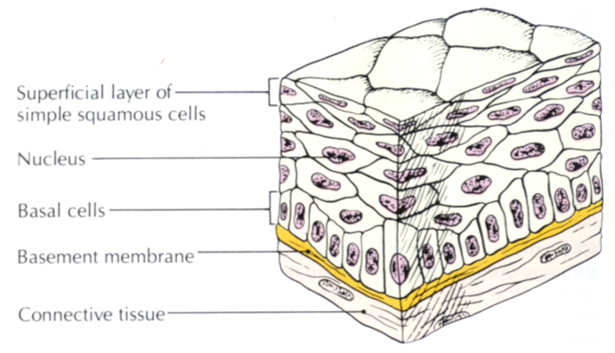
Stratified epithelium
non-keratinized
esophagus
oral cavity
vagina
keratinized - skin
Minimal transport, good isolation
basal cells:division
upper cells: apoptosis (cell death)

Slide 21
Stratified non-keratinized epithelium
str. planocellulare
str. polygonale, spinosum
str. basale, cylindricum, germinativum

Slide 22
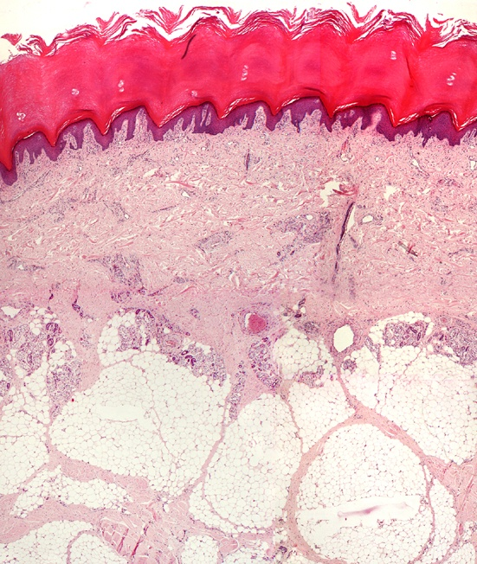
Stratified keratinized epithelium
str. planocellulare:
str. granulosum
str. lucidum
str. corneum
Thick corneal layer: isolation
glands, hair follicles etc.)

Slide 23
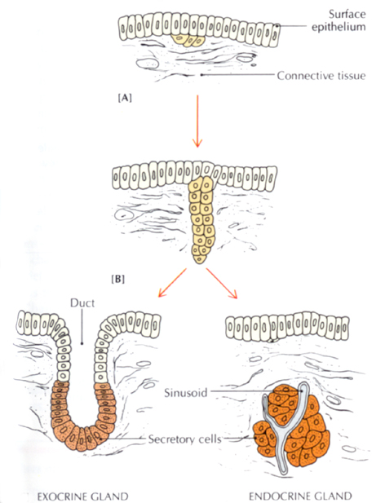
Epithelial tissue: glandular epithelium
Secretory function
endocrin and exocrin

Slide 24
Exocrin glands
Unicellular:
Endoepithelial: goblet cells
Exoepithelial

Slide 25
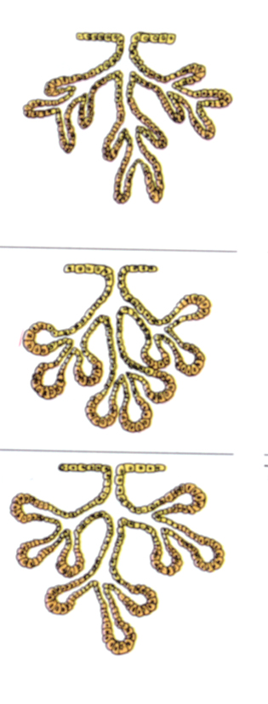
Exocrine glands: multicellular according to the shape
simple
compound
tubular
alveolar
tubulo-alveolar

Slide 26
Exocrine glands: secretory pathway: the way how to release the product
- merocrin (exocytosis)
- apocrin (modified sweat glands, mammary gland)
- holocrin (sebaceous gland)

Slide 27
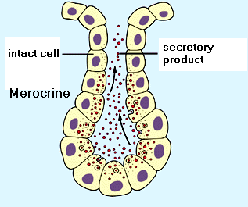
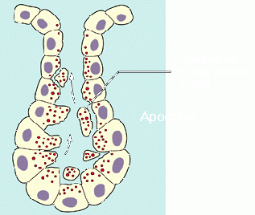
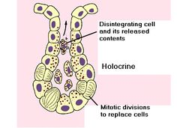
Exocrine glands
continuous exocytosis

Slide 28
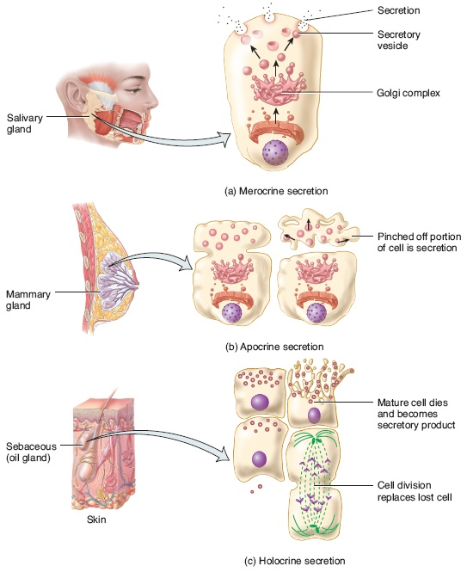
Exocrine glands
merocrine
apocrine
holocrine

Slide 29
Exocrine glands: component of the secretory product
well developed rER
a.) serous: protein
b.) mucus: carbohydrate
c.) mixed
well developed Golgi apparatus

Slide 30
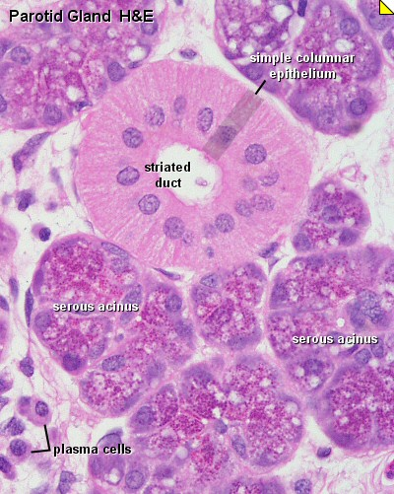
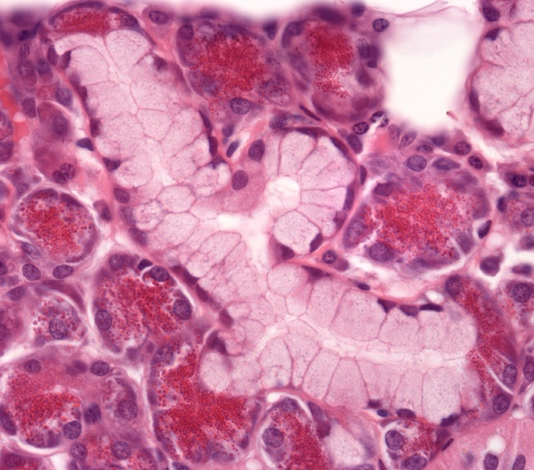
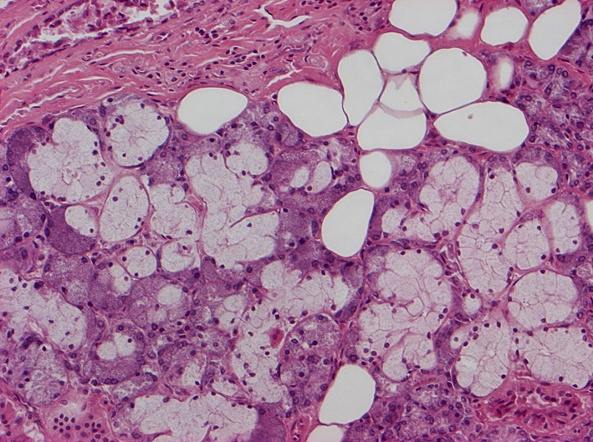
serous gland
mucous acini

Slide 31
References
Röhlich Pál: Szövettan. Budapest, 1999
A szövettani képek a Humánmorfológiai és Fejlődésbiológiai Intézet gyűjteményéből származnak.
Carola R, Harley JP, Noback CR: Human Anatomy & Physiology, McGraw-Hill Inc., USA, 1990

