Slide 1
Connective Tissue: cells and ground substance
Dr. Anna L. Kiss
Department of Anatomy, Histology and Embryology
Semmelweis University
Budapest
2021

Slide 2
Connetive tissue
Variety of tissues with different functional properites but with certain common characteristics
Function: connects organs, fills in spaces, storage, protection
Structure: cells+extracellular matrix
Origin: mesoderm
Fewer cells, in loose arrangement; extracellular matrix is the dominant component
Extracellular matrix:
- fibers:collagen
elastic
reticular
- ground substance: proteoglycans, glycosaminoglycans, adhesion molecules, inorganic salts)

Slide 3
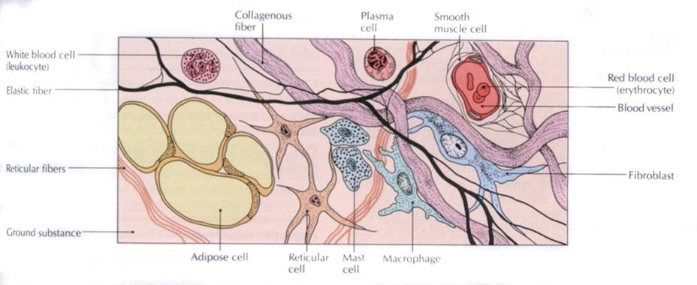
Connective tissue
Carola: Human Anatomy & Physiology

Slide 4
Connective tissue components
Cells Extracellular matrix
fix
mobile
fibers
ground substance
fibrocyte
reticular cell
adipocyte
melanocyte
mesoblast
macrophag
mast cell
plasma cell
granulocyte
(neutrophil,
eosinophil)
proteoglycans
glycosaminoglycans
adhesion
glycoproteins
collagen
elastic
reticular
fibrillin
hyaluronic acid
chondroitin sulphate
heaparan sulphate
keratan sulphate
dermatan sulphate
fibronektin
laminin
tenascin
enactin
trombospondin

Slide 5
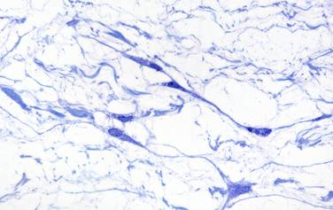
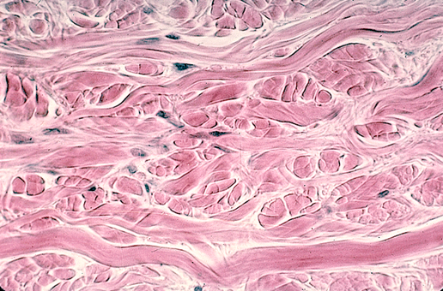
Fix cells
fibrocyta (inact.), fibroblast (act.) – fiber (collagen+elastic) and matrix protein synthesis
In adult: inactive fibrocytes, injury: growth factors: activation regeneration
reticular cells: - produce reticular fibers (spleen lymph nodes, red bone marrow)
Collagen fibers

Slide 6
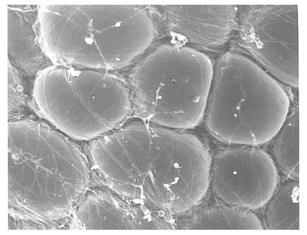
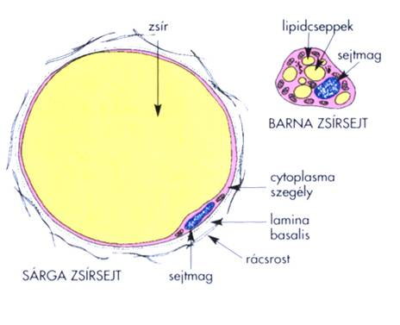
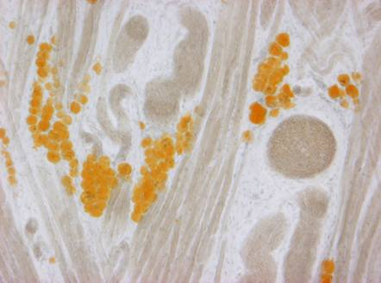
Fix cells
adipocytes – store lipids
- ATP production
  - thermoregulation
  (especially brown fat tissue)
brown adipocyte
white adipocyte
Röhlich Pál: Szövettan

Slide 7
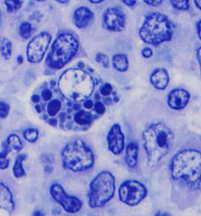
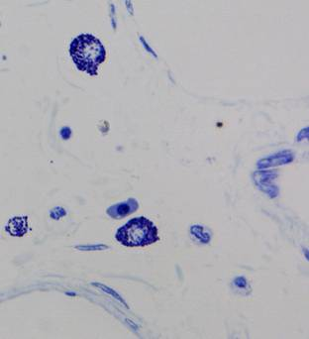
Mobile cells
„immune cells”
macrophag – phagocytosis, local defence, antigen-presentation
granulocytes – phagocytosis
lymphocytes– cellular and humoral immunity
plasma cells – immunoglobulin (antibody) synthesis
mast cell – ? allergy

Slide 8
Mobile cells
Macrophages: 15-20µm
Defence: pathogen phagocytosis (FcR)
    lysosomal digestion
    vesicular transport to the cell surface: antigen presentation
„Cleaning”: phagocytosis of the dead cells
Secretion: growth factors (IL1, IL6)
activation of the immune cells

Slide 9
Mobile cells
Mast cells: 0.5-1µm
Granules: heparin: blood clotting
      histamin: allergy
      Degranulation: regulated exocytosis
      IgE receptor-mediated signal transduction
Lymphocytes, plasma cells: antibody synthesis
Granulocytes: neutrophyl: phagocytosis
eosinophyl: allergy

Slide 10
Extracellular matrix
Proteoglycanes+adhesion molecules
filamentuos molecules: 3 dimensional network – gelatinuos material
is able to bind large amount of water – flexibility (turgor)

Slide 11
Proteoglycan
GAG chains
HA-binding region
Core protein
hyaluronic acid
link protein

Slide 12
Proteoglycanes
Membrane-proteoglycanes:
  Syndecan
  CD44
  Trombomodulin
ECM-proteoglycanes:
decorin
biglican
serglycine
versican
aggrecan

Slide 13
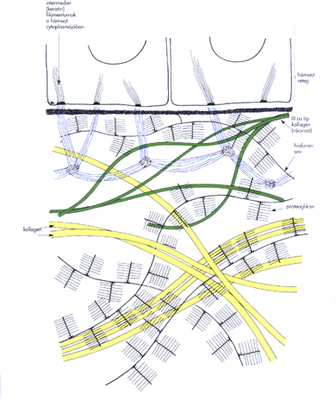
Extracellular matrix

Slide 14
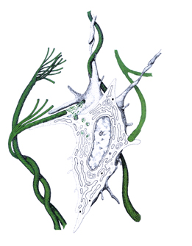
Fibers: collagen fiber
the most frequently present fibers
flexible, have remarkably high tensile strength
composed of collagen: many subtypes (I-XV), tissue specific distribution
Synthesis:
triple helix, composed of 3 α-chains procollagén
In the extracellular matrix enzymatic hydrolisis tropocollagén

Slide 15
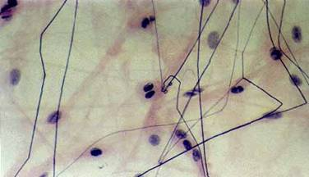
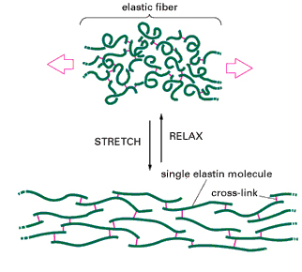
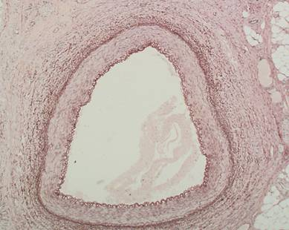
Elastic fibers

Slide 16
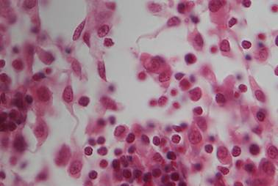
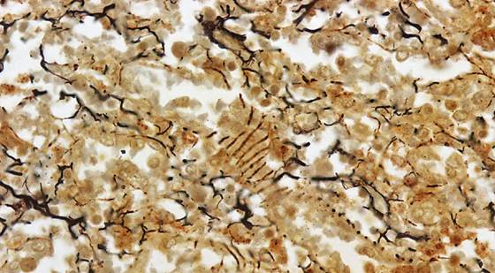
Reticular fibers
fine, branching network
framework of the haemopoetic, and lympatic organs
special staining: silver impregnation
IV. típ. collagen
reticulum cells

Slide 17
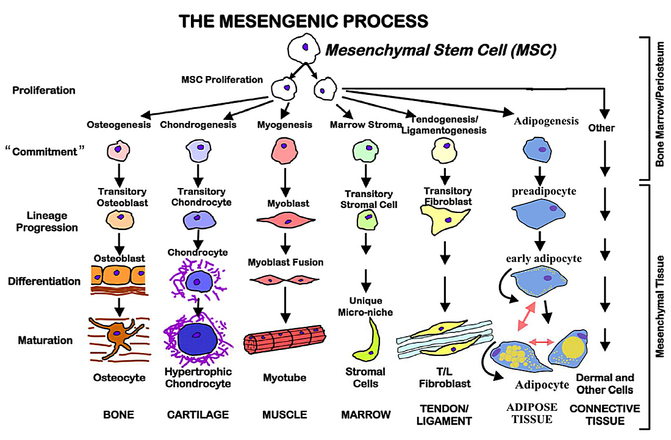
Types of connective tissue

Slide 18
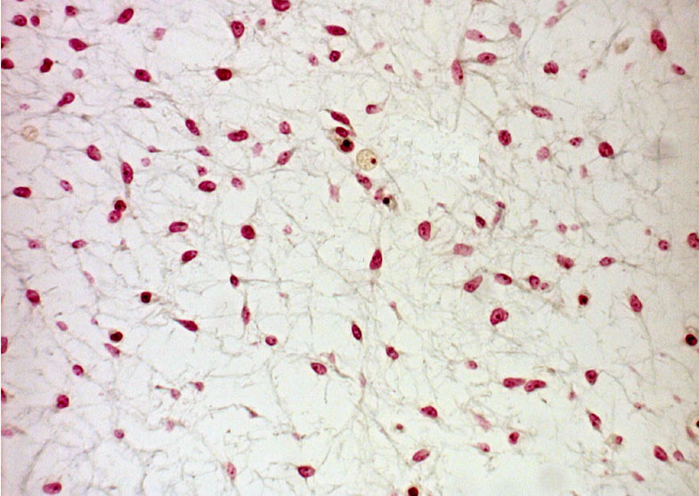
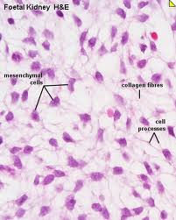
Mesenchymal tissue
Star-shaped mesenchymal cells and fibers: embryo, young developing tissue

Slide 19
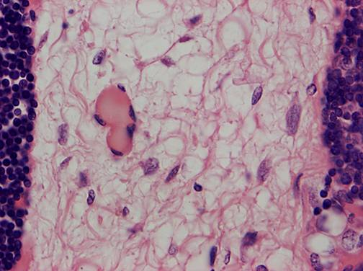
Types of connective tissue
loose connective tissue
few fibers, irregular structure
the most frequent type,
fills in spaces, connects organs with each other

Slide 20
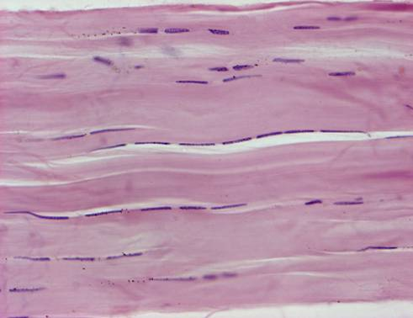
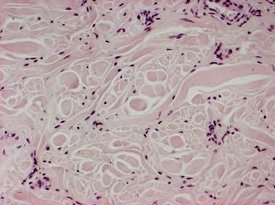
dense regular connective tissue
many collagen fibers in regularly arranged bundles: tendons
dense irregular connective tissue
many collagen fibers, in irregularly arranged bundles

Slide 21
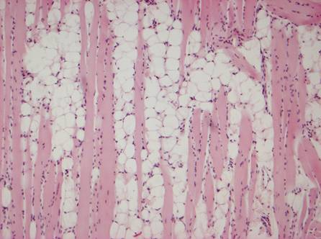
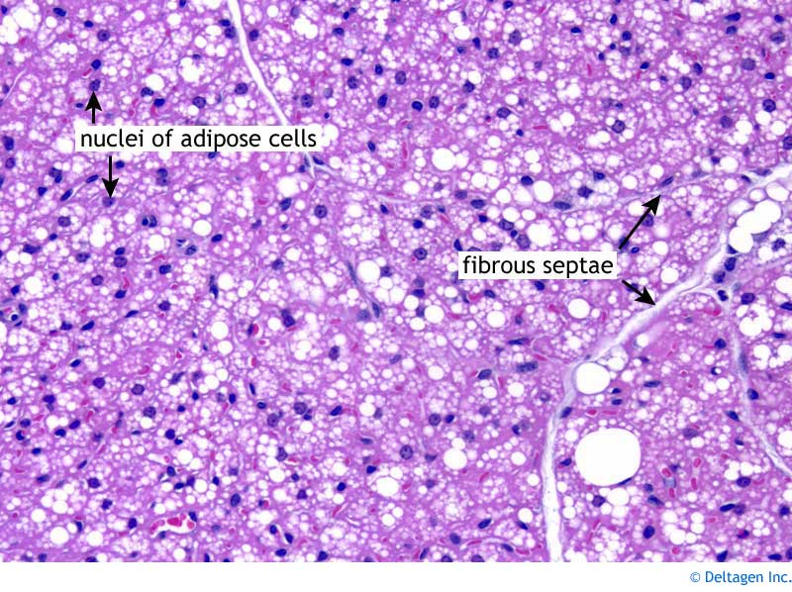
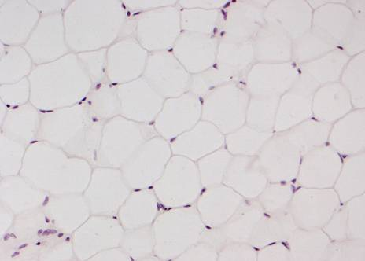
adipose tissue
adipocytes, a few reticular fibers
„Fat pad”
white and brown adipose tissue
brown adipose tissue

Slide 22
Supporting tissue
Function: supports the body
Structure: cells + extracellular matrix
Origin: mesoderm
Types: cartilage
  bone

Slide 23
Bone tissue

Slide 24
General characteristics
Mechanically resistent, hard, but relatively elastic and light skeletal structure.
Highly vascularized living tissue, adaptable to changing environmental conditions, continuously being remodeled and renewed
Components
I. Cells (osteocytes, osteoblasts, osteoclasts, osteoprogenitor cells)
II. Extracellular matrix (collagen fibers, proteoglycans, bone-specific proteins) + mineral salts: hydroxyapatite crystals

Slide 25
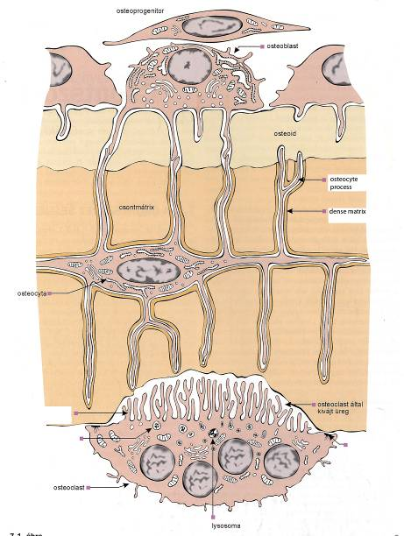
I. Cells in the bone tissue
osteoprogenitor
osteoblast
osteocyte
osteoclast
→

Slide 26
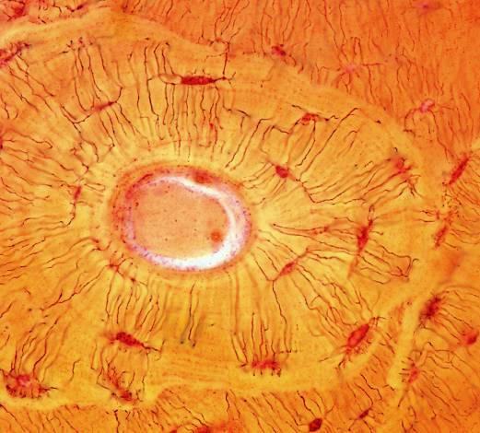
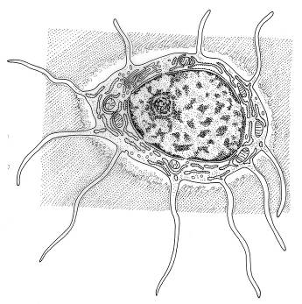
1. Osteocytes
Bone cells with many thin processes (connected with similar processes of neighboring bone cells by gap junctions). Maintains the surrounding bone matrix by synthesizing or resorbing matrix constituents, if needed. Situated in small cavities of the matrix: lacunae, canaliculi.
→

Slide 27
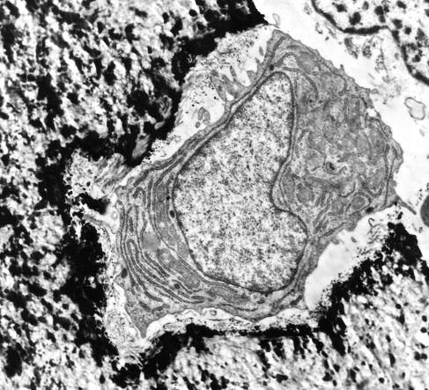
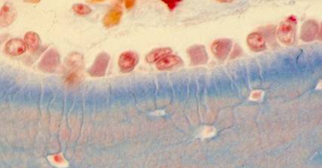
2. Osteoblasts
Cells synthesizing and secreting bone matrix components during development and restructuring of the bone. Sitting on the bone surface (often in a monolayer), they have a basophilic cytoplasm (rER!) and several processes penetrating into the newly formed matrix (osteoid). They are gradually embedded into the forming matrix and become osteocytes. At the end of osteogenesis, the remaining osteoblasts die with apoptosis or dedifferentiate into osteoprogenitor cells. Osteoblasts can induce the formation of osteoclasts on hormonal effects.
osteoblast
→
osteoid
mineralized bone tissue
→

Slide 28
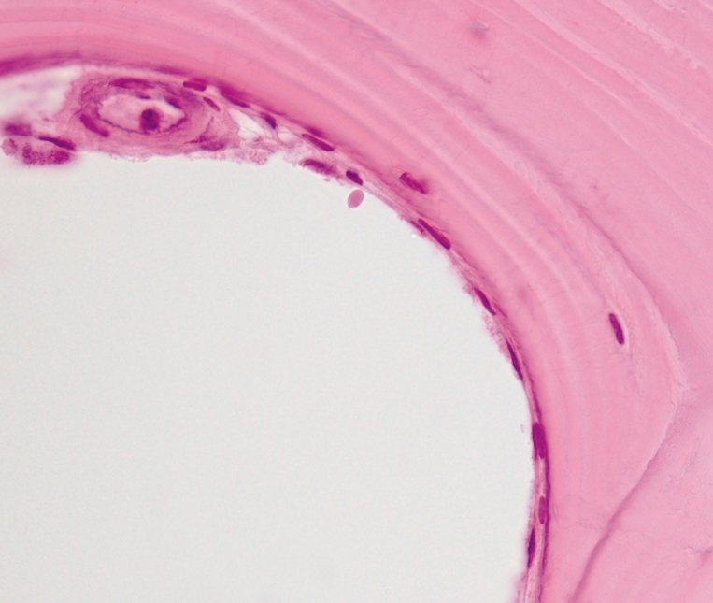
3. Osteoprogenitor cells
Flattened cells with oval nuclei, situated on the peri- and endosteal surfaces and around blood vessels in the bone. Derivatives of mesenchymal stem cells and committed to bone formation. Capable of cell division and to form not only osteoblasts, but chondroblasts and fibroblasts as well.
Endosteum, HE staining.
→

Slide 29
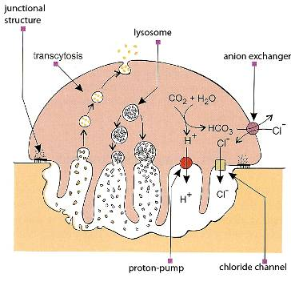
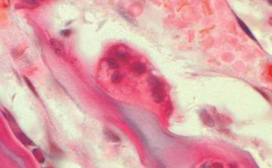
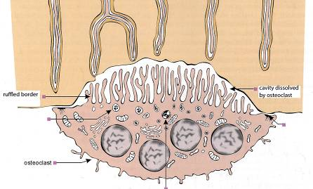
4. Osteoclasts
Giant cells with the capacity of degrading the bone tissue. Multinucleated cell with an eosinophilic cytoplasm rich in mitochondria and lysosomes. They derive from blood monocyte-like cells which fuse and form osteoclasts on contact with osteoblasts (parathyroid hormone, RANK, signal transduction, gene activation, …)
→
→
The cell surface facing the bone tissue has a ruffled border, consisting of many lamellar processes. Proton pumps of the membrane on this side pump H⁺ into the subcellular cavity, lysosomes are exocytosed releasing degrading enzymes, which leads to the degradation of both organic and inorganic components of the matrix. A ringlike peripheral zone of junctional structure (sealing zone) between the cell and the bone surface closes up the subcellular cavity.

Slide 30
II. Bone matrix
1. Collagen fibers. Main components (90%) of the organic matrix. Type I collagen. Parallelly arranged they often form 3-5 μm thick lamellae (in lamellar bone), but can be present as dense, woven structures (in woven bone). Collagen fibers are responsible for elastic resistence against bending and loading. Genetic defects of the collagen can lead to osteogenesis imperfecta (frequent fractures, deformities of the skeletal system).
2. Proteoglycans (PGs). They form a macromolecular network into which collagen fibers are embedded. PGs have shorter core proteins and fewer glysoaminoglycan (GAG) chains (mostly chondroitin 4,6 sulfate, keratansulfate) than in cartilage.
3. Bone-specific proteins. Osteocalcin and osteonectin (involved in mineralization), osteopontin (mediates the formation of the sealing zone in osteoclasts), bone sialoprotein (involved in attachment of osteoblasts to the matrix surface).
4. Inorganic material (mineral salts) makes 65% of the dry weight. Hydroxyapatite crystals: [3 Ca₃(PO₄)₂ . Ca(OH)₂], fine needle-like (40x2 nm) crystals bound to collagen fibrils with longitudinal orientation. Responsible for pressure resistence.
Formation of the matrix: osteoblasts synthesize components of the organic matrix and regulate mineralization.
Degradation of the matrix: osteoclasts degrade and dissolve both organic and inorganic constituents of the matrix.

Slide 31
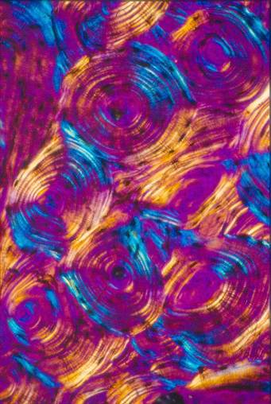
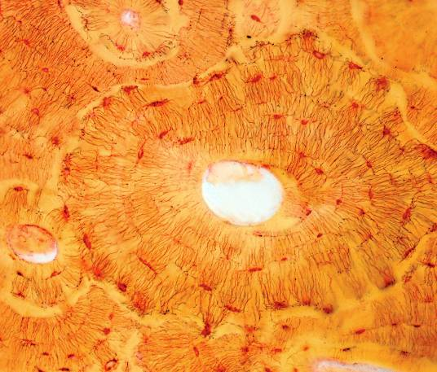
Osteon
Lamellae are arranged in concentric layers with layers of osteocytes between them. Canaliculi (containing osteocyte processes) form radial diffusion pathways for nutrients from the Havers canal up to the osteon periphery.
Haversian (concentric) lamellae
interstitial lamellae
Haversian canal
→
Osteon in cross section, Schmorl staining
→
Osteons with polarized light

Slide 32

Periosteum
Dense connective tissue covering on the bone. Outer layer: dense lamellar connective tissue, inner layer: in actively growing bone contains osteoprogenitor cells and osteoblasts, in inactive periosteum only few osteoprogenitor cells are present. No periosteum on articular surfaces.
Blood vessels (nutrition of the bone tissue) and nerves (inflammation, damage causes strong pain!)
Endosteum
Thin connective tissue layer covering all internal surfaces (lining the marrow cavity, the trabecular surfaces and the canals inside the bone). Usually one layer thick with osteoprogenitor cells.
→

Slide 33
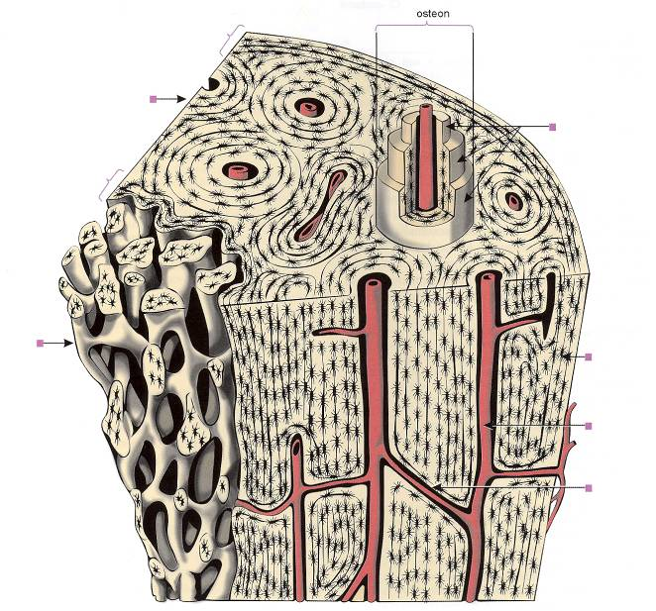
Haversian system in compact bone
outer circumferential lamellae
compact bone
osteonal lamellae
inner circumferential lamellae
spongy bone
Haversian canal with blood vessel
Volkmann’s canal with blood vessel
→

Slide 34
Bone development
1.) Intramemebranous ossification: connective tissue
2.) Chondrogenic ossification: cartilage

Slide 35
Intramembranous ossification
mesenchymal cells
osteoblasts
osteocytes

Slide 36
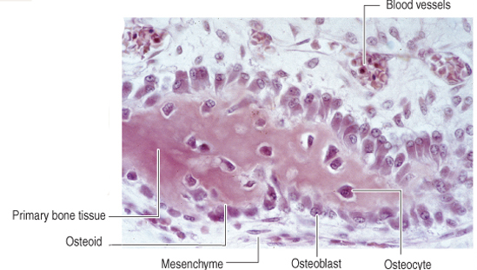
Intramembranous ossification
At the surface of the osteoid, osteoblasts continue the appositional deposit of matrix, mainly type I collagen and groud substance proteins

Slide 38
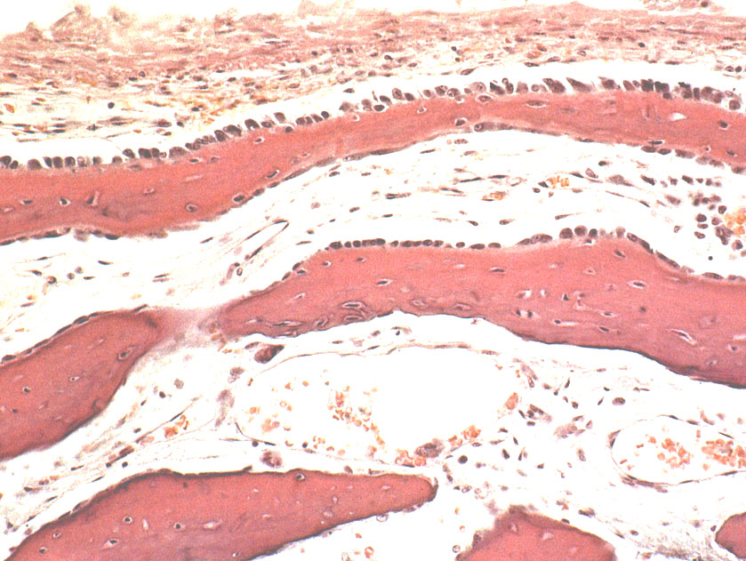
Connective tissue membrane
spicule
osteoblasts
osteocytes
osteoclast
spicule
Intramembranous ossification of the skull

Slide 39
Endochondral ossification
Hyalin cartilage is the template of the long bone
It has to be replaced by bone tissue
cartilage should be degraded: cartilage erosion
new bone should be produced: osteoblasts are needed

Slide 40
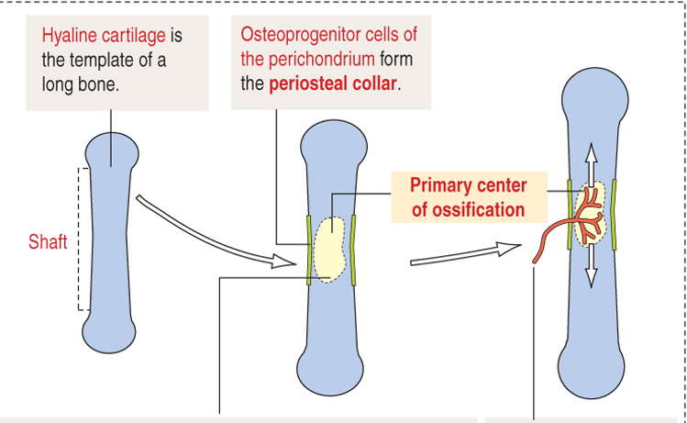
Endochondral ossification

Slide 41
Cartilage
Cells Extracellular matrix
chondroblasts
chondrocytes
fibers
ground substance

Slide 42
Cartilage
Cells + extracellular matrix
Cells: chondrocytes
Extracellular matrix: fibers (collagen, elastic) + ground substance
      ground substance: proteoglycans
        glycoproteins: chondrocalcin, cartilage matrix protein (CMP), chondronectin fibronectin

Slide 43
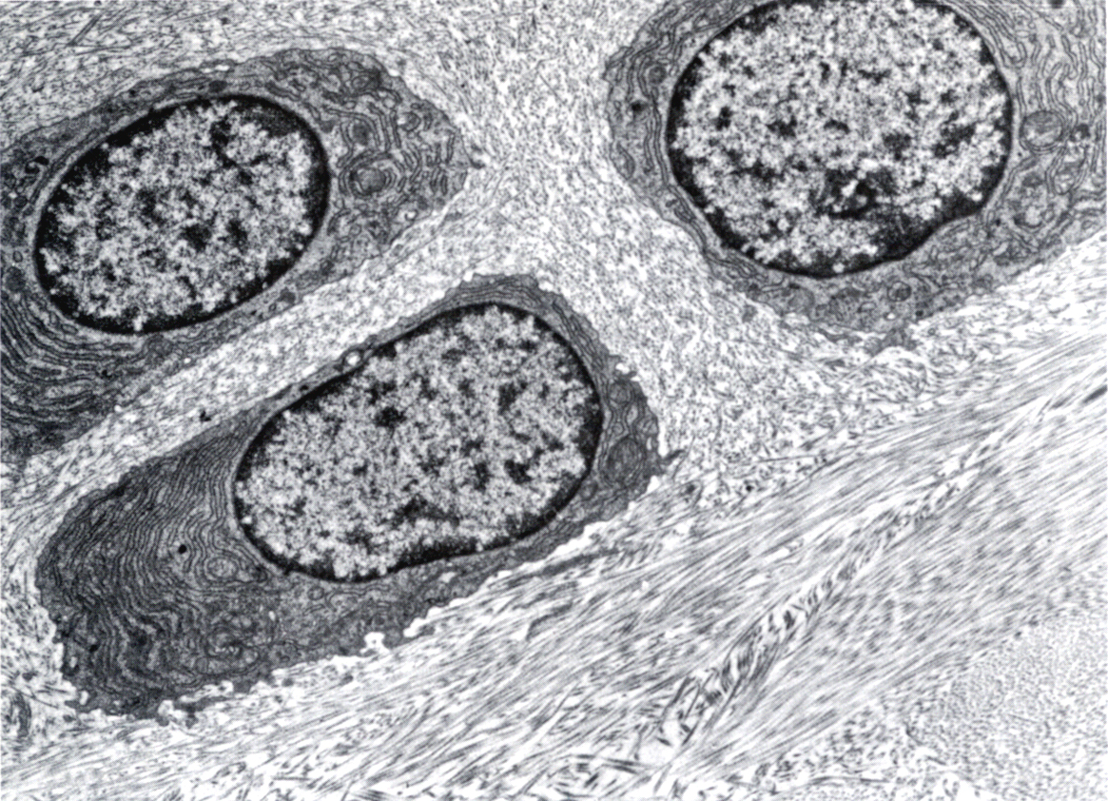

Slide 44
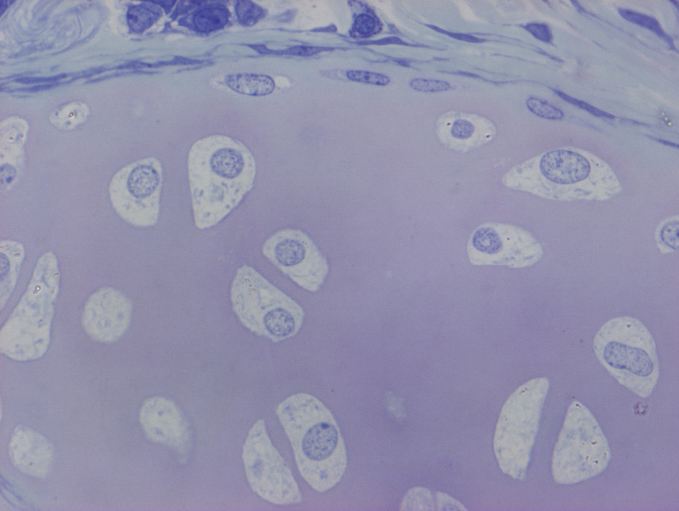

Slide 45
Extracellular matrix
Proteoglycanes+adhesion molecules
filamentuos molecules: 3 dimensional network – gelatinuos material
is able to bind large amount of water – flexibility (turgor)

Slide 46
GAG:
  Hyaluronic acid: glucuronic acid +
  N-acetilglucosamin
  Chondroitin sulfate: N-acetyl-galactosamin
  Keratan sulfate: N-acetyl-glucosamin + sulfated galactose
  Proteoglycane: „core” protein + chondroitin sulfate and keratan sulfate

Slide 47
Types of cartilage
Hyalin: functional unit: chondron: covers the bony surfaces of the joints
Elastic
Fibrous: intervertebral disc, temporomandibular joint

Slide 48
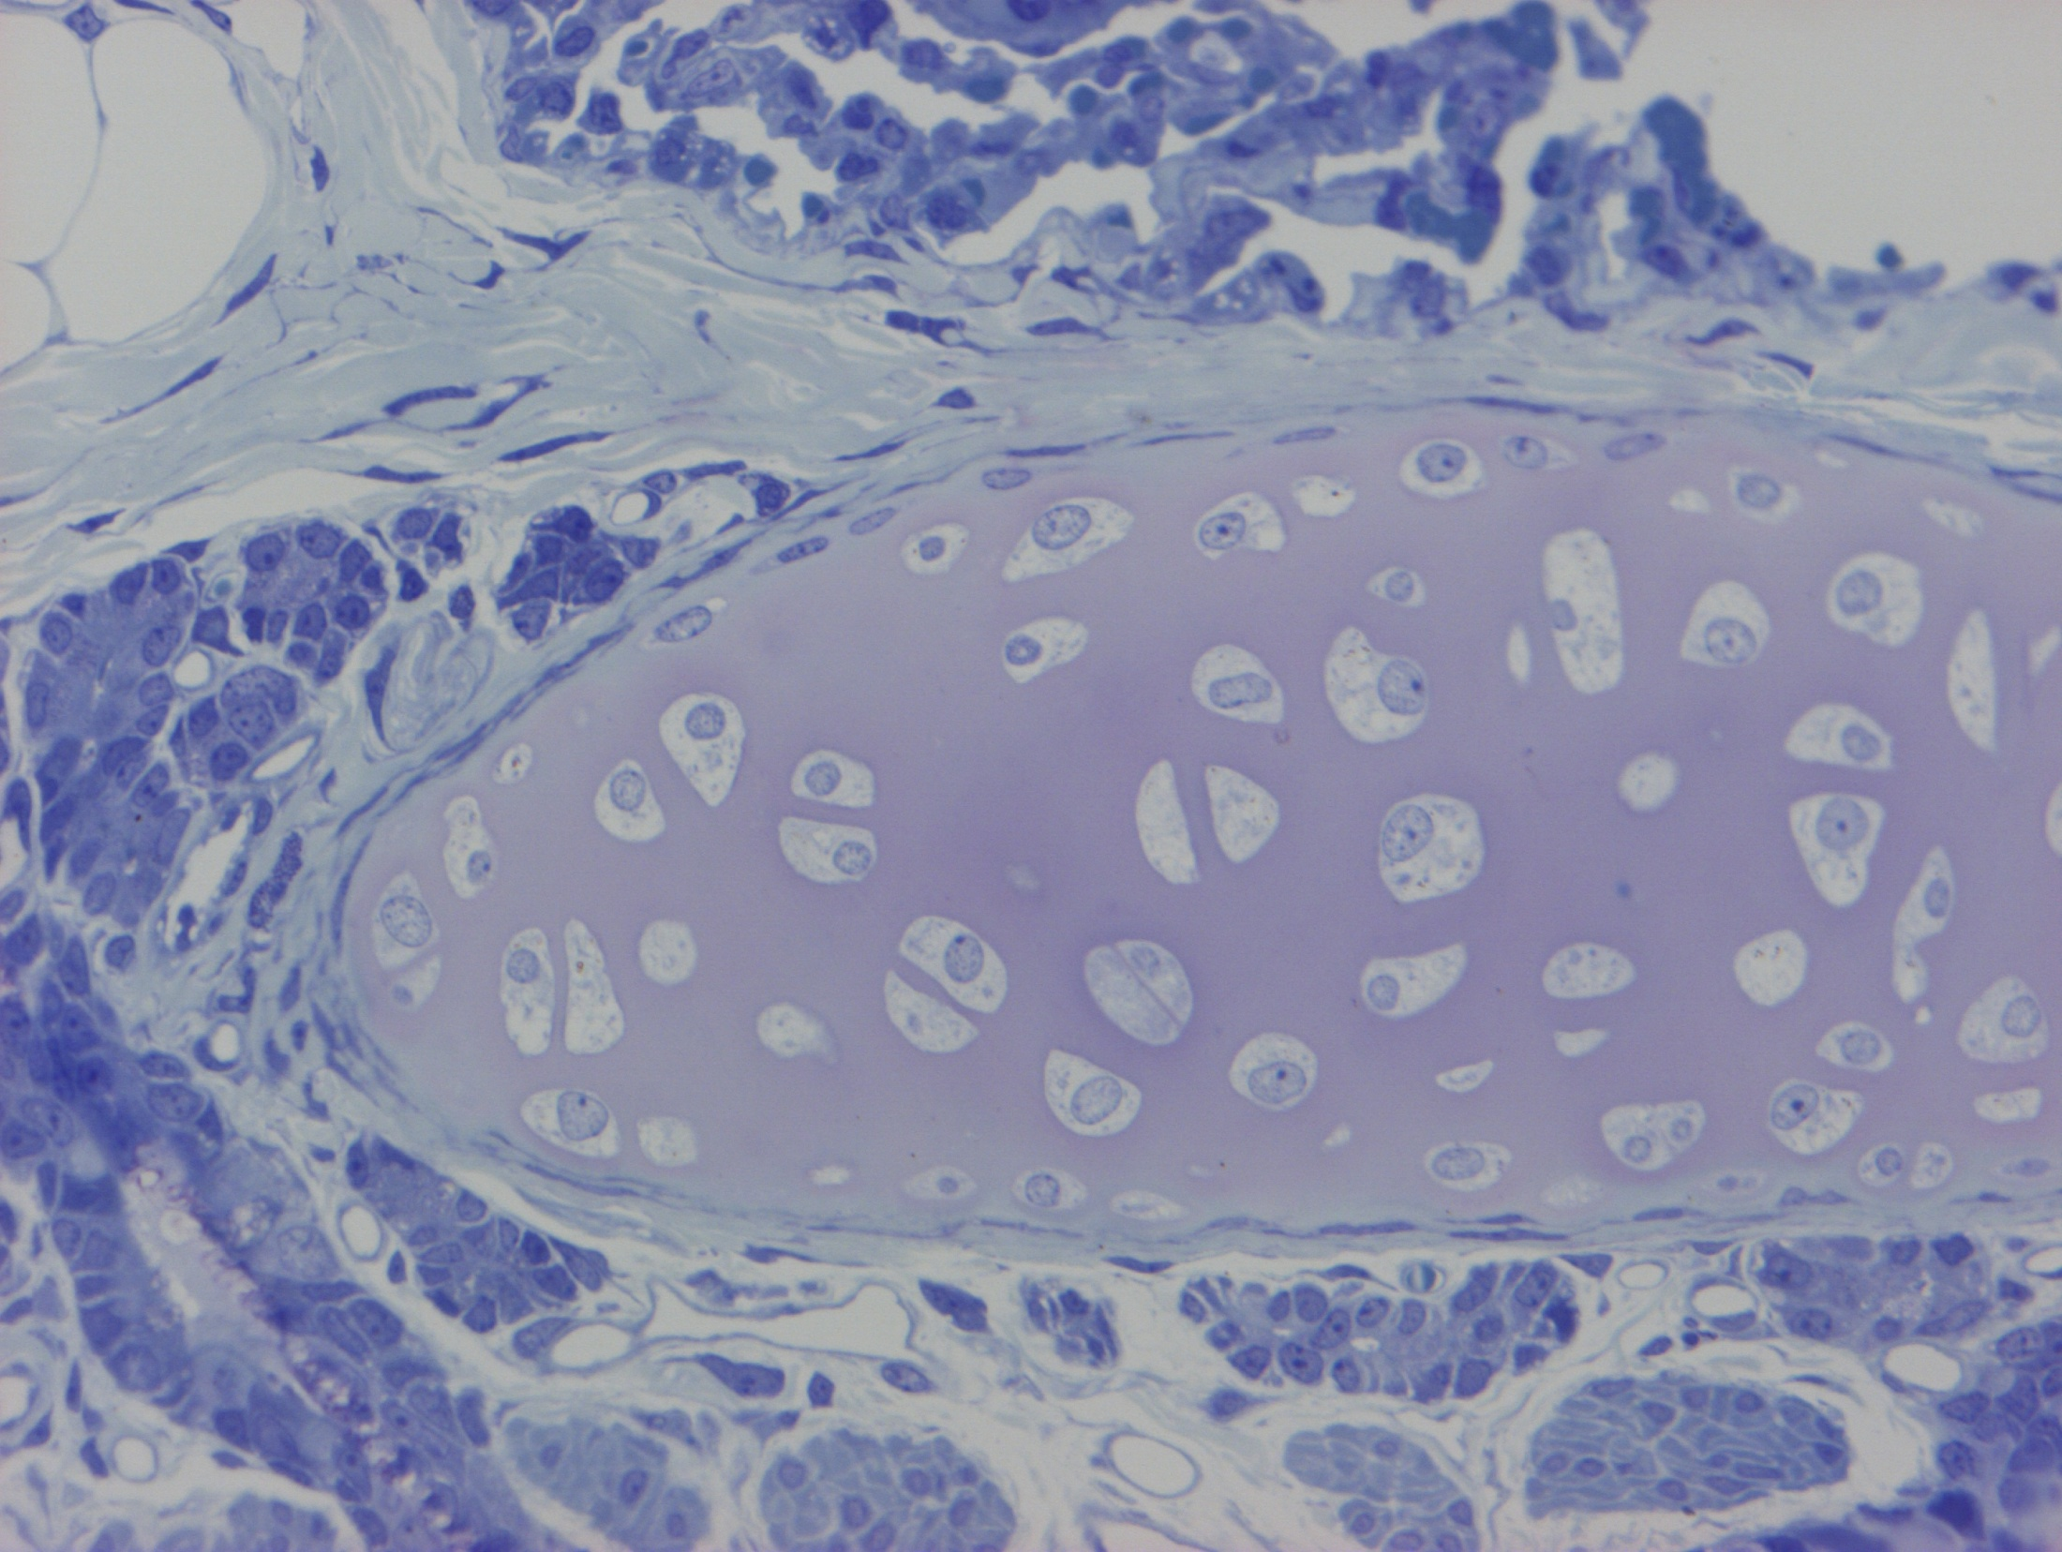

Slide 49
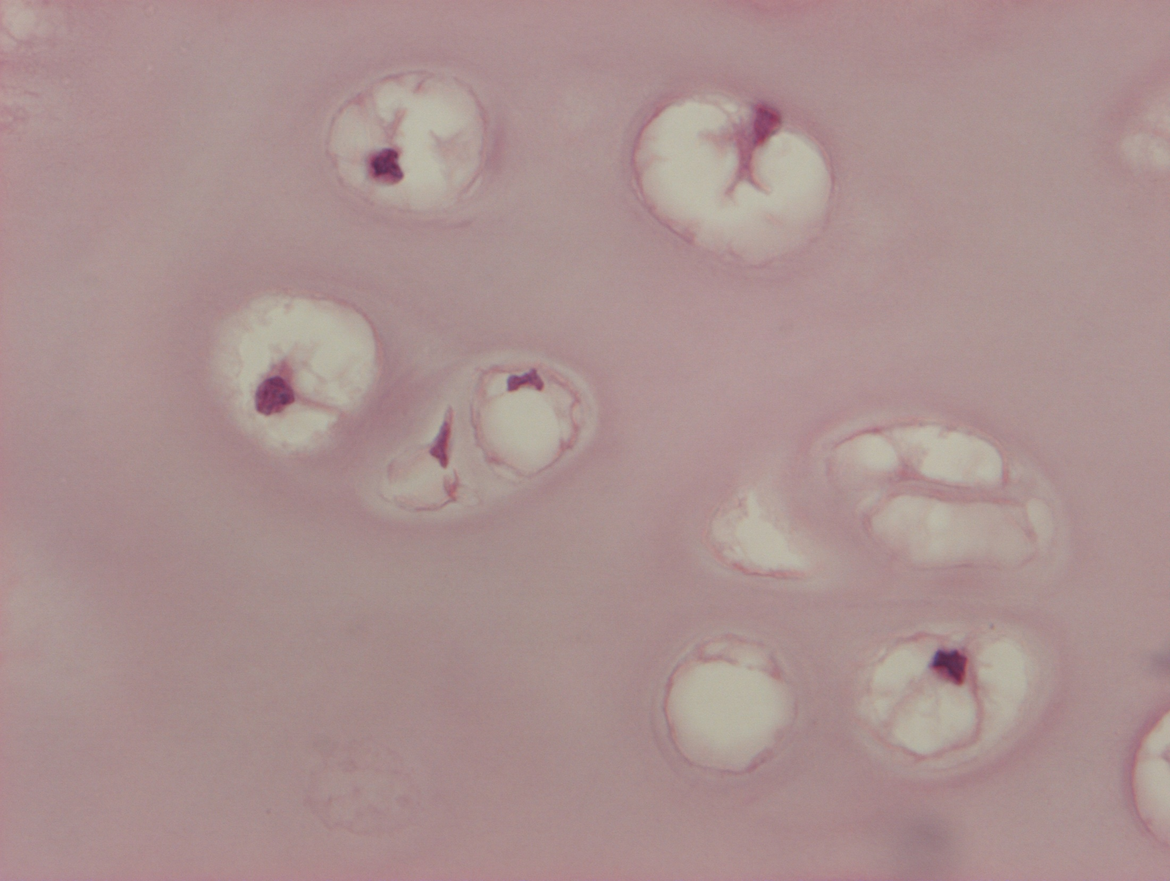
Chondron:
chondrocytes
basophylic capsule
territorial matrix

Slide 50
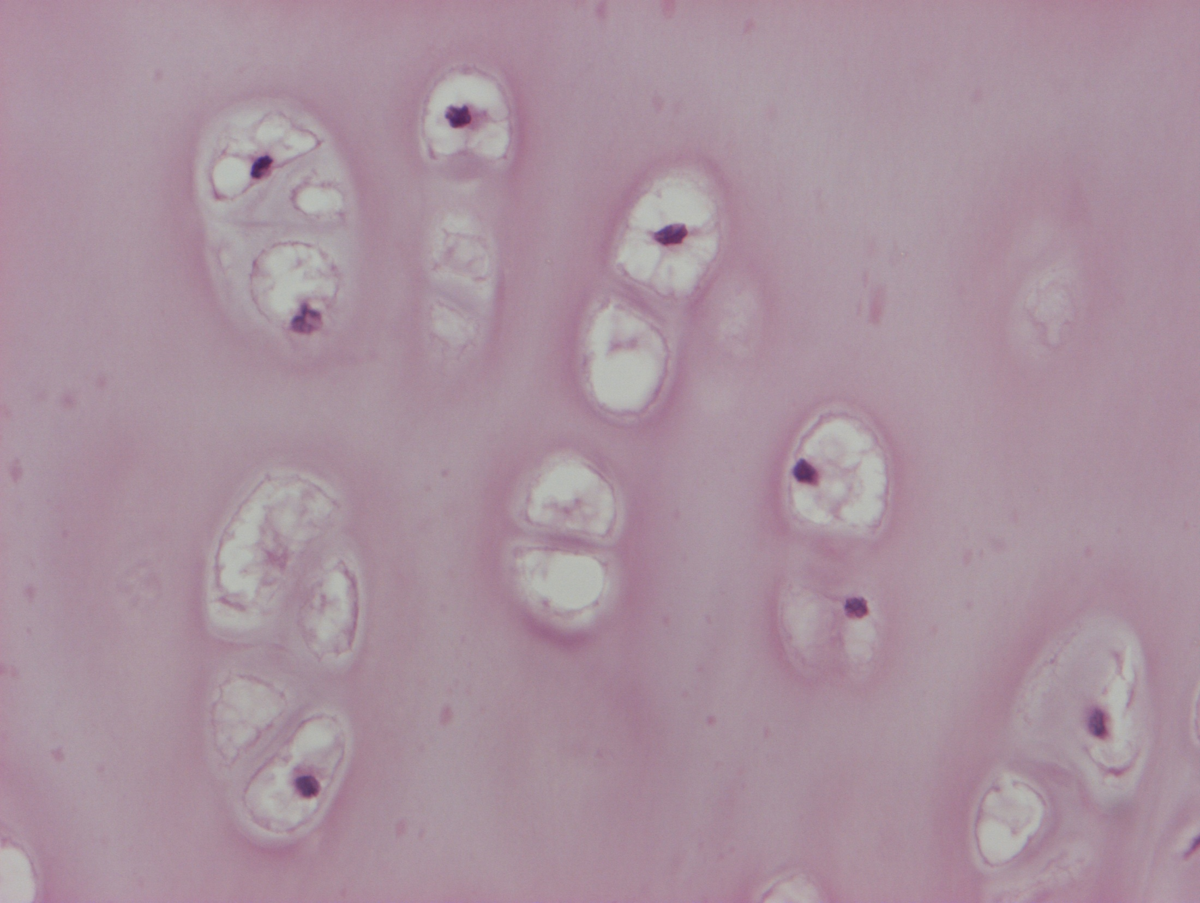
hyalin cartilage

Slide 51
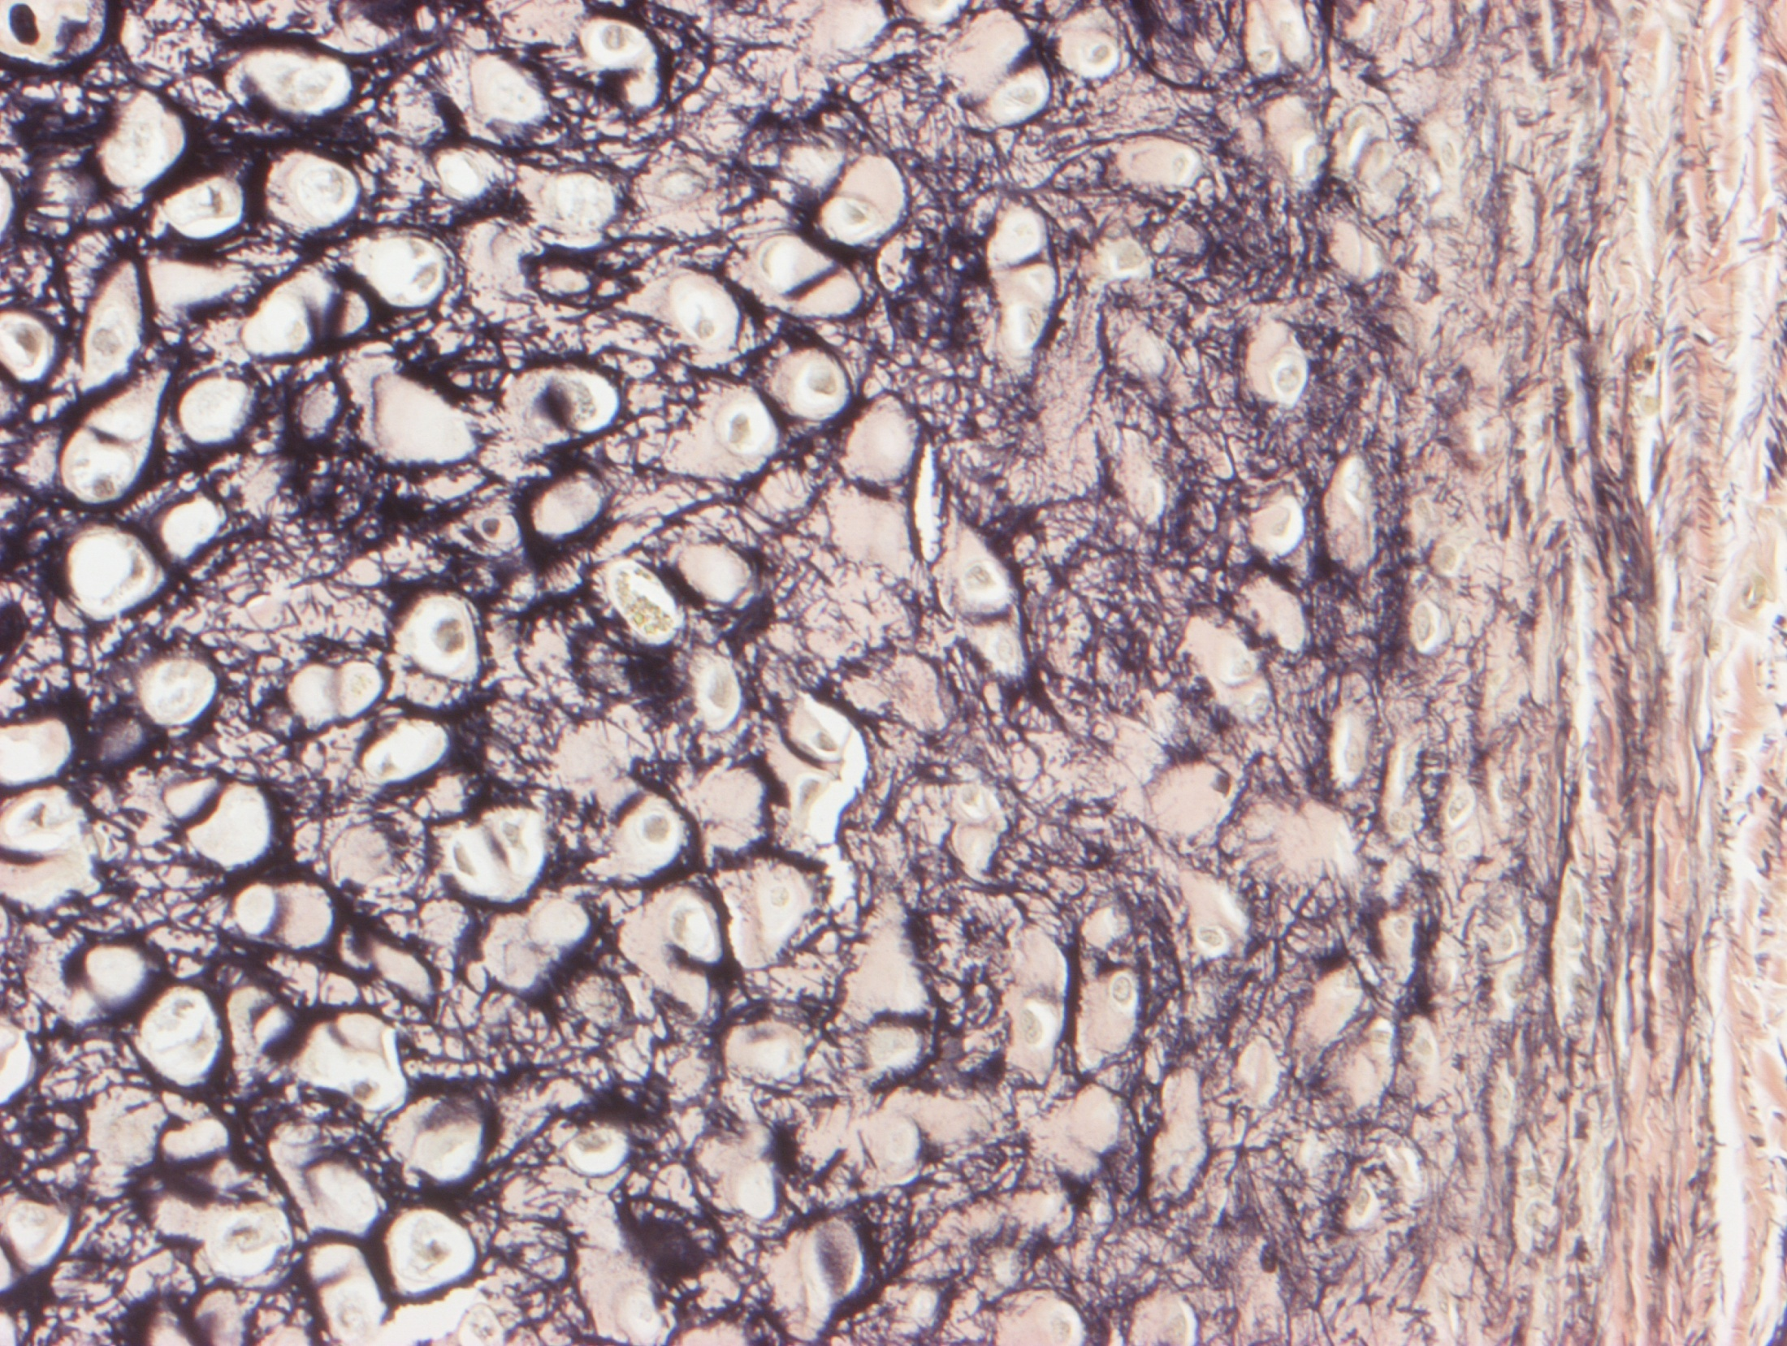
elastic cartilage

Slide 52
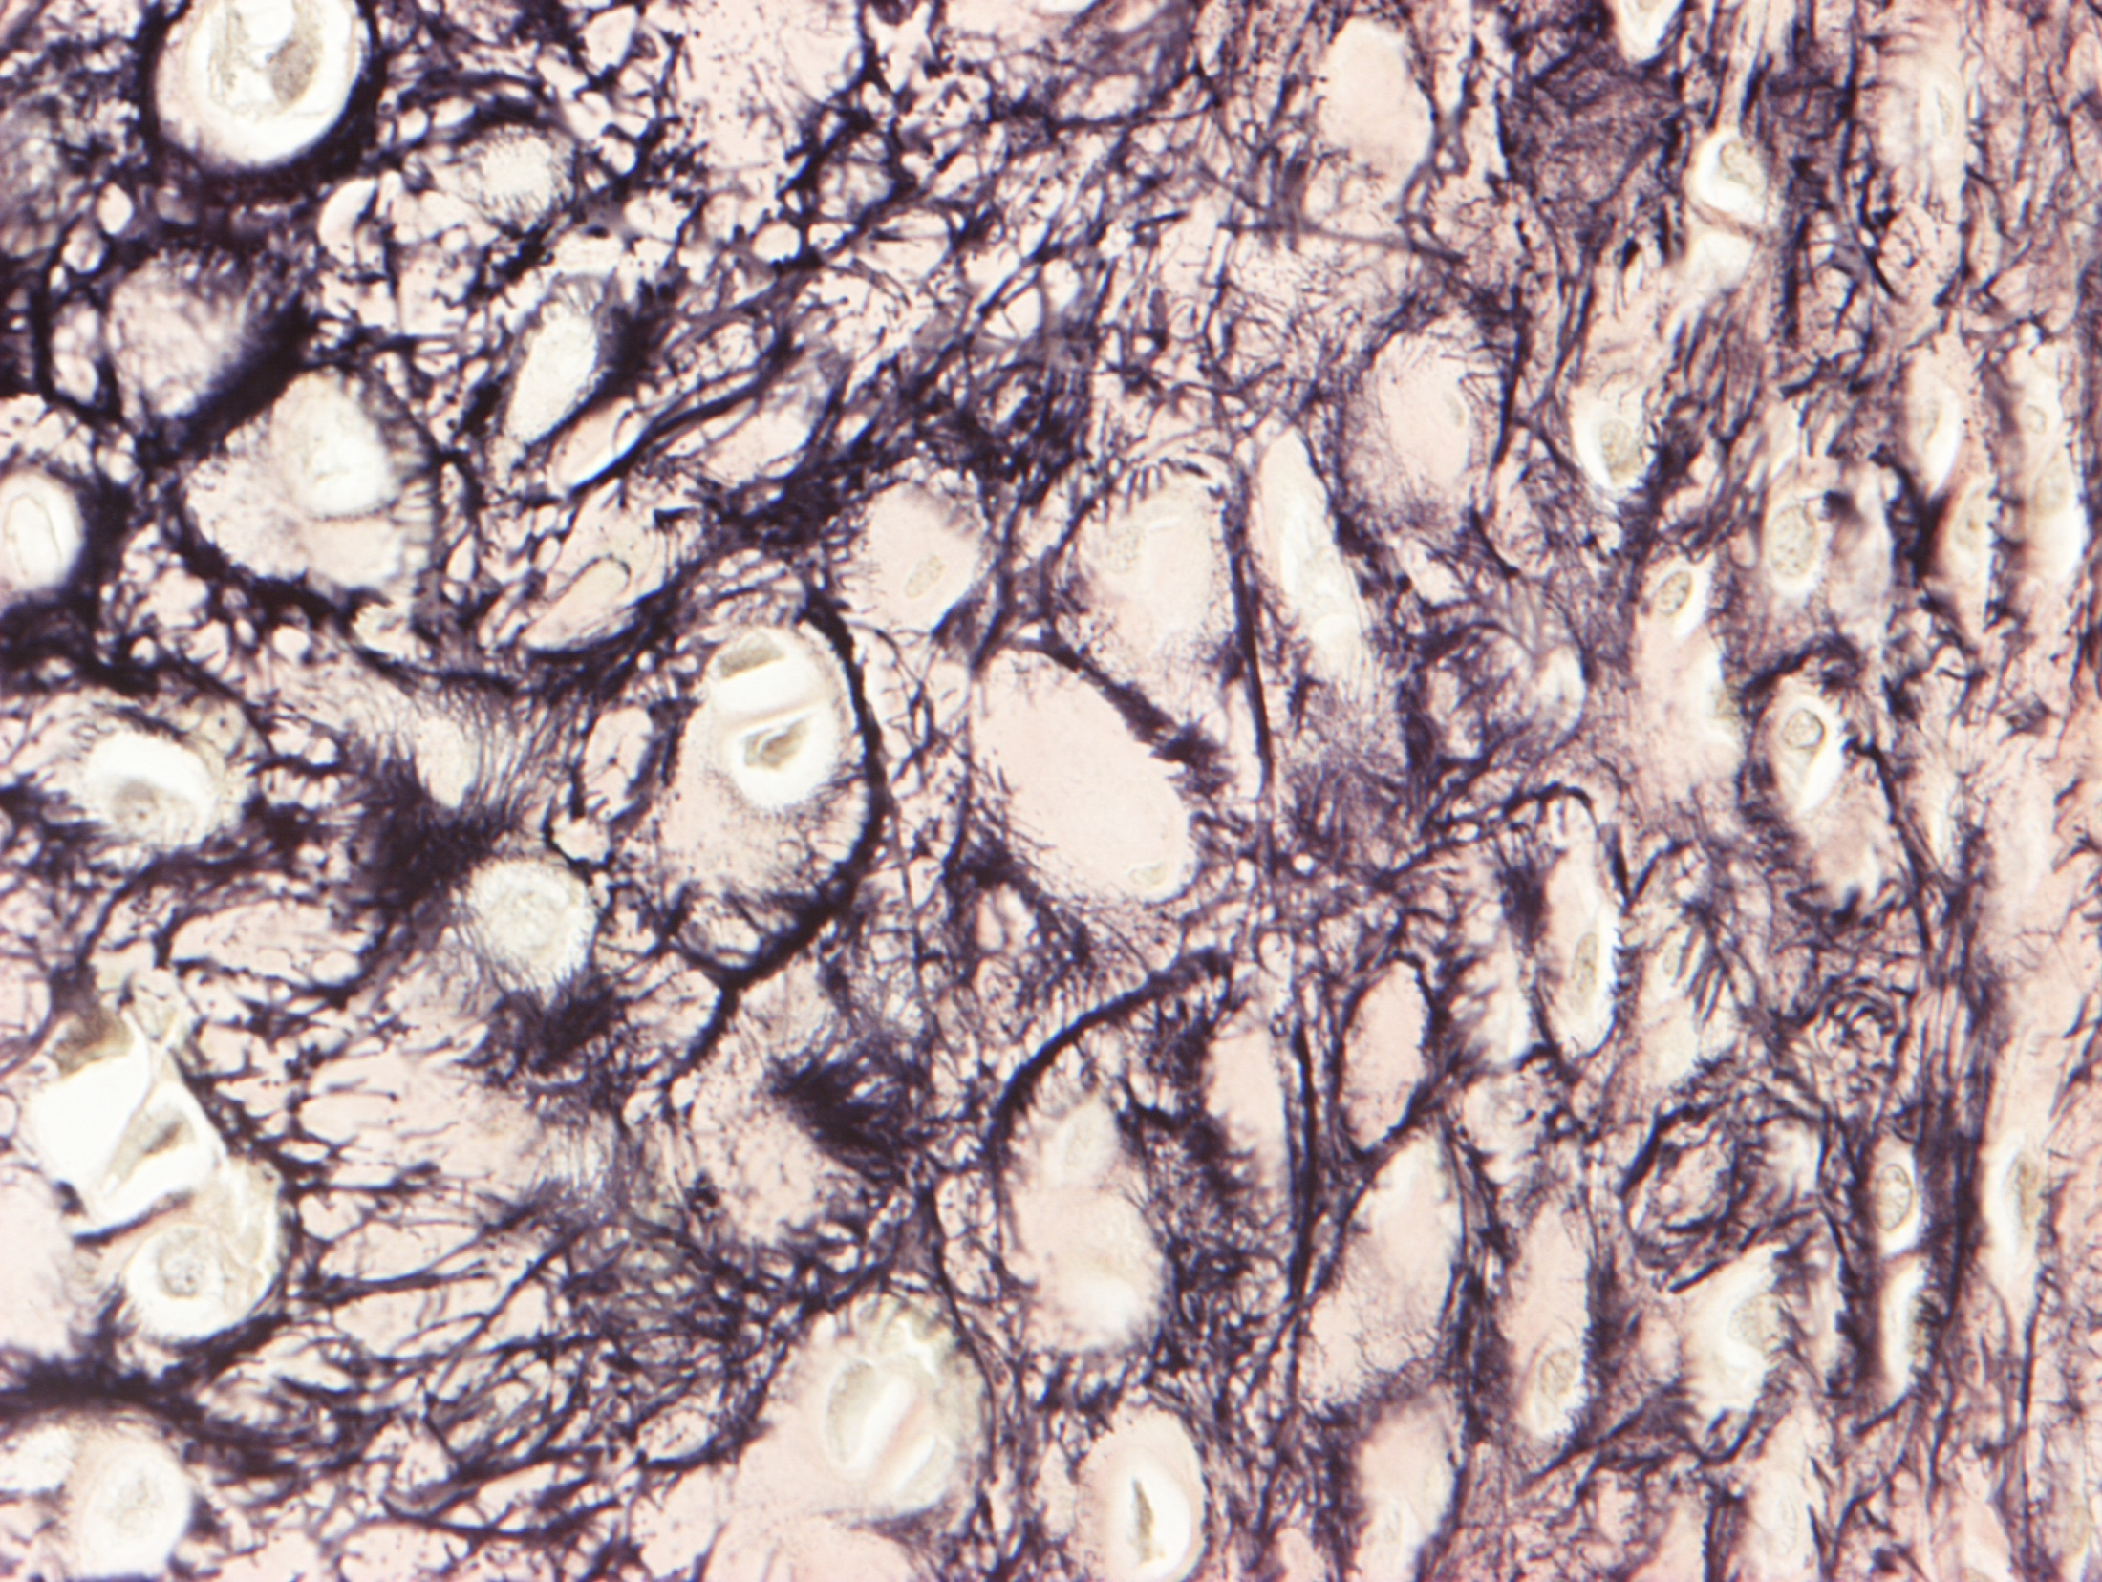

Slide 53
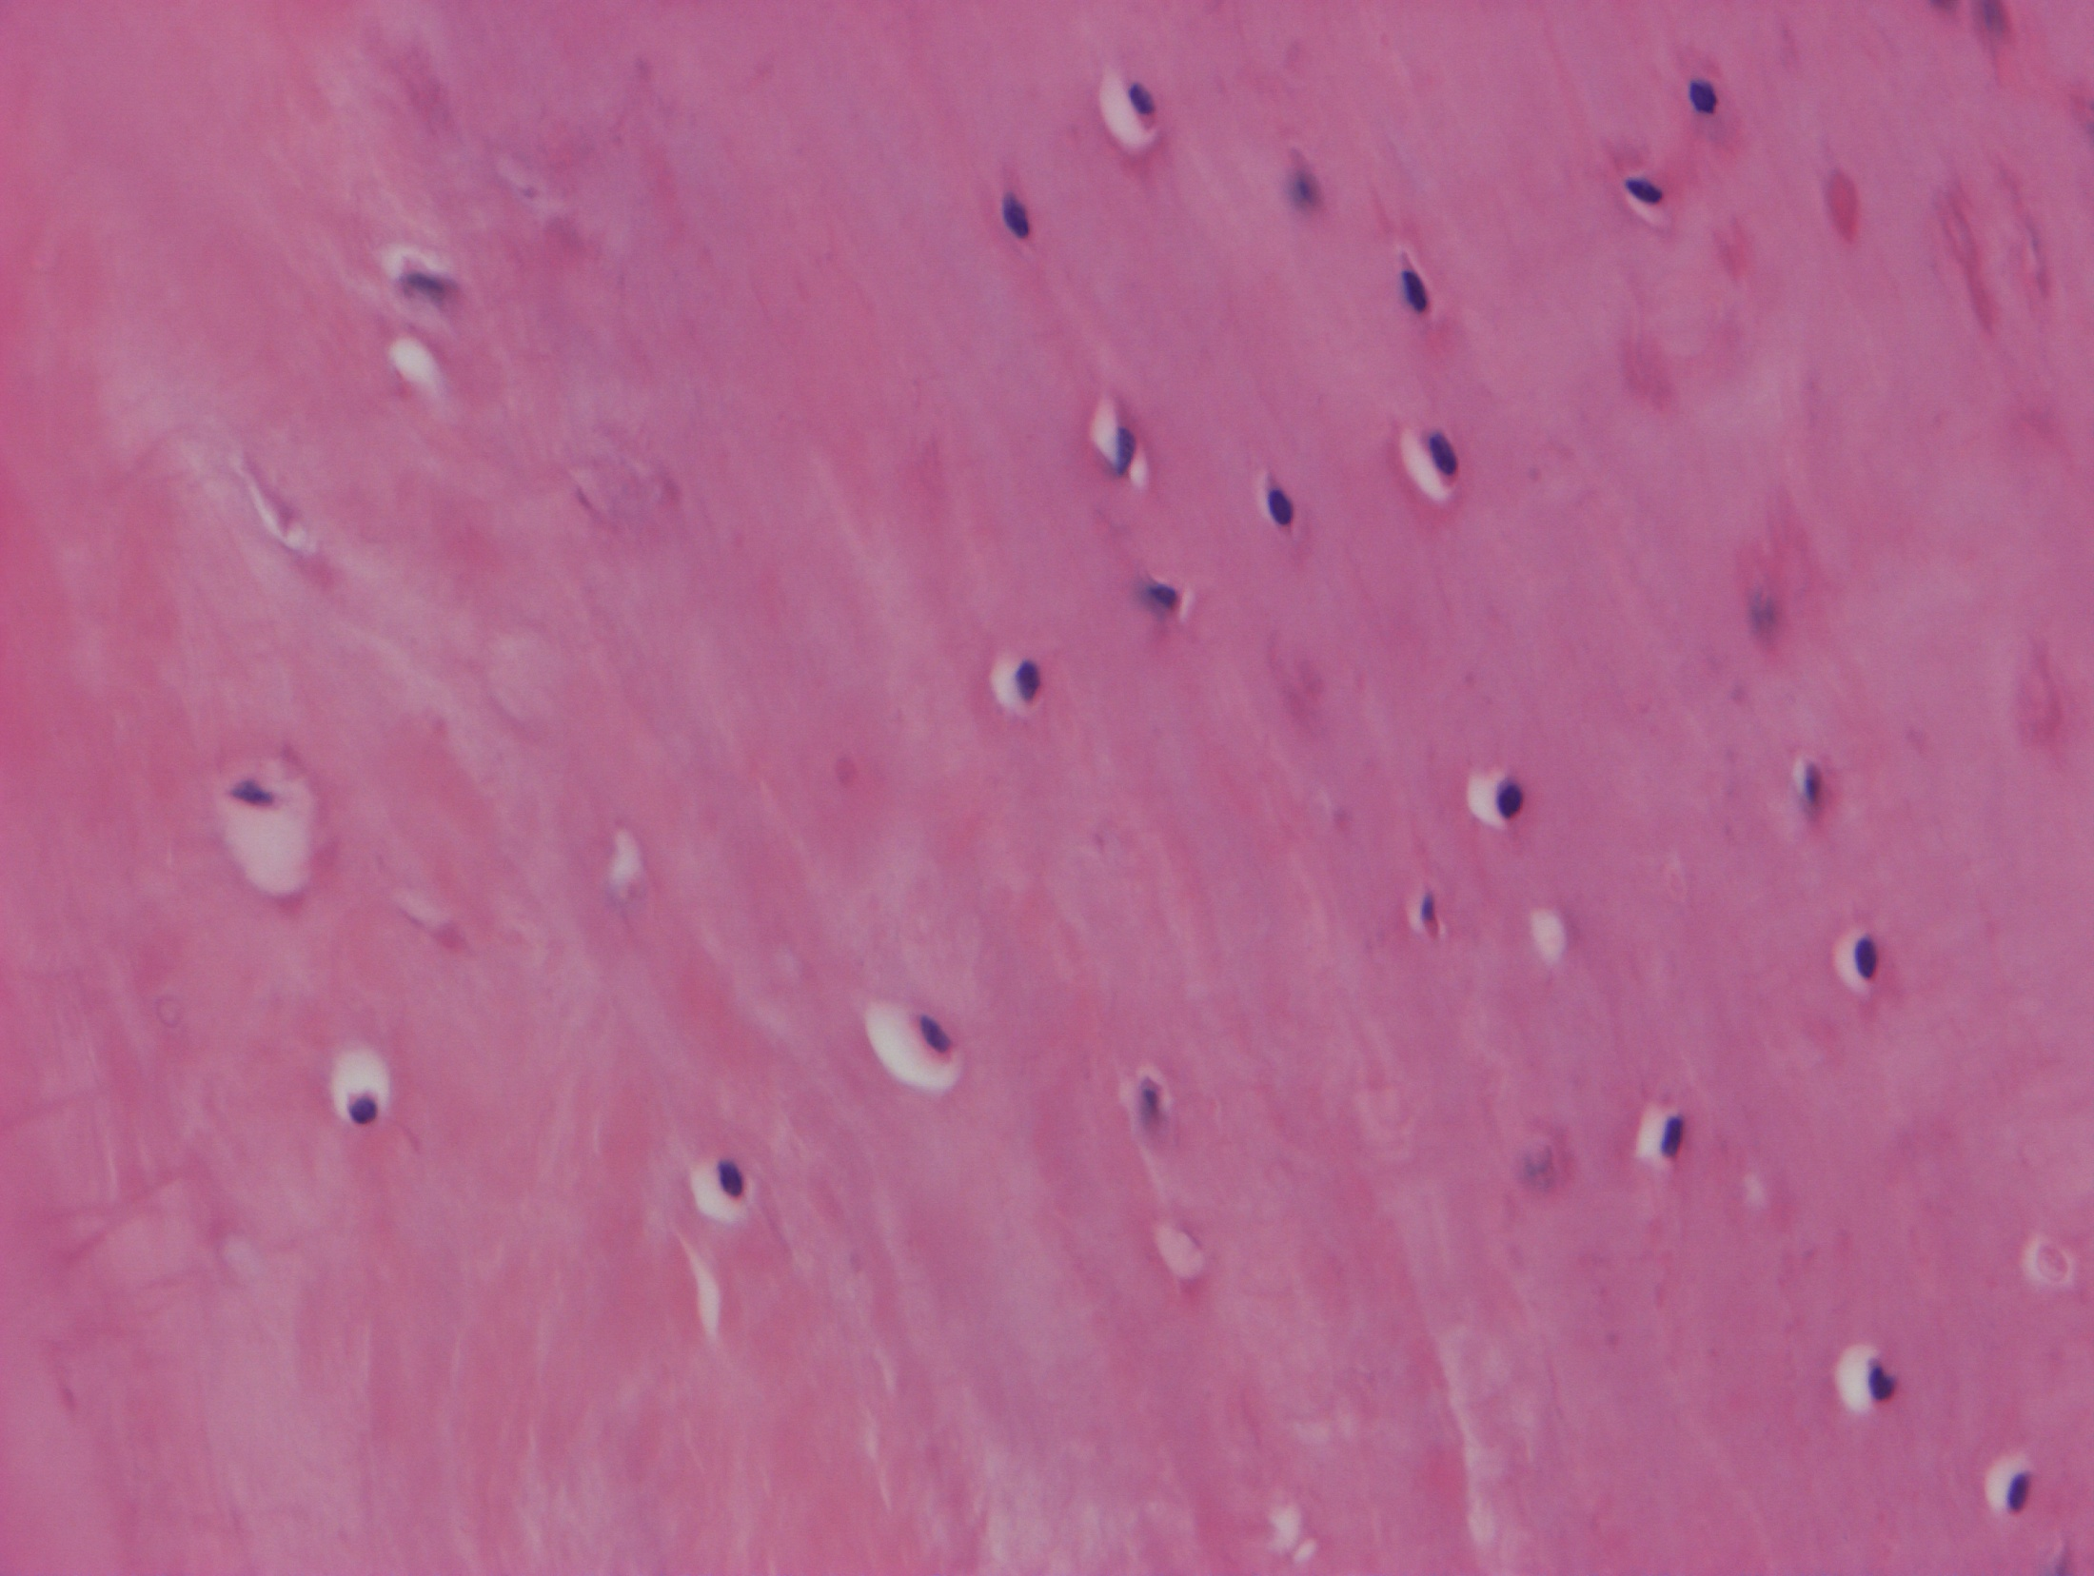
fibrous cartilage

Slide 54
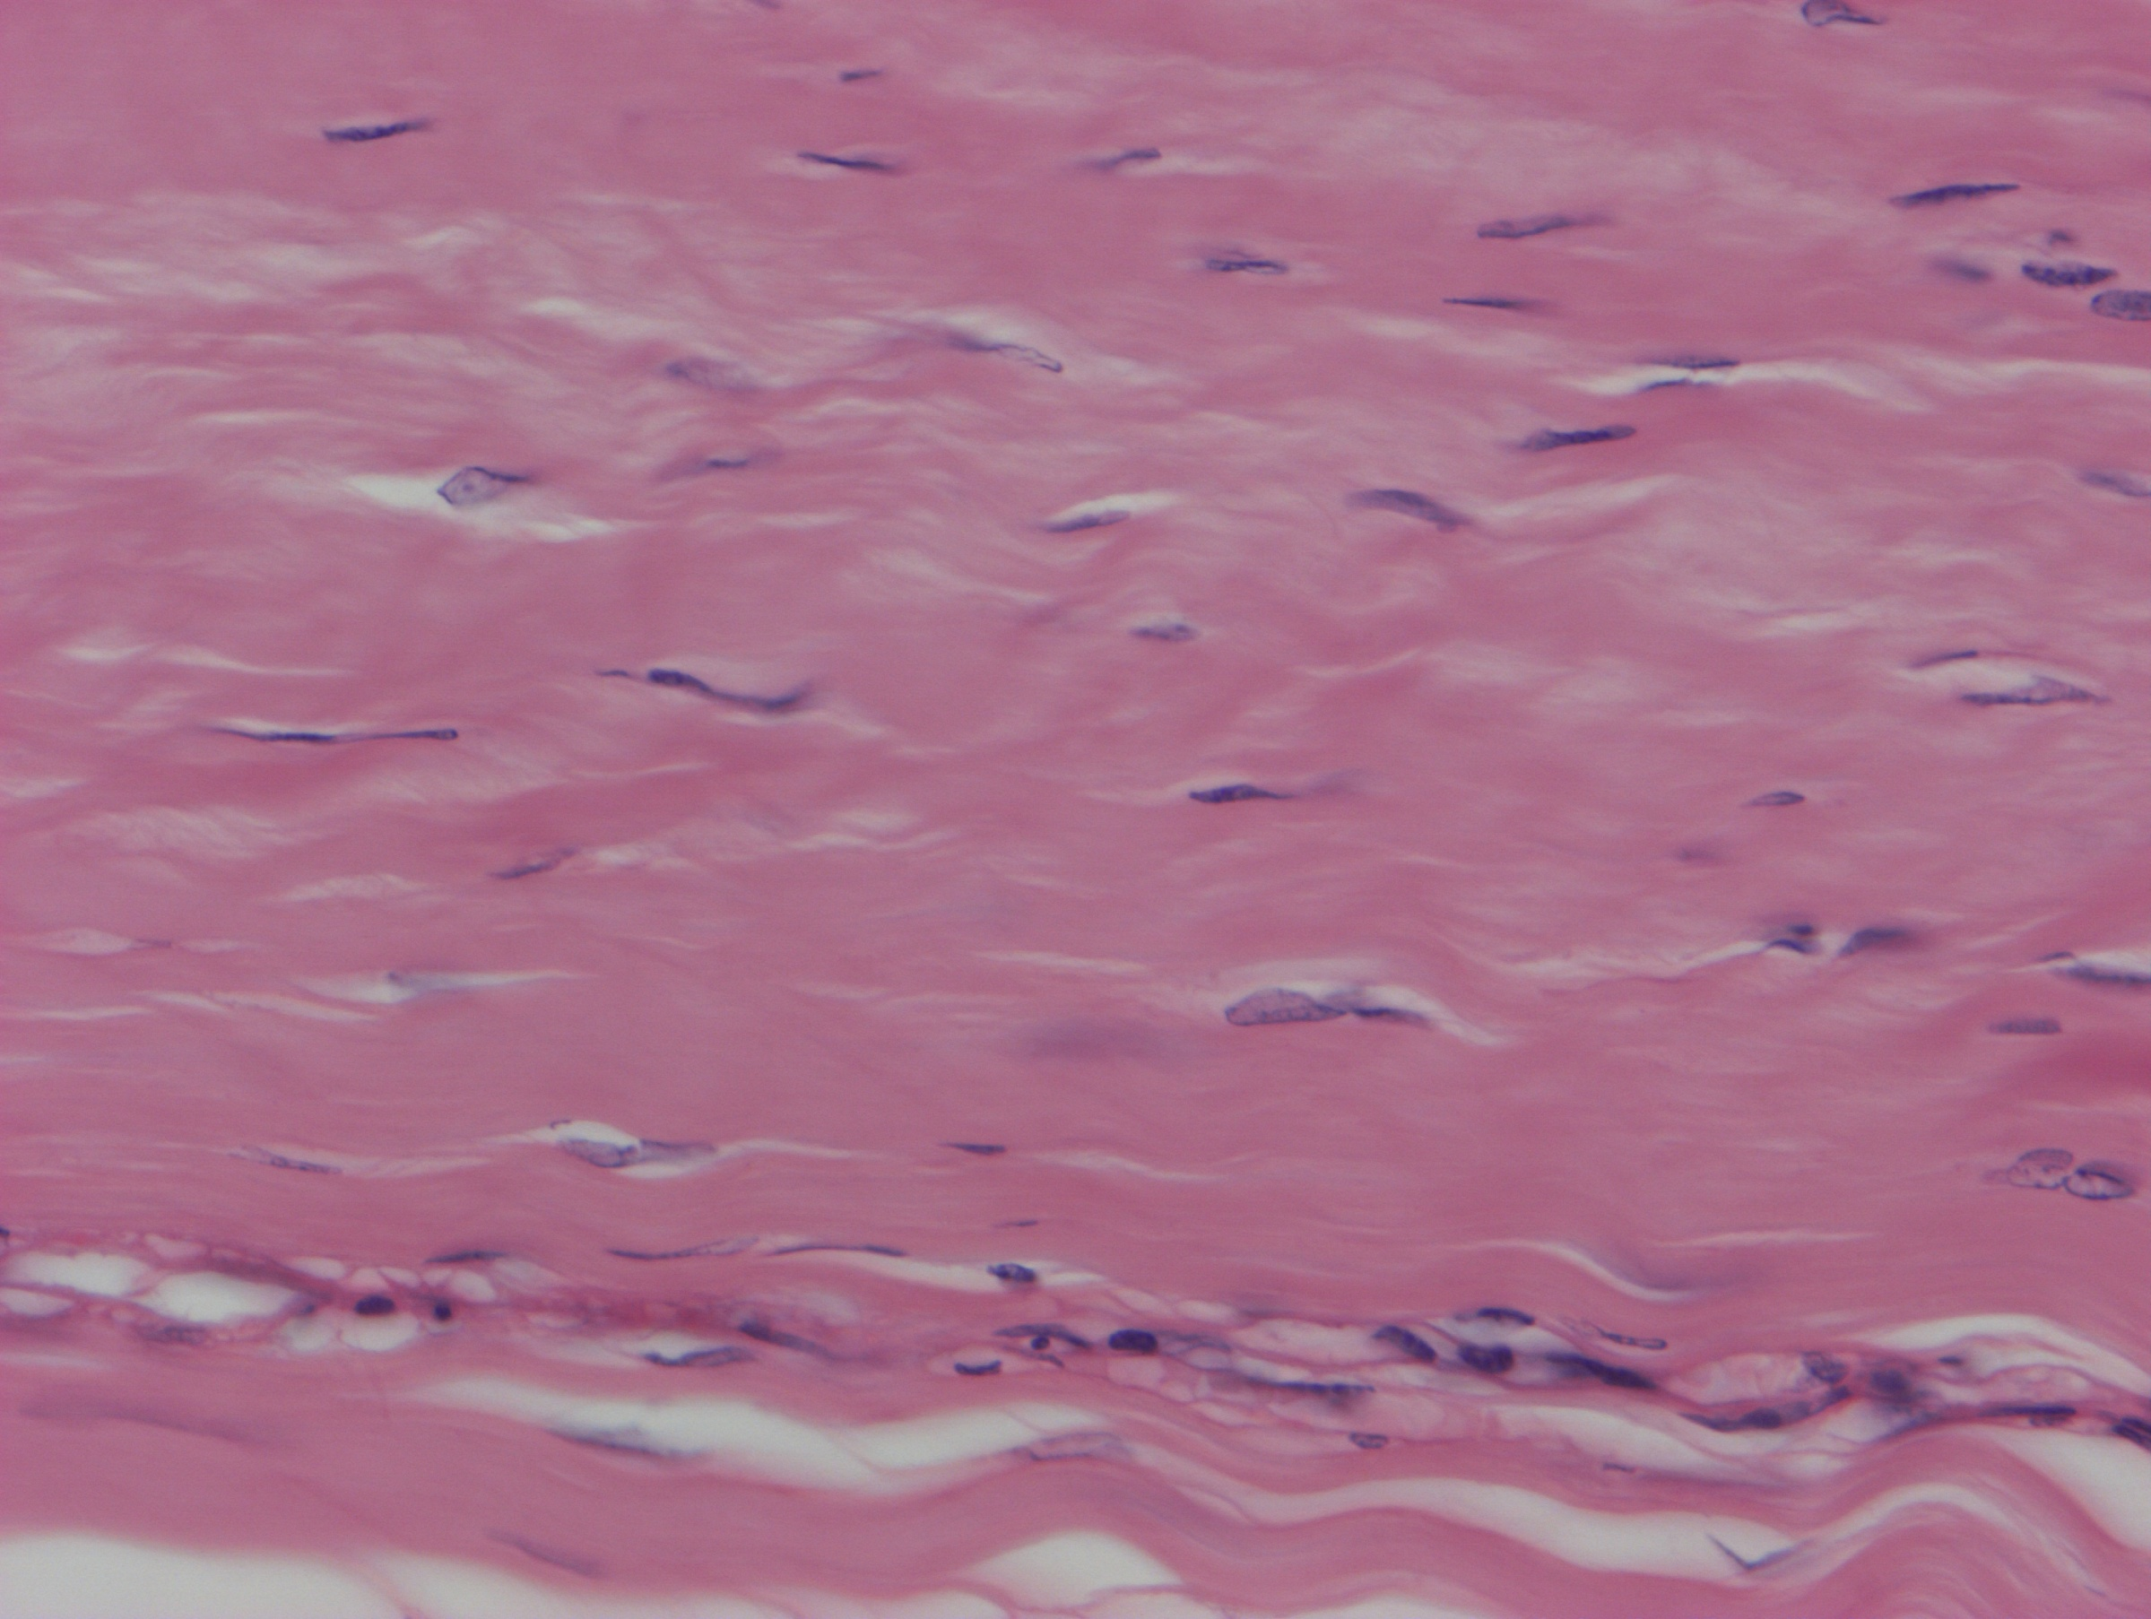

Slide 55
Irodalom
Röhlich Pál: Szövettan. Budapest, 1999
A szövettani képek a Humánmorfológiai és Fejlődésbiológiai Intézet gyűjteményéből származnak.
Carola R, Harley JP, Noback CR: Human Anatomy & Physiology, McGraw-Hill Inc., USA, 1990

