Slide 1
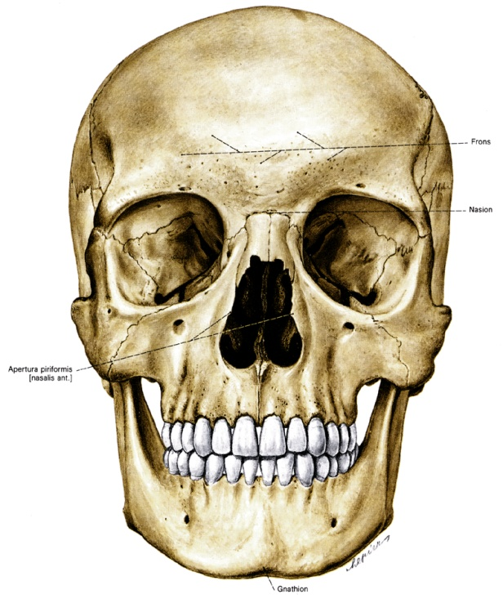
Skull
Anna L. Kiss
Department of Anatomy, Histology and Embryology
Semmelweis University
2021
Notes:
Viscerocranium, nerocranium, skull cap, internal and external base of the skull. Sutures, fontanelles

Slide 2
Skull:
Cranium
Mandible
Cranial cavity:
Roof of the skull: skull cap (calvaria)
Floor of the skull: base (basis cranii)

Slide 3
Skull:
Neurocranium: frontal
parietal
temporal
occipital
sphenoidal
Viscerocranium: maxilla
mandible
ethmoidal
zygomatic
nasal
lacrimal
palatine
vomer
inf. nasal concha

Slide 5
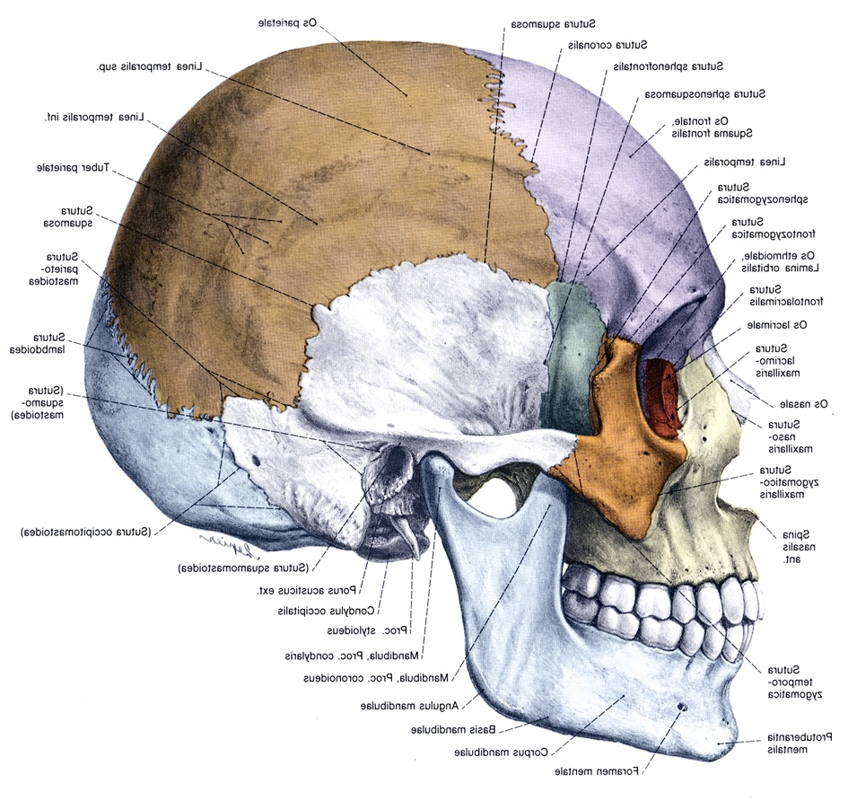
Temporal bone
squamous part
mastoid part

Slide 6
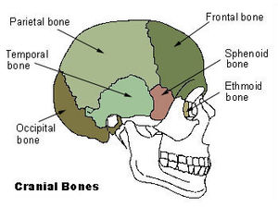
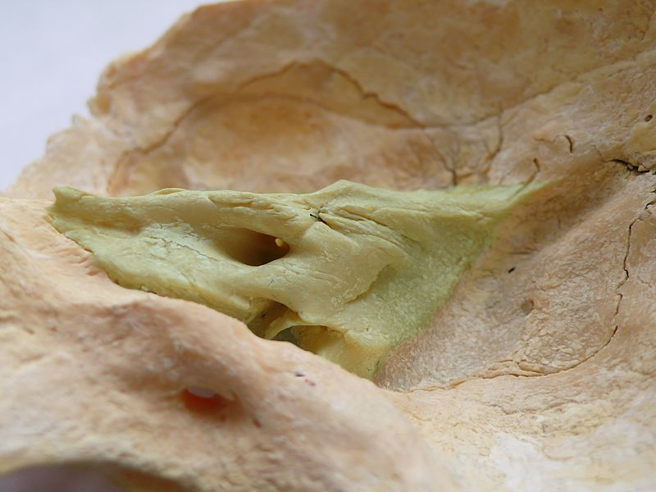
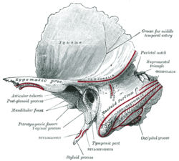
Temporal bone
squamous part
petrosal part
mastoid part

Slide 7
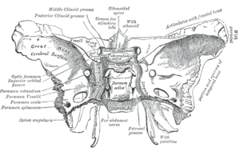
Sphenoidal bone
lesser wing
greater wing
body: sella turcica
pterygoid process

Slide 8
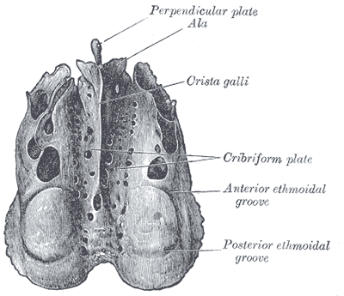
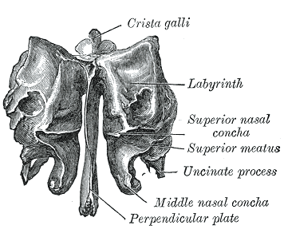
Ethmoidal bone
Cribriforme plate

Slide 9
Mandible

Slide 10
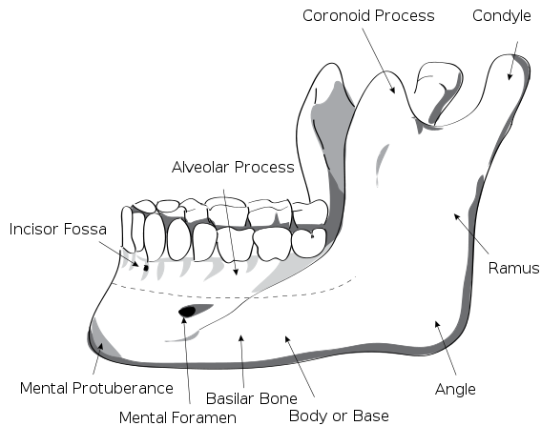
Mandible

Slide 11
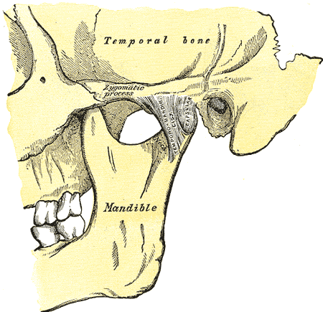
Temporomandibular joint

Slide 12
Sutures: (syndesmosis)
coronal: frontal and parietal
sagittal:parietal
lambdoid:parietal and occipital
parieto-mastoid:parietal and temporal
occipito-mastoid:occipital and temporal

Slide 13
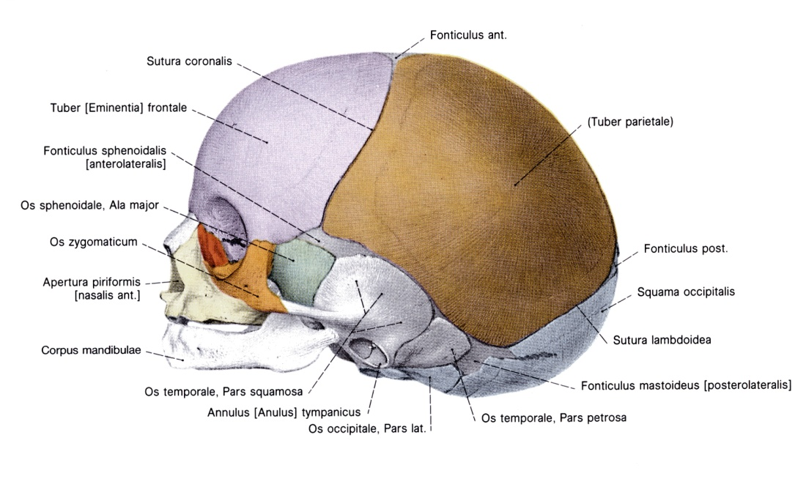
Fontanelles: (fonticulus)
anterior
posterior
anterolateral (sphenoidal)
posterolateral (mastoid)

Slide 14
Bregma: middline meeting place of the bones
Pterion: lateral meeting point (parietal, frontal, squama of the temporal, greater wing of sphenoidal)
Asterion: mastoid region meets the occipital and parietal bones

Slide 15
Base:
Anterior cranial fossa: frontal bones (pars orbitalis)+lesser wing of the sphenoidal bone
Middle cranial fossa: from lesser wing of sphenoid bone to pars petrosa of the temporal bone (groove for the sup. petrosal sinus)
Posterior cranial fossa: posterior surface of the pars petrosa (termporal bone)+occipital bone (squama)

Slide 16
Anterior cranial fossa
Crista galli (ethmoidal bone)
Cribriforme plate (ethmoidal bone)
Middle cranial fossa
sella turcica (hypophyseal fossa): sphenoidal bone
sup. orbital fissure (orbit)
foramen rotundum (fossa pterygopalatina)
foramen ovale (external surface of the skull)
foramen spinosum (meningeal artery)
sulcus n. petrosus major et minor
optic canal
Posterior cranial fossa
clivus
foramen magnum
foramen jugulare
sulcus sinus sigmoideus
sulcus sinus transversus

Slide 17
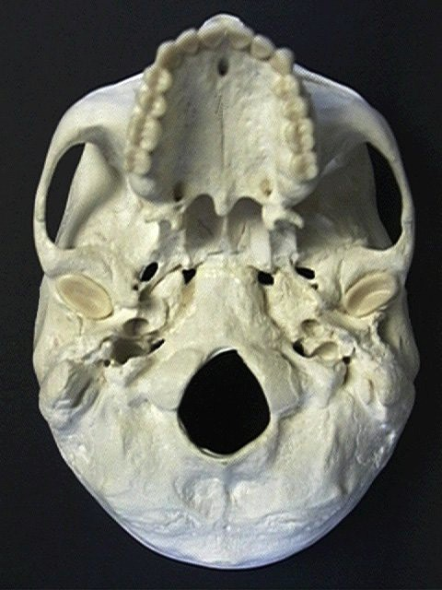
Skull: inferior view
palatine process of the maxilla
palatine bone
zygomatic arch
sphenoidal bone: pterygoid process
choana
mandibular fossa
external opening of the carotid canal
foramen magnum
jugular foramen
and fossa
occipital condyle

Slide 18
Hard palate: palatine process of the maxilla+horizontal plate of the palatine bone
Choana: horizontal plate of the palatine bone+pterygoid process of the sphenoidal bone+body of the sphenoidal bone
Atlanto-occipital joint: occipital condyles+sup. art. surfaces of the atlas

Slide 19
References
Wikipaedia
Sobotta Atlas

