Slide 1
Blood
Anna L. Kiss
Department of Anatomy, Histology and Embryology
Semmelweis University
Budapest
2021
Notes:
Blood cells, erythrocytes, granulocytes: neutrophyl, basophyl. Eosinophyl, monocytes, lymphocytes, platelets, haemopoesis, structure of the blood vessels

Slide 2
Blood
Structure: cells + „exracellular matrix” : plasma
Cells: red blood cells
white blood cells
Function: „connects” organs with each other
granulocytes
agranulocytes
Origin: mesoderm

Slide 3
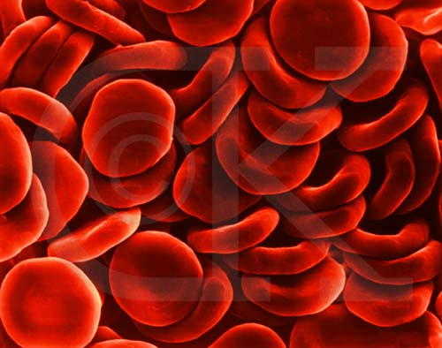
Erythrocytes
d:7µm
biconcave,
no nucleus,
limited life time (about 120days)

Slide 4
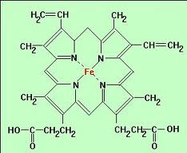
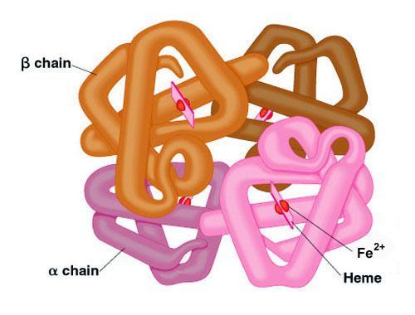
Haemoglobin: haem+globin protein
transport of molecular oxygen
reverseble binding
hem: iron ²⁺ containing molecule surrounded by 4 globin

Slide 5
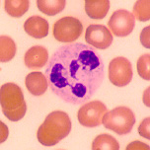
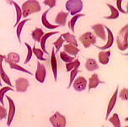
Erythrocytes
sickle-cell disease: 1 amino acid is changed in the globin molecule: genetic mutation

Slide 6
Leukocytes
Granulocytes: segmented nucleus
granules inside of the cytoplasm
neutrophyl
basophyl
eosinophyl
Agranulocytes: No granules n their cytoplasm
monocytes
lymphocytes

Slide 7
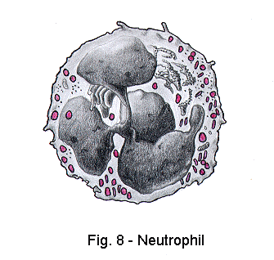
Granulocytes: neutrophyls
segmented nucleus, granules in the cytoplasm
they are ~75% of leukocytes
„microphages”: small particles, antibactarial effect

Slide 8
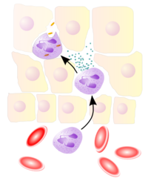
Extravasatio: white blood cells migrate out from the blood vessels

Slide 9
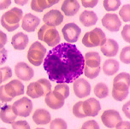
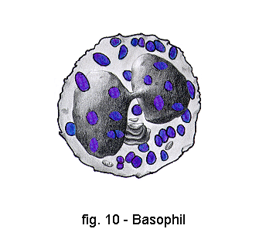
Granulocytes: basophils
Bilobed nucleus
Granules: stained with basic dye: , heparane-sulphate, histamine

Slide 10
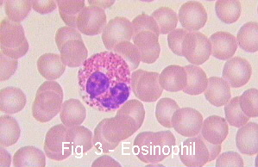
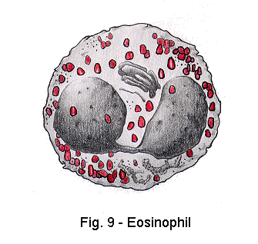
Granulocytes: eosinophils
allergy, parasitism
nucleus:bilobed
granules: stained by basic dye, cytotoxic materials: peroxidase, RNase, phospholipase etc

Slide 11
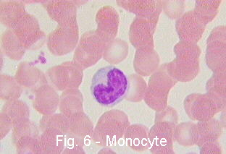
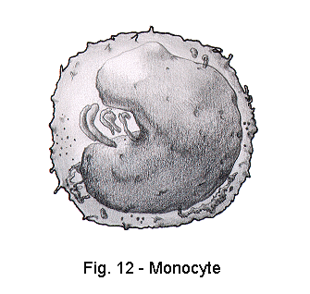
Agranulocytes: monocytes
professional phagocytes;
monocytes/macrophages:
macrophages: monocyte/derived cells in the connective tissue and in different organs

Slide 12
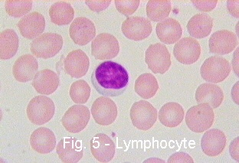
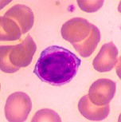
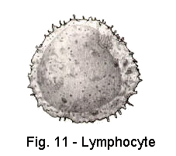
Agranulocytes: lymphocytes
small cells (d:7μm, with large nucleus
T cells: (thymus derived: killer, helper, supressor etc.)
B cells:
plasma cells: antibody production;
memory cells

Slide 13
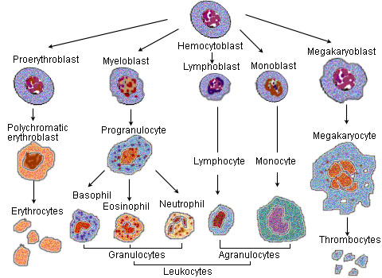
Haemopoesis

Slide 14
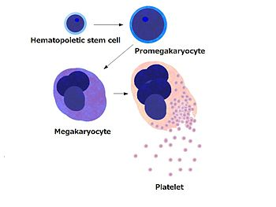
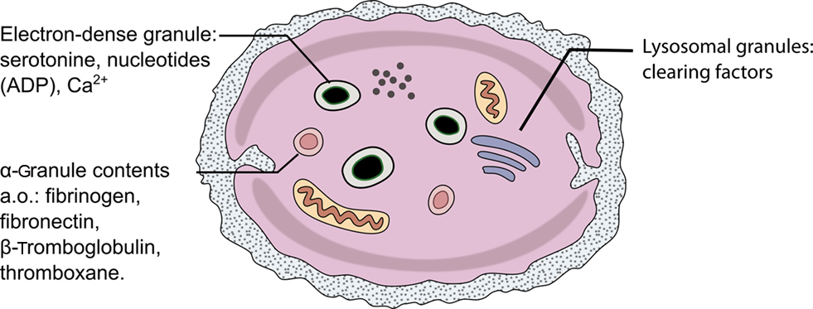
Platelets (trombocytes)
cell debris: containing secretory granules

Slide 15
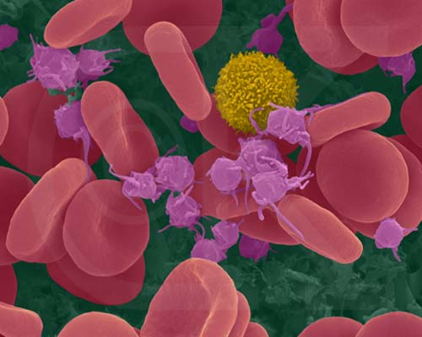
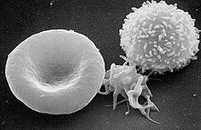
Platelet

Slide 16
Blood clothing
Blood clothing: chain reaction
Factors: many factors are involved, most of them come from platelets
protrombin (produced in the liver)
fibrinogen (globular, water soluble protein, produced in the liver)
fibrin: fibrillar proteins, water insoluble
Injury of the blood vessels: chain reaction starts, Ca ion present

Slide 17
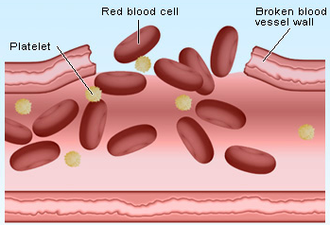
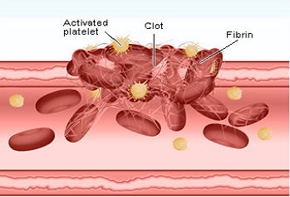
Blood clothing
protrombin trombin
Ca²⁺
fibrinogen fibrin

Slide 18
Immunresponse
Cells:
lymphocytes (T and B)
T lymphocytes: killer, helper, supressor
B lymphocytes:
plasma cells (antibody production)
memory cells
antigen presenting cells: dendritic cells,
macrophages

Slide 19
Antigen presenting cells

Slide 20
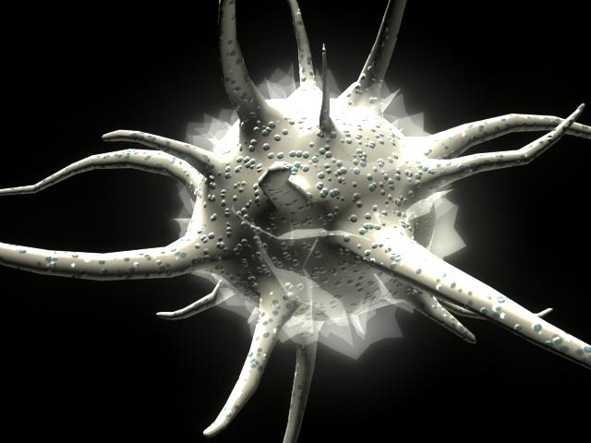
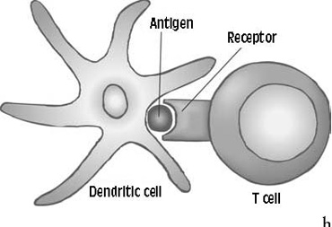
Dendritic cells

Slide 21
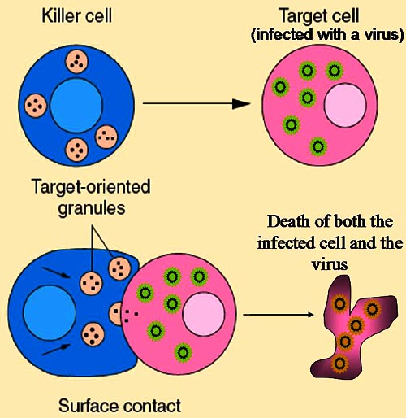
Humoral and cellular immune response
T lymphocytes:
killer cells
express antibody on their plasma membrane
cellular immunresponse
helper cells: secret interleukins
humoral immunresponse: helper cells (T lymphocytes)
plasma cells (B lymphocytes)

Slide 22
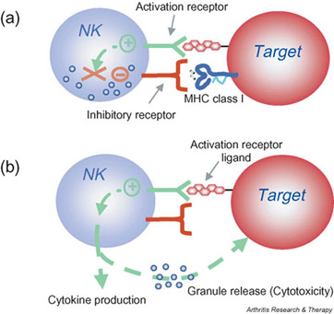
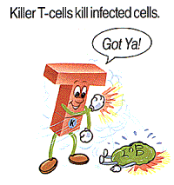
Cellular imune response: natural killer cells

Slide 23
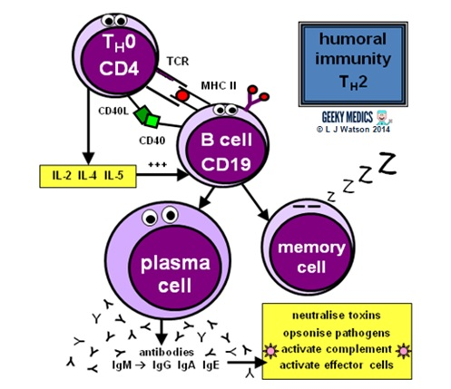
Humoral immune response
T helper cells activate B lymphocytes
plasma cells
antibody
memory cells

Slide 24
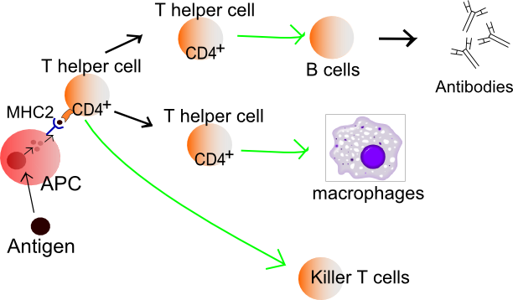

Slide 25
Blood vessels
3 layers:
t. intima: endothel+subendothelial conn, tissue
t. media: smooth muscle +elastic fibers
t. adventitia: connective tissue
internal elastic membrane
external elastic membrane

Slide 26
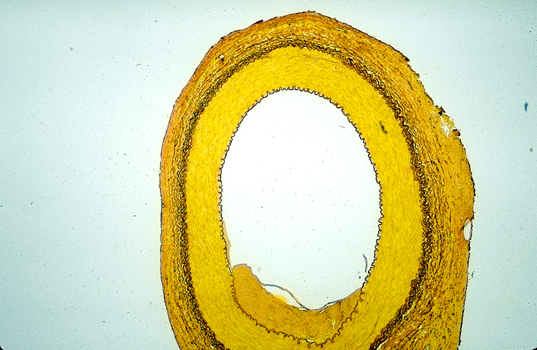
Blood vessels

Slide 27
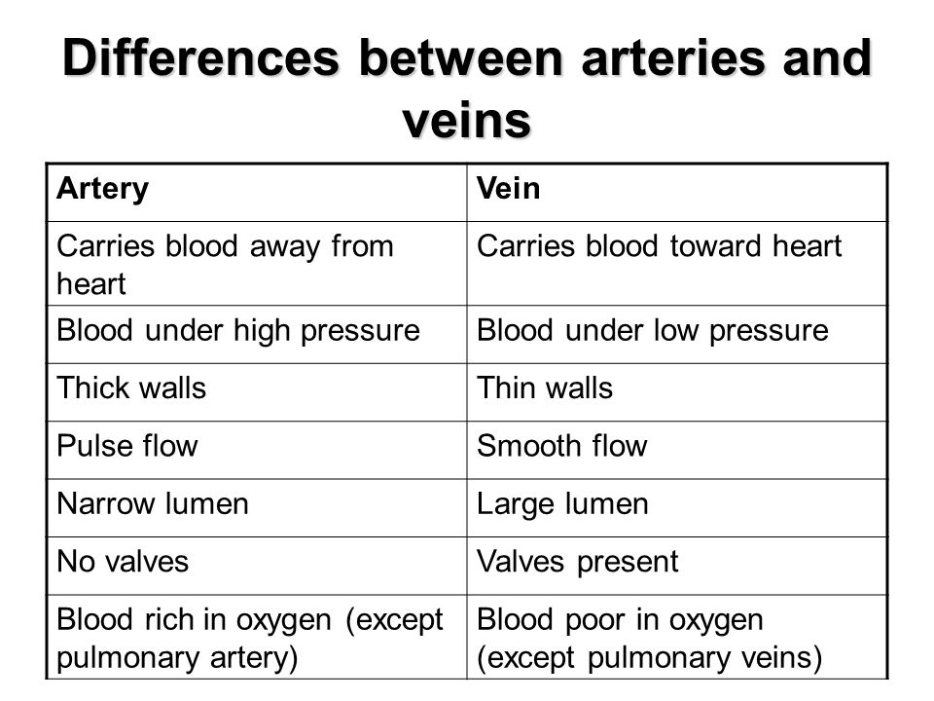
Tunica media is the thickest layer
Tunica adventitia is the thickest layer

Slide 28
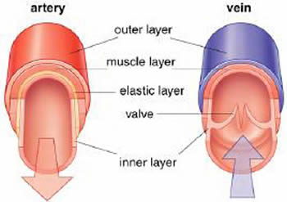
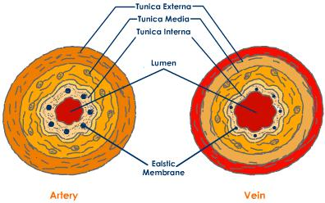
valves are made by the tunica intima

Slide 29
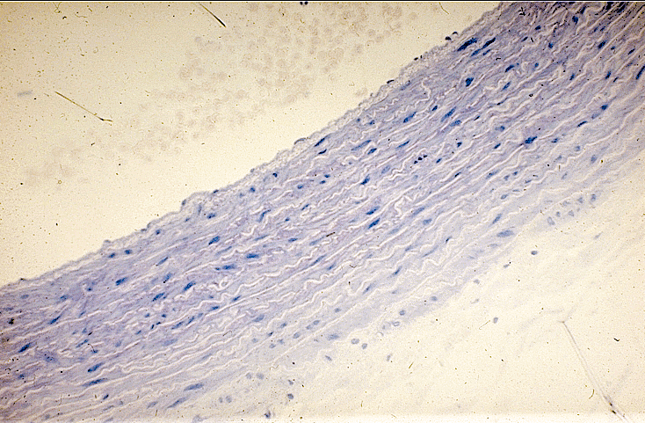
Aorta
elastic fibers are the dominant in the t. media

Slide 30
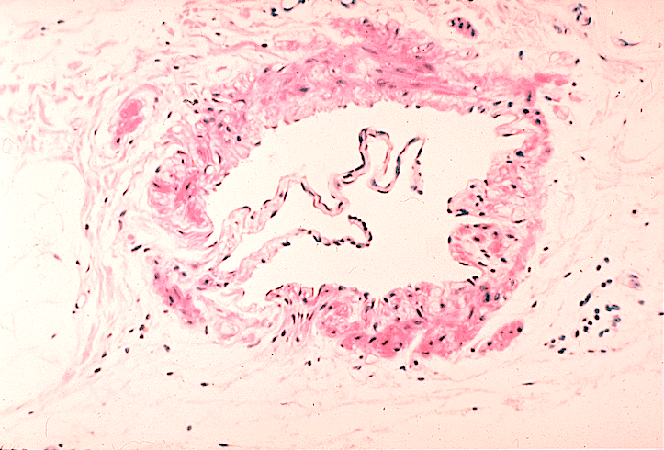
Vein with valve
Valves. t. intima

Slide 31
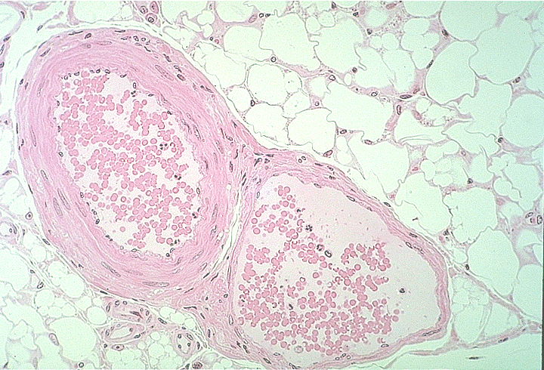
Artery and vein
more muscle cells in the t. media

Slide 32
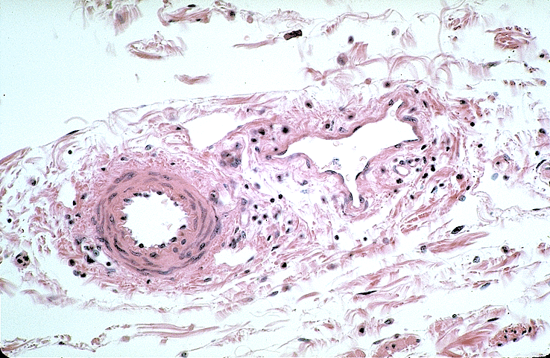
Small artery and vein

Slide 33
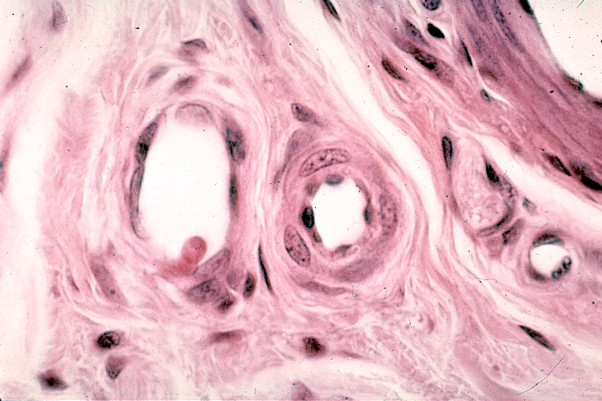
Arterioles, venules. capillaries
Smooth muscle cells
in the t. media
V
A

Slide 34
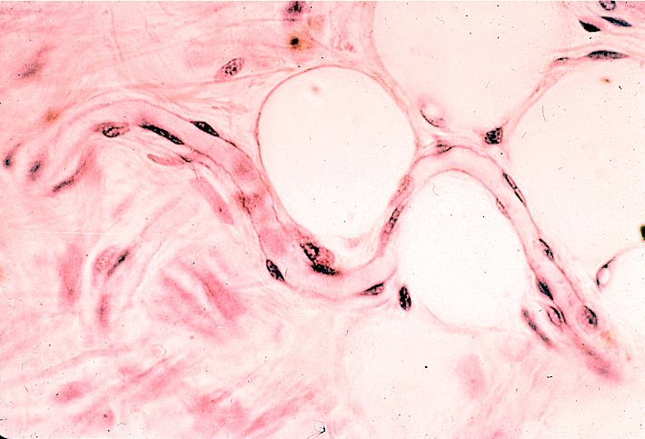
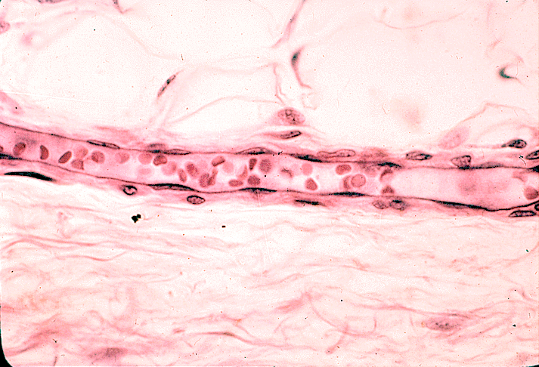
Capillaries and venules

Slide 35
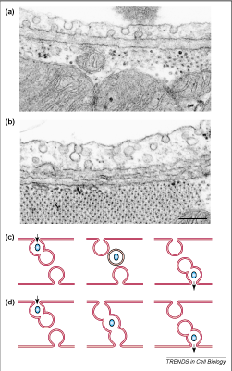
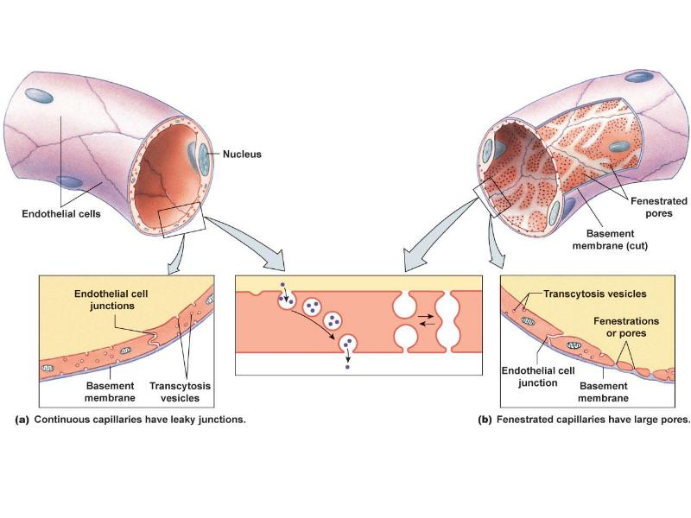
Capillaries

Slide 36
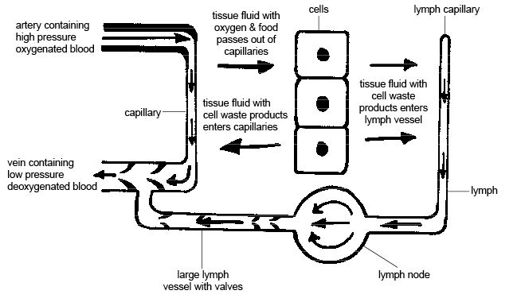
Lymphatic circulation

Slide 38
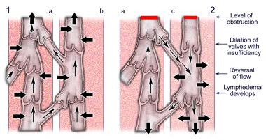
Lymphoedema

Slide 39
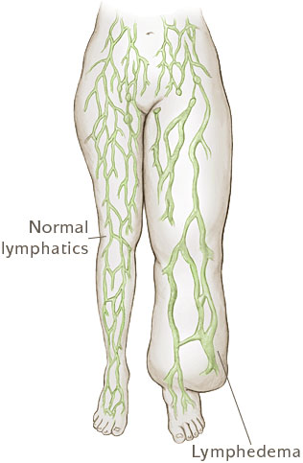
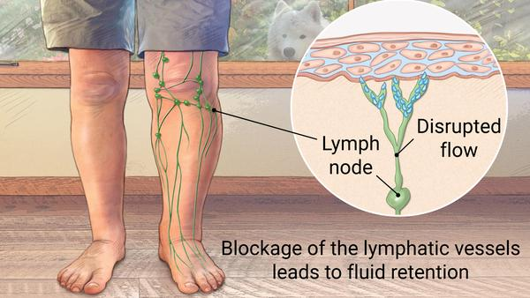
Lymphoedema

Slide 40
Röhlich Pál: Szövettan. Budapest, 1999
A szövettani képek a Humánmorfológiai és Fejlődésbiológiai Intézet gyűjteményéből származnak.
Carola R, Harley JP, Noback CR: Human Anatomy & Physiology, McGraw-Hill Inc., USA, 1990
Wikipedia

