Slide 1
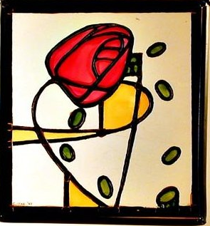
Epithelio-mesenchymal interactions I.
Development of lung and glands
Hám-mesenchyma kölcsönhatások I.
Tüdő, mirigyek fejlődése
Semmelweis University
Department of Human Anatomy, Histology and Embryology
Semmelweis Egyetem
Anatómiai Szövet- és Fejlődéstani Intézet
Dr. Kocsis Katalin
2020.04.01-02.

Slide 2
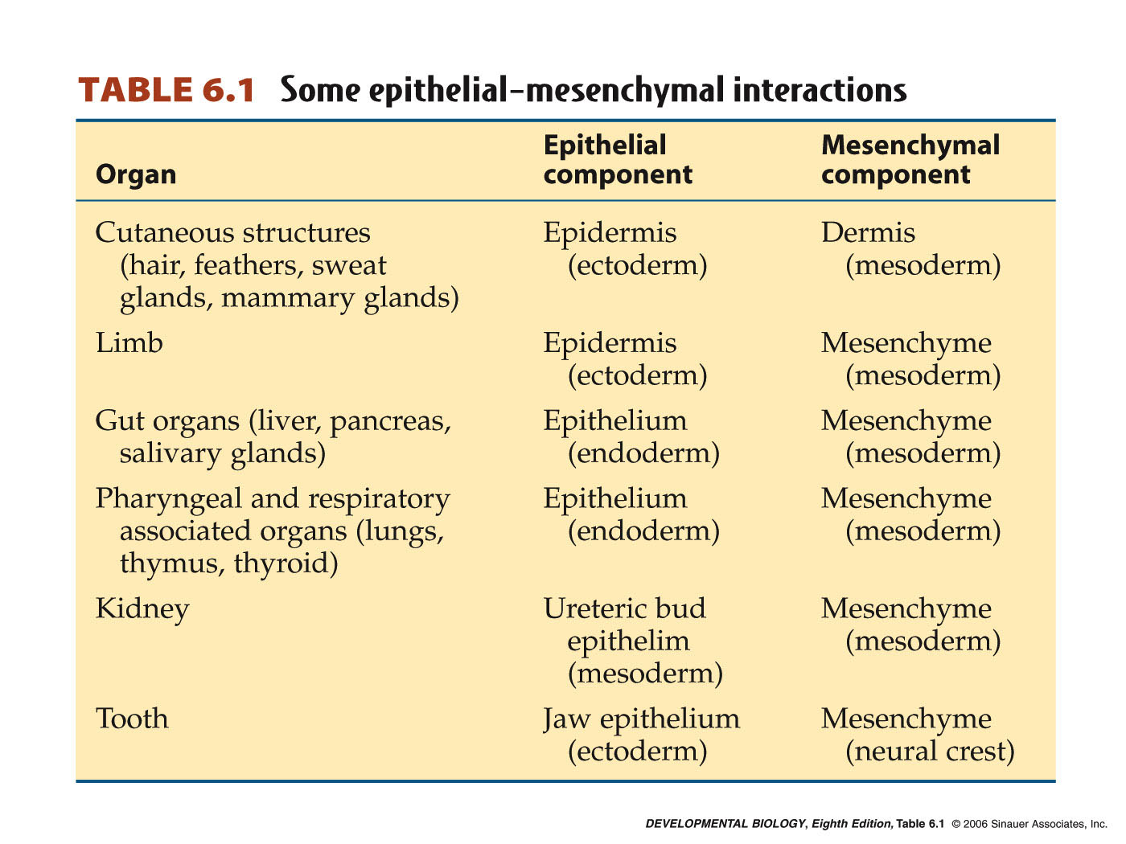
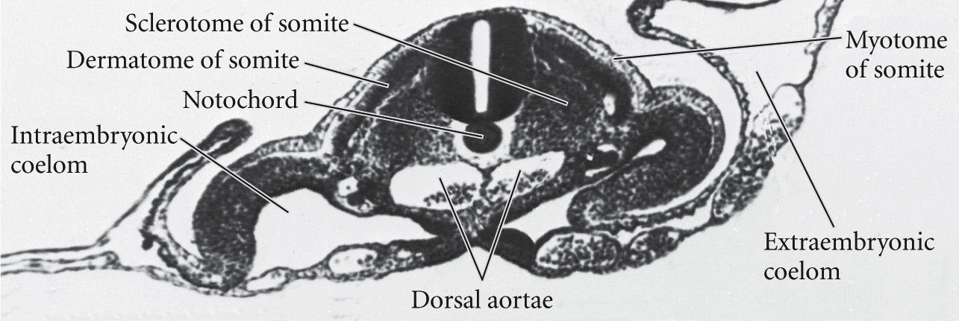
Epithelia: sheets or tubes of connected cells, originated from all germ layers
Mesenchyme: loosely packed and unconnected cells, originated from mesoderm or neural crest

Slide 3
The epithelial-mesenchymal interaction (EM) is a critical mechanism employed during embryogenesis. The signaling between these two different tissues is required to form the functional unit of the systems in which it is used. The gastrointestinal tract (gut) is dependent on EM interactions for its development and differentiation. The gut is a valuable model system to study EM interactions. EM interactions are critical in the formation of gross pattern along the anterior-posterior (AP) axis, and local pattern along the crypt-villous (CV) axis.

Slide 4
Rekombinációs kísérletek
-Szervtelepek szétbontása hámra és mesenchymára, majd újra összekeverése, majd ezt követően in vitro tenyésztése.
-Homotípiás és heterotípiás rekombinációk.
Általános vélemény: a hám morfogenetikai profilját a mesenchyma határozza meg

Slide 5
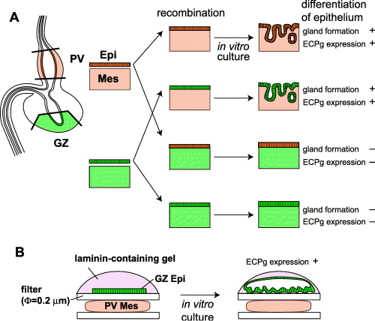

Slide 6
Lung development
Tüdő fejlődése

Slide 7
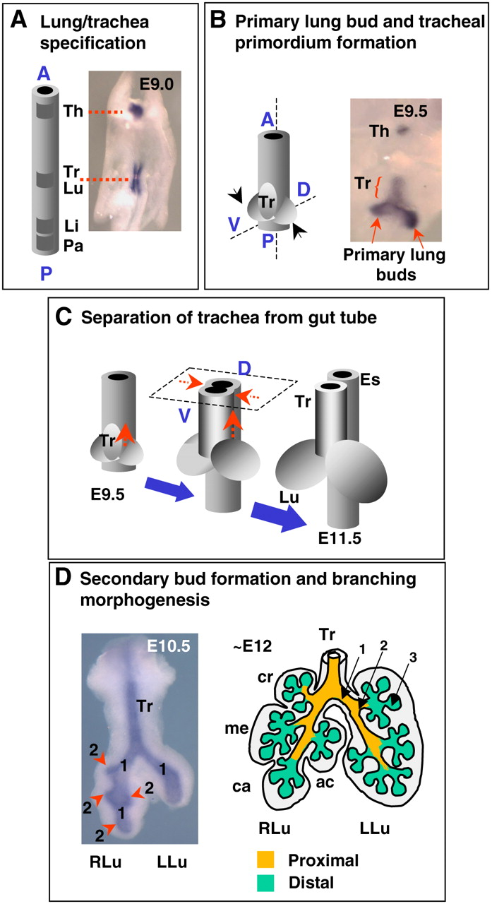
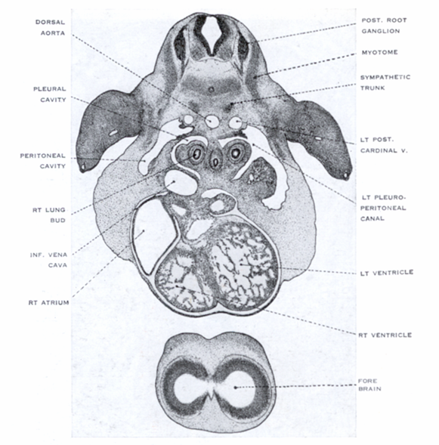
Principal bronchi in 8 mm long human embryo
Főbronchusok (jobb és bal tüdőbimbó) 8 mm-es humán embryoban
Epithelial and mesenchymal cell interactions have a critical role in lung development, and the precise temporal and spatial regulation of epithelial and mesenchymal cell functions is necessary for normal alveolarization.
Cardoso, W. V. et al. Development 2006;133:1611-1624

Slide 8
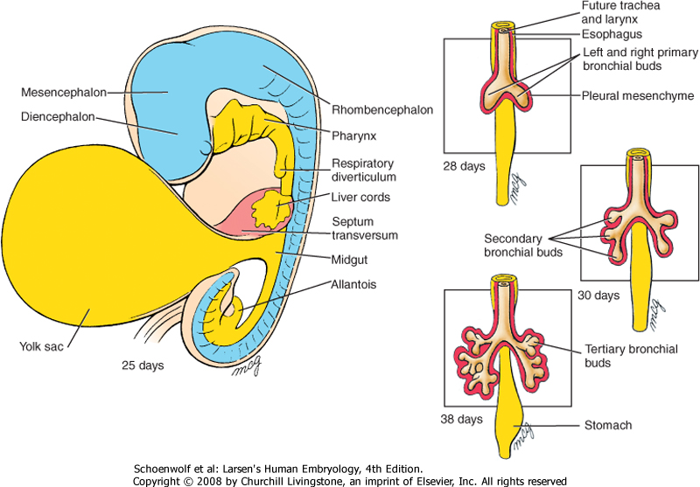
Figure 11-1 Development of the respiratory diverticulum. The respiratory diverticulum first forms as an evagination of the foregut on day 22 and immediately bifurcates into two primary bronchial buds between day 26 and day 28. Early in the 5th week, the right bronchial bud branches into three secondary bronchial buds, whereas the left bronchial bud branches into two. By the 6th week, secondary bronchial buds branch into tertiary bronchial buds (usually about 10 on each side) to form the bronchopulmonary segments.

Slide 9
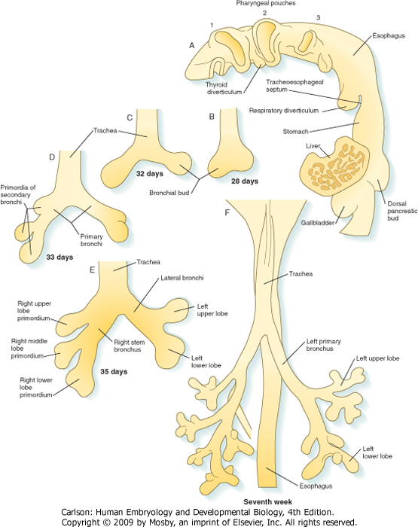
Figure 15-25 Development of the major branching patterns of the lungs. A, Lateral view of the pharynx, showing the respiratory diverticulum in a 4-week-old embryo. B, At 4 weeks. C, At 32 days. D, At 33 days. E, At the end of the fifth week. F, Early in the seventh week.

Slide 10
Stage of Development | Period | Events
Embryonic | 26 days to 6 weeks | Respiratory diverticulum arises as a ventral outpouching of foregut endoderm and undergoes three initial rounds of branching, producing the primordia successively of the two lungs, the lung lobes, and the bronchopulmonary segments; the stem of the diverticulum forms the trachea and larynx.
Pseudoglandular | 6 to 16 weeks | Respiratory tree undergoes 14 more generations of branching, resulting in the formation of terminal bronchioles.
Canalicular | 16 to 28 weeks | Each terminal bronchiole divides into two or more respiratory bronchioles. Respiratory vasculature begins to develop. During this process, blood vessels come into close apposition with the lung epithelium. The lung epithelium also begins to differentiate into specialized cell types (ciliated, secretory, and neuroendocrine cells proximally and precursors of the alveolar type II and I cells distally).
Saccular | 28 to 36 weeks | Respiratory bronchioles subdivide to produce terminal sacs (primitive alveoli). Terminal sacs continue to be produced until well into childhood.
Alveolar | 36 weeks to term | Alveoli mature.

Slide 11
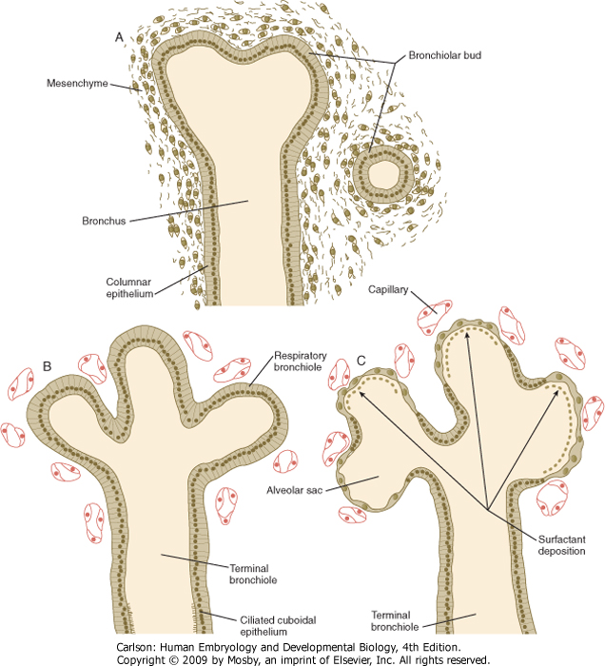
Figure 15-28 Stages in histogenesis of the lungs. A, Pseudoglandular phase (up to 17 weeks). B, Canalicular phase (17 to 26 weeks). C, Terminal sac phase (26 weeks to birth).

Slide 12
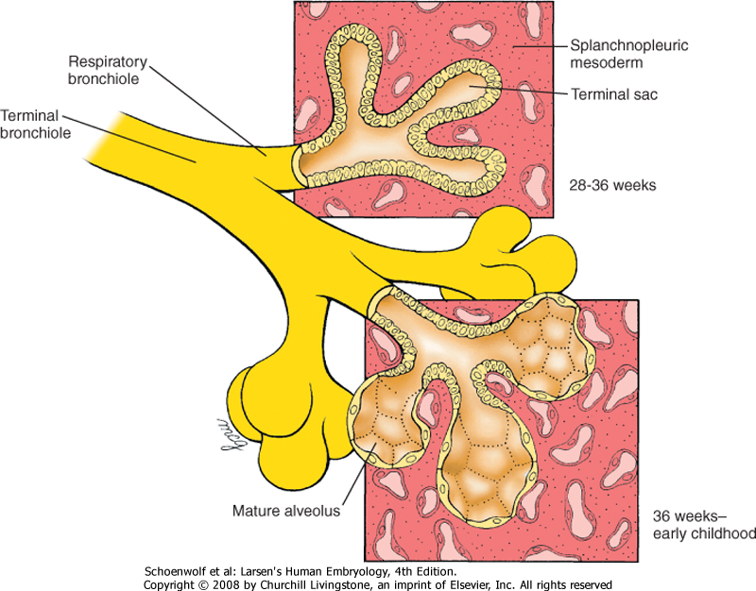
Figure 11-3 Maturation of lung tissue. Terminal sacs (primitive alveoli) begin to form between weeks 28 and 36 and begin to mature between 36 weeks and birth. However, only 5% to 20% of all terminal sacs eventually produced are formed before birth. Subsequent septation of the alveoli is not shown.

Slide 13
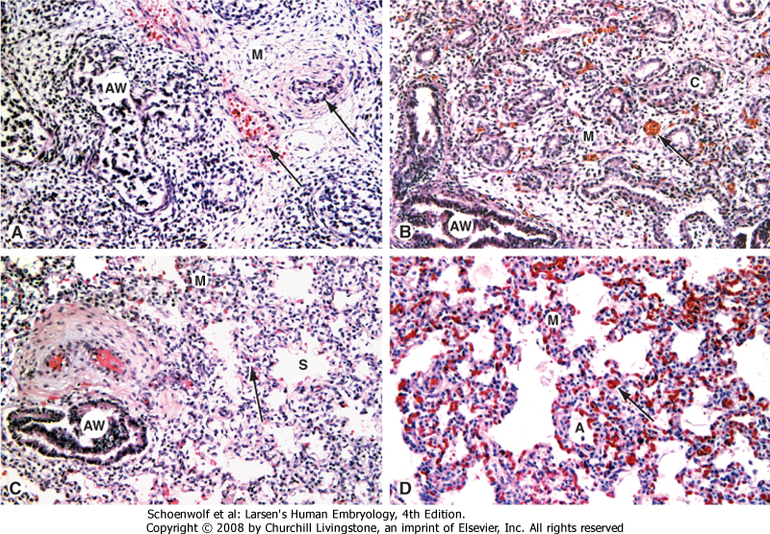
Figure 11-2 Histologic stages of human lung development. A, Pseudoglandular stage. B, Canalicular stage. C, Saccular stage. D, Alveolar stage. A, alveolus; AW, airway; C, smooth-walled canaliculus; M, mesenchyme; S, saccule; Arrows, part A, pulmonary artery (thick wall) and vein (thin wall); Arrows, parts B-D, capillaries.

Slide 14
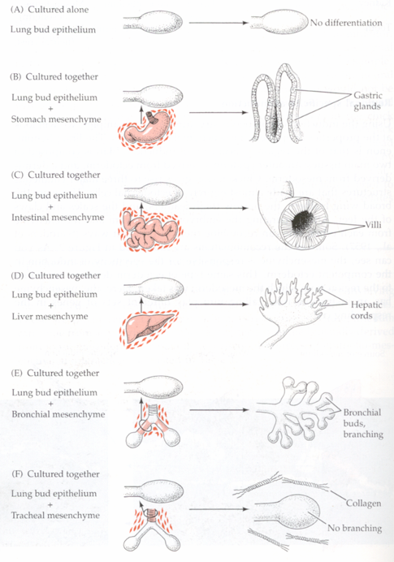
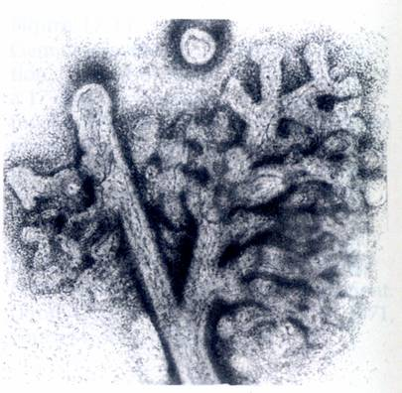
The branching development of the lung depends upon the interactions between the endodermal foregut diverticulum and the splanchnic mesenchyme by which it is surrounded.
Mesenchyme from the tracheal region will inhibit branching when apposed to distal lung epithelium, while distal mesenchyme (from the region of lung bud formation) will induce ectopic branches when grafted adjacent to isolated tracheal epithelium .

Slide 15
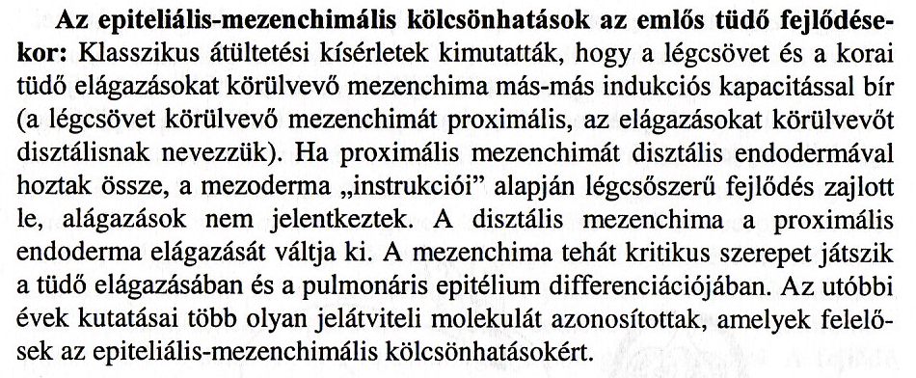
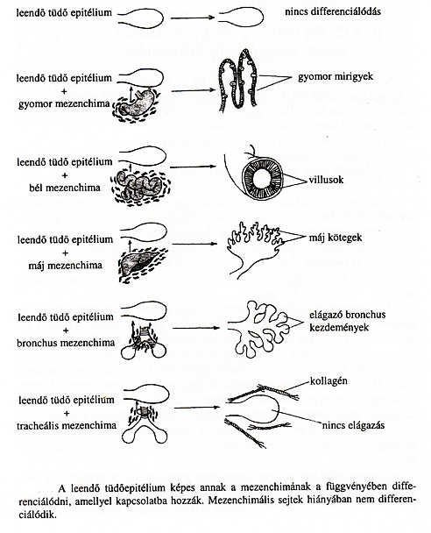
Pl. Tüdő-trachea rekombináció:
a bal hörgőt trachea eredetű mesenchymával tenyésztették.
A mesenchyma kritikus szerepet játszik az epithelium
differenciálódásában

Slide 16
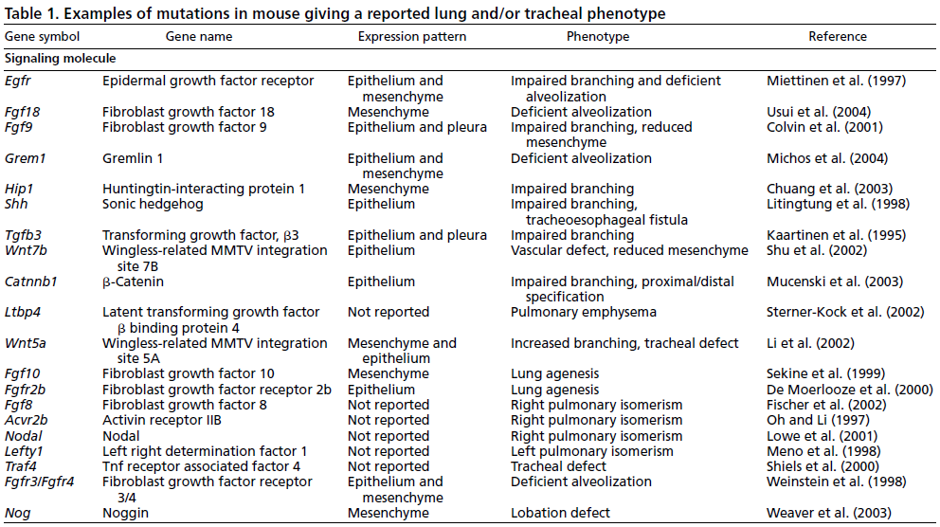
Cardoso, W. V. et al. Development 2006;133:1611-1624

Slide 17
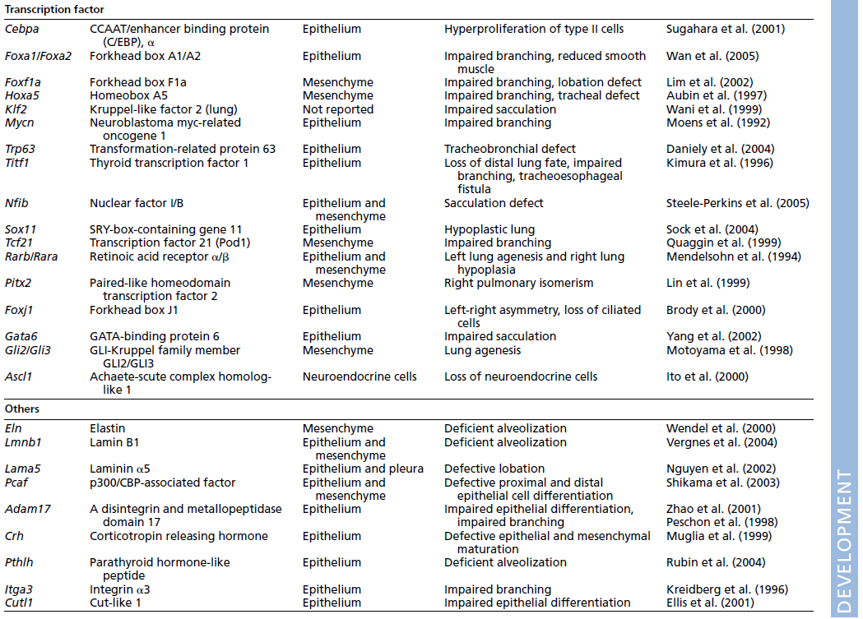
=Nkx2.1
Cardoso, W. V. et al. Development 2006;133:1611-1624

Slide 18
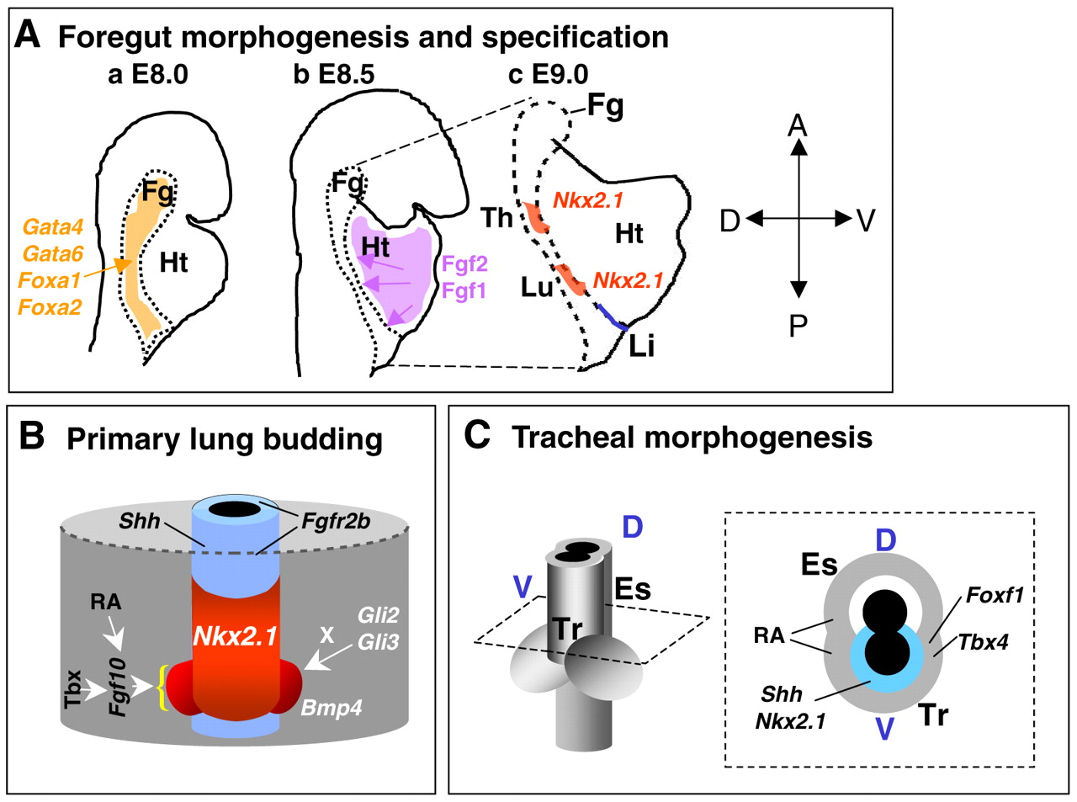
Molecular regulation of initial events in lung and tracheal development
Cardoso, W. V. et al. Development 2006;133:1611-1624

Slide 19
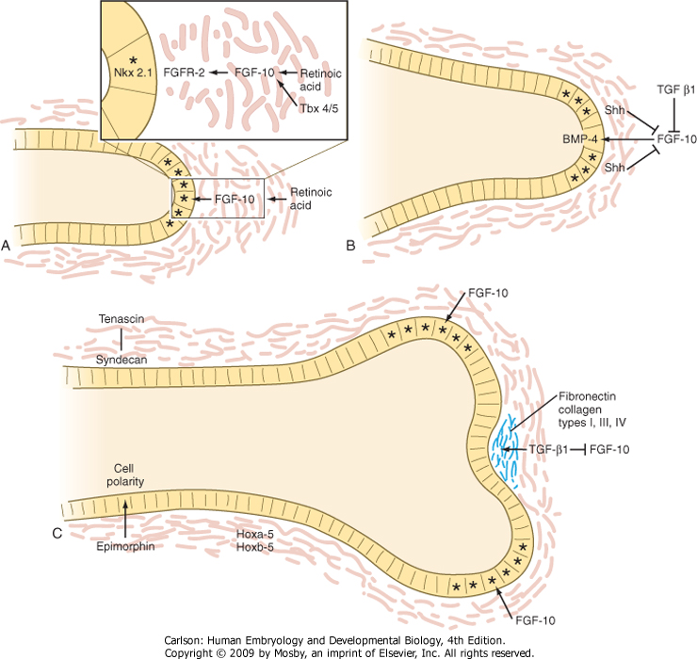
Figure 15-26 Molecular aspects of outgrowth and branching of the respiratory tree. A, The tip of an elongating respiratory duct. FGF-10 secretion in the mesenchyme stimulates the growth of the tip of the epithelial duct toward it. B, The prelude to branching. Inhibition of FGF-10 signaling at the tip of the duct leads to stabilization of that area. C, Cleft formation.

Slide 20
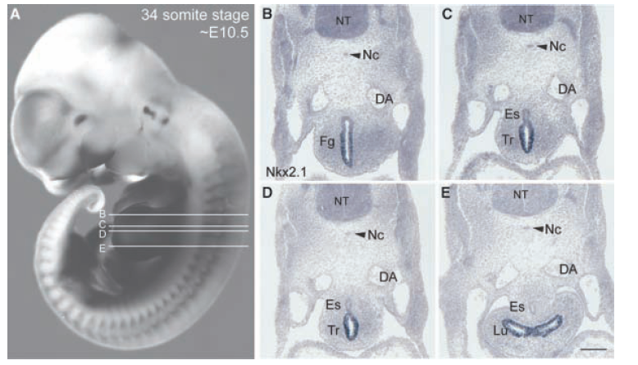
NKX2.1 is a homeodomain transcriptional factor expressed in thyroid, lung, and parts of the brain.
Nkx2.1 transcription factor: respiratory tract
Nkx2.1 transzkripciós faktor: légzőhám

Slide 21
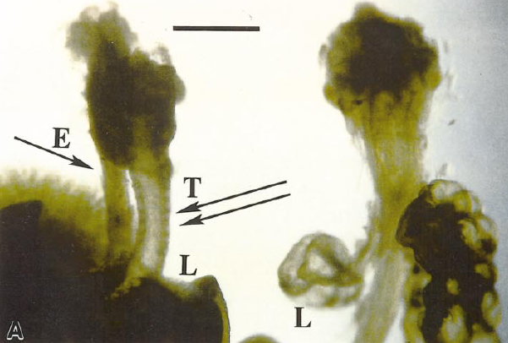
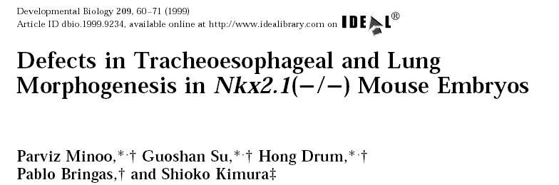
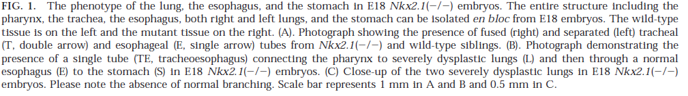
+/+
-/-

Slide 22
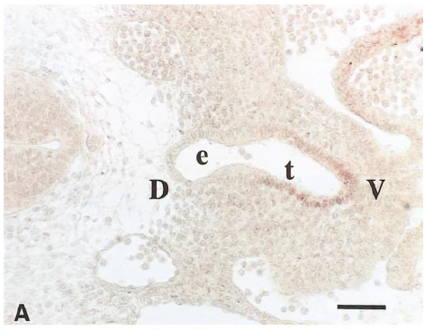
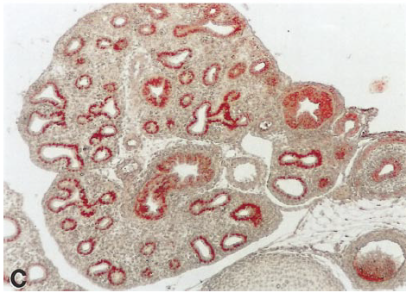
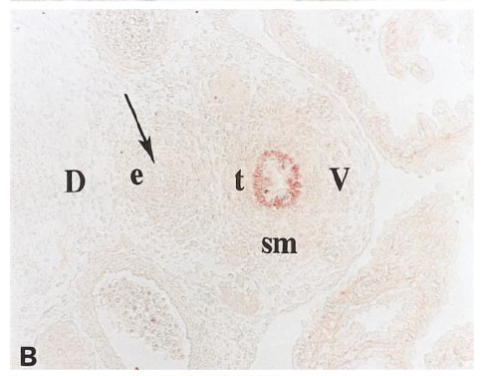
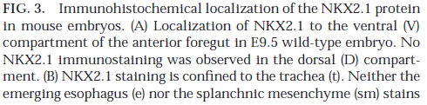


Slide 23
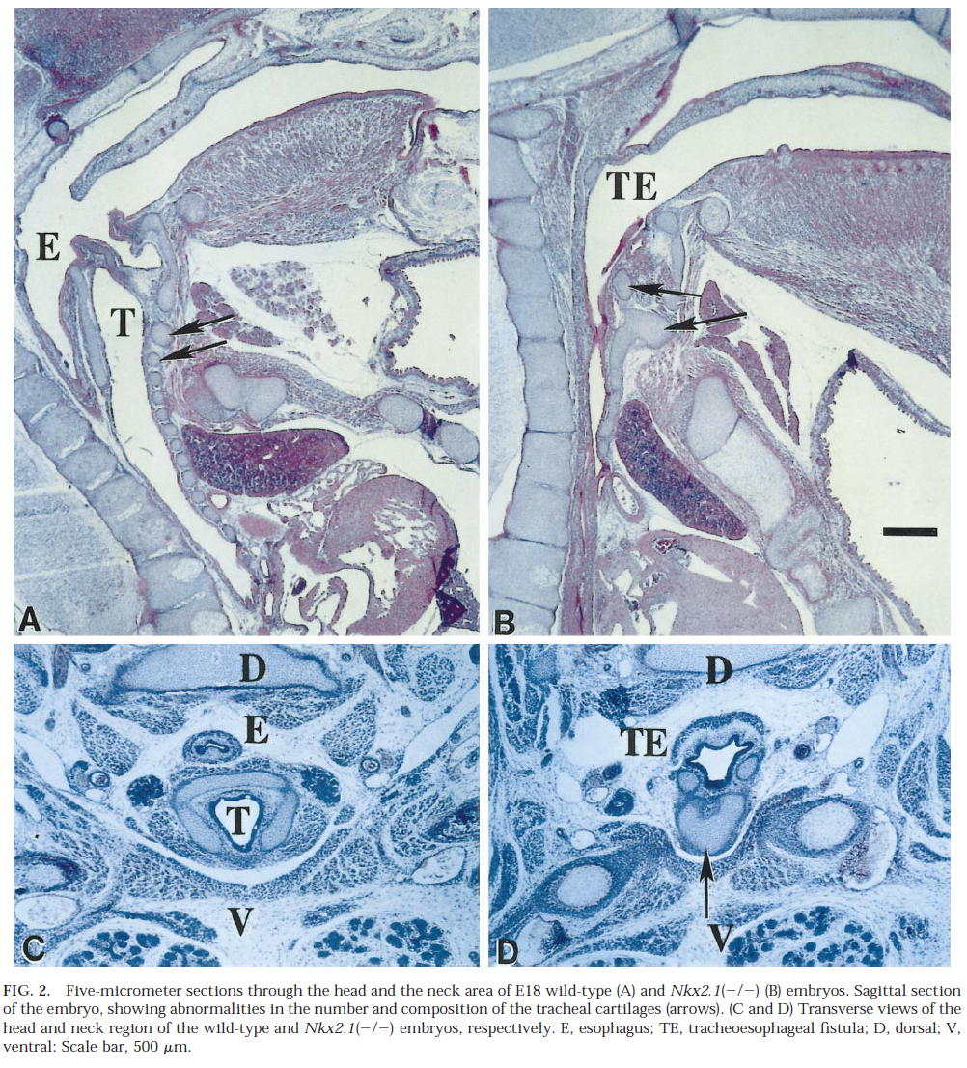

Slide 24
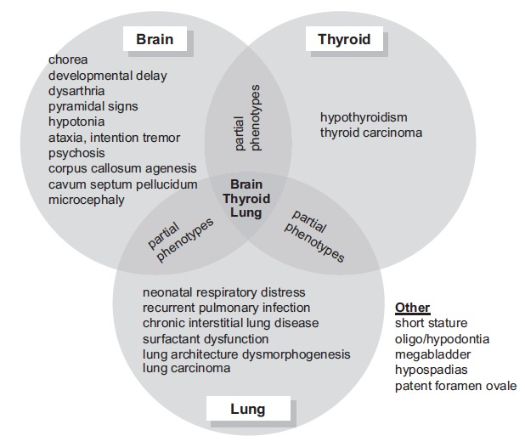
Figure 1.
Phenotypic spectrum of NKX2-1-related disorders
NKX2-1-related disorders may manifest as abnormalities in a single organ system or as any combination of brain, thyroid, and lung involvement. “Brain-lung-thyroid syndrome” refers to involvement of all three organ systems.
From Inzelberg et al [2011]; republished with permission

Slide 25
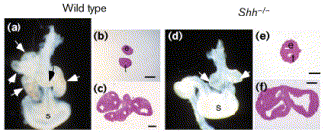
Morphology and epithellal phenotype of Shh−/− mouse lungs. (a–c) Wild-type mouse foregut at 12.5 dpc. (a) At this stage, the lung has branched several times to give rise to distinct lobes (arrows). (b) The trachea and esophagus are separate tubes. (c) Cross-section at the level of the lung shows branching and lobation. (d–f) Foregut from Shh mutant mice at 12.5 dpc. (d) Shh-deficient lungs have failed to undergo lobation or subsequent extensive branching. (e) The trachea and esophagus remain fused at the tracheo–esophageal septum. (f) Mutant lungs have branched only once.

Slide 26
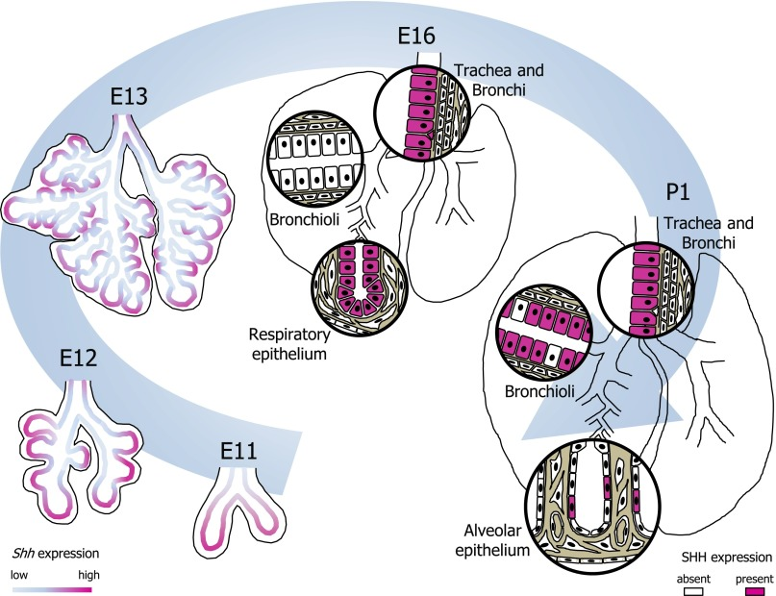
Schematic of SHH-expressing cells in the developing lung from embryonic day (E)11 to postnatal day (P)1. SHH-expressing cells and cell layers are highlighted in fuchsia. Shh expression is highest at the tips of the primary and secondary lung buds, but also present at lower levels along the developing bronchi. This pattern continues throughout the pseudoglandular stage. Around E16, SHH expression is transiently absent in the distal bronchioli but is vividly present in the respiratory epithelium and along larger bronchi and trachea. Toward P1 the majority of bronchial epithelial cells express SHH, whereas in the saccular-stage alveolar compartment SHH expression is restricted to a subset of epithelial cells.

Slide 27
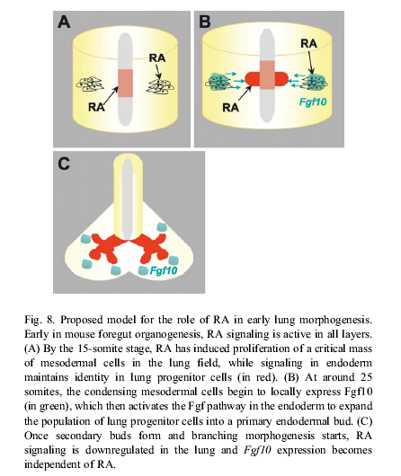
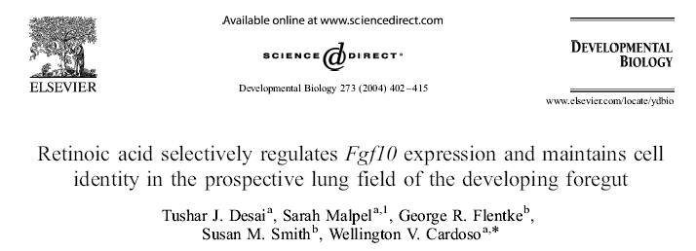

Slide 28
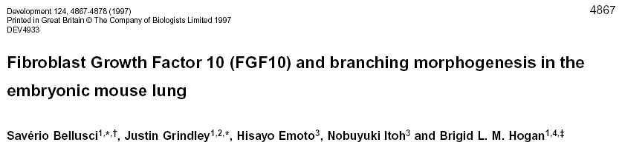
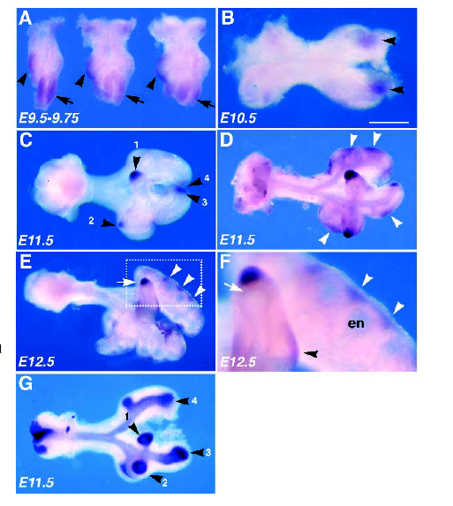
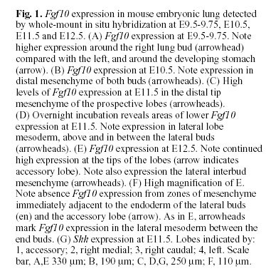

Slide 29
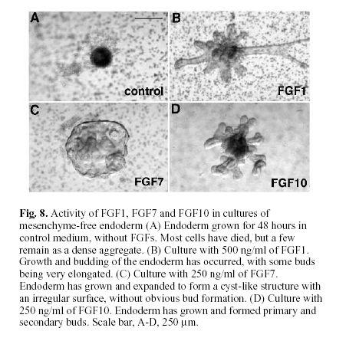

Slide 30
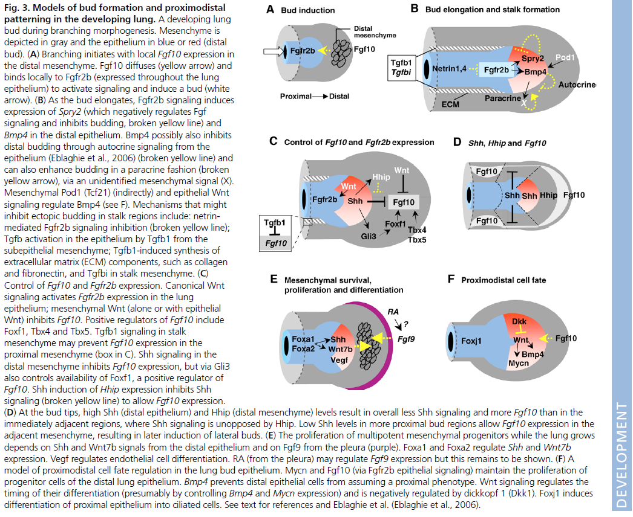
Cardoso, W. V. et al. Development 2006;133:1611-1624

Slide 31
Mirigyek fejlődése
Development of glands

Slide 33
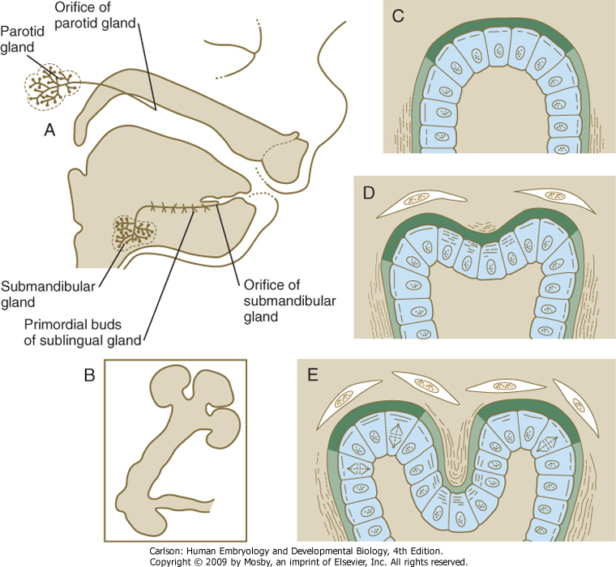

Slide 35
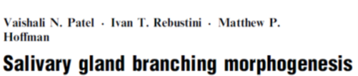

Slide 36
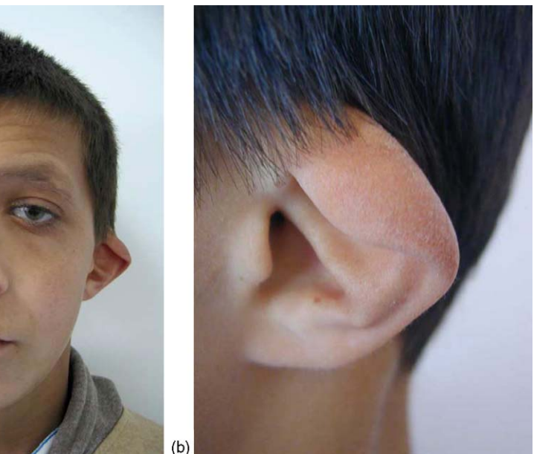
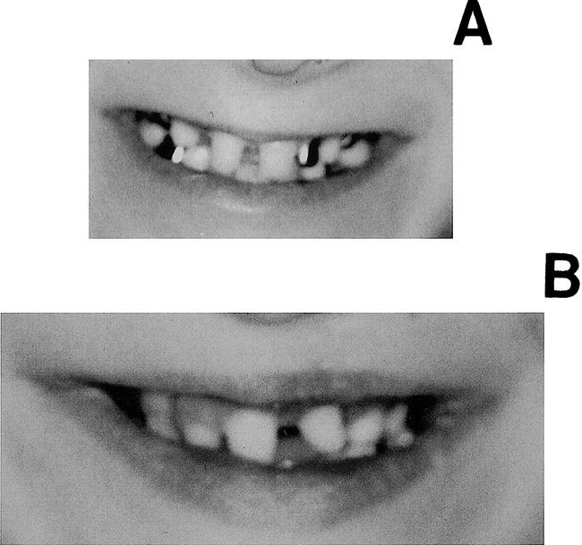

Slide 37
