Slide 1
Anatomy of the heart 1.
Chambers of the heart, external features. Structure of heart wall, myocardium, valves, anuli fibrosi
Semmelweis University,
Faculty of Medicine, Macroscopic Anatomy II.
Department of Anatomy, Histology and Embryology
Katalin Kocsis
2020.02.03-05.

Slide 2
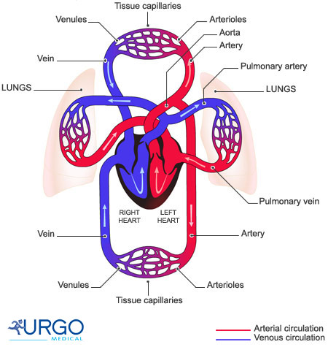
The circulatory system
LUNG
Pulmonary/respiratory circulation
HEART
Systemic/general circulation
BODY

Slide 3
Anatomy of the heart 1.
Surfaces of the heart

Slide 4
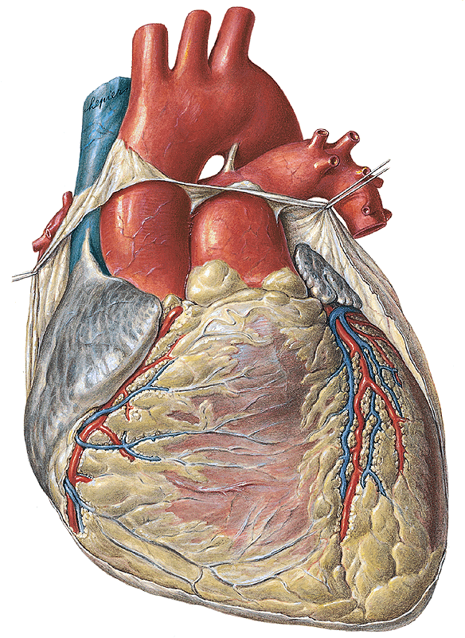
SURFACES OF HEART
anterior view
Sternocostal surface
Right surface
Left surface
Inferior margin
Right
Left

Slide 5
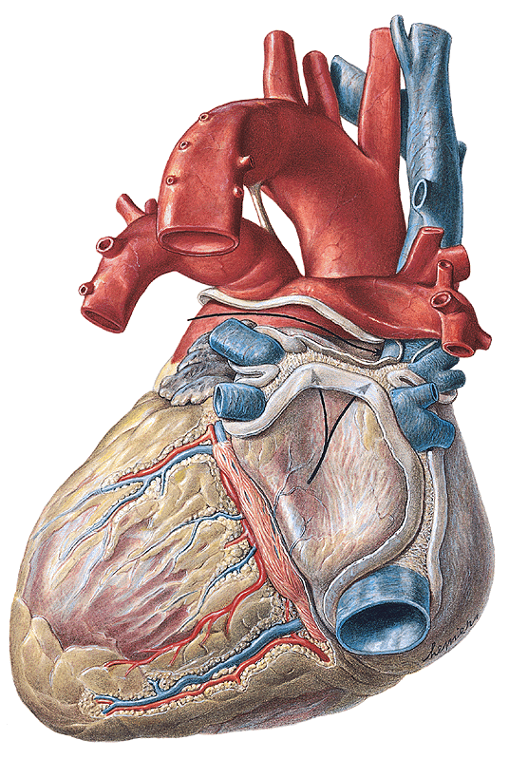
SURFACES OF HEART
posterior view
Posterior surface
(mediastinal)
Diaphragmatic
surface
Right surface
Left surface
Left
Inferior margin
Right

Slide 6
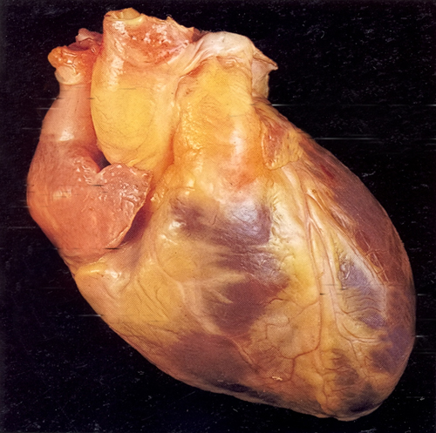
Cardiac size, external features
auricles
coronary groove
Pulm. tr.
LV
RV
ant. interventricular groove
-notch of cardiac apex
apex

Slide 7
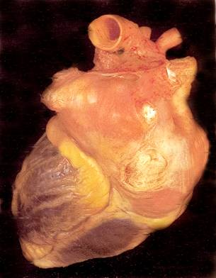
Facies diaphragmatica (facies posterior )
-upper border of the heart
LA
RA
LV
RV
-posterior interventricular groove

Slide 8
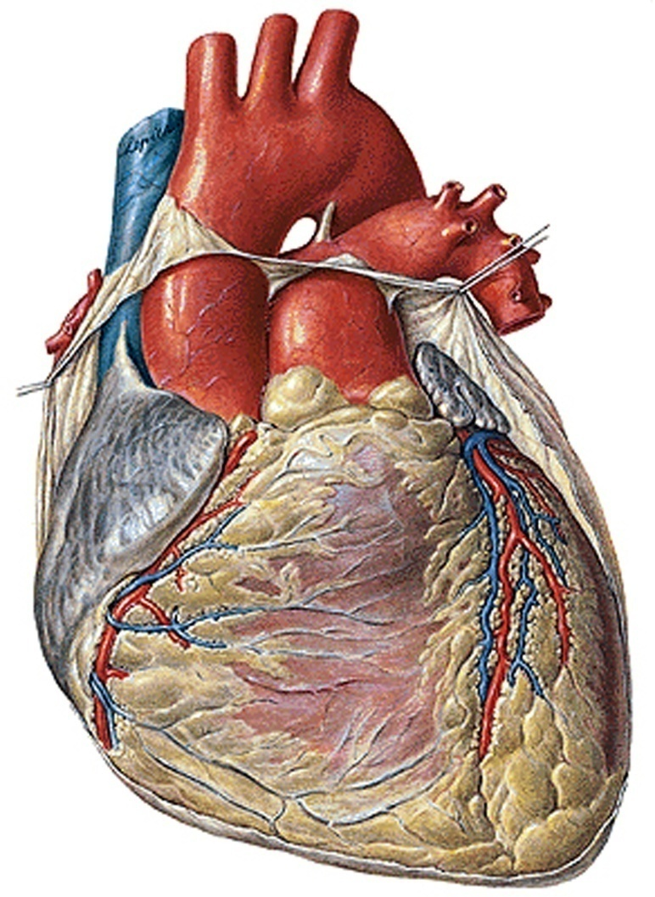
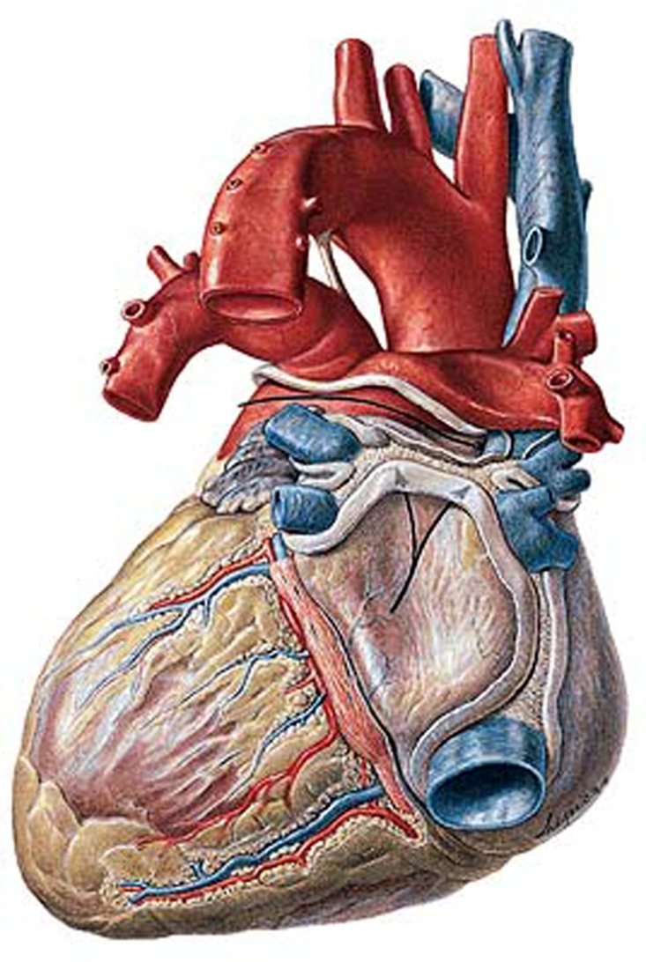
Heart: surfaces
Basis cordis
Facies
mediastinalis
Facies
sternalis
Apex cordis
Facies diaphragmatica

Slide 9

Heart: sternal surface (facies sternalis)
Aorta
Ligamentum arteriosum
Superior vena cava
Truncus pulmonalis
Right auricle
(auricula dextra)
Left auricle
(auricula sinistra)
Right atrium
(atrium dextrum)
Left ventricle
(ventriculus sinister)
Sulcus coronarius
Anterior interventricular sulcusior
Right ventricle
(ventriculus dexter)
Conus arteriosus
Apex cordis

Slide 10

Heart: posterior surface (facies mediastinalis)
Superior vena cava
Aortic arch
Truncus pulmonalis
Pulmonary veins
Sulcus coronarius
Left atrium
(atrium sinistrum)
Posterior interventriculari sulcus
Left ventricle
(ventriculus sinister)
Right atrium
(atrium dextrum)
Inferior vena cava
Apex cordis

Slide 11
Left auricle
(auricula sinistra)
Sulcus coronarius

Slide 12
Anatomy of the heart 1.
Chambers of the heart

Slide 13
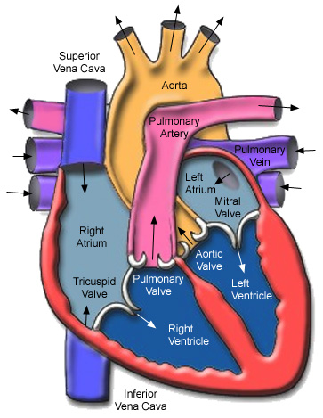
Cavities of the heart

Slide 14
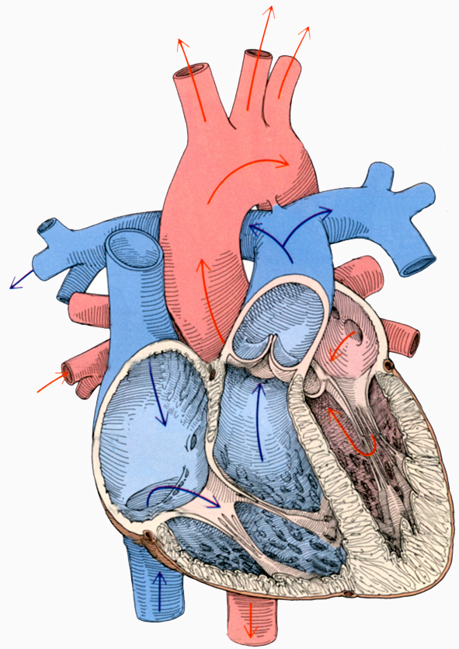
Cavities of the heart
Aortic arch
Truncus pulmonalis
Aortic valve (semilunar)
Left atrium
(atrium sinistrum)
Right atrium
(atrium dextrum)
Bicuspid valve
Pulmonary valve (semilunar)
Tricuspid valve
Right ventricle
(ventriculus dexter)
Left ventricle
(ventriculus sinister)

Slide 15
RIGHT ATRIUM
anterior view
Right auricle
Right
Left

Slide 16
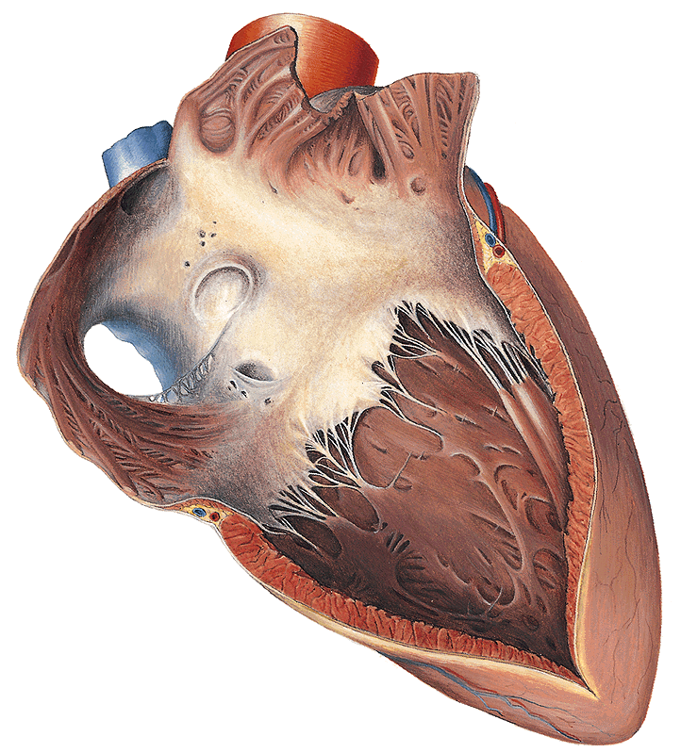
RIGHT ATRIUM
view from right
Right atrium proper
Sinus venarum cavarum
Posterior
Anterior

Slide 17
RIGHT ATRIUM
view from right
Musculi pectinati
Interatrial septum
Fossa ovalis
Crista terminalis
Posterior
Anterior

Slide 18
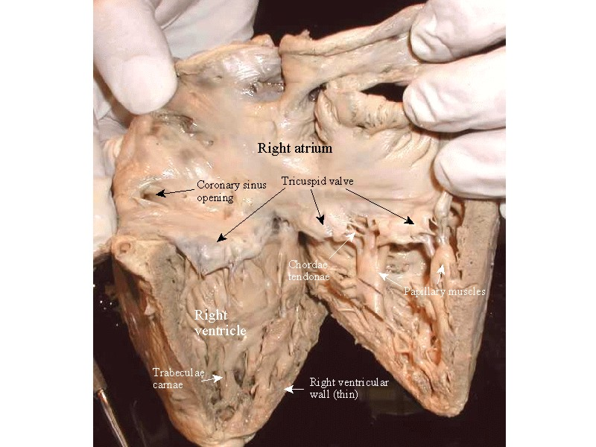
Crista terminalis
Musculi pectinati

Slide 19
RIGHT ATRIUM
view from right
Superior vena cava
Coronary sinus
Inferior vena cava
Valvule of inferior vena cava
Valvule of coronary sinus
Posterior
Anterior

Slide 20
RIGHT ATRIUM
view from right
Right atrioventricular orifice
Right ventricle
Posterior
Anterior

Slide 21
RIGHT VENTRICLE
anterior view
Pulmonary trunk
Conus arteriosus
Right
Left

Slide 22
RIGHT VENTRICLE
view from right
Trabeculae carneae
Posterior
Anterior

Slide 23
RIGHT VENTRICLE
view from right
Right atrium
Right atrioventricular orifice
Posterior
Anterior

Slide 24
TRICUSPID VALVE
view from right
Anterior cusp
Chordae tendineae
Septal cusp
Posterior cusp
Papillary muscles
(anterior)
Posterior
Anterior

Slide 25
DIRECTION OF BLOOD FLOW
Supraventricular crest: separates inflow and outflow tracts
Right
Left

Slide 27
LEFT ATRIUM
posterior view
Left auricle
Left
Right

Slide 28
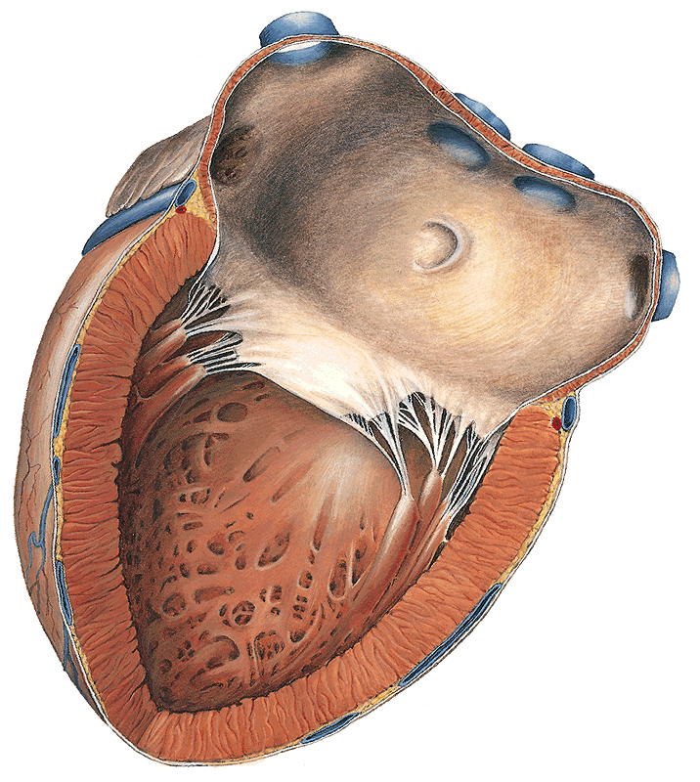
LEFT ATRIUM
view from left
Left auricle
Smooth surface
Anterior
Posterior

Slide 29
LEFT ATRIUM
view from left
Interatrial septum
Valvule of
foramen ovale
Anterior
Posterior

Slide 30
LEFT ATRIUM
view from left
Pulmonary veins
Anterior
Posterior

Slide 31
LEFT ATRIUM
view from left
Left atrioventricular orifice
Left ventricle
Anterior
Posterior

Slide 32
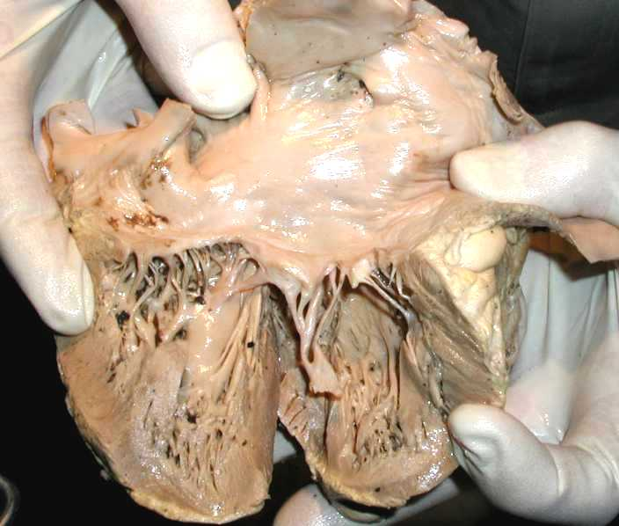
LEFT ATRIUM
view from left

Slide 33
LEFT VENTRICLE
posterior view
Left
Right

Slide 34
LEFT VENTRICLE
view from left
Trabeculae carneae
Anterior
Posterior

Slide 35
LEFT VENTRICLE
view from left
Left atrium
Left atrioventricular orifice
Anterior
Posterior

Slide 36
MITRAL VALVE
view from left
Anterior cusp
Anterior papillary muscle
Chordae tendineae
Posterior papillary muscle
Anterior
Posterior

Slide 37
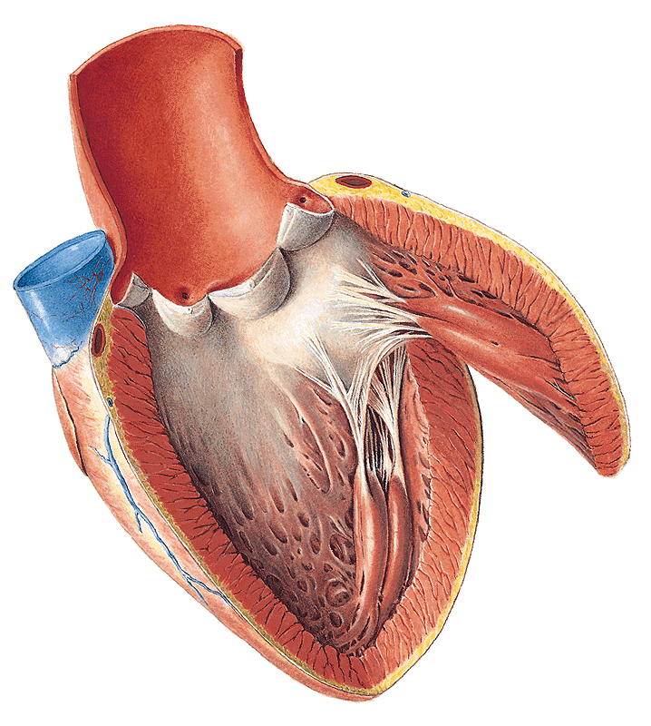
MITRAL VALVE
anterior view
Anterior cusp
Anterior papillary muscle
Posterior papillary muscle
Right
Left

Slide 38
LEFT VENTRICLE
anterior view
Aorta
Aortic orifice
Right
Left

Slide 39
AORTIC VALVE
anterior view
Left valvule
Right valvule
Posterior valvule
Right
Left

Slide 40
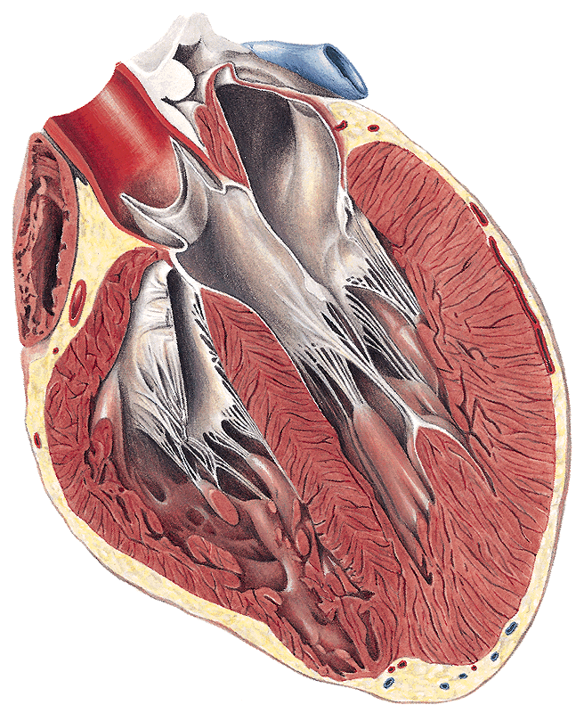
DIRECTION OF BLOOD FLOW
Anterior cusp
Right
Left

Slide 41
LEFT VENTRICLE, LEFT ATRIUM, MITRAL VALVE
view from left

Slide 42
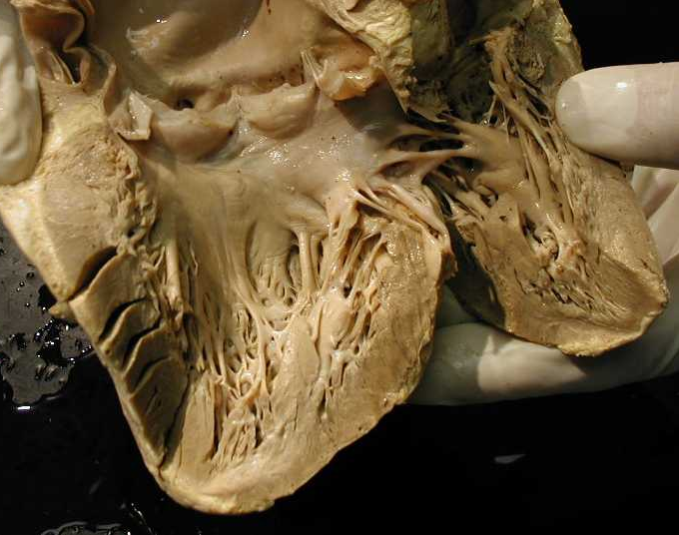
LEFT VENTRICLE,
MITRAL VALVE
view from left

Slide 43
LEFT VENTRICLE,
MITRAL VALVE,
AORTA SINUSES
view from left

Slide 44
Anatomy of the heart 1.
Anulus fibrosus

Slide 45
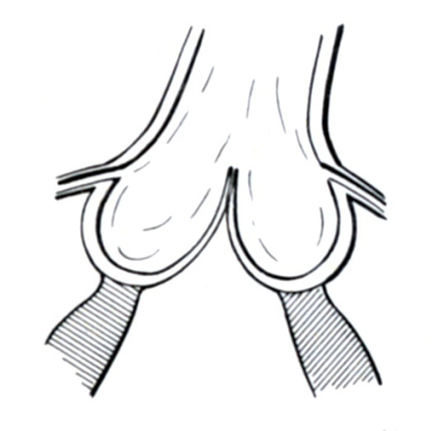
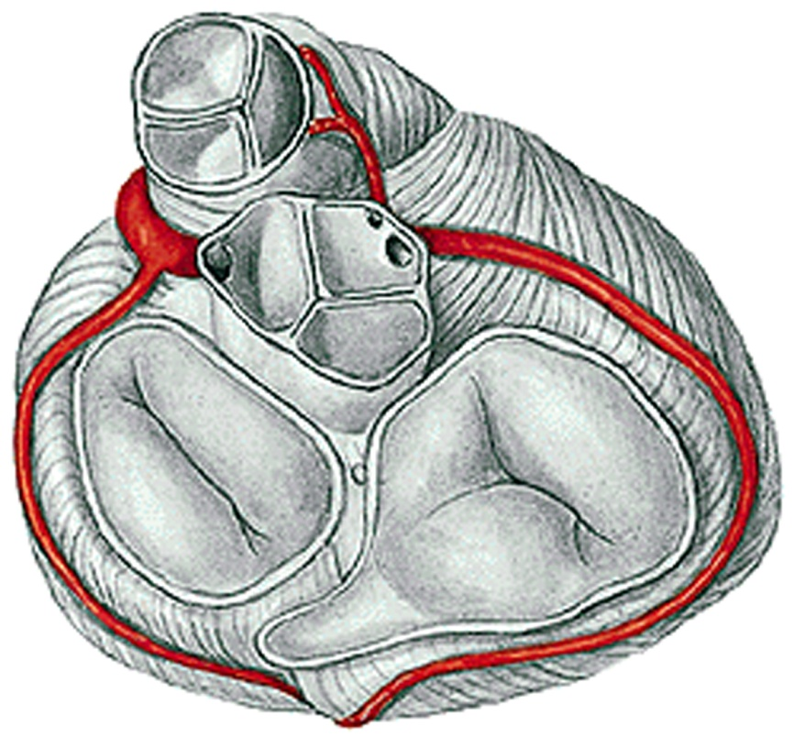
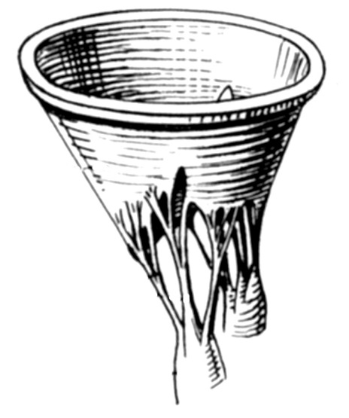
Anulus fibrosus
pulmonary artery
semilunar valve
aorta
semilunar valve
cuspid valve
left and right atrioventricular openings
semilunar valve
Aorta
Truncus pulmonalis
bicuspid or mitral valve
tricuspid valve

Slide 46
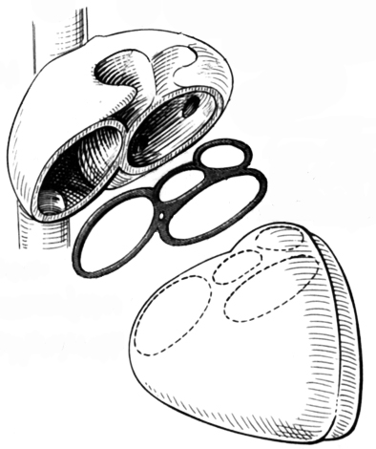
Cardiac skeleton
The four valves of the heart are anchored in dense fibrous connective tissue between them, they form a unit, the cardiac skeleton to which the atria and ventricles are attached.
superior v. cava
left atrium
pulmonary artery
semilunar valve
right atrium
aorta
semilunar valve
bicuspid or mitral valve
v. cava inferior
tricuspid valve
left ventricle
For the bundle of His
right ventricle

Slide 47
Anulus fibrosus

Slide 48
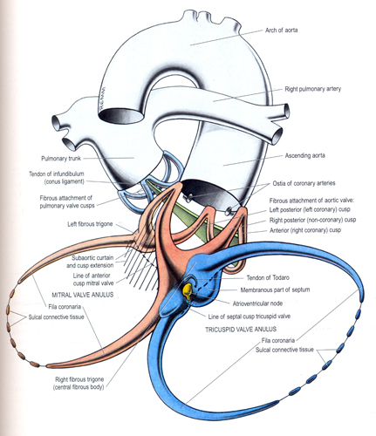
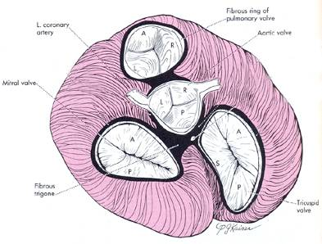
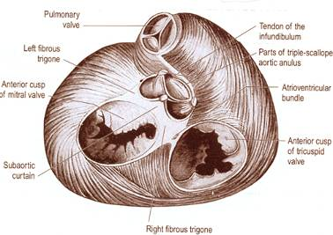
Fibrous skeleton of heart

Slide 49
Anatomy of the heart 1.
Valves of the heart

Slide 50
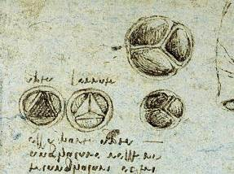
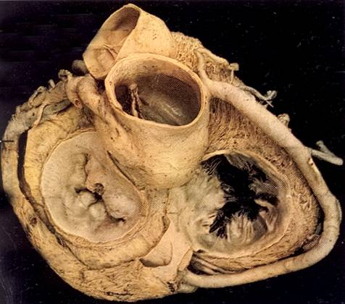
Cardiac valves
1. Atrioventricular – cusped valves
2. Arterial – semilunar valves
-they arise from the skeleton of the heart

Slide 51
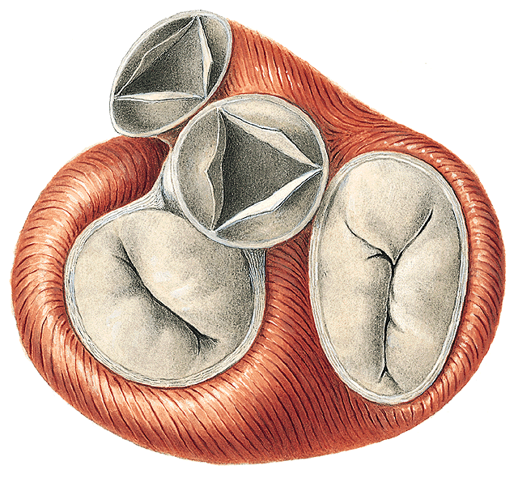
CARDIAC VALVES
Pulmonary valve
Aortic valve
Mitral valve
Tricuspidal valve
2/2/2020
Shina Alagia
51
Notes:
51

Slide 52
CARDIAC VALVES

Slide 53
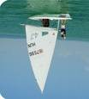

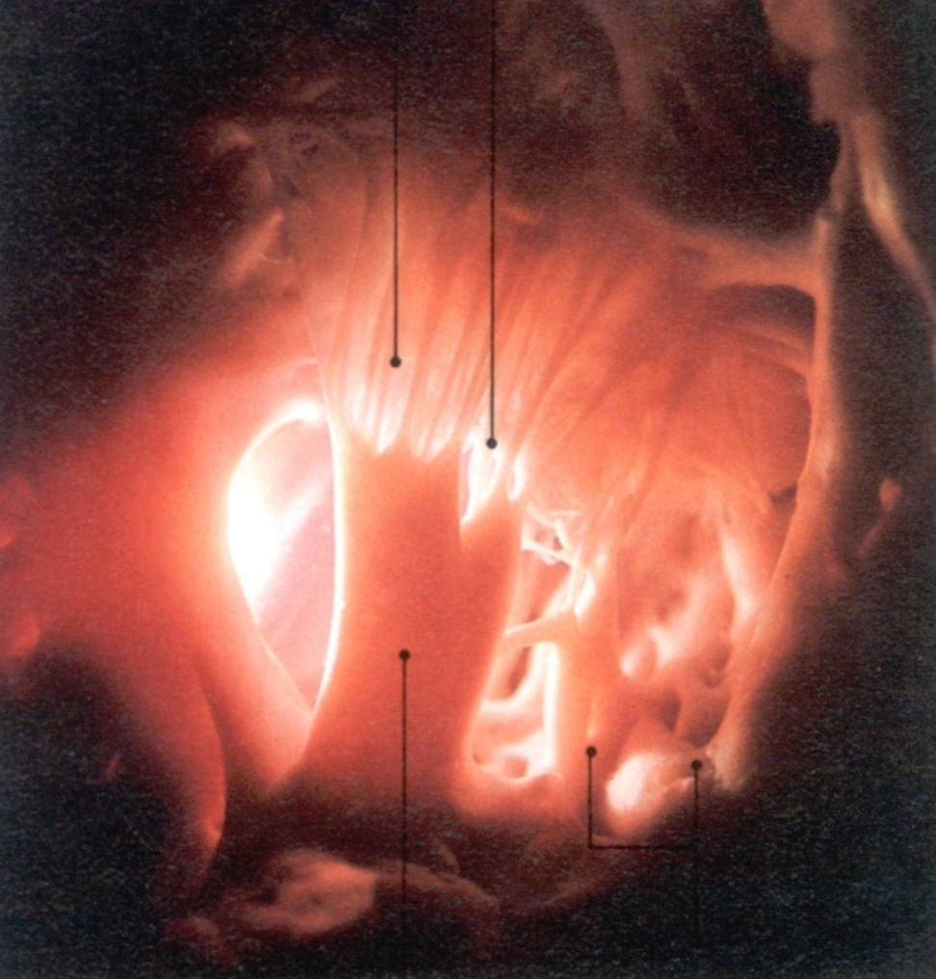
VALVES OF HEART
cuspid valves
cusp
chordae tendineae
papillary muscle

Slide 54
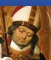
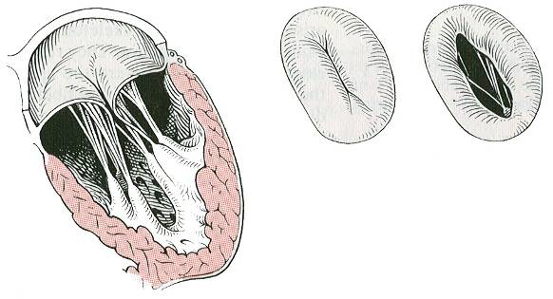
VALVES OF HEART
cuspid valves
Cusps
(2 or 3)
Chordae
tendineae
Closed
Open
Papillary muscles
Notes:
54

Slide 55
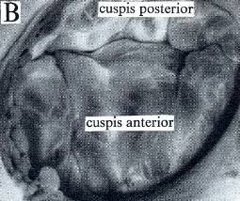
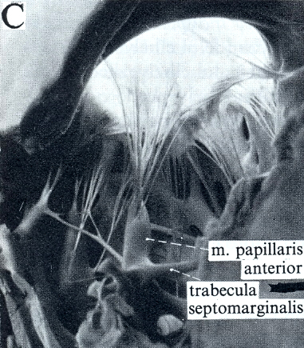
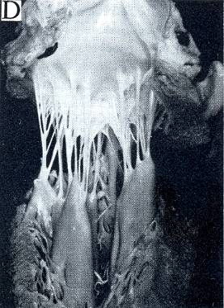
Tricuspid valve
Bicuspid valve (mitral)

Slide 58
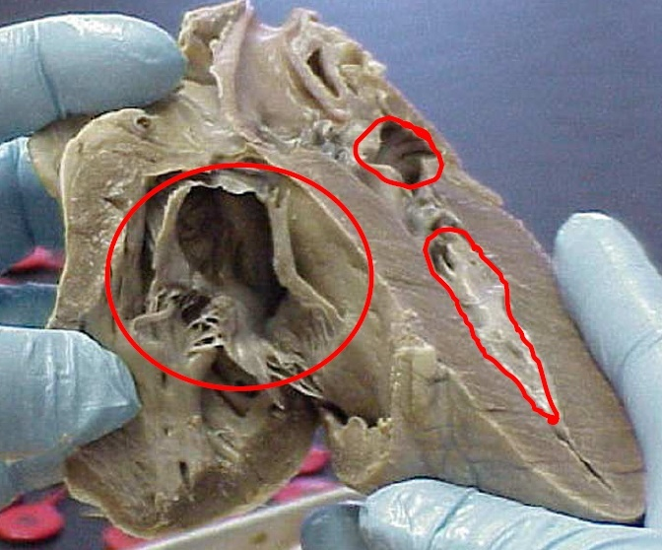
Tricuspid valve

Slide 59

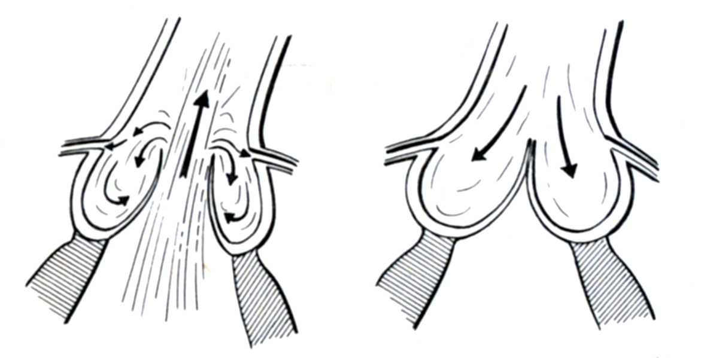
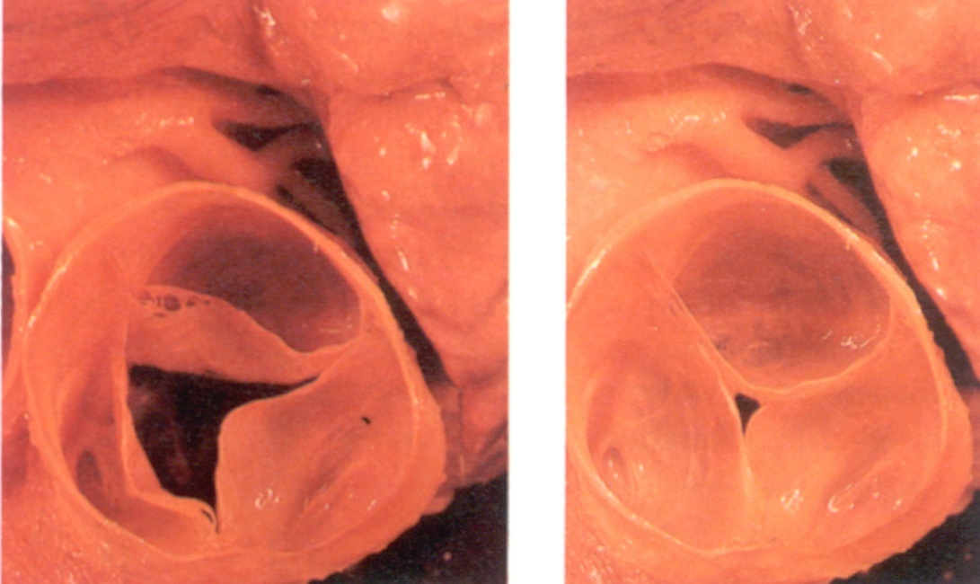
CARDIAC VALVES
(semilunar valves)
open
closed
open
closed
aortic opening and
pulmonary opening

Slide 60
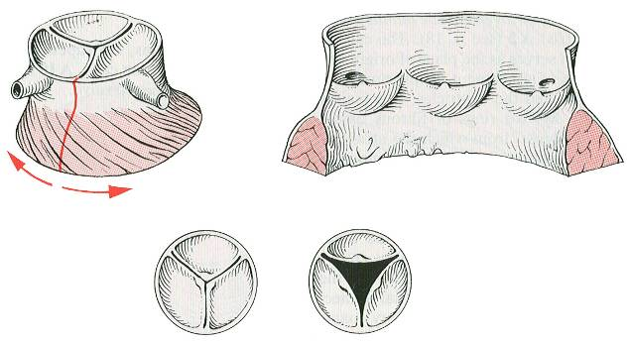
CARDIAC VALVES
(semilunar valves)
Valvulae
(3)
Closed
Open
Notes:
60

Slide 61
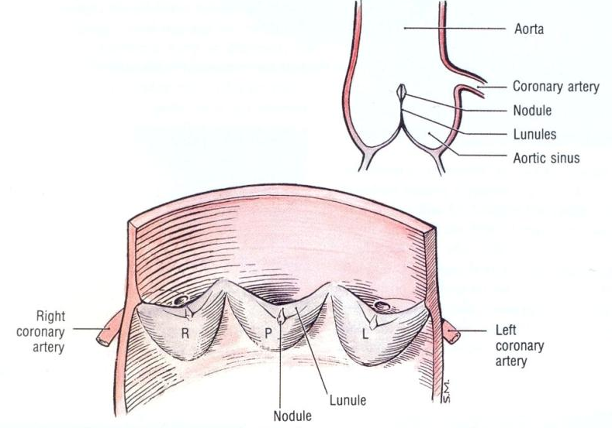
CARDIAC VALVES
(semilunar valves/cusps))
pars tensa
pars flaccida (lunula)
nodulus
pars tensa
pars tensa

Slide 62
CARDIAC VALVES
(semilunar valves/cusps - pulmonary valve)

Slide 63
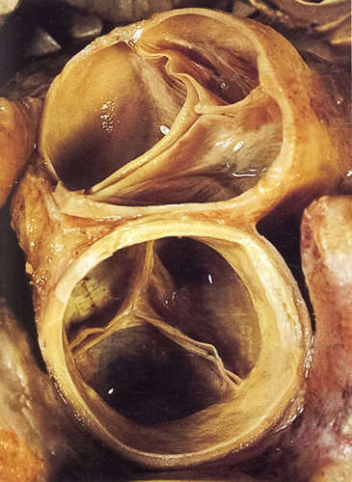
CARDIAC VALVES
(semilunar valves)
-pulmonary valve
A
R
L
L
R
P
-aortic valve

Slide 64
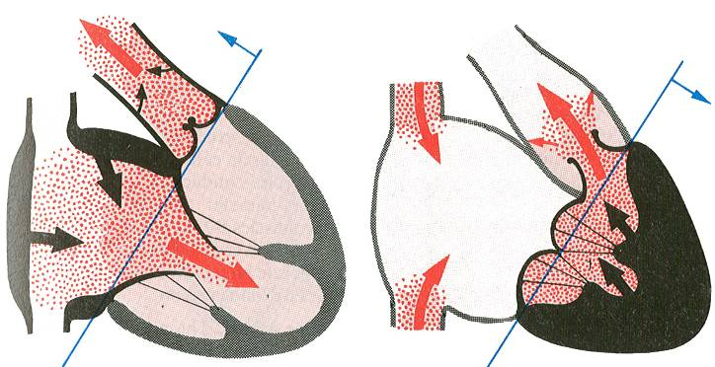
CARDIAC CYCLE
Diastole
Systole

Slide 65
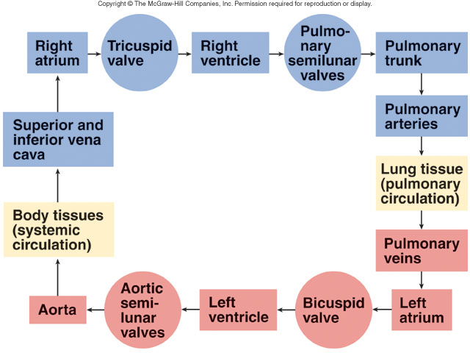
Cardiac Cycle
Shina Alagia
Notes:
65

Slide 66
Valvular diseases
Mitral stenosis:
decreased valve opening
left atrium hypertrophy
thick and calcified mitral valve
hypoxia, embolism, endocarditis
Mitral insufficiency (regurgitation):
bicuspid valve closure is not complete,
blood regurgitates

Slide 67
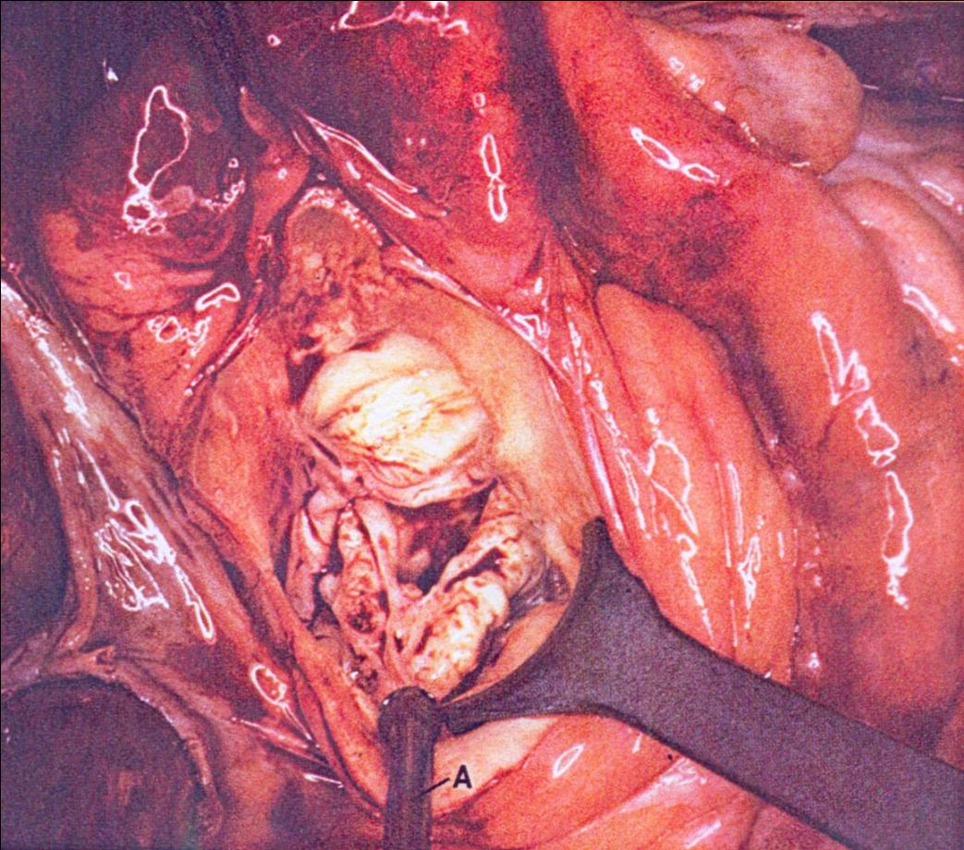

Slide 68
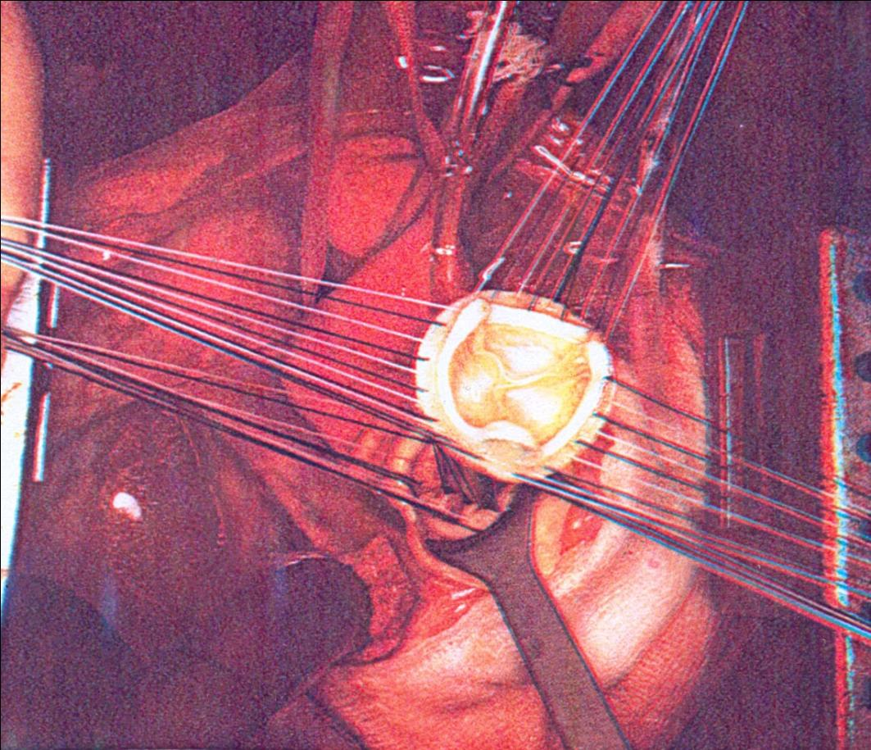

Slide 69
Anatomy of the heart 1.
Myocardium

Slide 70
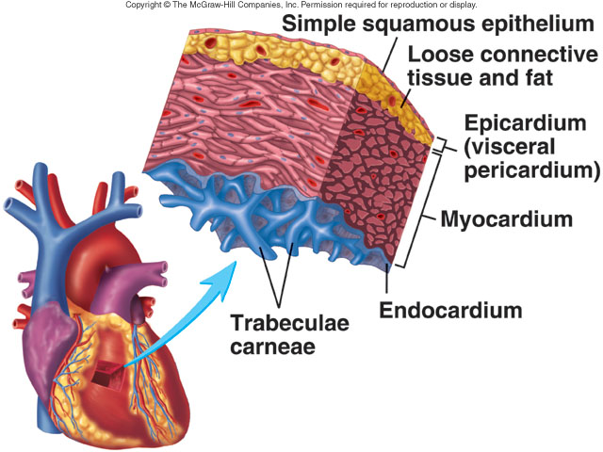
The Heart Wall
Components of the heart wall
  Epicardium: Outermost serous layer
  Myocardium: Middle muscle layer
  Endocardium: Innermost endothelium
Notes:
70

Slide 72
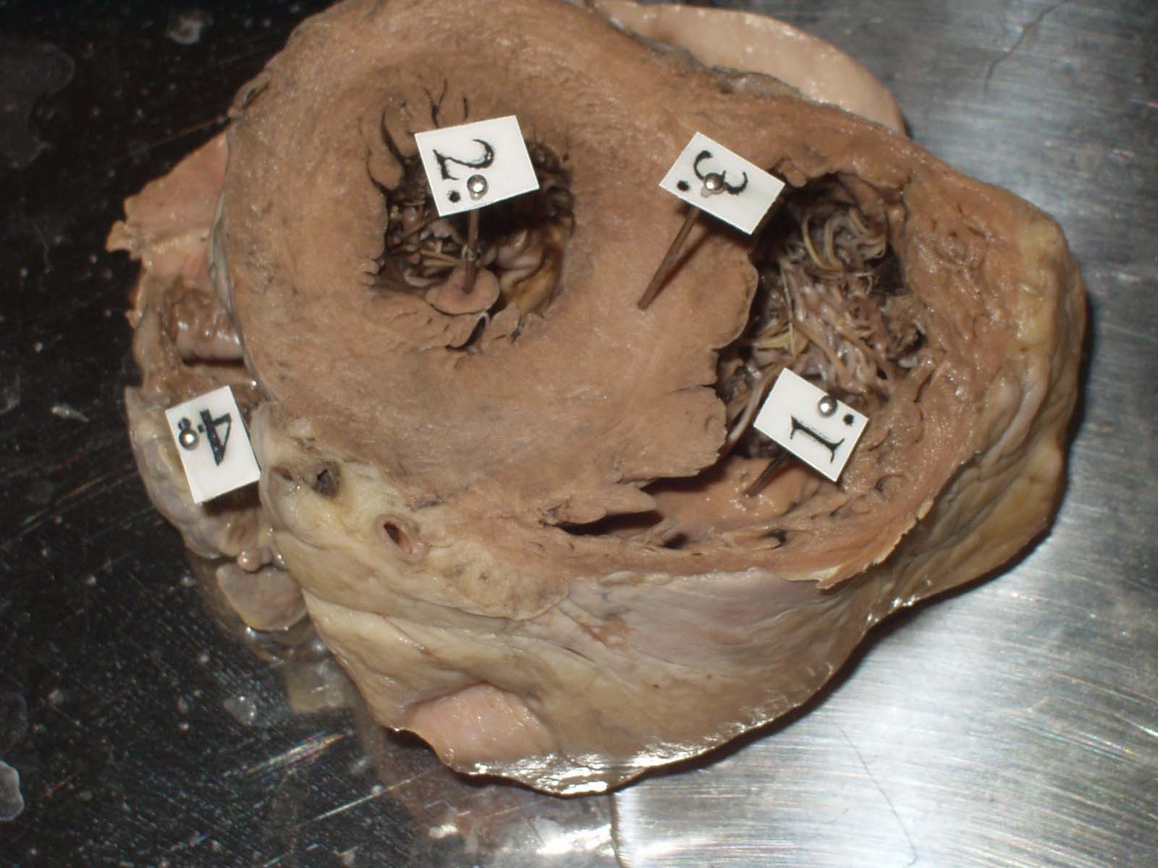

Slide 73
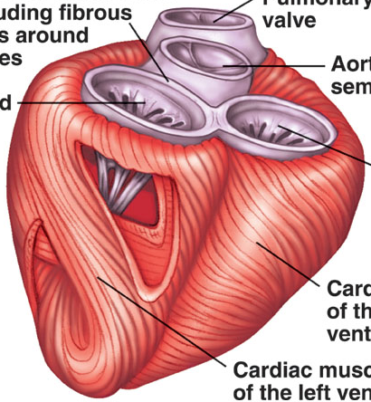
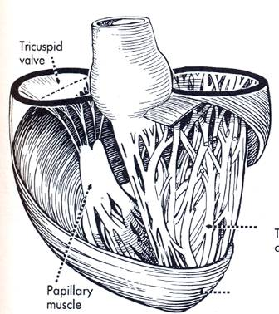
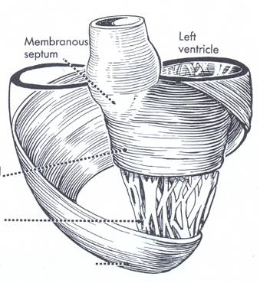
Myocardium
Ventricles: 3 layers
-outer spiraling longitudinal: arising from the cardiac skeleton (mainly fibrous trigones) fibers run towards the apex – they form a whorl: vortex of the heart
-inner spiraling longitudinal fibers: trabeculae carneae, papillary muscles
-middle circular: strong fibers
Atria: 2 layers
-inner longitudinal, outer circular

Slide 74
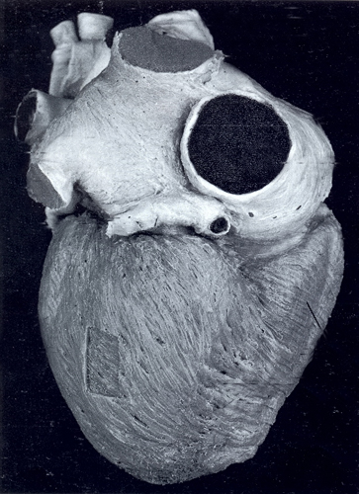
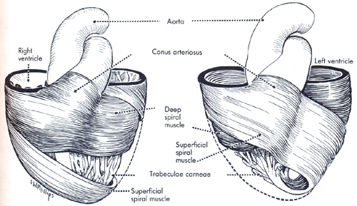
MYOCARDIUM

Slide 75

MUSCLES OF HEART
anterior view
Vortex
Right
Left

Slide 76

MUSCLES OF HEART
posterior view
Vortex
Left
Right

Slide 77

MUSCLES OF HEART
from the apex
Vortex
Right
Left

Slide 78

VENTRICLES
superior view
Left ventricle
Right ventricle
Interventricular septum
Left
Right

Slide 79
INTERVENTRICULAR SEPTUM
anterior view
Membranous part
Muscular part
Right
Left

Slide 80
INTERVENTRICULAR SEPTUM
pars membranacea

Slide 81








References

Slide 82


