Slide 1
Digestive tract II. Urinary tract
Faculty of Pharmacy
8th week histology practice
Department of Anatomy, Histology and Embriology

Slide 2
Colon
Simple coumnar epith. with many goblet cells
Lieberkühn cripts in the l. propria
Muscularis mucosae
  Inner circular&outer longitudinal layers
Submucosa – NO glands
Muscularis externa
  Inner circular&outer longitudinal layers the outer layer is not continous, it forms the 3 tenia coli
Serosa OR Adventitia

Slide 3
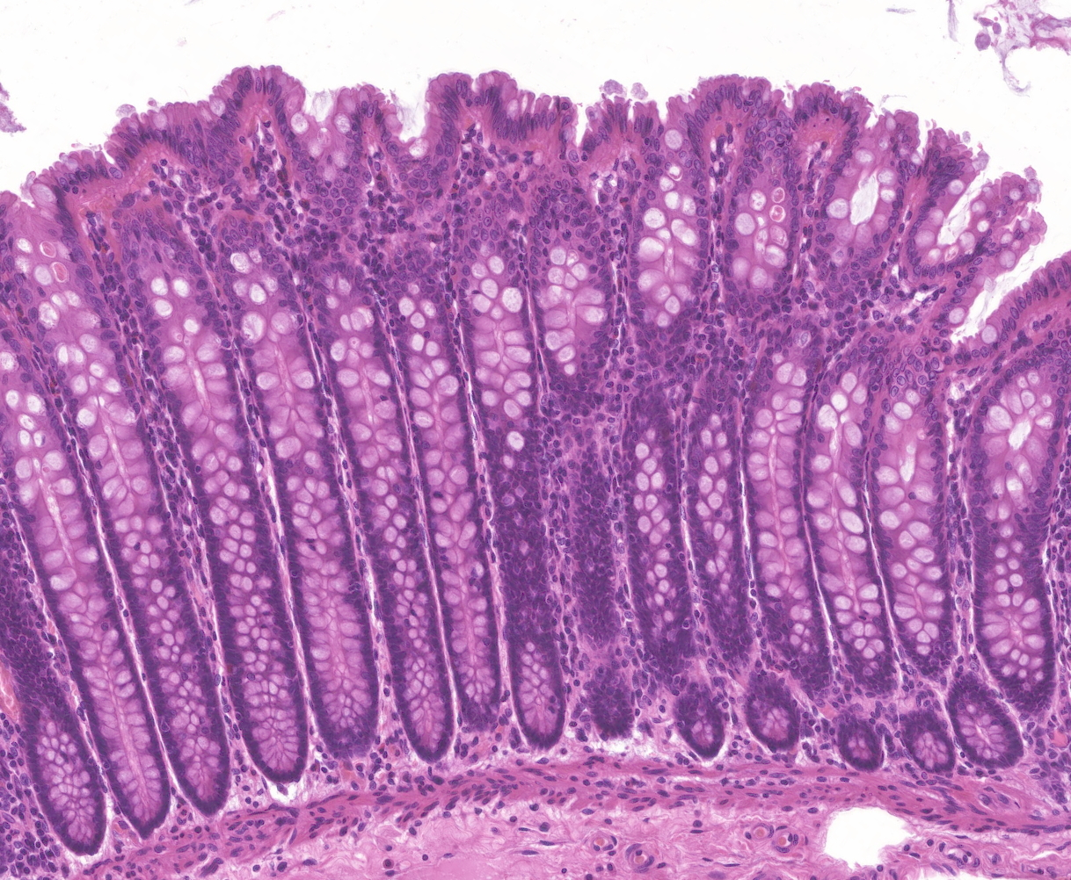
Colon

Slide 4
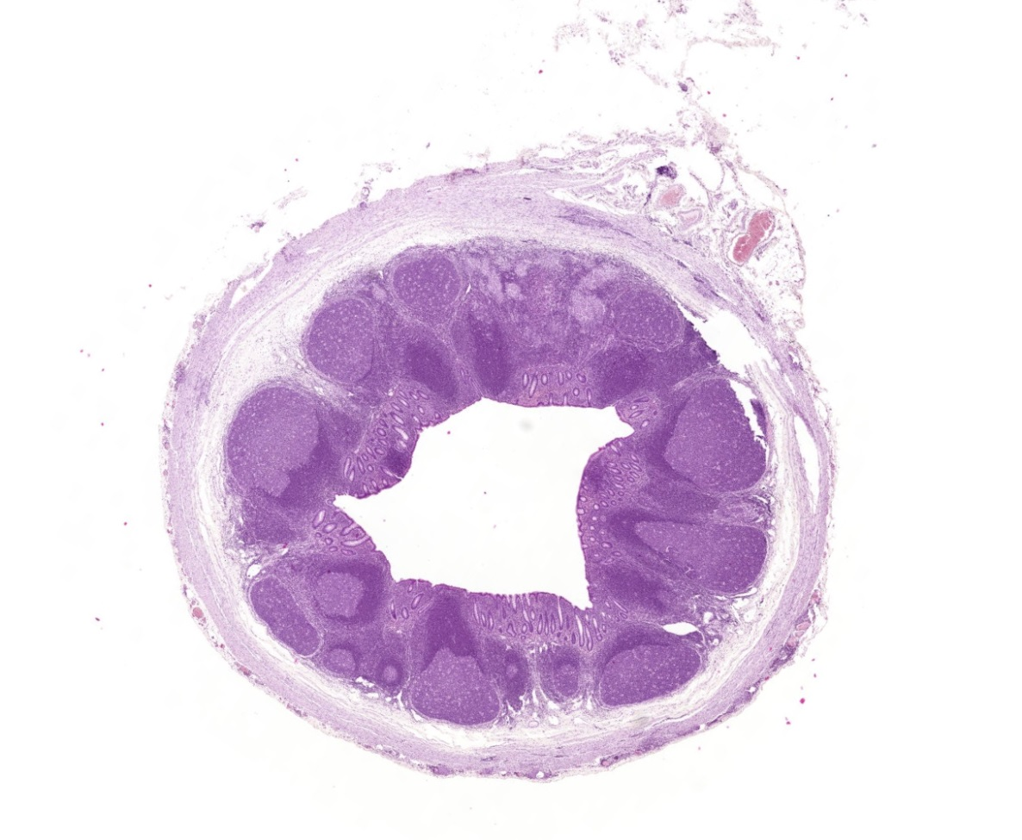
Vermiform appendix
Lymph nodules in the lamina propria and submucosa
Tenia coli is absent

Slide 5
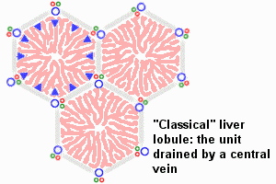
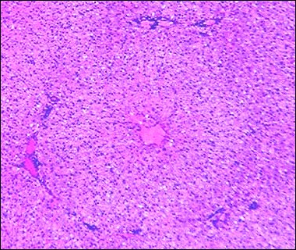
Liver
Hepatic lobules – hexagonal shape
(portal lobule, acinus)
  Portal triad – portal vein, artery, bile duct
  Hepatic sinusoids between the hepatic chords
  Central vein

Slide 6
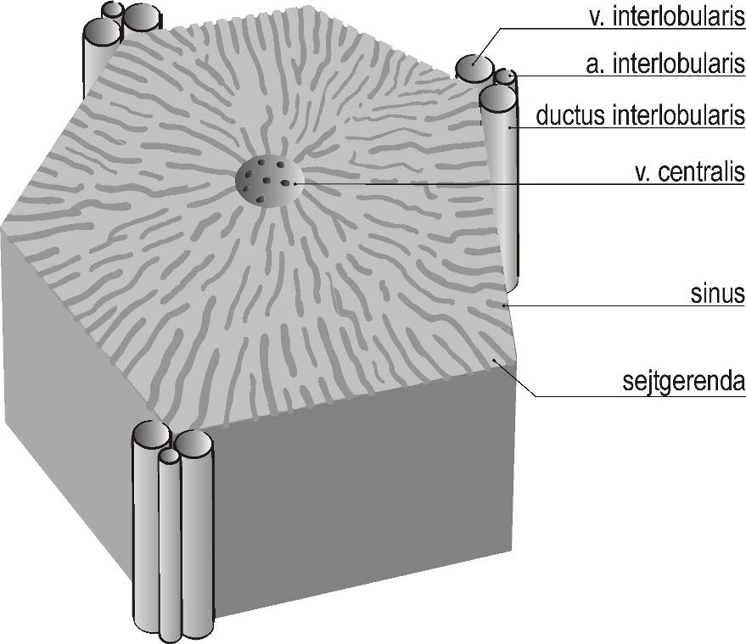
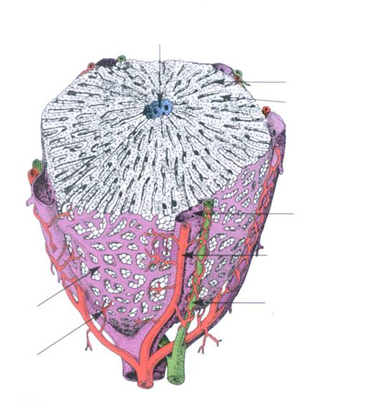
Hepatic lobule
Central vein
Hep. sinus
Hep. chord
Interlobular vein
Portal
triad
Interlobular artery
Interlobular duct

Slide 7
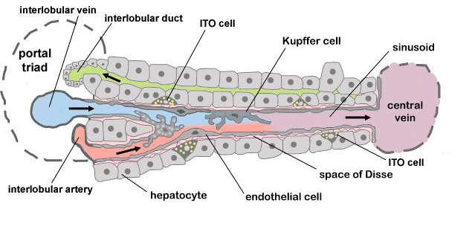
Hepatic sinus

Slide 8
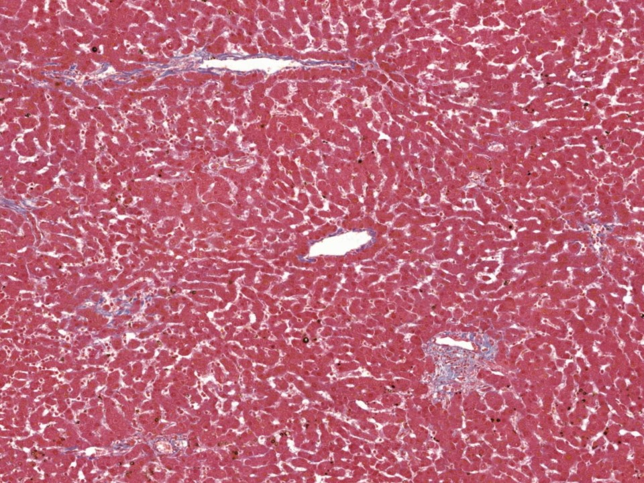
Central vein
Portal
triad

Slide 9
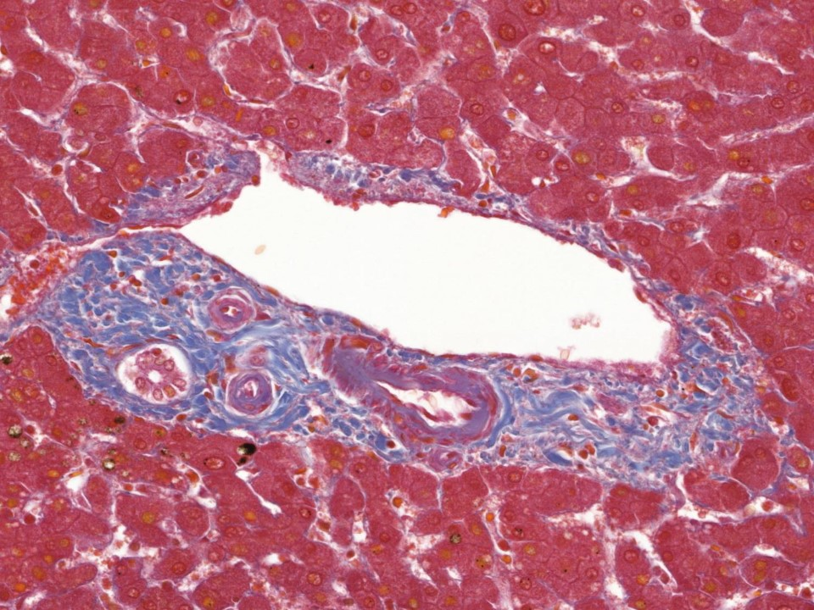
Interlobular duct
Interlobular vein
Interlobular artery
Portal triad

Slide 10
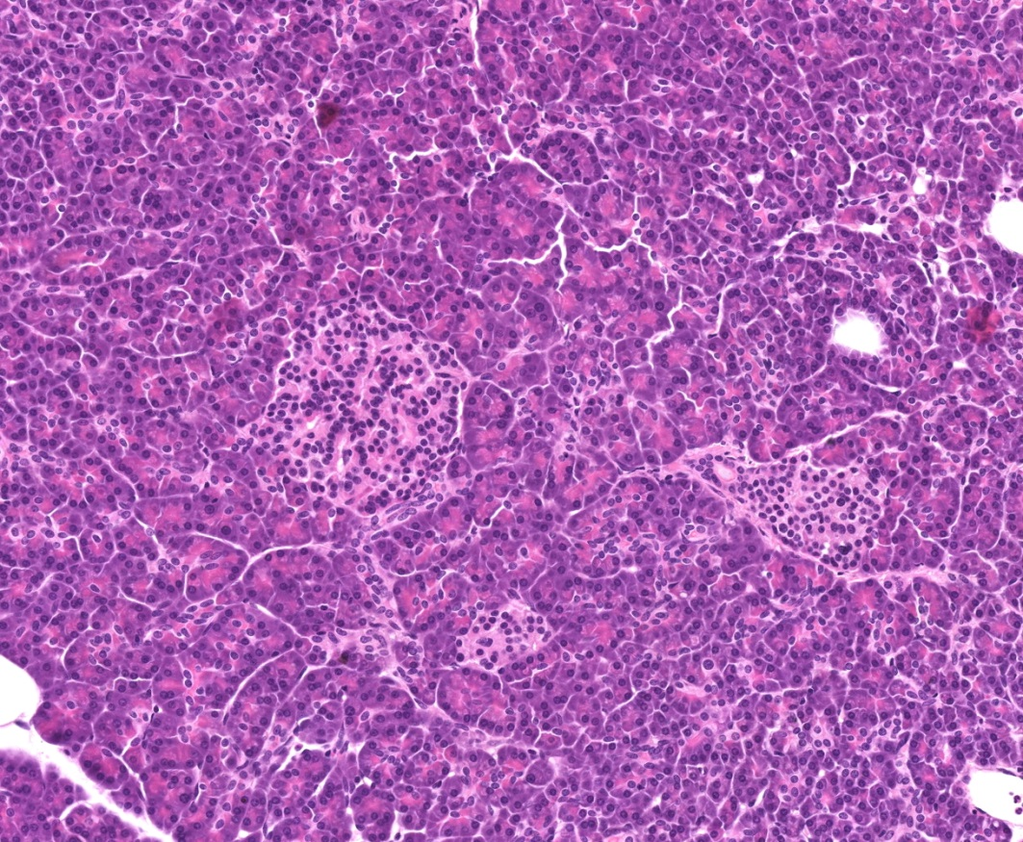
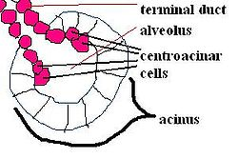
Histology of the pancreas
Serous gland
Centroaciner cell
Langerhans islets – endocrine part

Slide 12
Nephron

Slide 13
Macula densa
Malphigian corpuscule
interdigitating podocytes

Slide 14
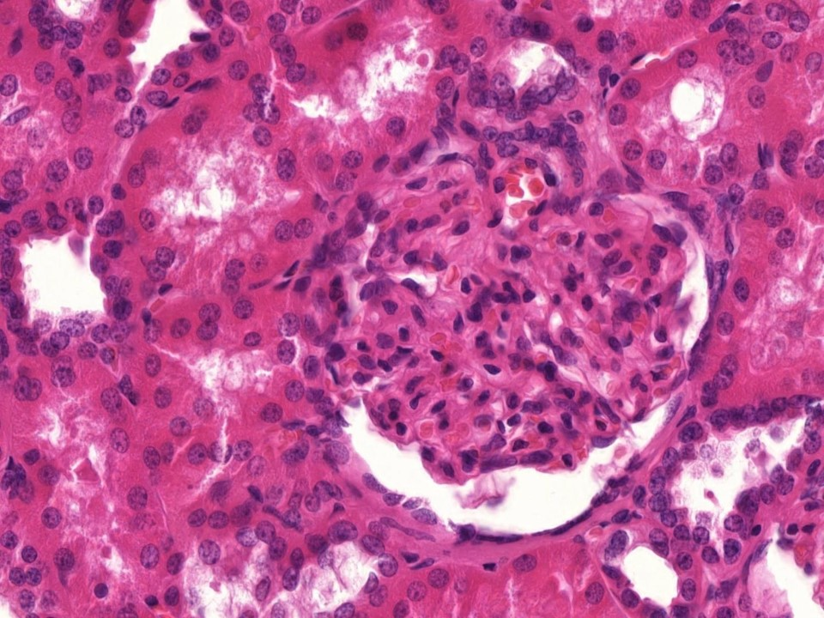
Macula densa
Proximal tubule
Parietal layer of Bowman’s capsule
Distal tubule

Slide 15
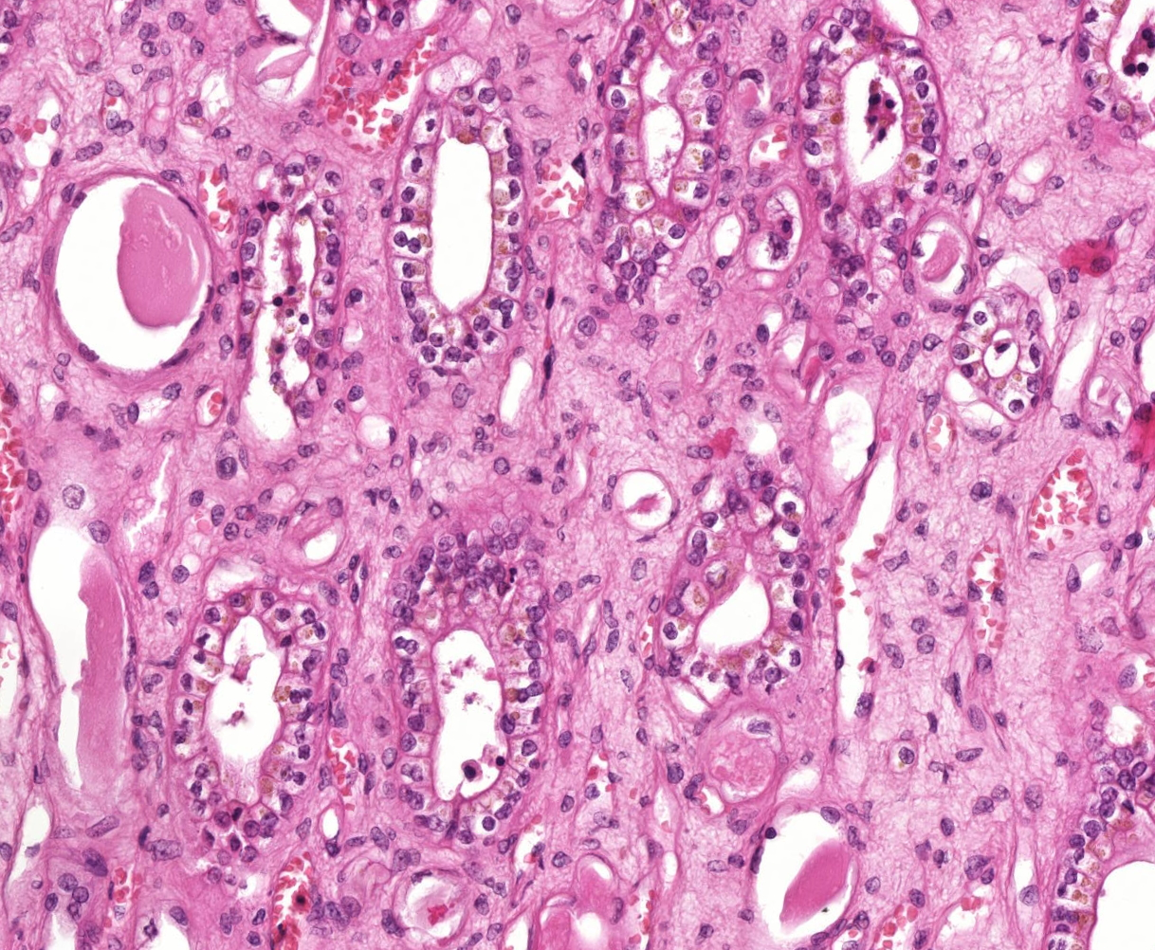
Collecting ducts

Slide 16
Sections and structures to identify

Slide 17
72. Liver (HE)
Central vein
Portal
triad

Slide 18
72. Liver (HE)
Interlobular duct
Interlobular vein
Interlobular artery
Portal triad

Slide 19
74. Kidney (HE)
Macula densa
Proximal tubule
Parietal layer of Bowman’s capsule
Distal tubule

