Slide 1
Respiratory system, Digestive tract I.
Faculty of Pharmacy
6th week Histology practice
Department of Anatomy, Histology and Embriology

Slide 2
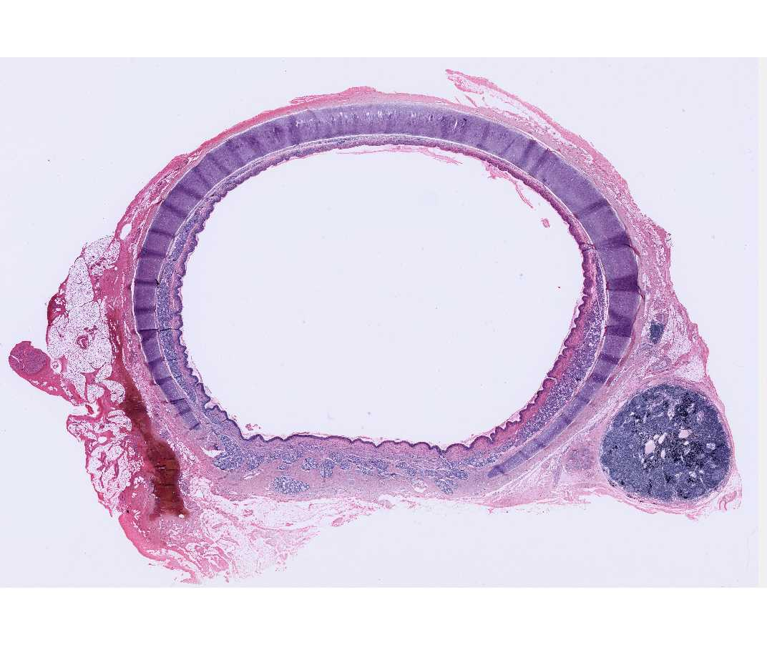
Trachea
Cartilagenous part (3/4)
-hyalin cartilage
Membranous part (1/4)
-smooth muscle
Trachealis muscle

Slide 3
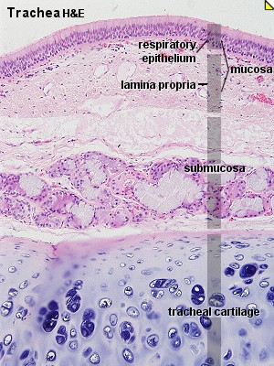
Trachea
Pseudostratified ciliated
columnar epitheliuum
Mixed glands

Slide 4
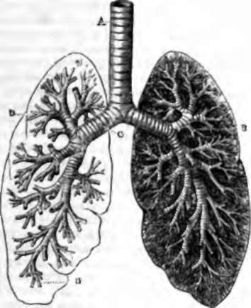
Bronchi
Bronchi
Principal
Lobar
Segmental
Terminal
Bronchiole
Terminal
Respiratory
Alveolar duct
Alveoli
The bronci contain hyalin cartilage, and glands in their wall. The epithelium is pseudostratified ciliated columnar epithelium.
The broncioles does NOT contain any cartilage, neither glands. The wall contains smooth muscle. The epithelium is simple columnar, or cuboidal epithelium.

Slide 5
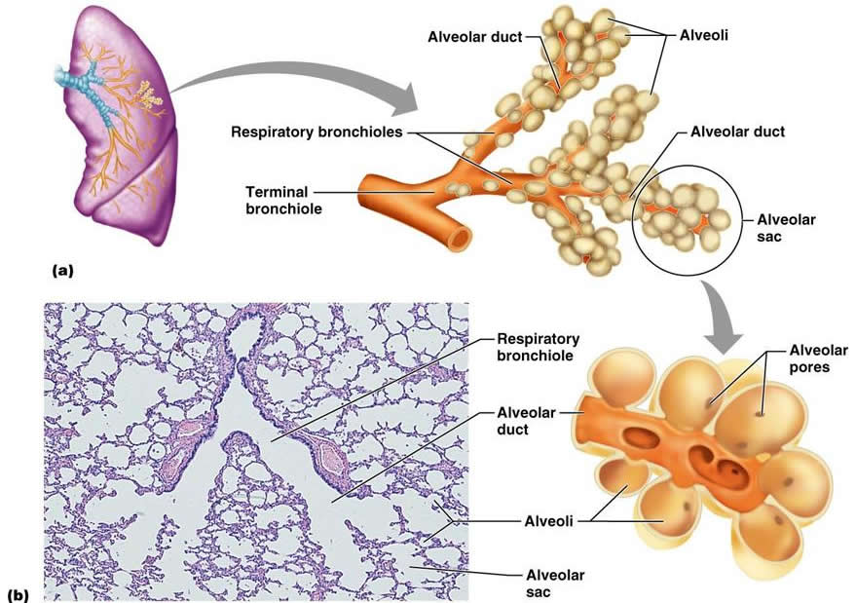
Bronchiole

Slide 6
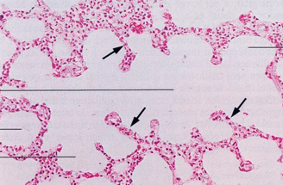
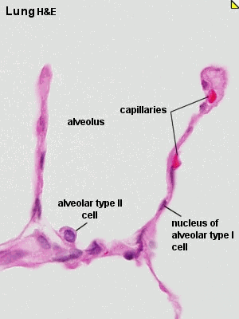
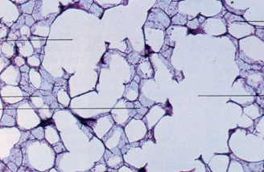
Alveoli

Slide 7
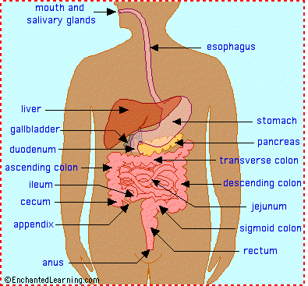
Digestive tract
Oral cavity
Pharynx
Esophagus
Stomach
Small intestie
Duodenum
Jejunum
Ileum
Large intestine (colon)
Vermiform appendix
Glands
Salivary glands
Liver
Pancreas

Slide 8
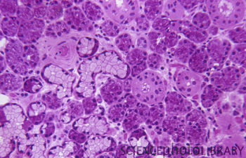
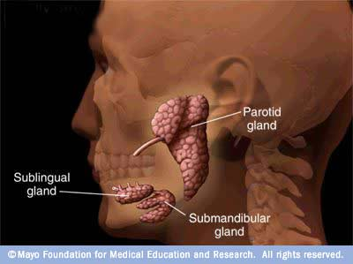
Salivary glands
Intercalated duct
Striated duct
Interlobular duct
Submandibular gland
Mixed gland

Slide 9
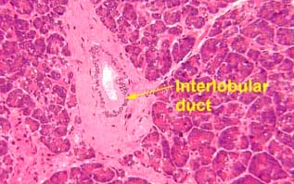
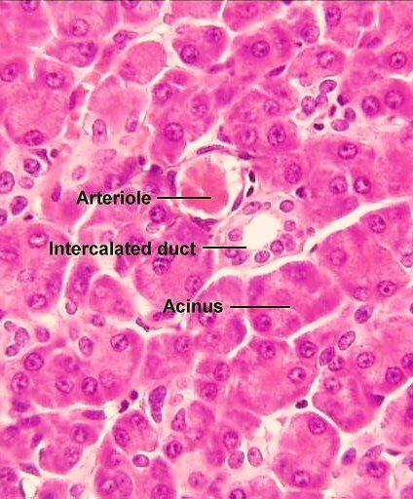
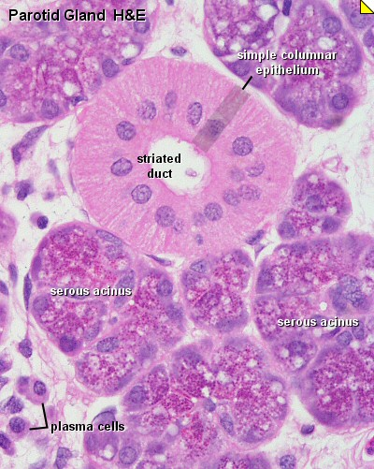

Slide 10
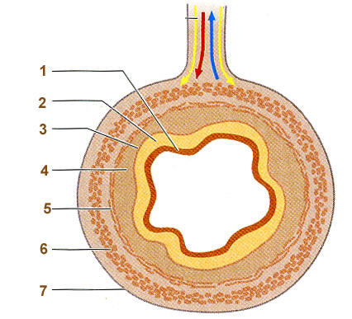
Structure of the wall in the GI tract
Mucosa
Epithelium (1)
Lamina propria (2)
Muscularis mucosae (3)
Submucosa (4)(submucosal plex.)
Muscularis externa (myenteric plex.)
Inner circular (5)
Outer longitudinal (6)
Adventitia / Serosa (7)

Slide 11
Esophagus
Non-keratinized stratified squamous epith.
Cardia-glands in the lamina propria
Muscularis mucosae is longitudinal
Glandulae esophageae in submucosa
Muscularis externa
Adventitia in the thoracic cavity, serora in the abdominal cavity

Slide 12
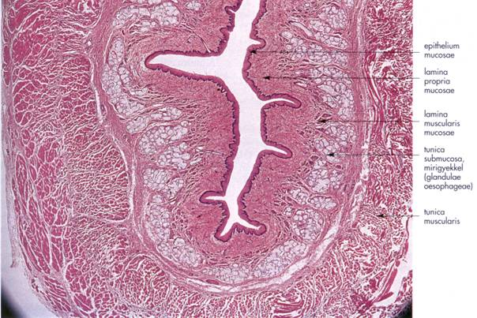
Esophagus

Slide 13
Stomach
Simple columnar epith. Gastric pits
Lamina propria: long, tubular glands
Mucous secreting neck cells
Chief cells on the base – pepsinogen
Parietal cells – gastic acid
Muscularis mucosae
Inner circular&outer longitudinal layers
Submucosa
Muscularis externa
3 layers: inner obilque, middle circular, outer longitudinal
Serosa

Slide 14
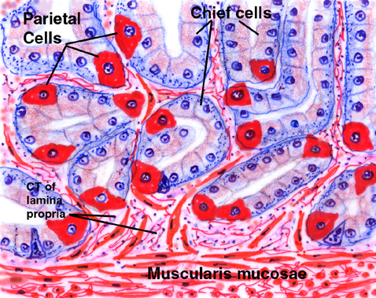
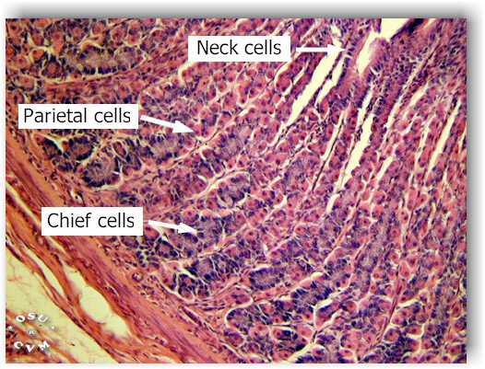
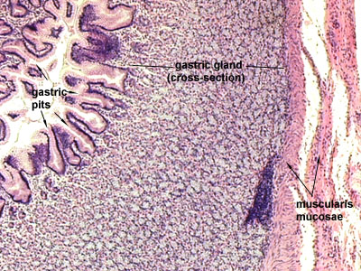
Stomach

Slide 15
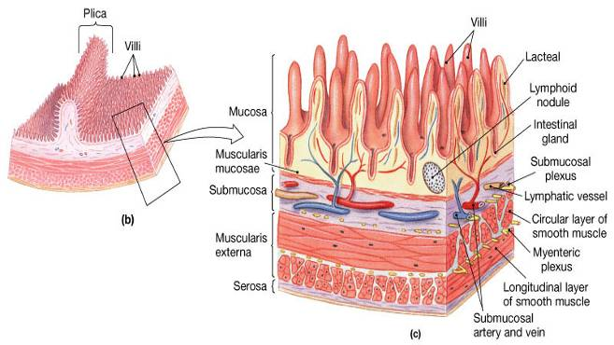
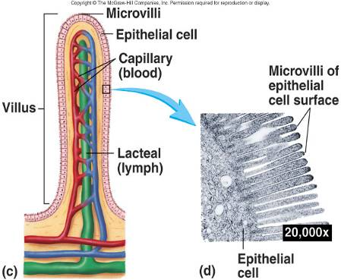
Histology of the small intestine
Structures helping absorbtion (with surface enlargment):
Circular folds(plicae circulares): More prominent in the duodenum and in the proximal part of the jejunum. They disappear at the terminal part of the ileum.
Villus (villi intestinales): projecting parts of the mucosa. They are more numerous in the duodenum and in the jejunum. Size: 0,5-1,5 mm
Microvilli: Projections on the apical surface of the epithelial cells.
3
1
2

Slide 16
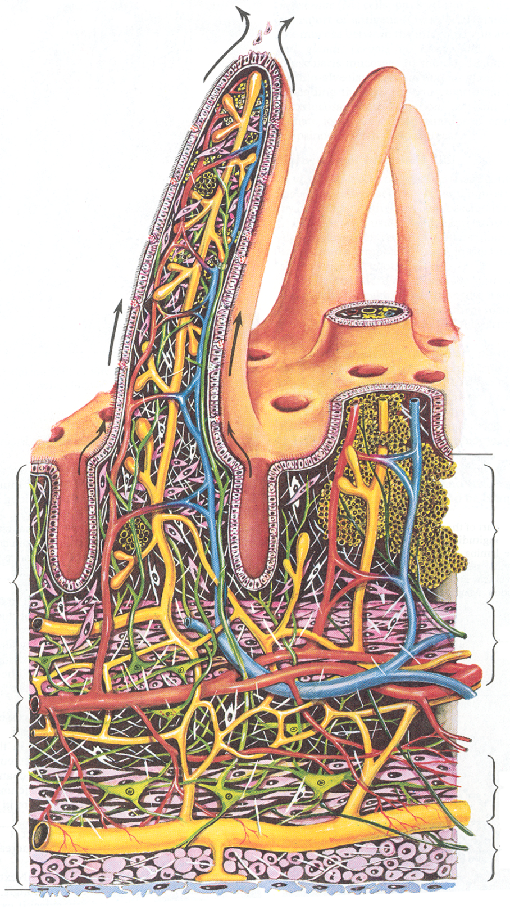
Histology of the small intestine
villi
Lieberkühn cripts
(intestinal galands)
epithelium
lamina propria
Mucosa
muscularis mucosae
Submucosa
circular longitudinali
Muscularis externa
Serosa

Slide 17
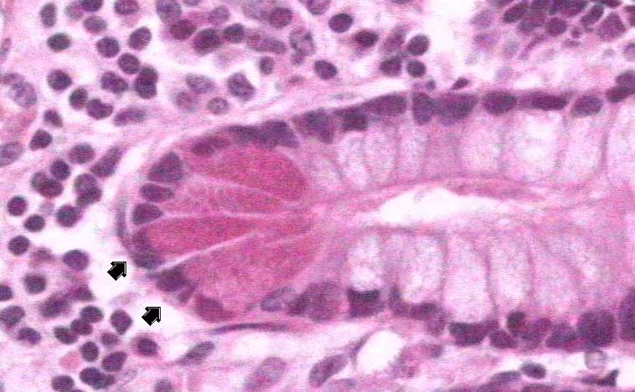
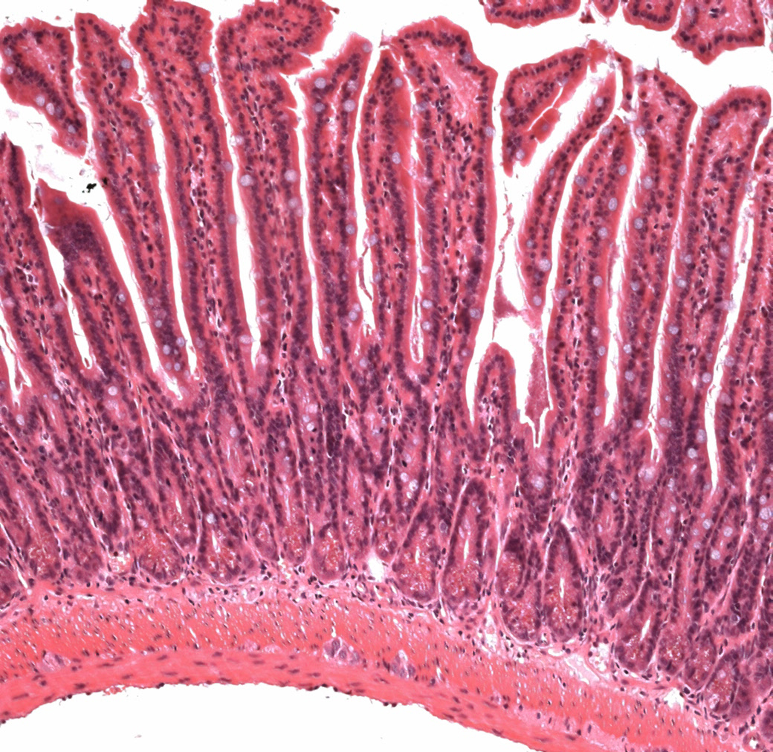
Ileum
Paneth cells

Slide 18
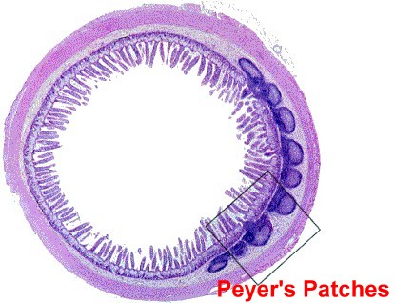
Peyer’s patches

Slide 19
Sections and structures to identify

Slide 20
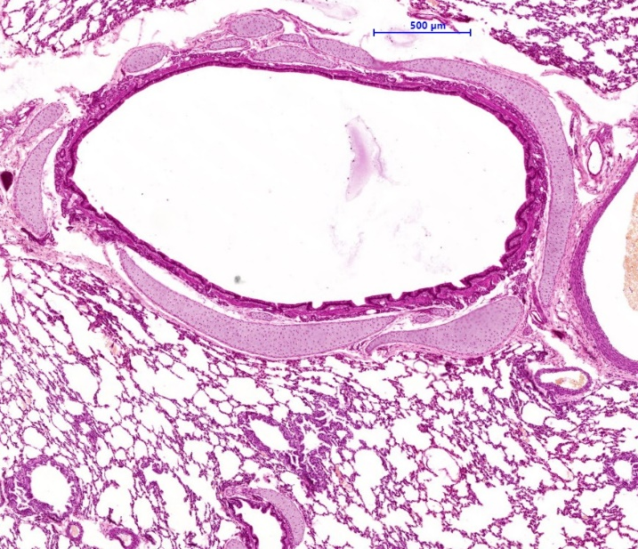
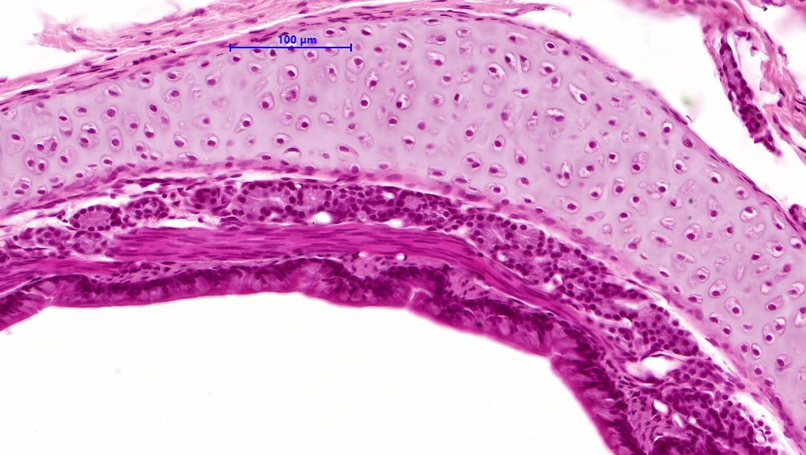
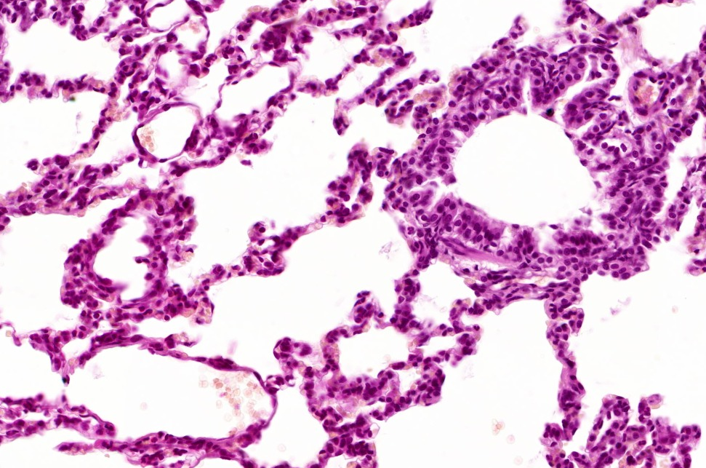
58. Lung (HE)
bronchus
cartilage
gland
bronchiolus
smooth muscle
pseudostratified columnar
epithelium
alveolus

Slide 21
62. Stomach (HE)
tunica mucosa
tunica submucosa
muscularis externa
parietal cell
chief cell

Slide 22
99. Ileum (HE)
intestinal villus
Lieberkühn's crypt
tunica mucosa
tunica submucosa
Peyer's patch
muscularis externa
tunica serosa

