Slide 1
Nervous system, Sensory organs
Faculty of Pharmacy
12th week histology practice
Department of Anatomy, Histology and Embriology

Slide 2
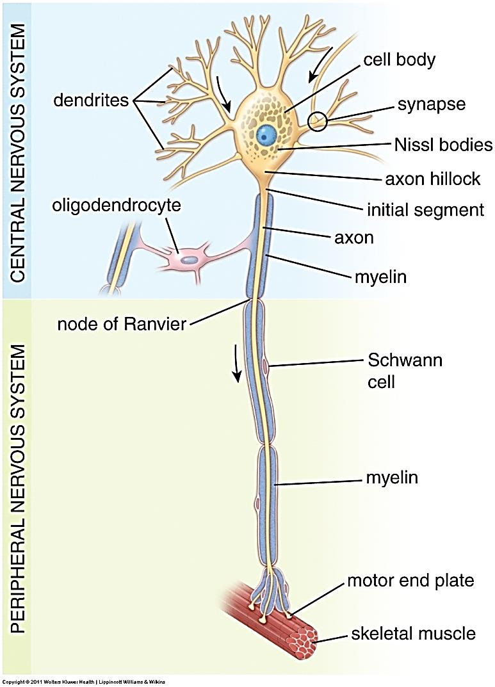
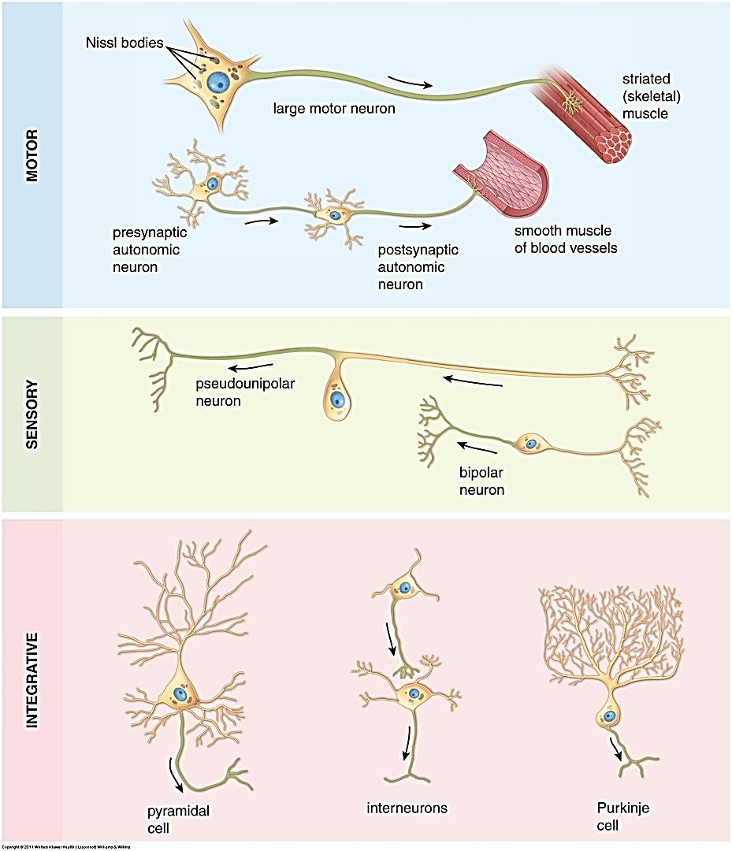
Organization of the nervous system
Illustrations of some neurons. Note the cell body, dendrites, axon. Also, recall that glial cells are support cells that are found throughout the nervous system.

Slide 3
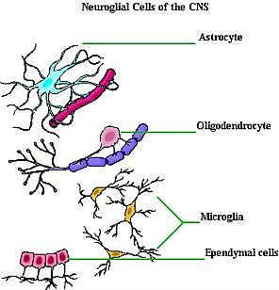
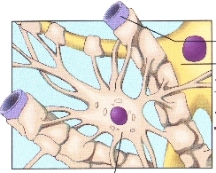
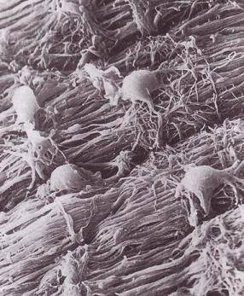
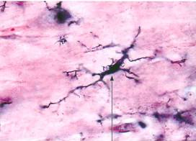

Slide 4
Cross section of spinal cord and meningies

Slide 5
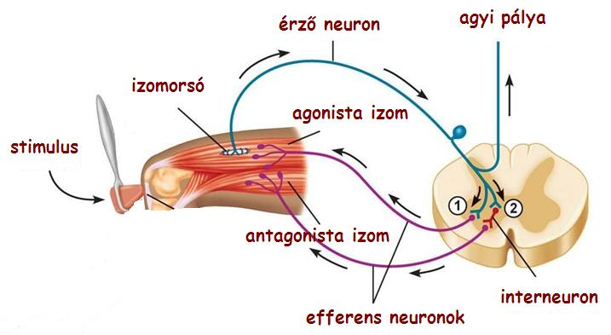
Fibers and cells in the spinal cord
Afferent fiber - sensory
Ascending pathway
Efferent fiber - motor

Slide 6
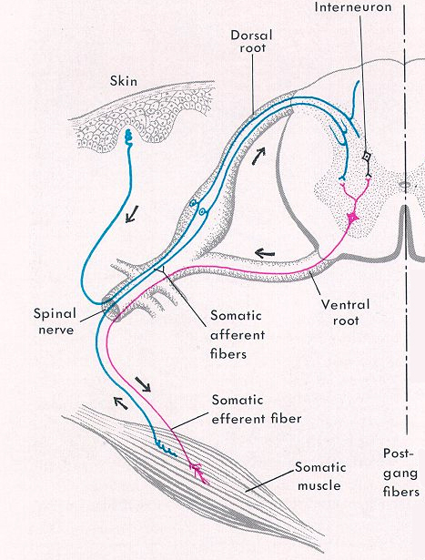
0
This slide only shows a few cells – obviously in real tissue, there are many cells or cell processes in each region.

Slide 7
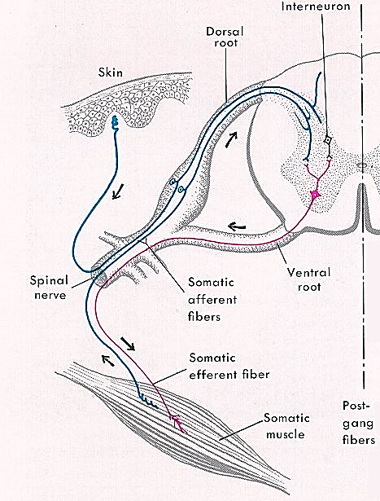
0
SPINAL CORD
The spinal cord has two major regions:
--gray matter, which has neuronal cell bodies
--white matter, which has axons and long dendrites

Slide 8
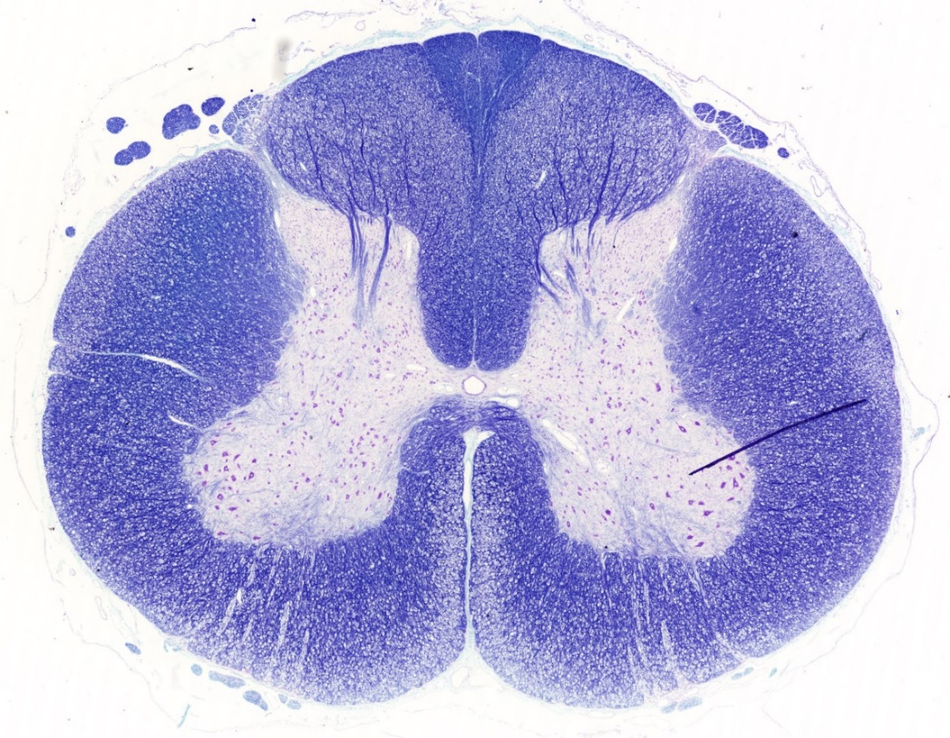
Gray matter
Posterior horn and afferent fibers
Pia mater and arachnoid
Anterior horn
Central canal lined by ependymal cels

Slide 9
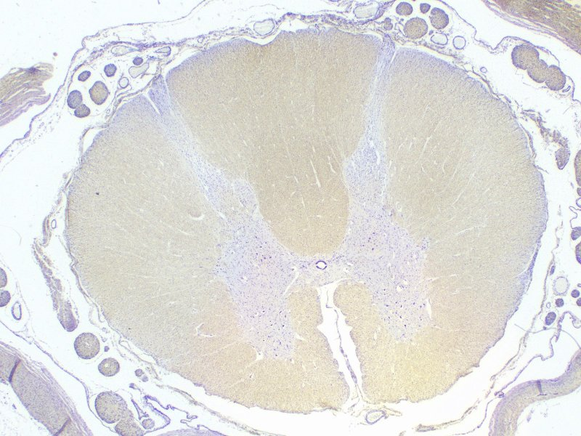
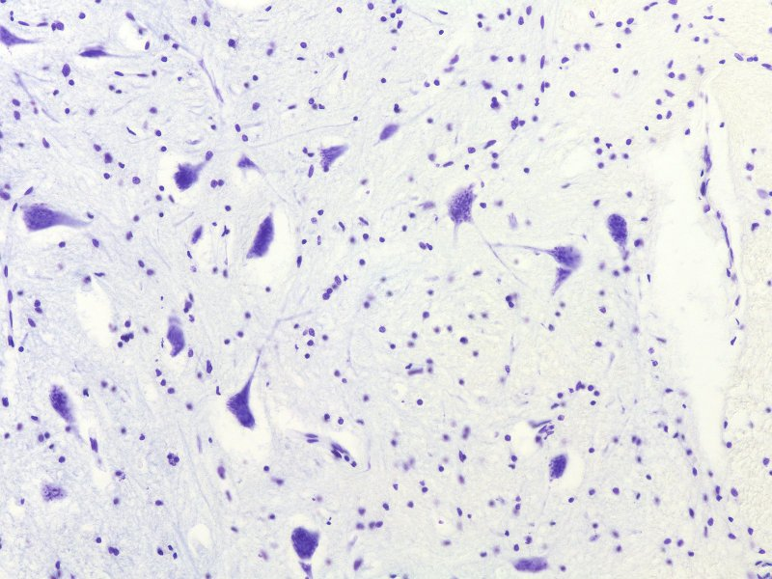
SPINAL CORD – Gray matter
This view shows several multipolar motorneuron cell bodies (black arrows).
(The smaller, round nuclei (red arrows) are associated with oligodendrocytes, non-neuronal cells. Advance for a higher power view….

Slide 10
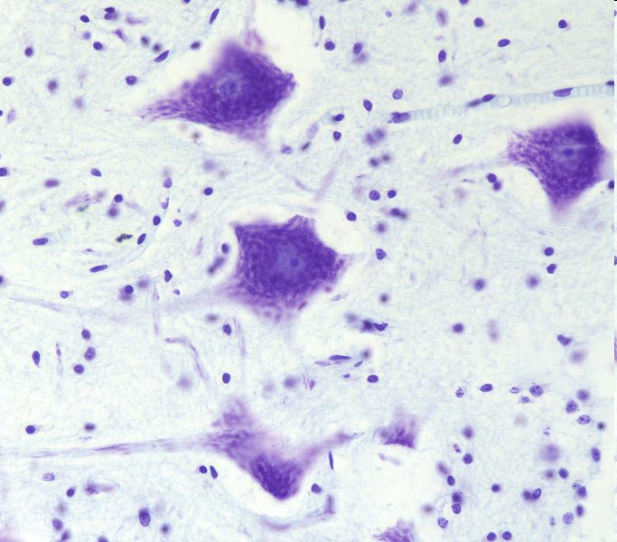
SPINAL CORD – high power view of gray matter
The nucleus of a neuron is large and round, with a prominent nucleolus (yellow arrow), and abundant euchromatin (pale area surrounding nucleolus). The black arrows delimit the nucleus.
The cytoplasm in the cell body, or perikaryon, is rich in clusters of rough endoplasmic reticulum, which in neurons are termed Nissl substance or Nissl bodies (the blue/purple flaky material).
Dendrites (green arrows) contain Nissl substance, while axons (next slide) can be recognized because they lack Nissl substance.
The small, condensed nuclei (red arrows) belong to glial cell. Their cytoplasm is either not visible or barely visible.

Slide 11
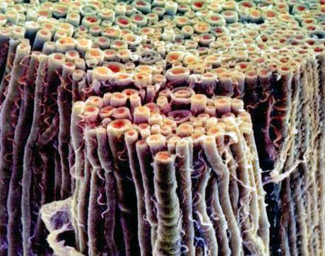
SPINAL CORD – white matter
0
The white matter of the spinal cord (e.g. blue box) contains myelinated axons (and some dendrites) that are sending information up and down the central nervous system.
Because the fibers are oriented cranial-caudal, they are cut in cross-section in our sections of the spinal cord.

Slide 12
White matter
Posterior funiculus
(sensory pathways)
Lateral funiculus
(sensory and
motor pathways)
Posterior funiculus
(sensory and
motor pathways)
Efferent fibers

Slide 13
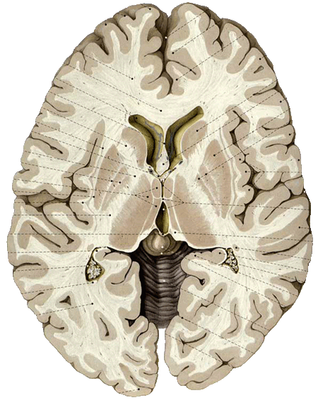
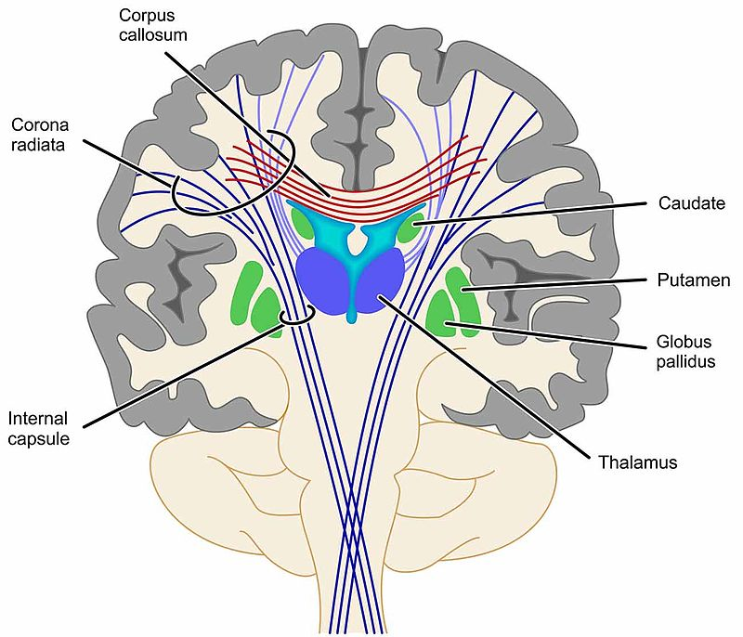
cerebrum
Gray matter(cortex and basaliganglia):
neuronal cell bodies and glial cells
White matter:
Pathways (axons)

Slide 14
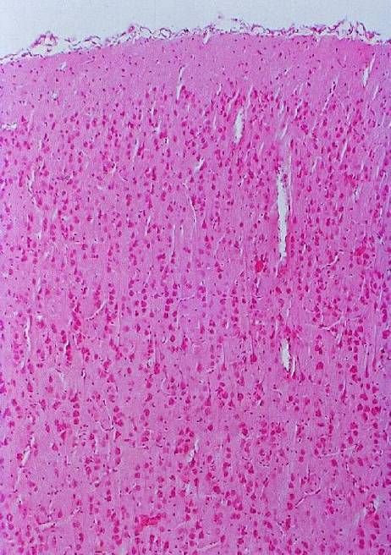
Cortex cerebri
The cells form layers due to the size and shape of the neurons.
90% of the human cortex consists of six layers .

Slide 15
Cortex cerebri
pia mater on the surface
Molecular layer- Fibers, few cells
(2) External granular layer-small stellate and pyramidal cells
(3) External pyramidal layer – small pyramidal cell
(4) Internal granular layer- small cells
(5) Internal pyramidal layer – big pyramidal cells
(6) Multiform layer
Cortex

Slide 16
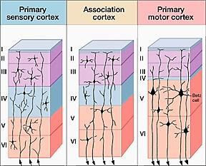
Sensory cortex Motor cortex
Afferent fibers efferent fibers

Slide 17
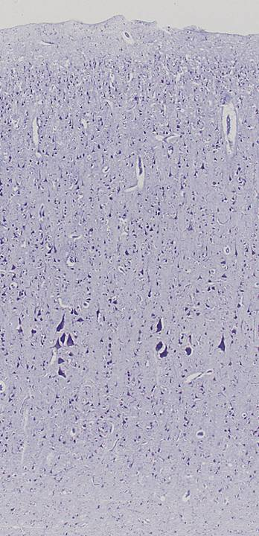
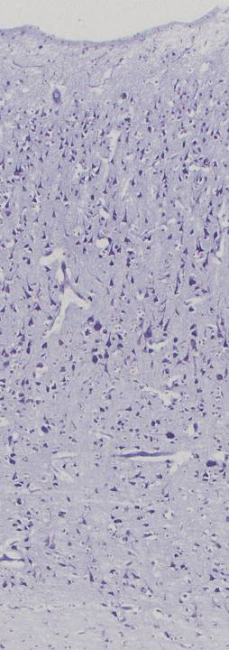
Cerebral cortex
Sensory cortex
Motor cortex
In the fifth layer of the motor cortex there are the biggest pyramidal cells : Betz cells
Medulla, white matter

Slide 18
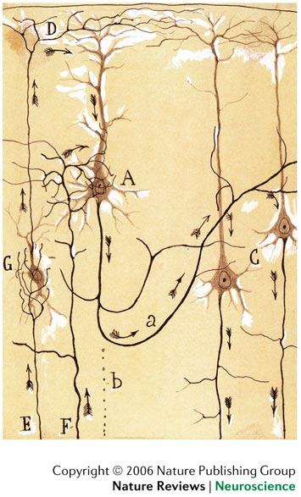
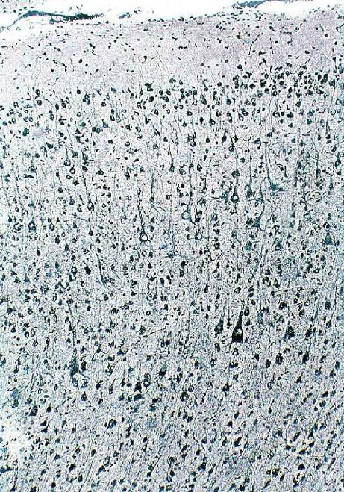
Cerebral cortex : pyramidal cell

Slide 19
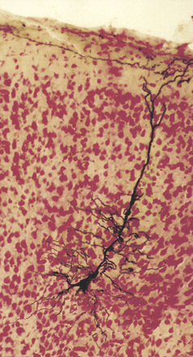
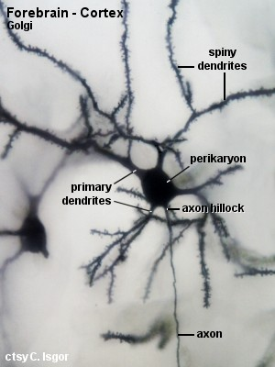
Pyramidal cell
Multipolar neuron

Slide 20
The eyebulb has three layers
Outer Coat or
the Fibrous Layer
Cornea
Sclera
Middle Coat or
the Vascular Layer
Choroid
Ciliary Body
Iris
Inner Coat or
the Inner Layer
Retina with two parts

Slide 21
Structure of eyebulb
outer tunic
middle tunic
Schlemm's-
canal
inner tunic
suspensory
anterior chamber
ligaments of lens
lens
pupila
fovea centralis
visual axis
cornea
iris
optic nerve
vitreous
body
posterior chamber
retina
ciliary body
choroid
sclera
external muscle

Slide 22
Iridocorneal junction
epithelium
of cornea
cornea
Schlemm's
canal
dilatator
pupillae
sphincter
iridocorneal
pupillae
angle
bulbar
iris
conjunctiva
sclera
lens
ciliary body

Slide 23
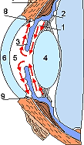
Iridocorneal angle
ciliary processes that secrete aqueous humor
that fills the posterior and
anterior chambers.
Schlemm- canal: absorption of the aqueous humor

Slide 24
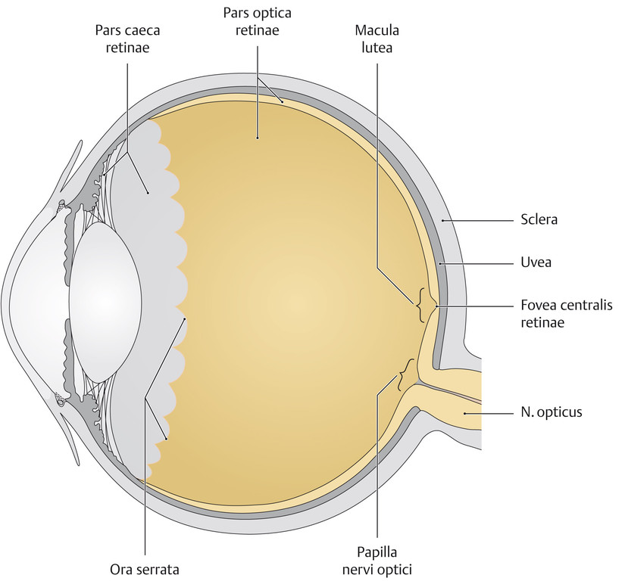
Sensitive and non-sensitive retina and the ora serrata

Slide 25
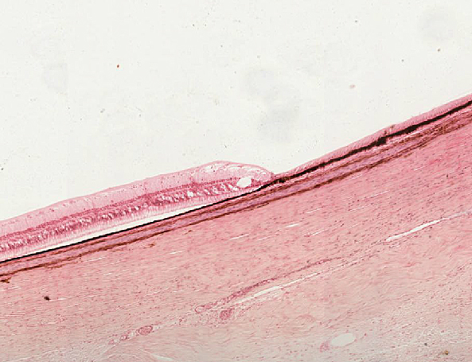
Ora serrata
sclera
choroid
Non sensitive retina sensitive retina

Slide 26
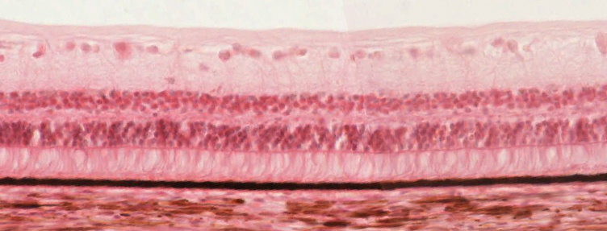
Photosensitive retina
10 layers, light passes through them
Fixed only at ora serrata and at optic nerve
choroid

Slide 27
The Optic part of the Retina: 10 Layers
choroid
pigmented epithelium
cones and rods
ext. limiting membrane
external nuclear layer
external synaptic layer
internal nuclear layer
internal synaptic layer
ganglion cell layer
optic nerve fibres
int. limiting membrane
vitreous body

Slide 28
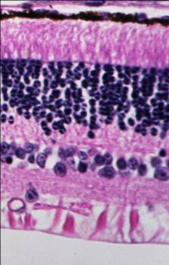
The layers:
pigment epithelium
rods and cones
outer limiting membrane
outer nuclear layer
outer plexiform layer
inner nuclear layer
inner plexiform layer
ganglion cell layer
nerve fiber layer
inner limiting membrane

Slide 29
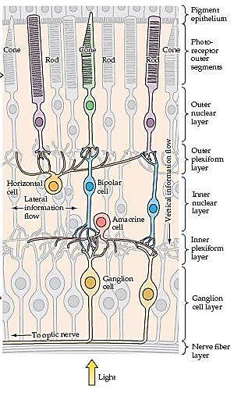
Sensitive retina: main cells
choroid
FOTORECEPTORS (I)
BIPOLAR CELLS (II)
GANGLION CELLS (III)
Optic fiber layer
Vitreous body
PERCEPTIONT
LIGHT

Slide 30
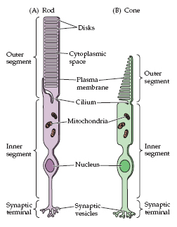
Light Perception: Photoreceptors
Daylight vision
(photopic)
Excellent spatial and temporal resolution
Night vision
(scotopic)
Poor spatial and temporal resolution

Slide 31
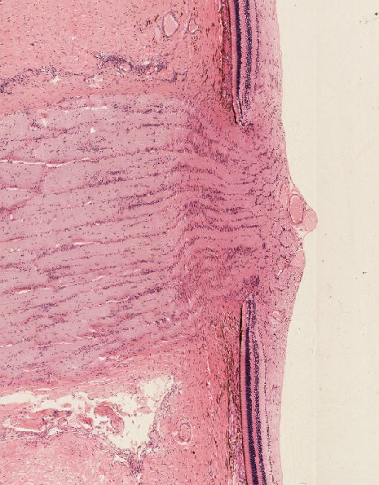
Exceptions
optic disc
This area does not
contain photoreceptors and thus
is insensitive to light (i.e., the "blind spot").

Slide 32
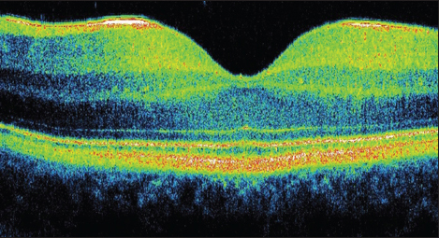
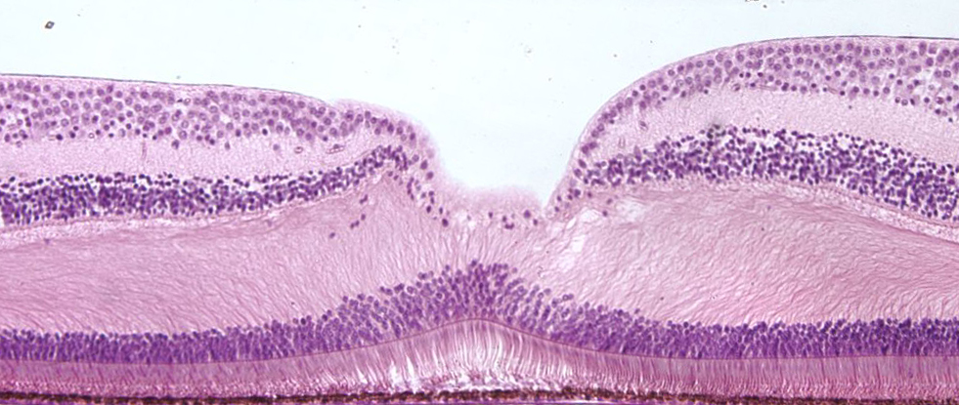
Exceptions
fovea centralis
(cones only - sharp vision area)

Slide 33
Structures to identify

Slide 34
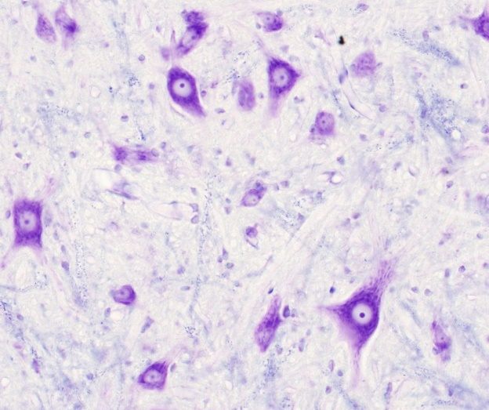
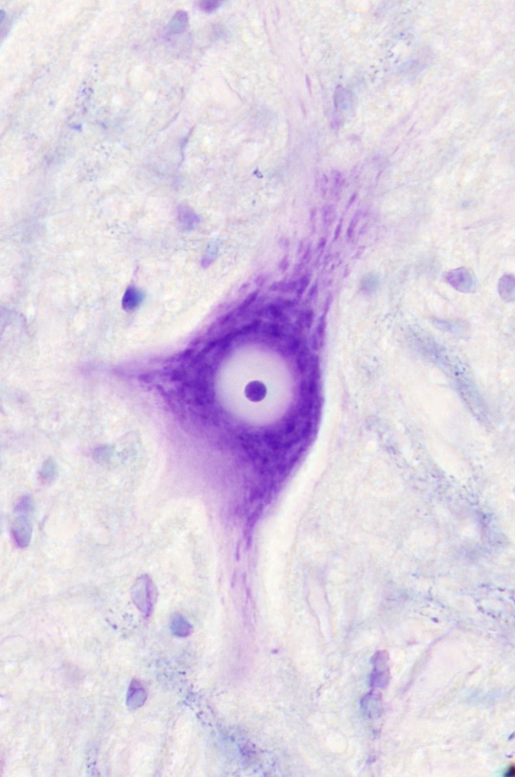
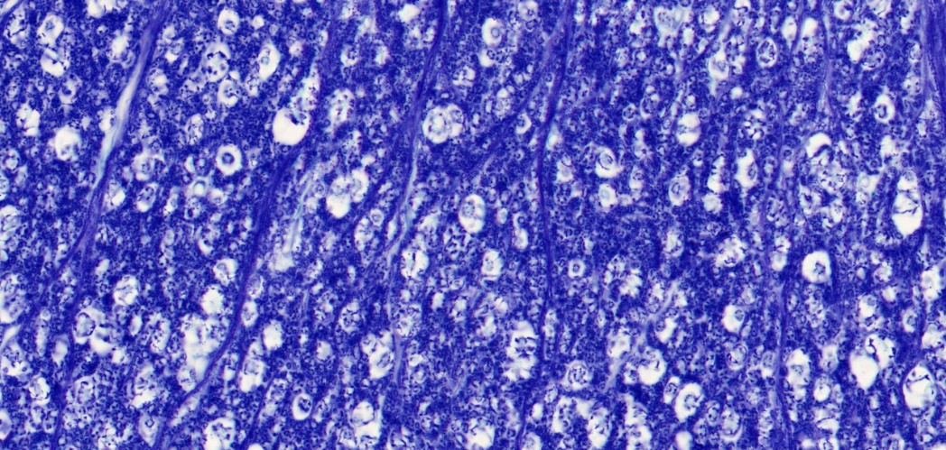
101. spinal cord
Gray matter
multipolar neuron
(alfa-motoneuron)
White matter
Nissl-substance
perykarion
nucleus
(nucleolus)
axon
(axon hillock)
dendrite
Myelin -sheeth

Slide 35
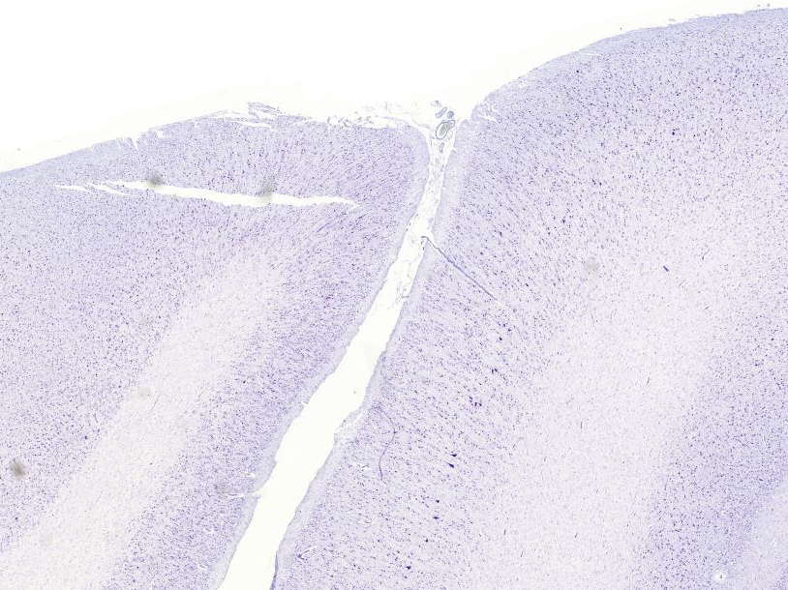
22.Cortex cerebri
Gary and white matter
sensory cortex
motor cortex
Betz cells
in the inner pyramidal layer

Slide 36
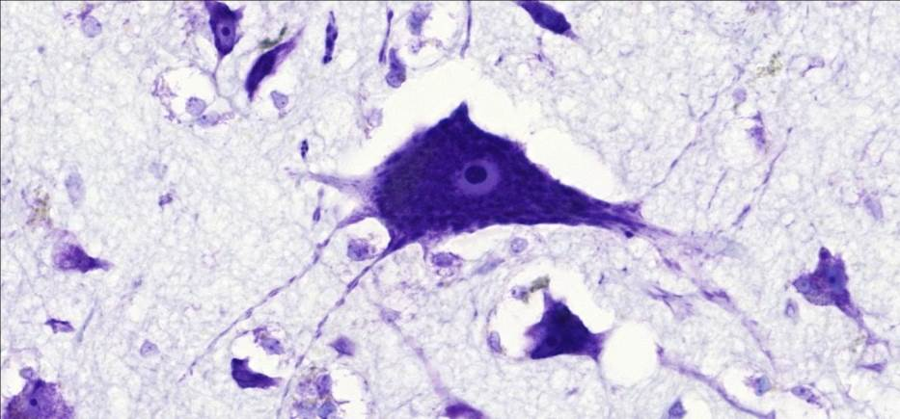
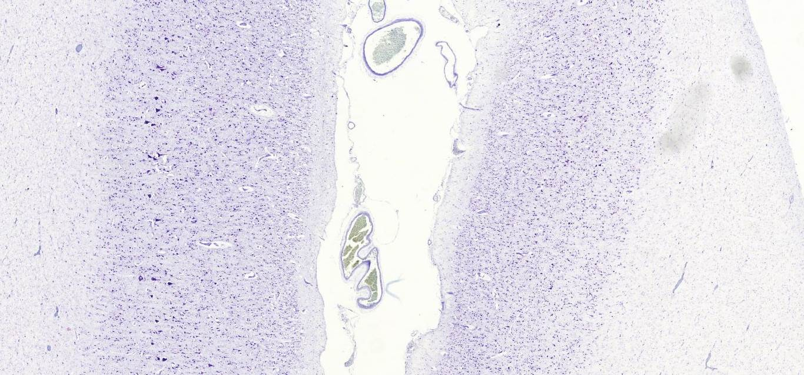
22. Cortex cerebri
pyramidal cell
Motor cortex Sensory cortex

Slide 37
29. Eye– HE
Cornea
Iris
lens
Vitreous body
sclera
Optic disc
Optic nerve

Slide 38
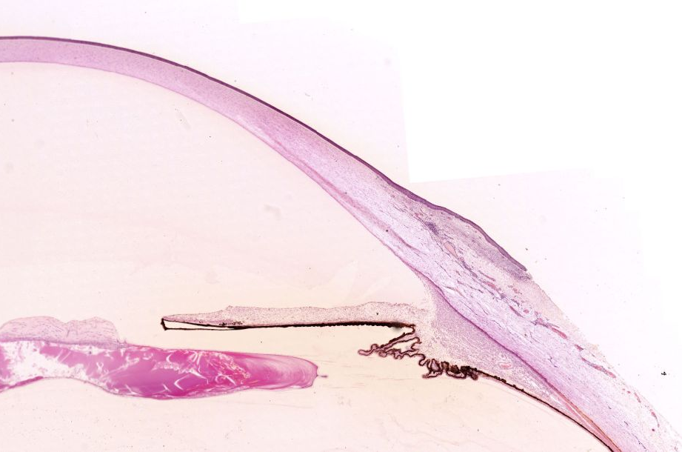
Cornea
Anterior chamber
Iridocorneal junction
iris
Posterior chamber
Ciliary body
Lens
Ciliary processes
sclera
Vitreous body

Slide 39
Sclera
Choroid
Pigment epithelium
Rods and cones
outer nuclear layer
Inner nuclear layer
Ganglion cell layer
perception
light

Slide 40
