Slide 1
Genital organs histology
Faculty of Pharmacy
10th week Histology practice
Department of Anatomy, Histology and Embriology

Slide 2
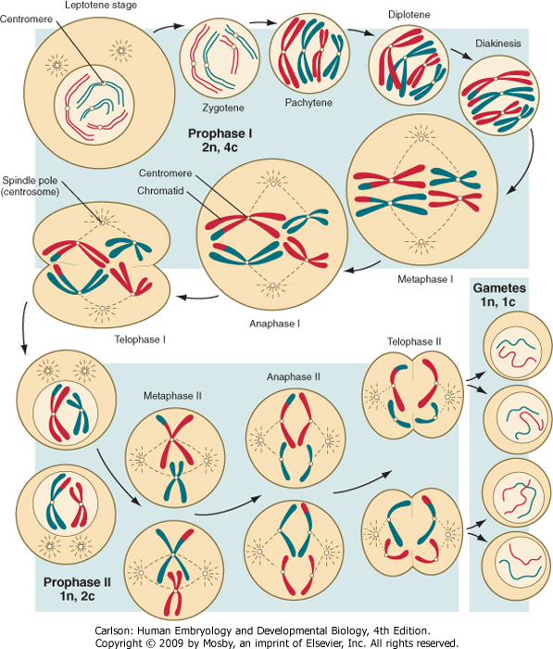
Meiosis

Slide 3
Female genital organs

Slide 4
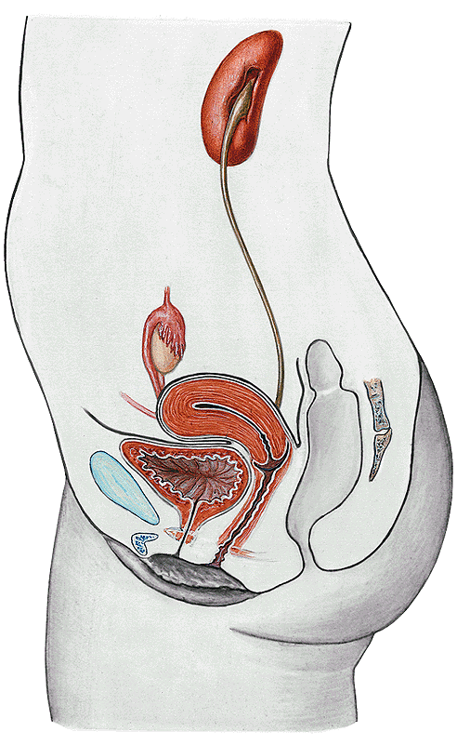
FEMALE GENITAL ORGANS - Organa genitalia feminina
Tuba uterina
Uterus
Ovarium
Vagina
Clitoris
Vestibulum
Labium major
Labium minor

Slide 5
About 7 million primary oocytes are present in the fetal ovary by midgestation
Due to gradual loss of oocytes at birth app. 400 000 oocytes remain
Only 400 follicles ovulate after puberty till the menopausa
Primordial
Primary
Secundary
Tertiary
Graafian follicle
tercier folliculus
secunder folliculus
Primordial follicle
oogonium
corpus albicans

Slide 6
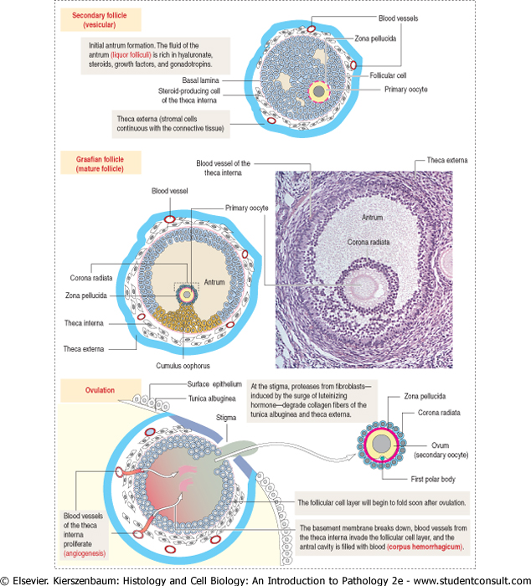
Tertiary follicle
Tertiary follicle: small cavities appear
Primary oocyte,
100-120 mikron
Theca folliculi
Graafian follicle :20mm
Primary oocyte
Antrum folliculi (liquor folliculi)
Cumulus oophorus
Mural cell layer
Theca interna : cells and capillaries
Theca externa: fibrous c.t.
ovulation
Corpus haemorrhagicum

Slide 7
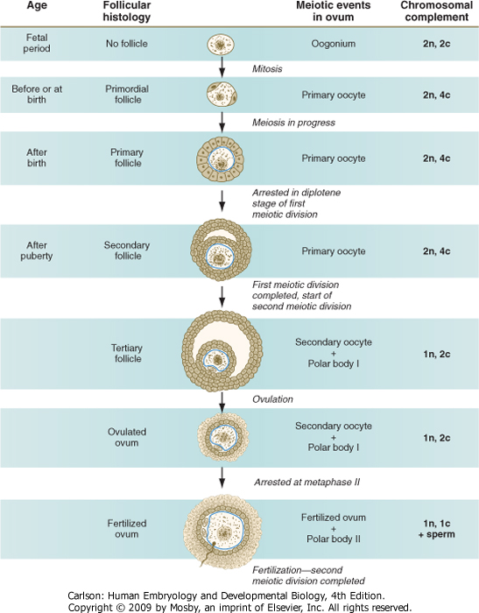
Oogenesis

Slide 8
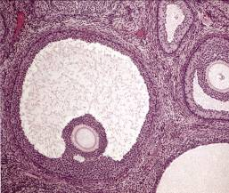
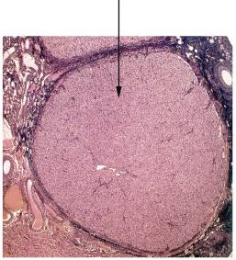
tercier follikulus
stroma
(„csírahám”)
corpus luteum
primer
follikulus
zona
pellucida
secunder
follikulus
primer
oocyta
theca
follikuli
atretizáló
follikulusok

Slide 9
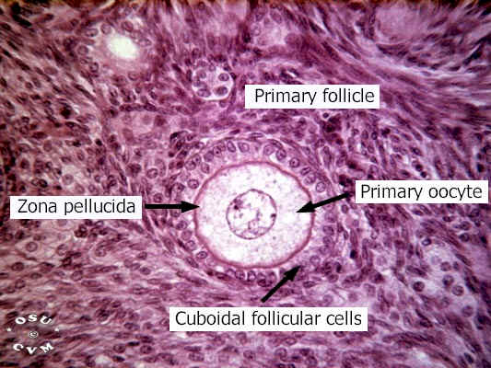
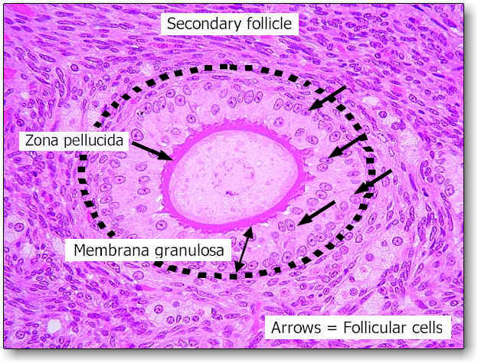

Slide 10
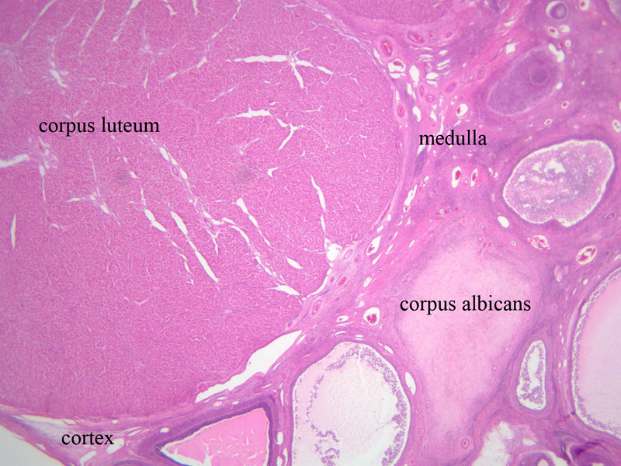

Slide 11
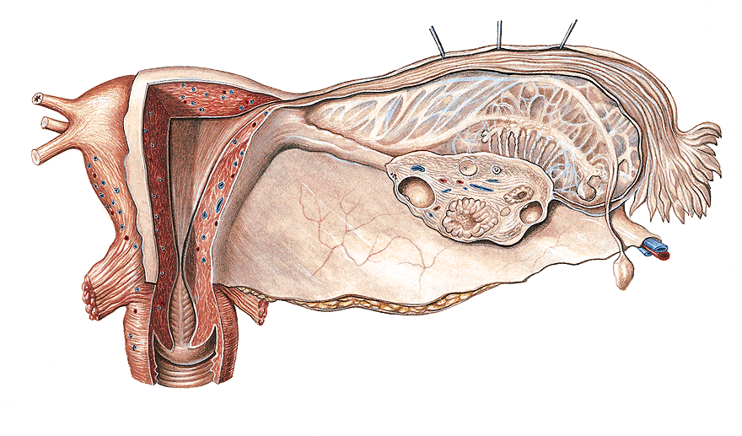
Uterine tube (Fallopian tube)
Isthmus
Ampulla
Intramural part
Infundibulum
Mesosalpynx
Oviduct is the site of fertilization

Slide 12
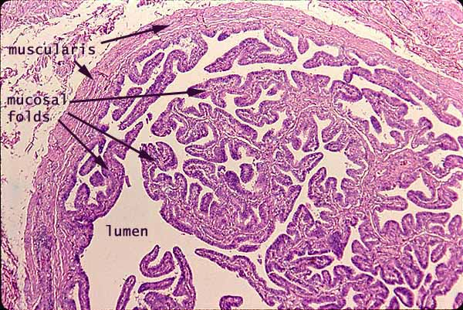
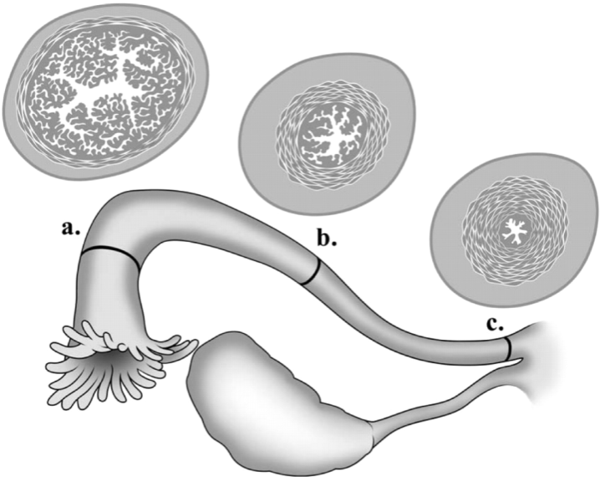
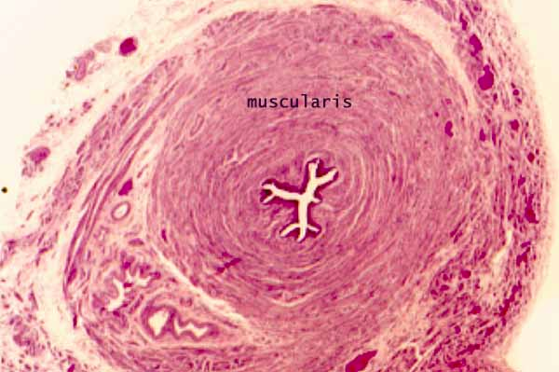
ampulla
isthmus
tunica mucosa folded with
ciliated and secretory columnar cells
NO muscularis mucosae and submucosa
Inner circular, outer longitudinal muscular layer
tunica serosa

Slide 13
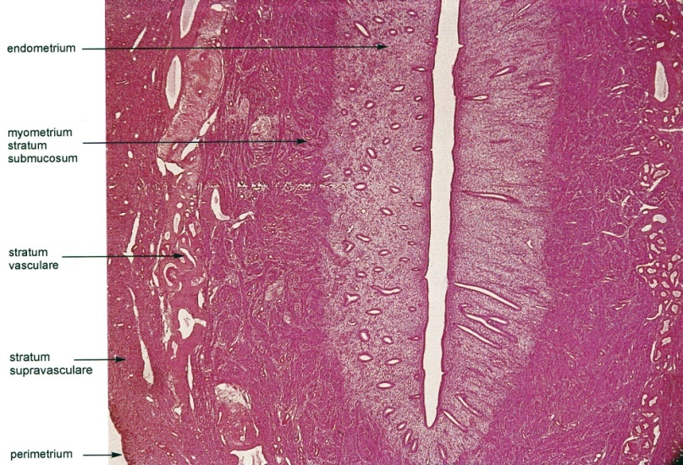
Uterus
Corpus cross section

Slide 14
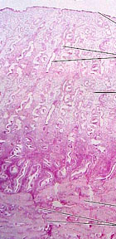
Endometrium
Stratum functionale
epithelium (columnar cells)
tubular glands
spiral arteries!
lamina propria,spinocellular conn. t.
(decidual transformation)
desquamated during the menstruation
Stratum compactum
Stratum spogiosum
Stratum basale
-deep layer of lamina propria with the buttom of the glands
- straight arteries supply
- is not lost after menstruation
- act in formation of the new str. functionale
endometrium
myometrium

Slide 15
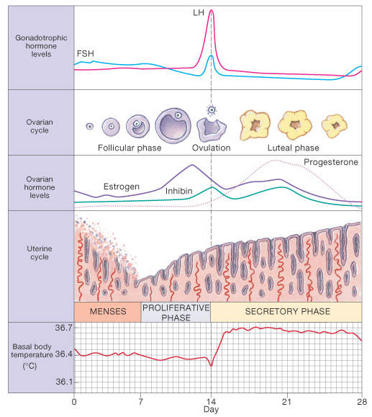
Ovarian cycle
Follicular phase
FSH stimulates the maturation of follicle
Granulosa cells proliferate and produce estrogen
Granulosa cells acquire LH receptors
Ovulation
A surge in LH secretion induces ovulation
Luteal phase
Luteinization of granulosa and theca inrterna cells
Synthesis of estrogen and progesteron
Endometrium become thicker (2-3mm)
Lack of fertilization
Menses: functional layer deteches and sheds into the uterine cavity

Slide 16
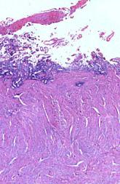
Uterine cycle: changes in the endometrium 1
Menstrual phase
1-5 day
Functional layer deteches

Slide 17
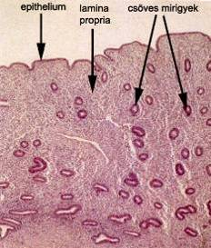
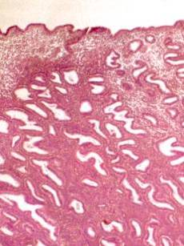
Uterine cycle: changes in the endometrium 2
Proliferative phase
6. – 14. day
Regeneration of the functional layer
early, late

Slide 18
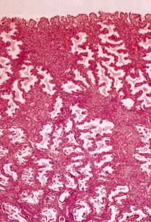
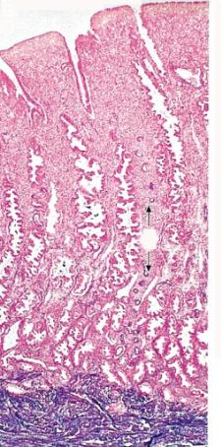
Uterine cycle: changes in the endometrium 3
Secretory phase
15. -28. day
Glands have a saw-toothed appereance
The stromal cells undergo decidual transformation

Slide 19
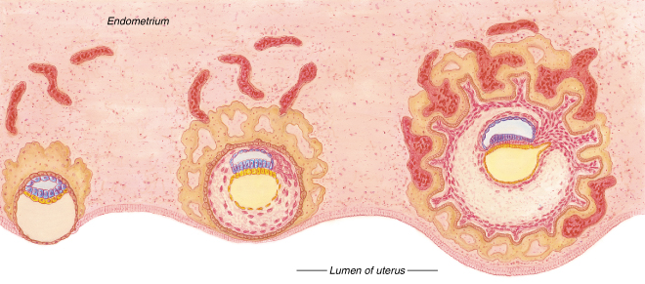
In case of fertilization
Implantation on the 6. day, blastocyst
Secretory phase continues
Starts the formation of placenta – about 10-12 days necessary till it can function
7.5 nap
9 nap
16 nap

Slide 20
Lack of fertilization…
No implantation
Stratum functionale desquamate

Slide 21
Vagina
Labium majus and labium minus

Slide 22
Male genital organs

Slide 23
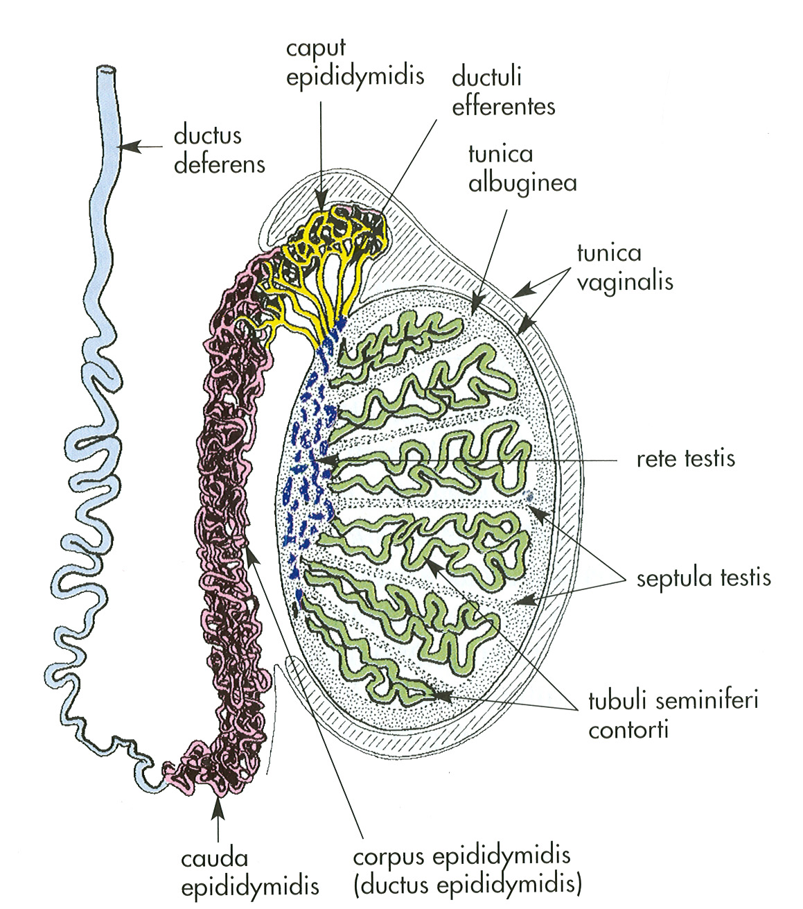
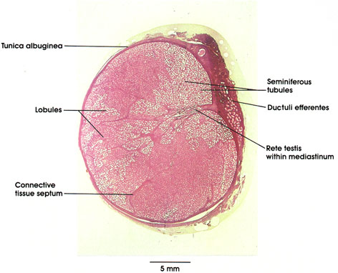
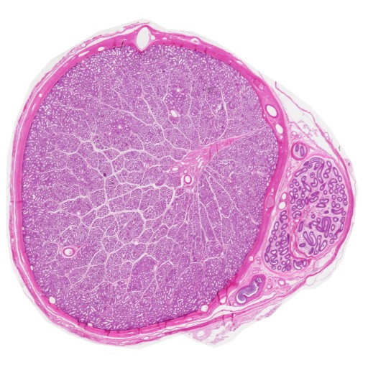
TESTIS
lobules (~200-300):
1.parenchym:
tubuli seminiferi cont. et recti:
30-60 cm lenght
2. interstitium: conn. t., Leydig c.
mediastinum:
rete testis

Slide 24
Meiosis
1: 2n 4c
2: 1n 2c
4: 1n 1c

Slide 25
Spermatogenesis
Spermiocytogenesis
Spermatozoon
Spermatid
Secondary spermatocyte
Primary spermatocyte
Sertoli sejt
Tight junctions (zonula occludens)
Blood-testis barrier
Spermatogonium
Myoid cell
Leydig cell

Slide 26
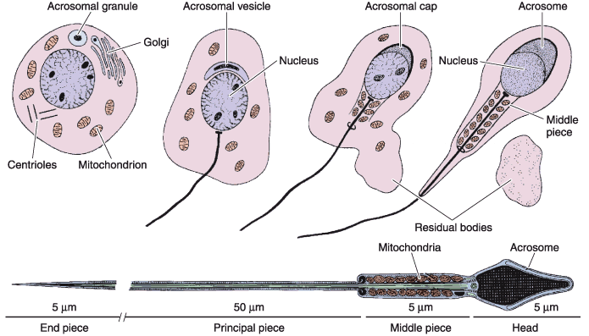
Spermiocytogenesis

Slide 27
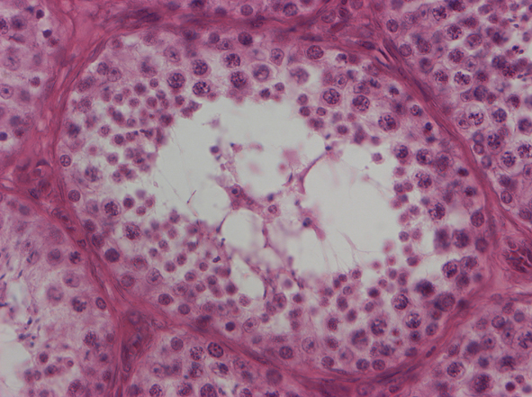
Primary spermatocytes
Spermatids
Spermatogonia
Sertoli cell

Slide 28
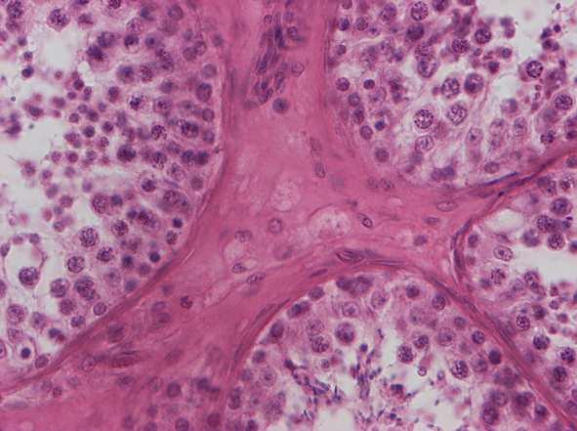
Leydig cells
Myoid cells

Slide 29
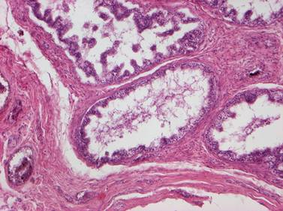
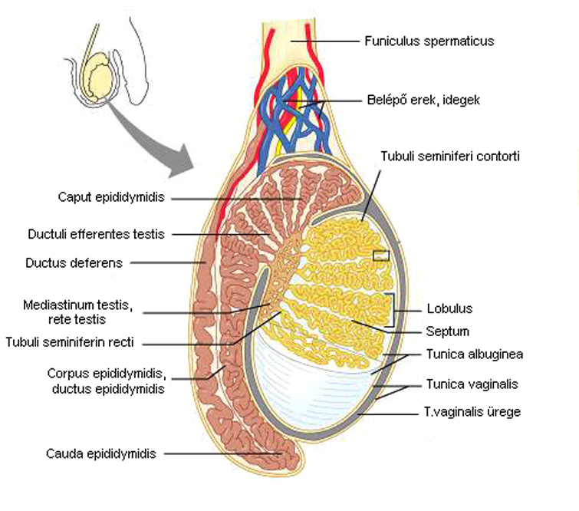
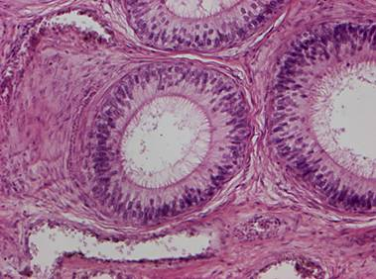
Epididymis

Slide 30
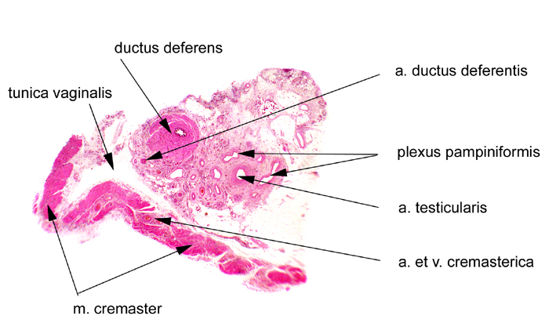

Slide 31
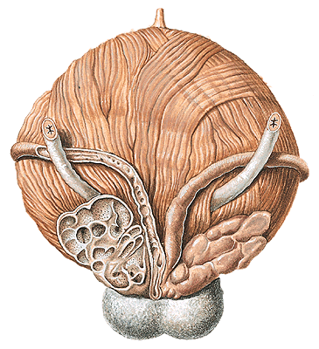
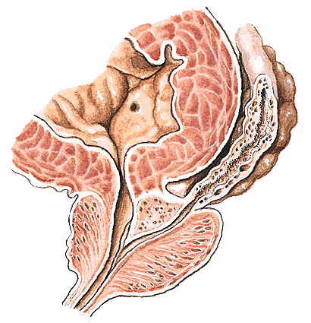
Seminal vesicle and prostate
section
ampulla
ductus deferentis
bladder
vesicula seminalis
ductus ejaculatorius
posterior v.
prostate
urethra

Slide 32
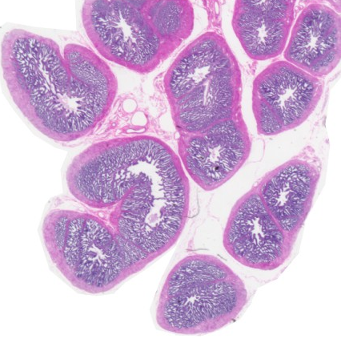
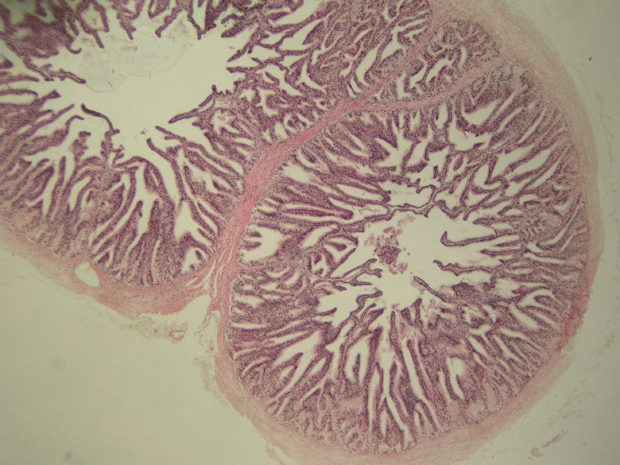
T. mucosa:
Simple columnar epithelium
Primary, secondary and tertiary folds
Labyrinth-like appearance
T. muscularis:
Thick muscular layers, inner and outer
T. adventitia

Slide 33
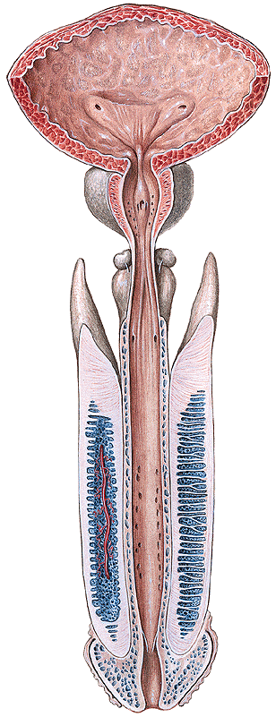
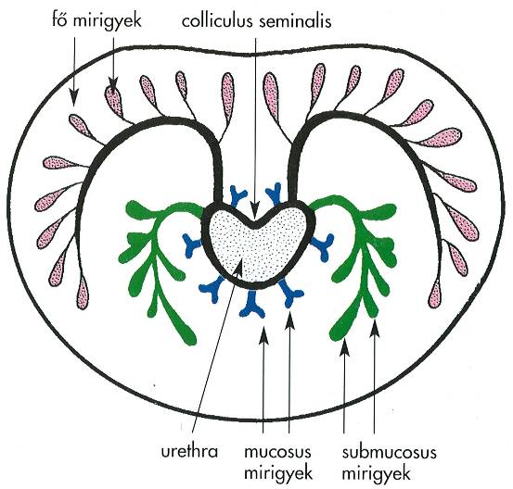
Prostate
4 x2 x3 cm
maroon-shaped
T. mucosa
urothel / stratified columnar e.
stroma:
smooth muscle
fibroelastic. conn. tissue
glands:
mucosal
submucosal
main

Slide 34
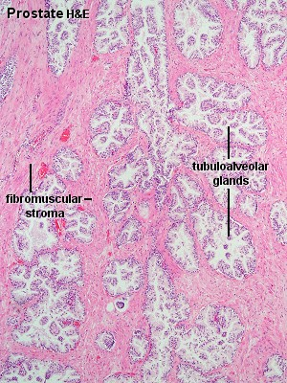
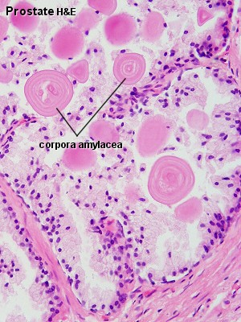
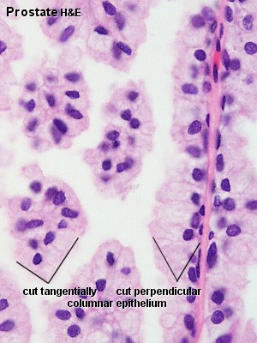
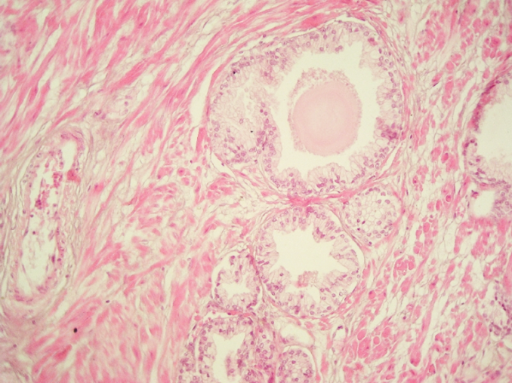
30-50 tubulo-alveolar gland
Squamose, cuboidal, columnar or pseudostratified ep.
Fibroelastic connective tissue
Prostatic concretions (corpora amylacea
calcified glycoprotein)

Slide 35
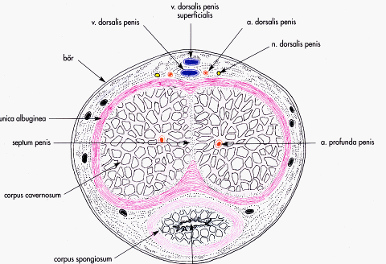
Cross section of penis
Thin skin without fat
(tunica dartos)
fascia penis
spf and deep veins
paired arteries and nerves
tunica albuginea, septum penis
trabeculae , sinuses:
(fibroelastic trabeculae
lined by endothelial cells)

Slide 36
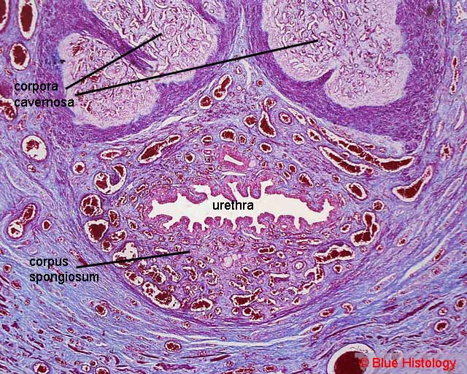
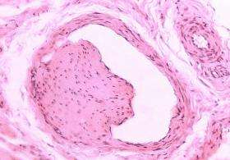
Ebner-cushions in the wall of the vessels and sinuses
controlling blood flow

Slide 37
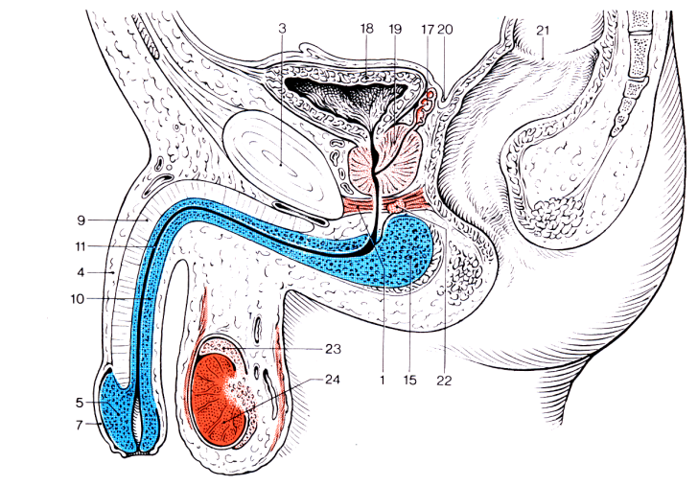
Male urethra
FÉRFI URETHRA
20-25 cm length
ostium urethrae internum – sphincter vesicae (smooth m.)
pars prostatica:
colliculus seminalis
pars membranacea – sphincter urethrae
(striated m.)
pars spongiosa
ostium urethrae externum

Slide 38
Structures to identify

Slide 39
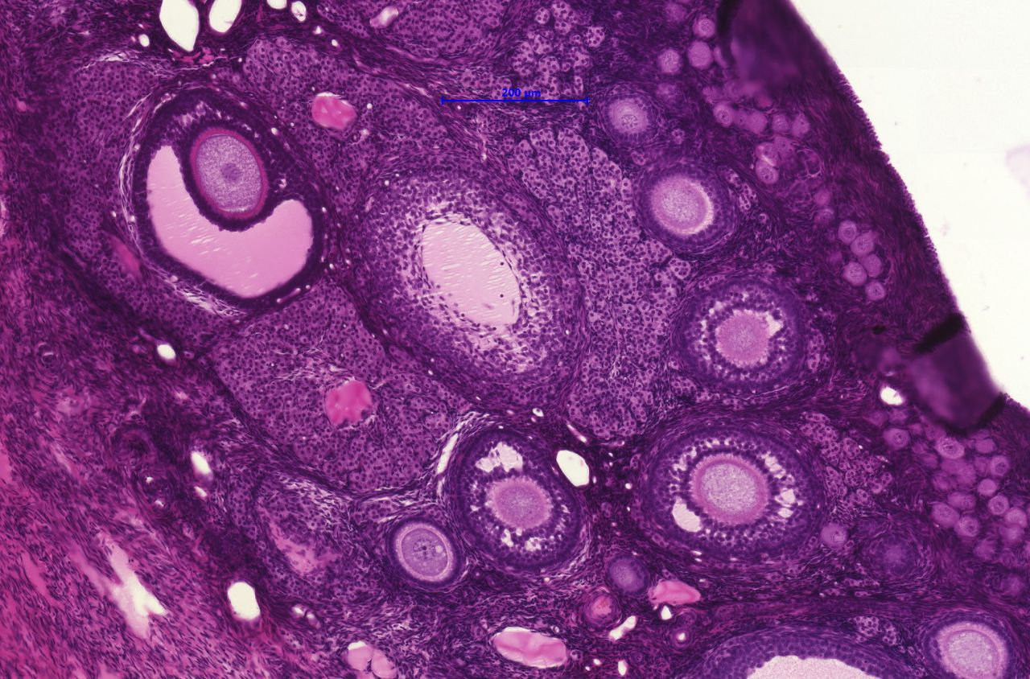
82. Ovary (HE)
oocyte
Graafian follicle
corpus luteum

Slide 40
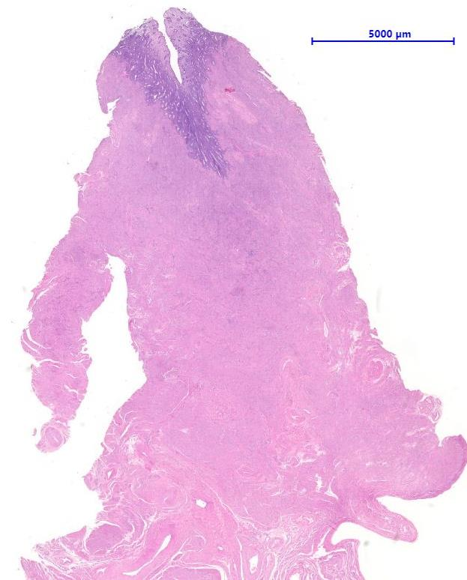
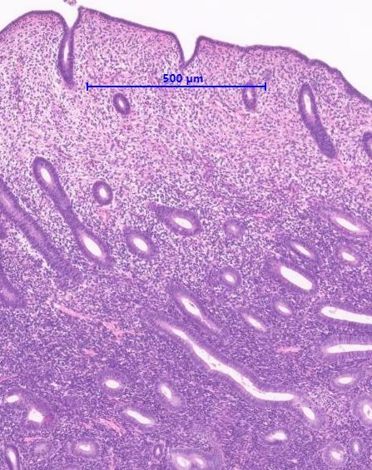
84. Uterus (HE)
endometrium
glands
myometrium
spinocellular connective tissue

Slide 41
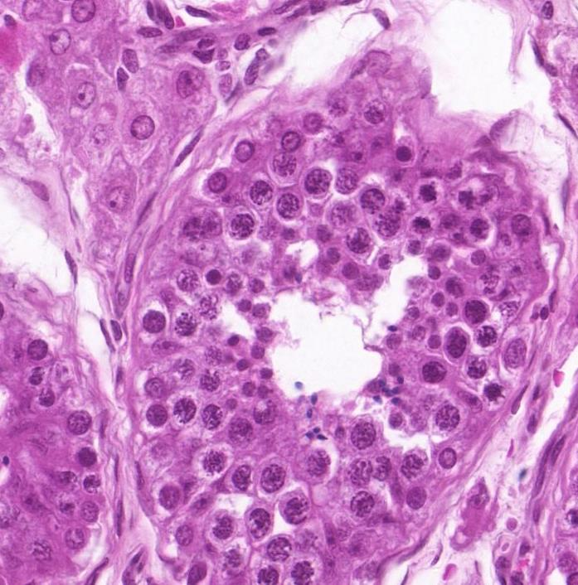
78. Testis (HE)
Leydig cell
artéria
spermatozoa
tubulus seminiferus contortus
spermatid
spermatocyte (primary)
spermatogonium

Slide 42
81. Prostate (HE)
smooth muscle
urethra
glands

