Slide 1
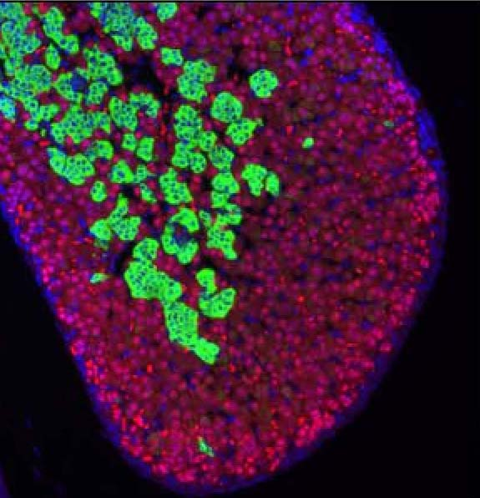
Entwicklung der Nebennieren
Medizinische Embryologie II
2019/2020Frühlingssemester
Attila Magyar
16.04.2020
Notes:
Huang, BMC Dev Biol 2010

Slide 2
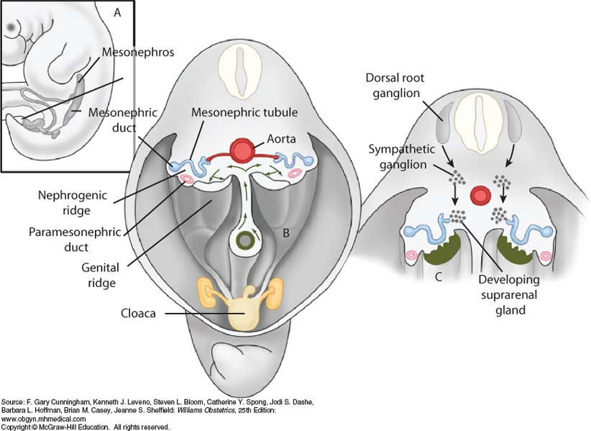
The adrenals develops from the urogenital ridge, on the medial and cranial part of the later mesonephric fold

Slide 3
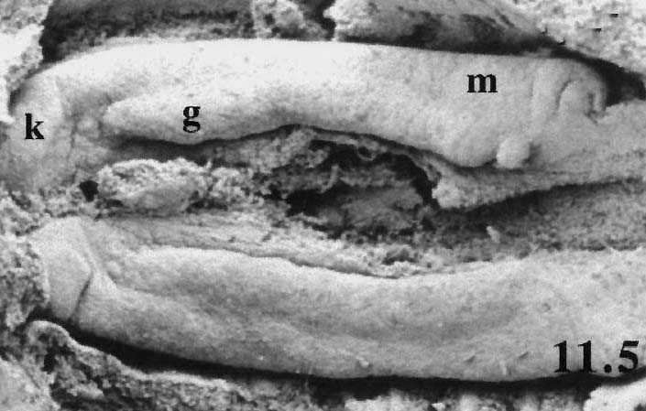
cranial
Mesonephric (m) and gonadal (g) ridge from a mouse embryo (SEM, ed11,5). Rest of mesentery is shown by the red arrow.
Notes:
Capel, MOD, 2000

Slide 4
Timetable
intermedier mesoderm + coelomepithel
ED 17-18
urogenital ridge
ED 24-25
adrenogonadal primordium
(gonadal ridge)
kidneys
(mesonephric ridge, metanephric blastem)
ED 28-30
adrenal
primordium
gonadal
primordium
ED 33-35
Early development of the adrenal gland
medial
lateral

Slide 5
Adrenal primordium
First time it appears at the cranial and medial part of the gonadal ridge
Adrenal gland has the most complex development: its cells derive from
1. the coelomic epithel (cortex)
2. the intermediate mesoderm (cortex)
3. the mesonephric nephrons (capsule)
4. neural crest cells (medulla)
At first the coelomic epithel cells migrate out of the epithel, and then they intermingle with mesodermal cells making cell clump: adrenal primordium, adrenal anlage: about ED33-35

Slide 6
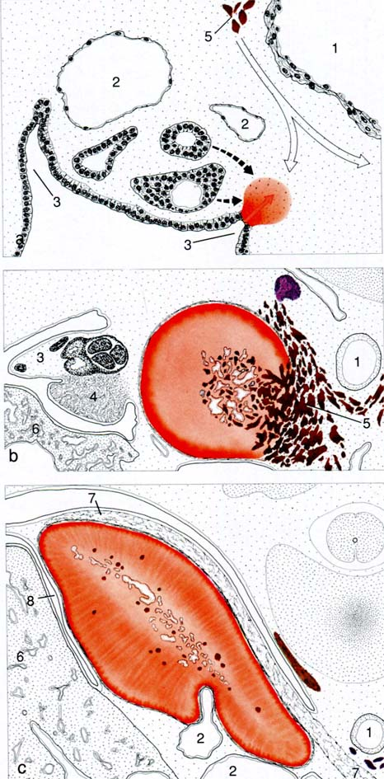
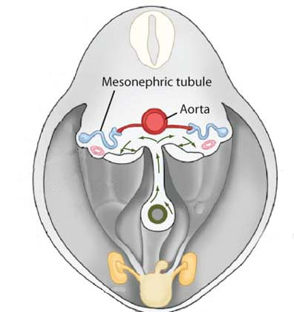
Adrenal gland development in human
at ED33 (a)
at ED44 (b)
at EW13 (c)
1: aorta
2: postcardinal (l) and subcardinal (m) veins (in a) or suprarenal (l) and inferior cava veins (m; in c)
3: mesonephric fold
4: gonad
5: sympathicoblasten
6:liver
7: diaphragm
8: coelom
orange: adrenal anlage
brown: neural crest
Notes:
Hinrichsen Humanembryologie, 1990

Slide 7
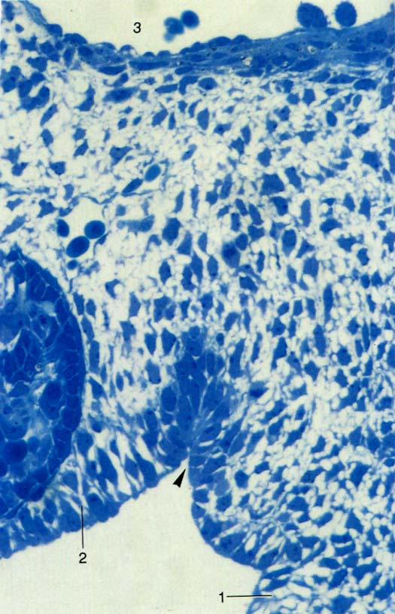
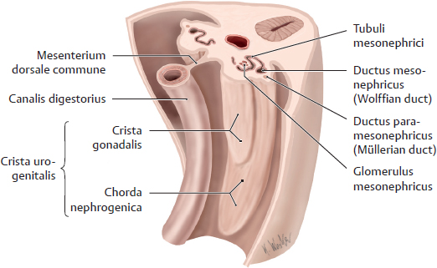
aorta
Human embryo; shortly before ED33:
local thickening of the coelomic epithelium of the adreno-gonadal ridge, migration of these cells out of the epithelial sheet
in the following days: cell migration to the cranial pole of the mesonephros, forming the adrenal blastem (primordium)
mesonephric nephron
mesonephric ridge
root of mesentery
Notes:
Hinrichsen Humanembryologie, 1990

Slide 8
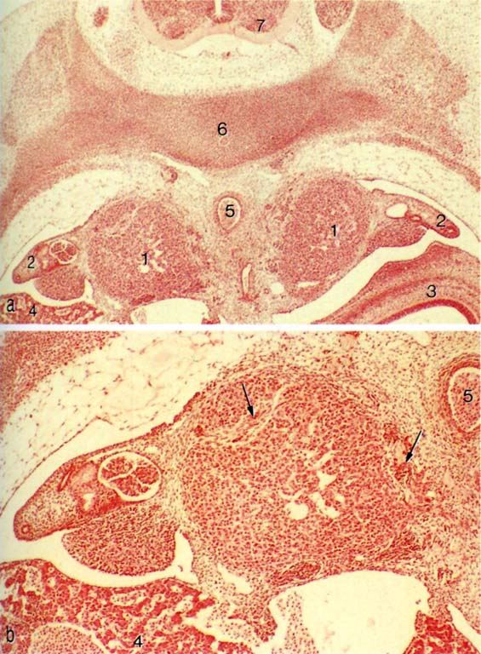
Adrenal primordium of a human embryo; ED 44
1: adrenal primordium
2: mesonephros and mesonephric duct
3: stomach
4: liver
5: aorta
6: vertebral anlage
7: spinal cord
8: gonad
b: higher magnification of a
arrows in b: nerv fibers (left) and sympathicoblasts (right)
Neural crest cells migrate in this primordium (EW5-6).
8
Notes:
Hinrichsen Humanembryologie, 1990

Slide 9
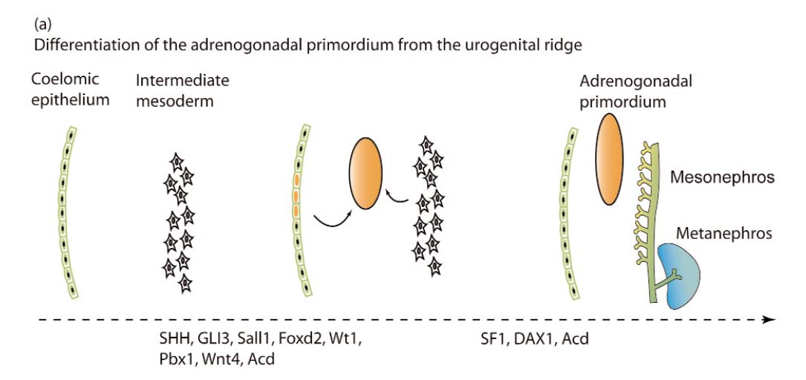
Notes:
Malendowicz Fol Histochem Cytobiol 2010

Slide 10
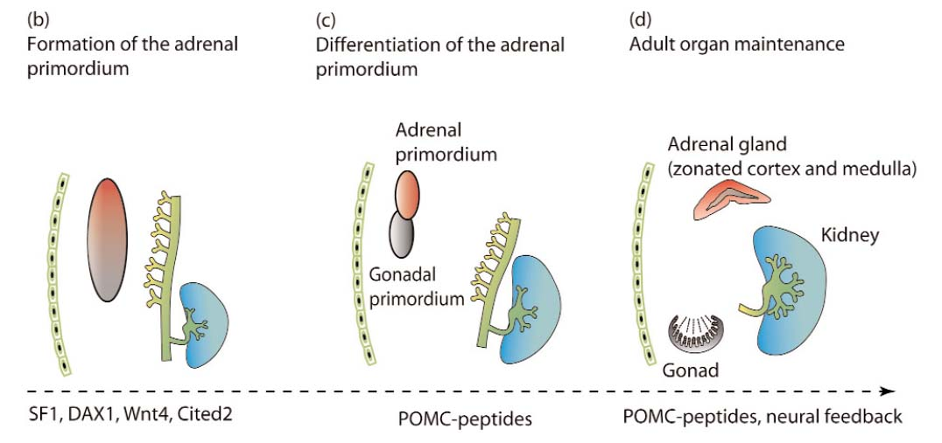
Notes:
Malendowicz Fol Histochem Cytobiol 2010

Slide 11
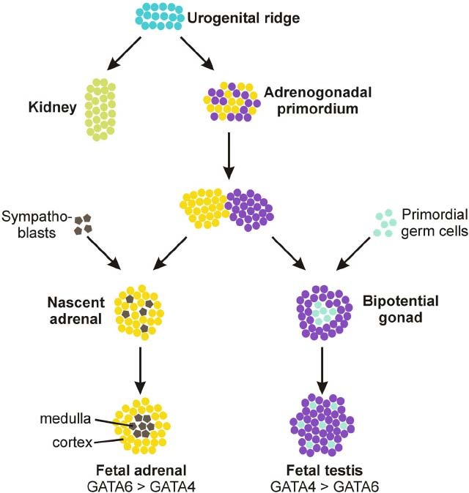
Notes:
Heikinheimo, Endocrinol, 2015

Slide 12
Timtable
adrenal primordium:
coelomic and mesodermal cells making a cell clump
ED 33-35
migration of trunk neural crest cells
ED36-42
development of the fetal and definitive zone of the cortex;
gland is encapsulated;
extensive vascularisation
EW 8-9
development of the transitional zone
after EW22
Embryonic and fetal development of the adrenal gland

Slide 13
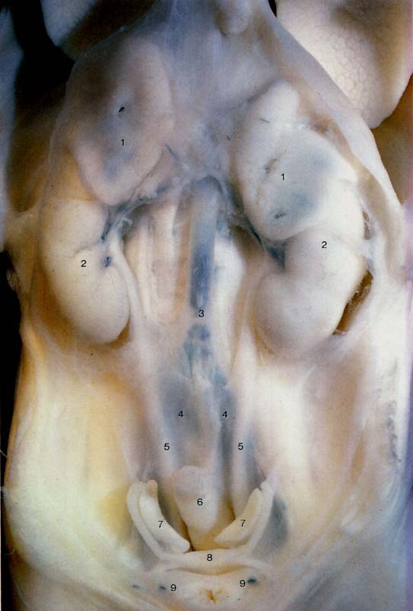
12EW fetus
between EW8 and EW20 adrenal weight doubles weekly, from EW20 (0,5 g) up term: 8-10 g
after birth: 2 g;
at the end of the puberty: 8-10 g
The rapid growth of fetal adrenal is almost entirely due to enlargement of the FZ.
Notes:
Hinrichsen Humanembryologie, 1990

Slide 14
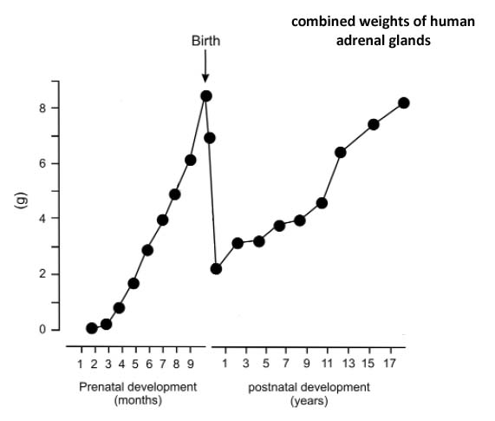
Notes:
Malendowicz Fol Histochem Cytobiol 2010

Slide 15
Structure of fetal adrenal gland
Capsule: thin layer of connective tissue with stem cells
Cortex: two regions, superficial thin layer is the definitive zone
(DZ) deeper is the fetal zone (FZ); from the EW20 a
third region appears: the transitional zone (TZ)
Medulla as a discrete strucute exists not in the fetal period,
sympathicoblast are making groups, that lie
scattered in the FZ
Proportions of the different zones:
at midterm FZ represents 75-80% of the gland
volume;
at term FZ: 70%; DZ: 14%, TZ: 7%, „medulla”: 9%;
anencephalic fetuses: midterm: FZ: 57%, at term FZ:
25%, DZ: 40%, TZ: 20%, „medulla”: 14%

Slide 16
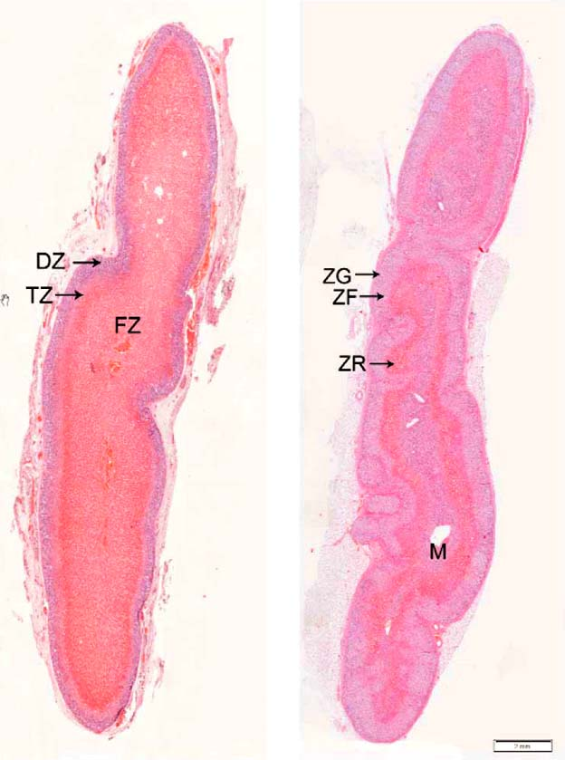
fetus (30 EW)
adult
Notes:
Malendowicz Fol Histochem Cytobiol 2010

Slide 17
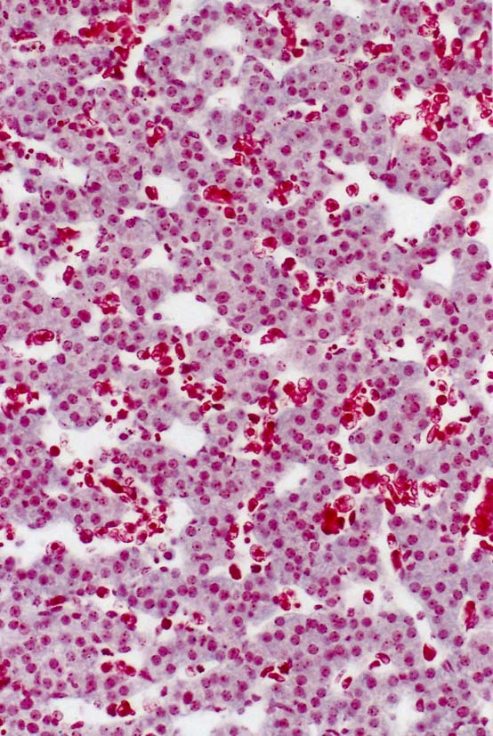
EW20:
fetal cortex with strangs of steroidogenic cells and wide capillaries
Notes:
Hinrichsen Humanembryologie, 1990

Slide 18
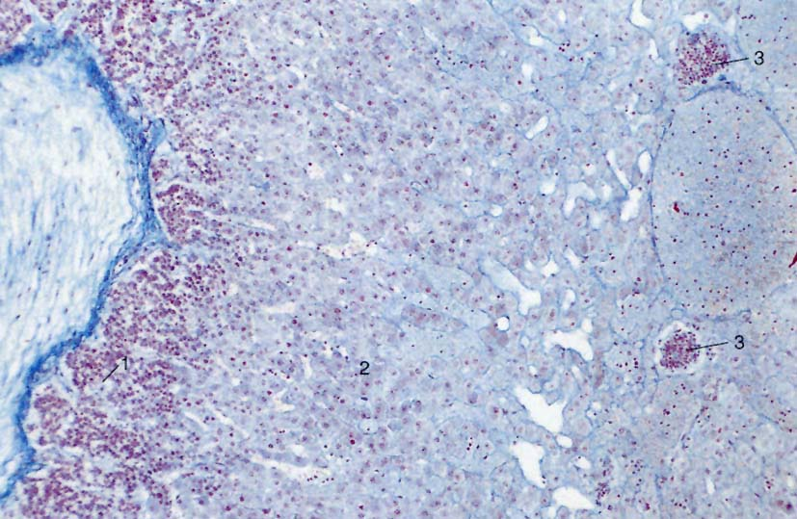
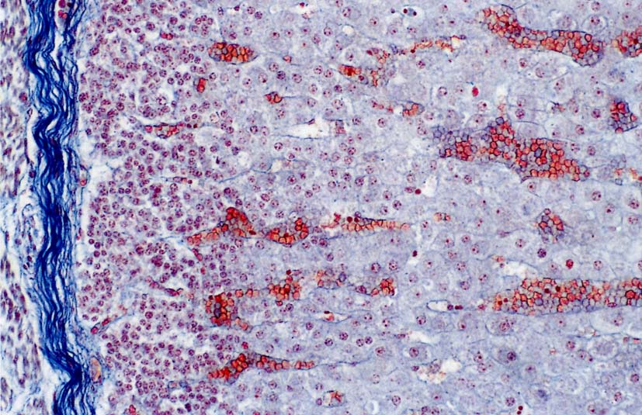
EW12 (Azan staining):
1: definitive zone
2: fetale zone
3: groups of sympathicoblast
EW12 (Azan staining):
higher magnification
Notes:
Hinrichsen Humanembryologie, 1990

Slide 19
Cells of the fetal cortex
Definitive zone: smaller, tightly packed basophilic cells, 10-20 mm diameter; many free ribosomes and glykogen particles; high proportion of them are positive for proliferation markers, like Ki67. At late gestation, the cells accumulate cytoplasmic lipid droplets and begin to resemble steroidogenically active cells.
Fetal zone: larger, acidophil cells 20-50 mm diameter, actively synthetising steroids (tubular mitochondria, sER, lipid drops); low mitotic activity
Differentiation of cortical cells: During the entire course of pregnancy, an intense proliferative activity is observed at the periphery of the gland, followed by migration of the newly formed cells throughout the fetal cortex. In the course of their migration, cells differentiate, enlarge (becoming rich in steroid-filled lipid droplets) and finally die from apoptosis in the center of the gland.

Slide 20
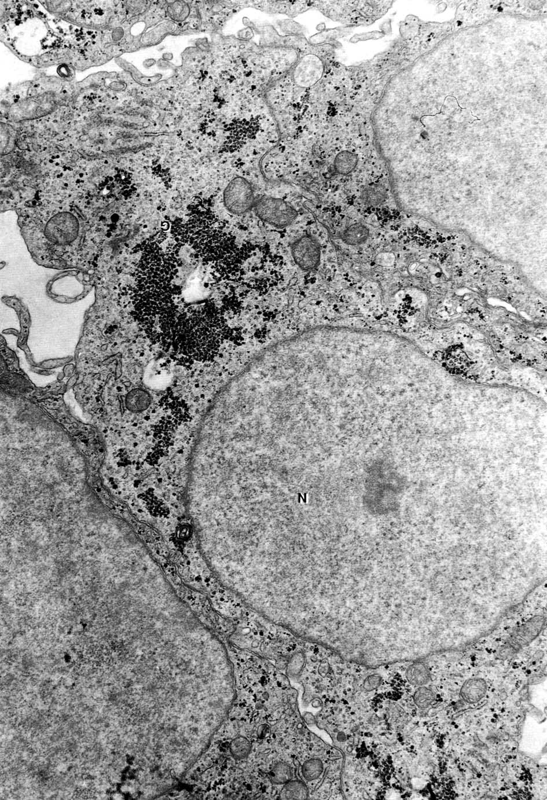
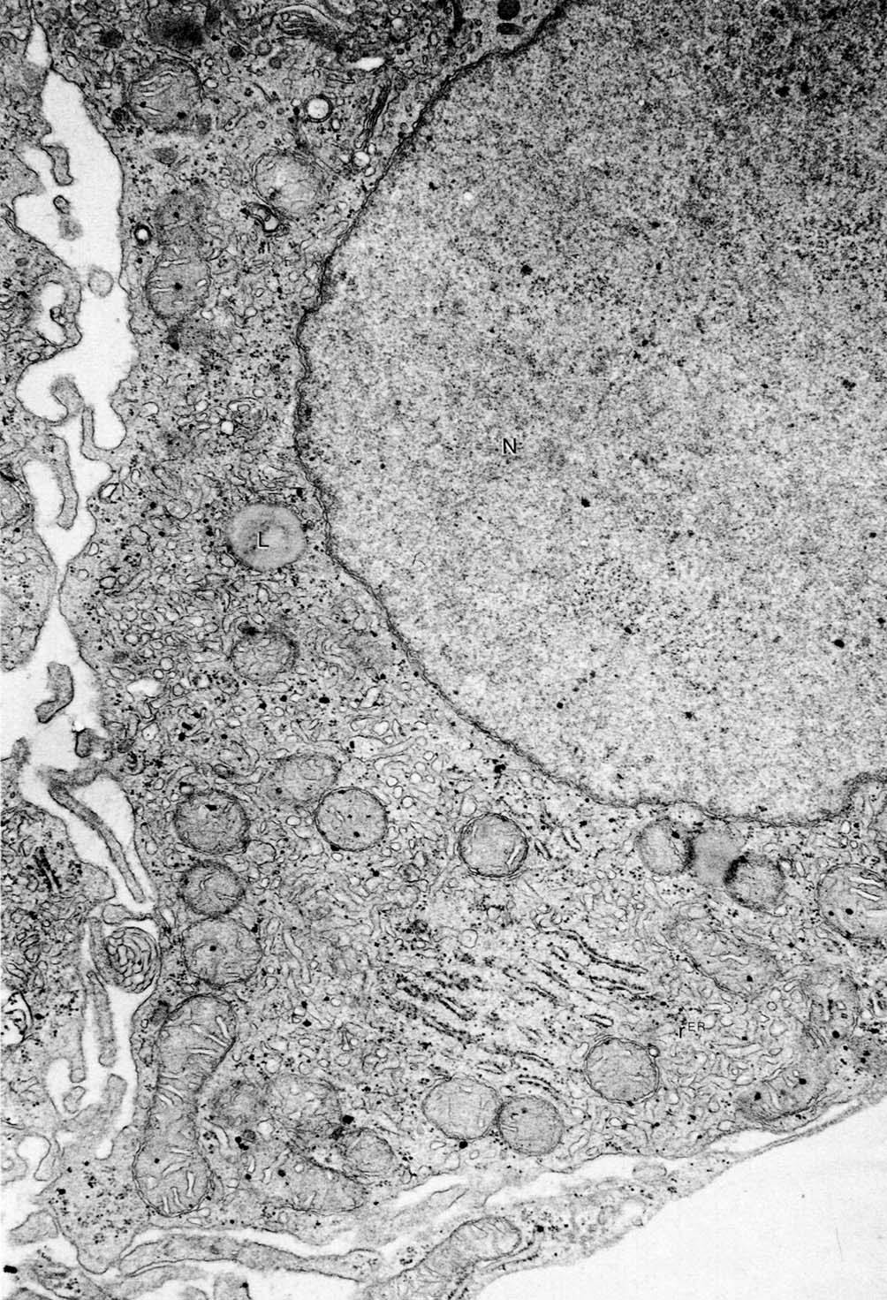
Fetal zone cell
Definitive zone cell
Human embryo, about ED50
Notes:
Hinrichsen Humanembryologie, 1990

Slide 21
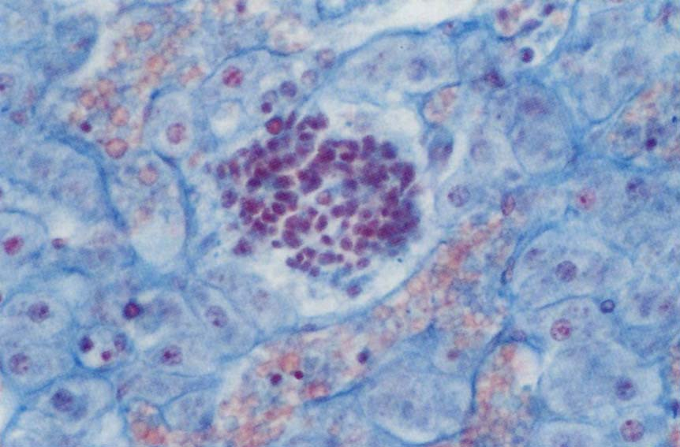
Fetal „medulla”
The medulla is absent from the primate fetal adrenal as a discrete structure throughout most of gestation except for small islands of chromaffin cells scattered through the cortex. Only after the involution of the fetal zone during the first postnatal weeks do the chromaffin cells an aggregate around the central vein and begin to form a medulla.
Immigration of sympathicoblast: from the EW6; TH⁺
EW12 (Azan staining): higher magnification fetale zone with sympathicoblasts
Notes:
Hinrichsen Humanembryologie, 1990

Slide 22
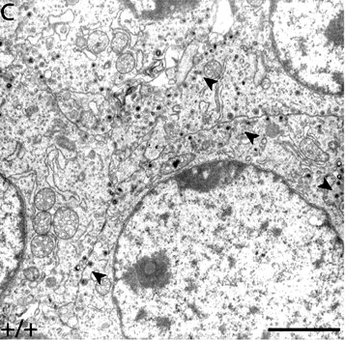
Chromaffin cell from fetal mouse adrenal gland (ED17,5) with dendse core vesicles (arrowheads).
Notes:
Gut, Development, 2005

Slide 23
Development of zonation
Three general hypothetical models on zonation of the adrenal cortex: 1) the cell migration model;
2) the transformation field model; and
3) the zonal model.
An increasing number of studies support the cell migration model of adrenal cortical cytogenesis. In this model, each zone is derived from a common pool of progenitor cells, which then migrate and differentiate to populate the cortical zones. Centripetal migration of lipid-containing cells from the DZ to the FZ was reported in earlier studies.

Slide 24
Timtable
adrenal gland at birth:
fetal zone largely disappear in several (2-4) weeks;
definitive zonae glomerulosa and fasciculata develop;
medulla first appears up to 4. week
from birth up to 4 weeks postnatal
development of zona reticularis
from 3-4 years
Postnatal development of the adrenal gland

Slide 25
Postnatal development 1.
Fetal zone: degenration starts after birth (accumulation of lipids, apoptose, haemorrhage); fetal uzone largely ddisappears up to 6 ewwk; small rests of fetal zona should remain up to 2. year
From the definitve zone the zonae glomerulosa and fasciculata develop. Morphological studies have identified rudimentary zonae glomerulosa and fasciculata (in the definitive zone) during late gestation.
The adrenal medulla appears in the first few postnatal weeks following the involution of the fetal zone. By 4th week, the chromaffin cells cluster at the centre of the gland. About 12-18 month of age that the infant has the medulla with the adult type architecture.

Slide 26
Postnatal development 2.
Zona reticularis: appears rudimental in the 2-3 years of age; fully developed is around/after puberty (11-18 years of life).

Slide 27
Steroidogenesis in the fetal adrenal

Slide 28
Early signals for the urogenital ridge
urogenital ridge: gonad-adrenal kidney; early defects result in malformations more than one organ
Hedgehog signalling: DHH muation: gonadal dysgenesis, Pallister-Hall syndrome (GLI3): absence of adrenal gland
SALL/Sall signalling: renal abnormalities/normal adrenals (human); kidney agenesis; absence of adrenal gland (mouse)
Fox2D: adrenal and kidney hypoplasia (mouse)
Wnt4: unilateral absence of kidney; adrenal not reported (human); masculinization of female mice, compromised Sertoli cell development, abnormal vascular pattern in gonad (female mice); decreased aldosterone production, ectopic adrenal cells in gonadal tissue, abnormal adrenal gland vasculature (mouse)
Pbx1: absence of gonads, kidney hypoplasia, absence of adrenal gland (mouse)

Slide 29
Signals for the adrenogonadal primordium
SF1/Sf1: XY sex reversal, adrenal insufficiency, adrenal hypoplasia (aplasia) (human); aplasia of the gonads, adrenal aplasia (mouse)
DAX1/Dax1: hypogonadotropic hypogonadism, XY sex reversal, Cytomegalic adrenal hypoplasia, persistence of fetal zone, adrenal insufficiency (human); male infertility and XY sex reversal, lack of X-zone regression (mouse)

Slide 30
Signals for the adrenal primordium
Cited 2: KO mouse lack adrenals, but have normal gonads (adrenocortical development has a failure)

Slide 31
Signals for the fetal and neonatal adrenal
Disorders of ACTH signalling: ACTH receptor mutations (MC2R, ACTHR, MRAP): adrenal insufficiency, hypoplasia with a grossly diminished or even absent ZF and are referred to as miniature adult adrenocortical hypoplasia congenita, AHC (human);
POMC mutations: Secondary adrenal insufficiency (human, mouse)

Slide 32
Differentiation of cortical cells
Shh signalling: secreted by subcapsular Sf1⁺/SteroidogenE⁻ cells; Gli1 is present in Sf1⁻/SteroidogenE⁻ subcapsular cells; these start to migrate centripetally and become Sf1⁺/SteroidogenE⁺ and become ZG specific cells (Cyp11b2⁺) or ZF specific cells (Cyp11b1⁺)
Delta-Notch signalling: DLK1 (delta like homolog1) is expressed by subcapsular cells; negatively regulate the differentiation of Gli1⁺ cells

Slide 33
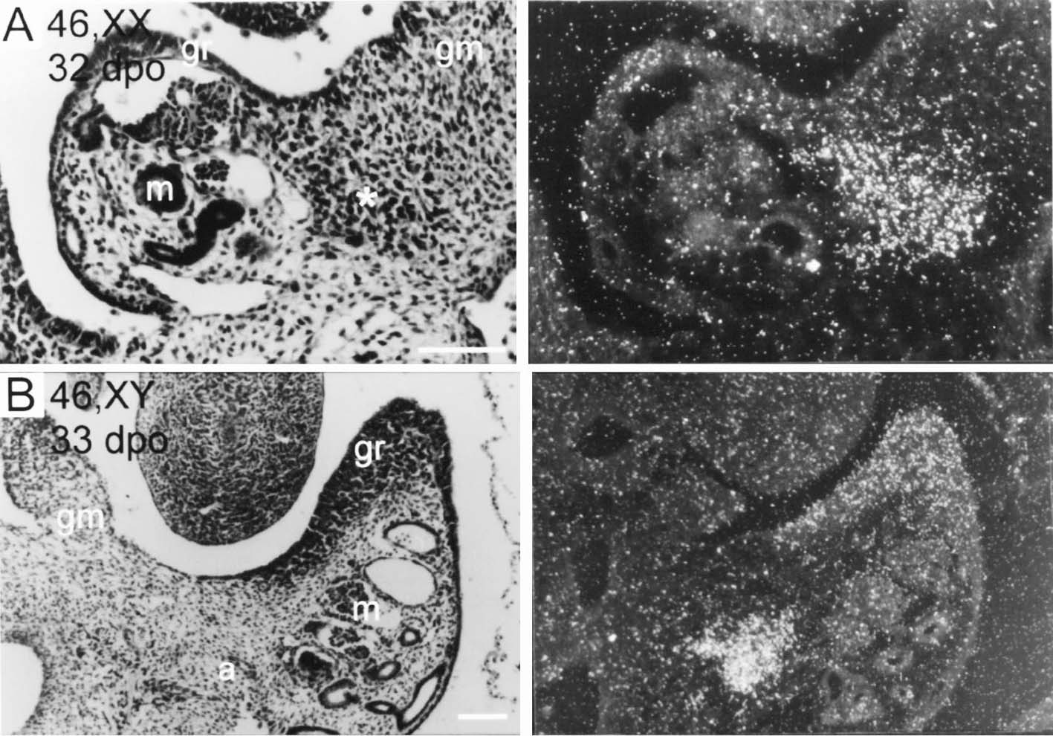
SF1 radioactive ISH in 32 or 33 dpo (days post ovulationem) human embryos
Gr, gonadal ridge; m, mesonephros; asterisk, pool of SF-1 positive cells; a, adrenal cortex; g, gonad; gm, gut mesentery.
Notes:
Hanley, MOD, 1999

Slide 34
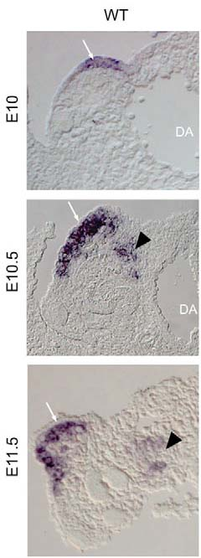
SF1 expression
white arrow: gonadal primordium
arrowhead: adrenal primordium
cited 2
expression
Notes:
Val, Development, 2007

Slide 35
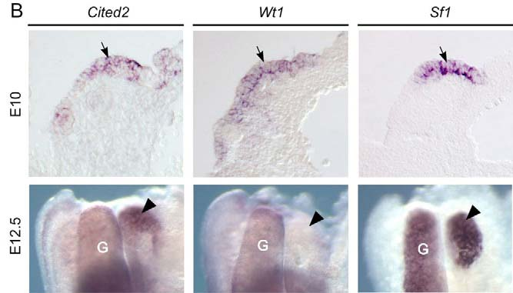
white arrow: gonadal primordium (G)
arrowhead: adrenal primordium
Notes:
Val, Development, 2007

Slide 36
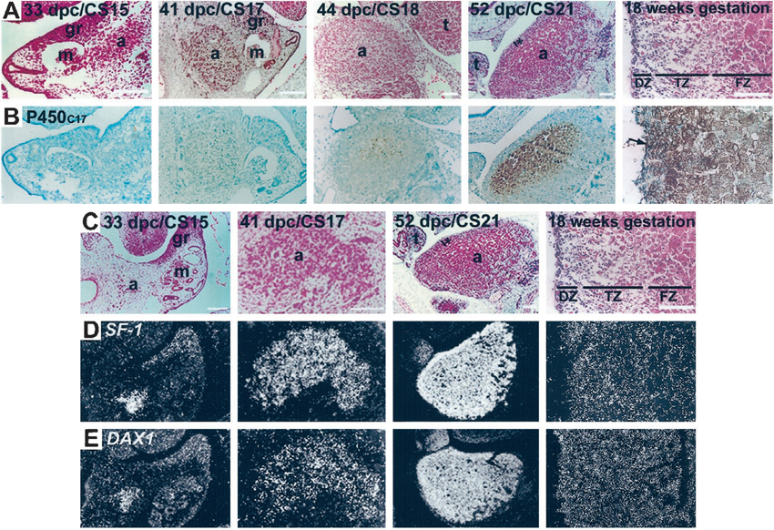
Notes:
Hanley, Mol Endocrin, 2001

Slide 37
?????weeks 8-10: two different cortical cell types differentiate (fetal and definitive), a brazil cikk szerint a definitv zóna sejtjei szintetikusan inaktívak és nem osztódnak. A második trimeszter végén (22-24 hetek között) differenciálódik a tranziciós zóna. Ennek a zónának lesz 3bHSD aktivitása, ami lehetővé teszi a fetus saját kortizol termelését….
Nothing is clear about the onset of 3ß-HSD or about the factors regulating it. Surely, this event is of importance to the fetus, in that the fetal cortisol is needed for a good maturation of numerous organs (lungs, gut, etc.).
Close to birth, the definitive zone acquires 3ß-HSD but this zone, being exempt (mentes) of cytochrome P450C17, will secrete mineralocorticoids, which will be needed for extra-uterine life.

Slide 38
ACTH secreted by the fetal hypophysis around the 8th week of pregnancy.
At the 16th week, fetal zone cells appear to be under the control of this hormone while the definitive zone is not.
However, even if ACTH is an important regulating factor of fetal adrenal functions during the entire pregnancy, it cannot explain the development of the fetal zone by itself. Indeed, anencephalic fetuses exhibit a fully constituted adrenal gland, even if reduced in the volume of the fetal zone.

Slide 39
The FZ consists of large (20–50 mm) cells with ultrastructural characteristics typical of steroidogenic cells. In the outer regions of the FZ, the cells are arranged in tightly packed cords. In the central portion, the FZ forms a reticular pattern, with cells spaced more widely and separated by numerous vascular sinusoids. Ultrastructural studies also have revealed a third zone between the DZ and FZ, which we have named the transitional zone (TZ) (11). Cells in this zone show intermediate characteristics (12). TZ cells have the capacity to synthesize cortisol, being analogous to cells of the zona fasciculata of the adult adrenal cortex. By the 30th week of gestation, the HFA cortex manifests a rudimentary form of the adult adrenal cortex; the DZ and TZ begin to resemble the zona glomerulosa and the zona fasciculata, respectively

Slide 40
Ishimoto: The widely accepted concept of a key role for adrenal glucocorticoids in chromaffin cell differentiation has been challenged by a recent study in mice lacking the glucocorticoid receptor; chromaffin cells in such mice develop quite normally.

Slide 41
The origin of progenitor cells during embryonic and fetal adrenal development is unclear. Some have hypothesized that the precursors in the adrenal primordia (mouse) give rise to Sf1-negative stem cells that reside in the adrenal capsule. In response to mitogenic/morphogenic signals, such Sf1-negative capsular stem cells would exit from the capsular niche into the subcapsular environment, where they commence Sf1 expression and proliferate.
by midgestation (16–20 wk), the FZ clearly dominates in the gland. In contrast to the DZ, mitotic figures in the FZ are scant. The cell number of the FZ is not necessarily higher, but the size of it is much larger than that of the DZ.
Apoptosis also appears to occur in the HFA, primarily in the central portions of the FZ.
(Freedman) Recent studies that used lineage tracing to map the cell fate of Shh- and Gli1-expressing progenitor cells demonstrated radial stripes that appeared to migrate through the zG into the zF, providing support for the model of centripetal migration.

Slide 42
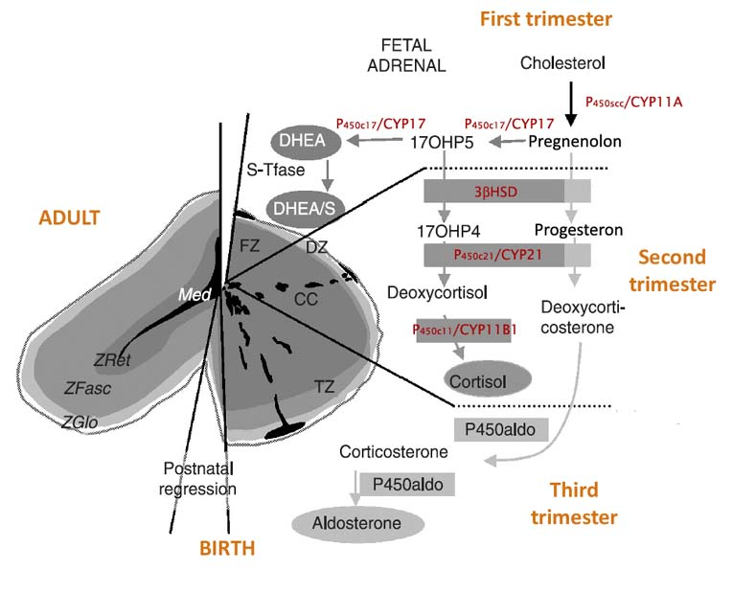

Slide 43
the newly constituted transitional zone (TZ, medium grey) acquires the enzyme 3ß-HSD while the expression of P450C17 remains, thus allowing the production of fetal cortisol.
Near birth, cells of the definitive zone which express only 3ß-HSD, acquire the P450aldo and begin to secrete mineralocorticoids such as aldosterone.
Adrenals acquire the ability to synthetise steroid hormones between weeks 6-8.
Generally, the activity of steroidogenic enzymes and regulatory proteins is higher in the fetal zone than in neocortex.
Of special importance are the studies on localization of the key enzymes, like 3βHSD and 17α hydroxylase. Both are required for the synthesis of cortizol.
When 3bHSD is expressed, cell have the capacity to synthetize mineralocorticoids, while 17a Hase only indicates the synh
thesis of androgens.

Slide 44
fetal zone: does not express 3bHSD but 17ahydroxylase.
Transitory zone (future zona fasciculata): both are expressed (from the weeks 25-30)
definitive zone (future zona glomerulosa): expresses 3bHSD from the weeks 22-24.
fetal adrenal gland secretes cortizol from the weeks 6-8: most probably it is synthetised from placental progesterone but not from cholesterol.
Neocortex produces cortizol fetal zone DHEA and DHEA-S
What about aldosterone?
CYP11A: 3-4 fold higher activity in the fetal zona than in the definitive
quantities of secreted steroids from tha fetal adrenals: fetal zone: DHEA and DHEA-S 200 mg/day at term (in both sexes); it starts at weeks 6-8
aldosteron secretion starts at weeks 20-24.

Slide 45
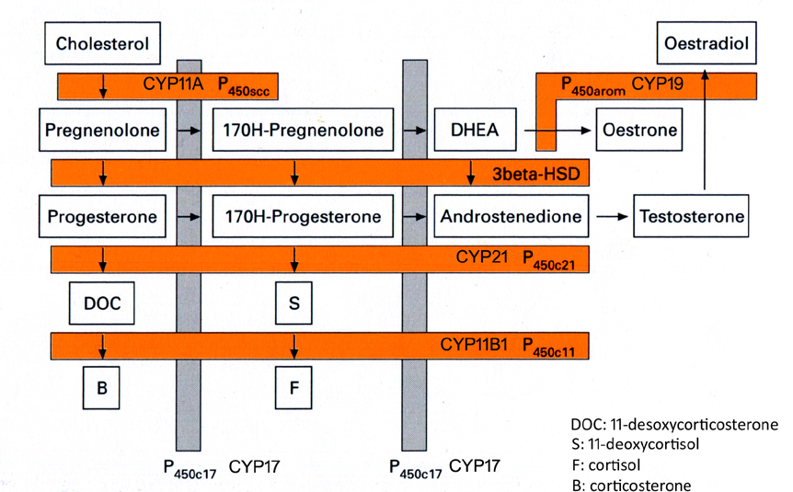
Notes:
Harding-Bocking Fetal growth and development 2001

Slide 46
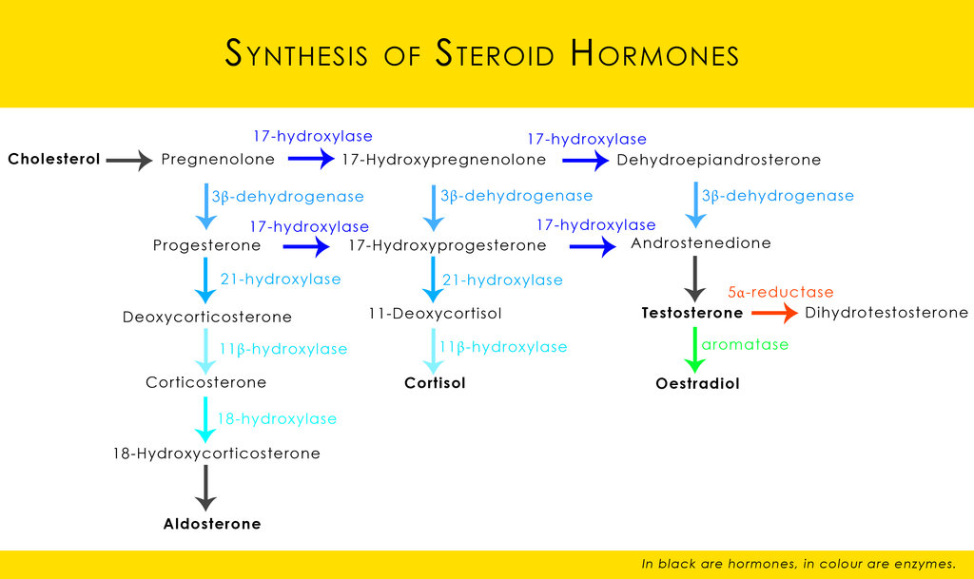

Slide 47
Ishimoto cikk friss összefoglalása:
The current data regarding the ontogeny of expression of steroidogenic components could account for zonal differential steroidogenic activity and its onset. The HFA
cortex after midgestation is composed of three functionally distinct zones, each of which expresses different combinations of steroidogenic enzymes and cofactors (Fig. 3): 1) the DZ, which is the likely site of aldosterone synthesis late in gestation because of the persistent lack of CYP17, and the eventual expression of HSD3B2, CYP11A, CYP21, and probably of CYP11B2; 2) the TZ, which appears to be the site of cortisol production late in gestation based on the persistent expression of CYP17, CYP11A, CYP21, and the eventual expression of HSD3B2, and probably of CYP11B1; and 3) the FZ, which expresses CYP11A and CYP17 but not HSD3B2, is the site of 5-steroid production, particularly DHEA and DHEAS, throughout most of gestation. The localization and ontogeny of the steroidogenic enzymes and cofactors fit well with the concept that the DZ develops to form the zona glomerulosa, the TZ is the equivalent of the zona fasciculata, and the FZ is analogous to the zona reticularis.

Slide 48
steroidogenic activity in the HFA is summarized as follows: 1) DHEAS production
appears to begin at around 8–10 wk gestation, continues thereafter, and increases considerably during the second and third trimesters, such that by term the HFA produces around 200 mg of DHEAS per day; 2) de novo cortisol production likely occurs transiently early in gestation (around 7–10 wk gestation); 3) due to the lack of
HSD3B2 expression, de novo cortisol biosynthesis appears to be suppressed until late gestation when cortisol production escalates (76 –78); and 4) aldosterone synthesis
in the HFA may be suppressed during midgestation due to the probable lack of CYP11B2 expression, but likely becomes active by term.

Slide 49
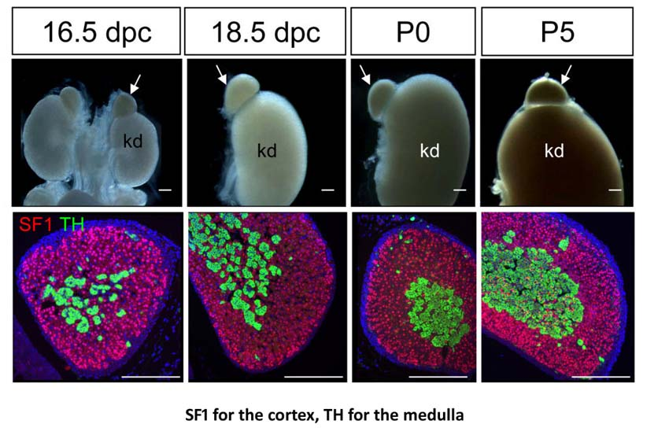
Notes:
Huang, BMC Developmental Biology 2010, 10: 66

Slide 50
Developmental abnormalities of the adrenal gland
Ectopic adrenal tissue (adrenal rest): The adrenal rests may contain cortical tissue only or other cortical and medullary tissue. Ectopic adrenal cortical tissue is found in up to 50% of neonates and usually atrophies, so that it only occurs in 1% of adults. Most ectopic adrenal tissue is found in the vicinity of the adrenals around the coeliac axis.
Adrenal heterotopia (very rare): accessory adrenal issue is incorporated into adjacent organs such as kidney or liver.
Congenital adrenal hyperplasia (CAH): a group of autosomal recessive disorders characterized by enzyme defects in the pathway of cortisol synthesis. Deficient cortisol production leads to increased ACTH production and hyperplasia of the adrenal cortex. fetal adrenal cortex cannot synthesize adequate amounts of cortisol. The suppressed cortisol inhibits negative feedback at the fetal anterior pituitary, which leads to a compensatory increase in ACTH secretion. The elevated ACTH causes fetal adrenal hyperplasia and increases production of DHEAS because its biosynthesis is not affected by CYP21 deficiency. In the first trimester when sexual differentiation occurs, there is a relative lack of aromatase (CYP19) activity in contrast to high placental aromatase activity seen later in gestation. Thus, the primary clinical manifestations of CYP21 deficiency are those of androgen excess, which are first expressed in utero, resulting in virilization of the external genitalia of female fetuses.

