Slide 1
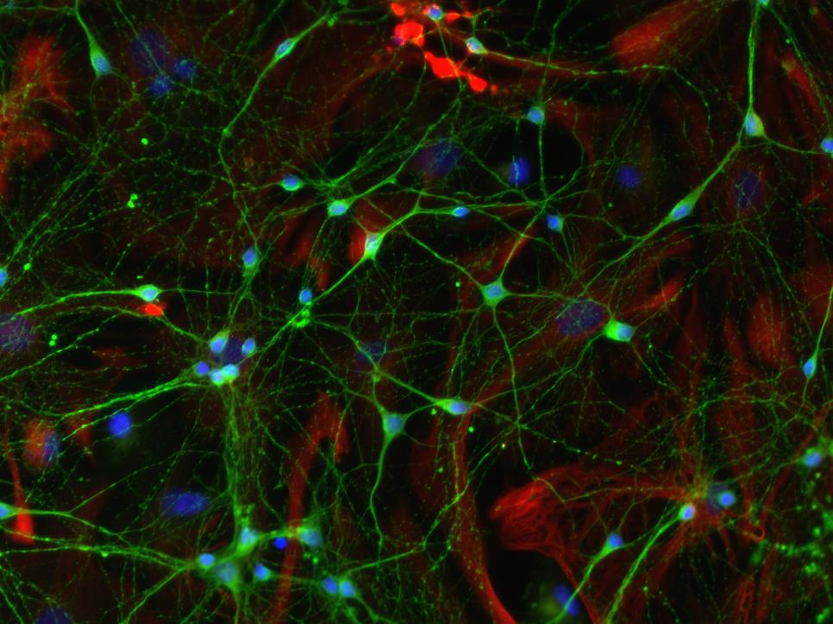
Patterning of the nervous system
by Krisztina H.-Minkó
Semmelweis University, Dept. of Anatomy, Histology and Embryology
Developmental Biology 2020
photo from B. Herberth
Notes:
Nervous system development, cranio-caudal, dorso-ventral axis, induction, positional patterning

Slide 2
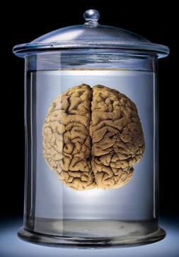

Slide 3
Origin of the neural plate
Neural induction
Establishment of the AP-DV axes

Slide 4
Origin of the central nervous system
Neural plate:
Homogenous epithelial cell population
Neural tube
Brain vesicles
Spinal cord
Site specific expression of regulatory genes.
Establishment of lots of cell types in the regions determined by these genes (morphology, synaptic properties etc.)

Slide 5
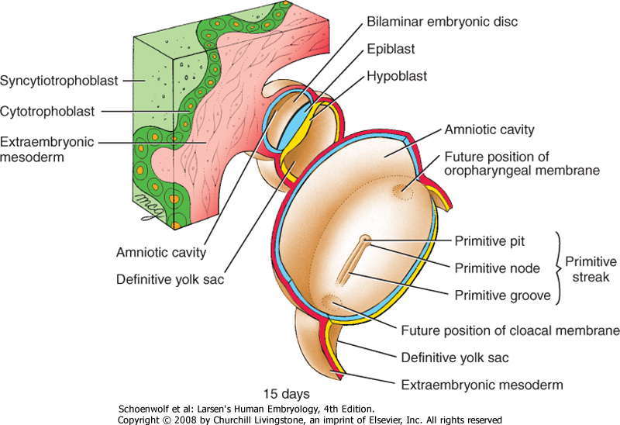

Slide 6
Gastrulation.flv
http://www.youtube.com/watch?v=iHmBIJs77ZQ&feature=related

Slide 7
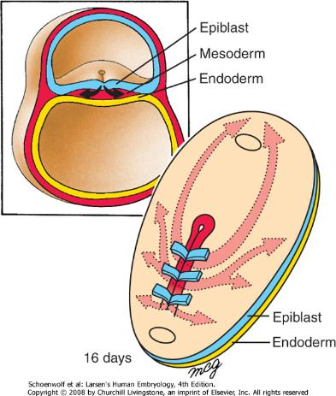
Gastrulation
Formation of the primitive streak also defines for the first time all major body axes. These consist of the cranial-caudal(or head-tail) axis, dorsal-ventral (or back-belly) axis, the medial-lateral axis and the left-right axis. Before the flat embryonic disc folds up into a three-dimensional tube-within-a-tube body plan, these axes remain incompletely delimited.
As gastrulation converts the bilaminar embryonic disc into a trilaminar embryonic disc, it brings subpopulations of cells into proximity so that they can undergo inductive interactions to pattern layers and specify new cell types. The first cells to move through the primitive streak and contribute to the intraembryonic mesoderm migrate bilaterally and cranially to form the cardiogenic mesoderm. Somewhat later in development, a longitudinal thick-walled tube of mesoderm extends cranially in the midline from the primitive node; this structure, the notochordal process, is the rudiment of the notochord. Migrating bilaterally from the primitive streak and then cranially, just lateral to the notochordal process, are cells that contribute to the paraxial mesoderm. In the future head region, paraxial mesoderm forms the head mesoderm. In the future trunk region, paraxial mesoderm forms the somites, a series of segmental blocklike mesodermal condensations. Two other areas of intraembryonic mesoderm form from the primitive streak during gastrulation: the intermediate mesoderm and lateral plate mesoderm. The intermediate mesoderm contributes to the urogenital system, and the lateral plate mesoderm contributes to the body wall and the wall of the gut (gastrointestinal system).

Slide 8
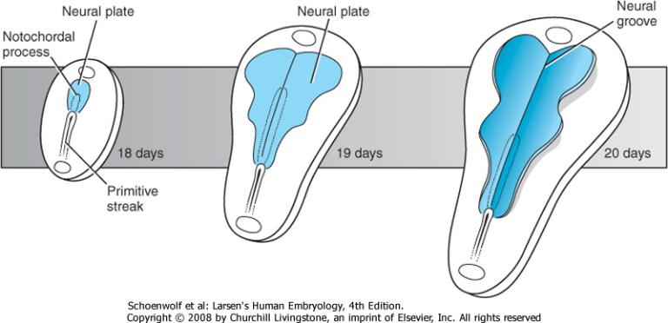
Neurulation
During gastrulation, a major inductive event occurs in the embryo: neural induction. In this process, the primitive node induces the overlying ectoderm to thicken as the neural plate, the earliest rudiment of the central nervous system. During subsequent development the neural plate will fold up into a neural tube. Neural crest cells arise from the lateral edges of the neural plate during formation of the neural tube. Also during subsequent development, the definitive endoderm will fold to form three subdivision of the primitive gut: foregut, midgut, and hindgut. The cranial midline endoderm, just cranial to the tip of the extending notochord, forms a thickened area called the prechordal plate. It contributes to the oropharyngeal membrane during later development and is an important signaling center for patterning the overlying neural plate. With the formation of endodermal, mesodermal, and ectodermal subdivisions during gastrulation, the stage is set by the end of the 3rd week for formation of the tube-within-a-tube body plan and subsequent organogenesis, the processes by which primitive organ rudiments are established and subsequently differentiated to form all major organ systems.

Slide 9
Neuronal induction is not a simple all-or-nothing process, rather considerable regional specificity exists.

Slide 10
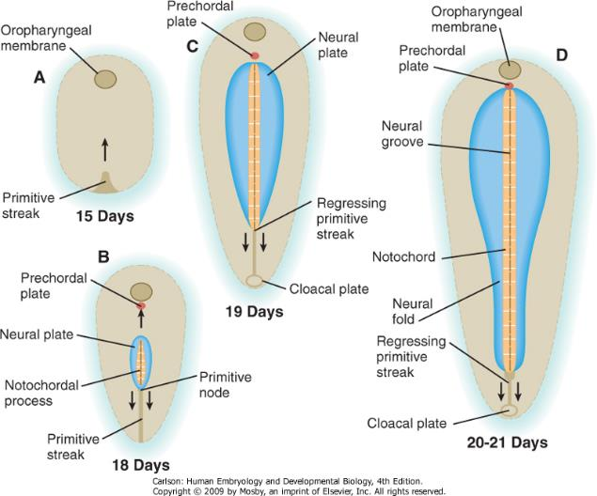
Figure 5-12 Relationships between the neural plate and primitive streak. A, Day 15. B, Day 18. C, Day 19. D, Days 20 to 21.
Downloaded from: StudentConsult (on 8 February 2011 04:03 PM)
© 2005 Elsevier

Slide 11
About the events before neurulation

Slide 12
Induction and competence
signals
inducer
responder
Cell shape changes
Changes in mitotic rate
Cell fate changes
In the case of neural induction:
Spemann organiser
notochord
ectoderm
neuroectoderm

Slide 13
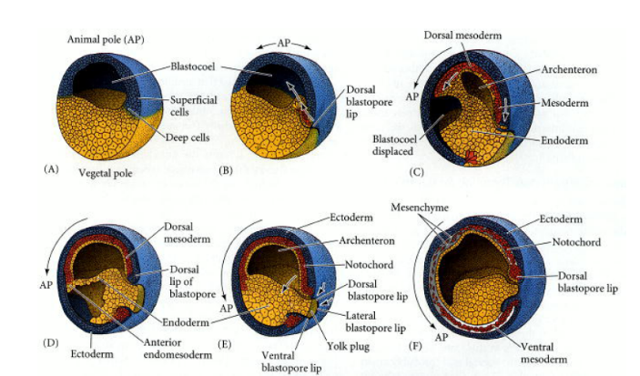
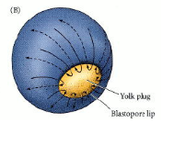
Amphibian development

Slide 14
The Spemann organiser

Slide 15
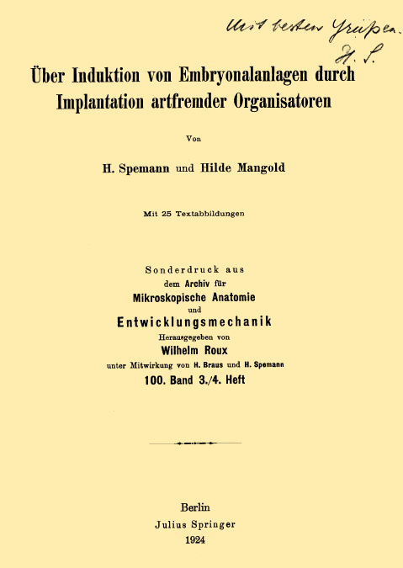
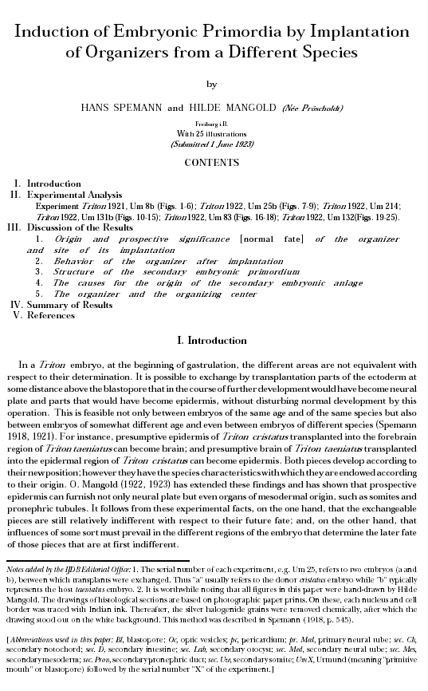
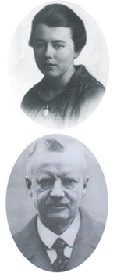
In the early gastrula only the dorsal blastoporal lip develops autonomically
They concluded that the dorsal lip acts not only as a neural inducer but also as an „organizer” of the entire
body axis. As a result of these experiments, this region of the embryo is known as the Spemann organizer.

Slide 16
Conserved role of the organiser in birds

Slide 17

Conserved role of the organiser in mammals

Slide 18
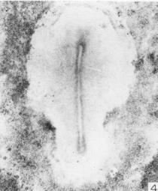
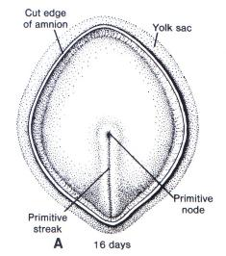

Spemann organiser homologue strucures
in higher vertebrates
Spemann Mangold organiser/ Hensen’s node/
Primitve node
Prechorda, notochord, endoderm of the pharynx, dorsoanterior endoderm, floor plate

Slide 19
What induce the organiser?
The role of the Nieuwkoop center
Dorsal vegetal cells are needed to induce dorsal
mesoderm in Xenopus

Slide 20
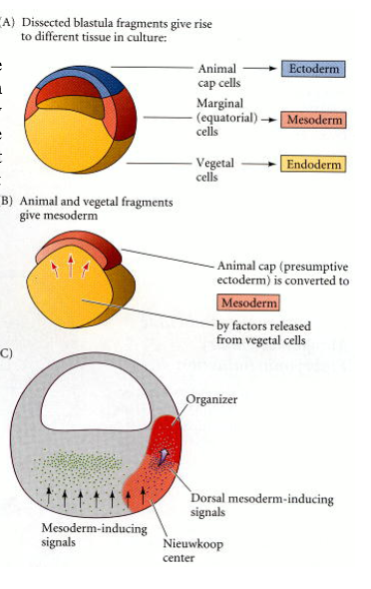
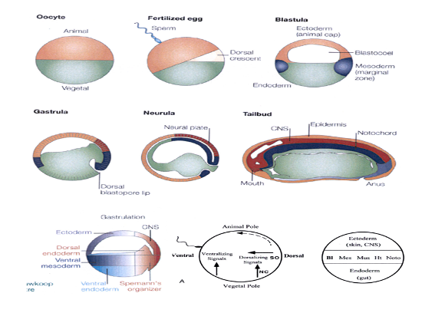
Early Xenopus development

Slide 22
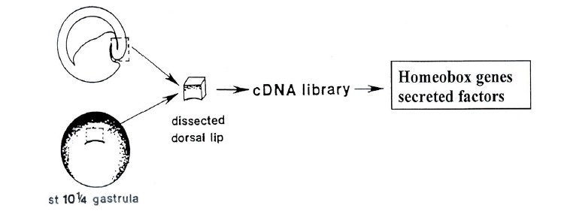
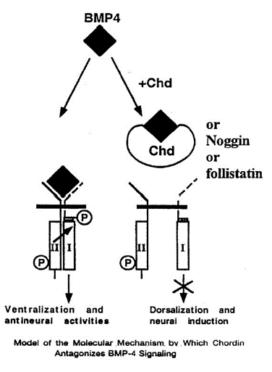
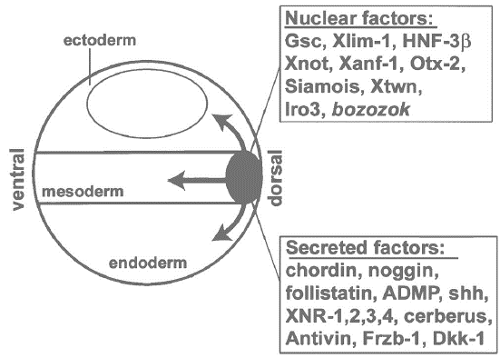
Molecular background of the induction
Eddy De Robertis
M267, March 2002 Lecture 3

Slide 23
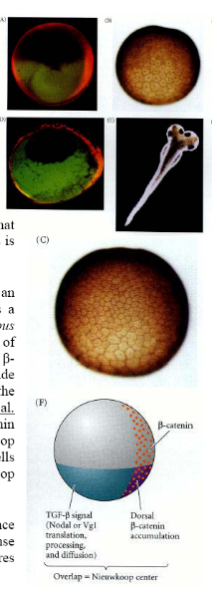

Slide 26
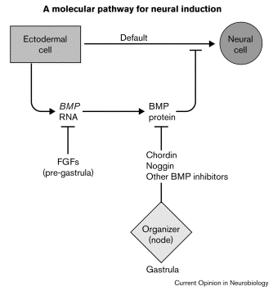
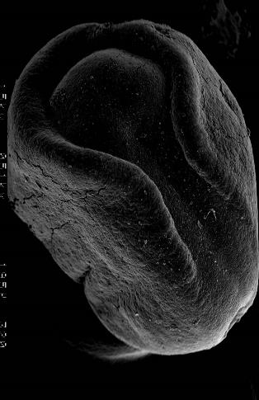
Jessell* and Joshua R Sanes† Current Opinion in Neurobiology 2000, 10:599–611

Slide 27
Establishment of the Hensen’s node and homologue organisers
Spemann Mangold organiser or Hensen’s node
Prechorda, notochord, pharynx endoderm, dorsoanterior endoderm, floor-plate
Nieuwkoop center
AVE (anterior visceral endoderm) in higher vertebrates

Slide 28
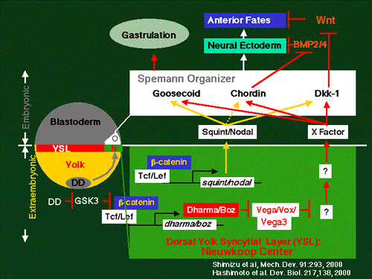
Summary of early organizing centers
The Nieuwkoop center is an early-forming organizing center that induces the organizer. The organizer in turn sends out signals to pattern the newly formed mesoderm into its medial-lateral subdivisions. These two signaling centers were first discovered in amphibians, but homologous centers exist in all vertebrate embryos. The Nieuwkoop center is not structurally distinct; rather it is defined by location in the early embryo and by its ability to induce the organizer. With molecular characterization of the Nieuwkoop center, gene expression patterns are also used to identify it. In contrast to the Nieuwkoop center, the organizer is structurally distinct; it consists of the dorsal lip of the blastopore in amphibians, the embryonic shield in fish, Hensen's node in chick, the node in mouse, and the primitive node in humans. It also can be defined by its position in the early embryo, its ability to induce and pattern an embryonic axis and gene expression patterns.

Slide 29
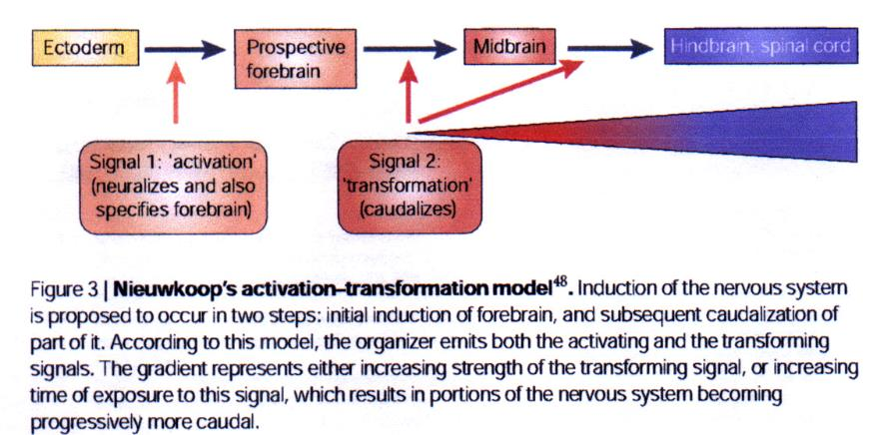
When neurulation starts?

Slide 30
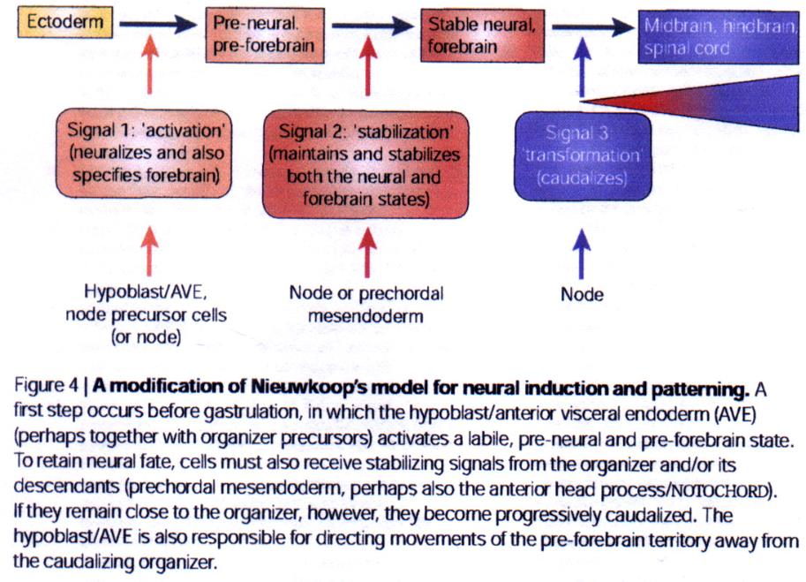

Slide 31
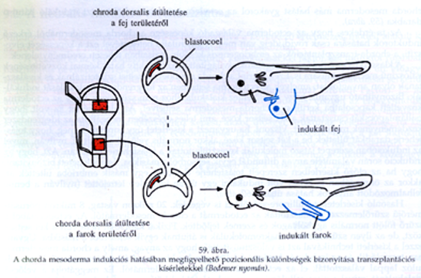
Cranial and caudal notochord do not induce the same structures
„Early node induces head and trunk, late node induces only trunk”

Slide 32
Cranio-caudal axis

Slide 33
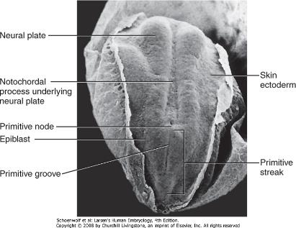
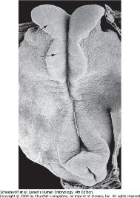
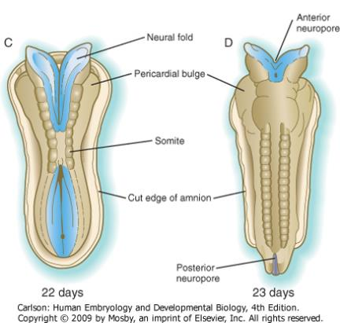
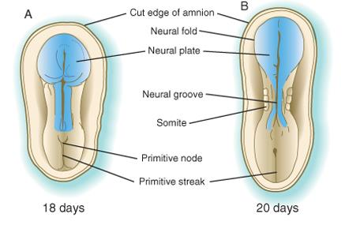
Figure 6-1 Early stages in the formation of the human central nervous system. A, At 18 days. B, At 20 days. C, At 22 days. D, At 23 days.
Downloaded from: StudentConsult (on 8 February 2011 04:16 PM)
© 2005 Elsevier

Slide 34
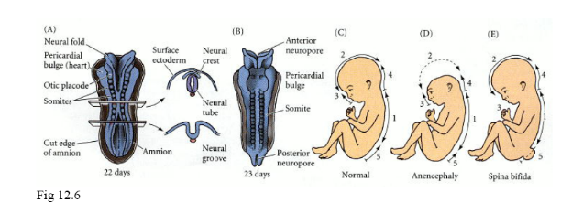
Neural tube closure:
http://www.youtube.com/watch?feature=endscreen&NR=1&v=ZcAAsr_8vOE

Slide 35
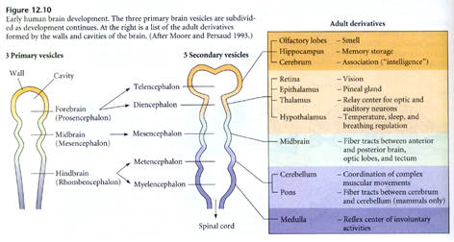
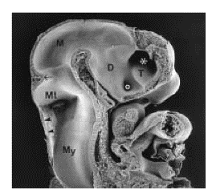
Cranio-caudal differentiation

Slide 36
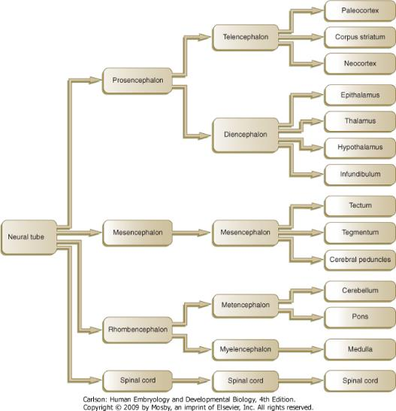
Figure 11-2 Increasing levels of complexity of the developing human brain.
Downloaded from: StudentConsult (on 8 February 2011 04:21 PM)
© 2005 Elsevier

Slide 38
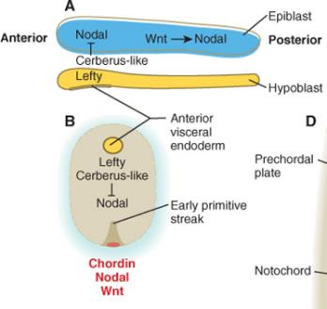
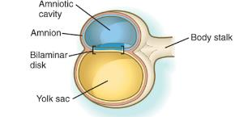
The anterior visceral endoderm soon begins to induce much of the head and forebrain and inhibits the formation of posterior structures. In the posterior part of the epiblast, nodal signaling activity stimulates the formation of the primitive streak, which is the focal point for gastrulation and germ layer formation. After the hypoblast has become a well-defined layer, and the epiblast has taken on an epithelial configuration, the former inner cell mass is transformed into a bilaminar disk, with the epiblast on the dorsal surface and the hypoblast on the ventral surface.
Notes:
It also forms two signaling domains within the early embryo. The anterior visceral endoderm soon begins to induce much of the head and forebrain and inhibits the formation of posterior structures. In the posterior part of the epiblast, nodal signaling activity stimulates the formation of the primitive streak (see next section), which is the focal point for gastrulation and germ layer formation. After the hypoblast has become a well-defined layer, and the epiblast has taken on an epithelial configuration, the former inner cell mass is transformed into a bilaminar disk, with the epiblast on the dorsal surface and the hypoblast on the ventral surface.

Slide 39
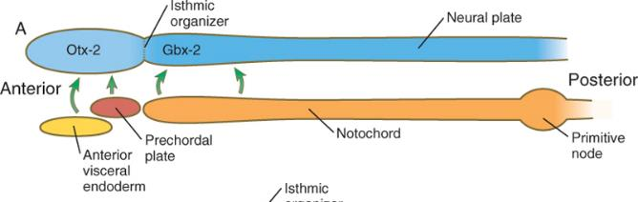
Ventral induction from AVE and prechorda in the head region
and from the notochord in the posterior region.
Head organiser : AVE and prechorda.
Despite inducing the neural plate within the overlying ectoderm,
however, the notochord does not stimulate the formation of anterior parts of the brain or head structures.
This function is reserved for the anterior visceral endoderm/prechordal plate.

Slide 40
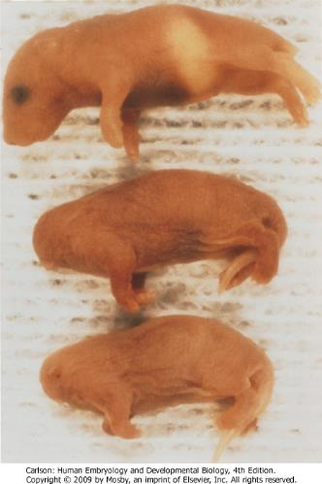
Results from „headless” mice
In mammals, even before mesodermal cells begin migrating through the primitive node, the anterior hypoblast (called the anterior visceral endoderm by mouse embryologists) expresses genes characteristic of the prechordal plate and initiates head formation. The anterior visceral endoderm itself is subdivided into an anterior part, which serves as a signaling center for early heart formation, and a more posterior part, which becomes part of the prechordal plate complex and induces formation of the head. According to one model, induction of the head and forebrain in mammals is a two-step process, in which an early induction by the anterior visceral endoderm confers a labile anterior character to the head and brain, and a later induction by the prechordal plate mesoderm reinforces and maintains this induction.
A major function of the anterior visceral endoderm is to emit molecular signals that inhibit the development of posterior embryonic structures. To produce a head, it is necessary to block the BMP-4 signal (by noggin) and a Wnt signal (by Dkk-1). Signaling molecules and transcription factors are produced in the head signaling centers. In mice bearing mutants of Lim-1 (Lhx-1), a homeobox-containing transcription factor, and cereberus-like 1, a signaling molecule, headless mice are born. The headless mice are born without neural structures anterior to rhombomere 3. Otx-2, another transcription factor present in the head signaling center, is also a general marker of the induced anterior region of the central nervous system. Many other molecules are also expressed in the head signaling center. How these orchestrate the formation of the head remains to be determined.
Newborn headless mice and a normal mouse. The headless mice have a null mutant of the Lim-1 gene. (From Shawlot W, Behringer RR: Requirement for Lim1 in head organizer function, Nature 374:425-430, 1994.)

Slide 41
Role of Cerberus

Slide 42
The first 2 main parts of the CNS are the forebrain/midbrain and hindbrain/spinal cord
While gastrulation is still taking place, the newly induced neural tube is subjected
to vertical inductions from the notochord and head organizing regions (anterior
visceral endoderm and prechordal plate), which are important in inducing the
forebrain region. These, together with a gradient of Wnt-8 (a gene homologous
with Wingless, a segment polarity gene in Drosophila ) signaling,
effectively subdivide it into forebrain/midbrain and hindbrain/spinal cord segments.
This subdivision is marked by the expression of two transcription factors, Otx-2
(orthodenticle homologue 2) in the forebrain/midbrain region, and in the hindbrain,
Gbx-2 (gastrulation brain homeobox 2), whose boundaries sharply define the
midbrain-hindbrain border. Fibroblast growth factors (FGFs),
produced in the early primitive streak, are known to exert a posteriorising effect
on the newly forming neural plate.

Slide 43
Further segmentation, brain vesicles, molecular regulation

Slide 44
Cranio-caudal differentiation

Slide 45
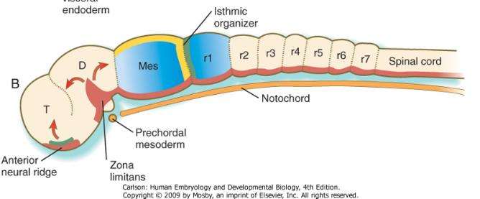
Later organising cell populations
The midbrain-hindbrain border becomes a powerful local signaling center, called the
isthmic organizer. Wnt-1 is synthesized in the neural ectoderm anterior, and FGF-8
is formed posterior to the isthmic organizer. The transcription factors,
Pax-2 and Pax-5 and engrailed (En-1 and En-2), are expressed on both sides of the
isthmic organizer as gradients that are crucial in organizing the development of the
midbrain and the cerebellum, a hindbrain derivative. Two additional organizing or signaling
centers are established early in the formation of the forebrain region.
One, the anterior neural ridge, is located at the anterior pole of the brain.
It is a site of sonic hedgehog and FGF-8 signaling activity and is important in organizing
the formation of the telencephalon, parts of the diencephalon, the olfactory area, and
the pituitary gland. A third signaling center, the zona limitans, is a sonic
hedgehog-secreting group of cells that organize the border between the future dorsal
and ventral thalamus.
Wnt-1
FGF-8
FGF-8
Wnt-1
Shh
Shh
FGF-8

Slide 46
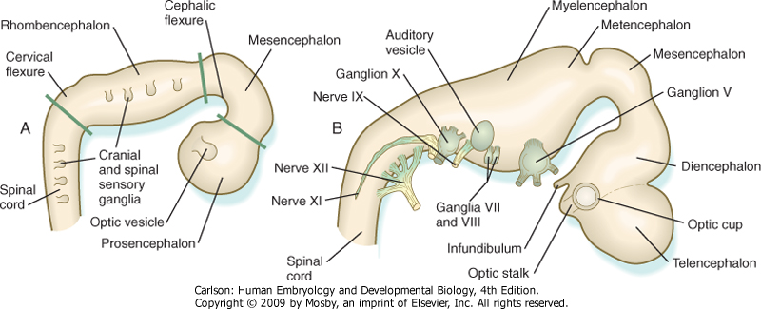
Figure 11-1 Basic anatomy of the three-part (A) and five-part (B) human brain.
Telencephalon
Diencephalon
Mesencephalon
Metencephalon
Myelencephalon
Prosencephalon
Mesencephalon
Rhombencephalon

Slide 47
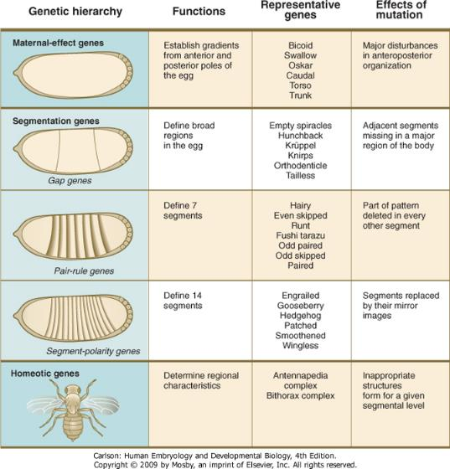
Figure 4-1 Sequence of genetic control of early development in Drosophila. Within each level of genetic control are listed representative genes.
Downloaded from: StudentConsult (on 31 August 2010 09:29 PM)
© 2005 Elsevier

Slide 48
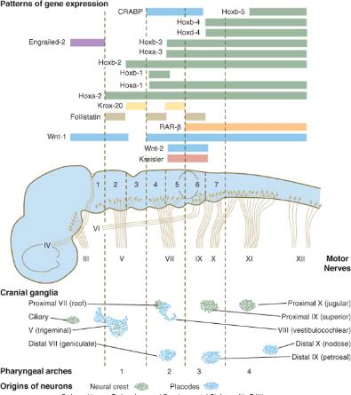
Segmentation in the hindbrain
Segmentation of the hindbrain into seven rhombomeres in humans, and eight in some other animals,
is the result of the expression of several categories of genes, which operate in a manner remarkably
reminiscent of the way in which the early Drosophila embryo becomes subdivided into segments.
Individual rhombomeres are initially specified through the ordered expression of unique
combinations of transcription factors; this patterning is then translated into cellular behavior by the
patterned expression of cell surface molecules.
After the Gbx-2-expressing area
defines the rough limits of the hindbrain, several
segmentation genes are involved in setting up the
basic pattern of segmentation that leads to
rhombomere formation. Krox 20, a zinc finger
transcription factor, is expressed in and guides
the formation of rhombomeres 3 and 5 (r3 and r5)
whereas kreisler, another transcription factor,
and Hoxa-1 are also involved in the formation of r5.
A decreasing gradient of retinoic acid, produced by
the anterior somites, plays an important role in
the formation of the posterior rhombomeres (r4 to r7),
but they are not involved in the specification
of r1 to r3, which is regulated by Gbx-2.
The Hox genes are principally involved in specifying
segmental identity. Under the influence of segmentation
genes, various Hox paralogues are expressed in a highly
specific sequence along the hindbrain and spinal cord.
The pattern of Hox gene expression determines the
morphological identity of the cranial nerves and other
pharyngeal arch derivatives that arise from specific rhombomeres.
The orderly expression of Hox gene paralogues extends anteriorly
through rhombomere 2. Hox proteins are not found in r1 largely
because of the antagonistic action of FGF-8, which is produced in
response to signals from the ishtmic organiser at the anterior end of
r1.
Figure 11-12 Patterns of Hox and other gene expression in relation to anatomical landmarks in the early mammalian embryo. The bars refer to craniocaudal levels of expression of a given gene product. Cranial sensory nerves derived from the neural crest and placodal precursors are laid out in proper register. CRABP, cytoplasmic retinoic acid-binding protein; RAR, retinoic acid receptor. (Modified from Noden DM: J Craniofac Genet Dev Biol 11:192-213, 1991.)

Slide 49
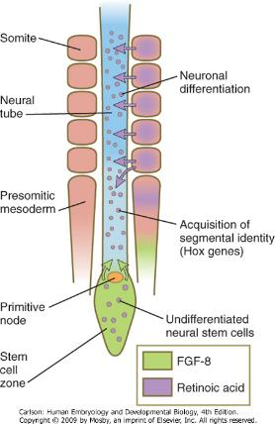
Segmentation in the spinal cord
Although neuromeres are not seen in the region of the neural tube that gives rise to the
spinal cord, the regular arrangement of the exiting motor and sensory nerve roots is
evidence of a fundamental segmental organization in this region of the body as well.
In contrast to the brain, however, segmentation of the spinal cord is to a great extent
imposed by signals emanating from the paraxial mesoderm, rather than from molecular
signals intrinsic to the neural tube.
As the body axis is elongating, and somites are forming, the
caudalmost part of the newly induced neural plate possesses
the properties of a stem cell zone (Fig. 6-5). Under the
influence of FGF-8, secreted by the adjacent presomitic paraxial
mesoderm, these cells, which go on to form the spinal cord,
proliferate without undergoing differentiation. Some of the daughter
cells are left behind by the posteriorly advancing stem cell zone.
These cells fall under the influence of retinoic acid, produced by the
newly formed somites, which are also being formed in a posterior direction.
Retinoic acid stimulates these cells to differentiate into neurons.
The opposing actions of retinoic acid, which promotes differentiation,
and FGF, which fosters proliferation at the expense of differentiation,
represent a recurring theme in the development of other structures.
For example, the spread of FGF-8 from the isthmic organizer antagonizes
the influence of retinoic acid in rhombomere 1. This permits the exuberant
proliferation of the cells in this rhombomere, which is necessary for the
formation of the large cerebellum from this structure.
Interactions between FGF-8 and retinoic acid in the forming spinal cord
and paraxial mesoderm help to set the Hox code that confers
anteroposterior identity to regions of the spinal cord and the adjacent somites.
Figure 6-5 Elongation of the spinal cord in the early embryo. Under the influence of fibroblast growth factor-8 (FGF-8) secreted by presomitic paraxial mesoderm, cells in the most posterior region continue to proliferate, whereas retinoic acid, secreted by newly formed somites, stimulates the neuronal differentiation.

Slide 50
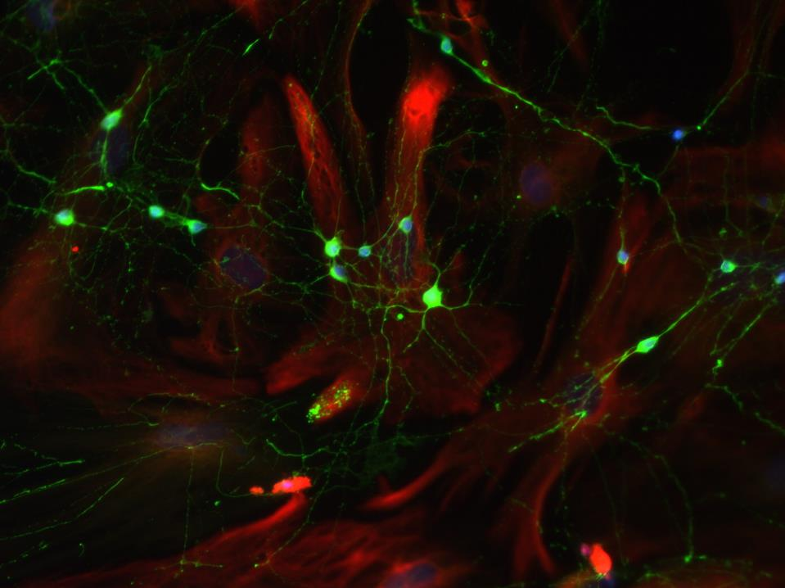
RA added in vitro to neuronal stem cell line is capable diffrentiate the cells into neurons

Slide 51
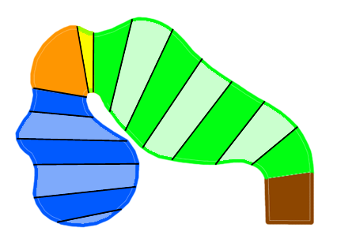
Segmentation in the brain (neuromeres)
Temporarily visible series of regular segments
isthmic neuromer
rhombomeres
mesencephalic neuromer
i
M
r1
r2
r3
P1
r4
P2
r5
r6
P3
r7-8
P4
P5
P6
prosomeres
day 21
By prof. Szél

Slide 52
In the case of the anterior part of the CNS specification/induction/pattern formation takes place in the neural tube itself, contrary to the posterior part of the CNS (spinal cord).
Important regulator is the neural crest also which patterns the scull, cranial nerves and head muscles.

Slide 53
Specification of the dorso-ventral axis
Signals from the ectoderm and notochord

Slide 54
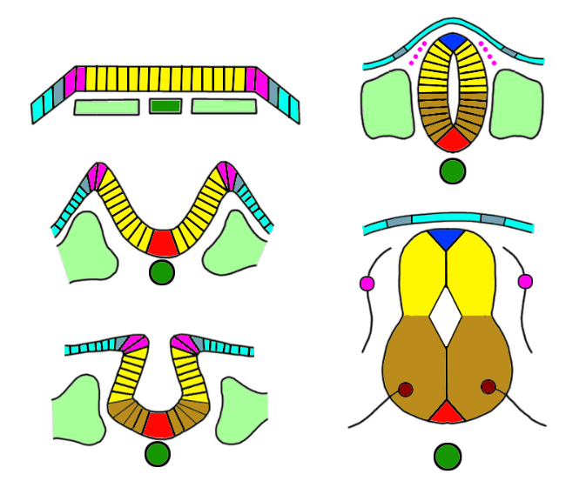
Morphological characteristics of the developing spinal cord
placod
neural crest
neuroectoderm
n. crest
neural tube
placod
ectoderm
sensory cell
roof plate
somite
alar plate
notochord
canalis centralis
sulcus limitans
basal plate
floor plate
motoneuron
By prof. Szél

Slide 55
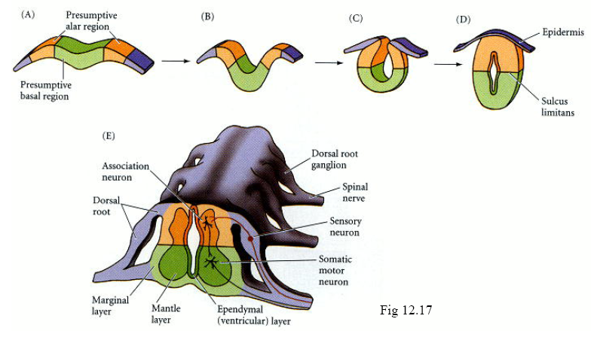
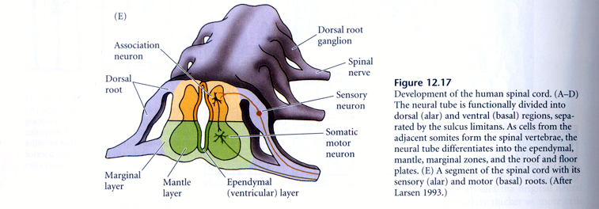

Slide 56
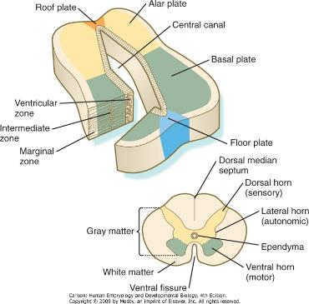
The developing spinal cord is a useful prototype for studying the overall structural and functional
features of the central nervous system because it preserves its fundamental organization through much
of development. With the beginning of cellular differentiation in the neural tube, the neuroepithelium
thickens and appears layered. The layer of cells closest to the lumen (central canal) of the neural tube
remains epithelial and is called the ventricular zone (the ependymal zone in older literature). This zone,
which still contains mitotic cells, ultimately becomes the ependyma, a columnar epithelium that lines the
ventricular system and central canal of the central nervous system (Fig. 11-6). Farther from the ventricular
zone is the intermediate (formerly called mantle) zone, which contains the cell bodies of the differentiating
postmitotic neuroblasts. As the neuroblasts continue to produce axonal and dendritic processes, the
processes form a peripheral marginal zone that contains neuronal processes, but not neuronal cell bodies.
As the spinal cord matures, the intermediate zone becomes the gray matter,
in which the cell bodies of the neurons are located. The marginal zone is
called the white matter because of the color imparted by the numerous
tracts of myelinated nerve fibers in that layer (see Fig. 11-6).
During development, the proliferating progenitor cell populations in the
ventricular zone become largely exhausted, but it is now known that a
subpopulation persists into adulthood as neural stem cells. The remaining
cells differentiate into the epithelium of the ependymal layer. When the
basic layers in the spinal cord are established, a number of important
topographical features can be recognized in cross sections of the cord.
A sulcus limitans within the central canal divides the cord into a
dorsal alar plate and a ventral basal plate on each side of the central canal.
The right and left alar plates are connected dorsally over the central canal
by a thin roof plate, and the two basal plates are connected ventrally
by a floor plate.The basal plate represents the motor component of the
spinal cord. Axons arising from neurons located in the ventral horn of the
gray matter exit the spinal cord as ventral motor roots of the spinal nerves.
The gray matter of the alar plate, called the dorsal horn,
is associated with sensory functions. Sensory axons from the spinal ganglia
(neural crest derivatives) enter the spinal cord as dorsal roots and synapse
with neurons in the dorsal horn. A small projection of gray matter between
the dorsal and ventral horns at spinal levels T1 to L2 contains cell bodies of
autonomic neurons. This projection is called the lateral horn or sometimes
the intermediolateral gray column (see Fig. 11-6).
Figure 11-6 Major regions in cross sections of the neural tube (top) and spinal cord (bottom).
Downloaded from: StudentConsult (on 8 February 2011 04:21 PM)
© 2005 Elsevier
Notes:
56

Slide 57
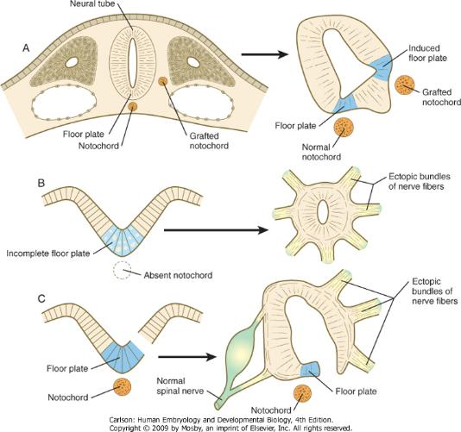
Experiments illustrating the influence of the notochord on development of the floor plate and exit sites of nerves from the spinal cord
Figure 11-7 A, Grafting an extra notochord near the neural tube induces a secondary floor plate. B, In the absence of a notochord, a very incomplete floor plate forms, and nerve fibers exit from multiple sites around the spinal cord. C, Slitting the neural plate on one side of the floor plate removes the wall of the neural tube from the influence of the notochord, allowing the disorganized exit of nerve fibers from that part of the spinal cord. (Modified from Hirano S, Fuse S, Sohal GS: Science 251:310-313, 1991.)
Downloaded from: StudentConsult (on 8 February 2011 04:21 PM)
© 2005 Elsevier
Notes:
57

Slide 58
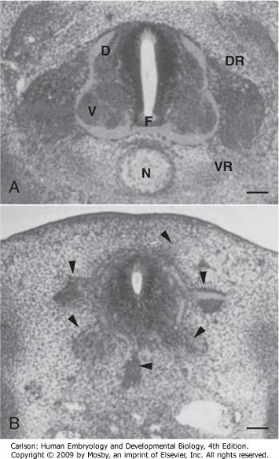
Figure 11-8 A, Photomicrograph of a normal embryonic quail spinal cord. B, In an experiment in which the notochord was absent, the spinal cord is disorganized and has multiple exit sites of nerve fibers (see Fig. 11-7B). Arrowheads indicate ectopic spinal nerves. D, dorsal; DR, dorsal root; F, floor plate; N, notochord; V, ventral; VR, ventral root. (From Hirano S, Fuse S, Sohol GS: Science 251:310-313, 1991.)
Downloaded from: StudentConsult (on 8 February 2011 04:21 PM)
© 2005 Elsevier
Notes:
58

Slide 59


Ventralising effect: Shh

Slide 60

Shh signaling

Slide 61

Dorsalising effect: TGF-β family

Slide 62

TGF-β signaling

Slide 63

Dorsal and ventral signaling in the early central nervous system
1. Pax-3, 7, Msx-1,2 expression in the neural tube
2.Shh from notochord inhibits the expression of Pax3, and 7 , initiation of the floor plate
3.Ventralisation: Shh produced by floor plate
4.Ectodermal BMP-4 és 7 induces the roof plate and BMP expression in it, maintain dorsalisation by Pax-3, 7, Msx-1 és 2
Basic pattern establised on the DV axis.
Induction of neuron subtype specific transcription factors
Figure 11-9 A, Signals from sonic hedgehog (Shh) (orange arrows) in the notochord induce the floor plate. B, In the dorsal part of the future neural tube, bone morphogenetic protein-4 (BMP-4) and BMP-7 (green arrows) from the ectoderm adjacent to the neural tube induce slug in the future neural crest and maintain Pax-3 and Pax-7 expression dorsally. Ventrally, Shh, now produced by the floor plate, induces motoneurons. C, Shh, produced by the floor plate, suppresses the expression of dorsal Pax genes (Pax-3 and Pax-7) in the ventral half of the neural tube.
Downloaded from: StudentConsult (on 8 February 2011 04:21 PM)
© 2005 Elsevier
Notes:
63

Slide 64


Cross section of the spinal cord

Slide 65

The molecular basis for the specification of neurons throughout
the cross section of the neural tube
Islet-1:
Motoneuron
specification
Figure 11-10 At the left, various classes of progenitor neurons are given labels beginning in P. At the right of the neural tube, a decreasing concentration gradient of sonic hedgehog is indicated by the fading red-brown background. The class I factors (upper bars) are repressed by sonic hedgehog, whereas the class II factors are induced by sonic hedgehog. To the right of the bars is the set of homeodomain codes that specify the various levels of precursor neurons, and at the far right is the molecular signature of the neurons. FP, floor plate; MN, motoneuron precursors.
Notes:
65

Slide 67

Proneural genes in the forebrain show DV regionalisation
Carol Schuurmans and François Guillemot Current Opinion in Neurobiology 2002, 12:26–34

Slide 68


BMP
D
A
P
hox1
hox4
V
Shh

Slide 70
SUMMARY

Slide 71
Positional information patterns neural plate and tube
In addressing the issue of cell patterning, it is helpful to think in terms of a Cartesian system of positional information, in which naive cells may sense their position on orthogonal gardients of morphogens acting along the cranial-caudal and medial-lateral axes of the neural plate. Cells would acquire a unique „grid reference” by measuring the ambient concentration of morphogen on each of the intersecting axes and would then interpret this, their positional value, by selecting an appropriate fate from the range made avaiable in the genome. This concept is un doubtedly simplistic but not wholly unrealistic.

Slide 72
Events of pattern formation
Polarisation of the entire AP axis of the CNS primordium
2. Setting up of distinct morphogen sources at particular positions along the axis that act as local signaling centers, informing neighboring cells about their position and fate.
Similar events occur on the ML axis of the the neural plate (later the dorsal-ventral, DV, axis of the neural tube) except that, being considerably shorter than the AP axis, morphogen sources established at the dorsal and ventral poles are sufficent to pattern the entire axis.

Slide 73
At gastrulation, when a region of the dorsal ectoderm is set aside to be the neural palte, the AP axis is polarised by a gradient of Wnt molecules diffusing from the caudal pole of the neural plate and by counteracting Wnt inhibitors at the cranial pole. In the absence of Wnt signaling , the default neural fate of anterior is realised. Higher Wnt levels effectively confer successively more posterior neural fates. Gradients of retinoid signaling, also high at the posterior end of the embryo, operate in addition to Wnts to polarize the AP axis. The initially coarse regional subdivison of the AP axis is manifest by the expression of transcriptional control genes in distinct domains that dictate the direction of their subsequent development. For example, Otx2 is expressed only in the anterior neural plate (forebrain and midbrain), whereas Hox genes are expressed in nested subdomains of the caudal neural plate (hindbrain and spinal cord). Gbx2 is expressed between the Otx2 and Hox expression domains.
Gbx2 and Otx2 proteins mutually repress each other’s expression, so their domains abut at a sharp line-this will become the midbrain/hindbrain boundary. At this interface between gene expression domains (isthmus region), a band of cells differentiates that secrete FGF8, which signals the formation of optic tectum in the Otx2 expression domain and cerebellum in the Gbx2 domain. Fgf8 is also released from a signaling center at the anterior pole of the axis (called: the anterior neural ridge: ANR), inducing the local expression of transcription factors such as Bf1 (also known as FoxG1) that establish the telencephalon as a distintct region of the forebrain. Similarly, a futher signaling center develops in the middle of the diencephalon (at the zona limitans interthalamica, ZLI) that releases another morphogen, Sonic hedgehog (Shh), which signals the formation of prethalamus anteriorly and thalamus posteriorly.

Slide 74
As the initially flat neural plate neurulates to form the neural tube, distinct signaling centers form at both ventral and dorsal midlines, along almost the entire length of the AP axis. The ventral pole cells, constituting the floor plate of the neural tube, secrete Shh, wheras the dorsal cells, constituting the roof plate of the neural tube, secrete Bmps. In the context of midbrain, hindbrain and spinal cord, Shh signaling from the floor plate induces the formation of a variety of neuronal cell types according to the concentration of Shh –at high levels, close to the floor plate, motoneurons are induced, whereas a diversity of interneurons is induced at successively lower Shh levels impinging on precursor cells at succesively more dorsal positions in the basal plate. The Bmp gradient from the roof plate counteracts the Shh gradient and is responsible for the elaboration of a range of alar plate cell types.
How AP and DV signals interact to confer position in two dimensions is not fully understood. However, it is clear that the signals from the dorsal and ventral poles are essentially uniform along the length of the AP axis, yet they induce different cell types at different AP positions. For example, Shh from the midbrain floor plate induces the formation of oculomotor neurons at one AP position and dopaminergic neurons of the substantia nigra at another AP position. One explanation is that the uniform ventral signal in this case acts on a preexisting bias, or competence, of the receiving cells that is conferred during patterning of the AP axis.
Having achieved a correct spatial pattern of differentiation, with individual neuronal subtypes either in their correct positions or specified to migrate into new setting positions, the next major event in brain development is the outgowth of axons to form connections with other neurons- the substrate of forming neural networks.

Slide 75
Thank you for your attention!

Slide 76

Main references:
B. M. Carlson Human Embyology and Developmental Biology
Larsen’s Human Embryology, edited by Schoenwolf
S. F. Gilbert: Developmental Biology

Slide 77
http://www.youtube.com/watch?NR=1&v=qisrNX3QjUg&feature=endscreen
http://www.youtube.com/watch?v=EQkYEHr8a8s
http://www.youtube.com/watch?feature=endscreen&NR=1&v=ZcAAsr_8vOE

