Slide 1
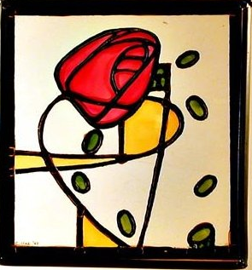
(Sejt-sejt kölcsönhatások, extracelluláris mátrix és integrinek az embrióban)
Epitheliális morfogenezis: a lamina basalis szerepe a sejtmigrációban és a hám-lefűződésben
Semmelweis Egyetem, ÁOK, Anatómiai, Szövet- és Fejlődéstani Intézet
Dr. Kocsis Katalin
2019.10.30.

Slide 2
Hámok
Sejt-sejt kapcsoló struktúrák

Slide 3
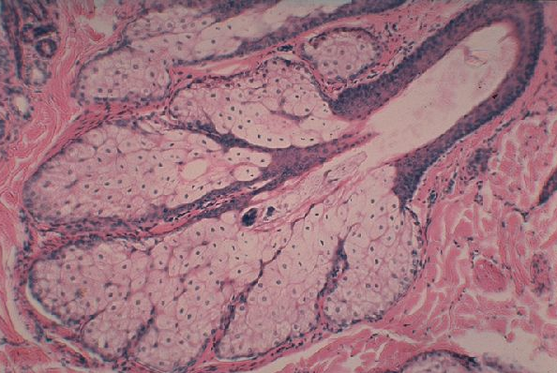
During embryogenezis, simple epithelial sheets are converted into functional three-dimensional tissues and organs.
Epithelial architecture:
Epithelia form the covering of all body surfaces with specialized function.
- filtration – kidney tubules absorption – intestine - secretion – exocrine glands
Az egy rétegű hámból, hogyan alakul ki a 3 dimenziós, funkcióval rendelkező szövet?
Hámszövet:
szorosan egymás mellett elhelyezkedő sejtekből áll, amelyeket sejtkapcsoló struktúrák kapcsolnak össze.
A test külső és belső felszínén mindenhol, specializálódott funkcióval ellátott szövettípus: - filtráció – vese - abszorpció – bélhám - szekréció – exokrin mirigyek

Slide 5
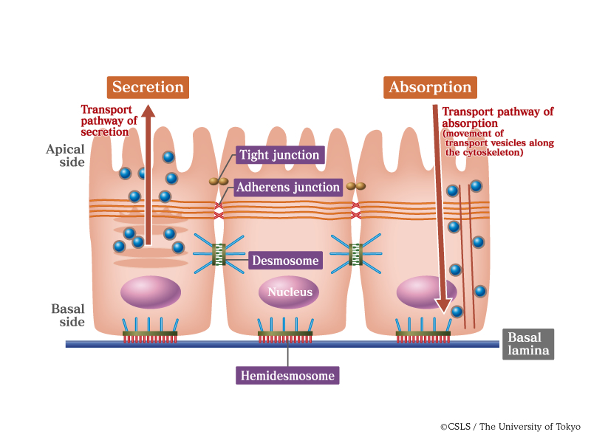
Polarity of the cell and cell-cell contacts
Sejtek polaritása, sejtkapcsoló struktúrák

Slide 6
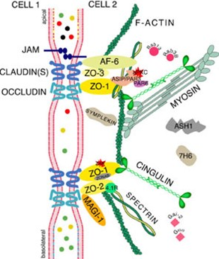
Tight junction/Zonula occludens:

Slide 7
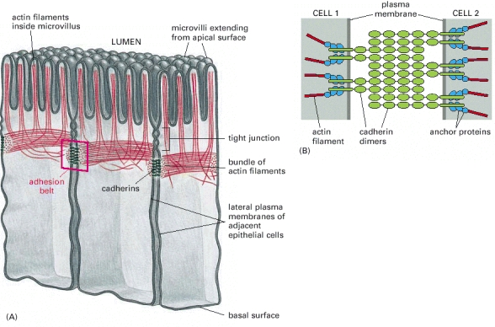
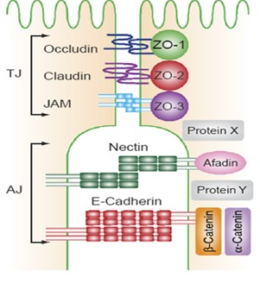
Zonula adherens: MECHANIKAI KAPCSOLAT

Slide 8
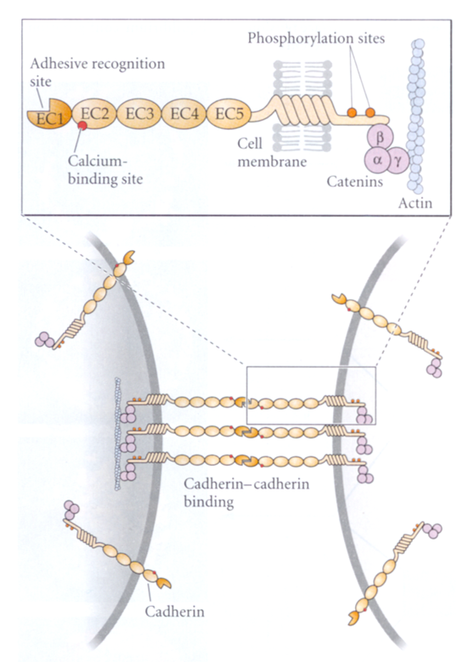
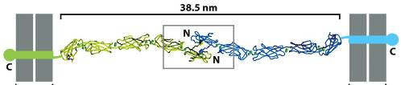
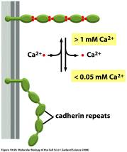
Cadherinek közvetítette sejtadhézió:
CADHERIN
Ca -dependens
sejtadhézió

Slide 9
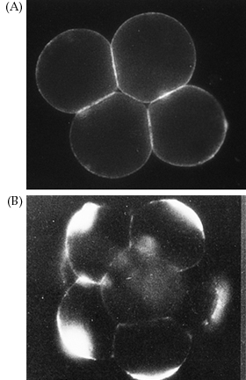
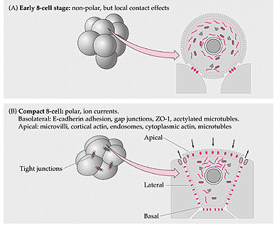
A kompaktizáció - E-cadherin expressio fontossága
E-cadherin
E-kadherin=uvomorulin: 54,000 D sejtadhéziós molekula

Slide 10
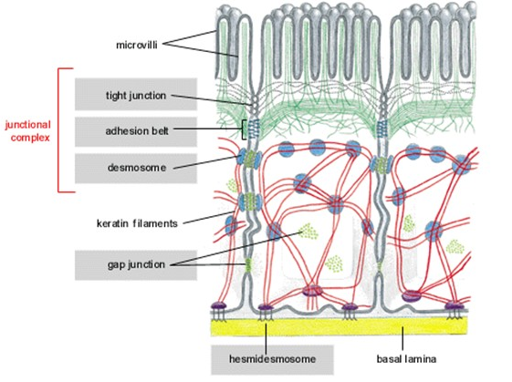

Slide 11
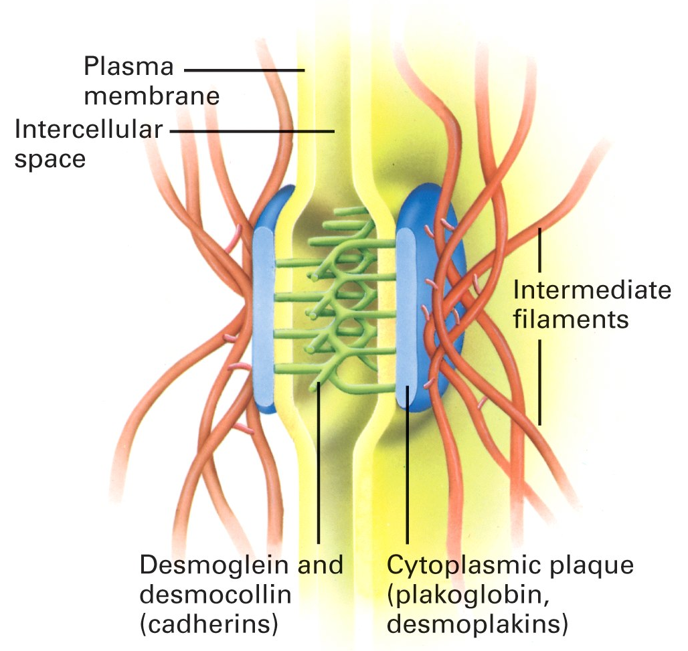
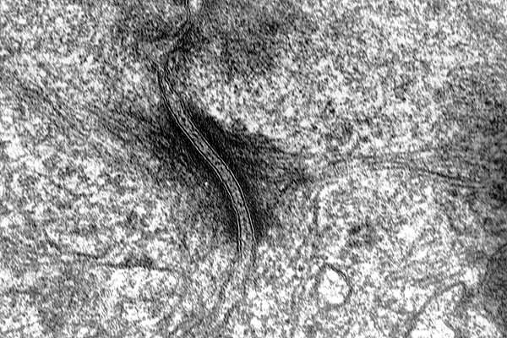
Desmosoma: erős mechanikai kapcsolat

Slide 12
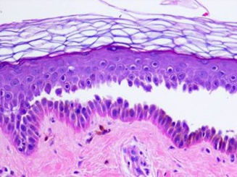
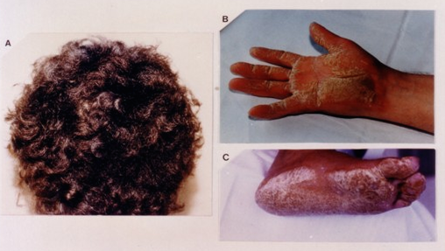
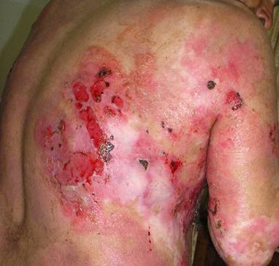
Desmosomális rendellenességek
Pemphigus vulgaris
Desmoglein1
Desmoglein3
Naxos-szindróma
-gyapjas haj
-palmoplantar keratoma
-kardiomyopathia
(desmoglobin, plakoglobin mutáció)
http://commons.wikimedia.org/wiki/Image:Naxos_disease.jpg

Slide 13
ECM

Slide 14
      Extracellular matrix (ECM)
      a) kollagének
      b) proteoglikánok, hyaluronsav
      c) elasztin
      d) glikoproteinek, pl.: fibronectin, laminin, tenascin

Slide 15
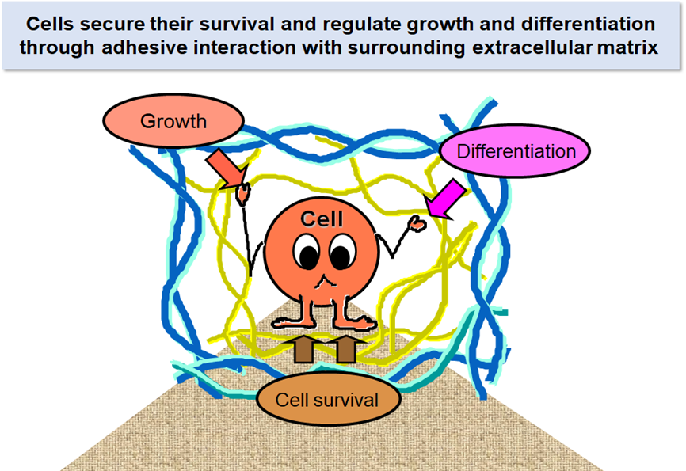
http://www.matrixome.co.jp/en/about/sekiguchi

Slide 16
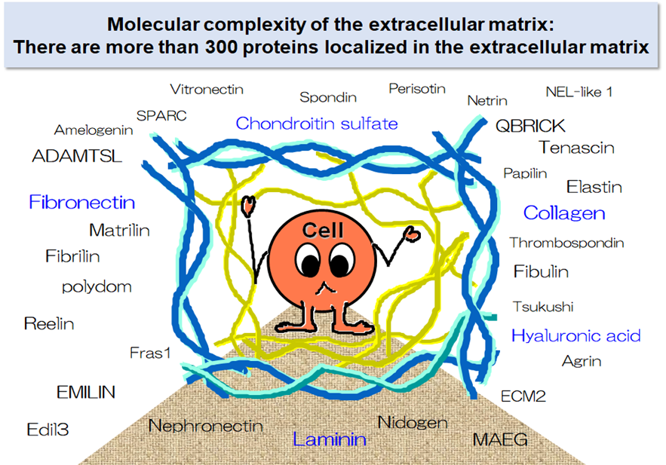

Slide 17
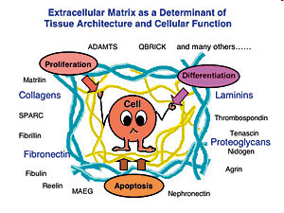

Slide 18
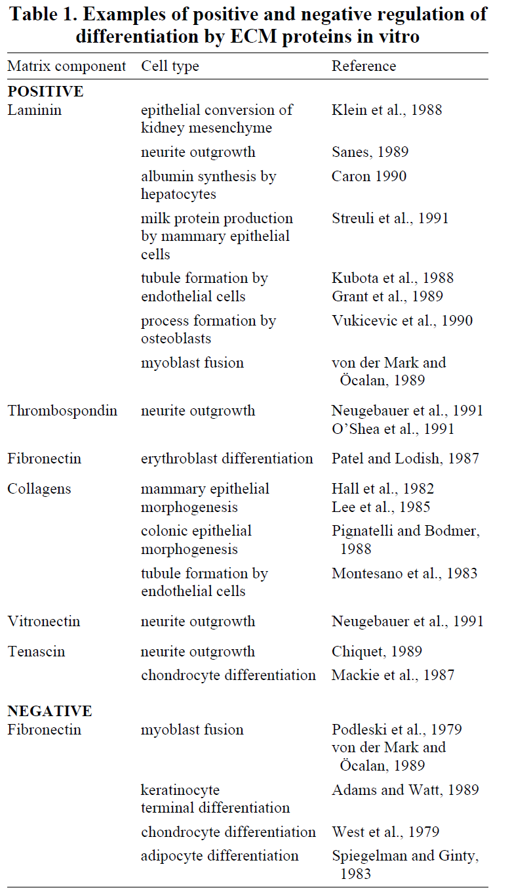

Slide 19
Factors Influencing the Migration of Crest Cells
Permissive molecules
Inhibitory molecules
dissociation of lamina basalis of neural tube: plasminogene activator
F-spondin (thrombospondin)
ECM components: laminin, fibronectin, tenascin, collagene typ. IV
ECM components: chondroitin-sulphate, aggrecan, versican, collagen type IX.
Cell adhesion molecules: (cadherin)
Ephrin-proteins (Ephrin B2 and B1)
on Eph receptors
Growth factors: Mash1, endothelin-3, neurogenin, GDNF.
Notes:
19

Slide 20
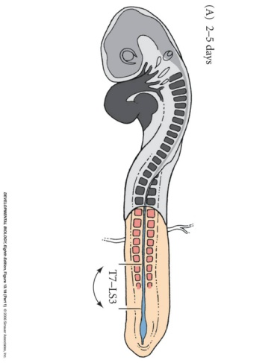
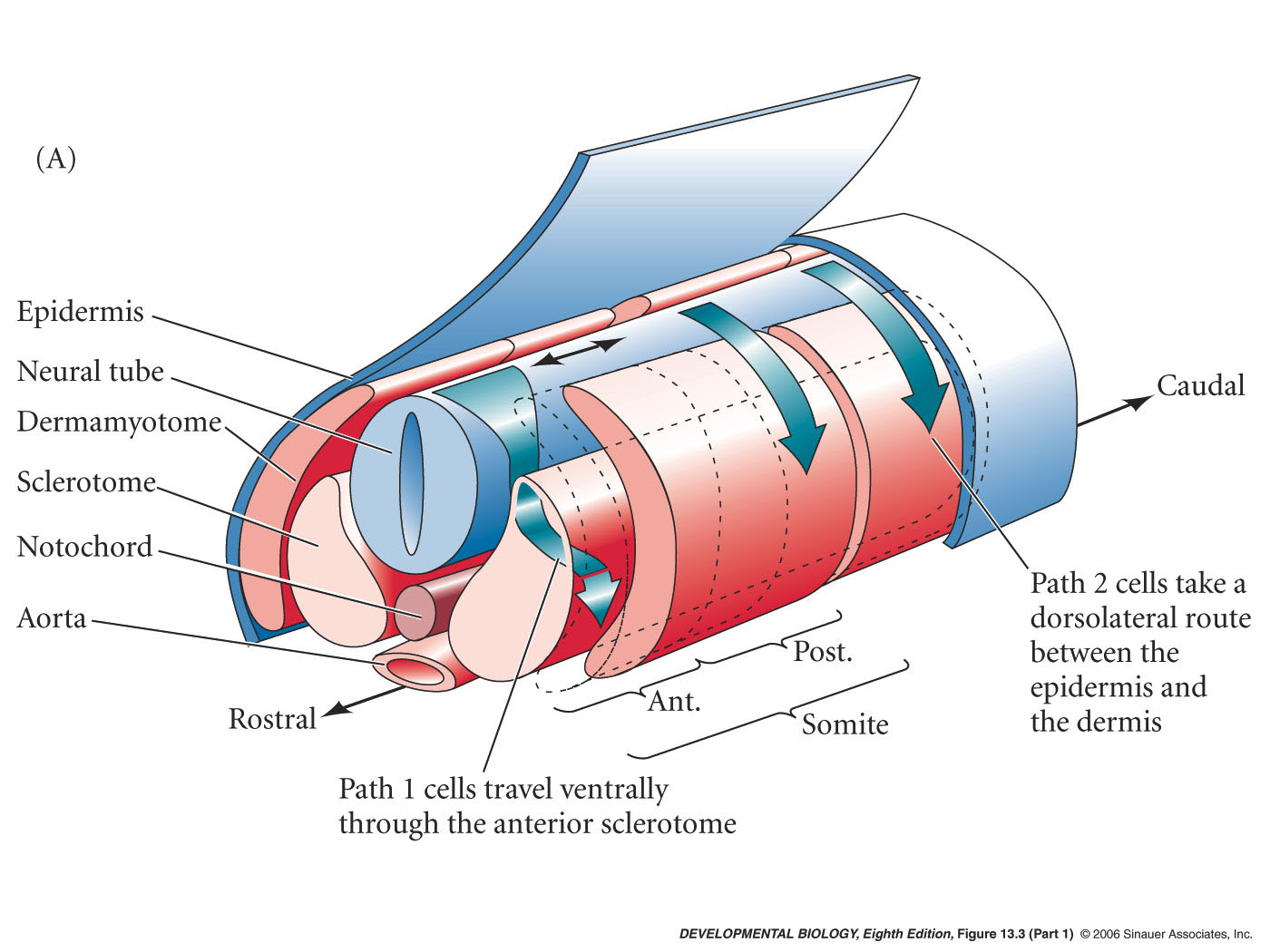
Neural crest cell migration in the trunk
Thrombospondin is expressed in the anterior section of sclerotomes, and cooperates with fibronectin and laminin to promote NC migration
Notes:
20

Slide 21
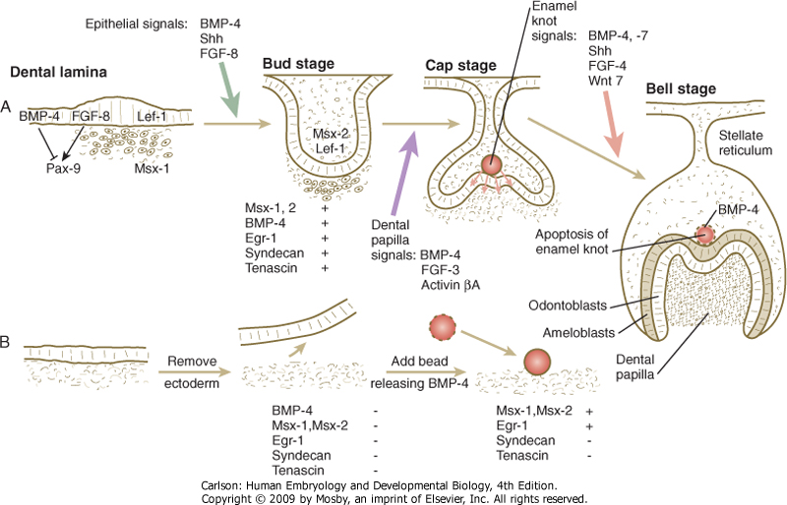
Figure 14-17 A, Inductive interactions during tooth development. Molecules associated with the green arrow represent components of the signal from dental lamina ectoderm to underlying neural crest mesenchyme; molecules associated with the violet arrow are signals from the dental papilla to the overlying ectoderm; molecules associated with the pink arrow are signals from the enamel knot to dental papilla. B, In vitro experiment showing that a bead releasing BMP-4 can induce dental mesenchyme to express specific markers (Msx-1, Msx-2, and Egr-1).

Slide 22
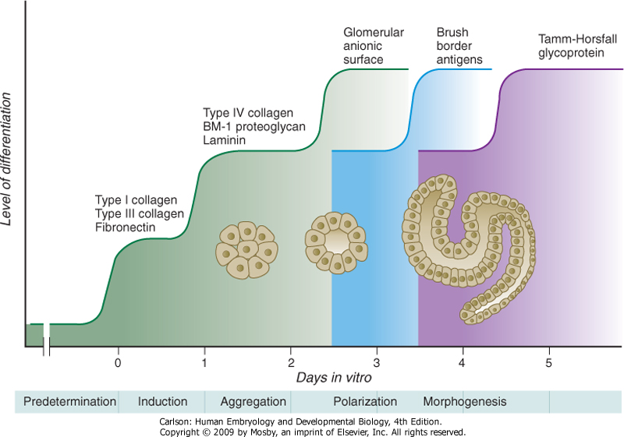
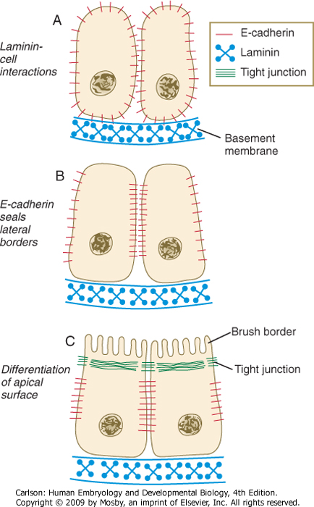
Nephron fejlődése során expresszálódó molekulák (szövettenyészet)
Molecules expressed during the development of the nephron
Proximalis kanyarulatos csatorna falának fejlődése
Proximal convoluted tubule: development of the wall

Slide 23
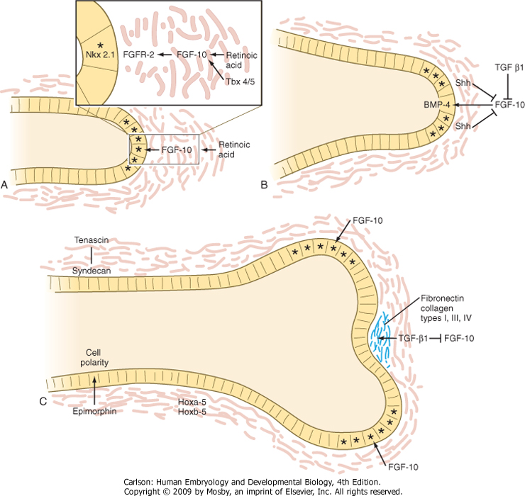
Figure 15-26 Molecular aspects of outgrowth and branching of the respiratory tree. A, The tip of an elongating respiratory duct. FGF-10 secretion in the mesenchyme stimulates the growth of the tip of the epithelial duct toward it. B, The prelude to branching. Inhibition of FGF-10 signaling at the tip of the duct leads to stabilization of that area. C, Cleft formation.

Slide 24
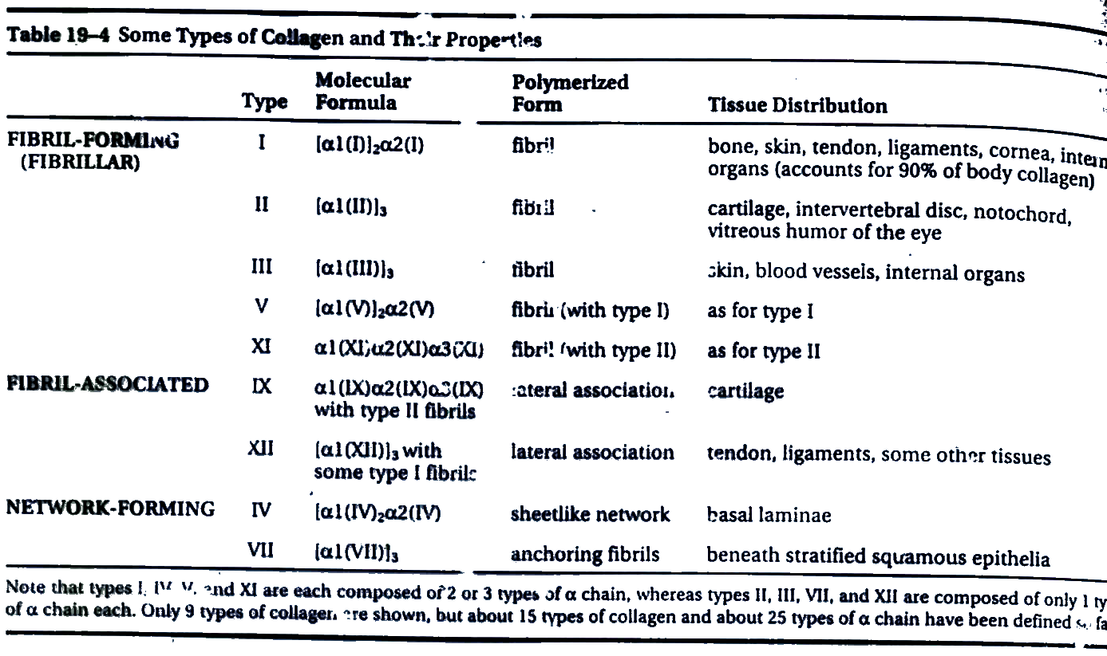
Kollagének

Slide 25
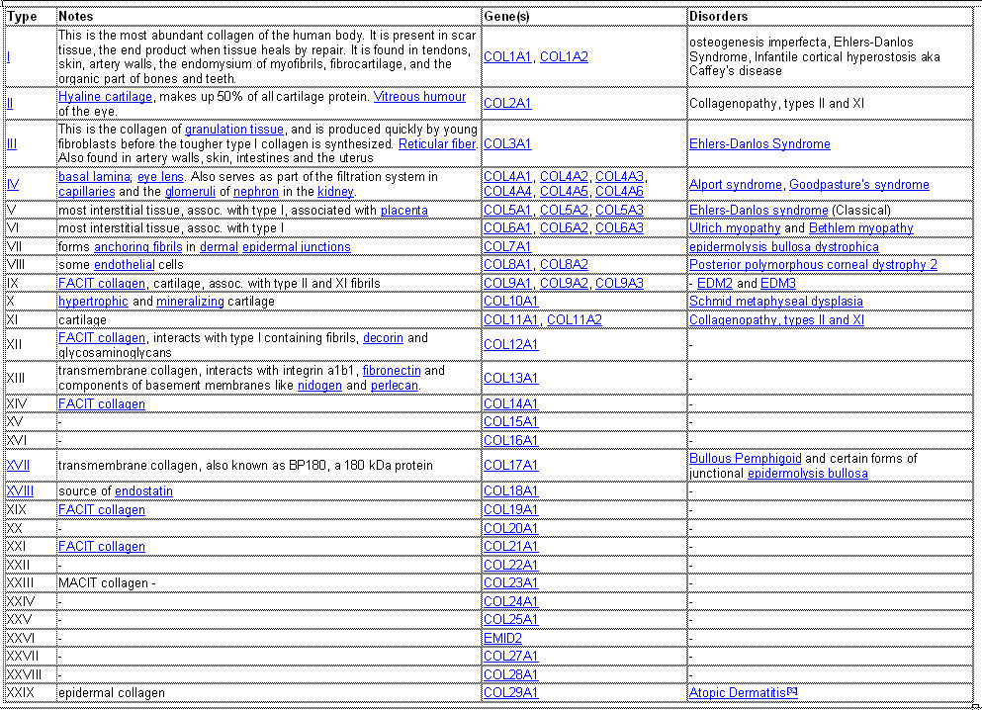
Kollagének

Slide 26
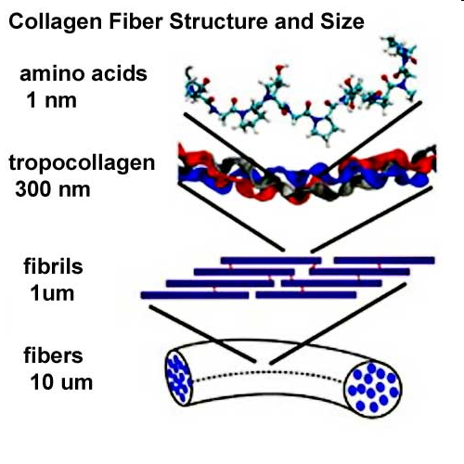
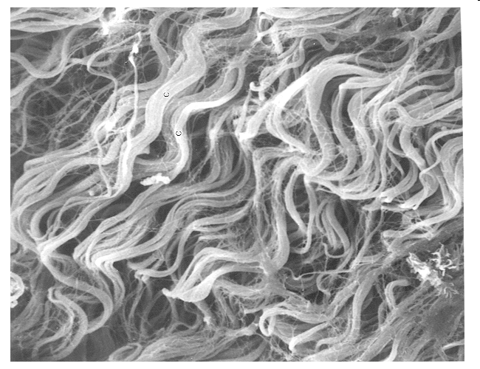
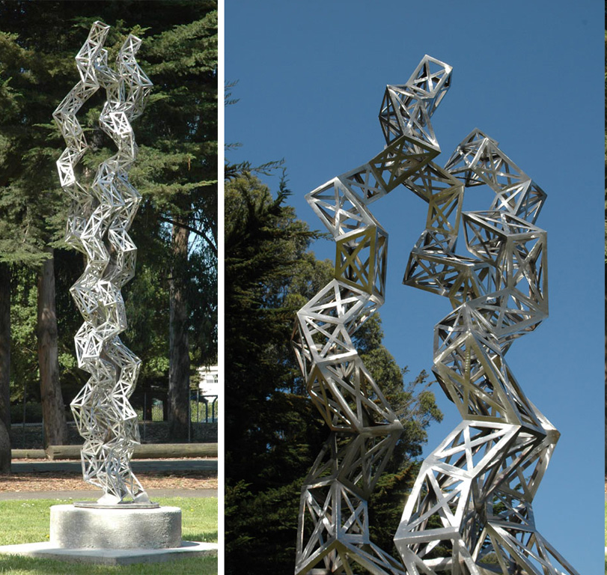
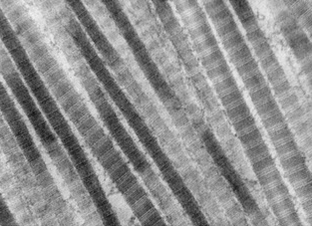
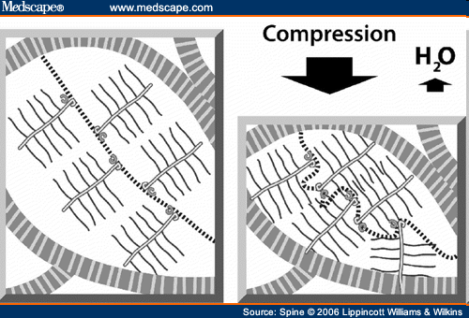
Artist: Julian Voss-Andreae
Sculpture shown: "Unraveling Collagen", 2005, stainless steel, height: 11'3' (3.40 m).
Location: Orange Memorial Park Sculpture Garden, City of South San Francisco, CA. Right panel shows the top.
Kollagének

Slide 27
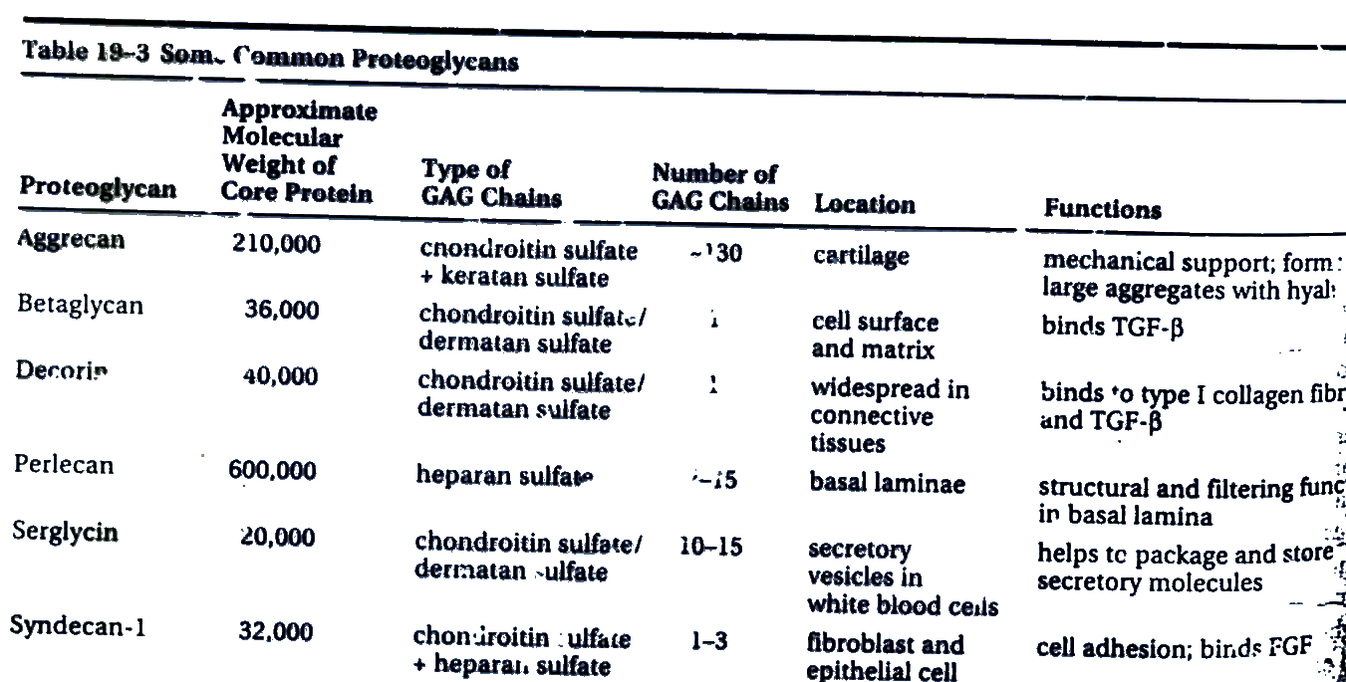
Proteoglikánok

Slide 28
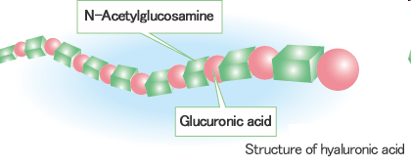
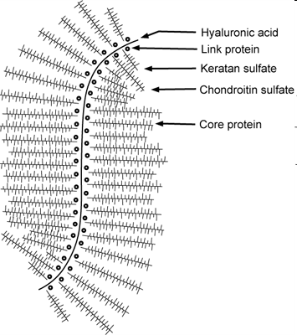
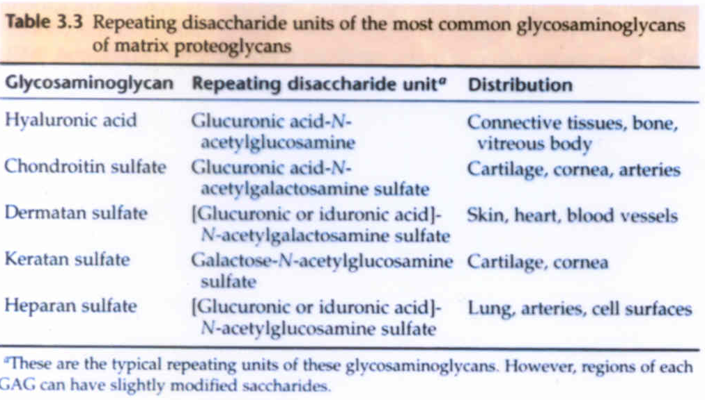
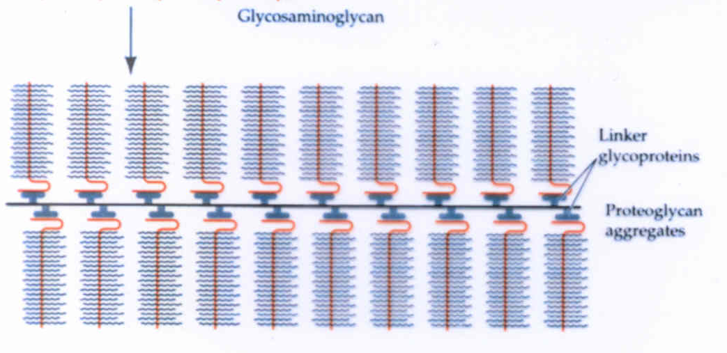
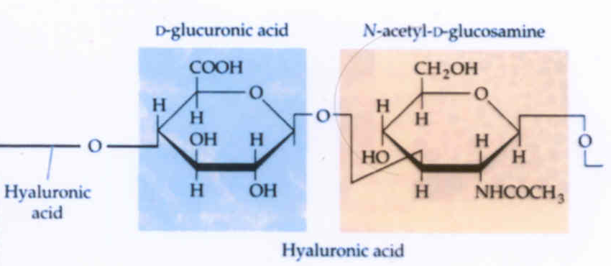
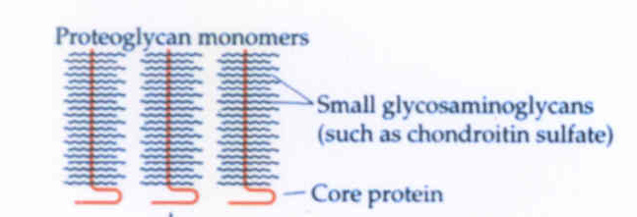
Proteoglikánok

Slide 29
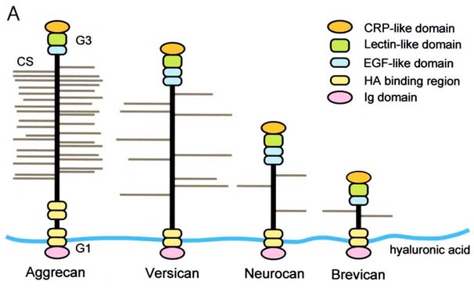
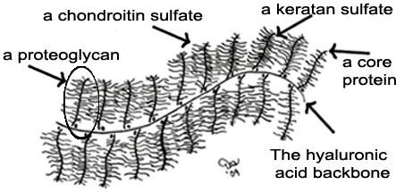
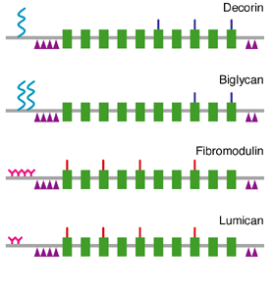
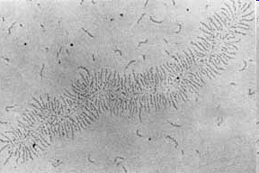
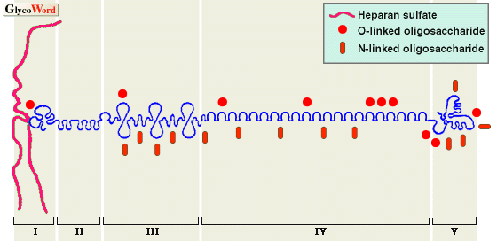
aggrecan
perlecan
Proteoglikánok

Slide 30
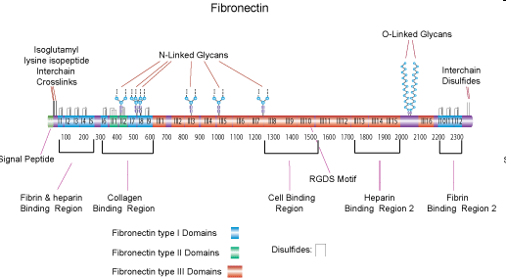
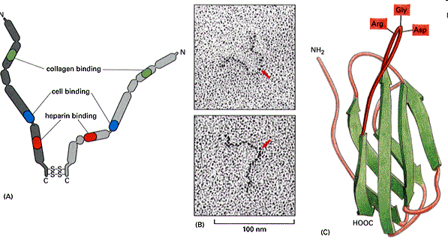
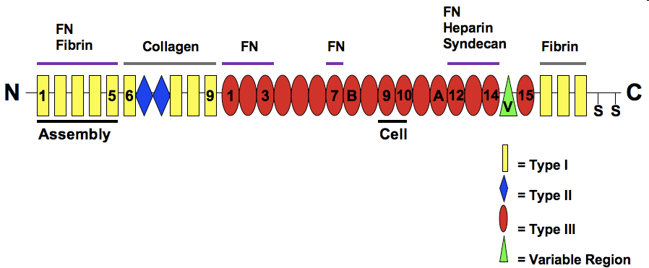
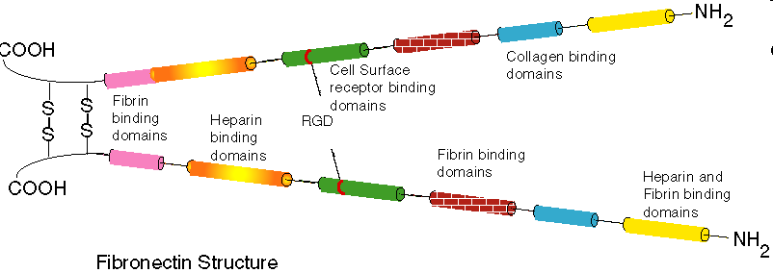
Fibronectin

Slide 31

Figure 6.32.
Fibronectin in the developing frog embryo. (A) Fluorescent antibodies to fibronectin show fibronectin deposition as a green band in the Xenopus embryo during gastrulation. The fibronectin will orient the mesoderm movements of the cells. (B) Structure and binding domains of fibronectin. The rectangles represent protease-resistant domains. The fibroblast-binding domain consists of two units, the RGD site and the high-affinity site, both of which are essential for cell binding. Avian neural crest cells have another site that is necessary for them to migrate on a fibronectin substrate. Other regions of fibronectin enable it to bind to collagen, heparin, and other molecules of the extracellular matrix.

Slide 32
Lamina basalis, membrana basalis

Slide 33


membrana basalis /
lamina basalis
a hámszövetek lamina basalishoz kötődnek.
lamina basalis sejtmentes matrix
a lamina basalis vékony
szerepe:
sejtpolaritás befolyásolása
proliferáció szabályozása
szűrő funkció

Slide 34


Lamina basalis
A hámréteg basalis felszínéhez illeszkedő vékony réteg (40-120 nm vastag, fénymikroszkóppal alig, elektronmikroszkóppal jól látható).
EM: két rétegből áll
lamina rara (sejtmembránhoz közelebb)
lamina densa
lamina rara
lamina densa
→
lamina fibroreticularis
perlecan
dystroglycan
integrin
laminin
nidogen
lamina densa IV-es kollagén
→
fibronectin

Slide 35

Lamina basalis

Slide 36


Slide 37




Lamina basalis
collagen type IV.
nidogen/entactin

Slide 38





Laminin

Slide 39


Slide 40

Figure 6.35.
Role of the extracellular matrix in cell differentiation. Light micrographs of rat Sertoli testis cells grown for two weeks (A) on tissue culture plastic dishes and (B) on dishes coated with basal lamina. The two photographs were taken at the same magnification, 1200×.

Slide 41

Figure 6.36.
Basement membrane-directed gene expression in mammary gland tissue. (A) Mouse mammary gland tissue divides when placed on tissue culture plastic. Cell division genes are on, and the genes capable of synthesizing the differentiated products of the mammary gland (lactoferrin, casein, whey acidic protein) are off. (B) When presented with basement membrane that contains laminin, the genes for cell division proteins are turned off, while the gene inhibiting cell division (p21) and the gene for lactoferrin are turned on. (C, D) Mammary gland cells wrap the basement membrane about them, forming a secretory epithelium. The genes for casein and whey protein are sequentially activated.

Slide 42




Dystroglycan

Slide 43
Integrinek
Sejt-matrix kapcsolatok

Slide 44




Integrinek
arg-gly-asp (RGD)

Slide 45


The integrin family.
DEAN SHEPPARD Physiol Rev 2003;83:673-686
Notes:
The integrin family. Solid lines indicate α,β pairings that have been identified to date on mammalian cells. Since, despite near completion of the human and murine genomes, no new integrin subunit has been identified in the past 2 years, it is likely that this subunit list is near complete. Additional heterodimeric pairings may remain to be identified.

Slide 46

Simplified model of integrin signaling complexes.
DEAN SHEPPARD Physiol Rev 2003;83:673-686
Notes:
Simplified model of integrin signaling complexes. The model depicts the types of components that are organized by integrins at points of close apposition to integrin ligands. These include kinases, such as src family members, dual kinase/adaptor proteins, such as the focal adhesion kinase (FAK), scaffolding proteins, such as paxillin, and links to the actin cytoskeleton, such as α-actinin and vinculin.

Slide 47


Hemidesmosoma, focalis contactus

Slide 48




Integrinek

Slide 49

Figure 6.37.
Two types of activation by cell adhesion molecules. (A) Cell-substrate adhesion molecules such as integrins may transmit a signal from the cytoplasmic portion of the integrin protein to the Ras G protein through a cascade involving caveolin and Fyn proteins. (B) The FGF receptors may be “hijacked” by cell adhesion molecules and dimerized. They may be brought together by the interaction of opposite cell adhesion molecules, or the “crosslinking” of FGF receptors by the apposing cell membrane may activate their kinase domains.

Slide 50


integrins in the preimplantation embryos
Expression of cell adhesion molecules during human preimplantation embryo development.
Bloor DJ¹, Metcalfe AD, Rutherford A, Brison DR, Kimber SJ.
Mol Hum Reprod. 2002 Mar;8(3):237-45.

Slide 51
Sejt-migráció

Slide 52

Figure 1: Integrin-mediated cell adhesion to the ECM. (a) Suspended cells adhere to the surface of ECM via integrins. Some of the nascent adhesion contacts grow and form mature focal adhesions (FAs). (b) Integrins function as a heterodimer composed of α- and β-chains. (c) The cytoplasmic portions of integrins recruit multiple cellular proteins and form cross-linked platforms to regulate both the actin cytoskeleton and signal transduction.
https://www.hindawi.com/journals/ijcb/2012/310616/fig1/

Slide 53

Focal adhesion migrating cell
Adhesion is closely coupled with the protrusions of the leading edge of the cell (filopodia and lamellipodia). Adhesions (nascent adhesions) initially form in the lamellipodium (although adhesions may also be associated with filopodia) and the rate of nascent adhesion assembly correlates with the rate of protrusion. Nascent adhesions either disassemble or elongate at the convergence of the lamellipodium and lamellum (the transition zone). Adhesion maturation to focal complexes and focal adhesions is accompanied by the bundling and cross-bridging of actin filaments, and actomyosin-induced contractility stabilizes adhesion formation and increases adhesion size.
Reference
J Thomas Parsons, Alan Rick Horwitz, Martin A Schwartz Cell adhesion: integrating cytoskeletal dynamics and cellular tension. Nat. Rev. Mol. Cell Biol.: 2010, 11(9);633-43 PubMed 20729930

Slide 54
Epithelialis transformatio,
tubulus képződés
különböző fajtái

Slide 55



Slide 56

Morphological Processes of Tube Formation
Wrapping: a portion of an epithelial sheet invaginates and curls until the edges of the invaginating region meet and seal, forming a tube that runs parallel to the plane of the sheet.
Budding: a group of cells in an existing epithelial tube (or sheet) migrates out and forms a new tube as the bud extends. The new tube is a direct extension of the original tube.
Cavitation: the central cells of a solid cylindrical mass of cells are eliminated to convert it into a tube.
Cord hollowing: a lumen is created de novo between cells in a thin cylindrical cord.
Cell hollowing: a lumen forms within the cytoplasm of a single cell, spanning the length of the cell.
caption

Slide 57

Tubulus képződés
Types of Simple Epithelial Tubes
Tube walls are formed by polarized epithelial cells with their apical membrane surface (red) facing inward toward the lumen space, and their basal surface (green) exposed to the extracellular matrix.
(A) A multicellular tube with four curved cells in the cross-section of the tube.
(B) A unicellular tube formed by a single cell, rolled up to enclose the lumen, and sealed with an autocellular junction.
(C) A unicellular tube with the lumen in the cytoplasm of the cell. There is no autocellular junction; the tube is “seamless.”

Slide 58
Neurulation
Chorda dorsalis

Slide 59
Elágazódások (branching) különböző formái

Slide 60


Branching morphogenesis drives the development of multiple organs.
James W. Spurlin III, and Celeste M. Nelson Phil. Trans. R. Soc. B 2017;372:20150527
© 2017 The Author(s)‏
Notes:
Branching morphogenesis drives the development of multiple organs. Some examples include the nervous system, vascular network, Drosophila trachea, mammary gland, ureteric network in the developing kidney and the airway epithelium in the lung. Diffusible signalling factors direct branching events; however, these factors are often specific to those particular tissues. These signals can regulate terminal branch locations and densities, as observed in nerve arborization and Drosophila trachea terminal tip cells. Additionally, these signalling pathways work to specify cells within cohorts undergoing branching, such as blood vessel and Drosophila dorsal branch tip cell selection, as well as highly proliferative Ret⁺ cells in ureteric branch tips. Mesenchyme-derived growth factors also facilitate collective migration of mammary epithelial cells to the terminal end bud (TEB). Growth factors found in the pulmonary mesenchyme promote airway epithelial branching, which requires airway smooth muscle differentiation and changes in epithelial cell shape. Top row: tissues that form branches by the action of single cells (nerves and Drosophila trachea terminal cells), or few cells within a cohort undergoing branching. Bottom row: branching systems that coordinate the behaviour of many cells within a cohort to drive branching. Cells that direct branching within a cohort are highlighted in green.

Slide 61

Branching morphogenesis
(A) The tracheal system of a stage 15 embryo, as visualized with a luminal antibody, 2A12.
(B) In white, preparation of the lung of an adult human using acryl polyester to fill in the airways. View from behind. The left lung has been filled less than the right half. Courtesy of H. Kurz, Anatomical Museum, University of Basel, Switzerland. In red, the descending aorta is visible.
(C) Collecting ducts of an adult kidney derived from the branched ureteric bud, filled with colored polyester. Courtesy of H. Kurz, Anatomical Museum, University of Basel, Switzerland.
(D) Branching in the mammary gland of a mouse in early pregnancy.

Slide 62

Branching Morphogenesis at the Cellular Level
Schematic representation of a typical branching process. In many cases, a subgroup of cells (schematically illustrated in black in [B]) of a preexisting epithelium (A) is assigned to undergo branching morphogenesis by the expression of a specific subset of transcription factors and/or signaling mediators. As a consequence of this determination step, these cells invaginate or form a primary bud (C). Branch formation is then initiated in the invaginated (or budded) structure (from [D] to [E]) and the branching process can be reiterated numerous times (F). In addition, lateral branches can be induced. After the branching process, complex processes lead to the development of specialized terminal structures, a process that is different in different branched organs. Because the development of the vascular system does not in general follow the scheme outlined in this figure, we have excluded in this review a description of how the branched aspects of the arterial and venous network arises.

Slide 63

Branching Morphogenesis at the Subcellular Level
Control of branch formation at the subcellular level in the Drosophila tracheal system. The FGF receptor tyrosine kinase Breathless is expressed in all tracheal cells. The activation of the receptor in the cells at the tip of the outgrowing branches, presumably due to their proximity to the localized source of the FGF ligand Branchless (blue), leads to the formation of filopodial cell extensions (A). Cells at the tip of the bud subsequently form broader cell extensions (B), and ultimately move toward the Bnl source (C and D). In (E) is shown a confocal image of a tracheal branch of a stage 14 Drosophila embryo expressing a membrane-bound version of GFP specifically in tracheal cells. One can clearly see that only the two leading cells produce filopodia (see also Sutherland et al. 1996 and Ribeiro et al. 2002).

Slide 64

Development of mammalian’s lung
The underlying principle is again a mesenchymal-epithelial cell-cell interaction mediated by FGF. Epithelial cells, expressing FGF receptor, respond to the secretion of FGF from nearby mesenchyme by bud formation and bud extension towards the FGF source. Exposure of the branch tip to high concentrations of FGF induces the expression of secondary genes in the tip such as bone morphogenetic protein 4 (BMP4), sonic hedgehog (Shh) and a mammalian sprouty ortholog (Sprouty 2), thus, turning the tips of the bronchial branches into signaling centers. BMP4 inhibits epithelial cell proliferation limiting branch extension. Shh is proposed to inhibit FGF10 expression in the mesenchyme near the tip, which splits FGF10 expression promoting the next round of branching and Sprouty2 (like drosophila sprouty) restricts branching to the tip of the branch.

Slide 65
Figure 15-26 Molecular aspects of outgrowth and branching of the respiratory tree. A, The tip of an elongating respiratory duct. FGF-10 secretion in the mesenchyme stimulates the growth of the tip of the epithelial duct toward it. B, The prelude to branching. Inhibition of FGF-10 signaling at the tip of the duct leads to stabilization of that area. C, Cleft formation.

Slide 66



