Slide 2
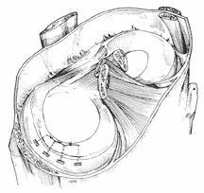
Functional and clinical anatomy of knee joints
Anatomy lecture
1st year medical students
14th October 2019
Dr. T. Wenger

Slide 3
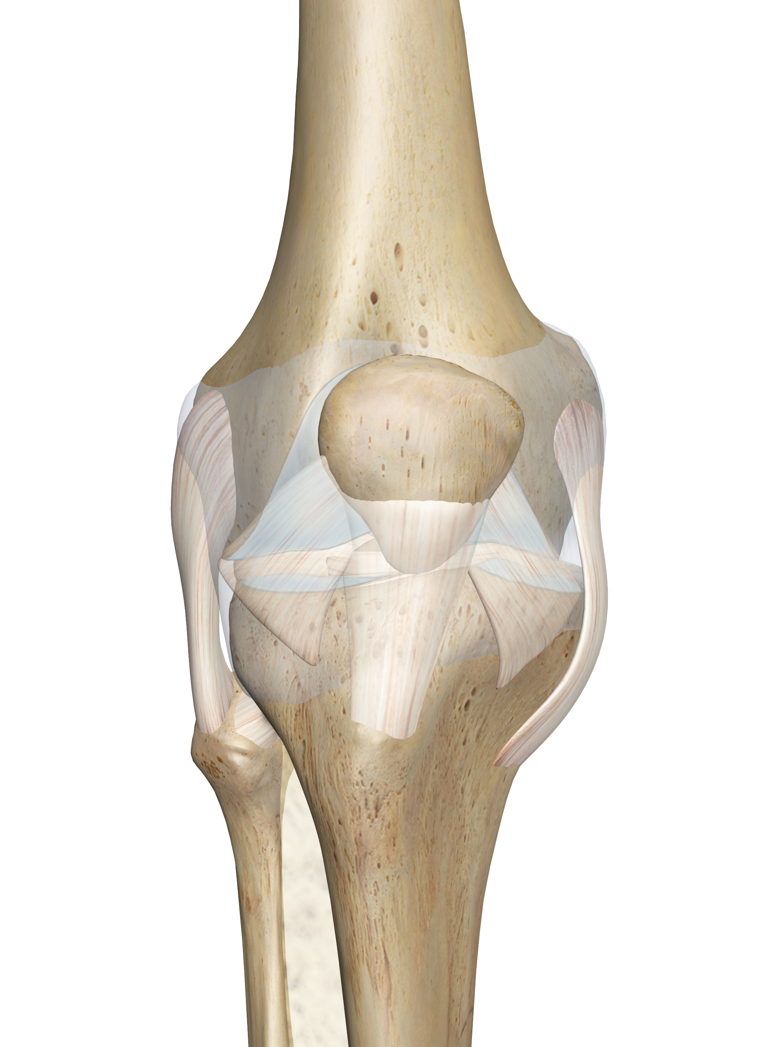
Knee joint (anterior view) schematic drawing
https://www.innerbody.com/assets/knee_joint.png

Slide 4
Knee joint (posterior view) schematic drawing
http://1.bp.blogspot.com/-MjA7naudakQ/USvDuPMtRDI/AAAAAAAAAOQ/9qKwi8R3wKE/s1600/Stuctures+of+Knee+Joint.jpg

Slide 5
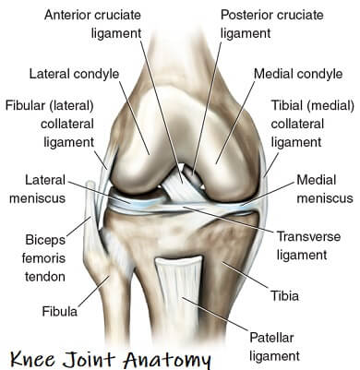
Knee joint ligaments (anterior view)
https://www.knee-pain-explained.com/images/knee-joint-anatomy-guide.jpg

Slide 6
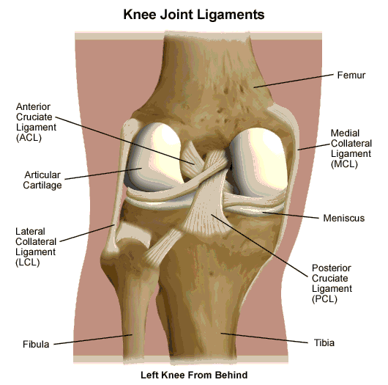
Knee joint ligaments (posterior view)
http://1.bp.blogspot.com/-MjA7naudakQ/USvDuPMtRDI/AAAAAAAAAOQ/9qKwi8R3wKE/s1600/Stuctures+of+Knee+Joint.jpg

Slide 7
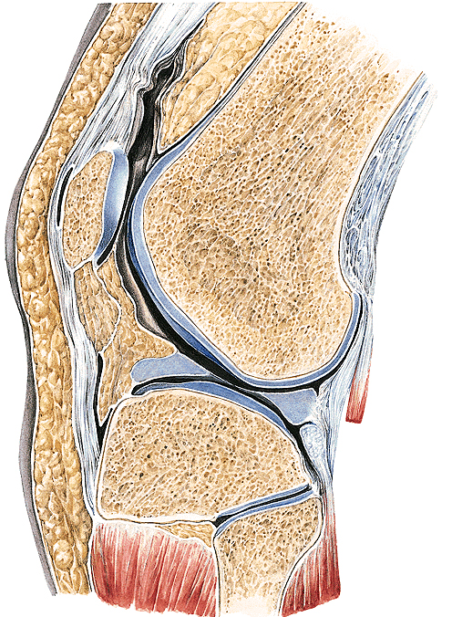
Knee joint, sagital view
Mechanism: trochoginglymus !!!
Two united joints (during the phylogenesis): „4” collateral ligaments!
Incongruentia: menisci
Frequent injuries (ligaments, menisci).
Source: Sobota - Atlas of Human Anatomy
Mouvements: flexion:130° ; extension:0-5° ;
lateral and medial rotacion:50° (only while in flexion!!!)

Slide 8
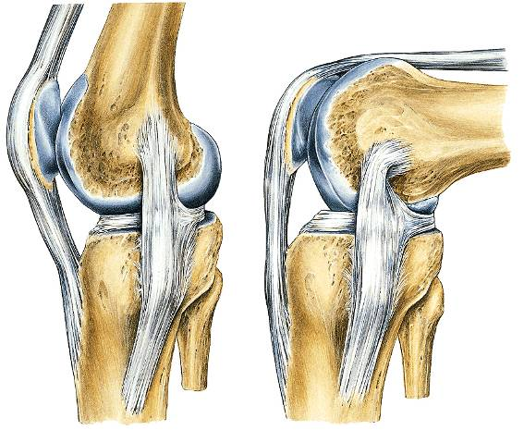
Collateral ligaments
Thighten in extension, loose in flexion (therefore rotation is possible).
Investigation is better while the knee is in extension.
When the knee is in 30⁰ flexion the cruciate ligaments inhibit more rotation.
Source: Sobota - Atlas of Human Anatomy

Slide 9
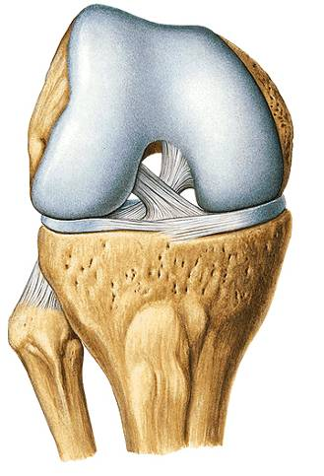
Cruciate ligaments
They are thighten in every position. Burden mainly while in flexion (skying).
They inhibit rotation, AP mouvements, lateral opening.
Test: lateral opening:”drawer” sign.
Anterior drawer sign: ant. cruciate lig. injury.
Posterior drawer sign: post cruciate lig. injury.
Source: Sobota - Atlas of Human Anatomy

Slide 10
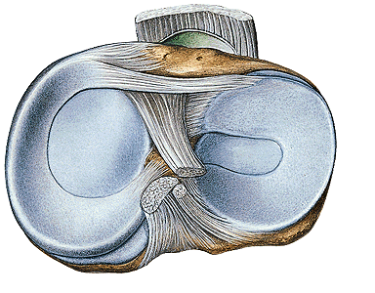
Menisci
Against incongruentia.
Fixed but mobile: they are mouving during flexion and rotation.
Medial is more fixed (more injury).
Signs of the injury: pain, no continuous mouvement.
Source: Sobota - Atlas of Human Anatomy

Slide 11
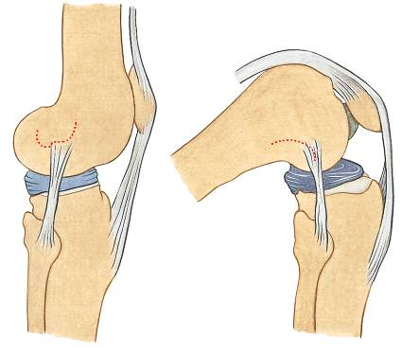
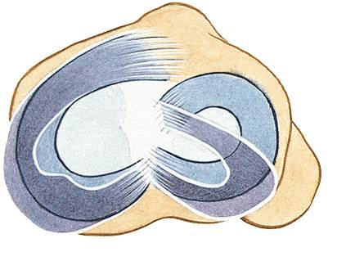
Mouvements (not active!) of the menisci
Source: Sobota - Atlas of Human Anatomy

Slide 12
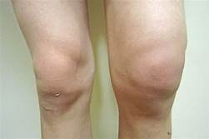
Knee joint: bursae
Bursitis
https://tse1.mm.bing.net/th?id=OIP.Yaiqkov34Y-CHFBI8g1hmQHaE7&pid=Api&P=0&w=251&h=168
https://study.com/cimages/multimages/16/1c0a1b72-fbac-4447-8f43-5eefe04a6fd9_knee_bursa.jpg
https://tse2.mm.bing.net/th?id=OIP.-mFSRaf_0eSrfpKT7EjYKgHaHk&pid=Api&P=0&w=300&h=300

Slide 13
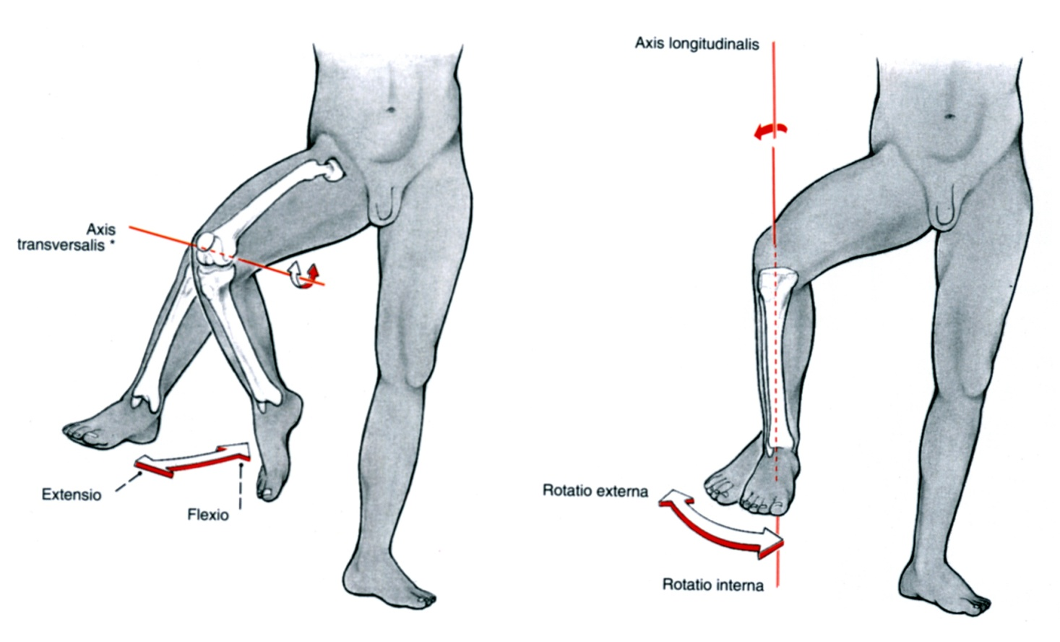
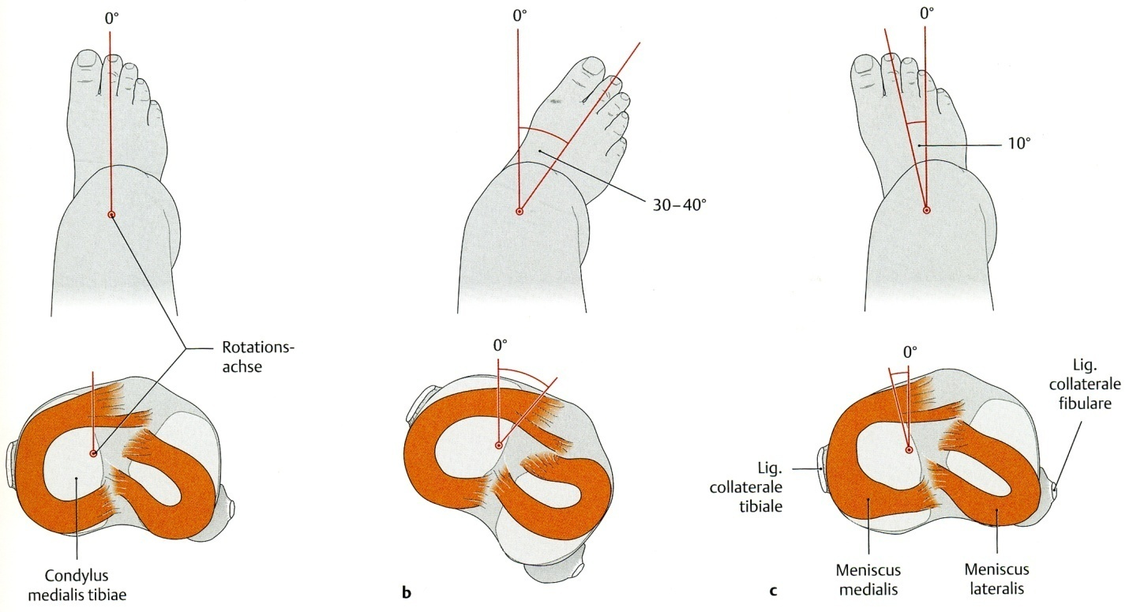
Axis of mouvements
of the knee joint

Slide 14
Arterial blood supply
of the knee joint

Slide 15
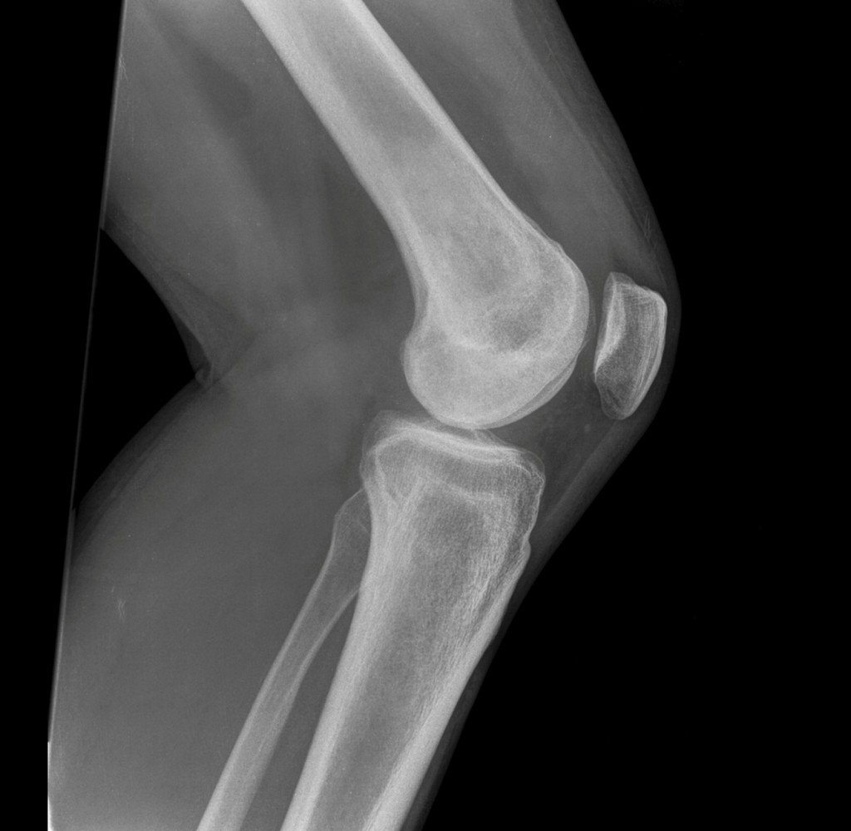
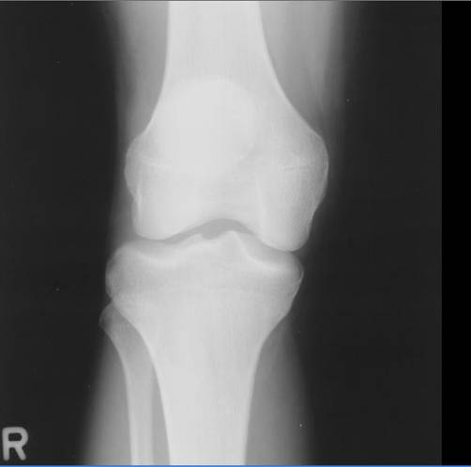
X-ray pictures of the knee joint

Slide 16
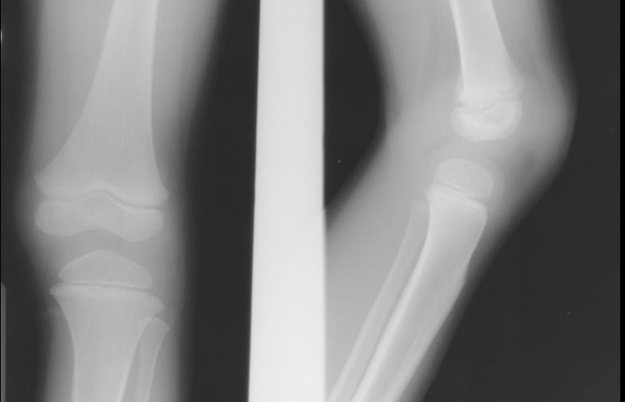
Child’s X-ray picture of the knee
Growth’s cartilage

Slide 17
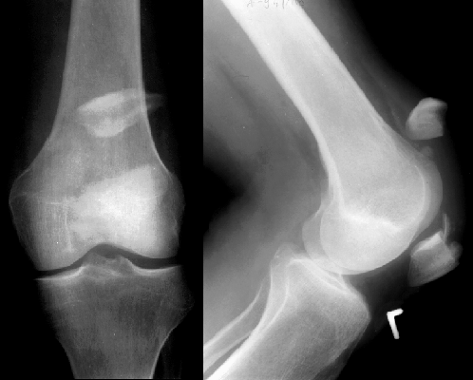
Patella fracture
The quadriceps femoris muscle pulls away the proximal fractured part.

Slide 18
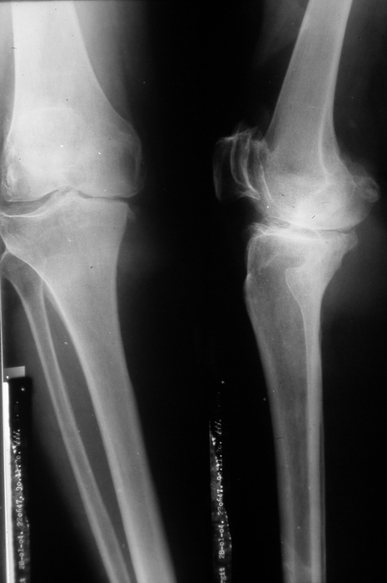
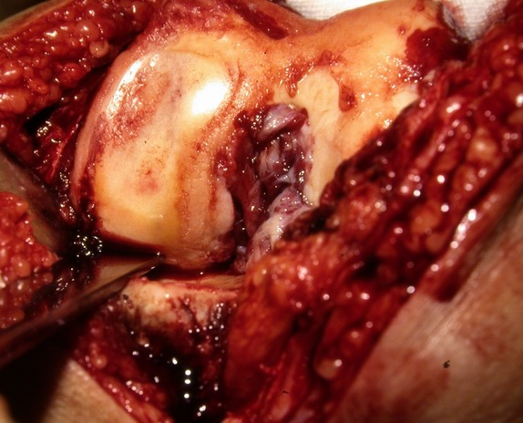
Knee joint necrosis

Slide 19
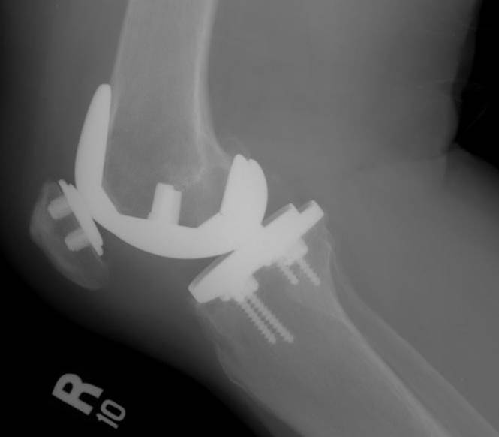
Knee joint prothesis
The cartilage of the synovial joint does not regenerate (no perichondrium)!

Slide 20
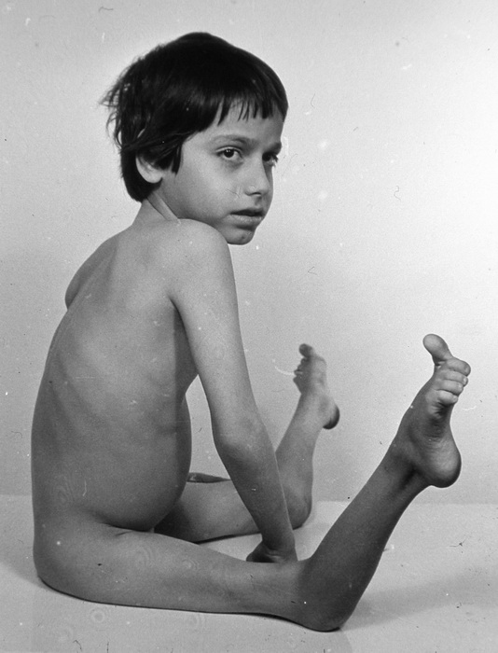
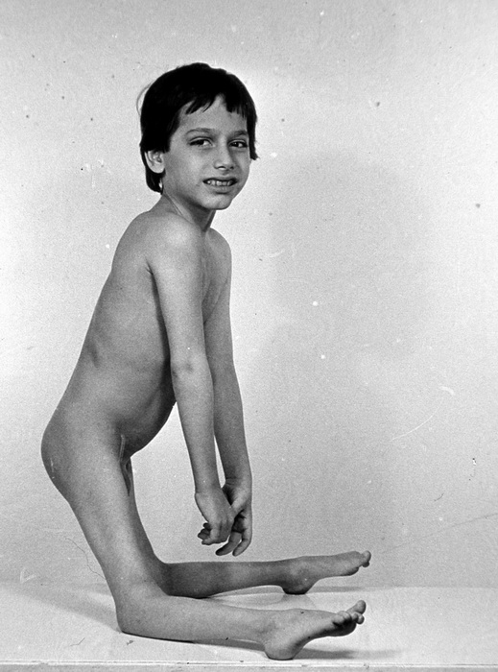
Congenital knee luxation
hyperextension

Slide 21
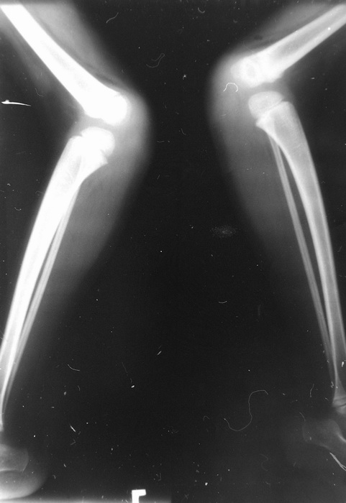
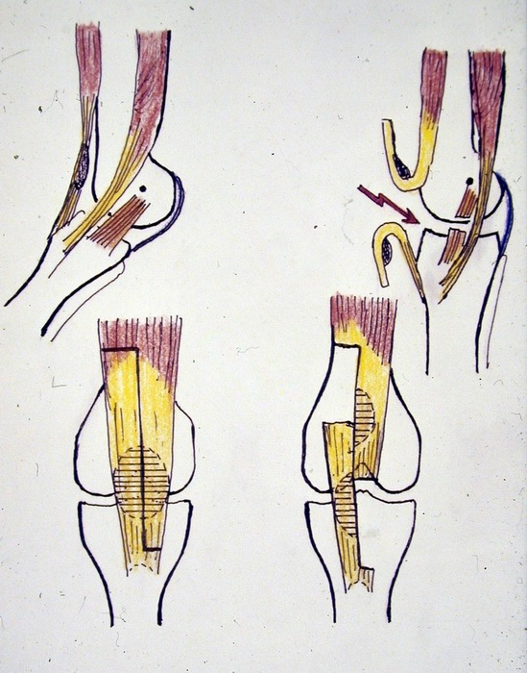
Congenital knee luxation (surgical treatment)

Slide 22
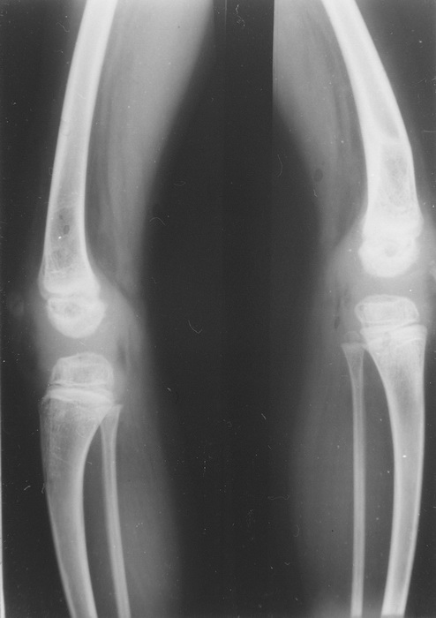
Congenital knee
luxation (X ray picture
after treatment)

Slide 23
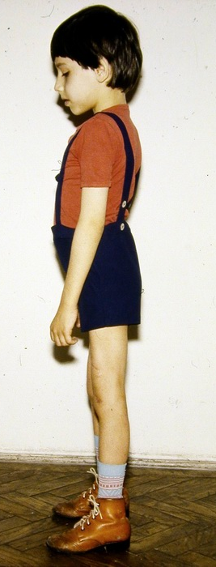
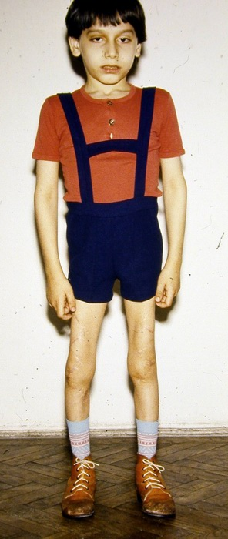
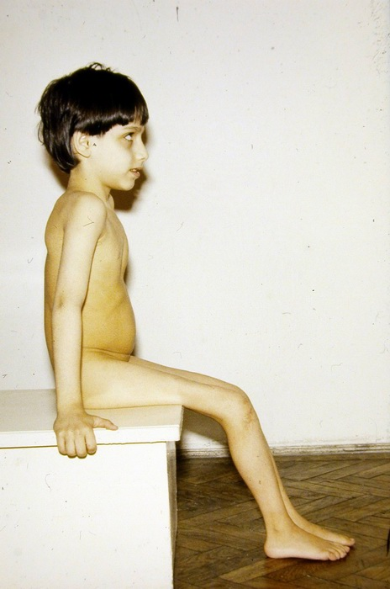

Slide 24
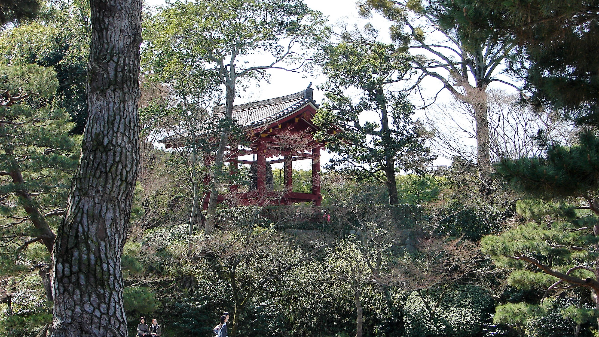
THANK YOU FOR YOUR ATTENTION

