Slide 1
Optogenetik
Attila Magyar
13.12.2019

Slide 2
Optogenetik
eine Kombination von Optik und Genetik:
hierbei werden lichtempfindliche Proteine auf gentechnischem Weg verändert und anschließend in bestimmte Zielzellen bzw. -gewebe eingebracht
unter Lichteinfluss ist es anschließend möglich, das Verhalten der in dieser Weise modifizierten Zellen zu kontrollieren: die Optogenetik erlaubt also eine gezielte und überaus schnelle (Millisekundenbereich) Kontrolle der Zelle
Notes:
Wikipedia

Slide 3
Optigenetik
Kontrolle über die Zellen (Neuronen): optogenetische Aktoren (Schaltelemente)
Channelrhodopsin, Halorhodopsin, Archaerhodopsin
oder Messen der neuronalen Aktivität mit optogenetische Sensoren (Ca-Flux; Abgabe von Neurotransmitter)

Slide 4
Optogenetische Aktoren
funktionieren mit einer Präzision im Millisekundenbereich
Grundlage: sehr schnelle, lichtgesteuerte Ionenkanäle, Pumpen oder Enzyme
Ionkanäle: erregende, wie Channelrhodopsin (ChR1, ChR2, VChR1, SFOs), hemmende, wie Anion-leitende Channelrhodopsin (ChloCs)
Pumpen: hemmende, wie Halorhodopsin (NpHR), Archaerhodopsin (Arch)

Slide 5
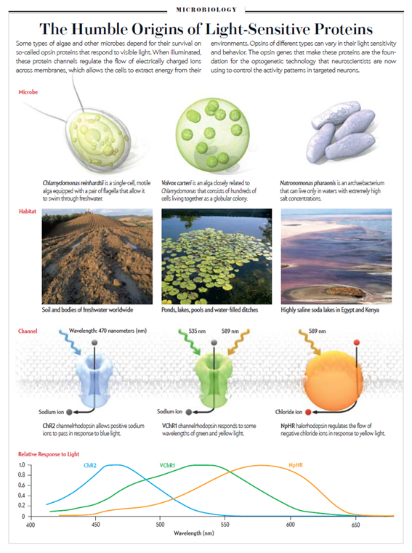

Slide 6
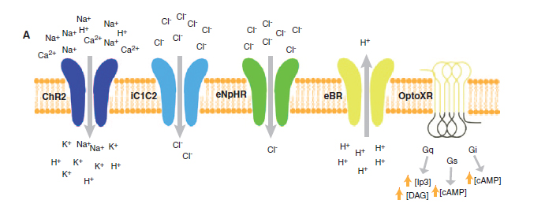

Slide 7
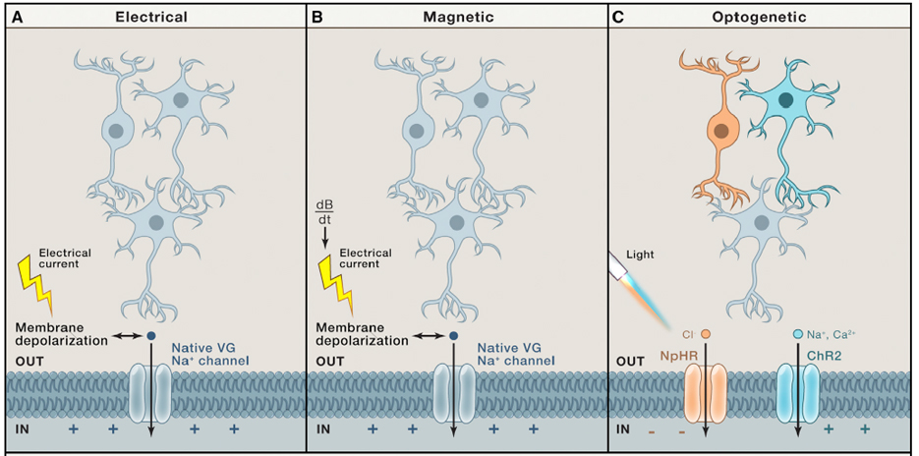

Slide 9
Channelrhodopsin-2 (ChR2) induces temporally precise blue light-driven activity in rat prelimbic prefrontal cortical neurons. a) In vitro schematic (left) showing blue light delivery and whole-cell patch-clamp recording of light-evoked activity from a fluorescent CaMKllα::ChR2-EYFP expressing pyramidal neuron (right) in an acute brain slice.

Slide 10
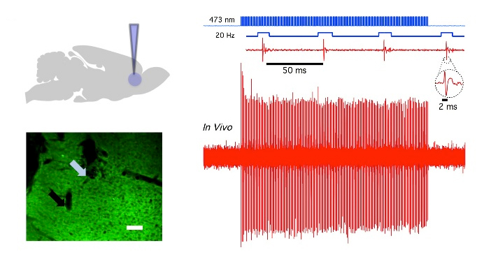
b) In vivo schematic (left) showing blue light (473 nm) delivery and single-unit recording. (bottom left) Coronal brain slice showing expression of CaMKllα::ChR2-EYFP in the prelimbic region. Light blue arrow shows tip of the optical fiber; black arrow shows tip of the recording electrode (left). White bar, 100 μm

Slide 11
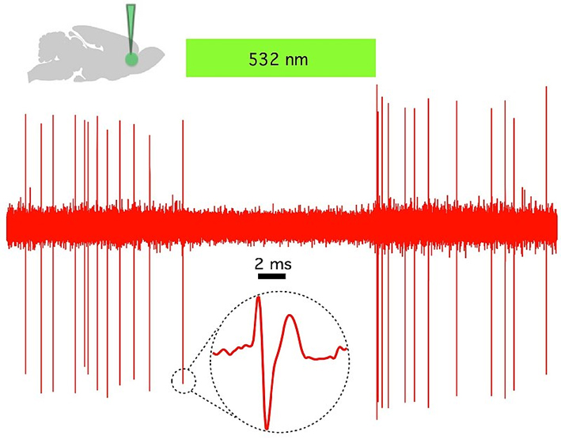
Halorhodopsin (NpHR) rapidly and reversibly silences spontaneous activity in vivo in rat prelimbic prefrontal cortex. (Top left) Schematic showing in vivo green (532 nm) light delivery and single- unit recording of a spontaneously active CaMKllα::eNpHR3.0- EYFP expressing pyramidal neuron. (Right) Example trace showing that continuous 532 nm illumination inhibits single-unit activity in vivo. Inset, representative single unit event; Green bar, 10 seconds

Slide 12
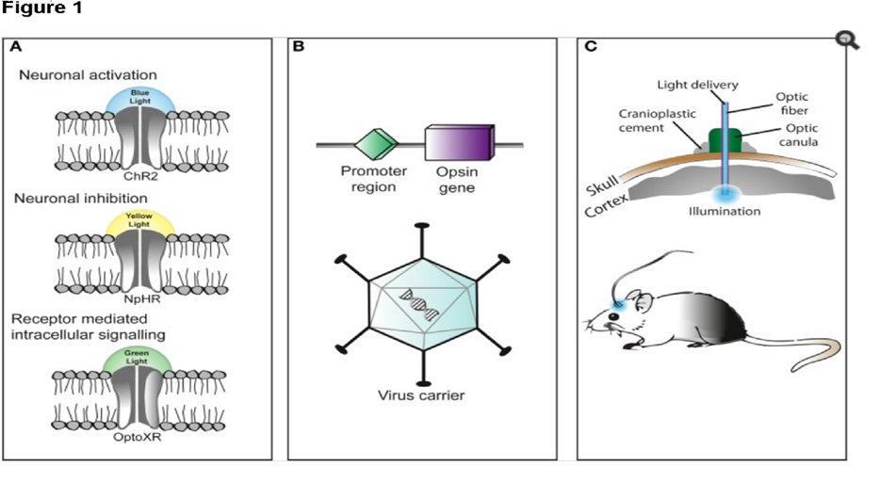
Three primary components in the application of optogenetics are as follows (A) Identification or synthesis of a light-sensitive protein (opsin) such as channelrhodopsin-2 (ChR2), halorhodopsin (NpHR), etc... (B) The design of a system to introduce the genetic material containing the opsin into cells for protein expression such as application of Cre recombinase or an adeno-associated-virus (C) application of light emitting instruments.[

Slide 13
https://www.youtube.com/watch?v=pulEflo39_U

Slide 14
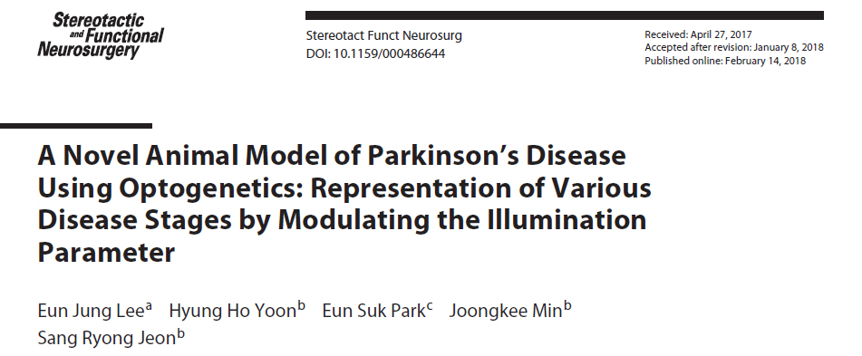

Slide 15
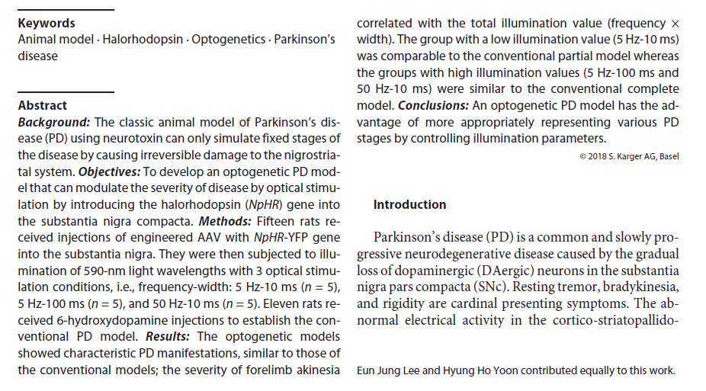

Slide 16
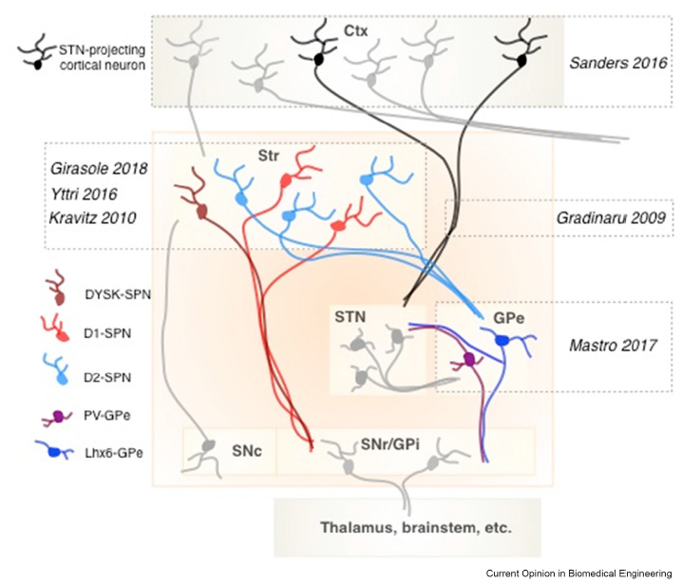

Slide 17
In a mouse model of PD, optogenetic stimulation of D1-SPNs activated the direct pathway and was sufficient to alleviate bradykinesia (slowness of movement), a canonical pathology of PD. In healthy mice, optogenetic stimulation of D2-SPNs activated the indirect pathway and was sufficient to induce bradykinesia

Slide 18
