Slide 1
The neural tube and the neurohistogenesis M. Kálmán
On the basis of the lectures for EM II 1-8 and 9-17
Sept. 9 and 10, 2019

Slide 2
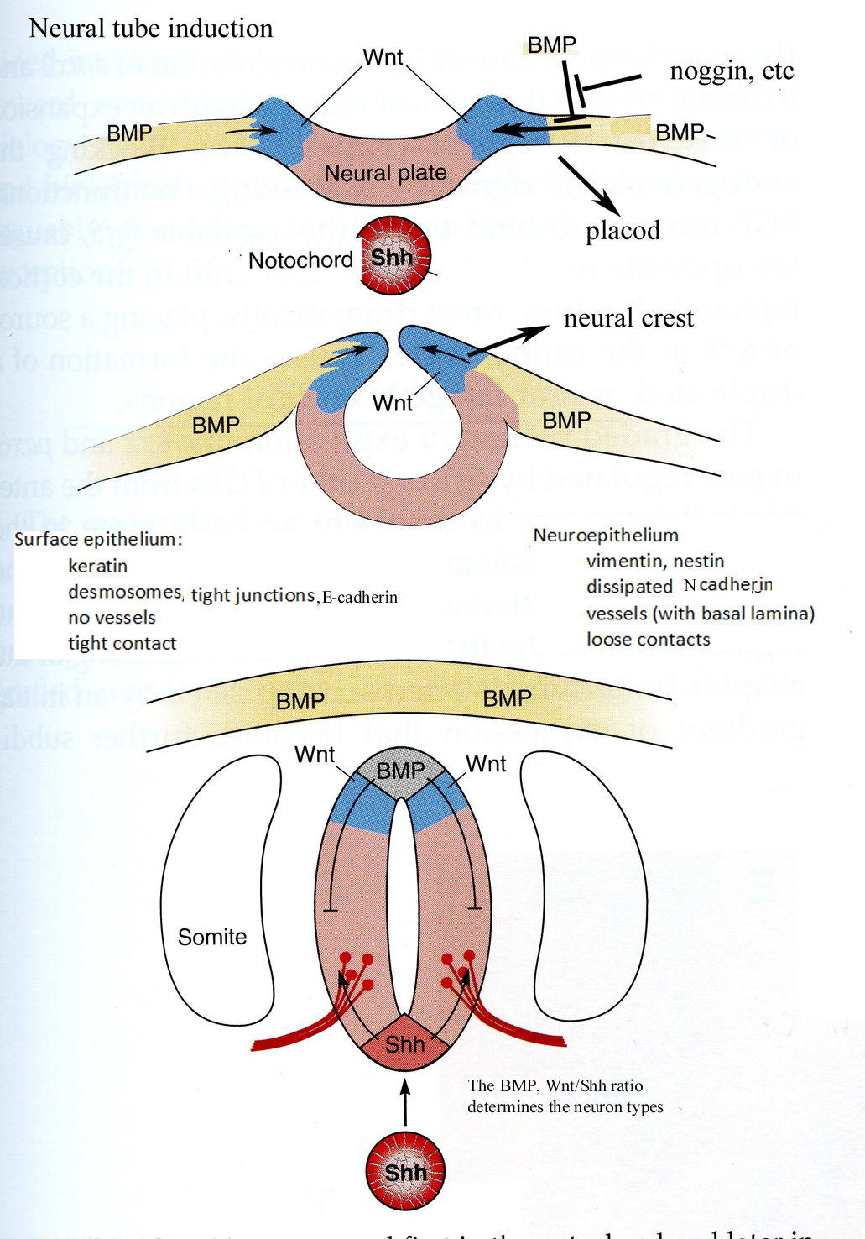

Slide 3
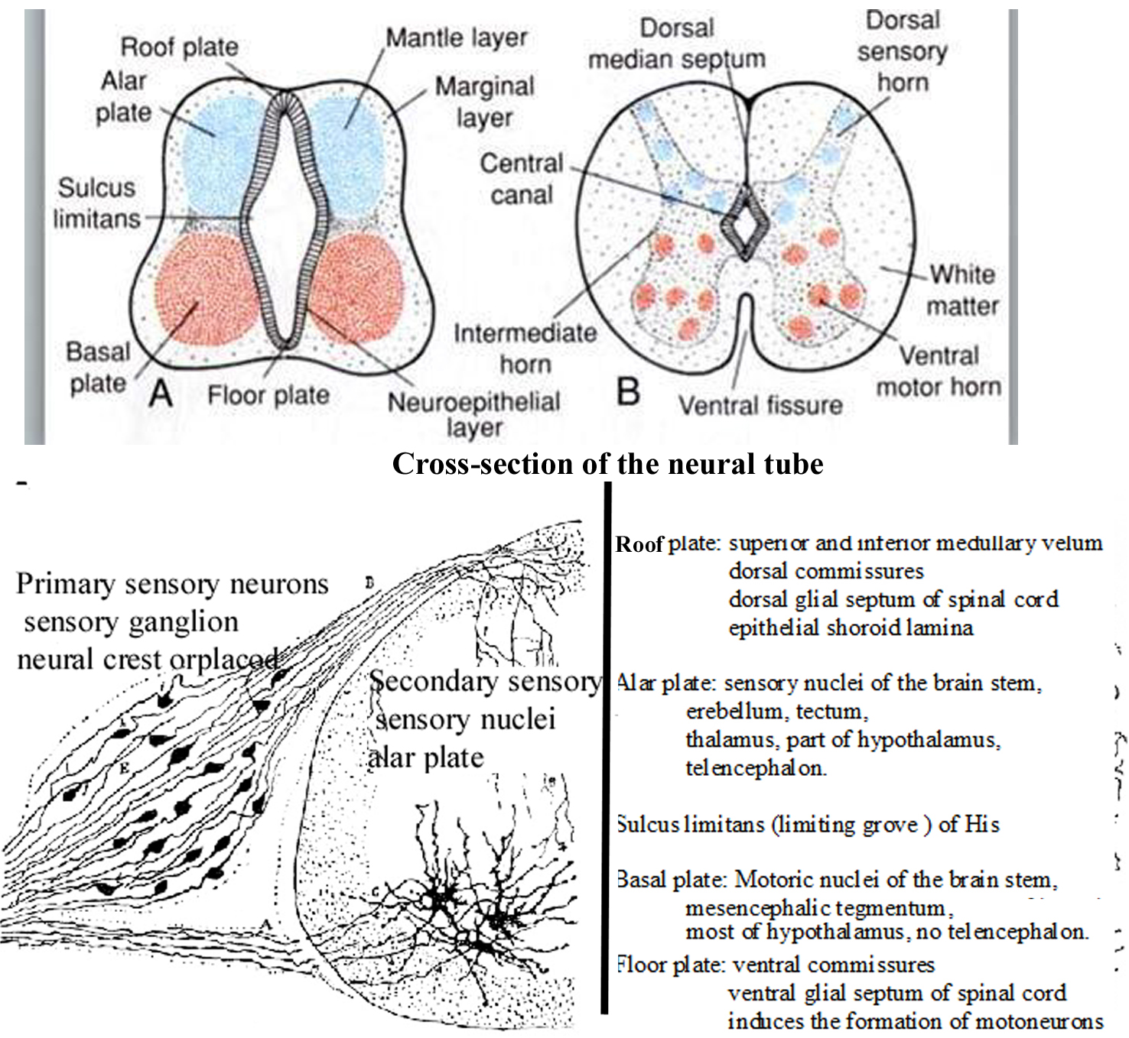

Slide 4
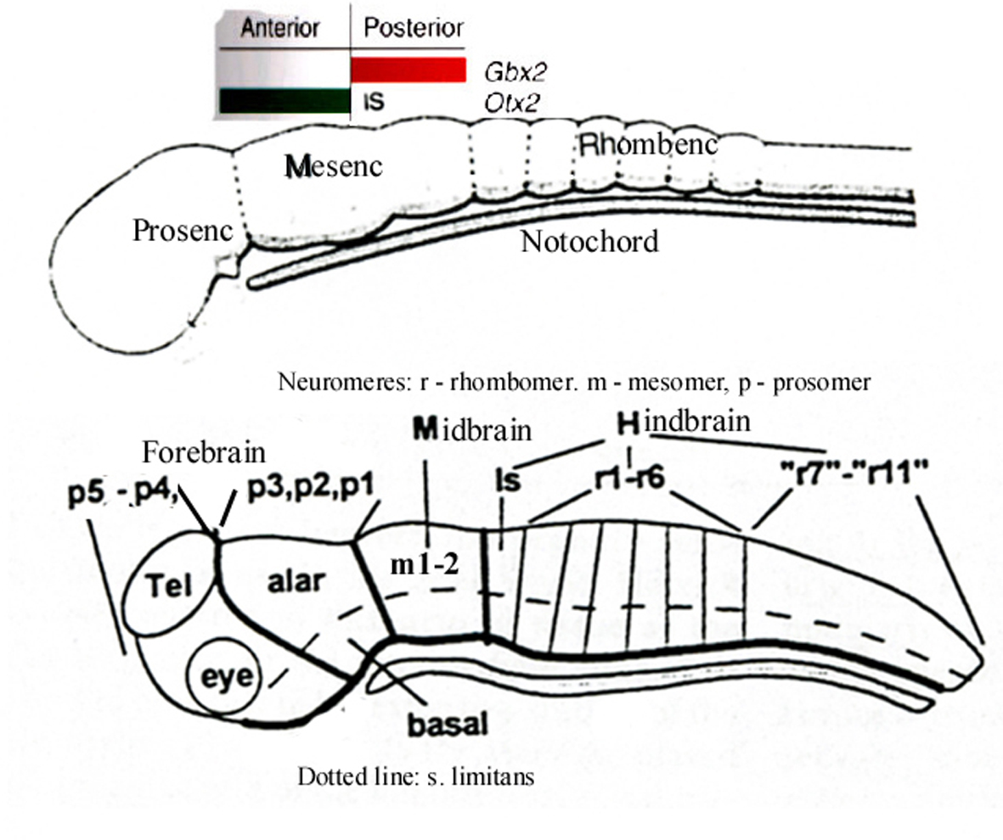

Slide 5
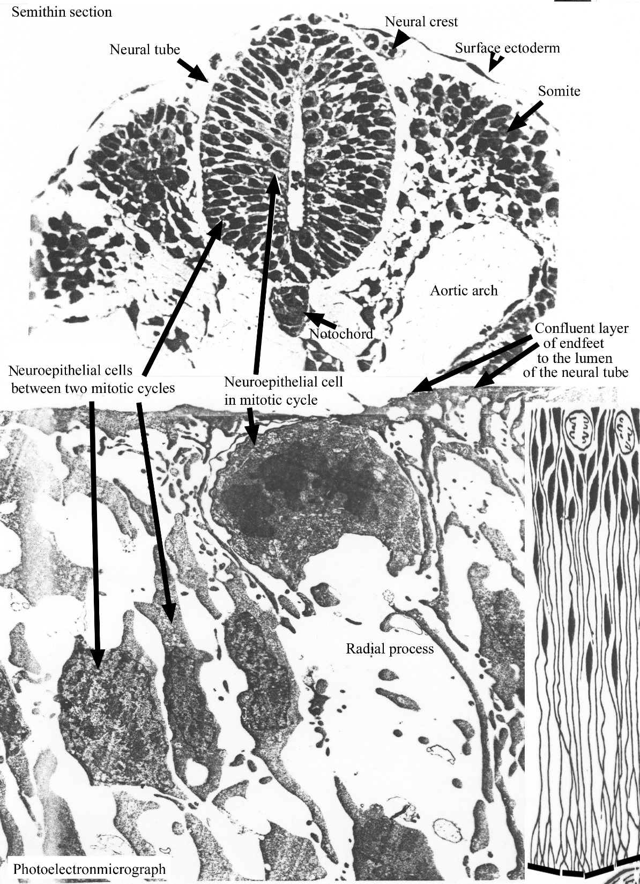

Slide 6
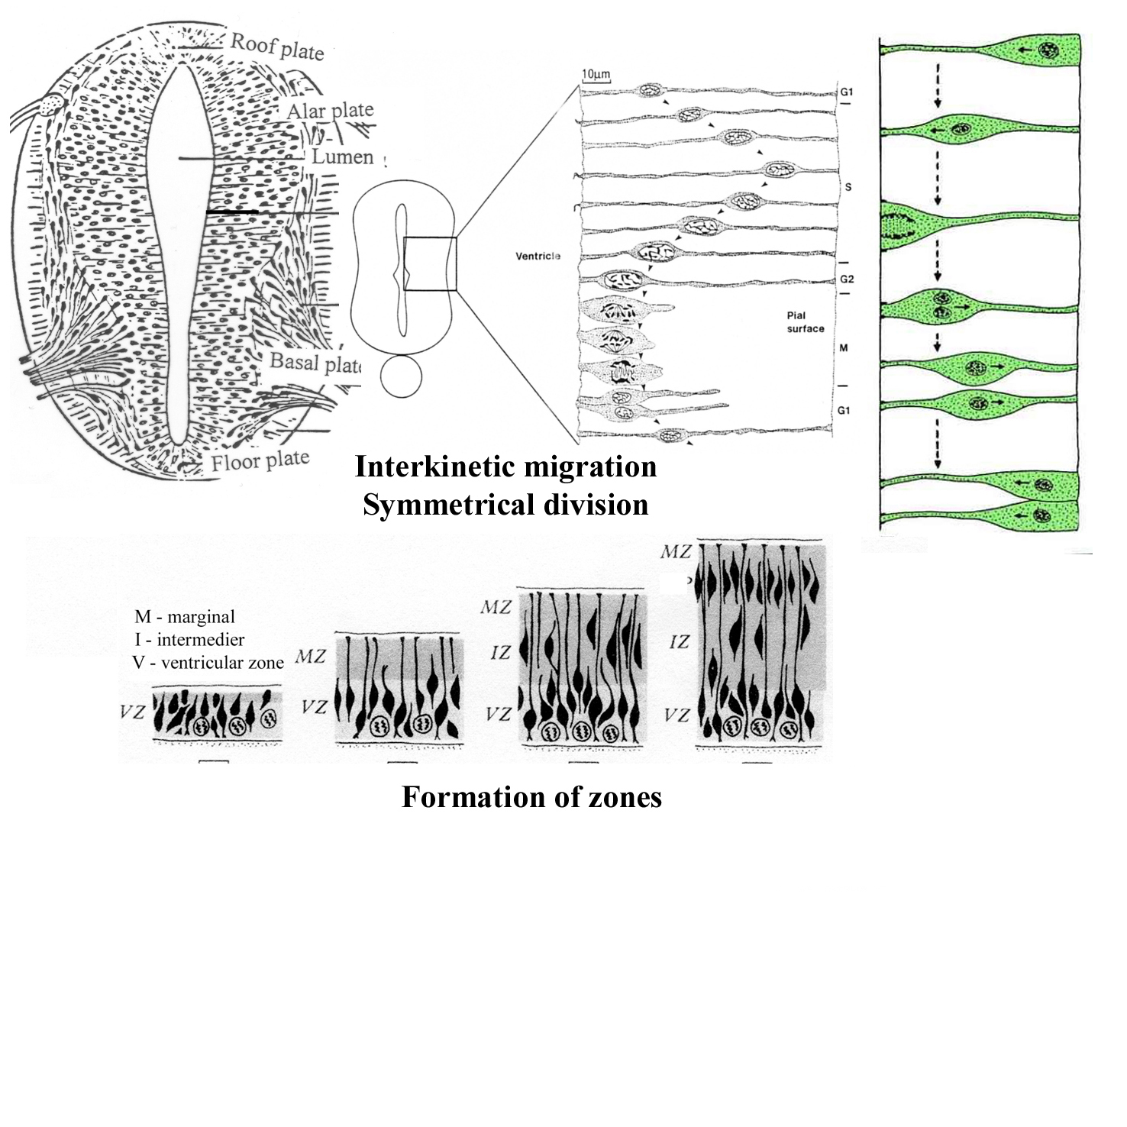

Slide 7
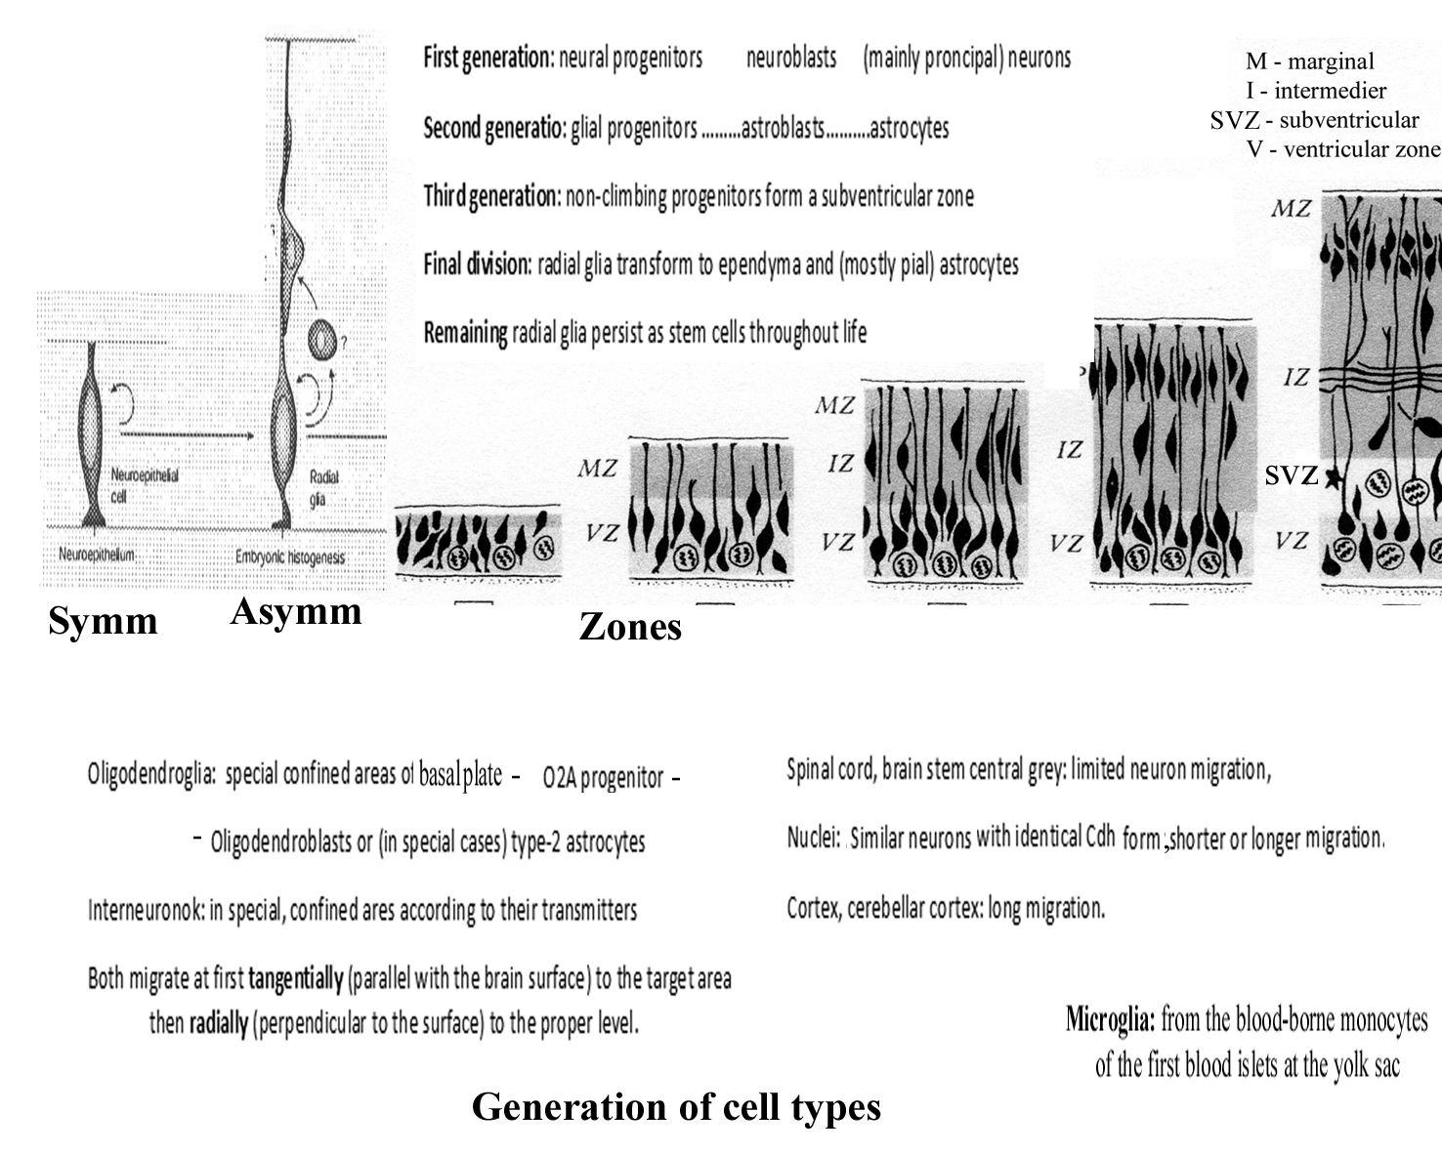

Slide 8
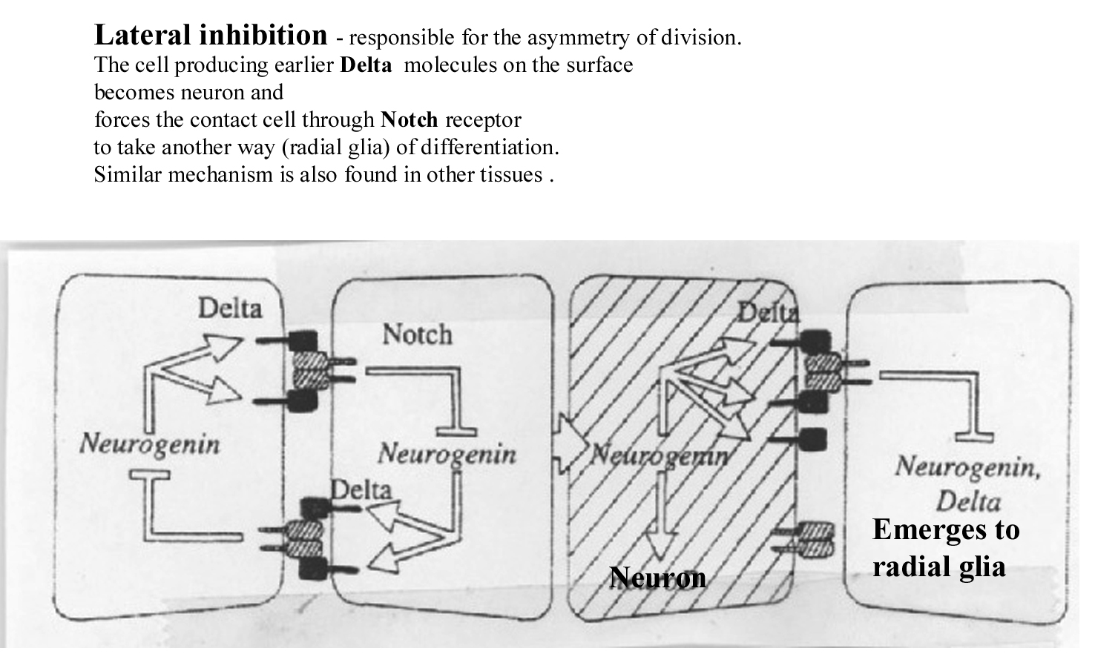

Slide 9
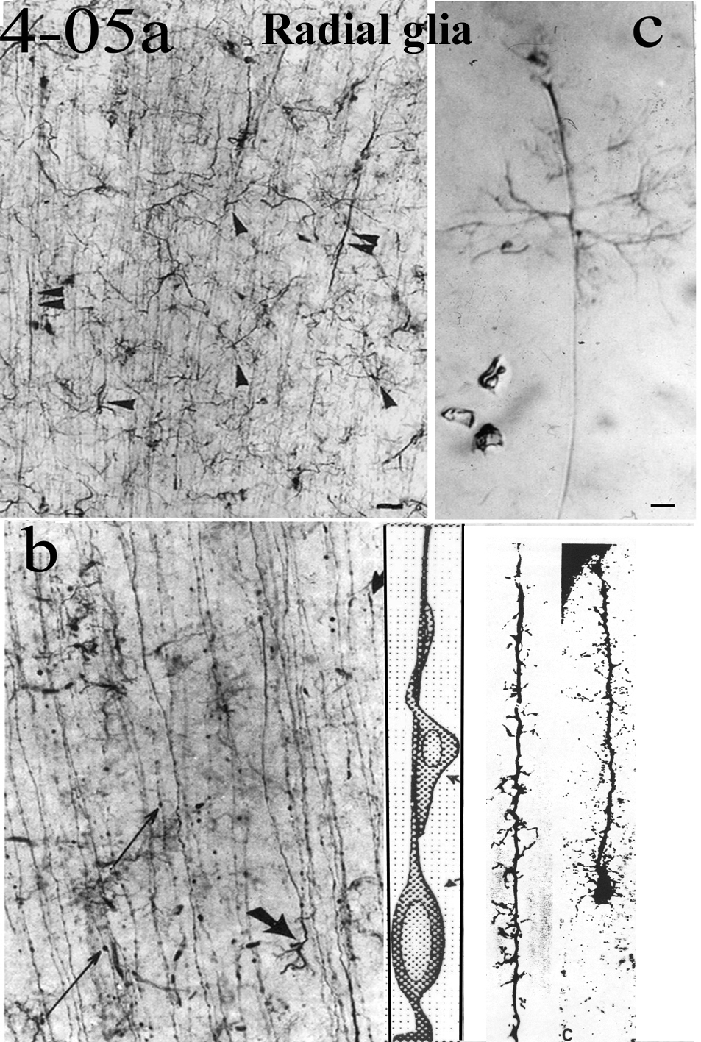

Slide 10
