Slide 1
Kálmán M: A formatio reticularis
Az AOK II E-H előadása, 2019. okt. 16.

Slide 2
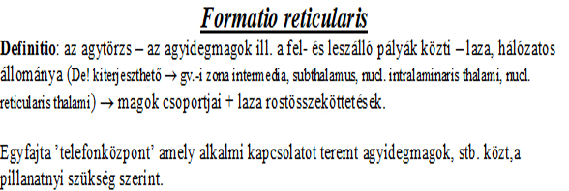

Slide 3
The reticular formation: - a network (’reticle’) of small neuron groups and axon bundles; - it occupies the empty spaces between the other nuclei; and - like a telephone center - - interconnects them to form different and temporary brain stem reflexes, e.g. swallowing, caughing.

Slide 4
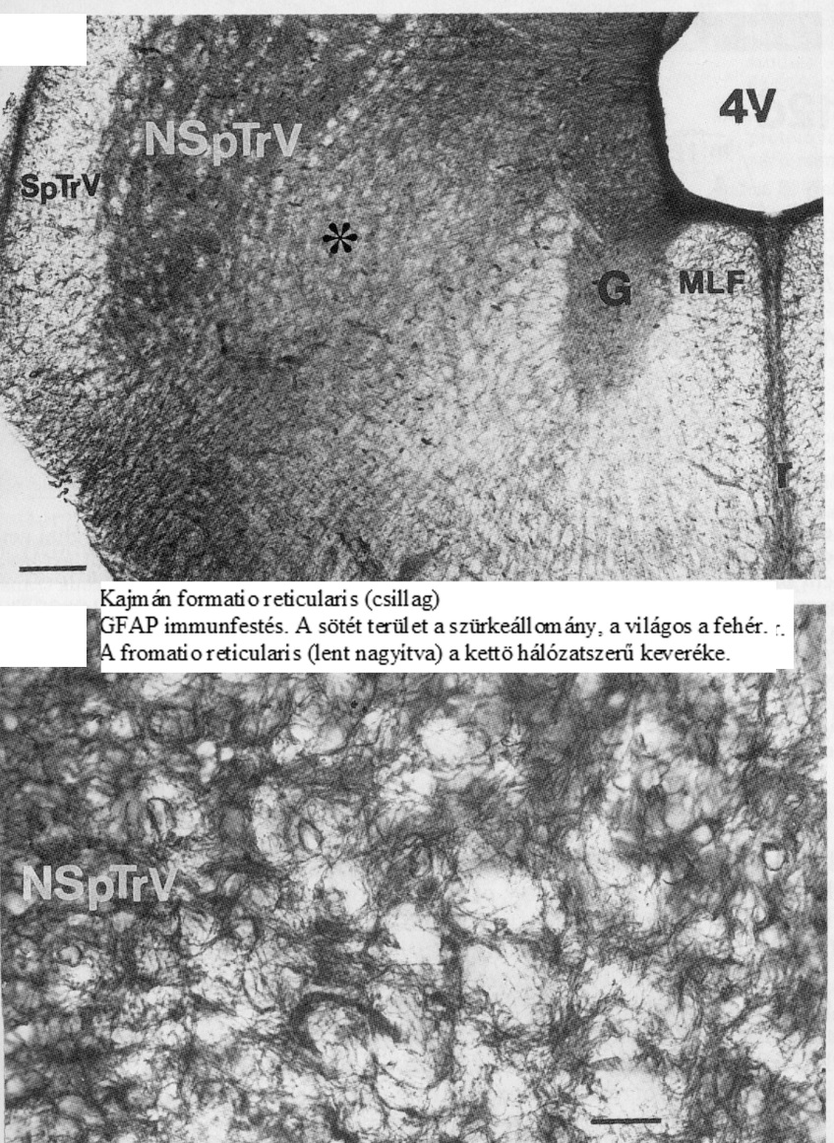

Slide 5
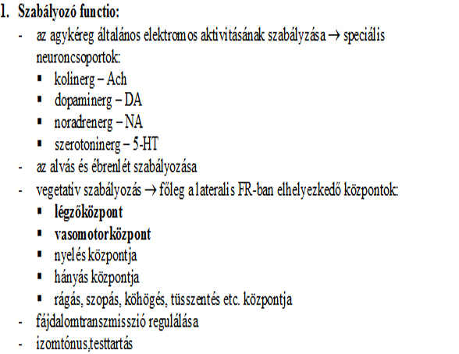

Slide 6
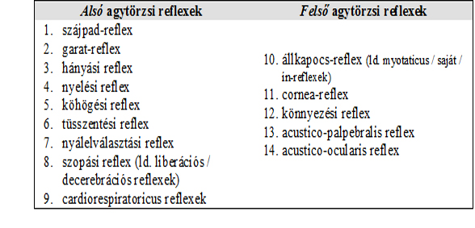

Slide 7
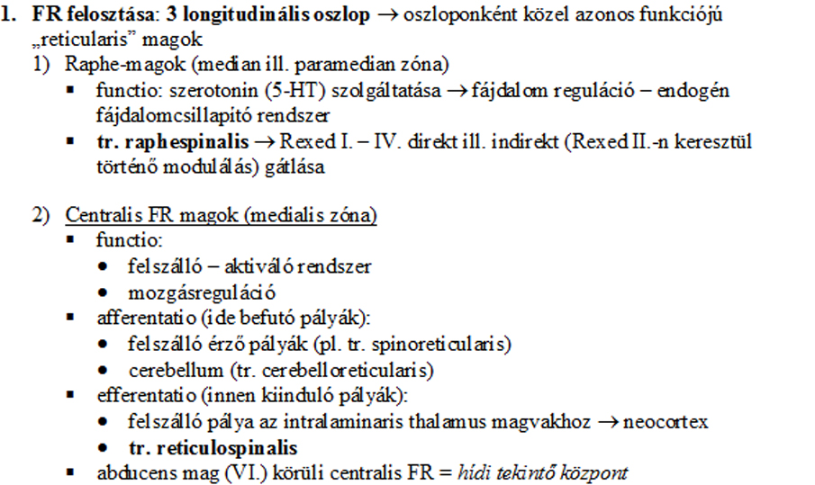

Slide 8
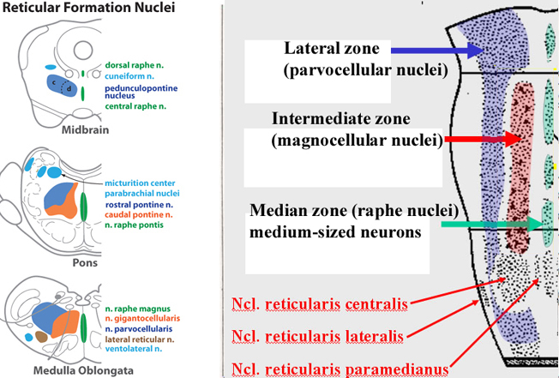

Slide 9
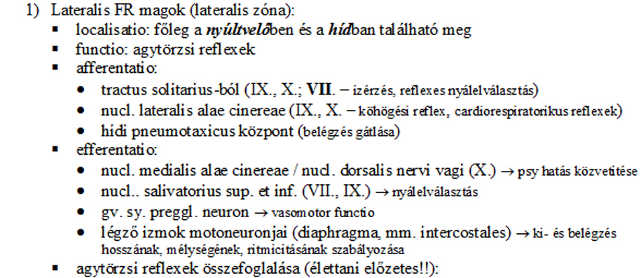

Slide 10
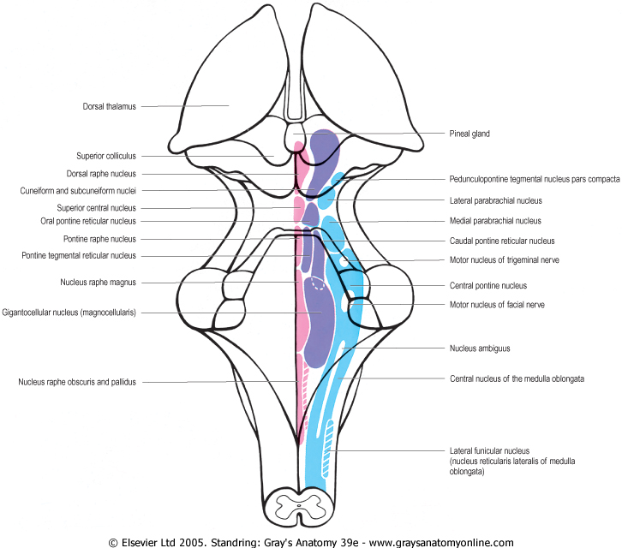

Slide 11
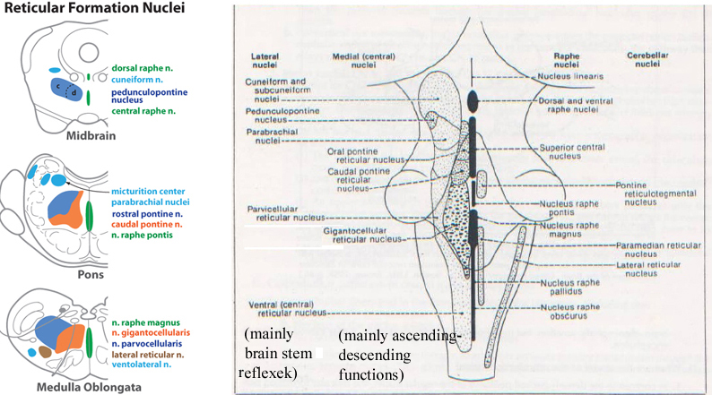

Slide 13
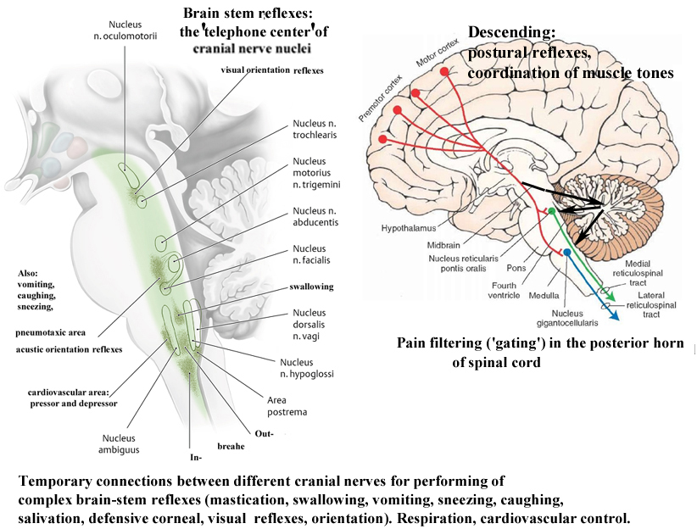

Slide 14
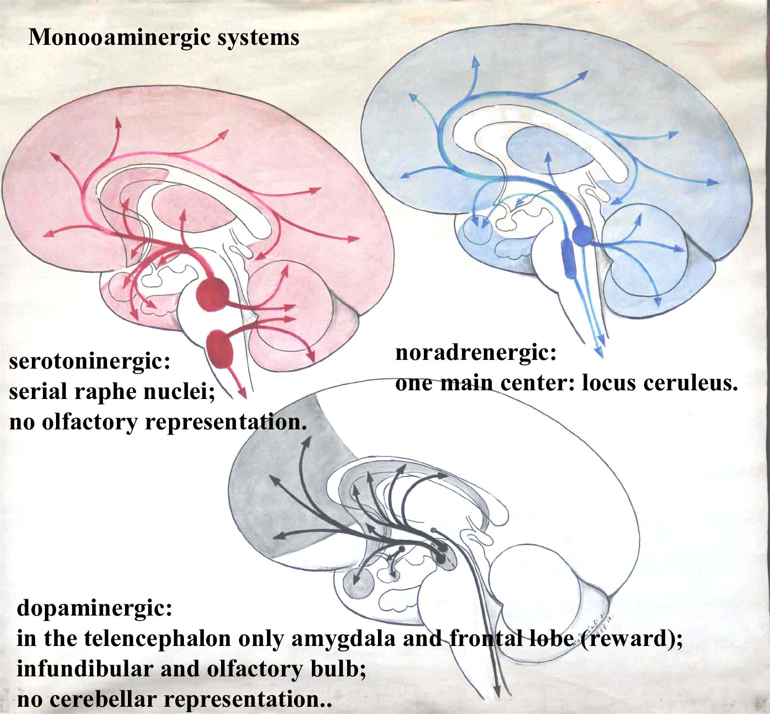

Slide 15
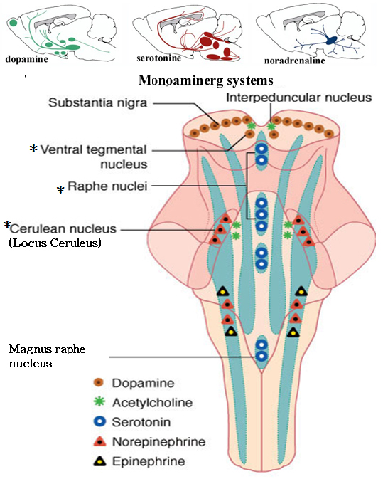

Slide 16
