Slide 1
Hand: Gelenke, Bewegungen
Dr. Erzsébet Fehér

Slide 2
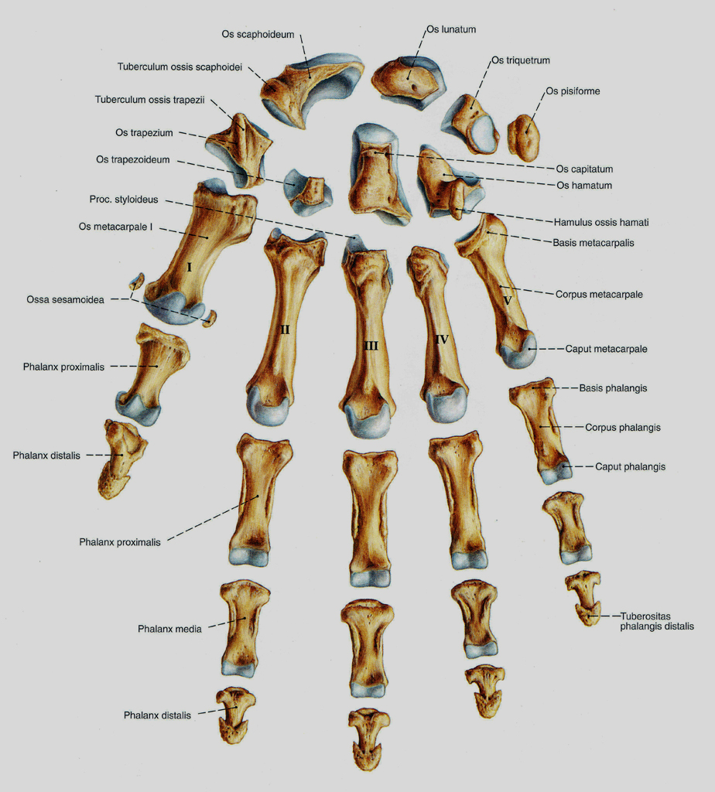
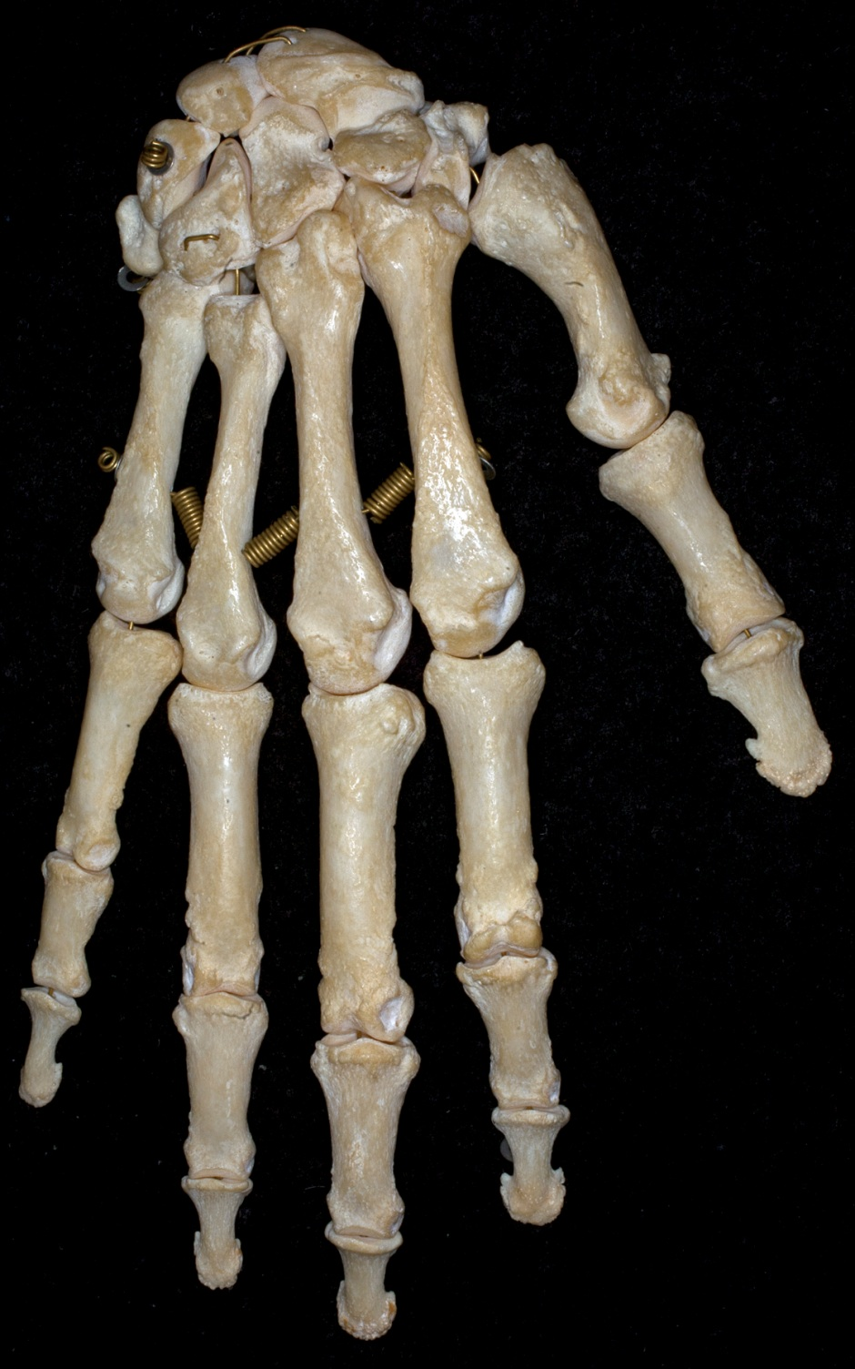
Sobotta

Slide 3
Articulationes manus
Articulatio radiocarpea
Articulationes carpi:
Articulatio radiocarpea (proximalis)
Articulatio intercarpea/ mediocarpea (distalis)
Articulatio ossis pisiformis
Articulationes carpometacarpeae:
Articulatio carpometacarpea communis
Articulatio carpometacarpea pollicis
Articulationes metacarpophalangeae (MCP) et intermetacarpeae
Articulationes digitorum manus:
Articulatio interphalangealis proximalis (PIP)
Articulatio interphalangealis distalis (DIP)

Slide 4
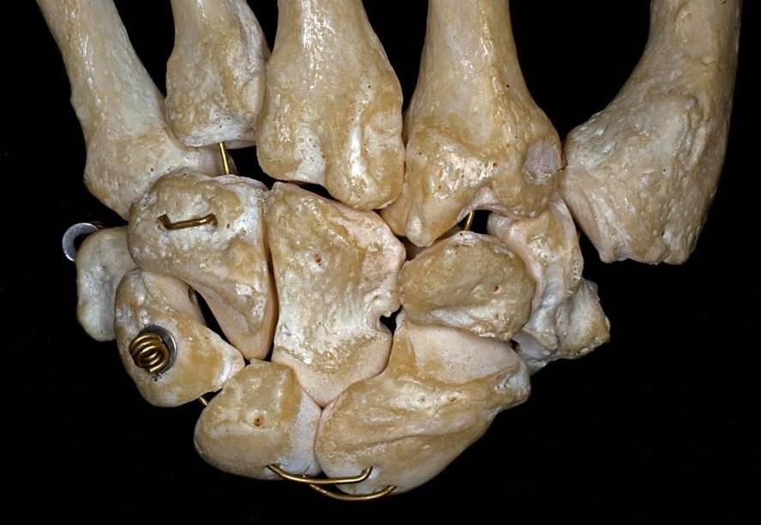
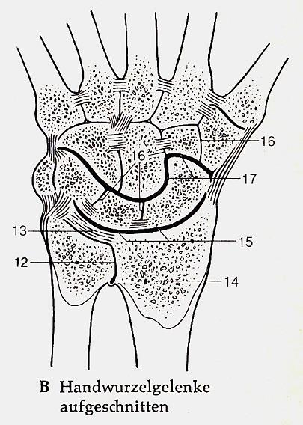
Articulatio radiocarpea
12: Articulatio radioulnaris distalis
13: Discus articularis
14: Recessus sacciformis
15: Articulatio radiocarpea
Discus articularis

Slide 5
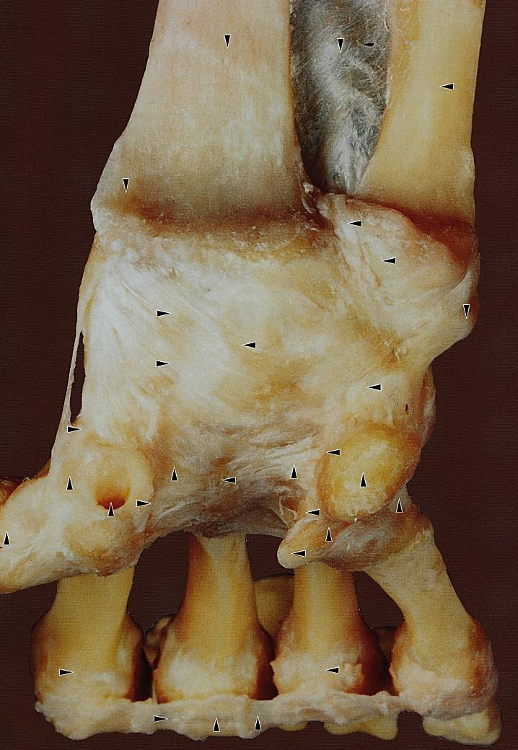
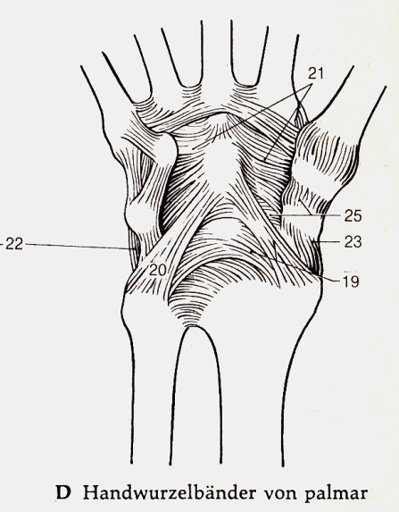
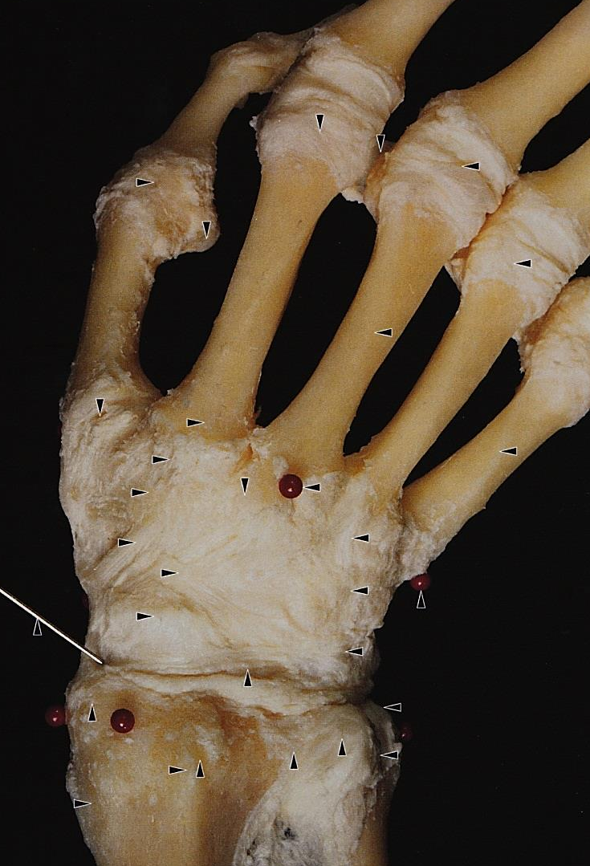
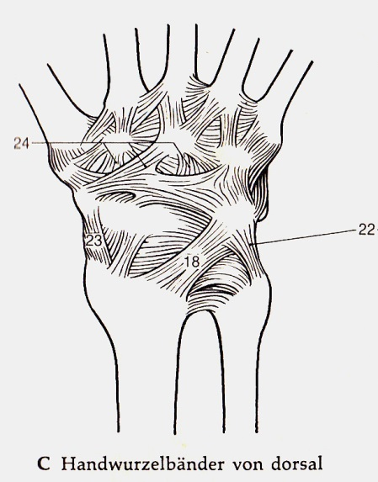
Articulatio radiocarpea
18: Lig. radiocarpeum dorsale
23: Lig. collaterale carpi radiale
19: Lig. radiocarpeum volare
20: Lig. ulnocarpeum volare
22: Lig. collaterale carpi ulnare

Slide 6
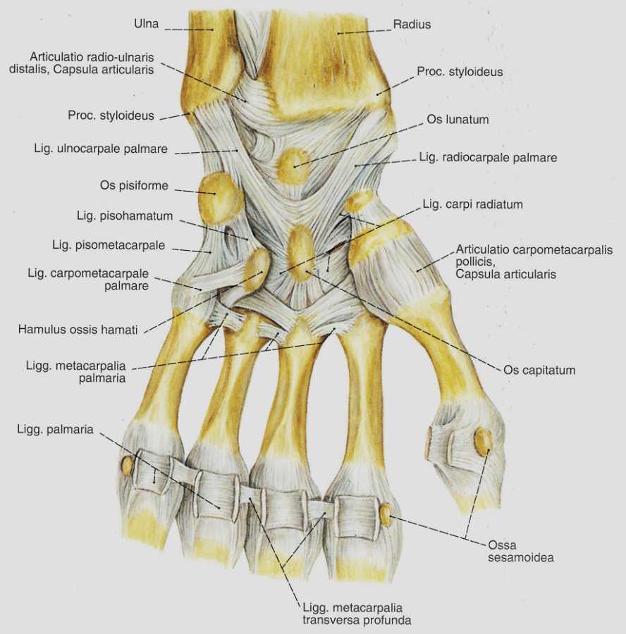
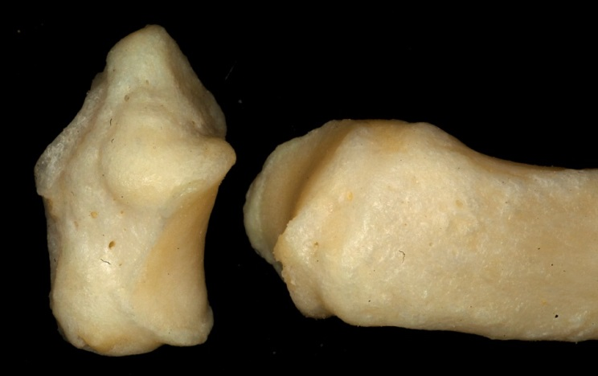
Articulatio carpometacarpea pollicis és communis
pollicis: Os trapezium és az I. metacarpus
Nincsenek ligamentumok, laza capsula!
Opposition – Reposition
Abduktion – Adduktion
Circumduktion
Art. sellaris

Slide 7
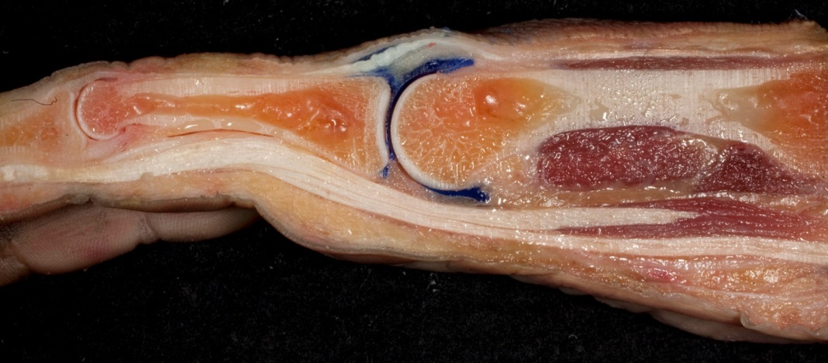
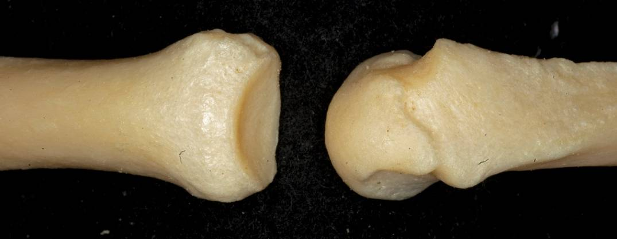
Articulationes metacarpophalangeae
Art. metacarpophalangeae:
Eingeschränkes Kugelgelenke
-flexio – extensio
abduktio - adduktio

Slide 8
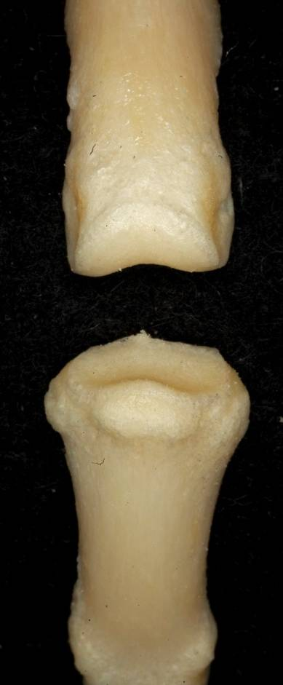
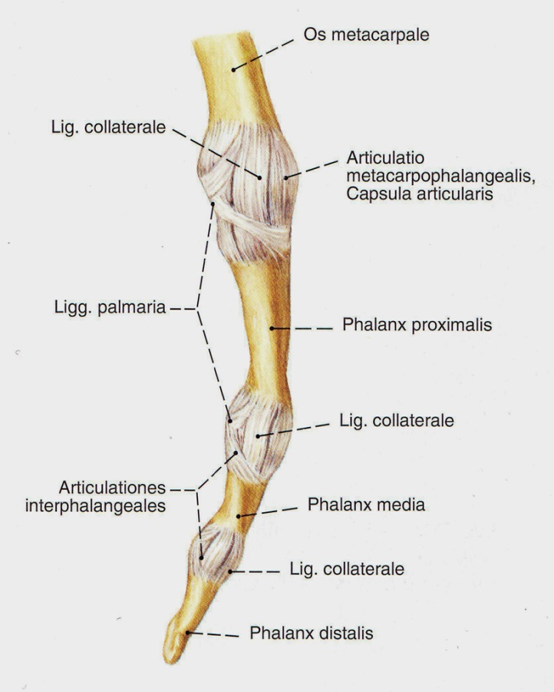
Articulationes interphalangeae

Slide 9
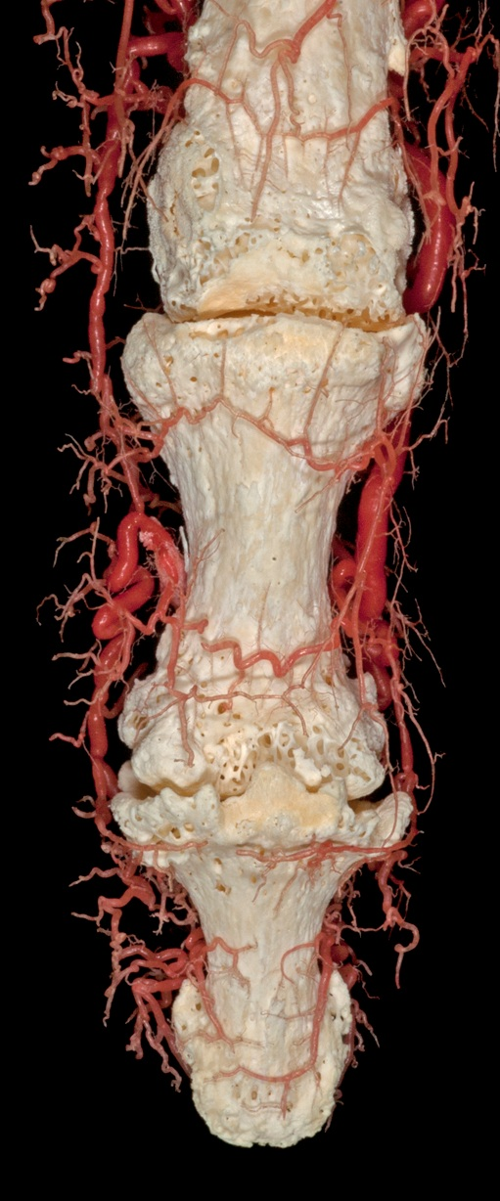
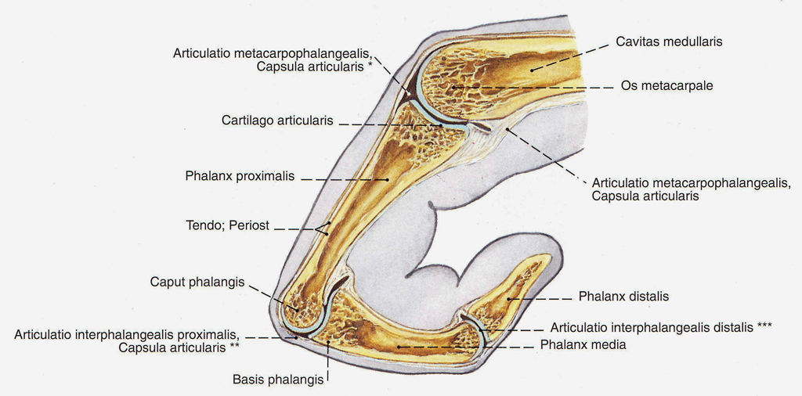
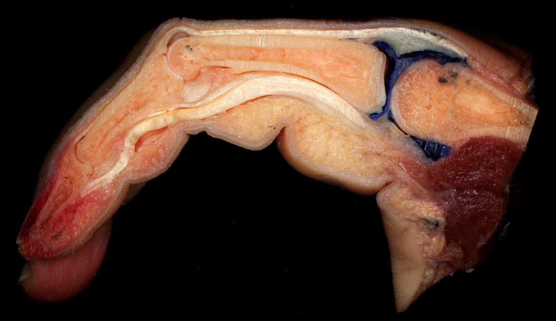

Slide 10
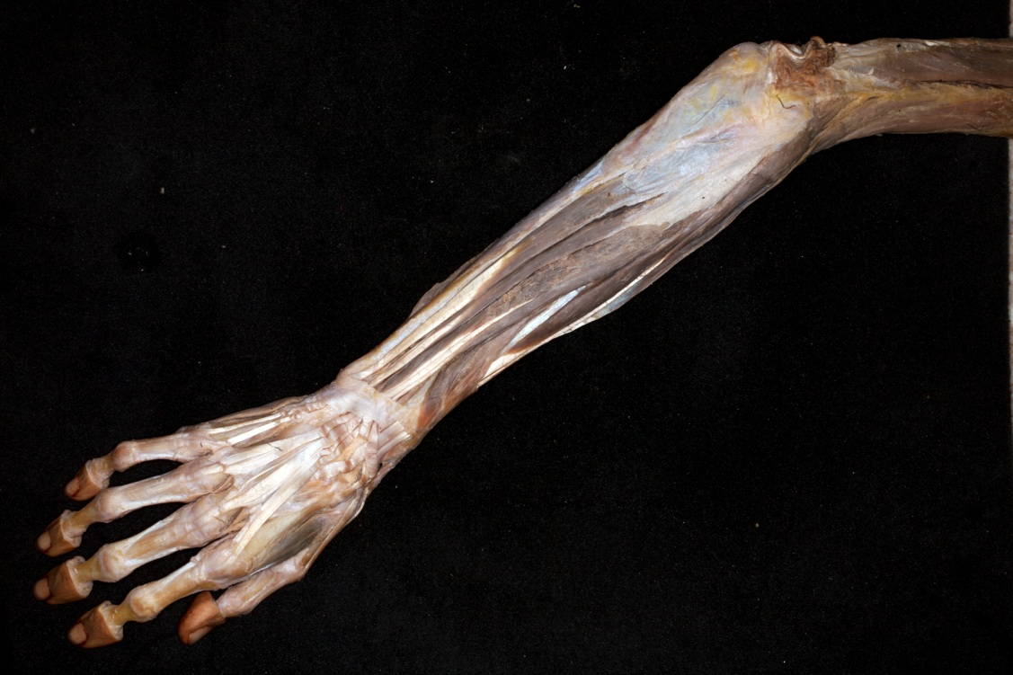

Slide 11
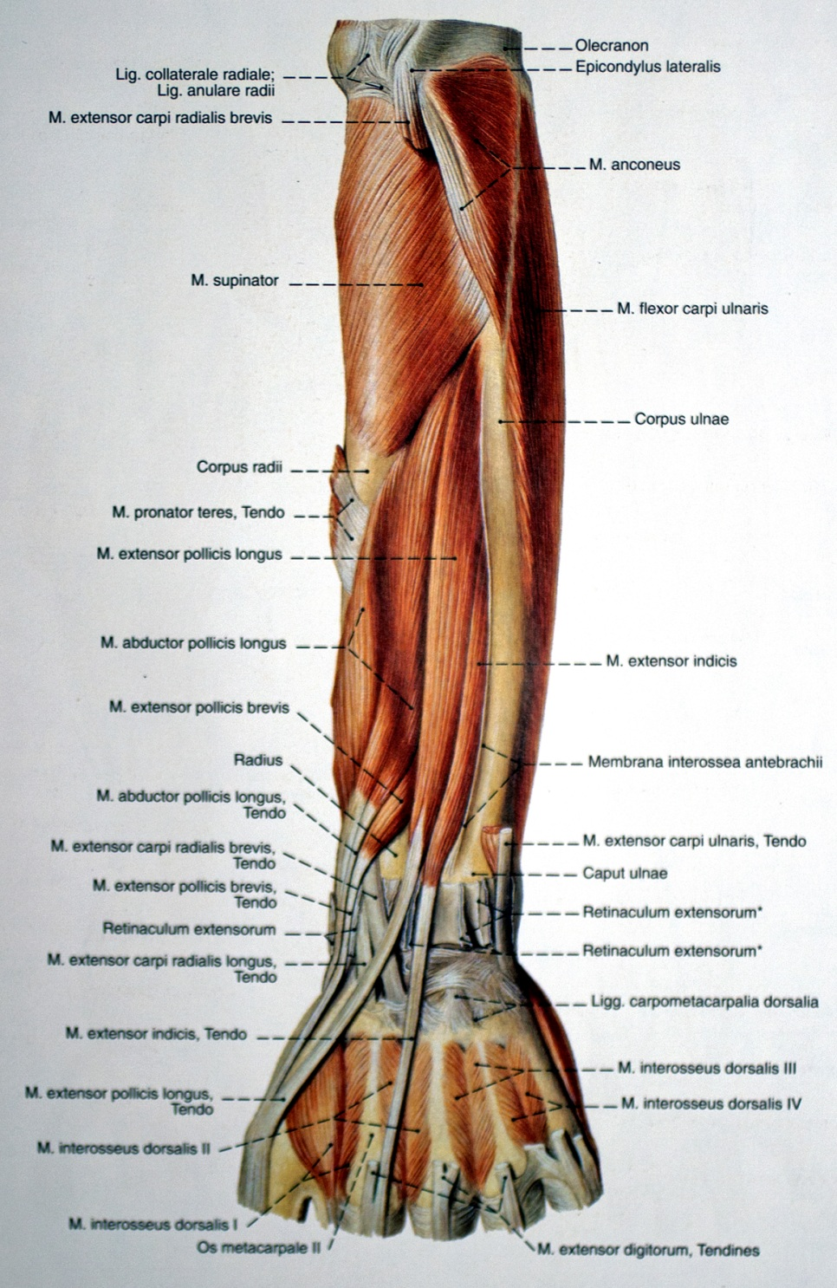

Slide 12
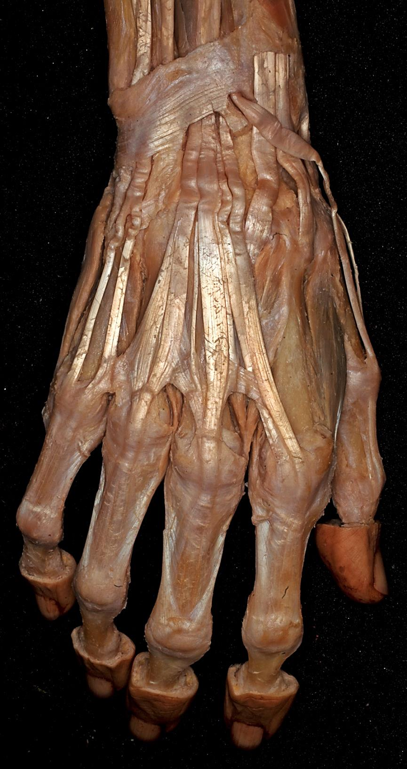
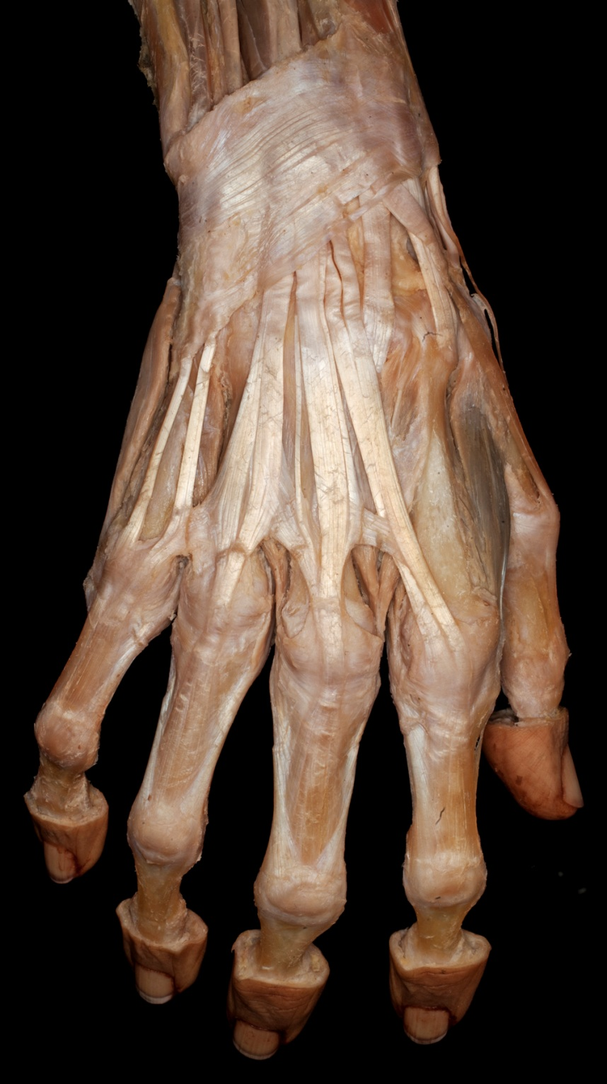
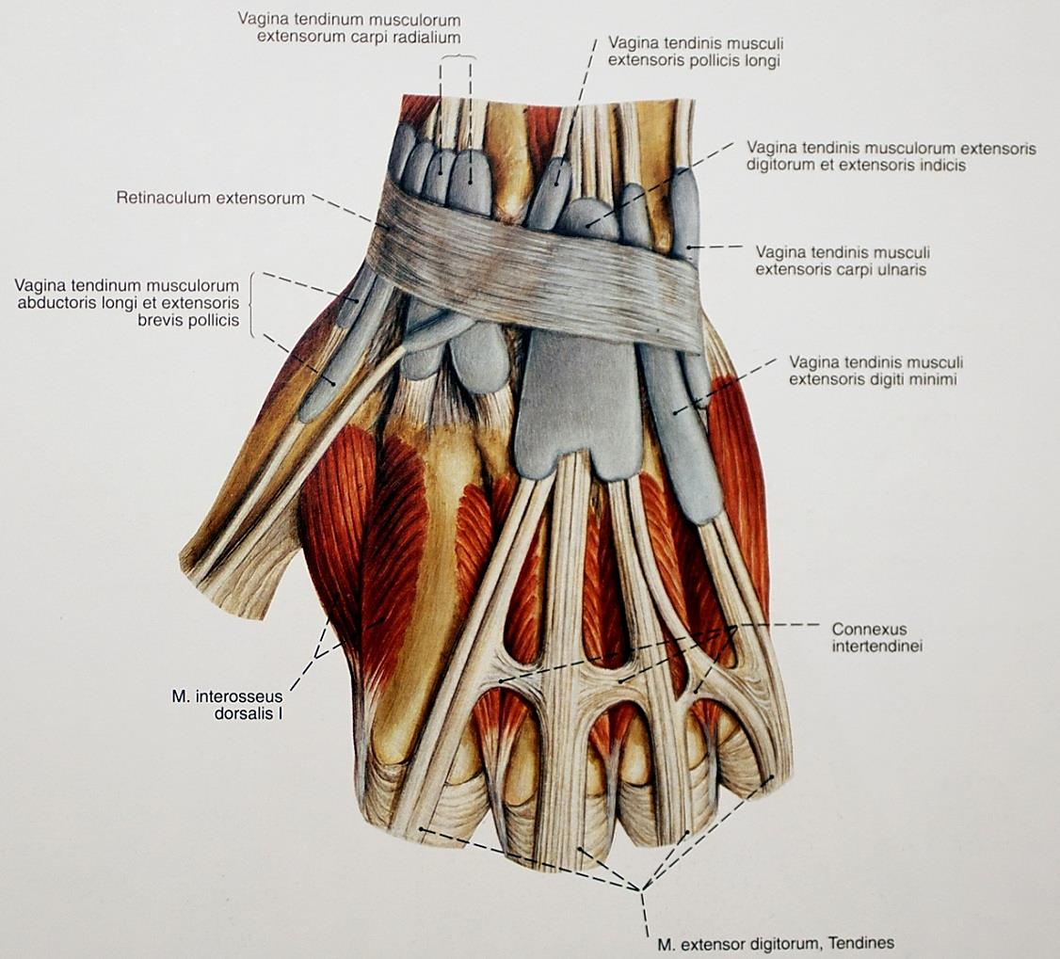

Slide 13
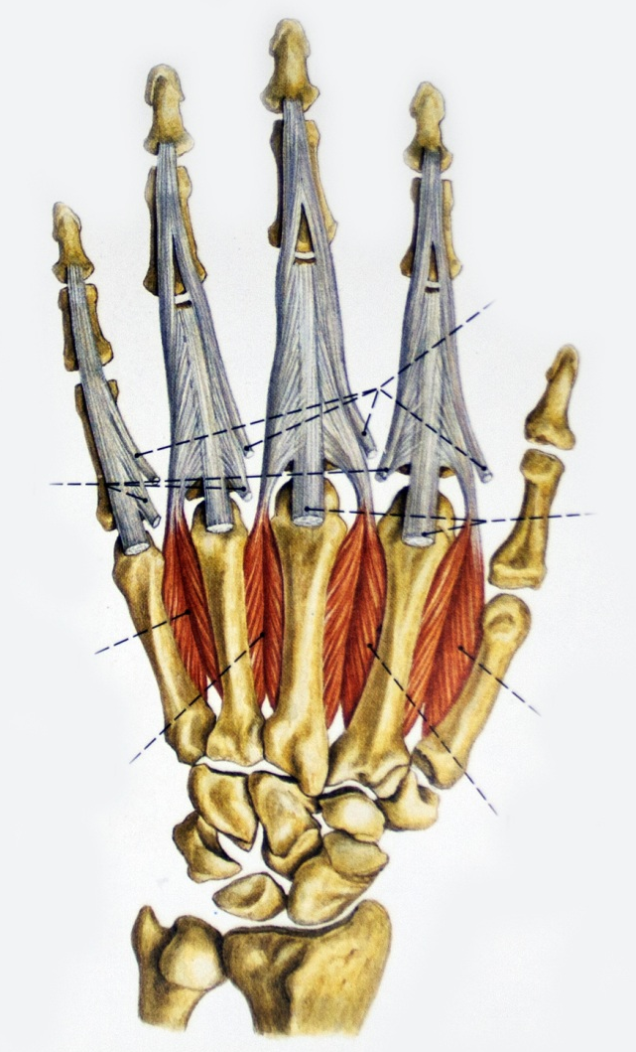
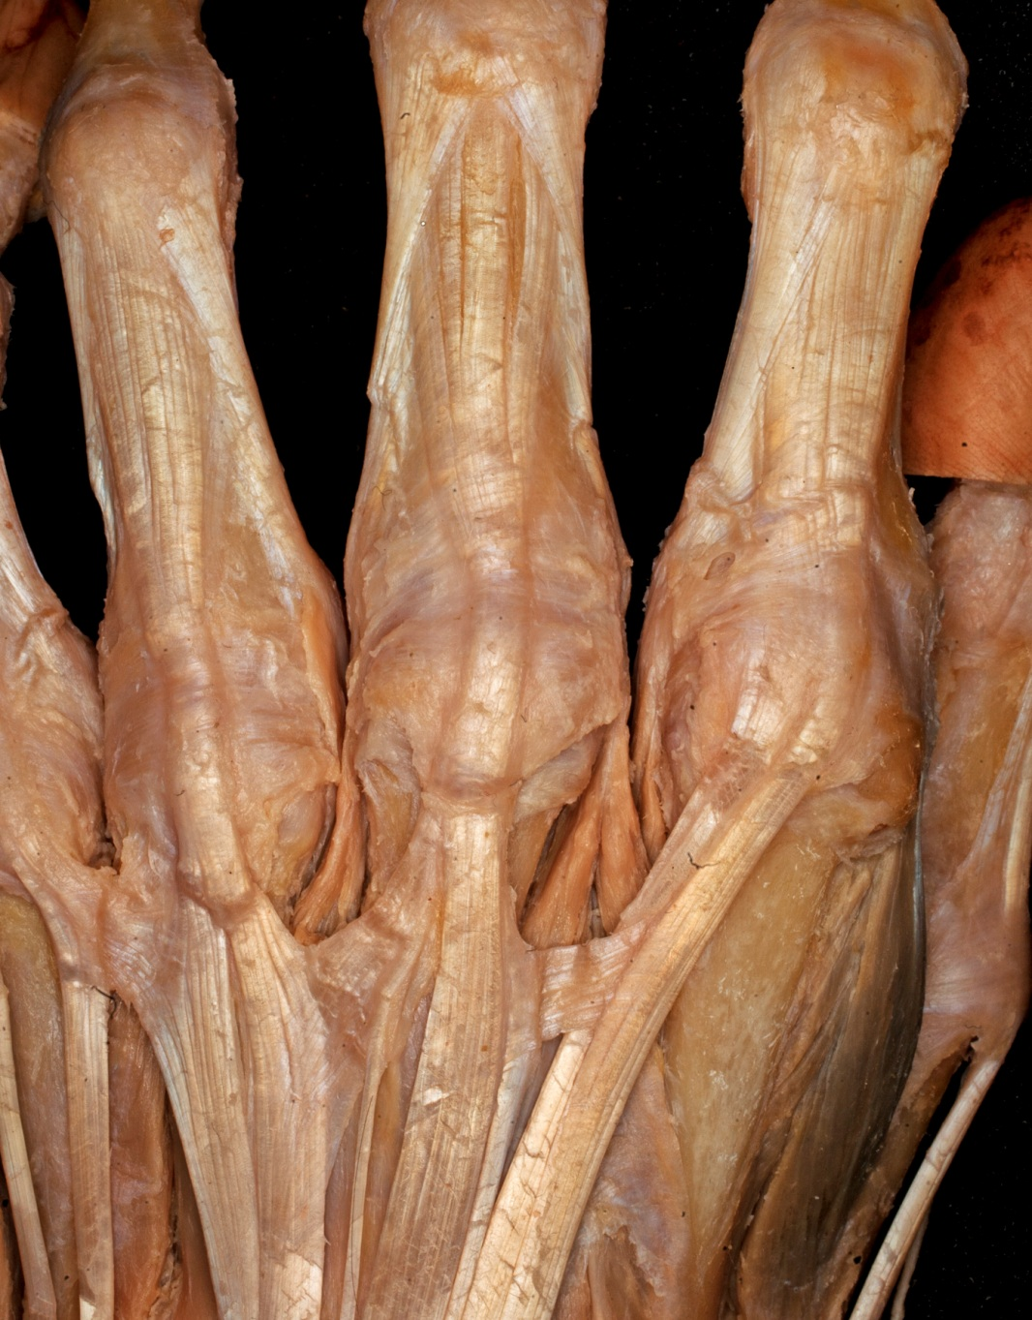
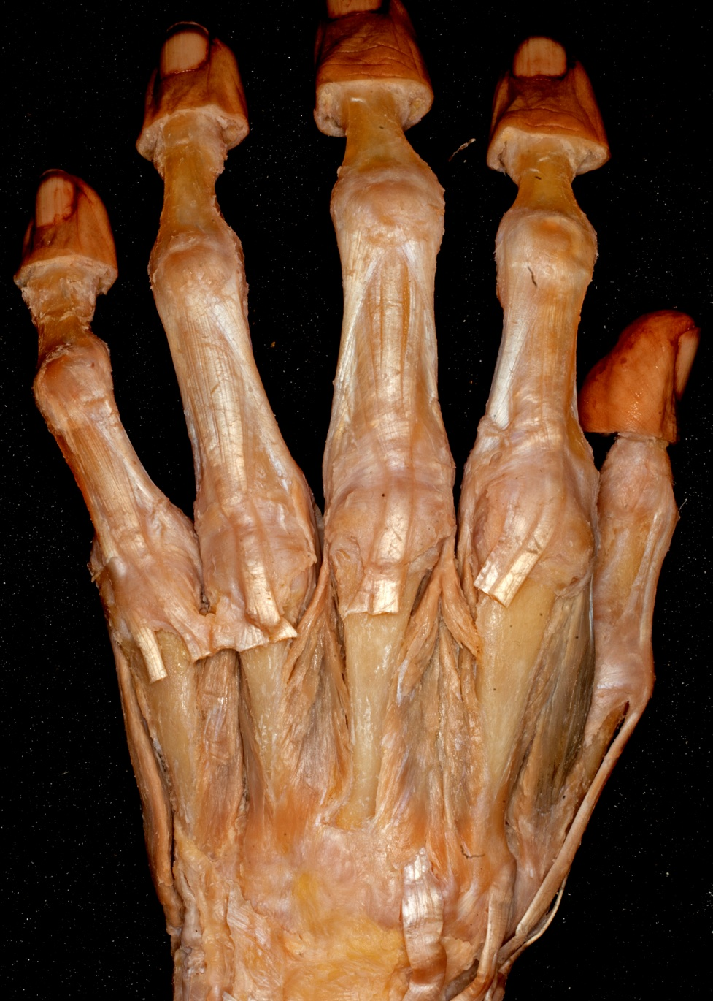

Slide 14
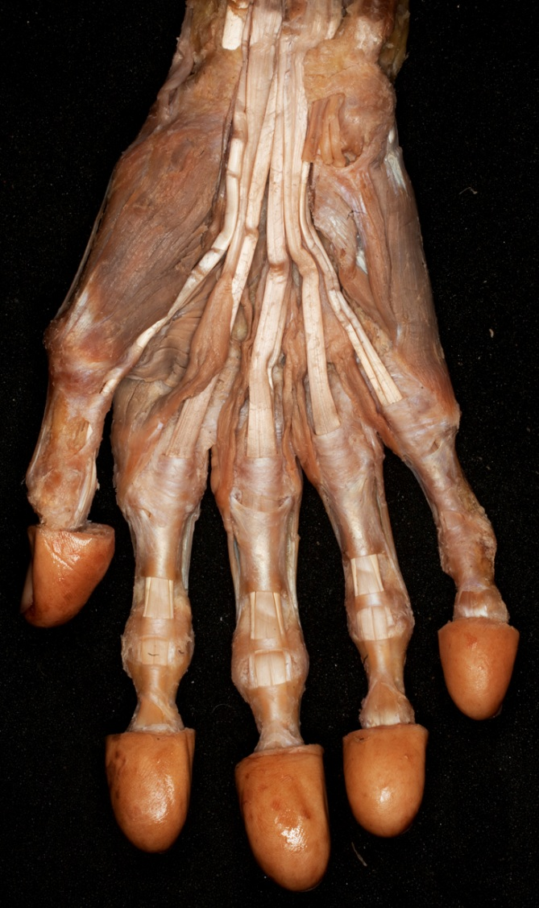
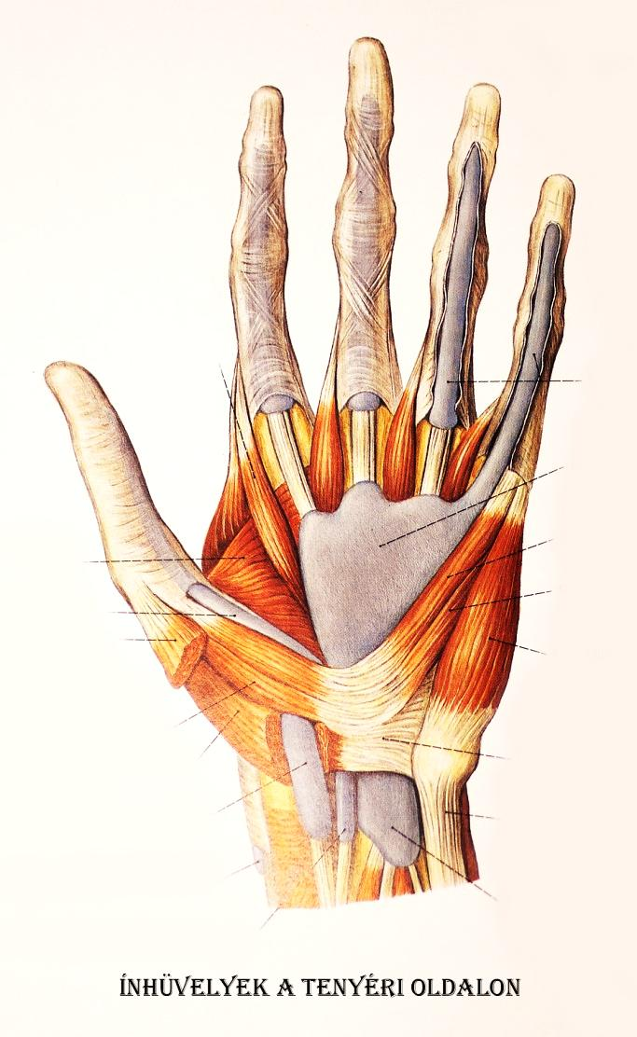
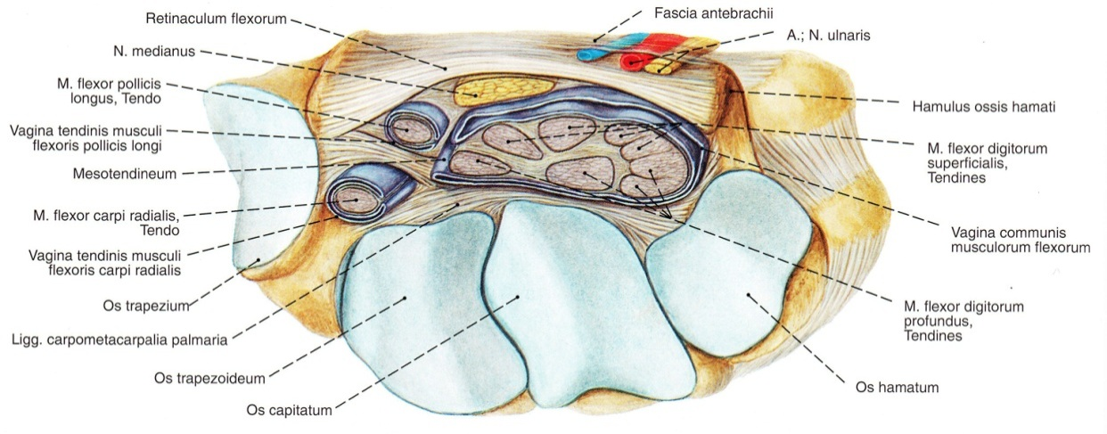
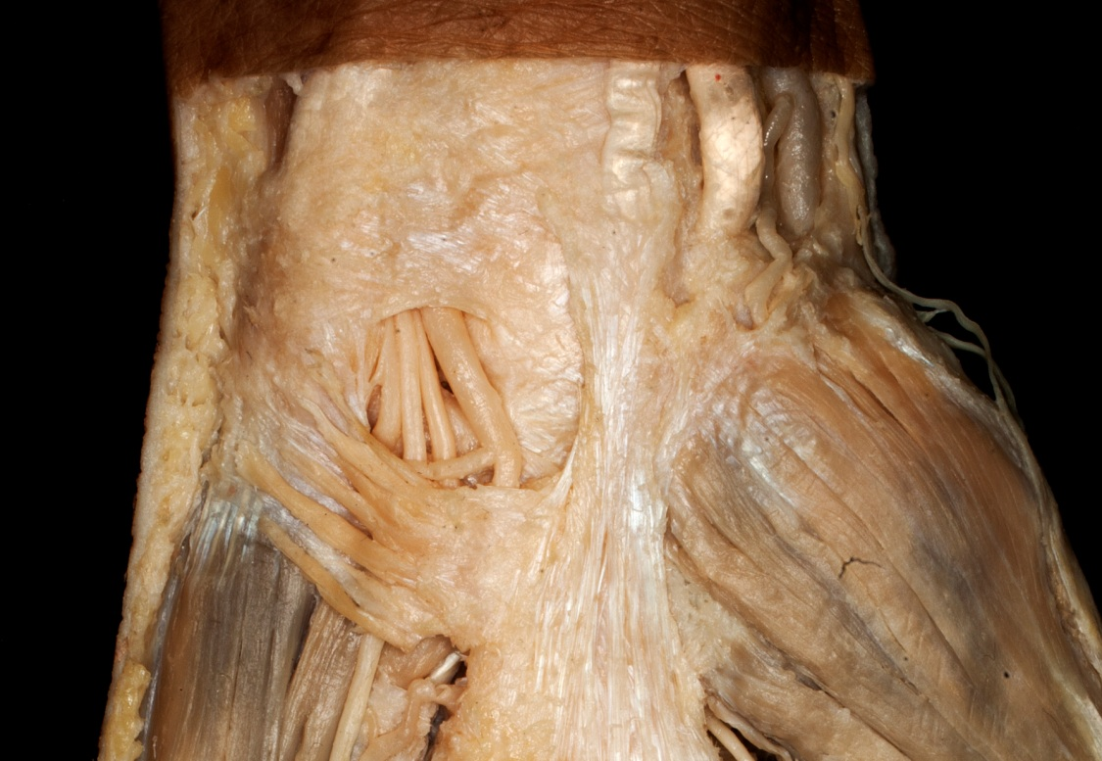
Guyon canal und Canalis carpi

Slide 15
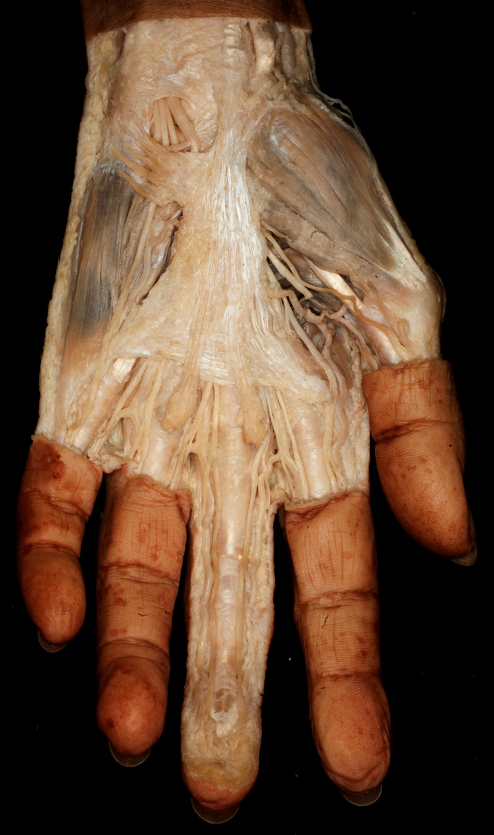
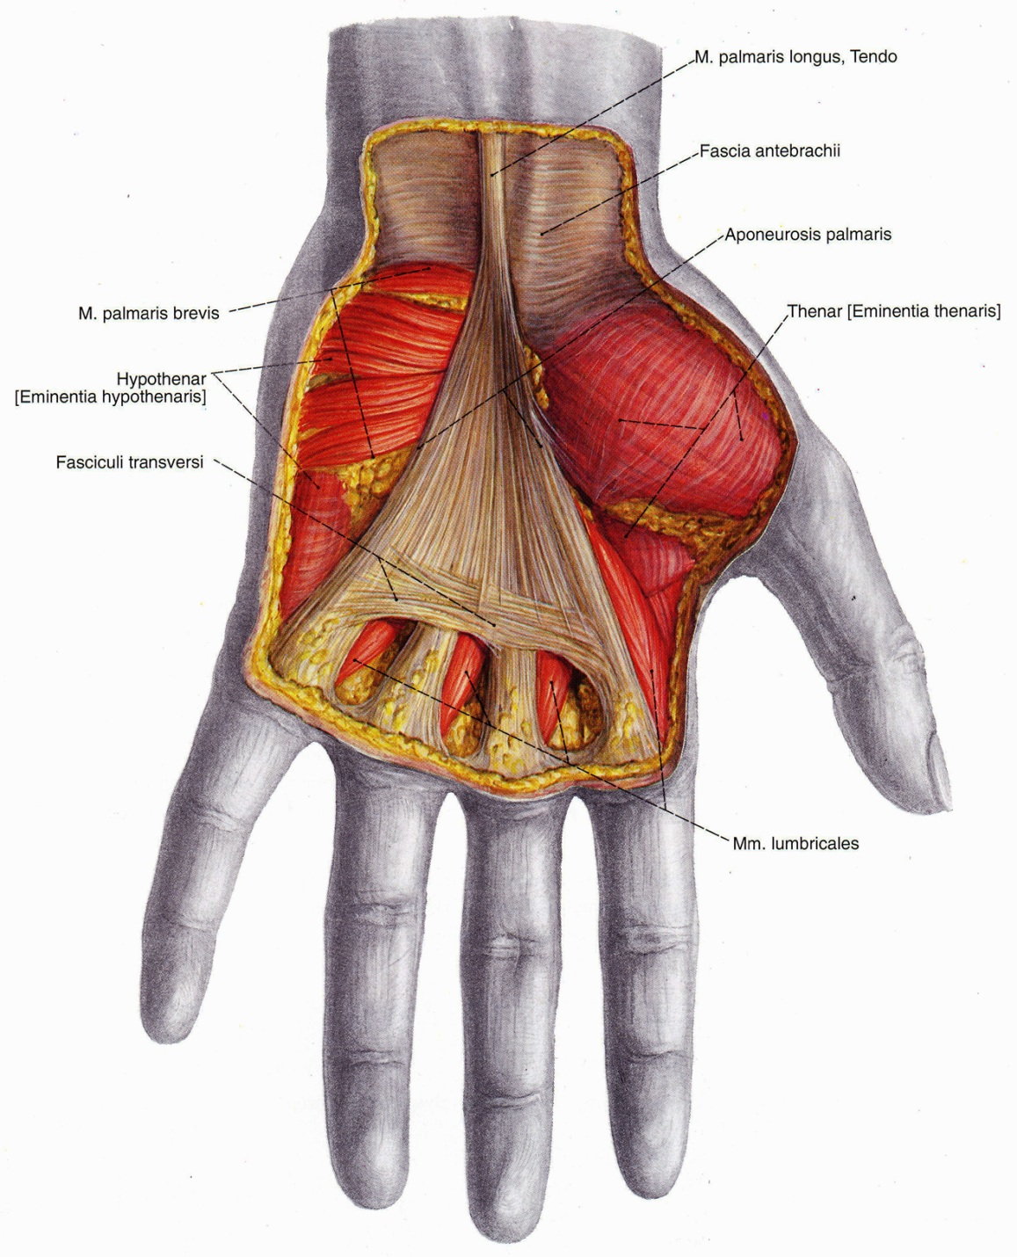

Slide 16
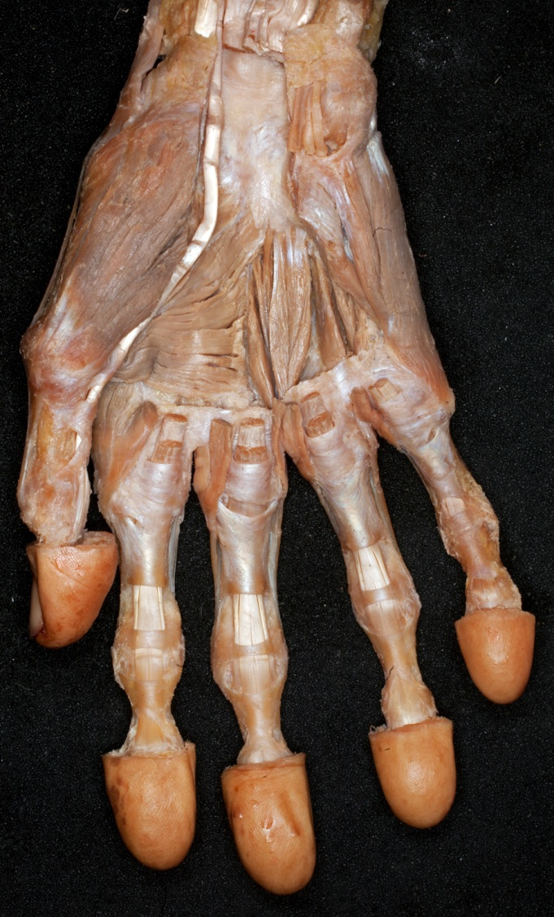
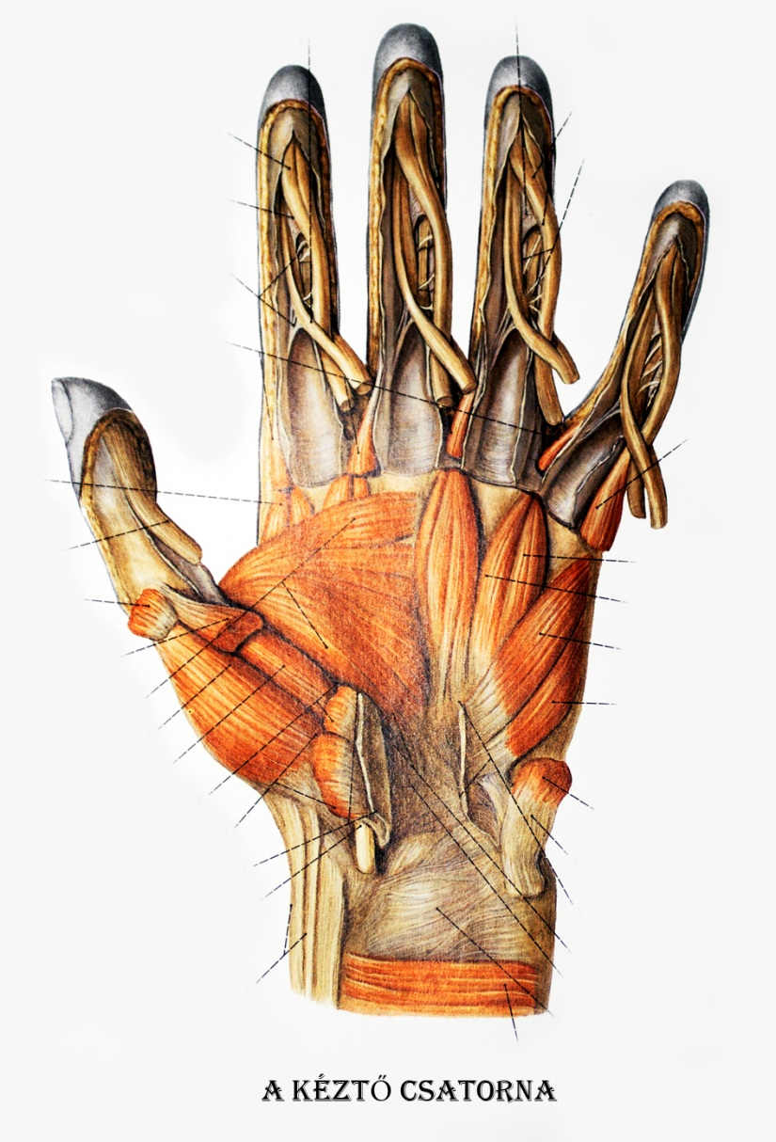

Slide 17
