Slide 1
Woche: Wirbelsäule: Aufbau, Gelenke, Bewegungen
Dr. Fehér Erzsébet

Slide 2
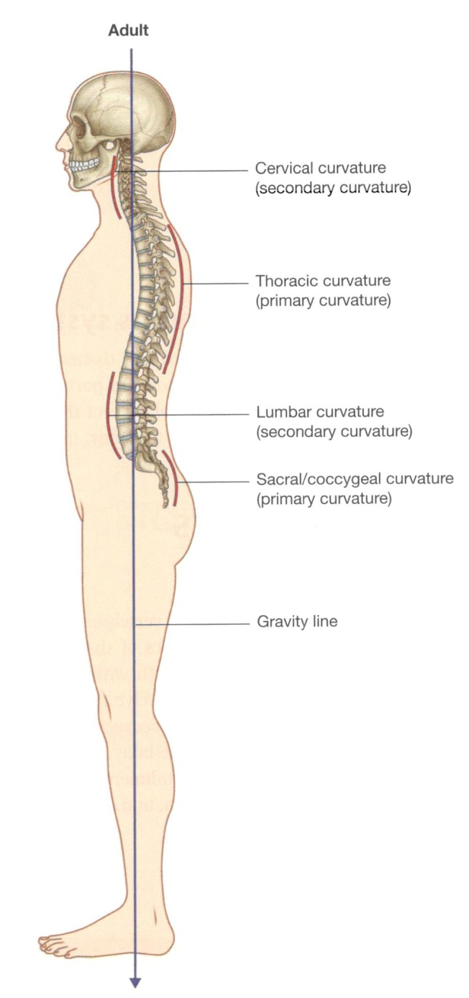
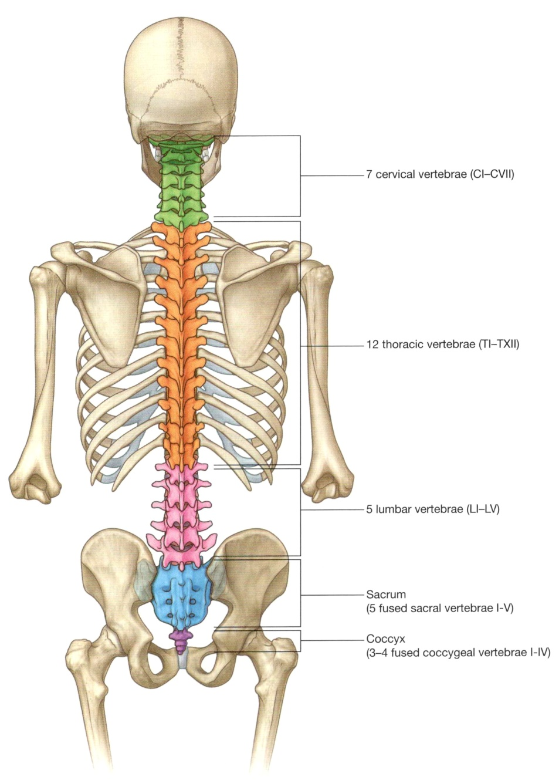
Curvatures of the vertebral column
Vertebrae
lordosis
kyphosis
lordosis
kyphosis

Slide 3
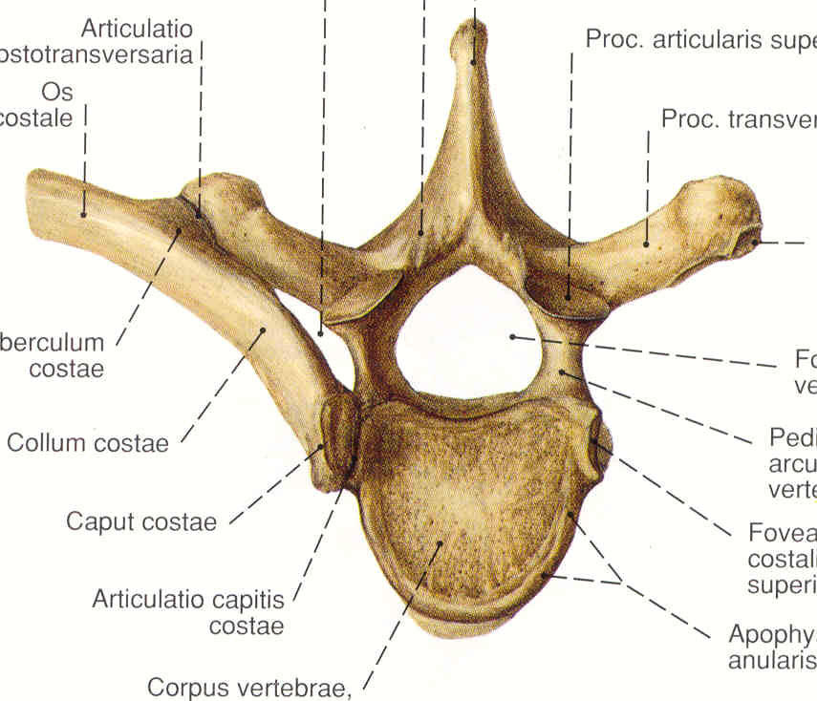
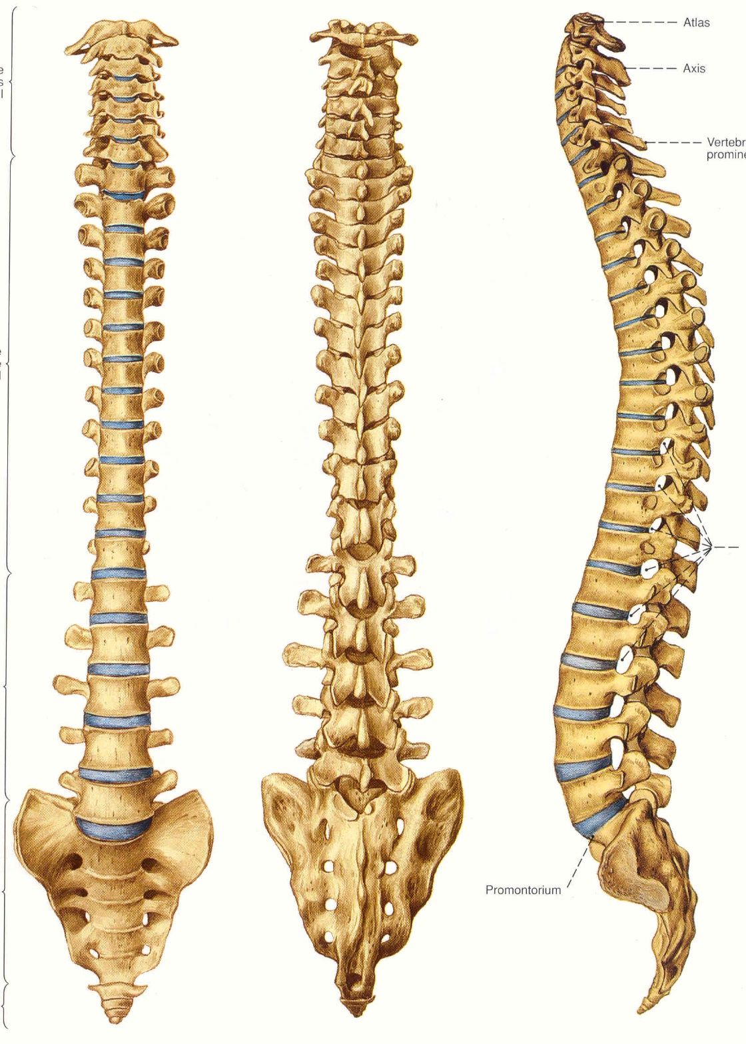
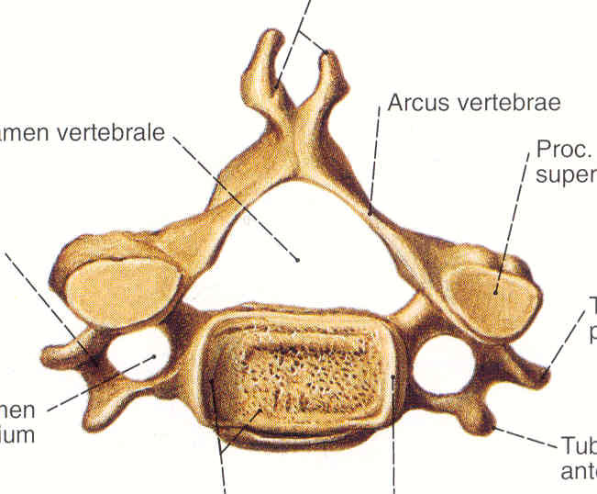
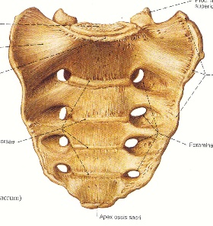
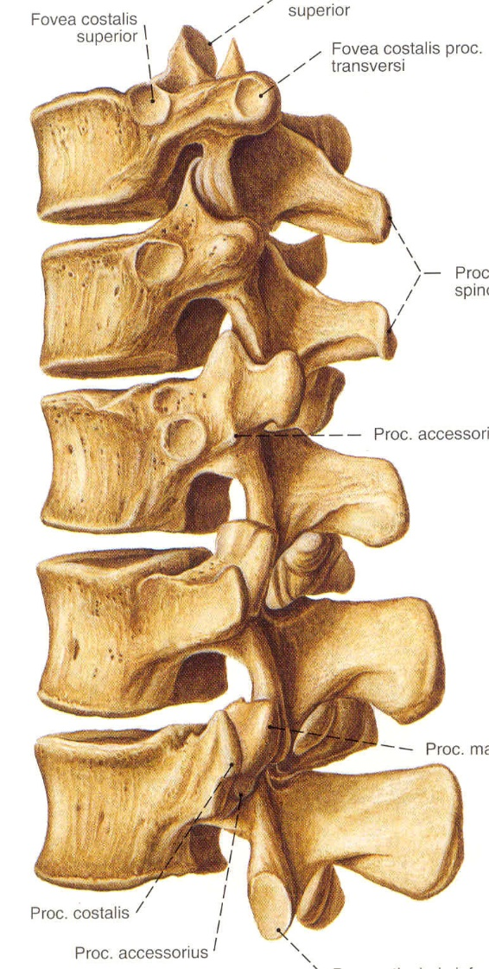
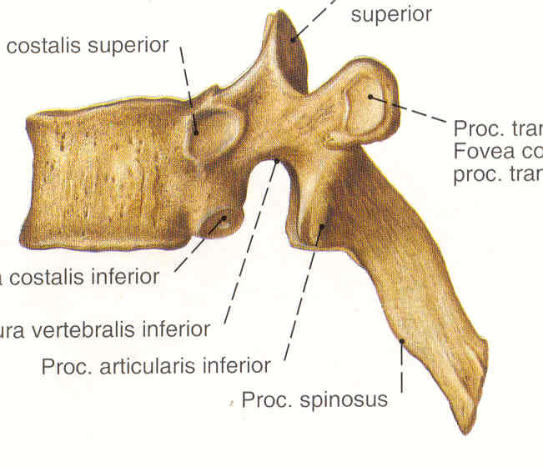
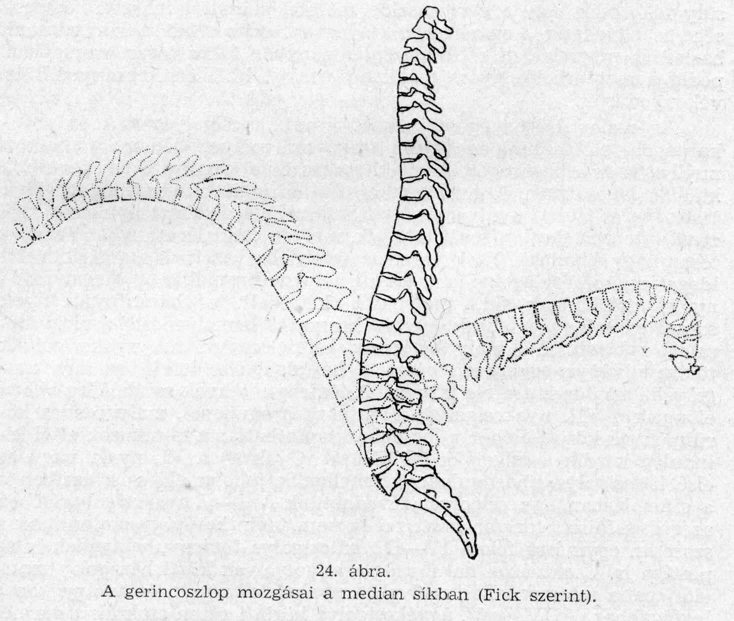
Th
C
C
Th
Th10
Th
L
S
L2
Cc

Slide 4
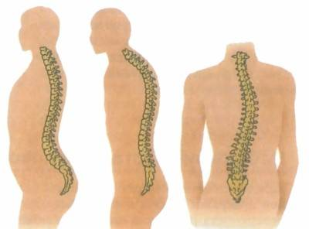
lordosis kyphosis scoliosis

Slide 5
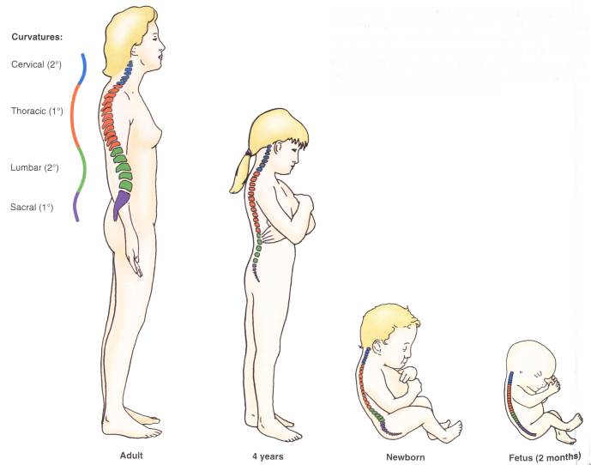
primer: thoracalis, sacralis kyphosis
fej emelése: cervicalis lordosis
ülés, állás: lumbalis lordosis

Slide 6
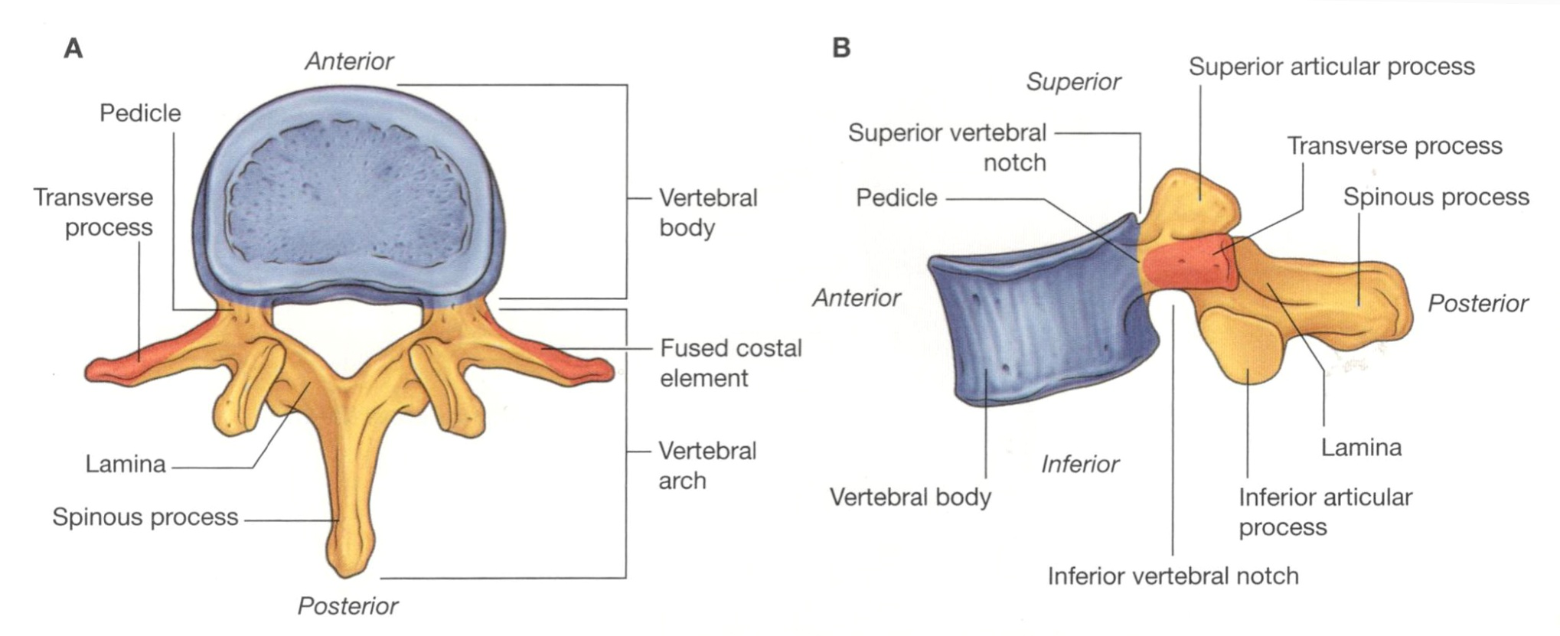
Bauelemente eines Wirbels
Vertebral foramen

Slide 7
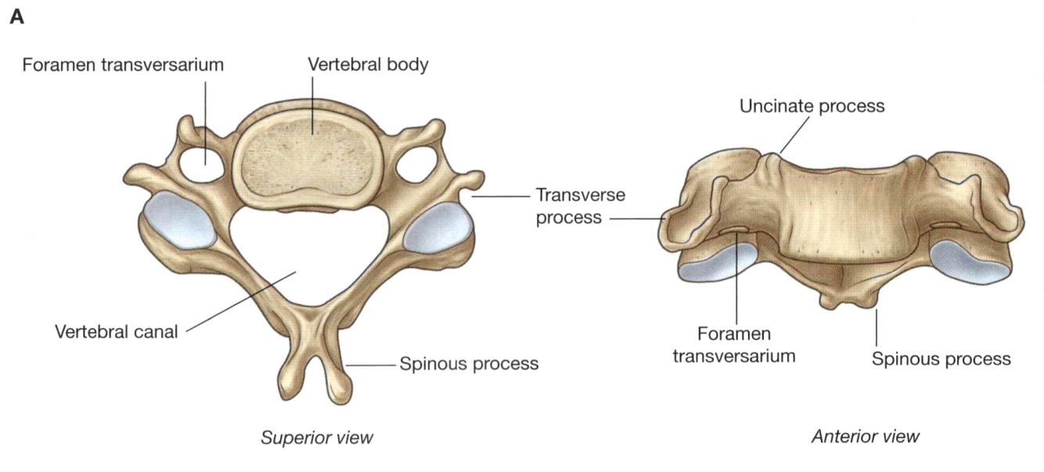
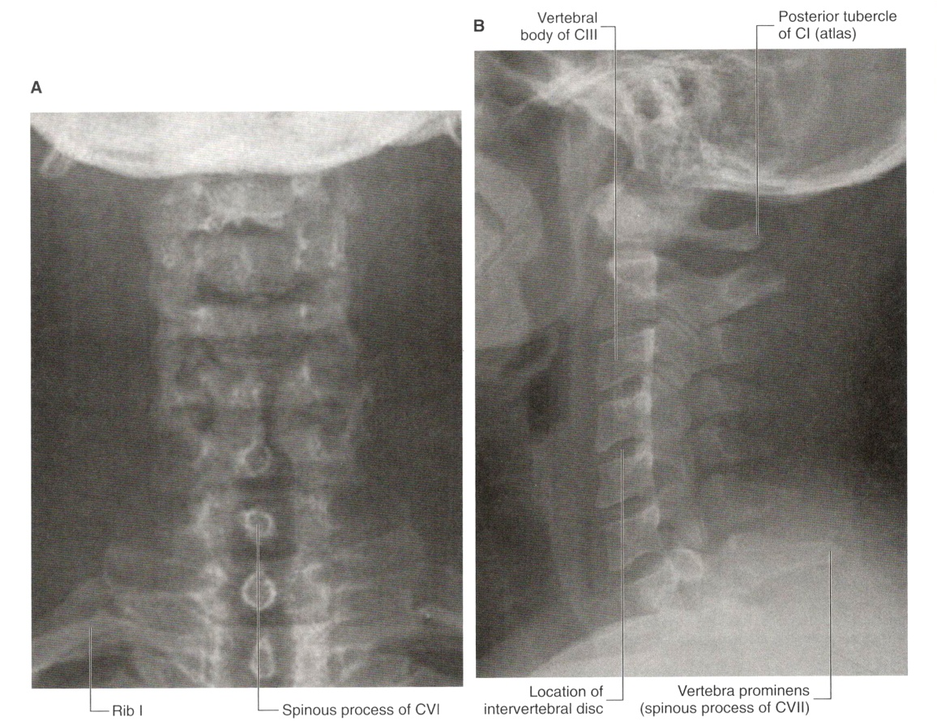
Cervical vertebrae, III-VII

Slide 8
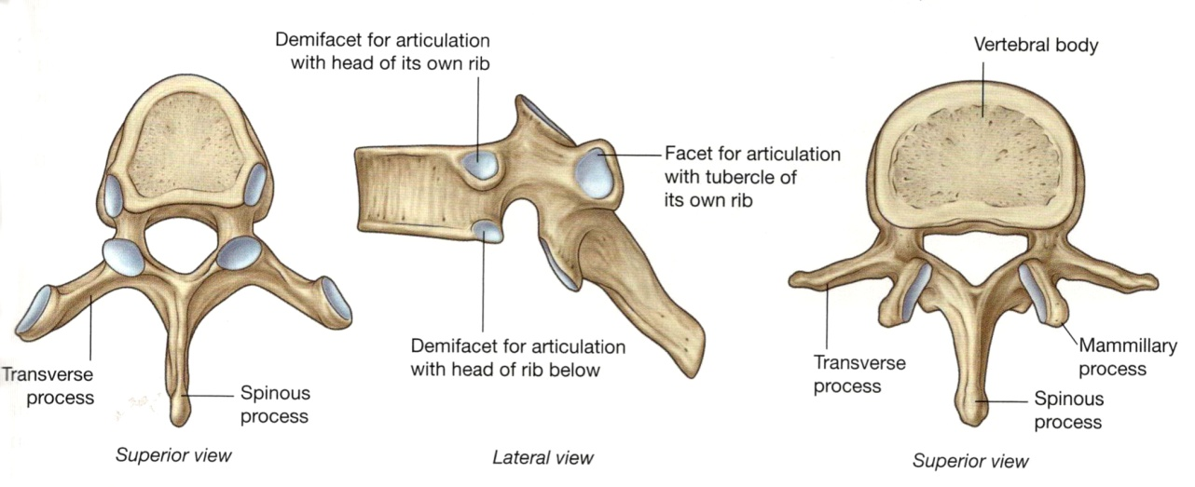
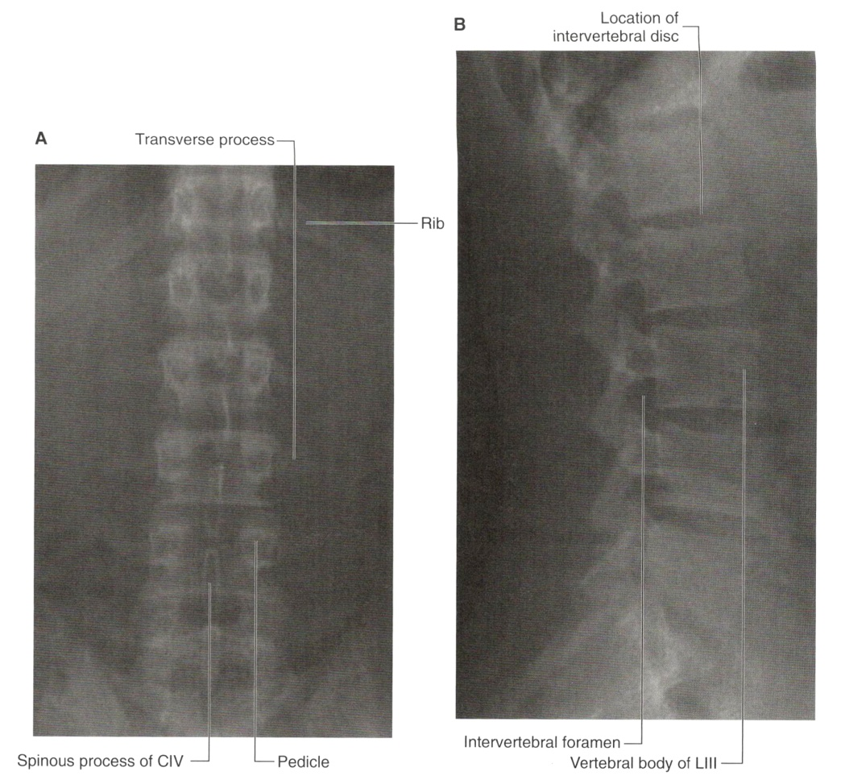
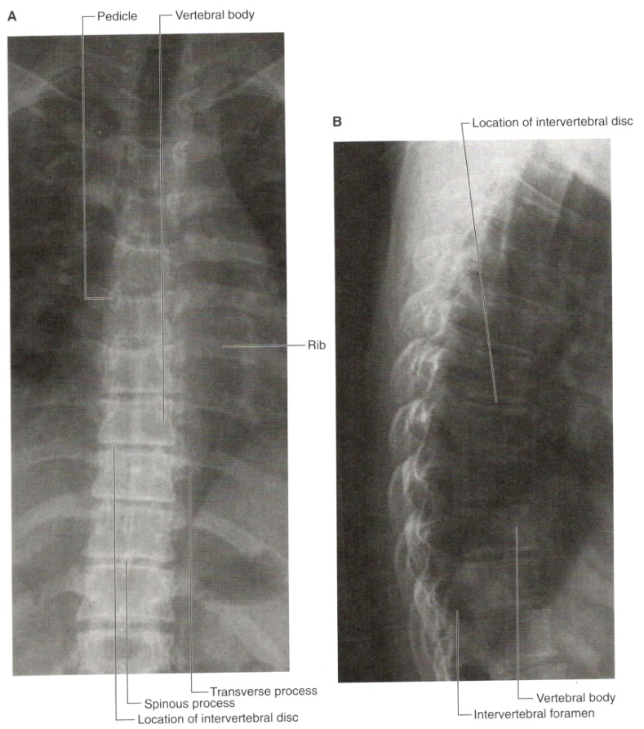
vertebra thoracica
vertebra lumbalis

Slide 9
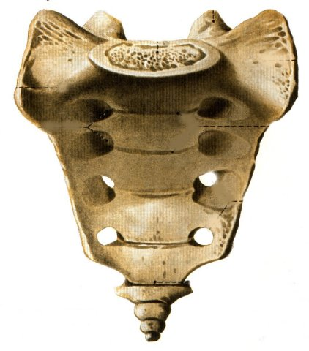
Wirbel Verbindungen
synostosis
synchondrosis
syndesmosis
articulationes

Slide 10
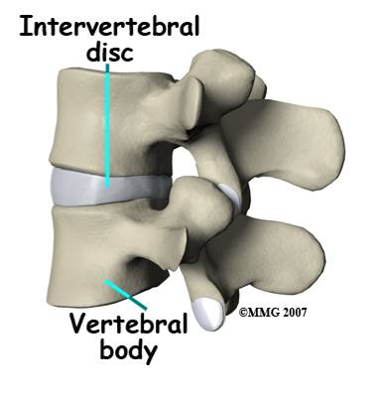
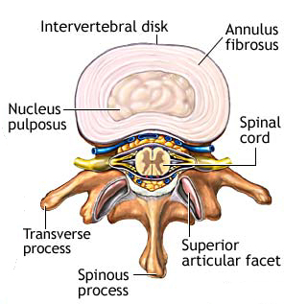
synchondrosis

Slide 11
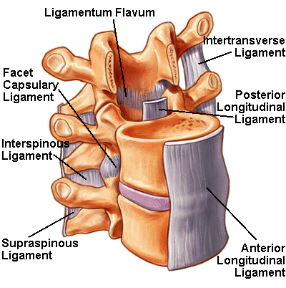
syndesmosis
lig. longitudinale anterius
lig. longitudinale posterius
membrana tectoria
ligg. flava

Slide 12
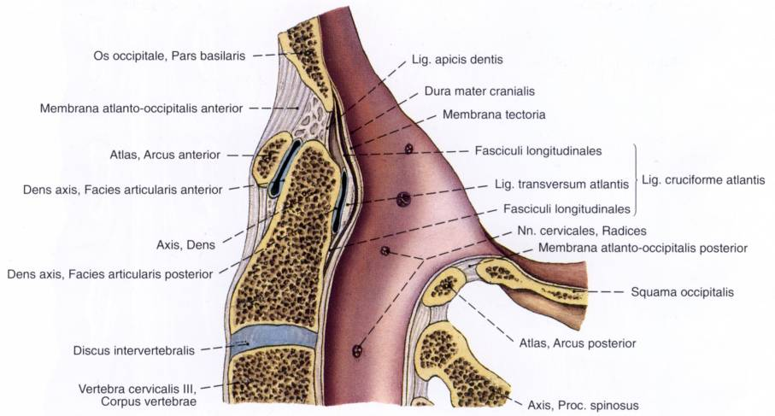
lig. longitudinale ant.
ligg. flava
lig. longitudinale post.

Slide 13
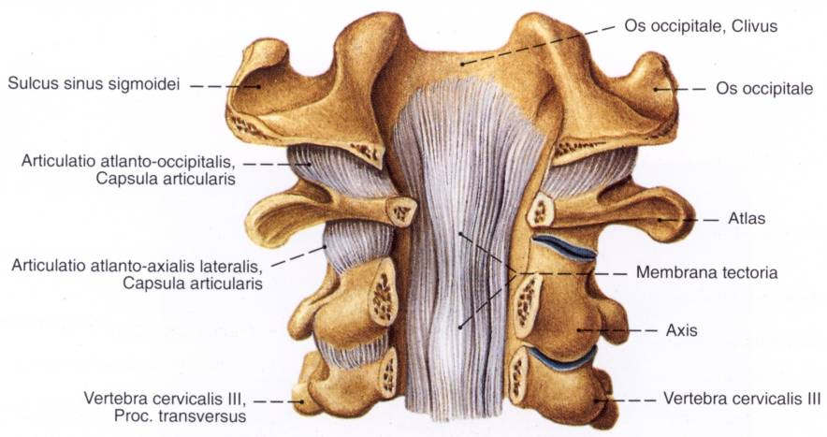
dens axis
lig. longitudinale post.

Slide 14
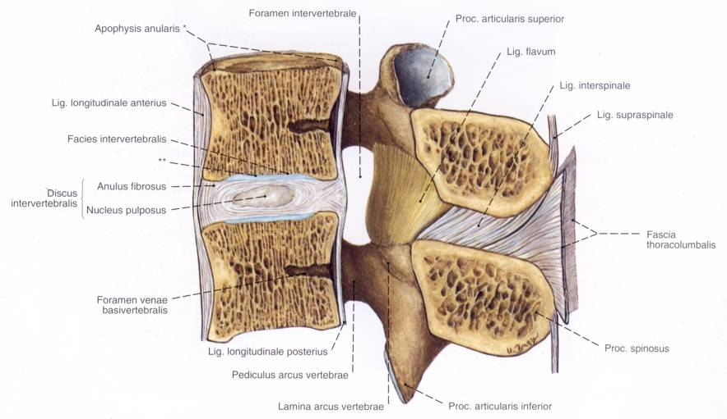

Slide 15
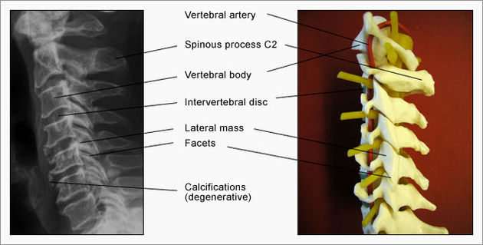
articulationes zygapophyseales

Slide 16
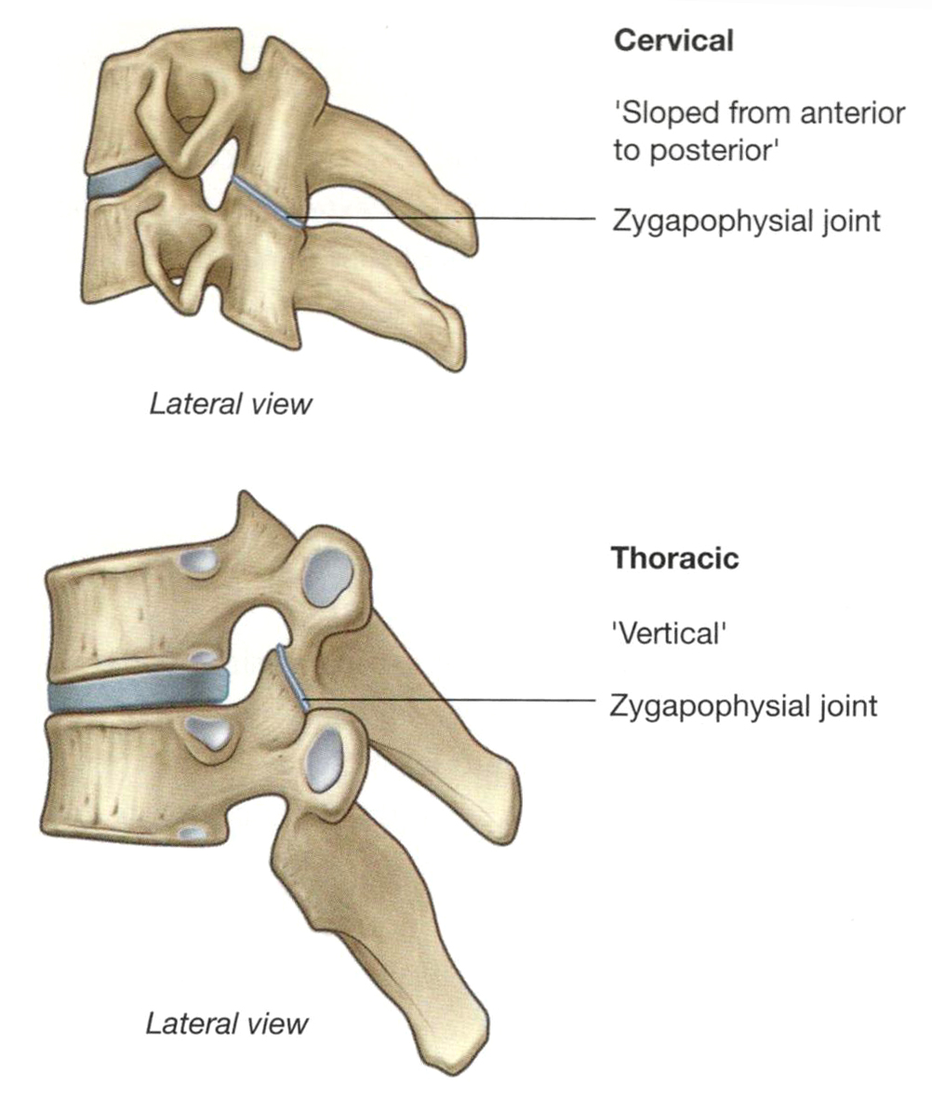
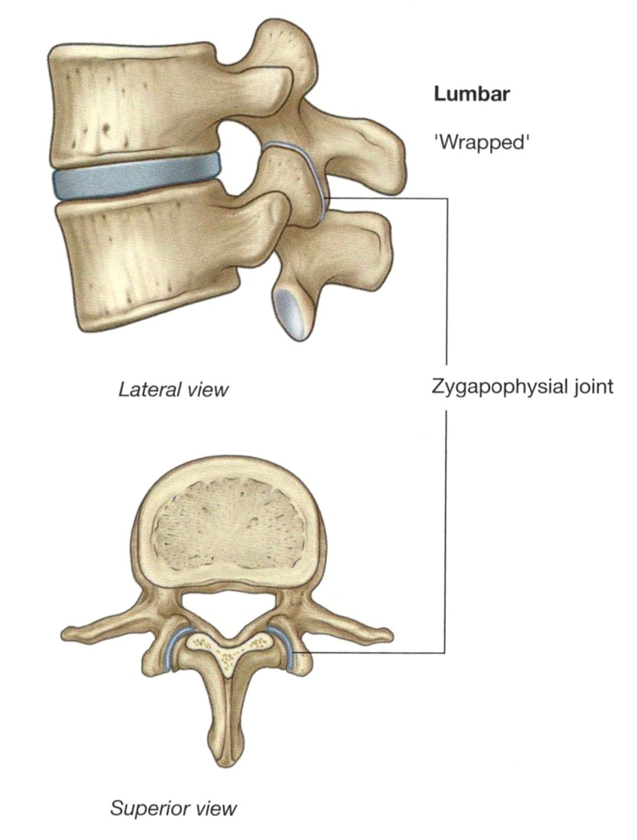
Joints between vertebrae
oblique plane
coronal plane
sagittal plane

Slide 17
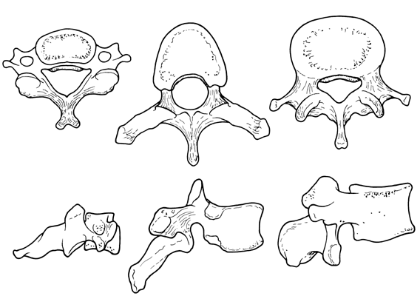

Slide 18
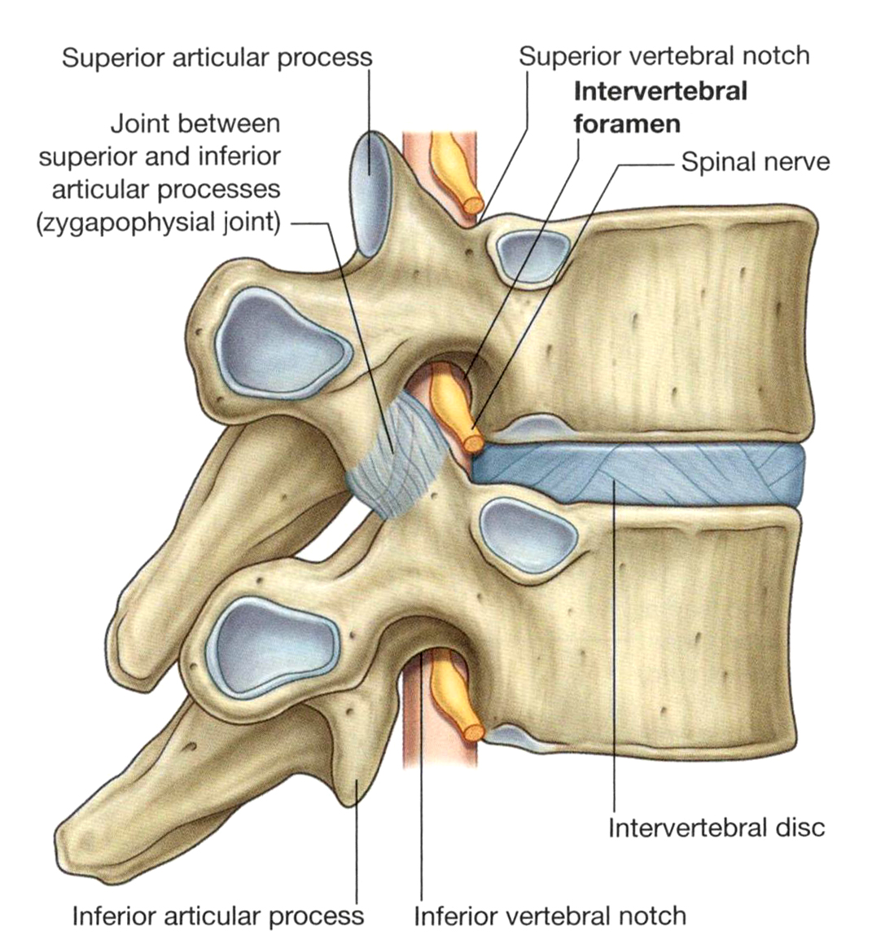
Intervertebral foramen

Slide 19
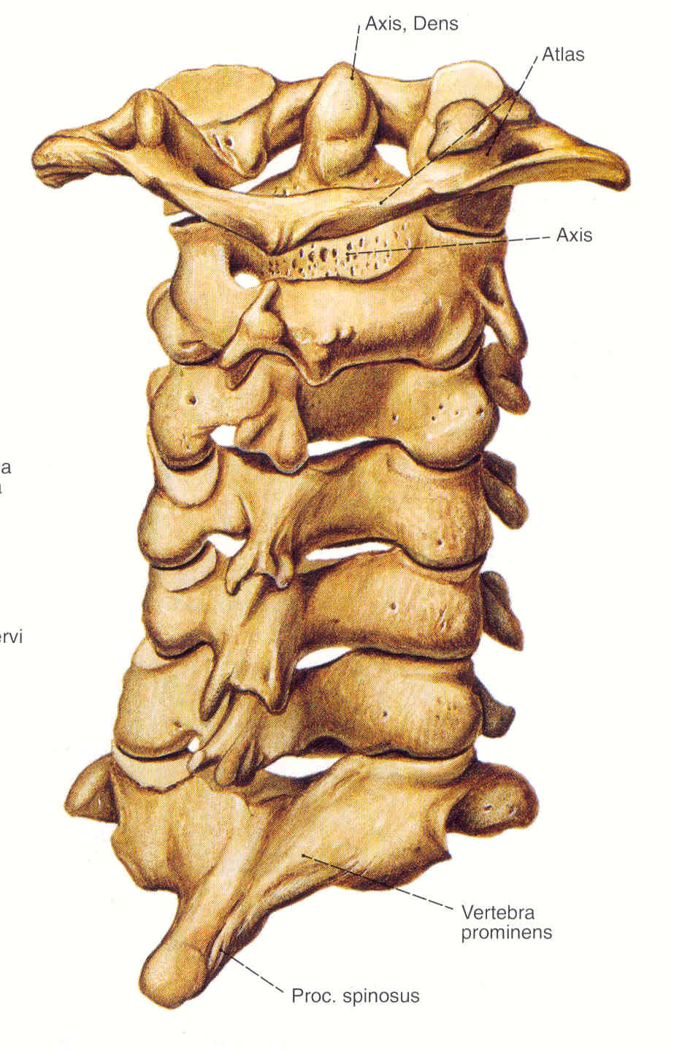
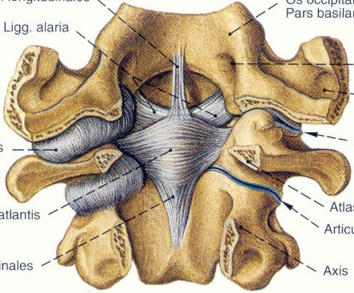
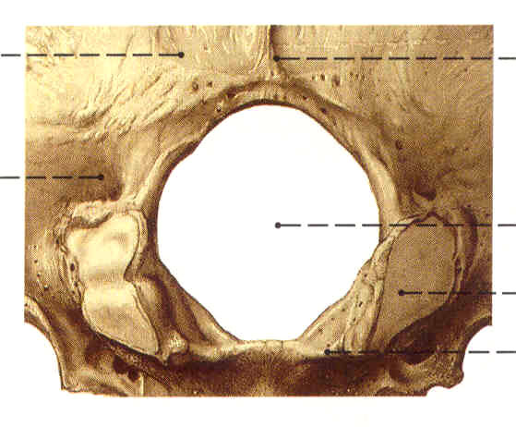
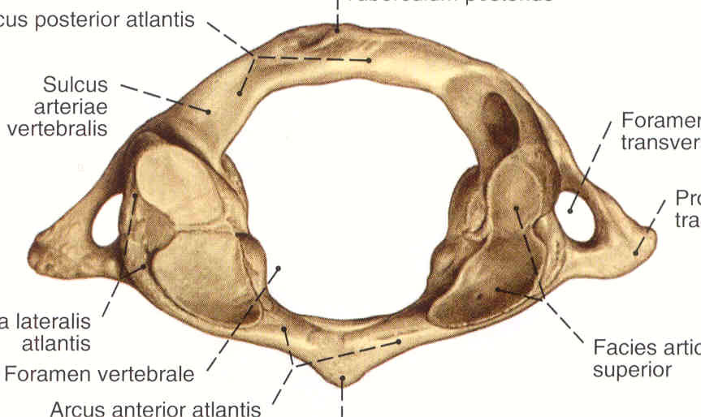
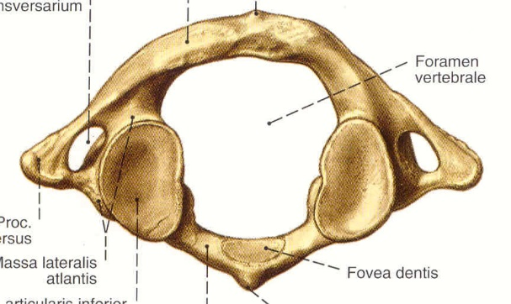
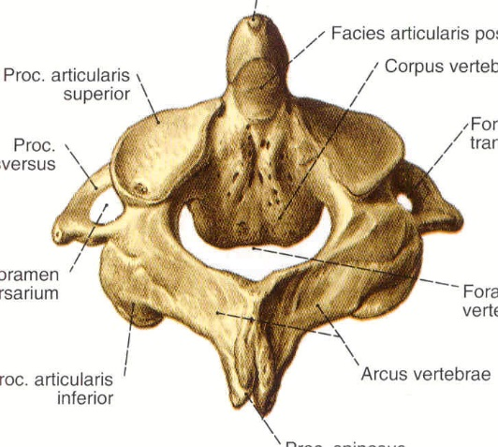
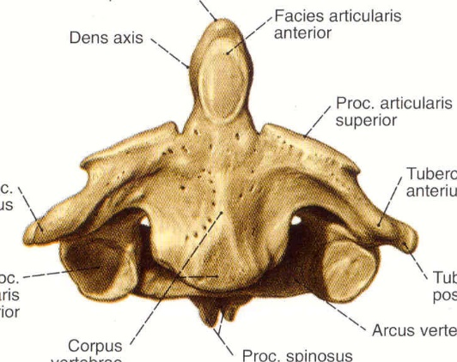
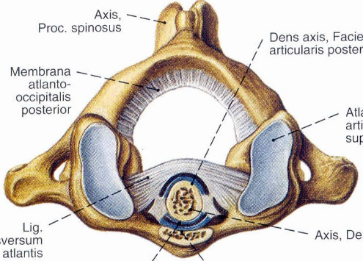
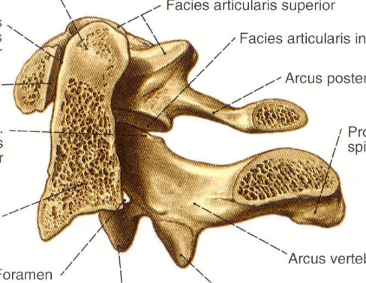
Kopfgelenke
os occipitale
1, Articulatio atlantooccipitalis (Os occipitale-C1)
atlas
2, Articulatio atlantoaxialis (C1-C2)
(C1-C7)
axis

Slide 20
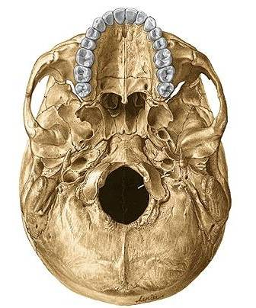
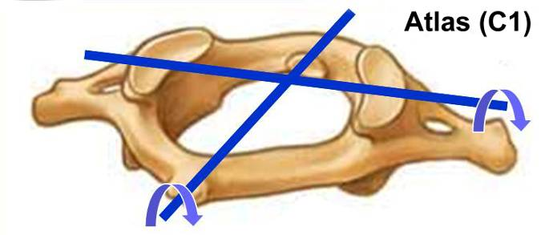
art. atlanto-occipitalis
art. elipsoidea

Slide 21
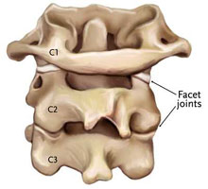
art. atlantoaxialis
1. facies art. inf. atlantis -
facies art. sup. axis
2. dens axis, facies art. atlantis + lig. trans. atlantis

Slide 22
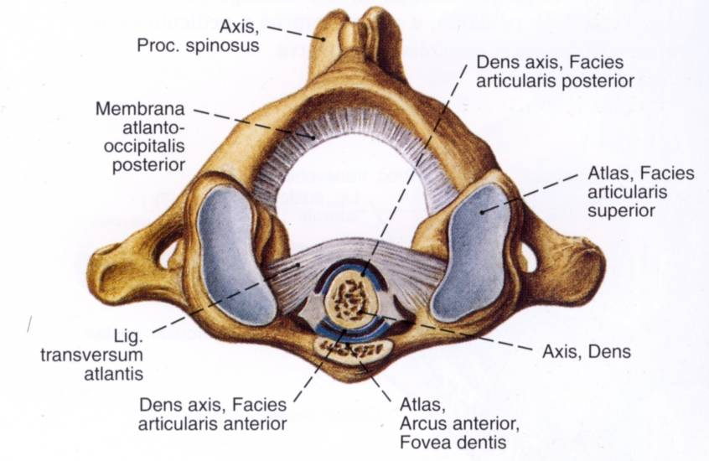
facies art. ant. dentis axis – fovea dentis
facies art. post. dentis axis – lig. transversum atlantis
vö.: art. radioulnaris proximalis

Slide 23
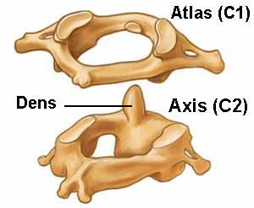
art. trochoidea: rotatio

Slide 24
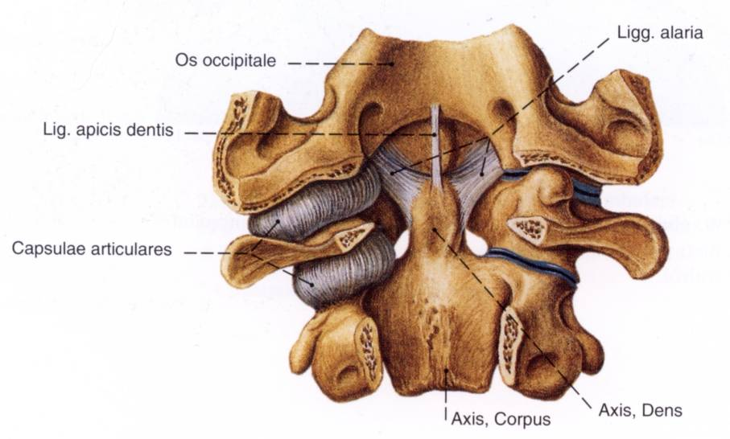

Slide 25
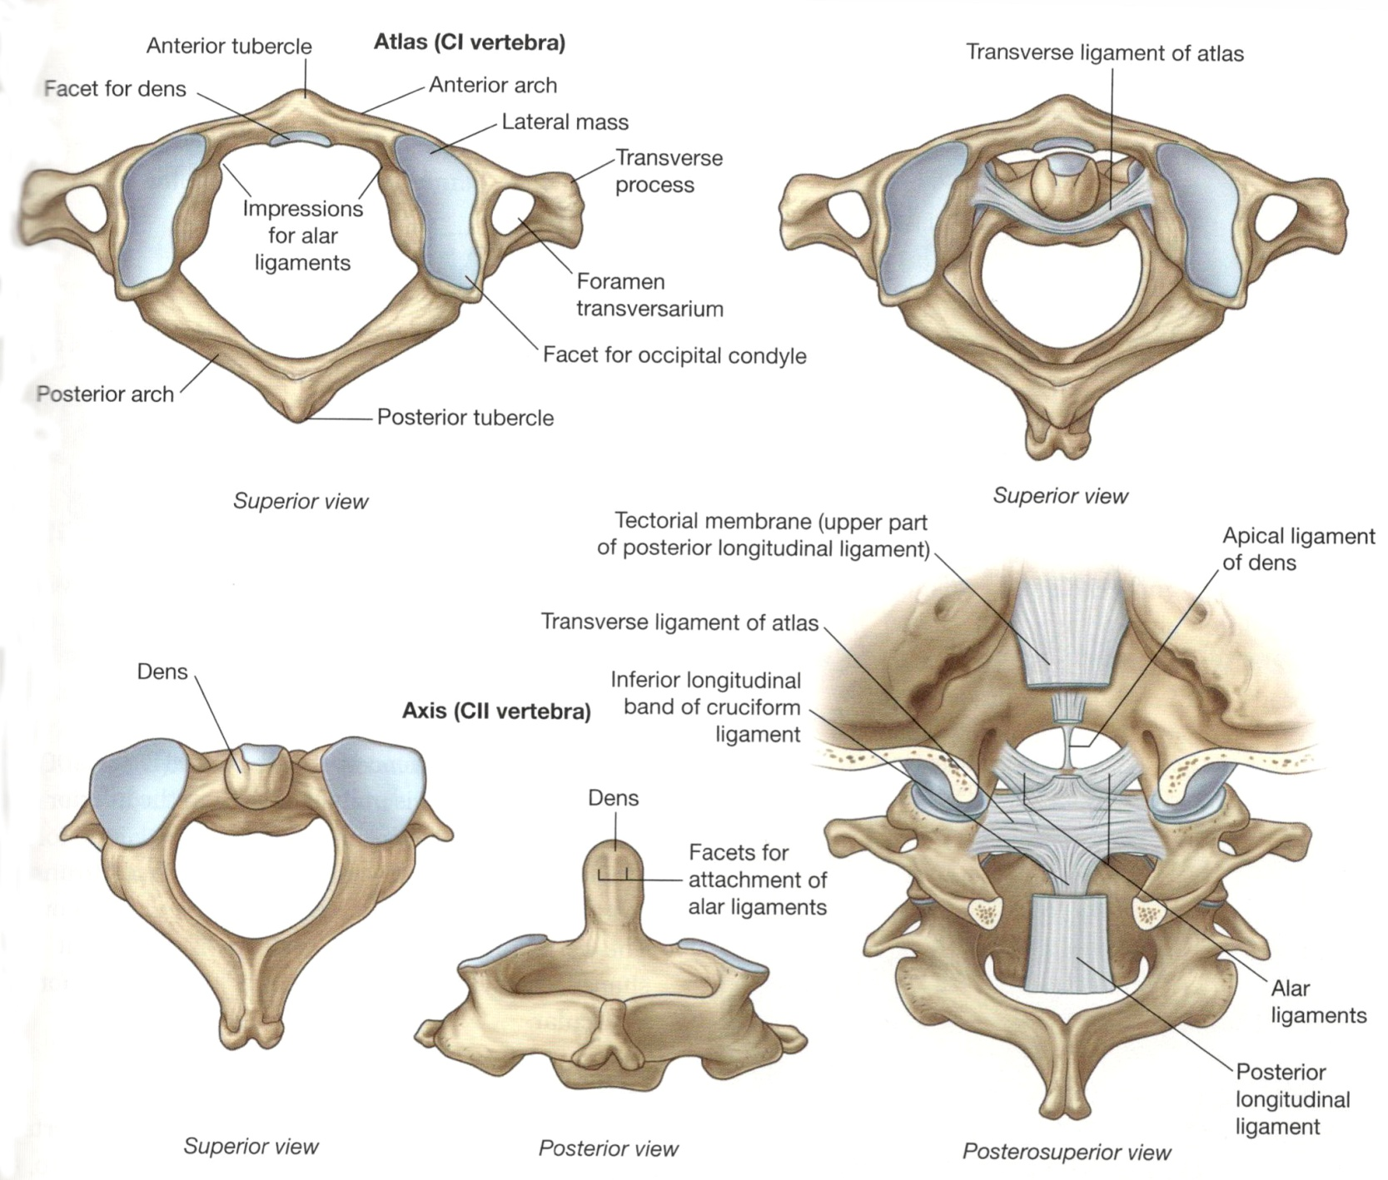
Atlas, axis
right - left
anterior
vertebral artery
posterior

Slide 26
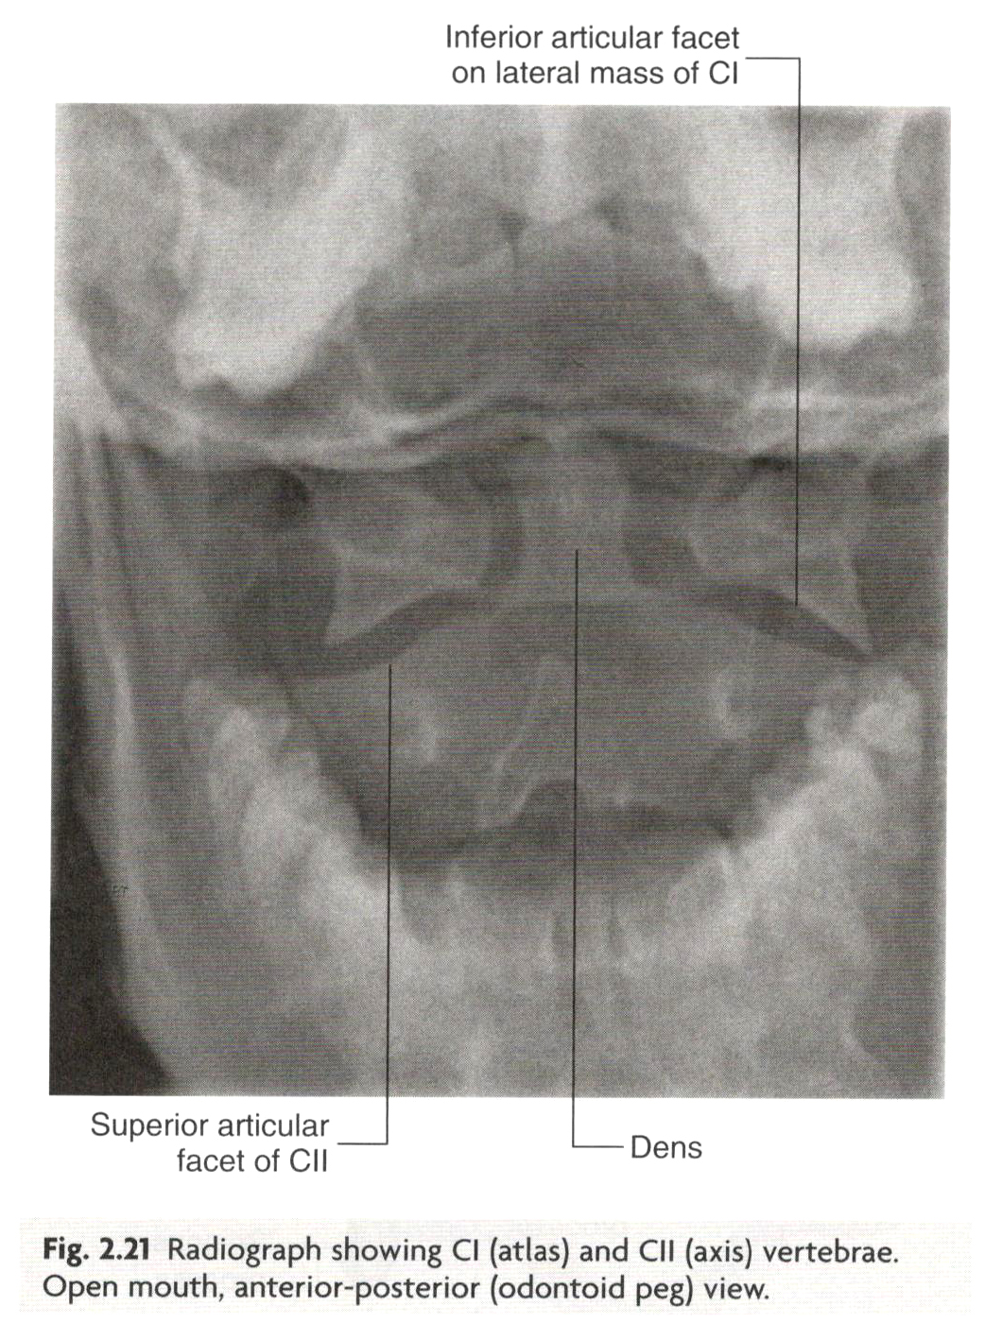
Atlas, axis
rotation

Slide 27
Kopfbewegung
(ventralis)
m. sternocleidomastoideus
m. rectus capitis lateralis
m. rectus capitis anterior
m. longus capitis
(dorsalis)
m. trapezius
m. splenius capitis, m. longissimus capitis
m. semispinalis capitis
m. rectus capitis posterior major et minor,
m. obliquus capitis superior et inferior
mm. prevertebrales
mm. suboccipitales

Slide 28
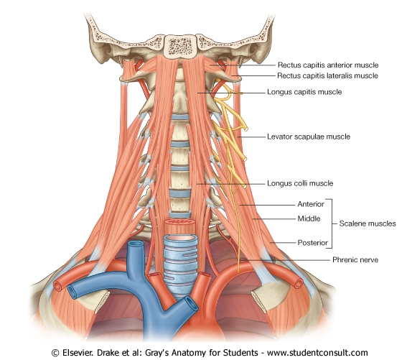

Slide 29
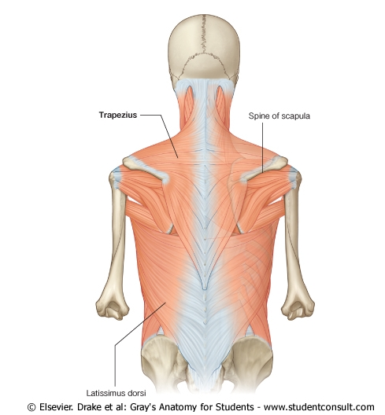
2. m. splenius et longissimus capitis
1. m. trapezius
3. m. semispinalis capitis
4. mm. suboccipitales

Slide 30
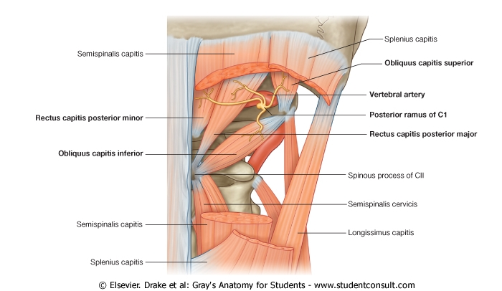
trigonum suboccipitale: a. vertebralis, nervus suboccipitalis (ex C1)

Slide 31
Rückenmuskulatur
Oberflächlichen
spinohumeralis izmok
trapezius, rhomboidei, latissimus dorsi, levator scapulae
Tiefen Rückenmuskeln (autochthone)
m. splenius cervicis
m. erector spinae
m. spinalis
m. longissimus
m. iliocostalis
mm. transversospinales
mm. semispinales
mm. multifidi
mm. rotatore

Slide 32
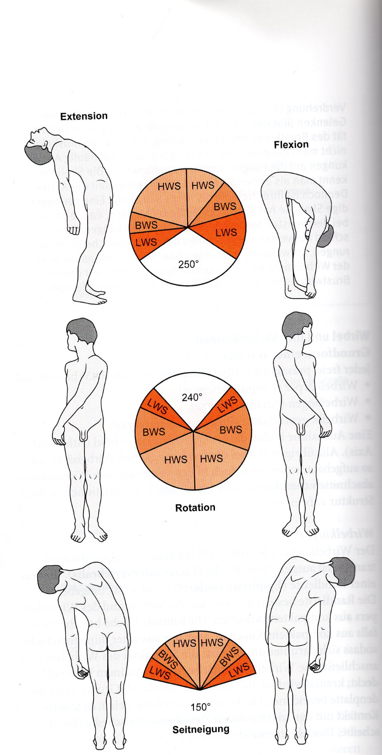

Slide 33
Bewegungen
Flexion – forwards and backwards
Flexion laterally
Torsion

Slide 36
Pathology

Slide 37
Lumbalpunctio

Slide 39
Discus hernia

Slide 41
spina bifida occulta
scoliosis
pectus carinatum (tyúkmellkas)
pectus excavatum (tölcsérmellkas)

