Slide 1
Bony framework of the skull
Sphenoid, ethmoid and temporal bone
Semmelweis Egyetem ÁOK
Humánmorfológiai és Fejlődésbiológiai Intézet
Dr. Csáki Ágnes
2019.11.19.

Slide 2
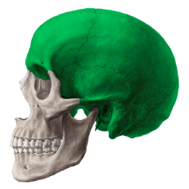
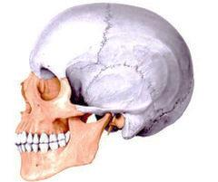
NEUROCRANIUM
CALVARIA
BASIS CRANII
BASIS CRANII INTERNA
FOSSA CRANII ANTERIOR
FOSSA CRANII MEDIA
FOSSA CRANII POSTERIOR
BASIS CRANII EXTERNA
VISCEROCRANIUM - FACIAL CRANIUM
ORBIT
CAVUM NASI
PTERYGOPALATINE FOSSA
TEMPORAL FOSSA
INFRATEMPORAL FOSSA
MANDIBLE, TEMPOROMANDIBULAR JOINT

Slide 3
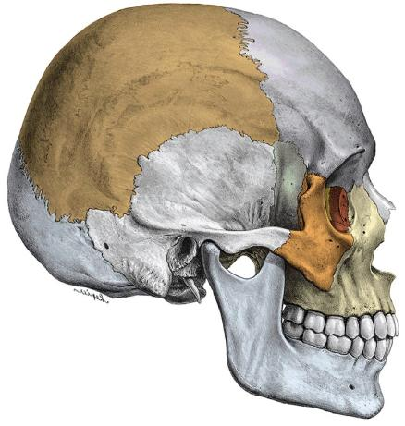
CRANIUM/SKULL
Neurocranium
Os frontale
Os sphenoidale
Os temporale
Os parietale
Os occipitale
Calvaria
Viscerocranium
Os ethmoidale
Maxilla
Os zygomaticum
Os lacrimale
Os nasale
Concha nasalis inferior
Vomer
Mandibula
Os hyoideum
(Malleus, Incus, Stapes)
cranial base /basis cranii

Slide 4
SYNDESMOSIS
sutura serrata (sagittal, coronal, lambdoid s., etc.)
sutura squamosa (temporoparietalis)
sutura plana (in the facial skeleton: nasomaxillary suture, etc.)
SYNCHONDROSIS (sphenopetrosa, petrooccipitalis around the pyramid)
SYNOSTOSIS (sphenooccipitalis - clivus)
ARTICULATIO temporomandibularis
Articulatio incudomallearis és incudostepedialis(in the tympanic cavity)

Slide 5
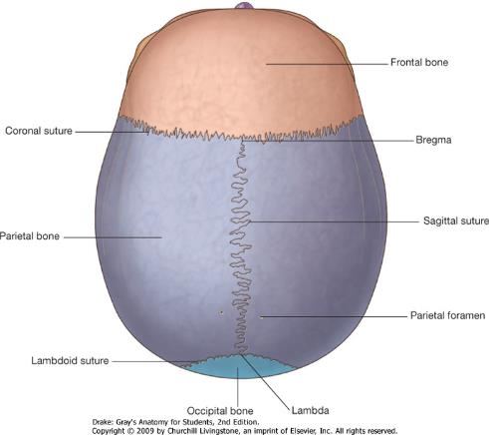

CALVARIA
top part of the skull (skull-cap or cranial vault)
some meeting points of the sutures: bregma (frontal angle),
lambda (occipital angle),
Squamous suture
plane sutures

Slide 6
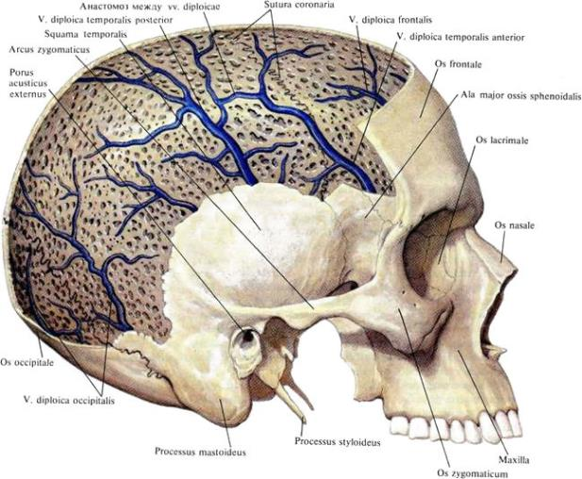
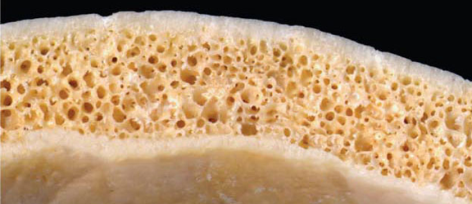
compact bone outer and inner layer + diploe: spongy bone between them with bone marrow spaces
The thickness varies with age, sex, race in different parts
Lamina corticalis (compact)
Diploe
}

Slide 7
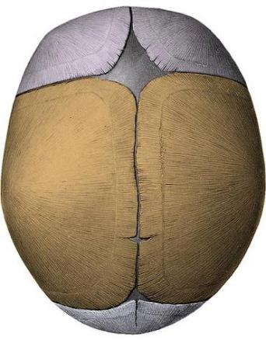
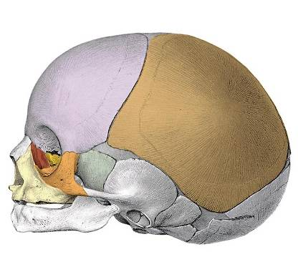
FONTANELLE (FONTICULUS) areas of fibrous connective tissue (soft spots), allows the skull to flex during birth
Anterior (major, greater) fontanelle: frontal, sagittal, and coronal sutures (closures in the 2. year)
Occipital (posterior, minor, lesser) fontanelle: lambdoid and sagittal sutures (in the 2. month)
Sphenoidal fontanelles: squamous and coronal sutures
Mastoid fontanelles: squamous and lambdoid sutures
Fonticulus anterior
Fonticulus spheniodalis
Fonticulus mastoideus
Fonticulus posterior

Slide 8
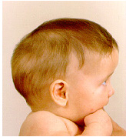
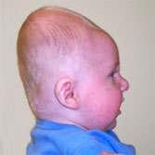
Fejlődési rendellenességek
Scaphocephalia
early closure of sagittal suture
Brachycephalia
early closure of coronal and lambdoid suture

Slide 9
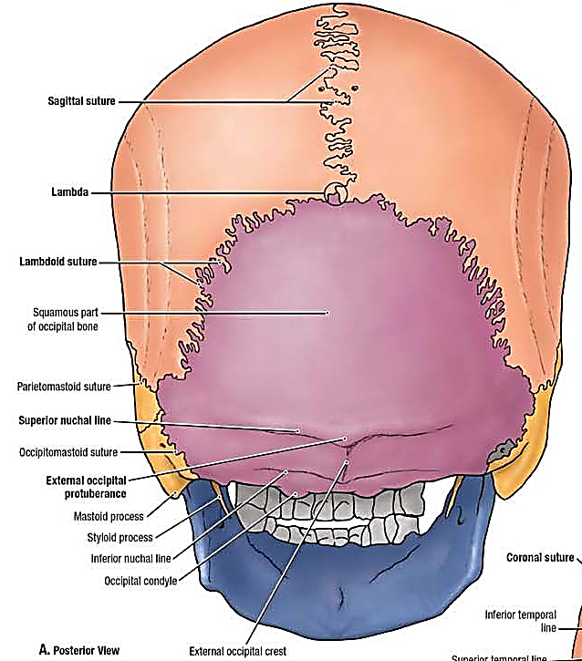
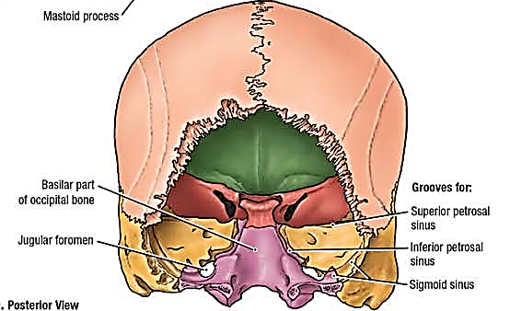
NEUROCRANIUM
2 parietal bone
2 temporal b. transverse upper arch
1 occipital b. sagittal lower arch
1 shenoid b.
1 frontal b.

Slide 10
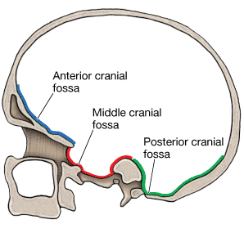
INTERNAL BASE

Slide 11
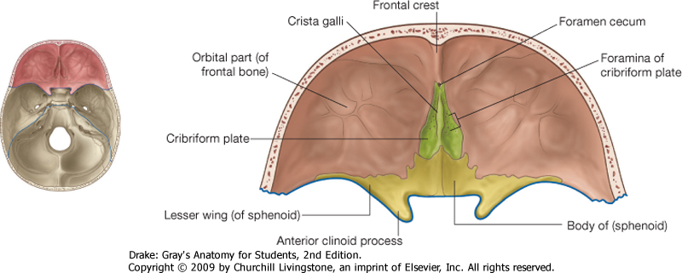
ANTERIOR CRANIAL FOSSA
Anterior ethmoid canal
frontal bones (pars orbitalis+lesser wing of the sphenoidal bone
Ciribriform plate
Crista galli

Slide 12
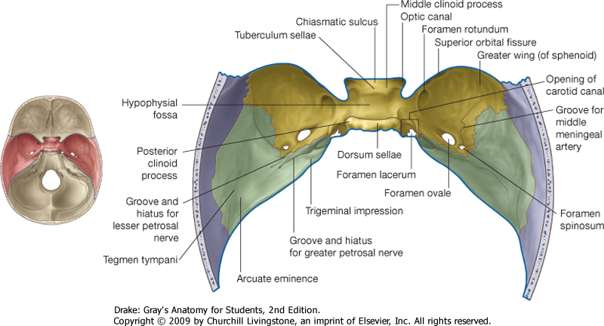
MIDDLE CRANIAL FOSSA
from lesser wing of sphenoid bone to pars petrosa of the temporal bone (groove for the sup. petrosal sinus)

Slide 13
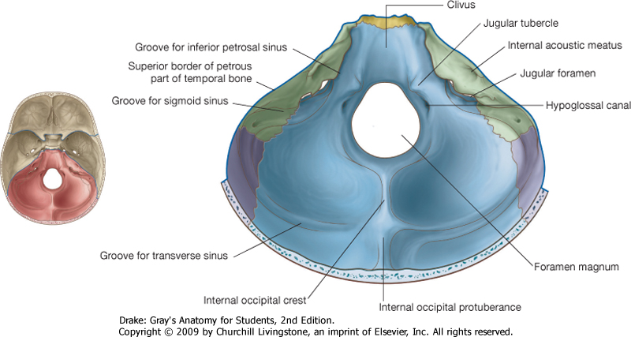
POSTERIOR CRANIAL FOSSA
posterior surface of the pars petrosa (termporal bone)+occipital bone (squama)

Slide 14
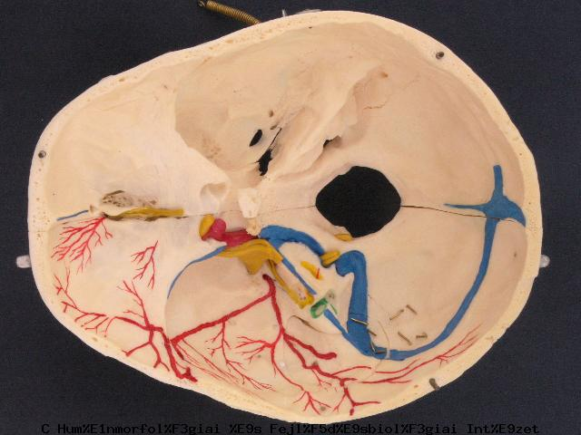
BASIS CRANII INTERNA

Slide 15
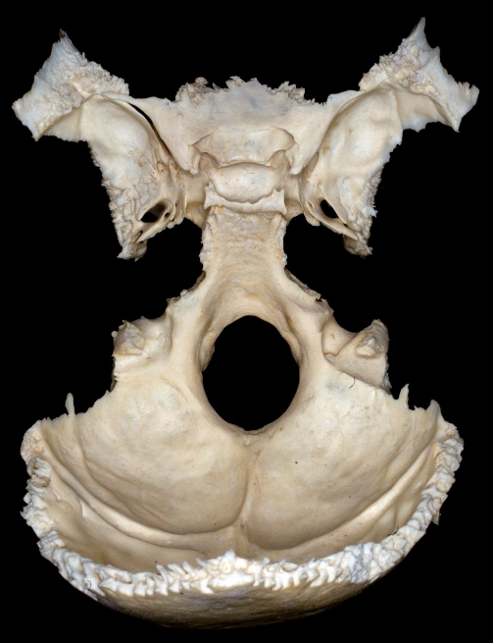
Synchondrosis sphenooccipitalis
fusion around the 18th year
Abbildung: G. Baksa

Slide 16
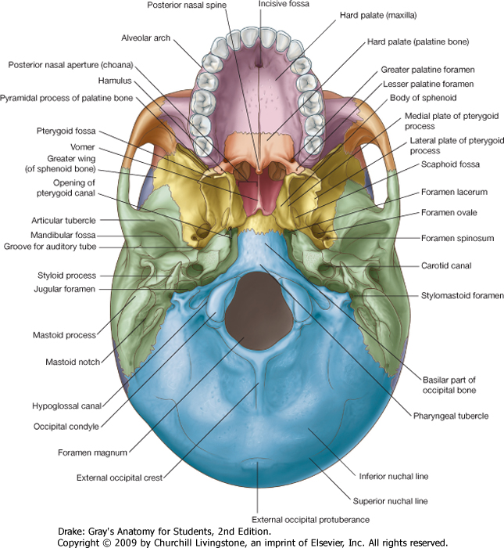
EXTERNAL BASE:

Slide 17
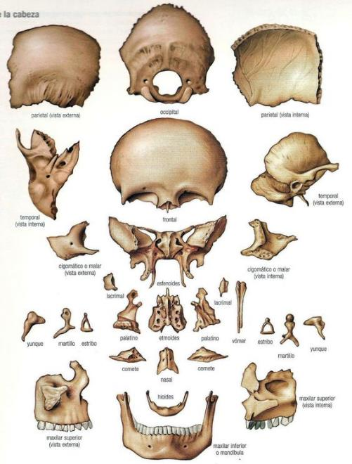
Temporal b.
Sphenoid b.
Ethmoid b.
Palatine b.
maxilla

Slide 18
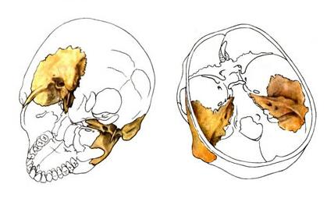
OS TEMPORALE I
CAVUM TYMPANI
CANALIS FACIALIS
CANALICULUS TYMPANICUS
CANALIS MUSCULOTUBARIUS
CANALIS CAROTICUS

Slide 19
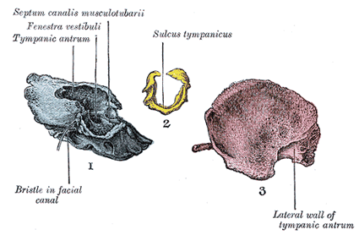
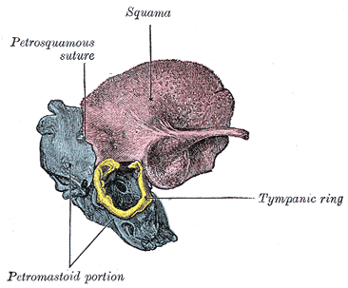
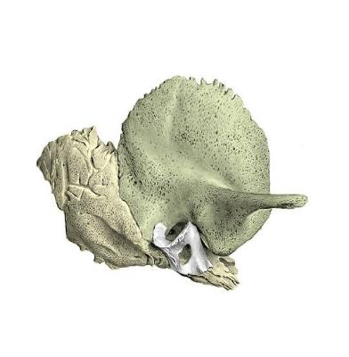
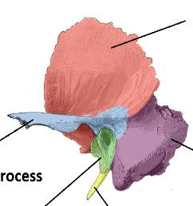
Pars squamosa
Pars petrosa
Pars tympanica
Styloid process

Slide 20
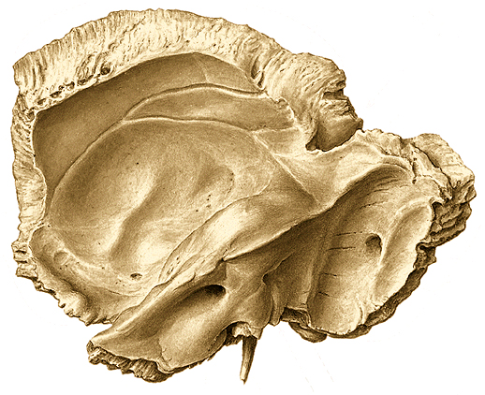
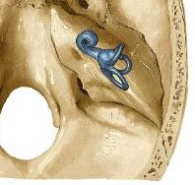
OS TEMPORALE II.
Sulci arteriosi
Tegmen tympani (roof of the tympanic cavity)
Arcuate eminence
Subarcuate fossa
vestibular aqueduct
Grooves for
petrosal nerves
Groove for sup. petrosal sinus
Inner surface
Porus acusticus
internus
Processus styloideus

Slide 21
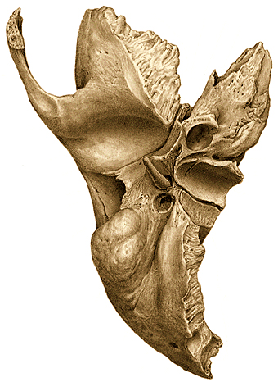
OS TEMPORALE III.
Canalis musculotubarius
Canalis caroticus
Fossa mandibularis
Fissura petrotympanica
Fossula petrosa!
Tympanic canaliculus
Cochlear canaliculus
Porus acusticus externus
Fossa jugularis
(Jugular notch,foramen)
Processus mastoideus
Inferior surface
Foramen stylomastoideum

Slide 22
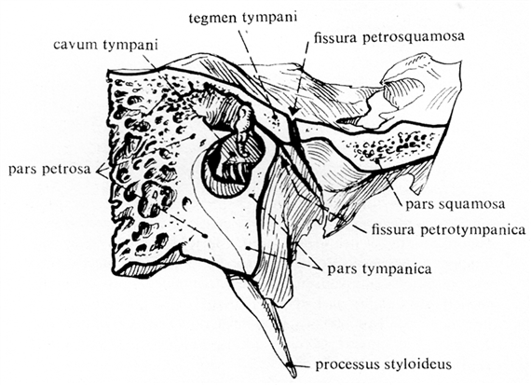
SAGGITAL SECTION:
Pyramid part is excavated to form the cavity which is closed by the tympanic part,
contains the middle ear.
The roof of tympanic cavity, the tegmen tympani turns downward and the edge of it
is seen on the external base beetwen the two fissures

Slide 23
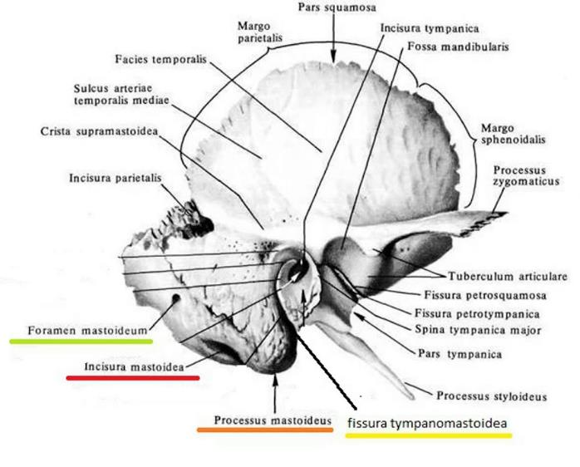
and groove for the
occipital artery

Slide 24
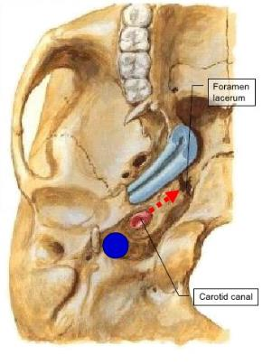
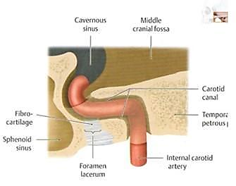
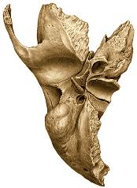
CAROTID CANAL
Canalis caroticus

Slide 25
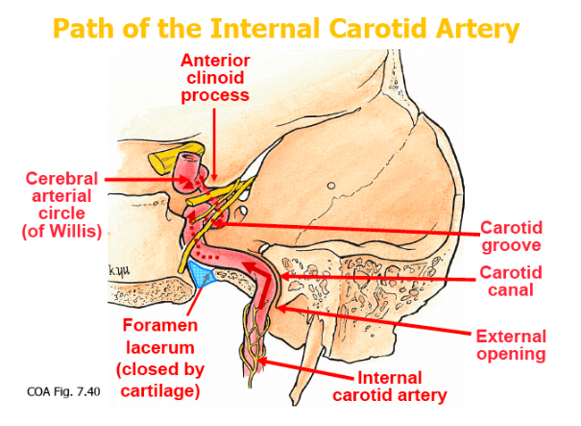
Path of the internal carotid artery
(Sphenoid body)
Synchondrosis sphenopetrosa

Slide 26
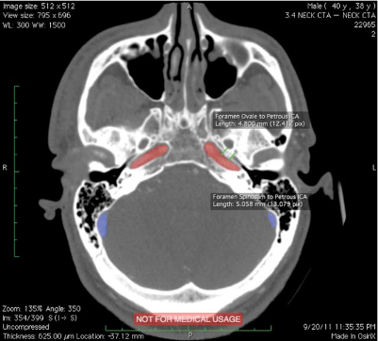
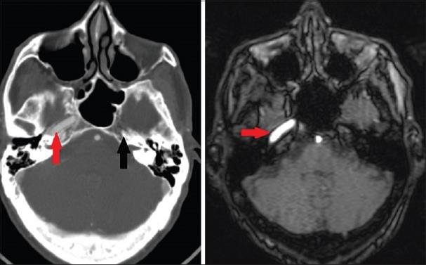

Slide 27
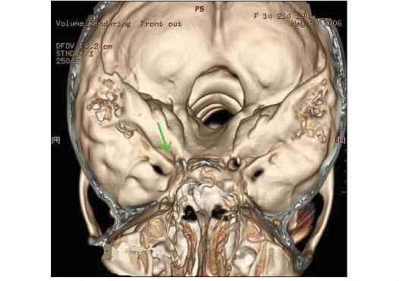
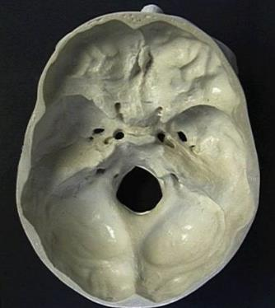
carotid agenesia , internal view
normal

Slide 28
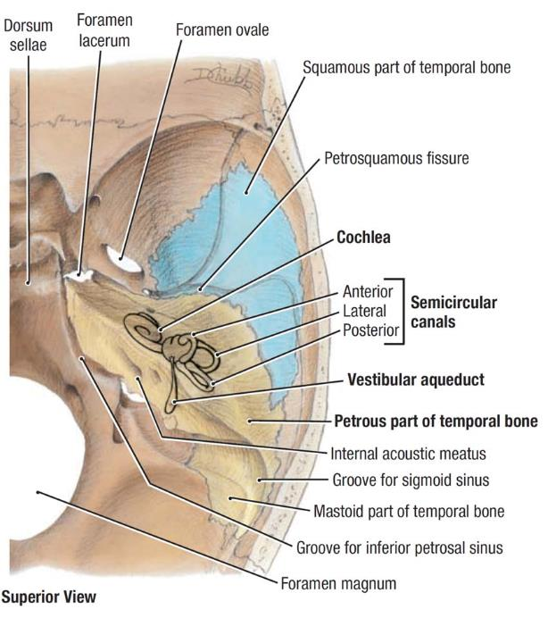
TYMPANIC CAVITY
Tympanic cavity
Fossa subarcuata

Slide 29
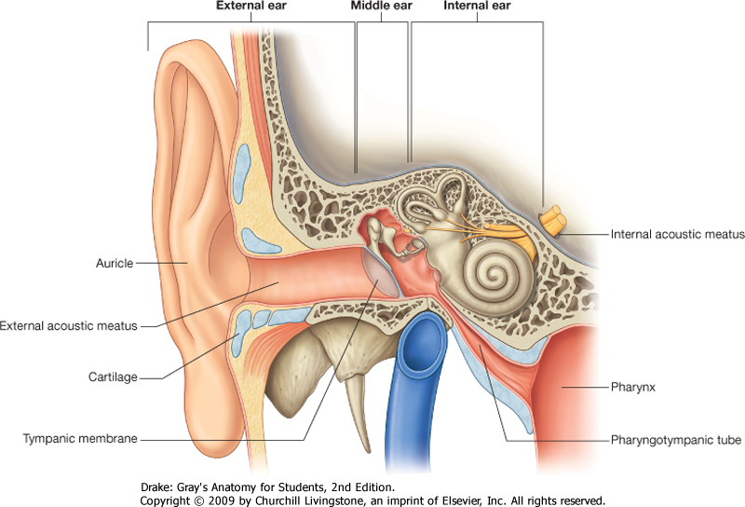
Tympanic cavity

Slide 30
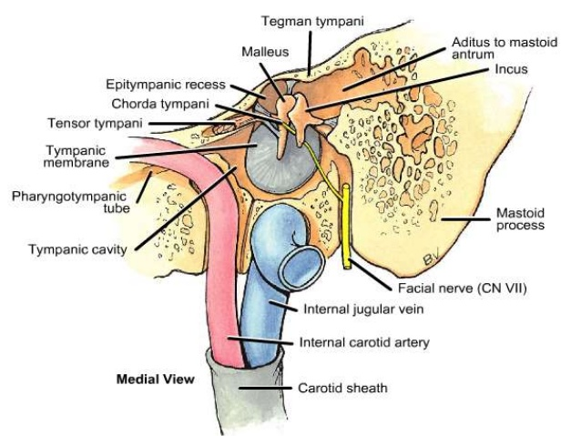
Cavum tympani

Slide 31
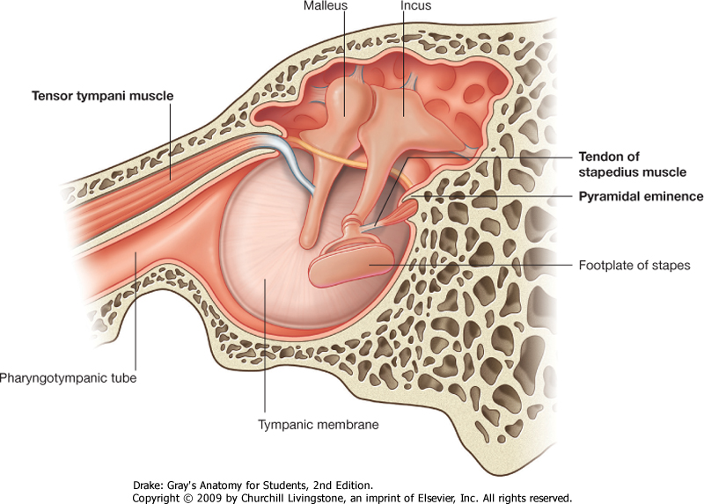
Lateral wall

Slide 32
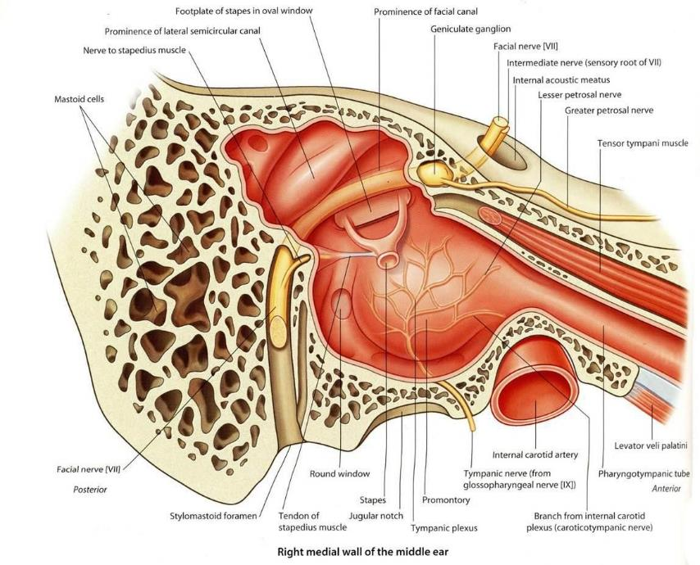
Medial wall

Slide 33
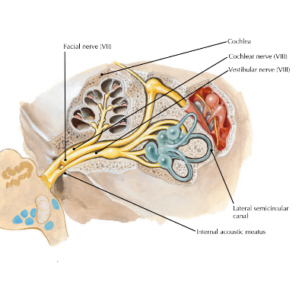
FACIAL CANAL

Slide 34
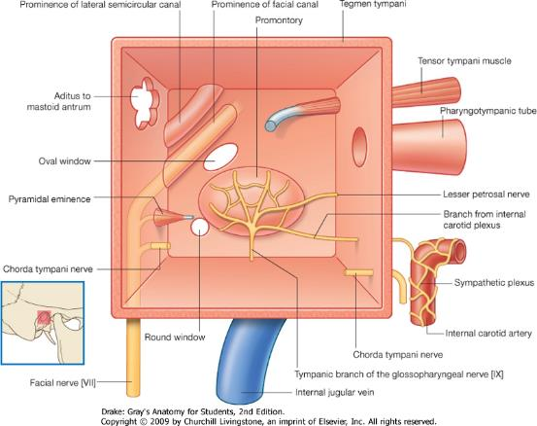
Scheme of the cavity
anterior wall: canalis caroticus with canaliculi caroticotympanici and musculotubarius canal
(pharyngotympanic tube)
inferior wall: jugular fossa, canaliculus tympanicus
posterior wall: entrance to the air cells (antrum mastoideum),canaliculus chordae tympani,
canaliculus stapedius
superior wall: canalis nervi petrosi minoris

Slide 35
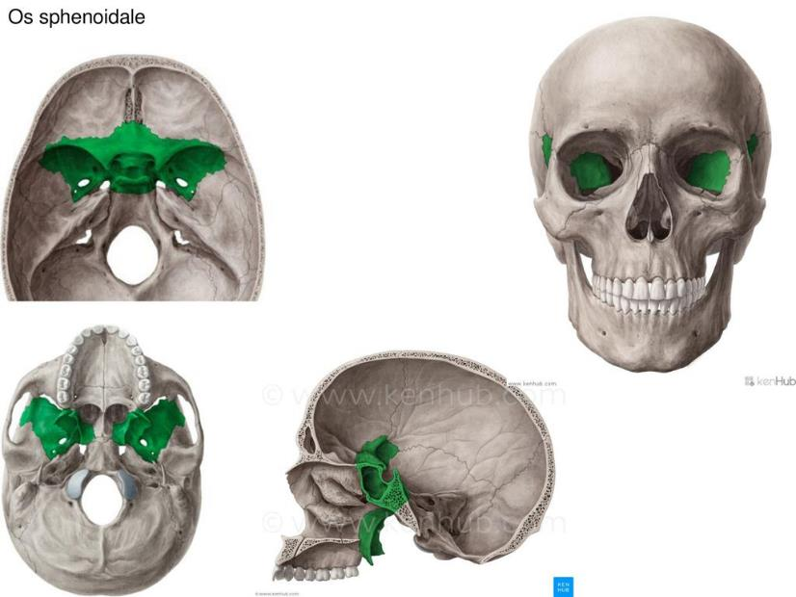
OS SPHENOIDALE
body with sinus
lesser wings
greater wings:
orbital surface
temporal surface
cerebral surface
infratemporal surface
maxillary surface
pterygoid processes

Slide 36
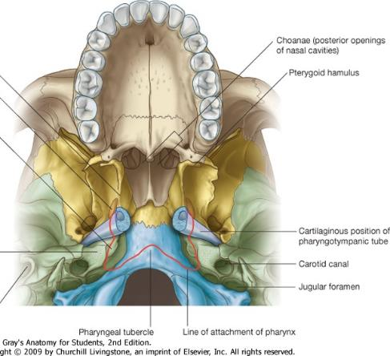
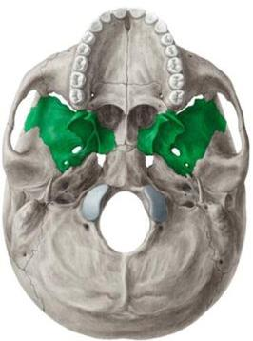
SCAPHOID FOSSA

Slide 37
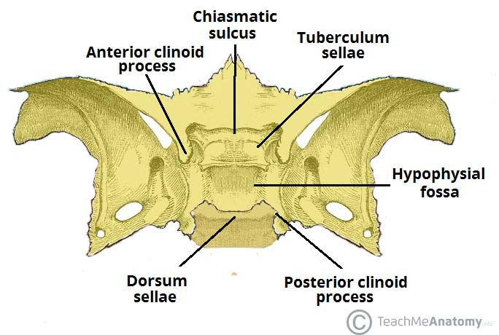
DORSAL SURFACE – SELLA TURCICA

Slide 38
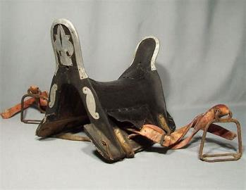


Sella turcica
Notes:
http://www.wikiradiography.net/page/Sinuses+Radiographic+Anatomy

Slide 39

Maxillary surface
Round foramen
Pterygoid canal
Dorsal surface
Sella turcica
(tuberculum, fossa
and dorsum)
Carotid sulcus

Slide 40


Maxillary surface
foramen rotundum
pterygoid canal
apertura sphenoidalis – nasal cavity
pterygoid process : lateral
and medial plate with
the hook
rostrum- vomer
crista – perp. plate of ethmoid

Slide 41


MAXILLA
four sided-pyramid body
(orbital, facial, temporal and nasal surfaces)
PALATINE BONE
Horizontal and perpendicular plate
with orbital process

Slide 42


MAXILLA
Maxilla
Os
palatinum
corpus maxillae processus frontalis
facies anterior crista lacrimalis anterior processus alveolaris
for. infraorbitalis
fossa canina
processus palatinalis
facies infratemporalis
tuber maxillae (foramina alveolares) hiatus maxillaris

Slide 43

MAXILLA, PALATINE BONE
facies nasalis:
hiatus maxillaris (sin. max.)
can. nasolacrimalis
INFERIOR NASAL CONCHA
Maxilla
Os
palatinum

Slide 44


OS ETHMOIDALE
Superior wiev
Frontal section
lamina perpendicularis bulla ethmoidalis ,processus uncinatus
crista galli
lamina cribrosa hiatus semilunaris (sinus frontalis)
labyrinthus ethmoidalis
lamina orbitalis
conha nasalis superior, media

Slide 45


Os ethmoidale
Os
ethmoidale
Os
sphenoidale
Os nasale
Os frontale
Os
zygomaticum
Os
lacrimale
Os
palatinum
Maxilla

Slide 46

Ethmoid bulla
Uncinate process

Slide 47

LATERAL WALL

Slide 48

CAVUM NASI
MEDIAL WALL:SEPTUM NASI
SUPERIOR AND
INFERIOR WALL

Slide 49

CHOANAE

Slide 50

LATERAL WALL

Slide 51
LATERAL WALL

Slide 52

SECTION OF THE NASAL CAVITY

Slide 53


Slide 54

Connections of the nasal cavity

Slide 55

CAVUM NASI
Meatus superior
Middle,
Inferior
and common

Slide 56


Sinus paranasales

Slide 57

SINUS PARANASALES

Slide 58

Spheno-ethmoid recess

Slide 59
FOSSA TEMPORALIS AND INFRATEMPORALIS

Slide 60

FOSSA PTERYGOPALATINA

Slide 61

PTERYGOPALATINE FOSSA

Slide 62
Sphenopalatine foramen

Slide 63

CONNECTIONS OF THE PTERYGOPALATINE FOSSA
„Entrance”
foramen rotundum middle cranial fossa
pterygoid canal external base of the skull
pterygomaxillary fissure infratemporal fossa
„Exit”
sphenopalatine foramen nasal cavity
inferior orbital fissure orbit
greater and lesser palatine canal oral cavity
(palatovaginal canal) pharynx)

Slide 64



Slide 65

ORBIT
Roof: frontal bone -orbital part
sphenoid bone - lesser wing
Floor: body of the maxilla
palatine bone !!
Medial wall:
maxilla, frontal process
    lacrimal bone
ethmoid bone - orbital plate
sphenoid body
Lateral wall: zygomatic bone
sphenoid bone - greater wing)
Entrance: aditus orbitae

Slide 66

Connections of the orbit
Optic canal fossa cranii media
(optic nerve + ophtalmic art.)
Sup. orb. fissure fossa cranii media
(oculomtory n., trochlear n., abducens n.,
ophtalmic n., sup. ophtalmic v.)
Inf. orbital fissure fossa pterygopalatina and infraorbital fossa (infraorbital a. and n.)
Anterior ethmoidal foramen fossa cranii ant.
(ant. ethmoidal a. and n.)
Post. ethm. foramen ethmoidal cellulae (post. ethmoid. a. and n.)
nasolacrimal canal nasal cavity
(nasolacrimal duct)
Infraorbital foramen fossa canina
(infraorbital nerve)
Supraorbital foramen and frontal notch front
(supraorbital and frontal nerve)

Slide 67

Infraorbital foramen fossa canina
(infraorbital nerve)
Supraorbital foramen and frontal notch front
(supraorbital and frontal nerve)

Slide 68


nasolacrimal canal nasal cavity, inferior meatus
(nasolacrimal duct)

Slide 69

References:
Kahle W, Leonhardt H, Platzer W: Color Atlas/Text of Human Anatomy, 1992, Thieme, Stuttgart
Putz R, Pabst R (editors): Sobotta Atlas of Human Anatomy, 1993, Urban & Schwarzenberg, München
Romanes GJ (editor): Cunningham’s Textbook of Anatomy, 1991, Oxford University Press, Oxford
Standring S (editor-in-chief): Gray’s Anatomy, 2005, Elsevier, Edinburgh
Szentágothai J, Réthelyi M: Funkcionális anatómia, 2002, Medicina, Budapest
Vízkelety T: Az ortopédia tankönyve, 1995, Semmelweis Kiadó, Budapest

Slide 70


Slide 71



1 Crista galli
2 Lamina perpendicularis
3 Lamina cribrosa
4 Labyrinthus ethmoidalis
5 Cellulae ethmoidales
6 Concha nasalis superior
7 Concha nasalis media
8 Lamina orbitalis / papyracea

Slide 72
Megszületéskor még hiányoznak melléküregek, nevezetesen a homloküreg és a sinus sphenoidalis (iköböl) is. Az iköböl kb. a 2-3. életév körül fejlődik ki teljesen, míg a homloküreg még később alakul ki, a végső méretét (arányát) a 8-9. életév körül éri el.
Az arcüregek születéskor babnyi nagyságúak, aljuk az alsó orrkagyló szintjében van. Az első három évben a melléküregek oldalirányban és hátrafelé nőnek.
A maradandó fogak kifejlődése után a szájpadok felé nő, s az arcüreg alja az orrnyílással lesz egy magasságban 10–12 éves korra. Az arcüreg végleges nagysága 15–18 éves korra alakul ki.
A fentiek segítik azt megérteni, hogy egy csecsemőnek miért csak rostasejt- és arcüreggyulladása lehet, és miért nem lehet iköböl, vagy homloküreg.

