Slide 1
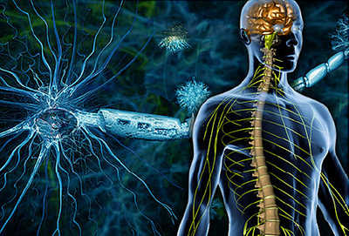
Idegrendszeri bevezető Agyburkok
Dr. GERBER Gábor

Slide 2
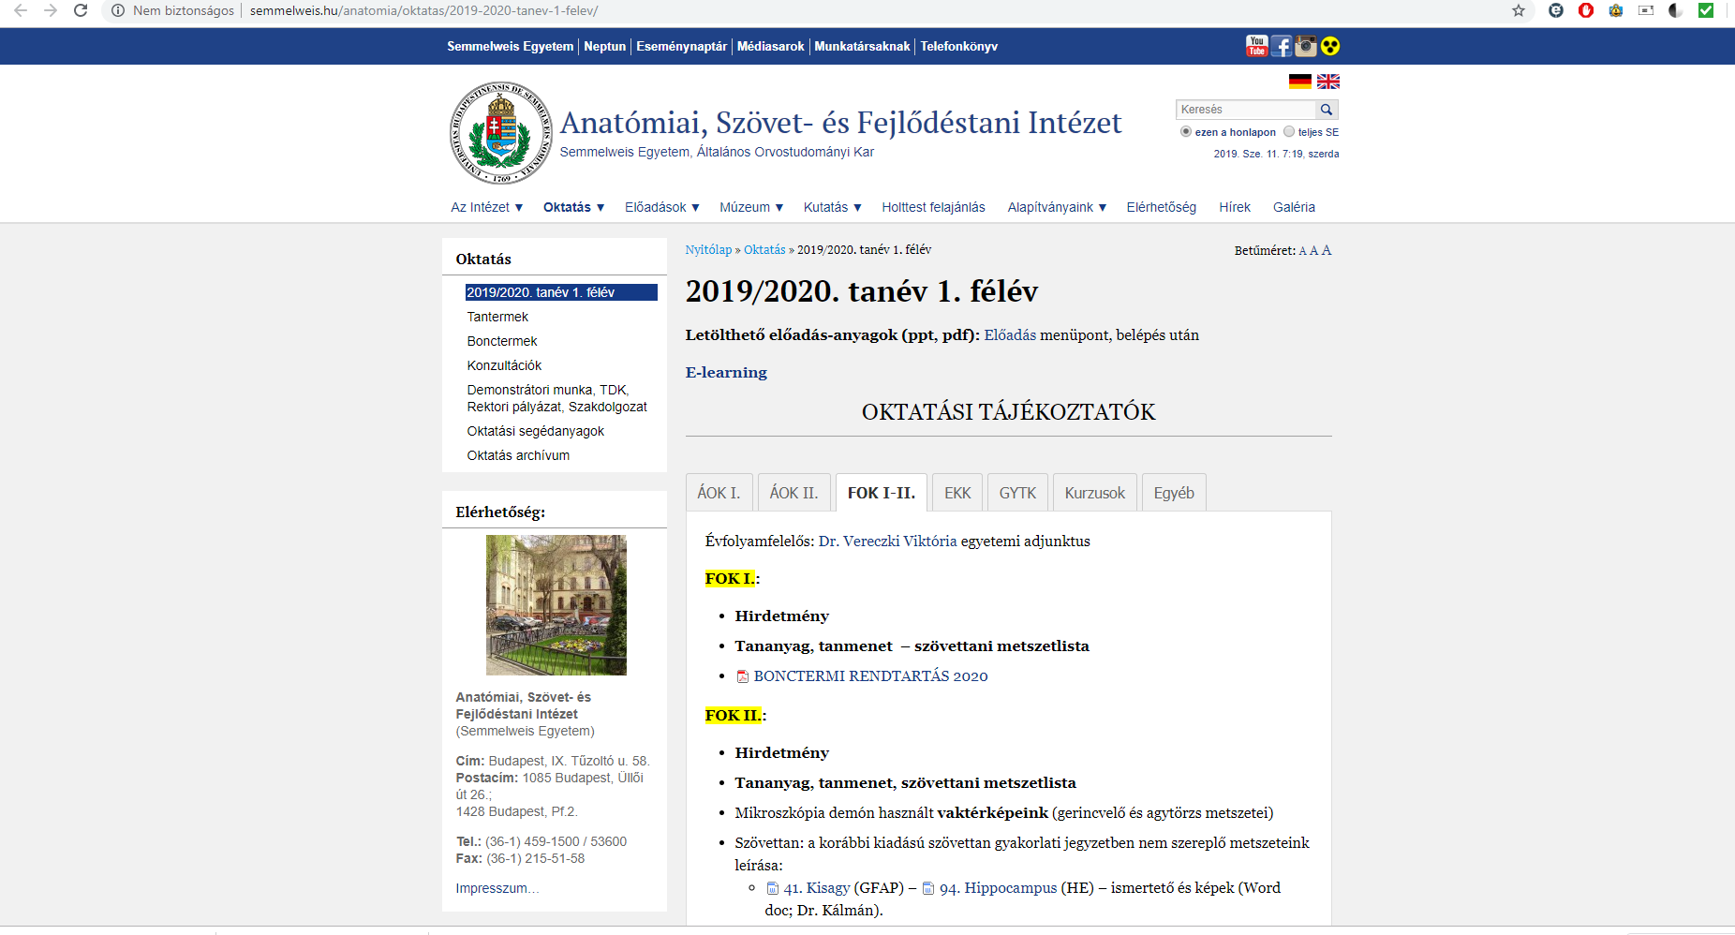
http://semmelweis.hu/anatomia/oktatas/2019-2020-tanev-1-felev/

Slide 5
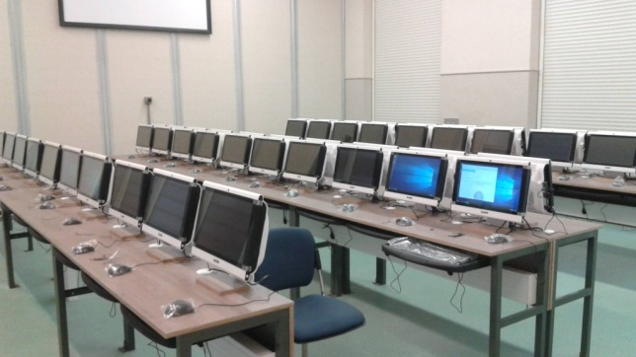

Slide 6
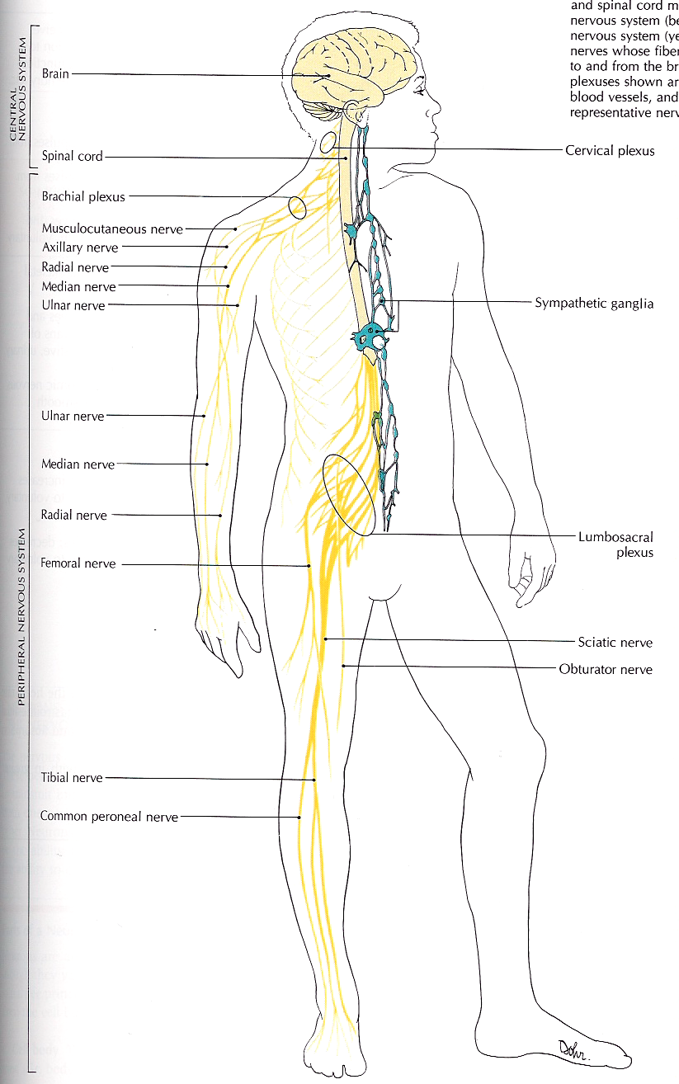
Az Idegrendszer felosztása
Központi --- Periferiás
Szenzoros --- Motoros
Szomatikus --- Autonóm

Slide 7
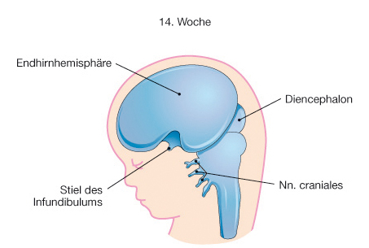
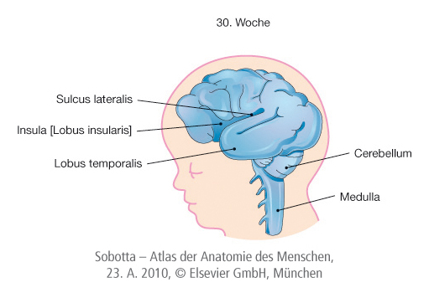
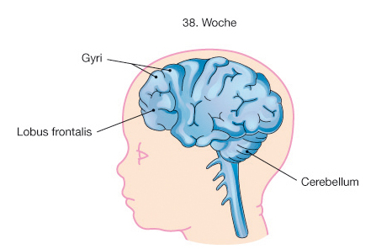
Fejlődés

Slide 8
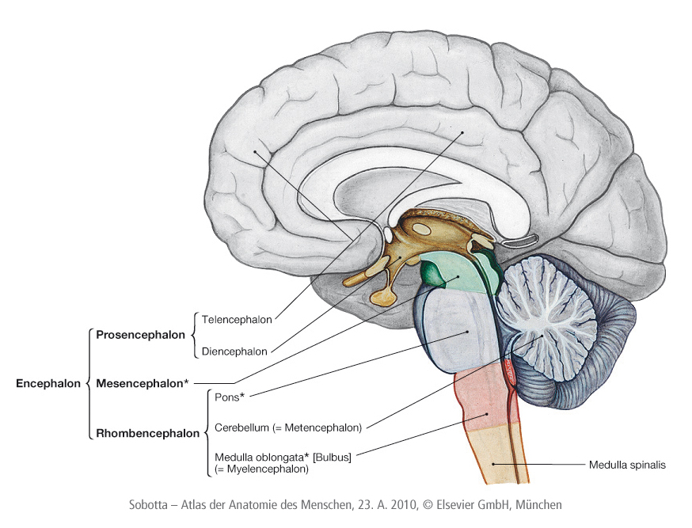

Slide 9
Agyburkok
Dura mater
Arachnoidea
Pia mater
Notes:
1350g liquor miatt csak kb. 50g súly

Slide 10
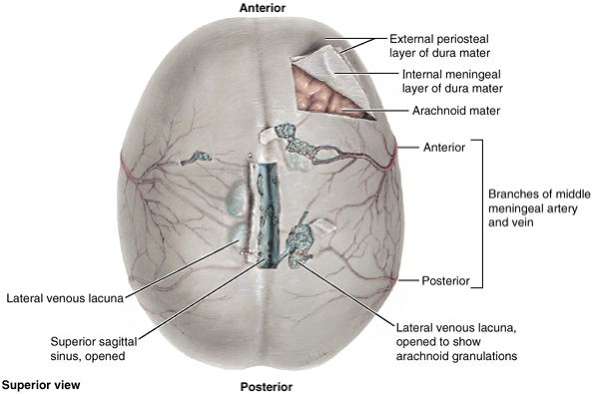

Slide 11
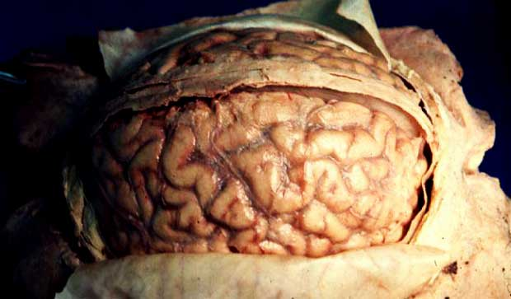

Slide 12
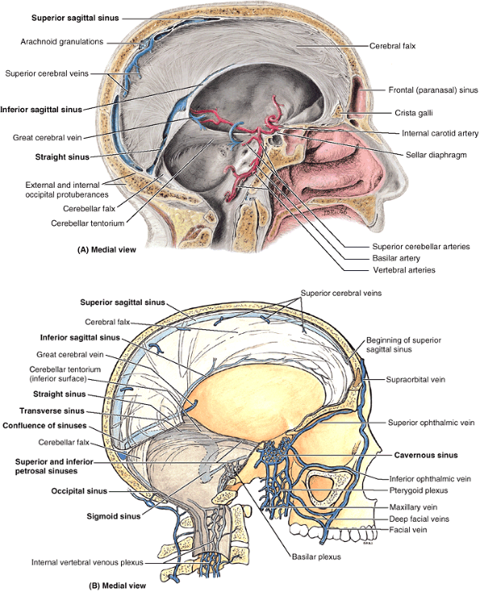
Dura kettőzetek, sinusok
falx cerebri
tentorium cerebelli
falx cerebelli
diaphragma sellae
(Cavum trigeminale)
Notes:
Figure 7.10. Dural infoldings and dural venous sinuses. The left side of the bisected head is shown. A. The two sickle-shaped dural folds (septae), the cerebral falx and cerebellar falx, are vertically oriented in the median plane. The two roof-like folds, the cerebellar tentorium and the small sellar diaphragm, lie horizontally. The left members of the paired arteries that supply the brain, the internal carotid and vertebral arteries, are shown. B. Venous sinuses of the dura mater and their communications are demonstrated. Cavernous sinuses lie on each side of the body of the sphenoid. These sinuses communicate anteriorly with the facial vein through the superior and inferior ophthalmic veins. The cavernous sinus also communicate inferiorly with the pterygoid venous plexus and posteriorly with the basilar plexus, which in turn communicates with the internal vertebral venous plexus.

Slide 13
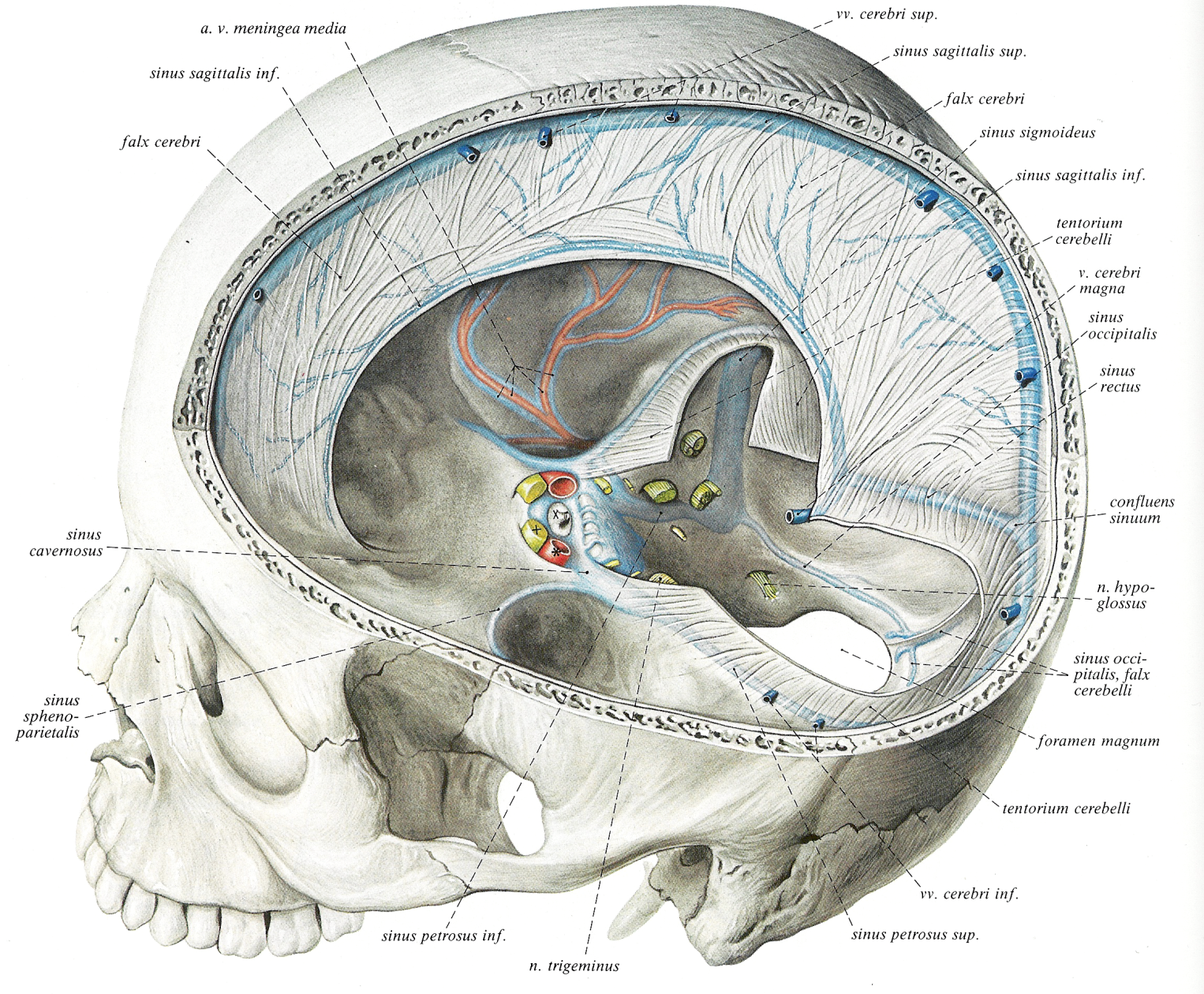

Slide 14
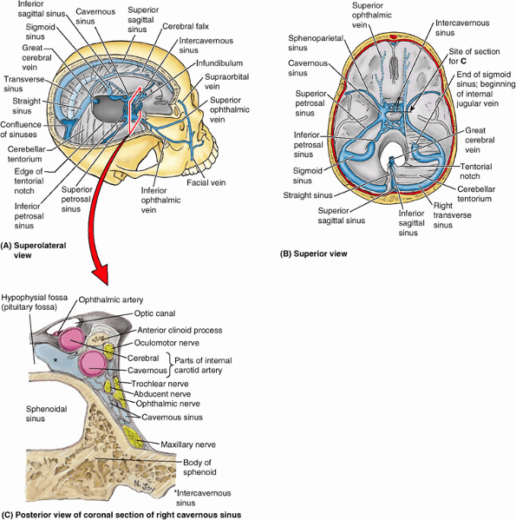
Dura mater vénás sinusok
Notes:
Figure 7.12. Venous sinuses of dura mater. Blood from the brain drains into the sinuses within the dura. A. The brain and part of the calvaria are removed to demonstrate the sinuses related to the cerebral falx and cerebellar tentorium. B. This view of the interior of the base of the cranium demonstrates the most communications of the cavernous sinuses (the inferior communication with the pterygoid venous plexus is a notable exception) and drainage of the confluence of sinuses. The ophthalmic veins drain into the cavernous sinus. C. The orientation and placement of this section of the right cavernous sinus and the body of the sphenoid are indicated in parts A and B. The cavernous sinus is situated bilaterally at the lateral aspect of the hollow body of the sphenoid and the hypophysial fossa. The internal carotid artery, having made an acute bend, is cut twice. Inferiorly, the cavernous part of the artery is sectioned as it passes anteriorly along the carotid groove toward the acute bend of the artery (radiologists refer to the bend as the âcarotid siphonâ); superiorly, the cerebral part of the artery is sectioned as it passes posteriorly from the bend to join the cerebral arterial circle. The ophthalmic artery has just arisen from the latter.

Slide 15
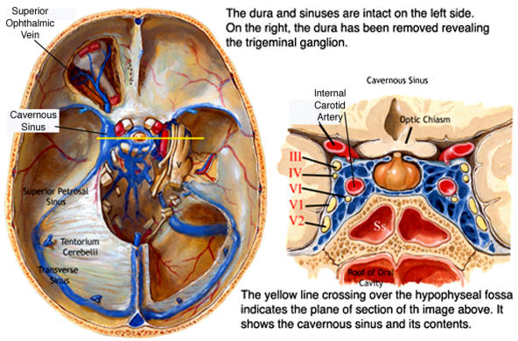
Sinus cavernosus

Slide 16
Dura mater
Arachnoidea
Pia mater

Slide 17
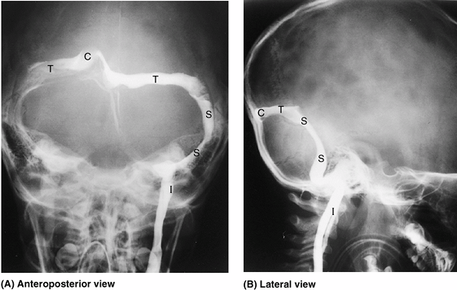

Slide 18
dura mater vérellátása
Fossa cranii anterior
Arteria meningea anterior (arteria ethmoidalis ág)
Fossa cranii media
Arteria meningea media (arteria maxillaris ág, foramen spinosum)
Fossa cranii posterior,numerous blood supply from different possible arteries:
Arteria meningea posterior (arteria pharingea ascendens ág , foramen jugulare)
Meningealis ágak a. occipitalis, a.vertebralis
Notes:
Arteria meningea media (arteria maxillaris ág foramen spinosum)
anterior and posterior branches, (accessory meningeal arteries through foramen ovale
B. meningeal arteries (from the ascending pharyngeal artery through hypoglossal canal) C. meningeal arteries (from occipital artery through jugular or mastoid foramen) D. meningeal arteries (from vertebral artery through foramen magnum)

Slide 19
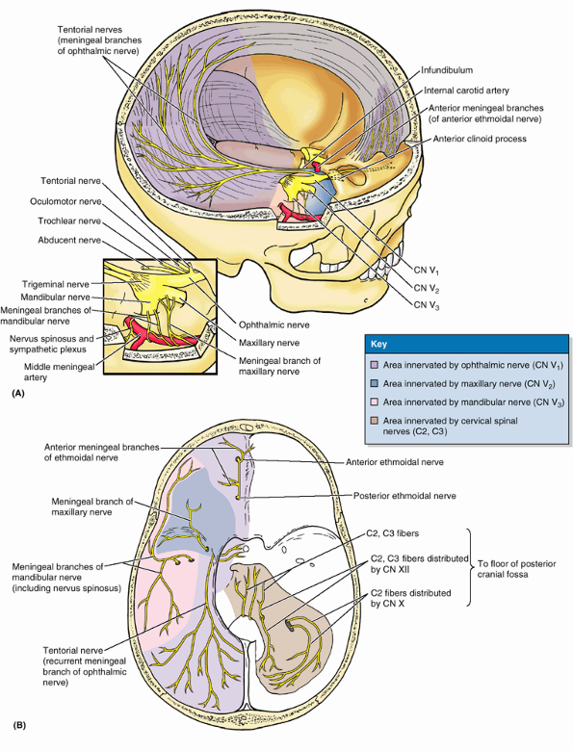
dura mater beidegzése
Notes:
Innervation of dura mater. The dura of the floor of the anterior and middle cranial fossa and the roof of the posterior cranial fossa is innervated by meningeal branches arising directly or indirectly from the trigeminal nerve (CN V). A. The right side of the calvaria and brain is removed and CN V is dissected. The cerebral falx is innervated by the ophthalmic nerve (CN V₁), through anterior meningeal branches of the ethmoid nerves and the tentorial nerve. The meningeal branches of the maxillary (CN V₂) and mandibular (CN V₃) nerves are distributed to the dura of the lateral part of the anterior and the middle cranial fossae as periarterial plexuses that accompany the branches of the middle meningeal artery along with vasomotor sympathetic nerve fibers from the superior cervical ganglion (inset). The dura of the cranial base is most sensitive in the region of the arterial branches and the superior sagittal sinus. B. The internal aspect of the cranial base shows innervation of the dura by branches of the trigeminal and sensory fibers of cervical spinal nerves (C2, C3) passing directly from those nerves or via meningeal branches of the vagus (CN X) and hypoglossal (CN XII) nerves.

Slide 20
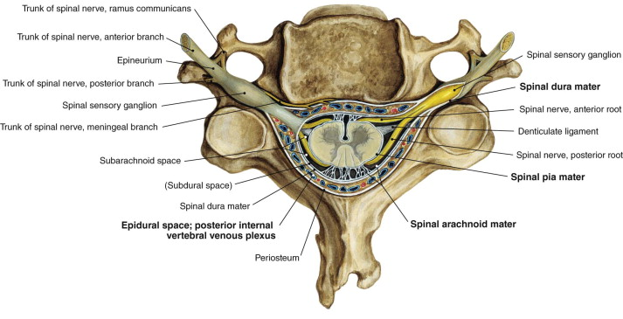
Dura mater spinalis,
(ligamentum denticulatum)

Slide 21
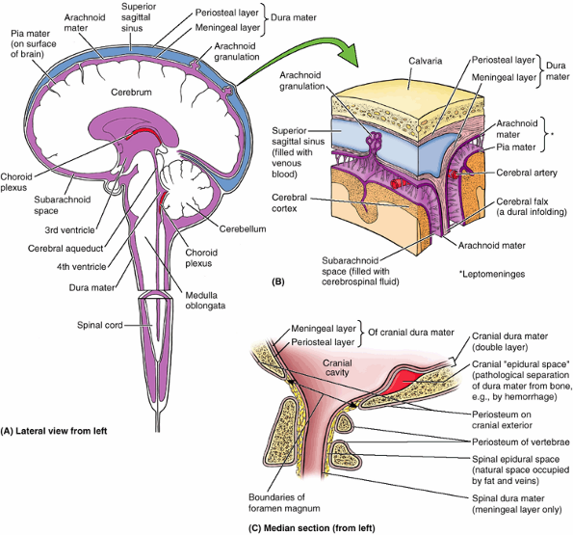
Notes:
Figure 7.8. Meninges and their relationship to calvaria, brain, and spinal cord. A. The dura mater and subarachnoid space (purple) surround the brain and are continuous with that around the spinal cord. B. The two layers of dura separate to form dural venous sinuses, such as the superior sagittal sinus. Arachnoid granulations protrude through the meningeal layer of the dura into the dural venous sinuses and effect transfer of cerebrospinal fluid to the venous system. C. The normal fat- and vein-filled spinal epidural (extradural) space is not continuous with the potential or pathological cranial epidural space. Cranial dura mater has two layers, whereas spinal dura mater consists of a single layer.

Slide 22
Spatium subarachnoideum
Cisterns

Slide 23
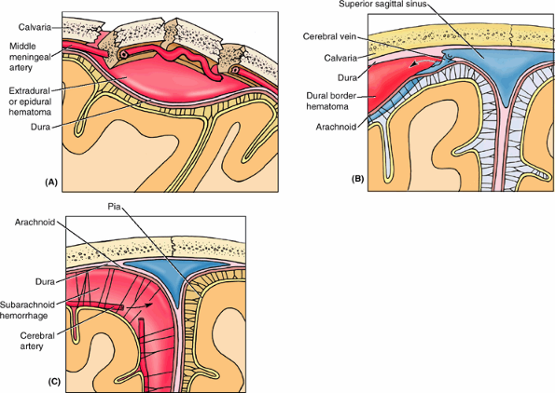
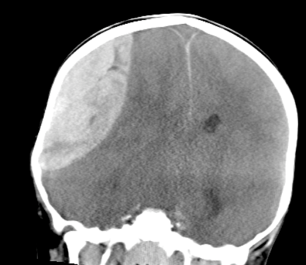
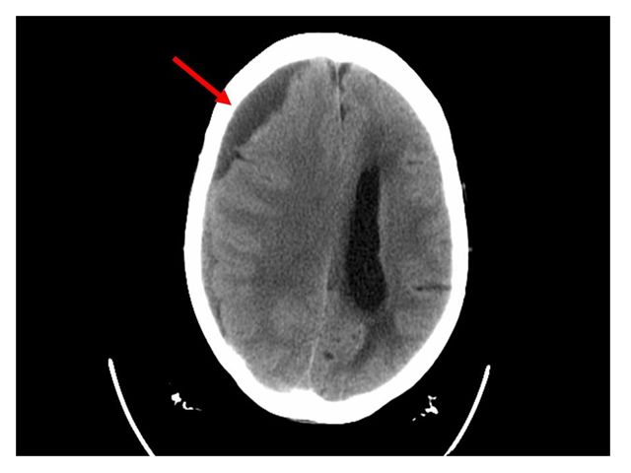
Intracranialis haemorrhagia
epiduralis
subduralis
Subarachnoidalis vérzés
Notes:
Intercranial hemorrhages. A. An extradural (epidural) hemorrhage is shown. B. A dural border (subdural) hematoma is shown. C. A subarachnoid hemorrhage is shown.

Slide 24
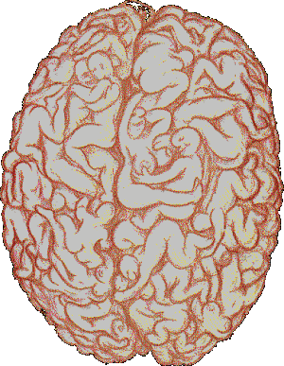
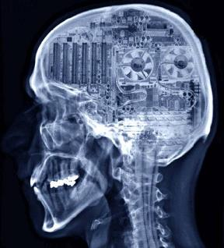
Elképzelések az emberi agyról

