Slide 1
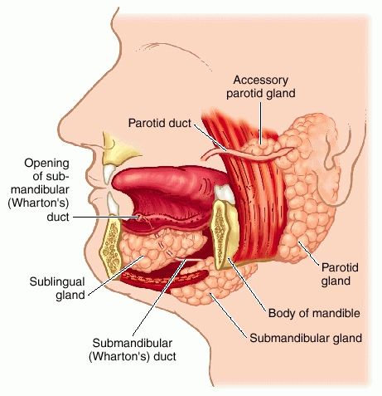
Dr. Altdorfer:
The salivary glands –
Anatomy, histology, innervation

Slide 2
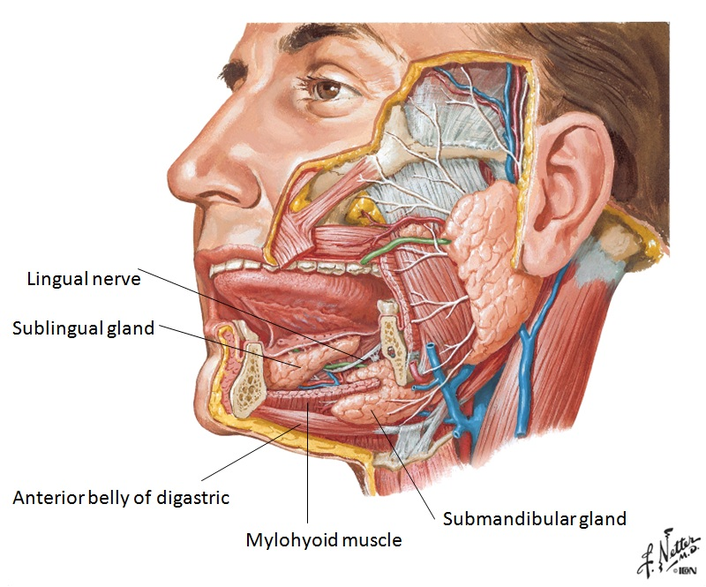

Slide 3
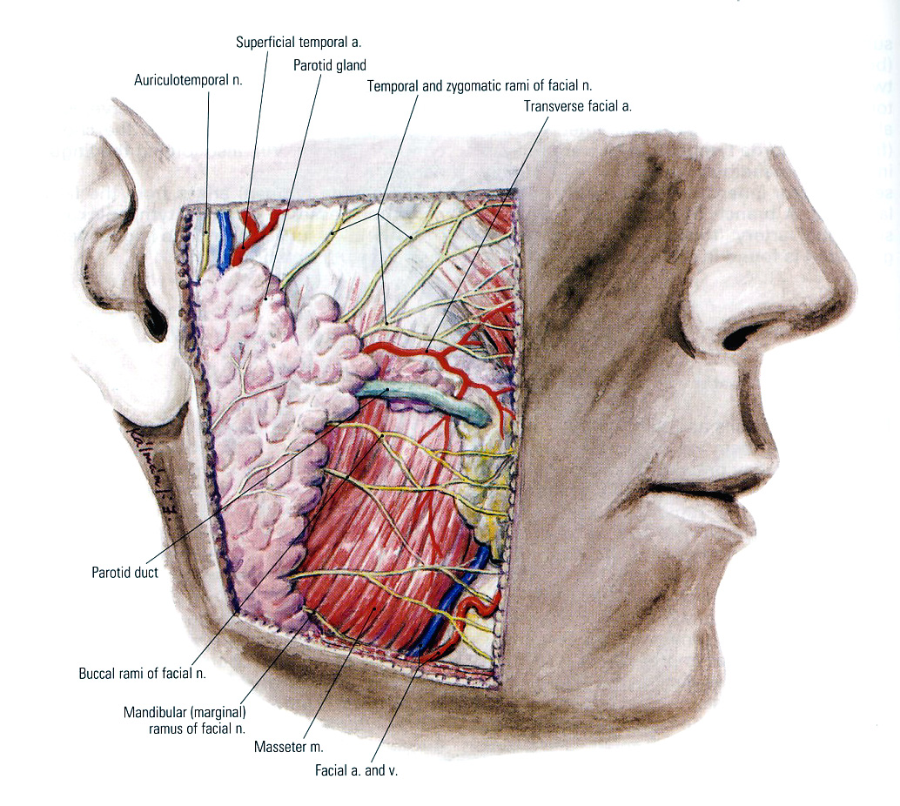
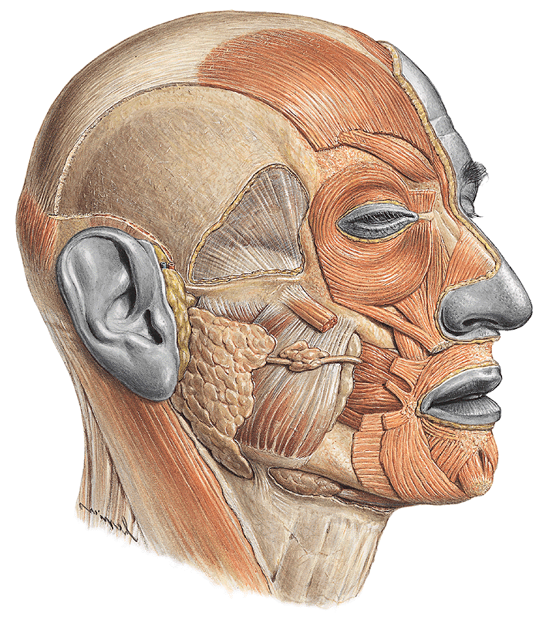
Parotid gland
Major salivary glands
Parotid duct
Parotid duct
Runs paralell with the zygomatic arch - on the external surface of the masseter,
- pierces the buccinator,
opens into the oral vestibule through the parotid papilla,
at the level of the 2nd upper molar teeth.
Superficial and deep parts
Accessory gland on the parotid duct

Slide 4
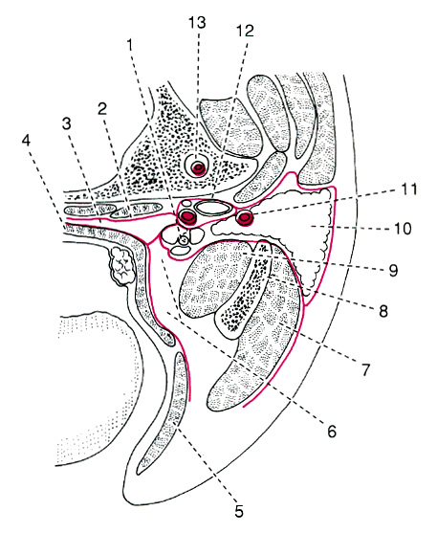
Borders of the parotid nest (nidus parotideus)
anterior:
posterior:
medial:
anterior: masseter m.
ramus of the mandible
medial pterygoid m.
posterior:
anterior: masseter m.
ramus of the mandible
medial pterygoid m.
posterior: sternocleidomastoid m.
posterior belly of the digastric
medial:
stylohyoid m.
stylopharyngeus m.
styloglossus m.

Slide 5
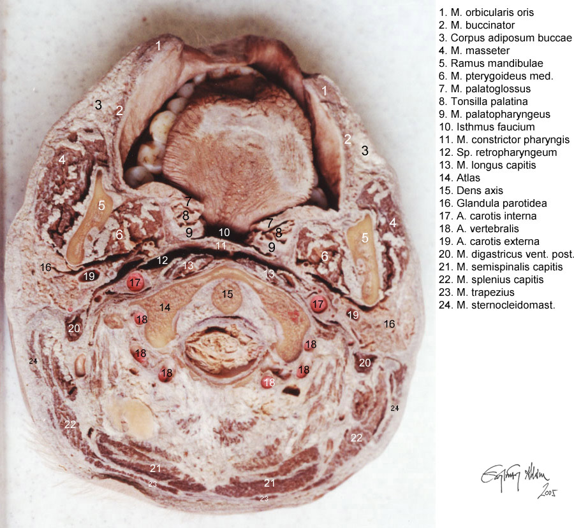
CROSS SECTION OF THE HEAD
PAROTID NEST
Structures piercing the parotid gland:
- facial nerve (parotid plexus)
- auriculotemporal nerve
- ext.carotid a. (spf. temp a.)
- retromandibular vein

Slide 6
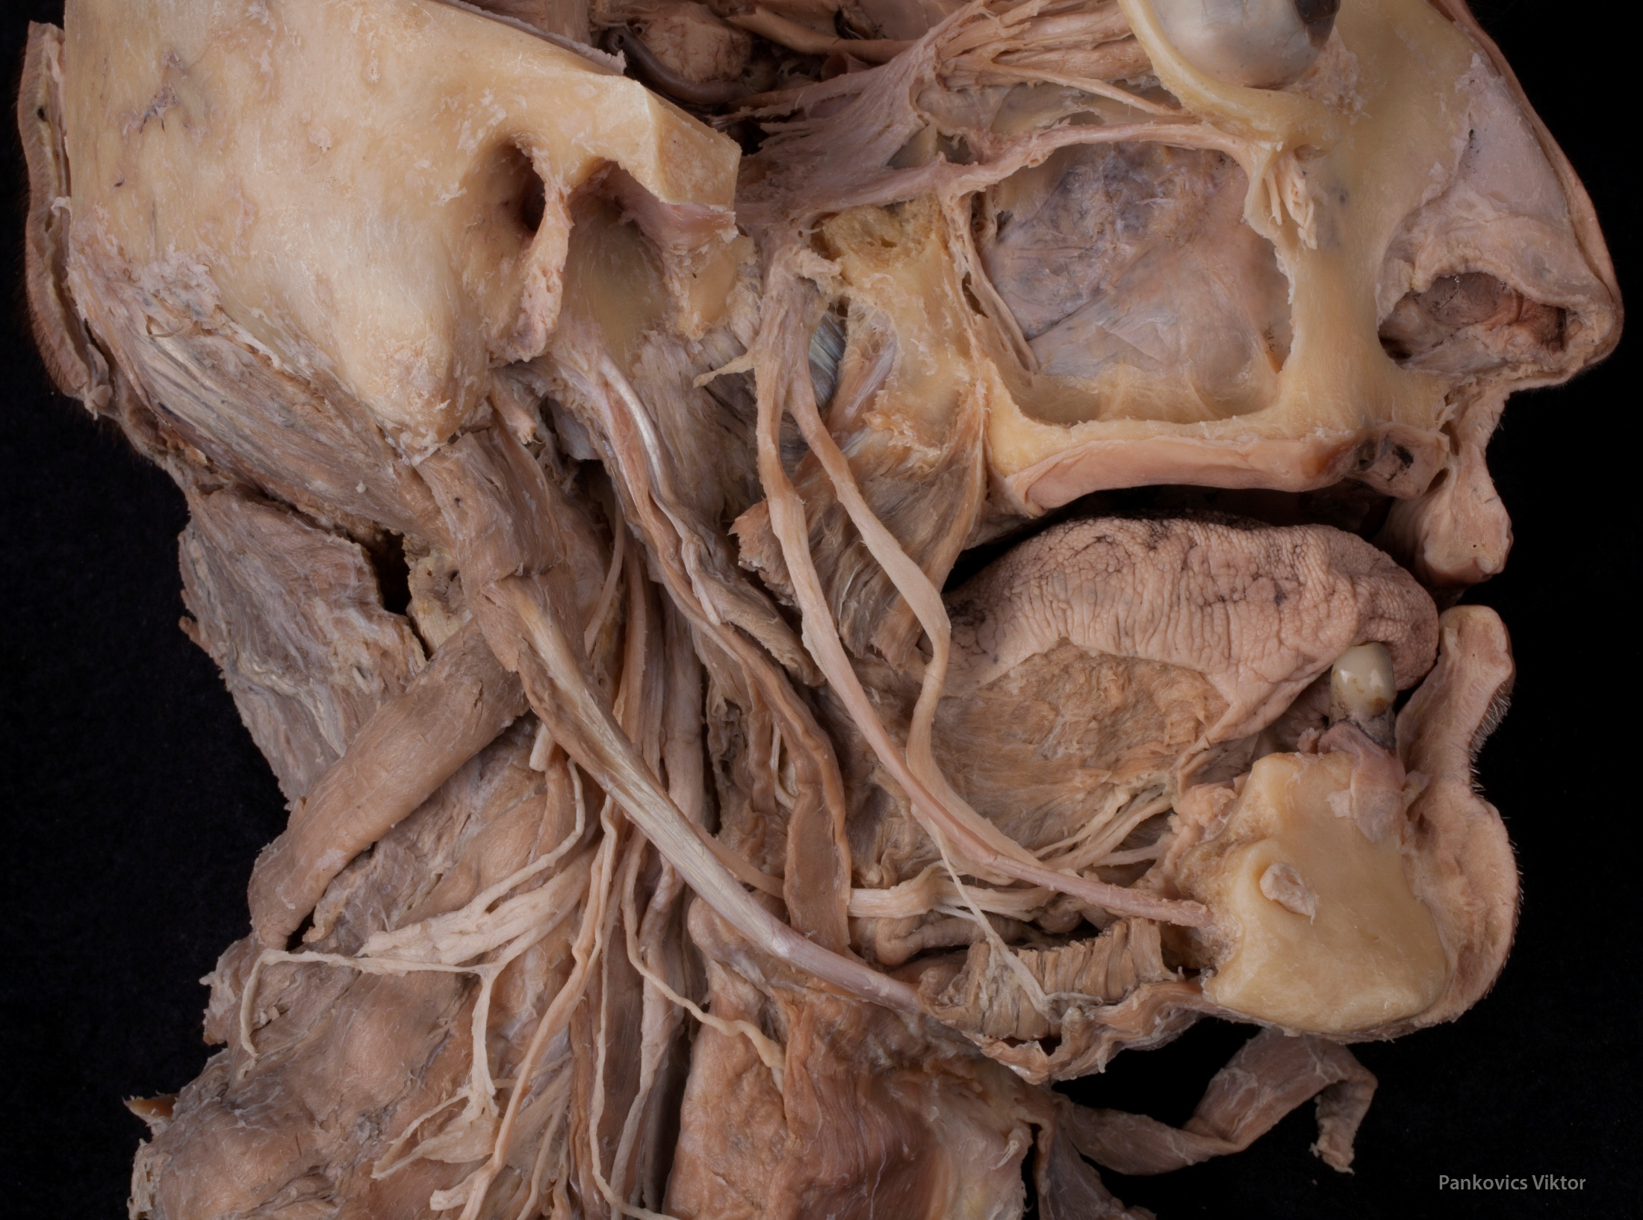
A
B

Slide 7
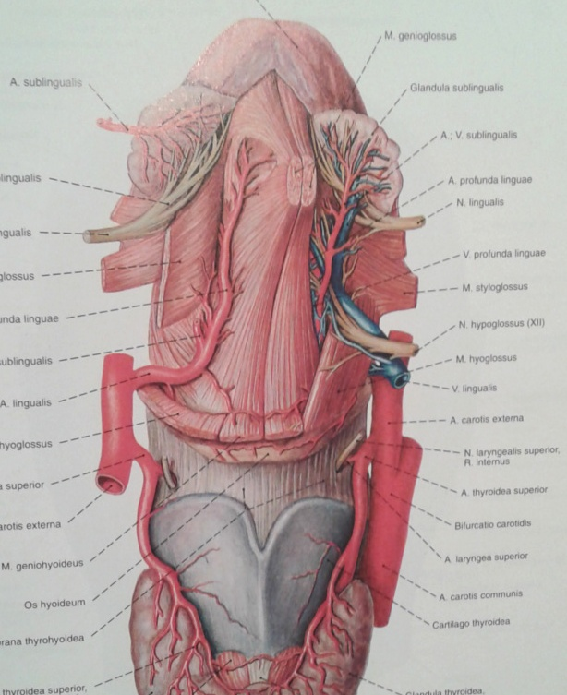
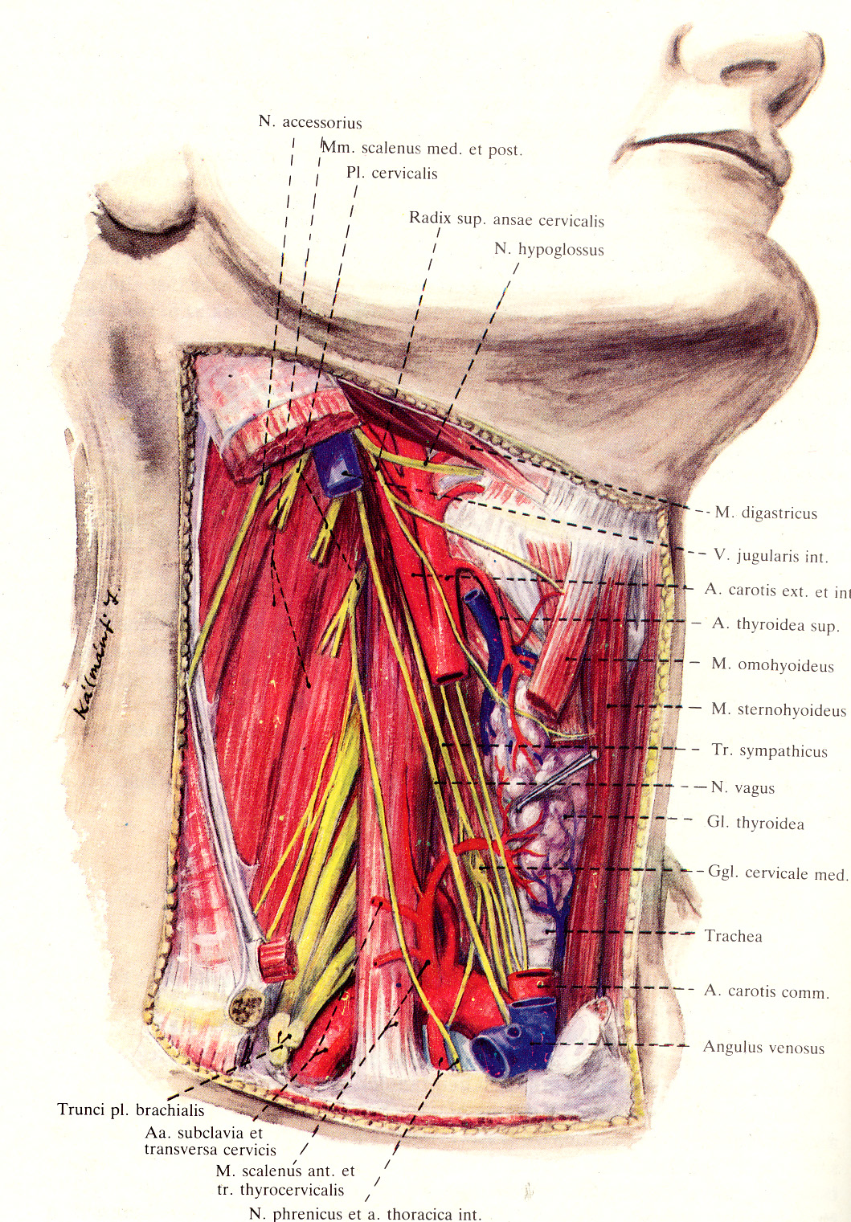

Slide 8
Parotid gland
Blood supply:
branches of the maxillary a.
masseteric a.
superficial temporal.a
Innervation:
parasympathetic: IX.
sensory: auriculotemporal n.
(V/3)

Slide 9
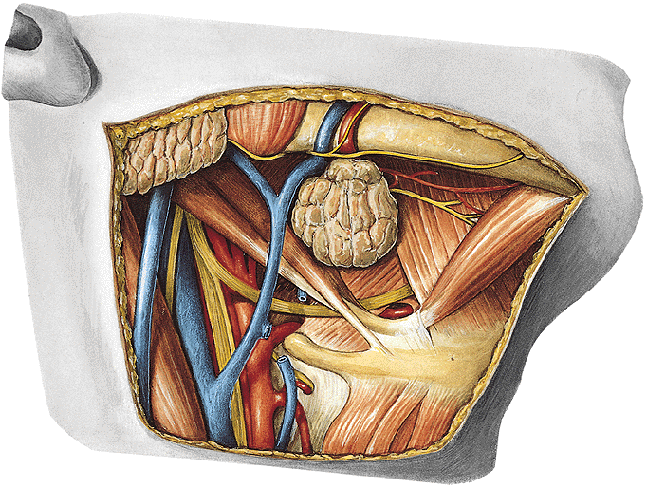
Submandibular gland
- main part can be found in the submandibular region, on the external surface of mylohyoid,
- smaller part turns around the posterior edge of mylohyoid and lies on its inner surface,
- facial artery embedded into the inner surface of the gland,
- facial vein runs on its external surface.
Blood supply: glandular branches of the facial artery
Innervation: parasympathetic (GVM) - chorda tympani (VII.).
hyoglossus
mylohyoid

Slide 10
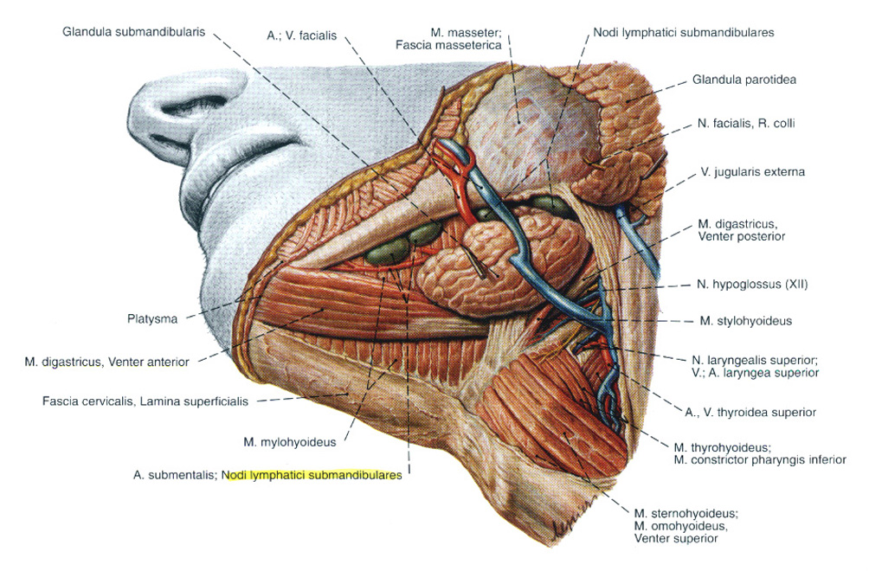
Submandibular gland

Slide 11
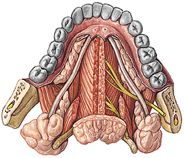
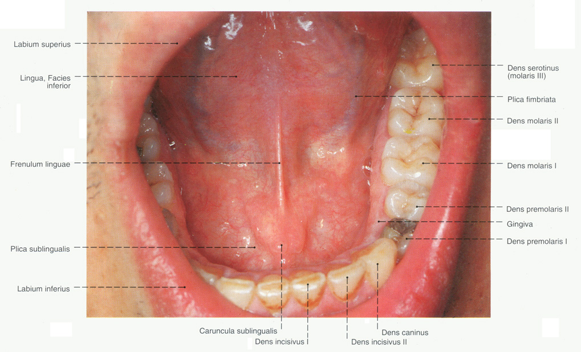
Submandibular duct – Wharton’s duct
Sublingual caruncula
in the lateral sulcus of the tongue
first between the lingual and hypoglossal nerves,
but than it crosses the lingual nerve and runs anteriorly above it,
opens through the sublingual caruncula together with
the main duct of the sublingul gland.

Slide 12
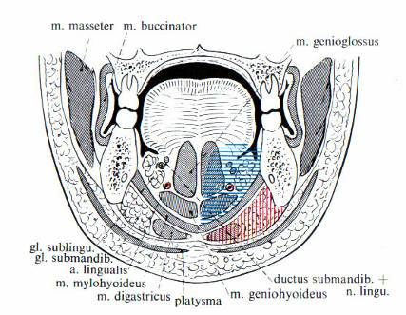
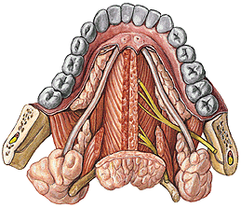
Submandibular and sublingual glands
Sublingual caruncula
Sublingual gland lies on the inner surface of the mylohyoid in the sublingual region,
it causes the sublingual fold,
main duct opens together with the submandibular duct through the sublingual caruncula,
accessory small ducts open along the sublingual fold.

Slide 13
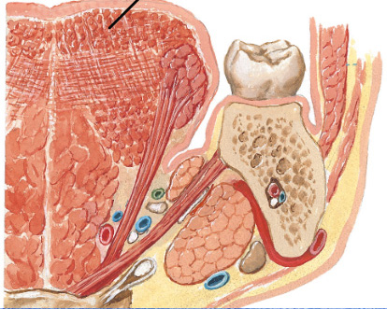
MEDIAL SULCUS OF THE TONGUE AND LATERAL SULCUS OF THE TONGUE
Hyoglossus m.
Genioglossus m.
Mylohyoid m.
Lingual a.
Hypoglossal n.
Submandibular gland

Slide 14
Facial nerve
Superior salivatory nucl.
GVM nucleus
preganglionar
parasympathetic fibers
pterygopalatine ggl.
greater petr. n.
V/2
postganglionar
parasympathetic fibers
chorda tympani
V/3
GLANDS
submandibular ggl..
Glossopharyngeal nerve
inferior salivatory nucl.
GVM
preganglionar
parasympathetic fibers
Otic ganglion
postganglionar
parasympathetic fibers
lesser petrosal nerve
V/3

Slide 15
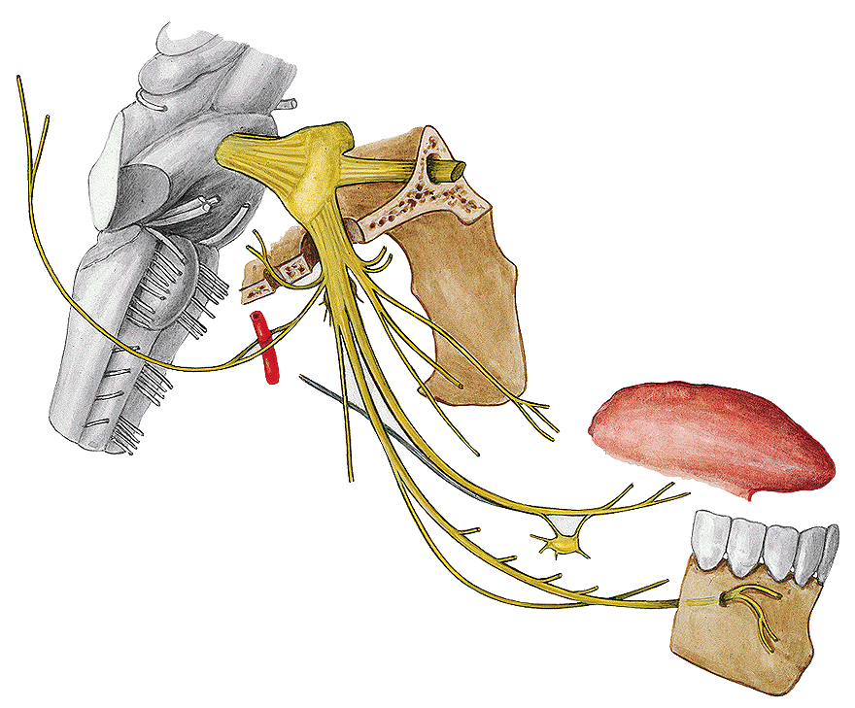
OTIC GANGLION
MOTOR ROOT
MENINGEAL BR.
LINGUAL N.
SUBMAND. GGL.
CHORDA TYMPANI
AURICULOTEMPORAL NERVE
INFERIOR ALVEOLAR N.

Slide 16
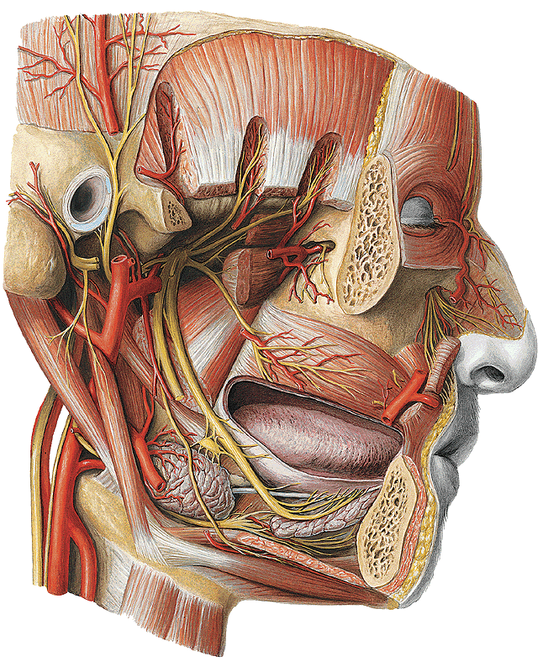
LATERAL SULCUS OF THE TONGUE, MANDIBULAR NERVE

Slide 17
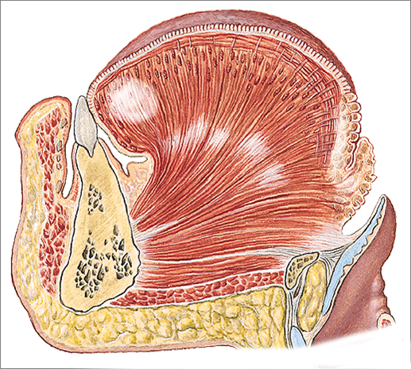
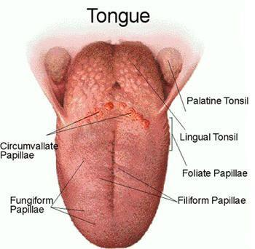
Minor salivary glands
Glands of the tongue
Nuhn-Blandin
von Ebner
Weber
mucous
serosus
mixed

Slide 18
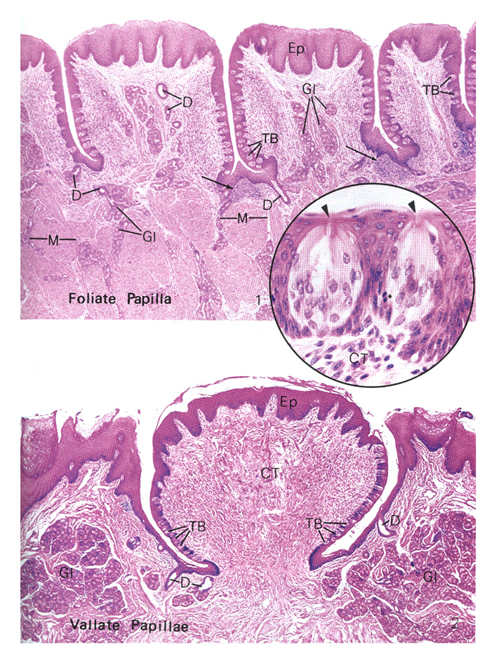
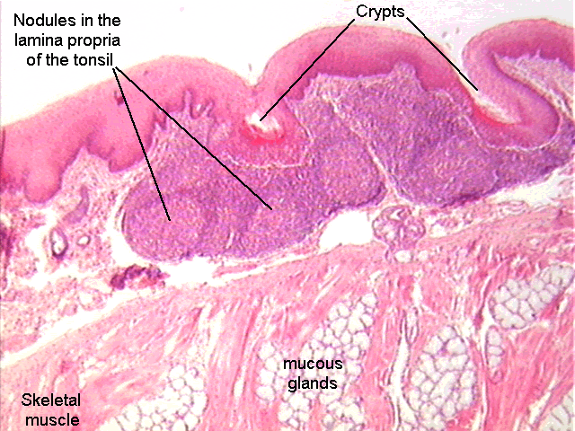
GLANDS OF THE TONGUE
von Ebner
Weber

Slide 19
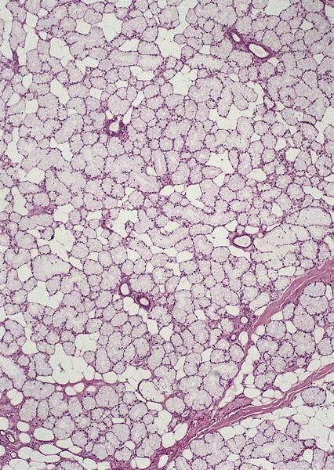
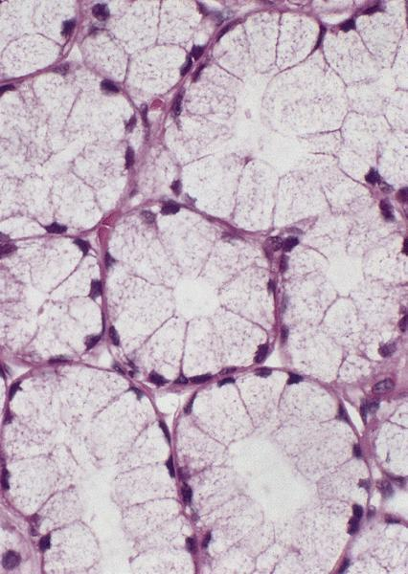
Minor salivary glands of palate
Aggregations of mucous acini
No striated duct

Slide 20
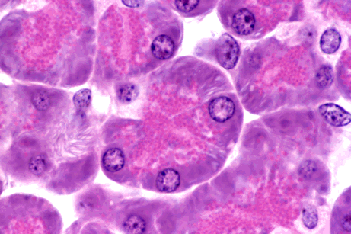
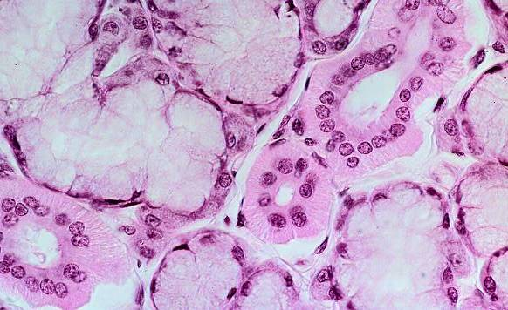
Histology of the salivary glands
Merokrine secretion
Serous acini
Mucous acini
Sekretion: protein-rich (amylase) → rER, Golgi
Basophil cytoplasm (basal),
Nuclei: round
apical: acidophil (secr. vesicles)
Lumen: narrow
Sekretion: mucous, viscous!
cytoplasm: vacuolizated, foamy
nuclei: basal, flattened
lumen: elongated

Slide 21
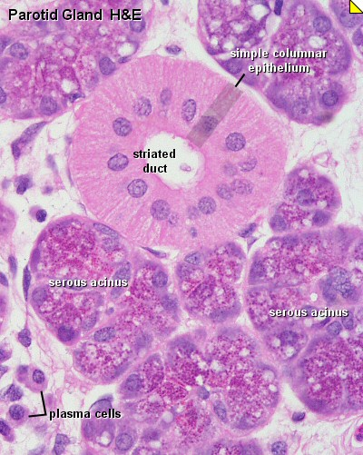
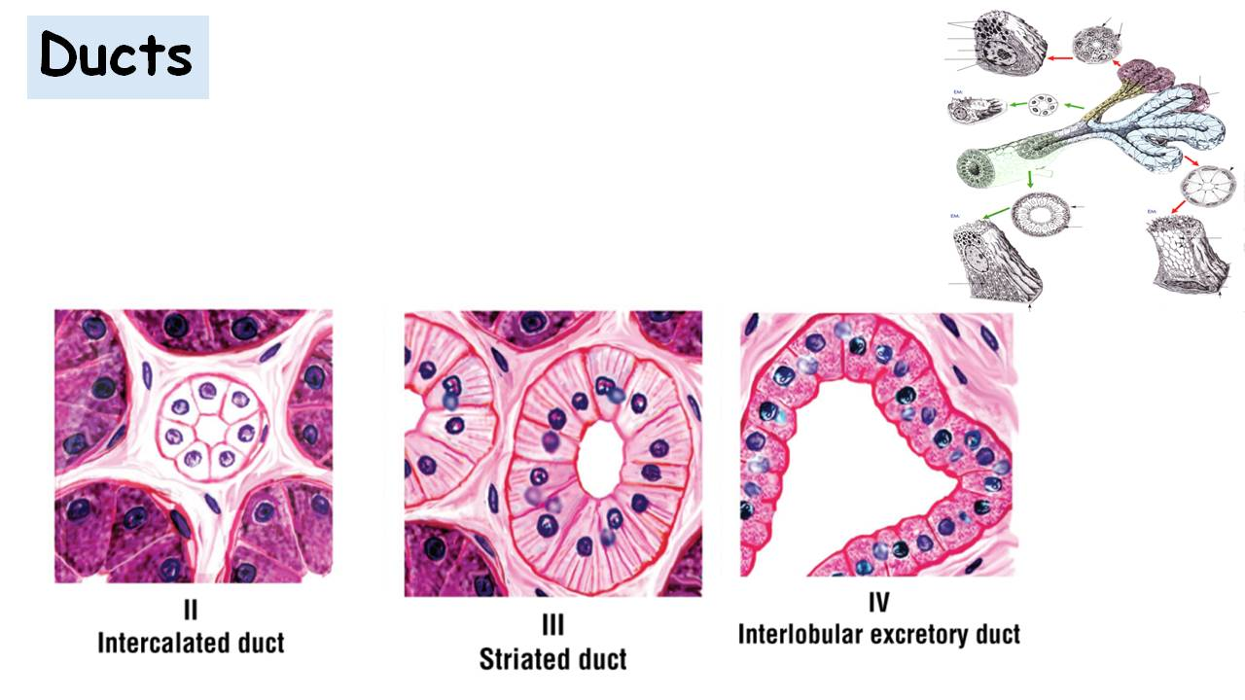
SRTIATED DUCT
Eosinophilic columnar cells
Central nuclei
Basal striation (foldings of the basal plasma membrane)

Slide 22
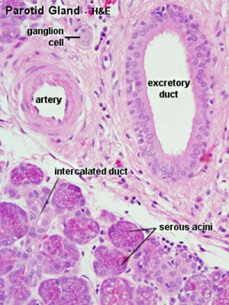

Slide 23
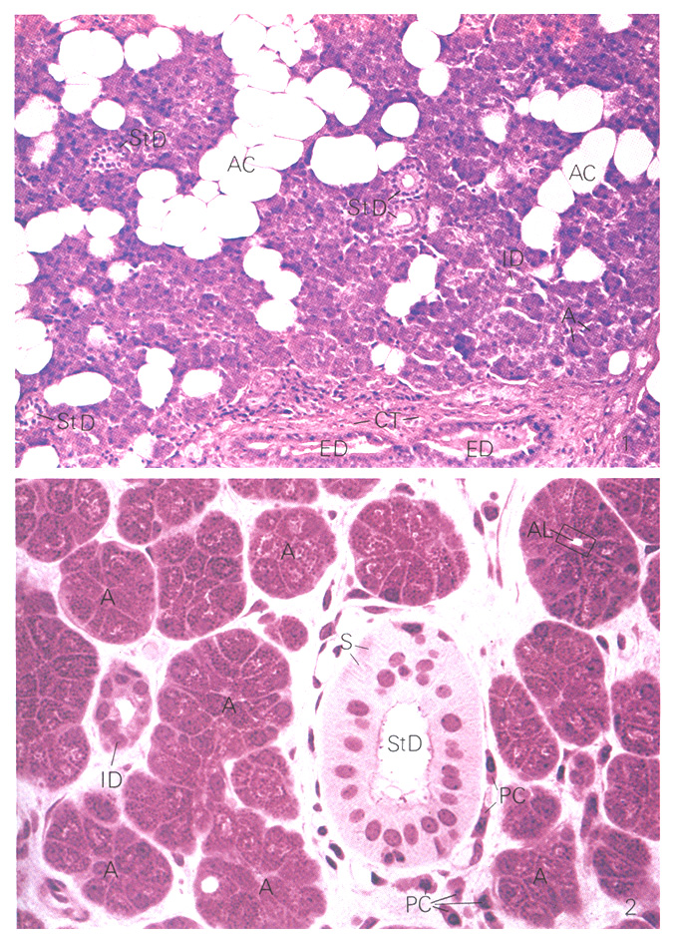
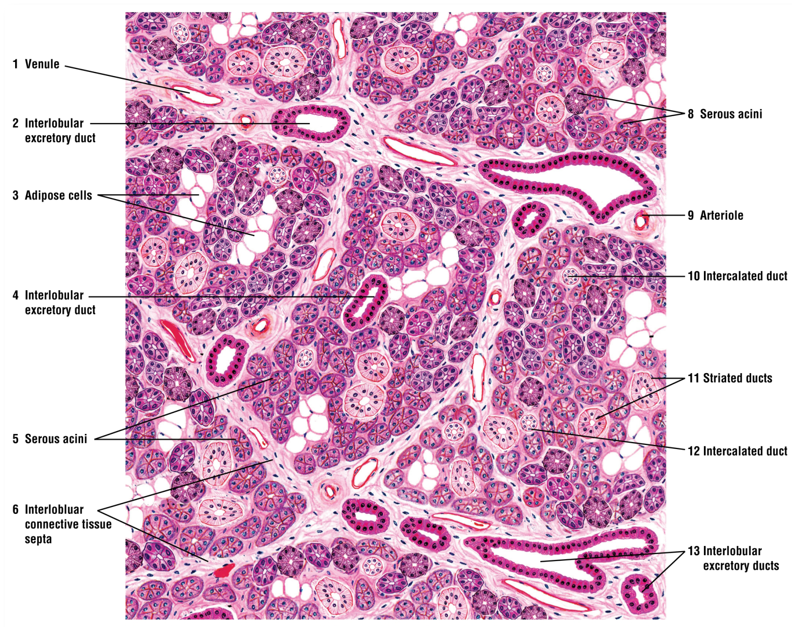
Parotid gland
exclusively (100%) serous,
compound
tubuloalveolar gland

Slide 24
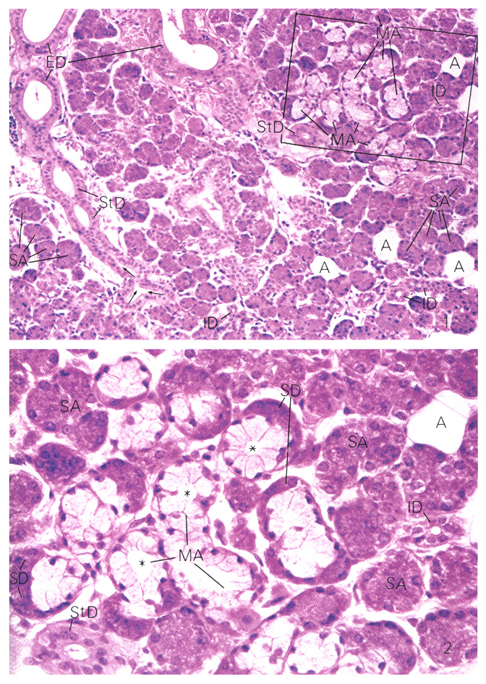
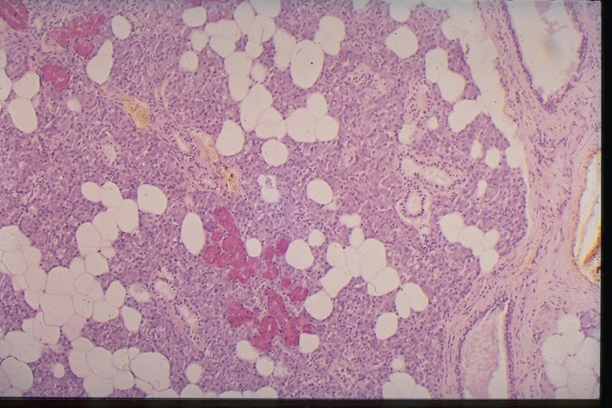
Submandibular gland
mixed seromucous,
compound tubuloalveolar gland,
with predominating serous (2/3) and
less mucous (1/3) acini
Ebner / Gianuzzi-demilunes

Slide 25
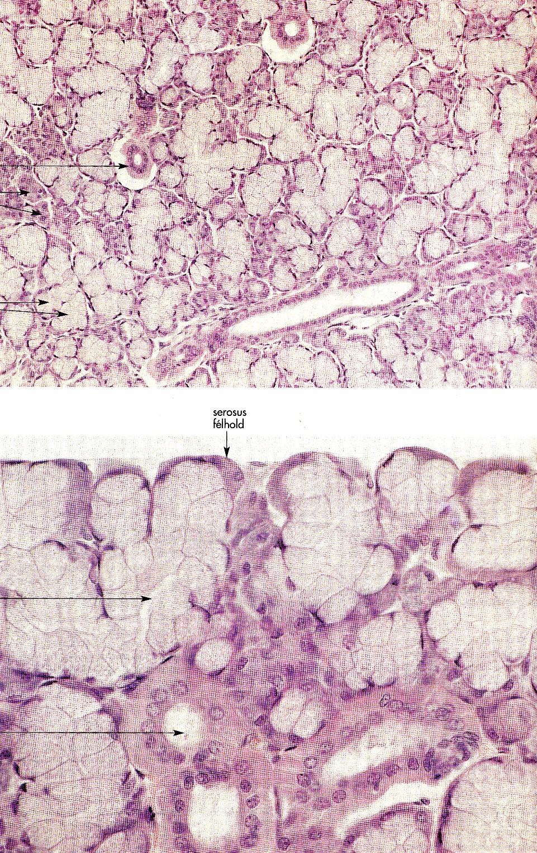
Sublingual gland
Compound tubuloalveolar gland,
Mixed muco-serous,
with predominating mucous (2/3)
and less serous (1/3) acini
Ebner / Gianuzzi-demilunes

Slide 26
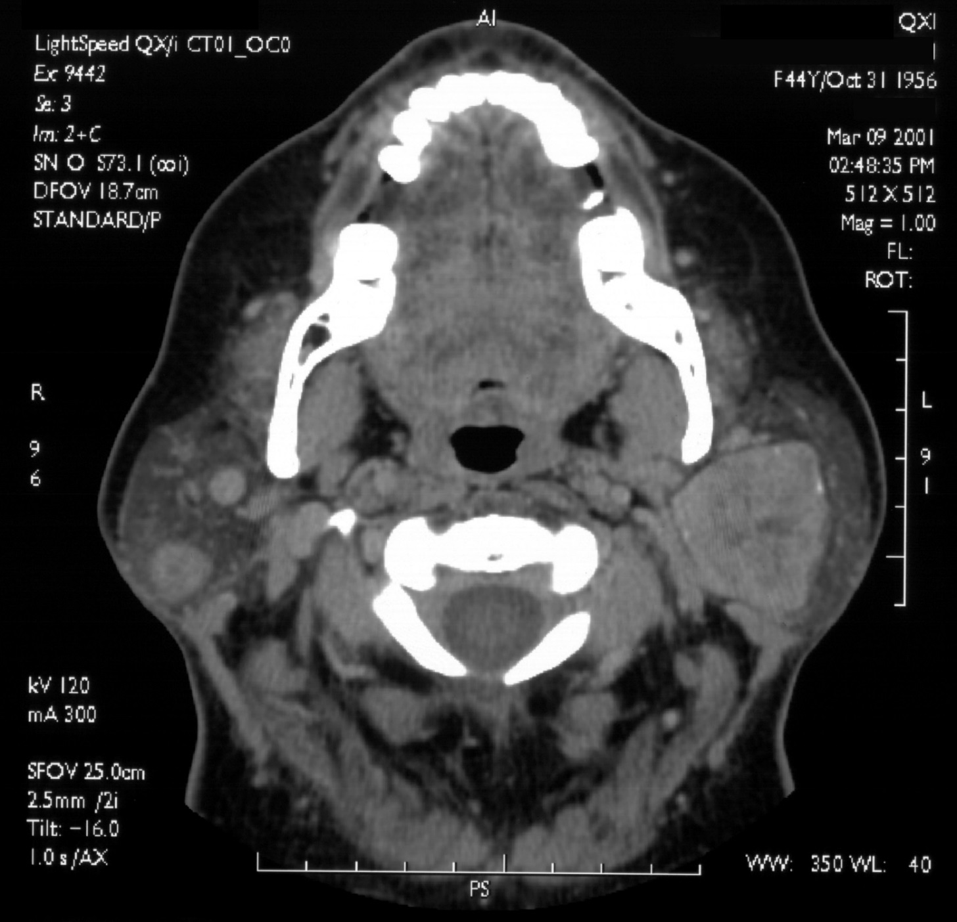
Pathology
TUMOR

Slide 27
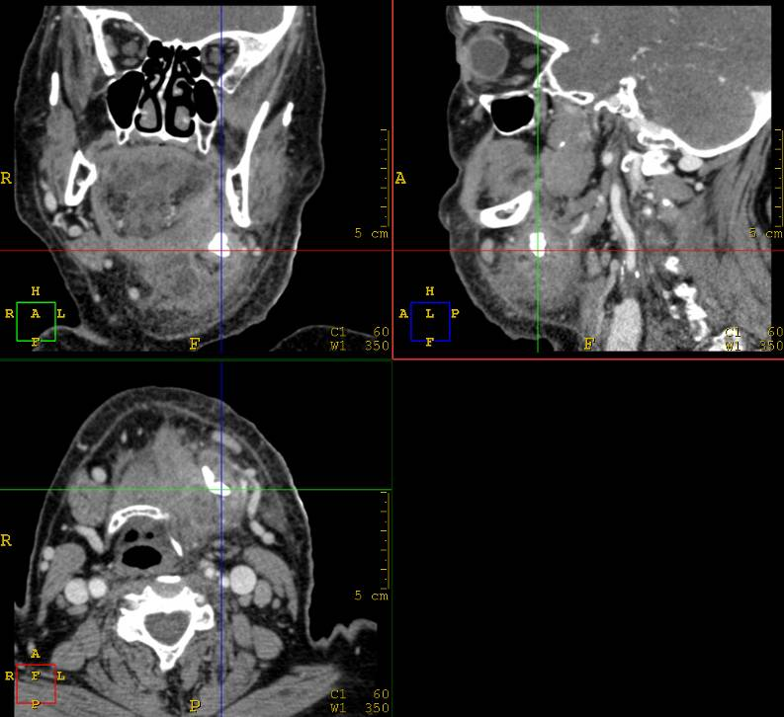
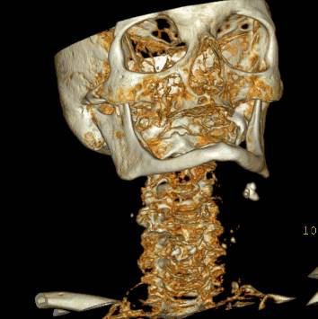
Pathology Sialolith+abscess

Slide 28
Literature:
Anatomy, Histology atlases
Dr. Gallatz’s, Dr. Székely’s lecture images

