Slide 1
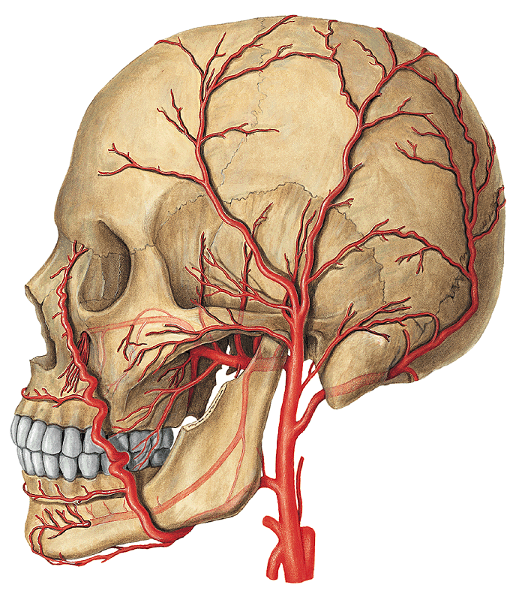
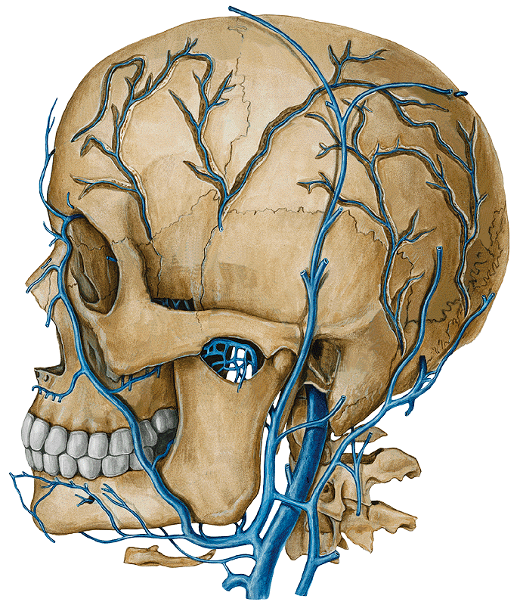
BLOOD VESSELS OF THE HEAD AND NECK
Dr. Gallatz Katalin

Slide 2
BRANCHES OF THE AORTIC ARCH
BRACHIOCEPHALIC TRUNK
RIGHT COMMON CAROTID
RIGHT SUBCLAVIAN ARTERY
LEFT COMMON CAROTID
EXTERNAL CAROTID ARTERY
INTERNAL CAROTID ARTERY
3. LEFT SUBCLAVIAN ARTERY

Slide 3
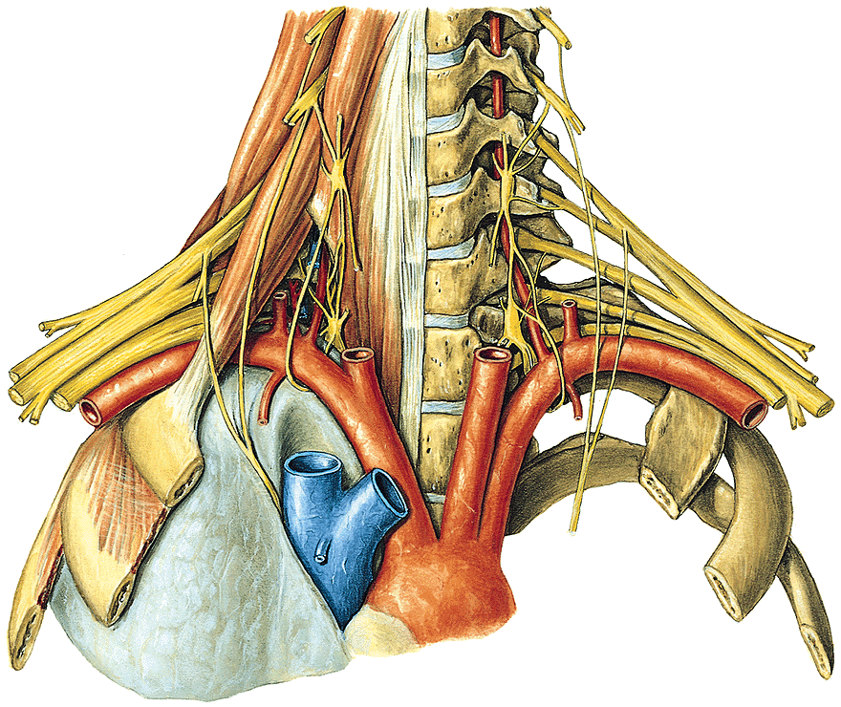
SUBCLAVIAN ARTERY
- thoracic part
- muscular part
- cervical part
SA
SM

Slide 4
SUBCLAVIAN ARTERY
THORACIC PART:
- VERTEBRAL ARTERY
- INTERNAL THORACIC ARTERY
- THYROCERVICAL TRUNK (3)
1.
3
2.

Slide 5
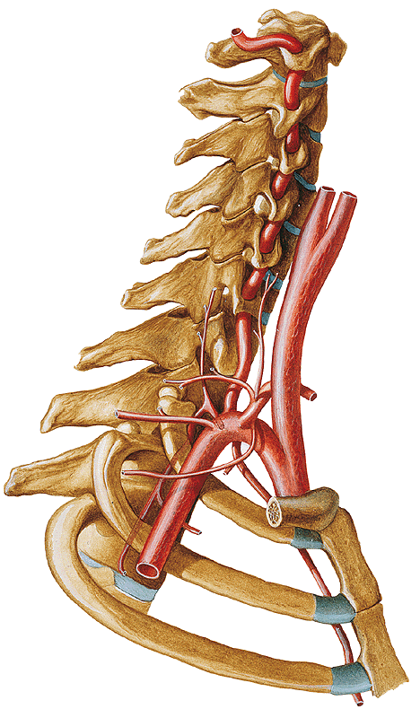
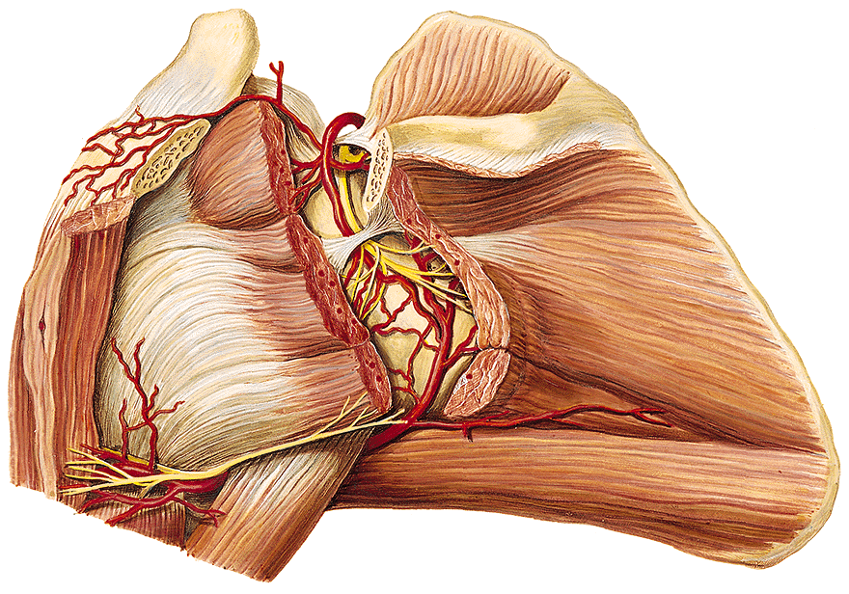
3. THYROCERVICAL TRUNK
ascending cervical artery (1)
superficial cervical artery (2)
suprascapular artery (3)
- inferior thyroid arteryr (4)
TT
as
a. circumflexa scapulae

Slide 6
MUSCULAR PART
costocervical trunk (tcc)
supreme intercostal artery -sia
deep cervical artery -dca
CERVICAL PART
transverse cervical artery -tca
dca
tca
tcc
sia

Slide 7
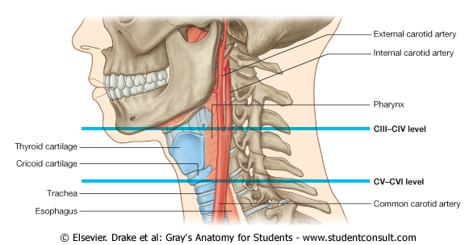
INTERNAL CAROTID ARTERY

Slide 8
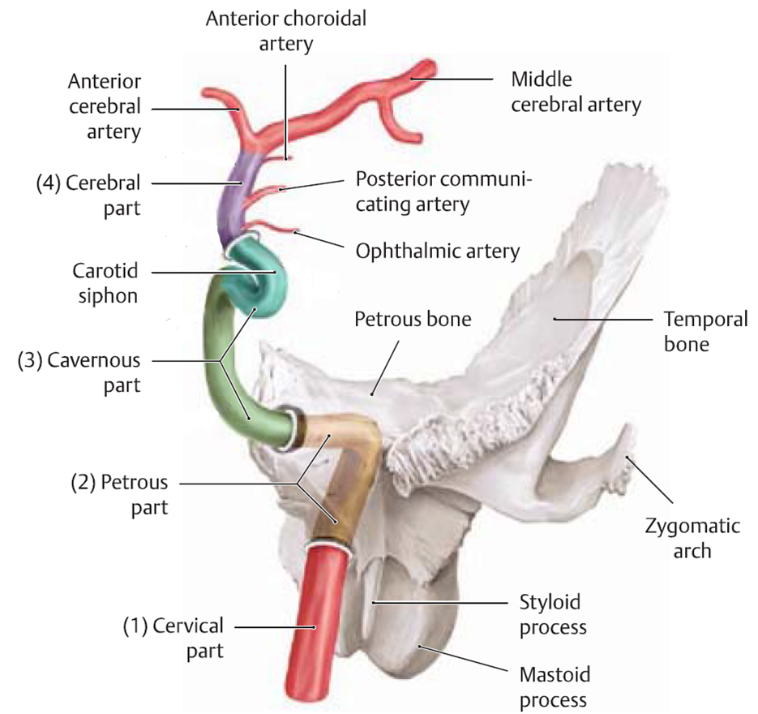
PARTS OF INTERNAL CAROTID ARTERY

Slide 9
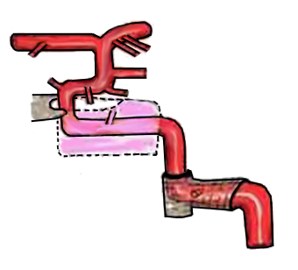
C7
sinus cavernosus
C6
C5
canalis caroticus
C4
C3
proc. clinoideus ant.
C2
C1
foramen lacerum
angiogram

Slide 10
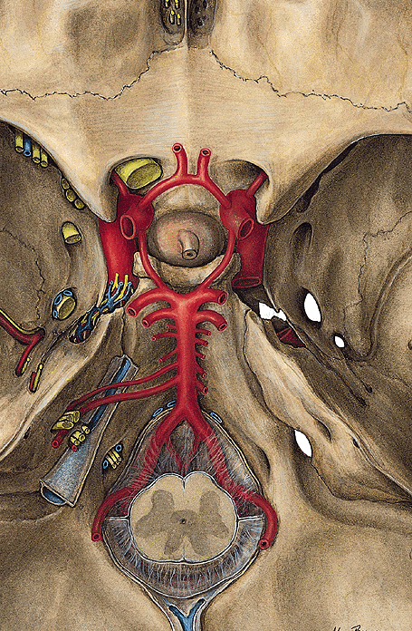
ARTERIAL CIRCLE OF WILLIS
C6
C7
C5
C4
Cavernous sinus
(C3)
C2

Slide 11
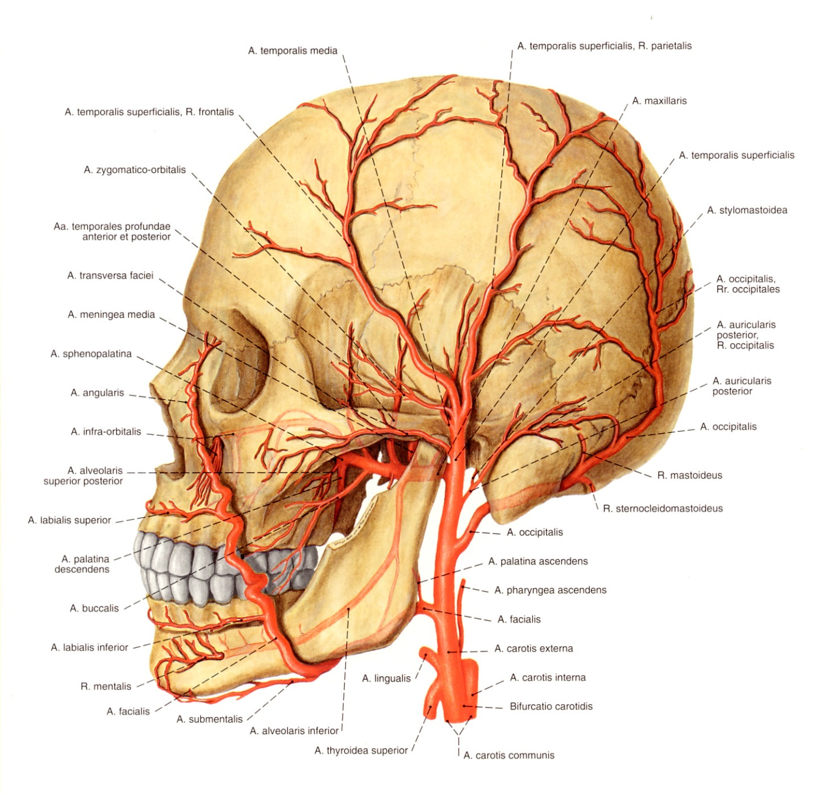
ARTERIES OF THE HEAD AND NECK
EXTERNAL CAROTID ARTERY
SUP. THYROID A.
LINGUAL A.
ASCENDING PHARYNGEAL A.
FACIAL A.
OCCIPITAL A.
MAXILLARY A.
SPF. TEMPORAL A.

Slide 12
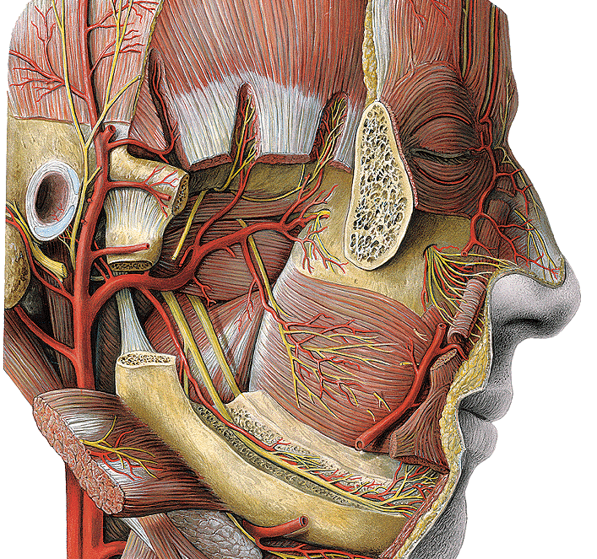
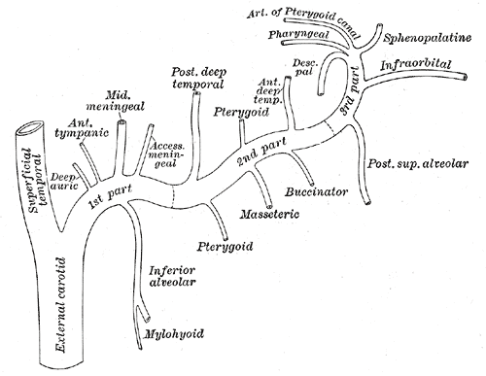
Mandibular part :
deep auricular a.
anterior tympanic a. inferior alveolar a. middle meningeal a.
Pterygoid part :
masseteric artery
deep temporal artery
pterygoid arteries
buccal arteries
post. sup. alveolares br.
Pterygopalatine part:
infraorbital artery
descending palatine a.
sphenopalatine a.
Branches of the maxillary artery

Slide 13
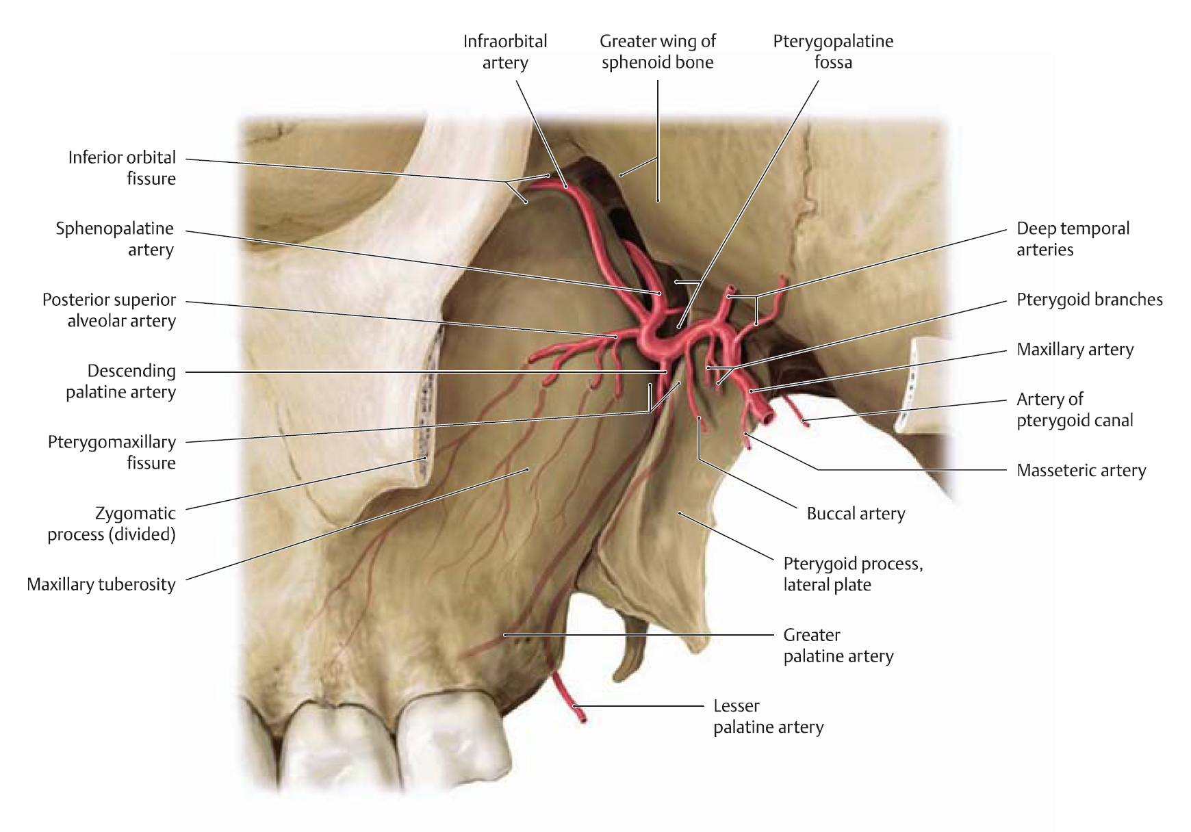
MAXILLARY ARTERY

Slide 14
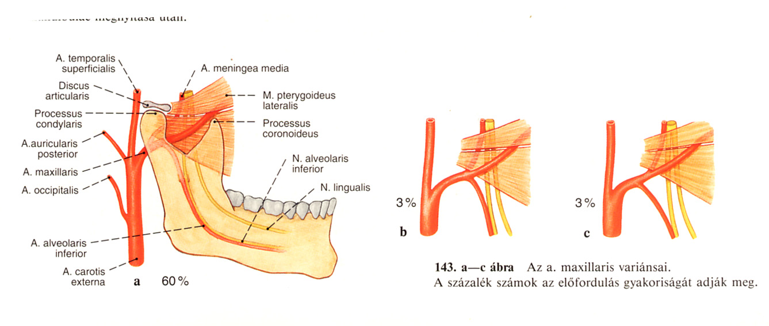
Variations of the maxillary artery

Slide 15
Branches of the facial artery
- ascending palatine a.
submental a.
glandular arteries
inferior and superior labial a.
angular a.

Slide 16
Branches of the lingual artery
- tonsillary branch
dorsal lingual artery
deep lingual artery
sublingual artery

Slide 17
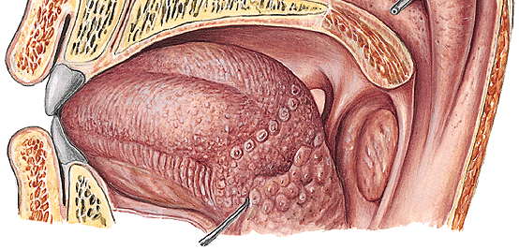
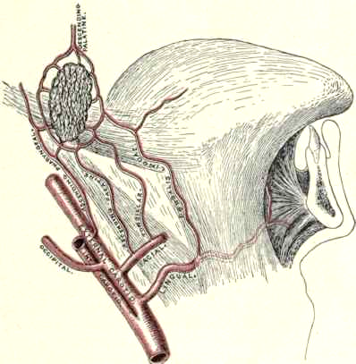
Blood supply of the palatine tonsil
1. Ascending palatine artery
(facial a.)
2. Descending artery
(maxillary)
3. Tonsillary branches of the lingual a.
4. a. pharyngea ascendens
(ex a. carotis ext.)

Slide 18
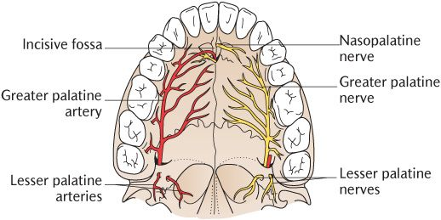
PALATE
BLOOD SUPPLY
- descendending palatine a.
ascending palatine a.
nasopalatine a.
INNERVATION:
nasopalatine n.
greater palatine n.
lesser palatine nerves

Slide 19
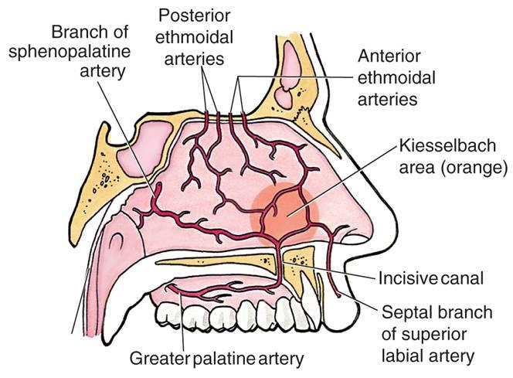

Slide 20
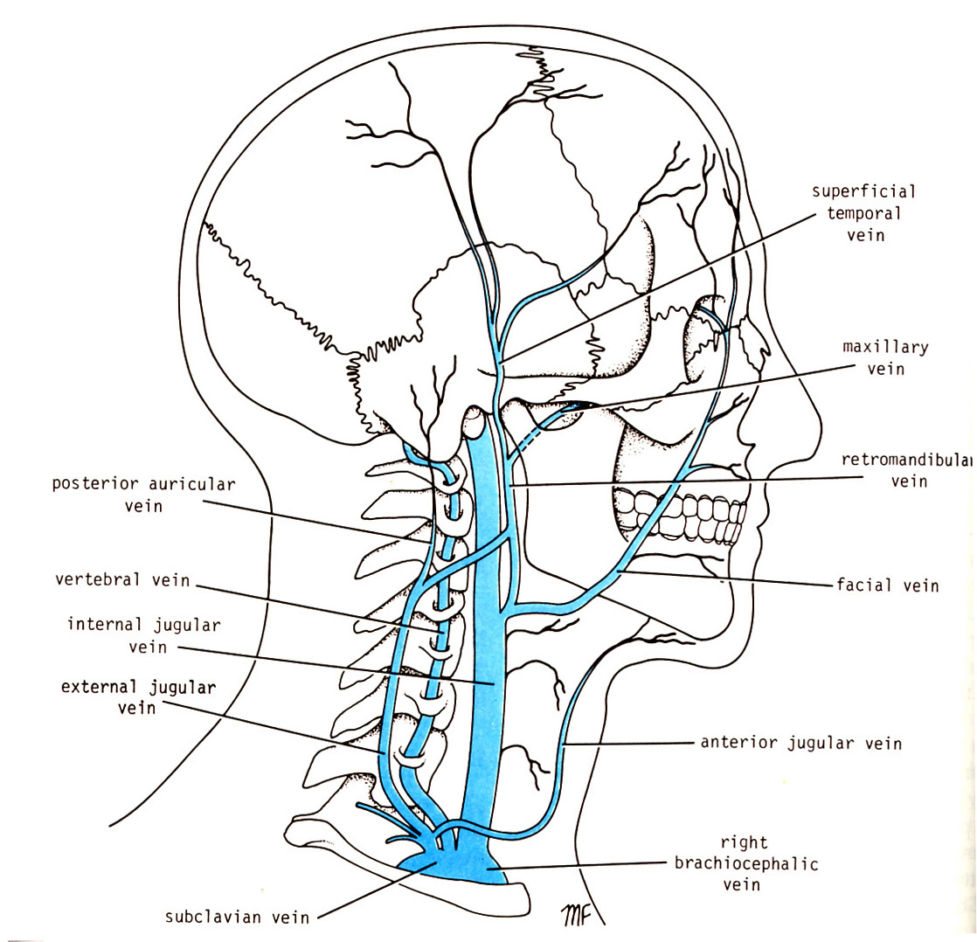
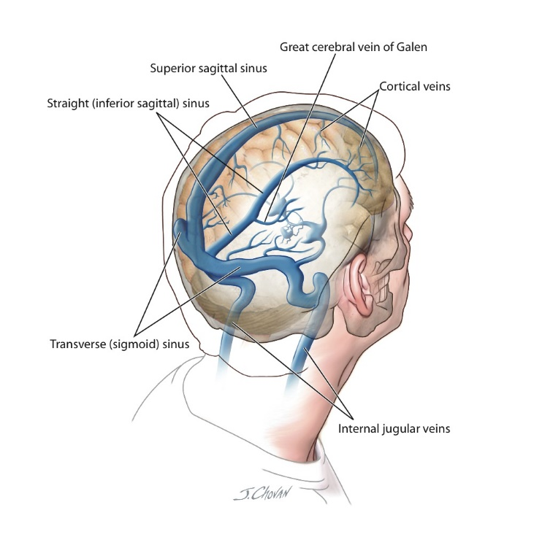
VENOUS DRAINAGE OF THE HEAD AND NECK
RETROMANDIBULAR VEIN + FACIAL VEIN
INTERNAL JUGULAR VEIN
SINUSES V. JUGULARIS INTERNA

Slide 21
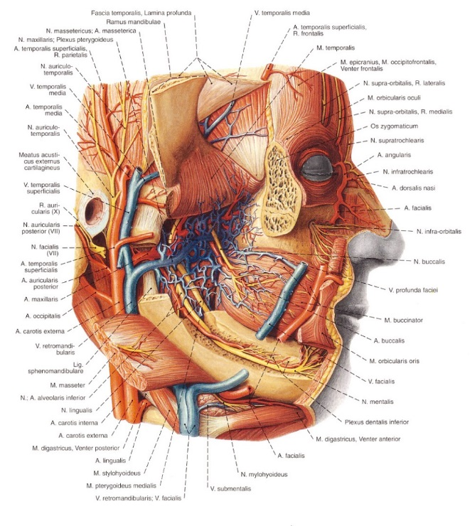
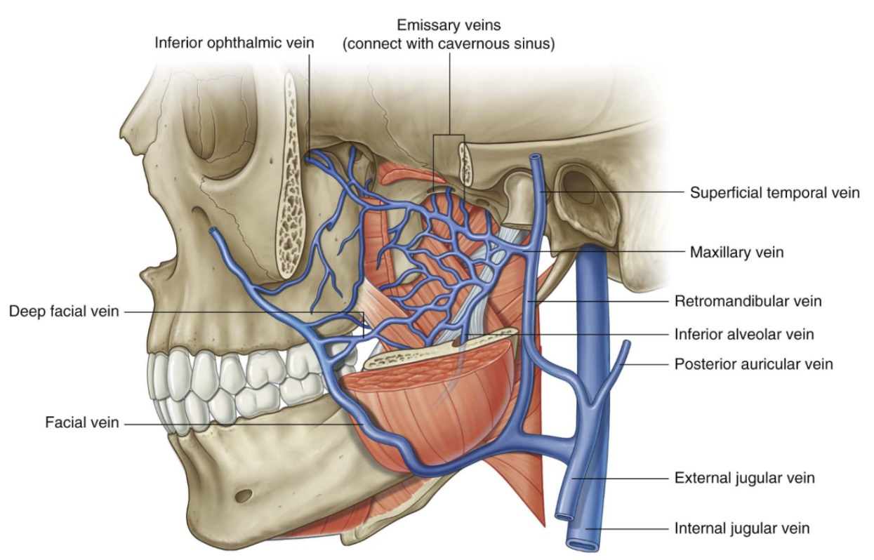
VENOUS DRAINAGE OF THE HEAD
- The blood of the pterygoid plexus
drains into the retromandibular vein,
and also into the deep facial vein, trought it
into the facial vein kerül,
A két véna INTERNAL JUGULAR VEINba
ba ömlik.
From the lateral surface of the head
the superficial temporal vein the venous blood into the
vezeti el a INTERNAL JUGULAR VEINba

Slide 22
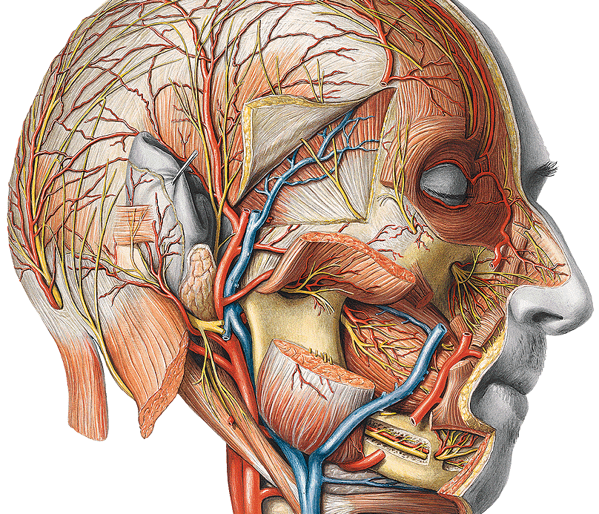
7.

Slide 23
Thank you for your attention!

