Slide 1
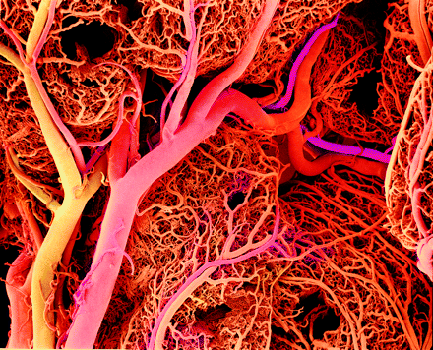
Development of the arteries and veins Fetal circulation. Malformations
http://gut.bmj.com/content/57/7/F1.medium.gif
Mark Kozsurek, M.D., Ph.D.
mark@kozsurek.hu
ED I., 19/02/2019

Slide 2
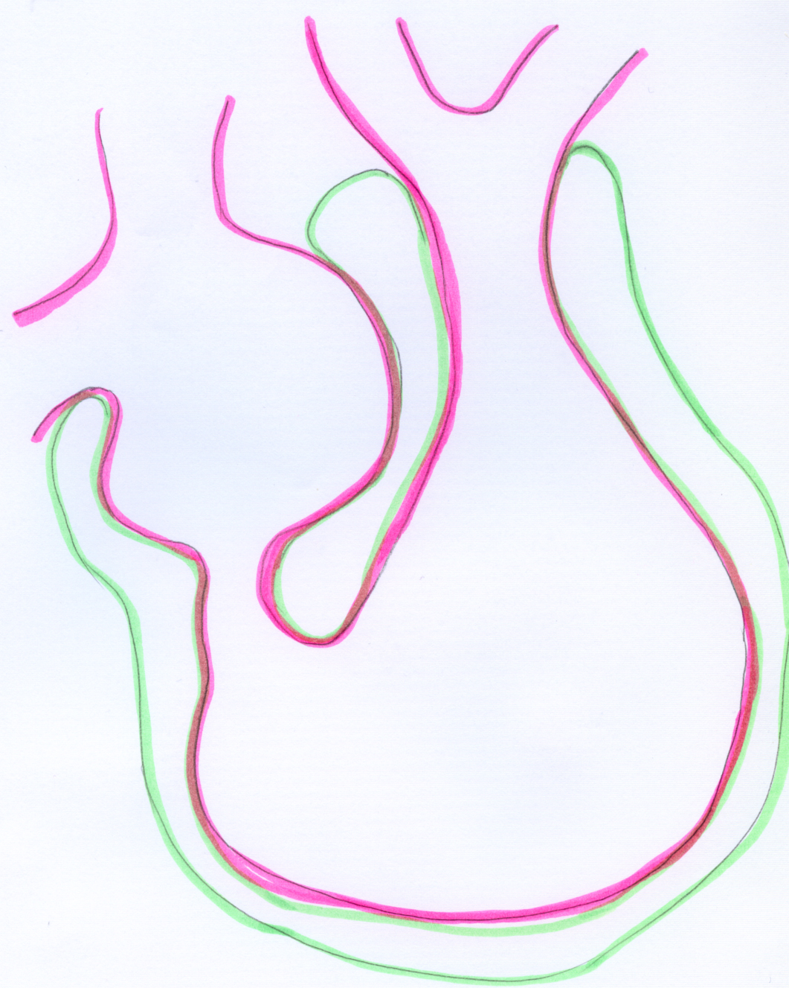
septum secundum
aorticopulmonary septum
interventricular septum, membranous part
foramen ovale
septum primum
interventricular septum, muscular part

Slide 3
Development of the veins

Slide 4
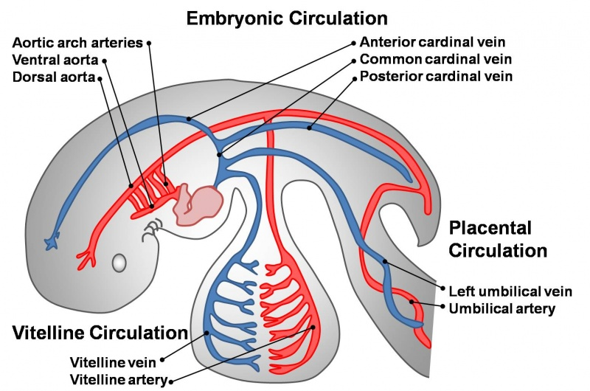
1
2
3
Veins draining into the sinus venosus:
common cardinal vein (formed by the fusion of anterior and posterior cardinal veins)
umbilical vein
vitelline vein

Slide 5
sinus venosus
atria
ventricles
anterior aspect !!!

Slide 6
anterior cardinal vein
common cardinal vein
cut edge ot the sinu-atrial junction
sinus venosus
umbilical
vein
vitelline
vein
posterior cardinal vein

Slide 7
anastomosis between the right and left anterior cardinal veins
anterior cardinal vein
sinus venosus
posterior cardinal vein

Slide 8
anastomosis between the right and left anterior cardinal veins
anterior cardinal vein
sinus venosus
posterior cardinal vein
anastomosis between the right and left posterior cardinal veins

Slide 9
right and left brachiocephalic veins
superior vena cava
oblique vein of the left atrium
coronary sinus
sinus venosus
posteriorcardinal vein
right and left common iliac veins

Slide 10
right and left brachiocephalic veins
superior vena cava
oblique vein of the left atrium
coronary sinus
sinus venosus
posteriorcardinal vein
right and left vitelline veins from the yolk sac
DUODENUM
right and left common iliac veins

Slide 11
right and left brachiocephalic veins
superior vena cava
oblique vein of the left atrium
coronary sinus
sinus venosus
posteriorcardinal vein
right and left vitelline veins from the yolk sac
DUODENUM
right and left common iliac veins

Slide 12
right and left brachiocephalic veins
superior vena cava
oblique vein of the left atrium
coronary sinus
sinus venosus
posteriorcardinal vein
right vitelline vein
DUODENUM
right and left common iliac veins

Slide 13
right and left brachiocephalic veins
superior vena cava
oblique vein of the left atrium
coronary sinus
sinus venosus
posteriorcardinal vein
right vitelline vein
DUODENUM
right and left common iliac veins

Slide 14
right and left brachiocephalic veins
superior vena cava
oblique vein of the left atrium
coronary sinus
sinus venosus
posteriorcardinal vein
right vitelline vein
left umbilical vein
placenta
umbilical veins
right and left common iliac veins

Slide 15
right and left brachiocephalic veins
superior vena cava
oblique vein of the left atrium
coronary sinus
sinus venosus
supracardinal vein
subcardinal vein
placenta
kidney
right and left common iliac veins

Slide 16
right and left brachiocephalic veins
superior vena cava
oblique vein of the left atrium
coronary sinus
sinus venosus
supracardinal vein
liver
subcardinal vein
placenta
kidney
right and left common iliac veins

Slide 17
right and left brachiocephalic veins
superior vena cava
oblique vein of the left atrium
coronary sinus
sinus venosus
ductus venosus
supracardinal vein
liver
subcardinal vein
placenta
kidney
right and left common iliac veins

Slide 18
right and left brachiocephalic veins
superior vena cava
oblique vein of the left atrium
coronary sinus
sinus venosus
ductus venosus
supracardinal vein
liver
subcardinal vein
placenta
kidney
right and left common iliac veins

Slide 19
hemiazygos vein
sinus venosus
accessory hemiazygos vein
azygos vein
liver
portal vein
placenta
splenic vein
superior mesenteric vein
gonadal veins

Slide 20
In the early stage of the embryonic development a pair of vitelline veins carry blood from the yolk sac, but later only the right one persists.
With the appearance and progressive development of the placenta the role of the vitelline veins is replaced by a pair of umbilical veins, but only the left one remains between the placenta and the primordial heart.
The main venous system draining the head and the caudal part of the embryo is represented by the anterior and posterior cardinal veins, respectively.
Supracardinal veins appear on the lateral side of the developing kidney. The supracardinal veins are connected with a horizontal anastomosis, resulting in a H-shaped structure.

Slide 21
On the medial sides of the primordial kidneys a new pair of veins develop: the subcardinal veins, which are also interconnected with a horizontal anastomosis.
The liver developing in the septum transversum devides the remaining right vitelline vein in three segments: prehepatic, intrahepatic and posthepatic parts can be distinguished.
Due to the growing liver the left umbilical vein is interrupted and looses its contact with the heart. The larger proportion of the blood arriving from the placenta enters the inferior vena cava on the surface of the liver via the ductus venosus, while the rest enters the hepatic sinuses.

Slide 22
On the left side the cardinal veins degenerate. The only notable persisting vessel is the coronary sinus.
The right anterior cardinal vein develops into the right brachiocephalic vein and the superior vena cava, while the anastomosis between the two anterior cardinal veins remains as the left brachiocephalic vein.
Supra- and subcardinal veins with the prehepatic segment of the right vitelline vein and the interconnecting anastomoses play an important role in formation of the inferior vena cava.
Prehepatic segment of the right vitelline vein develops into the portal vein.
The major part of the supracardinal veins persists as the vena azygos/hemiazygos system.
Subcardinal veins are incorporated into the inferior vena cava or develop into the renal and gonadial veins.

Slide 23
Development of the arteries

Slide 25
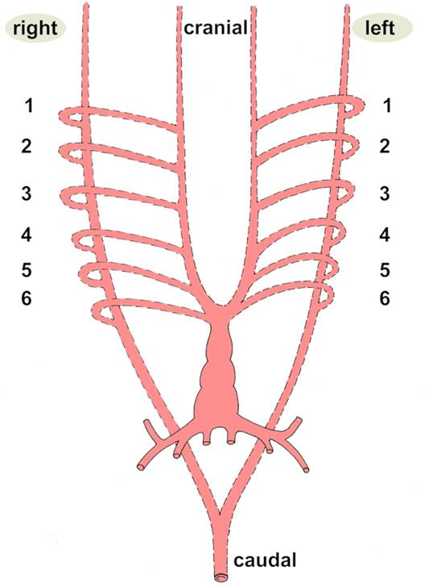
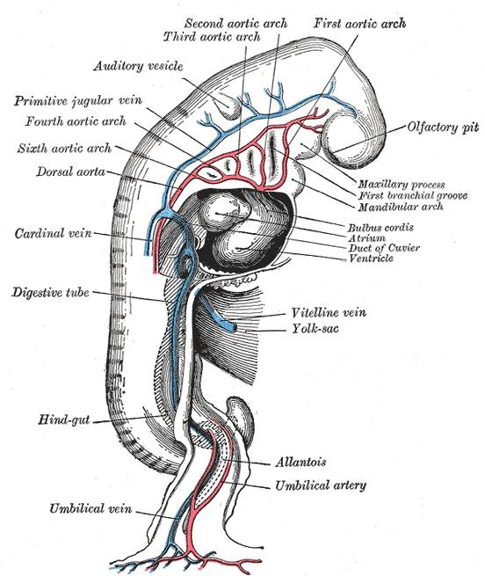

Slide 26
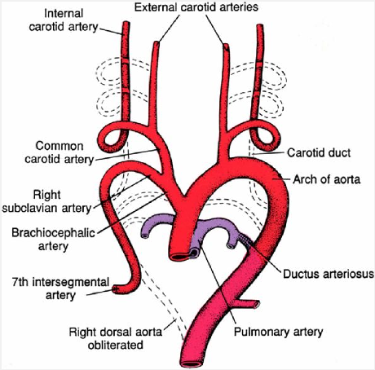
Langman’s Medical Embryology

Slide 27
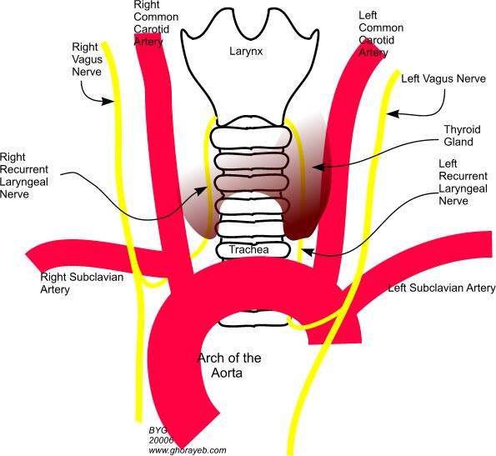

Slide 28
Fetal circulation Postnatal adaptation of the circulatory system

Slide 29
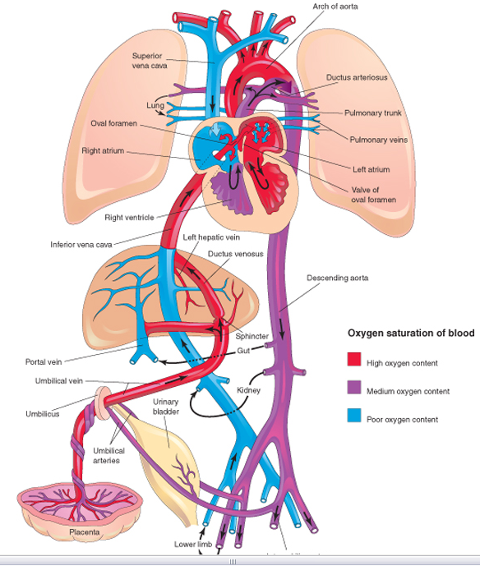

Slide 30
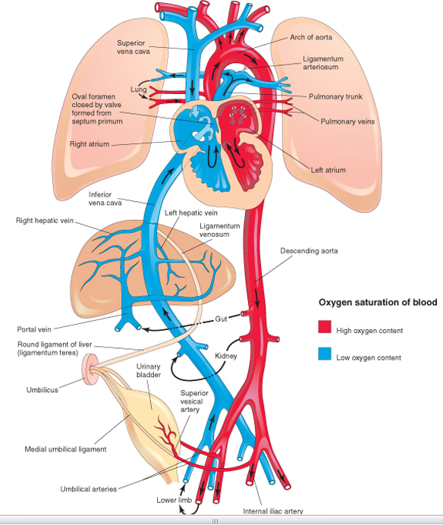

Slide 31
Arterious blood is carried into the fetus by the umbilical vein. A smaller proportion of this blood passes through the liver and is collected by the IVC. The majority of the oxygeneted blood bypasses the liver through the ductus venosus and drains directly into the IVC. The Eustachian valve directs the blood toward the foramen ovale and the left atrium. This blood is then pumped into the aorta and supplies the tissues of the fetus. Finally returnes to the placenta via the two umbilical erteries arising from the internal iliac arteries.
Venous blood derived from the head and neck regions as well as from the upper limb is collected by the SVC. This venous blood gets into the right atrium then into the right ventricle. As the lungs are collapsed the vascular resistance is very high: the blood may not flow toward the pulmonary arteries. This is why the ductus arteriosus is essential: it drains the venous blood of the pulmonary trunk into the aorta.Briefly: during the fetal period both of the ventricles eject blood into the aorta!!!

Slide 32
After birth no more arterious blood arrives through the umbilical vein. The lungs are inflated, the vascular resistance suddenly drops. There is no further reason for the blood ejected by the right ventricle to join the aorta. As more blood reaches the lungs, more returns through the pulmonary veins into the left atrium. The pressure increases here and the septum primum is pushed against the septum secundum: the foramen ovale closes, later the two septa completly fuse.
Due to the increased oxygen levels smooth muscles of the ductus arteriosus contract and obliterate the lumen. (Otherwise the higher pressure in the aorta would result in a reversed flow through the ductus venosus.)
Ductus venosus is slowly occupied by proliferating connective tissue and remains observable on the visceral surface of the liver as the venous ligament.

Slide 33
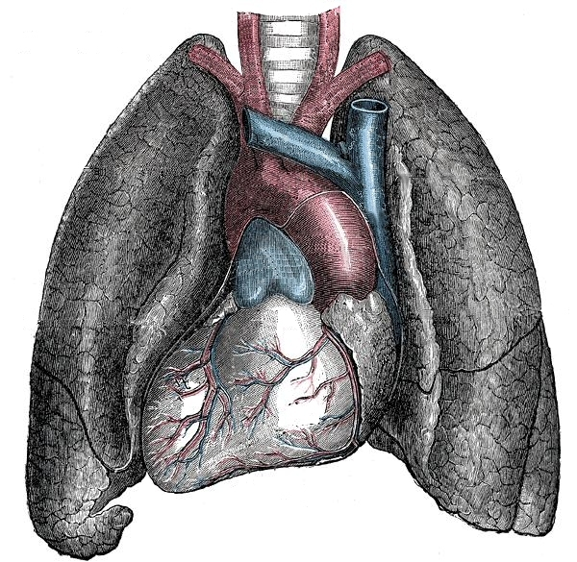
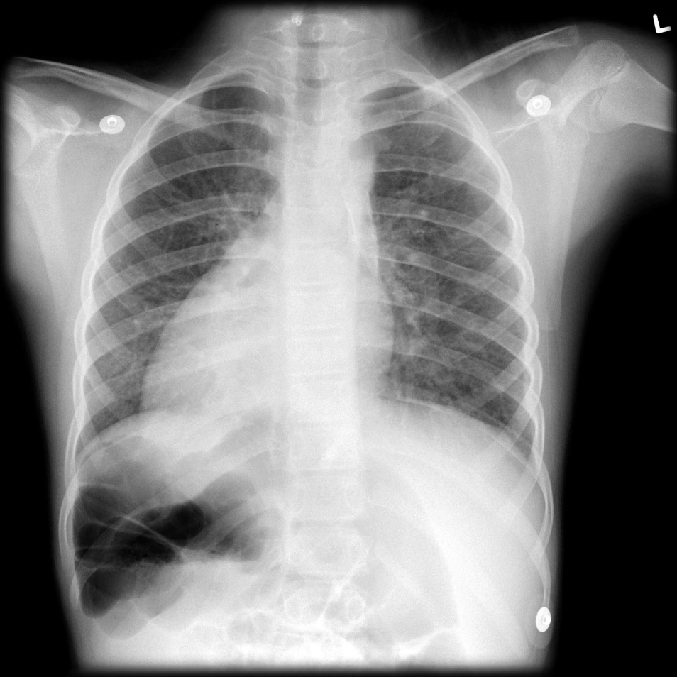
Malformations
1. situs inversus totalis: all the viscera are mirrored. Prevalance is less than 1/10 000.

Slide 34
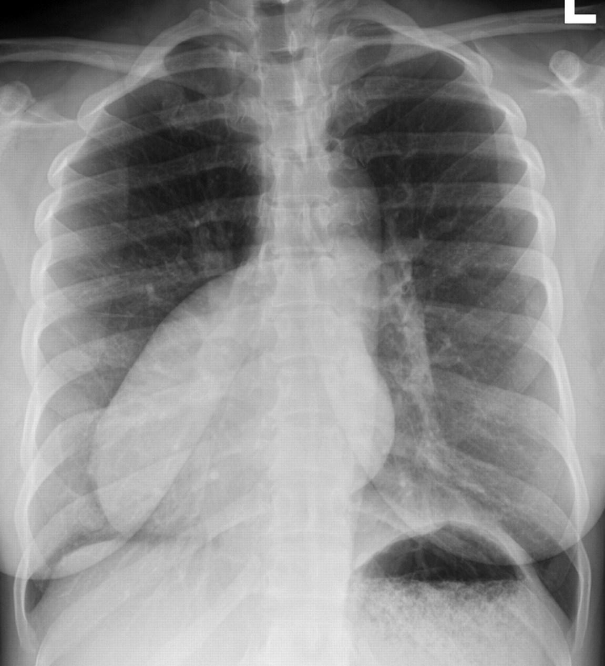
2. dextrocardia: only the heart is swapped to the right side of the thorax (first seen and drawn by Leonardo da Vinci in 1452–1519)

Slide 35
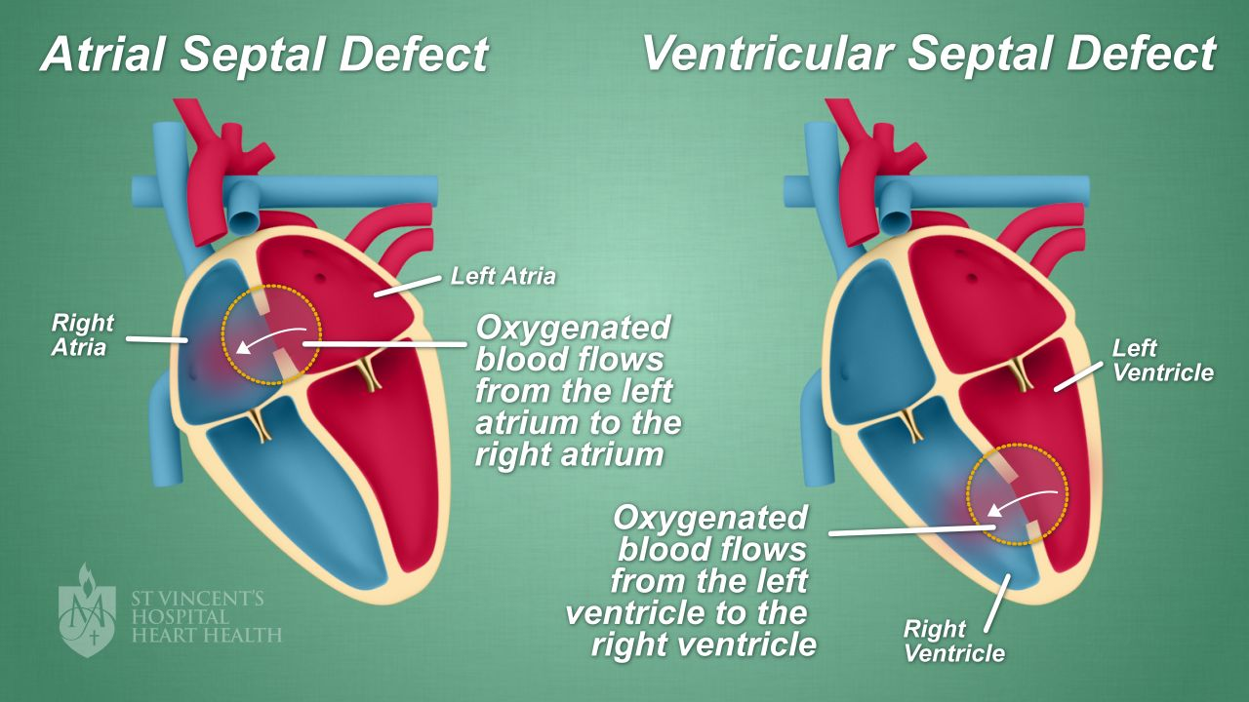
3. atrial and ventricular septal defect (ASD/VSD)

Slide 36
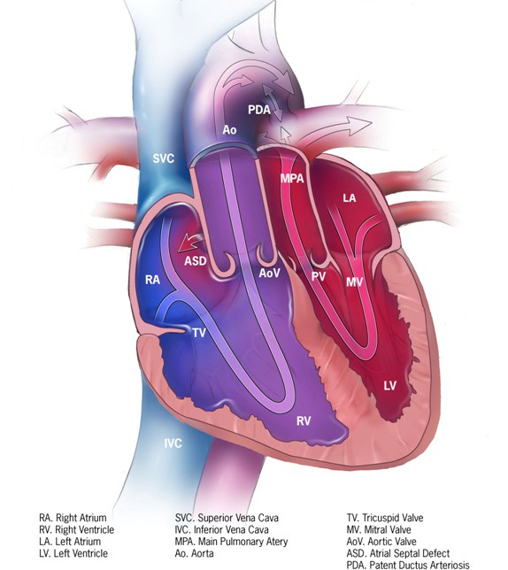
4. transposition of the great vessels: aorticopulmonary septum twists only 90 degrees.

Slide 37
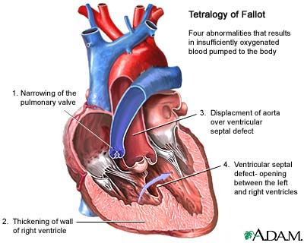
5. Tetralogy of Fallot: a complex malformation

Slide 38
Thank you for your attention!

