Slide 1
Signs of biological activities of 28,000-year-old mammoth nuclei in mouse oocytes visualized by live-cell imaging
Kazuo Yamagata et al.,
Nature
Scientific Reports, (2019) 9:4050.

Slide 2
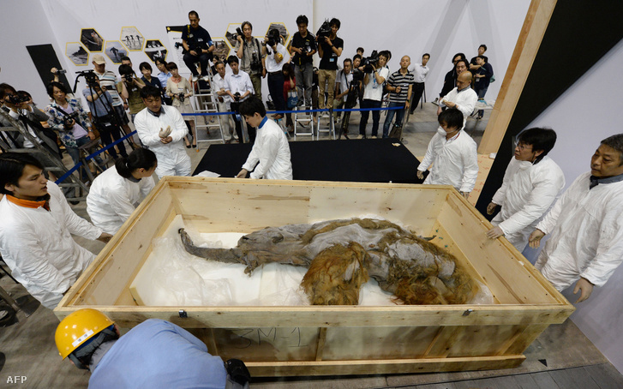

Slide 3
Fundamental studies on woolly mammoth (Mammuthus primigenius) genes, including whole genome
analyses1–3, led to the reconstitution of mammoth haemoglobin with cold tolerance4 and to an understanding
of the expression of mammoth-specific coat colour5 and temperature-sensitive channels6
Moreover, proteomic
analyses have shown the presence of proteins in the remains7,8. Meanwhile, the investigation of biological activities
of nuclei isolated from the remains using means of nuclear transfer (NT) approach is still in progress.

Slide 4
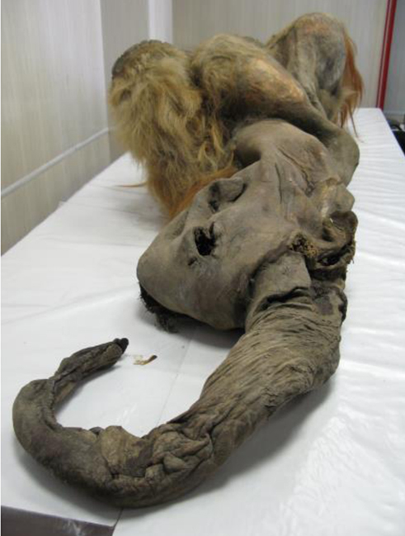
Radiocarbon dating suggested that Yuka mammoth was 28,140 (±230) years old.

Slide 5
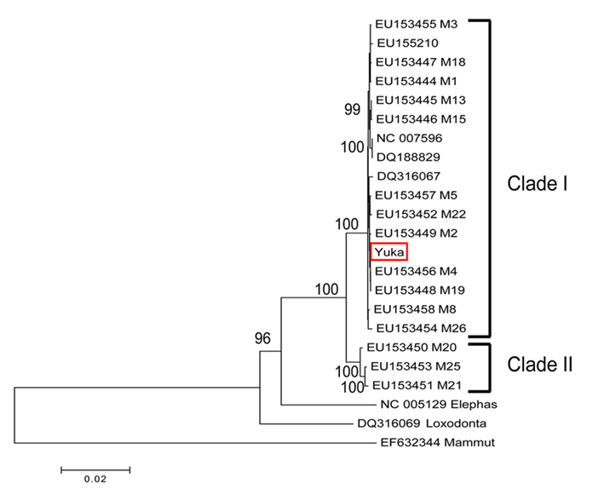

Slide 6
Genomic DNA libraries
of the Yuka mammoth remains were constructed using Phusion polymerase, which provides efficient amplification
with high fidelity, excluding post-mortem damage (C-to-T or G-to-A substitutions).

Slide 7
To further consolidate evidence of the identification of mammoth proteins, we performed comparative analyses between genomic sequences and our proteomic data. Of the proteins identified via LC-MS/MS as significant identities with the African elephant proteins, we selected one extracellular matrix protein (laminin subunit
gamma-1), five serum proteins (fatty acid binding protein 4, serum albumin, serotransferrin, complement factor H and fibrinogen alpha chain) and two intracellular proteins (aminopeptidase and glutathione S-transferase)
for further comparative analysis because all of them showed high sequence coverage. All thirteen amino acid substitutions in the eight proteins were found to be compatible with nonsynonymous SNVs described above and reported previously6,15 (Fig. 1d and Supplementary Table S4). Therefore, these results demonstrate that our proteomics analyses identified the protein sequences of the Yuka mammoth remains without contaminations from the environment.

Slide 8
Next, we evaluated protein aging of mammoth tissues with the non-enzymatic spontaneous modifications of peptides, because van Doorn et al. reported that site-specific deamidation can be used as the marker of protein deterioration. Mammoth samples showed more deamidation of asparagine and glutamine, oxidation of phenylalanine and partial degradation of peptide bonds than elephant samples (P < 0.05). These spontaneous modifications were suppressed in the muscle samples compared to the bone marrow samples.
In addition, we counted all the identified collagen sequences and calculated the degree of deamidation, which was significantly reduced (P < 0.05) in our muscle sample compared to our bone marrow sample and the previously reported Dent and La Sena mammoths but was similar to that of the Siberian mammoth. These data indicate that our mammoth samples, particularly from the muscle, were well-preserved.

Slide 9
Interestingly, the nuclear protein histone H4 was detected.
Search against the database of all mammalian species identified other nuclear proteins, such as histones, histone chaperones, proteins implicated in mRNA processing or transport and nuclear membrane proteins.
In addition, we identified two well-characterised epigenetic modifications on histone molecules, methylation of H3K79 and H4K20 (Supplementary Fig. S2A and B), which are involved in transcriptional regulation and genome maintenance. Our high-sensitive proteomic analysis suggests that the remains retain nuclear components.

Slide 10
These findings motivated us to seek cell nuclei from the muscle remains. Although DAPI-positive and autofluorescence-negative nucleus-like structures were rarely found.

Slide 11
Preparation of mammoth nuclei from remains for nuclear transfer. (a) Overview of the purification of mammoth nuclei. (b and c) The isolated nucleus-like structures after homogenising the mammoth muscle tissue (b: bright field, c: DAPI staining).
They chose the autofluorescence-negative structures for the subsequent live-cell imaging of nuclear-transferred embryos
since autofluorescence disturbs accurate tracing of fluorescent-tagged proteins.

Slide 12
Selection of nucleus-like structures from the mammoth tissue for nuclear transfer by excluding autofluorescence entities. (a) Fluorescent observation of the homogenates by 405, 488 and 561 nm excitations without any staining. Some structures (arrows) show strong autofluorescence.

Slide 13
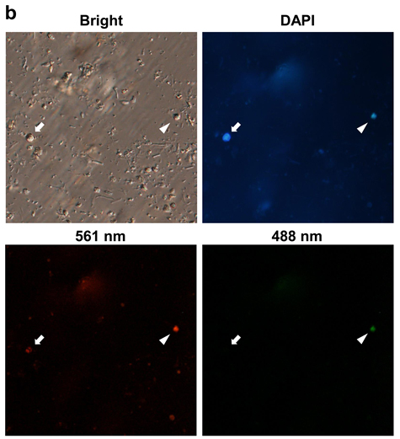
DAPI-staining of mammoth tissue homogenates. Two nucleus-like structures are positive for DAPI staining. The structure indicated by an arrowhead is positive for both red and green colours, whereas the structure indicated by an arrow is positive only for the red. We chose DAPI-positive and autofluorescence-negative nucleus-like structures as the donor nuclei in subsequent experiments.

Slide 14
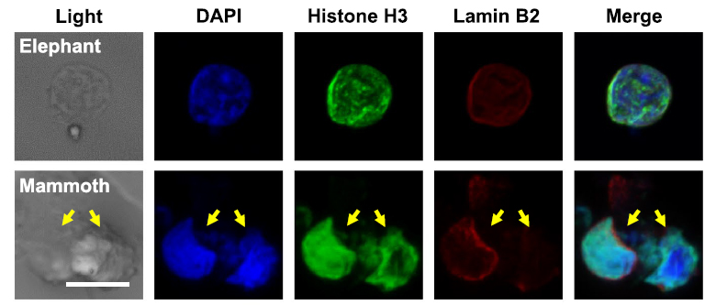
In total, 88 nucleus-like structures were collected from 273.5 mg mammoth tissue in 5 independent experiments. these structures were positive for lamin B2 and histone H3, both of which were identified by mass spectrometry, suggesting that cell nuclei are, at least partially, sustained even in over a 28,000 year period.

Slide 15
They asked whether the mammoth nuclei are able to show spindle and nuclear reconstitution upon NT to mouse oocytes by the traceable live-cell imaging technique, using EGFP-EB1 and histone H2B-mCherry as probes.

Slide 16
To compare the responses of injected nuclei with those of endogenous ones, the metaphase II plate, inherent chromosomes of oocyte, was not removed. Oocyte chromosomes were distinguishable from mammoth nuclei by their morphological characteristics. Namely, typical metaphase II chromosomes of mouse were already observed by EGFP-EB1 and histone H2B-mCherry signals when the imaging had started, while the assembly of the probes onto the injected nucleus took some time.
E
M
Soon after NT (Supplementary Fig. S7), H2B-mCherry was assembled onto the injected elephant (Fig. 3c;) and mammoth nuclei (Fig 3d). This H2B incorporation was observed in 96% and 88% of NT oocytes injected with elephant and mammoth nuclei, respectively, suggesting the possibility of the nucleosome formation in most of mammoth nuclei. Furthermore, oocyte-derived spindle was assembled around mammoth nuclei in 21% of the NT oocytes (Fig. 3d), indicating that some mammoth nuclei can react to mouse kinetochore proteins.
EB1 is a microtubule plus-end tracking protein

Slide 17
(c–h) Time-lapse images of NT oocytes injected with mammoth (d,f,g and h) or elephant (c and e) nuclei at the stages of before (c,d and g) and after (e,f and h) activation. Green and red colours represent EB1 (spindle) and H2B (chromatin), respectively. White colour represents H2B-mCherry signal (e and f). Yellow arrows indicate mammoth or elephant nucleus-like structures (c and d) and the mammoth chromosome that detached from nucleus-like structure and entered into the mouse pronucleus (g and h). Arrowheads indicate the injected mammoth or elephant nucleus forming pronucleus-like structures (nuclear blebs). Asterisks show metaphase II chromosomes. eSCN, mSCN and fPN represent elephant somatic cell nucleus, mammoth somatic cell nucleus and female pronucleus, respectively. The time (h:min) shown in the images indicates time duration from the starting point of imaging. Bar = 10 μm.

Slide 18
After activation of those NT oocytes, pronucleus-like structure budded from the injected elephant (yellow arrow heads; Fig. 3e) and even from a mammoth nucleus (yellow arrow heads; Fig. 3f; Supplementary Tables S8 and S9; and Supplementary Movie S2) simultaneously with the timing of mouse pronuclear formation. We define nuclear blebs that were transformed from condensed elephant/mammoth chromatin (Fig. 3e and f, arrows) as pronucleus-like structures.
White colour represents H2B-mCherry signal (e and f). After (e,f) activation.
eSCN, mSCN and fPN represent elephant somatic cell nucleus, mammoth somatic
cell nucleus and female pronucleus, respectively.

Slide 19
The mammoth chromosome that detached from nucleus-like structure and entered into the mouse pronucleus (g and h). Asterisks show metaphase II chromosomes.
Moreover, a part of mammoth chromosomes with spindle was apparently incorporated into mouse pronuclei in NT oocytes (Fig. 3g and h).

Slide 20
All reconstructed oocytes were arrested or degenerated during the one-cell
stage, probably due to the G2/M DNA damage checkpoint. These results indicate that a part of mammoth nuclei possesses the potential for nuclear reconstitution.

Slide 21
They subsequently evaluated the integrity of mammoth DNA in living mouse oocytes by monitoring changes in the phosphorylation of histone variant H2A.X (γH2A.X), a marker for DNA double-strand breaks (DSBs), and assessed the developmental potential of embryos. For reference, we prepared mouse sperm with different extents of DNA damage. Frozen damaged sperm cells showed stronger γH2A.X signals than the fresh ones, whereas H2B was stained as the same level (Fig. 4a).

