Slide 1
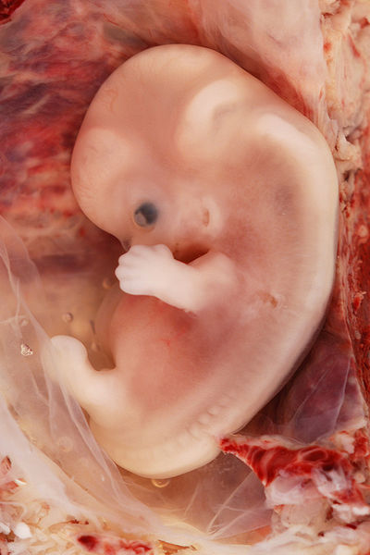

Limb development
Dr. Nandor Nagy
Semmelweis University,
Budapest
Notes:
Lateral plate mesoderm, limb bud, ossification, sonic hedgehog

Slide 2
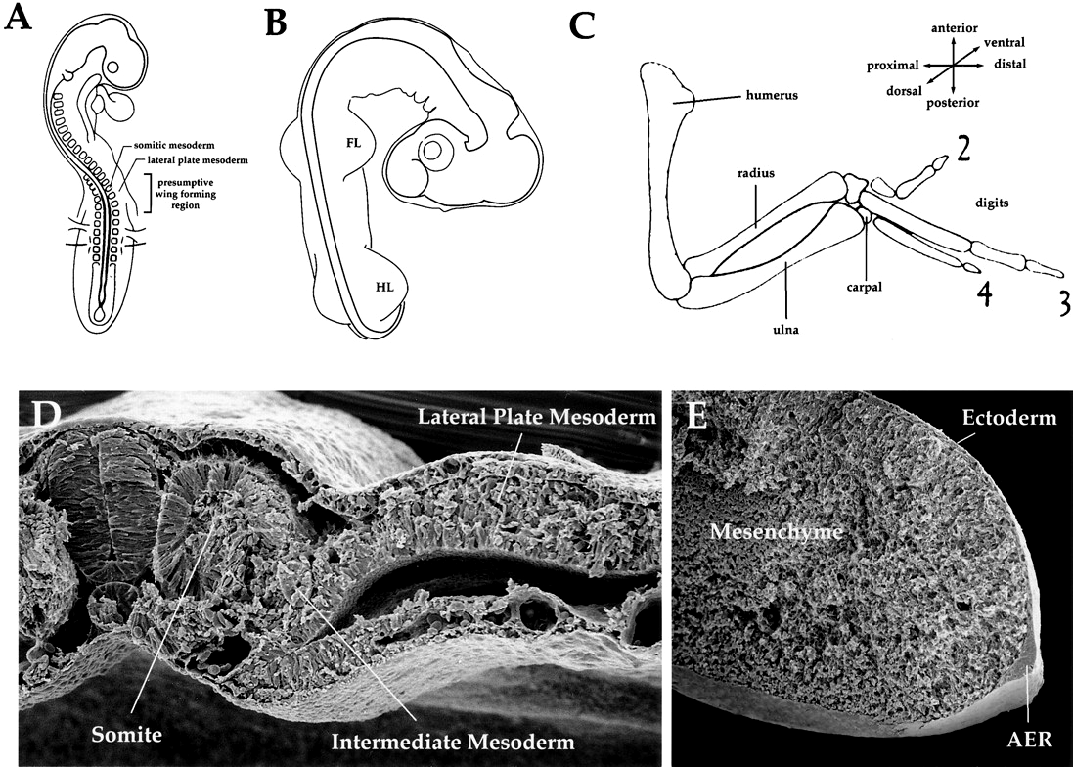
The Limb Field
  Morphogenetic field
  Includes all cells with the common fate of forming a limb
Limb Bud
  Ectoderm
  Mesoderm:
    Paraxial (somite)
    Lateral plate (somatic)
Specified by Hox genes
And retinoic acid
Limb formation begins in the limb field

Slide 3
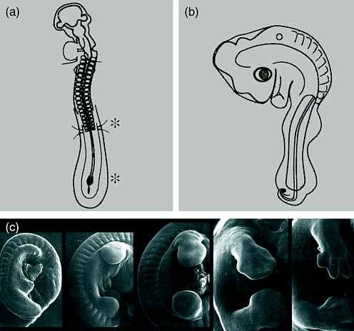
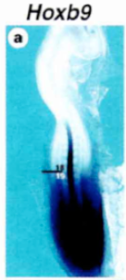
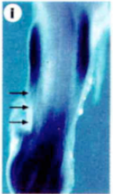
kar
törzs
láb

Slide 4
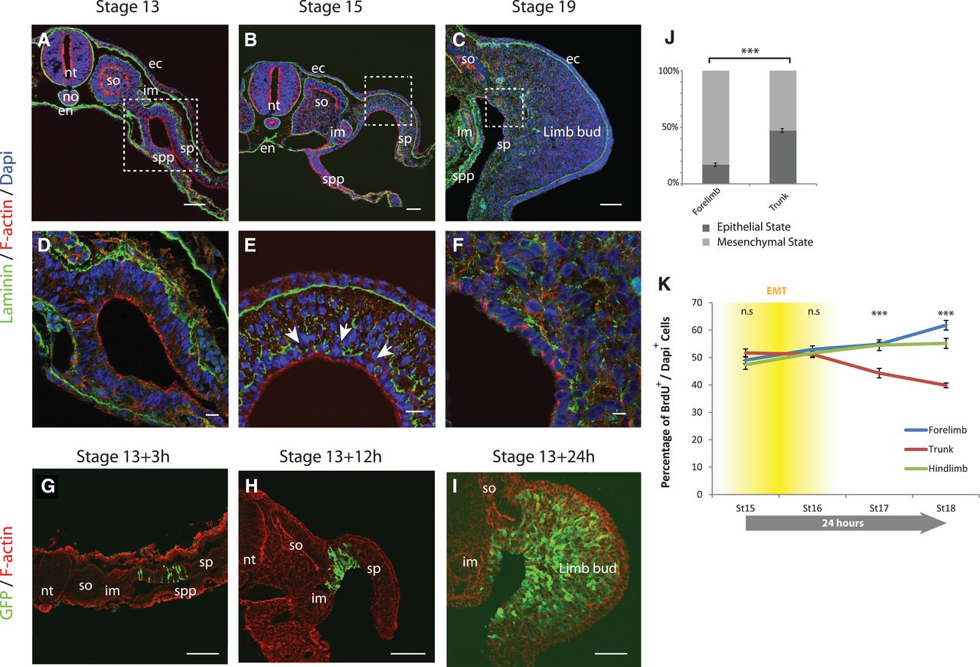

Limb progenitors arise from EMT of the epithelial somatopleure.(A to C) Transverse sections of stage-13 (A), -15 (B), and -19 (C) chick embryos at the forelimb level.
Jerome Gros, and Clifford J. Tabin Science 2014;343:1253-1256
Published by AAAS
Notes:
Limb progenitors arise from EMT of the epithelial somatopleure.(A to C) Transverse sections of stage-13 (A), -15 (B), and -19 (C) chick embryos at the forelimb level. Sections were stained with DAPI (4′,6-diamidino-2-phenylindole, blue), F-actin (red), and antibody against laminin (anti-laminin, green). (D to F) Higher magnifications of (A) to (C); arrows point at laminin basement membrane breakdown. (G to I) Transverse sections of chick embryos electroporated at stage 13 and harvested after 3, 12, and 24 hours. Sections were stained with phalloidin (red) and with anti-GFP (green). (J) Proportion of cells in epithelial or mesenchymal state at forelimb and trunk levels (n = 3723 cells, five embryos; Mann-Whitney U test ***P = 2.4 × 10⁻⁹). (K) Percentage of proliferating cells (BrdU+/DAPI+) in the somatopleure of chick embryos at stages 15 to 18 at the level of the forelimb (blue), trunk (red), and hindlimb (green) (n = 5 embryos for each stage; over 250,000 cells were counted in total; Mann-Whitney U test; n.s, nonsignificant P > 0.05; ***P < 10⁻⁷). The timing of EMT in relation to proliferation is represented in yellow. Errors bars indicate SEM. Scale bars represent 10 μm in (D) to (F) and 50 μm elsewhere. nt, neural tube; no, notochord; en, endoderm; so, somite; im, intermediate mesoderm; ec, ectoderm; spp, splanchnopleure; sp, somatopleure.

Slide 5
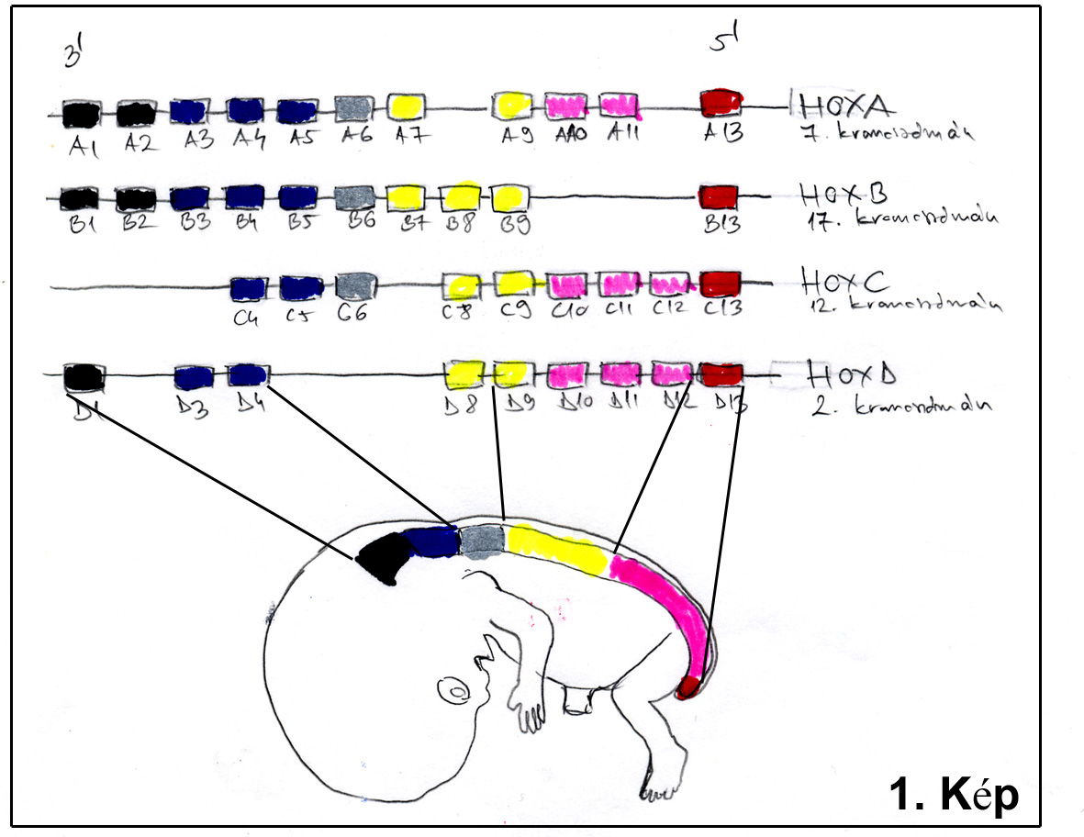
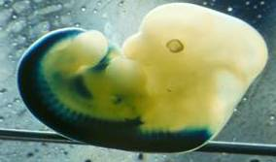
Limb field specified by the HOX genes

Slide 6
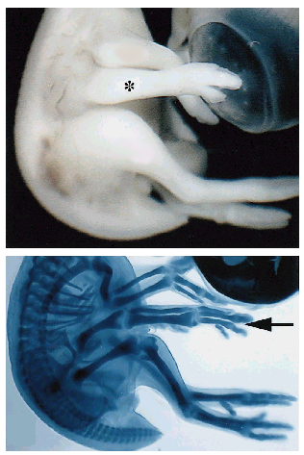
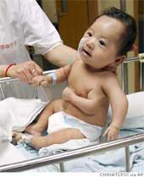
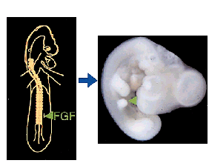

Fibroblast growth factor-10 (FGF-10); FGF-2
FGF induction

Slide 7
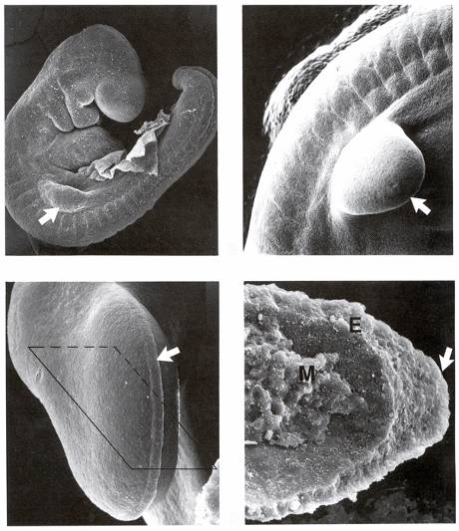
AER: (Saunders J.W. 1948)
Ektodermakappe: Kölliker A. (1879)
Mesoderm will induce ectoderm to form the
Apical Ectodermal Ridge (AER)
AER develops along the
distal margin of the limb bud
AER

Slide 8
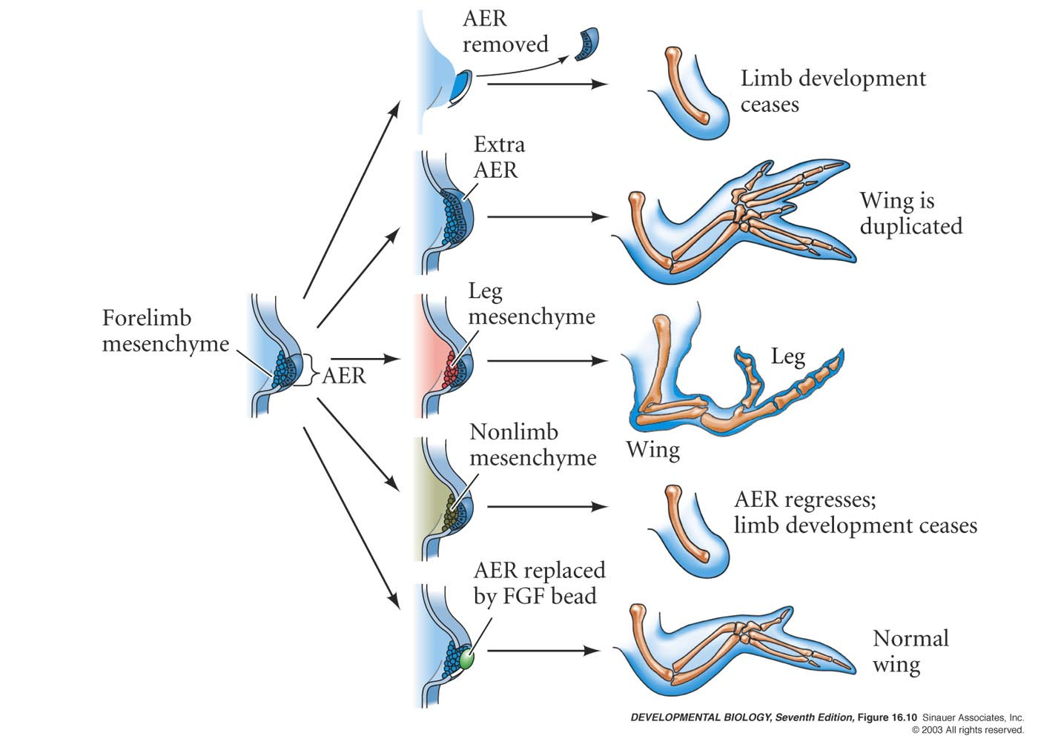
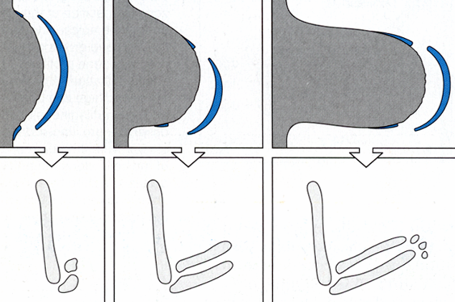
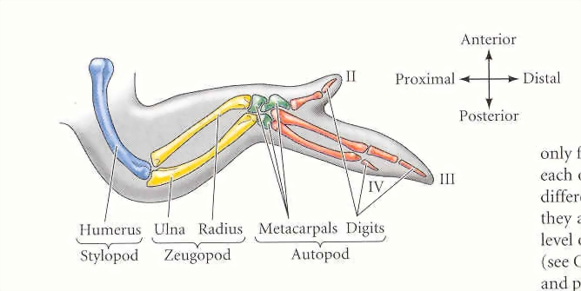
The vertebrate limb
develops from a limb bud
Removal of the AER will result in loss of distal structures depending upon the time of surgery.

Slide 10
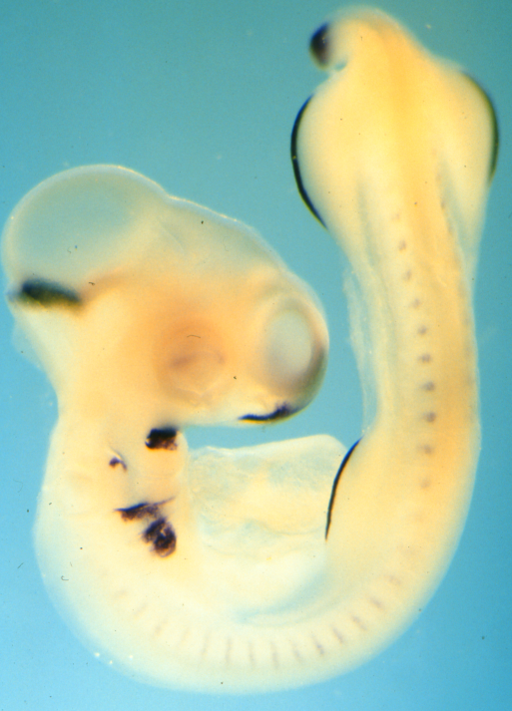
The outgrowth-promoting signal
produced by the AER is FGF-8
(fibroblast growth factor-8)

Slide 11
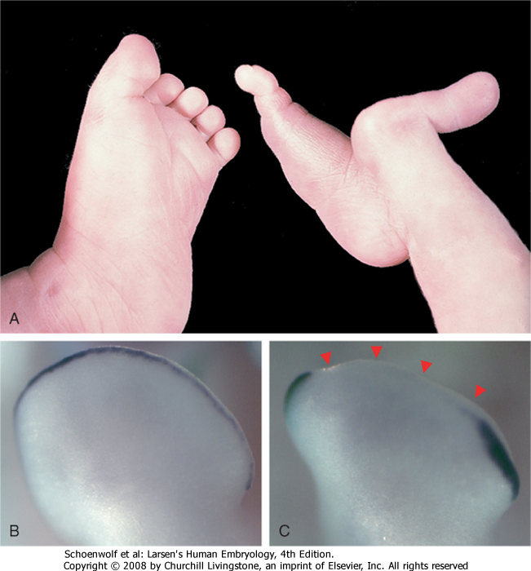
Split-foot anomaly
FGF-8
FGF-8

Slide 12
Apical Ectodermal Ridge
The AER is needed for outgrowth and proximo-distal patterning of the limb : Proximal-distal axis
Maintaining proliferation of the mesoderm (the AER produces FGF8). The mesenchyme (progress zone) in contact with the AER proliferates instead of differentiating into cartilage and muscle.
♦
Mesoderm determines type of limb and structure
  First to leave progress zone → Proximal structures
  Last to leave progress zone → Distal structures

Slide 13
Anterior-Posterior Axis of Limb
The polarizing region specifies position along the A/P axis
The limb bud has a zone of polarizing activity (ZPA) –
group of mesenchymal cells at the caudal part of the limb bud.
involves production of sonic hedgehog (SHH) and interactions with AER

Slide 14
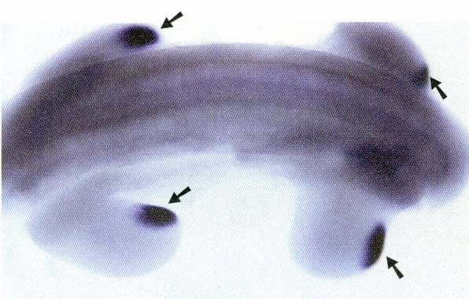
Shh mediates the signaling activity of the ZPA

Slide 15
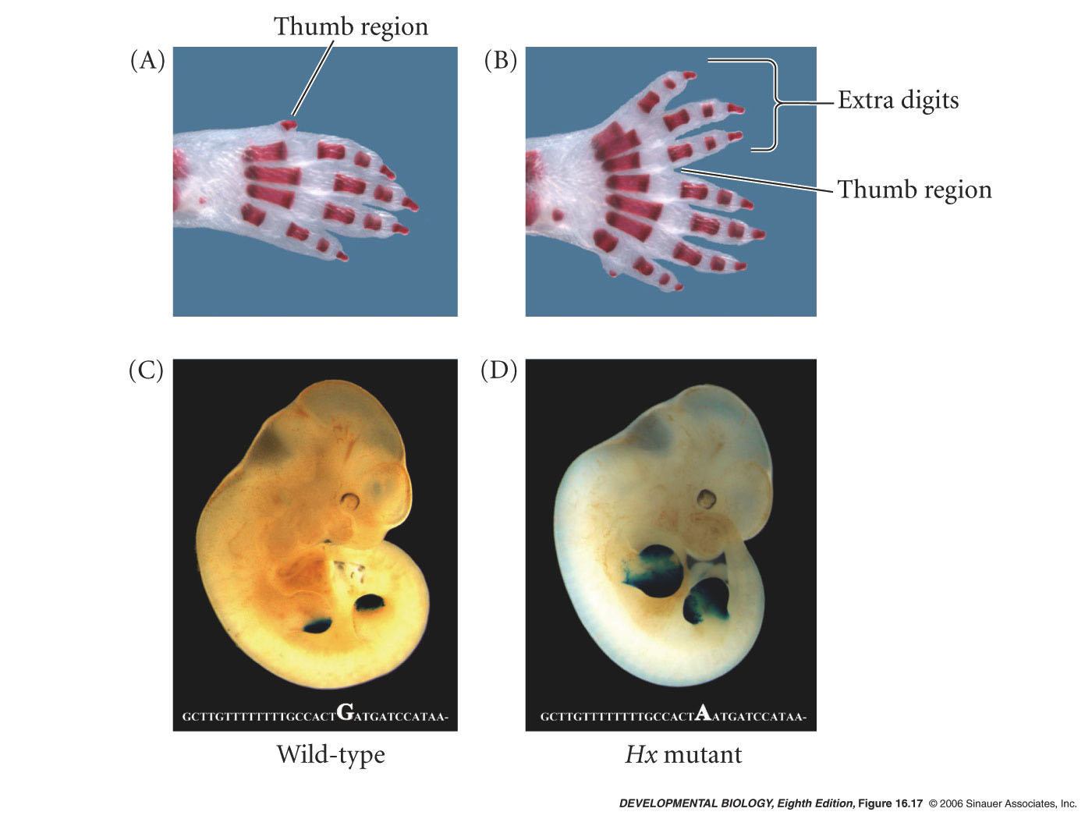
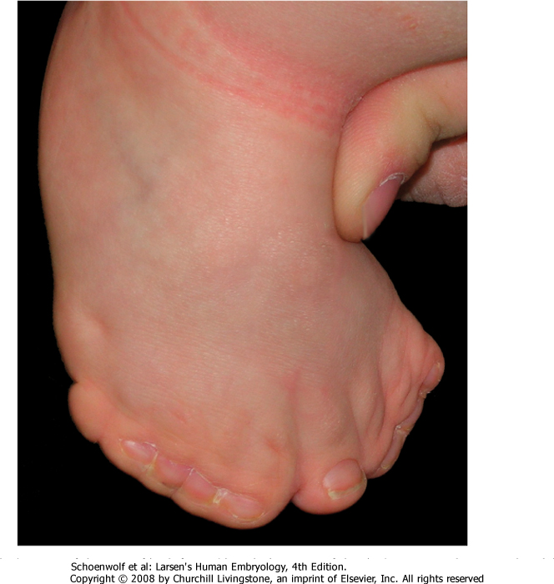
Ectopic expression of mouse sonic hedgehog in the anterior limb causes extra digit formation
Notes:
devbio8e-fig-16-17-0.jpg

Slide 16
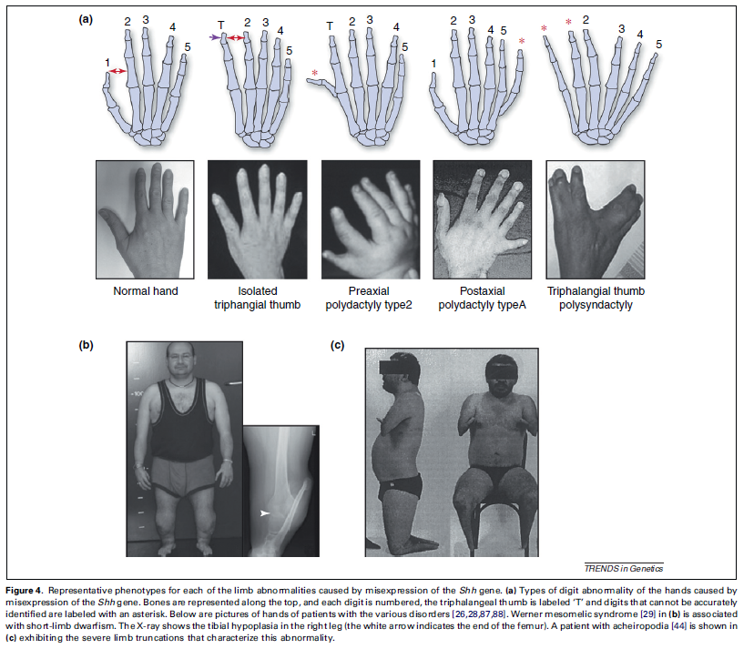
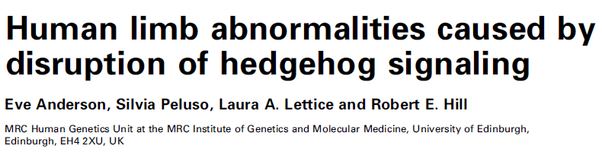
2012

Slide 17
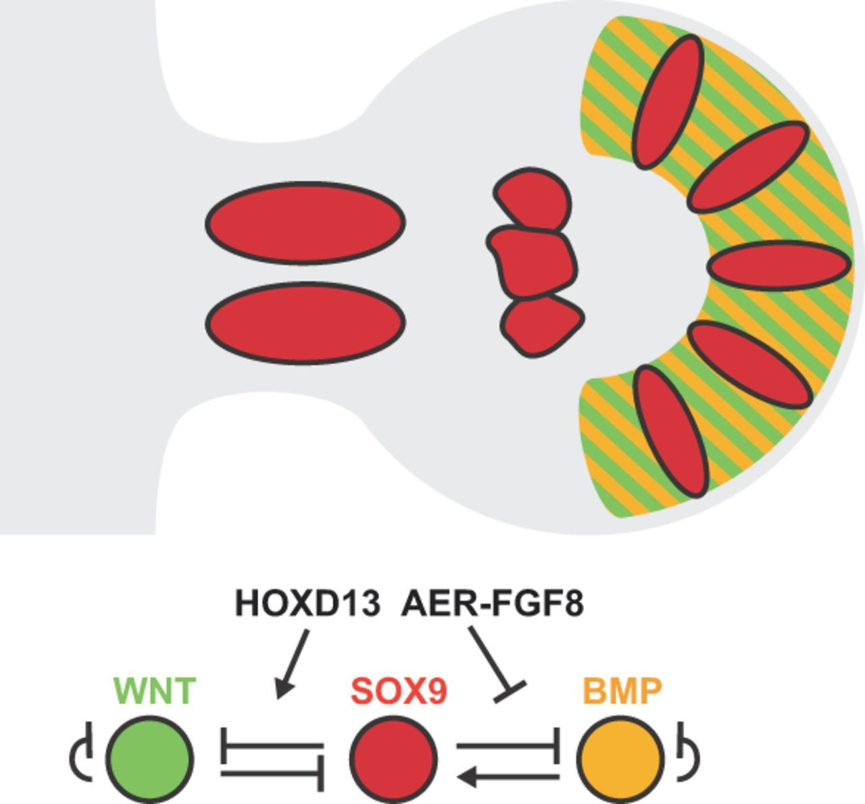

Data-driven simulations of digit patterning.
Aimée Zuniga Development 2015;142:3810-3820
© 2015. Published by The Company of Biologists Ltd
Notes:
Data-driven simulations of digit patterning. During hand plate development, the formation of digit ray primordia involves condensation of SOX9-positive digit progenitors (red), WNT signal transduction in the interdigit mesenchyme (green stripes) and BMP signalling from the interdigit (orange stripes) to the digit progenitors. WNT signal transduction inhibits Sox9 expression in the prospective interdigit mesenchyme, and BMPs are expressed by the interdigit mesenchyme and signal to upregulate the expression of Sox9 specifically in the digit-forming mesenchyme. Simulations of the resulting three-node Turing system can explain the periodic nature of the SOX9-positive digit ray primordia. Simulations and genetic analysis also reveal the important modulatory role of distal HOX transcription factors and AER-FGF signalling.

Slide 18
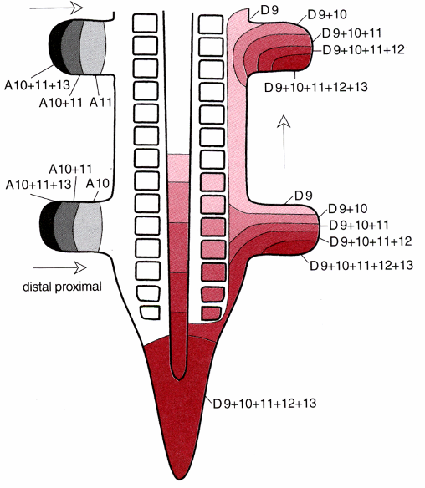
Members of HoxD and HoxA genes patterns the limb bud
Hoxd9-13 seems to control A/P (i.e. finger) identity.
Hoxa9-13 are expressed in a nested proximo-distal pattern.
-i.e. Hoxa9 only in the presumptive upper limb (humerus),
-Hoxa9-11 in the lower limb region (radius, ulna).
-Hoxa9-13 in the upper limb region to give rise to wrist and digits.
Notes:
18

Slide 19
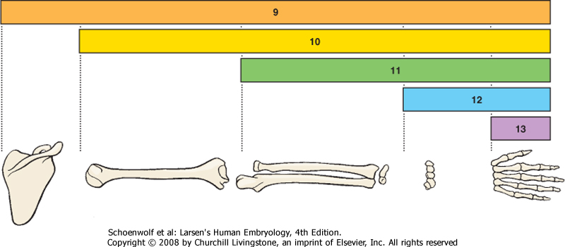
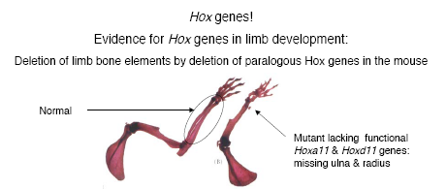

Slide 20
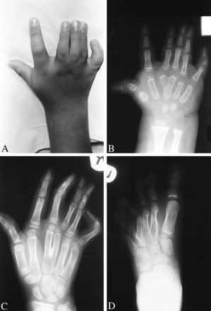
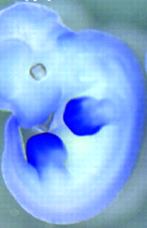
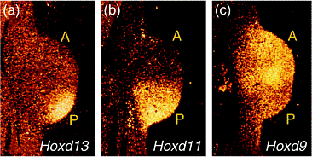
Loss of HoxD13 affects digit patterning (polysyndactyly)

Slide 21
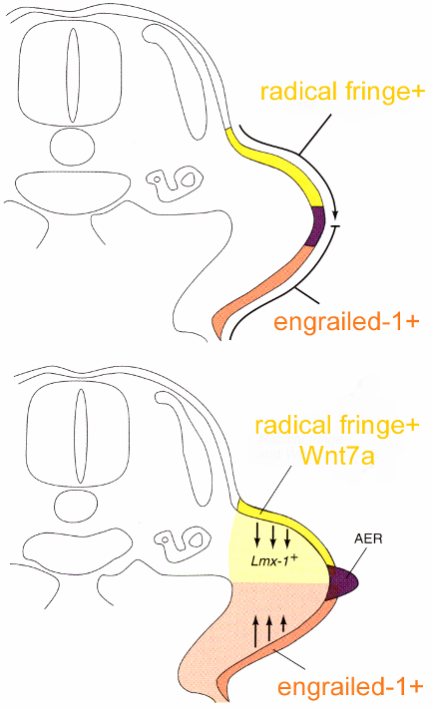
Dorsal-Ventral Axis of Limb is controlled by the ectoderm
Probably induced by presence of a specific paracrine factor (Wnt7a) in the dorsal ectoderm of the limb bud
Dorsal
ventral

Slide 22
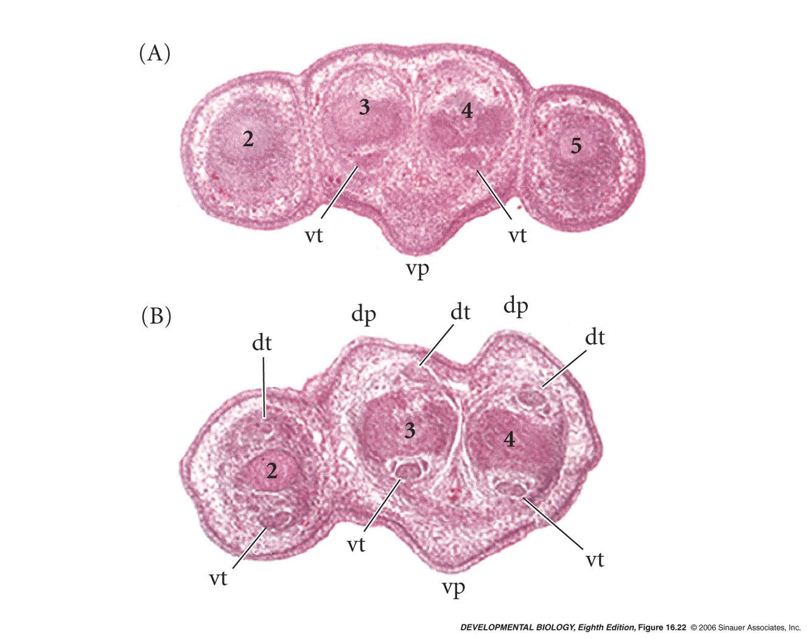
Dorsal-to-ventral transformations of limb regions in mice deficient for both Wnt7a genes
Wnt7a gene is expressed in the dorsal ectoderm of limb buds
Wnt7a-KO mice had ventral food-pads on both side
Notes:
devbio8e-fig-16-22-0.jpg

Slide 23
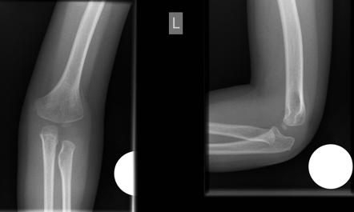
Nail-patella syndrome (LMX-1 mutation)

Slide 24
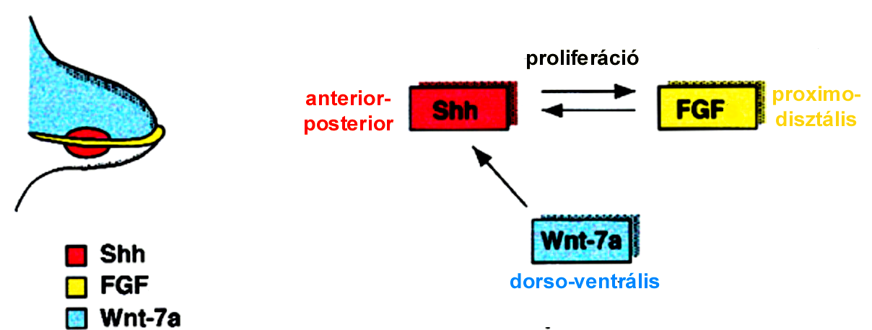
Molecular Interactions by which Limb Bud Formation and Growth are Initiated and Maintained
proliferation
Proximo-
distal
Dorso-ventral
Limb bud is mostly a regulative developmental field but two organizing centres exist.
1) apical ectodermal ridge (AER) at the limb bud tip and
2) zone of polarizing activity (ZPA) at the posterior mesenchyme.

Slide 25
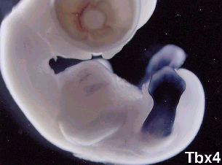
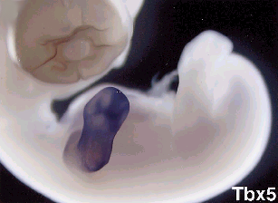
Arms vs. Legs:
Differential Gene Expression
Specification of forelimbs and hindlimbs: Tbx4 and Tbx5
Tbx5 gene in the Forelimbs
Tbx4 gene in the Hindlimbs

Slide 26
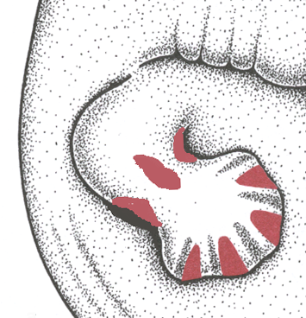
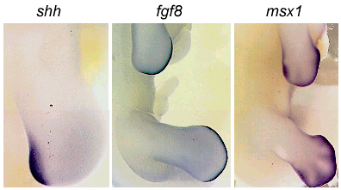
Development of Digits and Joints
Interdigital necrotic zone
Interior necrotic zone
Anterior-posterior necrotic zone
Programmed cell death (apoptosis) is a prominent feature of
limb morphogenesis.
In the forelimb it occurs in area of future axilla, elbow, wrist, and
interdigital areas.
Separation of the digits is the result of programmed cell death.
soft-tissue syndactyly

Slide 27
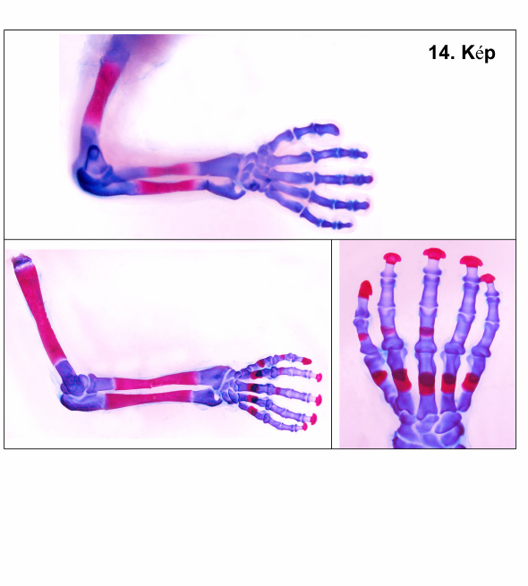
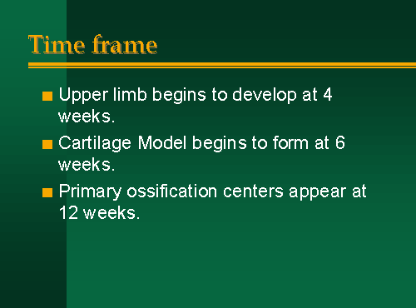
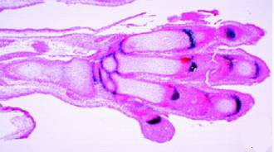
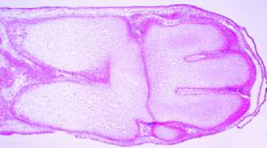
Joint formation

Slide 28
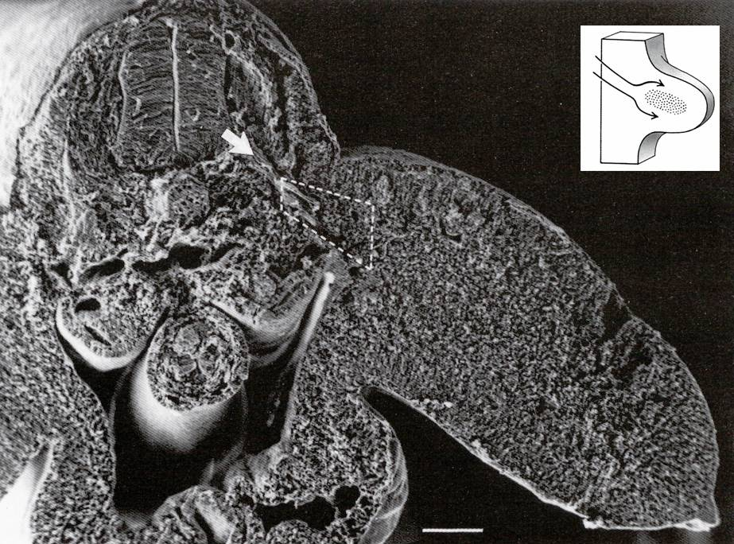
-actin
-GIIF3
-myosin

Slide 29
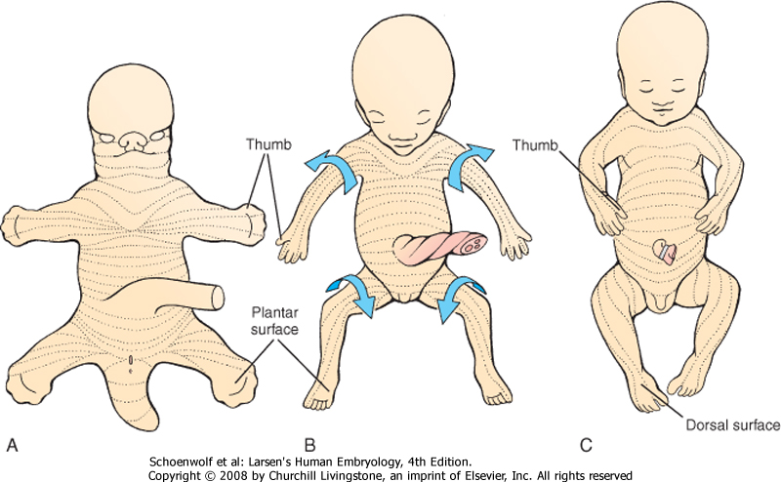
Rotations of the human limb:
The lower limb rotates medially so that the knee points cranially and the original ventral surface of the limb bud becomes the caudal surface of the limb.

