Slide 1
Entwicklung des Mittel- und Hinterdarms, der Leber, und des Pankreas
Dr. Attila Magyar
27.03.2019

Slide 2
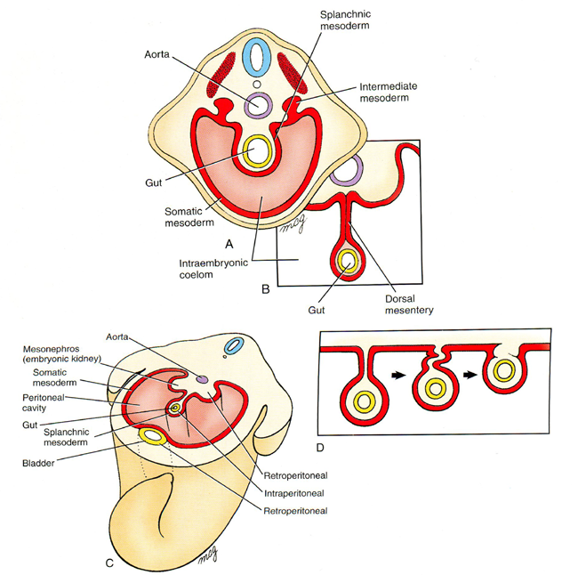
Entwicklung der Mesenterien – bei der Abfaltung des Embryos
Ein intraperitoneales Organ mit einem „Meso” kann sekundär retroperitoneal werden
Notes:
Larsen’s Human Embriology (4E, Schoenwolf, Bleyl, Brauer, Francis-West, Churchill-Livingstone, 2009)

Slide 3
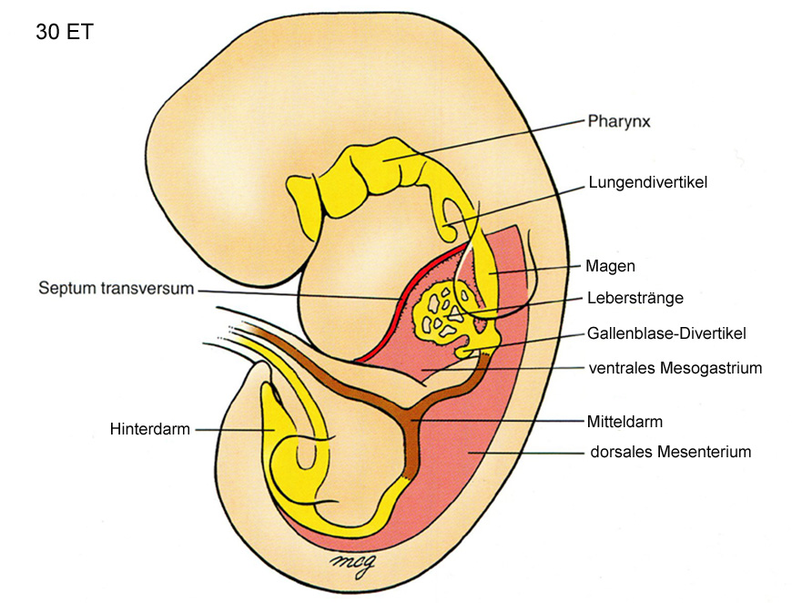
Rosa Gebiete: Meso in abdominalem Magen-Darm Kanal (dorsales Meso: überall, ventrales Meso: nu beim Magen und prox. Duodenum)
Notes:
Larsen’s Human Embriology (4E, Schoenwolf, Bleyl, Brauer, Francis-West, Churchill-Livingstone, 2009)

Slide 4
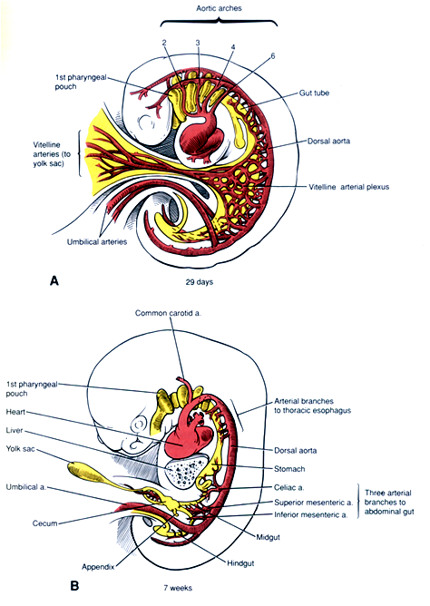
Viele Ästen stammen aus der dorsalen Aorta, die den Dottersack erreichen. Sie bilden einen Geflecht: Plexus vitellinus. Daraus werden später nur drei Hauptstämme zurückgeblieben: Truncus coeliacus, A. mesenterica superior, A. mesenterica inferior und einige Ästen zum Oesophagus.

Slide 5
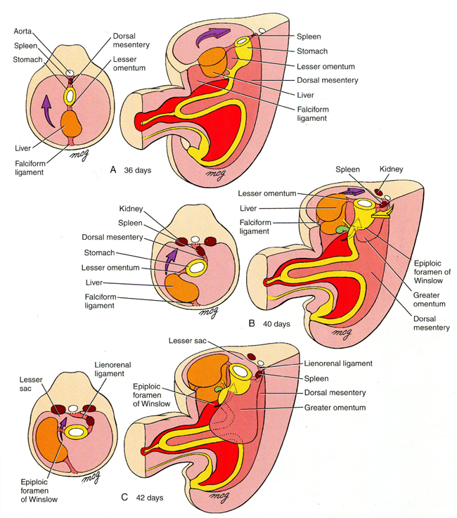
Notes:
Larsen’s Human Embriology (4E, Schoenwolf, Bleyl, Brauer, Francis-West, Churchill-Livingstone, 2009)

Slide 6
Entwicklung der Leber

Slide 7
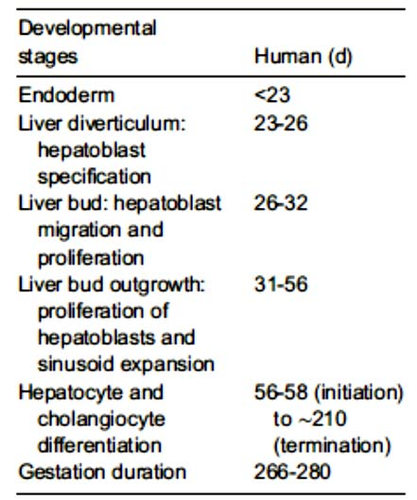

Slide 8
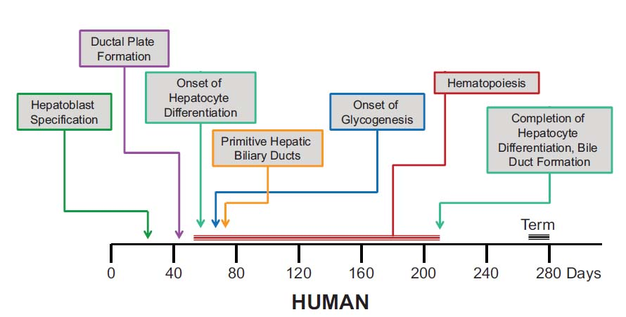
Notes:
Gruppuso J Mol Endocrin 2016

Slide 9
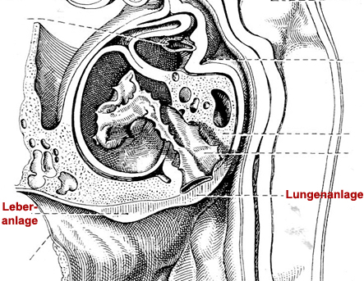
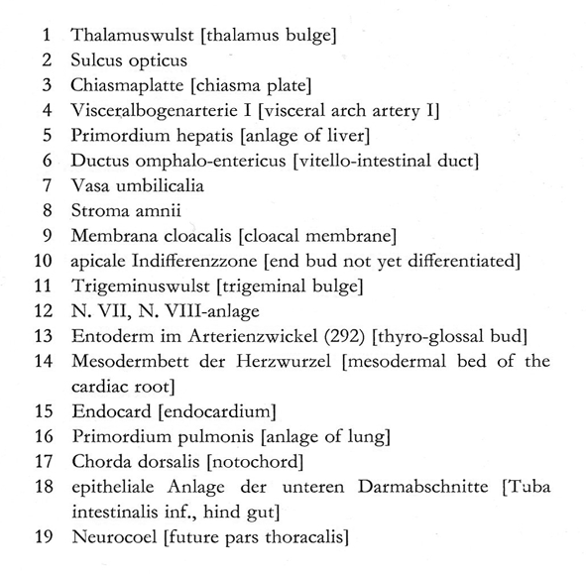
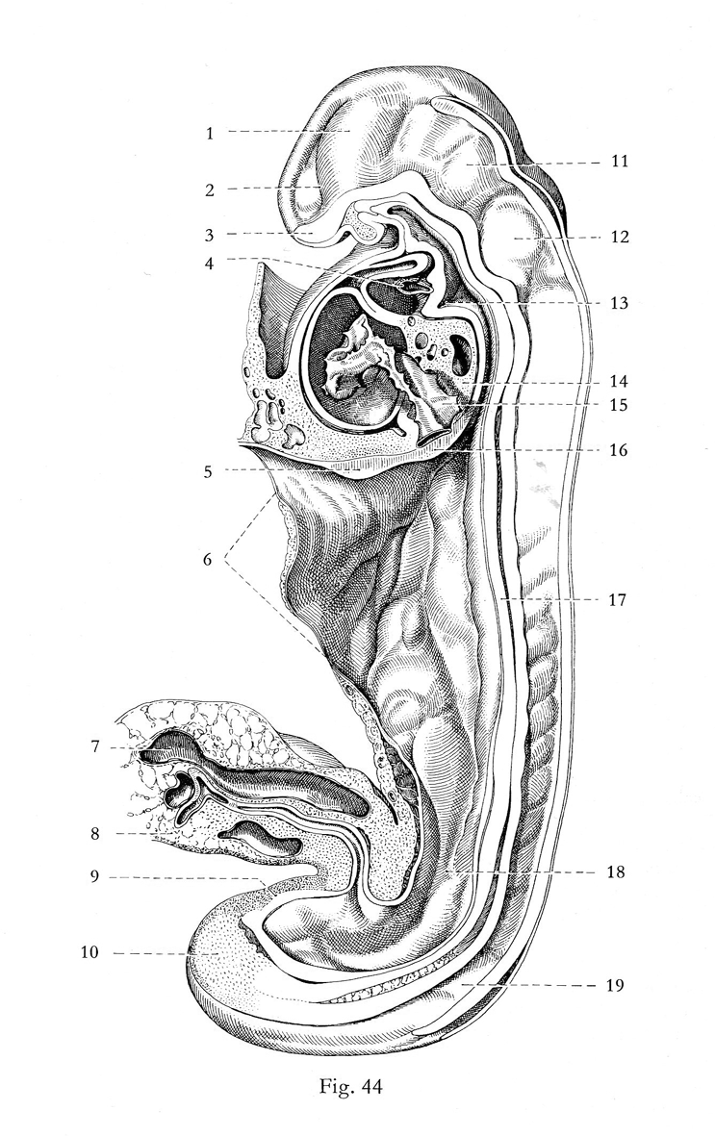
Notes:
E. Blechschmidt The stages of human development before birth, Karger, 1961
p 63.

Slide 10
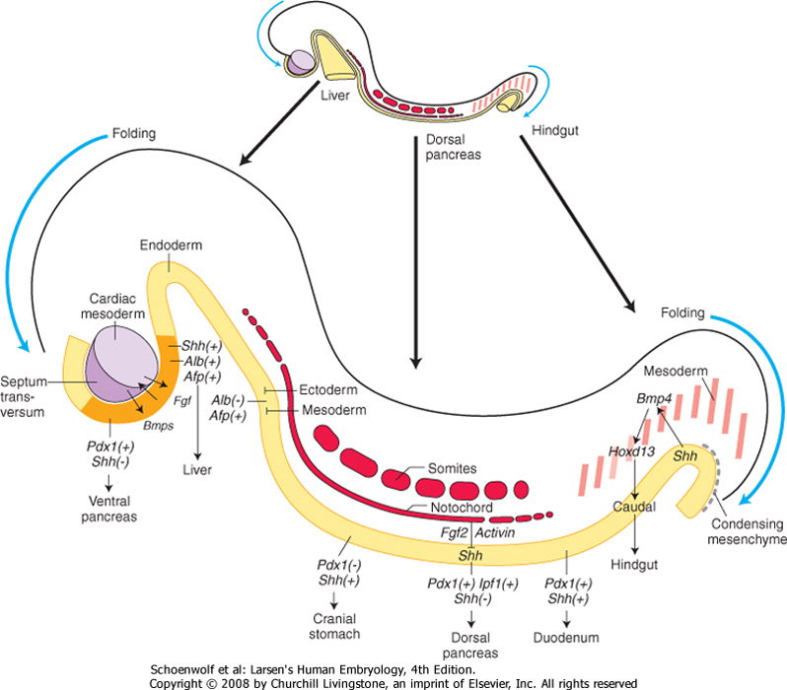

Slide 11
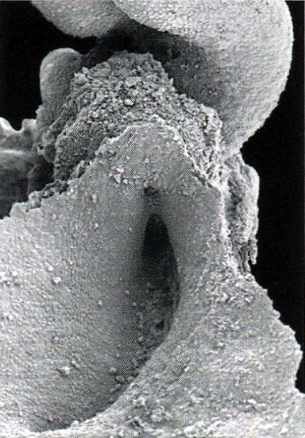
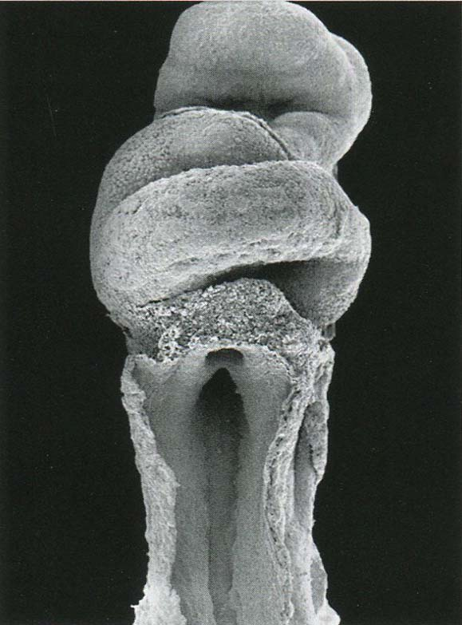
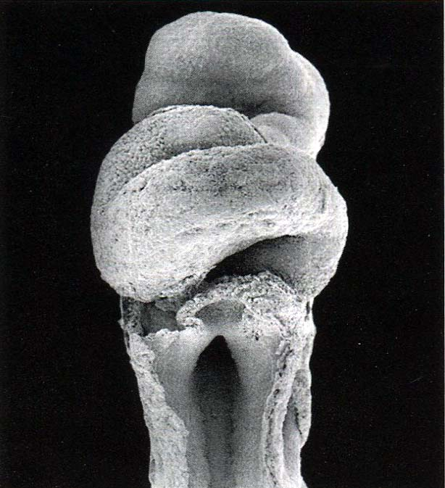
EW4
Notes:
Steding The Anatomy of the human embryo, Karger, 2009

Slide 12
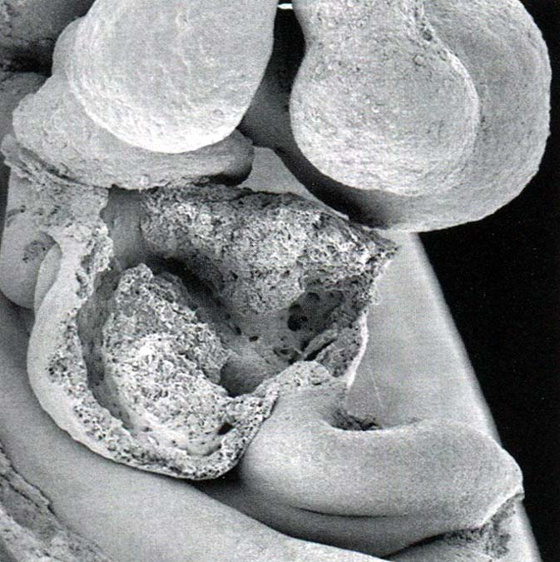
EW6
Notes:
Steding The Anatomy of the human embryo, Karger, 2009

Slide 13
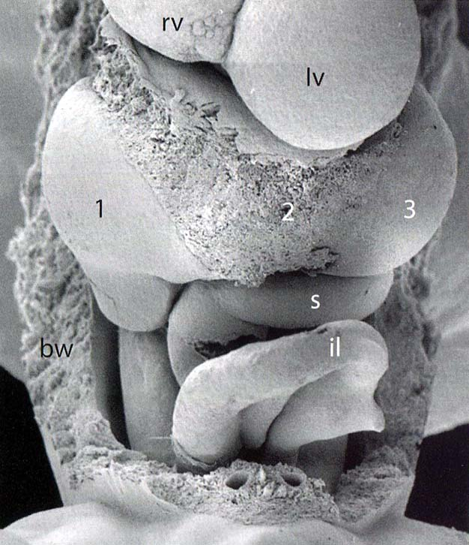
EW7
Notes:
Steding The Anatomy of the human embryo, Karger, 2009

Slide 14
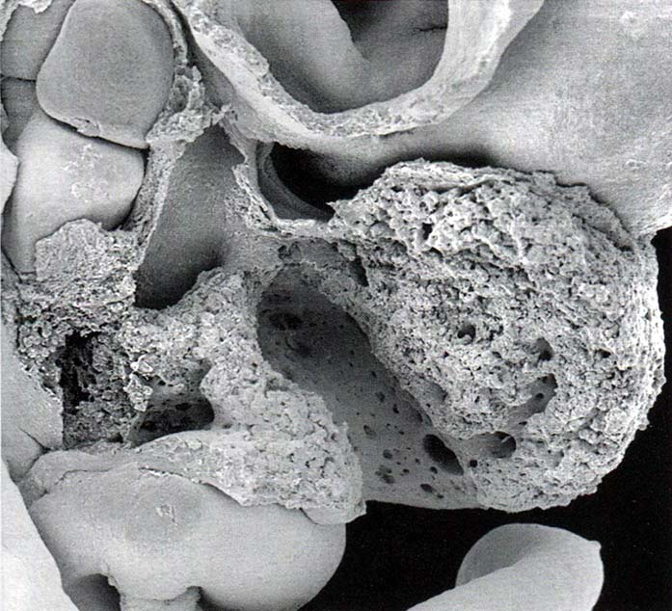
EW7
Notes:
Steding The Anatomy of the human embryo, Karger, 2009

Slide 15
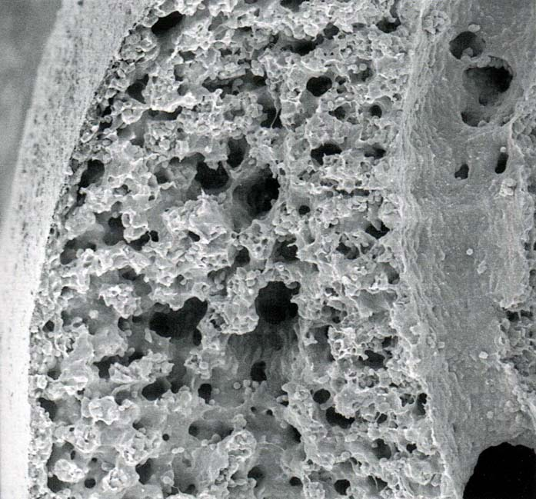
EW7
Notes:
Steding The Anatomy of the human embryo, Karger, 2009
hepatic peritoneum, parenchyma and the right marginal branch of the portal vein

Slide 16
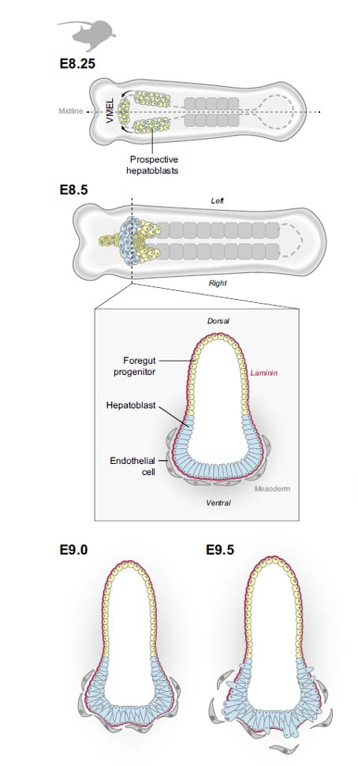
Notes:
Ober J Hepatol 2018

Slide 17
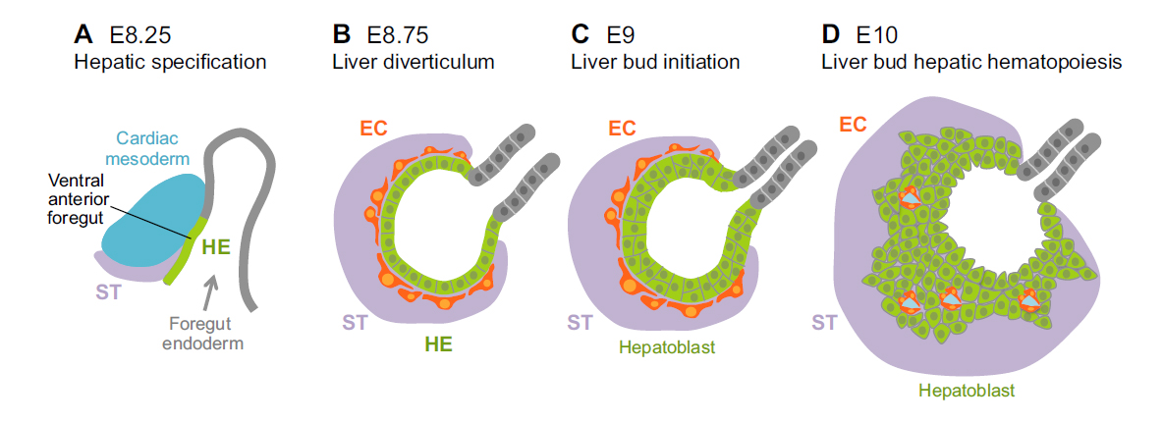
Notes:
Gordillo Development 2015

Slide 18
Querschnitt durch die Leberbucht eines menschlichen Embryo mit 25 Somitenpaaren
Notes:
A. Fischel Lehrbuch der Entwicklung des Menschen, Springer 1929

Slide 19
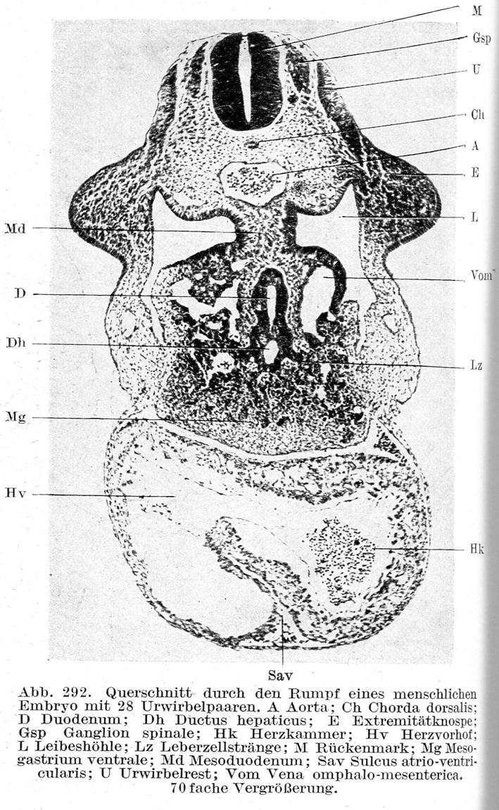
Notes:
A. Fischel Lehrbuch der Entwicklung des Menschen, Springer 1929

Slide 20
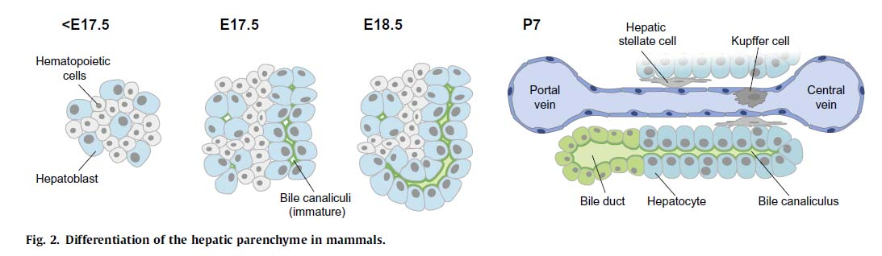
Notes:
Ober J Hepatol 2018

Slide 21
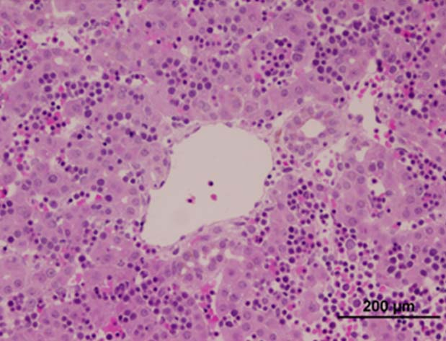
EW11: HE-Färbung
Notes:
Tzur PlosOne 2009

Slide 22
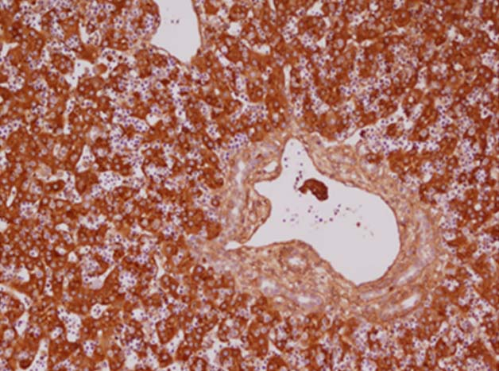
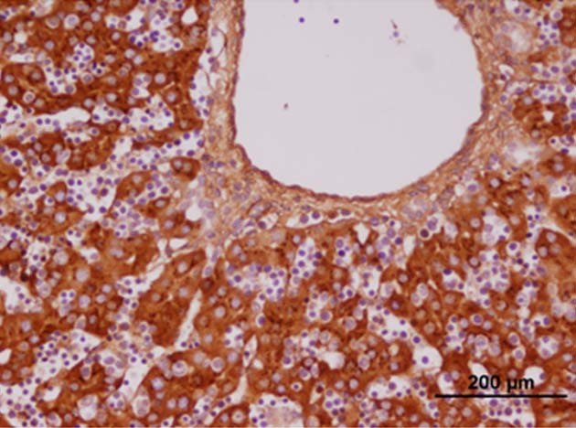
EW11: AFP-Immunohistochemie
Notes:
Tzur PlosOne 2009

Slide 23
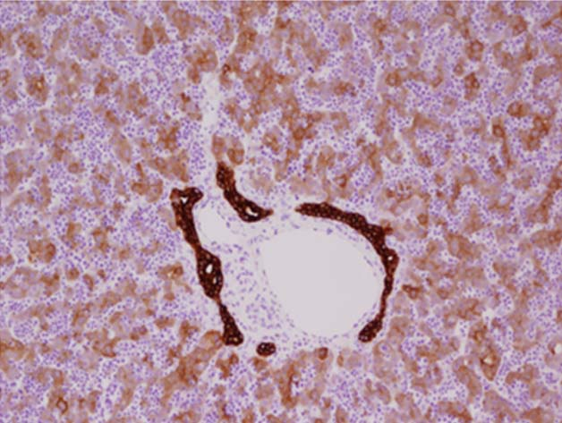
EW11: CK19-Immunohistochemie
Notes:
Tzur PlosOne 2009

Slide 24
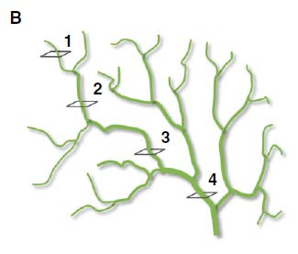
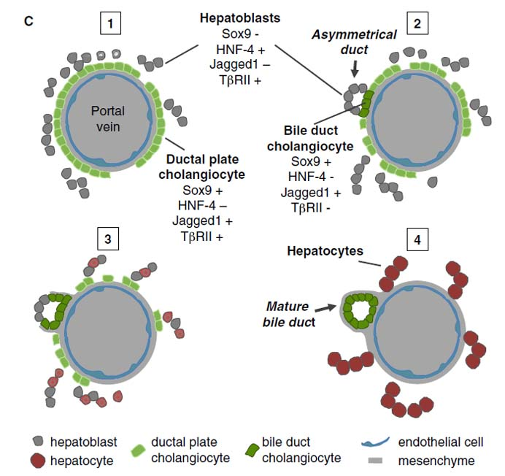
Notes:
Si-Tayeb Dev. Cell 2010
(B and C) Bile duct morphogenesis progresses from the hilum of the liver to the periphery of the lobes. The biliary tree is schematically represented at a stage when ducts have reached maturity near the hilum (section 4), while peripheral structures
still show cholangiocytes forming a single-layered ring of cells (ductal plate; section 1). Two intermediate maturation stages illustrate the progression from asymmetrical to radially symmetrical ducts, as well as markers that characterize the hepatoblasts
and cholangiocytes that line the developing ducts are mentioned (sections 2 and 3). When morphogenesis progresses, the ductal plate areas are not involved in duct formation regress.

Slide 25
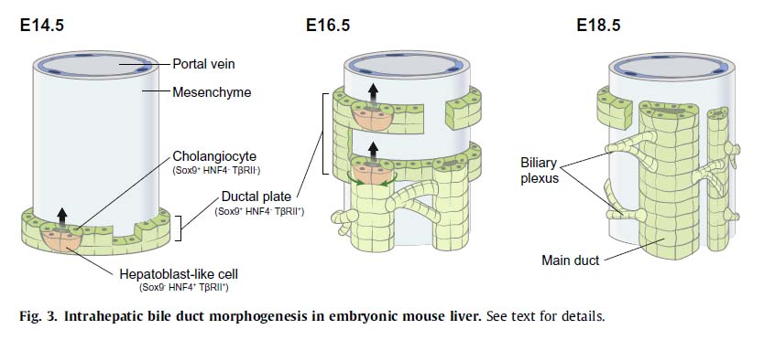
Notes:
Ober J Hepatol 2018

Slide 26
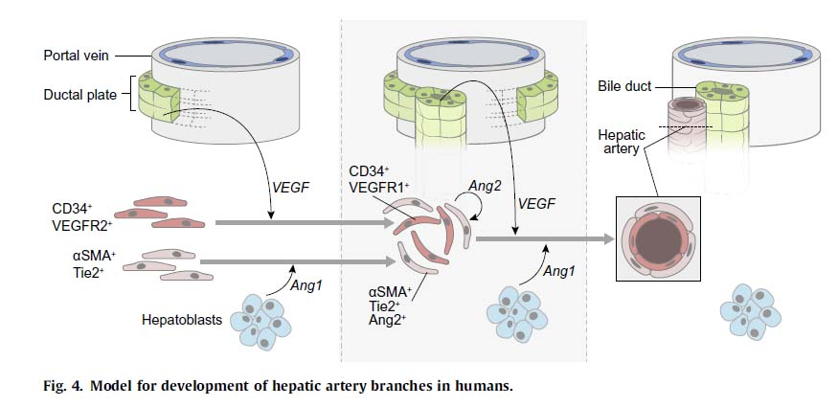
Notes:
Ober J Hepatol 2018

Slide 27
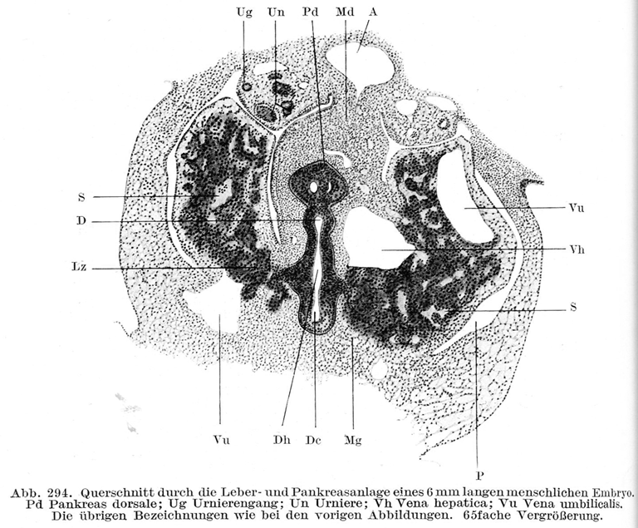
Notes:
A. Fischel Lehrbuch der Entwicklung des Menschen, Springer 1929

Slide 28
Notes:
Larsen’s Human Embriology (4E, Schoenwolf, Bleyl, Brauer, Francis-West, Churchill-Livingstone, 2009)

Slide 29
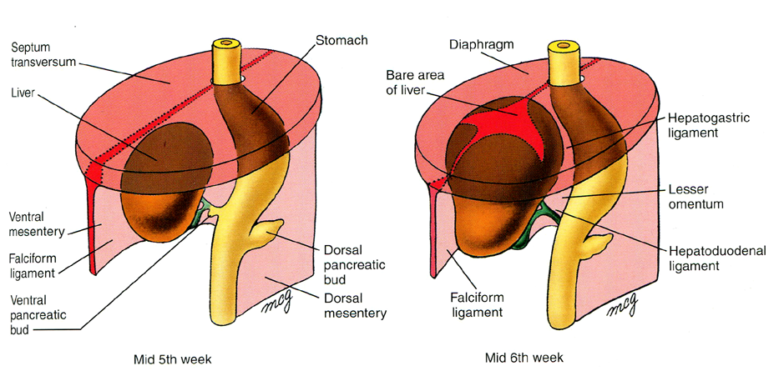

Slide 30
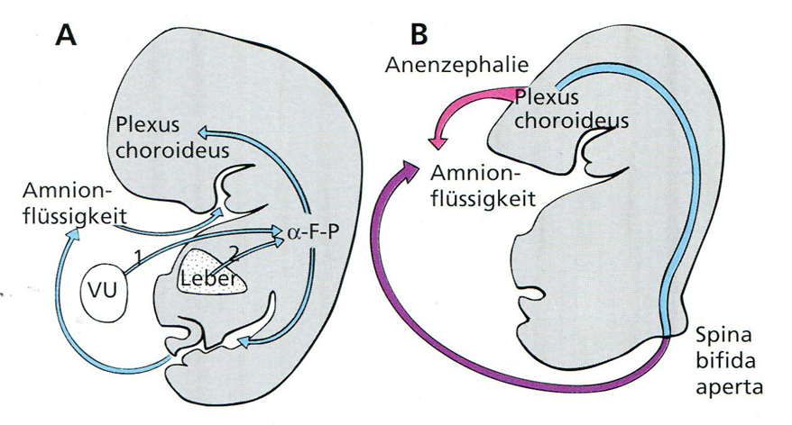
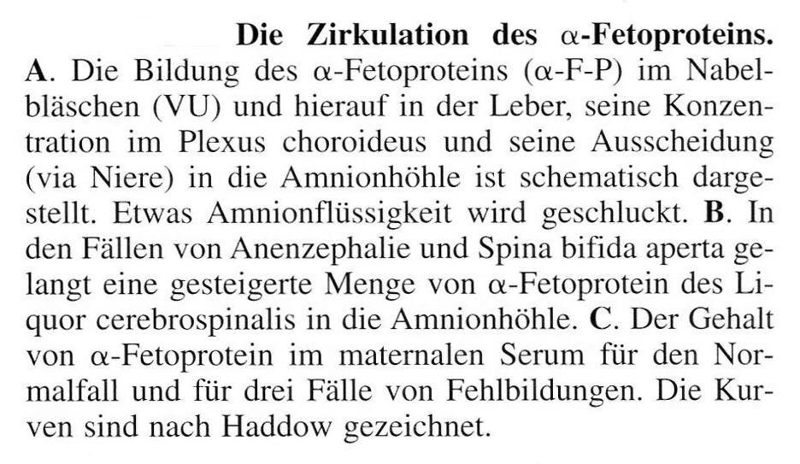
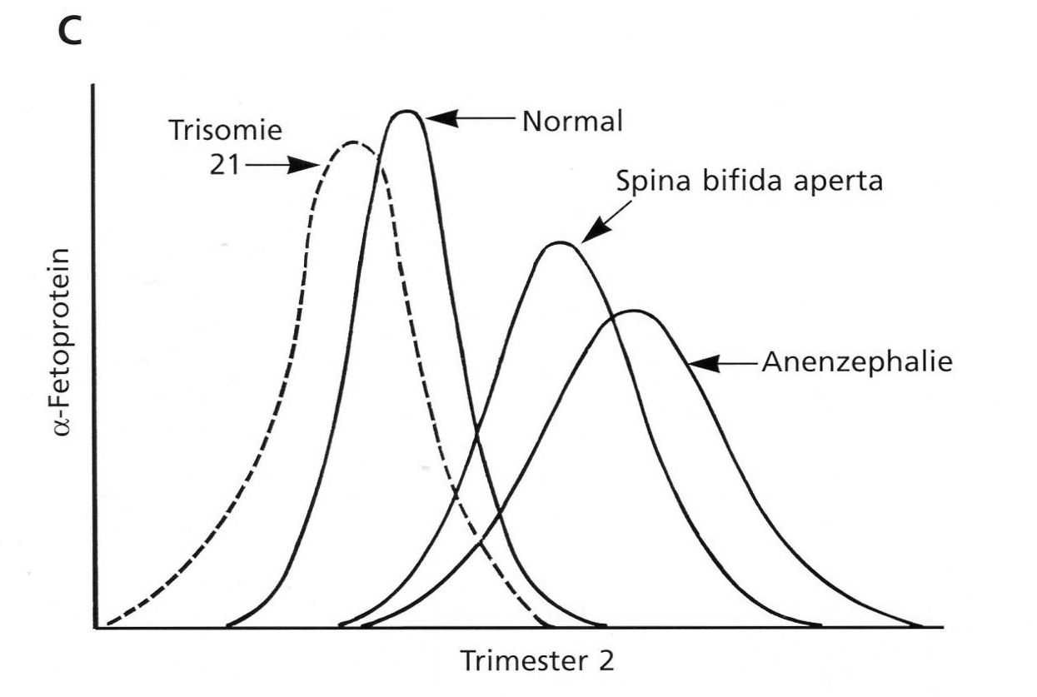
Zirkulation des α-Fetoproteins (AFP)
AFP in dem mütterlichen Serum
Notes:
O’Rahilly&Müller: Embyrologie und Teratologie des Menschen, Huber, 1999
30

Slide 31
Pankreasentwicklung

Slide 32
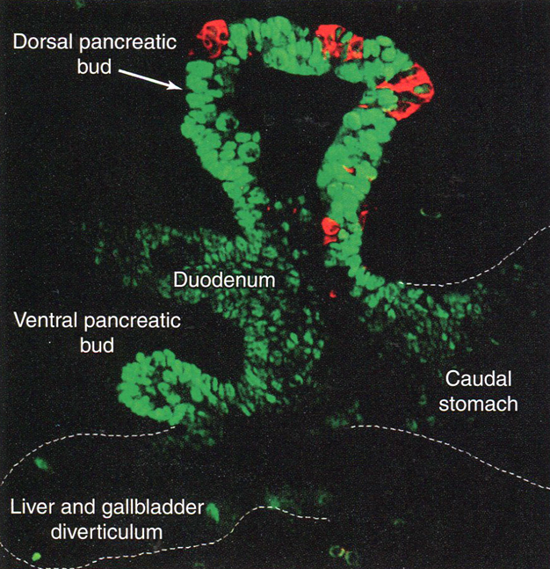
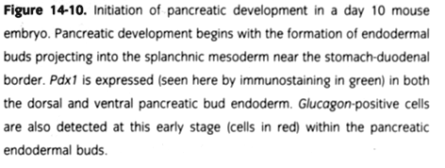
Pdx1
Glukagon
Notes:
Larsen’s Human Embriology (4E, Schoenwolf, Bleyl, Brauer, Francis-West, Churchill-Livingstone, 2009)

Slide 33
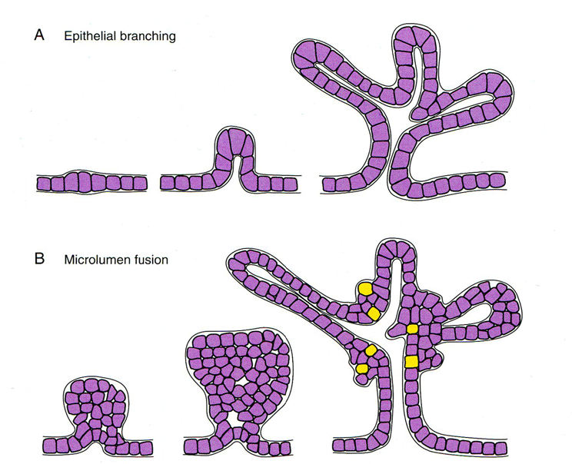

Notes:
Larsen’s Human Embriology (4E, Schoenwolf, Bleyl, Brauer, Francis-West, Churchill-Livingstone, 2009)

Slide 34
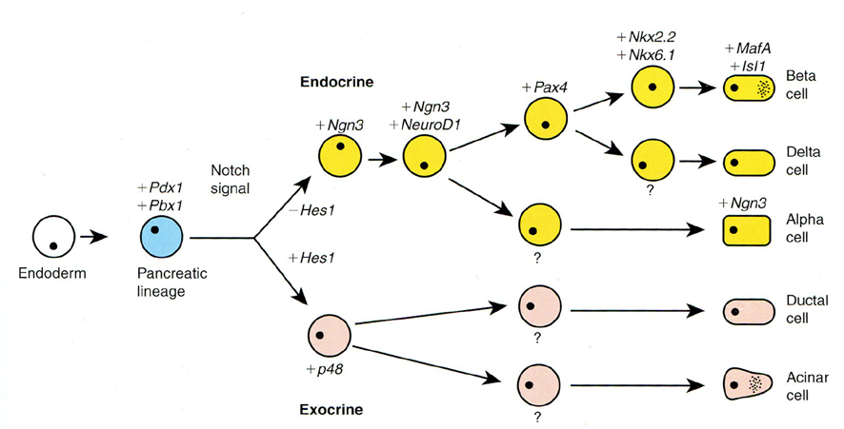
Notes:
Larsen’s Human Embriology (4E, Schoenwolf, Bleyl, Brauer, Francis-West, Churchill-Livingstone, 2009)

Slide 35
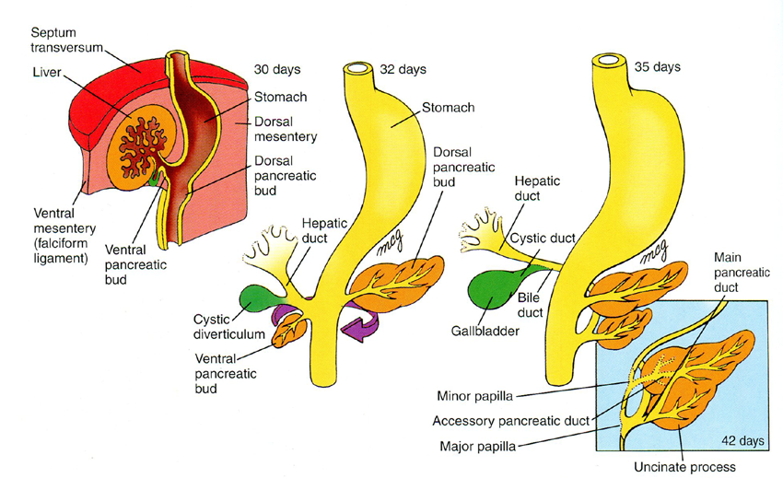
Notes:
Larsen’s Human Embriology (4E, Schoenwolf, Bleyl, Brauer, Francis-West, Churchill-Livingstone, 2009)

Slide 36
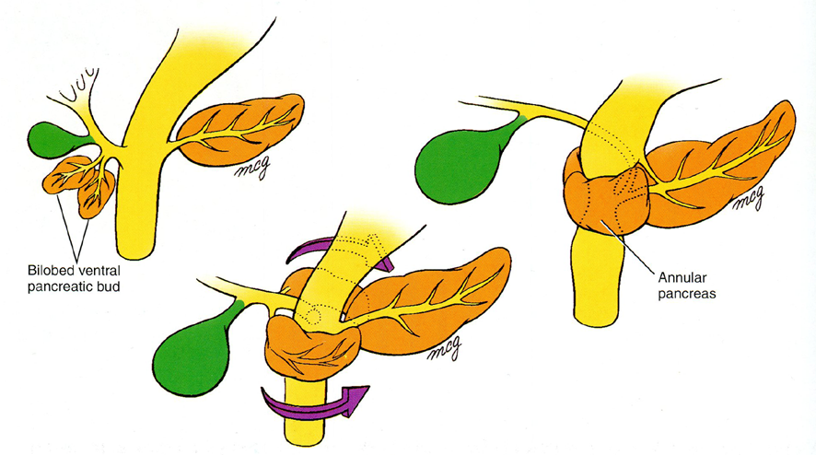
Notes:
Larsen’s Human Embriology (4E, Schoenwolf, Bleyl, Brauer, Francis-West, Churchill-Livingstone, 2009)

Slide 37
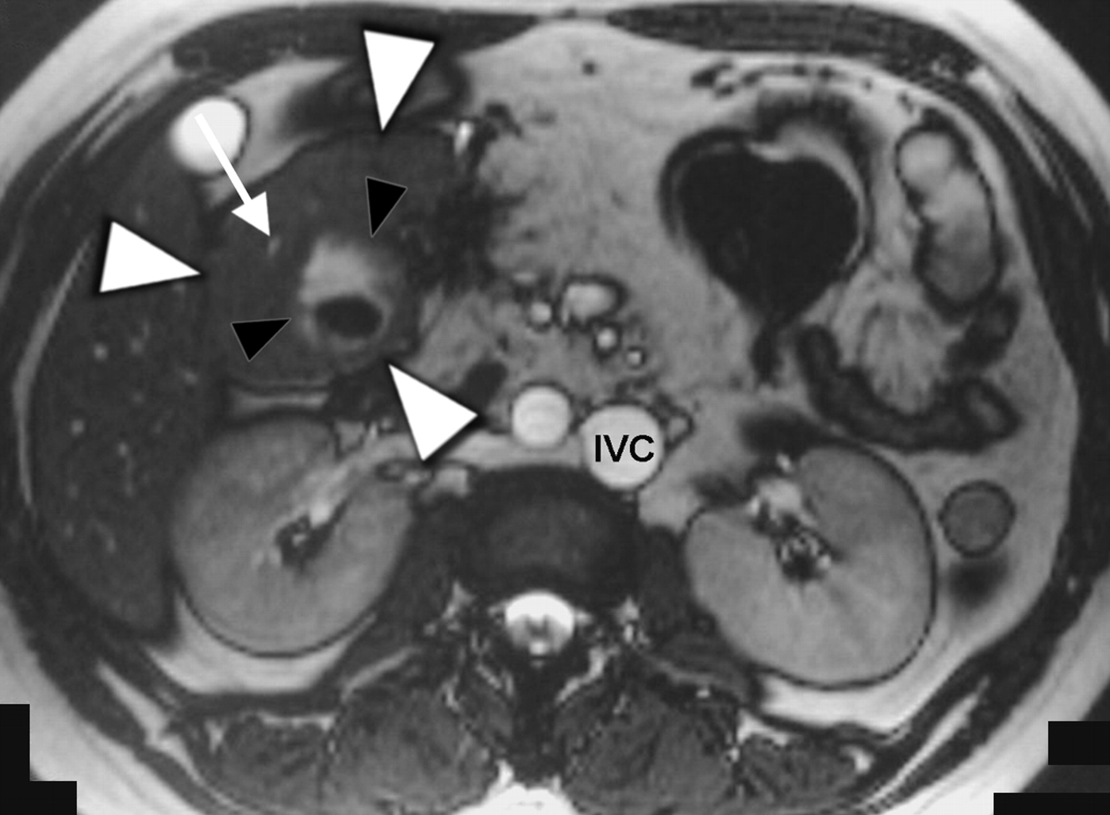

—30-year-old woman with annular pancreas and agenesis of dorsal pancreas associated with polysplenia syndrome.
Maier M et al. AJR 2007;188:W150-W153
©2007 by American Roentgen Ray Society
Notes:
—30-year-old woman with annular pancreas and agenesis of dorsal pancreas associated with polysplenia syndrome. Axial true fast imaging with steady-state free precession (FISP) MR image (TR/TE, 5.5/2.4; field of view, 308 × 380 mm; slice thickness, 5 mm) reveals annular pancreas (white arrowheads) completely encircling descending portion of duodenum (black arrowheads). Note annular pancreatic duct (arrow) and left-sided inferior vena cava (IVC).

Slide 38
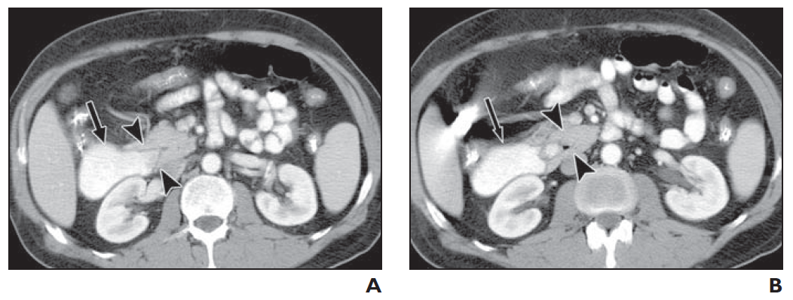
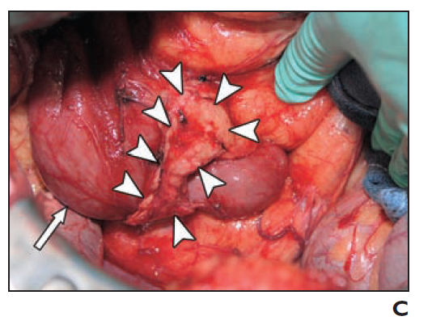

61-year-old man with vomiting and abdominal fullness
A and B, Axial CT images , with A more superior to B, show duodenum (arrow) partially encircled by head of pancreas, which has crocodile jaw appearance (arrowheads).
Diagnosis was radiologically incomplete annular pancreas.
C, Photograph obtained during laparotomy shows annular band (arrowheads) circling distended duodenum (arrow).
Pancreas anulare

Slide 39
Mitteldarm-Entwicklung

Slide 40
Physiologische Herniation des Darmes
(zwischen EW6 und 11)
Notes:
Larsen’s Human Embriology (4E, Schoenwolf, Bleyl, Brauer, Francis-West, Churchill-Livingstone, 2009)

Slide 41
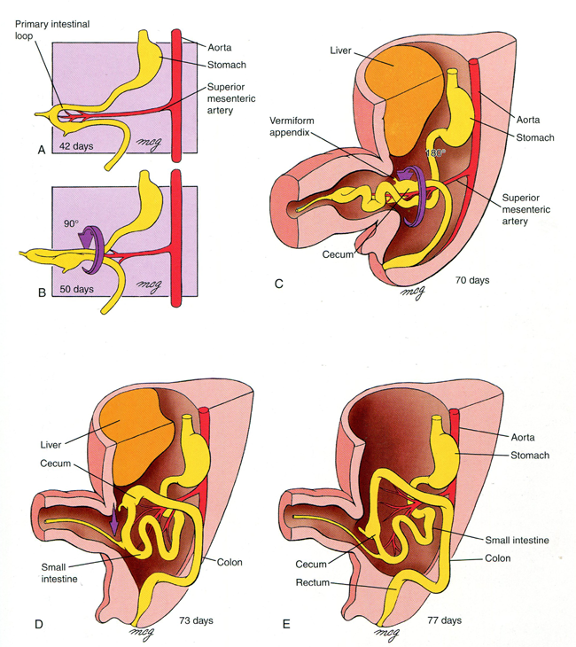
Rotation des Darmes:
270° gegen uhrzeigersinnig

Slide 42
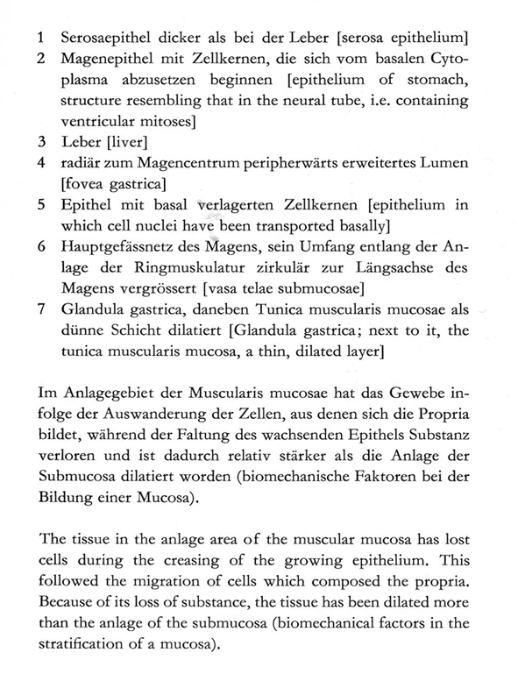
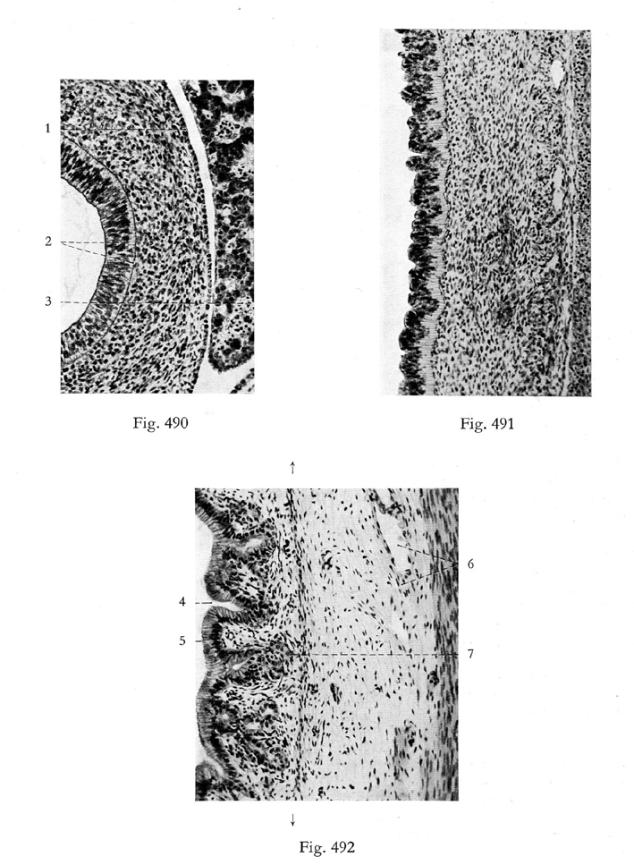
Notes:
E. Blechschmidt The stages of human development before birth, Karger, 1961

Slide 43
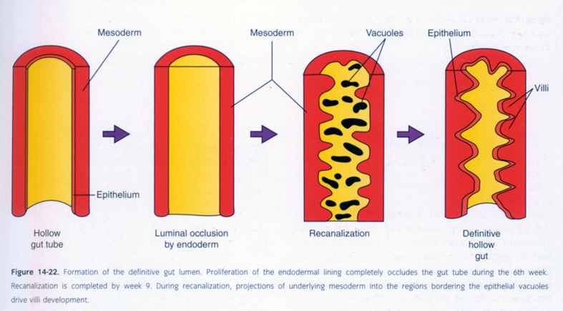

Slide 44
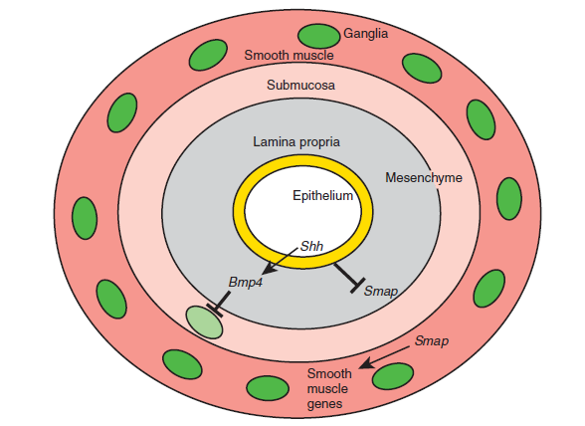
Notes:
Schematic representation of the differentiation of the gut wall along the radial axis. Studies suggest that Shh emanating from the endoderm inhibits the expression of Smap (Smooth muscle activating protein) in the adjacent mesoderm, thereby restricting smooth muscle tunic formation to the outermost radial axis of the gut tube. As a consequence, the mesoderm nearest the endoderm forms lamina propria and submucosa. Bmp4, induced by Shh
within the lamina propria and submucosa, limits enteric neuronal cell differentiation to the outer region of the gut wall.
Larsen’s Human Embriology (4E, Schoenwolf, Bleyl, Brauer, Francis-West, Churchill-Livingstone, 2009)

Slide 45
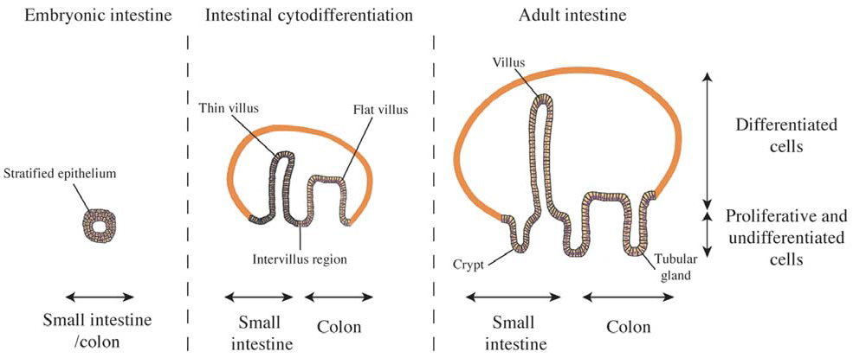
Notes:
de Santa Barbara, CMLS, Cell. Mol. Life Sci. 60 (2003) 1322–1332

Slide 46
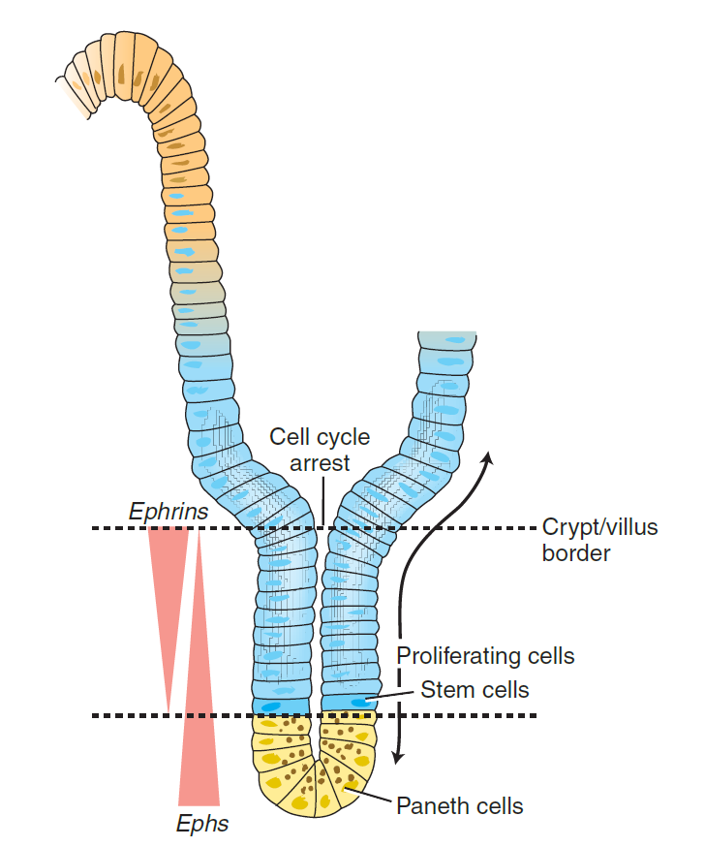
Notes:
Larsen’s Human Embriology (4E, Schoenwolf, Bleyl, Brauer, Francis-West, Churchill-Livingstone, 2009)

Slide 47

Notes:
Cytodifferentiation of the endodermal epithelium of the small intestines. Epithelial cells of the gastrointestinal tract undergo rapid turnover and must be replaced by stem cells. These stem cells produce the progenitors for enterocytes, enteroendocrine cells, Paneth cells, and goblet cells. Enterocytic, goblet, and enteroendocrine cells continue to proliferate, differentiate, and mature while migrating up the villus, where they are shed into the lumen at the tip. Paneth cells reside at the base of the crypt. In the small intestines, the stem cells reside in the region about the 4th cell position from the base of the crypt because Paneth cells occupy the base. Committed progenitor cells differentiate near the crypt/villus border and migrate toward the villus tips (or in the case of Paneth cells toward the bottom of the crypt). Hence, various stages in the life of a gastrointestinal epithelial cell are arranged along the radial (crypt-to-villus) axis of the gut.
Larsen’s Human Embriology (4E, Schoenwolf, Bleyl, Brauer, Francis-West, Churchill-Livingstone, 2009)

Slide 48

Notes:
Sheaffer CHS Lab Press 2012

Slide 49

Az intesztinális (bélhám-) őssejtek genetikai jelölése (ISC: kék színű), és a jelölt HSC-k utódai 60 nap (60d) múlva; egy bélboholy mentén.
Az őssejtek Lgr5⁺-ak (kék szín).
Notes:
Buske, Biochem Soc Transactions 2014

Slide 50
Hinterdarm-Entwicklung

Slide 51


Slide 52


Slide 53



Slide 54

Non-Rotation des Darmes (sog. Linksseitiges Colon)
(Colon, Blinddarm: häufig intraperitoneal)
Reversed (umgekehrte) Rotation des Darmes: fast normale Verhaltnisse, aber Duodenum liegt ventral vor Colon transversum und bleibt intraperitoneal

Slide 55

Mixed (gemischte) Rotation des Darmes: caudales Ende des Duod ist rechts fixiert, Caecum ist um Pylorus geblieben
Volvulus: kann in allen Fallen mit falsch rotierten Darm vorkommen. Häufigst wird das Duod durch ein abnormales meseteriales Band (Ladd’s Band) untergedrückt, Obstruktion, Gallenbrechen

Slide 56

Nonrotation of the gut. Single-contrast barium enema shows that the entire colon lies in the left hemiabdomen. This reflects the premature return of the postarterial limb of the midgut after the first 90 degrees of rotation.
http://imaging.consult.com/

Slide 57

Upper GI contrast study showing a malrotation with lack of normal C-shaped duodenum
and the small bowel "hanging" on the right side of the abdomen.
http://emedicine.medscape.com

Slide 58
Meckel-Divertikel

Slide 59


Slide 60
Levy and Hobbs, RadioGraphics 2004; 24:565–587
Notes:
(b) Image from a small bowel follow-through
study in an 11-year-old girl with abdominal pain and anemia shows an elongated Meckel diverticulum extending
from the antimesenteric border of the distal ileum. The neck of the diverticulum is narrow (arrow). (Fig 9b
courtesy of William M. Thompson, MD, Duke University, Durham, NC.)

Slide 61

Levy and Hobbs, RadioGraphics 2004; 24:565–587
Notes:
(a) Intraoperative photograph of a 19-year-old man who presented with gastrointestinal bleeding shows
the serosal surface of a 4.0 2.5-cm Meckel diverticulum (M) located on the antimesenteric side of the ileum.
(b) Intraoperative photograph of the serosal surface of the distal ileum in a 44-year-old woman with guaiac-positive
stools and anemia shows a 1-cm diverticulum on the antimesenteric border.

Slide 62
The facts about Meckel’s diverticulum can be remembered using the ‘‘rule of twos’’:
it occurs in 2% of the population and is
2 times more common in males;
2% of individuals with Meckel’s diverticulum have medical symptoms, usually by
2 years of age; it is usually present
2 feet proximal to the terminal ileum and is usually
2 inches long; and it contains
2 types of abnormal lining.

Slide 63

Normal small intestinal mucosa and a
focus of gastric mucosa (arrow) line the diverticulum.
Levy and Hobbs, RadioGraphics 2004; 24:565–587
Notes:
Meckel diverticulum. (a) Photomicrograph (original magnification, 16; hematoxylin-eosin [H-E]
stain) shows the diverticulum composed of all layers of the intestinal wall. Normal small intestinal mucosa and a focus of gastric mucosa (arrow) line the diverticulum. (b) Photomicrograph (original magnification, 48; H-E stain)
shows normal small intestinal mucosa with goblet cells along the luminal surface (arrow).

Slide 64
The vitelline duct normally regresses between the 5th and 8th weeks (discussed in Ch. 6), but in about 2% of live-born infants it persists as a remnant of variable length and location (Fig. 14-21). Most often, it is observed as a 1- to 5-cm intestinal diverticulum projecting from the antimesenteric wall of the ileum within 100 cm of the cecum (see Fig. 14-21A). In other cases, part of the vitelline duct within the abdominal wall persists, forming an open omphalomesenteric fistula, an omphalomesenteric cyst (or enterocyst), or an omphalomesenteric ligament (or fibrous band) connecting the small bowel to the umbilicus (see Fig. 14-21B-D). These conditions are known collectively as Meckel’s diverticulum in honor of J.F. Meckel, who first discussed the embryologic basis of the abnormality in the early 19th century. Meckel’s diverticulum is seen in about 2% of the general population and is about twice as common in males as in females.

Slide 65
Most cases of Meckel’s diverticulum are asymptomatic. However, it is estimated that 15% to 35% of individuals who have Meckel’s diverticulum develop symptoms of intestinal obstruction, gastrointestinal bleeding, or peritonitis—many before 10 years of age. Meckel’s diverticulum complications can manifest as a consequence of bowel obstruction caused by the trapping of part of the small bowel by a fibrous band representing a remnant of the vitelline vessels connecting the diverticulum to the umbilicus. Symptoms may closely mimic appendicitis, involving periumbilical pain that later localizes to the right lower quadrant. Up to 60% of Meckel’s diverticula harbor abnormal tissue, usually pancreatic or gastric. In the latter case, patients may develop bleeding ulceration of the gut. Mortality in untreated cases is estimated to be 2.5% to 15%.

Slide 66
Hirschsprung-Krankheit
Häufigste Mutationen des Menschen bei der HK:
RET (Rezeptor für Liganden der GDNF-Familie)
Endothelin3 oder sein Rezeptor
beide Rezeptor-Ligand Paaren sind für die Entwicklung der Neuralleiste-Zellen nötig.

Slide 67
Notes:
Schematic representation of the differentiation of the gut wall along the radial axis. Studies suggest that Shh emanating from the endoderm inhibits the expression of Smap (Smooth muscle activating protein) in the adjacent mesoderm, thereby restricting smooth muscle tunic formation to the outermost radial axis of the gut tube. As a consequence, the mesoderm nearest the endoderm forms lamina propria and submucosa. Bmp4, induced by Shh
within the lamina propria and submucosa, limits enteric neuronal cell differentiation to the outer region of the gut wall.
Larsen’s Human Embriology (4E, Schoenwolf, Bleyl, Brauer, Francis-West, Churchill-Livingstone, 2009)

Slide 68
Notes:
The origin of neural crest cells forming the enteric nervous system in the chick embryo. Postganglionic sympathetic fibers innervating the enteric nervous system are derived from neurons located within the sympathetic chain. These neurons and glia originate from neural crest cells arising from the dorsal neural tube at axial levels beginning at somite level 5 and extending into the sacrum (hatched). The origin of neural crest cells forming the suprarenal
medulla are shown in purple. Vagal postganglionic neurons and glia are derived from neural crest cells arising at somite levels 1 to 7 (tan, no stippling), whereas sacral enteric ganglionic neurons and glia arise from neural crest cells caudal to somite pair 28 in chickens (tan, stippled).
Larsen’s Human Embriology (4E, Schoenwolf, Bleyl, Brauer, Francis-West, Churchill-Livingstone, 2009)

Slide 69

Radiograph after a barium enema showing the constricted inferior gastrointestinal tract of an individual with Hirschsprung disease. The adjacent, more proximal, region of the tract with normal autonomic innervation is distended.

Slide 70

Mütter Museum in Philadelphia (13 kg)

