Slide 1
Anatomie der Herzentwicklung: ein Training
Attila Magyar
19.03.2019

Slide 2
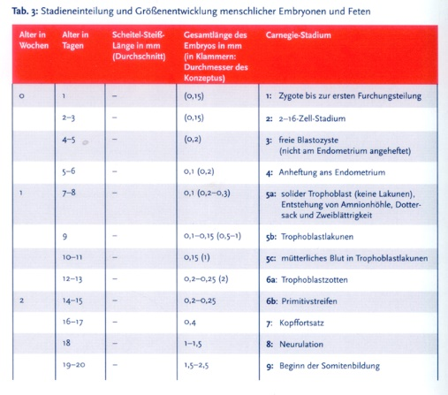
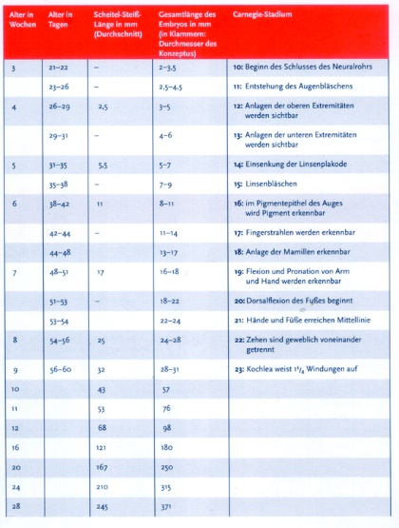
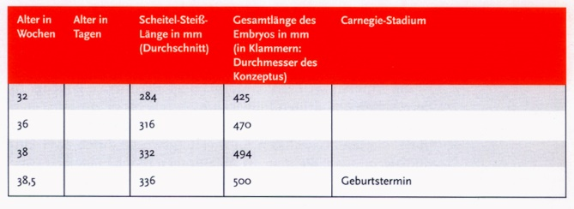

Slide 3
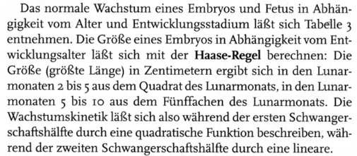

Slide 4
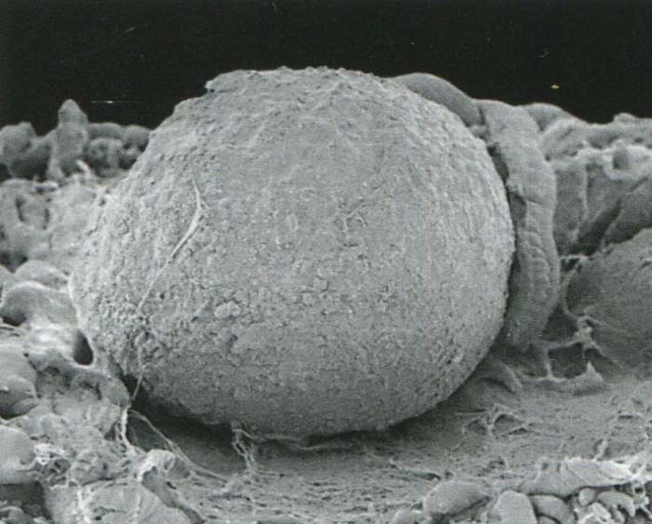
Anfang EW4
3-5 mm
Notes:
Steding The anatomy of the human embryo Karger 2009

Slide 5
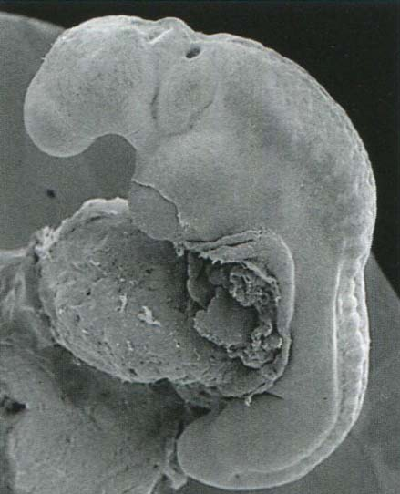
Anfang EW4
3-5 mm
Notes:
Steding The anatomy of the human embryo Karger 2009

Slide 6
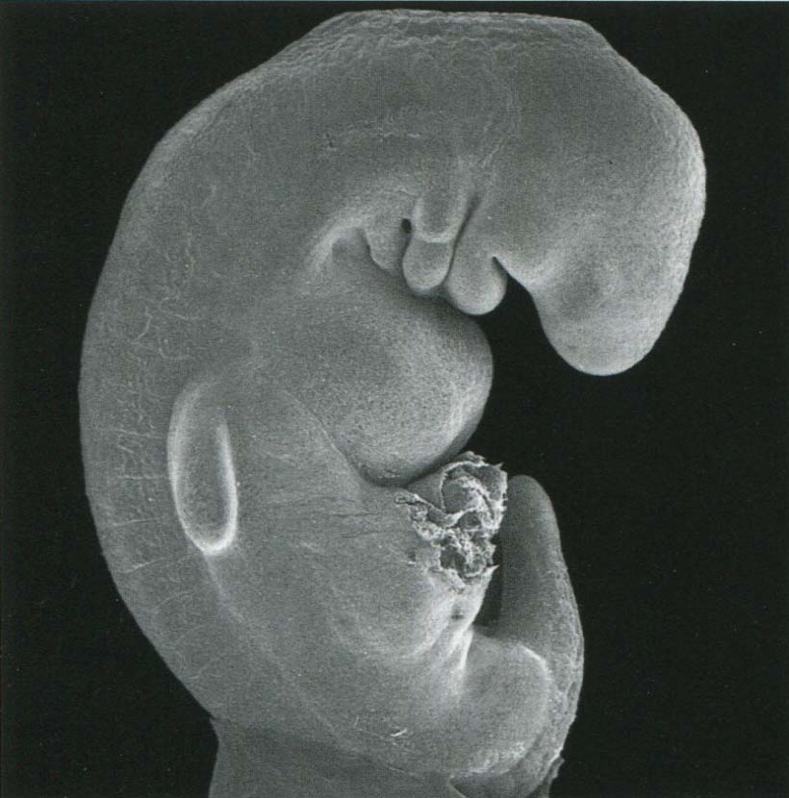
EW5
5-7 mm
Notes:
Steding The anatomy of the human embryo Karger 2009

Slide 7
Rautenhirn (Rh)
Mittelhirn (M)
Zwischenhirn (Di)
Endhirn (Tel)
Zunge
Strirnwulst
Herz
Somiten
Mundhöhle
Notes:
O’Rahilly & Müller, Embryologie und Teratologie des Menschens 1999

Slide 8
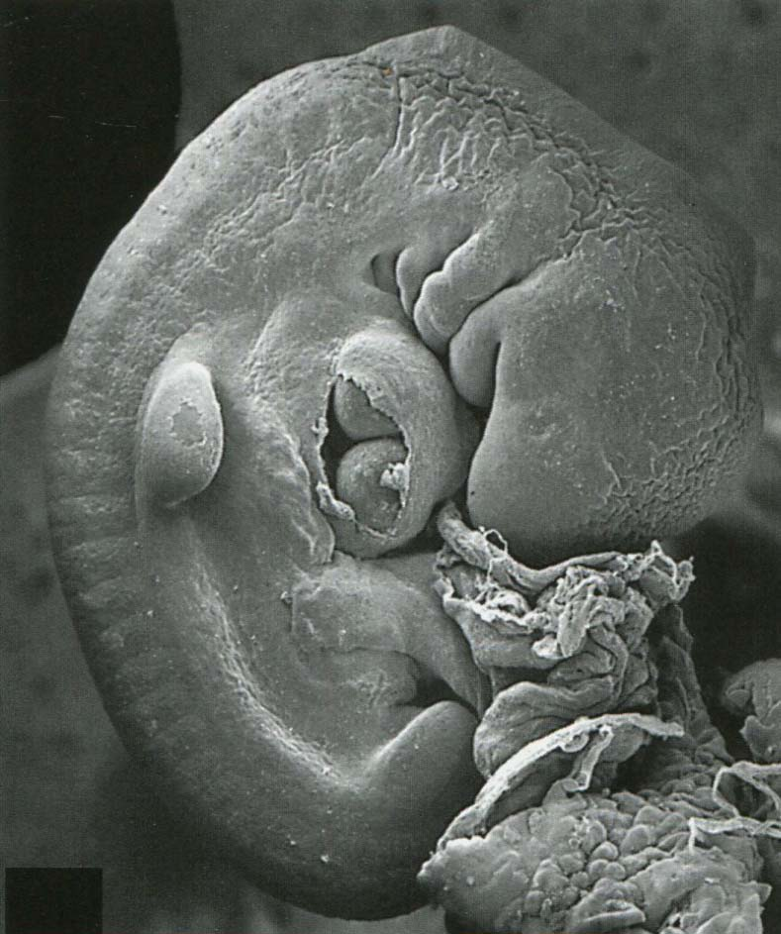
EW5
5-7 mm
Notes:
Steding The anatomy of the human embryo Karger 2009

Slide 9
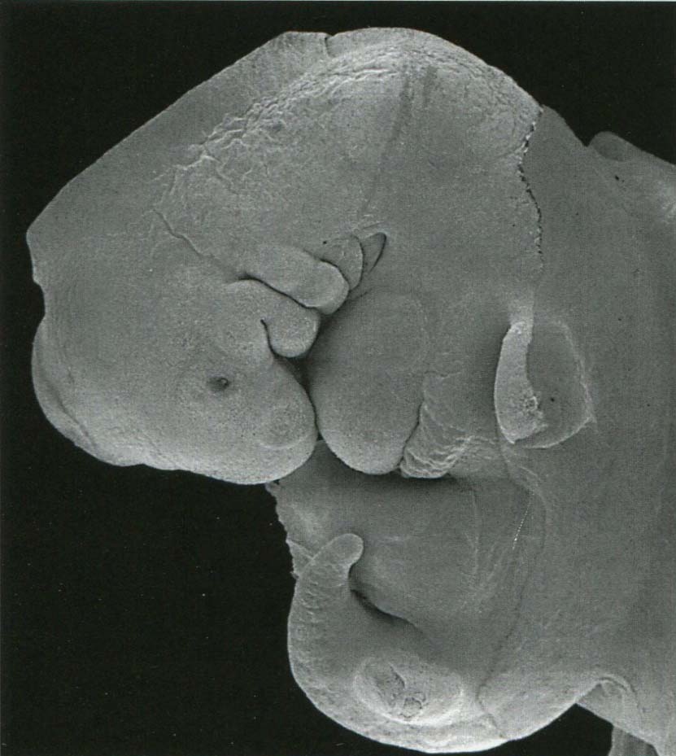
EW5
5-7 mm
Notes:
Steding The anatomy of the human embryo Karger 2009
balra: mounting medium
sinus cervicalis

Slide 10
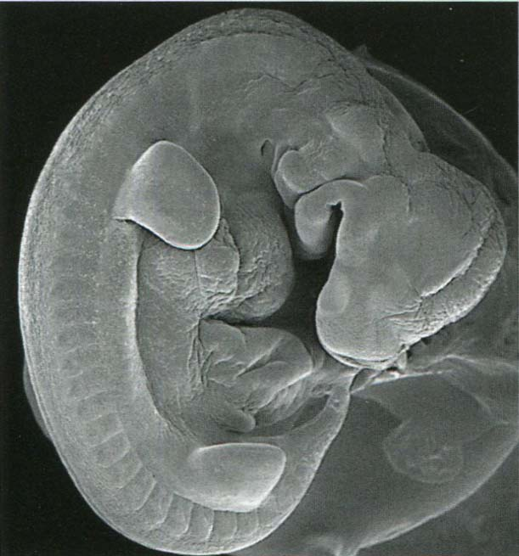
Ende der EW5
5-7 mm
Notes:
Steding The anatomy of the human embryo Karger 2009
liver bulge

Slide 11
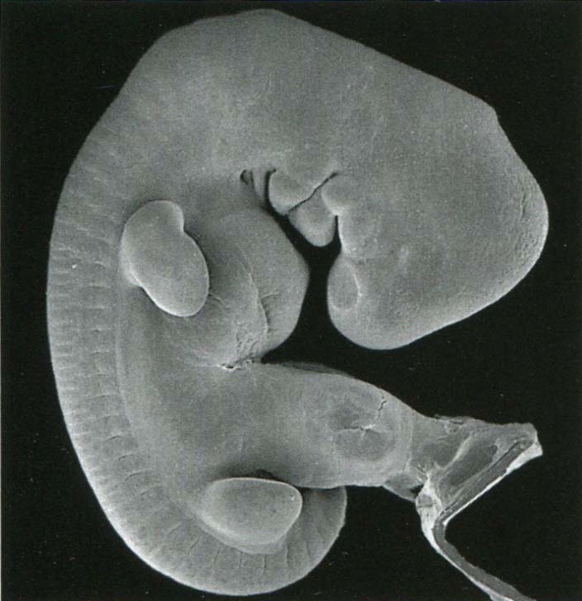
EW6
8-18 mm
Notes:
Steding The anatomy of the human embryo Karger 2009
liver bulge

Slide 12
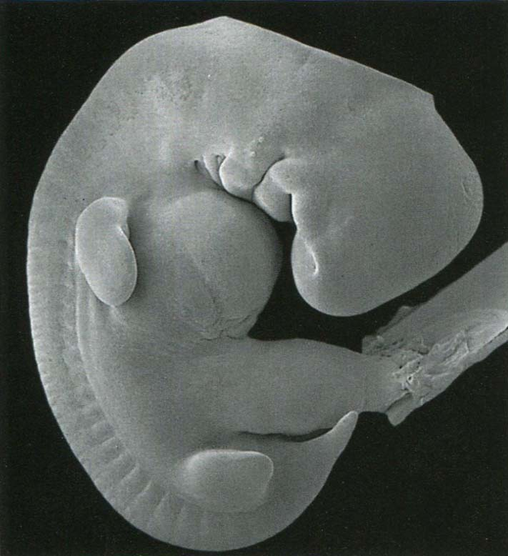
EW6
8-18 mm
Notes:
Steding The anatomy of the human embryo Karger 2009

Slide 13
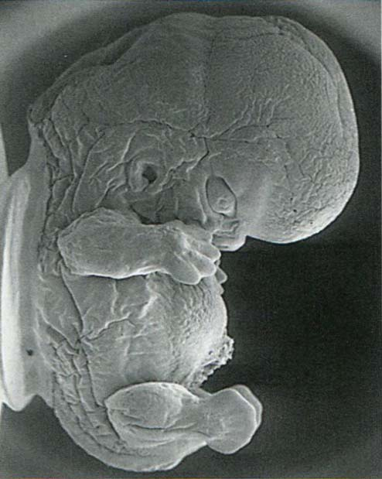
EW8
24-28 mm
Notes:
Steding The anatomy of the human embryo Karger 2009

Slide 14
Herzentwicklunmg

Slide 15
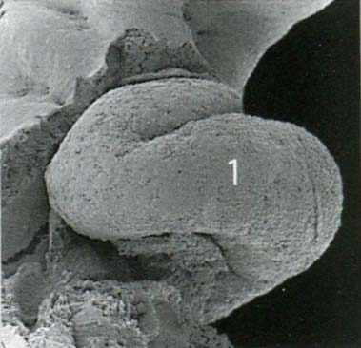
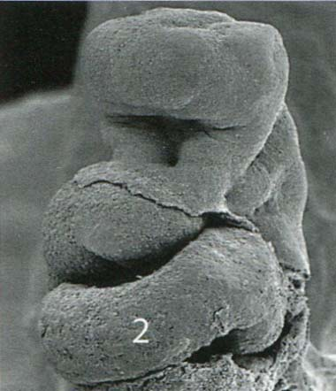
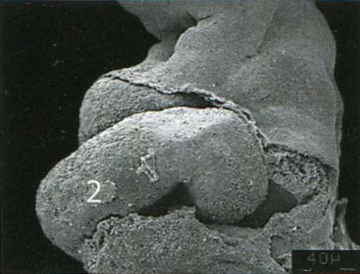
EW4
R
V
L
Notes:
Steding The anatomy of the human embryo Karger 2009

Slide 16
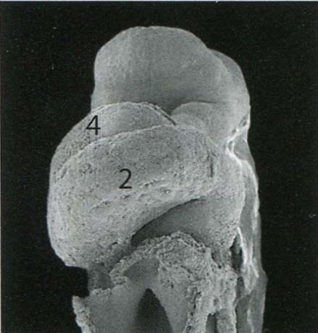
EW4
Notes:
Steding The anatomy of the human embryo Karger 2009

Slide 17
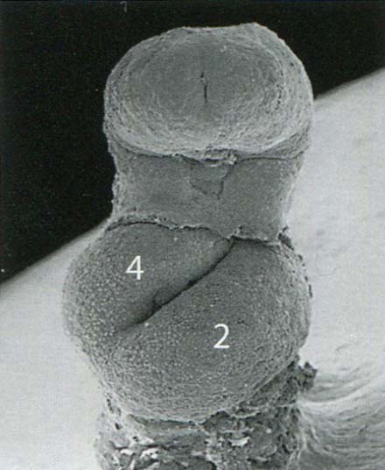
EW4
Notes:
Steding The anatomy of the human embryo Karger 2009

Slide 18
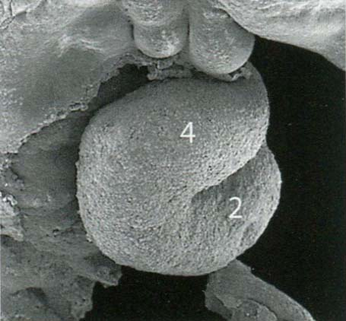
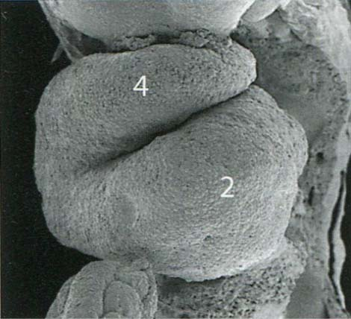
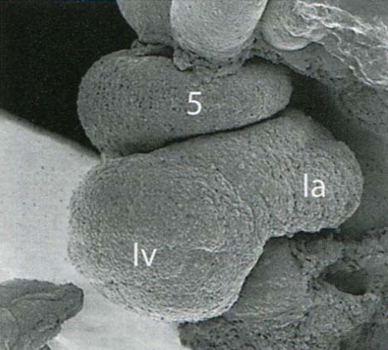
EW4
R
V
L
Notes:
Steding The anatomy of the human embryo Karger 2009
4: conus
5: truncus

Slide 19
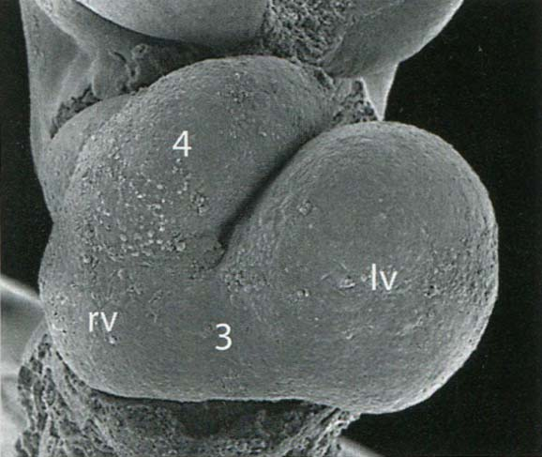
EW5
Notes:
Steding The anatomy of the human embryo Karger 2009

Slide 20
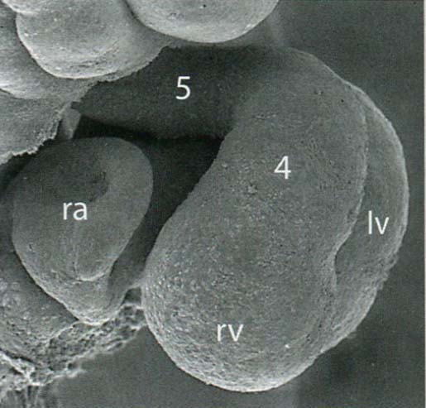
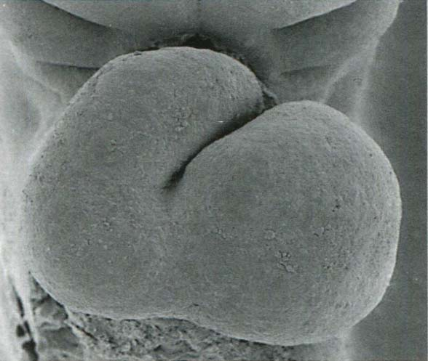
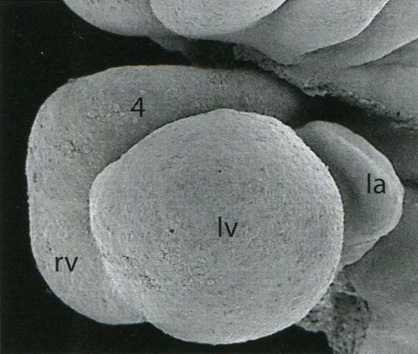
EW5
R
V
L
Notes:
Steding The anatomy of the human embryo Karger 2009

Slide 21
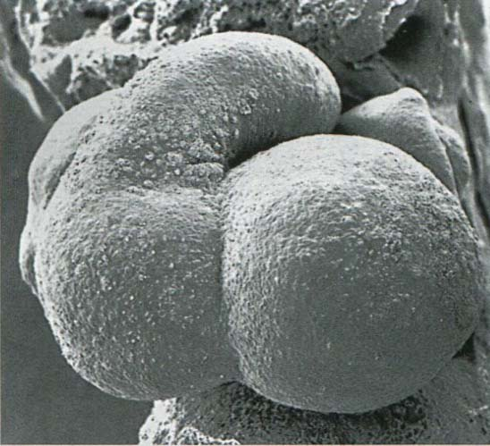
EW5
Notes:
Steding The anatomy of the human embryo Karger 2009

Slide 22
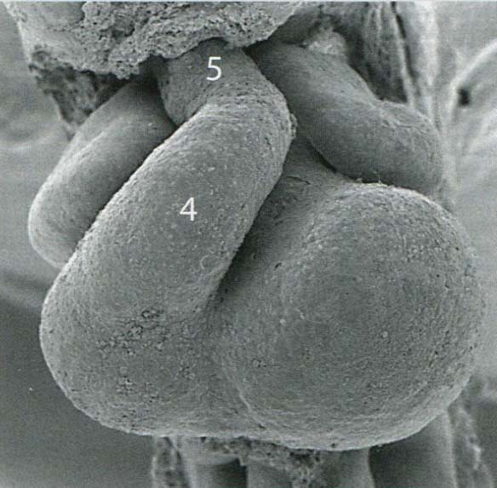
EW5
Notes:
Steding The anatomy of the human embryo Karger 2009

Slide 23
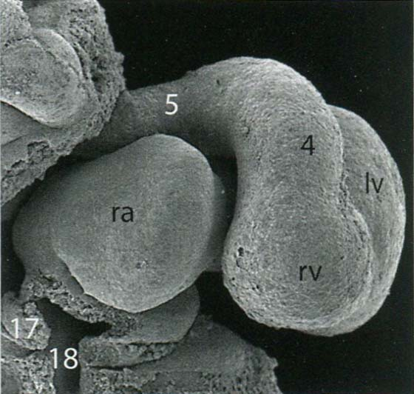
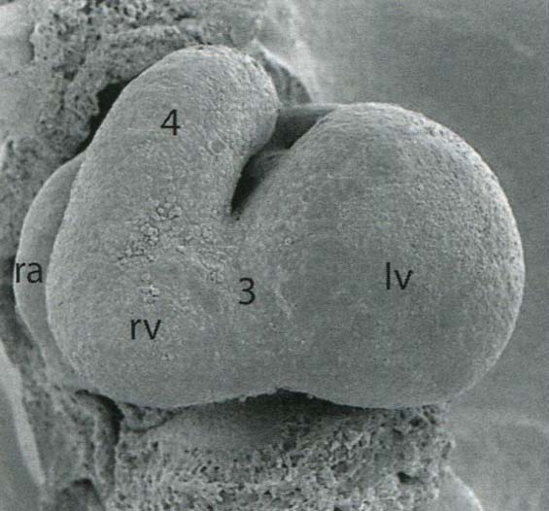
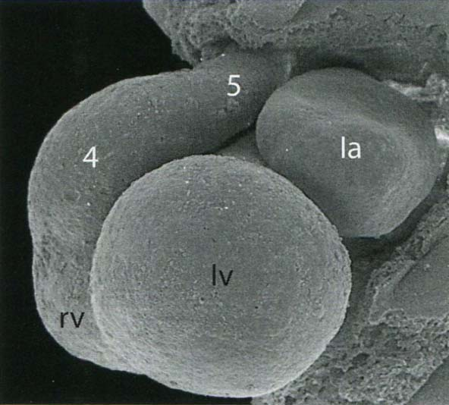
Ende der EW5
R
V
L
Notes:
Steding The anatomy of the human embryo Karger 2009

Slide 24
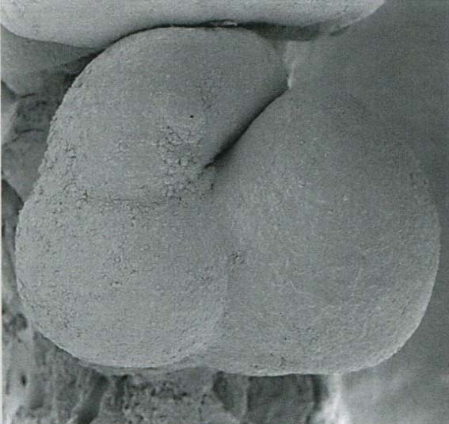
EW6
Notes:
Steding The anatomy of the human embryo Karger 2009

Slide 25
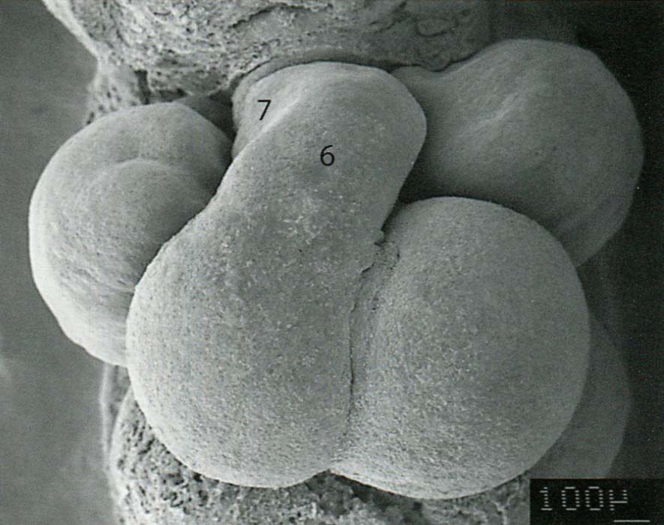
EW6
(früh)
Notes:
Steding The anatomy of the human embryo Karger 2009

Slide 26
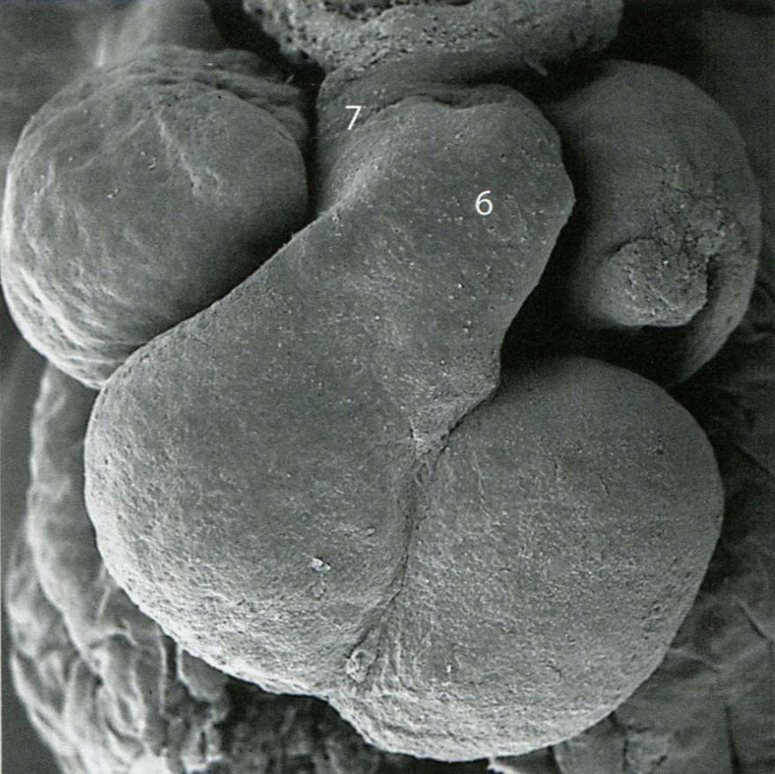
Ende der EW6
Notes:
Steding The anatomy of the human embryo Karger 2009

Slide 27
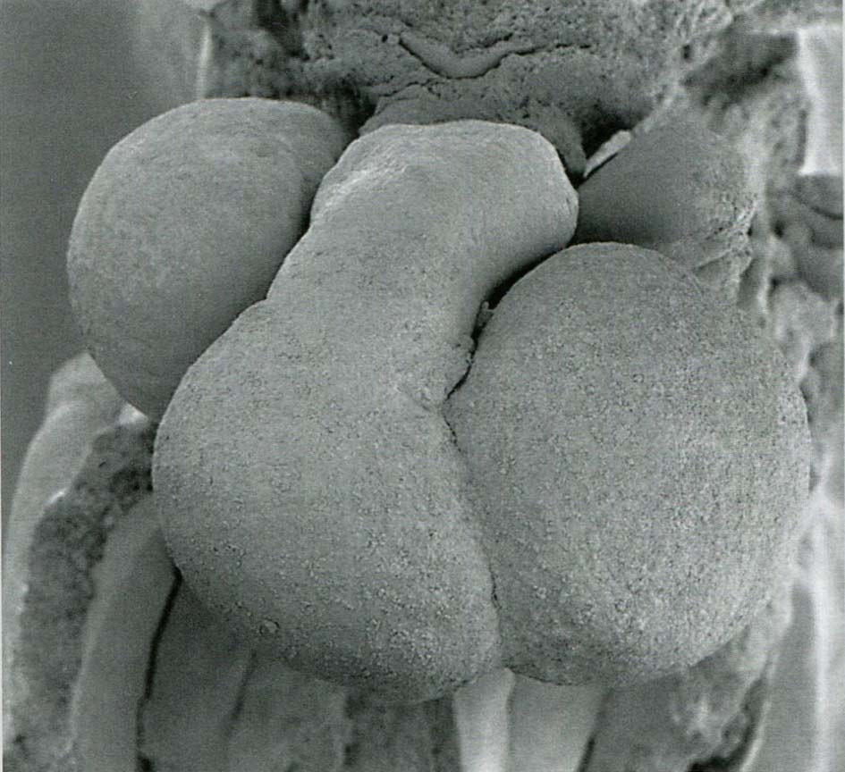
EW7
Notes:
Steding The anatomy of the human embryo Karger 2009

Slide 28
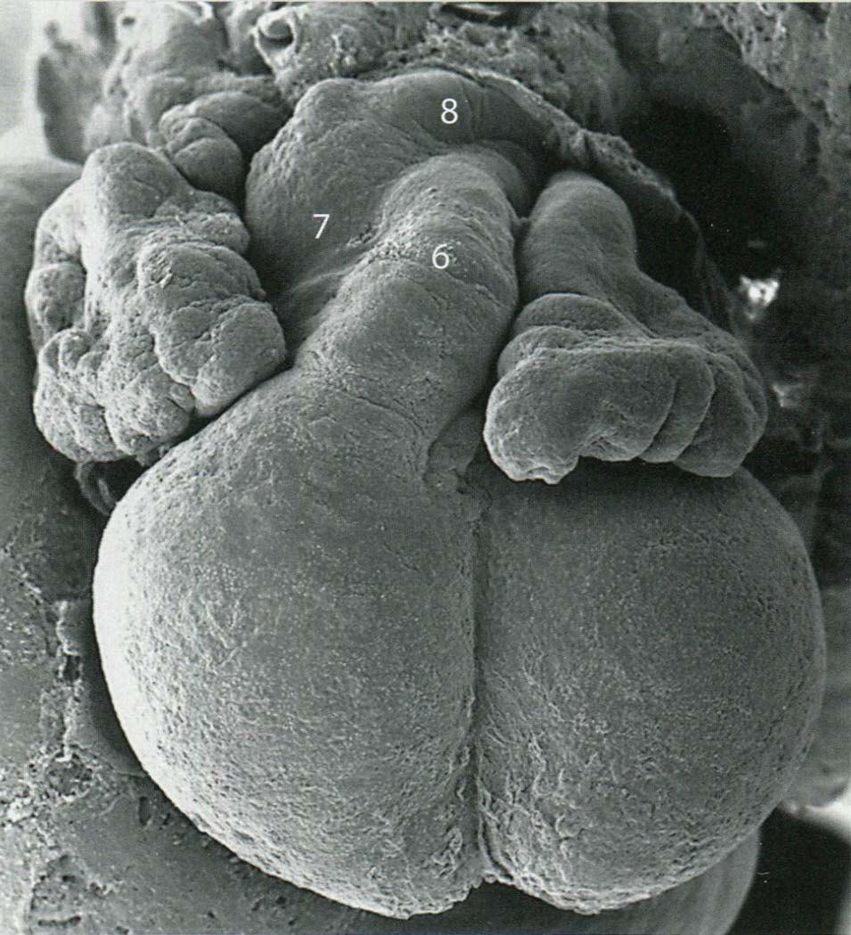
EW7
Notes:
Steding The anatomy of the human embryo Karger 2009

Slide 29
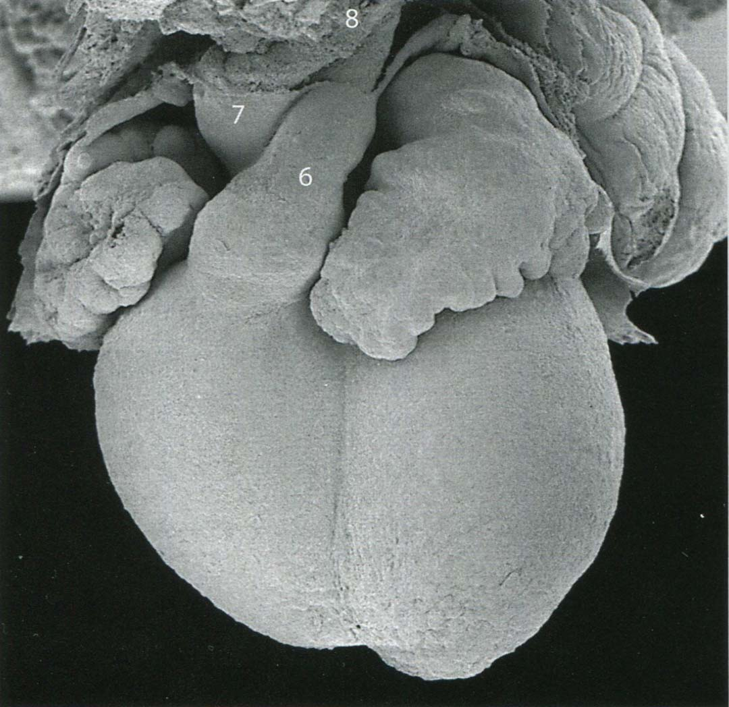
EW8
Notes:
Steding The anatomy of the human embryo Karger 2009

Slide 30
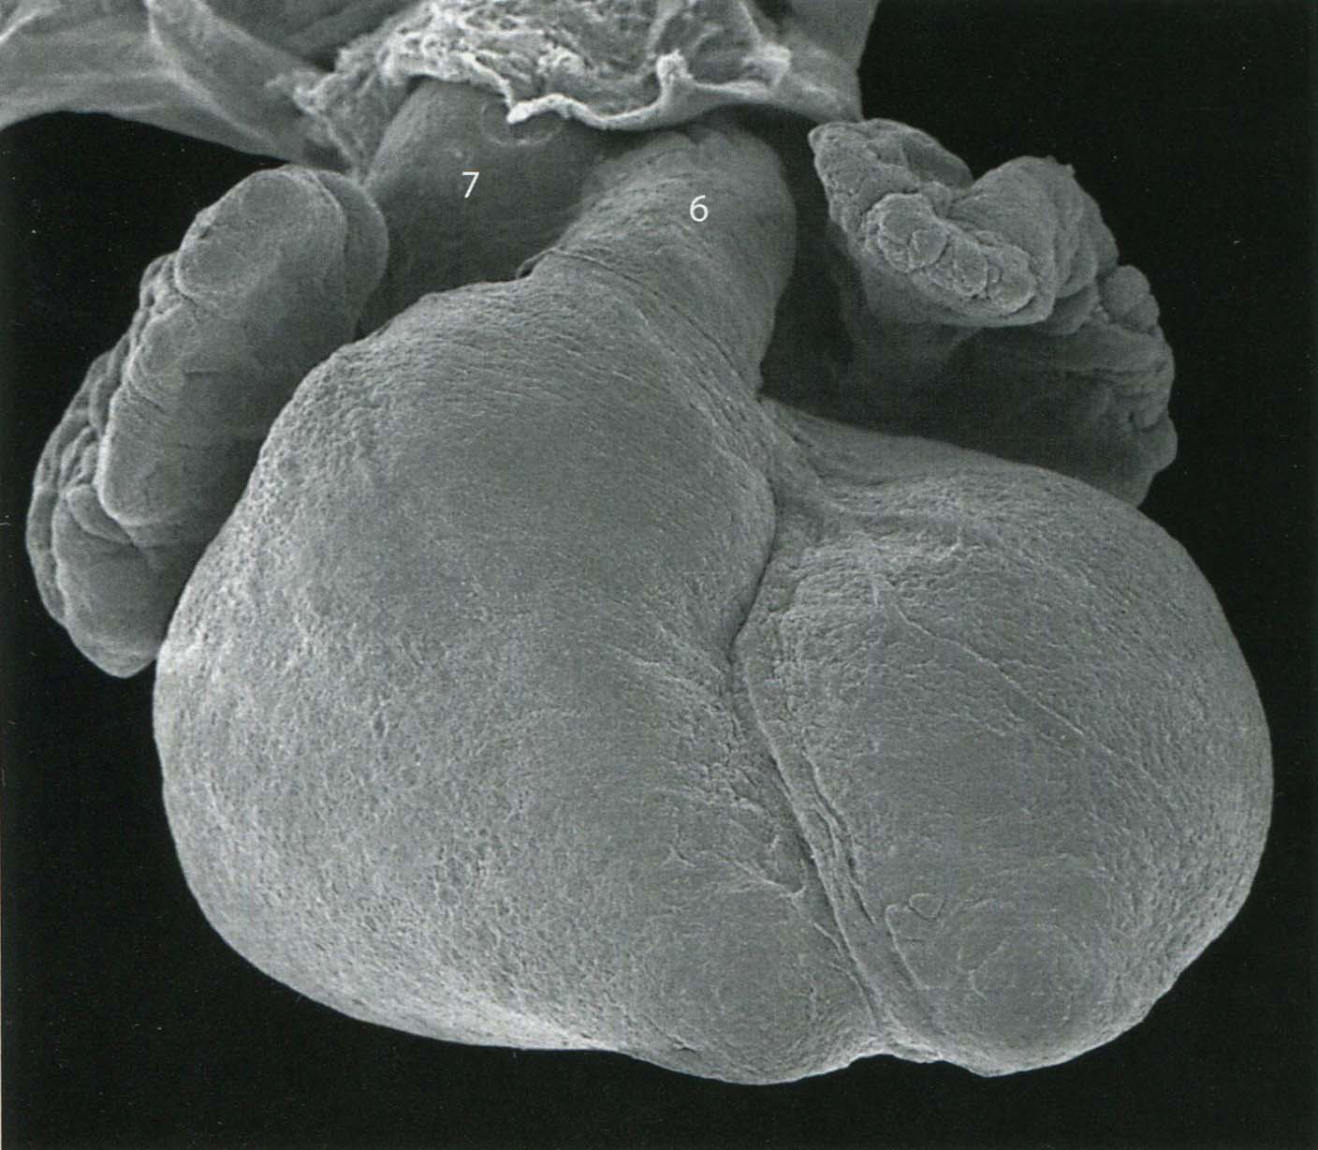
EW9
Notes:
Steding The anatomy of the human embryo Karger 2009

Slide 31
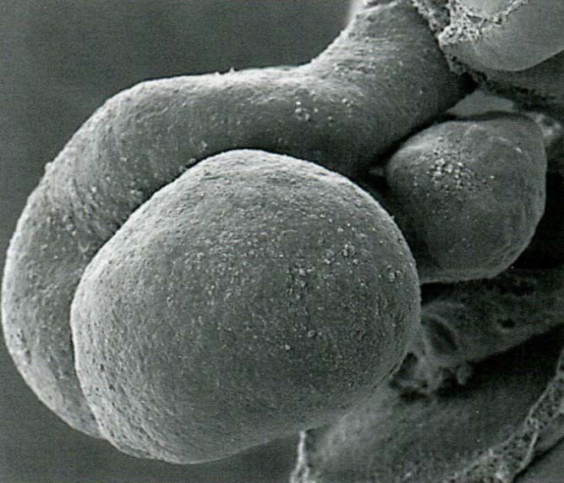
EW5
L
Notes:
Steding The anatomy of the human embryo Karger 2009

Slide 32
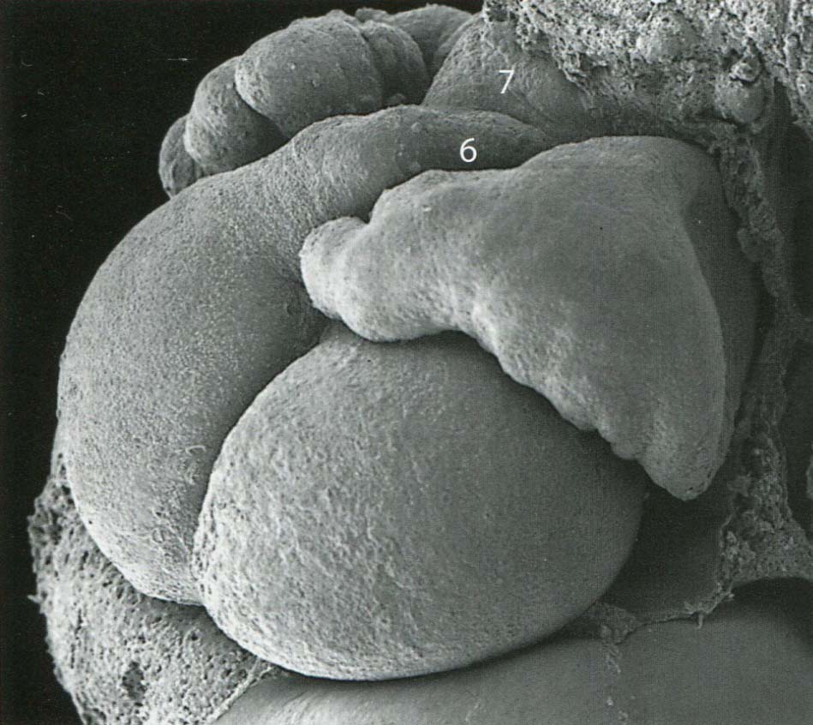
EW6
L
Notes:
Steding The anatomy of the human embryo Karger 2009

Slide 33
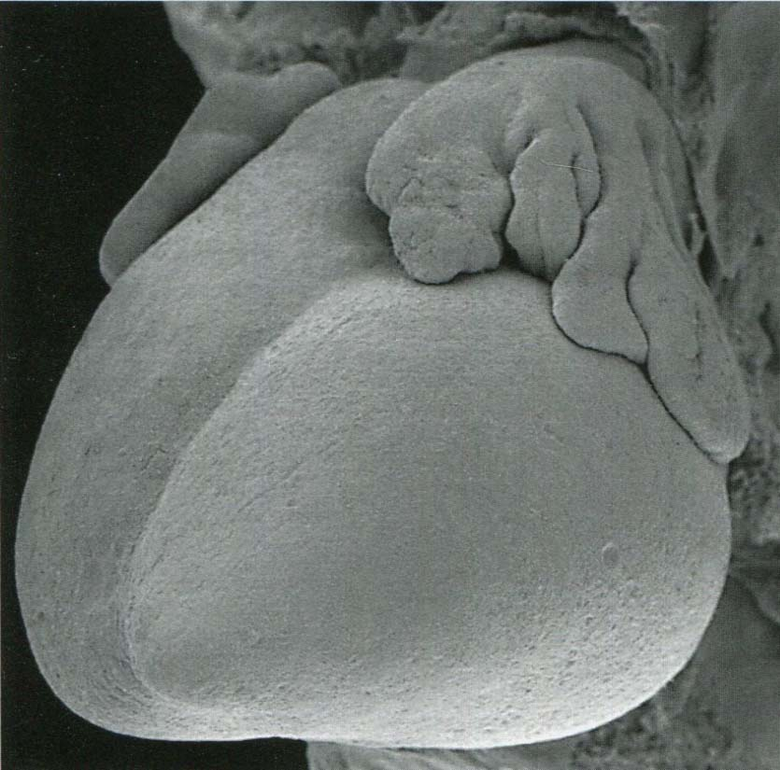
EW8
L
Notes:
Steding The anatomy of the human embryo Karger 2009

Slide 34
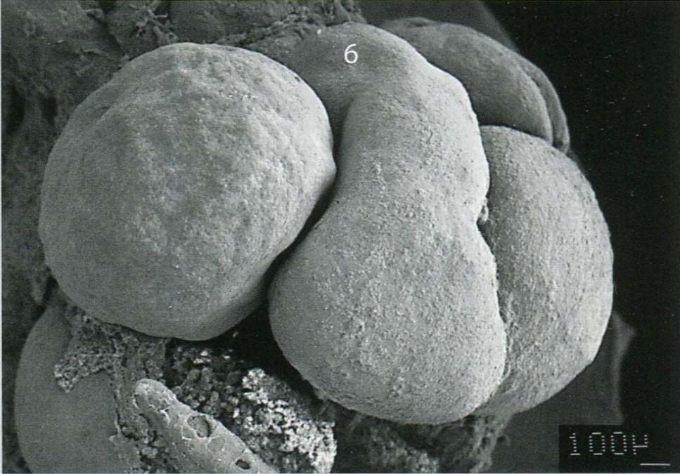
EW6
R
Notes:
Steding The anatomy of the human embryo Karger 2009

Slide 35
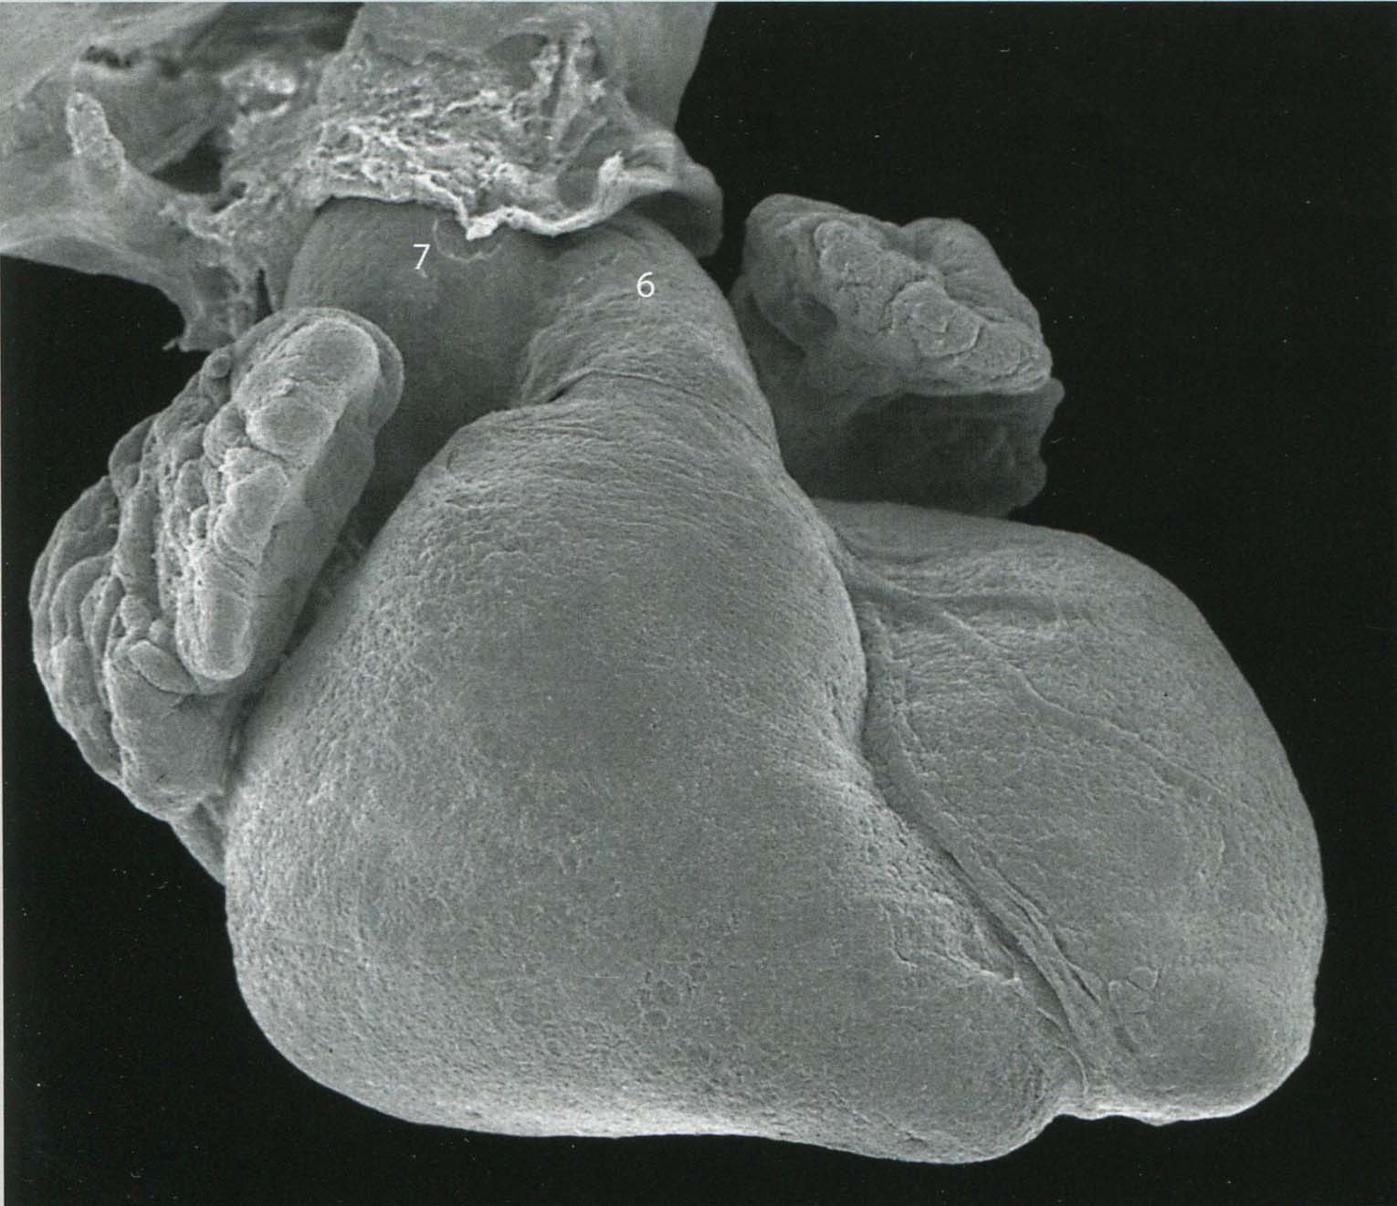
EW9
R
Notes:
Steding The anatomy of the human embryo Karger 2009

Slide 36
Septation

Slide 37
EW5
Notes:
Steding The anatomy of the human embryo Karger 2009

Slide 38
Ende der EW5
R
V
L
Notes:
Steding The anatomy of the human embryo Karger 2009

Slide 39
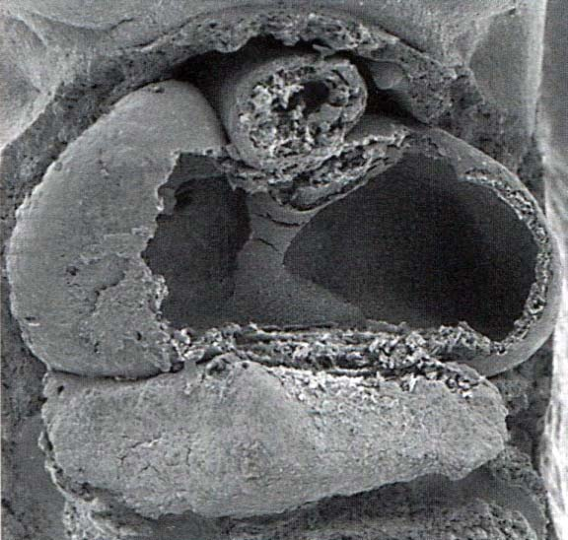
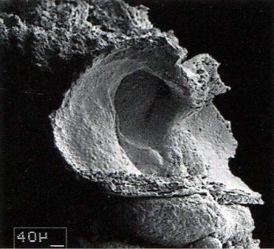
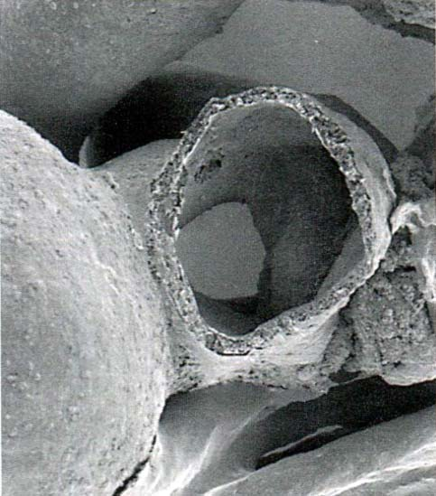
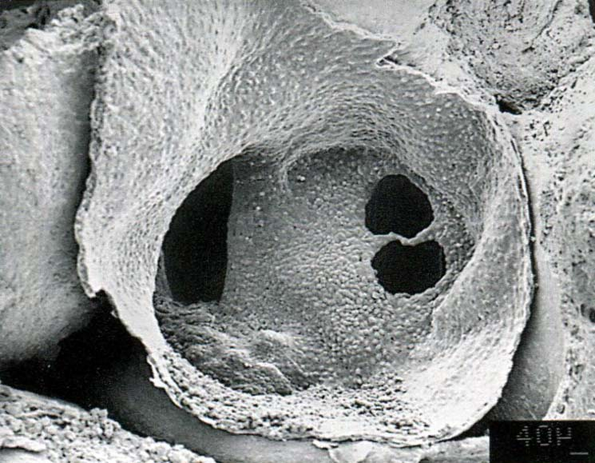
EW5
LA, RA, D.Cuv L. Sin Ven
von ventral-rechts gesehen
von ventral-kaudal gesehen
LA, RA, pulm. ridges, lSV, RSV
von links gesehen
von links gesehen

Slide 40
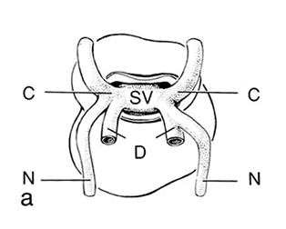
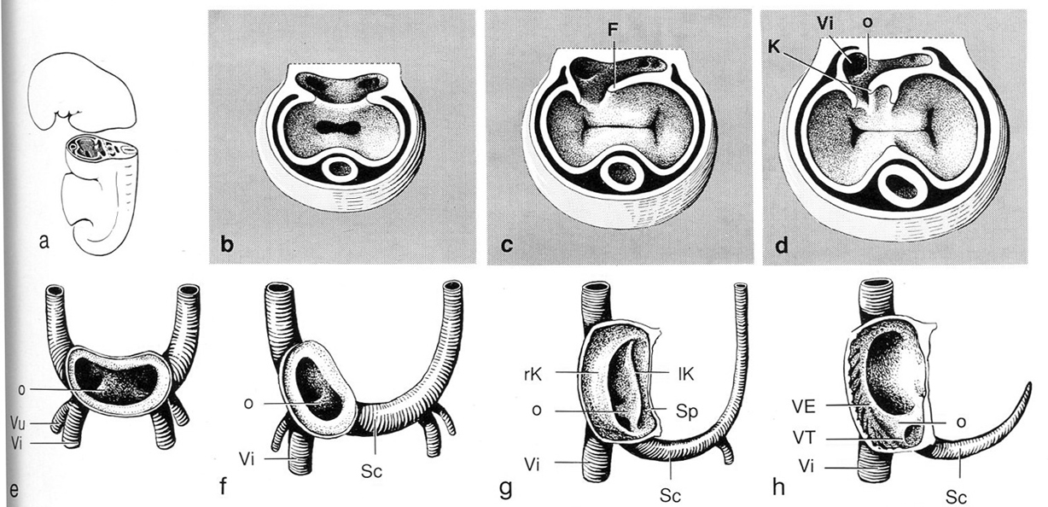
Hinrichsen Human Embryologie 1990
F: Sinu-atriale Falte
K: Sinu-atriale Klappe
o: Sinus venosus-Septum
Entwicklung des Vorhofes und Sinus venosus (von ventral gesehen)

Slide 41
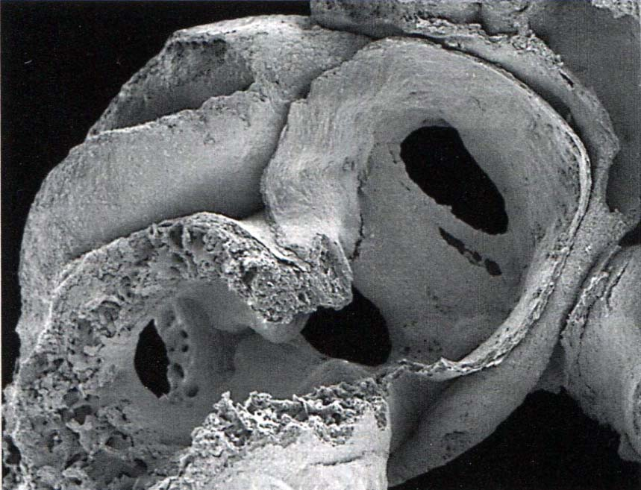
EW5
von links gesehen

Slide 42
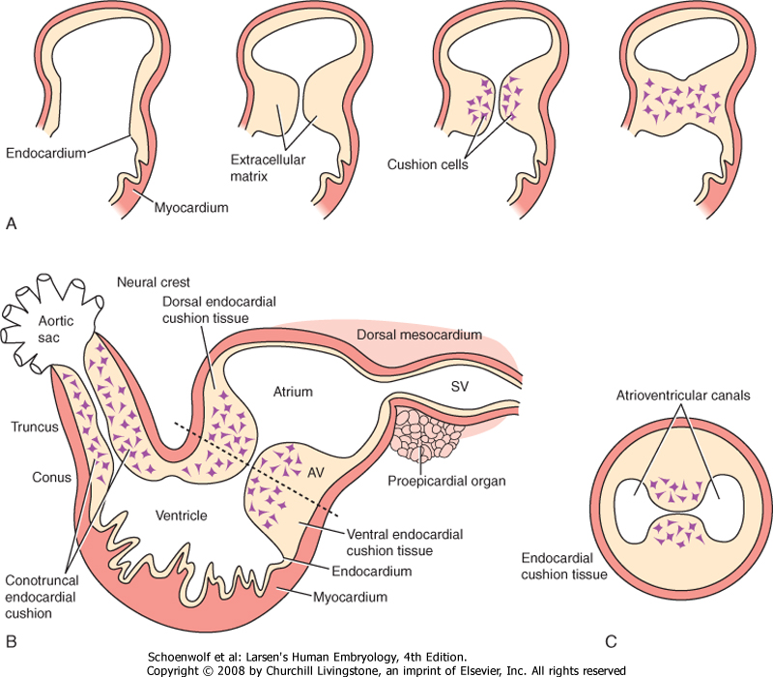

Slide 43
Notes:
Steding The anatomy of the human embryo Karger 2009

Slide 44
EW5
von links gesehen

Slide 45
EW6
(früh)
Notes:
Steding The anatomy of the human embryo Karger 2009

Slide 46
Ende der EW6
Notes:
Steding The anatomy of the human embryo Karger 2009

Slide 47
EW6
von rechts gesehen

Slide 48
EW6
von rechts gesehen
Notes:
18: V. hepatica

Slide 49
EW6
Septation von dem Konotrunkus, atrioventrikuläre Kissen

Slide 50
EW6
Septum intermedium,
atrioventricular cushions
von kaudal gesehen
Notes:
Steding The anatomy of the human embryo Karger 2009

Slide 51
EW6
von ventral-rechts gesehen

Slide 52
EW6
von ventral-rechts gesehen

Slide 53
EW7
Notes:
Steding The anatomy of the human embryo Karger 2009

Slide 54
EW7
Notes:
Steding The anatomy of the human embryo Karger 2009

Slide 55
EW7
von kranial gesehen

Slide 56
EW7
von ventral gesehen
Notes:
Steding The anatomy of the human embryo Karger 2009

Slide 57
EW7
von ventral gesehen
Notes:
Steding The anatomy of the human embryo Karger 2009

Slide 58
EW7
von ventral-rechts gesehen
Notes:
Steding The anatomy of the human embryo Karger 2009

Slide 59
EW7
von ventral-rechts gesehen

Slide 60
EW7-8
Pulmonarklappe:
von ventral gesehen

Slide 61
Notes:
Steding The anatomy of the human embryo Karger 2009

Slide 62
Notes:
Steding The anatomy of the human embryo Karger 2009

