Slide 1
Topographical and sectional anatomy of the head. Spaces and content of the neurocranium.
Dr. Csáki Ágnes
Anatómiai, Szövet és
Fejlődéstani
Intézet
2019

Slide 2
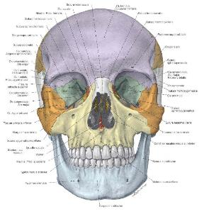
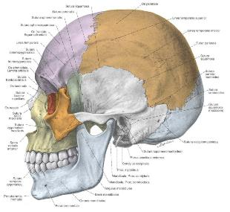
Skull
NEUROCRANIUM (8) – unpaired: frontale, occipitale, sphenoidale, ethmoidale
paired: parietale, temporale (ossicles – mobile)
VISCEROCRANIUM (14) -unpaired: mandibula (mobile), vomer.
paired: nasale, maxilla, zygomaticum, lacrimale, palatinum, concha nasalis inferior
Cavities:
cavitas cranii,
cavum nasi,
cavum oris,
orbita,
sinus paranasalis

Slide 3
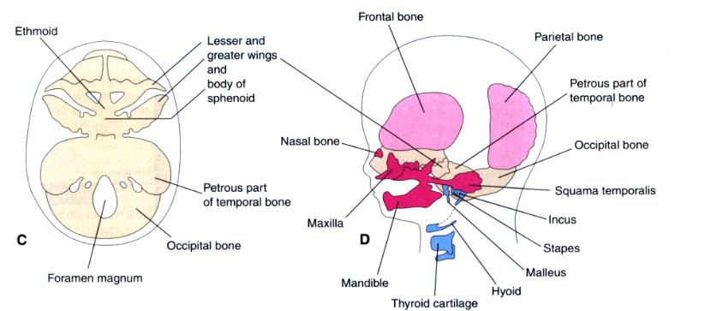
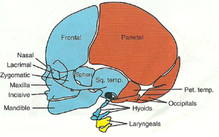
Development of the skull- NEUROCRANIUM and VISCEROCRANIUM
kék – dúcléc
brown – paraxial mesoderm (somite)
yellow – lateral mesoderm
Notes:
3
Moore and Perseaud The developing Human, 2008
http://www.oucom.ohiou.edu/dbms-Witmer/Downloads/Skull.pdf
Blue-brown-yellow skull is form Langmann’s Medical Embryology
1. Portions of the skull
The cranium is divided into viscerocranium amd neurocranium.
a. Neurocranium: surrounding the brain
b. Viscerocranium: the jaw apparatus and associated structures
2. Types of ossification
a. Endochondral ossification: bones are ossified from cartilaginous precursors
b. Intramembranous ossification: bones are ossified directly from mesenchyme
investing various structures (e.g., the brain, cartilaginous structures)
B. Developmental origins of the skull
1. Cartilaginous neurocranium (= chondrocranium)
a. Forms from fusion of several primordial cartilages
b. Forms structures in skull base via endochondral ossification
c. Adult bones: occipital, petromastoid part of temporal bone, sphenoid,
ethmoid
2. Membranous neurocranium
a. Forms bones around the brain via intramembranous ossification
b. Adult bones: frontal, parietal
3. Cartilaginous viscerocranium
a. Forms from the cartilages of the first two branchial arches via endochondral
ossification
b. Adult first branchial arch bones: malleus and incus (middle ear ossicles)
c. Adult second branchial arch bones: stapes (another middle ear ossicle), styloid
process of temporal bone
(note: the second branchial arch also contributes to the lesser horn and part of
the body of the hyoid bone and the third branchial arch contributes the
rest of the hyoid bone)
4. Membranous viscerocranium
a. Forms bones around the maxillary and mandibular prominences of the first
branchial arch via intramembranous ossification
b. Adult bones: premaxilla, maxilla, zygomatic, palatine, nasal, vomer, lacrimal,
squamous part of temporal, mandible

Slide 4
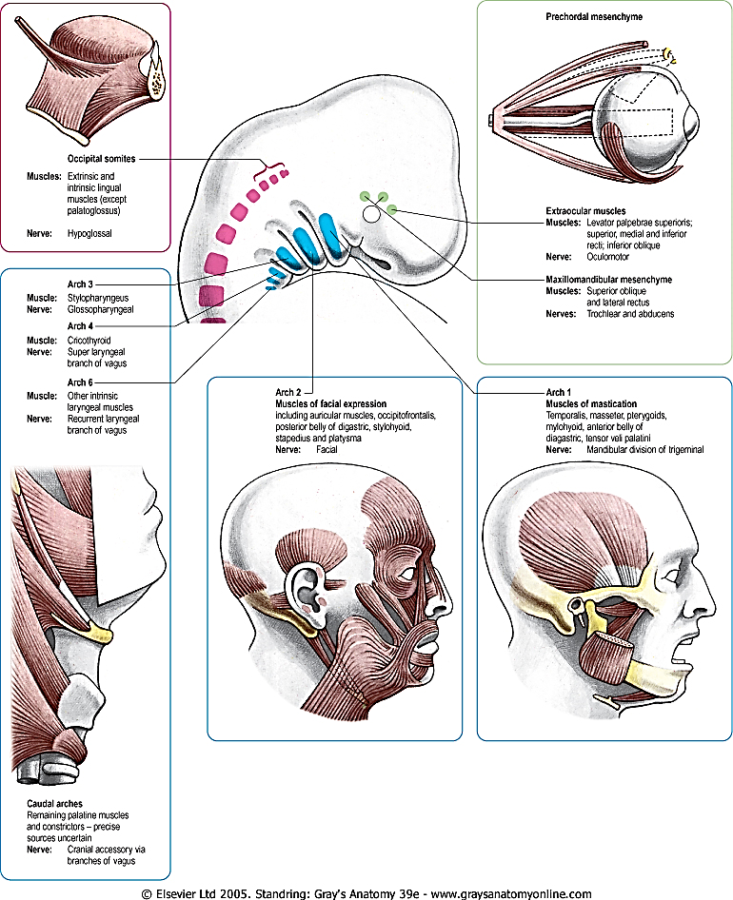
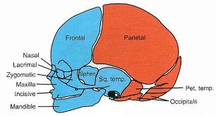
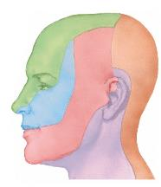
Development of the muscles
ECTOMESENCHYME
ORIGIN
blue= from notochord
red= from paraxial mesoderm
V.
(n. trigeminalis)
Notes:
4
Netter
Ectomesenchyme in the pharyngeal arches condense to form most non-retinal parts of the eyeball, dermis of the face, anterior bones of the neurocranium, and the leptomeninges around the brain. These areas are supplied by the ophthalmic (CN V₁), maxillary (CN V₂) and mandibular (CN V₃) divisions of the trigeminal nerve (CN V). Recall that the epidermis of the face is derived from ectoderm (as it is in the rest of the body).
Sadler (11th ed) Fig 16.1. The bones of the skull are derived from neural crest cells (colored in blue above) or paraxial mesoderm (colored in red above). Note the correspondence between the bones that derive from neural crest cells (e.g., viscerocranium) and the region of the face in which the dermis derives from neural crest cells.

Slide 5
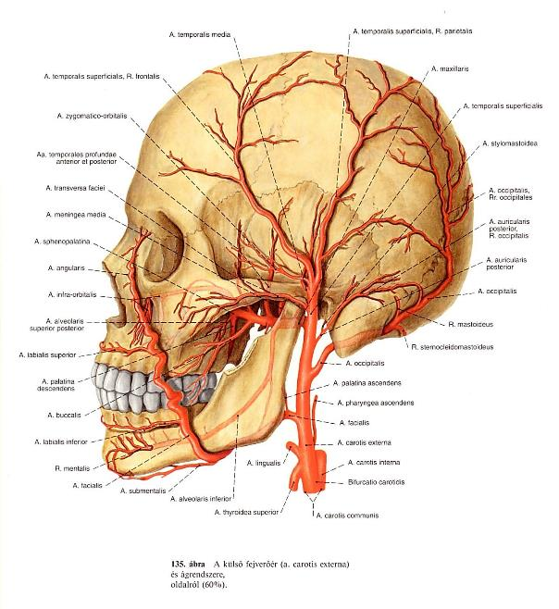
Arteries of the head
Arteria carotis externa
a. thyroidea superior
a. lingualis.
a. facialis
a. pharyngea ascendens
a. auricularis post
a. sternocleidomastoideus
a. occipitalis
a. maxillaris
temp. sup.
  r. frontalis és r. parietalis

Slide 6
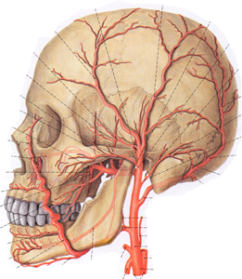
temporal pulse
Facial pulse

Slide 7
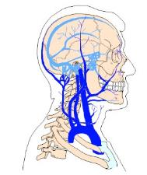
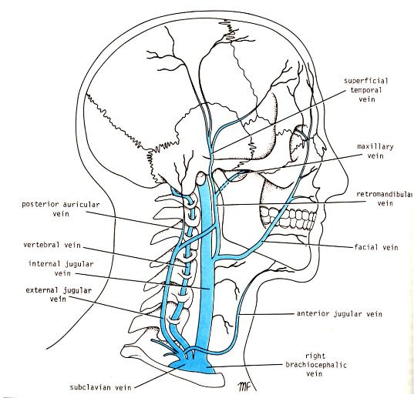
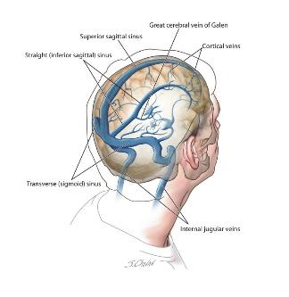
Veins of the head
Ismétlés: sinus cavernosus

Slide 8
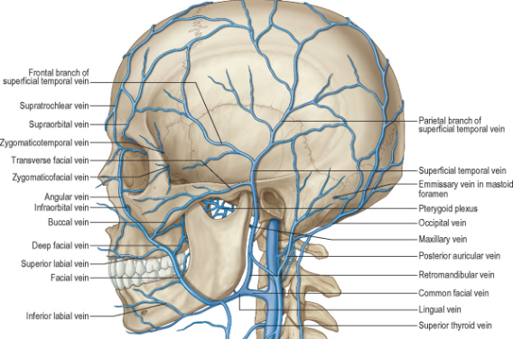
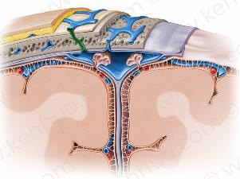
Veins
Emissary veins: connection between the veins of the skin and the veins of the meninges (Infection!)
Spf. veins
vv. diploicae
vv. emissariae

Slide 9
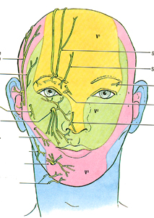
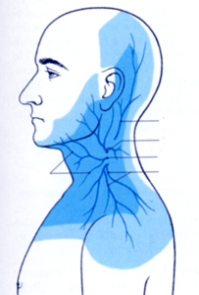
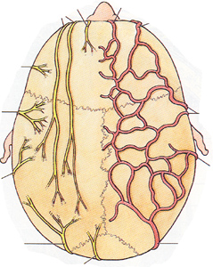
Nerves of the head
V/3 V/2 V/1
Punctum nervosum
Trigeminal n.
C2 and C3 ramus dorsalis
cervical plexus

Slide 10
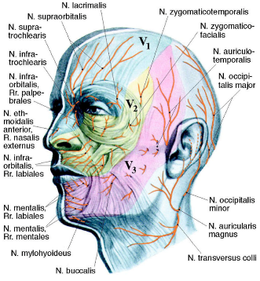
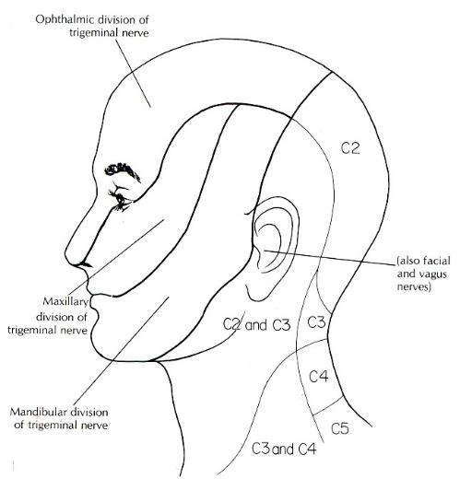
Sensory innervation
Front:
n. supraorbitalis V/1
n.supratrochlearis V/1
n.zygomaticotemporalis V/2
n.auriculotemporalis V/3
Occipital area:
cervical plexus
N. auricularis magnus
N. occipitalis minor
Dorsal rami of spinal nerves:
N. occipitalis major (C2)
N. occipitalis tertius (C3)

Slide 11
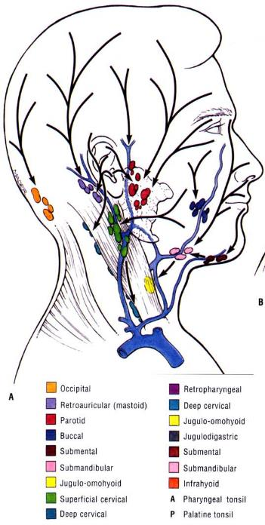
Lymphatic drainage of the head
Lymphoglandulae superficiales
n.l. occipitales:
n.l. retroauriculares/mastoidei:
n.l. parotidei superficiales et profundi:
nodi lymph.cervicales superfic
nodi lymph.cervicales proff.
The superficial lymph nodes of the head and neck receive lymph from the scalp, face and neck. They are arranged in a ring shape; extending from underneath the chin, to the posterior aspect of the head. They ultimately drain into the deep lymph node

Slide 12
Regions of the head
Regio frontalis
Rego parietalis
Regio occipitalis
Regio temporalis
Regio infratemporalis
Regio nasalis
Regio orbitalis
Regio infraorbitalis
Regio zygomatica
Regio buccalis
Regio parotideomasseterica
Regio oralis et mentalis
Regio sublingualis
Regiones capitis
Regiones faciei

Slide 13
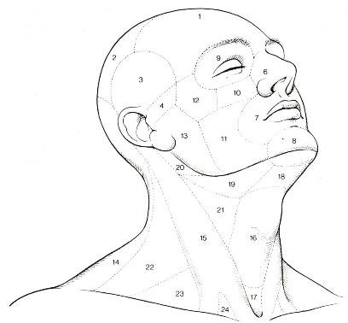
Top of he skull
Boundaries:
  linea nuchalis suprema
  linea temporalis superior
  margo supraorbitalis
Scalp
Regio occipitalis, parietalis, temporalis and frontalis
Similar clinical symptomes

Slide 14
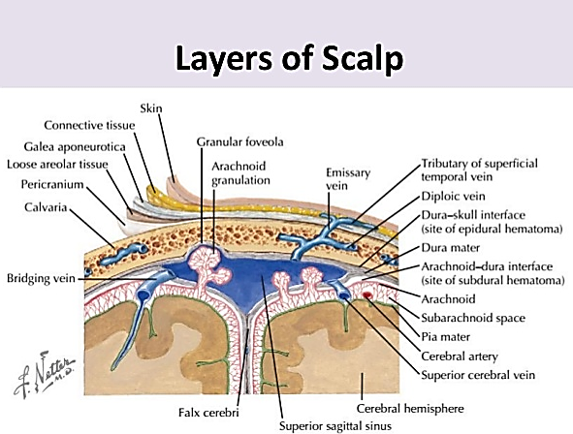

Slide 15
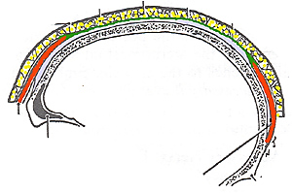
Loose connective tissue
-fluid, blood , infection can spread
Scalp
Galea aponeurotica
Thick fatty subcutis
rich in vessels
Thin skin
(rich in vessels,
Bleeding !

Slide 16
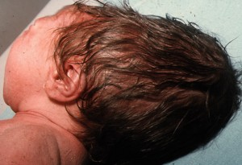
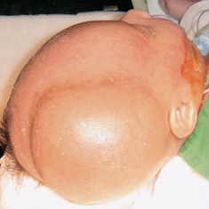
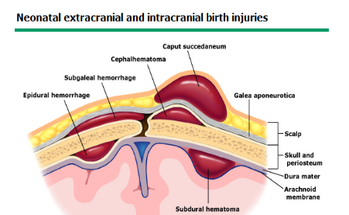
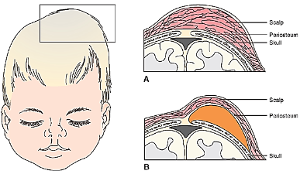
Hematoma
In beetwen the layers flat, diffuse
Caput succedaneum
Under the periosteum, (above only the single bones)
Subperiosteal hematoma
1
3
2

Slide 17
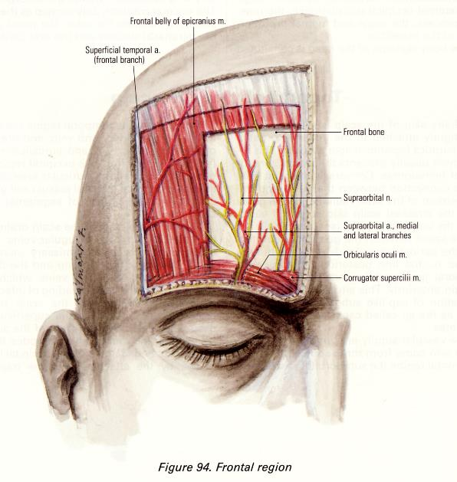
Frontal region
Boundaries:
sup. temporal line
supraorbital margin
coronal suture
Branches of V/1 : sensory
Temporal branch of facial: motor
Supraorbital and trochlear branch from the ophtalmic a.
  (a. carotis INTERNA)
  frontal branch of spf. temporal
  ( a. carotis externa)

Slide 18
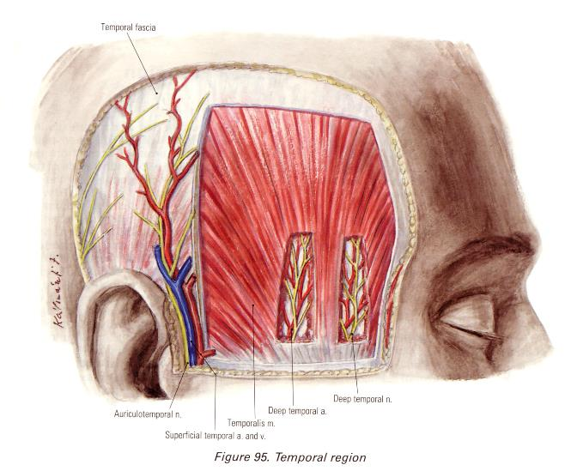
Temporal region
Boundaries:
sup. temporal line
zygomatic arch
Temporal m.
Temporal fascia two layers
Auriculotemporal n.: sensory
Superficial temporal a. (a. carotis externa),
Deep temporal aa.
Deep temp n.: motor

Slide 19
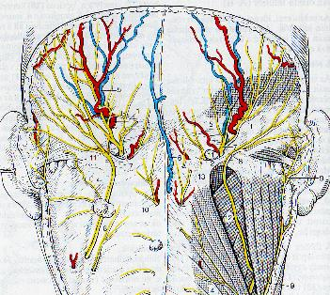
Regio occipitalis et parietalis
Boundaries:
  Linea nuchae superior (protuberantia occipitalis externa)
  Linea temporalis superior
  Sutura coronalis
  Through the trapezius
    a. occipitalis (a. carotis externa)
    v. occipitalis (v. jugularis externa)
    n. greater occipital (C2 dorsal branch
  Lateral from the trapezius
    v. posterior auricular (v. jugularis externa)
    n. lesser occipital(C2 ventral ramus/ plexus cervicalis)
  galea aponeurotica (insertion on the superior nuchal line)
  vv. emissariae

Slide 20
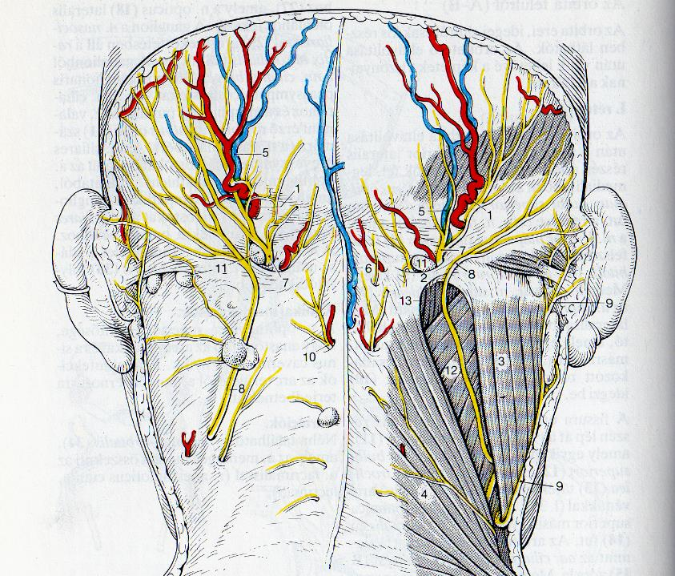

Slide 21
Cavitas cranii
Meninges
  sinuses
  cisterns
  vessels
  nerves
Brain
  vessels
  ventricules
  imagings

Slide 22
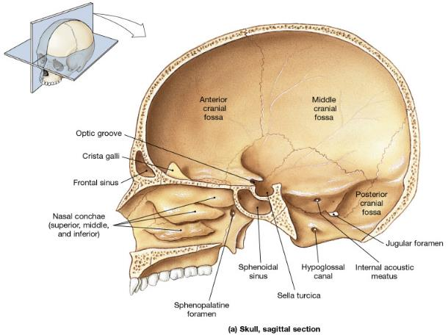
Fossae cranii
fossa cranii anterior
Os frontale, ethmoidale,ala minor ossis sphenoidalis
fossa cranii posterior Os occipitale, temporale, parietale
fossa cranii media sphenoid, temporal bones, parietal bones

Slide 23
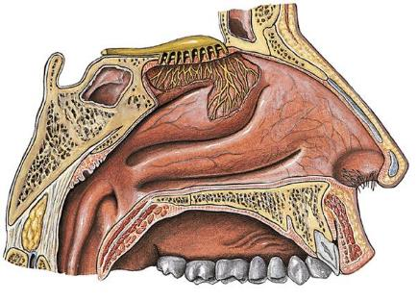
Basis cranii interna
Fossa cranii anterior
  Through the lamina cribrosa is connected to the nasal cavity!
  Drugs! NO blood-brain barrier!

Slide 24
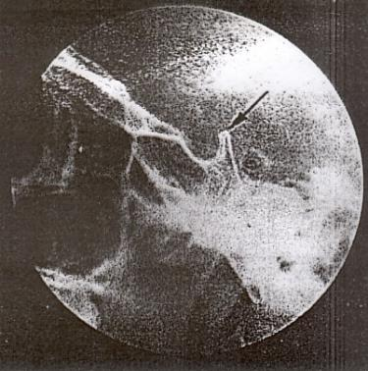
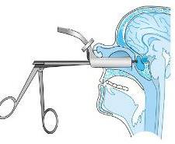
Basis cranii interna
Fossa cranii media
  fossa hypophysialis, thin bony plate separates from the sphenoidal sinus, operable through the nose

Slide 25
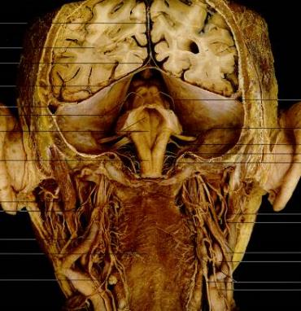
Basis cranii interna
Fossa cranii posterior
  tentorium cerebelli separates from the supratentorial space
  Severely high intracranial pressure can cause the brain to herniate to the foramen magnum

Slide 26
Meninges
Dura mater
has two layers: the superficial layer (also called the periosteal layer), which serves as the skull's inner periosteum; and a deep layer called the meningeal layer; the actual dura mater
It extends into the skull cavity as the falx cerebri and tentorium cerebelli, falx cerebelli
It surrounds and supports the dural sinuses (also called dural venous sinuses, cerebral sinuses, or cranial sinuses) and carries blood from the brain toward the heart.

Slide 27
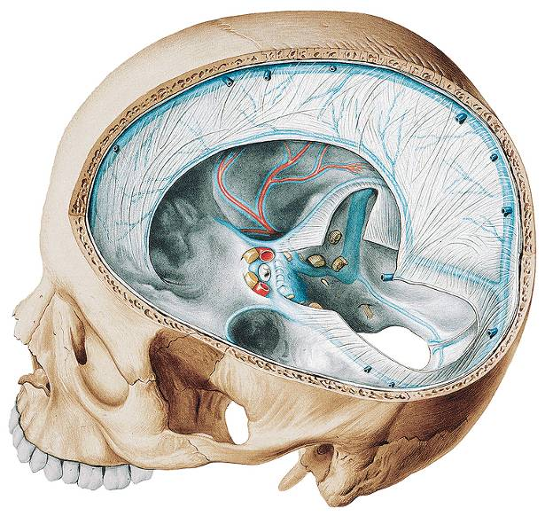
Falx cerebri
Tentorium cerebelli

Slide 28
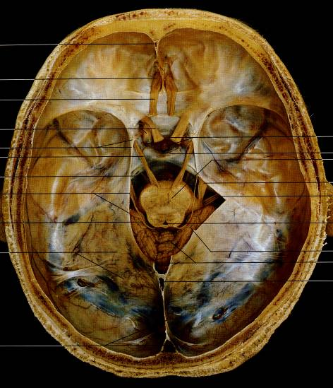
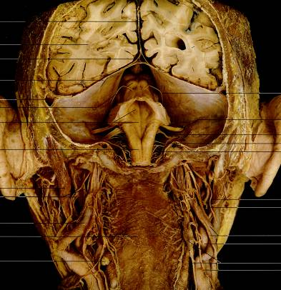
Diaphragma sellae
Supra- and Infratentorial spaces
Tentorium cerebelli

Slide 29
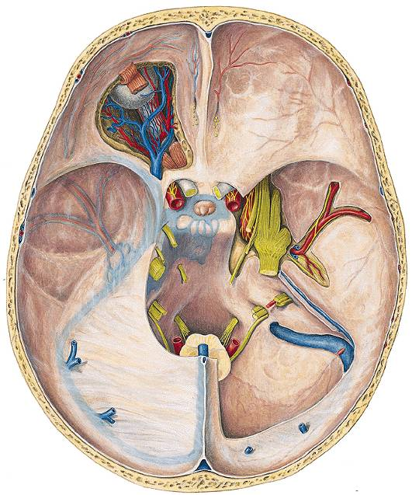
V/1.
n. ophtahalmicus
V/2.
n. maxillaris
V/3.
n. mandibularis

Slide 30
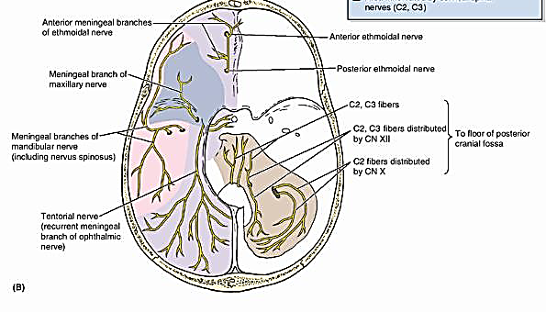
Innervation:
    Ramus meningeus (tentorius (V/1)
    Ramus meningeus anterior (N. ethmoidalis ant./N. nasociliaris/ V/1
    Ramus meningeus (V/2), fossa cranii anterior et media
    Ramus meningeus (V/3) fossa cranii media
    Ramus meningeus (X) fossa cranii posterior

Slide 31
Meninges
Dura mater-arteries
    ramus meningeus anterior (a. ethmoidalis ant/ a. ophtalmica/ a. carotis interna) lamina cribrosa
    arteria meningea media (a. maxillaris/ a. carotis externa) foramen spinosum
    arteria meningea posterior (a. pharyngea ascendens/ a. carotis externa) foramen jugulare

Slide 32
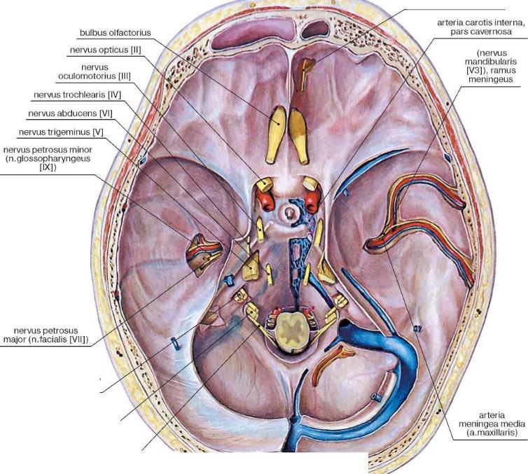
Art. meningea anterior
( a. ophtalmica)
    arteria meningea posterior
    (a. pharyngea ascendens)
    foramen jugulare
Art. meningea media
(a. maxillaris)

Slide 33
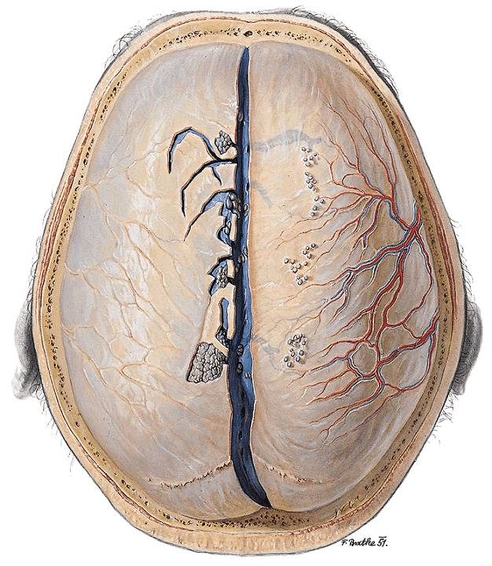
middle meningeal a: epidural bleeding
dura mater

Slide 34
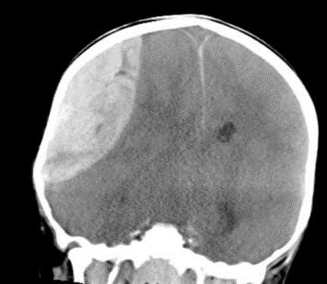
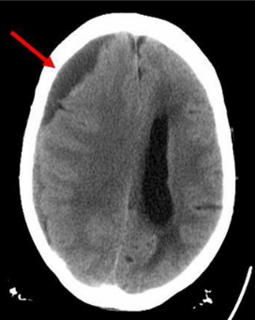
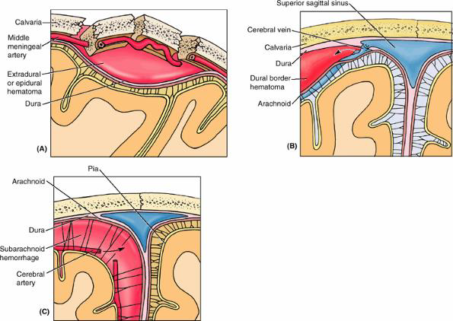
Subdural hemorrhage:
bridging veins
Epidural hemorrhage:
meningeal arteries
Subarachnoideal hemorrhage:
pial arteries

Slide 35
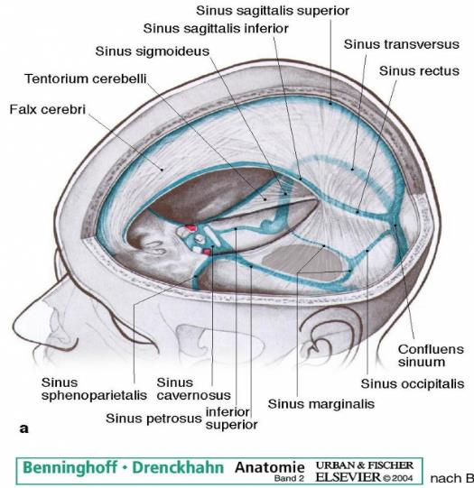
Dural sinuses(also called dural venous sinuses, cerebral sinuses, or cranial sinuses)
Most of them only carries blood from the brain :
  sup et inf saggital sinus,
  sinus rectus, sinus sigmoideus,
  sup et inf petrous sinus,
  sphenoperietal sinus
  But many structures run
  through the cavernous sinus

Slide 36
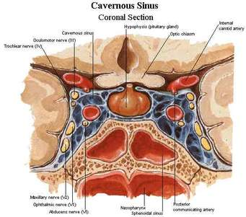
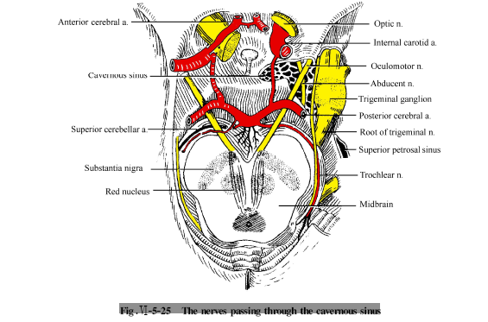
Frontal section
N.III
N.IV
N. V/1
N. V/2
N.VI.
Superior view

Slide 37
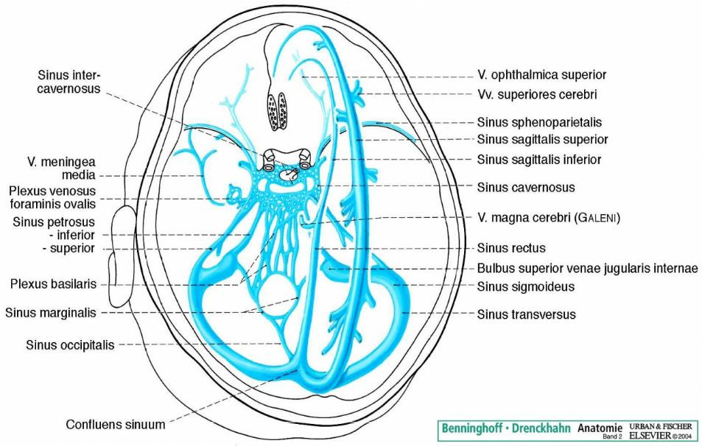

Slide 38

Arachnoid
  cisterns
  CSF circulation
Pia mater

Slide 39

CSF: liquor production and elimination
Production: ventricles choroid plexus
Elimination: arachnoid granulations
volume is 150 ml, with 25 ml in the ventricles and 125 ml in subarachnoid spaces.
CSF is renewed about four times every 24 hours

Slide 40


Granulationes
arachnoideales

Slide 41


Cerebrospinal fluid absorption by spinal arachnoid villi and meningeal sheaths of spinal nerves.
Spinal arachnoid villi in contact with the epidural venous plexus (a)
and adjacent to spinal nerve roots (b).
Absorption surfaces in the meningeal recess of spinal nerve roots (c)

Slide 42

Brain
Brain position
Arteries
Ventricles
Imagings

Slide 43


Slide 44

Ventricles
lateral ventricles
3rd ventr.
4th ventr.

Slide 46

Areries
a. carotis interna
cerebri anterior
(sensory and motor functions of lower extremity)
cerebri media
(sensory and motor functions of upper extremity, speech)
cerebri posterior
(vision, storing memory)
a. basilaris
a. vertebralis

Slide 47


cerebri anterior
(sensory and motor functions of lower extremity)
cerebri posterior
(vision, storing memory)

Slide 48


Slide 49


Slide 50


carotis interna angiográfia
Lateral view
A. carotis int. (16)
A. cerebri ant. (9.)
A. cerebri med. (12)
13. A. choroidea ant.
14. A. op hthalmica
15. Carotis syphon
1. A. frontalis int. med.
2. A. frontalis int. post
3. A. centralis
4. A. calloso-marginalis
5. A. pericallosalis
6. A. frontopolaris
7. A. orbitofrontalis
8. A. frontobasalis
10. A. temporales ant. et med.
11. A. temporalis post.
A. carotis ext. (21)
17. A. temporalis spf.
18. A. palatina ascendens
19. A. facialis
20. A. occipitalis

Slide 51


A. carotis interna angiográfia
AP view
A. cerebri med.
A. carotis int.
A. cerebri ant.
1. A. pericallosalis
2. A. callosomarginalis
3. Postcommunicating portion of a.
cerebri ant.
4. Precommunicating portion of a.
cerebri ant.
5.. Rami parietales postt.
6. Portio opercularis
7. Portio insularis
8. Portio sphenoidalis
9. Carotis syphon
10. Portio petrosa
11. Portio cervicalis

Slide 52


A. vertebralis angiográfia
lateral view
A. basilaris
1. Rami parieto-occipitales
2. A. cerebri post. dext.
3. A. perforans thalami
4. A. cerebri post. sin.
5. A. occipitalis int (calcarina)
6. A. cerebelli sup.
7. A. cerebelli inf. ant.
8. A. basilaris
A. vertebralis
9. A. cerebelli inf. post.
10. Loop between the transverse foramina o
of atlas and axis
11. Pars ascendens

Slide 53


A. vertebralis angiográfia
AP view
A. basilaris
A. vertebralis
1. Rami occipitales
2. A. cerebelli sup.
3. Rami perforantes thalami
4. A. cerebri post.
5. A. basilaris
6. A. cerebelli inf. ant.
7. A. cerebelli inf. post.
8. Pars intracranialis
9. Loop between transverse foramina of
atlas and axis
10. Pars ascendens

Slide 54

Circulus arteriosus Willisi
anterior cerebral a.
(sensory and motor functions of lower extremity)
anterior communicating a.
middle cerebral a. (sensory and motor functions of upper extremity, speech)
posterior cerebral a.
(vision, storing memory)
posterior communicating a.
basilar a.
vertebral a

Slide 55

Circulus arteriosus Willisii
CT angiográfia , 3-D SSD rekonstrukció
1. A. cerebri ant.
2. A. communicans ant. (tágult)
3. A. carotis int.
4. A. cerebri media
5. A. communicans post.
6. A. cerebri post.
7. A. basilaris

Slide 56


Slide 57

Superficial veins

Slide 58

Deep veins

Slide 59

Deep veins inferior view

Slide 60

Deep veis superior view
A fehérállomány vénái

Slide 61

Foramen Monroe

Slide 62


Veins of the face and the cavernous sinus connection
„danger zone” of nthe nface
-there are no valves in the veins!!
v. supraorbitalis
v. opht. sup.
sinus cav
plexus pterygoideus
sinus sigmoideus
v. maxillaris
plexus venosus
vertebralis
internus
sinus basilaris
Thrombophlebitis of facialis vein – thrombophlebitis of sinus cavernosus
Facial vein is connected to the cavernous sinus through the superior ophtalmic vein. This connection has a great clinical impotance it provides a pathway for spreading of infection

Slide 63
Imagings, sectional anatomy
Main planes
  frontal (radiology: coronal)
  saggital
  horizontal (radiológy: axial)

Slide 64

Frontal sections
T1
Scala ant.
Scala med.
1. Calvaria
2. Cavum subdurale et subarachnoidale
3. Lobus frontalis
4. Falx cerebri et fissura longitudinalis cerebri
5. Genu corporis callosi
6. Ventriculus lat., cornu ant.
7. Gyrus rectus
8. Lobus temporalis
9. Sinus sphenoidalis

Slide 65

T1
1. Calvaria
2. Cavum subdurale et subarachnoidale
3. Sinus sagittalis sup.
4. Falx cerebri
5. Ventriculus lat.
6. Septum pellucidum
7. Sulcus lateralis
8. Insula
9. Plexus choroideus ventr.lat.
10. Columna fornicis
11. Tela choroidea ventr. tertiii
12. Ventr. tertius
13. Thalamus
14. Lobus temporalis
15. Hippocampus
16. Fimbria hippocampi
17. Fossa interpeduncularis
18. Plexus choroideus ventr. lat. (cornu inf.)
19. Ventriculus lat., cornu inf.
20. Sulcus hippocampi
21. Pons
22. Gyrus parahippocampalis
23. Sulcus collateralis
24. Medulla oblongata

Slide 66

T1
Scala med.
Tentorium
Scala post.
1. Calvaria
2. Cavum subdurale
3. Sinus sagittalis sup. et dura mater
4. Cavum subarachnoidale
5. Falx cerebri
6. Lobus parietalis
7. Ventriculus lat. pars centralis
8. Crus fornicics
9. Plexus choroideus
10. Corpus pineale et recessus suprapinealis
11. Pulvinar thalami
12. Lobus temporalis
13. Colliculus sup.
14. Colliculus inf.
15. Ventriculus lat., cornu inf.
16. Pedunculus cerebellaris sup.
17. Ventriculus quartus
18. Tentorium cerebelli
19. Vermis cerebelli
20. Hemispherium cerebelli

Slide 67

Saggital sections
T2
T1

Slide 68

Horizontal sections
T2
1. Lobus frontalis
2. Fissura longitudinalis cerebri
3. Genu corporis callosi
4. Ventriculus lat. cornu ant.
5. Septum pellucidum
6. Caput nuclei caudati
7. Operculum temporale
8. Insula
9. Ventriculus lateralis, pars centralis
10. Plexus choroideus
11. Falx cerebri
12. Sinus sagittalis sup.

Slide 69

T2
1. Gyri orbitales
2. Fissura longitudinalis cerebri et falx cerebri
3. Forceps minor
4. A. cerebri ant.
5. Ventriculus lat., cornu ant.
6. Operculum frontale
7. Fossa lateralis
8. Caput nuclei caudati
9. Septum pellucidum
10. Gyri insulares
11. Fornix
12. Foramen interventriculare
13. Thalamus
14. A. cerebri media
15. Vena cerebri interna
16. Ventriculus lat.
17. Forceps maior
18. Lobus occipitalis
19. Sinus sagitalis sup.

Slide 70

T2
1. Cavum nasi
2. Bulbus oculi
3. Nervus opticus
4. Gyrus rectus
5. A. cerebri ant.
6. Operculum temporale
7. Sulcus lateralis
8. Thalamus
9. Ventriculus tertius
10. Gyri insulares
11. Vena cerebri interna
12. Forceps maior
13. Trigonum collaterale
14. Sinus rectus
15. Sinus sagittalis sup.

Slide 71

T2
1. Septum nasi
2. Bulbus oculi
3. Orbita
4. Cellulae ethmoidales
5. Nervus opticus
6. Gyrus rectus
7. Lobus temporalis
8. A. cerebri med.
9. Fossa et cisterna interpeduncularis
10. A. cerebri ant.
11. Tractus opticus
12. Mesencephalon
13. A. cerebri post.
14. Cisterna ambiens
15. Cisterna venae magnae
16. Trigonum collaterale
17. Vena cerebri magna (Galeni)
18. Sinus rectus
19. Fissura calcarina
20. Calcar avis
21. Ventriculus lateralis, cornu posterius
22. Sinus sagittalis sup.

Slide 72

T2
1. Septum nasi
2. Cellulae ethmoidales
3. Bulbus oculi
4. Orbita
5. Sinus sphenoidalis
6. A. carotis int.
7. Cisterna chiasmatis et infundibulum
8. Dorsum sellae
9. Fossa et cisterna interpeduncularis
10. Crus cerebri
11. Ventriculus lat., cornu inf.
12. Cisterna ambiens
13. Tectum mesencephali
14. Cisterna venae magnae
15. V. cerebri magna (Galeni)
16. Radiatio optica
17. Sinus sagittalis sup.

Slide 73

meningeoma

Slide 74


adenoma

Slide 75

Clivus chordoma

Slide 76



  www.instantanatomy.net
  http://hu.shvoong.com/medicine-and-health/1255208-koponya-fejl%C5%91d%C3%A9se/
  http://www.gwc.maricopa.edu/class/bio201/skull/skulltt.htm
  http://www.med.wayne.edu/diagradiology/Anatomy_Modules/axialpages/Home_Page.html
  http://www.anatomiedesmenschen.de/ie/neuro/schaedelbasis/schaedelbasis.pdf

