Slide 1
Hemispheres, meninges, lateral ventricles
Dr Anna L. Kiss
Department of Anatómy, Histology and Embryology
Semmelweis University
Budapest
2018

Slide 2
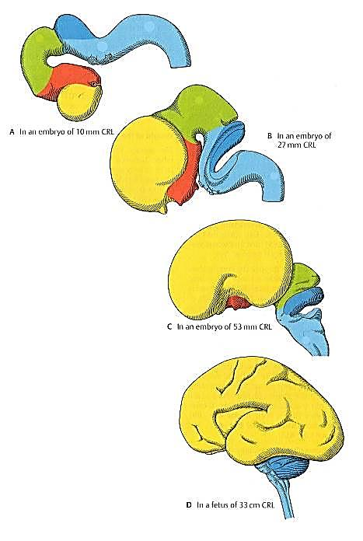
Encephalon
Prosencephalon (yellow+red)
telencephalon (lateral ventricles)
diencephalon (III. ventricle)
Mesencephalon (green)
cerebral aqueduct
Rhombencephalon (blue)
(IV. ventricle)
metencephalon - pons and cerebellum
myelencephalon – medulla oblongata
4. week
7. week
12. week
33. week

Slide 3
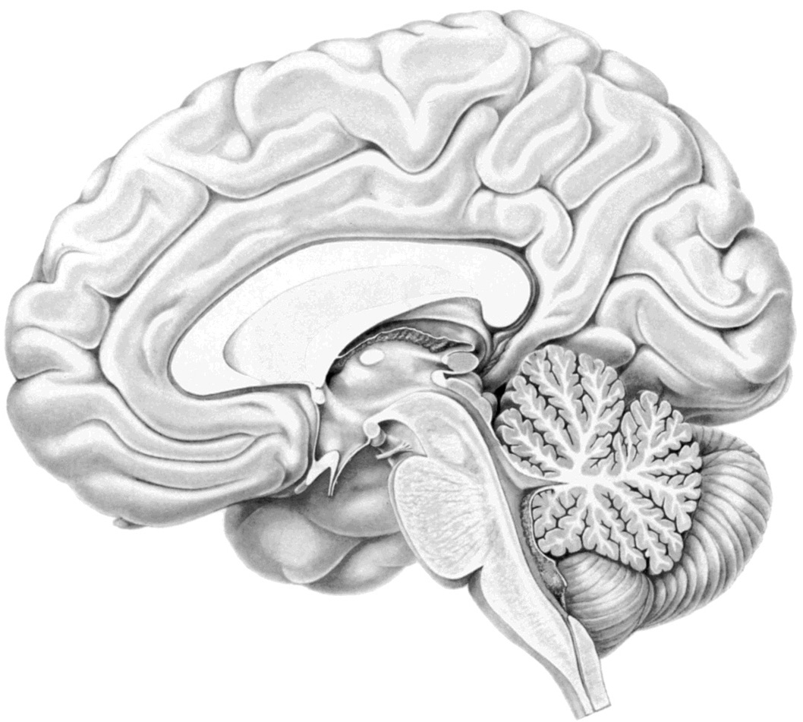
Brain (encephalon)
Cerebrum
Hemispheres
Diencephalon
Cerebellum
Brain stem
mesencephalon
pons
medulla oblongata

Slide 4
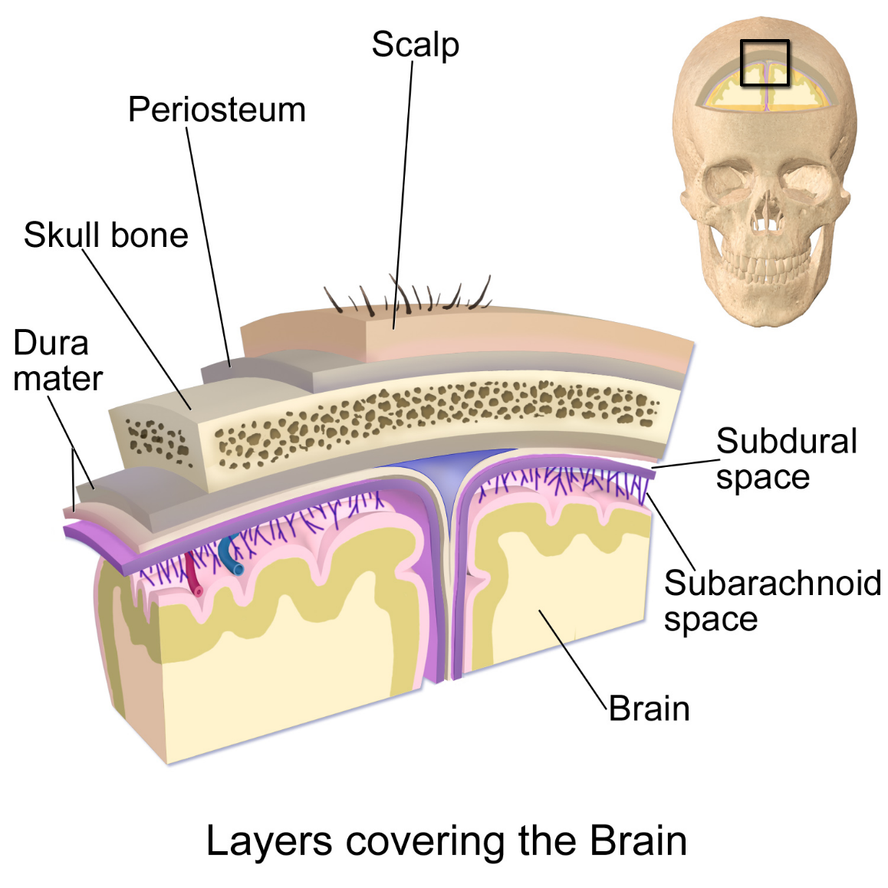
Meninges
1.) dura mater epidural space: sinuses
2.) arachnoid
3.) pia mater
subdural space
subarachnoidal space
cisterns

Slide 5
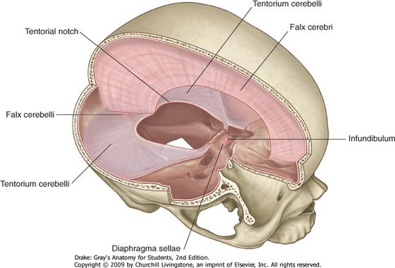
Dura mater

Slide 6
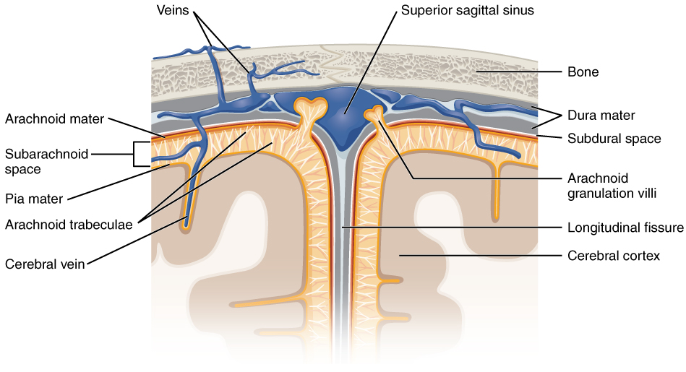
Meninges

Slide 7
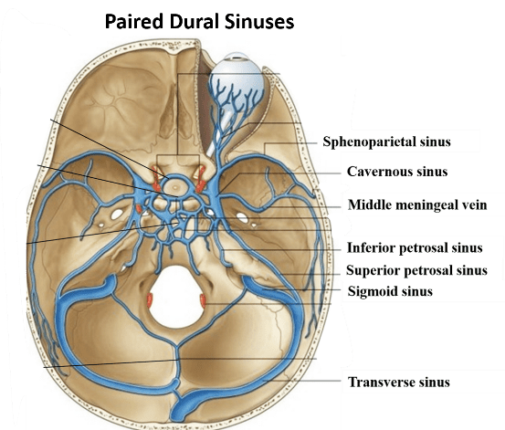
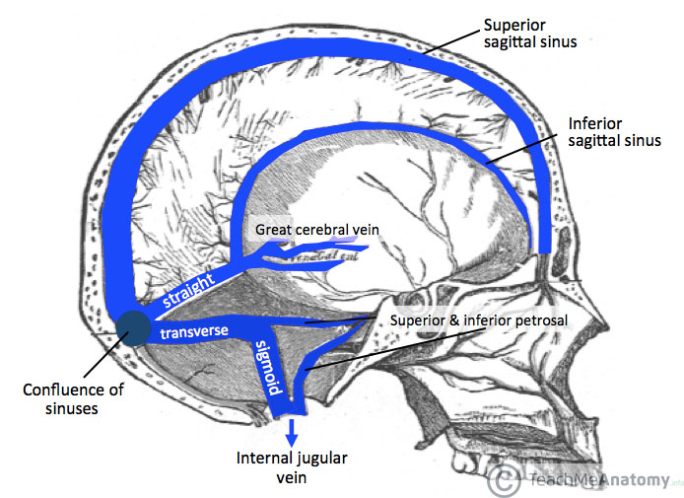
Sinuses
Paired sinuses

Slide 8
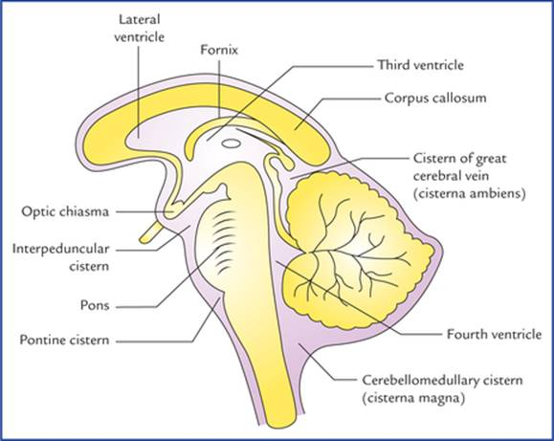
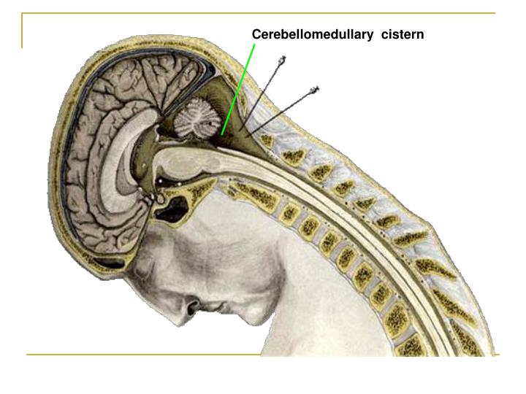
Enlarged subarachnoidal spaces: cisterns
cisterna cerebellomedullaris
cisterna venare magnae
cisterna ambiens
cisterna pontis
cisterna interpeduncularis
cisterna chiasmatis
cisterna fossae lateralis
cisterna corporis callosi……..

Slide 9
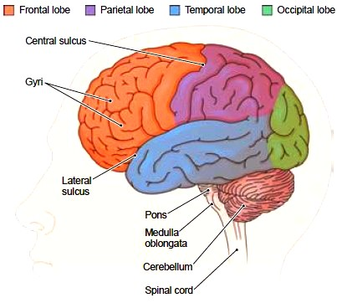
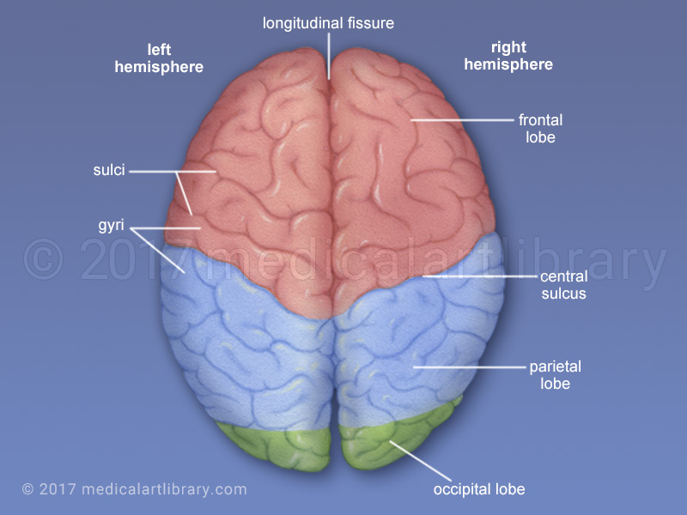

Slide 10
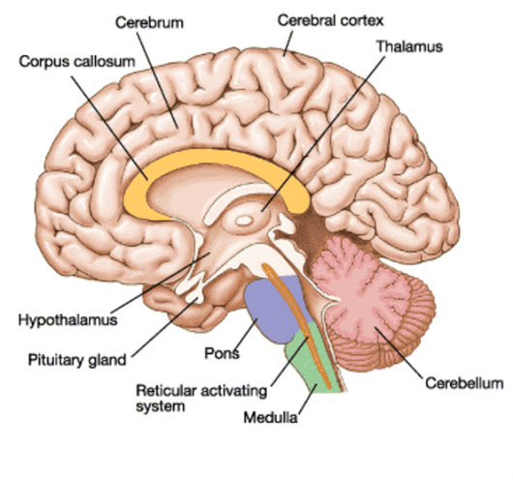
Median-sagittal section

Slide 11
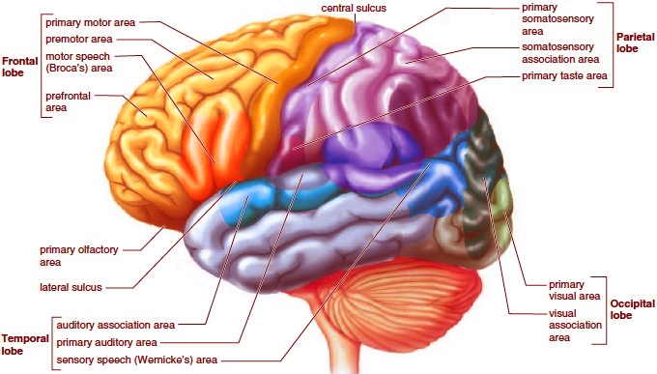
Hemispheres: functional division

Slide 12
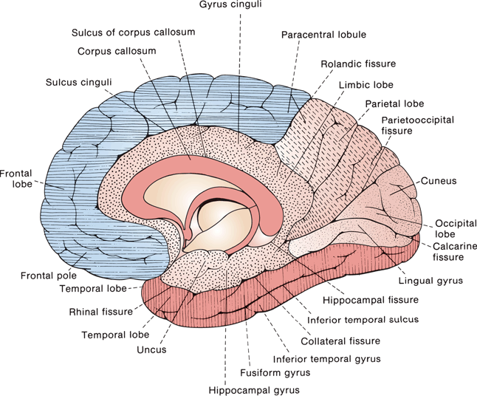
Hemispheres: median-sagittal surface

Slide 13
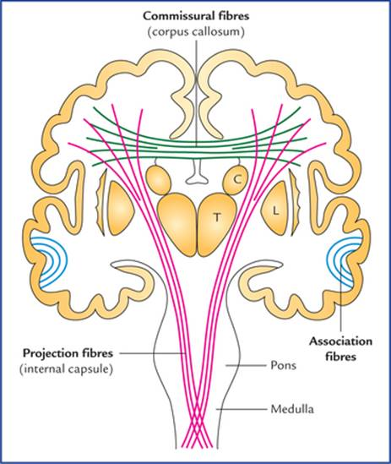
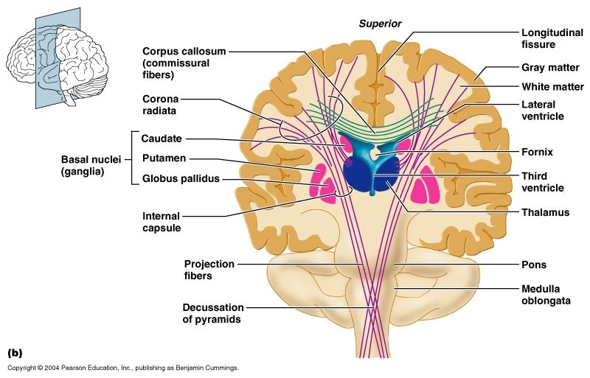
Pathways in the white matter

Slide 14
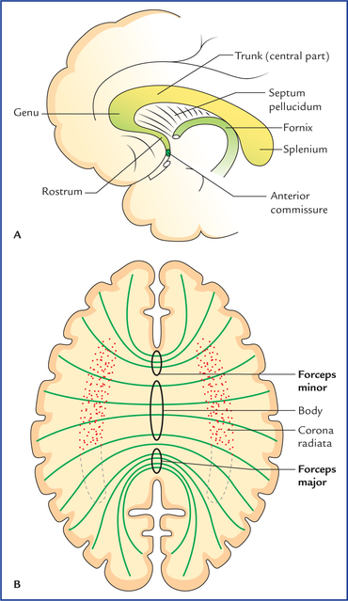
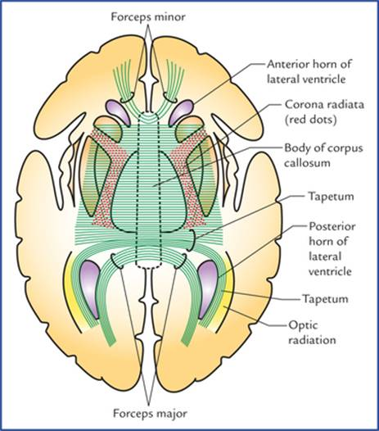
Corpus callosum

Slide 15
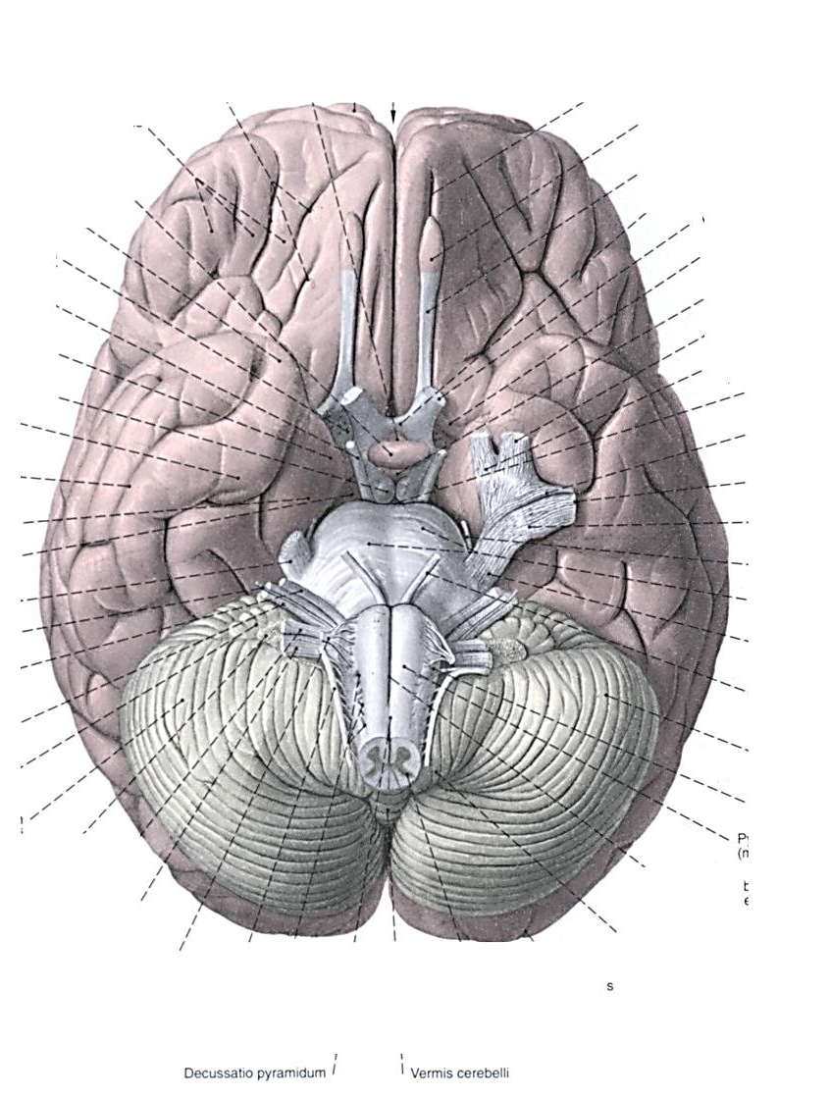
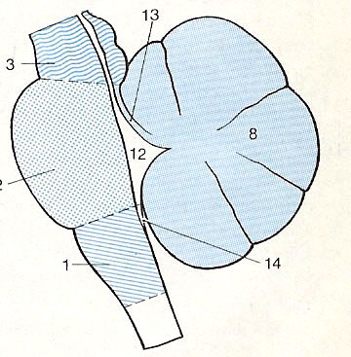
Brainstem
BASIS CEREBRI
Mesencephalon
Pons
Medula oblongata

Slide 16
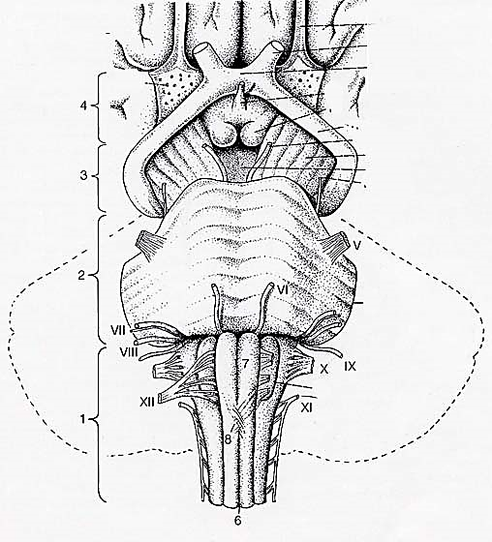
Base of the brain stem
Tractus olfactorius N.I.
Chiasma opticum, tractus opticus
Infundibulum (tuber cinereum)
Corpora mamillaria
Substantia perforata anterior
DIENCEPHALON
Pedunculus cerebri
Fossa interpeduncularis
(subatantia perforata posterior)
N. III.
MESENCEPHALON
Pedunculus cerebri
Basis pontis
Sulcus basilaris
Pedunculus cerebellaris medius
N.V.
PONS
Pedunculus cerebellaris medius
Sulcus bulbopontinus
N. VI. VII. VIII.
Fissura mediana anterior
Pyramis
Decussatio pyramidum
Oliva
Sulcus parolivaris medialis:
Fila radicularia nervi N. XII,
Sulcus parolivaris lateralis:
N. IX. X. XI.
MEDULLA OBLONGATA
Oliva
Pyramis

Slide 17
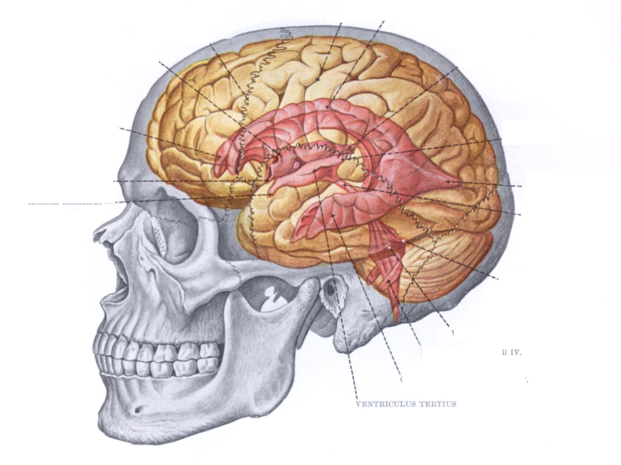
Ventricles

Slide 18
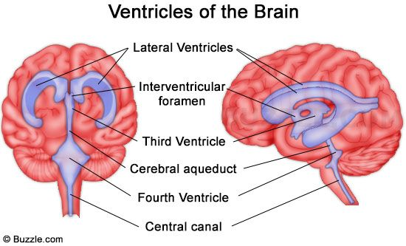
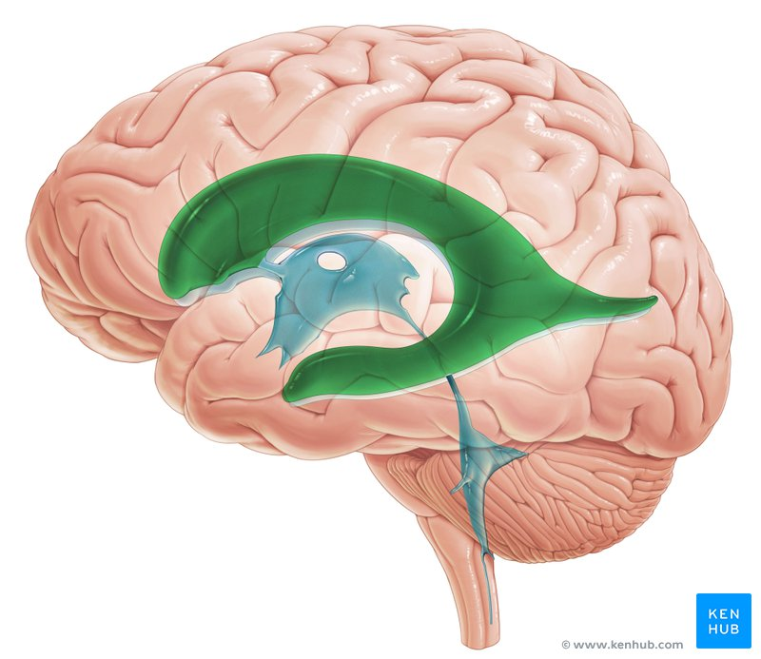
Ventricles

Slide 19
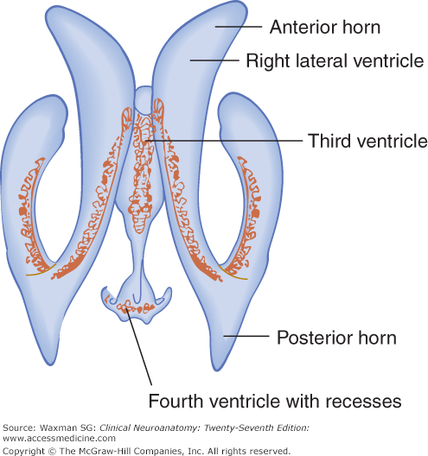
Lateral ventricles
Central part
Inferior horn

Slide 20
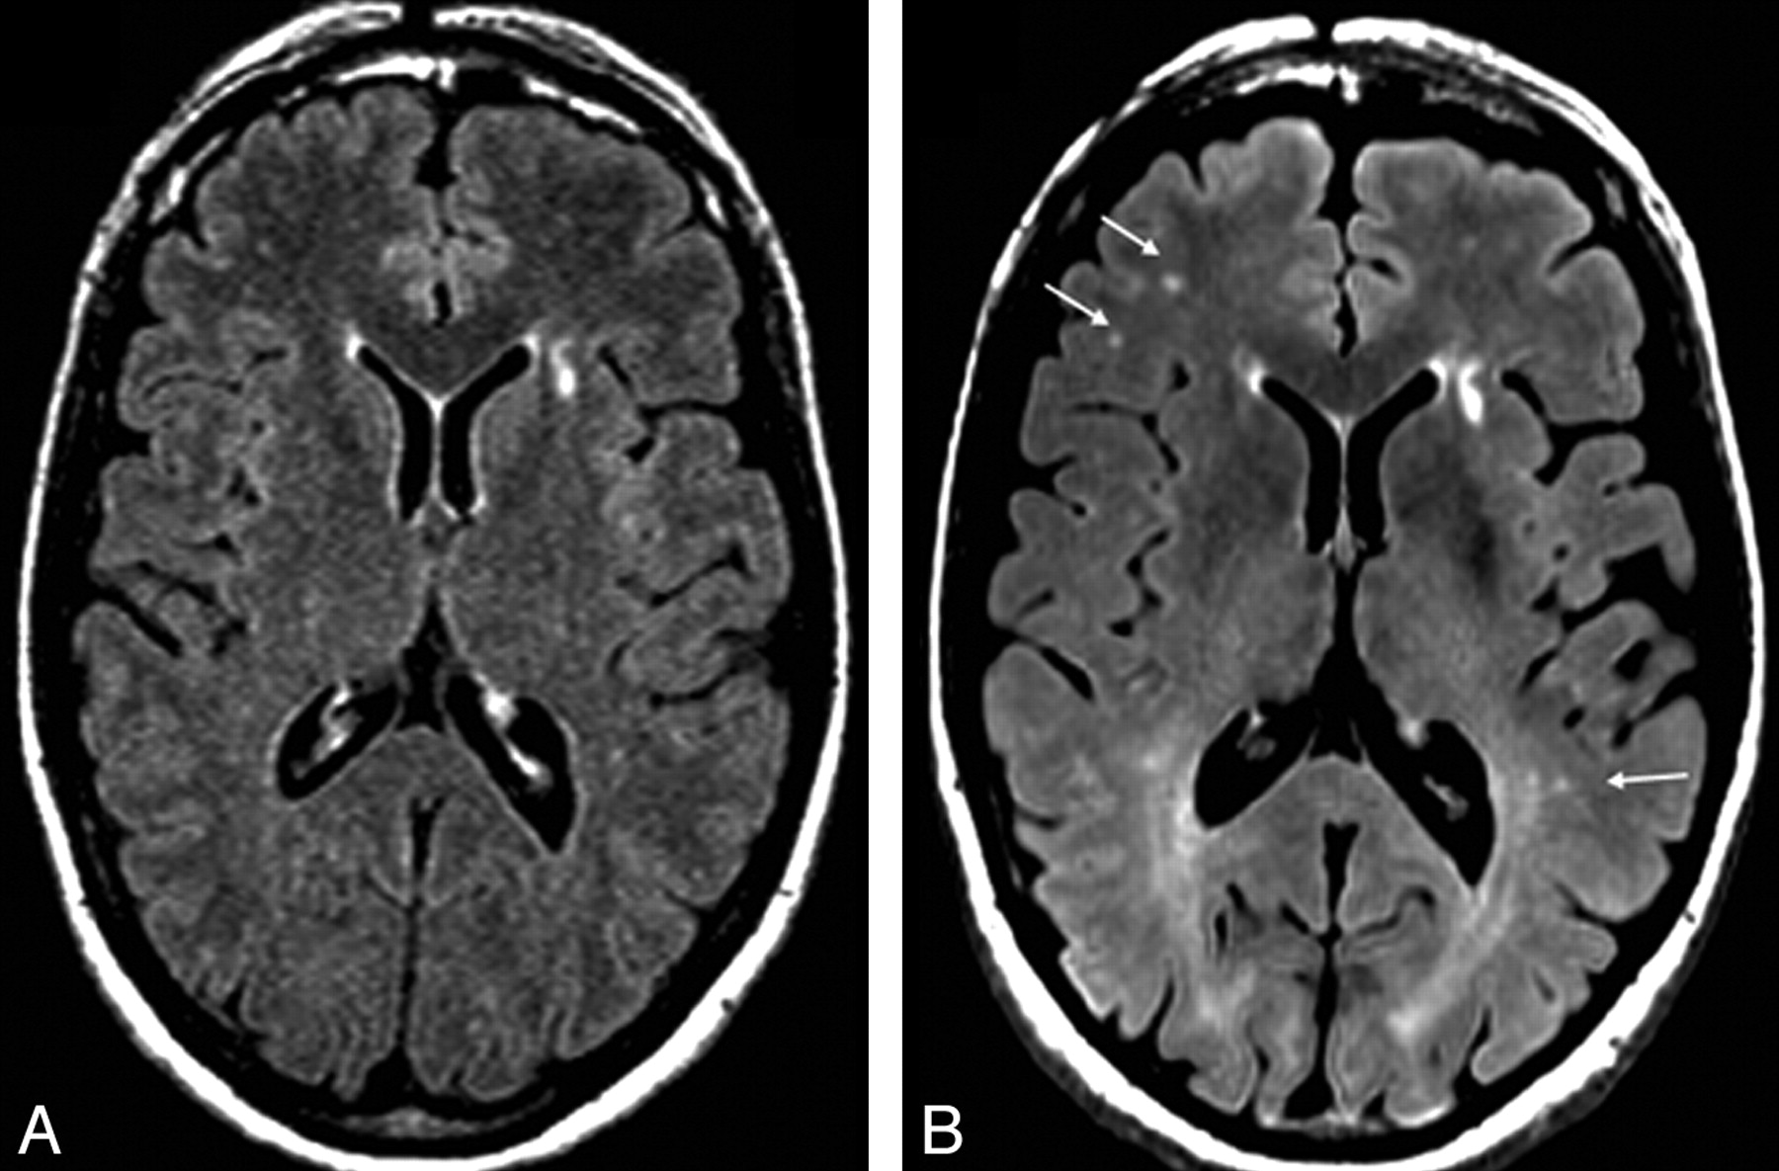

Slide 21
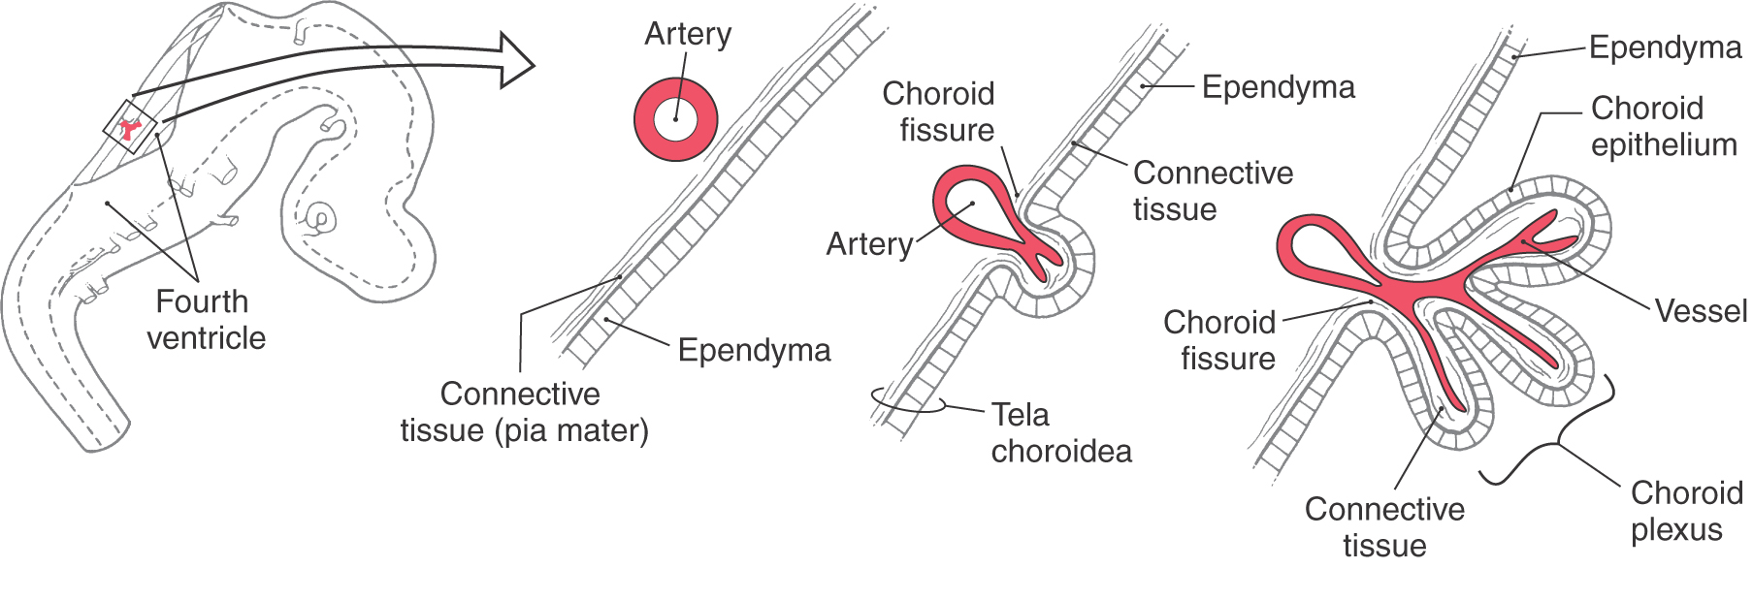
Plexus choroideus, tela choroidea

Slide 22
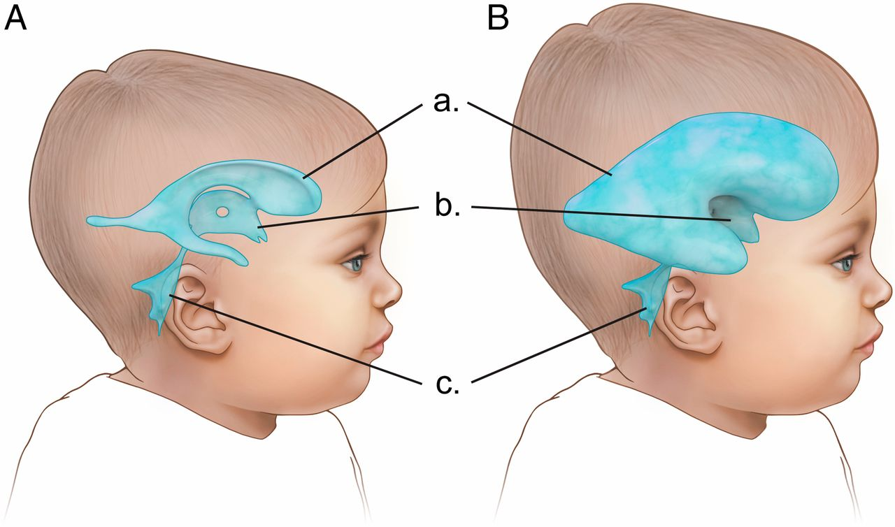
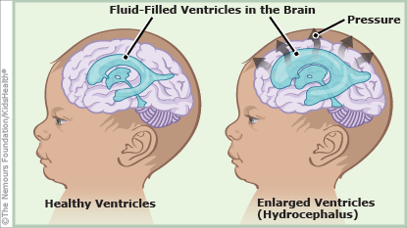
Hydrocaphalus

Slide 23
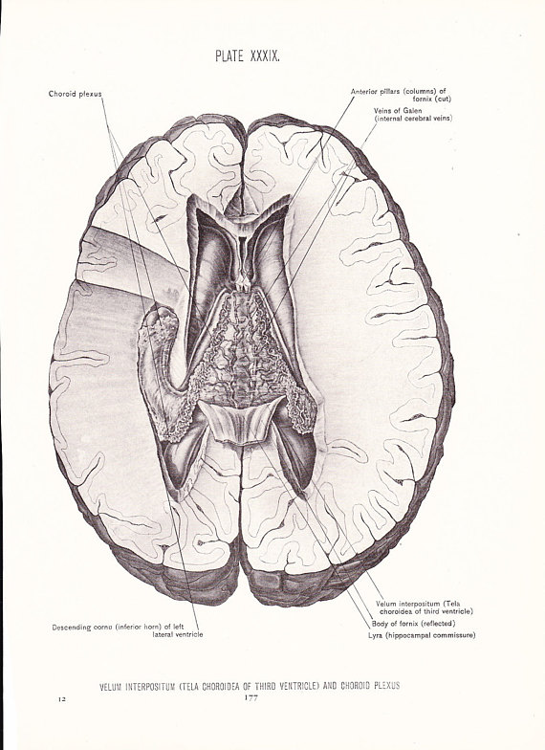
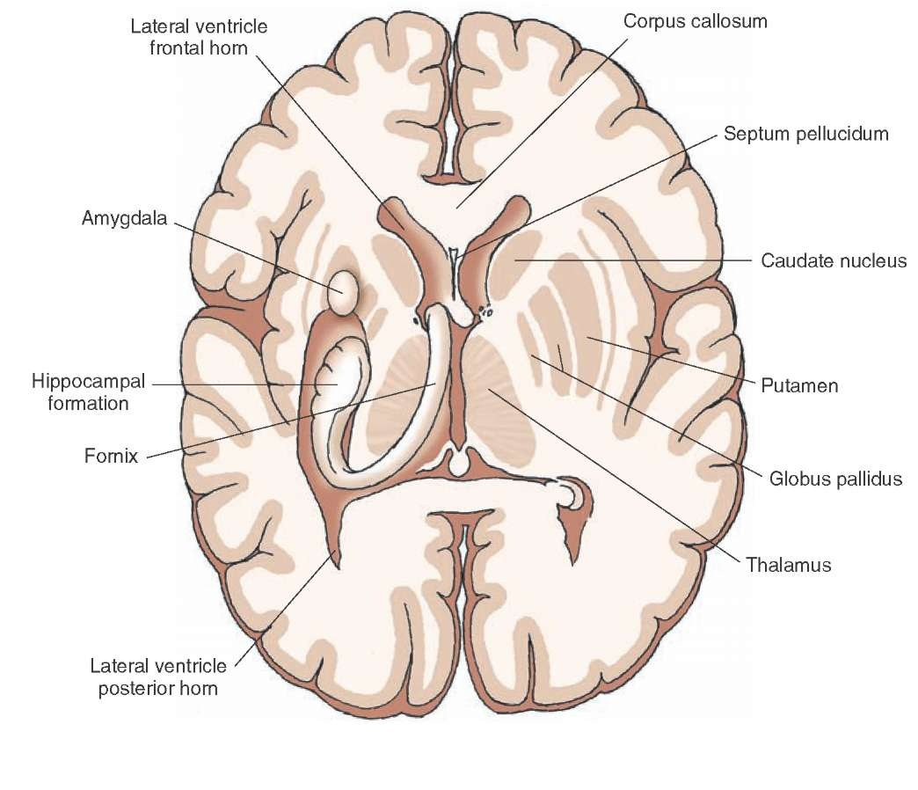
Lateral ventricle

Slide 24
Lateral ventricles
Cornu anterior: frontal lobe
inf.: rostrum corporis callosi
ant.: genu corporis callosi
sup.: corpus corporis callosi
lateral: caput nuclei caudati
medial: septum pellucidum
Pars centralis: parietal lobe
sup.: corpus corporis callosi
medial: fornix (corpus fornicis)
lateral: stria terminalis (v. thalamostriata)
inf: simple epithelium covering the surface of the thalamus (lamina affixa)
Cornu posterius: occipital lobe
sup., lateral: irradiation of the splenium corporis callosi
medial: impression of calcarine groove (sulcus calcarinus)(calcar avis)
Cornu inferior: temporal lobe
sup., lateral: irradiation of the corpus callosum (tapetum)
inf.: impression of collateral groove (sulcus collateralis): eminentia collateralis
medial: hippocampus

Slide 25
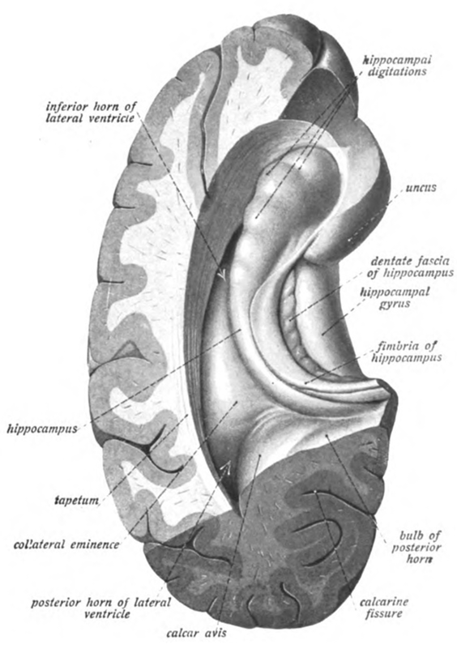
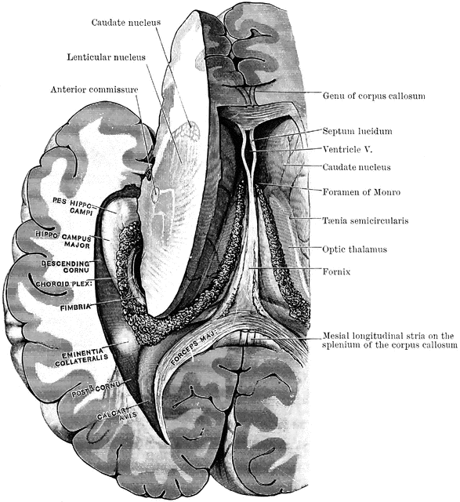
Lateral ventricle

Slide 26
References
Réthelyi-Szentágotai: Funkciona anatomy
Wikipaedia

