Slide 1
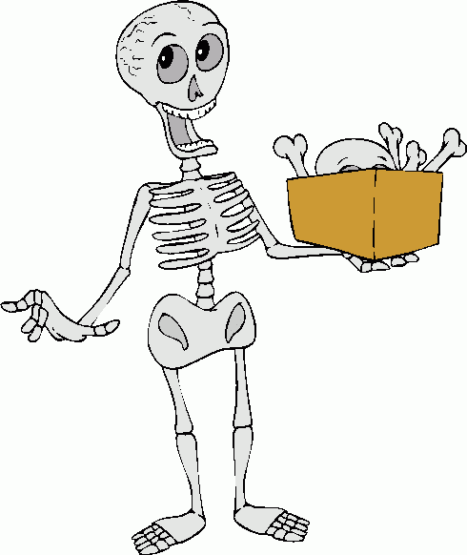
General arthrology and myology
Mark Kozsurek, M.D., Ph.D.
assistant professor
ED I., 24th Sept., 2018

Slide 2
Joints between bones
1. Continuous joints (synarthroses): no gap, more stable but less mobile or completly immobile connections
a) Fibrous joint (syndesmosis)
b) Cartilaginous joint (synchondrosis)
c) Bony union (synostosis)

Slide 3
Fibrous joints (syndesmoses)
Connection is made by connective tissue composed of mainly collagen and/or elastic fibres.
collagen-rich interosseous membrane between the radius and ulna

Slide 4
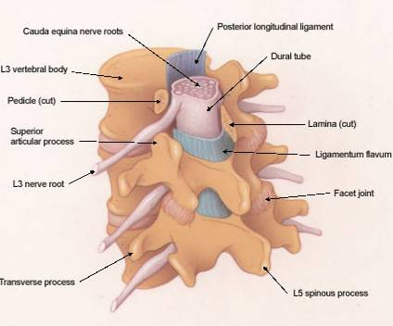
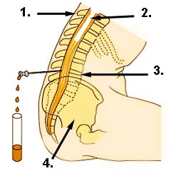
lumbarpucture, CSF sample
elastic liggamenta flava connecting adjacent vertebral arches

Slide 5
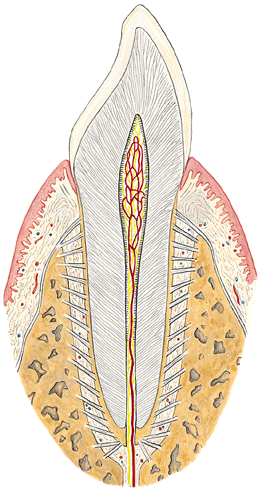
gomphosis
tibiofibularis syndesmosis

Slide 6
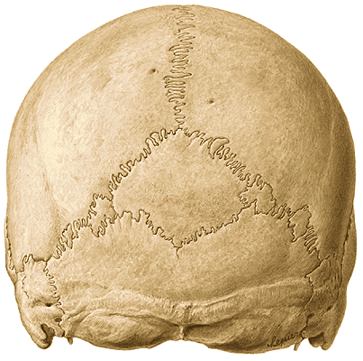
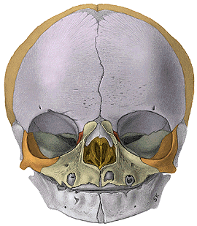
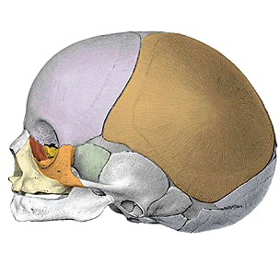
serrate sutures

Slide 7
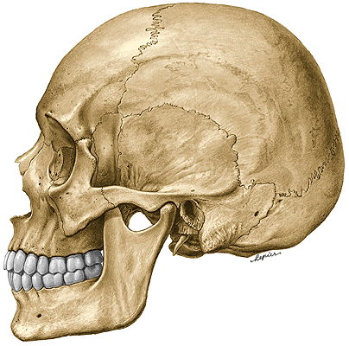
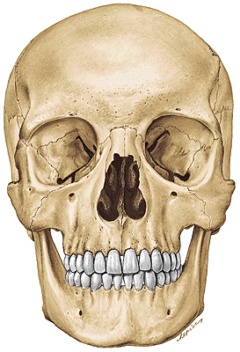
squamous sutures
plane sutures

Slide 8
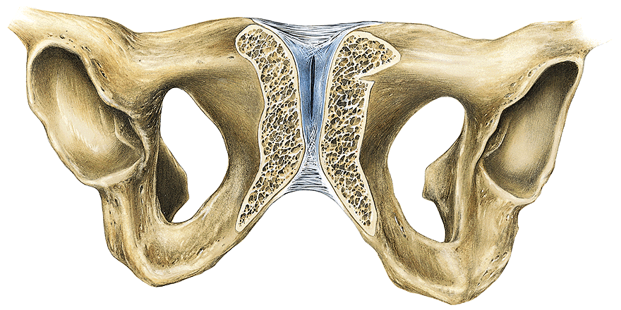
Cartilaginous joints (synchondroses)
Adjacent bones are connected together by hyaline or fibrocartilage. The most of those made of hyaline cartilage ossify by the end of puberty.
pubic symphysis: as a gap appears inside, this is a transitional form between regular cartilaginous joint and synovial joint - hemidiarthrosis

Slide 9
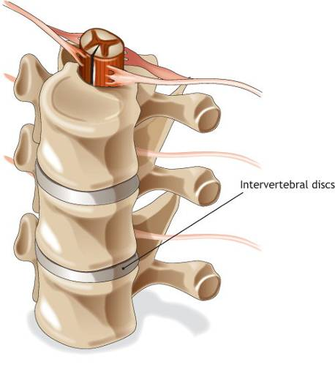
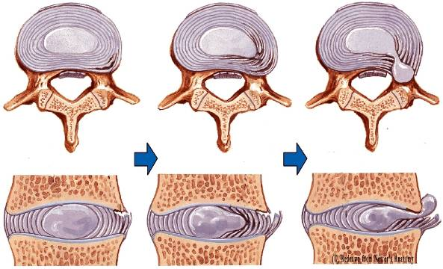

Slide 10
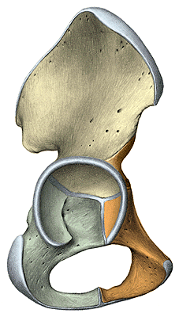
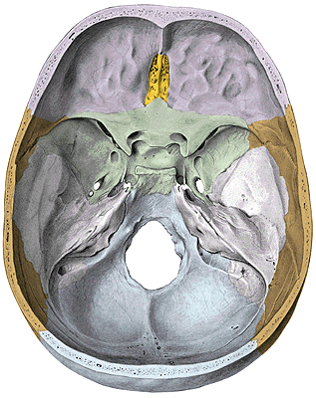
sphenooccipital synchondrosis
petrooccipital synchondrosis
Later all these synchodroses transform into synostoses!

Slide 11
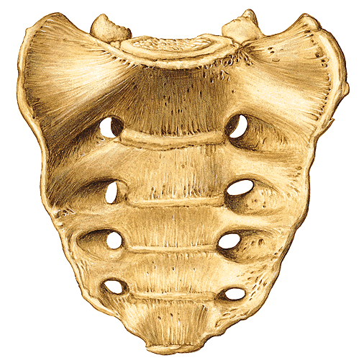
Bony unions (synostoses)
The most of them was cartilagineous connection that later ossified.

Slide 12
Joints between bones
1. Continuous joints (synarthroses): no gap, more stable but less mobile or completly immobile connections.
a) Fibrous joint
(syndesmosis)
b) Cartilaginous joint
(synchondrosis)
c) Bony union
(synostosis)
2. Discontinuous joints (synovial joints, diarthroses): hyalin cartilage-covered articulating surfaces isolated by a synovial gap filled by synovial fluid and enclosed by a capsule.

Slide 13
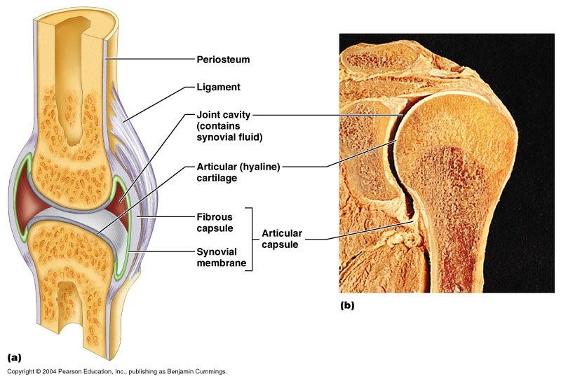
Obligatory components of synovial joints
1) articulating surfaces → determine available movements
2) articular capsule
3) synovial gap and fluid

Slide 14
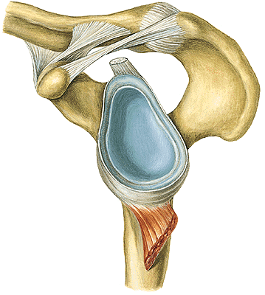
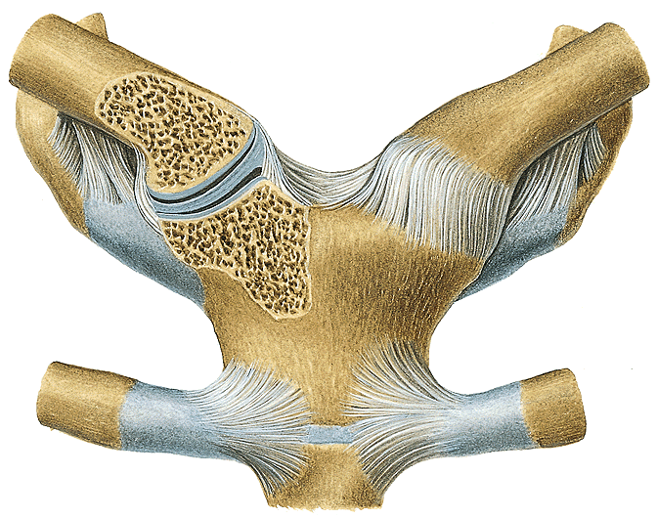
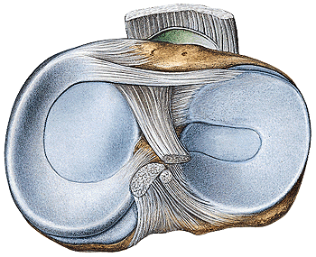
Additional components of synovial joints
articular ligaments
articular lips (glenoid and acetabular labrum)
articular discs, menisci
articular muscles (knee joint only)

Slide 15
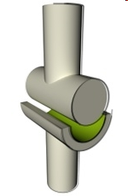
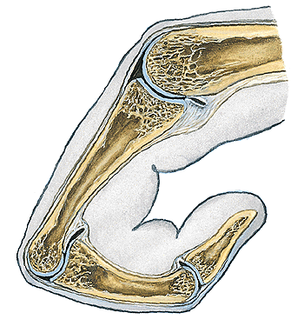
Classification of joints according to the number of axes
1. Uniaxial joints:
a) ginglymus (hinge joint): axis of movement is perpendicular to the axis of articulating bones (e.g. interphalangeal joints ).

Slide 16
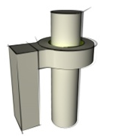
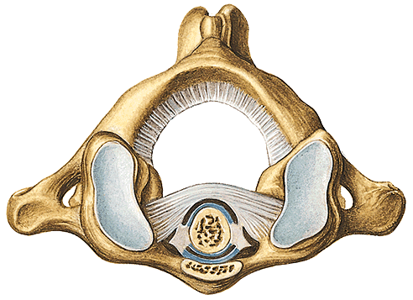
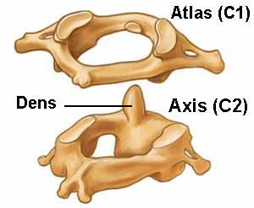
1. Uniaxial joints:
b) trochoid joint (pivot joint): axis of rotation is parallel to the articulating bones
e.g.: atlantooccipitalis joint

Slide 17
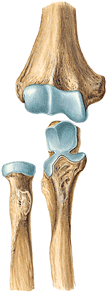
2. Biaxial joints:
a) trochoginglymus (hinge-and-pivot joint): combination of the former two types
e.g.: elbow joint

Slide 18
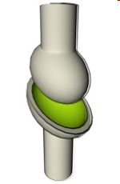
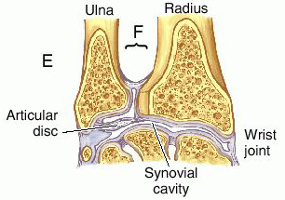
2. Biaxial joints:
b) ellipsoidal joint : two perpendicular axes
e.g.: wrist (radiocarpal) joint

Slide 19
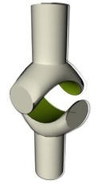
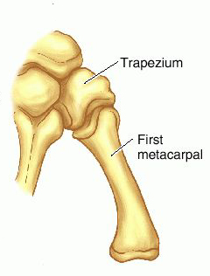
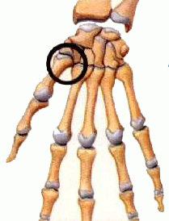
2. Biaxial joint:
c) saddle joint: carpometacarpal joint of the thumb isthe only one in the human body

Slide 20
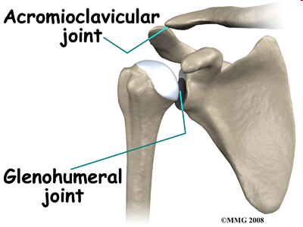
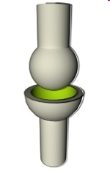
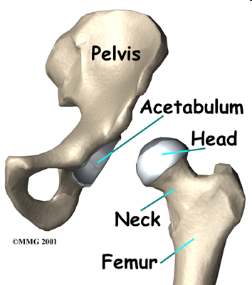
3. Multiaxial joint:
a) spheroid joint (ball-and-socket, free joint)

Slide 21
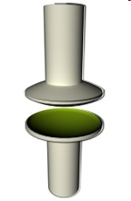
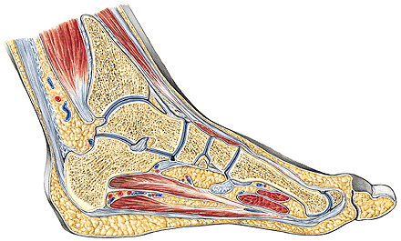
3. Multiaxial joint:
b) plane joint: limited gliding movement
e.g.: joints of carpal and tarsal bones

Slide 22
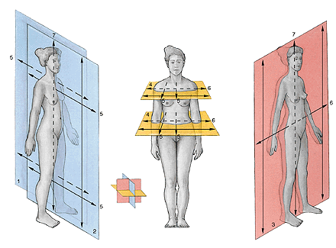
Describing movements
AXES 5: sagittal, 6: transverse, 7: longitudinal
PLANES sagittal transverse frontal

Slide 23
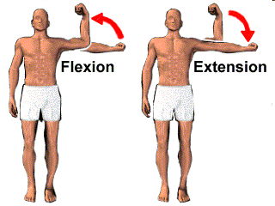
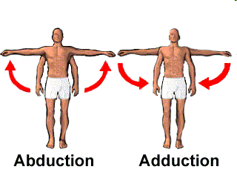
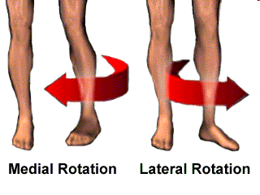
Flexion – extension
Abduction – adduction
Rotation
The most of the joints have their
specific terms for describing
their specific movements.

Slide 24
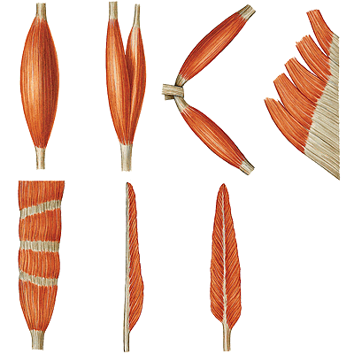
About muscles is general...
fusiform biceps biventer plane
Mobile end – fixed end, origin – insertion
Auxiliary features of muscles:
Tendon sheaths and synovial bursae
Connective tissue sheaths, fasciae
Fatty bodies
Sesamoid bones
intersected unipennate bipennate

Slide 25
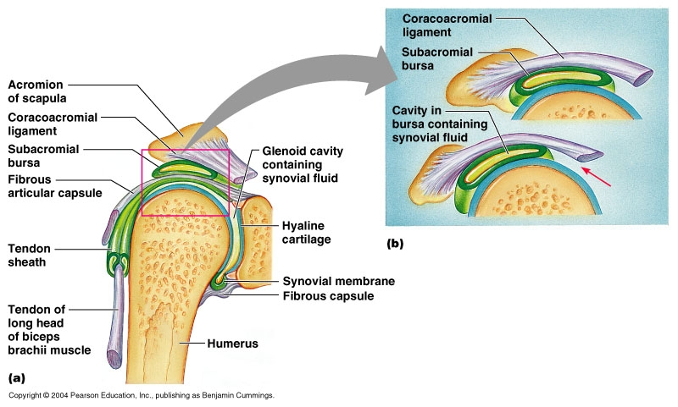
Bursae and tendon sheats
Both of them are found at points of friction between moving structures (a tendon and a bone, typically). Both of them consists of an inner synovial layer and an outer fibrous layer. In fact, tendon sheats might be considered as special bursae into which the tendon completly invaginates. Supplying small vessels as well as nerve fibres reach the thendon through the mesotendineum.

Slide 26
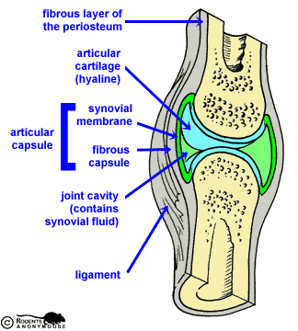
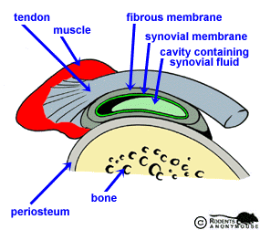
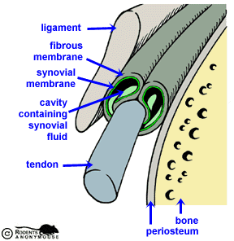
Note the homologous structure of the capsule, tendon sheaths and bursae: outer fibrous and inner synovial layers.

Slide 27
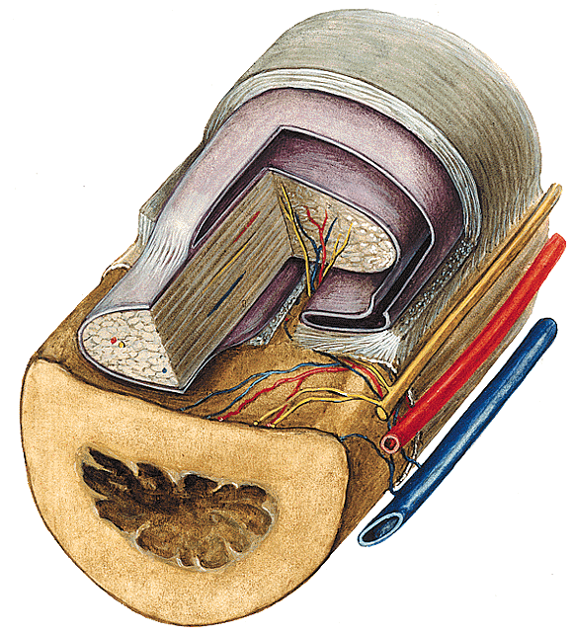
Lifting the tendon sheath interrupts supplying vessels that leads to the necrosis of the tendons involved.

Slide 28
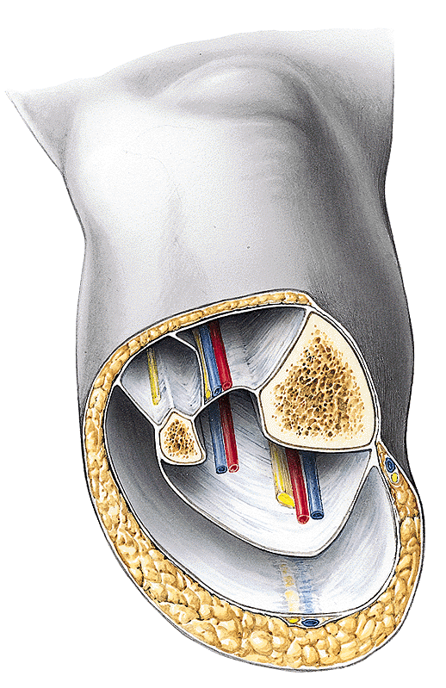
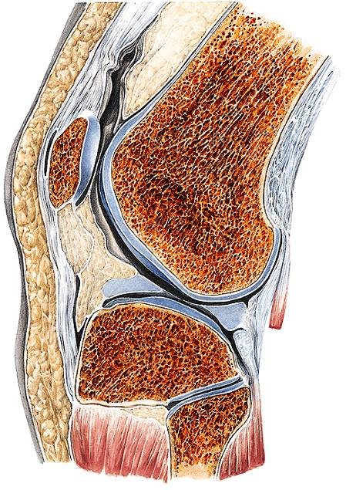
muscle compartments isolated by fasciae fatty bodies

Slide 29
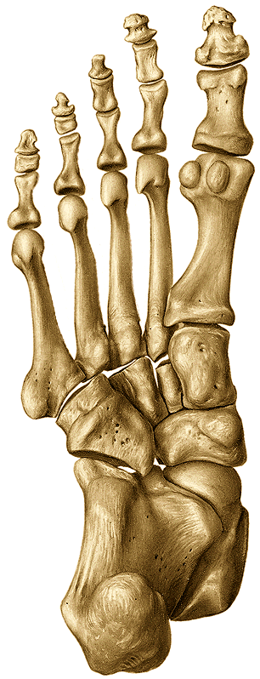
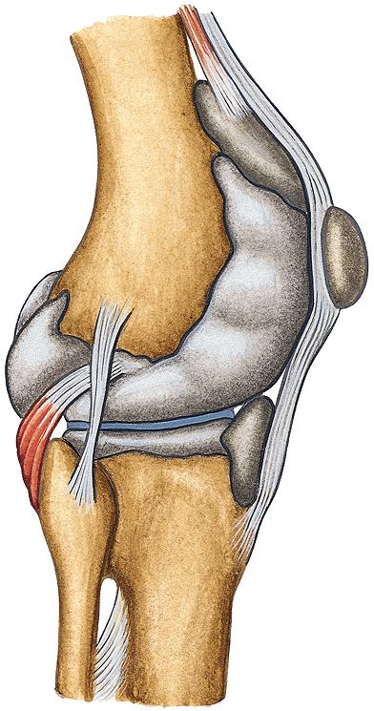
Axis of movement
Sesamoid bones
Due to the elongation of the moment arms, the same forces result in bigger torques.

Slide 30
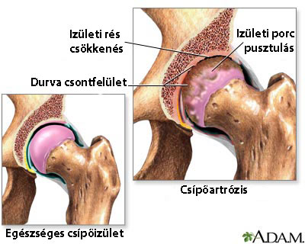
Clinical considerations
Rheumatoid artritis
Arthrosis

Slide 31
Mozaicplasty
OATS: osteochondral autograft transfer system

Slide 32
Knee and hip prostheses

Slide 33
Thank you for your attention!

