Slide 1
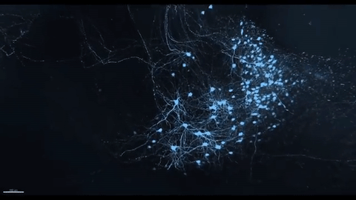
Gross anatomy of spinal cord
Dr. Andras Attila Horvath, MD, PhD

Slide 2
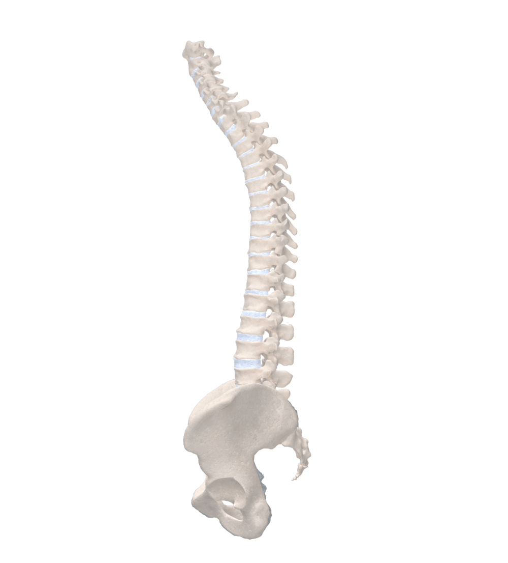
Agenda
Macroscopy
Blood supply, meninges
Dermatomes

Slide 3
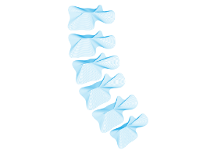
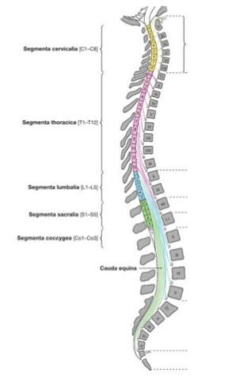
Position of medulla spinalis
Foramen magnum
Medulla spinalis- adults
Lumbal vertebrae 1-2.
Medulla spinalis-newborns
Coccyx

Slide 4
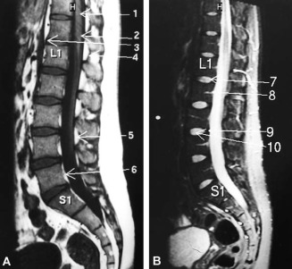
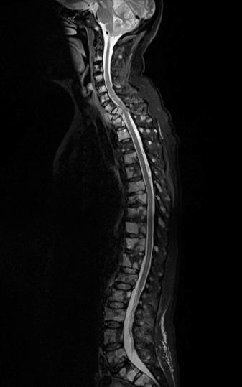
Position of medulla spinalis

Slide 5
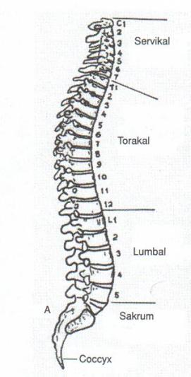
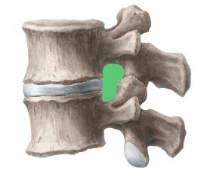
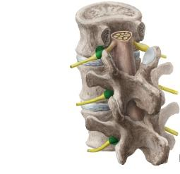
Vertebral column/ spinal canal
C1-C7
Vertebral body
Intervertebral foramen
Th1-12
Intervertebral disc
Spinal canal
L1-L5
Sacrum (5)
Coccyx (3-5)

Slide 6
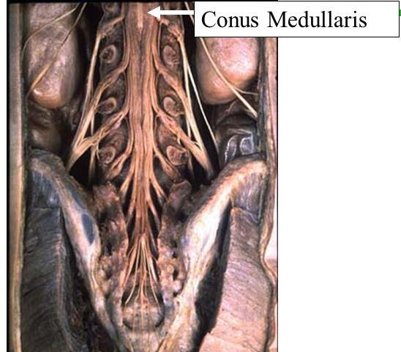
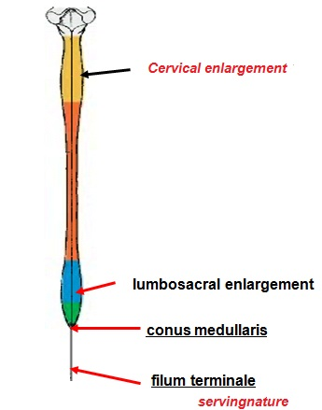
Parts
Medullary cone
Cervical
enlargement
Lumbar
enlargement
Cauda equina
Medullary cone
Terminal filum

Slide 7
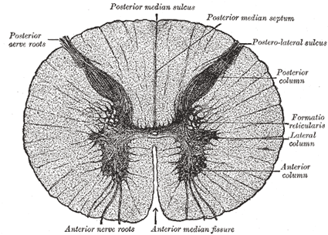
Cross section
Median posterior sulcus
Posterior funiculus
Median posterior septum
Posterolateral sulcus
Posterior
radix
Posterior horn
Lateral funiculus
Lateral horn
Central canal
Anterior horn
Anterior funiculus
Anterior radix
Anterior median fissure

Slide 8
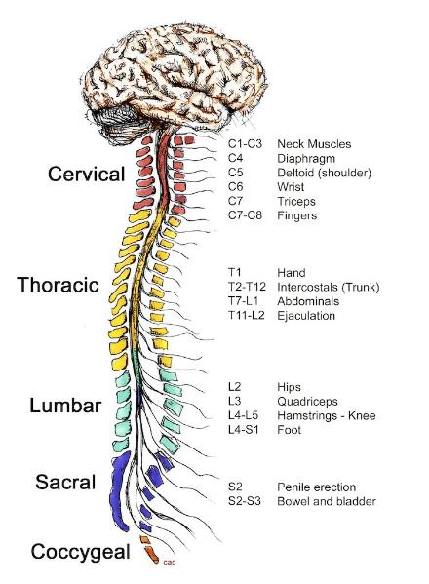
Segments
Section belonging to 1 pair of spinal nerves
8C, 12T, 5L, 5S, 1Co=31
Nerve exit is below the corresponding vertebra, excepting cervical part (above, since we have 7C vertebrae and 8 C nerves)

Slide 9
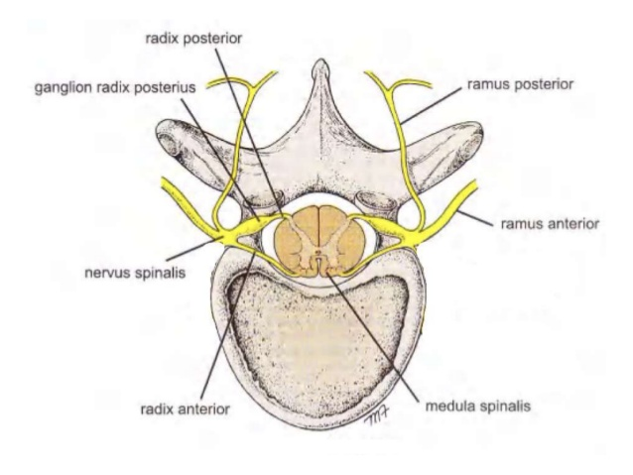
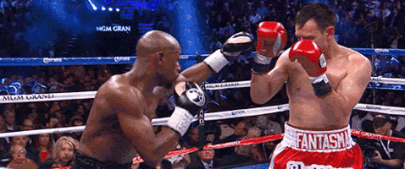
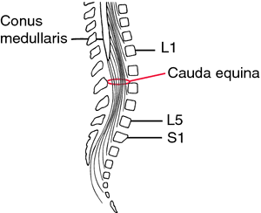
Radix Vs nerve
Spinal canal= radices
Intervertebral foramen-= nerves

Slide 10
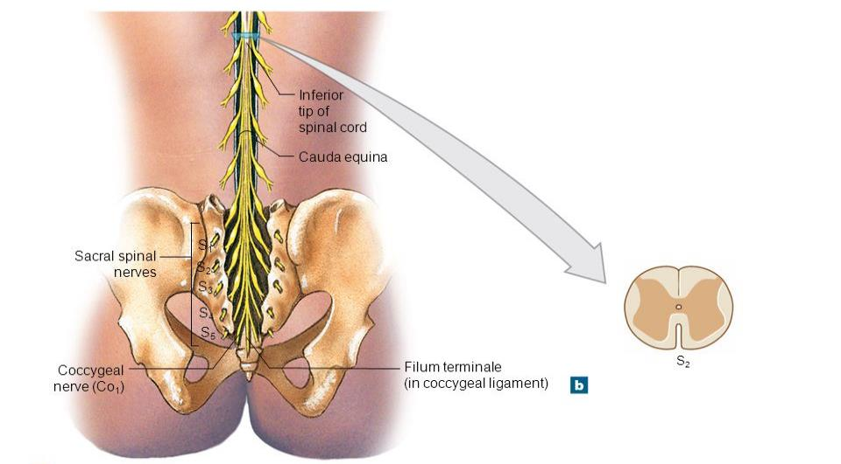
S2
Medullary cone
Cauda equina
S2 segment
S2 spinal nerve
Coccygeal nerve
Terminal filum

Slide 11
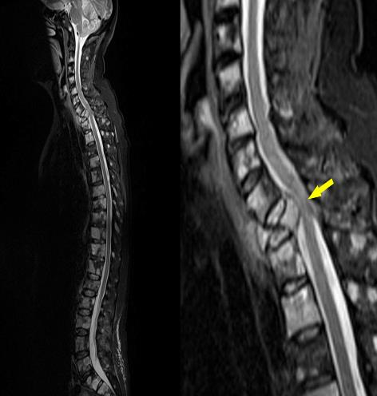
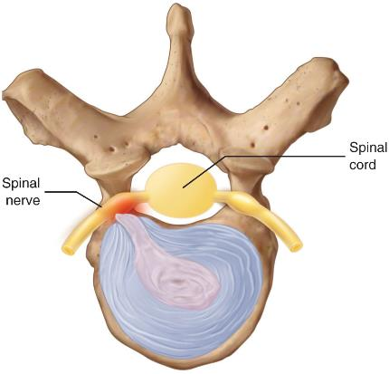
Discus herniation
Spinal cord
Spinal nerve
Intervertebral dics

Slide 12
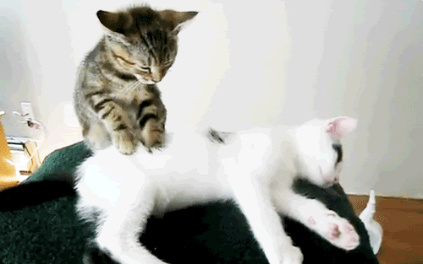
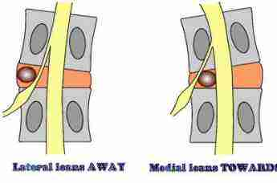
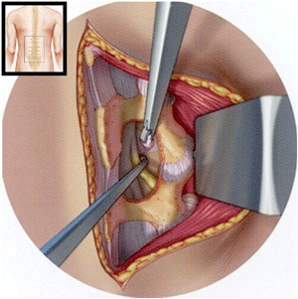
Medial vs lateral hernia

Slide 13
Agenda
Macroscopy
Blood supply, meninges
Dematomes

Slide 14
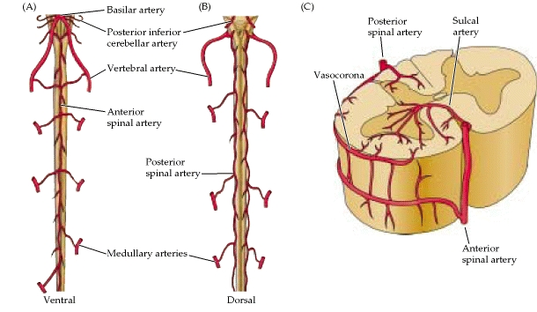
Arterial blood supply
Basilar a.
Posterior
spinal a.
Sulcal a.
PICA
Vertebral a.
Vasocorona
Anterior spinal a.
Posterior spinal aa.
Medullary aa.
Anterior spinal a.

Slide 15
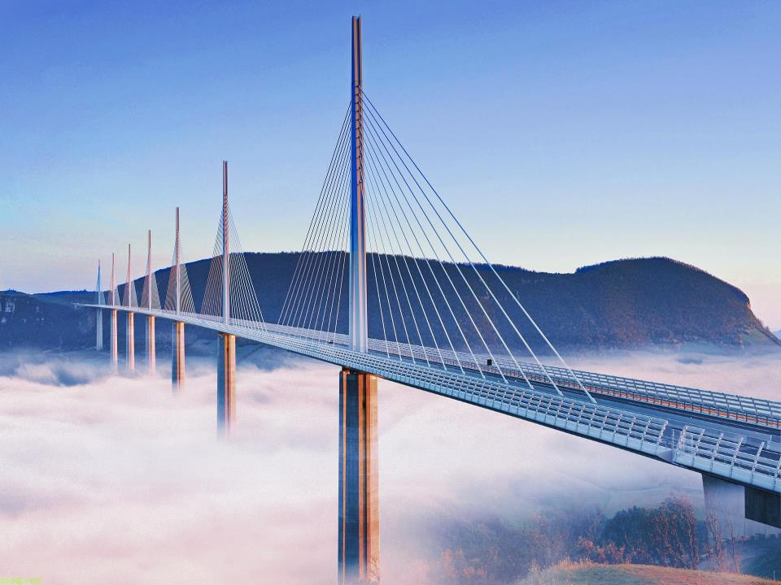
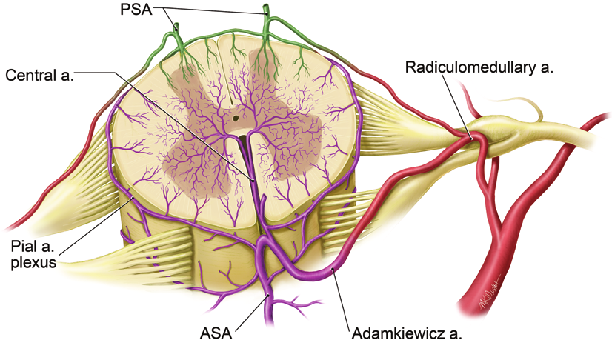
Vérellátás

Slide 16
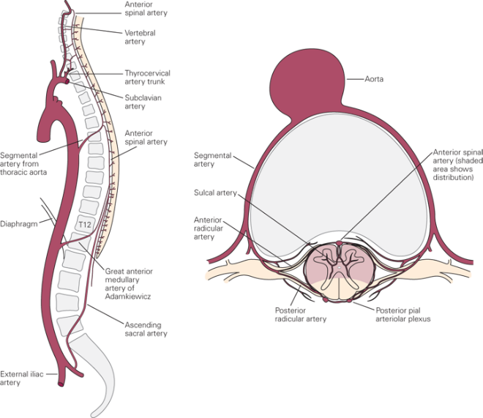
Medullary arteries
Anterior spinal a.
Vertebral a.
Thyrocervical trunk
Aorta
Subclavian a.
Anterior spinal a.
Segmental aa. from thoracic aorta
Segmental a.
Sulcal a.
Diaphragm
Radicular a.
Segmental aa. from abdominal aorta
Great radicular a.
Posterior spinal a.
Lateral sacral a., iliolumbar a.
External iliac a.
Internal iliac a.

Slide 17
Great radicular artery
Posterior spinal aa.
Sulcal artery
T8- L1 radicular a.
Pial plexus
Anterior spinal a.
Great radicular a. „Adamkiewitz”

Slide 18
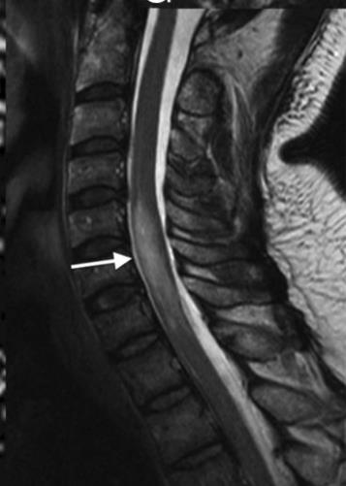
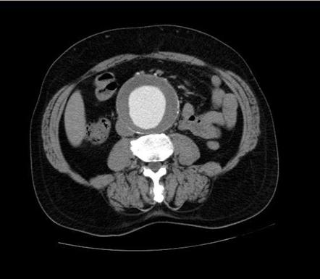
Adamkiewitz syndrome
Lower limb weakness
Urination, defecation problems

Slide 19
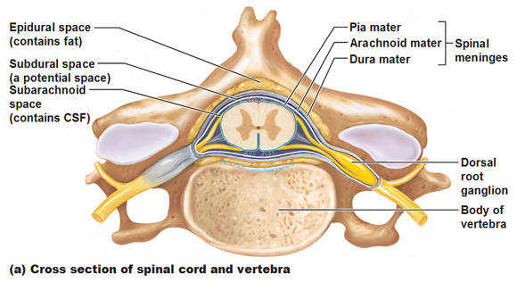
Meninges
Epidural space (fat, venous plexus)
Pia mater
Arachnoid
Subdural space (virtual)
Dura mater
Subarachnoid space
(CSF, spinali arteries)
Spinal ganglion
Body

Slide 20
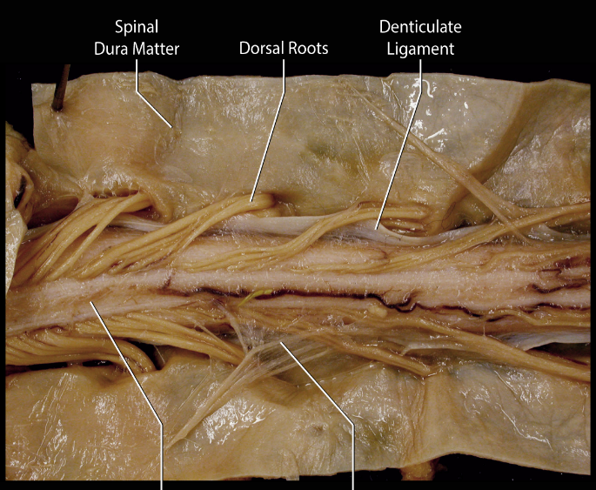
Denticulate ligaments
Dura mater spinalis
Posterior radix
Denticulate ligament
C1-T12
18-20 pairs
Distributes CSF circulation into anterior and posterior portions
Medulla spinalis
Arachnoidea spinalis

Slide 21
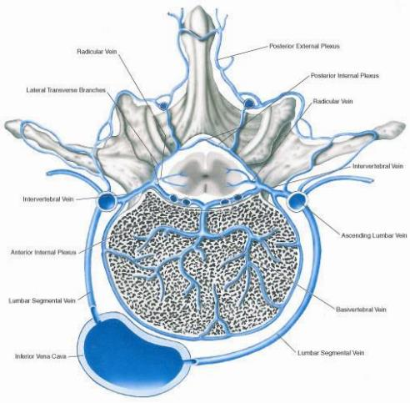
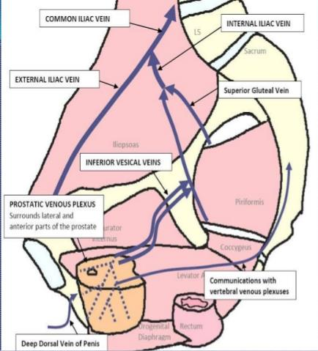
Santorini-plexus

Slide 22
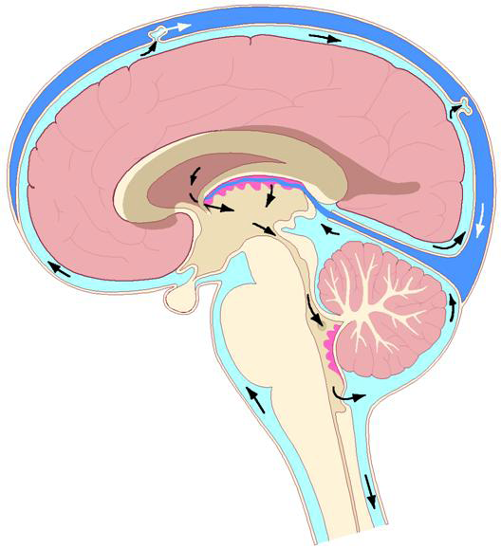
CSF circulation

Slide 23
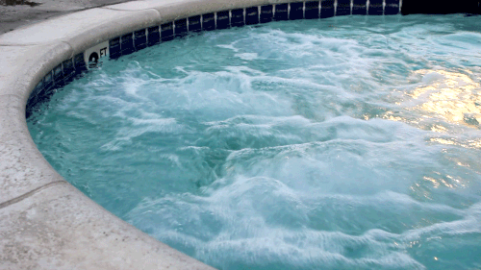
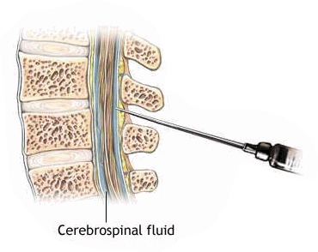
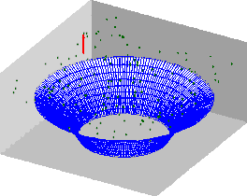
Lumbar punction
L3
L4
L5
Subarachnoid space

Slide 24
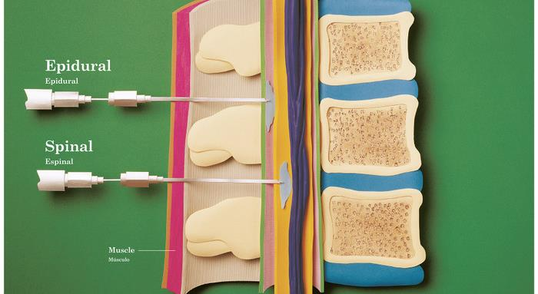
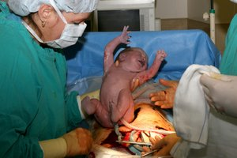
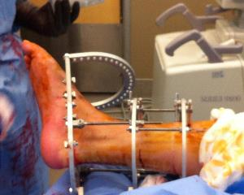
Epidural vs spinal anaesthesia

Slide 25
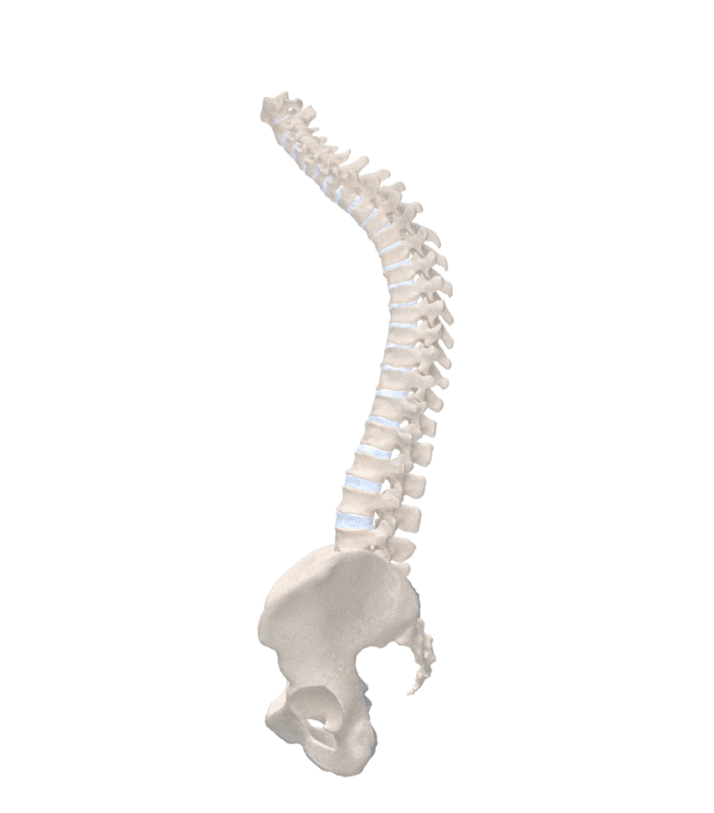
Agenda
Macroscopy
Blood supply, meninges
Dermatomes

Slide 26
Dermatomes
Skin surface belonging to 1 spinal nerve
Peripherial nerve≠ spinal nerve
Dermatomes overlap
Dermatom deficit= radix or segment; peripherial nerve area deficit = peripherial nerve

Slide 27
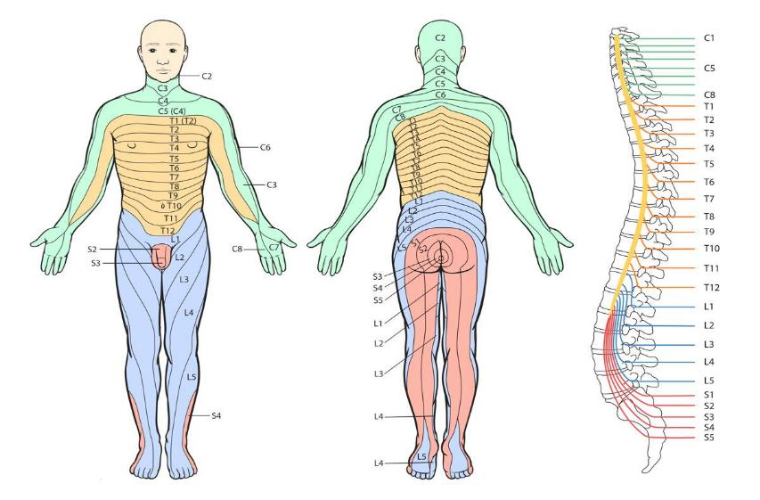
Dermatomes

Slide 28
