Slide 1
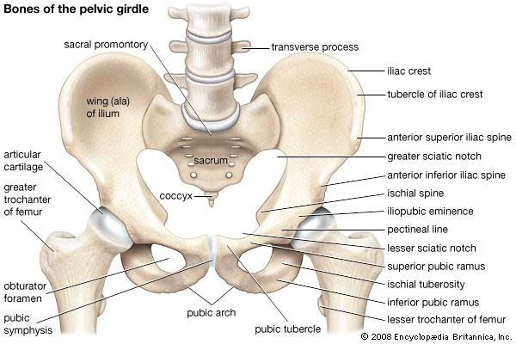
Pelvic girdle
Dr. Károly Altdorfer

Slide 2
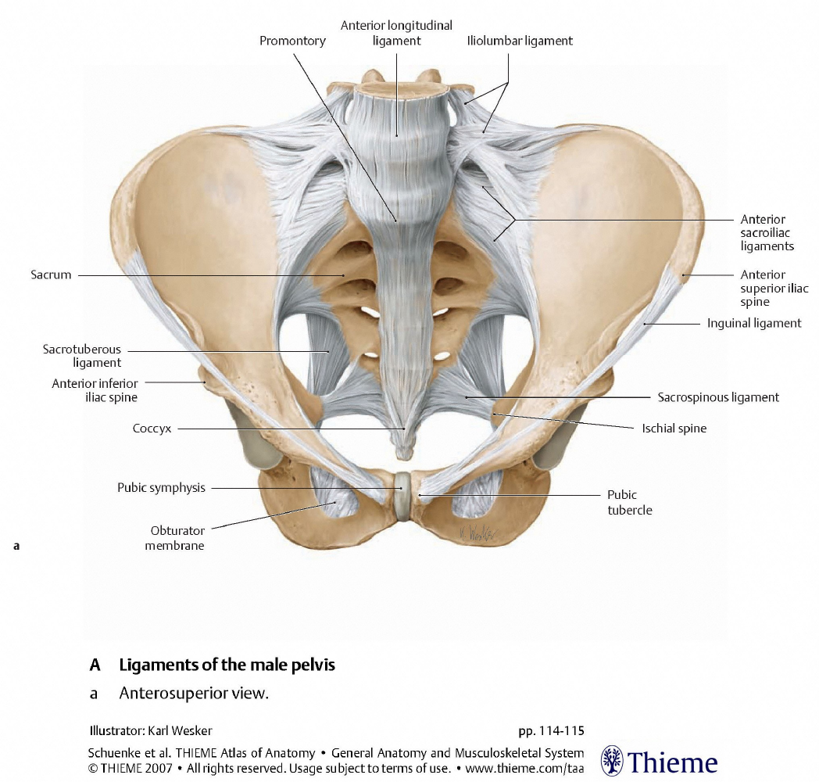
pelvis major
pelvis minor
- GREATER PELVIS
- LESSER PELVIS
SEPARATED BY
LINEA TERMINALIS

Slide 3
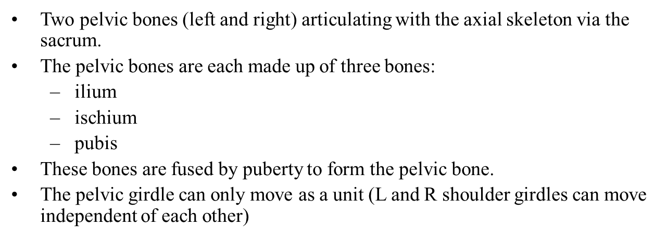

Slide 4
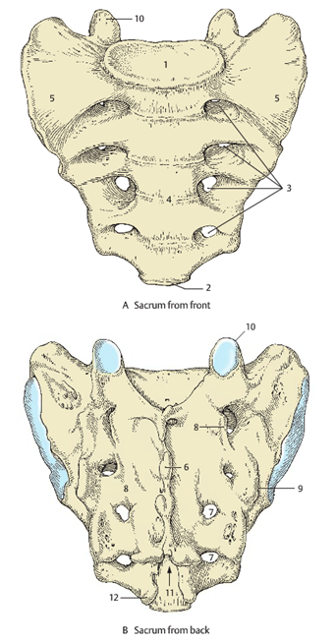
BONES

Slide 5
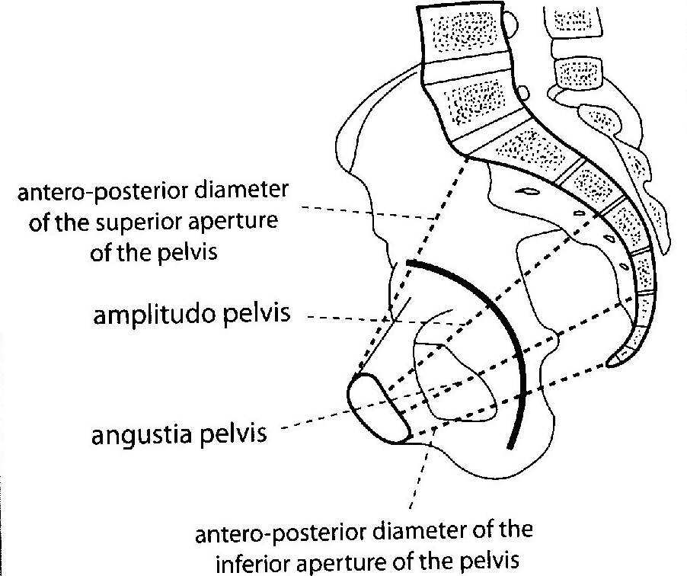
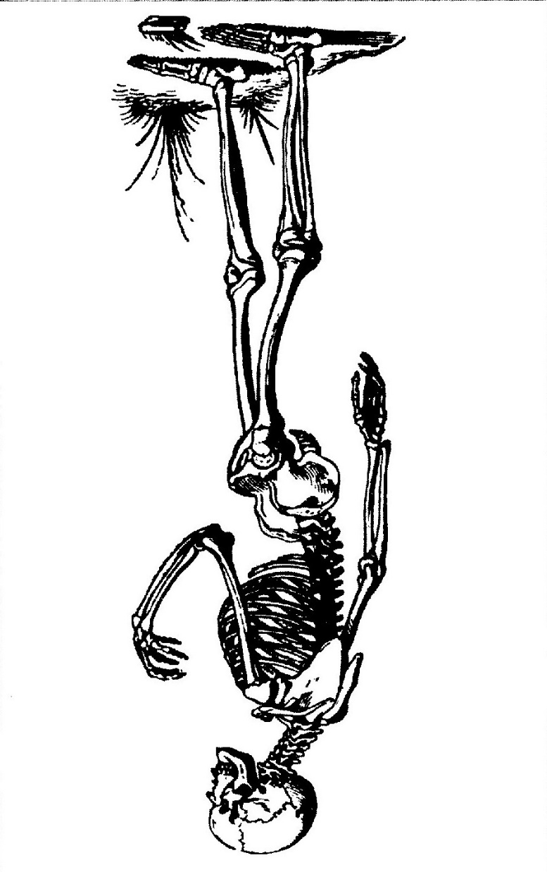
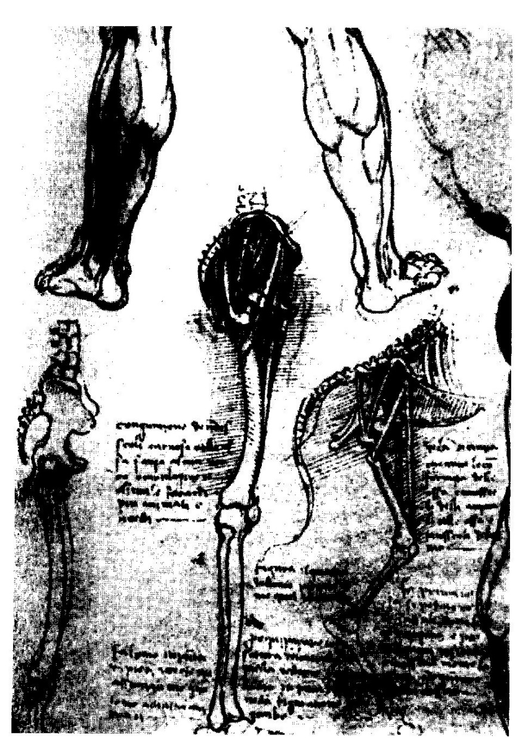
INCLINATIO PELVIS
Male: 60° female: 65°
Vesalius Leonardo

Slide 6
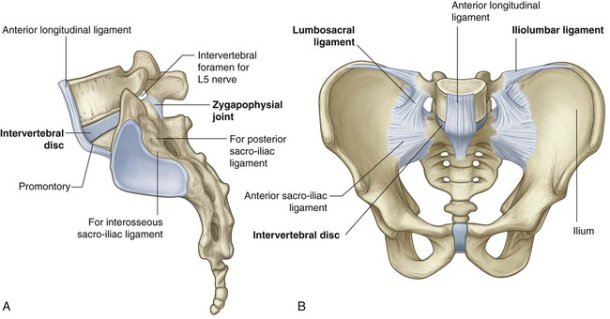
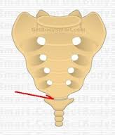
Connections
LUMBOSACRAL synchondrosis, syndesmosis
intervertebral disc
anterior and posterior longitudinal ligg.
ligg. flava
interspinal and supraspinal ligg.
lig. iliolumbale (stabilizes the joint)
ZYGAPOPHYSIAL JOINT
Synovial joint between the 5th lumbar vertebra and
the correspondig articular process of the sacrum
SACROCOCCYGEAL
SYNCHONDROSIS

Slide 7
SACROILIAC JOINTS
Pubic symphysis

Slide 8
1. Sacroiliac joints: hip bones + sacrum
auricular surfaces of sacrum and ilium
hyalin cart. superficialy, fibrous cart. deeply!
Capsule: tight, dense, limited articular cavity
Ligaments: - ventral sacroiliac ligaments (weak)
- dorsal sacroiliac ligaments (strong)
- interosseal sacroliliac ligaments (strong)
2. Pubic symphysis
- symphyseal surface of pubis and an interpubic disc
- synchondrosis, fibrocartilage
Not a real joint, however, it may contain a „cavity” within the disc.
Ligaments: superior pubic lig.
(inf.!) arcuate pubic lig.

Slide 9
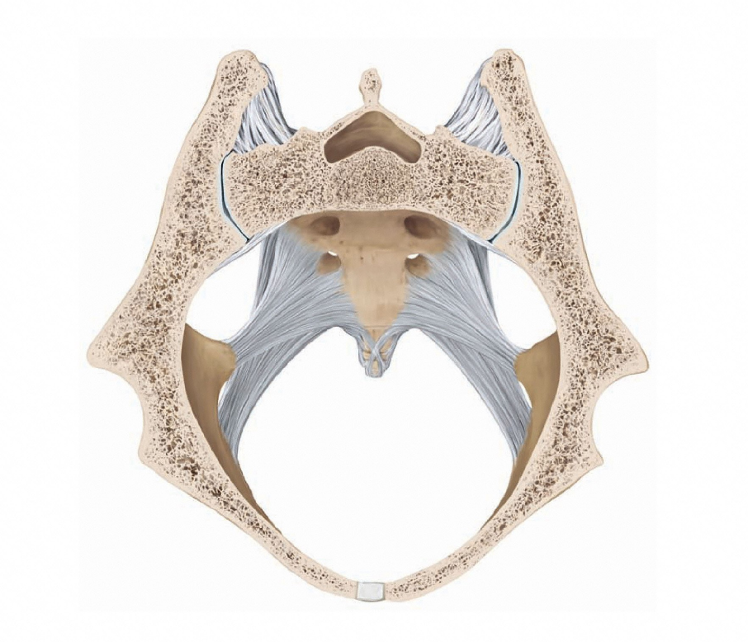
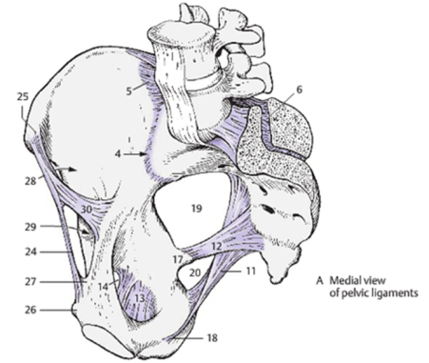
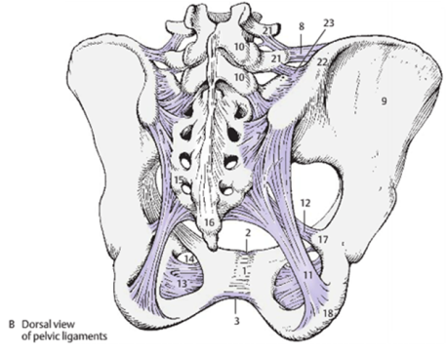
SACROILIAC JOINTS
Sacroiliac ligg.
dorsal
interosseal
Hyalin cart.
ventral
Fibrous cart.
Pubic symphysis

Slide 10
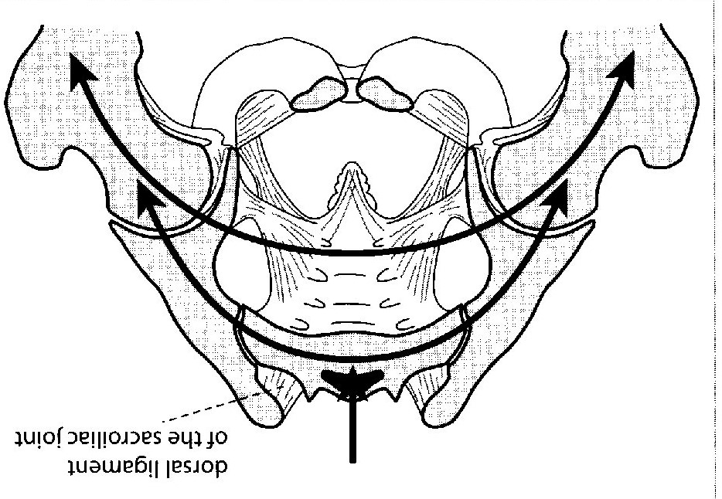

Slide 11
Ligaments of the pelvis
- sacrospinous ligament
- sacrotuberal ligament
- obturator membrane
- inguinal ligament
(-- aponeurosis of the external oblique abdominis m.!)

Slide 13
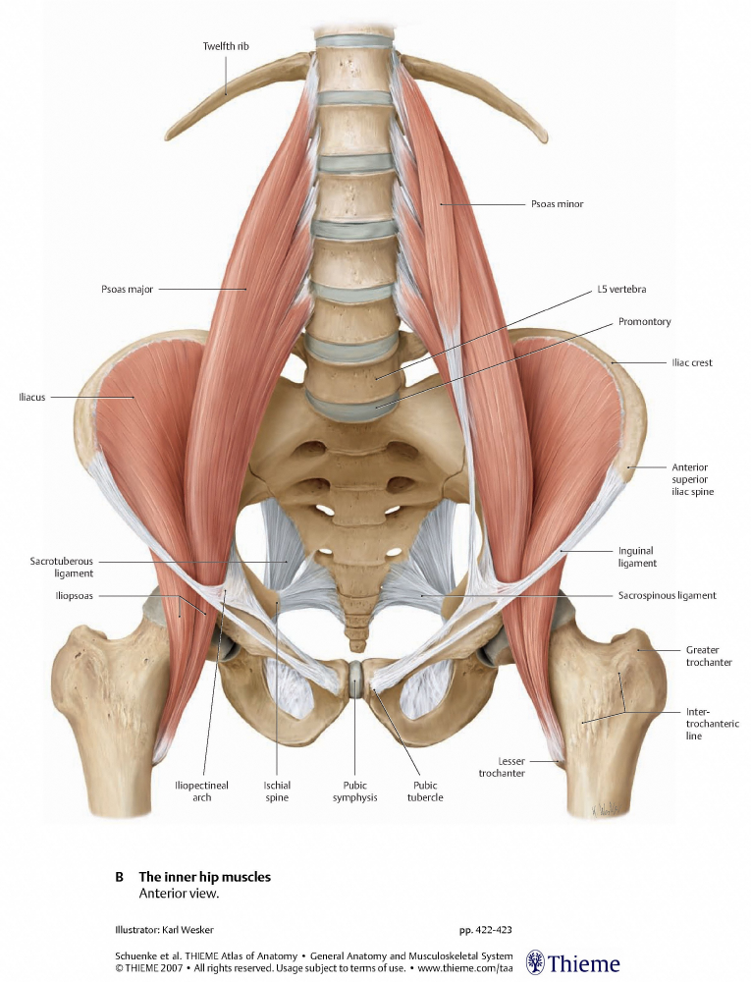
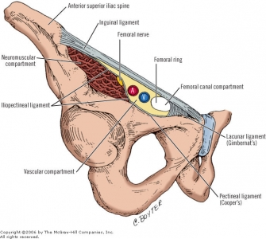
Inguinal ligament,
subinguinal hiatus
Inner hip muscles:
-psoas major
-iliacus
(-psoas minor)

Slide 14
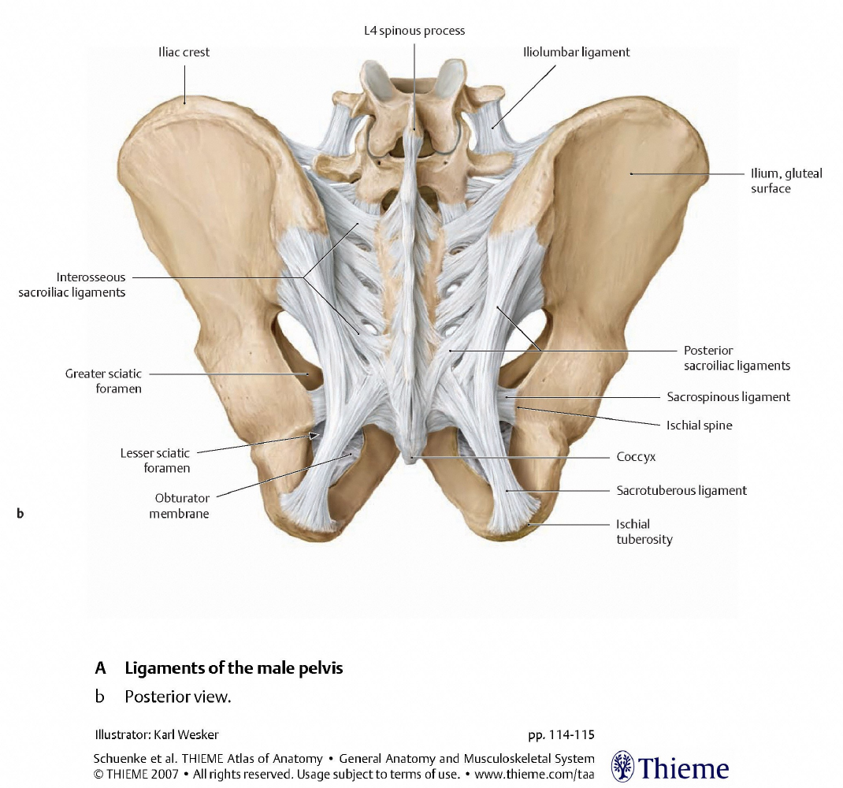

Slide 15
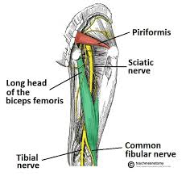
Greater sciatic foramen.
divided by piriformis m.
forms
suprapiriform and infrapiriform hiatuses

Slide 16
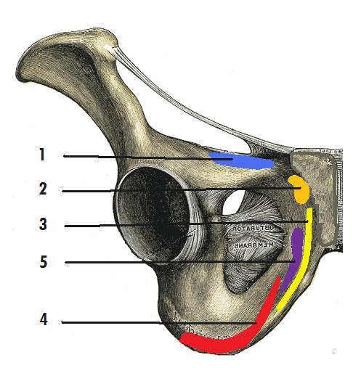
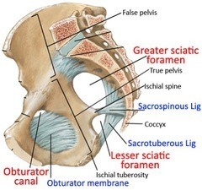
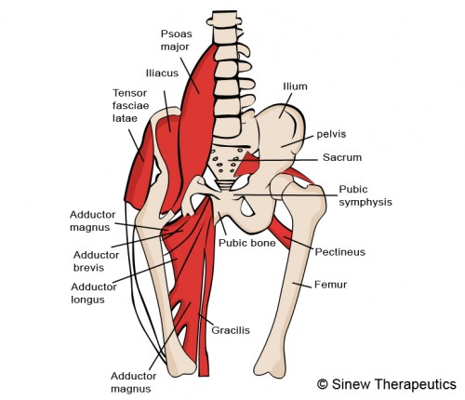

Slide 17
MALE AND FEMALE PELVIS - differences
INCLINATIO PELVIS
Male: 60° female: 65°

Slide 18
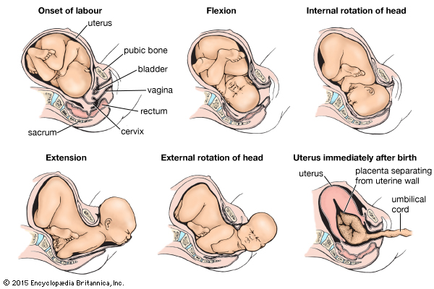

Slide 19
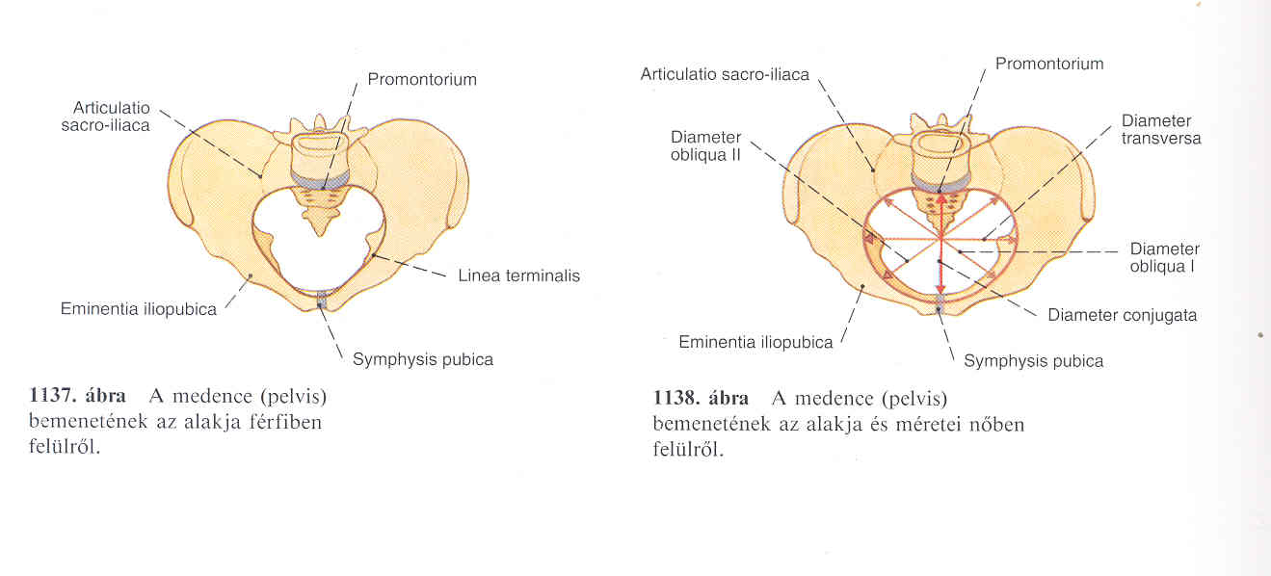
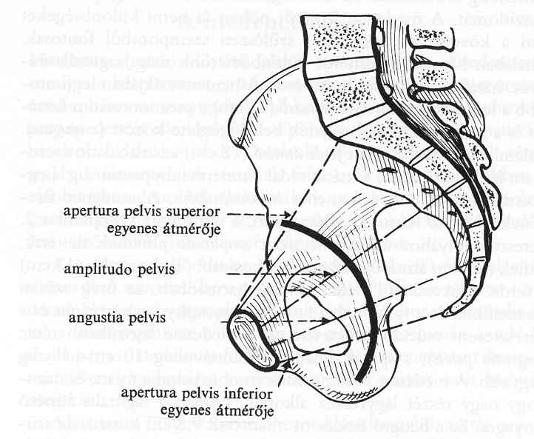
DIAMETERS
MALES
FEMALES
OBLIQUE
DIAMETER
TRANSVERSE
DIAMETER
SAGITTAL
DIAMETERS

Slide 20
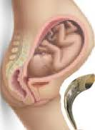
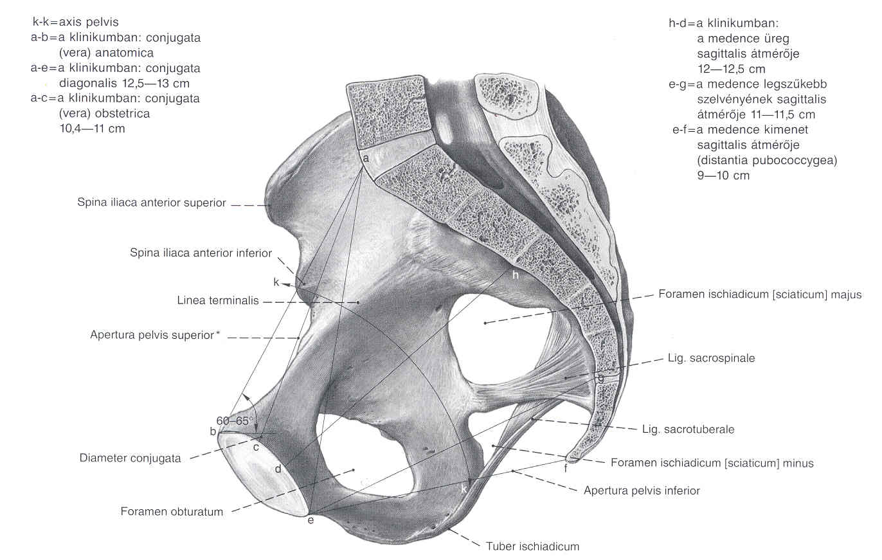
DIAMETERS
FEMALE PELVIS
DIAGONAL CONJUGATE (DIAMETER)
SAGITTAL DIAMETER of amplitudo pelvis
ANATOMICAL CONJUGATE
Pelvic inlet
OBSTETRIC CONJUGATE
Pelvic outlet
AXIS PELVIS

Slide 21
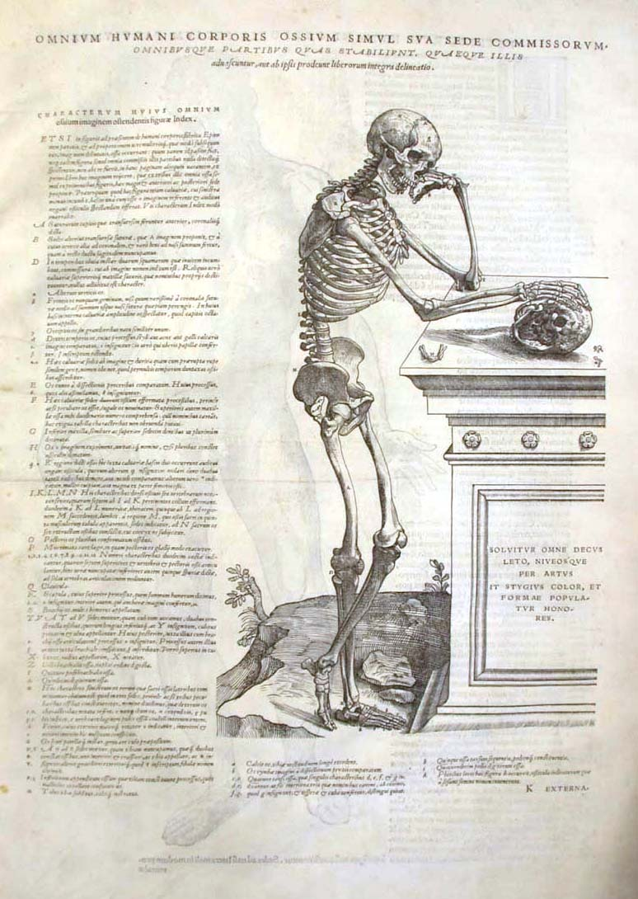
Folio 9v from the Epitome of Vesalius, Basel, 1543.

Slide 22
Images:
Réthelyi-Szentágothai: Functional anatomy
Dr. János Hanics

