Slide 1

Shoulder girdle, shoulder joint and muscles acting upon it
Dr. Vereczki Viktória
Semmelweis Egyetem
Anatómiai, Szövet- és Fejlődéstani Intézet
2018. október 16. 13:40 ED I

Slide 10
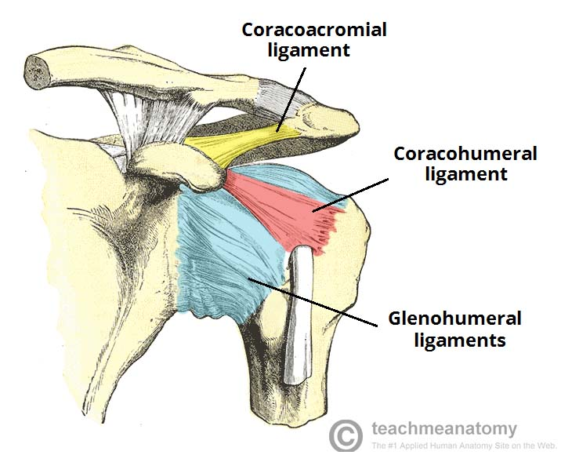
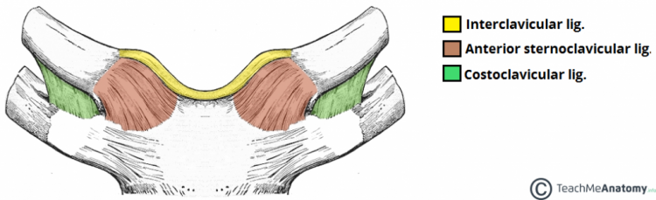
Ligaments of shoulder joint
-coracohumeral ligament
-Superior glenohumeral ligament
Medius glenohumeral ligament
inferios glenohumeral ligament
-Coracoacromial ligament
Ligaments of the shoulder girdle:
-Coracoclavicular ligament:
trapezoid and conoid ligament
-Acromioclavicular ligament
-Costoclavicular ligament
-Sterno- and interclavicular ligament

Slide 11
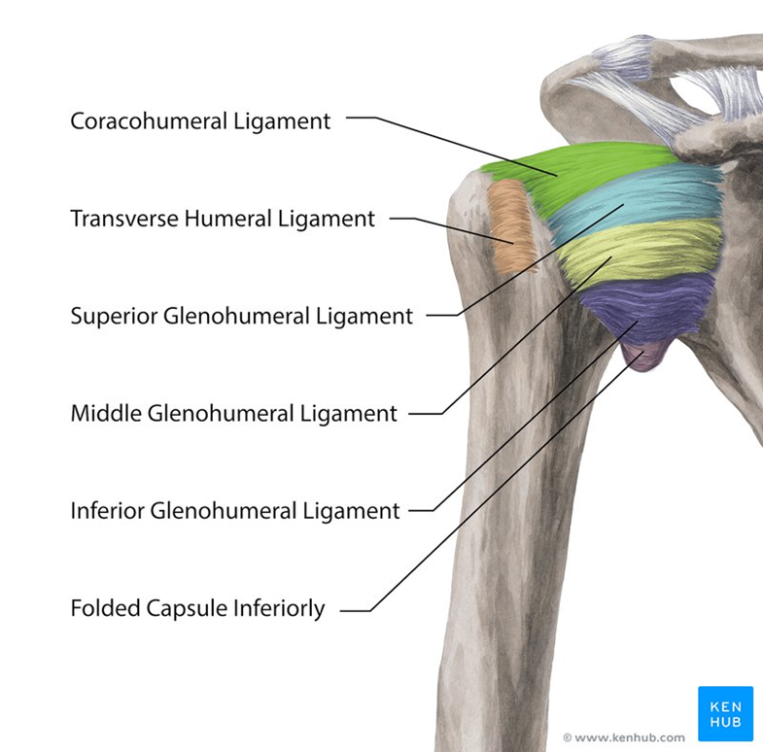
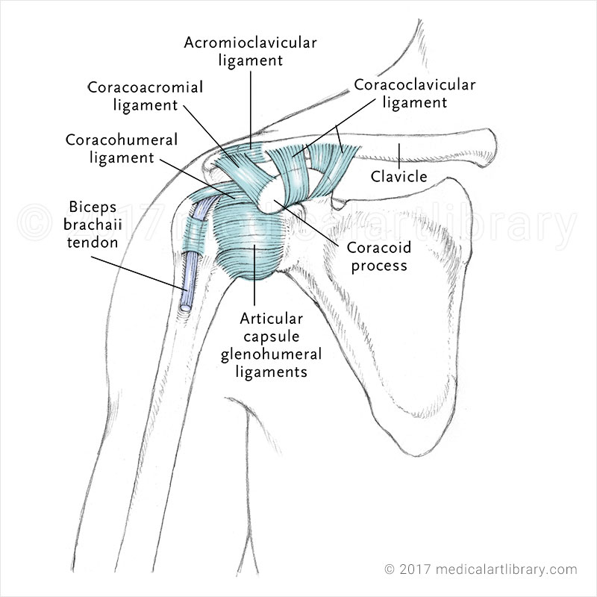

Slide 15
Shoulder muscles 1:
Deltoid muscle
 | origin | insertion | innervation | function
Deltoid muscle | Clavicular part: lateral thirsd of the calvicle Acromial part Spinal part:lower border of the spine of the scapule | Deltoid tuberosity | Axillary nerve (C4-5) | Anteversion, medial rotation Abduction up to 90 degree Retroversion, lateral rotation
Subscapularis muscle | Subscapular fossa | Lesser tubercule and the proximal part of its crest | Subscapular nerve (C5-8) | Medial rotation: the strongest
Subscapularis
muscle

Slide 16
Shoulder muscles 2:
supraspinatus muscle
infraspinatus muscle
teres minor muscle
teres major muscle
 | origin | insertion | innervation | function
supraspinatus muscle | Supraspinatus fascia and fossa | Upper facet of the greater tubercule | Suprascapular nerve (C4-6) | Abduction up to 90 degree
infraspinatus muscle | Infraspinatus fossa | middle articular facet of the greater tubercule | Suprascapular nerve (C4-6) | Lateral rotation
teres minor muscle | Lateral border of the scapule | lower facet of the greater tubercule | Axillary nerve (C5-6) | Lateral rotation
teres major muscle | Lateral border of the scapule | Crest of the lesser tubercule | Subscapular nerve (C5-8) | Retroversion, medial rotation, adduction

Slide 17
Spinohumeral muscles:
 | origin | insertion | innervation | function
1. Trapezius muscle | Descending part :superior nuchal line Transverse part: 7th cervical-3rd thohracic vertebrae’s spinous processes Ascending part: 2-12th thoracic vertebrae’s spinous processes | lat.1/3rd of claviclaa Acromial end of the clavicula and scaular spine Scapular spine | Accessory nerve (N. XI), trapesius bracnch (C2-4)
2. Latissimus dorsi muscle | Vertebral part: Spinous processes of the 7-12th thoracoc vertebrae, thoracolumbar fascia Iliac part: poserior 1/3rd of the iliac crest costal part: 10-12th rib scapular part: inferior angle of the scapula | Crest of the lesser tubercule | Thoracodorsal nerve (C6-8) | „dress coat pocket” , adduction ,medial rotation, retroflexion Forced expiration : „coughing muscle”
3. Rhomboid major muscle | Spinous processes of 1-4th thoracic vertebrae | Medial margin of the scapula | Dorsal scaapular nerve (C4-5) | Retract the scapula towards the vertebral column
4. Levator scapulae muscle | Dorsal tubercules of the transverse processes of 1-4th cervical vertebrae | Superior angle of the scapula | Dorsal scaapular nerve (C4-5) | Elevates the scapula
5 . Rhomboid minor muscle | Spinous processes of 6-7th cervica lvertebrae | Medial margin of the scapula | Dorsal scaapular nerve (C4-5) | Retract the scapula towards the vertebral column

Slide 18
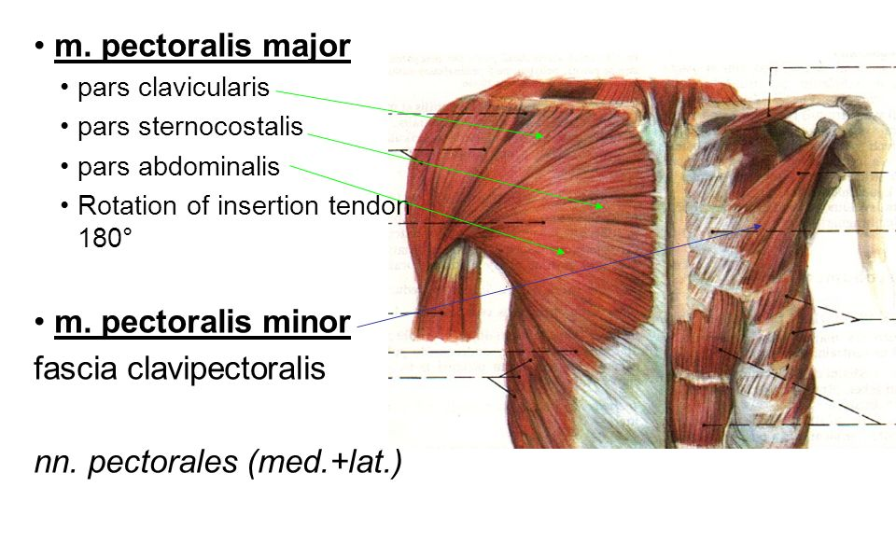
Thoracohumeral muscles:

Slide 19
Thoracohumeral muscles:
1. Pectoralis major muscle
2. Pectoralis minor muscle
3. Subclavius muscle
4. Serratus anterior muscle
 | origin | insertion | innervation | function
1.Pectoralis major muscle | Clavicular part: clavicle Sternocostal part: 2-6th rib’scartilages Abdominal part :rectus sheeth | Crest of the greater tubercule | Lateral and medial pectoral nerves (C5-7) | Medial rotation Adduction If shoulder girdle if lift than it acts like a respiratotry muscle for expiration
2. Pectoralis minor muscle | 3-5th rib | Coracoid process | Medial pectoral nerves (C6-8) | Lowers and rotates the scapule
3. Subclavius muscle | 1st rib’s cartilage | Sulcus for the subclavius muscle | Subcalvian nerve (C5-6) | Stabilizes the sternoclavicular joint
4. Serratus anterior muscle | Slips from the 1-9 th ribs | Medial margin of the scapuke | Long thoracic nerve (C5-7) | Elevation of the arm above 90 degree, press teh scapule toward the thorax If shoulder girdle if lift than it acts like a respiratotry muscle for expiration

Slide 28
Good luck in the Midterm!

