Slide 1
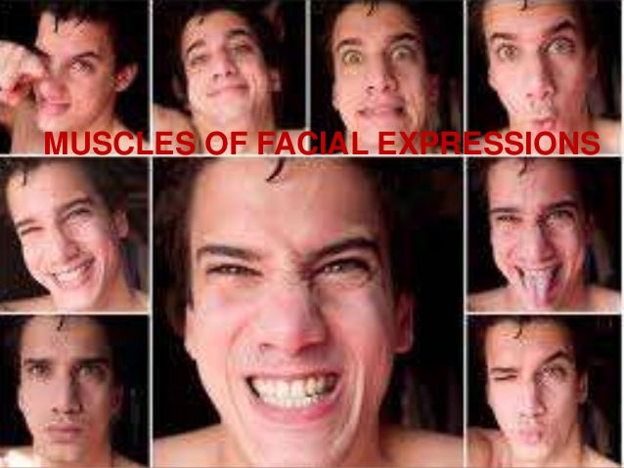
Viktória Vereczki M.D., PhD.
November 27^{th, 13:40}, 2018

Slide 2
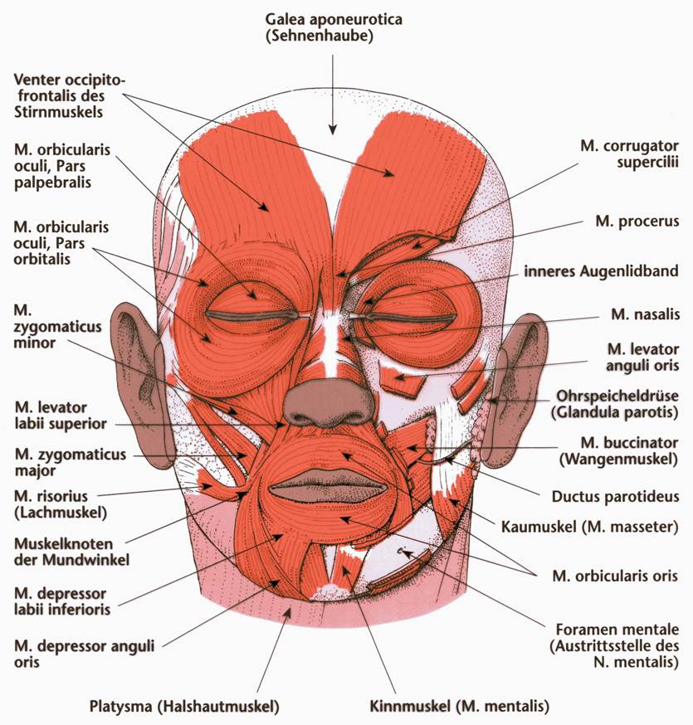

Slide 3
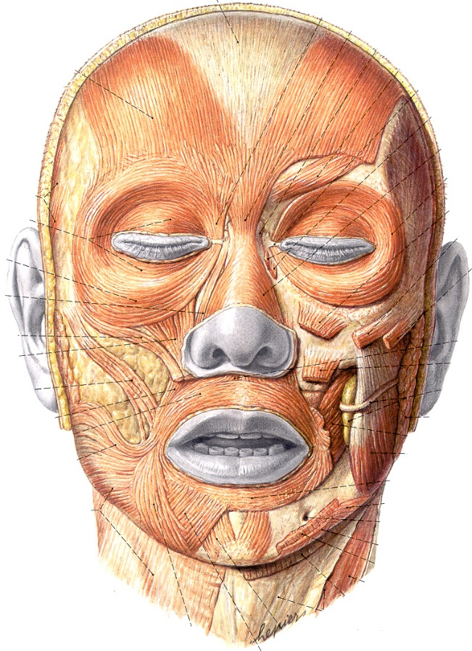
*

Slide 4
SURGICAL IMPLICATIONS
Danger space of the scalp: a "fascial cleft" between the galea and the pericranium (cranial
periosteum) containing loose areolar CT that allows scalp mobility. Purulent material
or blood can accumulate in this space.
The frontalis muscle lifts the eyebrows upward, creating transverse furrows in the soft
tissue. As the brow rises, it also stretches the skin around the eye.
Surgical manipulation of this muscle is part of cosmetic recontouring of the upper one-third of the face and has
a direct effect on the position of the eyebrows.

Slide 5
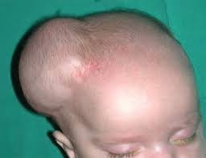
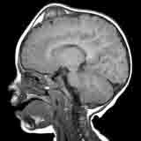
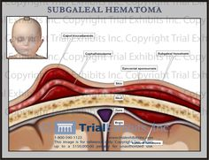
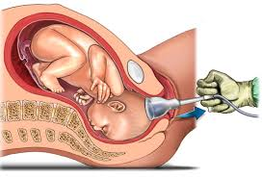
GALEA APONEUROTICA
Between the Aponuerosis of mm. frontalis et occipitalis
periosteum (Pericranium) and
galea there is loose connective tissue– SUBGALEAL BLEEDING
SUBGALEALIS HAEMATOMA
During delivery (CAPUT SUCCEDANEUM)
Bleeding liftsd the skin
CAPUT SUCCEDANEUM

Slide 6
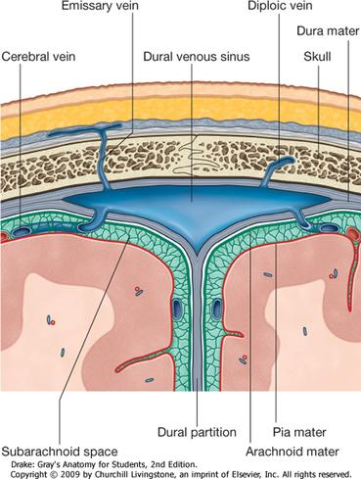
GALEA APONEUROTICA
Vv. Emissariae, Sinus durae matris, Vv. diploicae

Slide 7
*

Slide 8
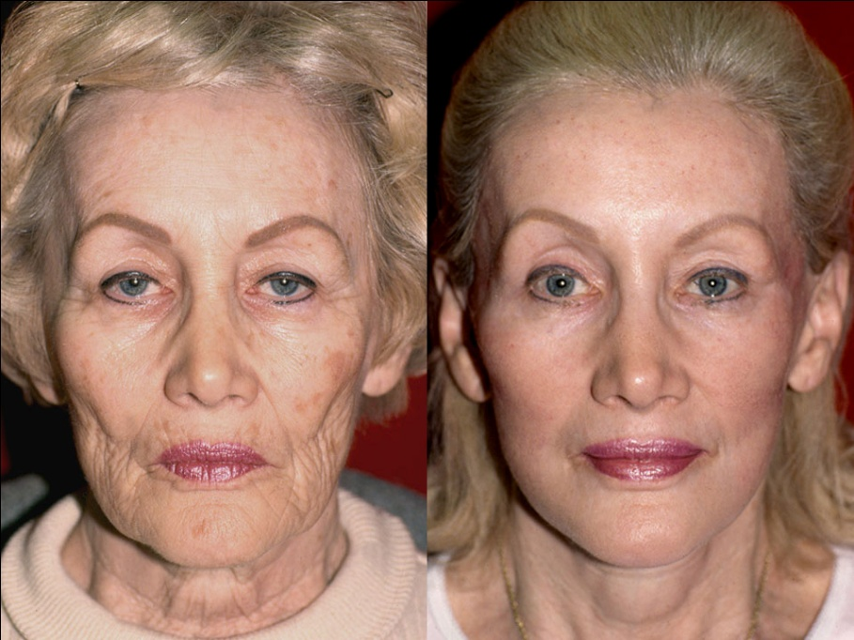
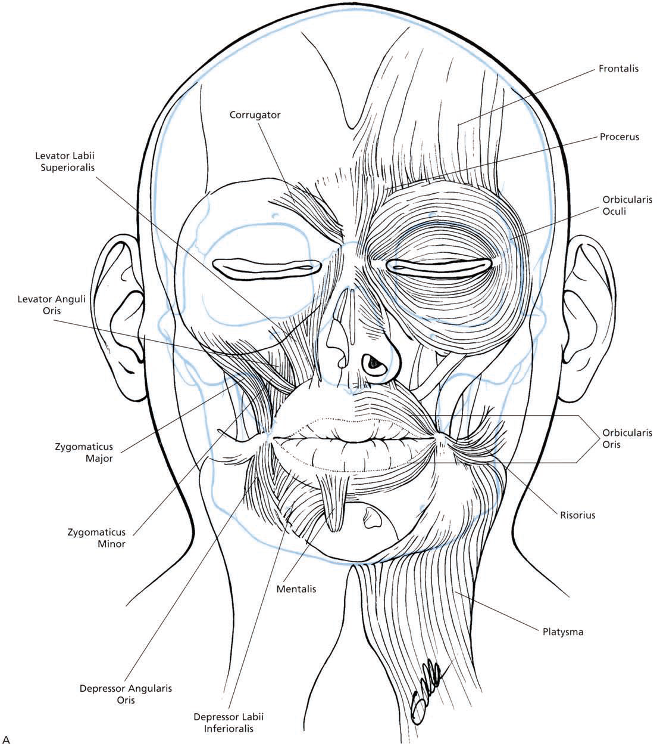
Muscles of the eyelid.
SURGICAL IMPLICATIONS
The corrugator supercilii muscle is important in cosmetic surgery of the upper face. It is responsible for vertical frown lines in the glabellar area. In forehead rhytidectomy, it
is partially excised.

Slide 9
*

Slide 10
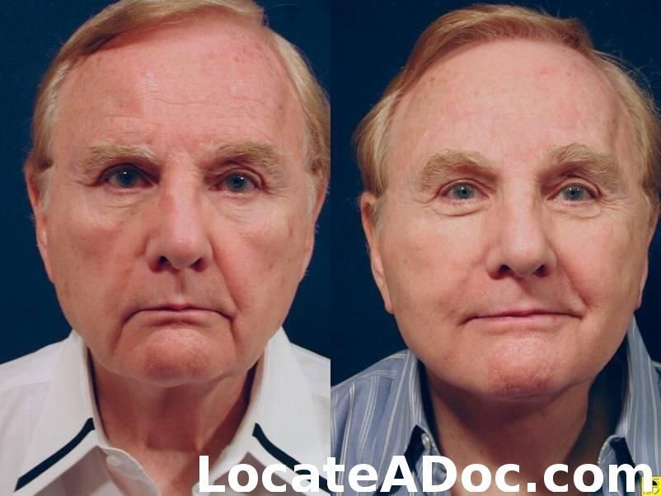
Muscles of the Nose Procerus Muscle
SURGICAL IMPLICATIONS
This muscle is important in surgical management of the aging face. Its action produces
horizontal frown lines in the glabellar area. It lies in a more superficial position than the
corrugator supercilii and also must be addressed in forehead rhytidectomy.

Slide 11
*
*
*
M. Orbicularis oculi
-pars palpebralis
-pars lacrimalis
-pars orbitalis

Slide 12
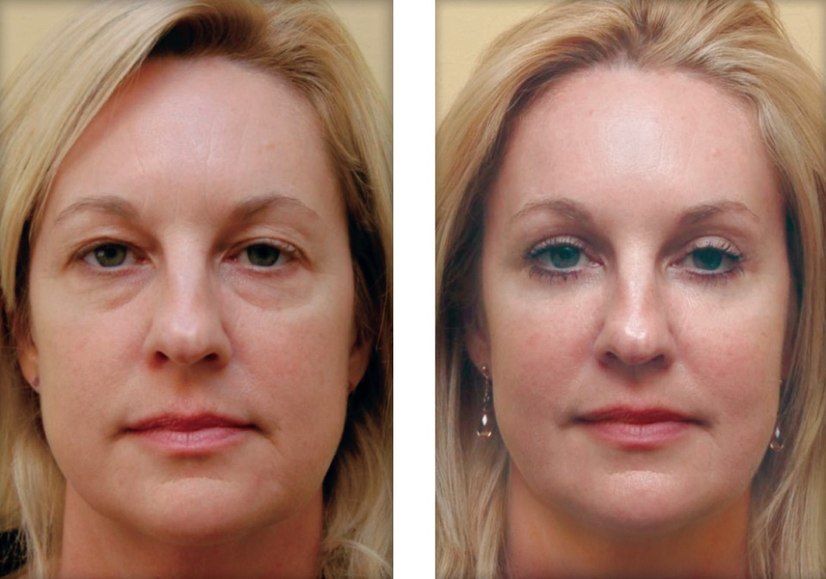
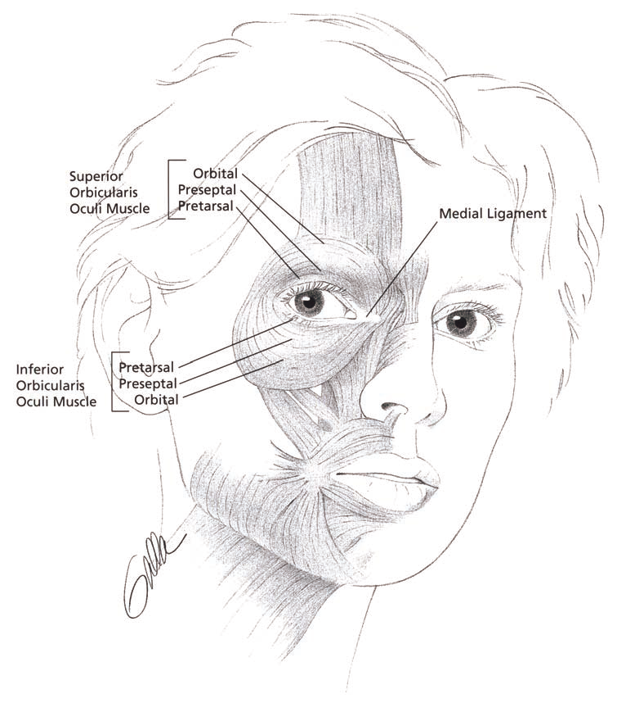
Muscles of the eyelid.
SURGICAL IMPLICATIONS
When the orbicularis oculi muscle contracts, the skin around the eye is pulled toward the nasal bridge. This muscle is important in blepharoplasty surgery, as its position is critical to the management of the aging eyelid.

Slide 13
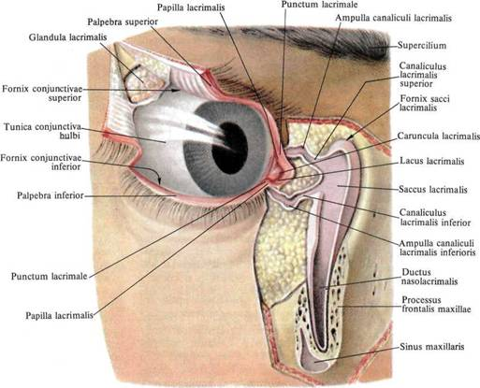
DUCTUS NASOLACRIMALIS:
Connection between the orbita and meatus nasalis inferior

Slide 14
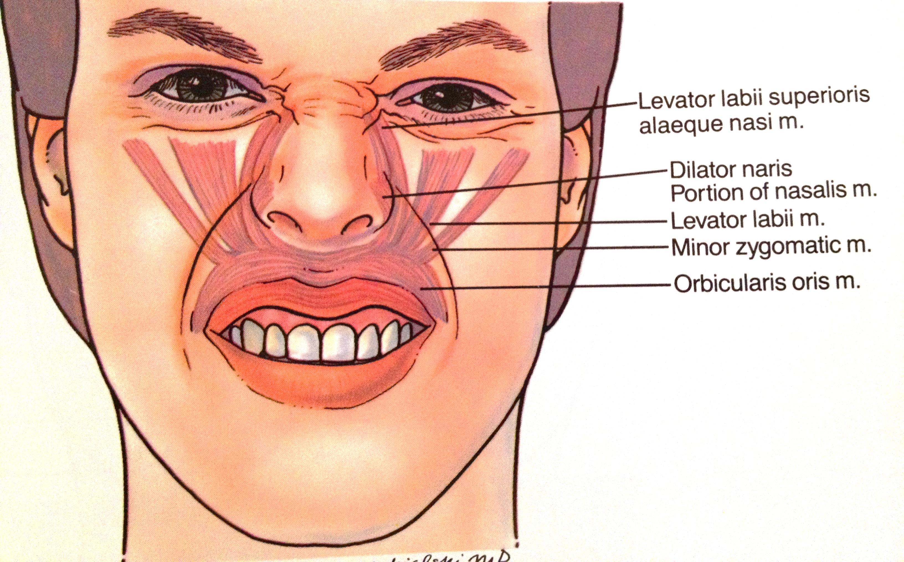

Slide 15
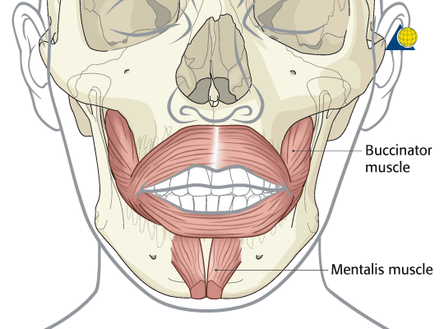

Slide 16
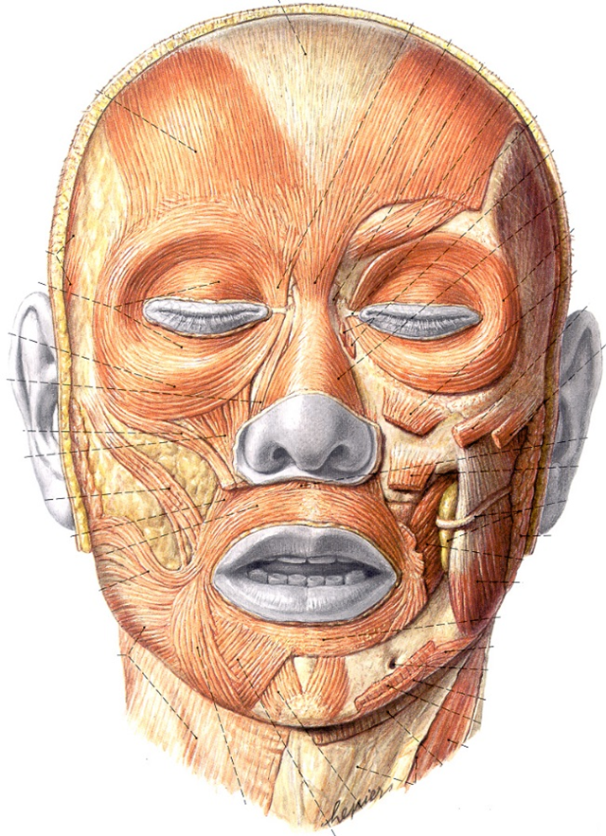
*
*

Slide 17
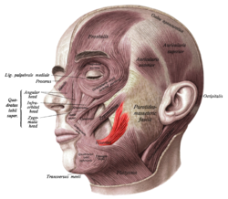
*

Slide 18
*

Slide 19
*
*

Slide 21
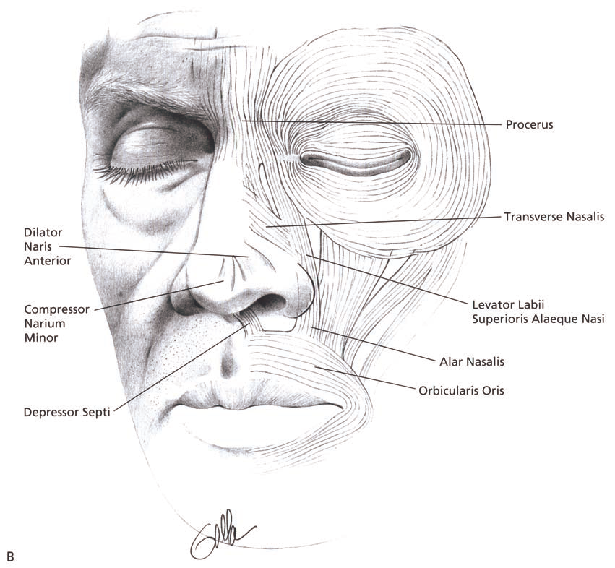
Muscles of the Mouth Levator Muscle of the Upper lip
SURGICAL IMPLICATlONS
The levator muscle of the upper lip is a strong muscle that attaches to the orbicularis oris
muscle along the upper lip margin. Its contraction produces upward retraction of the lip. In patients with facial paralysis, reanimation of the face with dynamic facial slings
must include reestablishment of the proper muscle vector to the medial upper lip.
The greater zygomatic muscle is the primary muscle for lateral oral excursion. Reestablishment
of this muscle vector is the primary focus of all procedures that attempt to reanimate the paralyzed face.

Slide 22
*

Slide 23
*

Slide 24
*

Slide 25
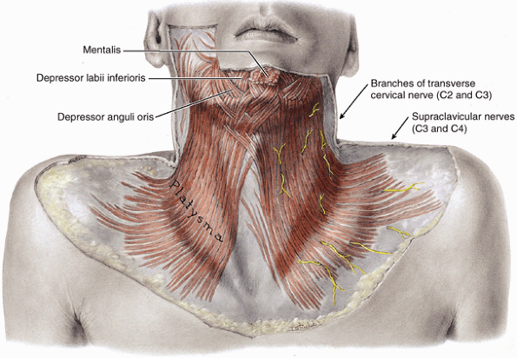

Slide 26
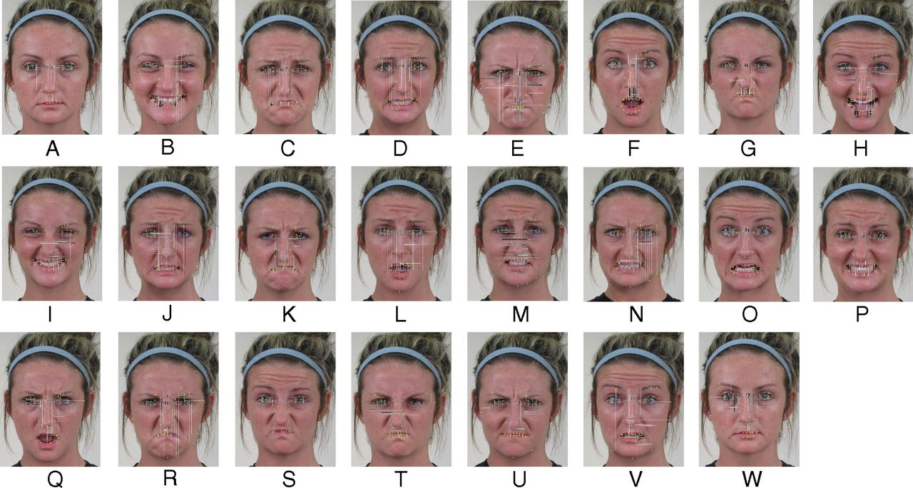

Slide 27
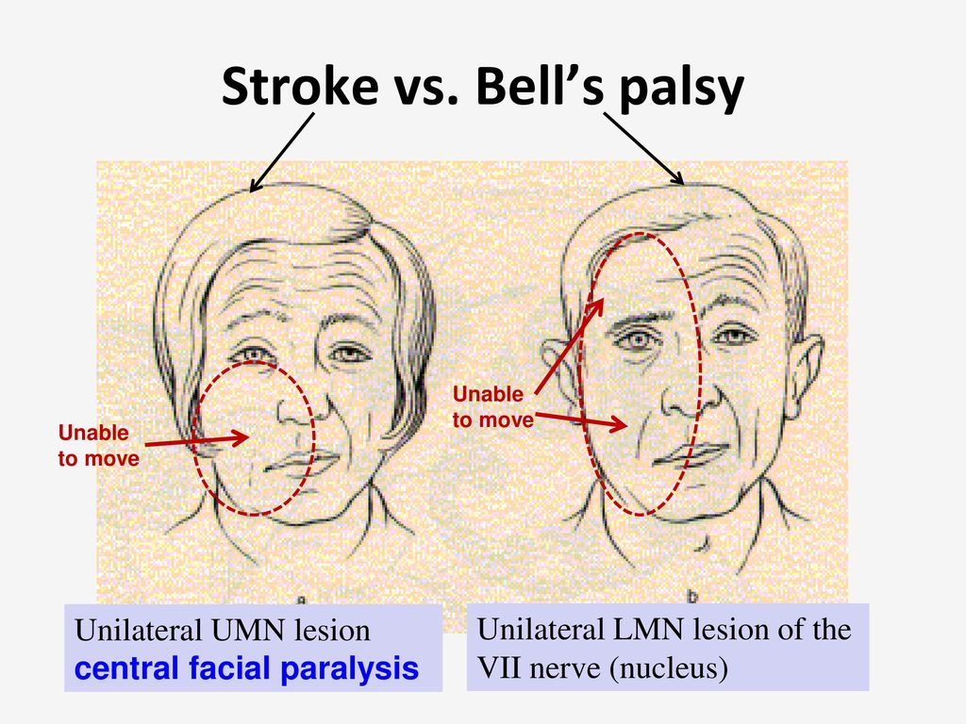
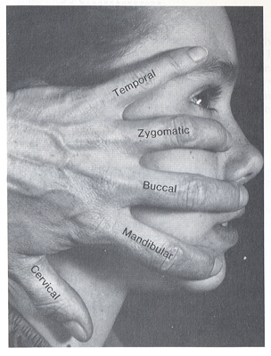
Motor innervation of mimic muscles:
VII., Facial nerve
Facial palsy
http://upload.wikimedia.org/wikipedia/commons/6/60/Paralisis_facialMOCHE.jpg

Slide 28
Superficial arteries on the face
-superficial branches of external carotid artery :
- a. temporalis superficialis
– a. transversa faciei
-a. facialis

Slide 29
Palpatable arteries
Superficial temporal art.
(Occipital art.)
Facial art.
Carotid art.

Slide 30
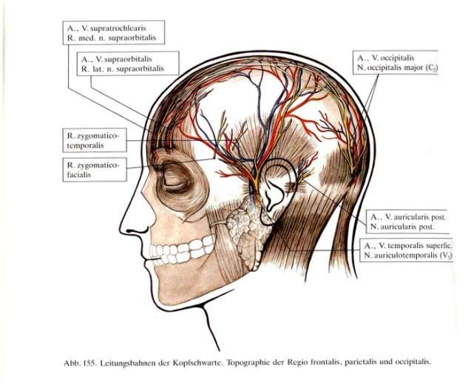
Blood supply and innervation of the skin on the head
REGIO FRONTALIS
A., V. ET N. SUPRAORBITALIS
REGIO TEMPORALIS
A., V. TEMPORALIS SUPERFICIALIS, N. ZYGOMATICUS (N. V/2),
N. AURICULOTEMPORALIS (N. V/3)
REGIO OCCIPITALIS
A.OCCIPITALIS, A. AURICULARIS POSTERIOR, N. OCCIPITALIS MINOR
(PLEXUS CERVICALIS),
N. OCCIPITALIS MAJOR (C2 dorsális ága)

Slide 31
Blood supply on the head
Medial angle of orbit
Arteria angularis (end branch of a. facialis –ex external carotid artery) anastomosis with ophthalmic artery
(A. carotis interna)
V. angularis (V. facialis) via V. ophthalmica superior - Sinus cavernosus !

Slide 32
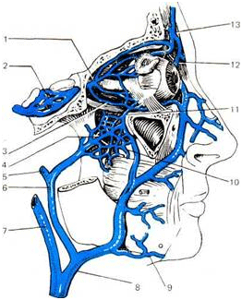
Superficial veins on the head
FORAMEN JUGULARE:
Sinus sigmoideus ‘ junction with V. jugularis interna bulbus superiorjába
Sinus cavernosus connects plexus venosi foraminis ovalis, foraminis laceri, plexus
caroticus interni and plexus pterygoideussal
1 – v. nasofrontalis
2 – v. angularis
3 – anastomose (v. ophtalmicae inferior et plecsus pterygoideus) 4 – v. facialis anterior 5 – v. subrnentalis
6 – v, facialis comm. 7 – v. jugularis interna
8 – v. facialis posterior 9 – v. temporalis superficialis 10 – plexus pterygoideus
11 – v. ophtalmica interna 12 – sinus cavernosus 13 – v. ophtalmica superior

Slide 33
Trigeminal pressure points
Supraorbital, supratrochlear n. (V/1)
Frontal sinus inflammation
Infraorbital n. (V/2)
Maxillary sinus inflammation
Mental n. (V/3)
Lover teeth inflammation

